Slide 1
HI-ECN3 WP4 coordination meeting #2
Jean-Louis GRENARD
28-06-2024

Slide 2
Agenda
Target station and Trolley system updates
Target complex building
BDF/SHiP Power converters
Dismantling of TCC8
Trolley system update → Michal
Target cooling systems → Nikola/ Francesco
TCC8 crane replacement → Cristina
AOB

Slide 3
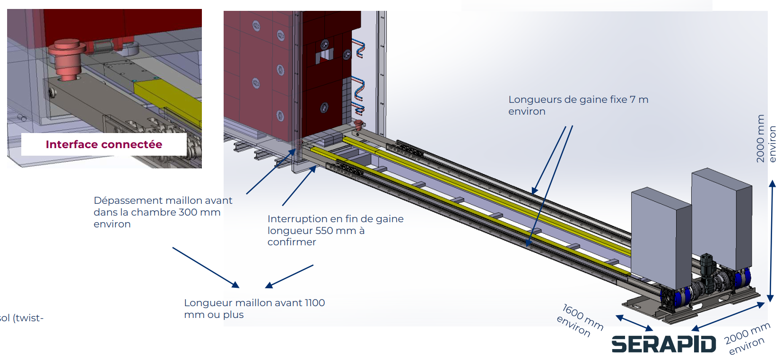
Target station and Trolley systems - updates
Target station inventory of shielding blocks to extract -> christophe
Discussion with rigid chain supplier for the push pulls system for the trolley
  Discussion ongoing for a design contact (risk assessment, detail design, definition of interfaces)

Slide 4
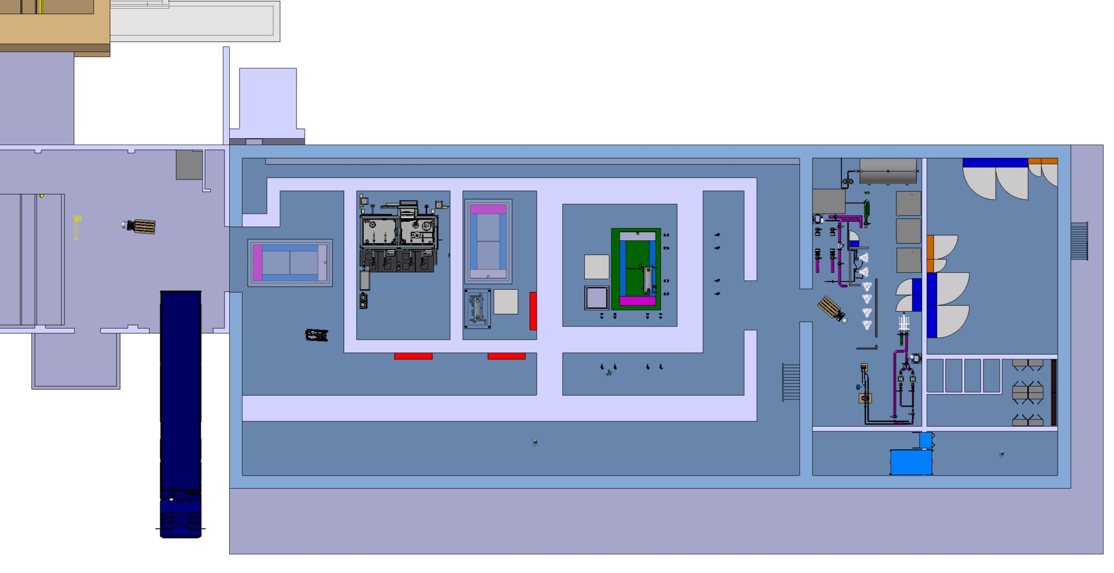
Target complex building
Draft identification of flows for personnel and material (Melania)
Definition of crane and associated crane coverage
Details being discussed during building integration meeting
Need to have the cooling station room(s) as part of a sector linked to the machine access system? → need discussion with AA and WP6

Slide 5
Target complex building
Needs in term of control racks:
1 RP monitoring
2 target control
1 IT network
1 beam instrumentation
1 acess system
1 spare
Other needs?

Slide 6
Target complex building
Power distribution
Need a preliminary power estimates:
Crane(s)
Cooling station
Ventilation station
Service cell
Else?
Main contributors

Slide 7
Service cell process
Extraction of target from shielded cask in service cell
Target material separation (core removed from vessel) destructive work with possibly dust creation
Packing on final repository containers
→ Will be developed in the coming months (Faezeh)

Slide 8
Handling point to be adressed
Definition of handling casks volume (target, hadron stopper coil, proximity shielding)
Space reservation for lifting beams
→ Cristina/Roberto

Slide 9
Target complex building – 911 modification
SCE design office green light
  Information for new door details in the coming 2 weeks (EN-ACE)
EL (Eva) need to perform cable inspection
CV identification of relocation of services completed
HE identification of possible new equipment location
AA relocation of their systems launched via Service now
Integration study to be launched in the coming week → BE-EA

Slide 10
Target complex building – points being addressed
Building classification definition
  Will define applicable standards especially for ventilation requirements
Assessment of internal and external wall(s) thickness and service cell lead window(s)
Assessment of needs for evaporators
Definition of sumps
WP6

Slide 11
BDF/SHiP Power converters
Slowly converging to a new baseline
  Joint effort between HI-ECN3 and NA-CONS
  Most likely no need to have PCs in/attached to the new target complex building
  Reusing existing PCs
  New Power Converters located in BA82 and ECN3
  New baseline aimed by September

Slide 12
TCC8 Dismantling
Detail list of equipment extracted from 3d models thanks (Beatriz/Sylvain)
Identification what is kept what is to be sent to waste
To be defined timeline with WP5 and WP7and what can/should stay in the tunnel for future reused or before long term storage
  We should think using part of TCC8 as a buffer zone during LS3
    Shielding blocks
    Magnets

Slide 13
Target station pre-assembly surface definition of needs
  Covered building
  Floor capacity ~20-25t/m2
  Equipped with an overhead traveling crane minimum capacity 30t
  Min width ~10m
  Surface ~500m2
  Access with truck and forklift
  Timeline from Q1 2027 till Q3 2029
  Justification: preconstruction of target station before final installation in the tunnel to test assembly, target replacement process and assess failure scenarios
  Assumed no other need (CV equipment directly delivered to the new building)

Slide 14
AOB
Beam line / experiment skeleton definition

