Slide 1
BDF: Rollers and Sealing
Michal Macha, PhD
27.06.2024

Slide 2
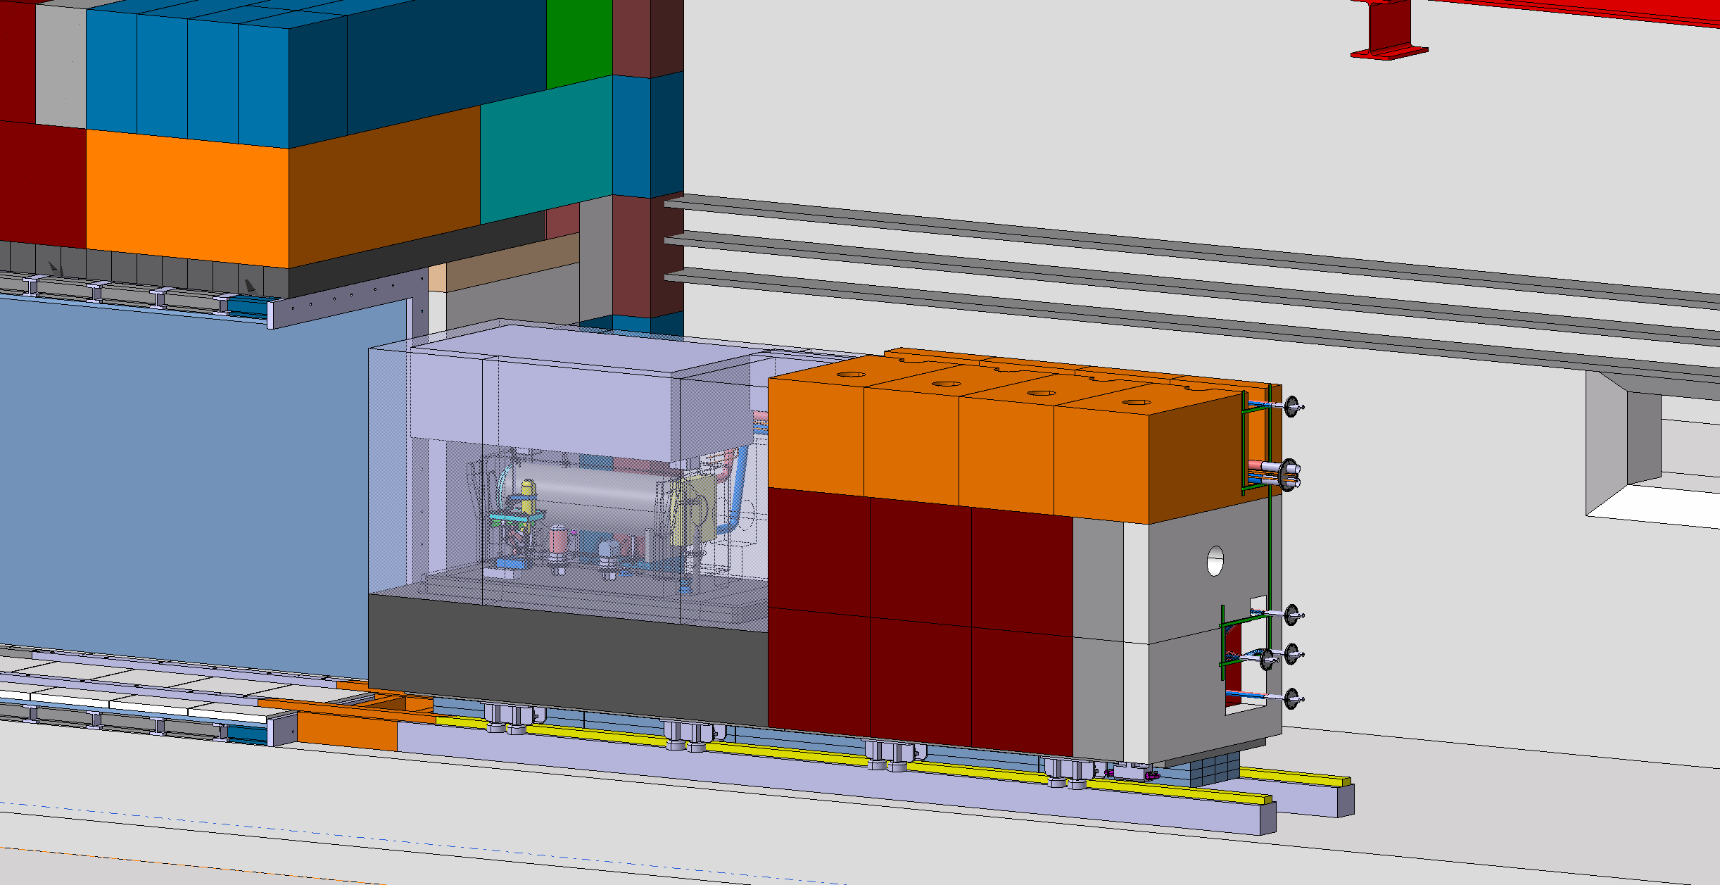
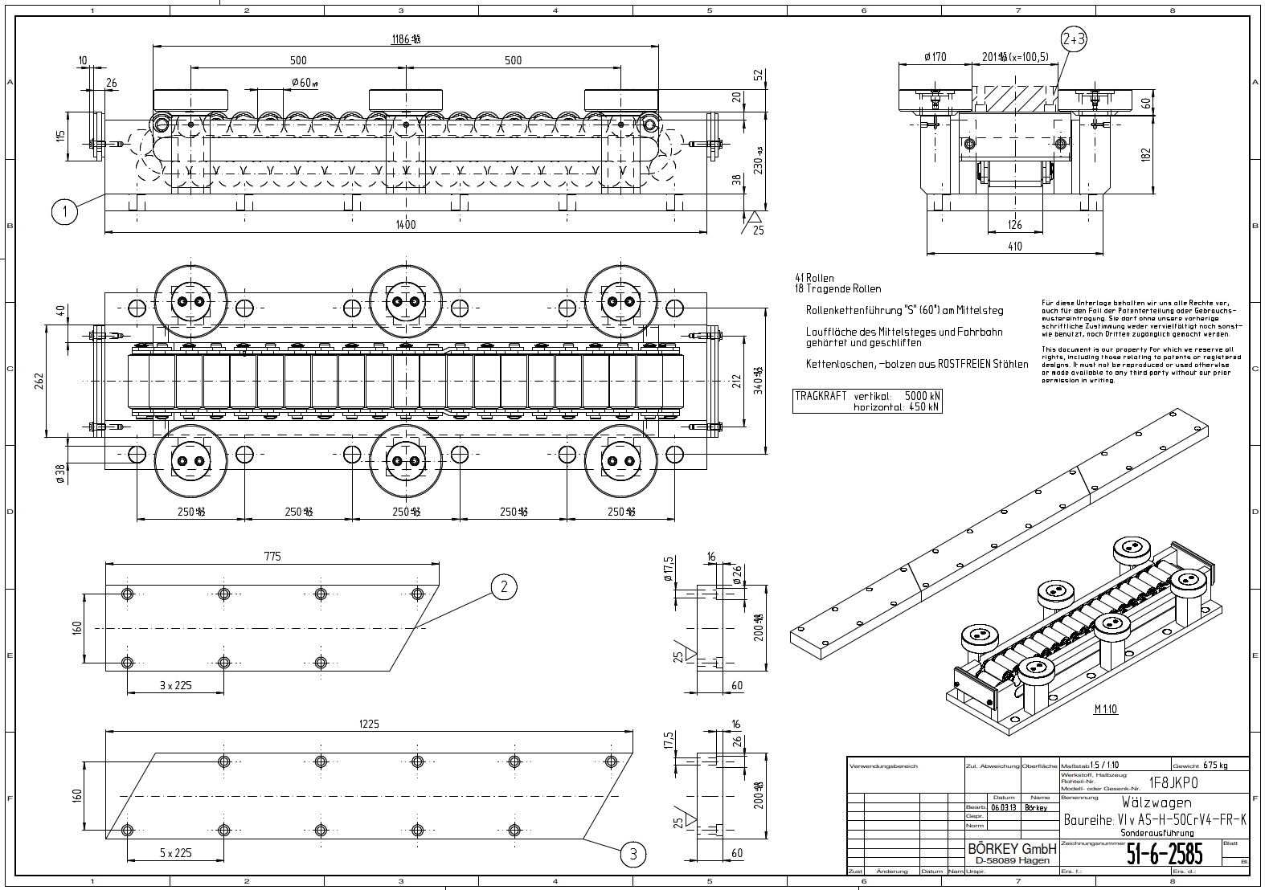
BDF Trolley – surface protection
2. Solutions to the problem:
Estimating the durability of used materials in the most extreme conditions through:
Gamma radiation aging in the external facility to study general rad-resistance of susceptible steel elements
Salt-spray / climate chamber tests to evaluate corrosion resistance
Evaluation of using radiation-tolerant protective coatings to mitigate the cold welding risk and increase corrosion resistance
Simulating the semi-static moving conditions and environmental risks in dedicated setup
3. Current R&D development track:
Establishing the research plan
Researching potentially usable coatings (conclusion: Cr-based, PVD)
Acquiring test material, including test coatings
Preliminary tests of the roller assembly elements in non-irradiated, non-corroded state <- we are here
Gamma radiation aging of coated and uncoated elements (external service), up to 10-20 MGy (TBD)
Salt-spray tests and/or other climate chamber tests
Final mechanical and surface tests of samples (coated, uncoated, irradiated, corroded and non-corroded)
On-site assembly simulation testing
Final recommendations
1. Context of the problem:
Highly loaded steel assembly in semi-static condition (moving once-twice per year)
Risk of cold welding
Risk of environmental damage
Risk of increased surface corrosion due to radiation

Slide 3
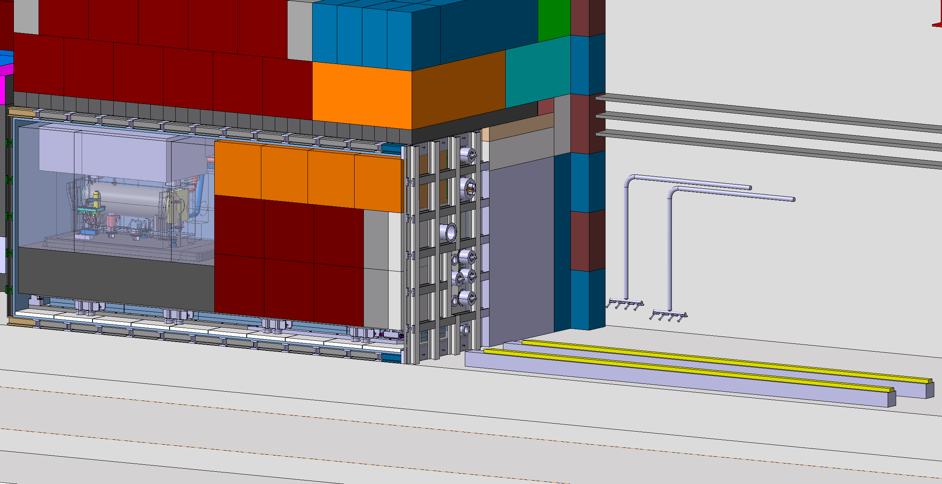
Vacuum Assembly Sealing
2. Solutions to the problem:
Based on available knowledge – EPDM elastomer gaskets are the most viable solution:
Generally resistant up to 1-2 MGy based on experimental studies (Sonia Allegretti)
Radiation tolerance varies depending on the supplier (due to the purity/elemental composition of EPDM), best option: James Walker products
Viable to manufacture on a large scale to match the aperture size
Final durability and radiation resistance has to be established experimentally
We can use manufacturer know-how and advice in adapting the design to match the best practices in practical use of such a large sealing
3. Current R&D development track:
Gathering offers from suppliers <- we are here
  Angst-Pfister – refused to propose an offer
  Kurt J. Lesker – refused to propose an offer
  James Walker – waiting for the offer (2nd month, huge delay on their end)
  Elastotech – no reponse
Based on the offer:
  Vacuum assembly design recommendations
  Maintenance and spare sealing storage recommendations
  Sealing exchange recommendations
On-site radiation aging (e.g. nTOF NEAR station)
Mechanical tests of the sealing to establish radiation-damage limits and the recommended exchange frequency
1. Context of the problem:
Primary vacuum sealing in the highly radioactive area
Semi-static moving conditions (moving once-twice per year)
Rough, industrial external atmosphere
Necessity of using either elastomers, intrinsically rad-damage susceptible materials or metal gaskets
Very large sealing aperture size (~2x3m)

