Slide 1
TCC8 Crane removal study
HI-ECN3 WP4 - Coordination meeting #2 – C. Duran Gutierrez, R. Rinaldesi – EN-HE
2024-06-28

Slide 2
Building 911
Shaft: 8000 x 4000 x 10720 (mm)

Slide 3
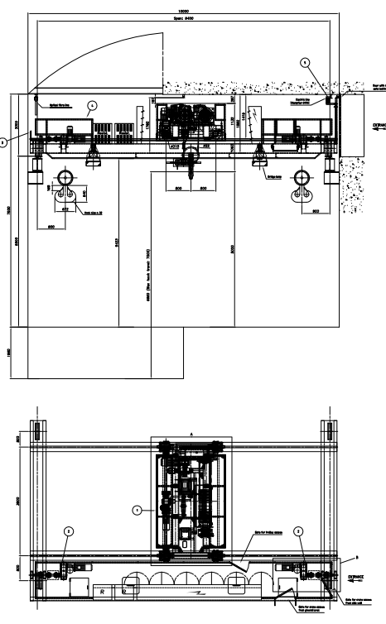
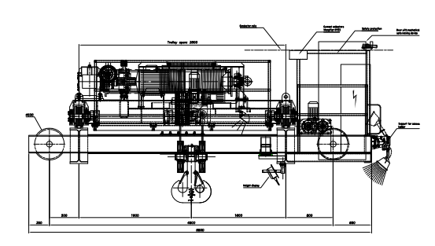
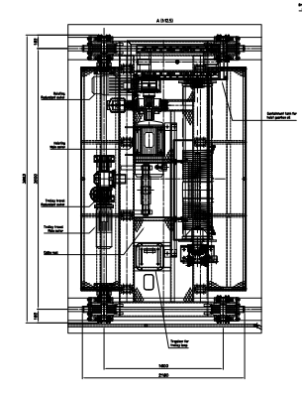
Crane
General dimensions
10000 x 5800 x 2800
It is possible to divide the crane in 2 parts because the end trucks are bolted in the middle.
Exact bolting point to be confirmed.
1
2

Slide 4
Crane
Girder 1
Most restrictive
Girder 2 (+ walkway)
10000
10000
3200
1850
2100
3200

Slide 5
Extraction study
Girder 1
Girder lifting sequence
1
2
3

Slide 6
Extraction study
Girder 1
We lift the girder and start to turn it to face the door.
Gradually the height is balanced until the final position is reached.
4
5
6
7
*Top view
*Top view

Slide 7
Extraction study
Girder 2 + walkway
Volume too large
Unstable grip
Impossible to turn in shaft
*Top view

Slide 8
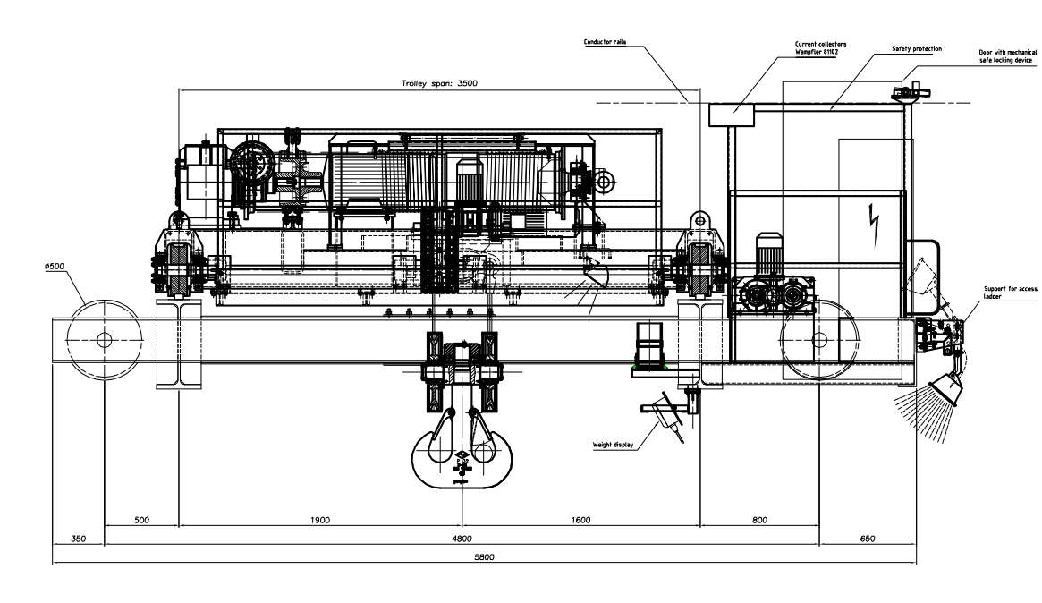
Proposal for girder 2
Cut the walkway
No structural damage
Small cuts

