Slide 1
CERN-Cornell collaboration on SRF
FCC week - San Francisco
10 June 2024

Slide 2
Main RF parameters and layout
 | Z |  | W |  | H |  | ttb
 | collider | booster | collider | booster | collider | booster | collider | collider | booster
RF Frequency [MHz] | 400.79 | 801.58 | 400.79 | 801.58 | 400.79 | 801.58 | 400.79 | 400.79 | 801.58
Cavity type | 1-cell | 5-cell | 2-cell | 5-cell | 2-cell | 5-cell | 2-cell | 5-cell | 5-cell
Eacc [MV/m] | 3.77 | 10.7 | 10.1 | 15.35 | 10.6 | 19.4 | 10.6 | 20.1 | 20.1
Q0 | 2.7E+09 | 3.0E+10 | 2.7E+09 | 3.0E+10 | 2.7E+09 | 3.0E+10 | 2.7E+09 | 3.0E+10 | 3.0E+10
Epk [MV/m] | 8.3 | 22 | 20.2 | 31.5 | 21.2 | 39.8 | 21.3 | 41.3 | 41.3
Bpk [mT] | 20.2 | 46.3 | 54 | 66.5 | 56.4 | 84.1 | 56.7 | 87.3 | 87.3
Beam current [mA] | 1283 | 14.3 | 135 | 11.8 | 53.6 | 2 | 10 | 10 | 0.3
RF power [kW] | 894 | 110 | 377 | 144 | 378 | 32 | 78 | 163 | 5
Optimum QL | 2.5E+04 | 1.7E+06 | 8.4E+05 | 2.7E+06 | 9.2E+05 | 2E+07 | 4.5E+06 | 4.2E+06 | 1.3E+08
Optimum detuning [Hz] | 13884 | 191 | 601 | 90 | 112 | 11 | 9 | 56 | 1.4
Operating temp. [K] | 4.5 | 2 | 4.5 | 2 | 4.5 | 2 | 4.5 | 2 | 2
dyn losses/cav [W] | 8 | 2.3 | 117 | 4 | 128 | 9 | 129 | 23 | 20
# CM (with 4 cav/CM) | 14 per beam | 2 | 33 per beam | 7 | 66 | 27 | 66 | 122 | 135
one RF system per beam
common RF system for both beams
PH
Beam 1
33 CM
Beam 1&2
Beam 2
33 CM
33 CM
122 CM
33 CM
Booster
Booster
PL
Beam 1
Beam 1&2
Beam 2
Booster
Booster
Total of 351 cryomodules and 1404 cavities (38% for booster)
7 CM
135 CM

Slide 3
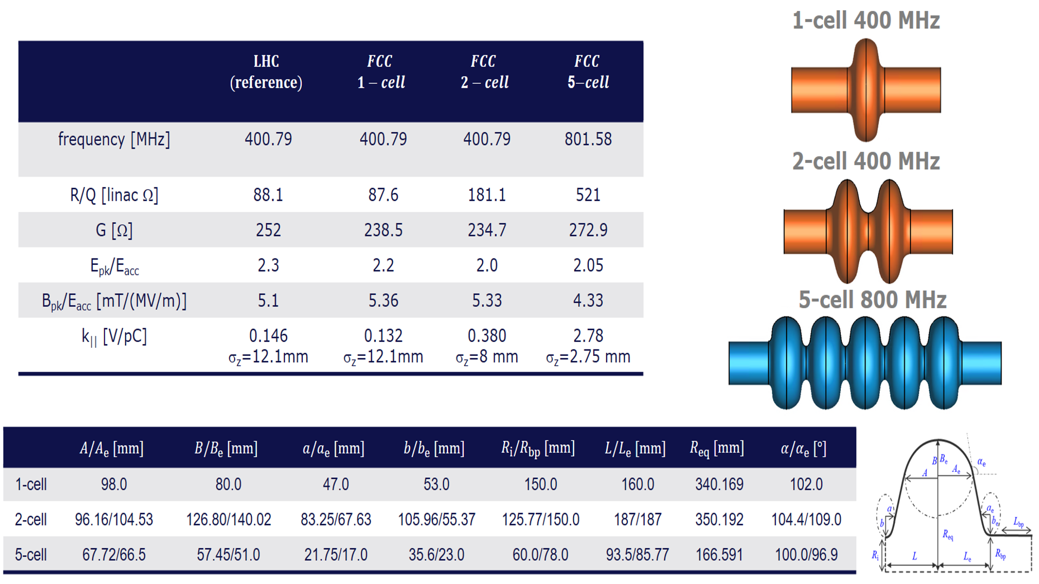
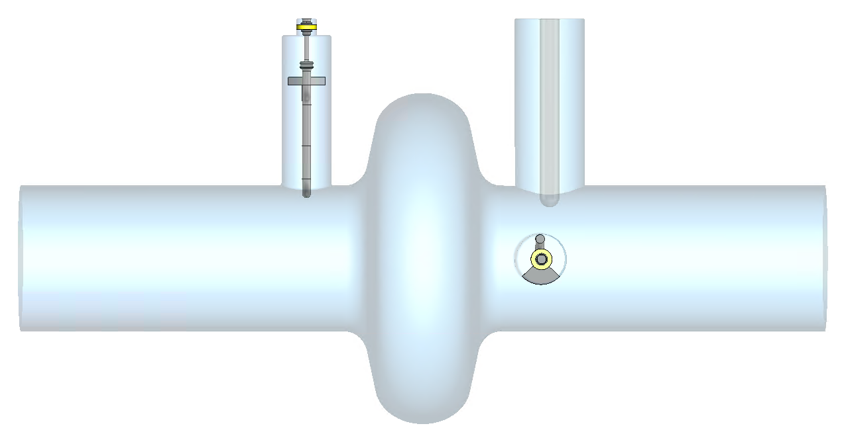
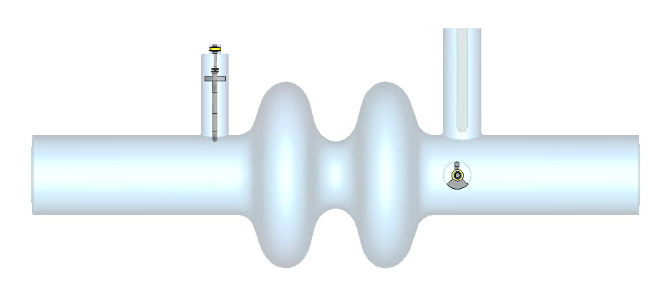
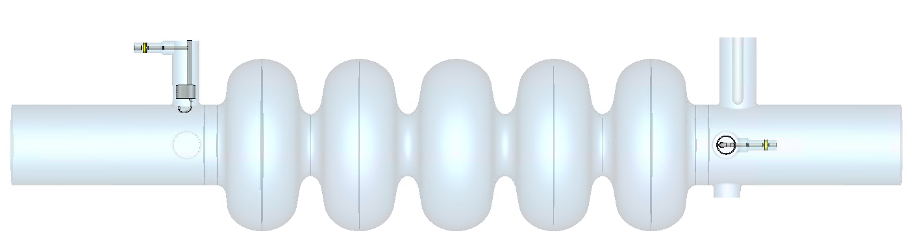
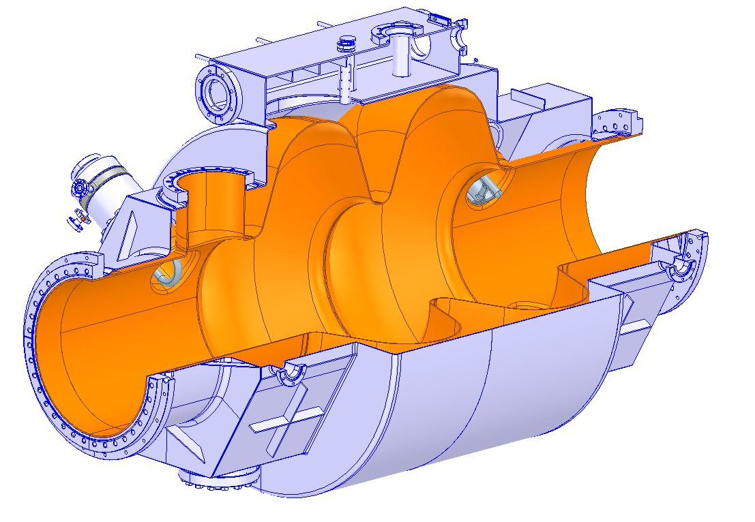
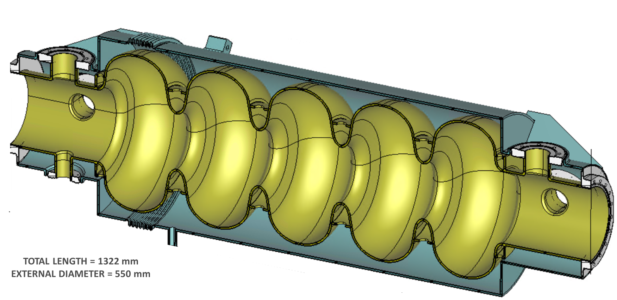
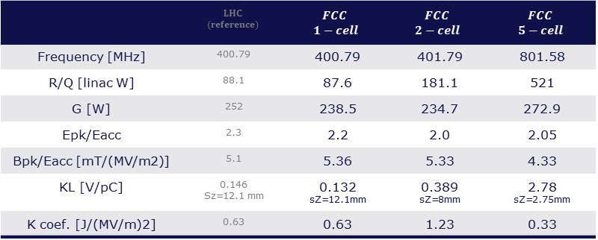
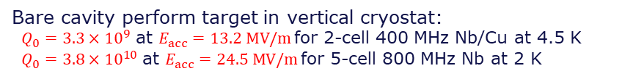
Cavity design – RF performances
Bare cavity perform target in vertical cryostat:
$Q_{0}=3.3×{10}^{9}$ at $E_{acc}=13.2 MV/m$for 2-cell 400 MHz Nb/Cu at 4.5 K
$Q_{0}=3.8×{10}^{10}$ at $E_{acc}=24.5 MV/m$for 5-cell 800 MHz Nb at 2 K
 | $$LHC$$ $$(reference)$$ | $$FCC$$ $$1−cell$$ | $$FCC$$ $$2−cell$$ | $$FCC$$ $$5−cell$$
Frequency [MHz] | 400.79 | 400.79 | 401.79 | 801.58
R/Q [linac W] | 88.1 | 87.6 | 181.1 | 521
G [W] | 252 | 238.5 | 234.7 | 272.9
Epk/Eacc | 2.3 | 2.2 | 2.0 | 2.05
Bpk/Eacc [mT/(MV/m2)] | 5.1 | 5.36 | 5.33 | 4.33
KL [V/pC] | 0.146 Sz=12.1 mm | 0.132 sZ=12.1mm | 0.389 sZ=8mm | 2.78 sZ=2.75mm
K coef. [J/(MV/m)2] | 0.63 | 0.63 | 1.23 | 0.33

Slide 4
Status of the discussions
15 December 2023:
visit of Cornell representatives at CERN
identification of some collaboration topics on FCC accelerator technology and especially on SRF and Nb3Sn.
January - April 2024:
First draft of MoU (?)
Topics:
R&D on Nb3Sn sputtering on Nb ?
….
May 2024:
Possible Cornell visitor at CERN: Liana Shpani
4 weeks in Sept. 2024 (DOE funds)
Topic: optimizing Nb3Sn growth
Possible activity at CERN: QPR samples measurement and studies

