Slide 1

FRAS project
Updates in the PL design

Slide 2
Contents
Small summary from previous activities
Updates in the FTA and LOPA
Conclusions

Slide 3
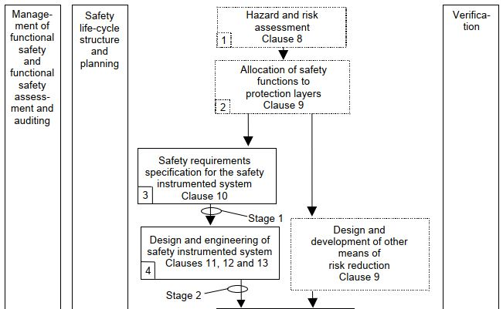
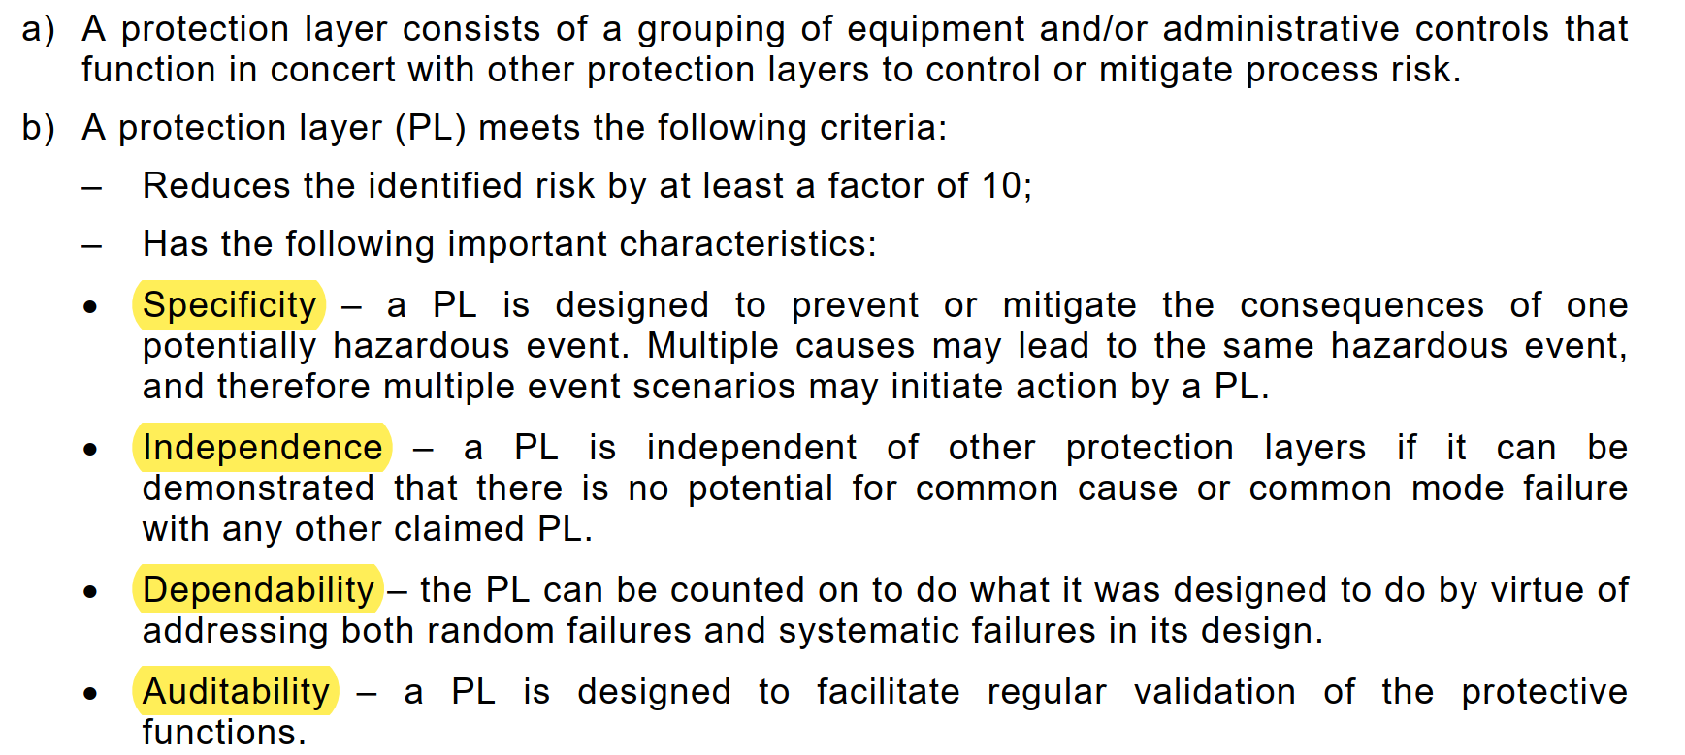
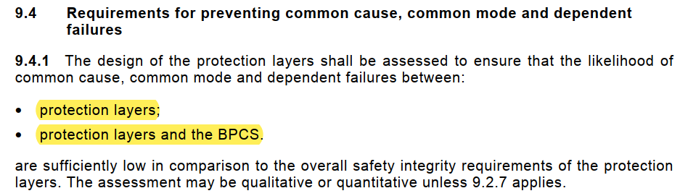
Protection Layers design (IEC 61511)
Necessary Risk Reduction | Number of PLs
> 10 (SIL1) | 2
> 100 (SIL2) | 3

Slide 4
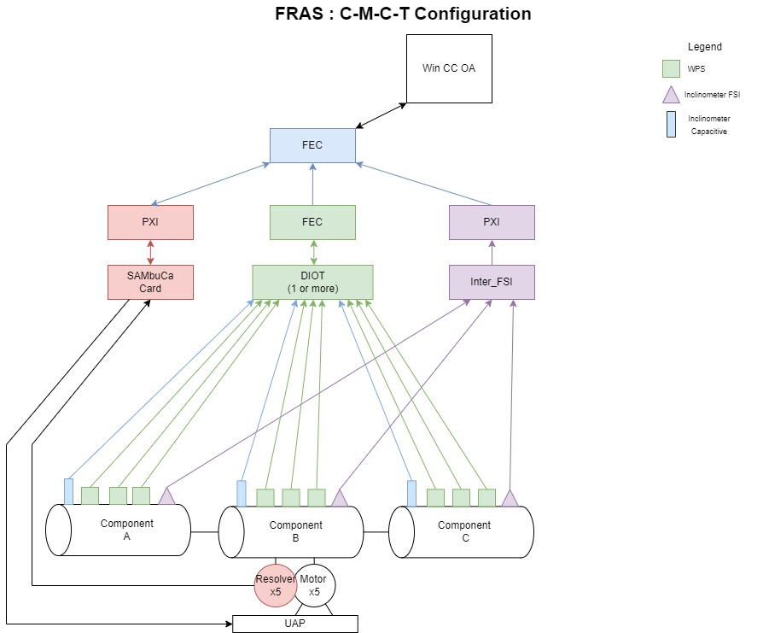
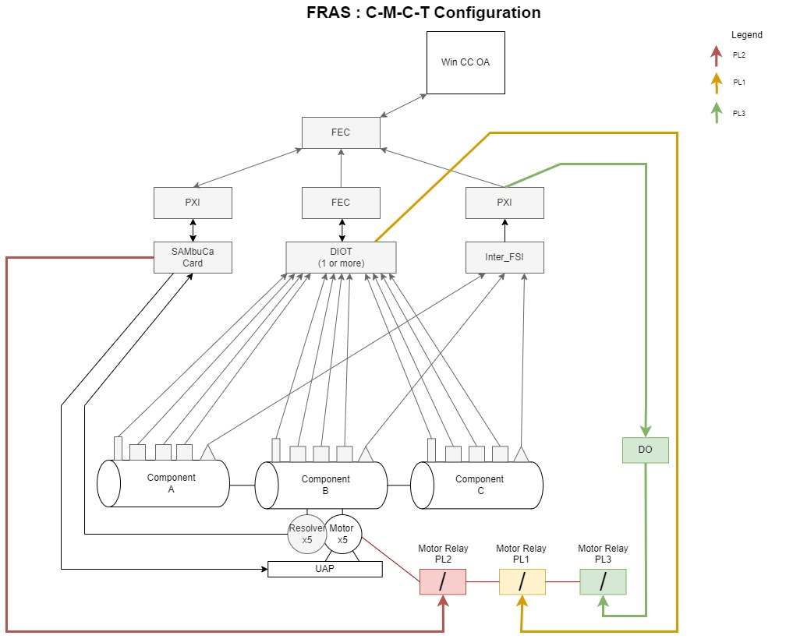
FRAS control system vs FRAS PLs
New hardware

Slide 5
FRAS control system vs FRAS PLs
“Independent” Protection Layers
(except for the FESA framework dependency)
No more diversity was proposed since the LOPA results showed that we can achieve the tolerable risk with the current architecture

Slide 6
Contents
FMEA (device failures)
FTA review (System failures)
LOPA + safety matrix (do we achieve the tolerable risk?)

Slide 7
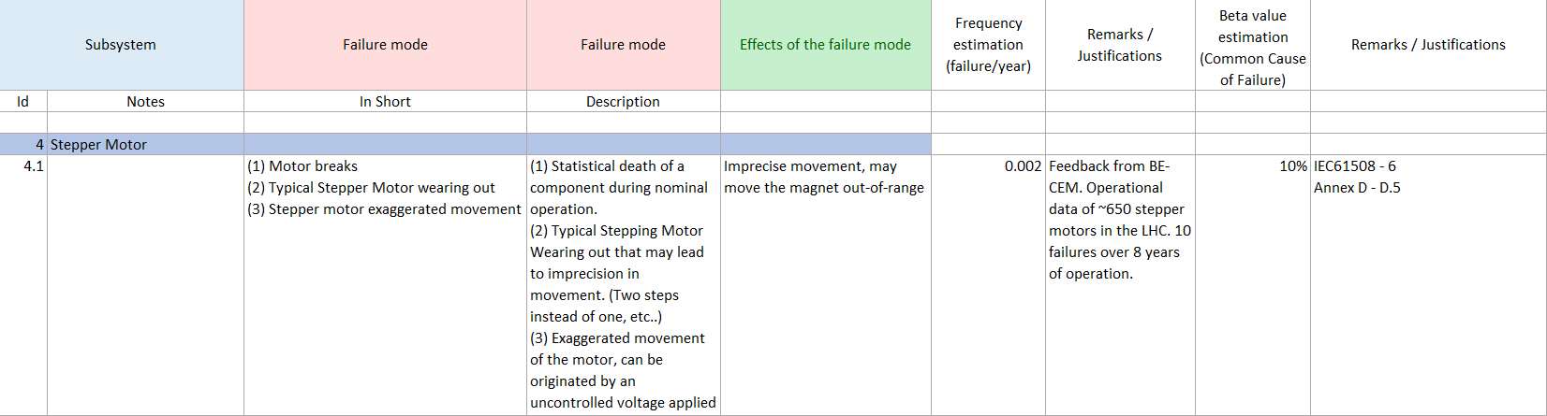
Contents
FMEA (device failures)
FTA review (System failures)
LOPA + safety matrix (do we achieve the tolerable risk?)

Slide 8
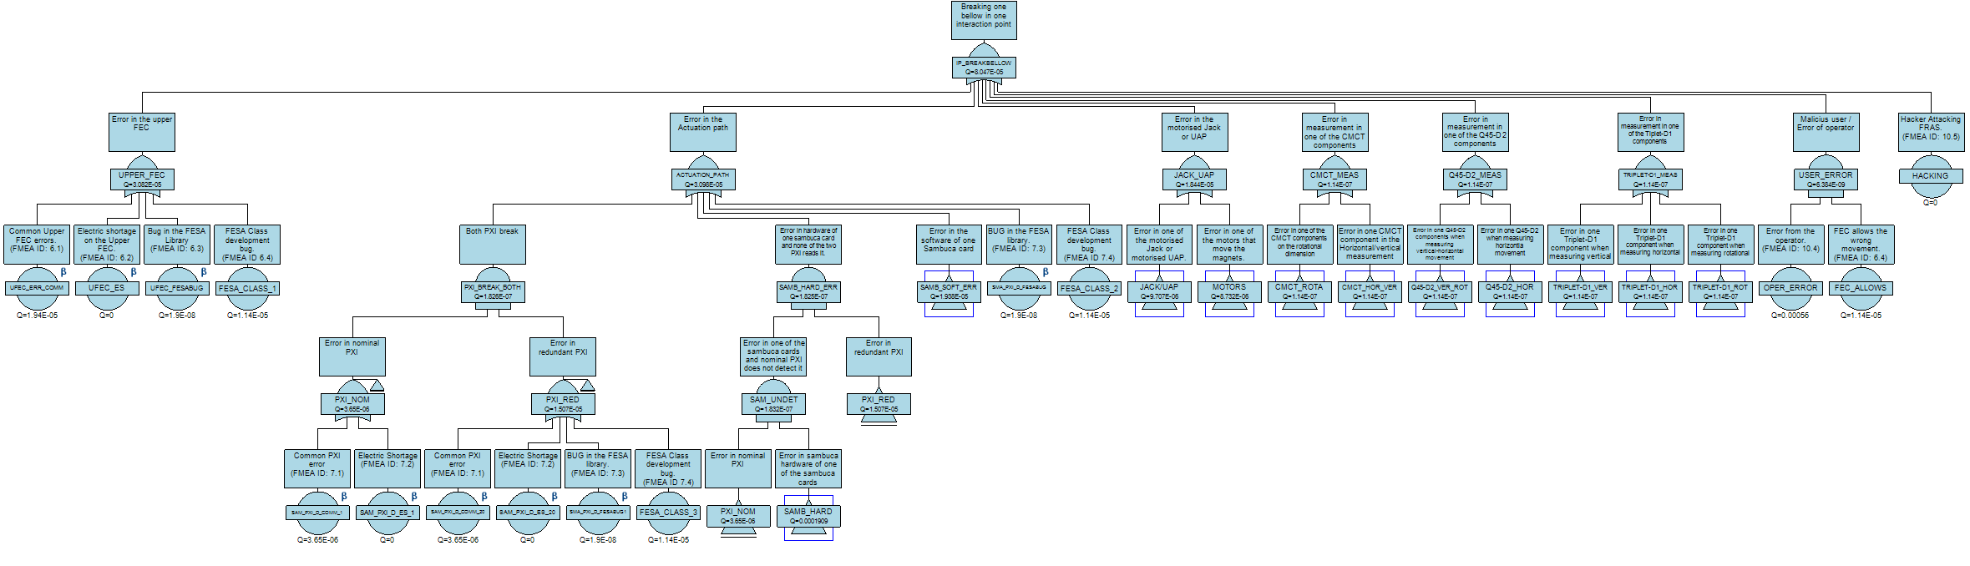
Contents
FMEA (device failures)
FTA review (System failures)
LOPA + safety matrix (do we achieve the tolerable risk?)

Slide 9
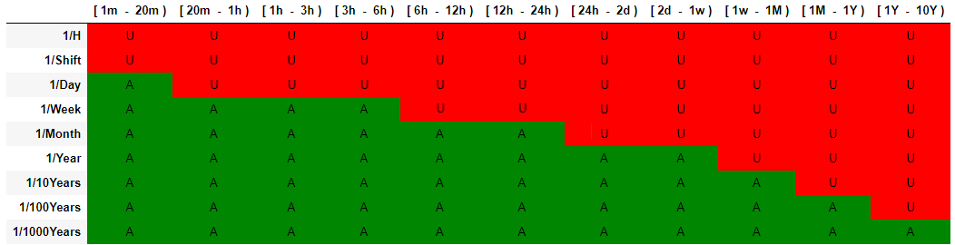

Contents
FMEA (device failures)
FTA review (System failures)
LOPA + safety matrix (do we achieve the tolerable risk?)
$$λ_{1}$$

Slide 10
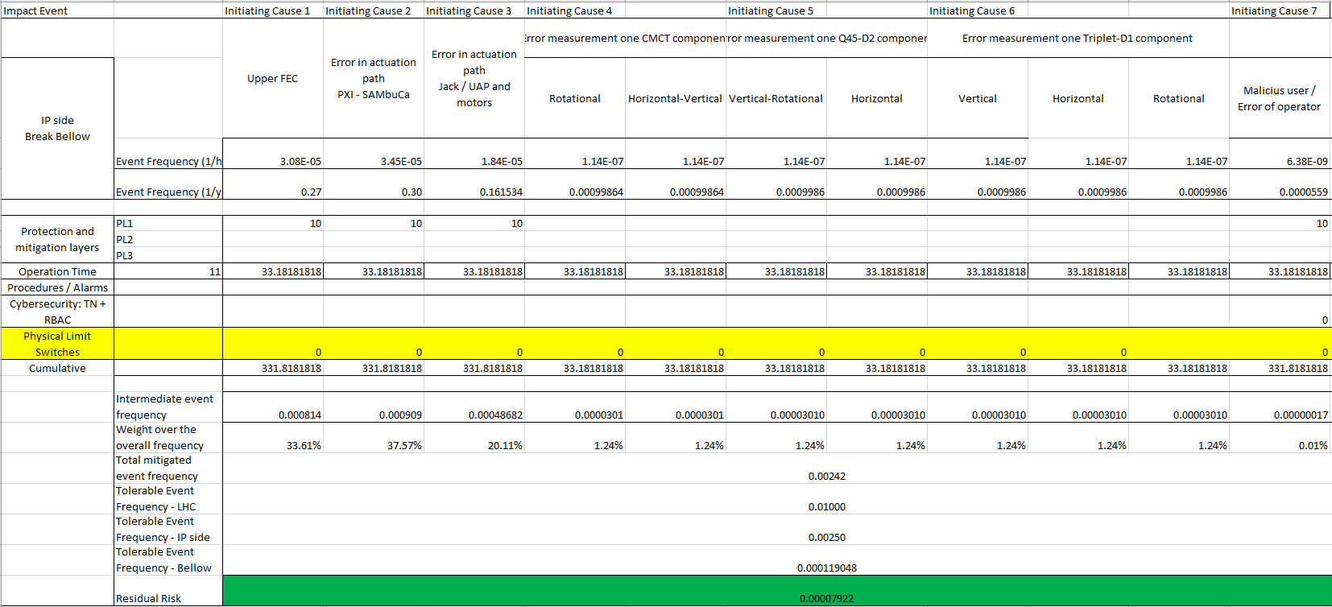
Layers of Protection Analysis (LOPA)
We don’t meet the independence and diversity requirements
From the IEC 61511 standard

Slide 11
What have we changed?
FMEA (device failures)
FTA review (System failures)
LOPA + safety matrix (do we achieve the tolerable risk?)

Slide 12
FRAS PLs changes
Changes:
Capacitive sensors path: we must use the LGC algorithm (same as top FEC) with different “parameters/configuration”
Resolvers path: initial position (before movement) given by the top FEC
FSI sensors path: it can only measure (and then protect from) rotational movement

Slide 13
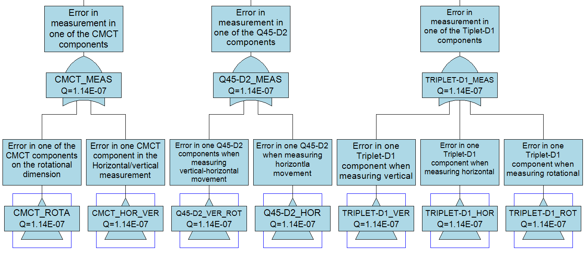
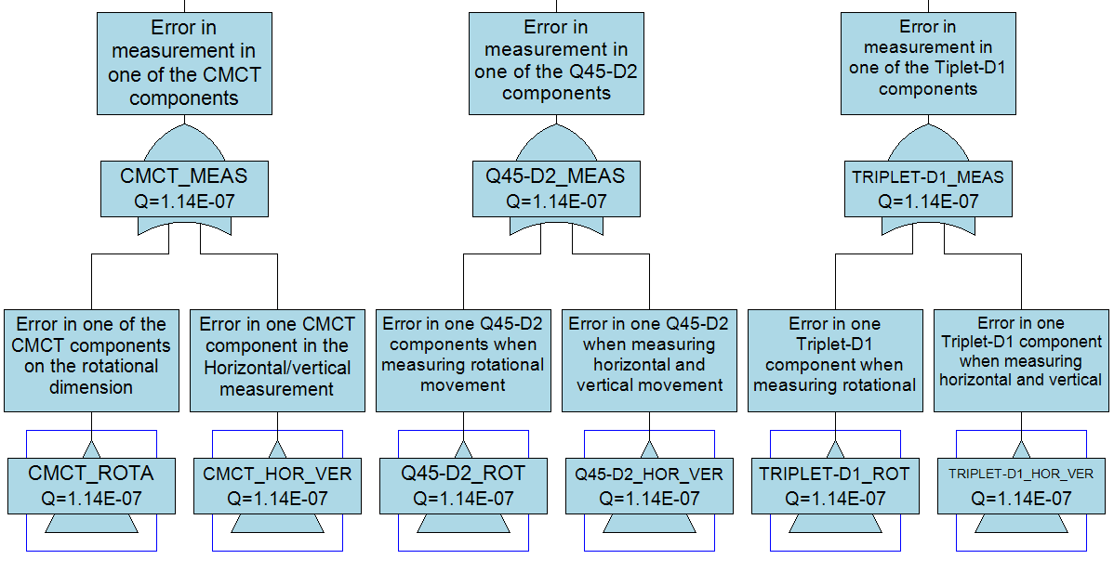
Changes in the FTA
Change: FSI can only measure rotational
Conclusion: failure frequencies barely change
Before
Now

Slide 14
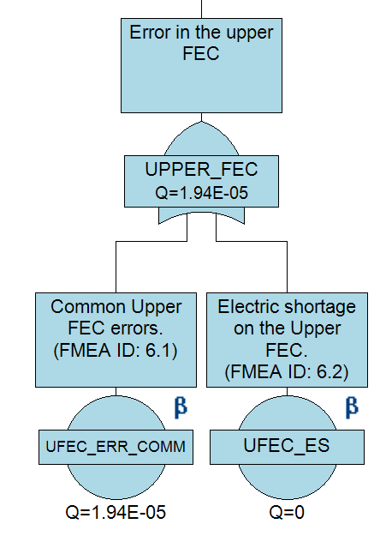
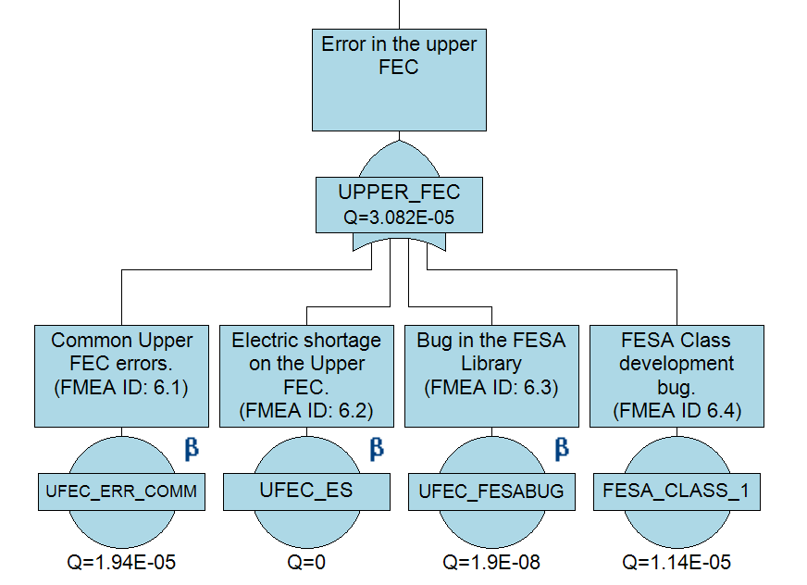
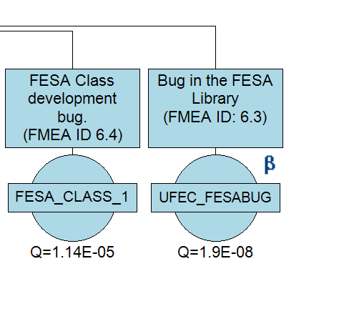
FRAS PLs changes
Change: Dependencies with top FEC – we split the failure modes
Conclusion: more granularity for the LOPA analysis
Before
Now

Slide 15
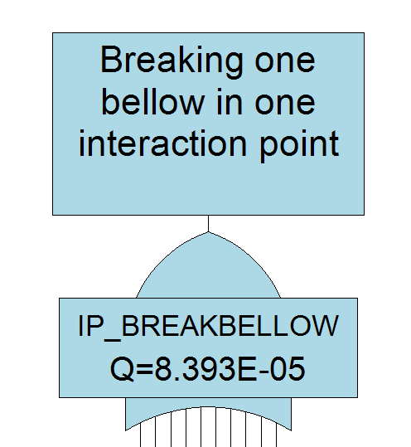
FRAS PLs changes
Conclusion: global failure rate does not change. We just got more granularity for the LOPA analysis
Before
Now

Slide 16
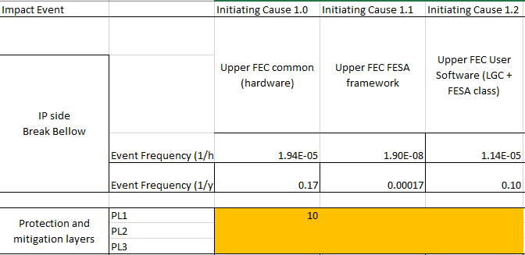
FRAS PLs changes
Change: more granularity for the top FEC failures
Conclusion: (conservative approach) some relevant (according to the assumptions) failure modes are not protected
Before
Now

Slide 17
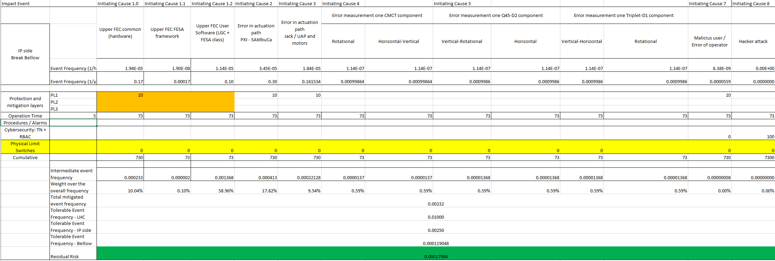
FRAS PLs changes

Slide 18
FRAS PLs changes
However,
Purely systematic failures (e.g., software failures) will not be affected by the operation time
Therefore,
We should not consider this risk reduction in LOPA
These failures will be treated separately, following the risk reduction recommendations for software from the IEC standards (including testing, procedures, runtime monitors, specification, etc.)

Slide 19
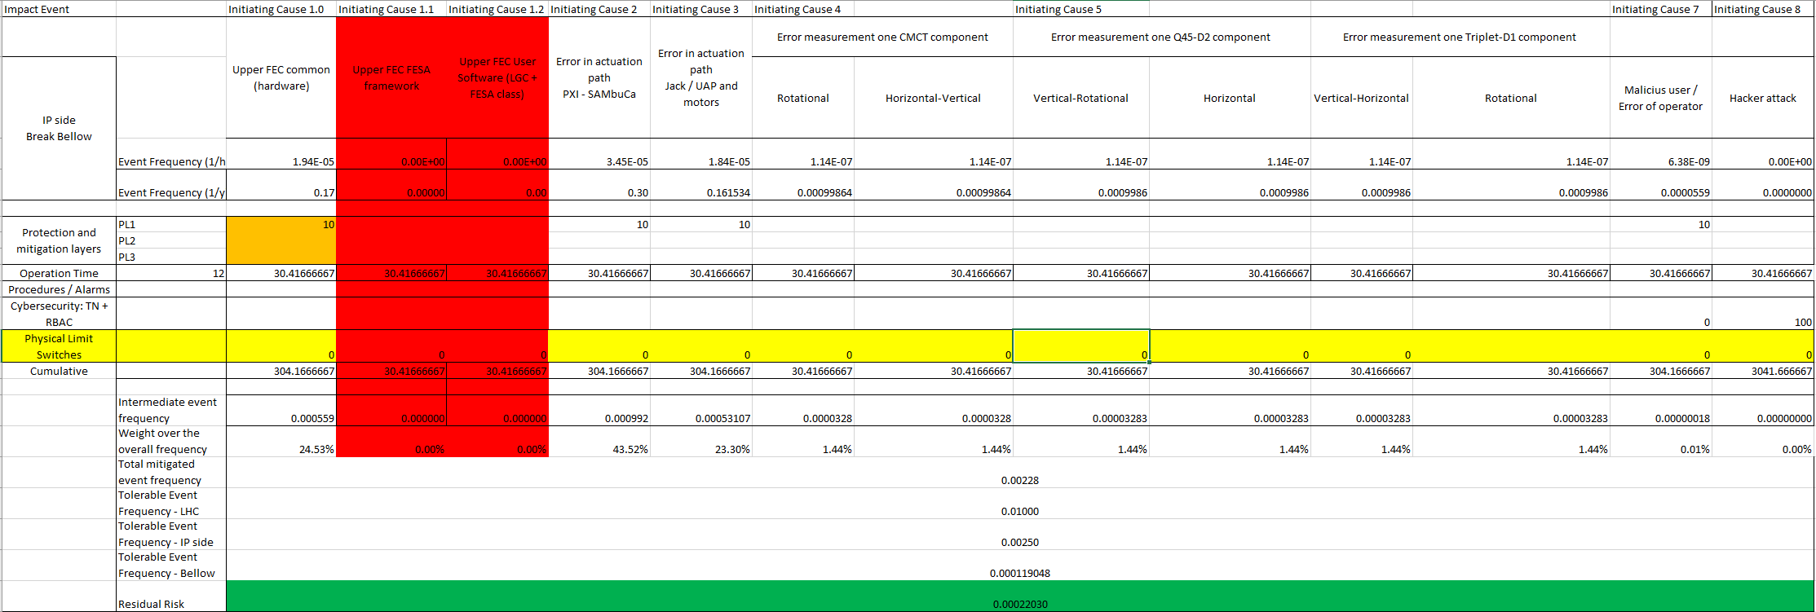
FRAS PLs changes

Slide 20
Conclusions
Same reliability data as before (same assumptions)
PLs cannot protect from all failures
New single point of failure -- LGC logic:
  58% of chances of breaking the bellow (according with the data)
  Testing, runtime monitors (?) and procedures should be put in place
Max. operation time limit = 12 days – assuming a perfect mechanism/procedure to switch off the motors and excluding pure software failures from the top FEC

Slide 21
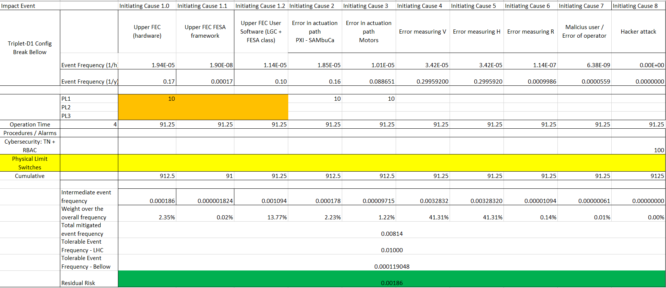
RAC3 PLs changes

Slide 22
RAC3 PLs changes
However,
Purely systematic failures (e.g., software failures) will not be affected by the operation time
Therefore,
We should not consider this risk reduction in LOPA
These failures will be treated separately, following the risk reduction recommendations for software from the IEC standards (including testing, procedures, runtime monitors, specification, etc.)

Slide 23
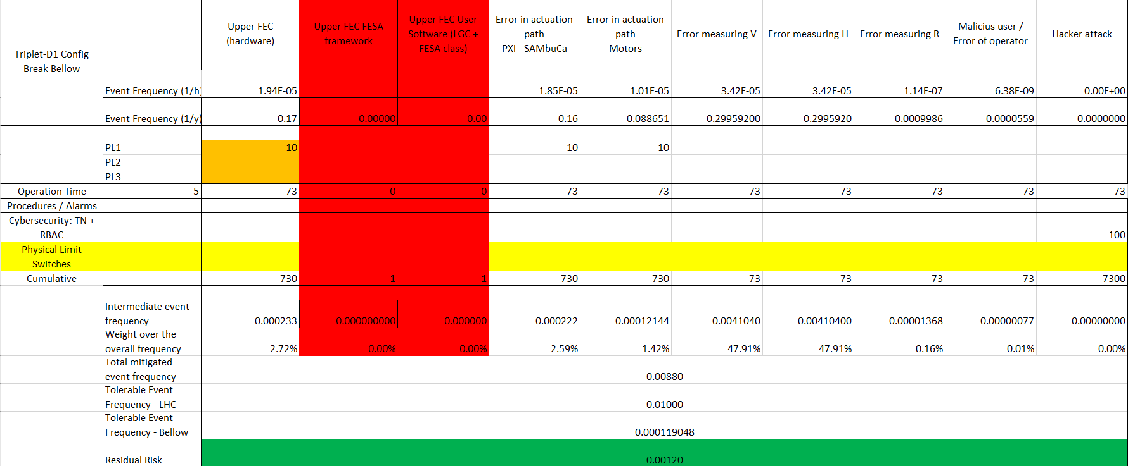
RAC3 PLs changes

