Slide 1
HL-LHC cell 4 collimators mock-up
Objectives
Tests to be performed
Preparation status
Timeline discussion
M. Sosin on behalf of WP15.4
2024.06.18

Slide 2
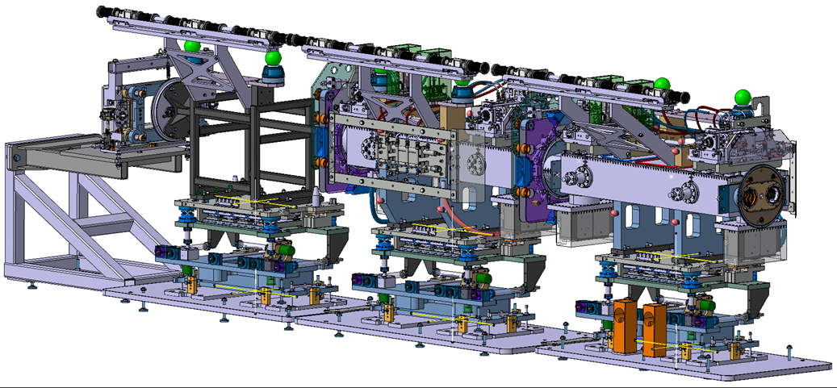
HL-LHC cell 4 collimators mock-up – FRAS components
Scope of the mock-up FRAS equipment for 2 collimators TCTPXH and TCLPX)
  2 side pillars + 2WPS (wire supports + reference)
  6 WPS on arms (3 per collimator)
  2 inclinometers (capacitive) → For the first tests in case of delays with capacitive inclinometers readiness - the WYLER inclinometer (preferred) or FSI-inclinometers to be used as replacer for the test period. The SCT optical inclinometers to be used for integration tests.
  Only 1 UAP (TCLPX) motorized considered for now (manual parametrization of motorized axes)
Main objective
  Validation of the different systems and their respective interfaces

Slide 3
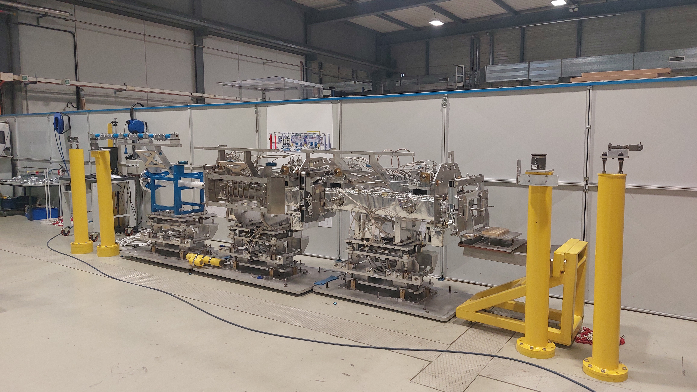

Slide 4
Mock-up validations, related to FRAS integration, installation and exchange
Rehearsal platform prior to the installation in the tunnel
  Alignment of supporting foot – DONE
  Pre-adjustment of collimator by ASG – DONE
  Test of WPS supporting arm rigidity, tests of UAP – DONE
  WPS system, inclinometers, motors integration – DONE
  FRAS cables routing + ergonomics of installation validation - ONGOING
  Collimator handling – DONE
Rehearsal platform for repair and exchange procedure to proof ALARA principle – ONGOING
  FRAS related activities when replacement of a collimator is requested
    In situ mount/dismount of the different key equipment:
      Removing/re-installation of WPS line components and triple-WPS installation bar)
      Mount/dismount of inclinometer
      Mount/dismount of motorized adapters
      Cables handling while collimator replacement
    All of above activities to be crosschecked versus ALARA: validation of assumptions from of working dose planning
Tests details and report links:
  https://confluence.cern.ch/display/FRAS/Collimator+mock-up+927

Slide 5
Mock-up validations – vacuum systems, UAP FRAS operation
Validation of collimators and UAP equipped in FRAS sensors/motorized adapters (representative to FRAS operation) - tests of position determination, 3D motion, safety functions – TO DO
  Test steps:
    Validation of adjustment precision and motorized adapters resolution - performed only on motorized collimator.
    3D alignment (with sensors and motorized adapters / or setting position manually on non-motorized UAP). Various motion steps will be applied to UAP axes / motorized adapters.
  Simplest approach for above validation test is to use LGC software which is in big
    Motion/adjustment steps follow-up by LGC software block
    Multiple steps, representing various scenarios (1D/2D/3D motions including angular) to be applied
    Safety functions validation with collimator assembly → use of LGC “Bellows” software
    Test with (minimum necessary) parallel AT401 measurements to confirm system performance.
Validation of vacuum systems during FRAS UAP operation requested by TE-VSC – details and movements still to be discussed (can be done parallel to UAP-FRAS representative test) – TO DO

Slide 6
HL-LHC cell 4 collimators mock-up
FRAS components preparation status
Mechanics and sensors:
  Extremity pillars : installed
  5 Motorized adapters : Being assembly and tests (available end of June)
  Pulley + fixed point : installed
  Reference sensor support : installed
  Temperature sensor : Installed
  Pulley system : installed
  Tension point : installed
  WPS 3 balls interface : Installed
  WPS Sensor (8 Units): Production in progress (end of June)
  WPS Sensor mock up (3x): Ready, but need to wait for protection beam installation
  WPS protection pipe (new design - new pipe - bellow included) : Parts received. To be installed
  Inclinometer - Wyler version : Adaptation design ready. To be manufactured
  Inclinometer - Capa version - developments ongoing: September
Electronics and controls related:
  RACK - installed
  FEC - requested to Julien (see RQF2654677) - mid June
  FIP extension; Ethernet in the rack - requested to Julien as part of same ticket of FEC - mid June
  DIOT Crate + Main board - can temporarily use ones meant for SM18 IT String test
  8 WPS conditioner cards - ordered and ready from last batch
  WPS Cables - in progress from EN/EL (see RQF2617226)
  Inclinometer (Wyler version) - Jonas did preliminarily-design. ASG might borrow 2 Wylers up-to 1 month
  CEM-MRO equipment:
    Patch panel + temporary rack for tests period - TBC (?)
    Temporary (semi-m annual) motion control racks for 5 axis TBC (?)

Slide 7
HL-LHC cell 4 collimators mock-up
FRAS components preparation status
Electronics and controls related:
  RACK - installed
  FEC - requested to J. Palluel (see RQF2654677) - mid June
  FIP extension; Ethernet in the rack - requested to Julien as part of same ticket of FEC - mid June
  DIOT Crate + Main board - can temporarily use ones meant for SM18 IT String test
  8 WPS conditioner cards - ordered and ready from last batch
  WPS Cables - in progress from EN/EL (see RQF2617226)
  Inclinometer (Wyler version) - Jonas did preliminarily-design. ASG might borrow 2 Wylers up-to 1 month
  CEM-MRO equipment:
    Patch panel + temporary (semi-m annual) motion control rack for tests period - TBC (?)
Software preparation:
  Preparing the GEODE data structure and insert all necessary data
  Preparation of LGC configuration file
  FESA/SCADA:
    LGC - Aligned component position is ready. The bellows need to be finalized
    Inclinometer object finalization and data acquisition from WYLER

Slide 8
Summary, Timeline discussion
Big part of collimator test stand ready. Most of the system could be installed in next few months
Following initial analysis - UAP-FRAS representative test date could be chosen for end of
August ’24 (?), but this must be confirmed:
  Software deployed + LGC file readiness
  MRO equipment readiness
  Availability of ASG (Ludovic). Help of ASG discussed, but due to delays need to be re-confirmed
  Test should not take longer than 2 days
Remaining validations (routing, installation/de-installation of components) will be performed during installation of FRAS systems (when ready)
Other constraints ?

