Slide 1
WP19 CEM-GM-ICS FRAS meeting
AOB:
PPS2 patch panel integration
HL DIC, DIFs etc
Vincent Barbarroux
18.06.2024

Slide 2
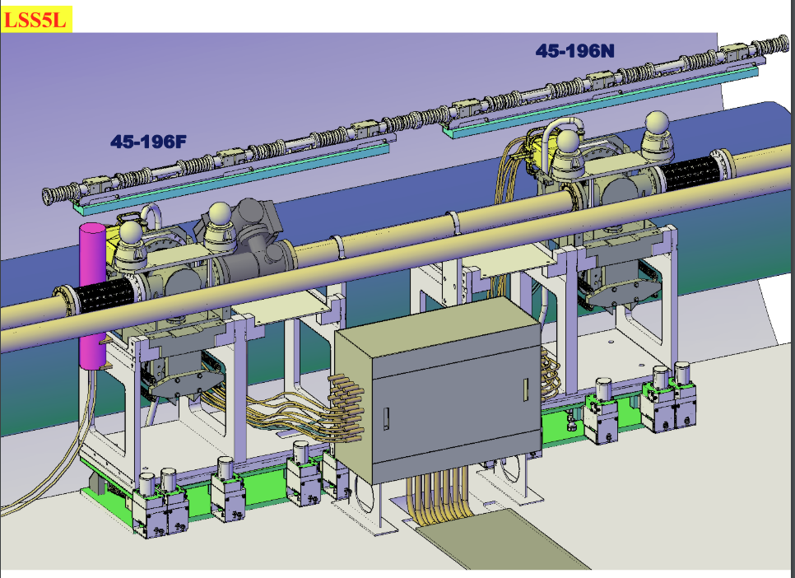
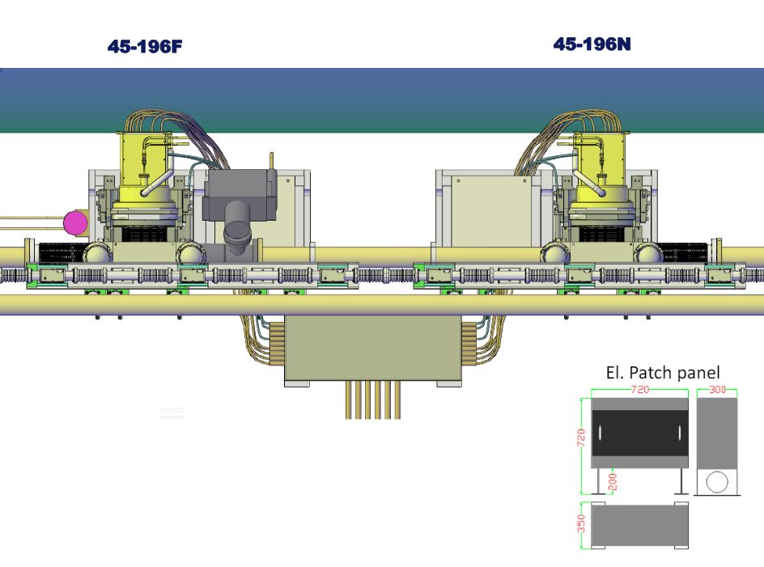
PPS2 patch panel integration
2 Motors patch behind PPS2 patch panel
1 OF patch for 2 stations here
Routing to be defined ( similar to Collimators)

Slide 3
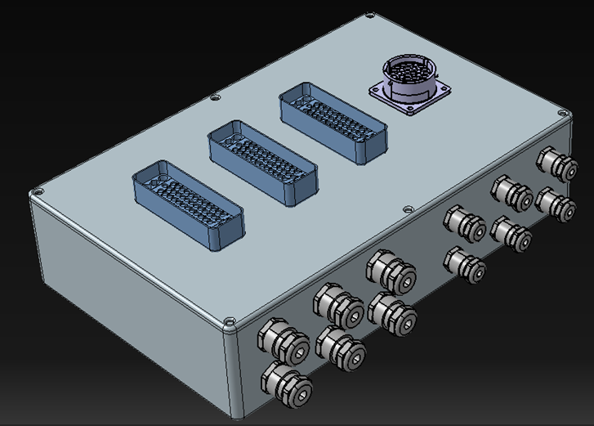
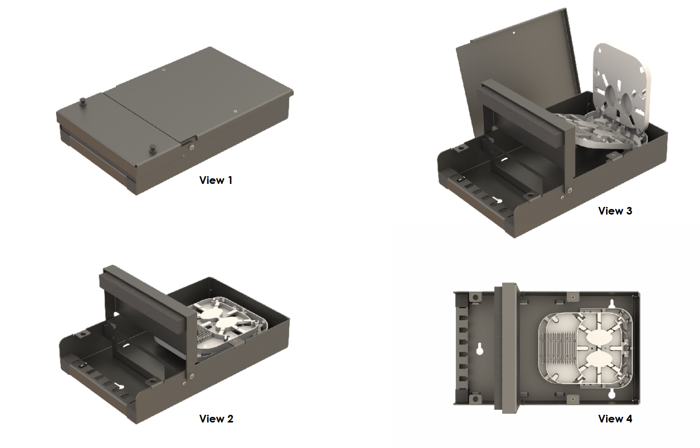
PPS2 patch panel integration
Motors patch panel first design
Example of Small patch for Optical Fibers (up to 12 channels)

Slide 4
HL DIC, DIFs etc
Need to confirm number of power supply sockets
Number of ethernet sockets in each racks
PPS2 motor Sambuca racks: in UR55? ( some space in GYPOS04=UR55 or extension to 52U) or in UA?
WP7 DIC for BIS to be updated. Initially defined in GYPOS1 of US15, USC55. Sambuca racks + relay boxes layout to be agreed
IP | Side | Location | Defined use | Rack |  |  |  |  |  |  |  |  | Total
 |  |  |  |  |  |  |  |  |  | Equipment
 |  |  |  |  | HLS | WPS | TEM | HUM | PRE | Motor | WIRE Stretcher | GXHR
5 | R | UPS | WPS rack (12U) | GYPOS01=UPS56 | 0 | 16 | 0 | 0 | 0 | 0 | 0 | 0 | 16
 |  |  | WPS rack (12U) | GYPOS02=UPS56 | 0 | 15 | 0 | 0 | 0 | 0 | 0 | 0 | 15
 |  |  | WPS rack (12U) | GYPOS03=UPS56 | 4 | 0 | 9 | 3 | 9 | 0 | 0 | 0 | 25
 |  | UR | MT-FSI LASER RACK | GYPOS01=UR55 | 0 | 0 | 0 | 0 | 0 | 0 | 0 | 0 | 0
 |  |  | MT-FSI LASER RACK | GYPOS02=UR55 | 0 | 0 | 0 | 0 | 0 | 0 | 0 | 0 | 0
 |  |  | MOTOR CONTROL FRAS | GYPOS03=UR55 | 0 | 0 | 0 | 0 | 0 | 0 | 10 | 0 | 10
 |  |  | SENSOR RACK | GYPOS04=UR55 | 4 | 0 | 0 | 0 | 0 | 0 | 0 | 0 | 4
 |  |  | MOTOR CONTROL FRAS | GYPOS05=UR55 | 0 | 0 | 0 | 0 | 0 | 15 | 0 | 0 | 15
 |  |  | MOTOR CONTROL FRAS | GYPOS06=UR55 | 0 | 0 | 0 | 0 | 0 | 15 | 0 | 0 | 15
 |  |  | MOTOR CONTROL FRAS | GYPOS07=UR55 | 0 | 0 | 0 | 0 | 0 | 10 | 0 | 0 | 10
 |  |  | MOTOR CONTROL FRAS | GYPOS08=UR55 | 0 | 0 | 0 | 0 | 0 | 15 | 0 | 0 | 15
 |  |  | SENSOR RACK | GYPOS09=UR55 | 0 | 0 | 21 | 5 | 6 | 0 | 0 | 0 | 32
 |  | UL | SENSOR RACK | GYPOS01=UL557 | 17 | 0 | 0 | 0 | 0 | 0 | 0 | 0 | 17
 |  |  | MOTOR CONTROL FRAS | GYPOS02=UL557 | 0 | 0 | 0 | 0 | 0 | 15 | 0 | 0 | 15
 |  |  | MOTOR CONTROL FRAS | GYPOS03=UL557 | 0 | 0 | 0 | 0 | 0 | 15 | 0 | 0 | 15
 |  |  | SENSOR RACK | GYPOS04=UL557 | 0 | 0 | 0 | 0 | 0 | 0 | 0 | 0 | 0
 |  | UA | SENSOR DAQ | GYPOS01=UA57 | 0 | 35 | 0 | 0 | 0 | 0 | 0 | 0 | 35
 |  |  | SENSOR DAQ | GYPOS02=UA57 | 0 | 0 | 0 | 0 | 0 | 0 | 0 | 0 | 0
 | USC55 |  | MOTOR CONTROL FRAS | GYPOS01=USC55 | 0 | 0 | 0 | 0 | 0 | 15 | 0 | 0 | 15
 |  |  | MOTOR CONTROL FRAS | GYPOS02=USC55 | 0 | 0 | 0 | 0 | 0 | 15 | 0 | 0 | 15
 |  |  | MT-FSI LASER RACK | GYPOS03=USC55 | 0 | 0 | 0 | 0 | 0 | 0 | 0 | 0 | 0
 |  |  | SENSOR RACK | GYPOS04=USC55 | 0 | 0 | 0 | 0 | 0 | 0 | 0 | 0 | 0
 | L | UR | SENSOR RACK | GYPOS51=UR55 | 0 | 0 | 21 | 5 | 6 | 0 | 0 | 0 | 32
 |  |  | MOTOR CONTROL FRAS | GYPOS52=UR55 | 0 | 0 | 0 | 0 | 0 | 15 | 0 | 0 | 15
 |  |  | MOTOR CONTROL FRAS | GYPOS53=UR55 | 0 | 0 | 0 | 0 | 0 | 10 | 0 | 0 | 10
 |  |  | MOTOR CONTROL FRAS | GYPOS54=UR55 | 0 | 0 | 0 | 0 | 0 | 15 | 0 | 0 | 15
 |  |  | MOTOR CONTROL FRAS | GYPOS55=UR55 | 0 | 0 | 0 | 0 | 0 | 15 | 0 | 0 | 15
 |  |  | MOTOR CONTROL FRAS | GYPOS56=UR55 | 0 | 0 | 0 | 0 | 0 | 0 | 10 | 0 | 10
 |  |  | SENSOR RACK | GYPOS57=UR55 | 4 | 0 | 0 | 0 | 0 | 0 | 0 | 0 | 4
 |  |  | MT-FSI LASER RACK | GYPOS58=UR55 | 0 | 0 | 0 | 0 | 0 | 0 | 0 | 0 | 0
 |  |  | MT-FSI LASER RACK | GYPOS59=UR55 | 0 | 0 | 0 | 0 | 0 | 0 | 0 | 0 | 0
 |  | UA | SENSOR DAQ | GYPOS01=UA53 | 0 | 35 | 0 | 0 | 0 | 0 | 0 | 0 | 35
 |  |  | SENSOR DAQ | GYPOS02=UA53 | 0 | 0 | 0 | 0 | 0 | 0 | 0 | 0 | 0
 |  | UPS | SENSOR RACK | GYPOS01=UPS54 | 0 | 16 | 0 | 0 | 0 | 0 | 0 | 0 | 16
 |  |  | SENSOR RACK | GYPOS02=UPS54 | 0 | 15 | 0 | 0 | 0 | 0 | 0 | 0 | 15
 |  |  | SENSOR RACK | GYPOS03=UPS54 | 6 | 0 | 9 | 3 | 9 | 0 | 0 | 0 | 27

Slide 5
Thank you
12.06.2024

