Slide 1
CERN REU Presentation #1
Katie Ream
June 24, 2024

Slide 2
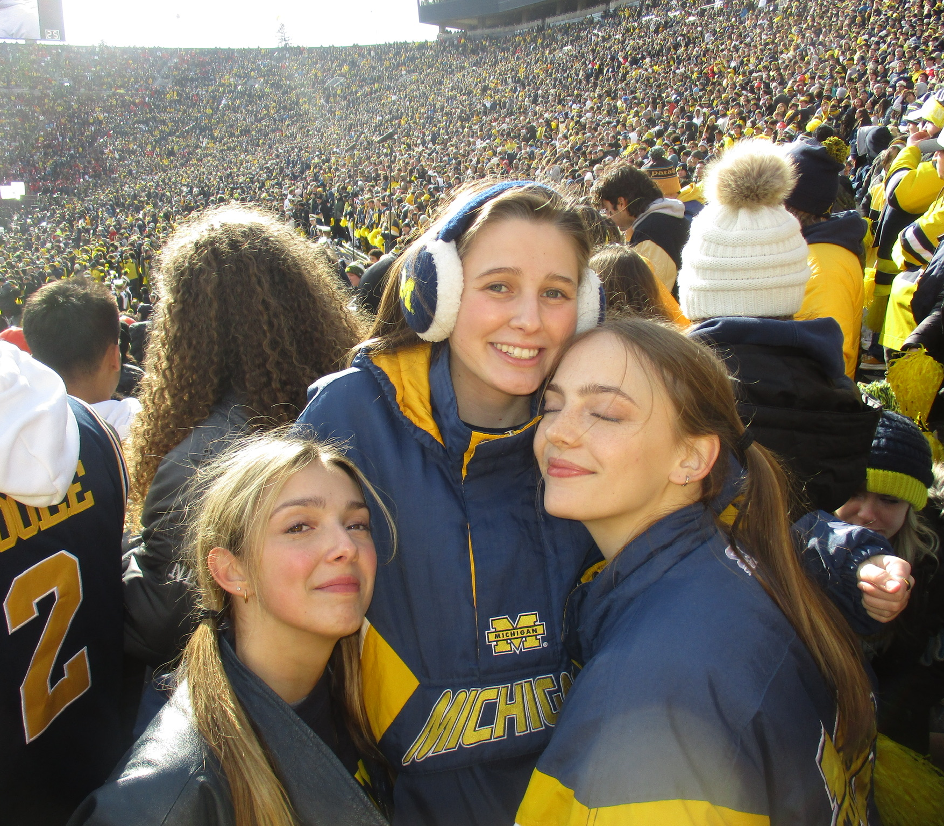
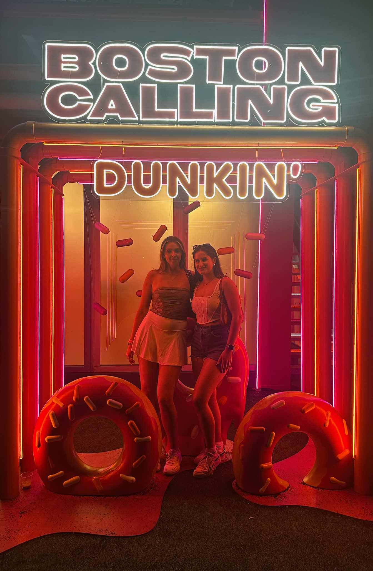
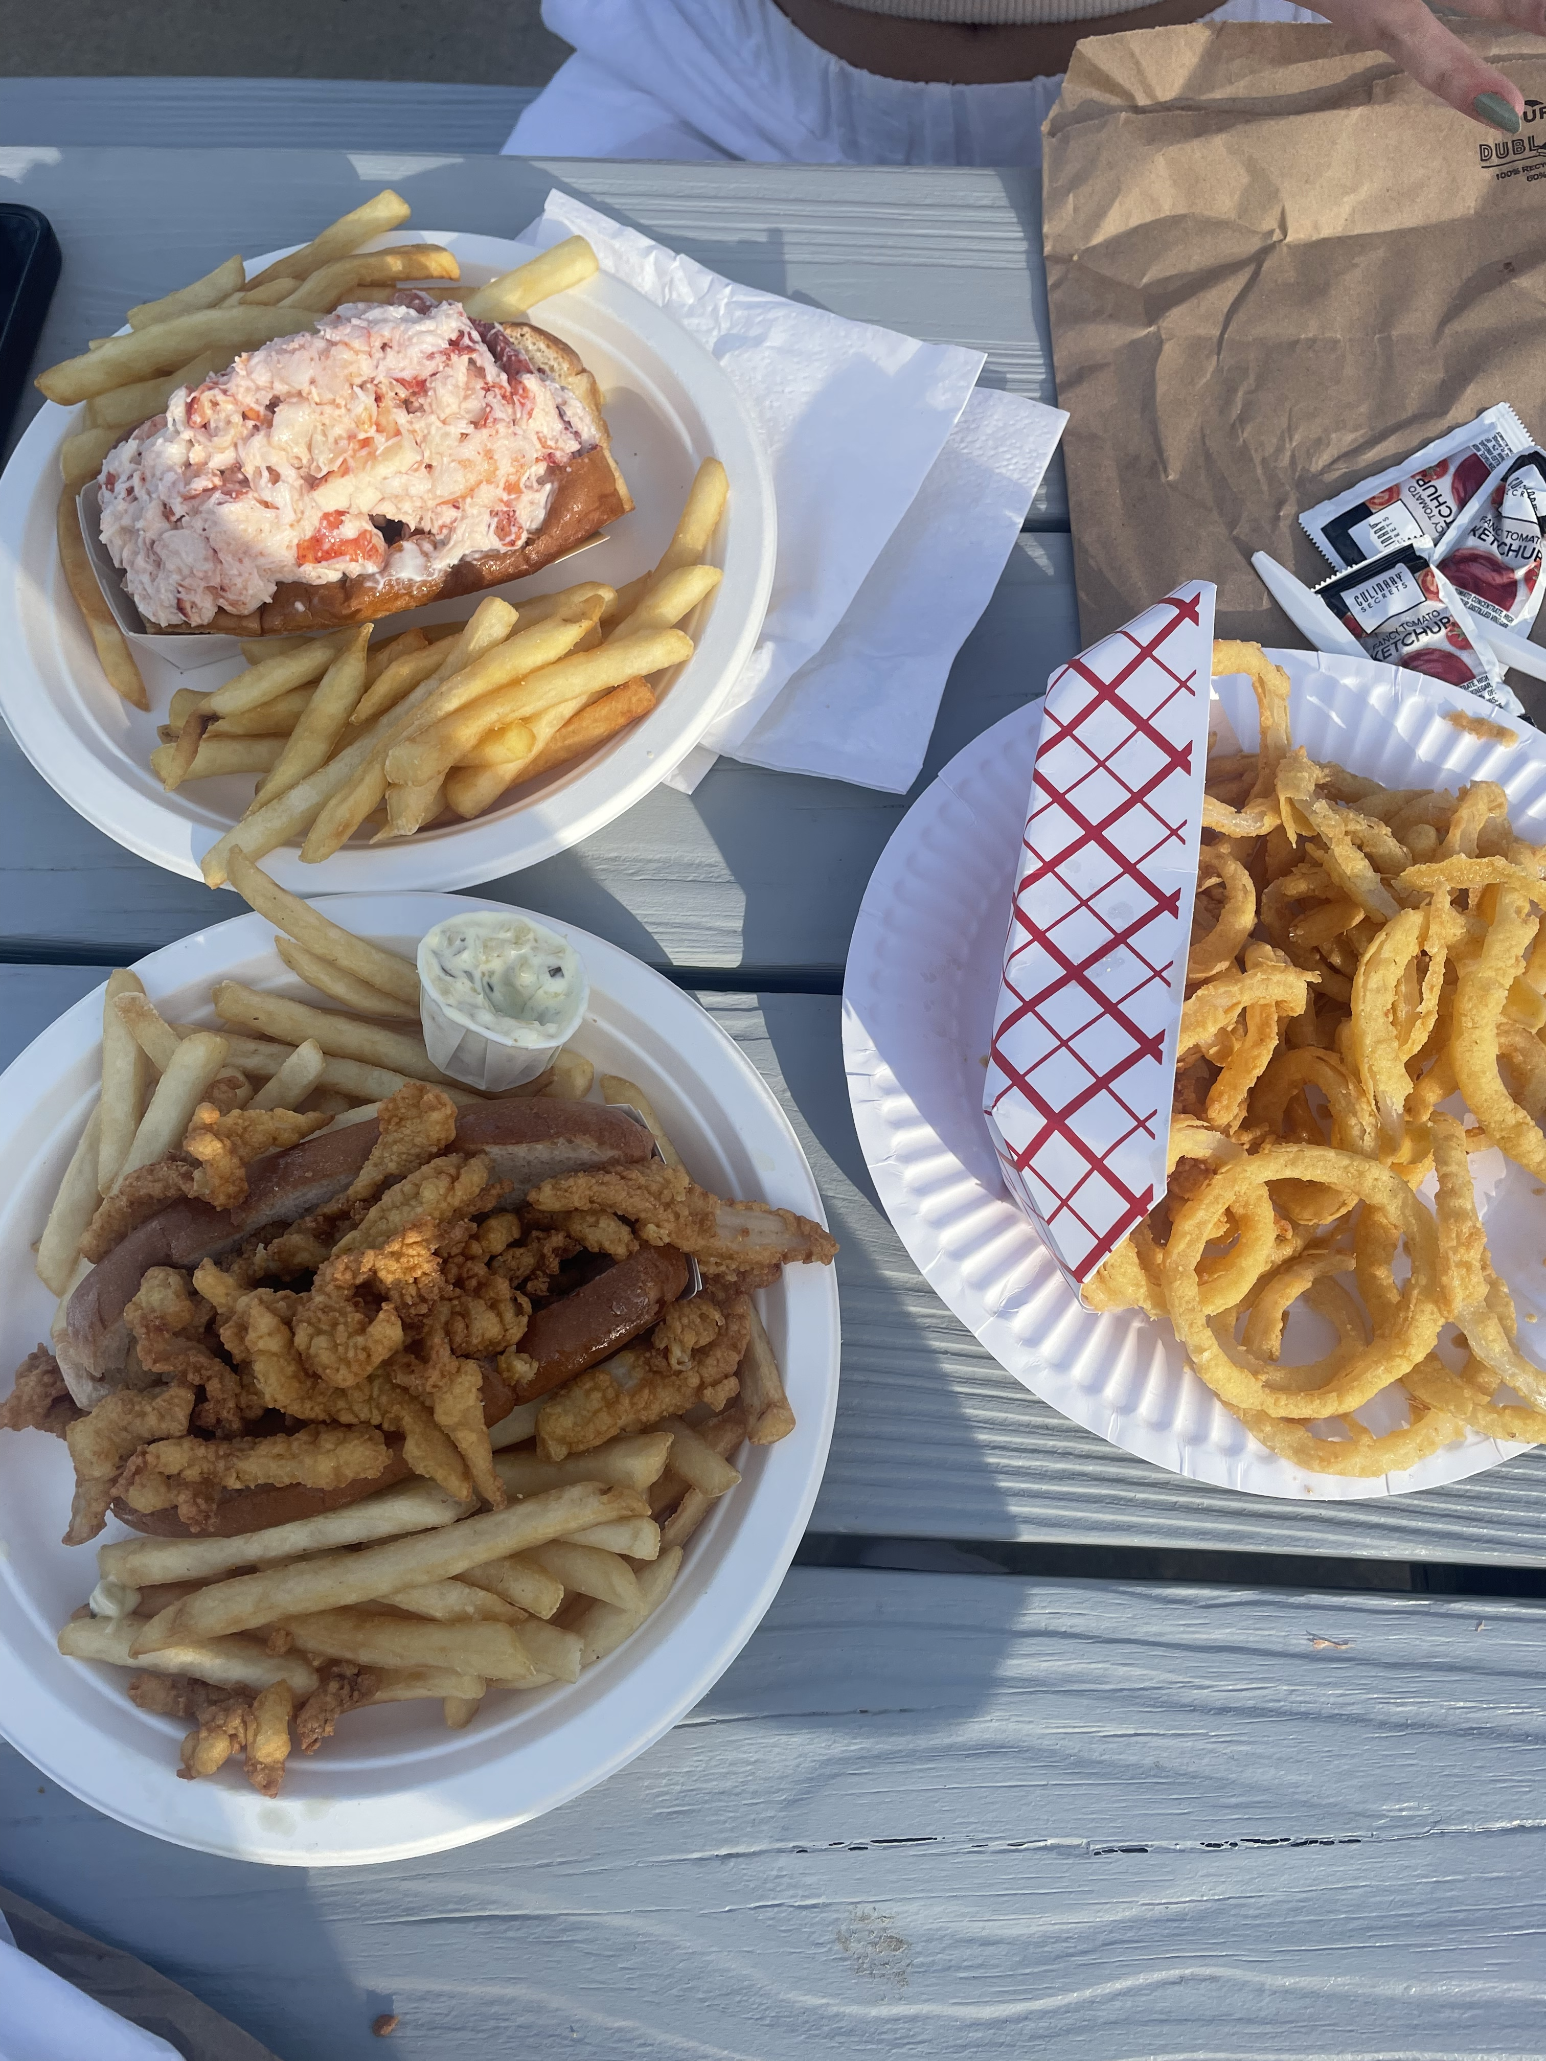

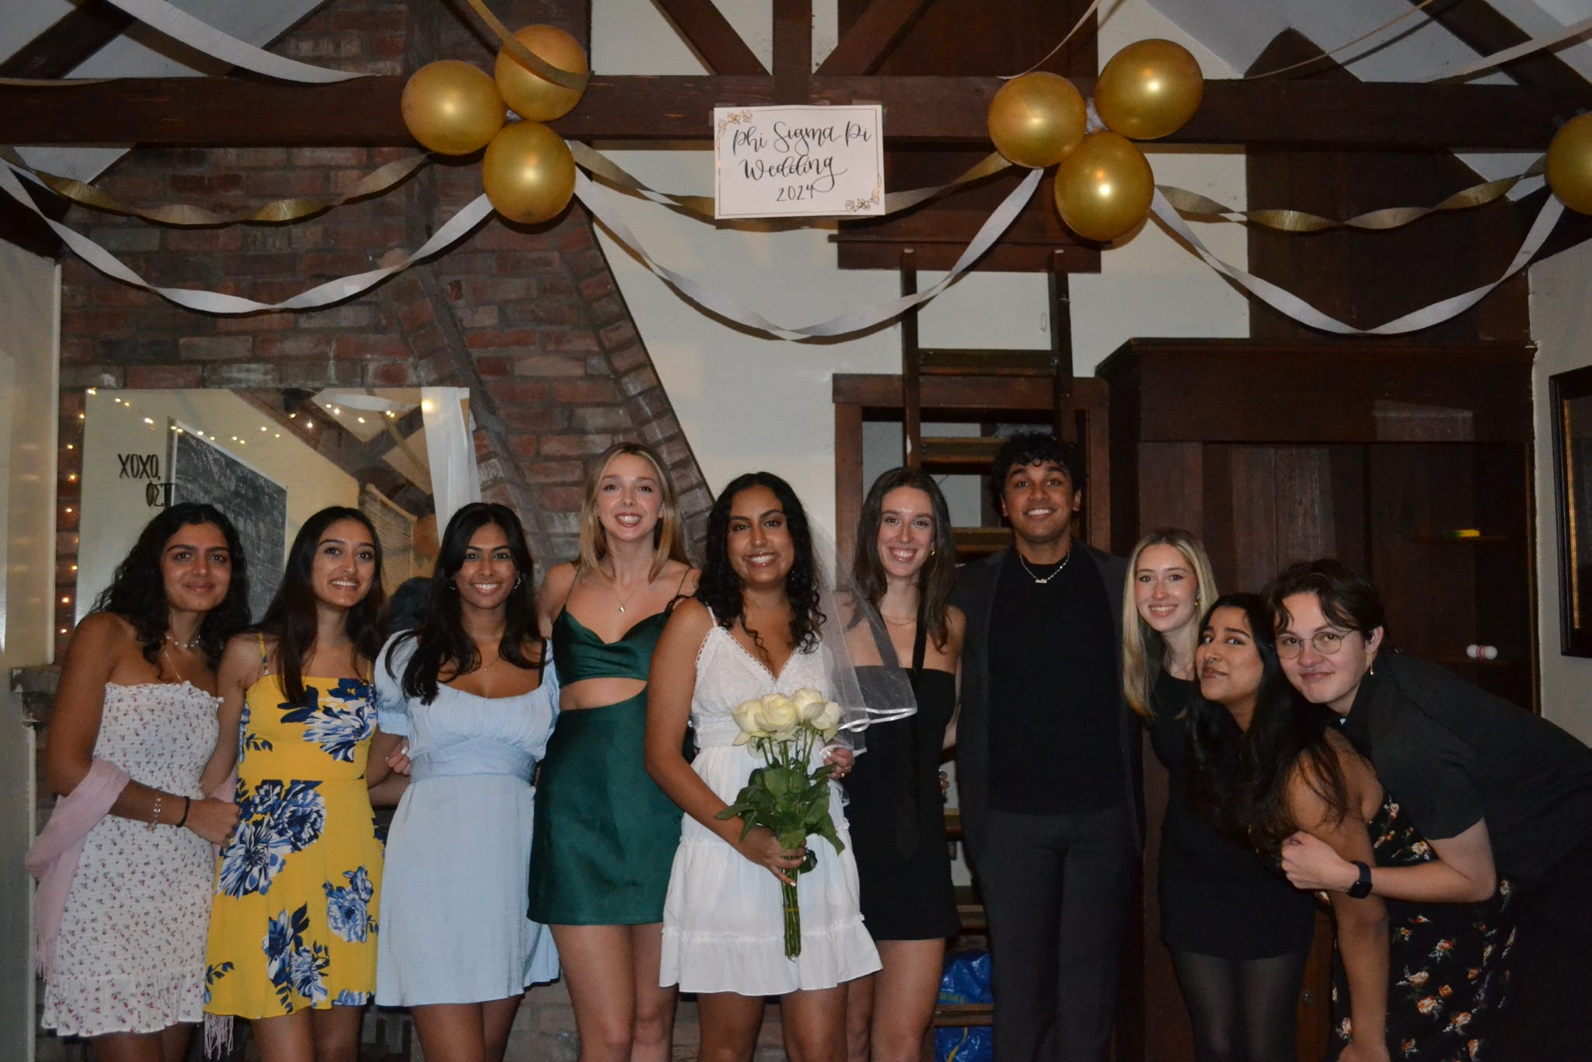

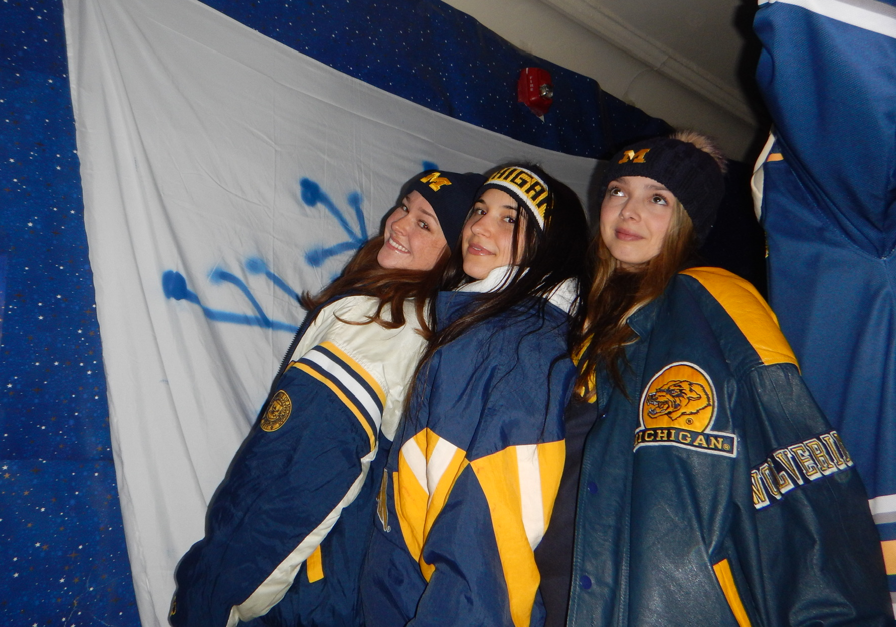
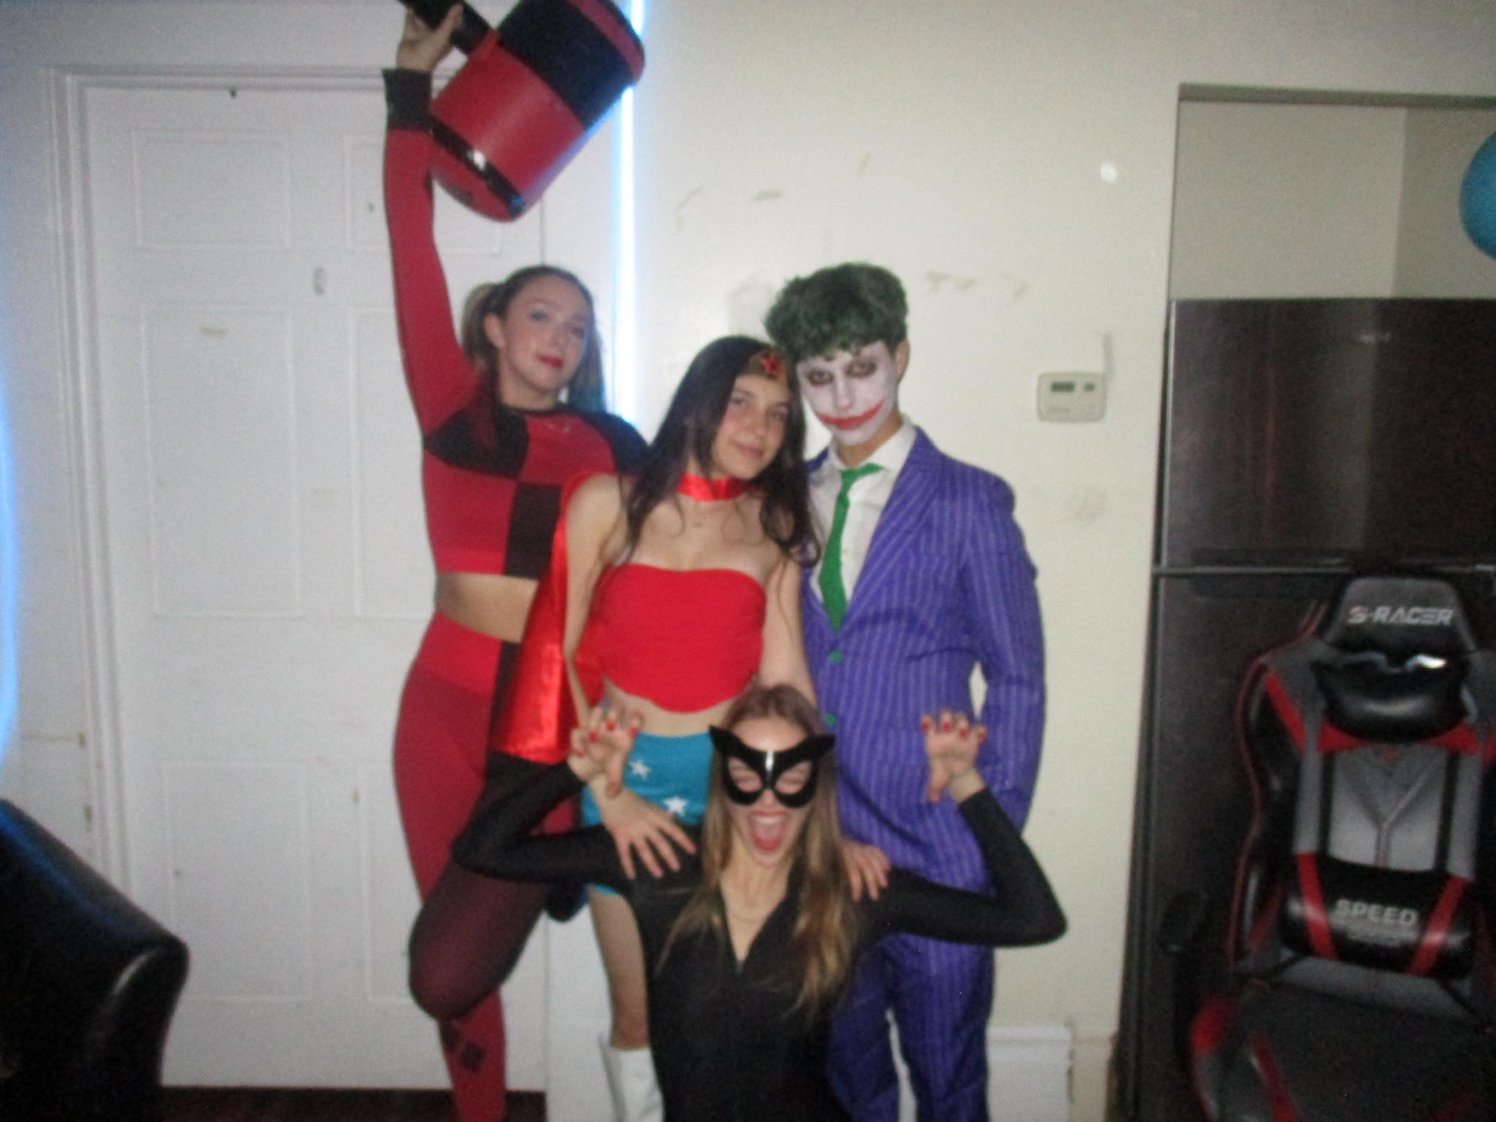
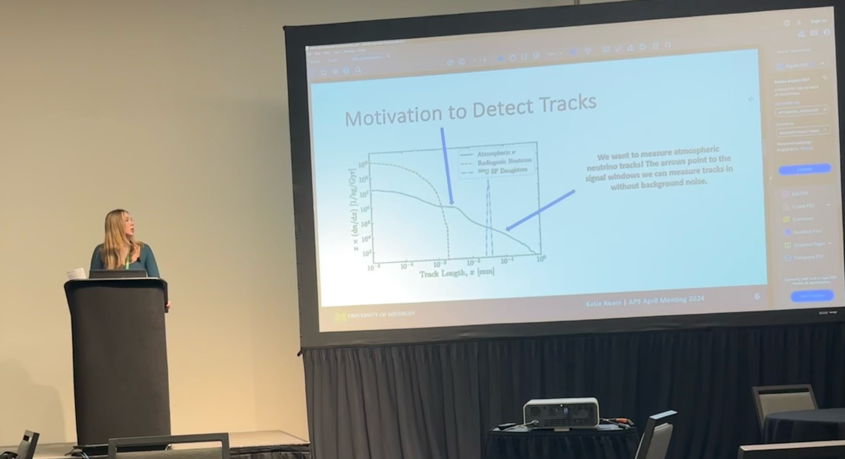
Introduction
Rising senior at the University of Michigan, physics major
  I love Michigan football <3
From: Holliston, MA
Favorite food: seafood (lobster) and anything pasta
Clubs: PSP (professional frat), SPS, women’s glee club
Favorite band: Paramore
Beach >>> mountains
Previous work: neutrinos (paleodetector and SBND), ATLAS

Slide 3

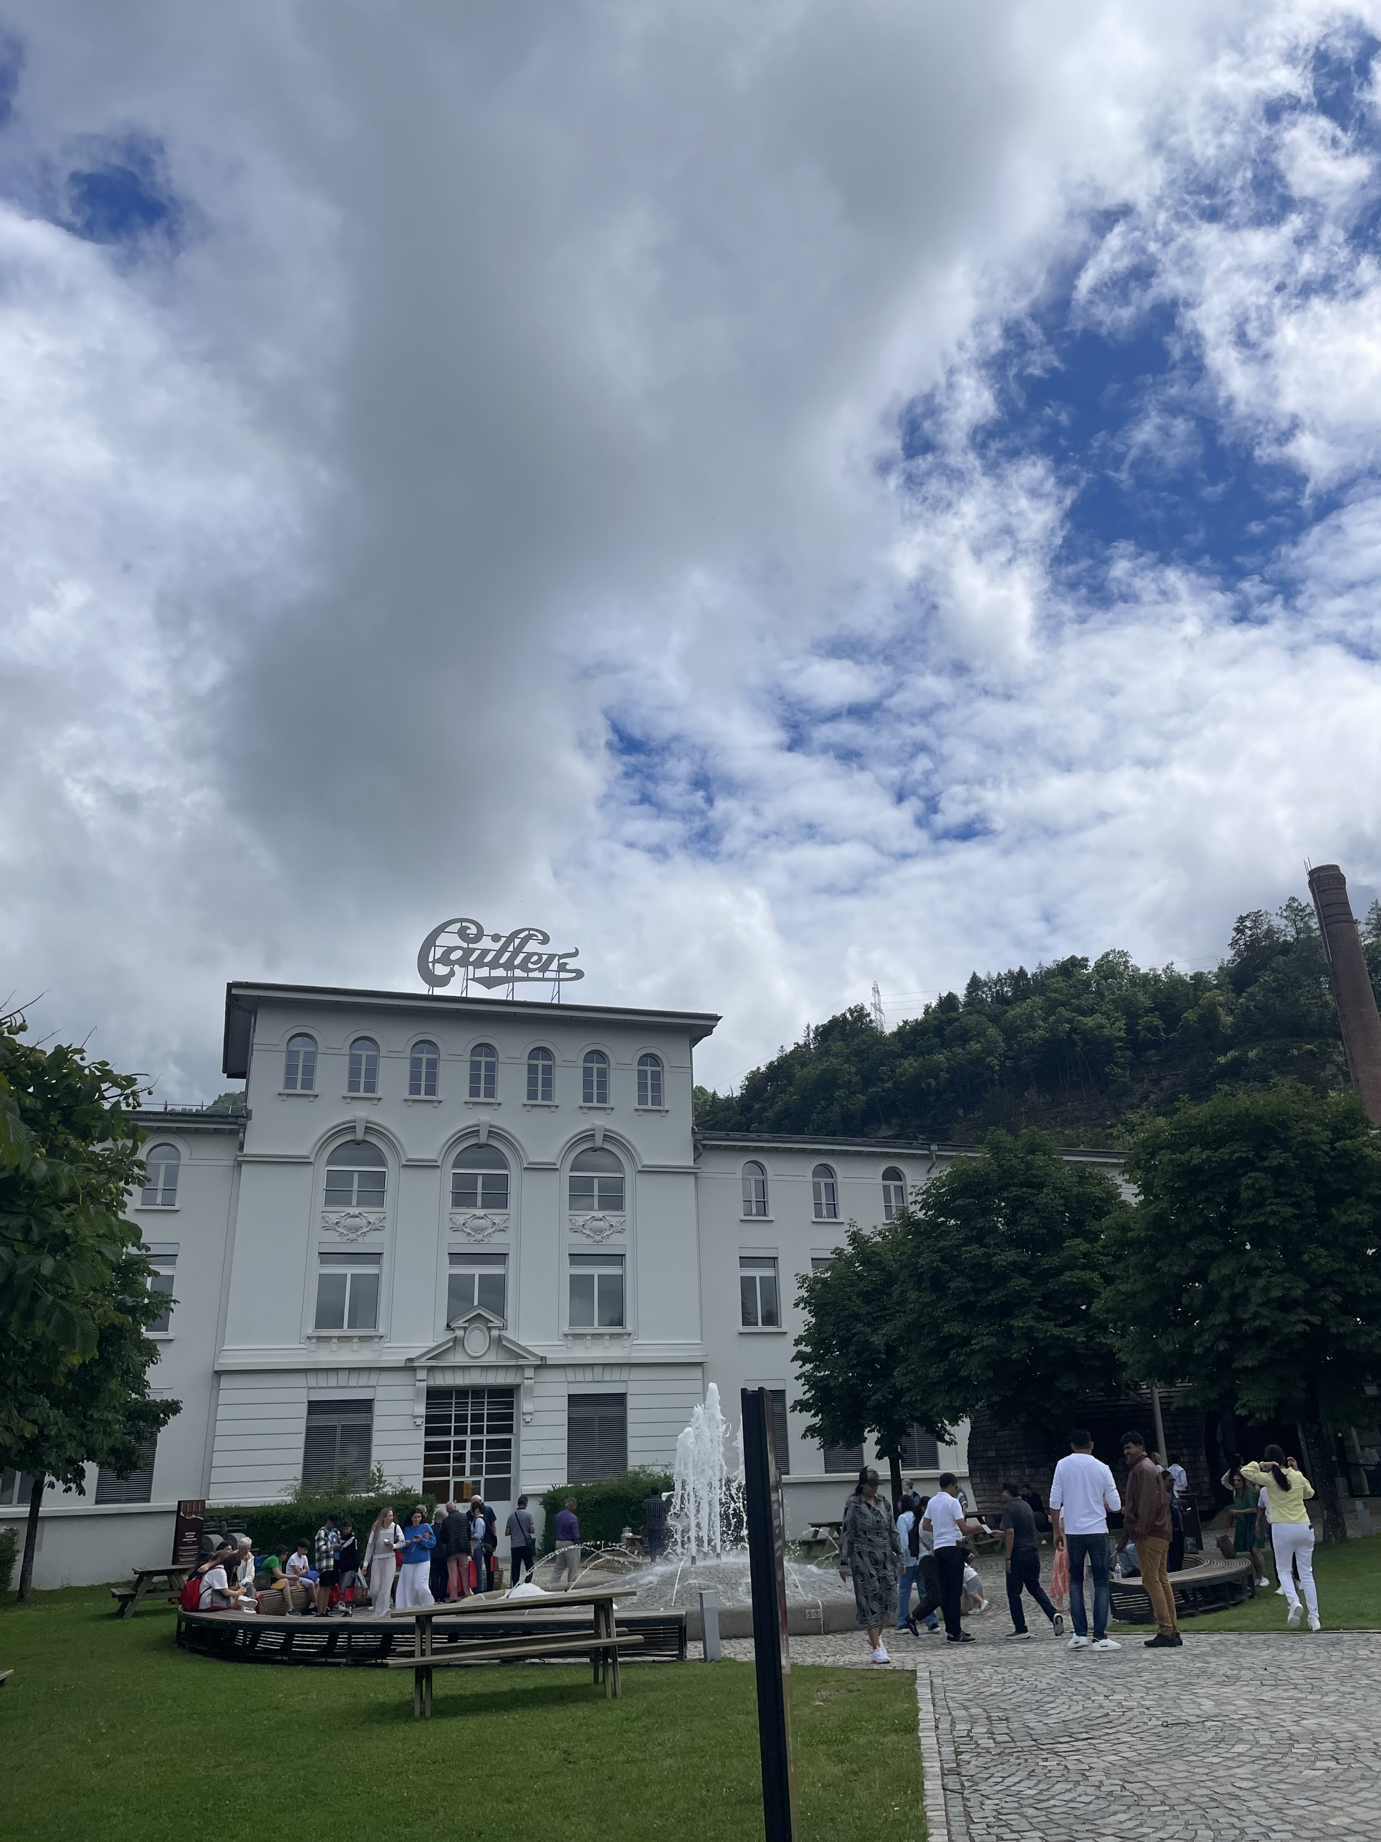
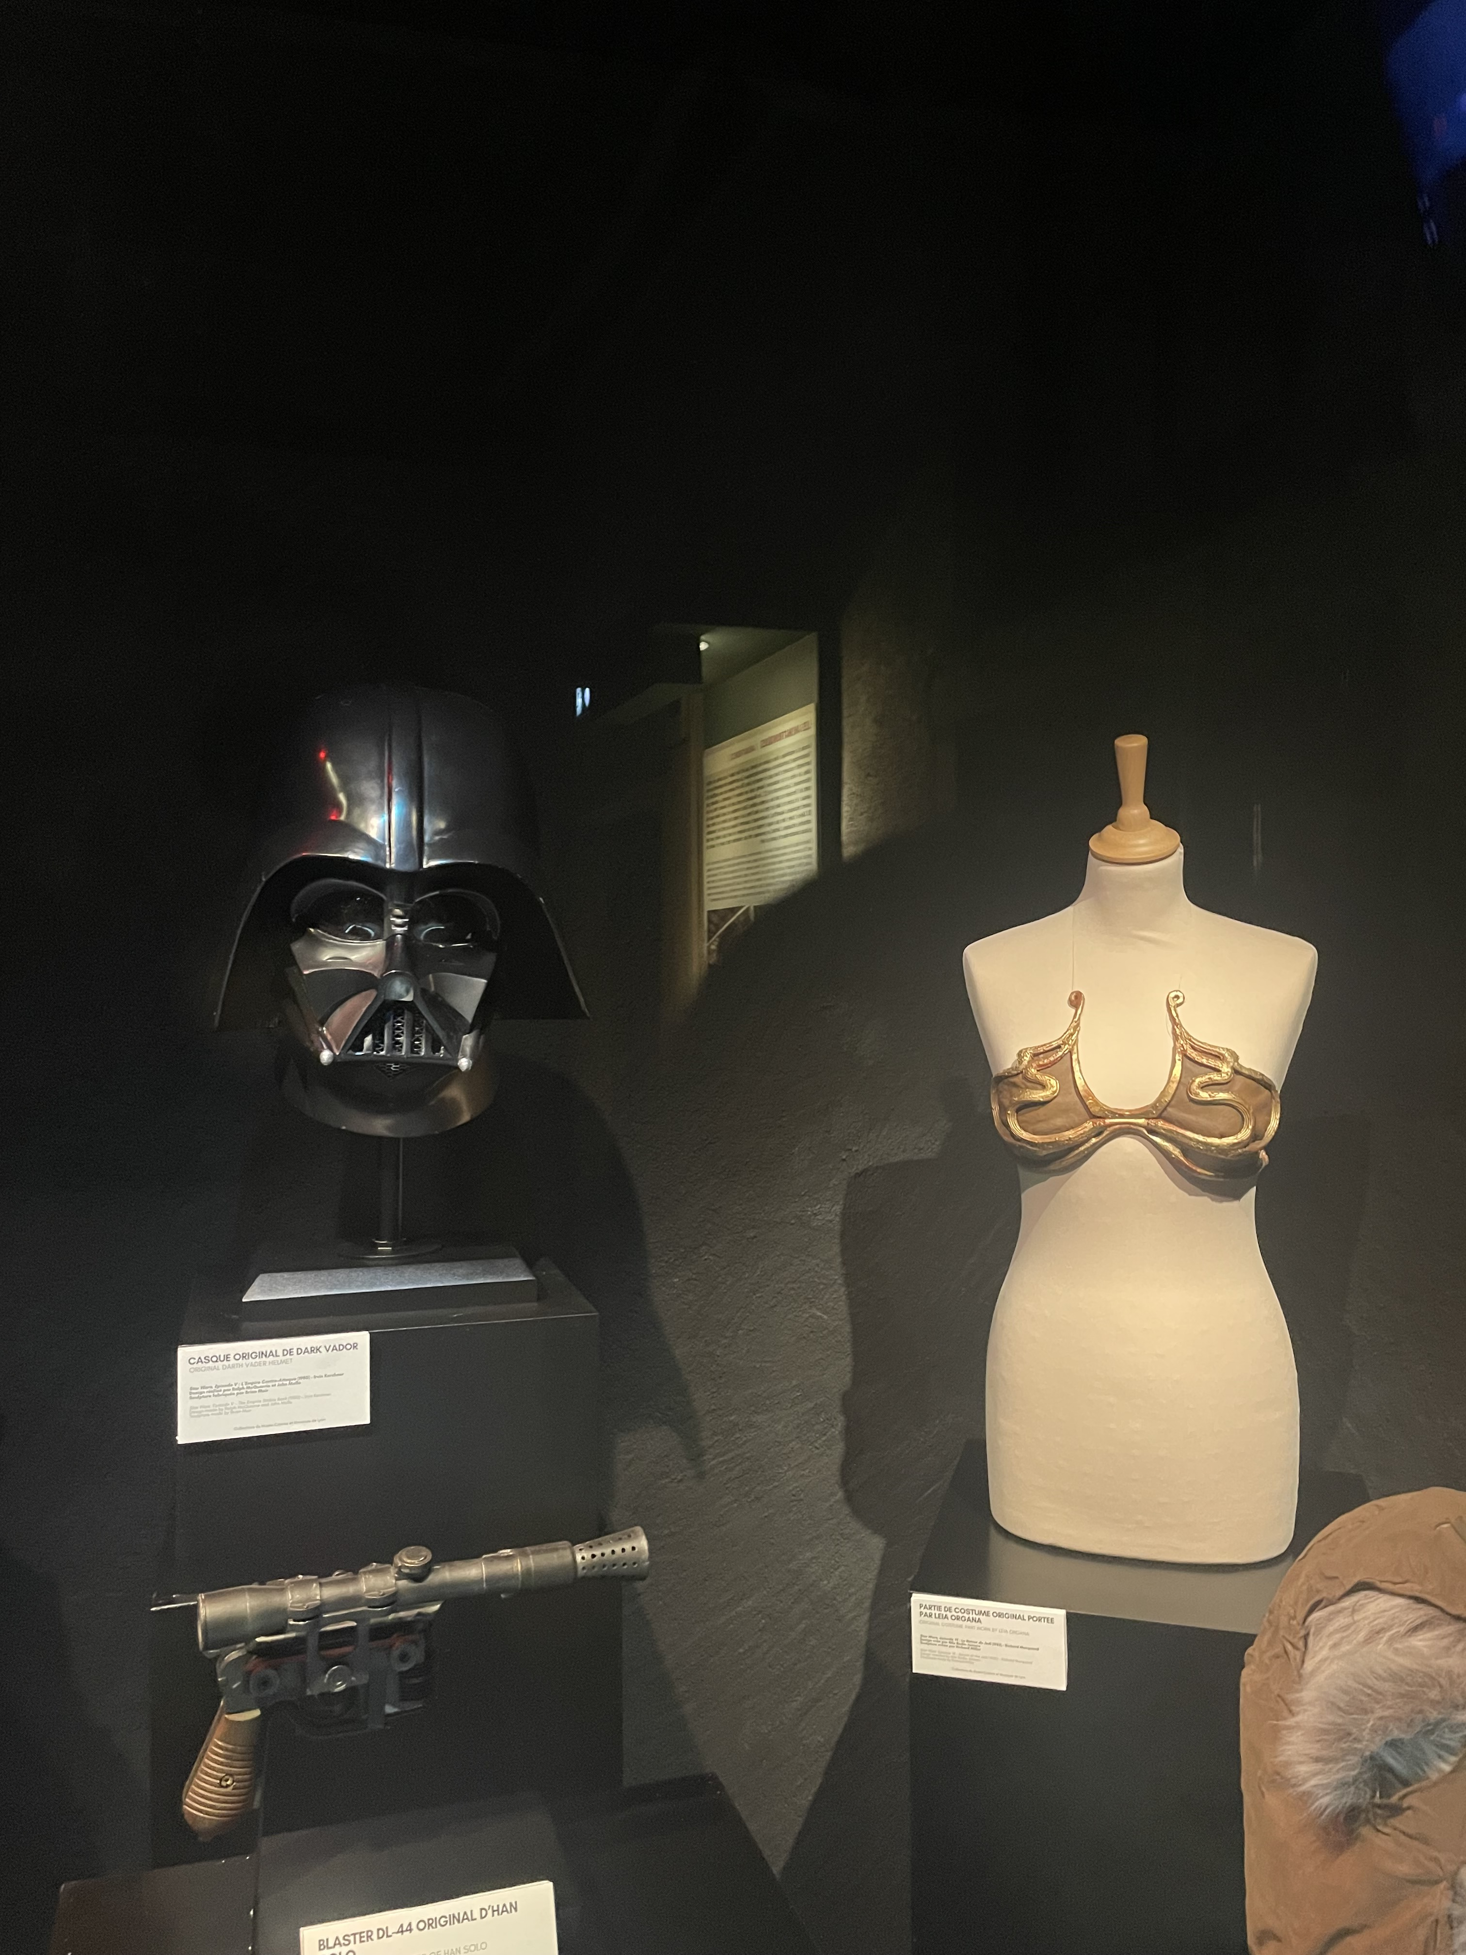
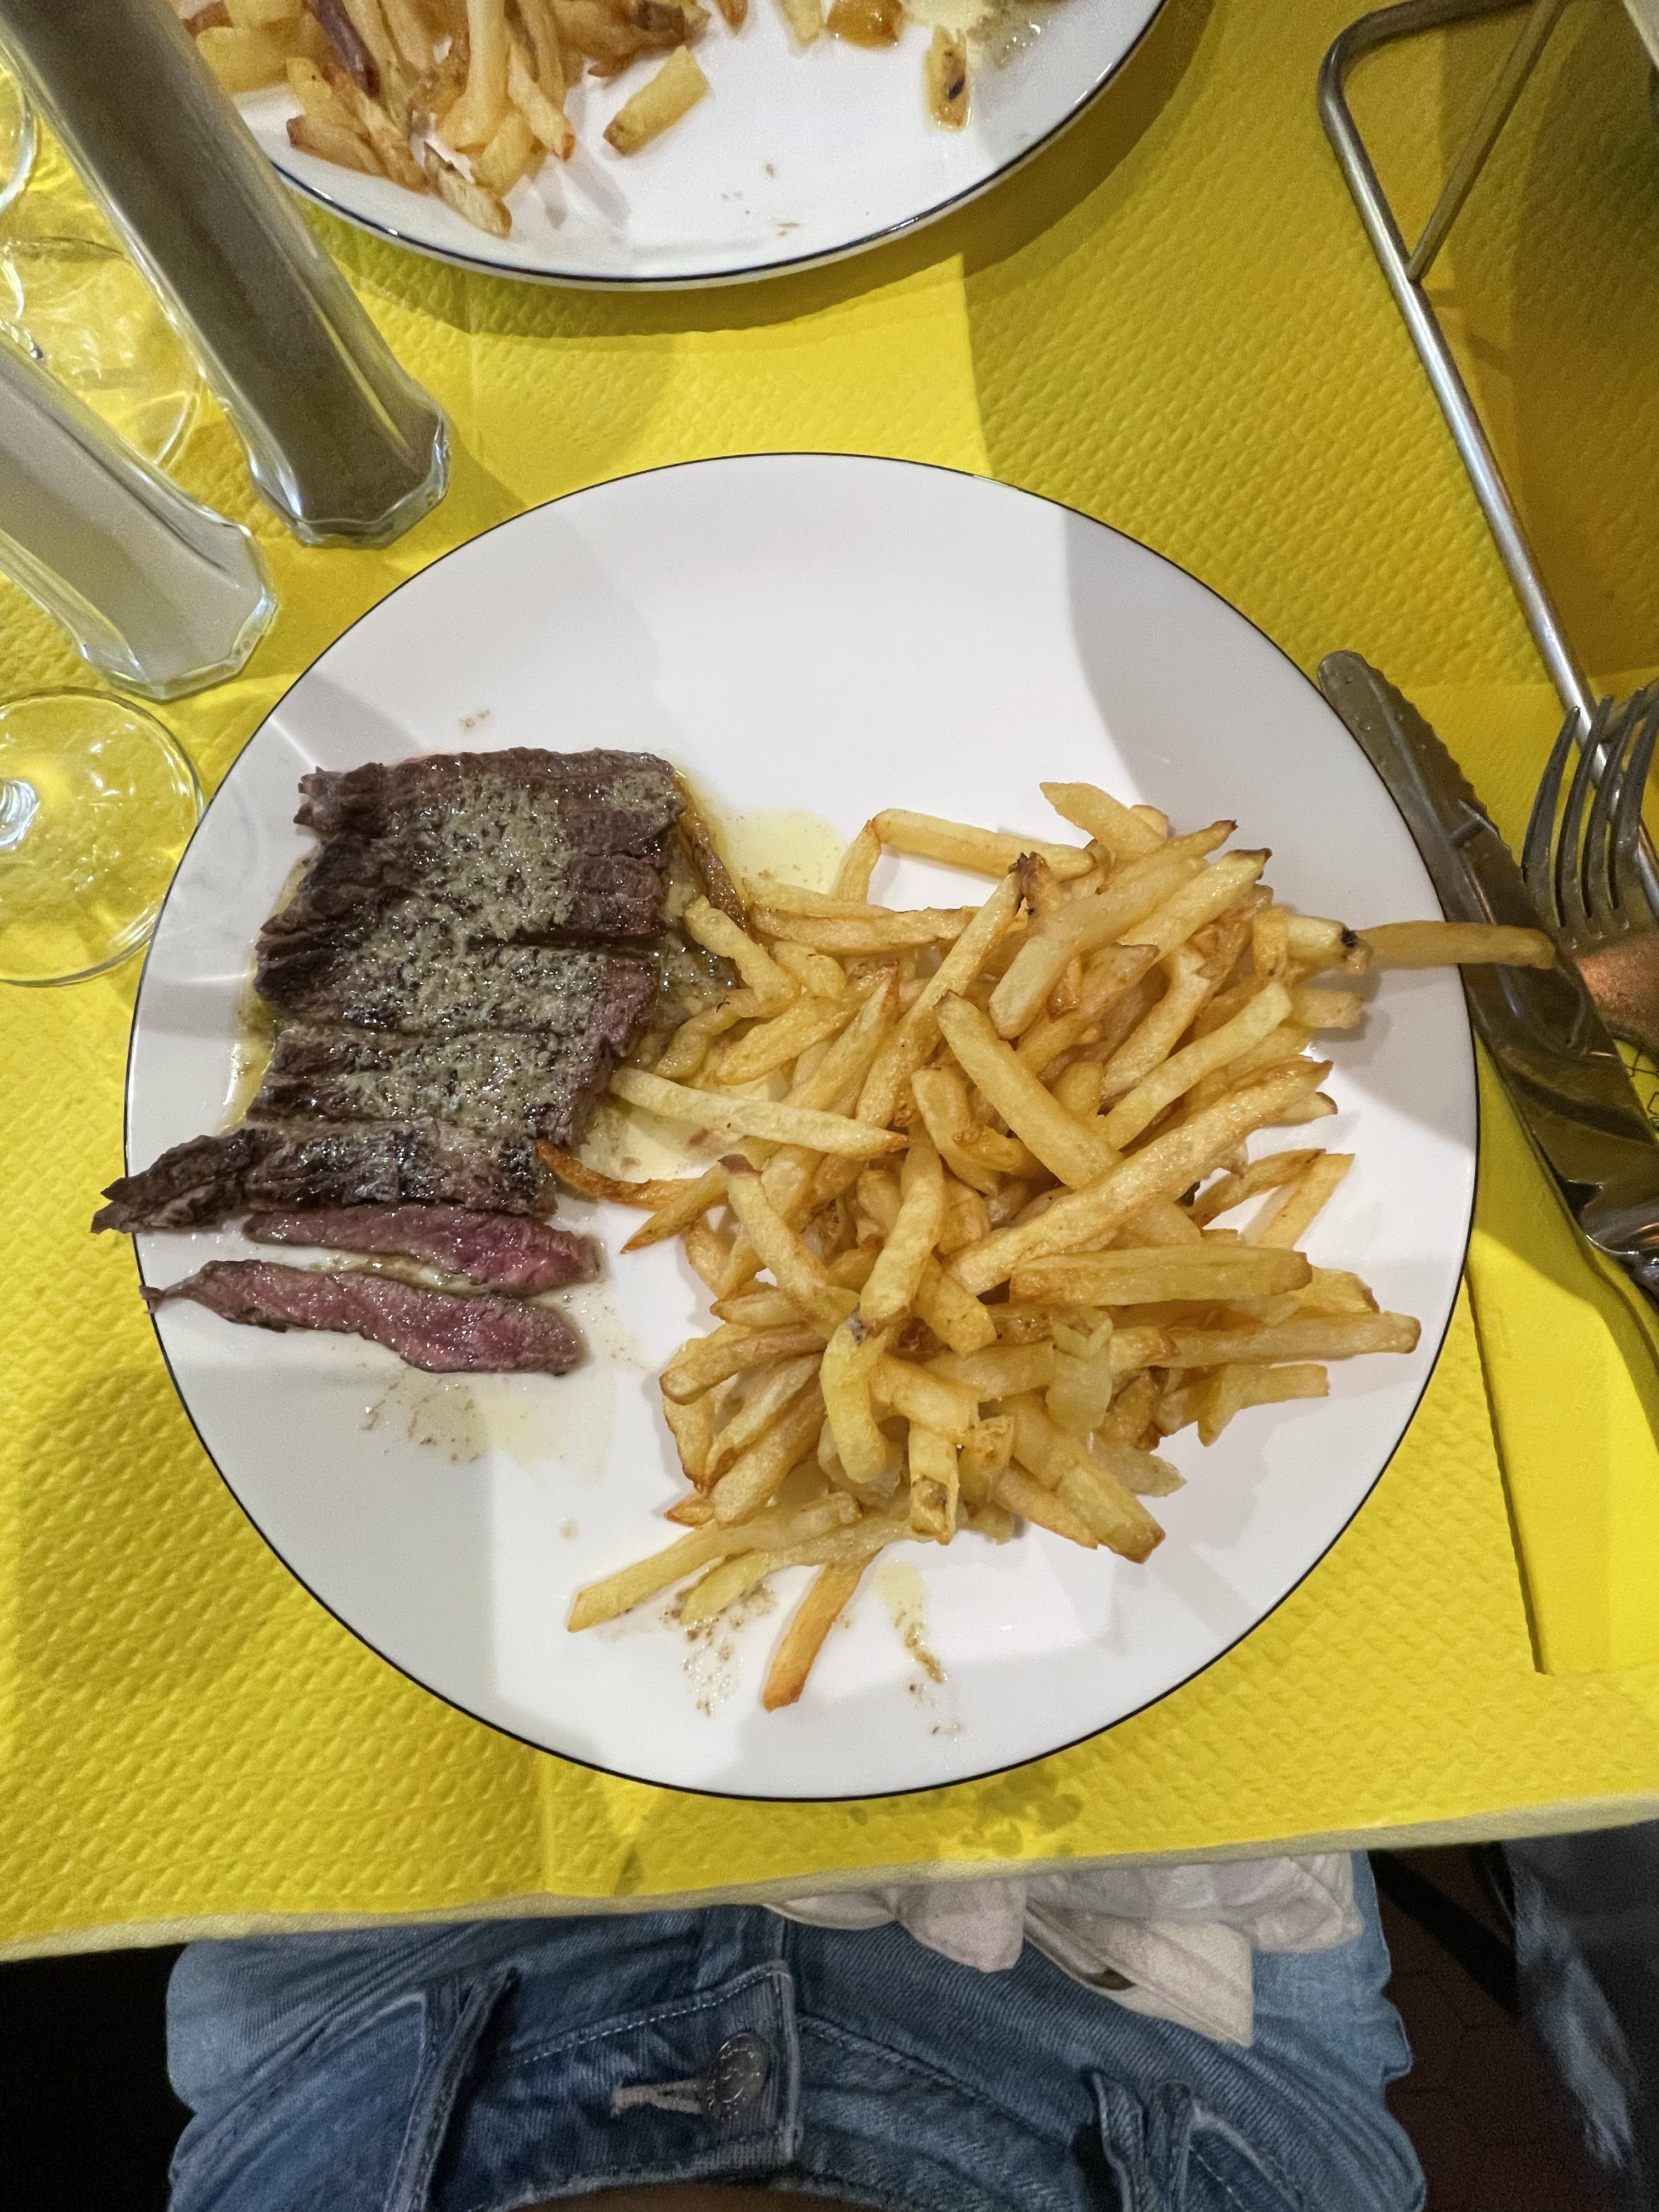
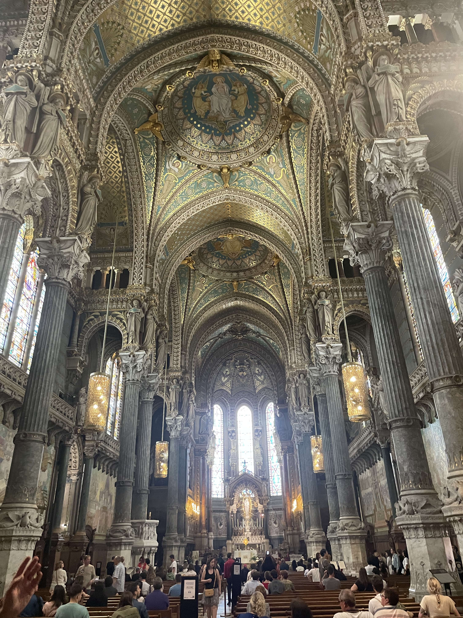
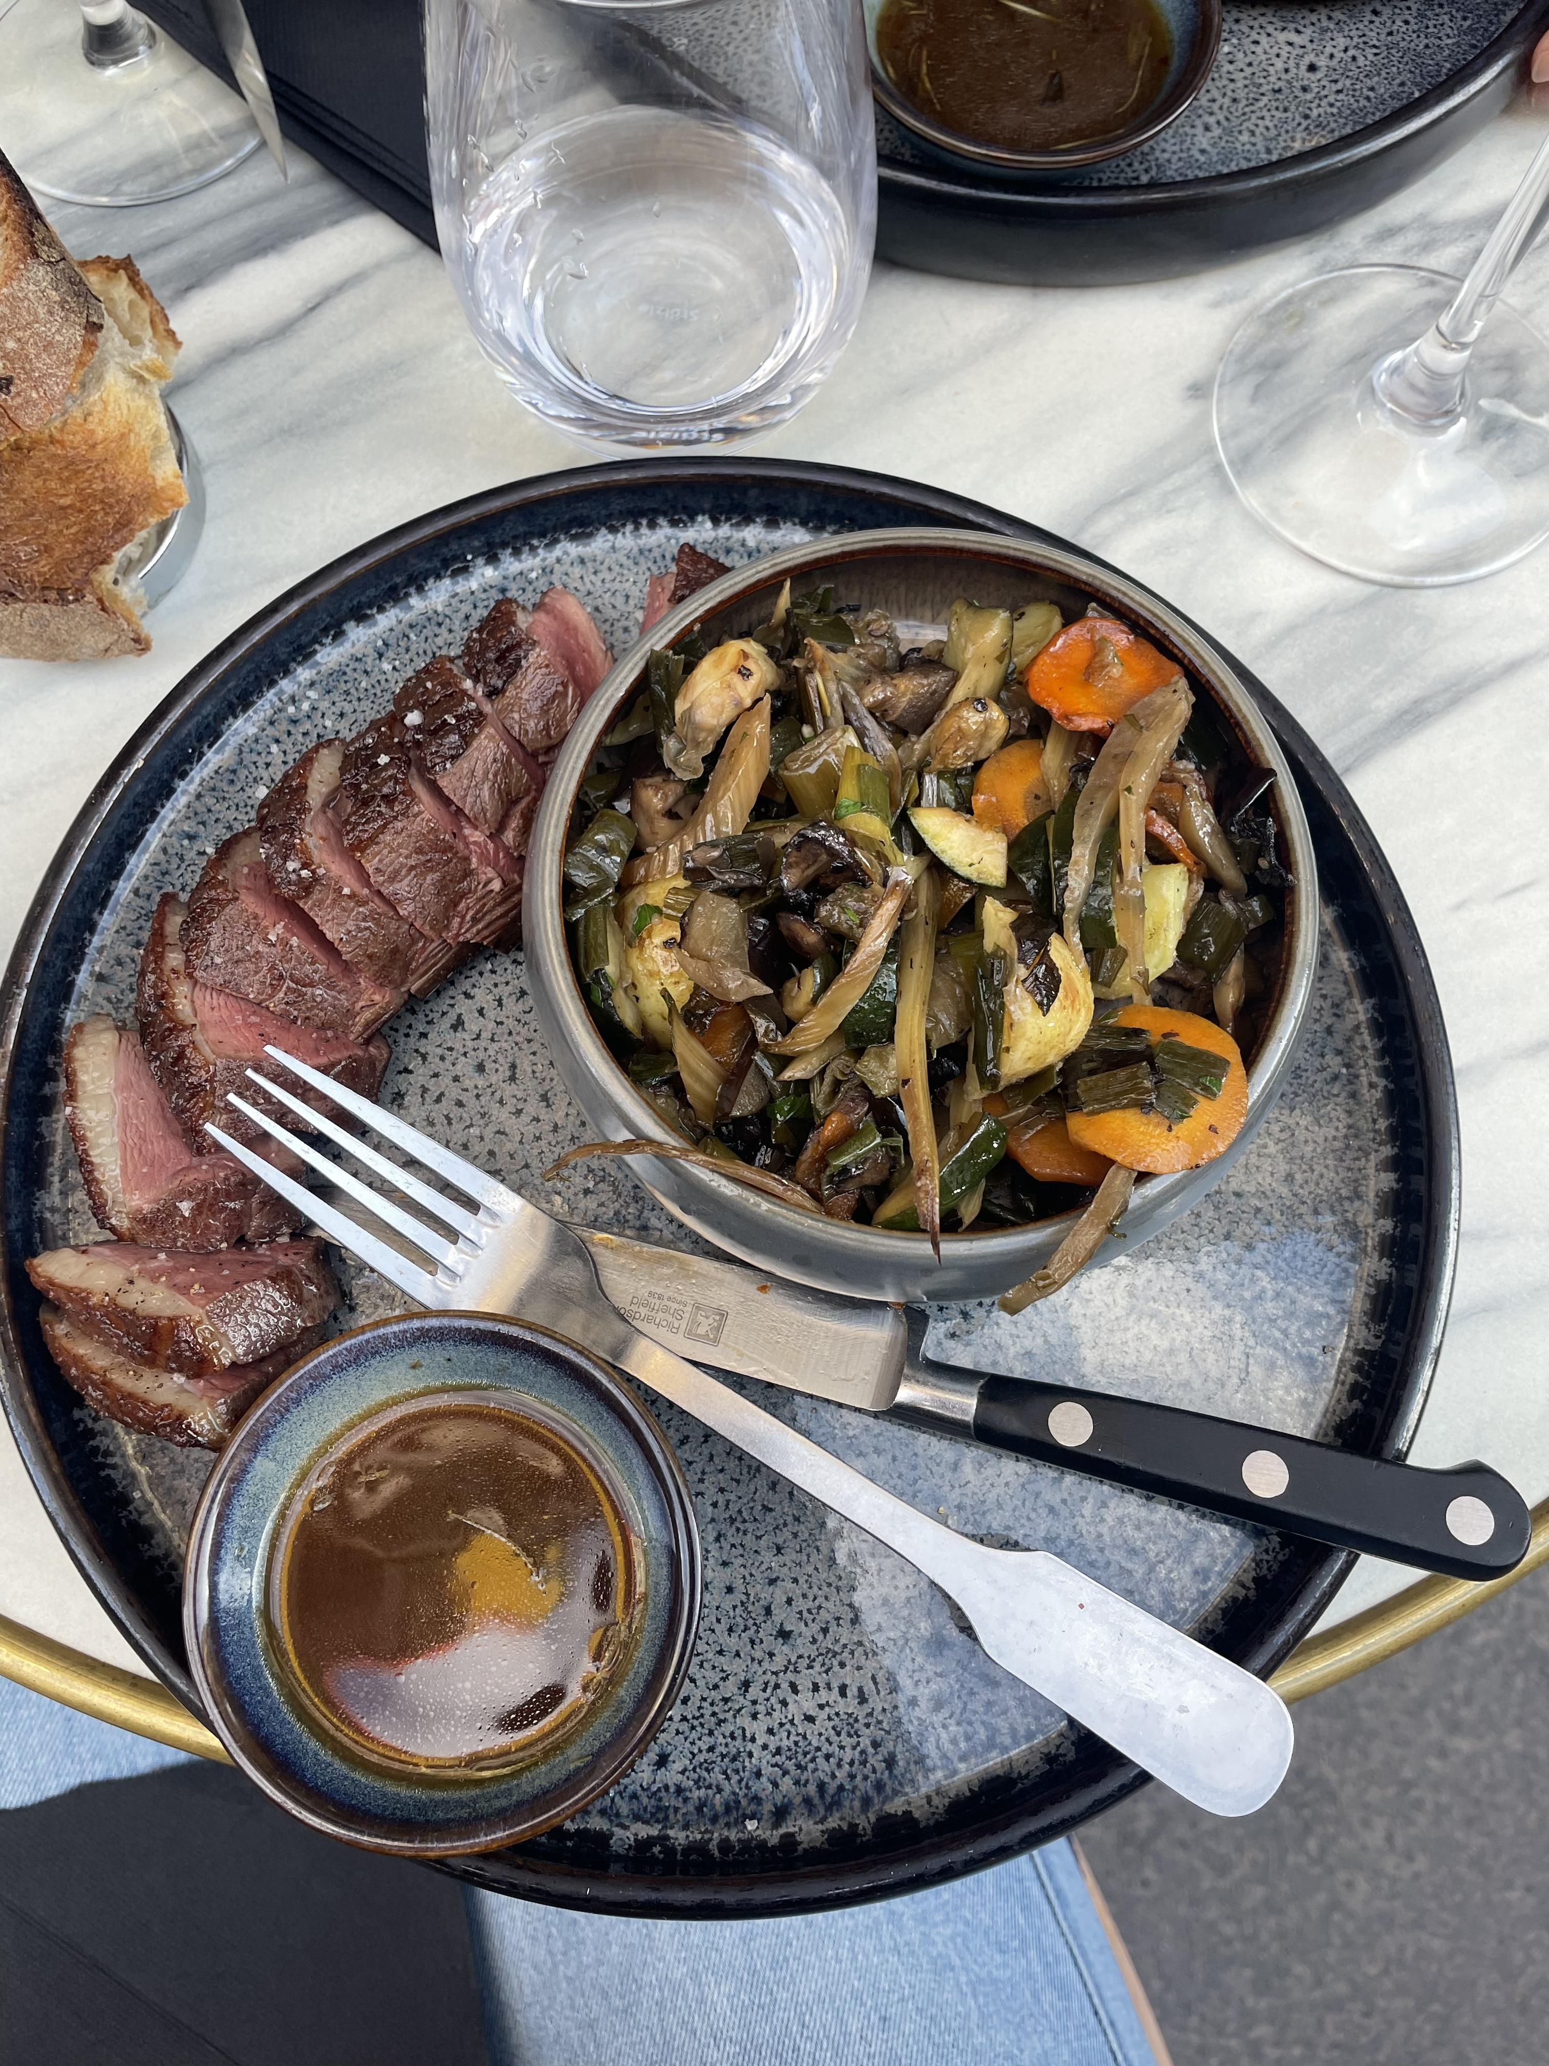
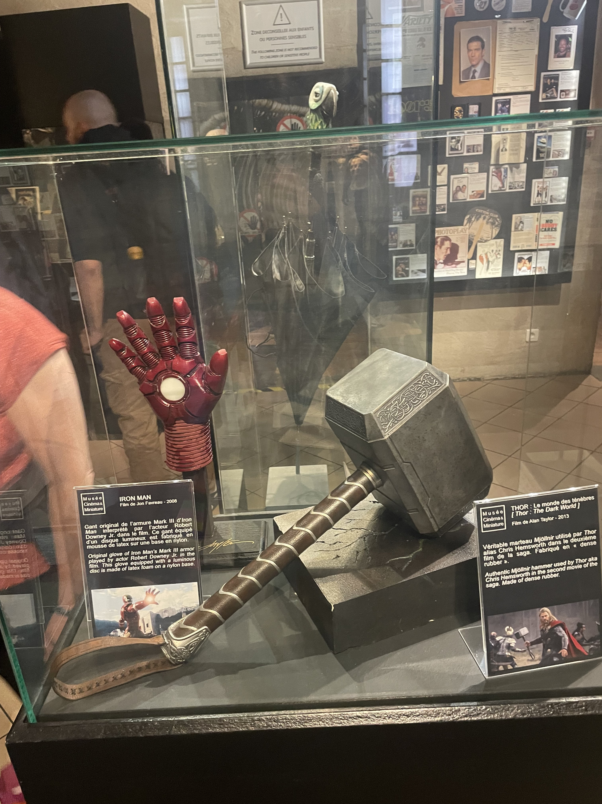
Things Done in Europe
Eaten a bunch of croissants and macarons
Explored Lyon
Explored Geneva music festival
Tried duck and steak frites!
Saw the original Darth Vader helmet
Went to Cailler chocolate factory

Slide 4
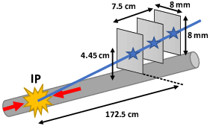
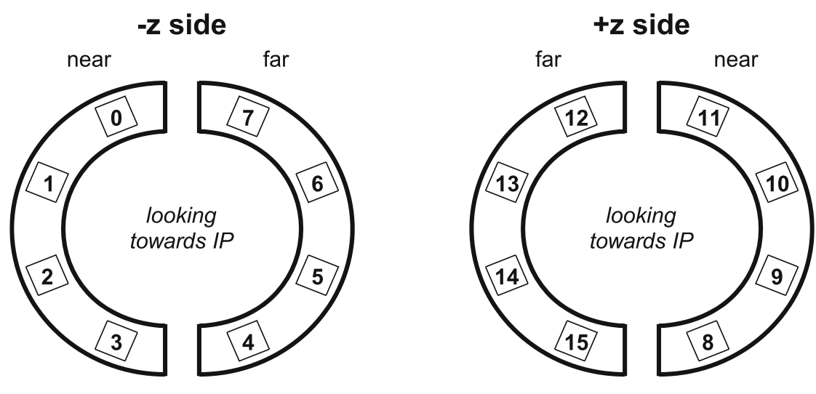
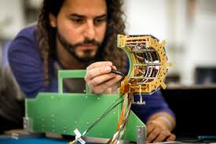
CERN Project Overview
Working on a subgroup of CMS called BRIL – Beam Radiation, Instrumentation and Luminosity
  Specific detector is called the PLT – Pixel Luminosity Telescope, consisting of 16 “telescope” channels
Goal of the BRIL group is to deliver accurate integrated luminosity results for the LHC and CMS detectors
  Important because it is an input to cross-section measurements and searches for new physics
My project: creating an algorithm that detects anomalies in the luminosity data so that it can be later removed before being sent off as the final value

Slide 5
CERN Project Specifics
The algorithm created looks ”somewhat” like a machine learning model
  Current approach: using a python package called adtk for time series anomaly detection purposes – if this doesn’t work, will turn to use ML
  Goal is for this to become semi-automated, where it flags confident anomalies automatically and flags some smaller, less obvious anomalies that require the person looking at the data to confirm or deny it as such
Challenges:
  How to ensure that it doesn’t overflag so that the person isn’t sitting there all day?
  How to ensure it doesn’t miss important anomalies?
  How to ensure important data that needs to be kept but looks like an anomaly isn’t flagged? (example: emittance scan)

Slide 6
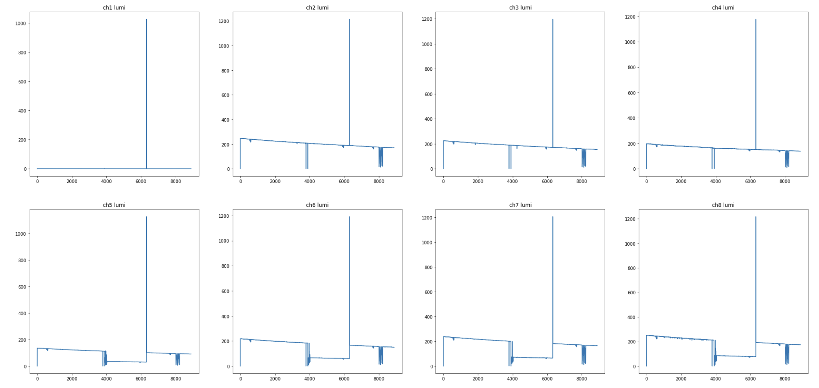
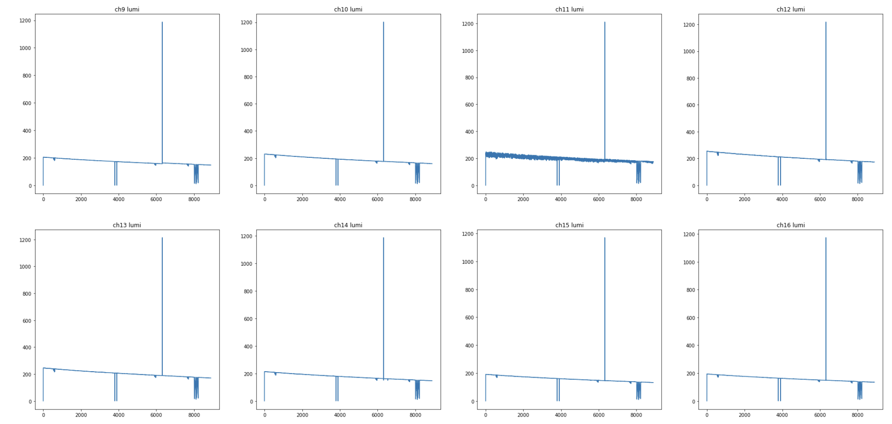
Channels 1-8
Example “bad” channel
Channels 12-16
Emittance scan!
Example “good” channel

Slide 7
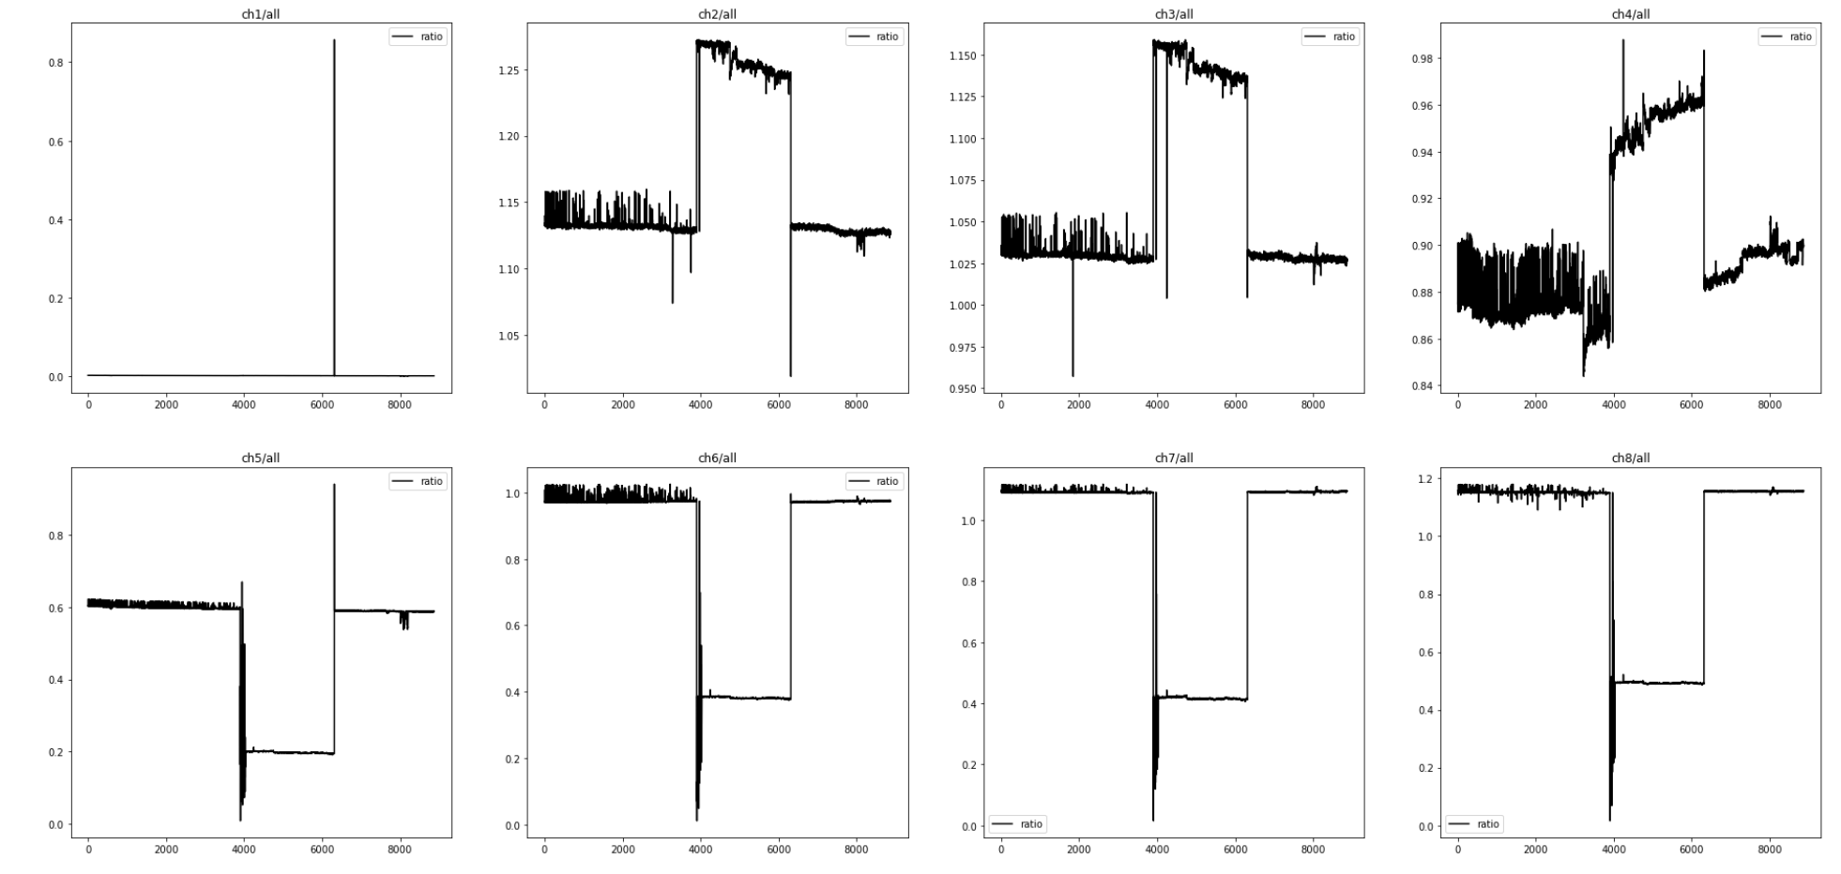
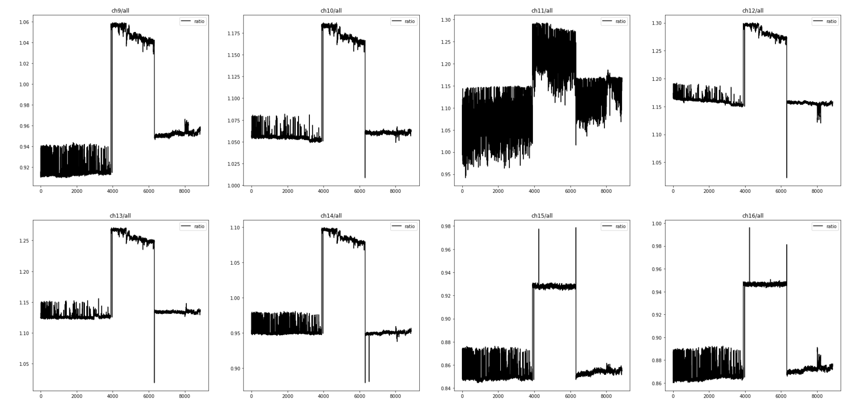
Channels 1-8 (ratio)
Channels 12-16 (ratio)

Slide 8
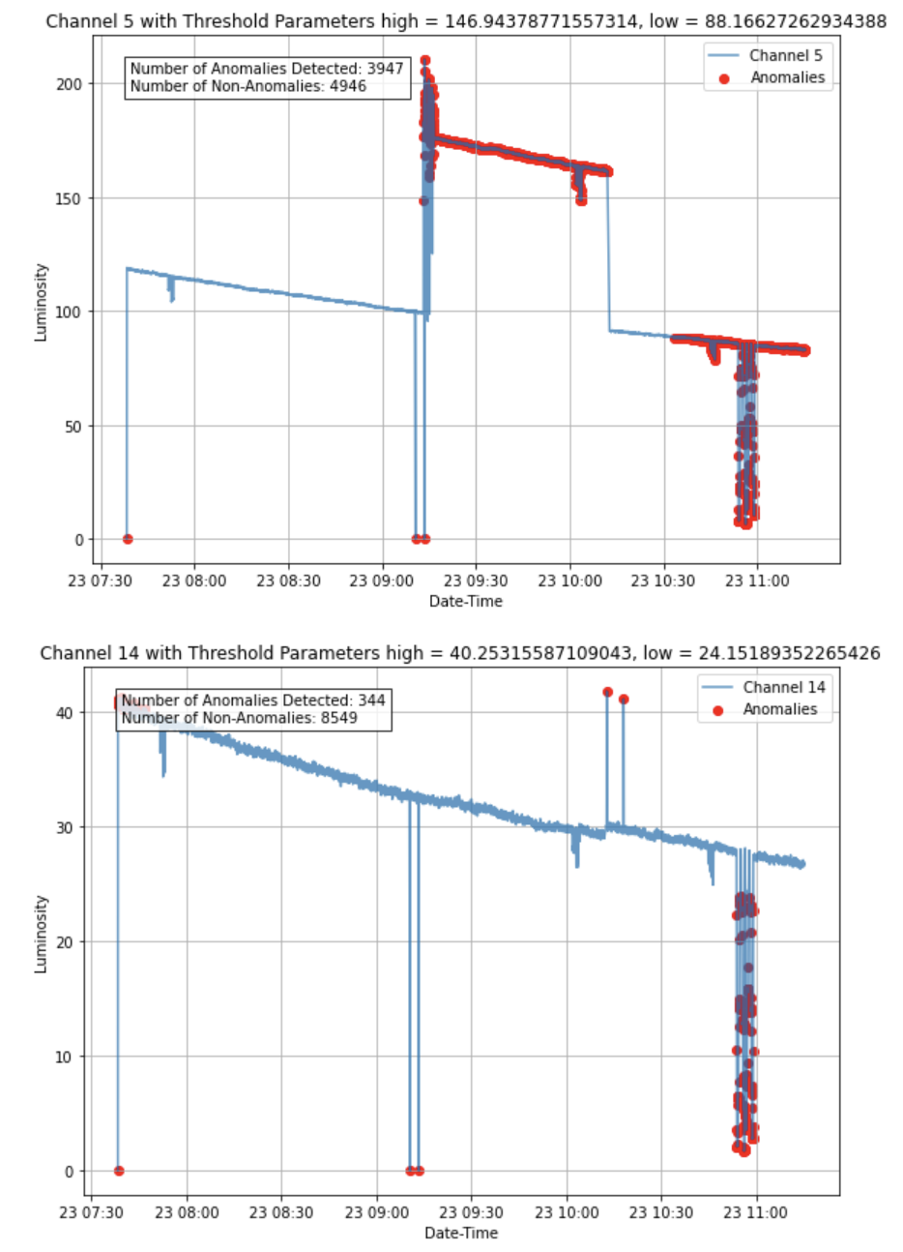
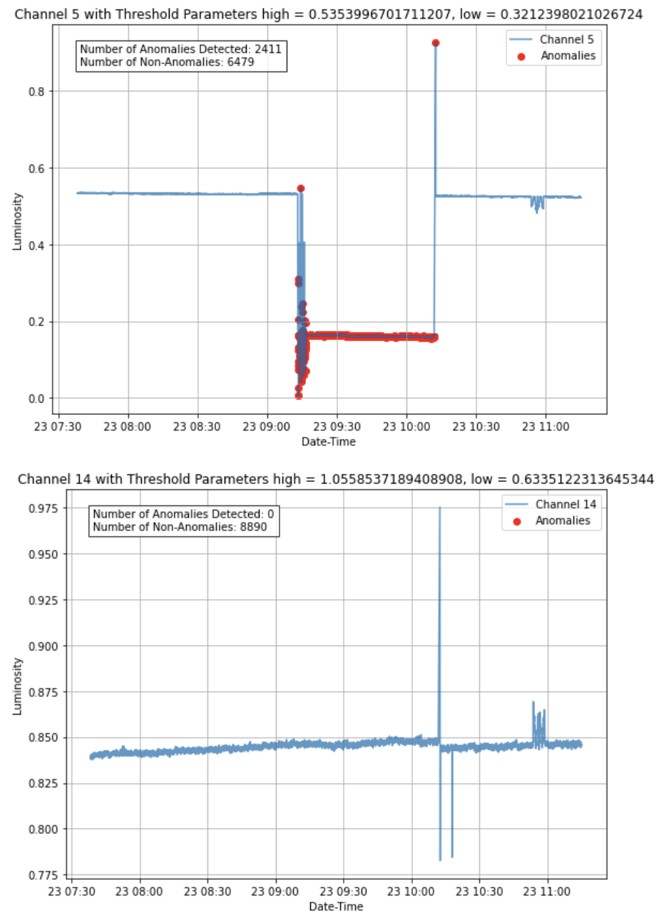
Current path forward

Slide 9
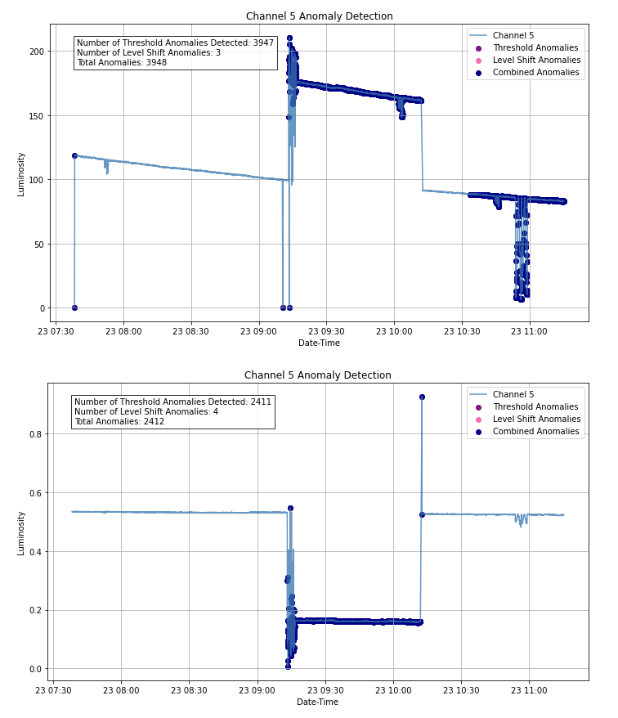
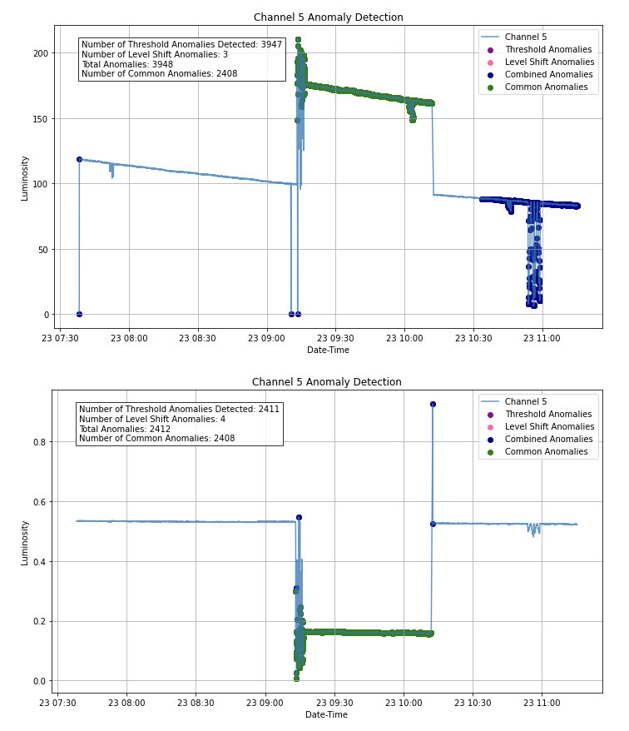
Current path forward

