Slide 1
LHCb Jet Flavour Classification with a Graph Neural Network (GNN)
Gabriella Pesticci
June 24, 2024
Notes:
Who are you and where are you enrolled;

Slide 2
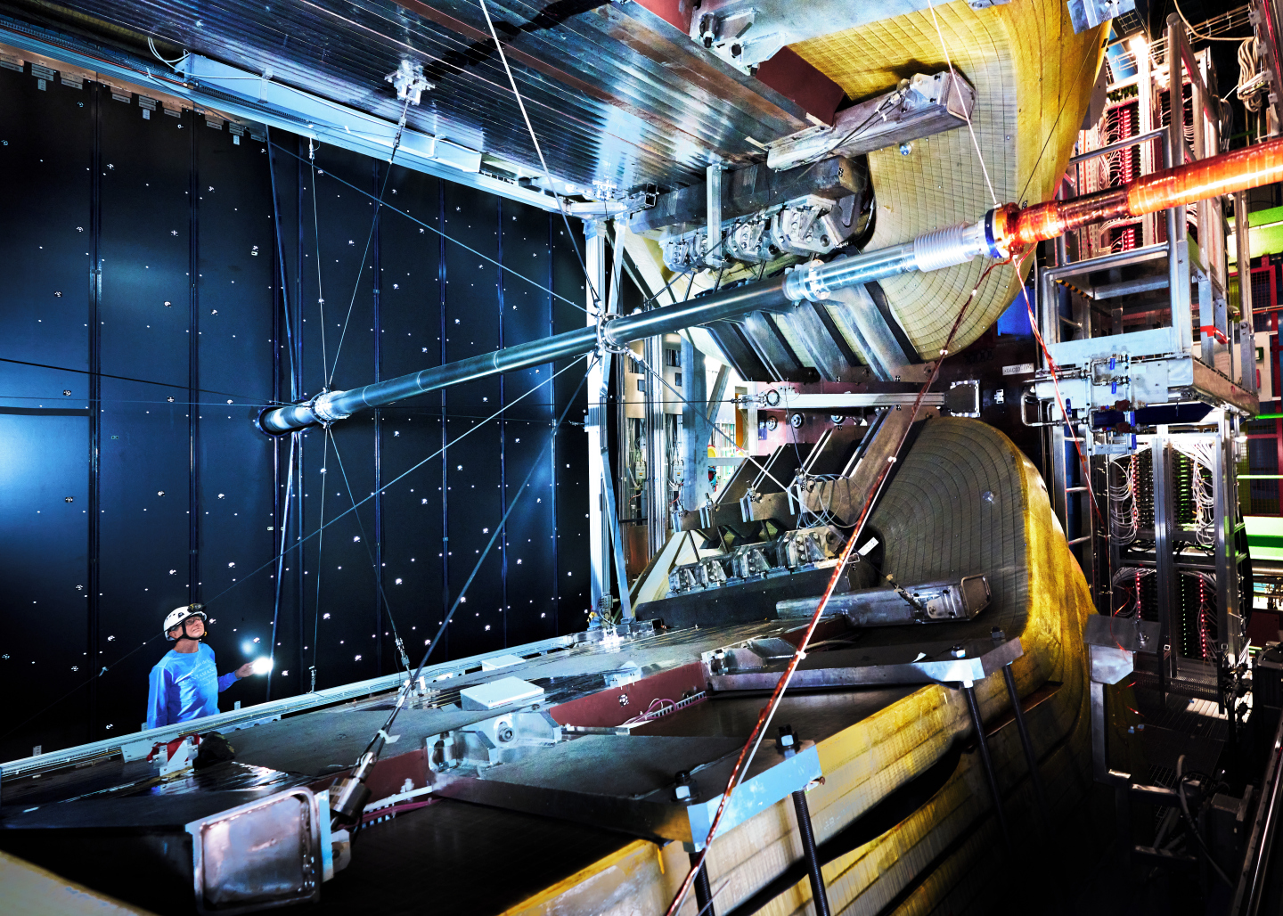
LHCb Experiment
Investigating the beauty (or bottom) quark
Matter vs anti-matter
Single-arm spectrometer and series of sub-detectors
Focuses on forward-moving particles produced by proton-proton collisions

Slide 3
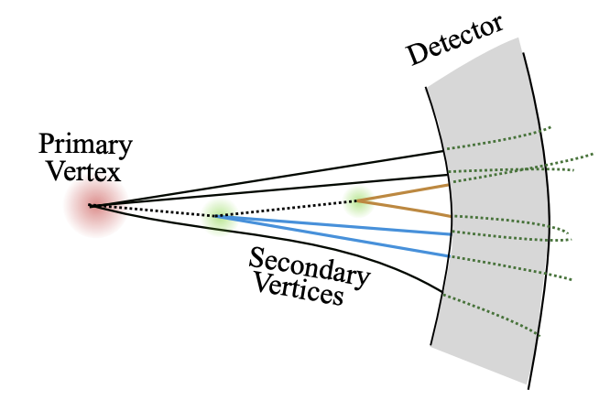

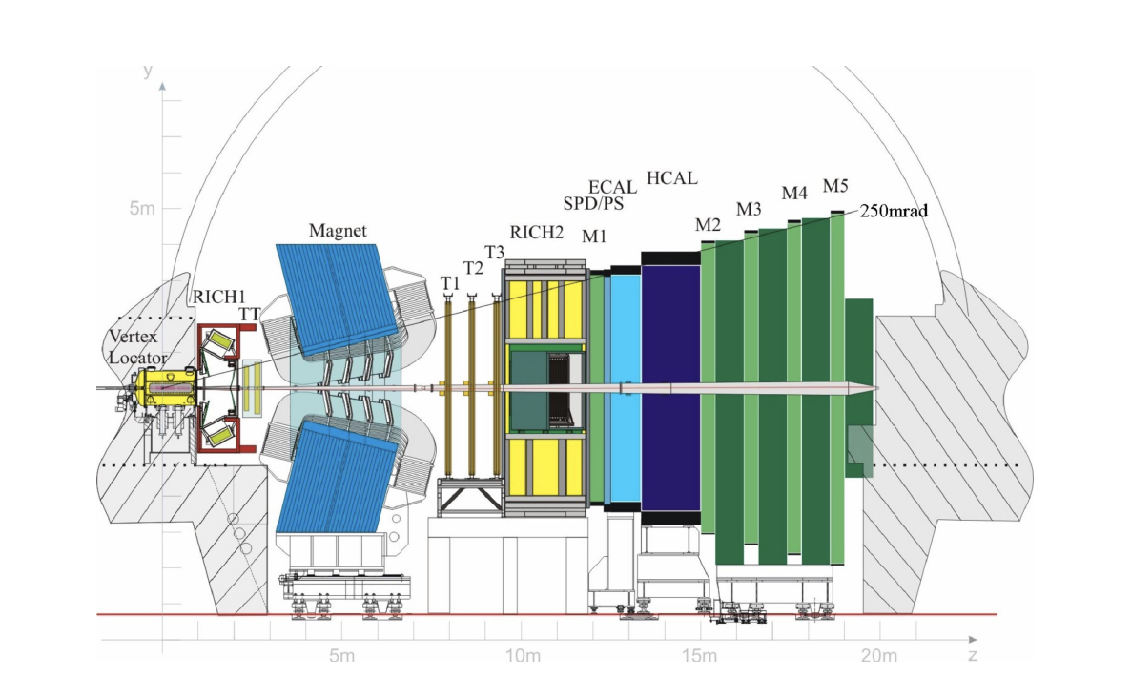
Jet Flavour Classification
Mentors:
  Dr. Conor Henderson
  Dr. Nathan Allen Grieser
What are jets?
  Proton-proton collisions produce gluons and quarks
  Jets are sprays of particles produced from hadronization
  b quarks have longer lifetimes

Slide 4
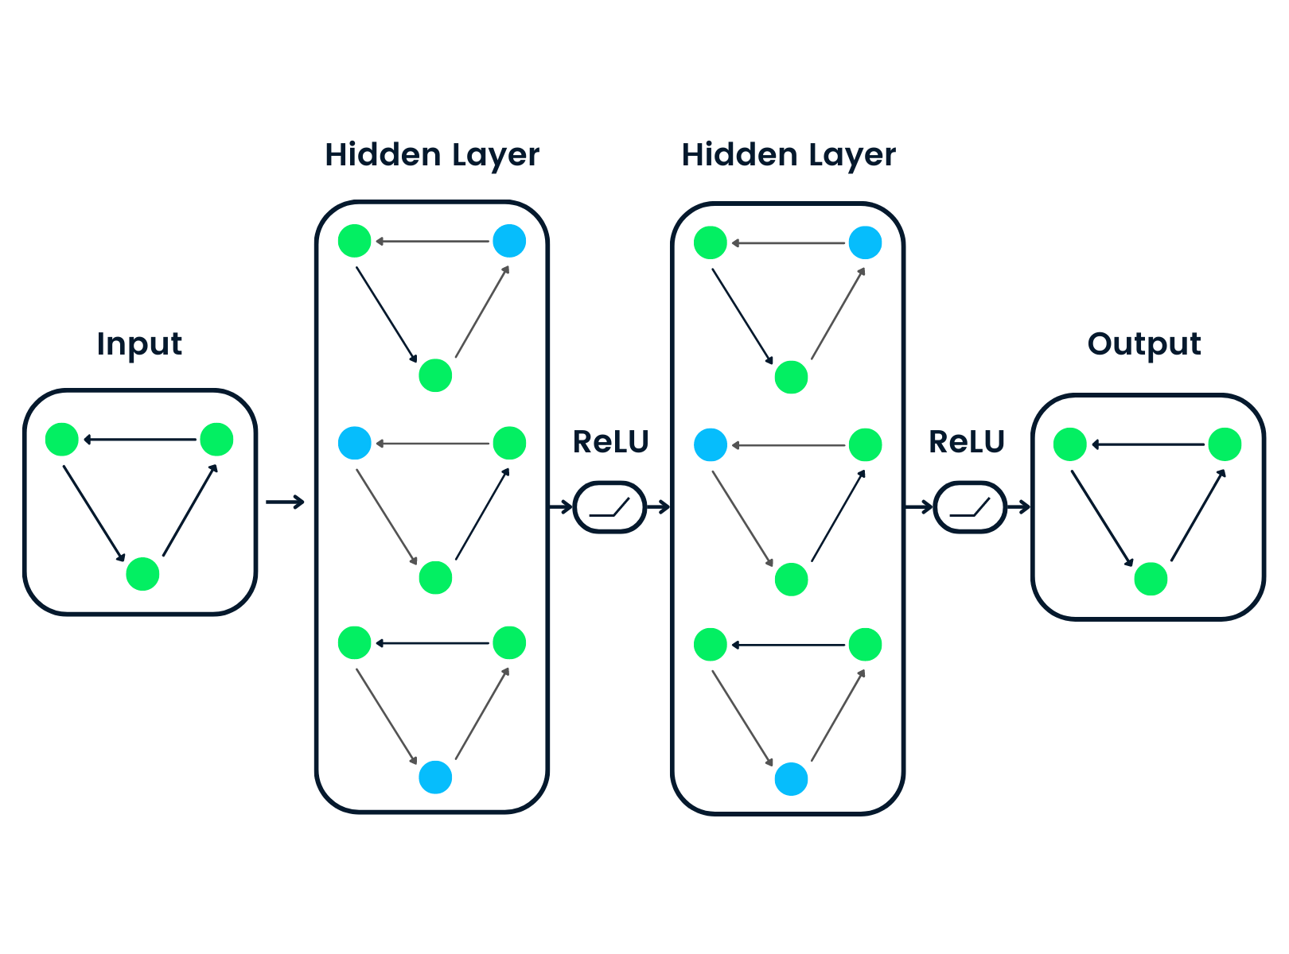
Graph Neural Networks (GNN)
Deep Learning
  GNN are artificial neural networks
  They process data represented as graphs
  Can be trained to identify jet flavours
Architecture
  Composed of nodes, edges, and features
  Uses activation functions to introduce non-linearity between layers
Python
  PyTorch → PyTorch Geometric

Slide 5
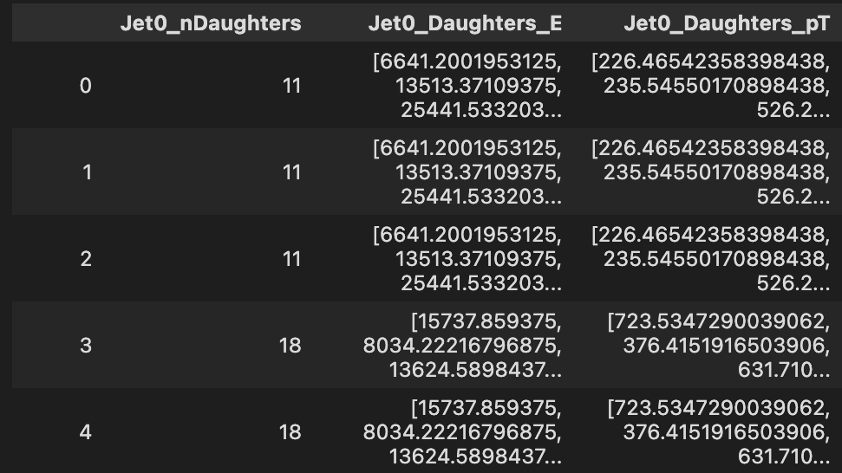
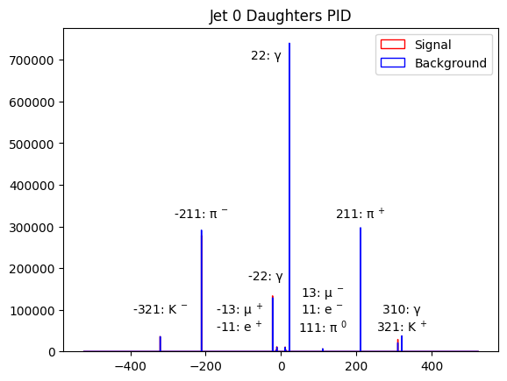
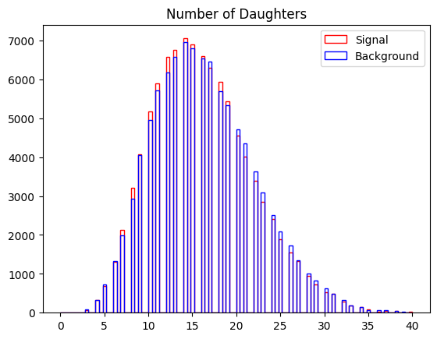
Current Progress
Plotting
  Visualizing signal vs background dijet data
GNN Framework
  Load data
  Creating, training, and testing the model
  ROC and AUC
Setbacks
  Defining nodes, edges, features
  Handling data

Slide 6
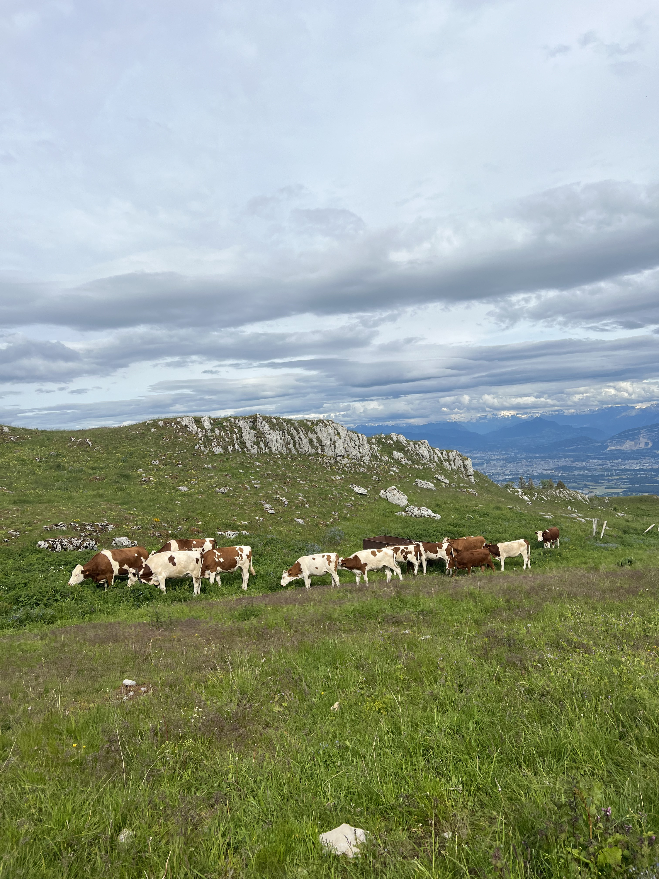
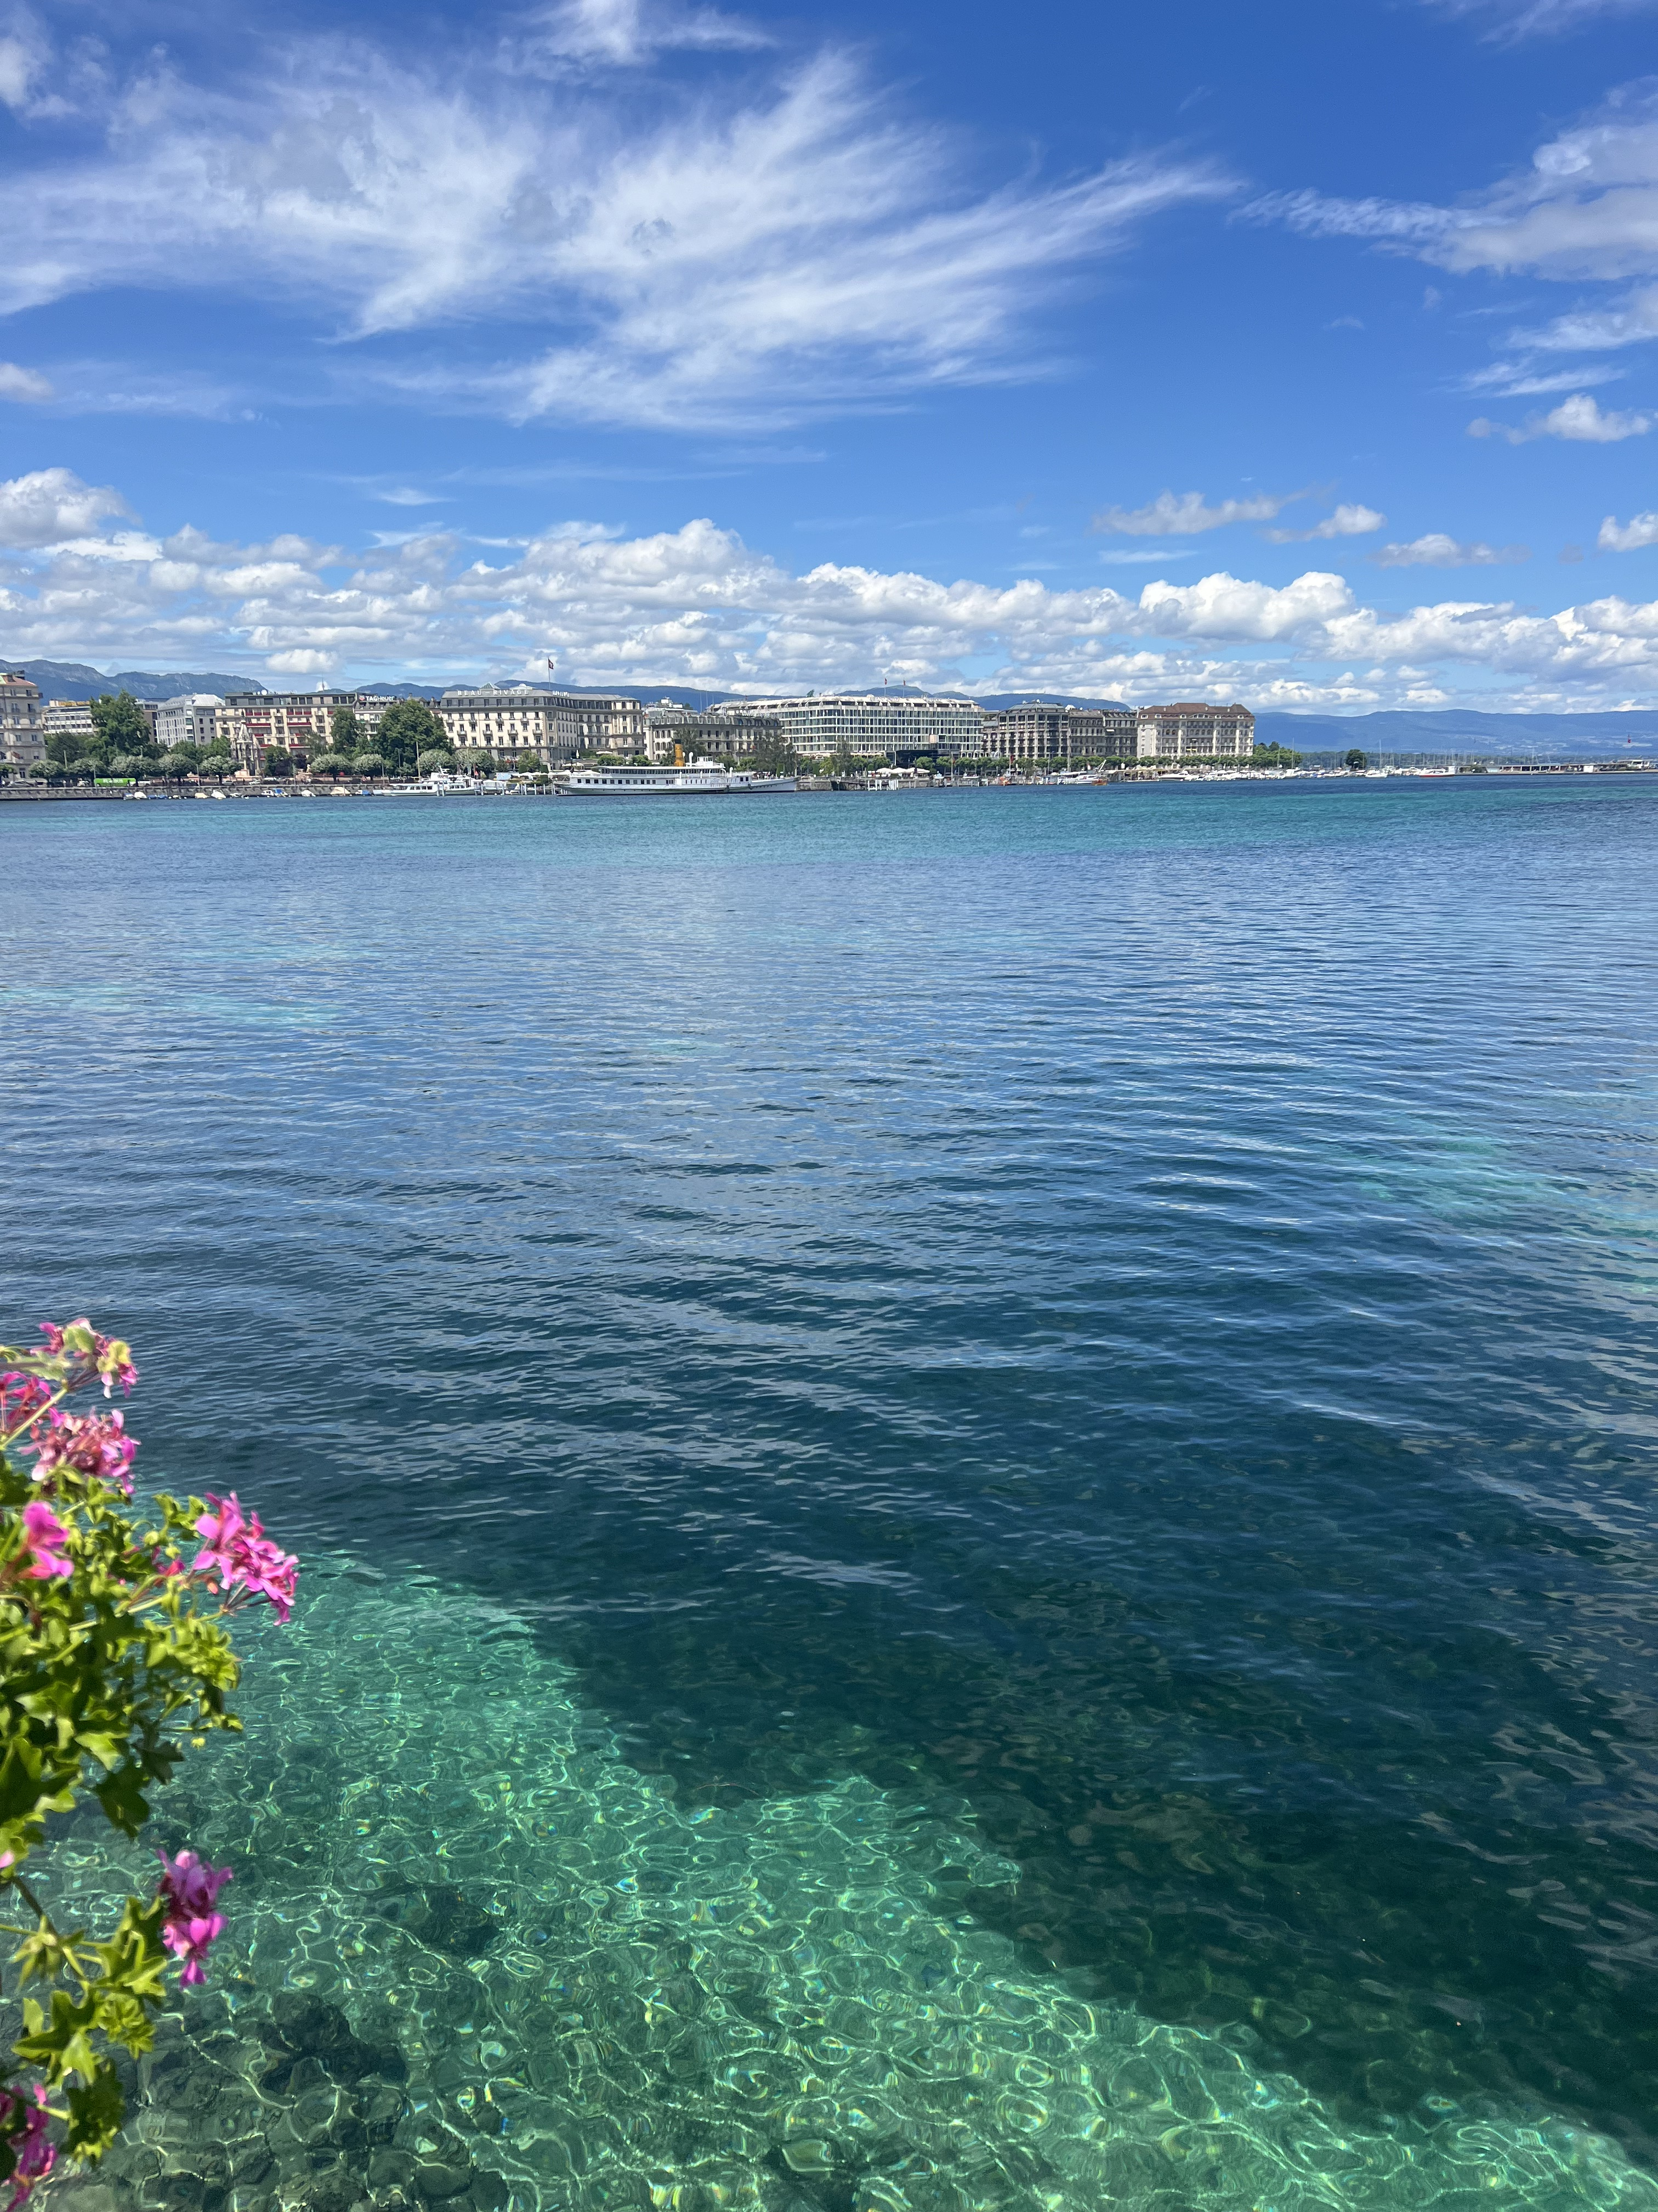
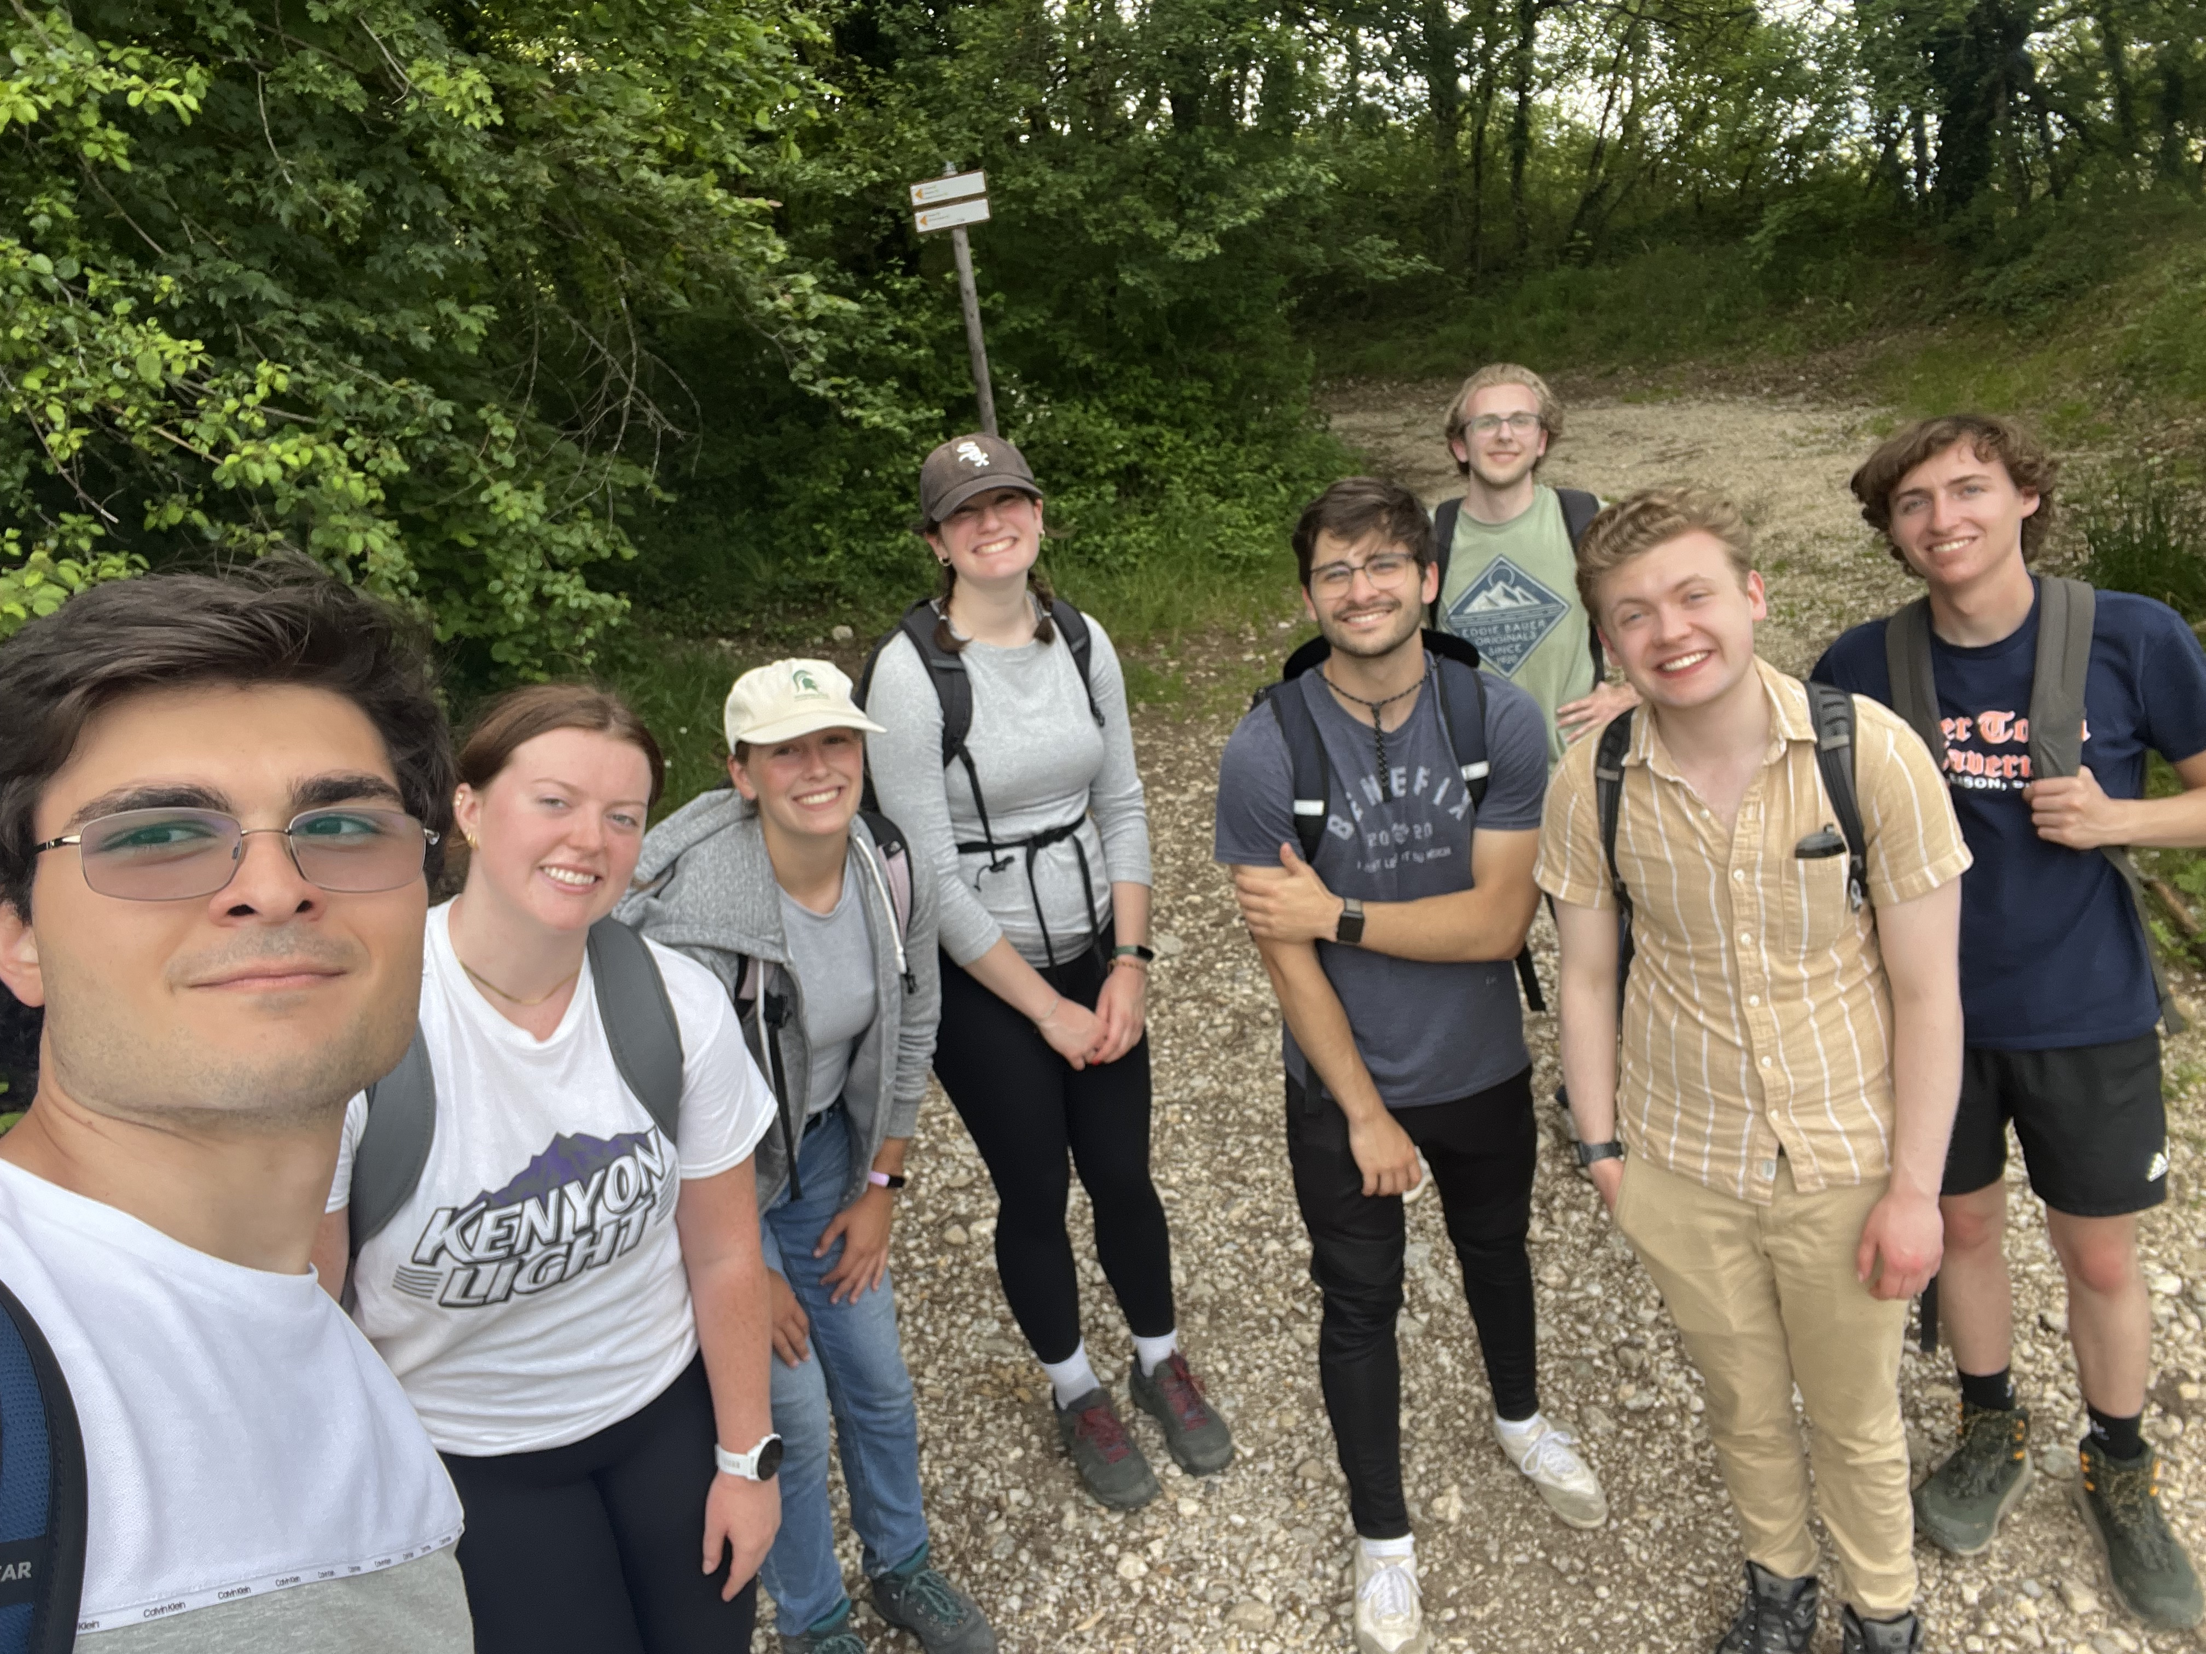
References & Sights
Awan, A. A. (2022, July 21). A comprehensive introduction to Graph Neural Networks (GNNS). DataCamp. https://www.datacamp.com/tutorial/comprehensive-introduction-graph-neural-networks-gnns-tutorial
LHCb detector performance. (2015). International Journal of Modern Physics A, 30(07), 1530022. https://doi.org/10.1142/s0217751x15300227
LHCB. CERN. (n.d.). https://home.cern/science/experiments/lhcb
Shlomi, J., Ganguly, S., Gross, E., Cranmer, K., Lipman, Y., Serviansky, H., Maron, H., & Segol, N. (2021). Secondary vertex finding in jets with Neural Networks. The European Physical Journal C, 81(6). https://doi.org/10.1140/epjc/s10052-021-09342-y

