Slide 1
REU Project Update #1
Project Introduction
Investigation of New Small Wheel High Current/Noise Interruptions at High Luminosity
Aimee Dubuque, University of Michigan
Supervisor: Margaret Lutz
24/06/2024

Slide 2


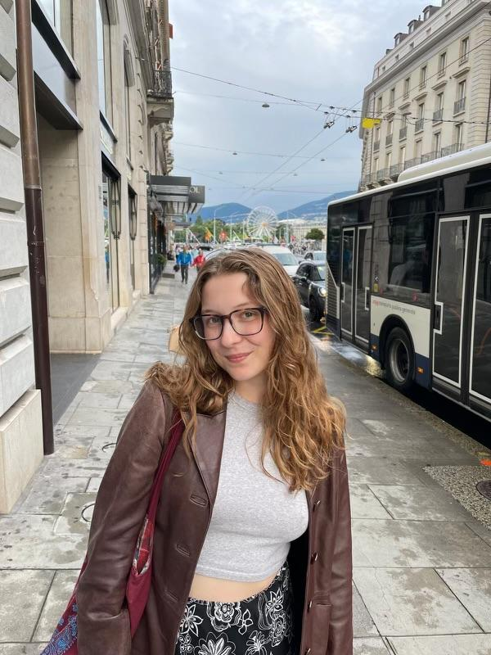
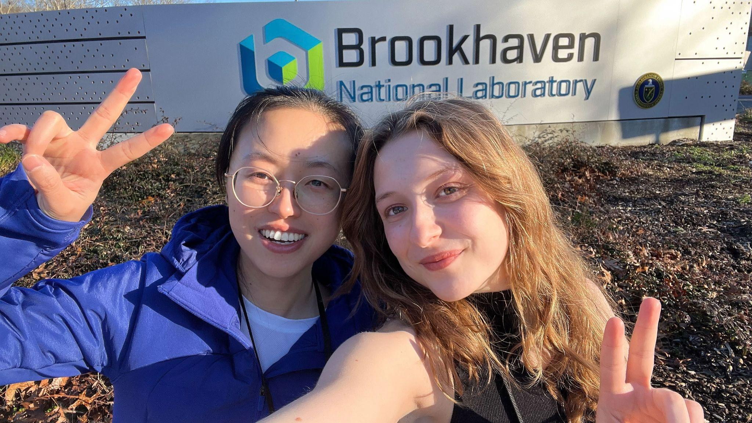
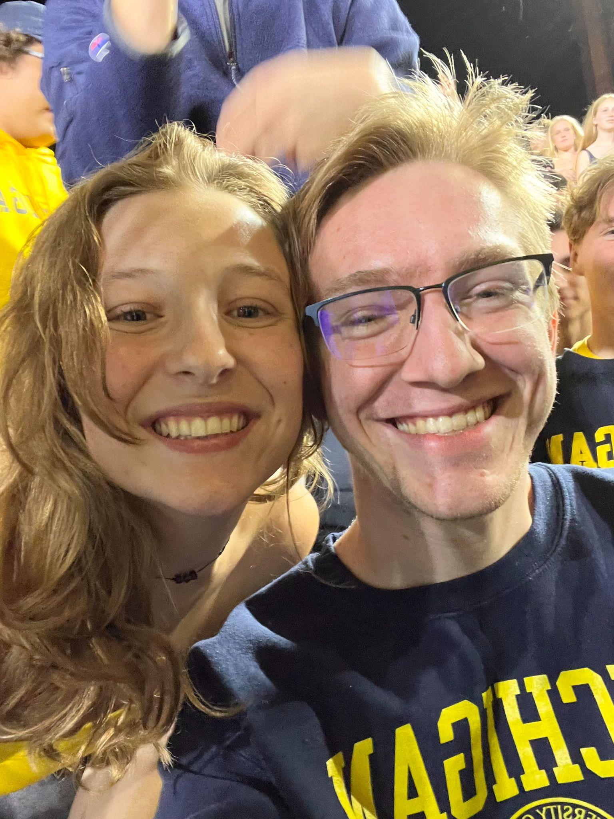
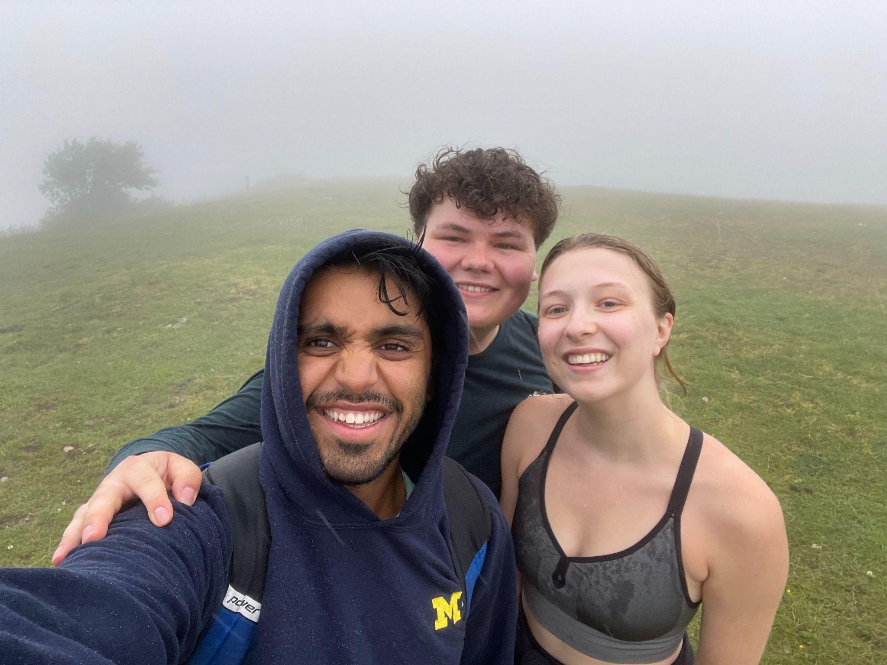
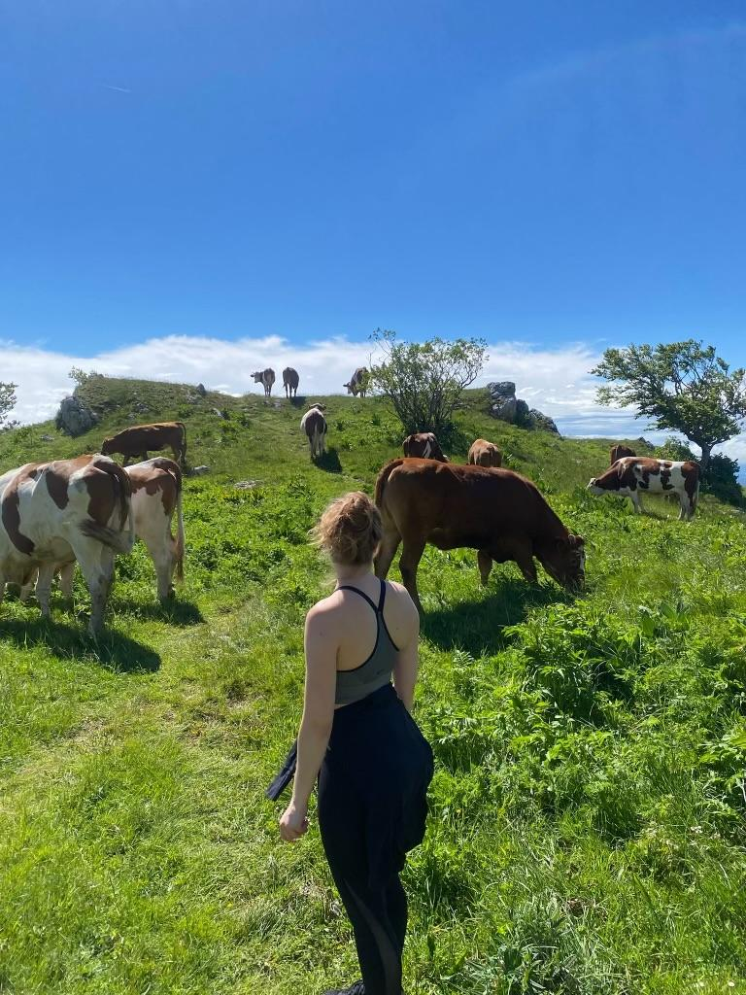
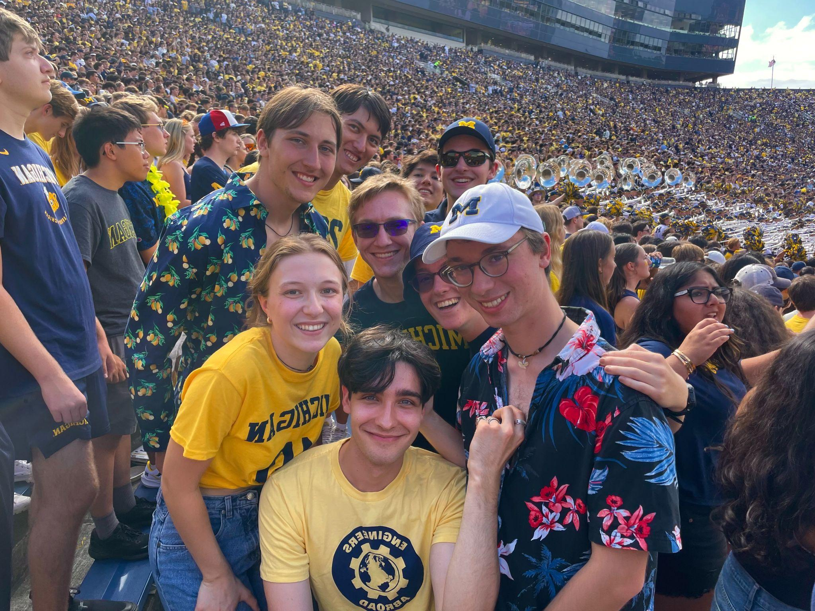
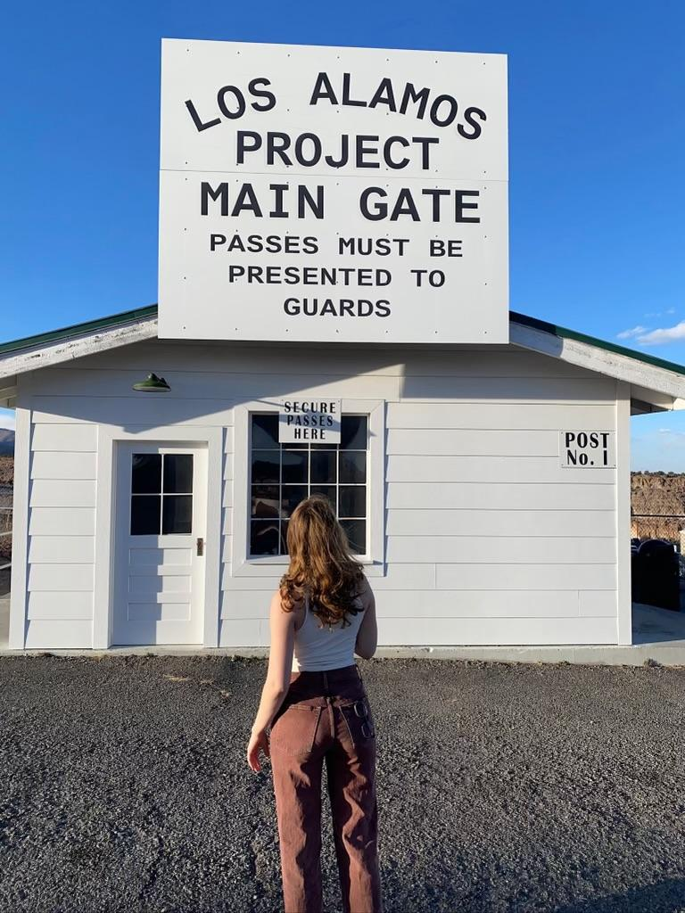
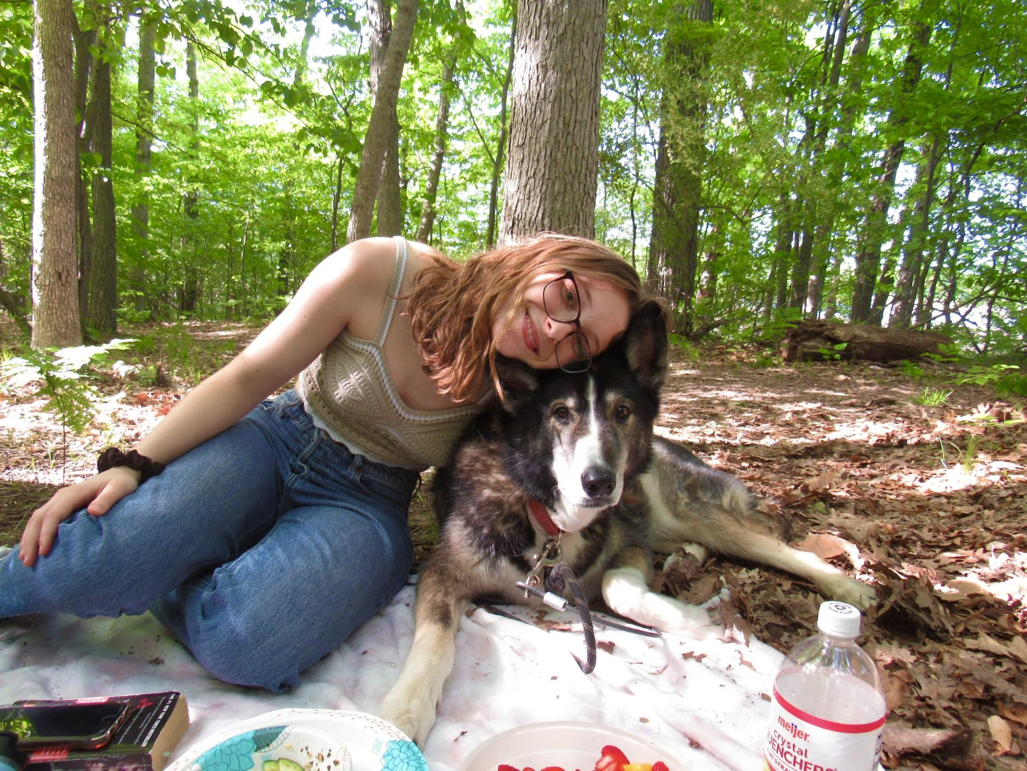
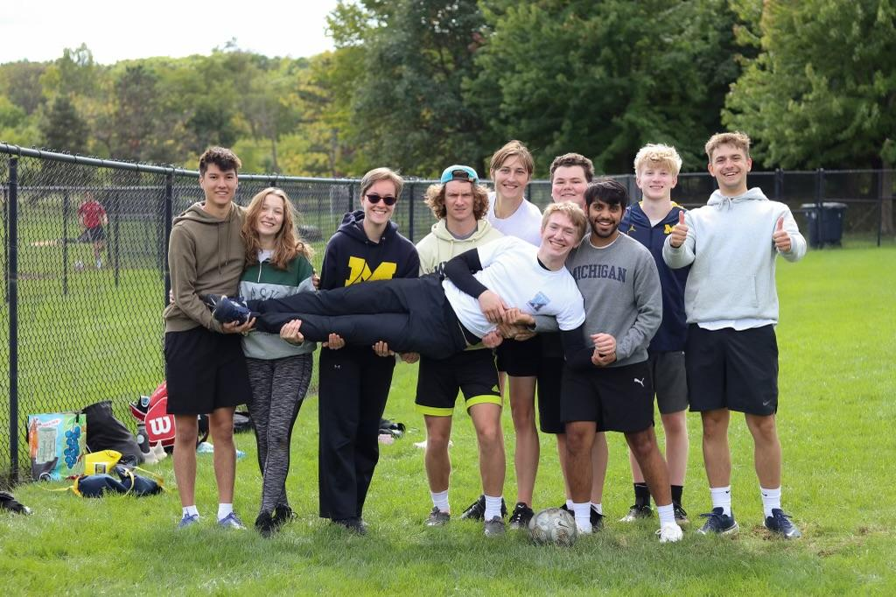
University of Michigan: Majoring in Physics and German, 4th year
Previous research: ATLAS work at UofM, Radiation testing at Brookhaven and Los Alamos, DES Astrophysics
Hobbies: Hiking, thrifting, dancing

Slide 3
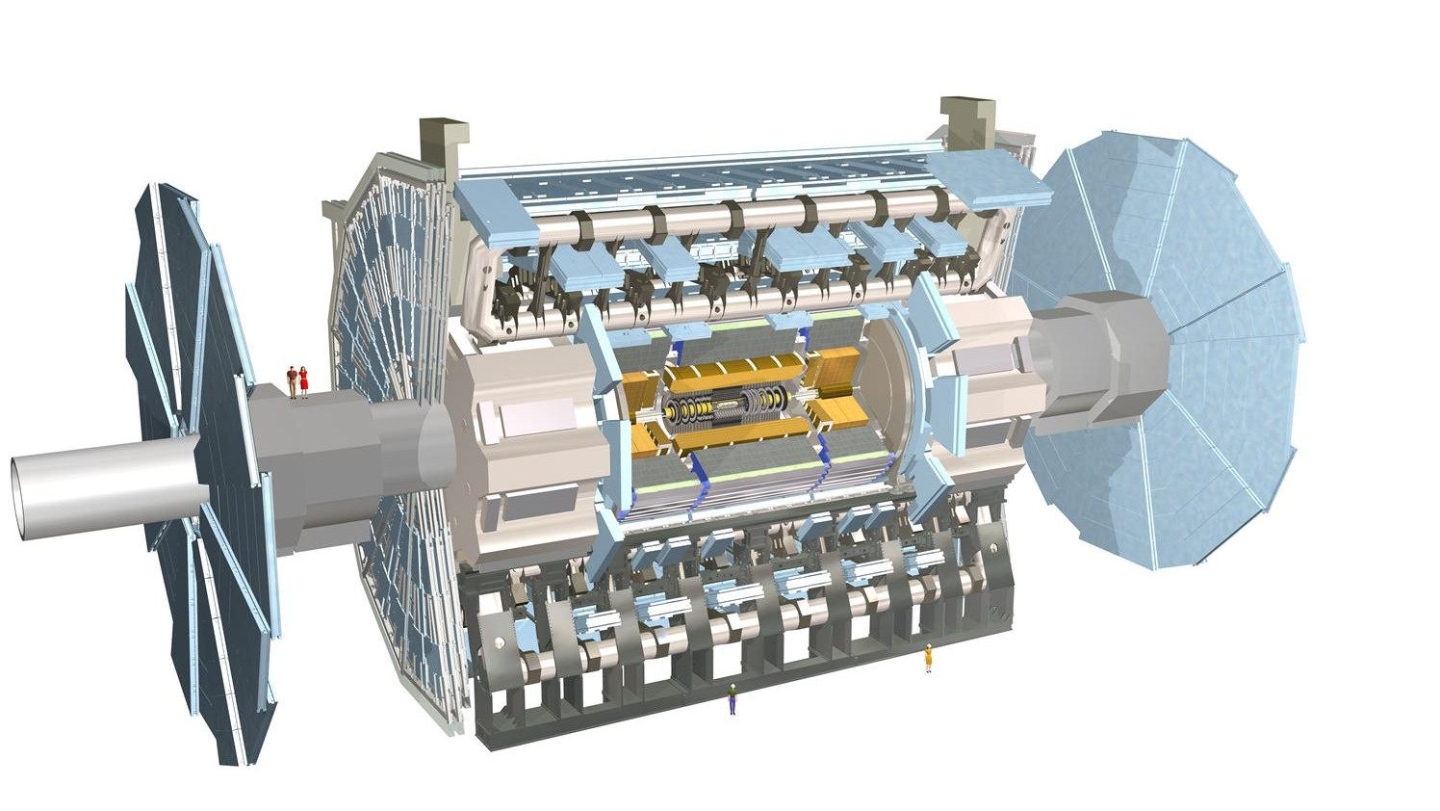
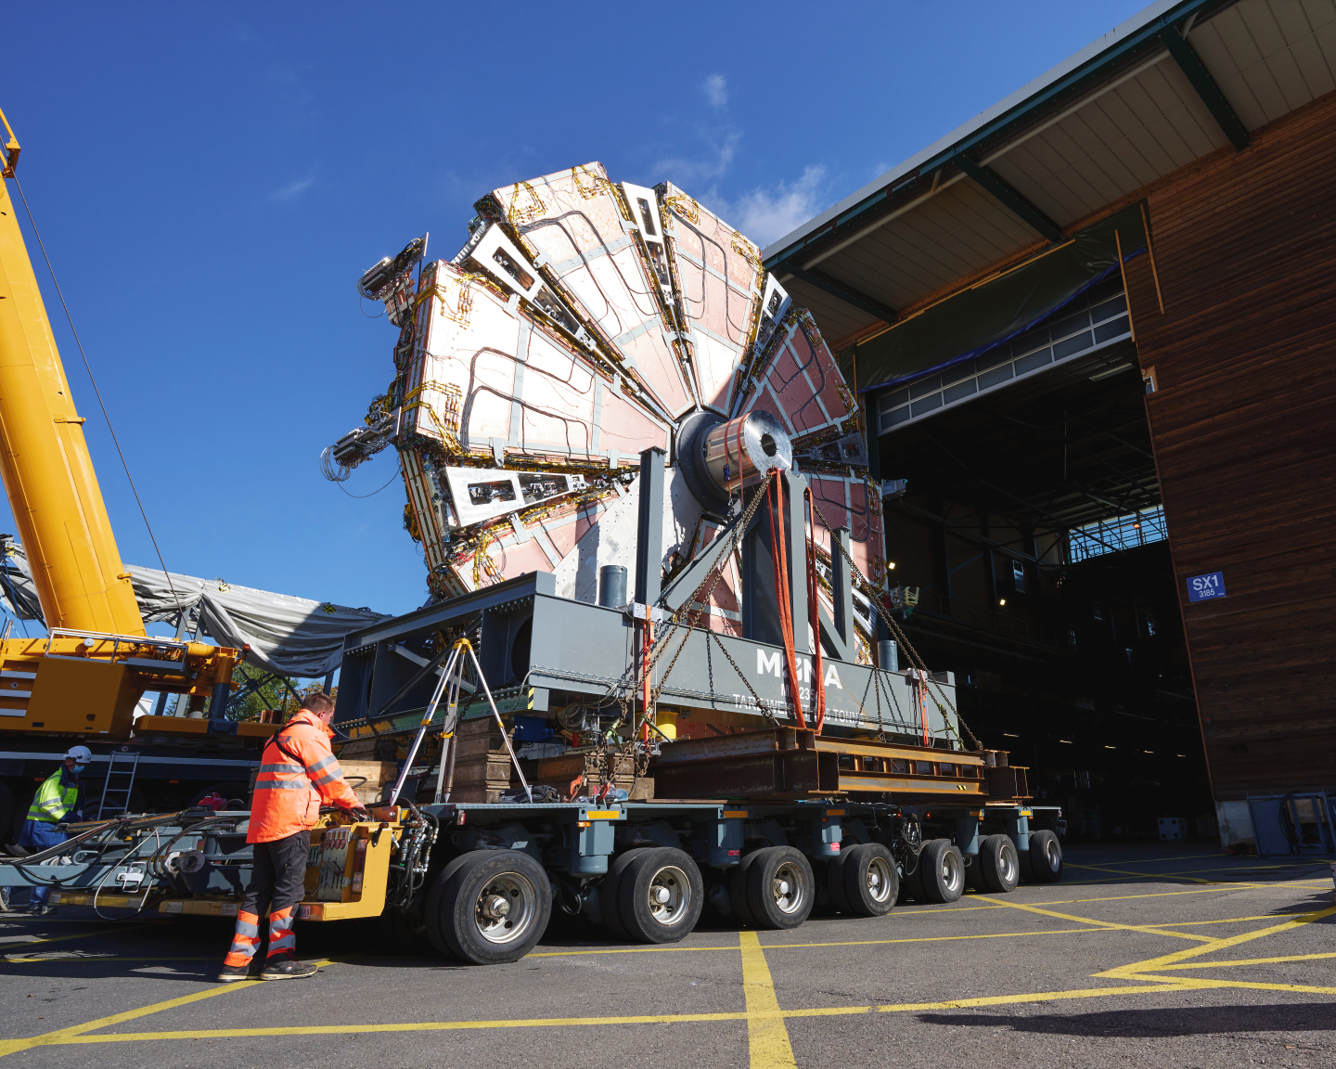
New Small Wheel - ATLAS Experiment
Team: Margaret Lutz & Stergios Tsigaridas
Major Goals:
ATLAS: Detect particle collisions using extensive electronics
New Small Wheels: Detect muons using Small-strip Thin Gas Chambers and Micromega detection systems
Small-strip Thin Gas Chambers: Use ionizing gas chambers with high voltage wires to detect muons

Slide 4
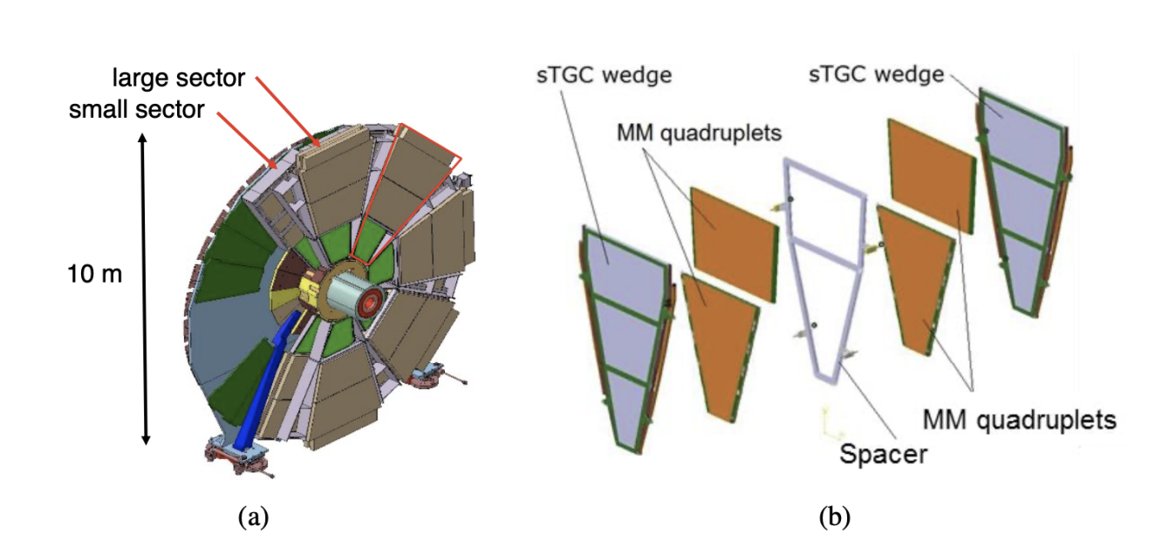
Project
Current Problem: High voltage chambers are showing prolonged spikes in current which are creating noise (over 10% limit)
Project (for now): Investigate the relationship between high luminosity and current discharges
Problem areas

Slide 5
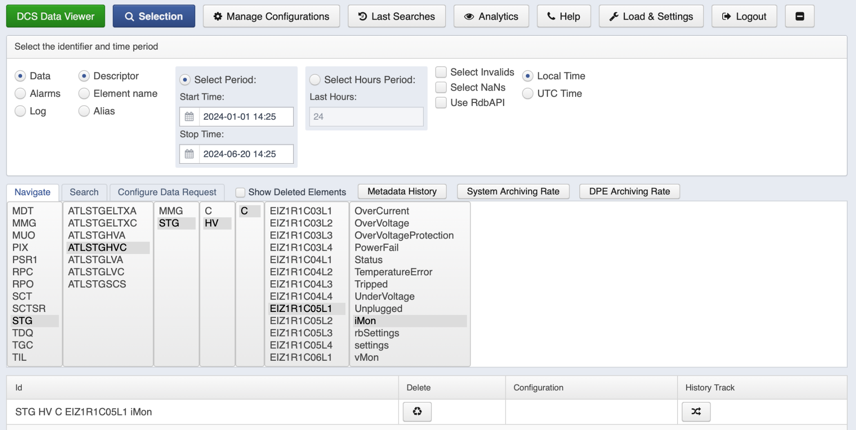
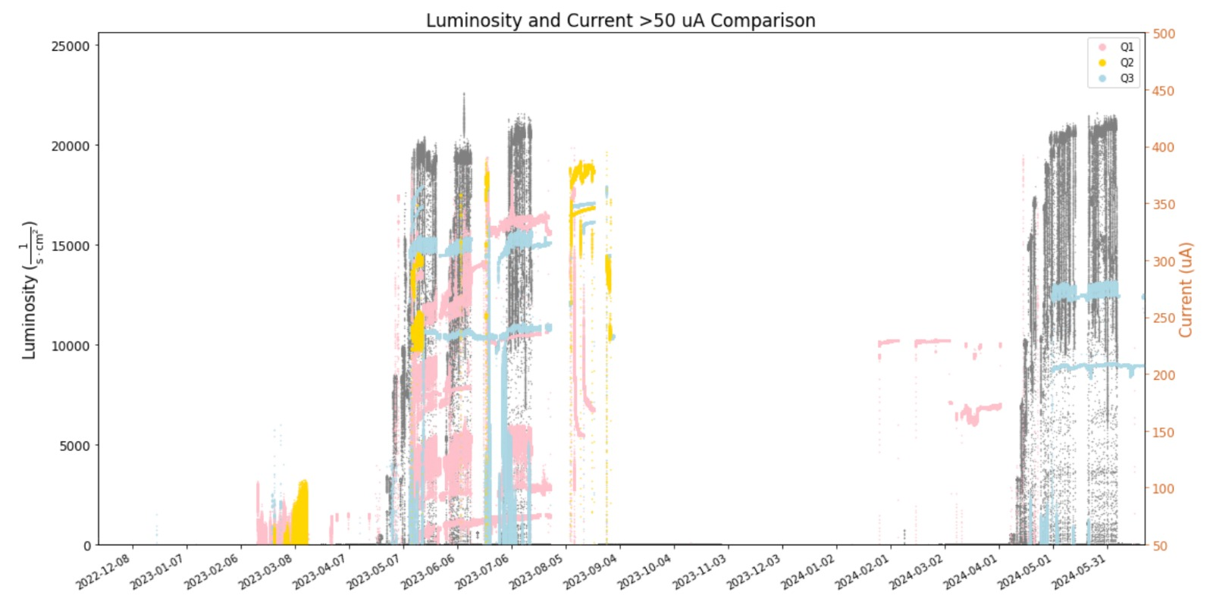
Progress
To be continued…
Compare New Small Wheels on each side
Extensive electronic testing

