Slide 1
Measuring the Leading Order Hadronic Contribution to the Muon g-2
Sena Ghobadi

Slide 2

Who am I?
Sena Ghobadi
Incoming 4th year physics major (astro concentration)
Georgia Institute of Technology

Slide 3

The Muon-E Experiment
A new experiment!
Attempts to experimentally compute anomalous magnetic moment of muon to very high precision
Focused on the hadronic component which presents the largest contribution to g-2 apart from normal QED corrections

Slide 4
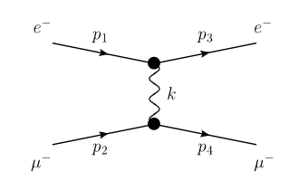
The Muon-E Experiment
Attempts to measure running coupling constant α by measuring the scattering angles of the μe -> μe process
In practice, shoot muons at metal target to induce scattering and measure angular distribution with silicon detectors

Slide 5
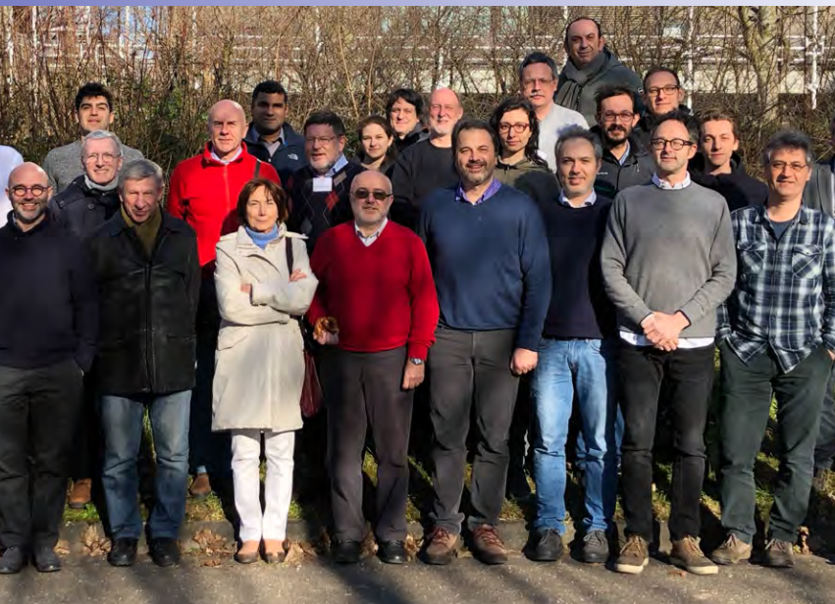
Team
Working under the supervision of Clara Matteuzzi (Milano-Bicocca) and Carlo Ferrari (Pisa)
Will meet several American researchers from UVA later on when experiments are performed
Perform computing and data analysis with Clara, experimental tests with Carlo (TBD)

Slide 6
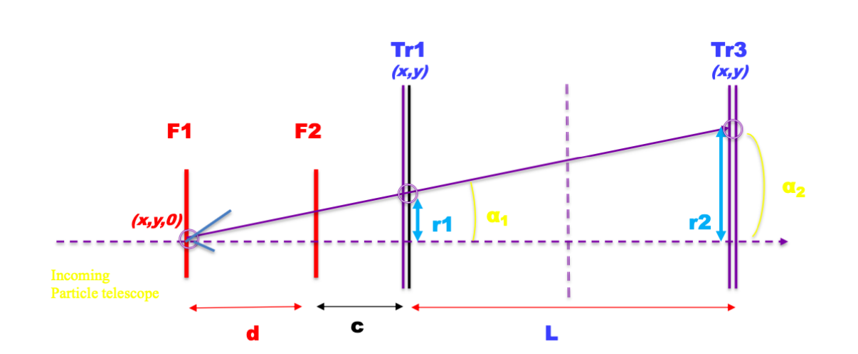
My Role
Current objective – analyze data from last year’s beam test run
Write a program to calibrate the distance between the targets based on physical criteria specified in previous research
Analyze if uncertainty is below certain threshold, O(1 μm)!!!
Almost done! Will be performing experimental beam tests during July

Slide 7
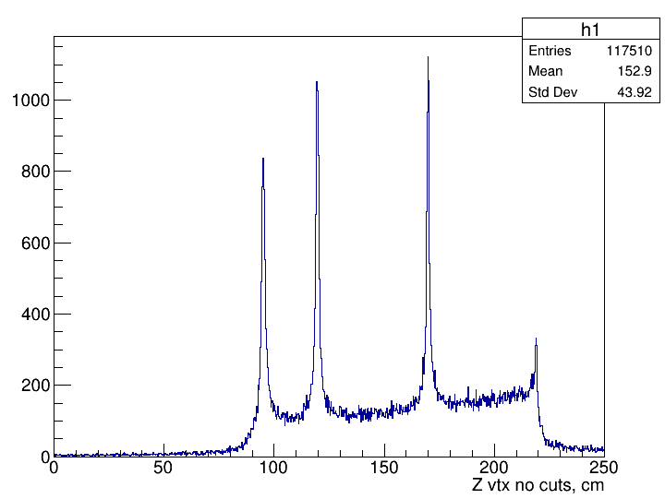
Upcoming Challenges
Mitigate sources of error, i.e. multiple scattering which I encounter in data analysis
Will likely be the bulk of my future computational work
Experimental calibration of calorimeter to be done in July and subsequent beam test

Slide 8

