Slide 1
Creating a Zenodo Jupyter Lab Extension
Michael Zengel

Slide 2
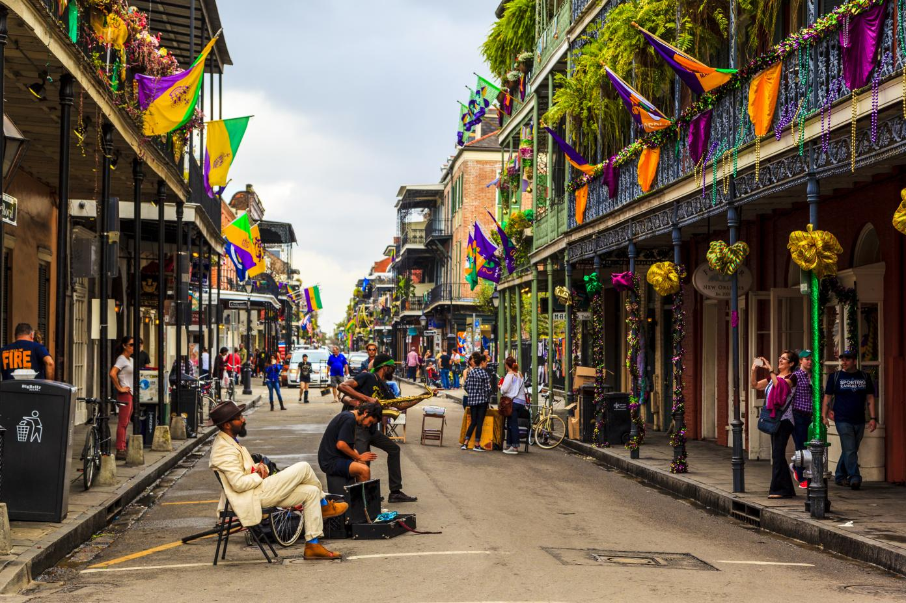
Who I am

Slide 3

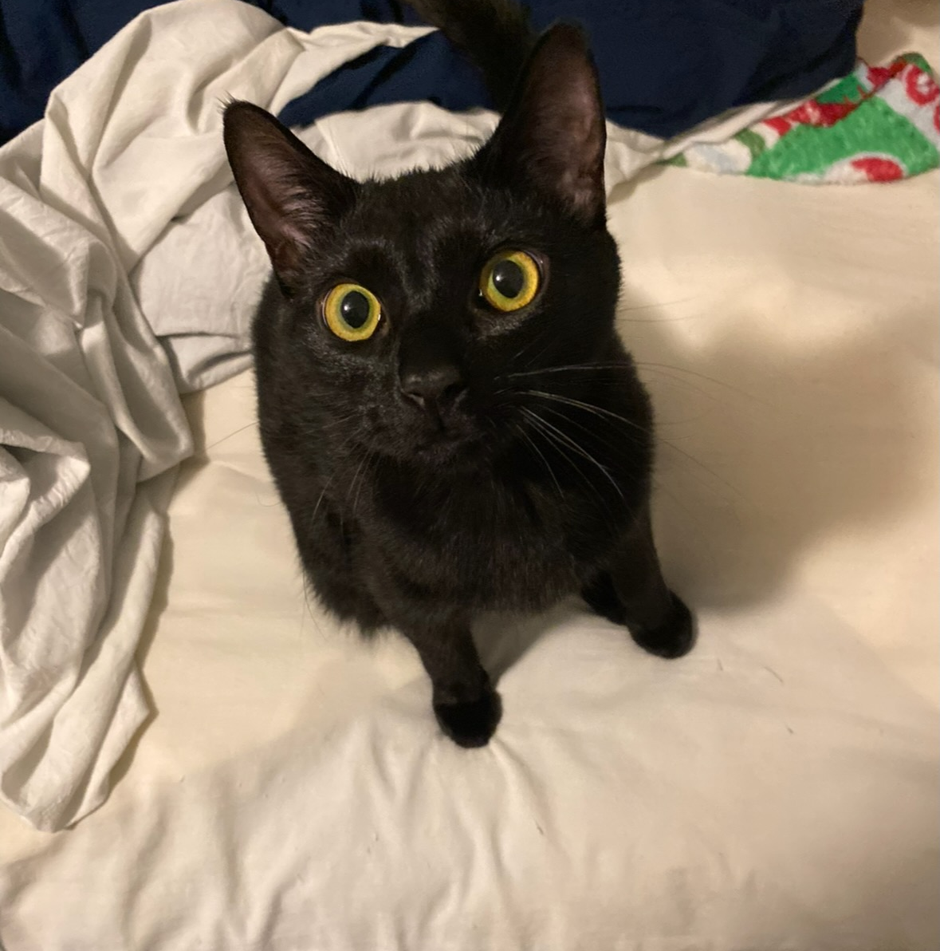
Who I am

Slide 4
Who I am

Slide 5

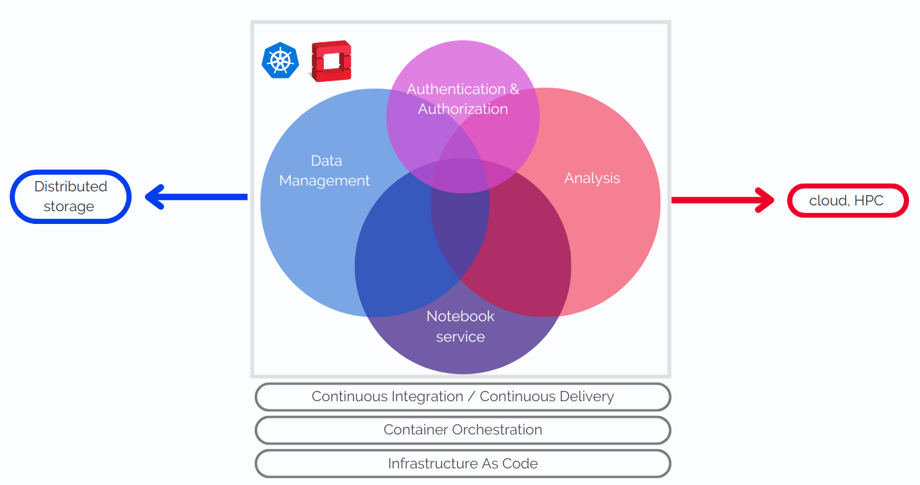
My “experiment”
Working in the IT department on the Virtual Research Environment (VRE)

Slide 6
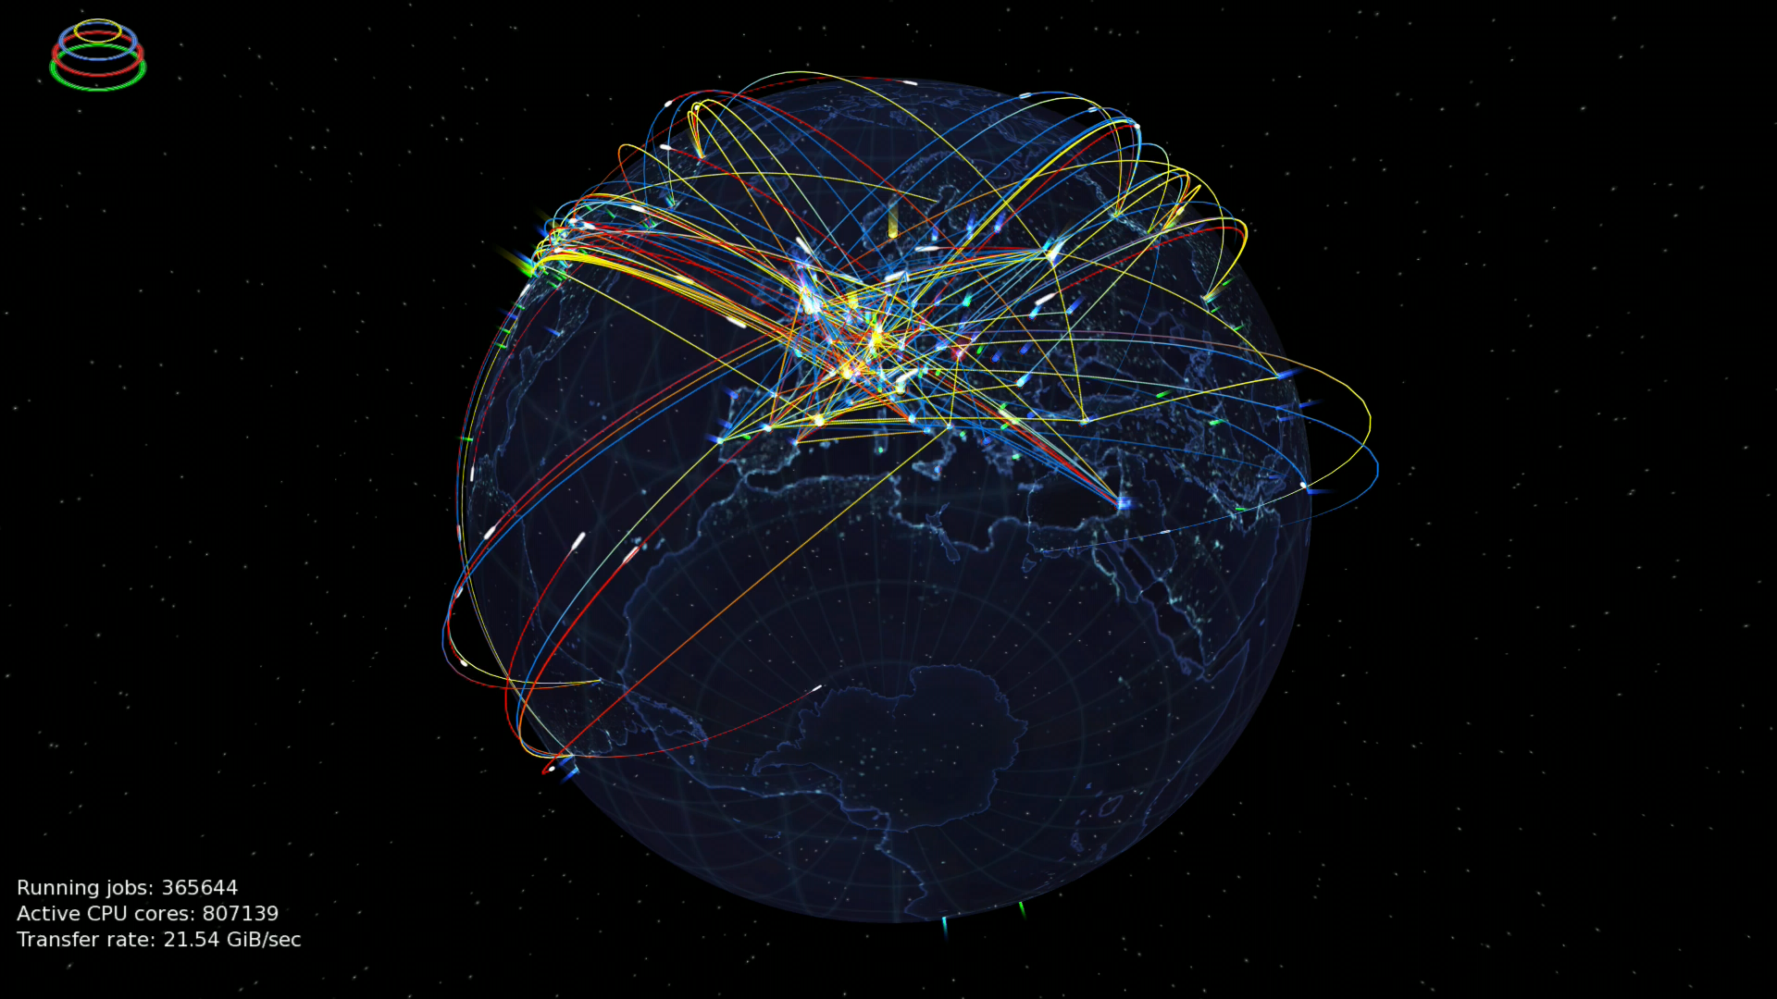
My “experiment”
The goal is to develop end-to-end physics workflows for use by any researchers in the WLOG and other researchers

Slide 7
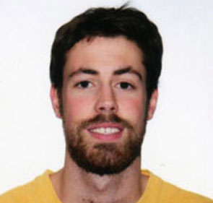
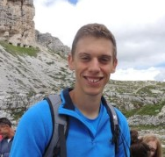
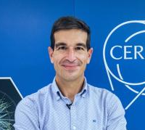
My mentors/supervisors
Enrique Garcia
Giovanni Guerreri
Xavier Espinal
Mentors
Supervisor

Slide 8

My Project
Developed by the OpenAIRE project
Encourages open data policies
Used by researchers all over the world
Databasing software with different communities

Slide 9

My Project
Developed by the OpenAIRE project
Encourages open data policies
Used by researchers all over the world
Databasing software with different communities
Computing Environment
Already integrated with Github and python packaging
Extension already exists that integrates Rucio

Slide 10
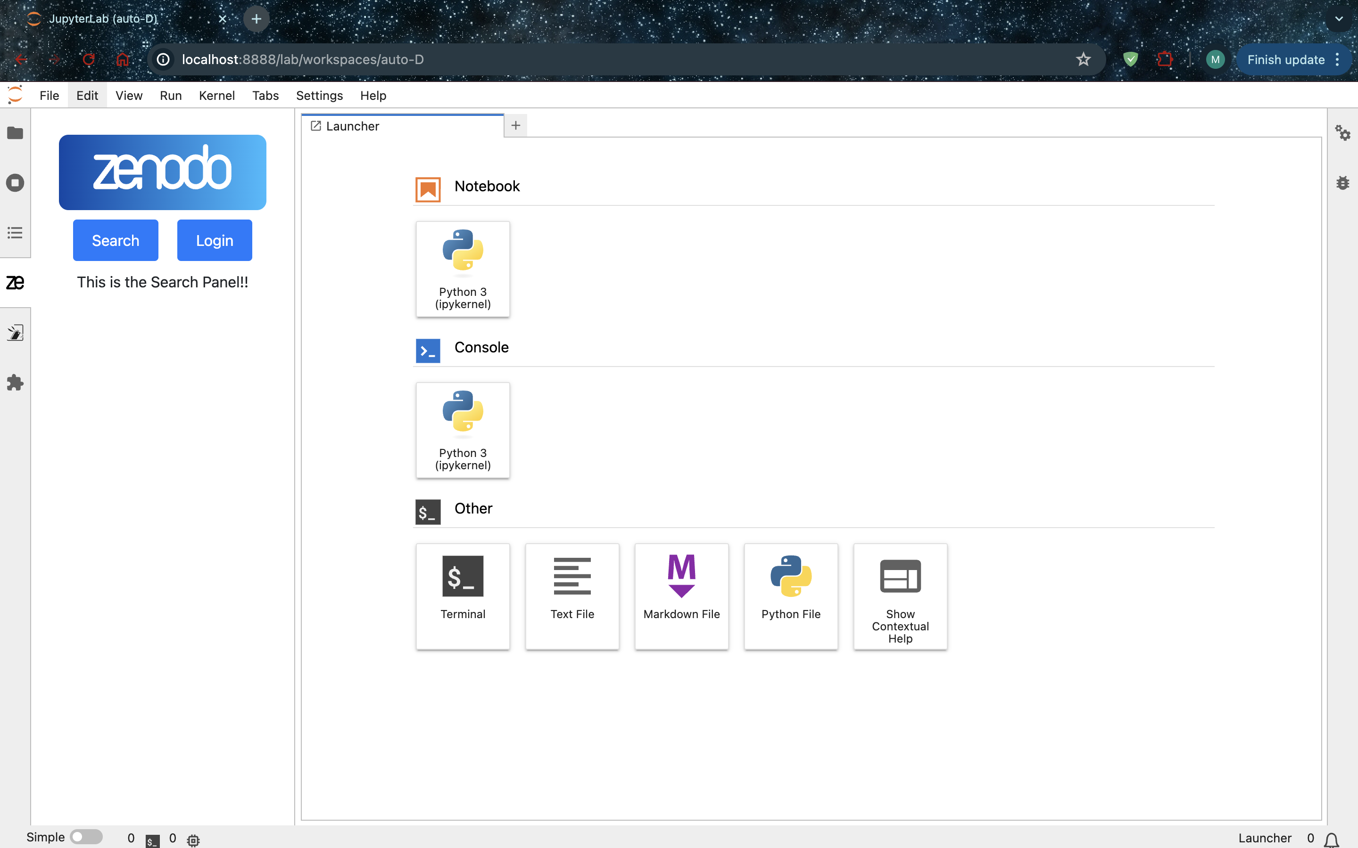
My Project
Developed by the OpenAIRE project
Encourages open data policies
Used by researchers all over the world
Databasing software with different communities
Computing Environment
Already integrated with Github and python packaging
Extension already exists that integrates Rucio

Slide 11
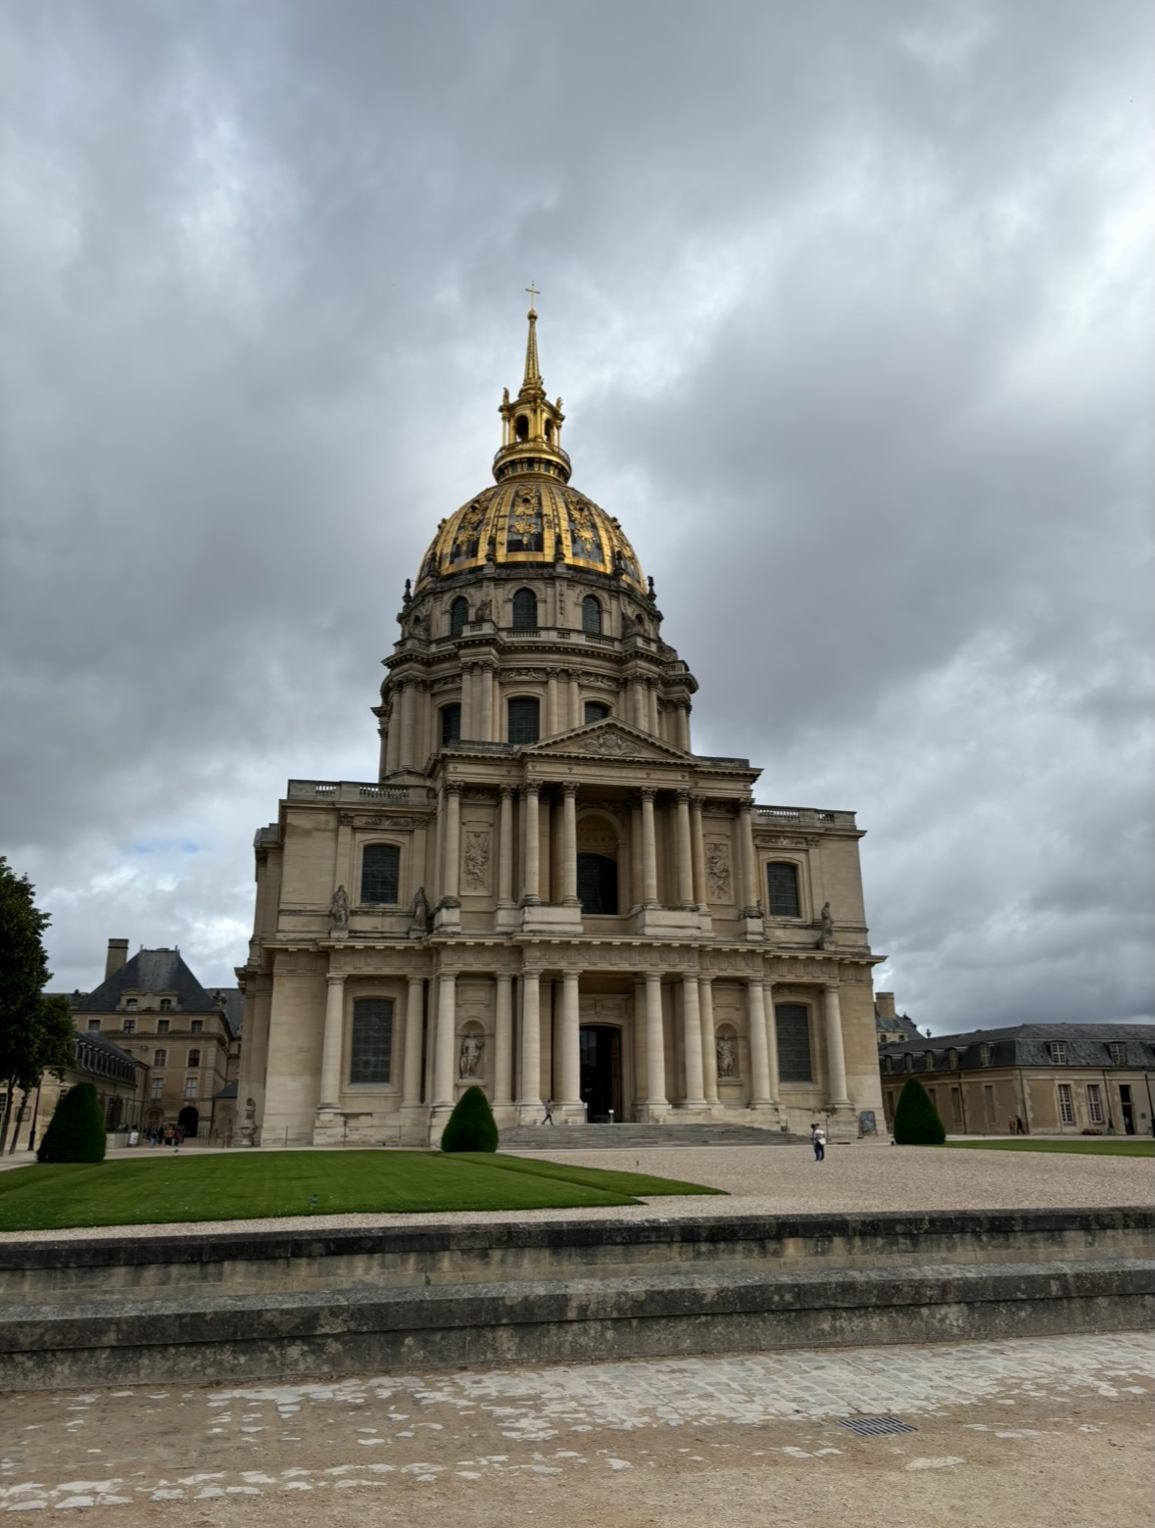
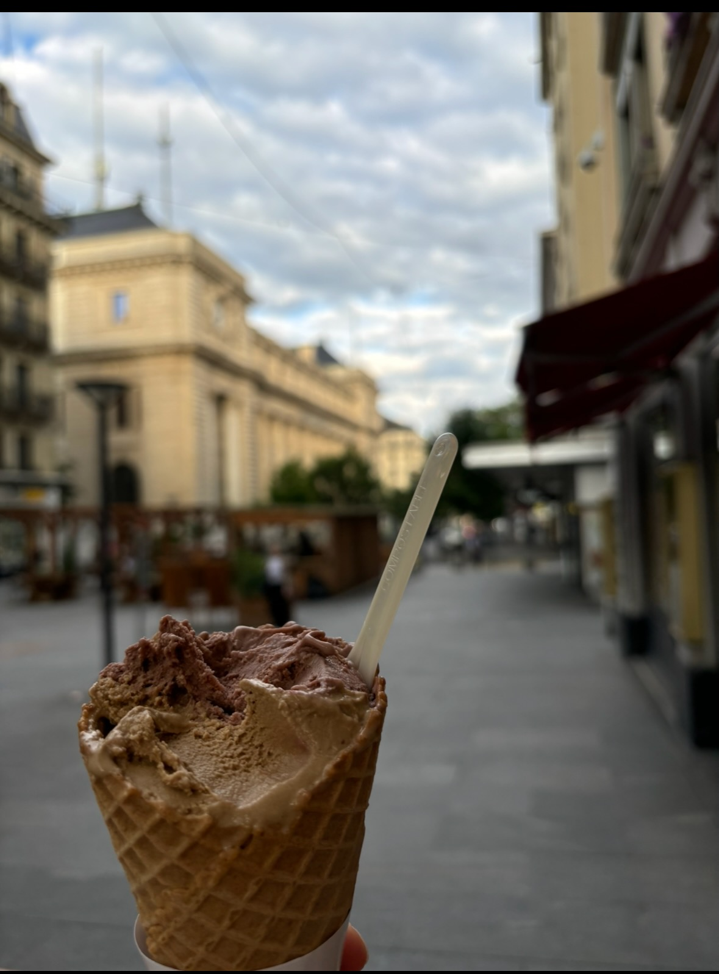
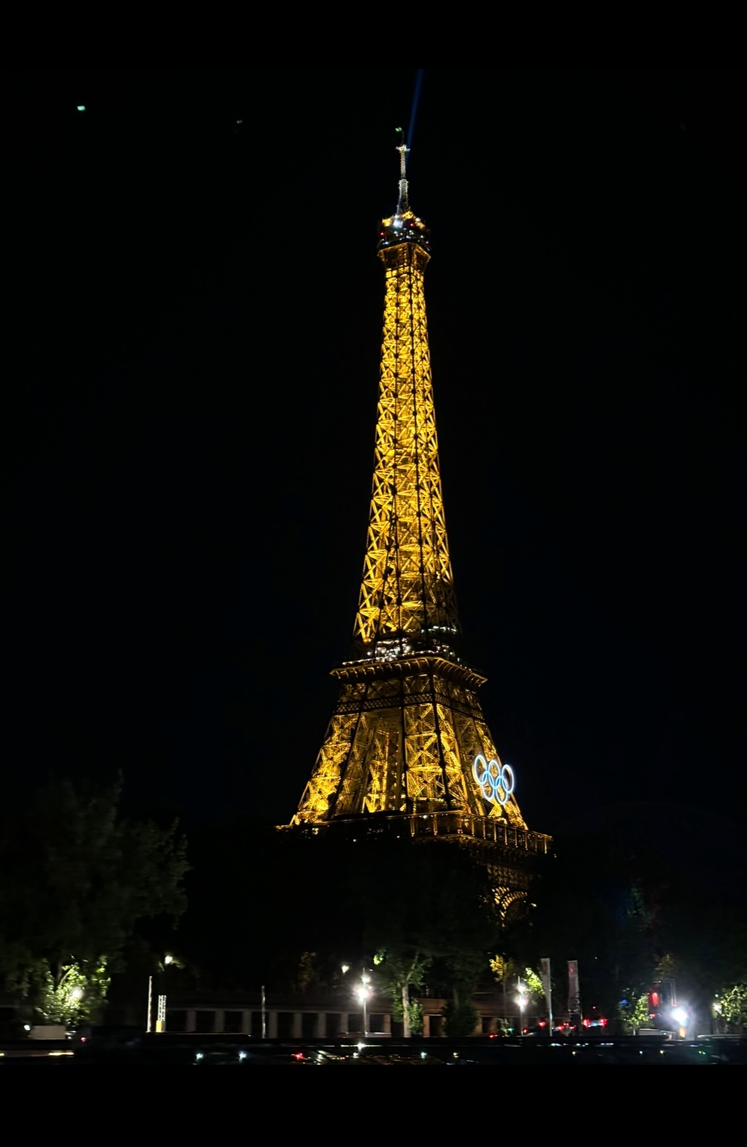
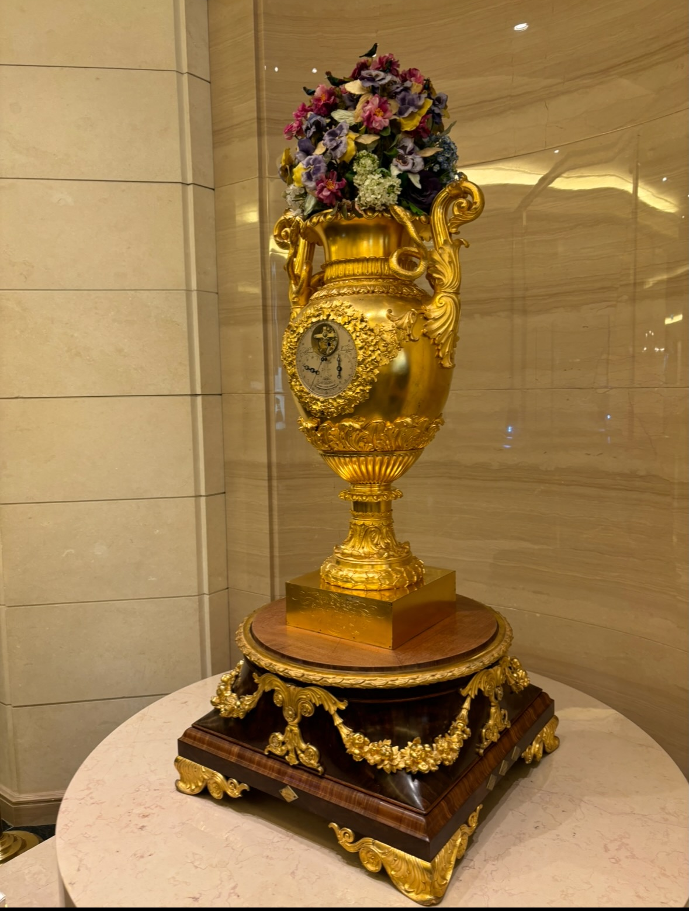
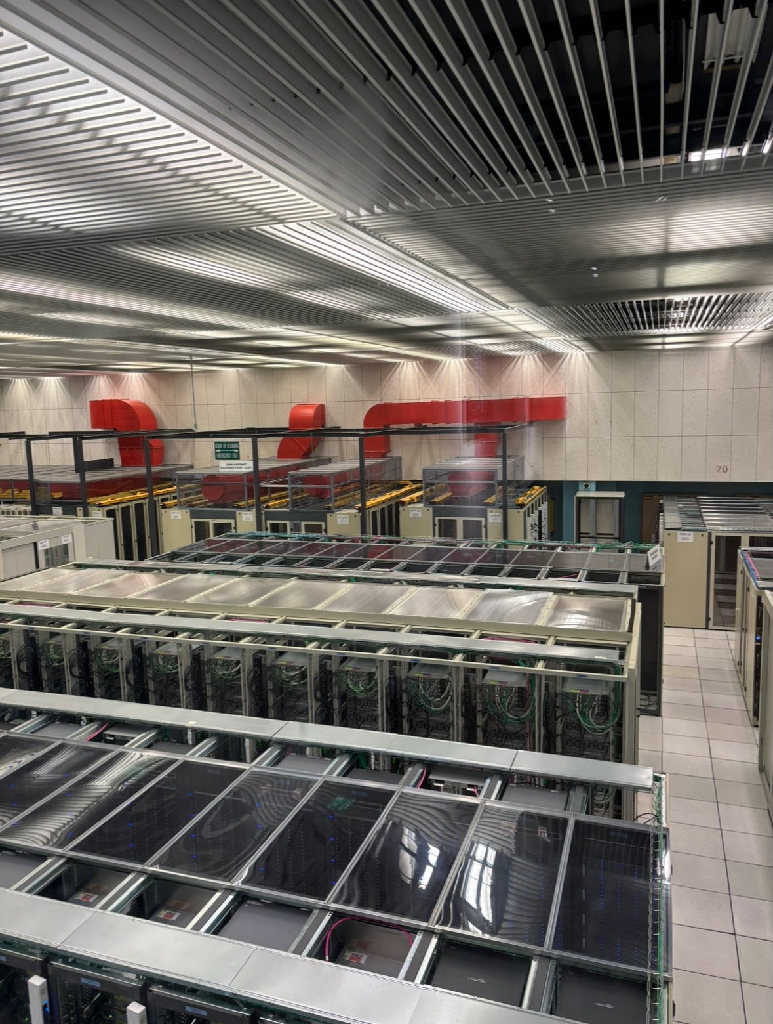
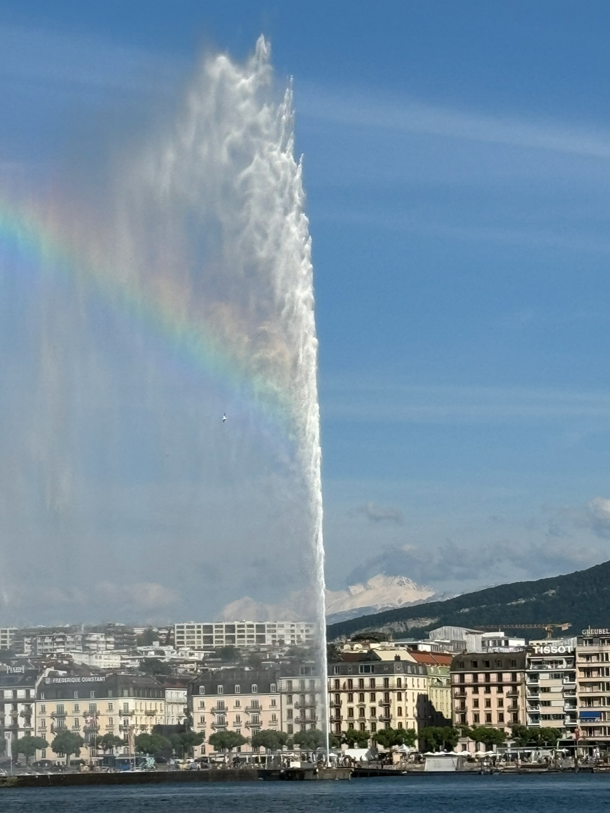
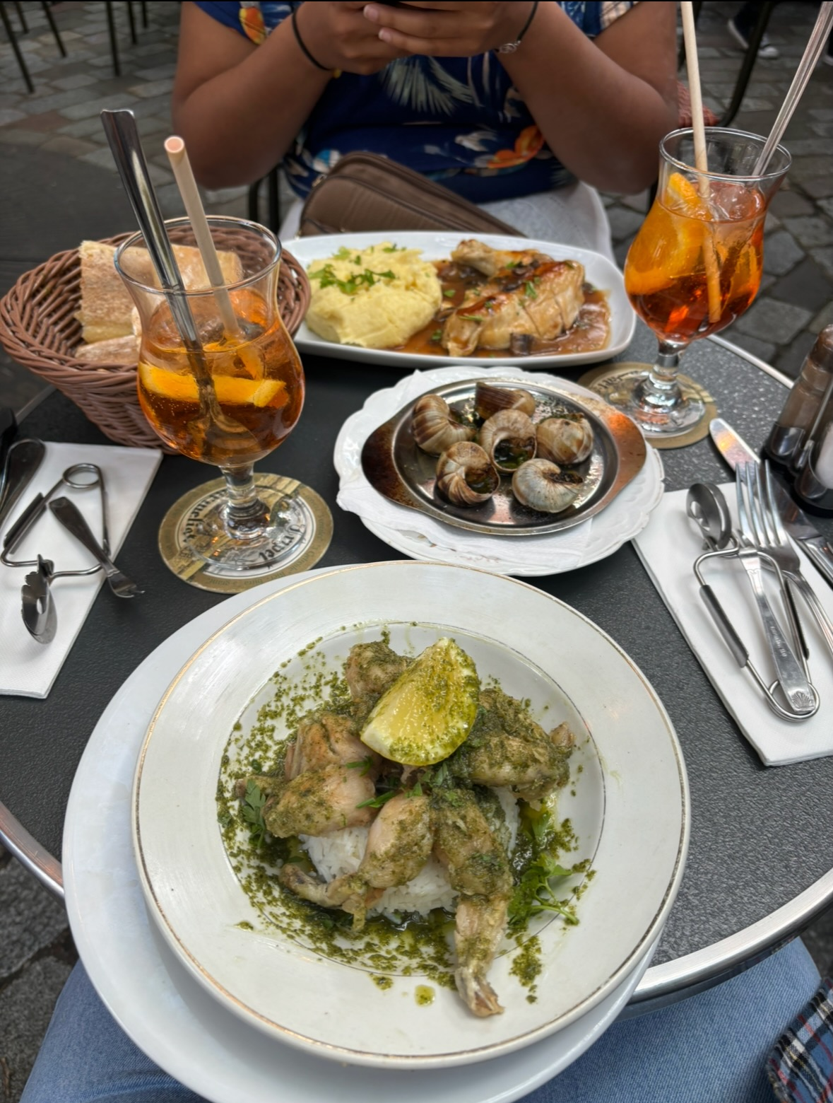
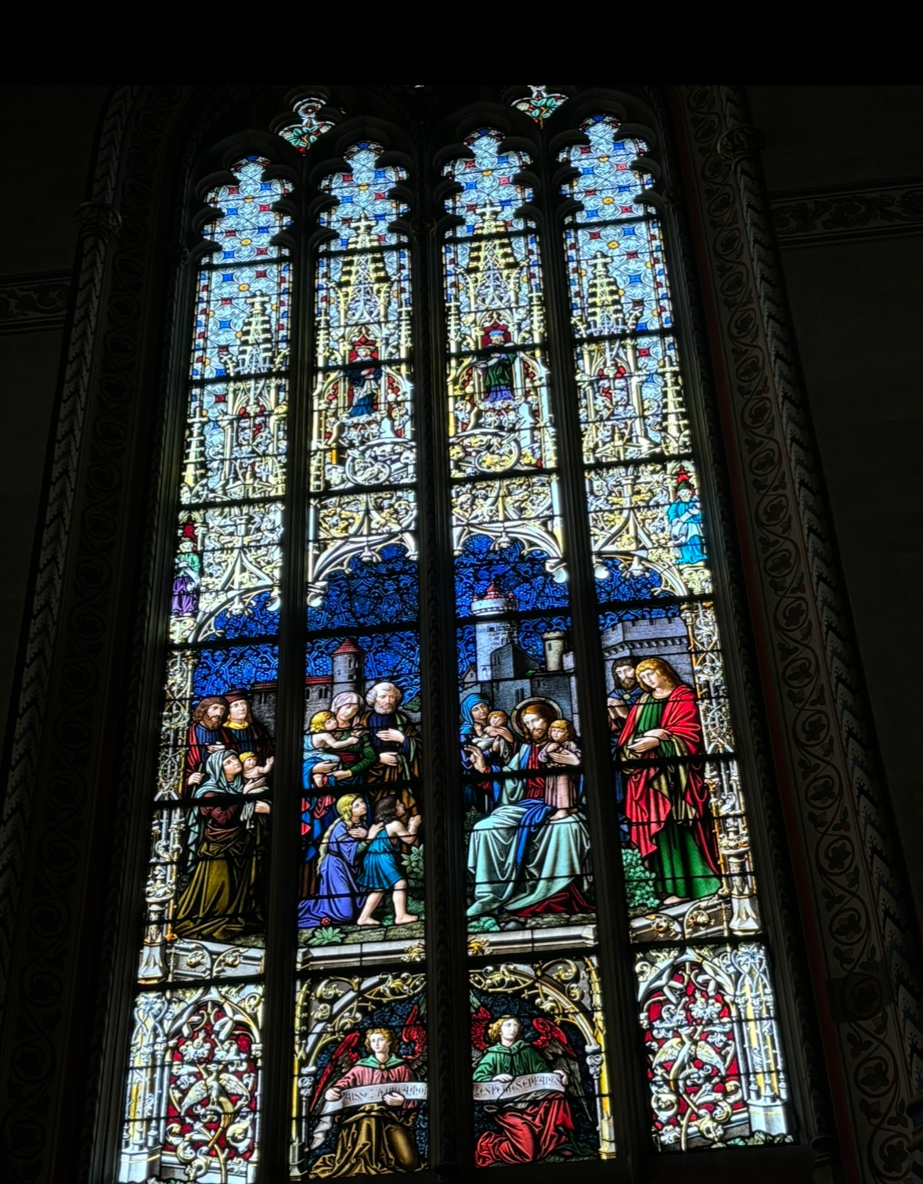
Traveling

