Slide 1

EP-DT
Detector Technologies
Strategies for optimizing
the usage of greenhouse gas
in particle detection systems
R. Guida, B. Mandelli, G. Rigoletti
CERN EP-DT Gas Systems Team

Slide 2
Outline
Greenhouse gases (GHGs) for particle detection
F-gas regulations
Strategies for optimizing GHGs usage: results, new projects and plans
  Recirculation systems
  Recuperation systems
  Ecofriendly gases
  GHGs disposal
Conclusions/Lessons to remember

Slide 3
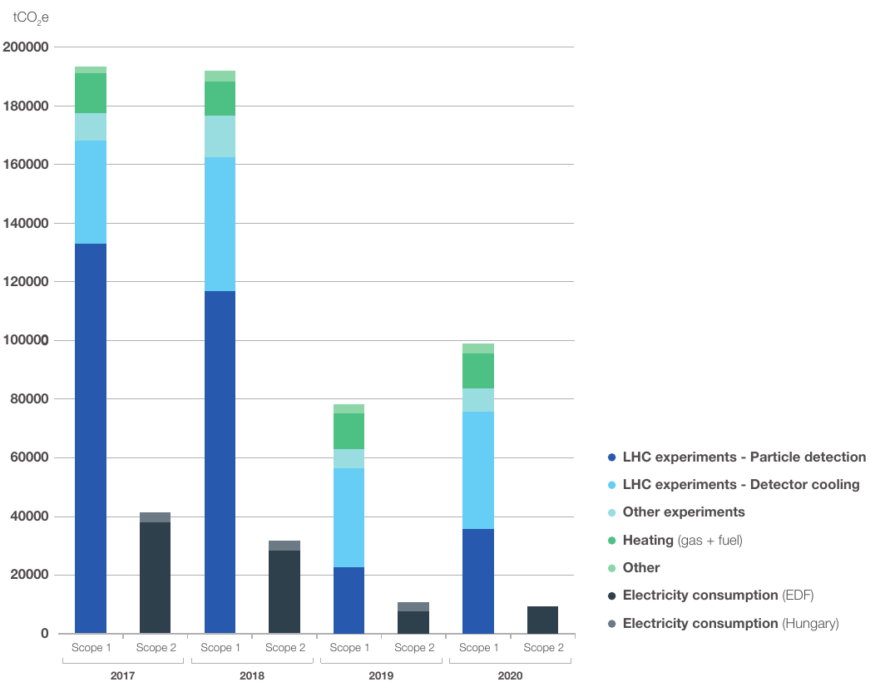
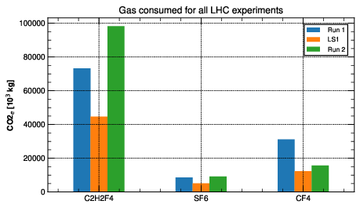
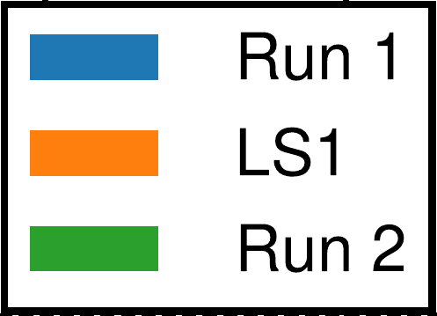

Greenhouse gas usage
CERN Environment Report 2019-2020
2021: CERN’s Year of Environmental Awareness.
CERN Environment workshop: 12 and 13 October 2022
CERN Environment Report 2021-2022
Total CERN emissions during 1 year of Run 2 ~ 200 000 tCO2e
~ 50% from particle detectors → mostly due to leaks and operation
C₂H₂F₄/R-134a biggest contributor → leaks from RPC detector
CF₄ → due to operation of CSC and RICH systems
SF₆ → Related to RPCs as R-134a
Emissions from
particle detection
tCO_{2e}
R-134a
SF6
CF4
-40% GHG emissions from Run1 to Run2 excluding ATLAS and CMS-RPCs
-25% GHG emissions from Run2 to Run3 excluding ATLAS and CMS-RPCs
New objective: -28% by 2024 wrt 2018 (Run2)
2017
2018
2019
2020
Run2
LS2

Slide 4
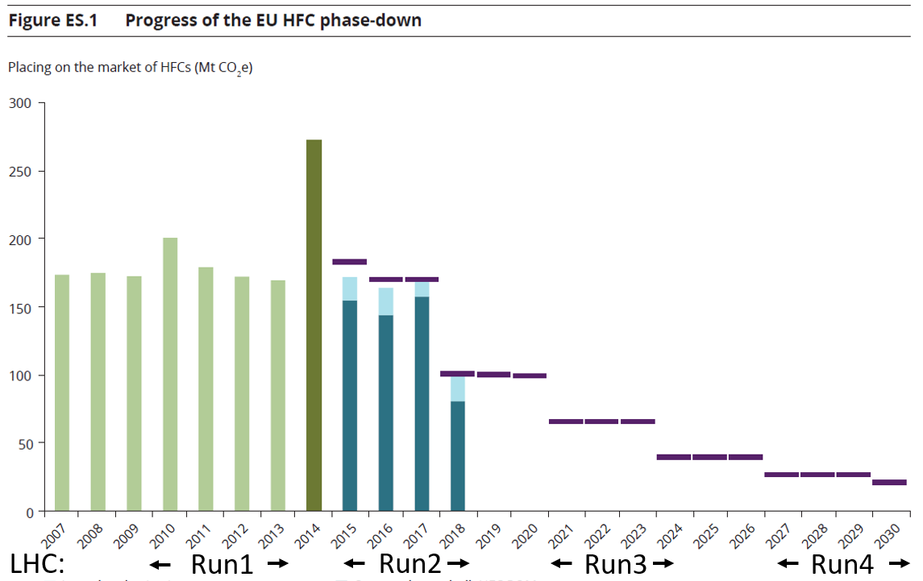
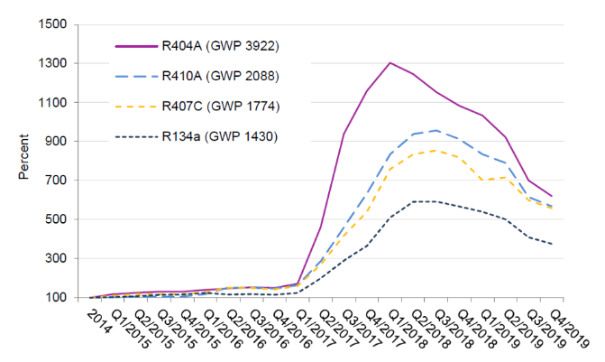
Greenhouse gas regulation
Due to the environmental risk, “F-gas regulations” started to appear. For example, the EU517/2014 is:
Limiting the total amount of the most important F-gases that can be sold from 2015 onwards. By 2030, it limits the use to 1/5 of 2014 sales.
Banning the use of F-gases in new equipment where less harmful alternatives are available.
Preventing emissions of F-gases from existing equipment by requiring checks, proper servicing and recovery of gases.
HFC phase down: effects on HFC availability and prices
Price fluctuations:
decrease due to industrial conversion to new low GWP gases
Reduction in availability over LHC operation
increase due to EU HFC phase-down/reduced availability
100%
93%
Today
63%
45%
31%
24%
21%
Today
Run3
Run4
Sources: European Environment Agency, Fluorinated greenhouse gases 2019 report
Öko Recherche report, March 2020 J. Kleinschmidt et al.
Goal: reduce F- gases consumption and emissions from particle detectors

Slide 5
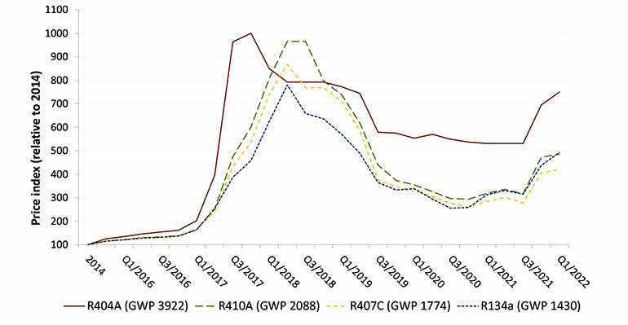
New F-gas regulation: from phase down to phase out
The new Regulation establishes the total elimination of HFCs by 2050
It is a major step towards climate neutrality
First goal: reduction of 55% GHG emissions by the end of this decade compared to 1990 levels
New restrictions also in the use of SF6 and especially for high GWP gases
It will result in a reduction in production and reduced quotas for F-Gas refrigerants, leading to an inevitable increase in prices for higher GWP refrigerants
    It will probably affect not-EU market
Important also to consider possible new regulation for all PFAS
EU F-gas 2015
Average purchase prices of the most commonly used HFC refrigerants
EU-2023 revision
increase due to EU HFC phase-down/reduced availability
decrease due to industrial conversion to new low GWP gases
LHC RUN 2
LHC RUN 3
LHC RUN 4
LHC RUN 5
LHC RUN 6

Slide 6
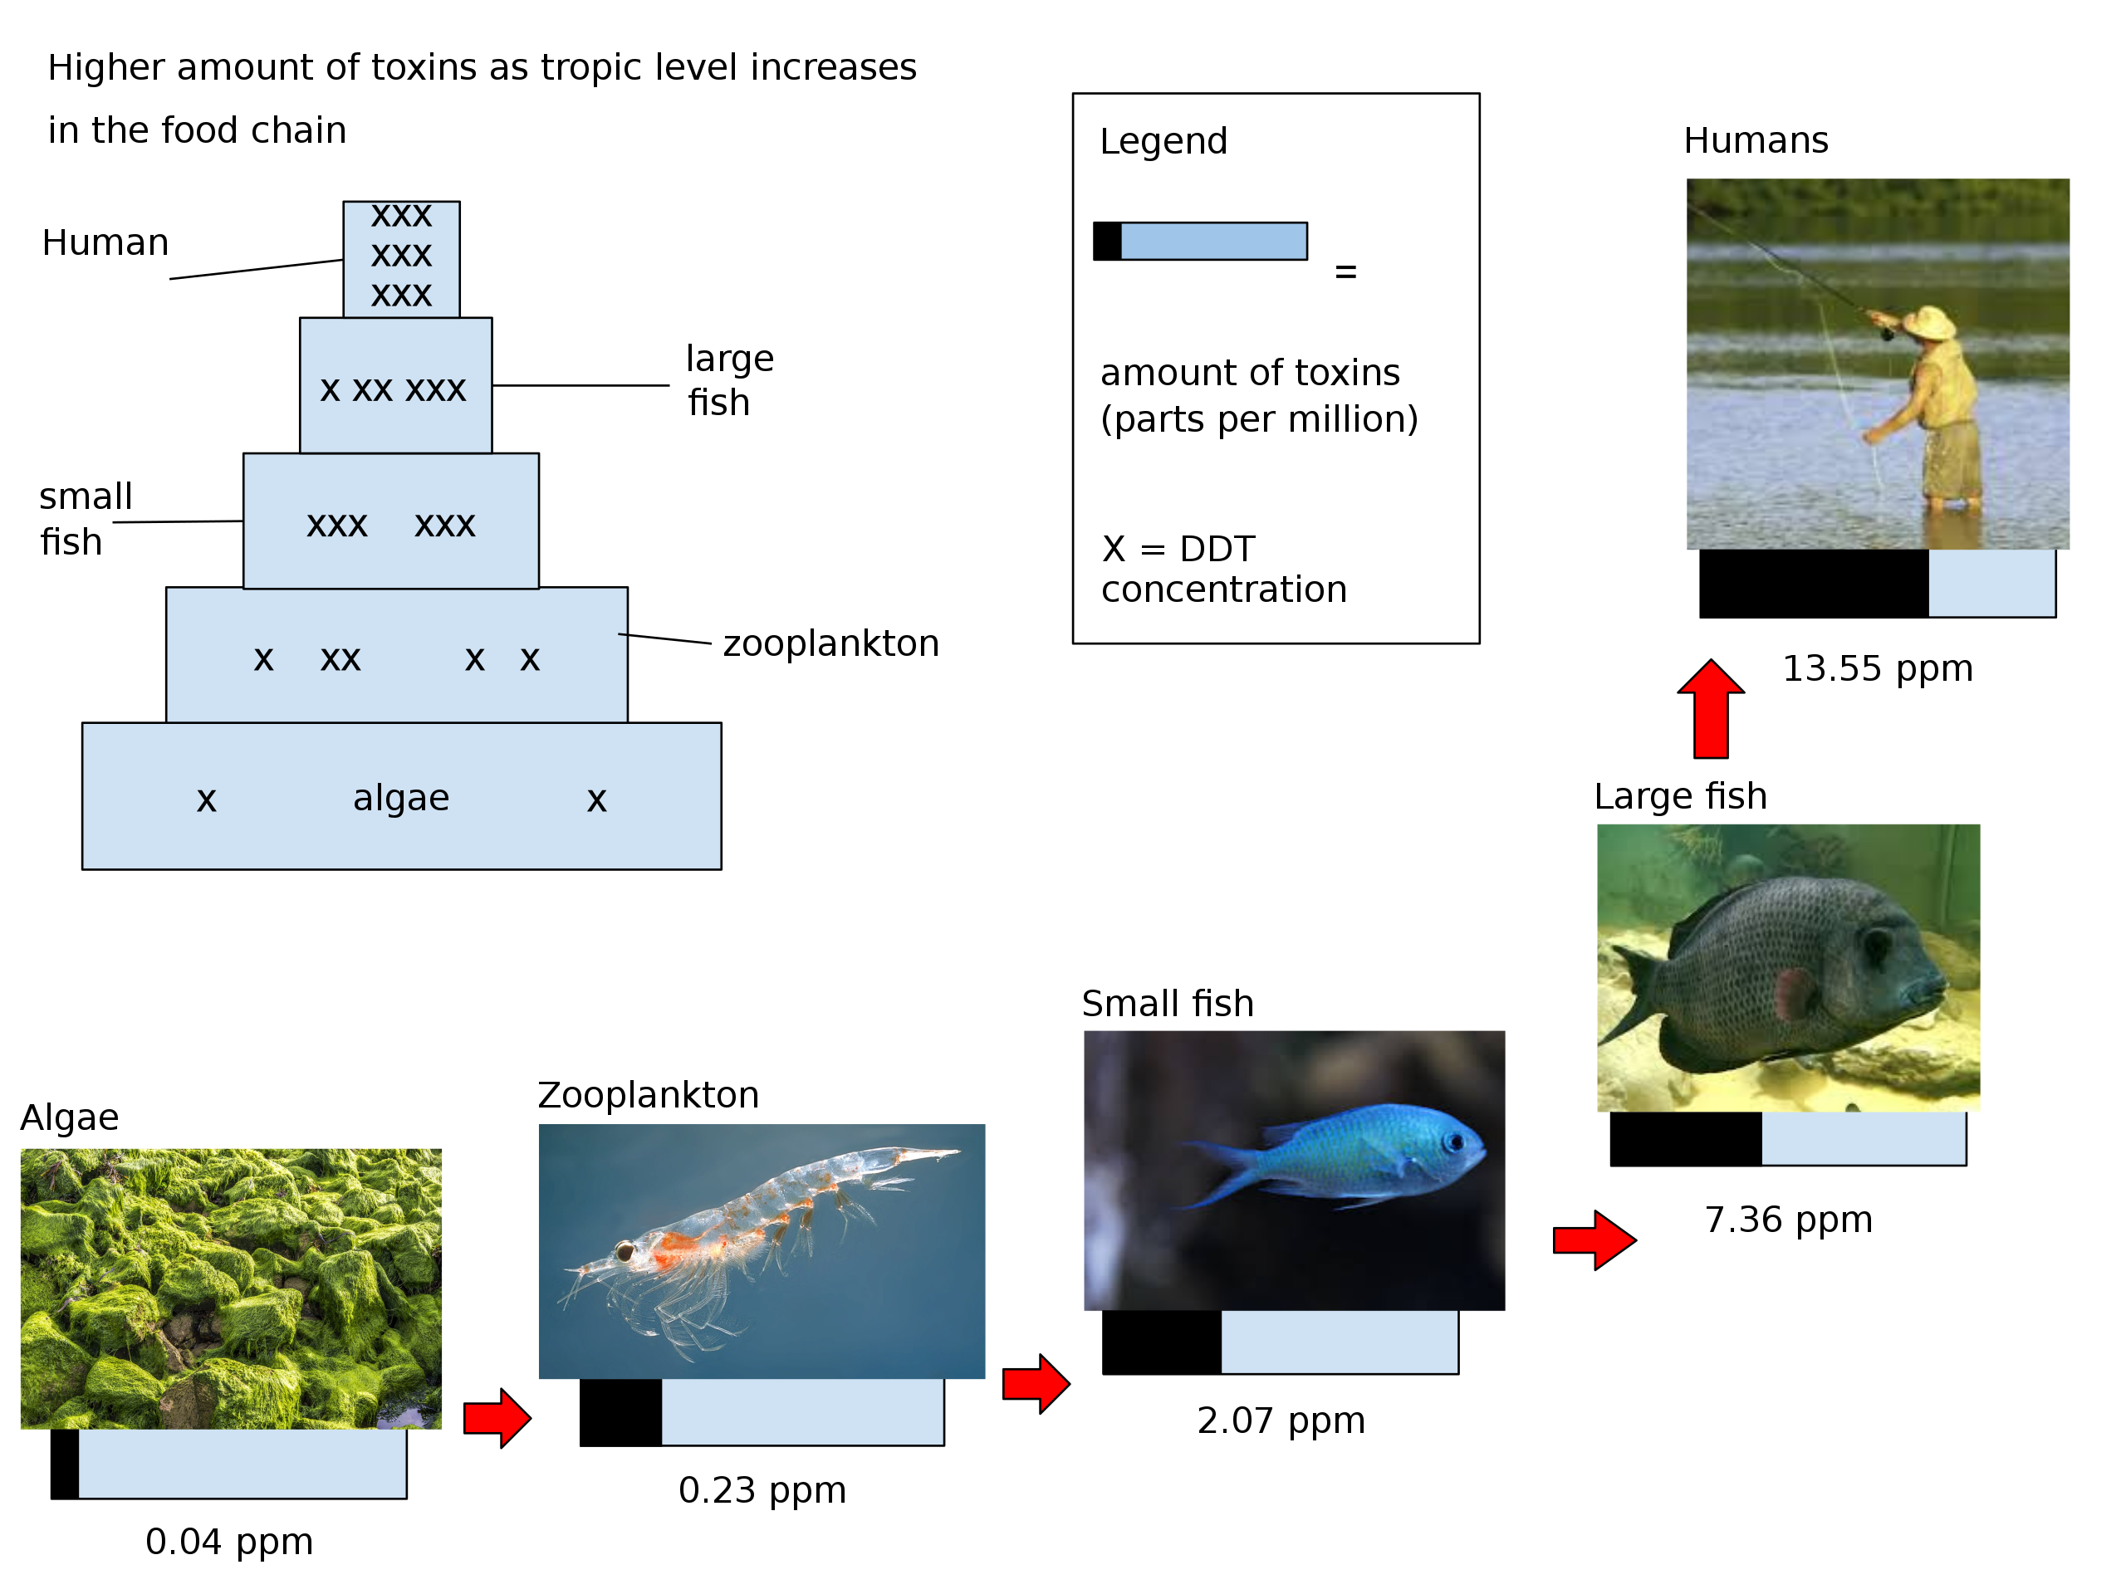
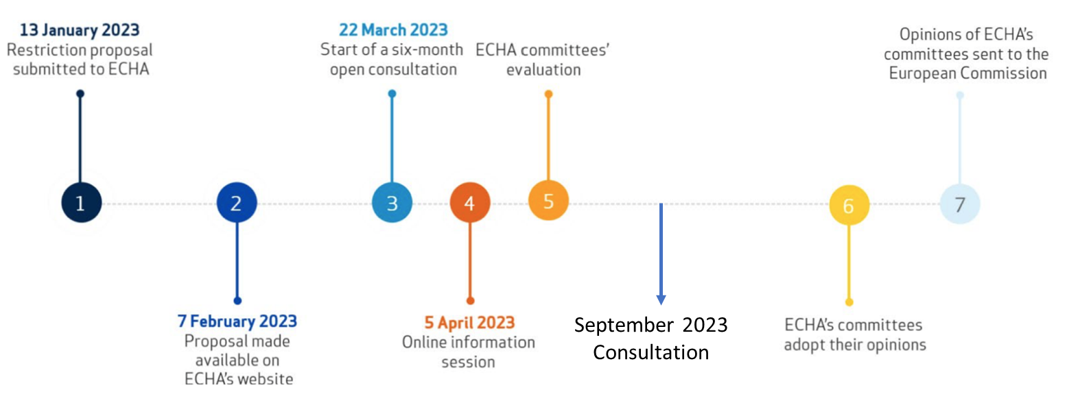
And now: PFAS - “forever chemicals”
PFASs: any chemical with at least a –CF3 group or a–CF2– group (without any H/Cl/Br/I atom attached to it)
PFASs play a key economic role. In 2022, 3M announced that it will end PFAS production by 2025
The restriction was proposed by Germany, Netherlands, Sweden, Denmark and Norway for EU
It aims to be the biggest chemical ban out of health considerations
Imports will be also considered in the restriction
Bioaccumulation and biomagnification

Slide 7
GHG Optimization: CERN Strategies
How to reduce greenhouse gas usage
Optimization of current technologies
Gas Recuperation
Alternative Gases
Gas disposal
Gas recirculation
Membrane separation
Pressure swing
Particular attention to operation
Improved controls and monitoring
Cryogenic/cold separation
GHGs destruction
New eco-friendly gases, HFOs, …
In collaboration with HSE/CEPS

Slide 8
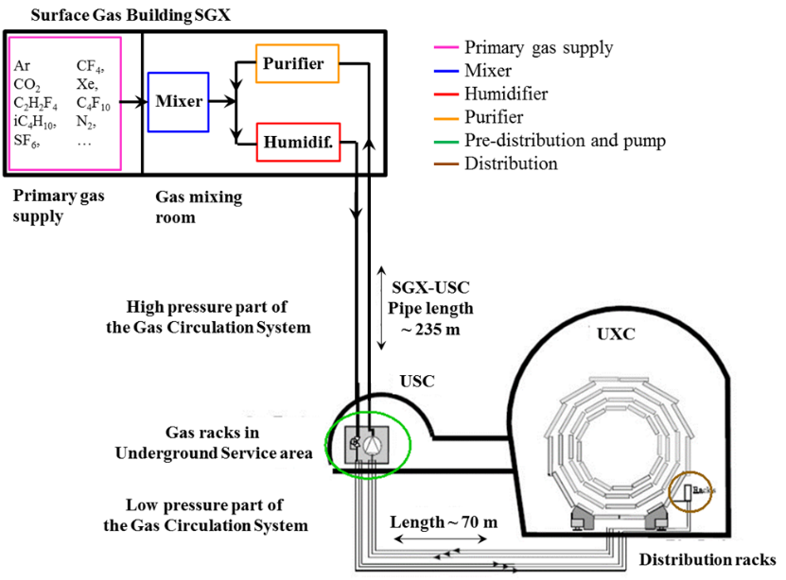
Gas mixture recirculation system
Gas systems extend from the surface building to service balcony on the experiment following a route few hundred meters long.
Primary gas supply point is located in surface building
Gas system distributed in three levels:
  Surface (SG)
  Gas Service room (USC)
  experimental cavern (UXC)
The gas systems were built according to a common standard allowing minimization of manpower and costs for maintenance and operation.
Few numbers:
  Construction started in 2000; Operational since 2005-2006
  Need to validate the gas system components (ageing test setup)
  30 gas systems detectors at the LHC experiments
  300 Universal Euroracks → x2 height of Eiffel Tower
  60 PLCs
  150 MFCs
  4000 flow meters in distribution racks
  ~ 70 gas analysers and 6 gas chromatographers
The CERN gas service team (EP-DT-FS, BE-ICS)
Reliability
  LHC experiments are operational 24/24 7/7
  Gas systems must be available all time
Automation
  Large and complex infrastructure
  Resources for operation
  Repeatability of conditions
Stability
  Detector performance are strictly related with stable conditions (mixture composition, pressures, flows, …)

Slide 9
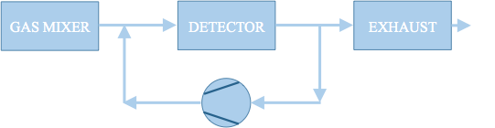
Optimization of current technologies: gas recirculation
All gas systems are designed to recirculate the gas mixture: average 90% gas recirculation → 90% reduction of consumption/emissions
Advantages:
- Reduction of gas consumption
Disadvantages:
- Complex systems
- Constant monitoring (hardware and mixture composition)
- Use of gas purifying techniques
The remaining 10% is what we started to address from LS1. It is needed to compensate for:
  Leaks at detector: 85 % (mainly ATLAS and CMS RPC systems)
  15% N₂ intake (CMS-CSC, LHCb-RICH1, LHCb-RICH2)
Two remaining open mode systems upgraded to gas re-circulations from Run1 to Run2:
ALICE-MTR: from Run1 to Run2: 75% GHG reduction
LHCb-GEM: from Run1 to Run2: 90% GHG reduction
  → For both detector systems: Original investment was totally paid back by gas cost saving during few years of operation
and laboratory setups:
2013: Development of "A portable gas recirculation unit" JINST 12 T10002
2020: Development of Gas recirculation systems for RPC detectors: from LHC experiments to laboratory set-ups - RPC2022

Slide 10
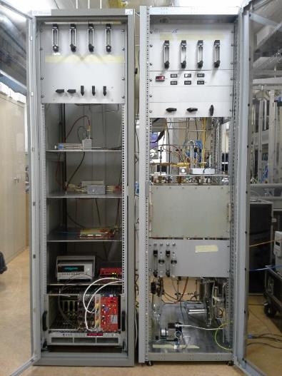
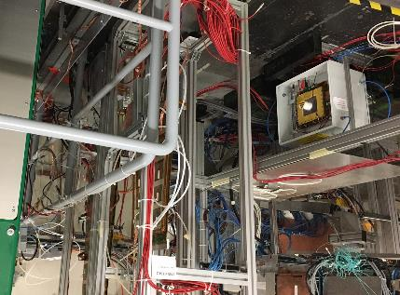
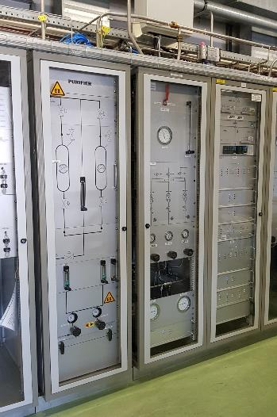
Gas recirculation and “small” detector system: LHCb-GEM example
Mixture: CF₄ 40%, Ar 45%, CO₂ 15%
Detector volume: ~ 50 liters (but very high flow needed) → R&D for operation of GEM detector systems with gas recirculation
2013:
Development of small gas recirculation systems
Started test in lab with radioactive source (GEM never operated in recirculation before)
2016-…:
Validation continued at CERN Gamma Irradiation Facility
2016-…:
LHCb-GEM upgraded to gas recirculation
From Run1 to Run2:
90% GHG reduction
Gas mixture purification studies
"A portable gas recirculation unit" JINST 12 T10002
Original investment already largely paid back by gas cost saving during operation
LHCb-GEM detector operation became more stable thanks to less frequent replacement of CF₄ cylinders
Need to consider longer time scale:
as this example shows also for a small system there can be a positive balance on longer time

Slide 11
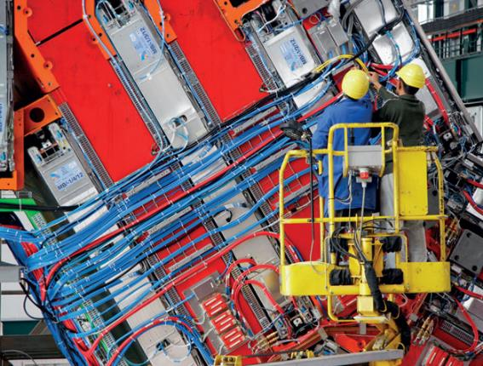
ATLAS and CMS RPC systems
Nowadays GHGs usage for particle detectors @ LHC is dominated by the large ATLAS and CMS RPC systems:
mixture recirculation is already almost at design level (85-90%) and today it is limited by leaks at detector level
Further optimization requires:
Fixing leaks at detector level
  Huge ongoing effort of RPC detector communities (ATLAS and CMS)
  but critical/fragile gas connectors are extremely difficult to access
  Good technical progress
Gas system upgrade to minimize any pressure/flow fluctuation
  Goal: new upgrades to cope with observed fragility of some detector components
  Positive effects already visible at end of Run2:
  Reduced leak developments at start-up
  Pressure regulation improved by 70%
Minimize impact of cavern ventilation (tested in collaboration with EN-CV)
Look for other external causes (vibrations, …)
Detector R&D to validate higher recirculation fraction
Tools to check detector and gas system tightness

Slide 12
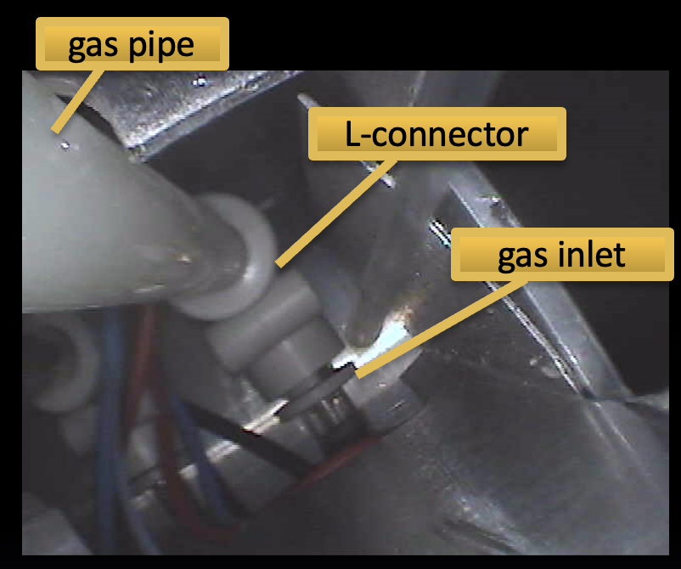
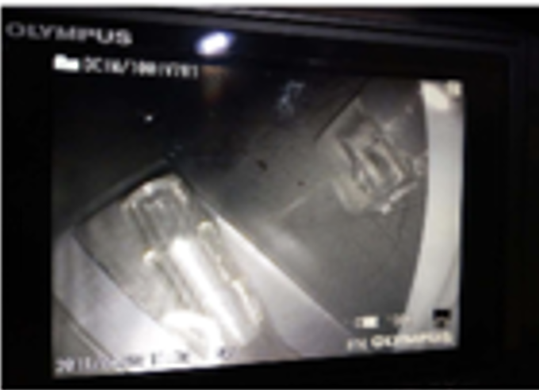
ATLAS and CMS RPC systems
Since Run 1 the ATLAS and CMS RPC systems experience the development of leaks at the chambers level
ATLAS RPC case
Leaks originate at the gas inlets which tend to crack due to inborn fragility
    Aggravated by mechanical and chemical stress
    Cracks develop slowly (over months) until reaching a breaking point
8000 inlets in total, located in couples in 4000 boxes on chamber corners, often with difficult access
    Difficult to localize some types of leaks
Reparation campaign during EYETS and LS
    But new leaks keep developing
CMS RPC case
Two sources of gas leaks appeared at different time scale
    T or L polycarbonate gas connectors break due to original construction fragility in few of them
    Polyethylene LD pipes become brittle/deteriorated
Very difficult (or sometimes impossible) access to reach these connectors and pipes
Reparation campaign during LS
New policy of disconnecting chambers with big leaks (RPC system redundant for CMS trigger)
Avoid plastic pipes
More attention to mechanical coupling of pipes and detectors

Slide 13
GHG Optimization Strategies
How to reduce greenhouse gas usage
Optimization of current technologies
Gas Recuperation
Alternative Gases
Gas disposal
Membrane separation
Pressure swing
Cryogenic/cold separation

Slide 14
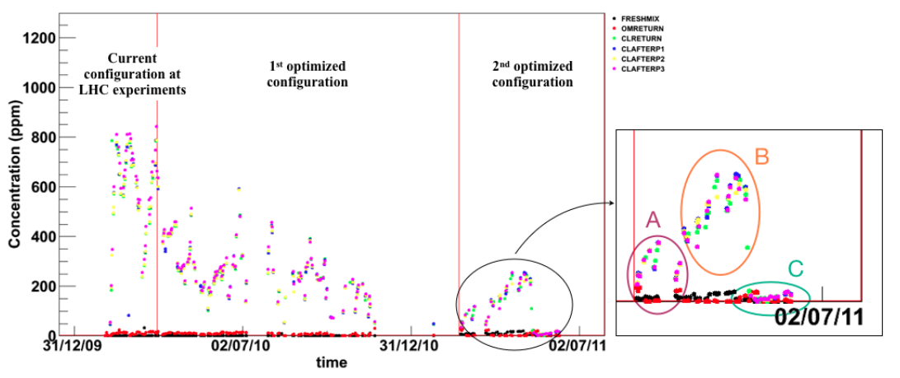
Beyond gas recirculation: why?
Not always the recirculation fraction can be increased easily: two examples
Detector operation validated for ageing up to 90%
  What about recirculating more? (example RPC: only short test performed in the past (2011) up to 97-99%)
N2 intake by diffusion (example: CMS-CSC detector)
RPC: Gas recirculation and impurities in past test
Higher recirculation fraction:
97%
99%
94%
https://pos.sissa.it/159/029/pdf
Need to validate at max recirculation rate the detector operation since the beginning of the R&D phase
Avoid materials permeable to air for the detector construction

Slide 15
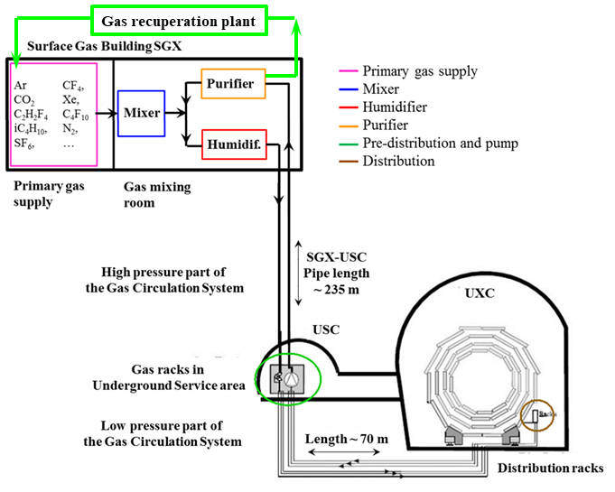
Gas systems and recuperation
Possibility to recuperate a single gas component from exhausted mixture
Many LHC gas systems already with gas recuperation
Advantages:
- Further reduction of gas consumption
Disadvantages:
- Higher level of complexity
- Dedicated R&D
- Gas mixture monitoring fundamental
Ongoing R&D aims in testing the feasibility for new recuperation systems:
  R134a for ALICE-RPC, ATLAS-RPC, CMS-RPC, ALICE-TOF
and substantial improvements of existing systems:
  CF₄ for CMS-CSC, LHCb-RICH2
  C₄F₁₀ for LHCb-RICH1
Recuperation is effective only if leaks at detector level will be reduced
R134a recuperation can drastically decrease GHG consumption
Costs for R134a recuperation system paid back in two years

Slide 16
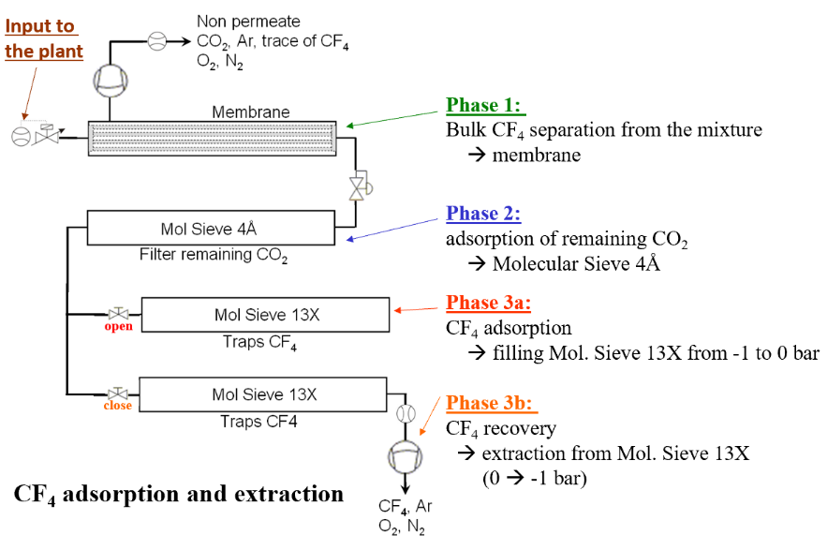
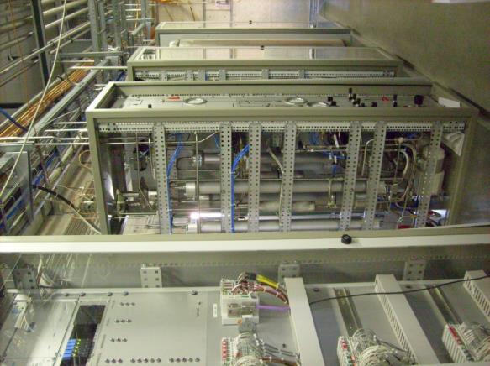
Gas Recuperation: the CF4 case
CMS-CSC CF₄ recuperation plant
Problem:
Too high N₂ concentration for gas recirculation due to diffusion leak from detector components
Technical challenge:
First plant built for CF₄ warm adsorption
A completely non-standard system
From Run1 to Run2
up to 44% GHG reduction
R&D started in 2009, Operation from 2012. Several technical and resource problems
Average efficiency 60-70% reached in 2021 (with additional resources)
If gas recuperation system is needed: fundamental to invest in R&D and resources since the beginning

Slide 17
Gas Recuperation: costs vs benefits
Positive effects – CF4 and R134a examples:
CF4 recuperation for CMS-CSC
10% CF4 in gas mixture ~ 70 l/h ~ 2200 kg/year ~ 100 kCHF/year (at current price)
With 65% or recuperation efficiency
→ 1400 kg/year CF4 saved ~ -60 kCHF/year ~ -10500 tCO2e/year
R134a recuperation for CMS-RPC
95.2% R134a in gas mixture ~ 700 l/h ~ 12t/year ~ 130 kCHF/year (at current price)
With 80% or recuperation efficiency
→ 12 t/year R134a saved ~ -130 kCHF/year ~ -18000 tCO2e/year
allowing to maintain constant operational cost and GHG emissions despite the increase in fresh flow required to cope with the increase of luminosity
Detector operation is less subject to market crisis affecting price and availability.
Indeed, the availability of recuperated gases can mitigate difficult situations when there is a shortage of fresh gas.
In 2022 when there was a major disruption of CF4 availability in Europe: the CMS-CSC detectors could be operated and therefore participate to the CMS data taking only thanks to the usage of recuperated CF4.

Slide 18
GHG Optimization: CERN Strategies
How to reduce greenhouse gas usage
Optimization of current technologies
Gas Recuperation
Alternative Gases
Gas disposal
New eco-friendly gases, HFOs, …

Slide 19
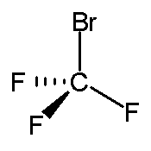
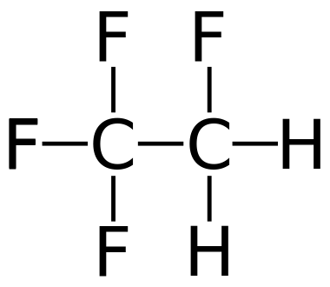
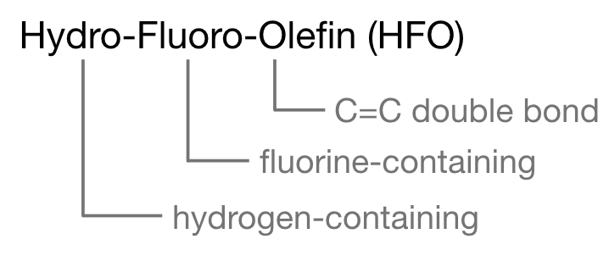
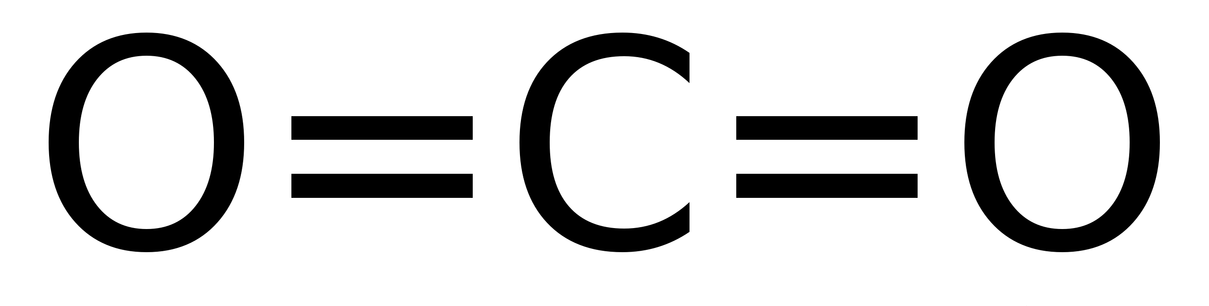
Gases for particle detectors
It is not the first time we are looking for “new” ecofriendly gases…and, probably, not the last
ODP
Ozone Depletion Potential
GHG
Greenhouse gases
“ECO” gases
Natural gases
R13B1
(CBrF3)
GWP 6900 - ODP 10
R134a
(C2H2F4)
GWP 1430 - ODP 0
and
3MTM NovecTM
and
GWP <10 - ODP 0
hydrocarbons
~20-30 years ago, it was the time to get rid of ODP gases
There was not the awareness on the use of GHGs
    Many gaseous detectors were conceived with use of GHGs
Now it is time to address the usage of GHG worldwide, including particle detectors
New concerns are already raising for the use of new “eco-friendly” gases, most of which are PFAS
GWP 1 - ODP 0

Slide 20
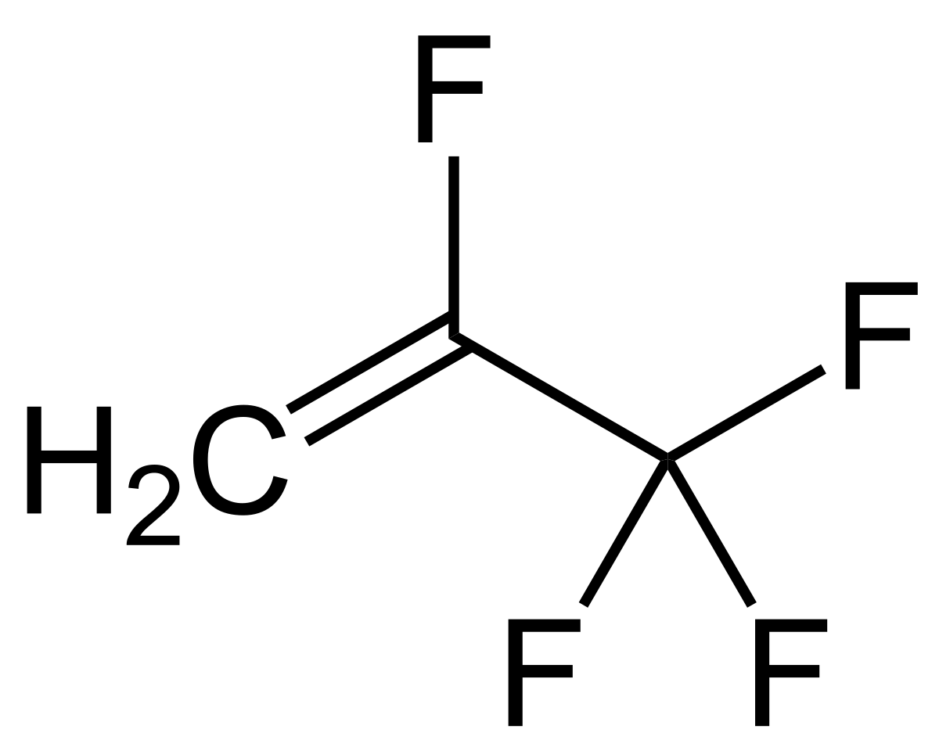
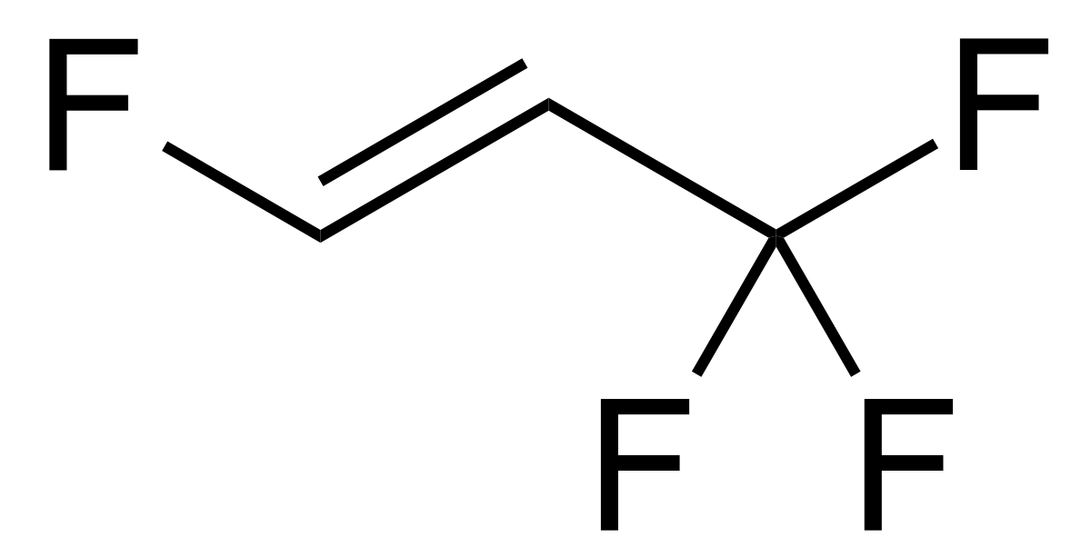
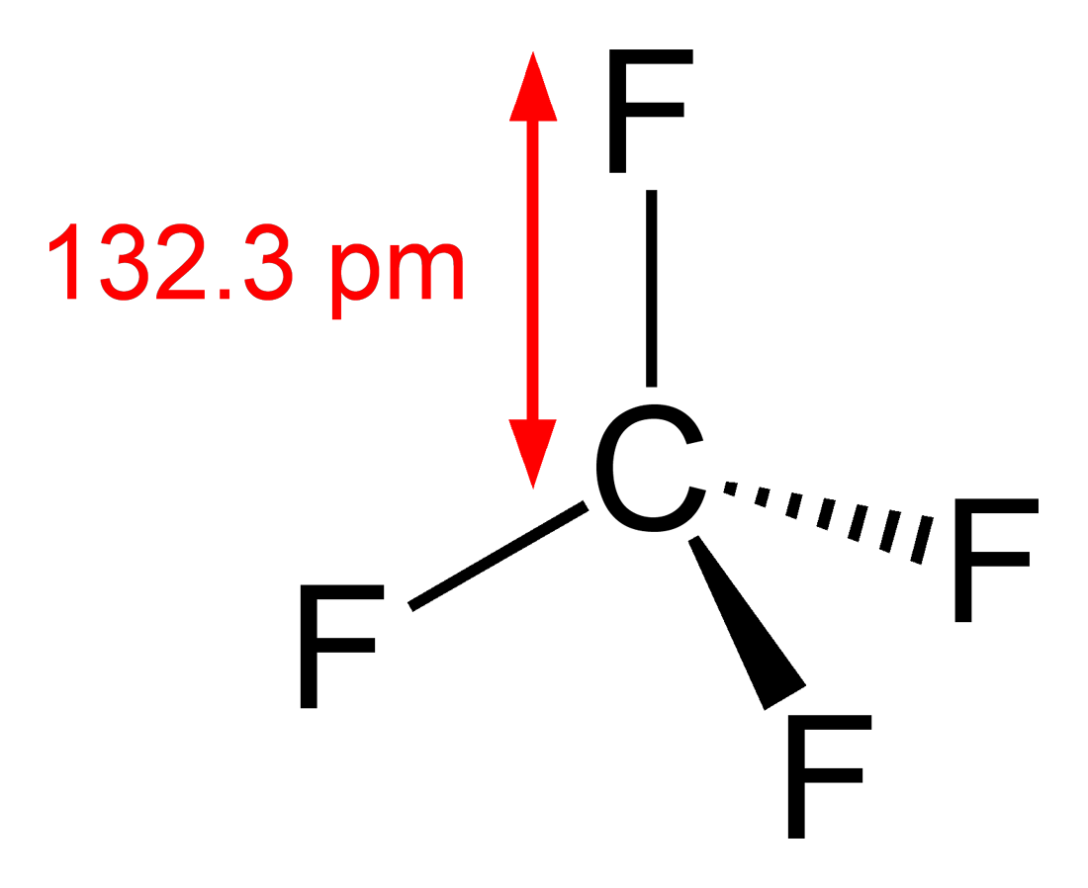
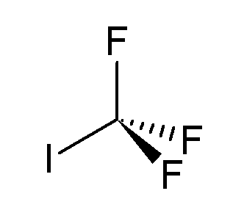
Possible alternatives to GHG gases
New eco-friendly liquids/gases have been developed for industrial applications as refrigerants and HV insulating medium…
→ many gases tested, but not straightforward for detector operation. Best options:
HFO-1234ze
(C3H2F4)
GWP 6
R134a (C2H2F4)
GWP 1430
HFO-1234yf
(C3H2F4)
GWP 4
flammable
?
CF3I
GWP 0.4
toxic
R14 (CF4)
GWP 5700
Very difficult challenge for already installed detectors where it is not possible to change of FEB electronics, HV system, etc
However, in any case to be considered
Long-term operation (to evaluate possible aging issues)
No flammability or toxicity of the gas mixture

Slide 21
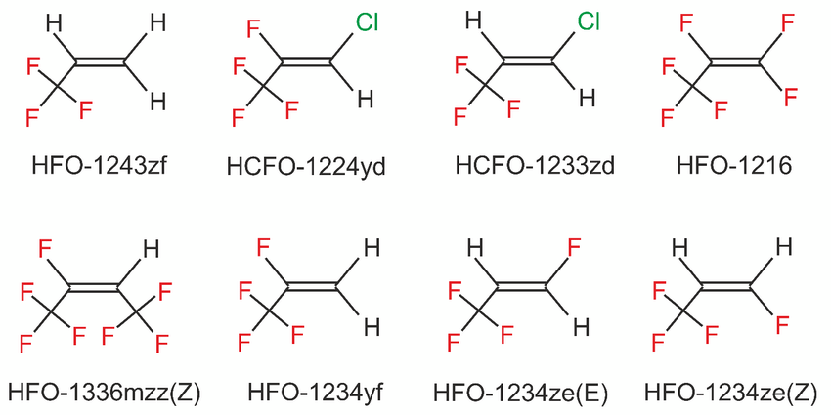
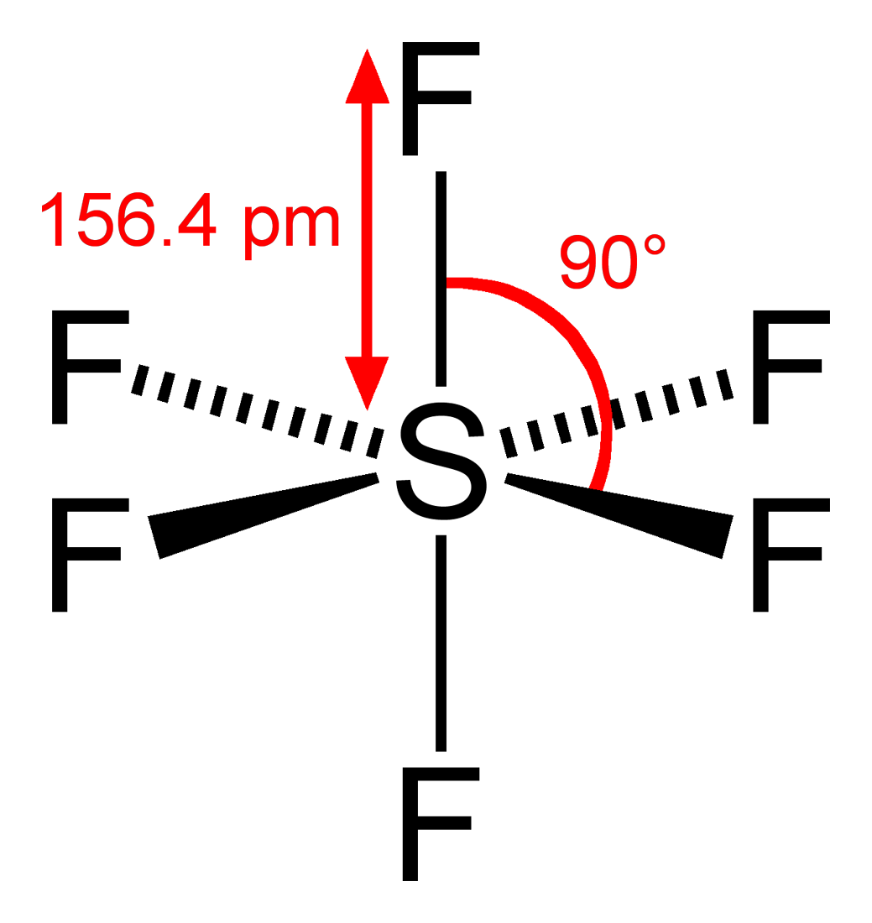
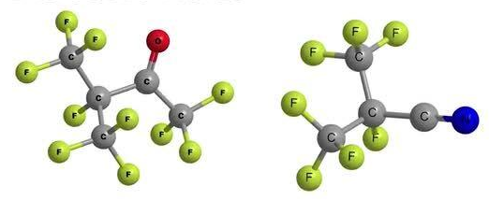
Alternatives for RPC gas mixture: R134a and SF6
~95%
Replacement of R134a with ~30-50% CO2 to lower GHG emissions
Detector performance slightly affected
C2H2F4
GWP 1430
Detector performance affected and long-term effects to investigate
+
From 0.3% up to 7%
“Forever chemicals”
Possible concerns for environment
CF3I
GWP 0.4
SF6
GWP 22800
Very good detector performance, but “reactive” in detector environment
+
3MTM NovecTM 5110
(CF3C(O)CF(CF3)2 )
GWP <1
3MTM NovecTM 4710
((CF₃)₂ CFCN)
GWP 2100
~5% iC4H10

Slide 22
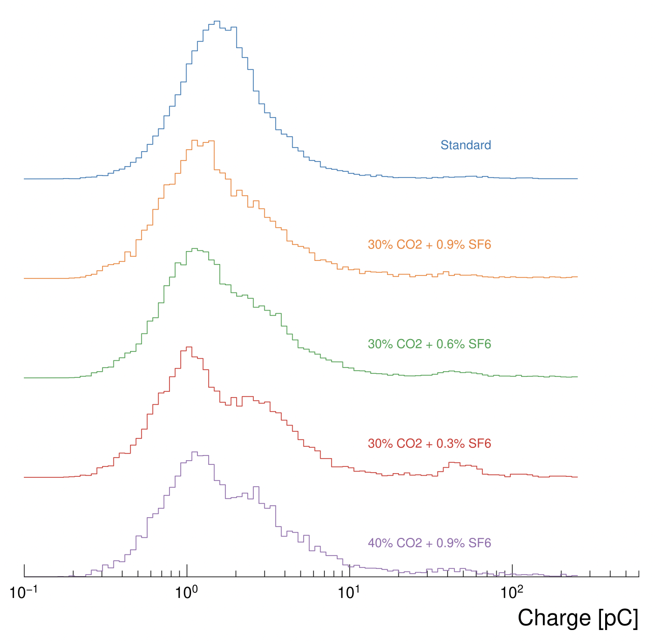
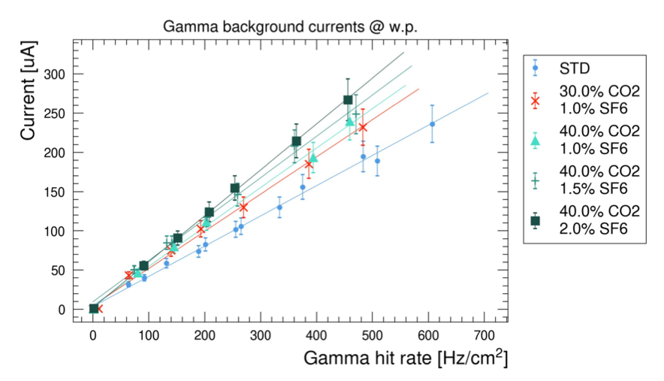
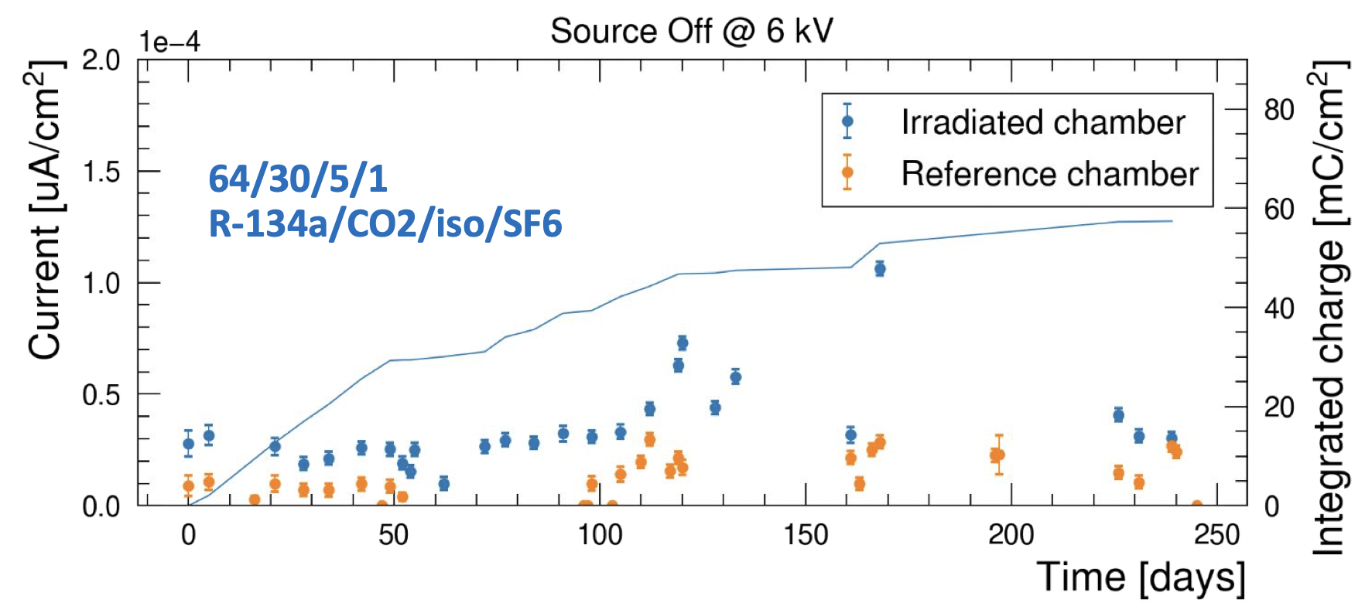
Mid-term solution: addition of CO2 to std gas mix
CO2 as mid-term solution for RPC to mitigate GHG emissions of LHC RPC systems
doi 10.1016/j.nima.2023.168088
CO2 selected as best compromise
    He also good candidate but cannot use in experimental caverns
The addition of CO2 increases the streamer probability and broad the charge distribution
    Necessary to increase the SF6 concentration up to 1%
    Increase of currents of >15% under irradiation
Very good time resolution
    The CO2 reduce the mean free path
Long-term performance studies under gamma irradiation
    Up to now, no sign of performance degradation
Already in use in ATLAS RPC system since summer 2023

Slide 23
Mid-term solution: addition of CO2 to std gas mix
Positive effects:
Replacement of 30% R134a with CO2 brings a reduction of 14% of the tCO2eq emitted per year
mixture | GWP | tCO2e/year
R134a+iC4H10+SF6 | 1482 | 52373
CO2+R134a+iC4H10+SF6 | 1529 | 44784
 |  | -14%
In addition, the operational cost is lower
mixture | R134a used (kg/m3 gas mix) | SF6 used (kg/m3 gas mix)
R134a+iC4H10+SF6 | 4.3 | 0.02
CO2+R134a+iC4H10+SF6 | 2.91 | 0.065
 | -11 t/year | +356 kg/year
 | -115 kCHF | +13 kCHF | -102 kCHF/year -29% 1 year with std+CO2 mix ~ 250 kCHF
and detector operation is less subject to market crisis affecting price and availability

Slide 24
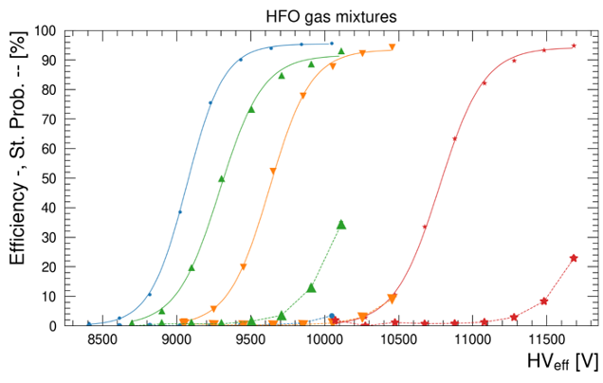
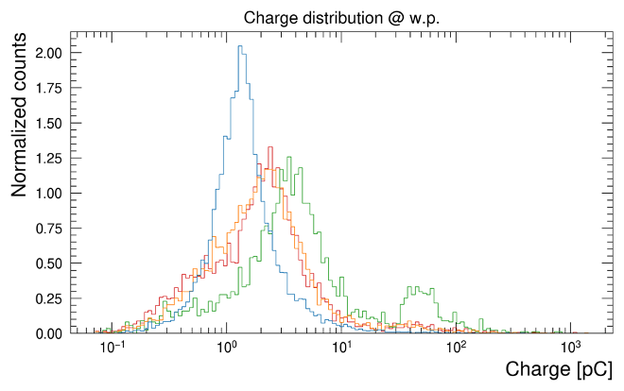
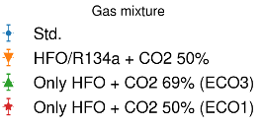
Use of HFO in RPC detectors
HFO1234ze identified as possible replacement of R134a
Cannot replace 1:1 the R134a
    Too high w.p.: add He or CO2 to lower it
    The HFO and CO2 move the charge distribution towards higher values
    Currents increase seems to be dominated by the CO2
HFO brings a higher prompt charge content than R134a
The addition R-134a helps lowering the background currents and prevent w.p. to be too high
+2 kV
45% HFO + CO2
25% HFO + CO2
22 % HFO + 22% R134a + CO2
R-1234ze performance with CO2 (+ R-134a) with cosmic muons
45% HFO + CO2 (ECO1)
    Too high w.p. and high charge
25% HFO + CO2 (ECO3)
    Low GWP
    High charge content and presence of streamers. Higher currents
22% HFO + 22% R134a+ CO2
    Higher GWP
    Lower charge content than HFO only
    Possible compromise between performance and environment

Slide 25
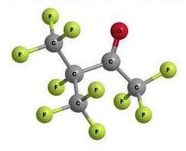
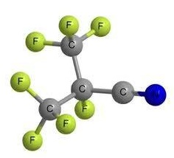
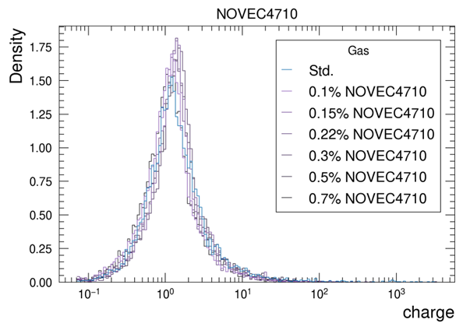
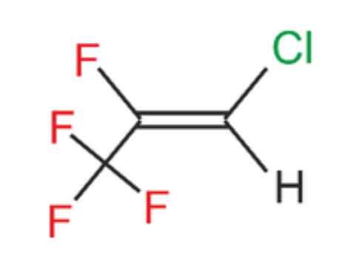
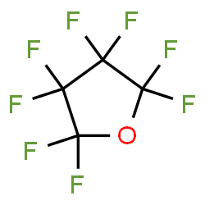
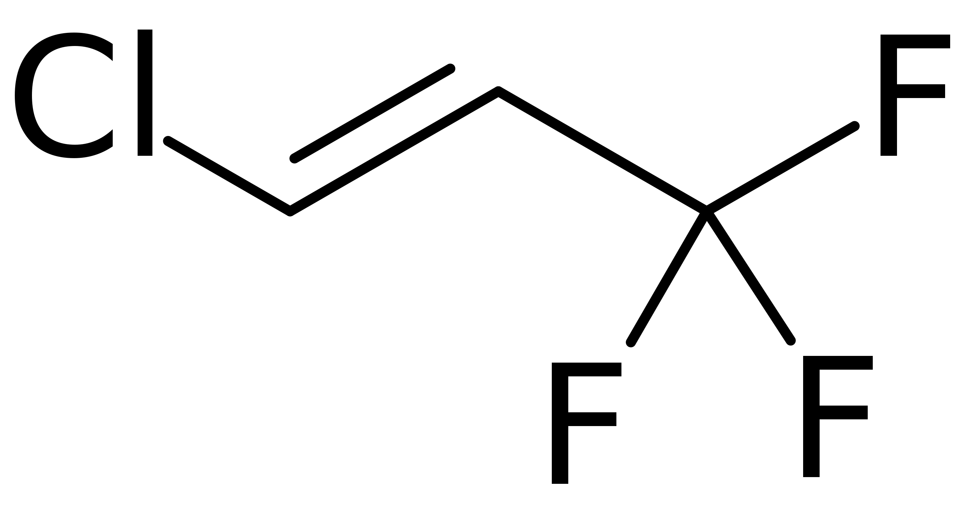
Alternatives to SF6
10 F
7 F
Scrivi good/bad
6 F
3MTM NovecTM 5110
(CF₃C(O)CF(CF₃)₂ )
GWP <1 - Atm. lifetime 15 days
High boiling point: 27 C
Sensitive to UV radiation
Higher HV working point
Not very good performance
3MTM NovecTM 4710
((CF₃)₂ CFCN)
GWP 2100 - Atm. lifetime 30 years
Good performance, but it may react with H2O
SF6
GWP 23900
3-4 F
8 F
3 F
Chemical inertness: extremely stable
Exceptionally long lived in the atmosphere
Excellent dielectric property
  SF6 x 2.5 than Air
Non-flammable and toxic
Gaseous form
No major reactions
  Ok with H2O, Cl and acids
>1.5% needed
No gain in GWP
toxic
AMOLEATM HFO-1224yd
(CF3-CF=CHCl)
GWP <1 - Atm. lifetime 20 days
CF3I
GWP 0.4
Atm. lifetime 6 days
C4F8O
GWP 8700
Atm. lifetime >3000 years
Good performance.
Presence of Cl (aging test mandatory)

Slide 26
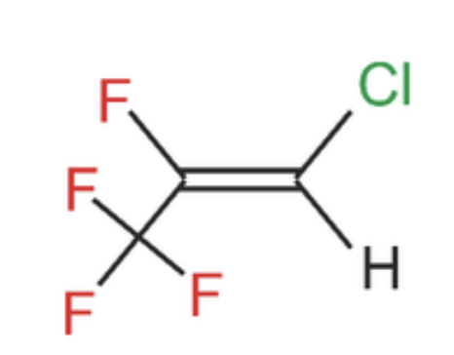
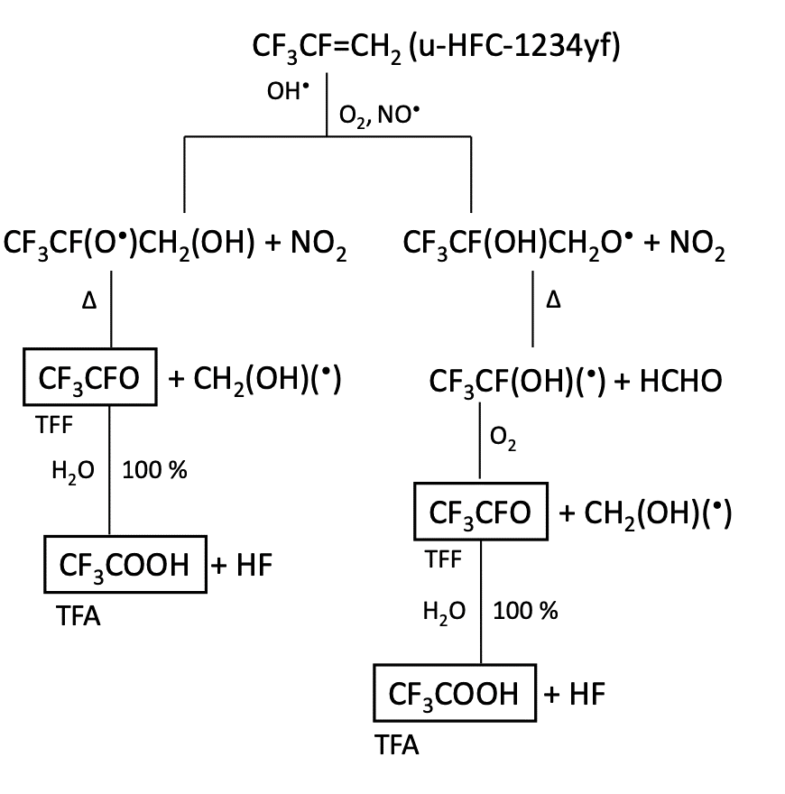
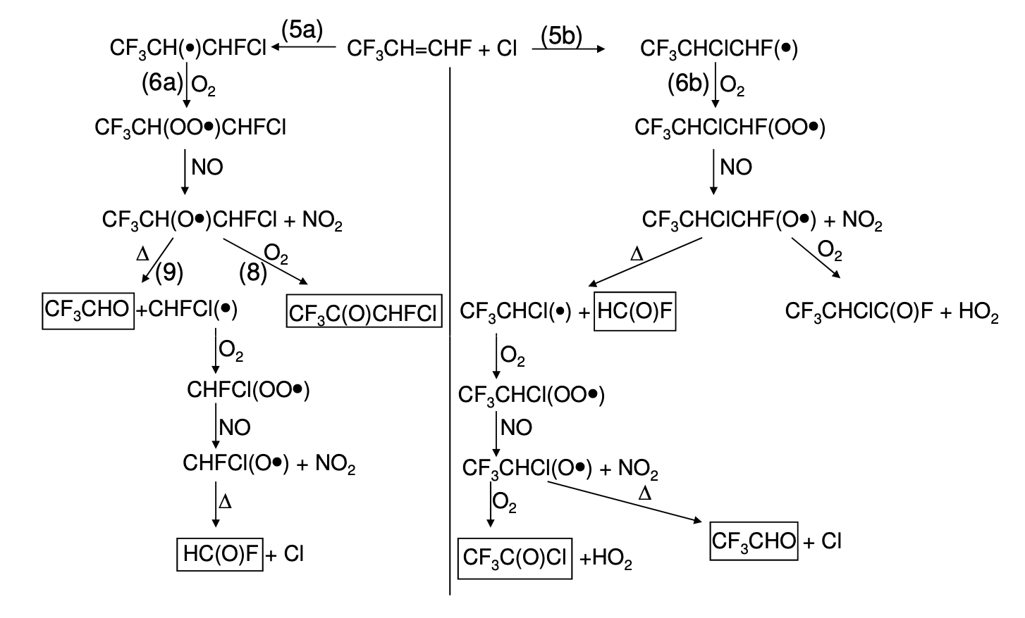
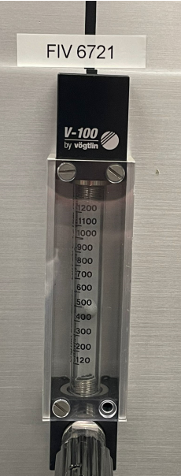
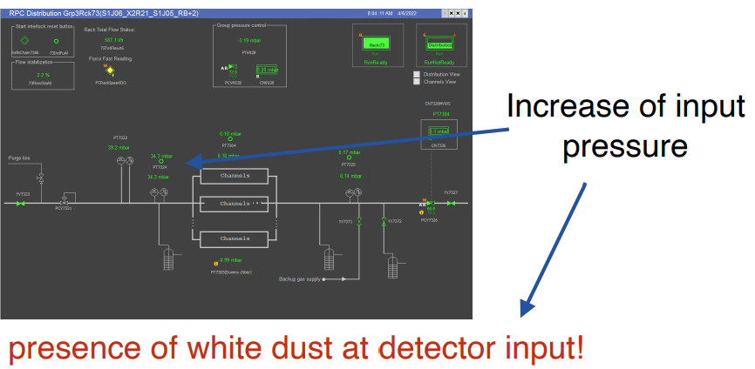
Not only detector performances….
Two factors identify the greenhouse gases and their effects on climate:
the radiative efficiency and lifetime in the atmosphere
The lower are the GWP and the lifetime, the easier is the creation of sub-products
HFO-1224yd
Degradation products:
TFA, CO2, HF, HCl
Do these sub-products have an impact on detector lifetime?
Three factors determine the atmospheric lifetime
Rain out
Water solubility
Oxidation
Reactivity with OH
Photolysis
UV absorbance
Hydrofluoric Acid (HF)
HFO produces much more HF than R134a in RPC detectors
Observation with ppm of HCFC
(importance of long-term validation tests):
Trifluoroacetic acid (TFA)
HFO1234ze is estimated to break down into TFA at less than 10%, whereas R-1234yf will break down into TFA at 100% (R134a at 21%)
TFA highly soluble: no formation of insoluble salts
Phytotoxic

Slide 27

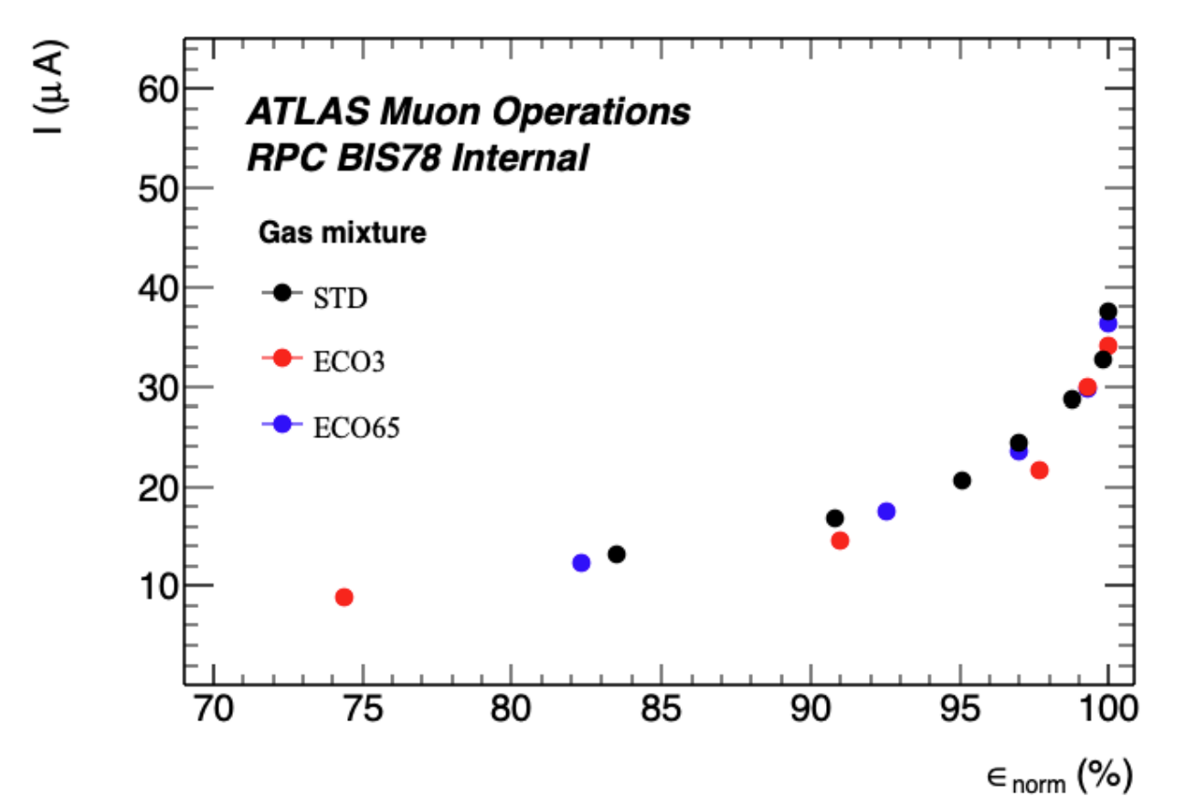
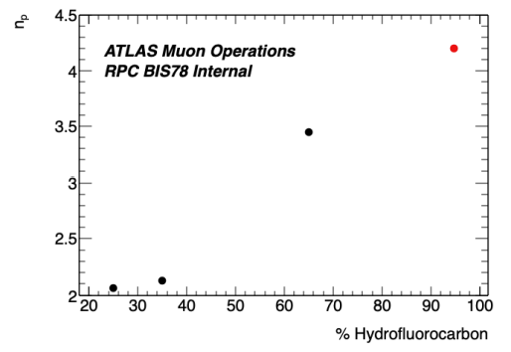
ATLAS and CMS - RPC upgrade programs: new detectors & FEB
New detectors for upgrades (ATLAS-BIS/BI)
Mixtures from ECOGAS@GIF
collaboration:
Triplet (3 single gaps; 1 mm gas gap)
Very effective Faraday cage allowing to operate with low noise and trigger on 2/3 coincidence
New FEB with new chip:
  Low noise
  Allowing threshold as low as 1 fC
→ from 30 to 3 pC per photon count
      Increased rate capability (x10)
      Low ageing (÷10)
3 independent singlets providing 3D+time
Combined σ_{t} 160 ps
ABS=22
Std mix
< 𝑛𝑝 >= 𝑙og(1/(1 − 𝜖))
New detectors for upgrades (CMS-iRPC)
double gap (1.4 mm gas gap)
new FEB:
  PETIROC2C re-designed
  Threshold < 50 fC
  TDC σt 20 ps
  TDC and detector σt ~ 160 ps
    → position resolution of ~1.6 cm
From:
CERN EP Seminar: Summary of RPC workshop
RPC 2022 workshop: Overview:
Exploring the performance limits of the new generation of ATLAS RPCs
XVI Workshop on Resistive PlaCMS iRPC FEB development and validation

Slide 28


Not only RPC: Possible CF4 and C₄F₁₀ replacements
CF4 is used in different types of particle detectors to prevent aging, to enhance time resolution or because of its scintillation photon emission
CMS CSC studies
(K. Kuznetsova)
CF4 is a source of fluorine radicals to protect against anode ageing
  Now 10% CF4 in CSC gas mixture
Two possibile approaches to reduce GHG consumption (beyond the recirculation and recuperation systems)
  Decrease the CF4 concentration: preliminary results show that 5% could be safe for operation
  CF3I and HFO1234ze not best candidates
  Look for other alternatives to CF4 on-going
LHCb RICH studies
(S. Easo and O. Ullaland)
RICH detectors use either CF4 or C4F10
  Necessary for good refractive index
Replacement of C4F10 with C4H10
  Refractive index matches very well
  But C4H10 flammable
Replacement of CF4 with CO2
  Under investigation
Use of SiPM to reduce the chromatic error and increase the yield

Slide 29
GHG Optimization: CERN Strategies
How to reduce greenhouse gas usage
Optimization of current technologies
Gas Recuperation
Alternative Gases
Gas disposal
GHGs destruction
New eco-friendly gases, HFOs, …
Membrane separation
Pressure swing
Cryogenic/cold separation
Gas recirculation
Particular attention to operation
Improved controls and monitoring

Slide 30
GHG abatement system
Industrial system able to destroy GHGs avoiding their emission into the atmosphere have been considered.
Abatement plants are employed when GHG are polluted and therefore not reusable.
Very high costs if compared with recirculation and recuperation plants.
Found also companies available to take PFC/HFC based mixture for disposal, but extremely expensive.
In addition, the GHGs disposal is not helping in the current market situation where availability decreases and price increase.
On the contrary, the advantages of gas recuperation plants are going beyond the reduction of GHG emissions and the economical aspects:
the availability of recuperated gases can mitigate difficult situations when there is a shortage of fresh gas.
In 2022 when there was a major disruption of CF4 availability in Europe: the CMS-CSC detectors could be operated and therefore participate to the CMS data taking only thanks to the usage of recuperated CF4.

Slide 31
Conclusions
GHGs usage in particle detectors
F-gas regulation
Due to the environmental risk, “F-gas regulations” started to limit the GHGs usage and requiring recovery, proper servicing to prevent emission (EU case)
availability and price are today critical for old F-gases
Detector design
It is fundamental to look not only at detector performance but also at the infrastructure
New generation detectors should limit the risk of developing leaks
If detectors are tight, gas consumption can be limited thanks to gas recirculation and recuperation plants (useful not only for GHGs but also for any expensive gases)
Strategies for GHG usage optimization
Optimization of current technologies
Particular attention to gas system and detector operation
Gas systems upgrade beyond original design
Improved/higher gas recirculation

Slide 32

Conclusions
Gas recuperation plant
Gas recuperation will be effective only if leaks at detector level will be reduced
R&D costs for R134a recuperation system is well justified by running costs
R134a recuperation prototype0 is more complicated than expected but showed good performance:
  ~ 80% recuperation efficiency and good gas quality
Consolidation of existing plants (CF4, C4F10) ongoing:
  CMS-CSC-CF4 recuperation efficiency increased to 70%
  LHCb-RICH2-CF4 installed
  LHCb-RICH1-C4F10 design ongoing
New eco-gases
New low-GWP gases can easily break
  Sensitive to UV, humidity and oxidation
  HF, TFA sub-products are produced and their effects on long-term operation need to be evaluated
Missing cross-section to perform simulation studies
  Dedicated measurements needed
R-1234ze, NOVEC, … are currently the main fluorinated alternative but:
  For 2 mm gas gap RPC, the addition of a 4th mixture components (CO2, ?) is needed to maintain reasonable HV working point
  availability and price are still a matter of concern
  long term operation in high radiation environment to be studied
New generation detectors and electronics seems to be more compatible with new eco-friendly gases than old-generation 2 mm gas gap RPC
  Upgrades for LHC experiments (ATLAS and CMS RPC Phase2 upgrades)
Recuperation of R134a can drastically decrease GHG consumption

Slide 33
Conclusions
GHGs abatement/disposal
Commercial systems exist. Adopted when gases cannot be reused.
Heavy infrastructures required (CH4+O2 supply, Wastewater treatment)
Since availability/price can become a real problem in the future it is better to optimize consumption
Destruction in external companies: more expensive than Gas abatement system.
Additional challenge: finding right profile for resources for R&D and new recuperation plants operation:
Chemist, industrial chemistry engineer, engineer, physicist
Right level of resources should be allocated to GHGs related activities since the beginning (detector and infrastructures design phase)

Slide 35

GHG emissions: a comparison
Run 2 emissions from F-gases ~ 130 000 tCO2e
Geneva emissions 2019 ~ 2 650 000 tCO2
Switzerland emissions 2018 ~ 39 637 007 tCO2e
CERN contribution ~ 5% of Geneva, 0.3 % of Switzerland GHG emissions
https://www.epa.gov/energy/greenhouse-gas-equivalencies-calculator

Slide 36


Optimization of gas consumption
gas recuperation improvement:
CF₄: CMS-CSC
gas recirculation increased:
ALICE-RPC
LHCb-GEM
Today optimization challenge
gas recirculation:
ALICE-RPC
LHCb-GEM
run optimization:
LHCb-RICH1
LHCb-RICH2
gas recirculation for most detectors (gas systems design, 2000):
90% optimization => 90% reduction
gas recuperation:
CF₄: CMS-CSC
LHC-LS1
LHC-LS2

Slide 37
GHG abatement system
Industrial system able to destroy GHGs avoiding their emission into the atmosphere have been considered
Abatement plants are employed when GHG are polluted and therefore not reusable.
However, PFCs are stable and difficult to abate
Carbon‐fluorine bond is the fourth strongest single bond
  Multiple C‐F bonds on the same carbon enhance stability
  C‐C or C‐H bonds are weaker and decrease stability
  S‐F bond is strong too
Stability is reflected in atmospheric lifetimes
Stability is closely related to ease of abatement
Fluorinated gas lifetime in atmosphere (years)
CF4 | 50000
C2F6 | 10000
SF6 | 3200
C3F8 | 2600
c‐C4F8 | 3200
NF3 | 740
CHF3 | 270
C2H2F4 | 14
CH2F2 | 5

Slide 38

GHG abatement system
Reaction of CF₄ to CO₂ and HF is very exothermic, but also requires a big push to break the very strong C‐F bonds
-This is why CF₄ abatement is so difficult
-Actual reaction is much more complicated than shown
Burn‐wet is the primary POU (point of use) abatement technology
Huge quantities of
O₂ and CH₄
needed to overcome E_{A}
Some 100 m³/day needed
Final product is HF!
One liter of CF₄ generates 4 liters of HF
Water treatment plant required!
Some m³/day wastewater produced
Small commercial systems for burn-wet exist but require heavy infrastructures:
CH₄+O₂ supply
Waste water treatment

Slide 39



GHG abatement system
Industrial system able to destroy GHGs: two options considered
Approximative cost of burner system: 130 kCHF

Slide 40

GHG abatement system
Waste water treatment plant
Sewage resulting from operation are compressed for disposal
Approximative cost of wastewater treatment system:
500 kCHF
The EnviroChemie “STEP” wastewater treatment plant
One already in operation at CERN and similar to what we would need

Slide 41
Economic analysis: recovery vs abatement
 | Recovery systems |  |  | Abatement systems
gas potentially recovered (2012 -2025) | R134a (kg) | SF6 (kg) | CF4 (kg) | R134a (kg) | SF6 (kg) | CF4 (kg)
Beginning of operation | 2023 | ~2025 | 2012
 | 17200 | 96 | 6505 | 0 | 0 | 0
Money saved from gas recovered (kCHF) (2012 -2025) | ~500 |  |  | 0
Money spent for construction – CAPEX (kCHF) | 525 |  |  | 617
M&O (kCHF/year) | 15 |  |  | 16
Manpower (kCHF/year) | 60 |  |  | 84
Emissions (tCO2eq/year) | 39114 |  |  | 2600

