Slide 1
Involvement of QTI, OQI and IT dpt in the
24/25 Public Events season
19 June 2024
Indico

Slide 2
Agenda
Overview of key priorities and needs for QTI, OQI and IT dpt In terms of events
Introduction to the Public Event 24/25 season
    Plugging into the season (regular events)
    Other events to consider
    Focus on Sparks! 2025
Public event communication strategy: collaboration
Defining next steps

Slide 3
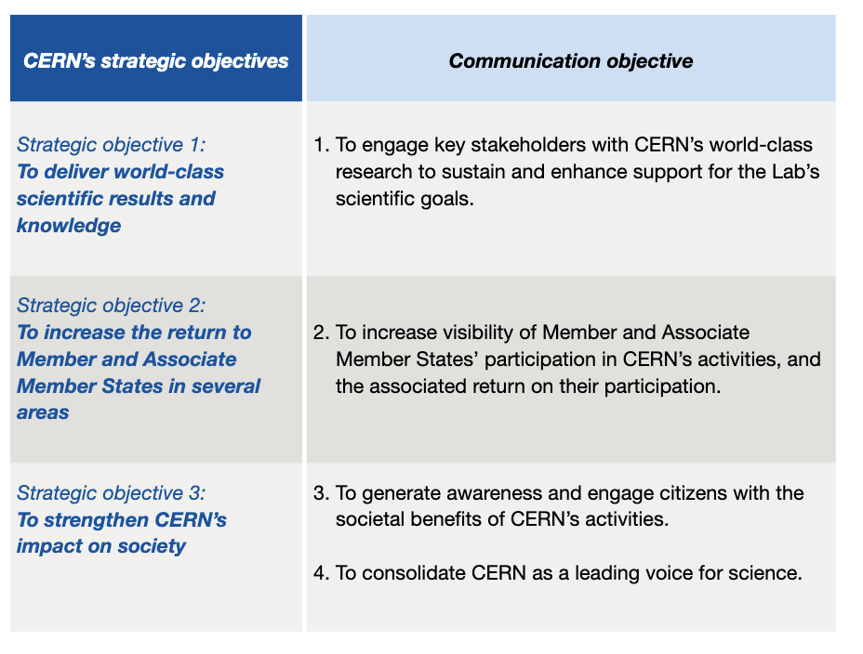
Overview of key priorities and needs for QTI, OQI and IT dpt In terms of events
QTI, OQI and IT dpt outreach priorities
Strategic event curation
Contribution to CERN communication objectives
Your input:
Collaborations and partnerships to highlight / Core and emerging themes to focus on / Speakers /
Event synergies / Communication alignment / Help with promotion (targeted audience)

Slide 4

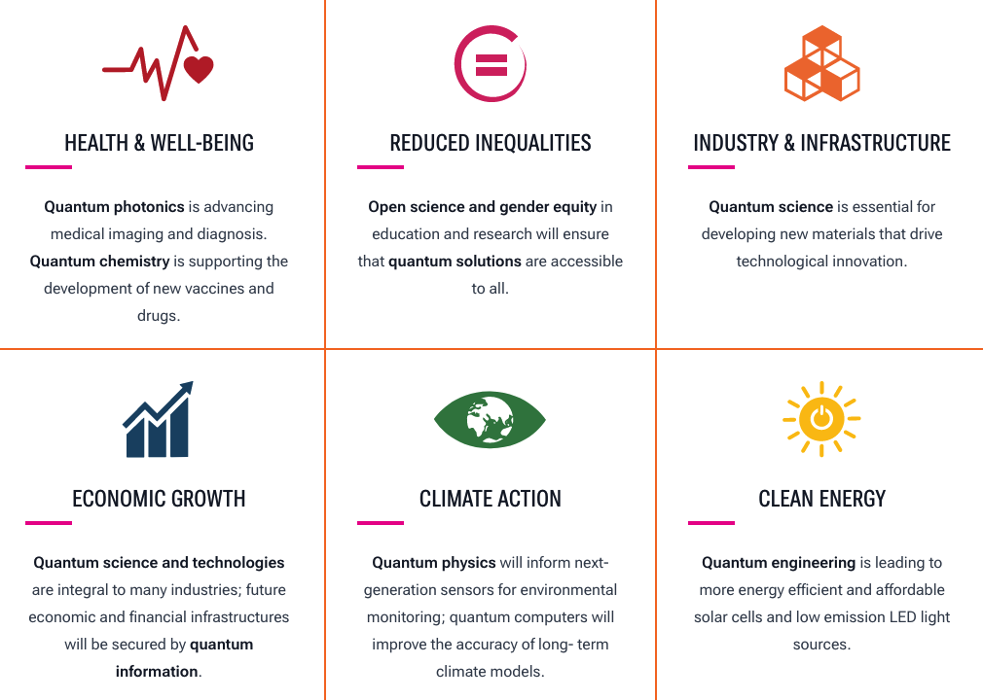
Theme for the 2024/25 season – Quantum Science
Formally proclaimed by the U.N. on June 7 2024
Year-long, worldwide initiative to increase public awareness of the importance of quantum science and applications.
https://quantum2025.org/

Slide 5
Event Overview
Year | Event | Date | Type | Link with Quantum | Your input suggestions?
2024 | Dark Matter Day | Oct-31 | Talk | Yes | Speaker(s) Collaboration with students
 | Danser avec l’évolution | Nov-19 | Performance / Talk | No | tbd
 | Bell Theorem Event | December | Talk | Yes | Speaker(s)
2025 | Arts & Science Summit | Feb-05 | Talk | tbc | Artist
 | De Temps en Temps (Int. day of Women & Girls in Science) | Feb-11 | Performance | tbc | Speaker
 | Les Dieux et le Père Noel: Vers une solution quantique | March | Performance | Yes | promotion
 | Cine Globe | May | Film festival | tbc
 | Sparks! | June | Talk | Yes | Sub-themes Collaborations/partnerships to highlight Speakers

Slide 6

Sparks! 2025
Date: May/June 2025
Theme: Quantum Science (incl. ethical, social, political aspect)
Format:
Public event
Workshops
Networking sessions
Your input:
Sub-themes
Collaborations/partnerships to highlight
Speakers

Slide 7
Other events to consider?
Events/ conferences organise by QTI, OQI and IT dpt
Events on Quantum in the region

Slide 8
Communication strategy
Our missions
Inspired by science & technology, create high-quality educative and entertaining events
Plan and organise a thematic season of public events
Connect the dots with peers from science, arts & wider society
Promote inclusiveness and diversity through these events

Slide 9
Communication strategy
Communication channels
- CERN websites (ex. visit.cern., voisins.cern)
Public events newsletter
CERN social media
University/personal invitations
Posters at CERN and in Geneva
Screens in SGW, R1, R2
Agendas on local websites
TPG
Press release
Radio, TV, podcasts
… and partners
CERN Society Foundation
Arts at CERN
KT
IPPOG/EPPCN
Alumni
Ideasquare
IT, QTI, OQI

Slide 10
Suggested next steps
Share core and emerging themes
Share communication plan
Communicate your events and ones of the region
Identify a pool of speakers (internal & external)
Highlight key partnerships & cooperation

