Slide 1
DRD4 Collaboration meeting WP 4.4 – Time-of-Flight Detectors session
Jon Lapington – WP Lead
Eugenio Nappi – WP Deputy Lead

Slide 2
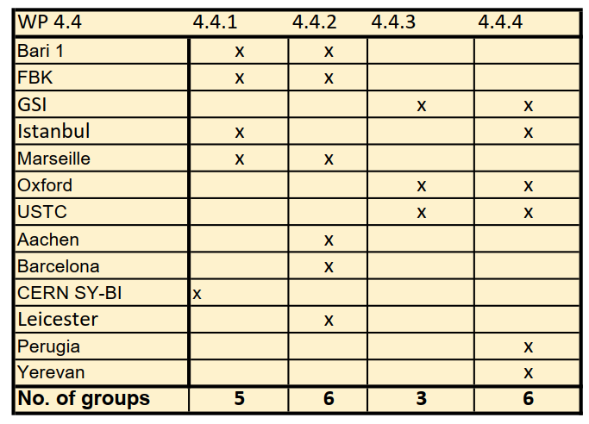
WP4.4 Participants
13 groups initially expressed interest in WP4.4 – now only 11
Perugia and CERN SY-BI have since withdrawn
Reasonably even spread between subtasks
However by far the lowest membership of WP4 overall
  WPs 1-3 #s: 21, 23, 24 respectively

Slide 3
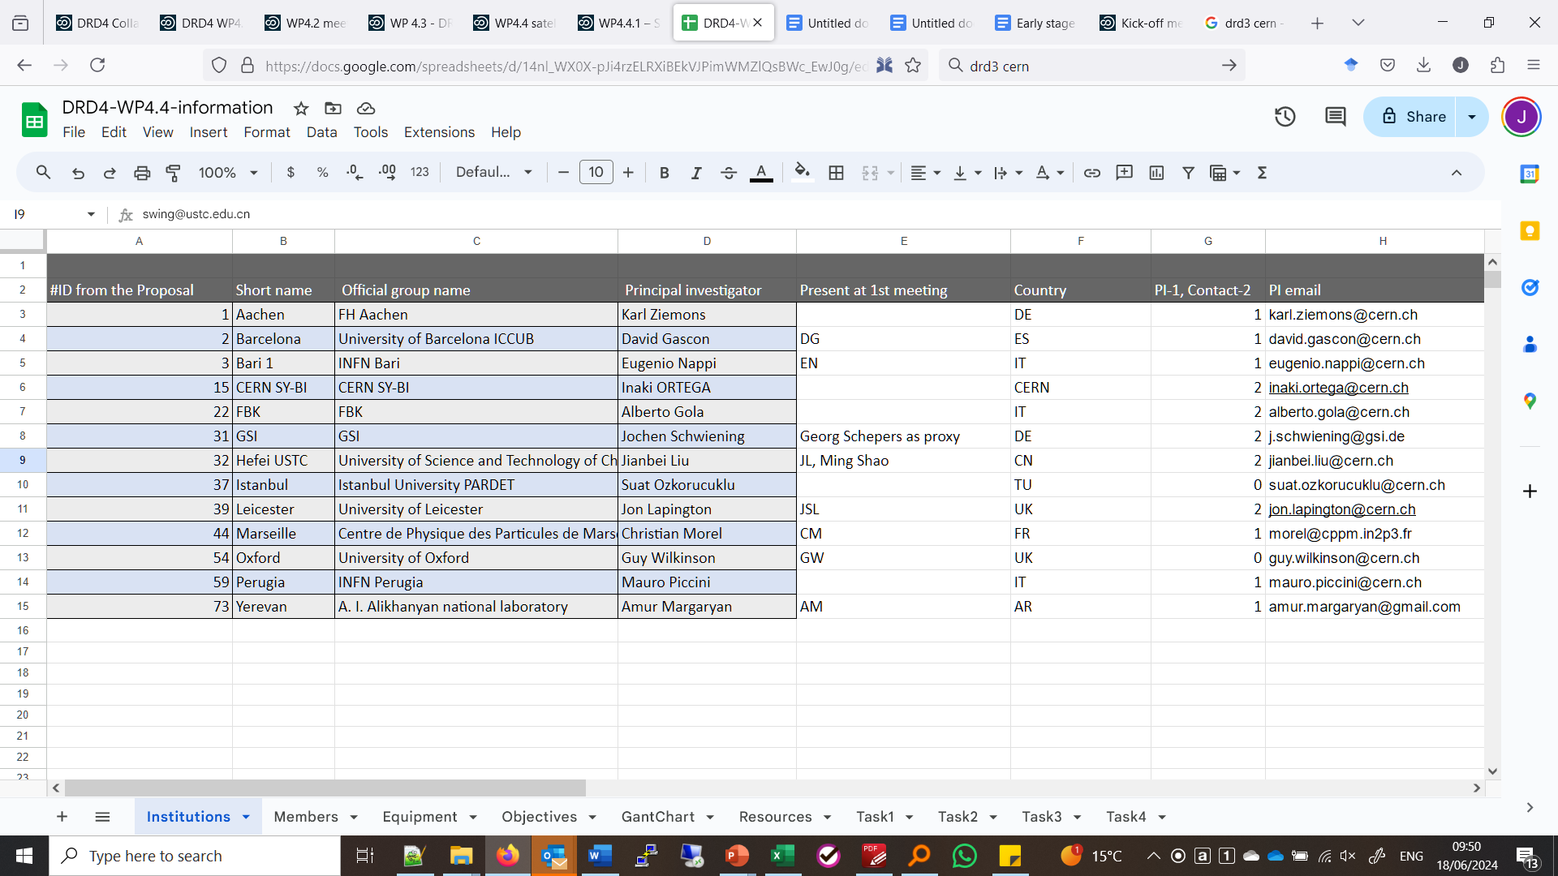
WP4.4 Participant information
Google sheet – link on today’s indico page

Slide 4
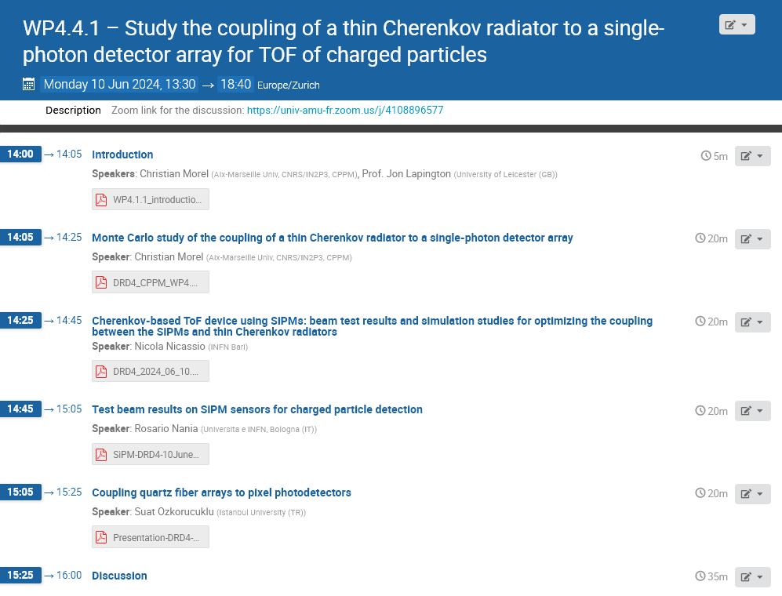
WP4.4 meetings
Kick-off meeting – 19th March 2024
  10 attendees from 9 groups
  8 group presentations – group interest and capabilities
  See minutes - indico.cern.ch/event/1395797/
WP4.4.1 sub-task meeting – 10th June 2024
  Led by Christian Morel
  17 attendees – open to drd4-interested
  4 presentations

Slide 5
WP4.4 sub-tasks
WP4.4.1: Study the coupling of a thin Cherenkov radiator to a single-photon detector array, for TOF of charged particles
WP4.4.2: Develop a SiPM array for single-photon detection, with mm-scale pixelation, suitable for use in TOF prototype
WP4.4.3: Develop lightweight mechanical supports for DIRC-type TOF detectors
WP4.4.4: Develop techniques for measuring the optical properties of optical components for TOF detectors

Slide 6
WP4.4: Linkages with other WPs
Large parallelism with other work packages. Strong linkages between:
WP4.1:
  WP4.1.2 - Fast radiation hard SiPMs and WP4.4.2 - Develop a SiPM array for single-photon detection, with mm-scale pixelation, suitable for use in TOF prototypes.
  In conversation with Rok Pestonik, Alberto Gola, and David Gascon to resolve requirements and responsibilities.
WP4.3:
  WP4.3.1 - New Materials Radiators and Component and WP4.4.4 - Develop techniques for measuring the optical properties of optical components for TOF detectors
  WP4.3.3 - Prototype Single-Photon Sensitive Module for Imaging Arrays from sensor to DAQ and self-calibration systems and WP4.4.2 - Develop a SiPM array for single-photon detection, with mm-scale pixelation, suitable for use in TOF prototypes
Continuous reciprocal coordination, consultations and information exchange will be needed to rationalize the work.

Slide 7
WP4.4.1 Introduction

Slide 8
Task 4.4.1
Task coordinator: Christian Morel
Study the coupling of a thin Cherenkov radiator to a single-photon detector array, for TOF of charged particles
Cherenkov light is prompt and therefore ideal for fast timing.
Cherenkov light yield is small compared with scintillation light; such limitation can be overcome by using sensors capable of detecting single Cherenkov photons.
Goal: high precision timing (σt∼10-15 ps)
Principle: high refractive index solid Cherenkov radiators coupled to arrays of silicon photomultipliers or multichannel plates.

Slide 9
Task 4.4.1
Task coordinator: Christian Morel
Partners:
  Bari – Eugenio Nappi
  FBK – Alberto Gola
  Istanbul – Suat Ozkorucuklu
  Marseille – Christian Morel
Milestone: M4.4.1 Selection of suitable material for the Cherenkov radiator and its coupling to the sensor (M18)
Deliverable: D4.4.1 Fully characterized prototype TOF detector, with a report on design and performance (M36)

Slide 10
WP4.4.2 Introduction

Slide 11
Task 4.4.2
Task coordinator: Open
Develop a SiPM array for single-photon detection, with mm-scale pixelation, suitable for use in TOF prototypes
This task concerns R&D on SiPM detectors and electronics to provide mm-scale position sensitivity and fast timing of Cherenkov light at the very high rates expected with HL-LHC and future colliders.
Focus on the system aspects of combining SiPM arrays with radiation hardness, mm-scale pixelation, and cooling, integrated with multichannel readout electronics such as the FastIC ASIC family, with the overall aim of achieving the best possible time resolution.
** Shared with Task 4.1.3

Slide 12
Task 4.4.2
Task coordinator: Open
Partners
  Aachen - Karl Ziemons
  Barcelona - David Gascon
  Bari – Eugenio Nappi
  FBK – Alberto Gola
  Leicester – Jon Lapington
  Marseille – Christian Morel
Milestone: M4.4.2 Demonstrate performance for single-photon detection of SiPM arrays with FastIC readout (M18)
Deliverable: D4.4.2 Prototype of array of cooled, mm-scale segmented SiPMs with integrated readout, with report on design and performance (M36)
** Shared with Task 4.1.3

Slide 13
Task 4.1.3
Task coordinator: David Gascon**
Objectives:
Study and improve the timing of Silicon Photomultipliers.
Enable the exploitation and co-design of a suitable, multi-channel readout ASIC capable of exploiting all the detection’s timing potential.
3. Develop an optimized, reliable, cost-effective integration scheme and packaging solution with integrated cooling.
Study the vertical integration of dedicated SiPM arrays to the readout electronics to optimize timing resolution by reducing the interconnections’ parasitic inductances and capacitances.
Preliminary agreement with Rok Pestotnik to coordinate activities between WP4.1.3 and WP 4.4.2
  development of photosensor and integration in the WP4.1.3 and a complex testing and evaluation of the sensor in the WP4.4.2

Slide 14
SiPM and electronics considerations
Timescales with drastically limit the technologies and hardware available for the deliverable
May need to settle on common off-the-shelf SiPM design
Custom integrated cooling may be impossible to achieve in 2.5 years
Little sensor-electronics integration expertise available
  Collaboration with DRD3 experts valuable?
Is there time for custom ASICs in DRD4 timescale?
  Likely not – use current families e.g. FastIC, of multichannel electronics –
→ Discussion

Slide 15
WP4.4.3 Introduction

Slide 16
Task 4.4.3
Task coordinator: Neville Harnew
Develop lightweight mechanical supports for DIRC-type TOF detectors
Cherenkov radiators typically large, heavy quartz plates.
Optical component coupling requires very high precision.
Prototype support developed using lightweight materials.
  Adjustable and accurate positioning required.
  Minimize distortion + support quartz, detectors, electronics.
  Lightweight materials will be investigated and reported.
A prototype will be developed and performance verified.

Slide 17
Task 4.4.3
Task coordinator: Neville Harnew
Partners:
  GSI – Jochen Schwiening
  Hefei-USTC – Jianbei Liu
  Oxford – Guy Wilkinson
Milestone: M4.4.3 Report on material choices and mechanical design for a lightweight TOF module (M18)
Deliverable: D4.4.3 Prototype of a lightweight mechanical support for a DIRC-type TOF detector, with report on design and performance (M36)

Slide 18
WP4.4.4 Introduction

Slide 19
Task 4.4.4
Task coordinator: Suat Ozkorucuklu
Develop techniques for measuring the optical properties of optical components for TOF detectors
Characterization of the quartz Cherenkov radiators.
  Radiator optical specification is demanding.
  Challenging to manufacture and difficult to measure.
Facilities already exist within the project partners.
  These will be available for task collaborators.
Precision measurement will be further developed.

Slide 20
Task 4.4.4
Task coordinator: Suat Ozkorucuklu
Partners:
  Armenia – Amur Margaryan
  GSI – Jochen Schwiening
  Hefei-USTC – Jianbei Liu
  Instanbul – Suat Ozkorucuklu
  Oxford – Guy Wilkinson
Milestone: M4.4.4 Report on progress in setting up optical laboratory for characterizing TOF radiator (M18)
Deliverable: D4.4.4 Completion of commissioning of an optical laboratory for characterizing the performance of a DIRC-style quartz radiator plate (M36)

