Slide 1
DRD4 WP4.1 Task 3:
Timing of SSPD + Readout electronics
Introduction and discussion
DRD4 meeting
CERN
17/06/2024
David Gascón
Institute of Cosmos Sciences
Universitat de Barcelona

Slide 2
Introduction
The aim of this meeting is to discuss goals, methods and activities of the task
  We need to define specific milestones
  We need to identify groups that will carry out specify R&D efforts
Today we don’t aim to discuss specific solutions (SiPMs, ASICs, etc)
  See WG presentations for a review of some of the available electronics
This material is based on the preparatory meeting held last week
  Link: https://indico.cern.ch/event/1423845/
  Many thanks to all the participants for comments, questions and suggestions

Slide 3
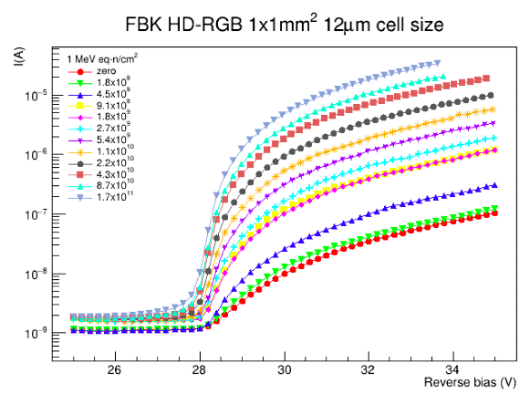
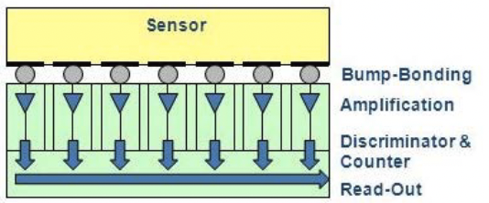
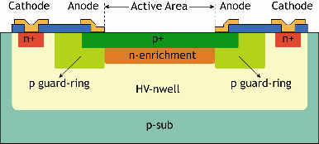
Introduction: Context: Other Tasks
Task 4.1.1 - SSPD w new configurations and modes (16 groups)
Custom sensing layer optimization
  Backside illuminated (BSI) SiPMs: potential for an enhanced PDE and a better radiation tolerance.
  Vacuum ultraviolet (VUV) or near-infrared (NIR) sensitive SiPMs: design, fabrication, and characterisation
  Developing ultra-granular SiPM that integrates with the readout electronics by using 2.5D or 3D interconnection techniques.
CMOS-SPAD light sensors: co-integration of SPADs and electronics, digitized output signals with low power consumption and fast read-out.
New materials for light detection, e.g., SiC, GeC, InGaAs, GaAs technology: possible advantages in SSPDs.
Task 4.1.2 - Fast radiation hard SiPMs (17 groups)
Standardize procedures for quantification of radiation effects.
Characterize the irradiated SiPMs in a wide range of temperatures down to -200 deg..
Study of annealing.
Study and quantify other measures enabling the use of SiPM in highly irradiated areas:
  smaller SiPMs
  macro- and micro-light collectors
Bias current increase after the irradiation
© Fraunhofer IMS
Ultra graniular SiPMs
BSI SiPMs

Slide 4
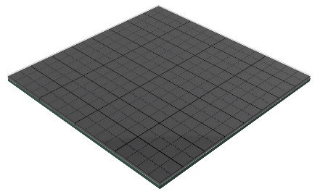
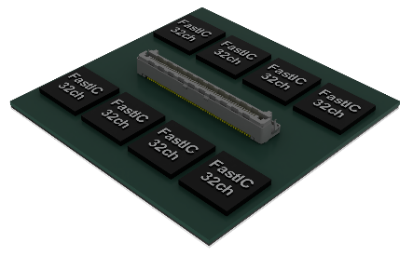
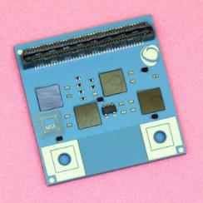
Introduction: our task
Goals defined so far
Task 4.1.3 Timing of SSPD + Readout electronics (16 groups)
RO electronics - transversal activity for all WPs
Study and improve the timing of SiPMs.
Co-design of a multi-ch. readout ASIC exploiting the timing potential.
Optimized, reliable, cost-effective integration and packaging with integrated cooling.
Vertical integration of SiPM arrays to FEE: optimize timing by reducing the interconnections' parasitic inductances and capacitances.
Vertical cost effective integration of sensor and readout electronics
Integrated cooling: SUBLIMA

Slide 5
Introduction
Specific milestones and deliverables (coordinated with other WPP4.1 taks)
Milestones:
M4.1.1.1 Tested Back-side illuminated SiPM samples (M24)
M4.1.1.2 Tested CMOS-SPAD samples (M24)
M4.1.2 Standardization of characterization procedures and standards to measure SiPM performance after irradiation (M18)
M4.1.3 Demonstrated high-performance readout electronics for solid-state photon detectors (M24)
Deliverables:
D4.1.1.1 Demonstrator of BSI SiPM array (M36)
D4.1.1.2 Demonstrator of CMOS-SPAD monolithic sensor (M36)
D4.1.2 Report on achieved state-of-the-art fast and radiation hard SiPMs and analysis of prospects (M36)
D4.1.3 Demonstrator of the ultra-fast SiPM with optimized readout electronics (M36)

Slide 6
Participants
Introduction: participants
Task 4.1.1 - SSPD w new configurations and modes
16 groups: Bologna, CERN EP, Ferrara, FNAL, Genova, Maryland, Michigan, Pavia, Trento, Milano , Virginia, Bologna, Iowa, SNU, Tokyo Metropolitan, Bari2
Task 4.1.2 - Fast radiation hard SiPMs
17 groups: Bologna, Ferrara ,Genova, KEK, Bucharest, CERN-SY-BI, FBK, Giessen, Iowa, Laussane EPFL, Ljubljana, Nagoya, Padova B2, Padova LHCb, Perugia, SNU, Tokyo Metropolitan
Task 4.1.3 - Timing of SSPD + Readout electronics
16 groups :Barcelona, Bologna, Bucharest , CERN-EP, FNAL , Genova, Ljubljana, Michigan, Monash, Omega, Padova, Perugia, Virginia, Maryland, FBK, FZU Prague
Sorry if you are not included:
Latest table https://docs.google.com/spreadsheets/d/1i2oQ8434eZem529sKwUhyBIWXuWH2bWUHpR2oL5TooM/edit?usp=sharing

Slide 7

Fast timing and electronics: where we are?
In DRD4 we care about single (or few photons)
  Different considerations and implications when dealing with many photons
    Calorimetry, PET, etc
  Optimal solutions can be different !
The Single Photon Time Resolution (SPTR) of a detector depends on sensor (single photon time response) and electronics
  Neglecting photo-statistics of photon generation
$σ_{t_SPTR}^{2}=σ_{t_sensor}^{2}+$ $σ_{t_el}^{2}$

Slide 8
Fast timing and electronics: where we are?
The time resolution of a typical binary discriminator FE depends at least of:
$σ_{t_el}^{2}={\left(σ_{t_el}^{TW}\right)}^{2}+{\left(σ_{t_el}^{Jit}\right)}^{2}+{\left(σ_{t_el}^{TDC}\right)}^{2}={\left({\left[\frac{t_{r}V_{th}}{S}\right]}_{RMS}\right)}^{2}+{\left(\frac{N}{dS/dt}\right)}^{2}+{\left(\frac{{TDC}_{Bin}}{\sqrt{12}}\right)}^{2}$+ ${\left(σ_{t_el}^{CLK}\right)}^{2}$…
Time-Walk
Electronics Jitter
Quantization error
N. Cartiglia, “Ultra-Fast Silicon Detector”
https://www-physics.lbl.gov/seminars/Cartiglia.pdf
Different expression for waveform sampling systems

Slide 9
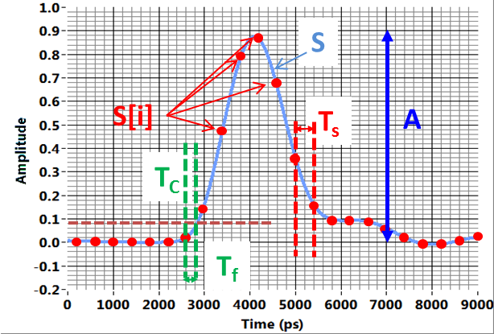
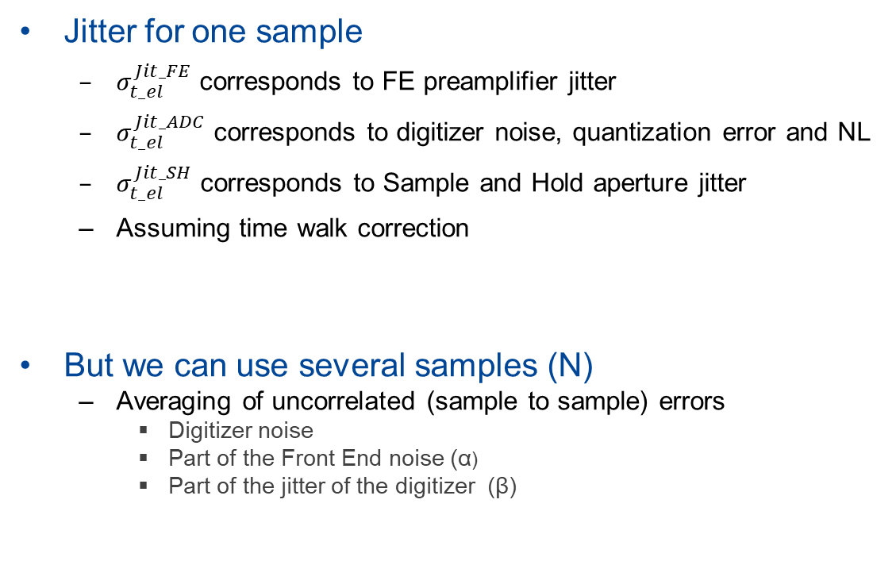

Fast timing and electronics: where we are?
Jitter for one sample
  $σ_{t_el}^{Jit_FE}$ corresponds to FE preamplifier jitter
  $σ_{t_el}^{Jit_ADC}$ corresponds to digitizer noise, quantization error and NL
  $σ_{t_el}^{Jit_SH}$ corresponds to Sample and Hold aperture jitter
  Assuming time walk correction
But we can use several samples (N)
  Averaging of uncorrelated (sample to sample) errors
    Digitizer noise
    Part of the Front End noise (α)
    Part of the jitter of the digitizer (β)
$σ_{t_el}^{2}={\left(σ_{t_el}^{Jit_FE}\right)}^{2}+{\left(σ_{t_el}^{Jit_ADC}\right)}^{2}$ $+{\left(σ_{t_el}^{Jit_SH}\right)}^{2}$
Many DSP algorithms to extract timing:
  Digital leading edge
  Digital constant fraction
  Interpolation
  Initial slope approximation
Baseline correction
Time walk correction
$σ_{t_el}^{2}=\frac{α}{N}{\left(σ_{t_el}^{Jit_FE}\right)}^{2}+{\frac{1}{N}\left(σ_{t_el}^{Jit_ADC}\right)}^{2}$ $+\frac{β}{N}{\left(σ_{t_el}^{Jit_SH}\right)}^{2}$
E. Delagnes “Precise Pulse Timing based on Ultra-Fast Waveform Digitizers”, Lecture given at the IEEE NSS Symposium, 2011

Slide 10
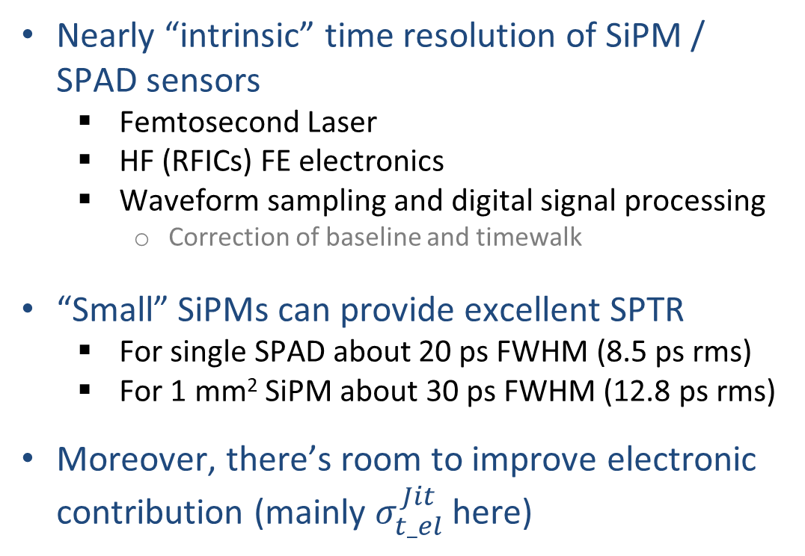
Fast timing and electronics: where we are?
Nearly “intrinsic” time resolution of SiPM / SPAD sensors
  Femtosecond Laser
  HF (RFICs) FE electronics
  Waveform sampling and digital signal processing
    Correction of baseline and timewalk
“Small” SiPMs can provide excellent SPTR
  For single SPAD about 20 ps FWHM (8.5 ps rms)
  For 1 mm² SiPM about 30 ps FWHM (12.8 ps rms)
Moreover, there’s room to improve electronic contribution (mainly $σ_{t_el}^{Jit}$ here)
$σ_{t_SPTR}^{2}=σ_{t_LASER}^{2}{+σ}_{t_sensor}^{2}+$ $σ_{t_el}^{2}$
M. Penna “Timing performance characterization of FBK SiPM NUV-HD-MT technology”, 16th Pisa Meeting on Advanced Detectors, 2024
Why do we think that?

Slide 11
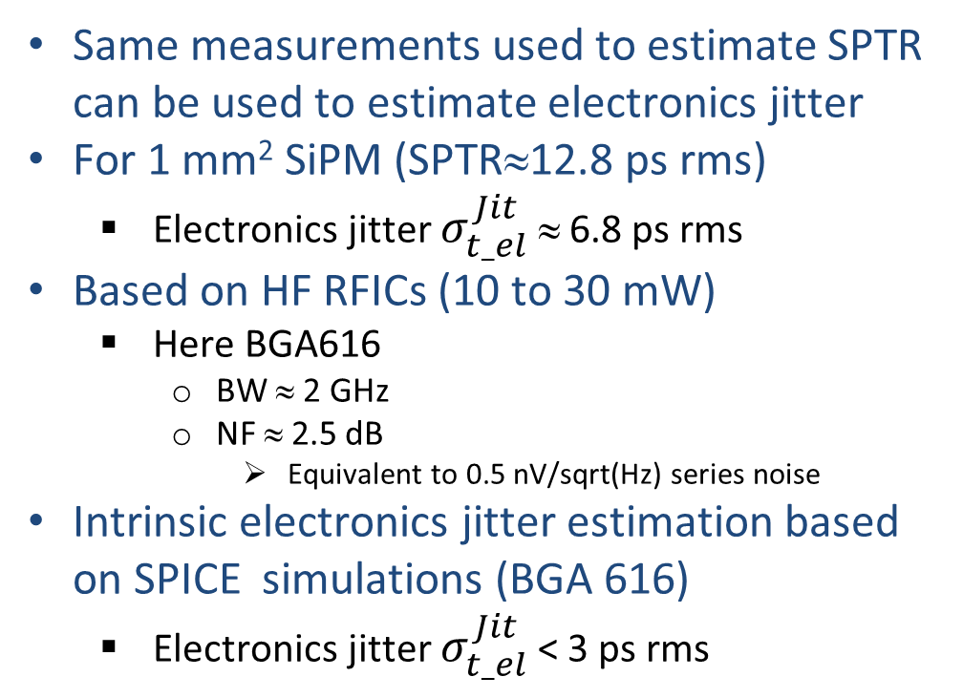

Fast timing and electronics: where we are?
Same measurements used to estimate SPTR can be used to estimate electronics jitter
For 1 mm² SiPM (SPTR≈12.8 ps rms)
  Electronics jitter $σ_{t_el}^{Jit}$ ≈ 6.8 ps rms
Based on HF RFICs (10 to 30 mW)
  Here BGA616
    BW ≈ 2 GHz
    NF ≈ 2.5 dB
      Equivalent to 0.5 nV/sqrt(Hz) series noise
Intrinsic electronics jitter estimation based on SPICE simulations (BGA 616)
  Electronics jitter $σ_{t_el}^{Jit}$ < 3 ps rms
$σ_{t_el}^{Jit}$= $\frac{N}{dS/dt}$
D. Mazzanti, A. Mariscal (ICCUB)
What do we need to improve?
  Slew Rate is limited by interconnect parasitic
  Noise increased by pick-up contributions (EMI)
And we need to “translate” this performance to a low power / scalable ASIC readout

Slide 12
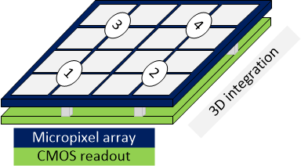
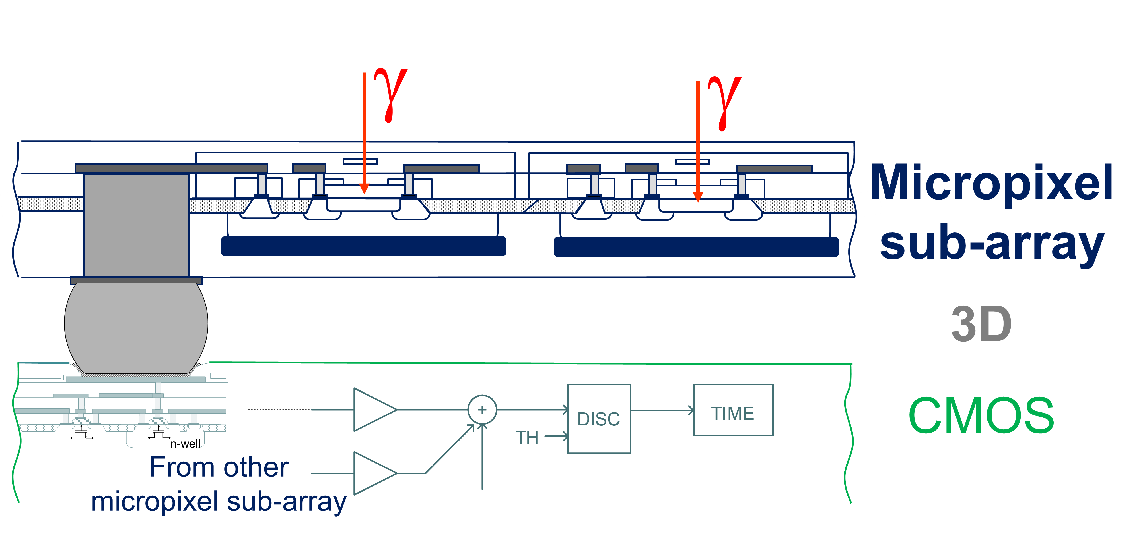
Discussion: the approach in task 4.1.3.
Try to exploit the excellent intrinsic performance of analog SiPM technology and develop a scalable module
  Focus on small analog SiPMs < 1 mm² (mini SiPMs)
    Long term: single cell access / digital readout?
  Optimize FE ASICs
  Vertical integration (2.5D and 3D)
  Robust design against EMI
  Clock distribution
From FastICPix ATTRACT proposal. D. Gascon, R. Ballabriga

Slide 13
Discussion: goal review
Goal 1: Study and improve the timing of SiPMs
What is Task 3 role?
SiPMs will be developed in the context of Tasks 1 and 2
Possible activities in Task 3:
  Characterize SiPMs with specific front end electronics
  Understand (electrical simulation, etc) how to customize SiPMs to improve timing
    SPAD parameters
    Segmentation
    Interconnection (at SiPM level)
    …

Slide 14

Discussion: goal review
Goal 2: Co-design of a multi-ch readout ASIC exploiting the timing potential
According to M4.1.3 and D4.1.3 demonstration of high-performance readout electronics for solid-state photon detectors should happen in M24 (M36)
  Is it realistic to have a new ASIC in << 24 months ?
Possible approach
  Base demonstrator for D4.1.3 on existing ASICs
  Develop optimized IP blocks for a new generation of FE ASICs
    Optimized analog FE (input stage, discriminator, baseline/DCR correction, etc) based on inputs from goal 1
    TDC and clock distribution
    Address cryogenic operation
    Address single cell (digital) readout ASICs
We should not forget about TDC (and clock) !
$σ_{t_el}^{TDC}=$ $\frac{{TDC}_{Bin}}{\sqrt{12}}$= $\frac{25 ps}{\sqrt{12}}=7.2 ps rms$
And this is just the quantization error, then we need to consider TDC jitter, DNL, clock/PLL jitter

Slide 15
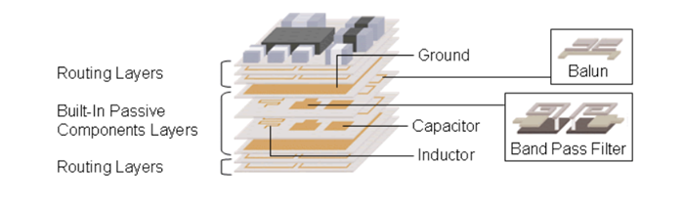
Discussion: goal review
Goal 3: Optimized, reliable, cost-effective integration and packaging (cooling)
Achieving this goal will require important contributions in different areas:
  Interconnects and packaging
  Non conventional high density PCB design
    LTCC, buried components, etc..
  Cooling
  Power distribution and generation
    SiPM bias voltage
  Grounding and EMC aspects
  Very precise clock distribution

Slide 16
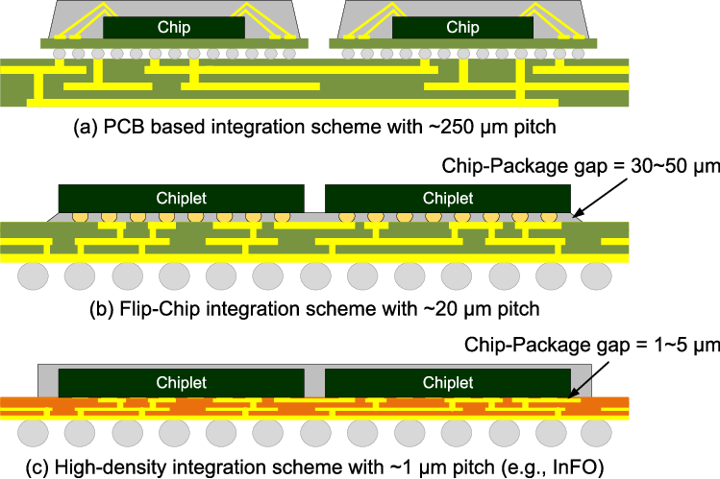
Discussion: goal review
Goal 4: Vertical integration of SiPM arrays to FEE
Trade-off: performance versus cost/yield
Vertical integration here means:
  2.5-D integration based on interposers, flip-chip, custom BGA packages, etc
    Commercially available
  3-D integration
    Under development (for our community)
    Also being adressed in Task1
2.5-D integration schemes
3-D integration scheme from FBK
L. Parellada-Monreal et al., “3D integration technologies for custom SiPM: From BSI to TSV interconnections,” NIMA, 2023, 10.1016/j.nima.2023.168042.
Kabir, A. et al. (2021). Holistic Chiplet-Package Co-Optimization for Agile Custom 2.5D Design. IEEE TCPMT 10.1109/TCPMT.2021.3069724.

Slide 17
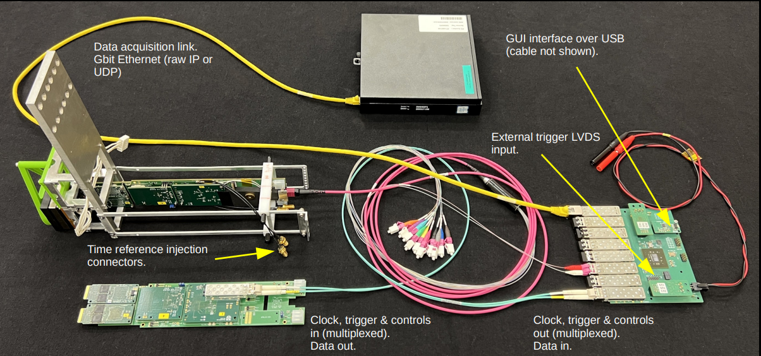
Discussion
And what about scalability??
We should keep in mind a scalable solution
  Concentrator and readout boards
  Trigger and clock distribution
  Power distribution
Not an easy task !
This will be discussed in WP 4.3.3.
  https://indico.cern.ch/event/1425321/
  Can we develop something compatible to reuse as much as possible?
  See S. Wotton talk in WG3 meeting (https://indico.cern.ch/event/1416002/)

Slide 18
Next Steps: proposal
Try to agree on the specific goals of Task 4.1.3
Define what are the specific interests and contributions of the collaborators in these goals
  Please let us know who is interested in contributing in any of the previously mentioned activities
    SiPM + FE characterization and modelization
    ASIC design
    Module development
    Vertical integration
Prepare a more detailed plan
  Schedule and intermediate milestones
  Needs to be agreed with Task 1 and Task 2
We need to know the resources (contributors) to draft a detailed plan

Slide 19
Preliminary conclusions
In this task we will develop a module < 1mm pixel SiPM array based on existing ASICs (FastIC+, FastRICH, etc)
  In a first version for M24 milestones the number of channels will be limited
    We can target O(200) ch in about 5x5 cm² area but not O(2000) ch
This array could probably used for WP4.4.2
A similar module targeting 2 mm pixels will be developed in WP4.3.3
  We can collaborate in module design and vertical integration
More resources on vertical integration and module design are needed!

Slide 20

Thanks a lot for your attention !!!
http://icc.ub.edu/technology
Thanks a lot for materials and contributions to our colleagues !!
dgascon@fqa.ub.edu

Slide 21
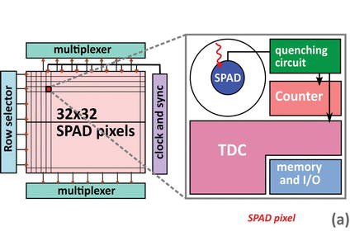
Discussion: interfaces and overlaps with other tasks
https://pegaso.ific.uv.es/mailman/listinfo/cpan-instrumentacion
A simplified view?
Task 1 (and 2)
Task 1
Task 3

Slide 22
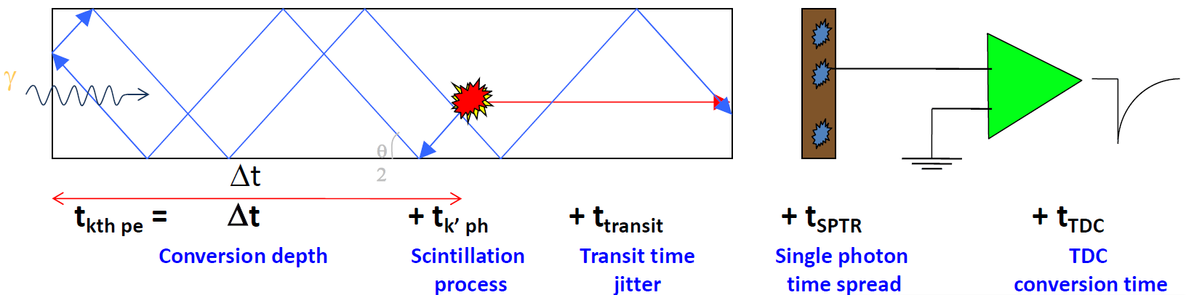

I. Introduction
What is a fast detector?
  “Prompt” signal generation
    Timing measurements
      Many more factors involved !!
What is required to the electronics?
  Low electronics jitter
  Deal with time walk problems
  Accurate conversion
    TDC, waveform sampling
Example: scintillating crystal readout by photosensor
Electronics Timing resolution
$$σ_{t_el}^{ }$$
Courtesy: E. Auffray (CERN)
Notes:
And of course the electronics is also essential to achieve good timing and this involves different angles: minimize electronics jitter, deal with time walk problems and perform and accurate conversion and time pick-off.

Slide 23
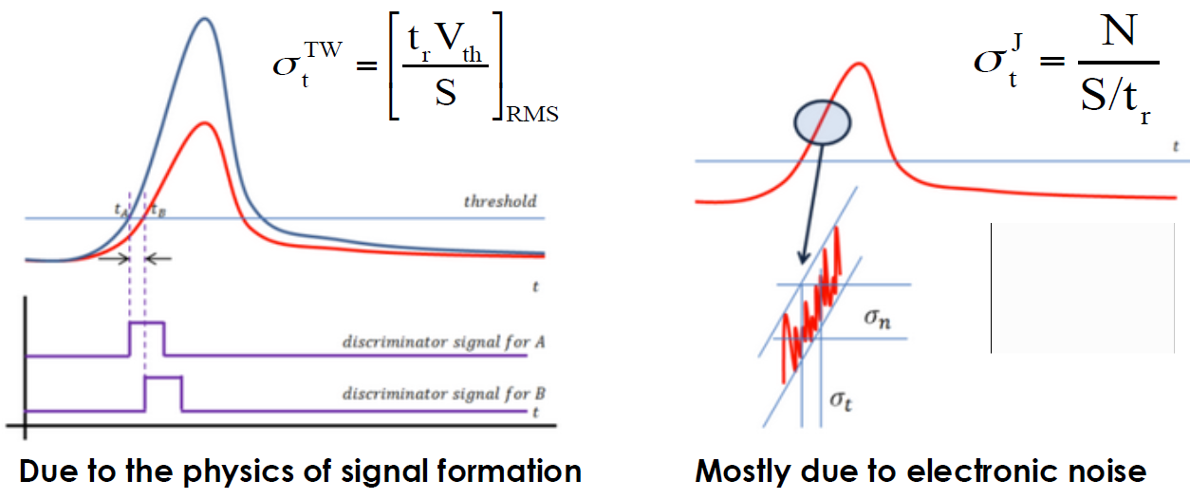
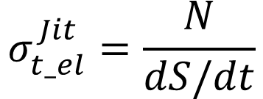
I. Introduction
What is a fast detector?
  “Prompt” signal generation
    Timing measurements
      Many more factors involved !!
What is required to the electronics?
  Low electronics jitter
    High slew rate and low noise
  Deal with time walk
  Accurate conversion
Jitter: electronics noise (N) added to the signal.
For discriminator: uncertainty in threshold crossing time
$$σ_{t_el}^{Jit}=\frac{N}{dS/dt}$$
N. Cartiglia, “Ultra-Fast Silicon Detector”
https://www-physics.lbl.gov/seminars/Cartiglia.pdf
Notes:
The electronics jitter depends on the electronics noise and the signal slew rate, and for a leading edge discriminator it is computed as its ratio.
High slew rate is related to large BW, but it is not synonym since non-linearities play sometimes a relevant role.

Slide 24

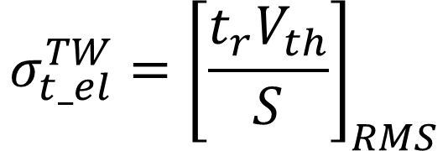
Time walk: the voltage value V_{th} is reached at different times by signals of different amplitude (S)
I. Introduction
What is a fast detector?
  “Prompt” signal generation
    Timing measurements
      Many more factors involved !!
What is required to the electronics?
  Low electronics jitter
  Deal with time walk
    Time walk correction
      CFD, digital signal processing, offline…
  Accurate conversion
$$t_{r}:signal rise time$$
$$σ_{t_el}^{TW}={\left[\frac{t_{r}V_{th}}{S}\right]}_{RMS}$$
N. Cartiglia, “Ultra-Fast Silicon Detector”
https://www-physics.lbl.gov/seminars/Cartiglia.pdf
Notes:
For a leading edge discriminator, the time walk is caused by the fact that the threshold value is reached at different times for different signal amplitudes.
We will see different calibration and time pick-off methods to deal with the time walk.

Slide 25
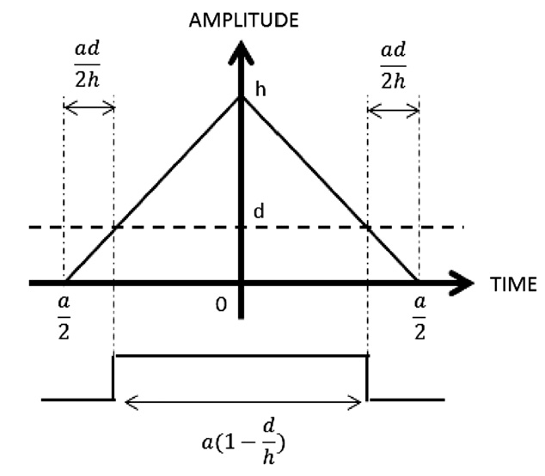
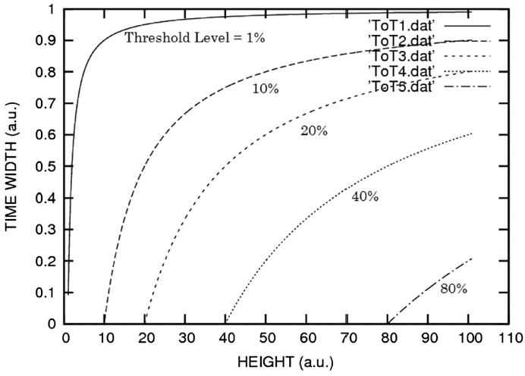
I. Introduction
What is a fast detector?
  “Prompt” signal generation
    Timing measurements
      Many more factors involved !!
What is required to the electronics?
  Low electronics jitter
  Deal with time walk
    Time walk correction
      CFD, digital signal processing, offline…
  Accurate conversion
Time-walk correction
  Most precise correction is based on accurate energy measurement (see A. Rivetti talk)
  If not available: poor man ADC is ToT
    The pulse width at the output discriminator is proportional to the signal amplitude
    It is known as Time-over-Treshold (ToT)
    The relation with signal amplitude is non-linear
    ToT information can be used to estimate signal amplitude an perform time-walk correction
Orita, NIMA 648, S24-27, 2011
Notes:
One way to correct Time Walk is using the discriminator ToT response.
The pulse width at the output discriminator is proportional to the signal amplitude
It is known as Time-over-Treshold (ToT) The relation with signal amplitude is non-linear
ToT information can be used to estimate signal amplitude an perform time-walk correction.
Example for linear signal with triangular shape. Transfer functions depends on the threshold.

