Slide 1
Coordinated Outreach and
Promoting Young Talents in Netzwerk Teilchenwelt
German LHCb groups meeting
Bochum, 23./24.9.2024
Uta Bilow, TU Dresden
Notes:
Aachen, Bochum, Bonn, Dortmund, Freiburg, Heidelberg, Siegen + Max-Planck-Institut für Kernphysik in Heidelberg

Slide 2
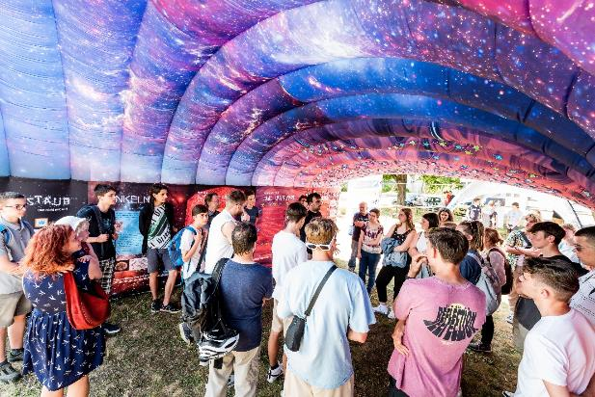
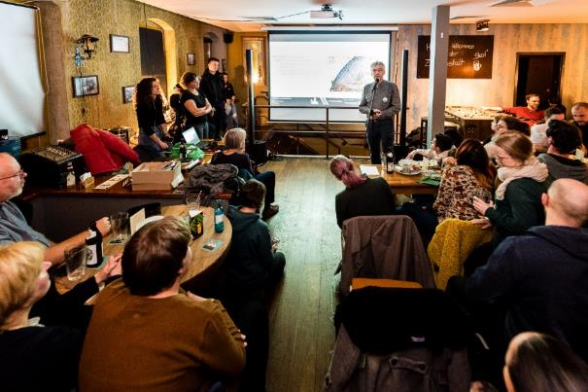
Public outreach
Reach out to the people with our research topics, methods, technologies, and science in general
Goals
Foster a connection between our community and the world outside
Satisfy existing curiosity and spark interest in science
Promote appreciation for fundamental research
Stimulate to study STEM, attract new talents
Build trust, create transparency, educate on Nature of Science
© Philipp Lindenau
Pop-up exhibition Urknall unterwegs
© Philipp Lindenau
Pub festival Beerology

Slide 3
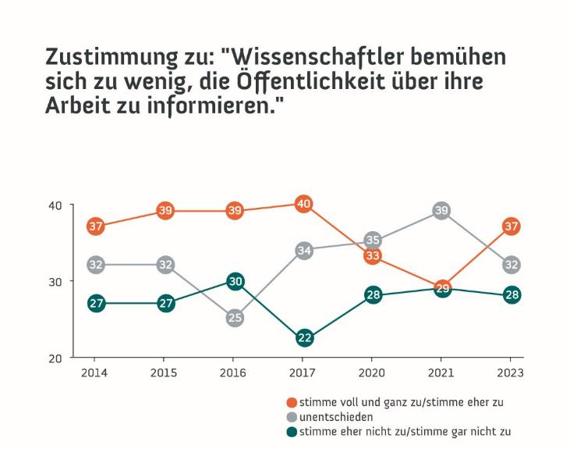
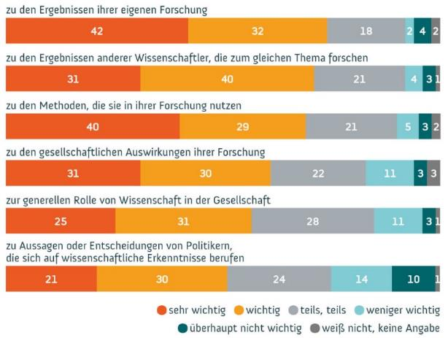
Public interest in science
74%
69%
Communication of own results and methods highly requested
Authenticity
Scientists make too little effort to inform the public about their work
Wissenschaftsbarometer 2022, Wissenschaft im Dialog/Kantar
Wissenschaftsbarometer 2023, Wissenschaft im Dialog/Kantar
Notes:
In dialogue with the public, scientists should talk about ...

Slide 4
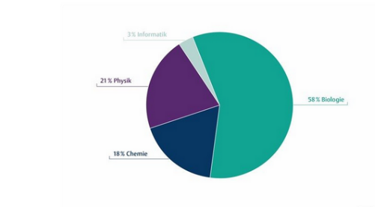
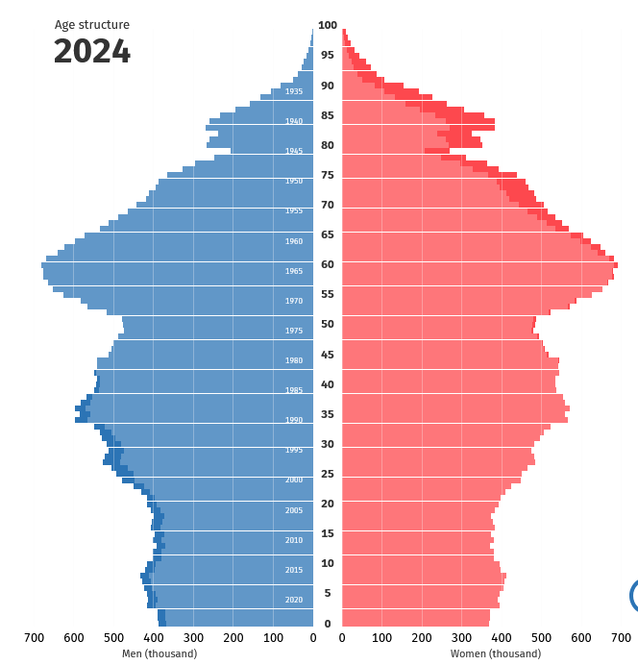
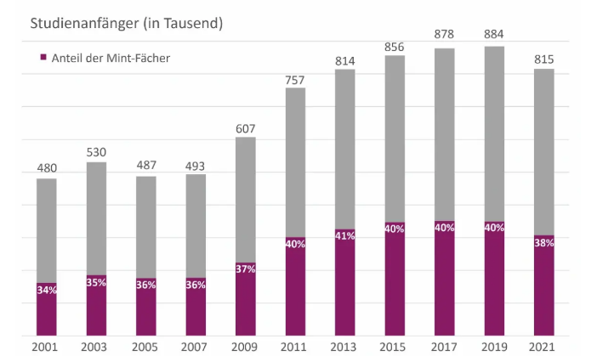
German population and study choice
Only 20% of high school students choose science on a higher level (advanced course or “Leistungskurs”)
Specialization decisive for choice of field of study and professional development
Number of university students in STEM studies going down (share is stable)
Physics
Biology
Chemistry
First-year students (in thousands)
Share of STEM
Statistisches Bundesamt
MINT Nachwuchsbarometer + Statistisches Bundesamt
Notes:
Birth rate going down
Number of working-age persons is decreasing
Shortage of STEM specialists (Fachkräftemangel)

Slide 5
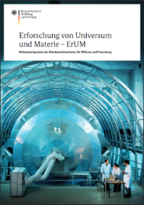
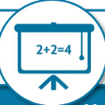

BMBF Framework program ErUM (Exploration of the Universe and Matter)
4 Fields of action
  Large Scale Facilities
  Networking
  STEM young scientists
  Transfer & participation
Explicitly supported via KleT³ project
  KleT³: Kleinste Teilchen: Teilhabe und Talente (2024-27)
  2018-2021: KONTAKT, 2021-2024: KONTAKT2
→ Outreach is integral part of research within the framework program ErUM
More outreach via LHC ErUM-FSP office, other funding sources (SFBs, EXC etc.), ...
MINT Nachwuchs
Nachwuchs für MINT Fächer faszinieren
Wissenschaftlichen Nachwuchs qualifizieren
Karriereperspektiven schaffen
Transfer und Partizipation
Wissenschaftstransfer von Forschung in
Wirtschaft und Gesellschaft anregen
Dialog zwischen Forschung und
Bürgerinnen und Bürgern intensivieren

Slide 6
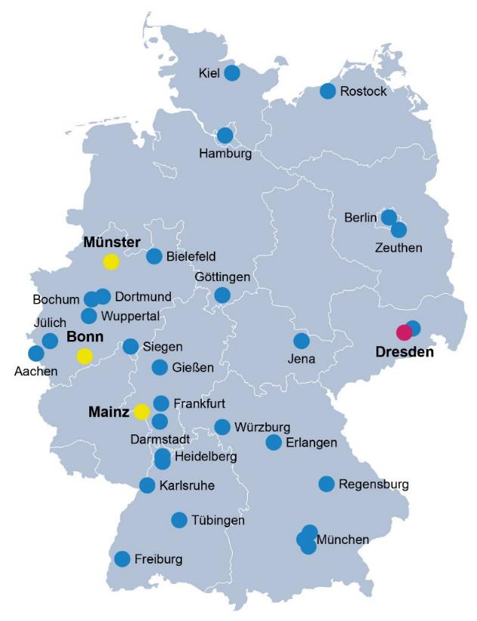
Netzwerk Teilchenwelt
34 universities/research labs
all LHCb institutes are present
Teilchenwelt contact person at each institute
Joint outreach for Particle Physics since 2010
  Bundle existing activities
  Share structures and programs
  Synergy effects
  High visibility and impact of outreach
Target groups: high school students, young university students, teachers, broad public
Project team: TU Dresden + hubs at Bonn, Mainz, Münster
Collaboration with LHC ErUM-FSP office

Slide 7
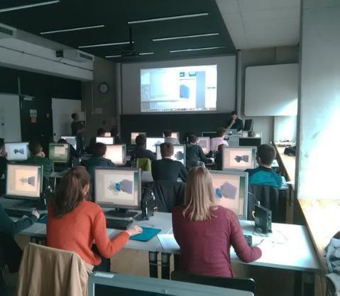
Masterclasses
Project day in school or university or online
  International Masterclasses, International Day of Women and Girls in Science
Talks and Q&A with researchers
Own measurements and analysis of original data
Diverse set
  LHCb: D0 lifetime, Hadron Spectroscopy
  ALICE, ATLAS, CMS, Belle II
  Machine Learning, Numeric (Planetary Orbits)
  Hadron Therapy
  Nuclear Astrophysics
  IceCube, Auger, Cosmic@Web
High school students do research supported by young scientists
© Sebastian Neubert

Slide 8
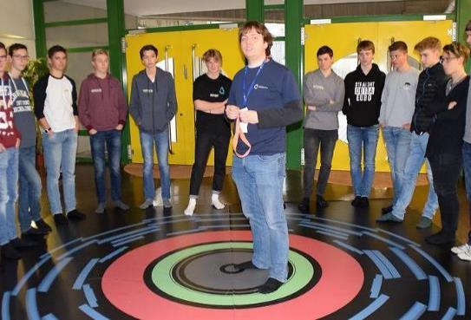
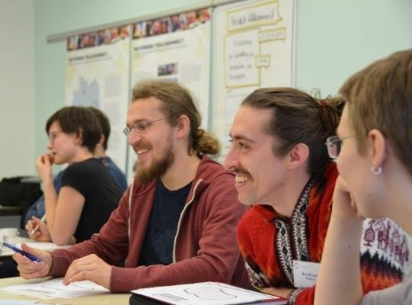
Facilitators
150 PhD and Master students engaged
guide Masterclasses, supervise students´ research projects
get central reimbursement of expenses and travel cost*
yearly science communication and outreach training
  Next Workshop: 11.-13.11.2024 in Fulda
  Fully funded by Heraeus foundation, except travel cost
Frequent (online) onboarding events
Acquire soft skills, for personal and professional development. (Outreach is an integral component of research … and increasingly important for your career − be it for scholarships, grant applications or appointments.)
@Students: Please join this great team!
@Supervisors: Please support this important task!
ATLAS Masterclass in Bonn
Outreach workshop in Fulda
* currently suspended due to funding cuts

Slide 9
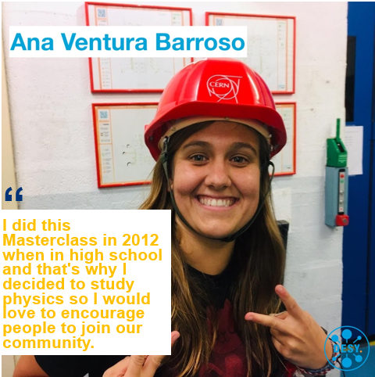
Inspire the next generation of scientists
Result from survey 2024:
38% of PhD students guiding Masterclasses attended a Masterclass as a high school student

Slide 10
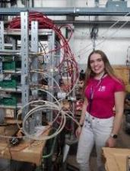
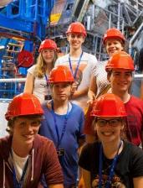
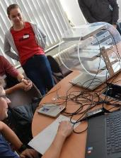
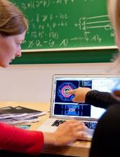
Masterclasses – first level of a multi-step program
CERN project weeks*, research projects at institutes
List of 156 essays, incl. 46 awards
CERN workshops*, Particle physics academy in Mainz
Active engagement, detector projects
Masterclasses
15
High proportion of women on higher levels
50% female
75
Female share in physics exams 2023:
22% Bachelor
25% Master
22% PhD
250
3500
Number of students per year
* currently suspended due to funding cuts

Slide 11


Fellow program
SCHOOL
RESEARCH GROUPS
150 people, 50% female (program launched in 2017)
Mainly alumni of CERN workshops
  experienced talents, participated in several program levels, now studying physics or shortly before
→ Foster connection between highly motivated students and research groups
Central offers: yearly Fellow physics school, frequent online events Ask the expert (research highlights, career development), yearly Fellow meeting*, invitation to national physics conferences*
Local offers: internships, invitation to group events (scientific, outreach, social), excursions, colloquia, regulars´ table etc.
Win for Fellows: Close and early connection to research, extra training, networking
Win for groups: Close connection to highly motivated, well trained students, support in science and outreach

Slide 12
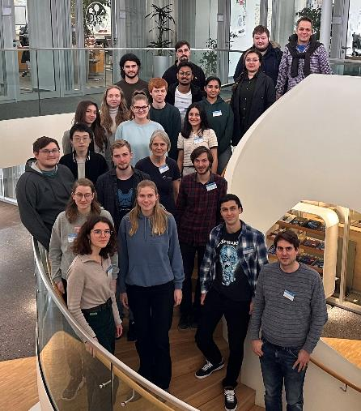
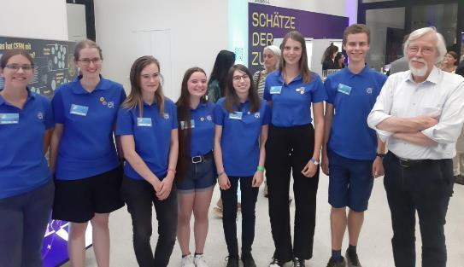
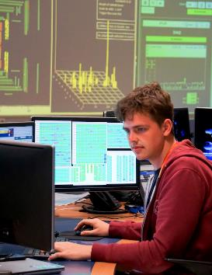
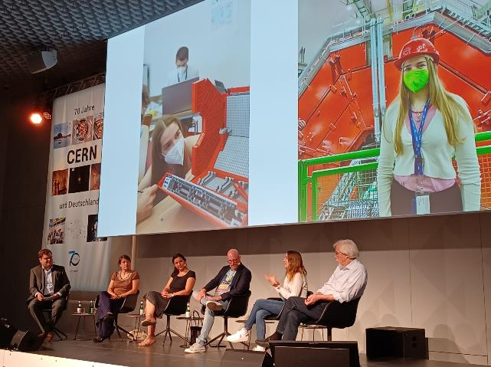
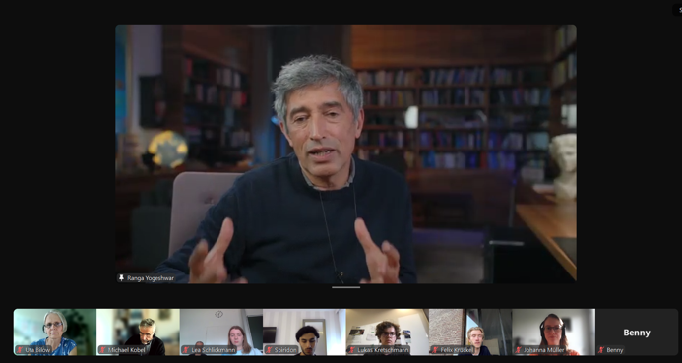
Fellows in science and outreach
School Introduction to the Terascale for Fellows and B.Sc.students
Fellows at CERN70 in Berlin helping as guides
Fellow Lukas: From internship to authorship ATLAS blog
Fellows invite prominent speakers for Ask the expert: Ranga Yogeshwar, Reinhard Genzel...
Fellow Julia Els in panel discussion at CERN70 LinkedIn

Slide 13
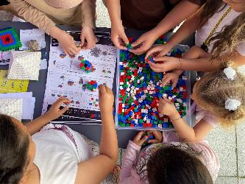
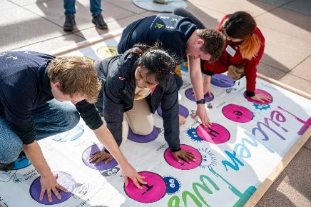
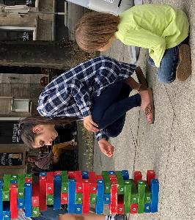
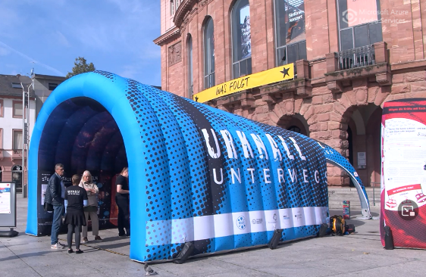
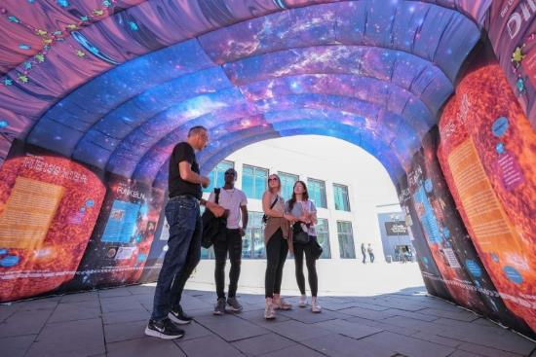
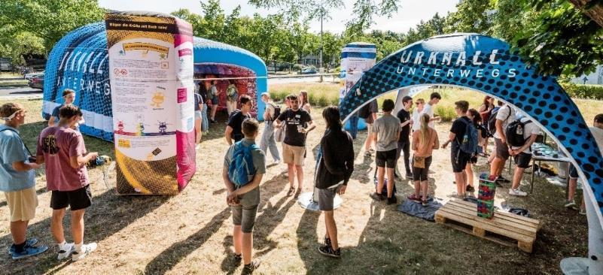
Urknall unterwegs
Pop-up exhibition on particle physics
  Tunnel: time travel through the history of the universe
  Pavilion with games
Target audience: general public, people with less affinity for science
Goes to public places, pedestrian zone, shopping mall, festival, campus....
© Philipp Lindenau
13

Slide 14
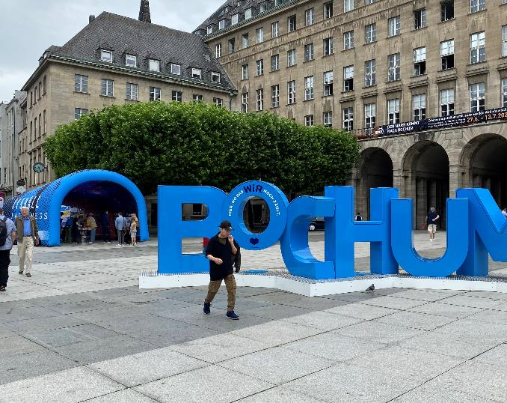
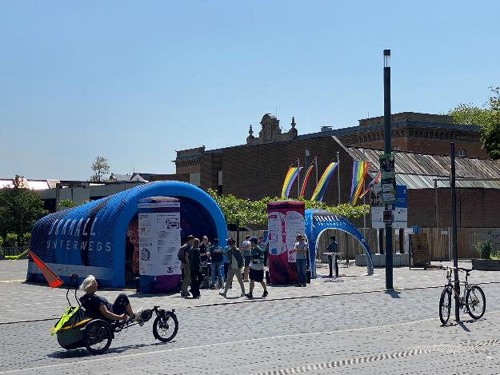
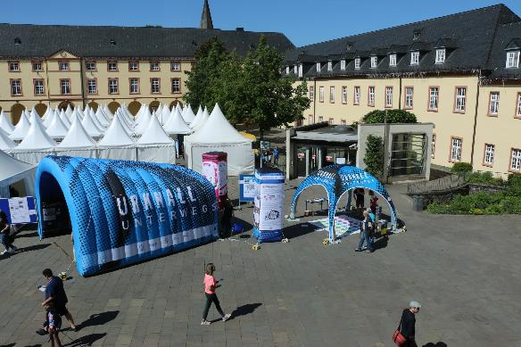
Urknall unterwegs
25+ places visited since 2022 (photo gallery), incl. Aachen, Bochum, Heidelberg, Siegen
From now on located in Mainz, can be loan by institutes (transportation costs)
No tour manager*, due to funding cuts
© Sarah Kästner
© Sarah Kästner
© Uni Siegen
Notes:
War in
Aachen
Bochum
Heidelberg in CERN70 week
Siegen
Nicht Bonn
Dortmund

Slide 15
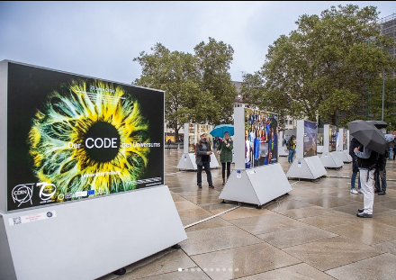
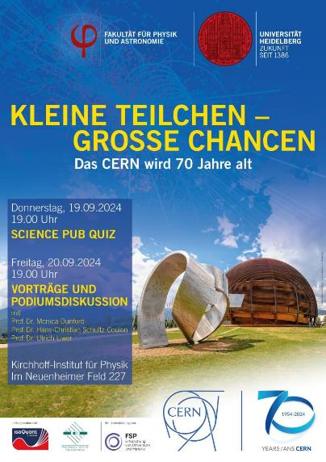
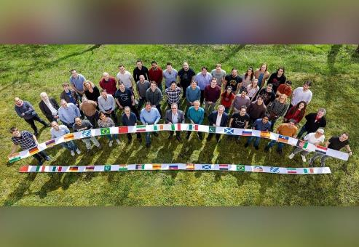
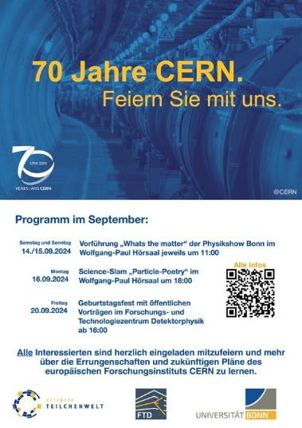
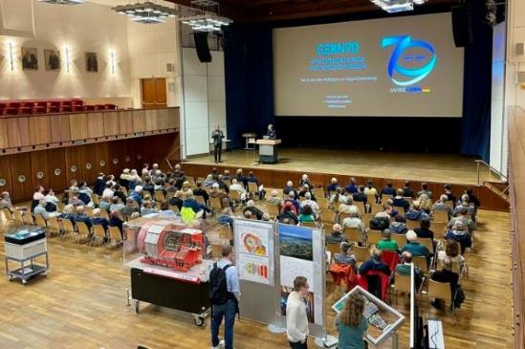
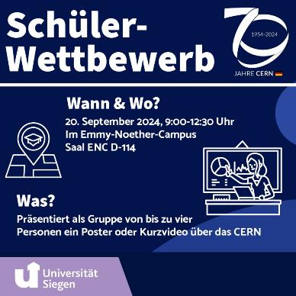
More outreach: CERN70 week events
36 events at 18 sites (including Aachen, Bonn, Freiburg, Heidelberg, Siegen, ...)
© Uni Siegen
© Oliver Pooth

Slide 16


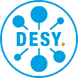

You want to get (more) involved in outreach and promoting young talents?
PROJEKTLEITUNG
PARTNER
Become facilitator (Vermittler:in), guide Masterclasses, supervise high school students´ research projects at institutes
Attend onboarding event for new (PhD) students, every 3 months
  Next event: 29.11.2024, 10:00, Onboarding in English registration
Attend communication and outreach training (2.5 days)
  Next workshop: 11.-13.11.2024 in Fulda (in German)
Meet local Netzwerk Teilchenwelt contact person at your university
Register at www.teilchenwelt.de/aktuelles/newsletter/
Group leaders:
Support your students to be active in outreach
Involve the Fellows (young students) at your university
SCHIRMHERRSCHAFT
FÖRDERER
info table @ coffee break area

