Slide 1
ECFA DRD4
Work-Package(s) 4.5
Blake Leverington¹, Guido Haefeli²
¹Heidelberg Universitaet, ²EPFL

Slide 2
WP 4.5
Currently only 1 work package, WP 4.5.1 in Scintillating Fibres
The WG4.5 is the place to propose new Work Packages with well defined goals, milestones, deliverables, and dedicated resources.
Inclusion of Luxium and Kuraray as Industrial Partners
  We would like to advance more in our development/selection of new materials
  (would they help us advance faster? How much basic R&D would they do?)
  Need the document from the DRDC/CERN Knowledge Transfer Office clarifying this for MOUs.
Strong synergy with DRD6 WP3 (Optical Calorimeters) (TASK 3.4 MATERIALS)
New groups are welcome, but will need to commit resources. The Working Group is open.
  Do we need to vote to join the WP?
  Contributions without commitment?
  Presentation by Vilnius, Lithuania group today regarding their labs

Slide 3
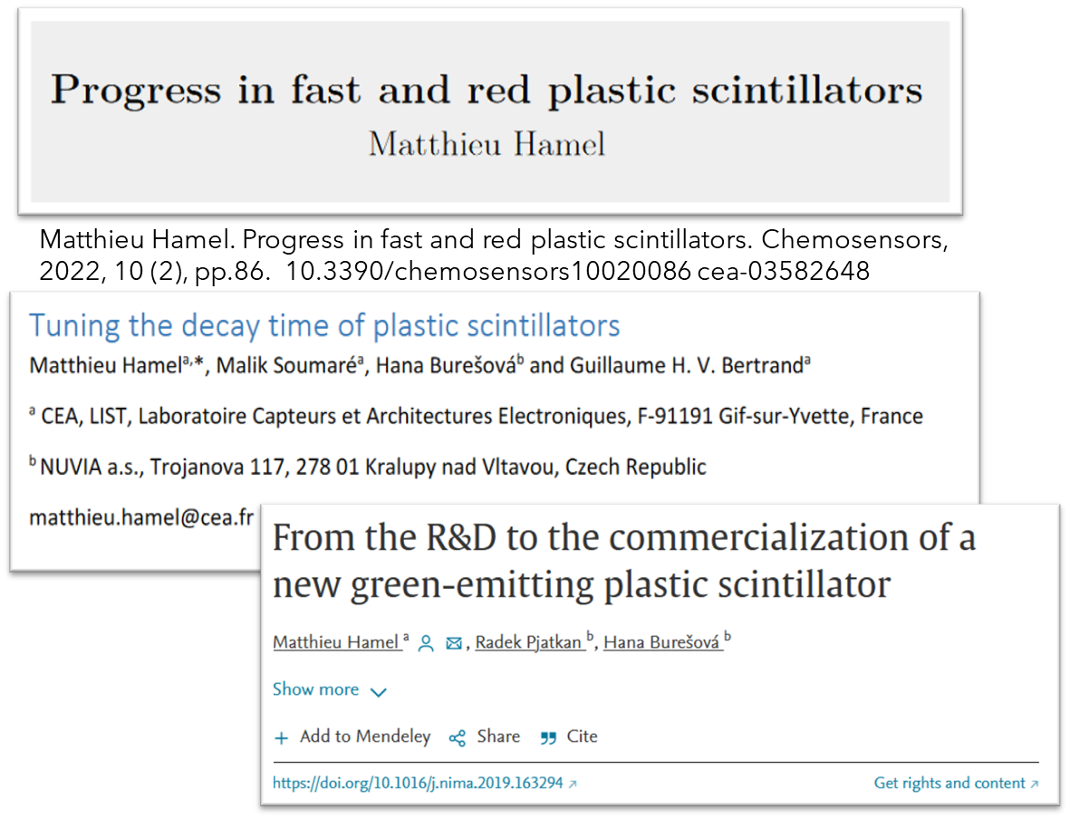

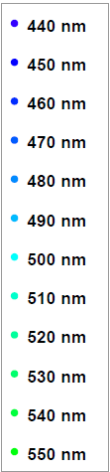
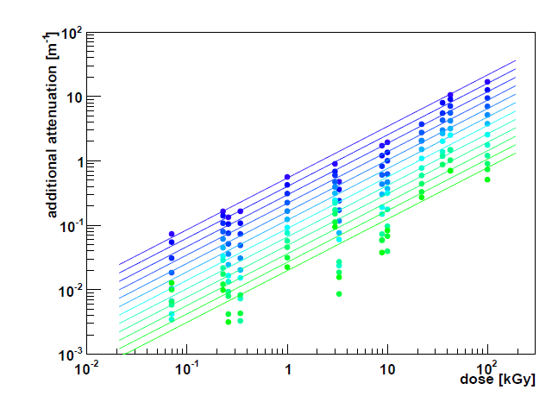
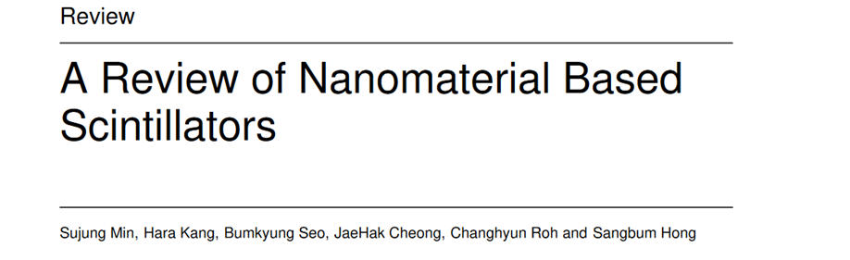
WP 4.5
Task 4.5.1:
“Develop an improved radiation hard scintillating fibre with a fluorescence decay time less than 4 ns.”
The standard fast fibre is over 25 years old (SCSF-78M and -78MJ from Kuraray)
  Peaks at 450nm, 3.5m attenuation length, 2.8ns decay time
  3HF has a decay time of 8ns, but peaks at 550nm.
Goal: A new fibre with larger Stoke’s Shift (to >500nm ) would improve the transmission after irradiation of the fibre
  Should have same or better light yield, attenuation, decay time, and stable in time.
Approx. Operational range of 78MJ
Intrinsic attenuation length 3.5m
Lots of “promising, but…”
From the thesis of R. Ekelhof, 2016. TU Dortmund

Slide 4
4.5.1 Work in Progress
Nuvea SP32 & SP33 samples confirmed to be irradiated in July 2024 at IRRAD facility
  Now sliced in 1mm samples; more similar to a fibre mat than the cube samples
Existing and any new fibres and scintillator should have their time characteristics consistently and precisely measured
  Fast Light yield is more important for efficiency
  long tails are important for noise/spillover clusters when you have 1-2 p.e. thresholds
  Presentation by Vilnius, Lithuania group today regarding their labs
EPFL ordered fibres from Luxium (4km each of 3 types)
  Luxium is interested as an Industry Partner, waiting for feedback from us on the process to join and legal aspects.
  We should discuss industry partners in the Round Table

Slide 5
Inclusion of Industry Partners: Key Considerations
Alignment of Goals and Interests
Intellectual Property (IP) Rights
Funding and Resource Allocation
Confidentiality and Data Management
Regulatory and Compliance Issues
Collaboration Governance
Performance Metrics and Evaluation
Communication and Engagement
Cultural Compatibility
Exit Strategy

Slide 6
Inclusion of Industry Partners: Key Considerations
1) Alignment of Goals and Interests
Ensure industry partner’s goals align with research objectives.
Evaluate strategic fit within both parties’ long-term plans.
2) Intellectual Property (IP) Rights
Clearly define ownership of any IP generated.
Establish terms for licensing, commercialization, and revenue sharing.
3) Funding and Resource Allocation
Determine financial contributions and management of funds.
Outline sharing of resources including personnel, equipment, and facilities.
4) Confidentiality and Data Management
Implement robust confidentiality agreements.
Develop clear protocols for data sharing, usage, storage, and protection.

Slide 7
Inclusion of Industry Partners: Key Considerations
5) Regulatory and Compliance Issues
Ensure compliance with relevant regulations and standards.
Address ethical concerns, especially in sensitive research areas.
6) Collaboration Governance
Establish a clear governance structure with defined roles and responsibilities.
Develop transparent decision-making processes and conflict resolution mechanisms.
7) Performance Metrics and Evaluation
Set specific milestones and deliverables to track progress.
Define criteria for evaluating the success of the collaboration.
8) Communication and Engagement
Develop a comprehensive communication plan for regular updates.
Identify key stakeholders and plan for their engagement.

Slide 8
Inclusion of Industry Partners: Key Considerations
9) Cultural Compatibility
Assess cultural compatibility between research team and industry partner.
Promote practices that foster a collaborative working environment.
10) Exit Strategy
Include clear termination clauses and conditions for dissolution.
Plan for the continuation of the project if the partnership ends prematurely.

