Slide 1
4.3.4 : Study of RICH Detectors for Future Electron positron Colliders
Summary and directions

Slide 2
Introduction
FCC-ee will produce copious heavy flavour hadrons
World class flavour physics programme is possible IF one can have excellent hadron separation for deteriming modes, resolving combinatorics.
Also necessary for H->ss/cc/bb separation
Expected range of momentum for B decay children 1-40 GeV
Concept is the ARC detector
Kick-off meeting held 6/6/24
  IndicoPageHere (source of this talk’s material)
Milestones as stated in the project:
  Milestone 4.3.4: Full conceptual design for ARC detector (M12).
  Deliverable 4.3.4: Evaluation of prototype ARC cell (M36).

Slide 3
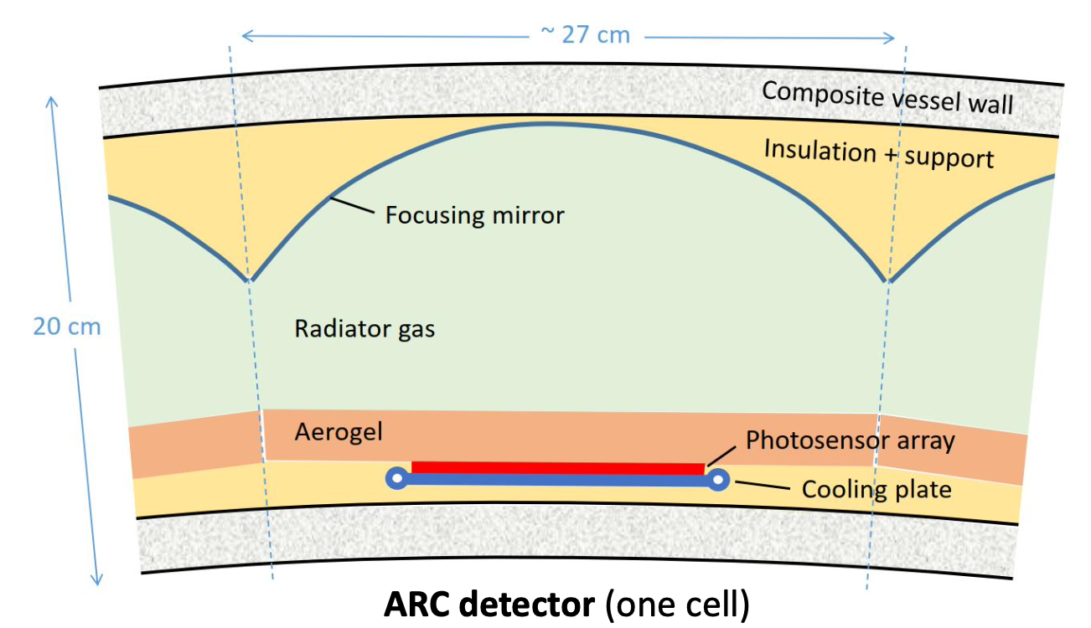
ARC concept
Compact in size, cellular in design
Tile the tracking detector
Aerogel as secondary radiator for low P tracks, also a thermal insulator for photosensor
Material budget <0.1 X₀
Goal: Construct prototype of single cell in 3 years

Slide 4
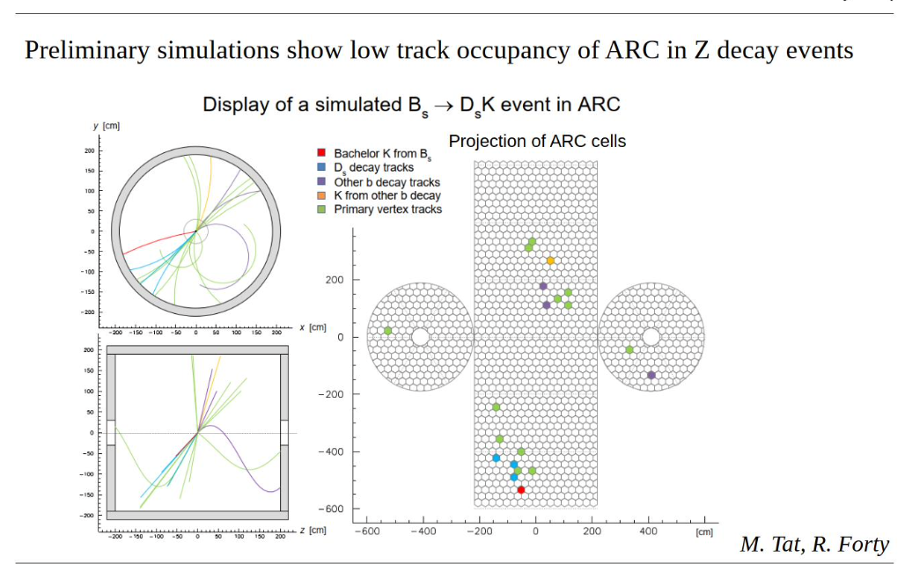
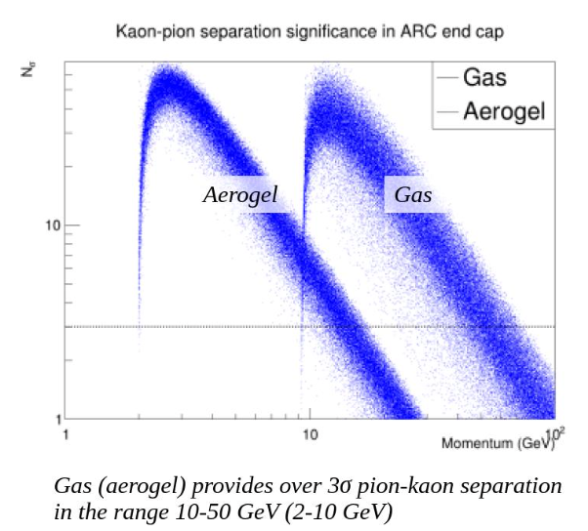

Slide 5
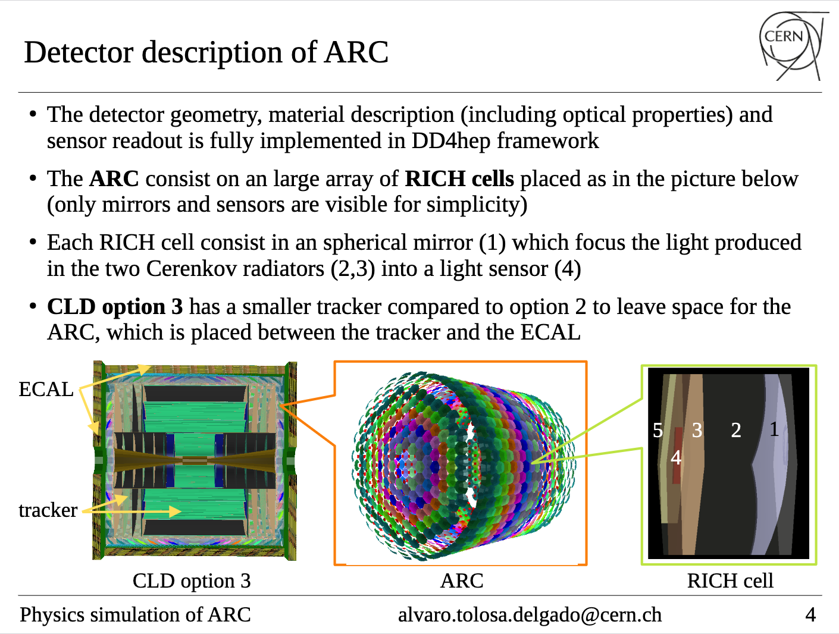
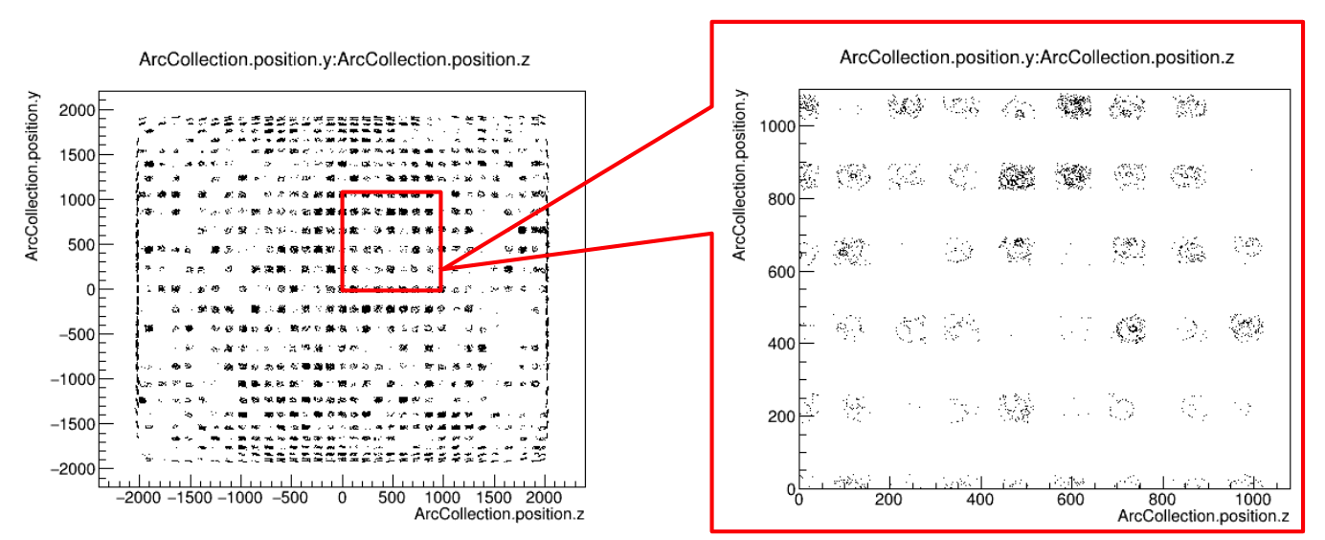
SIMulation
Work advanced
Lower diagram shows simulation of H→ss events. Hit pattern for photons in ARC
Zoom in show rings
Can see the inner rings and outer rings from gas/aerogel radiators
So far studied with stand-alone ray-tracing
Implement reconstruction for particle ID, including effects of scattering and background

Slide 6
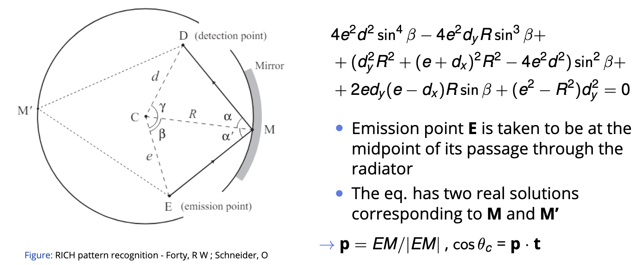
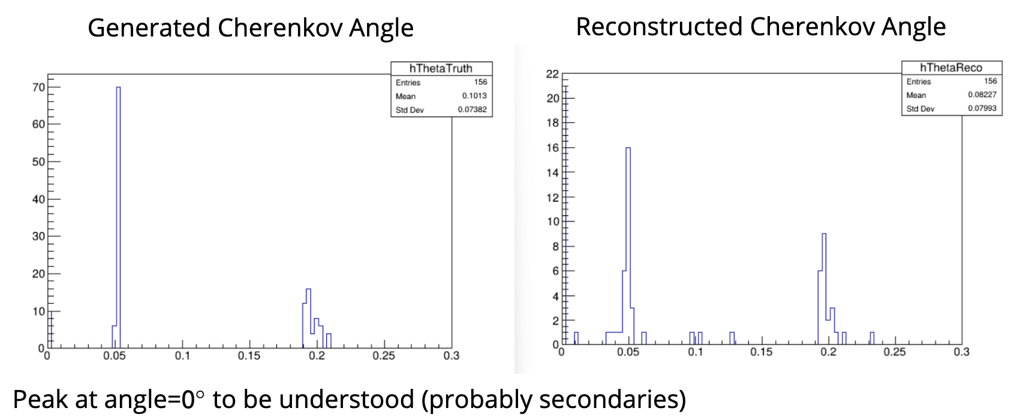
reconstruction
The goal is to implement the local pattern recognition method, originally described by Roger Forty and Olivier Schneider (LHCB/98-040) here
Particle Gun simulation
Serena Pezzulo

Slide 7
Milestones & Deliverables
Milestone 4.3.4: Full conceptual design for ARC detector (M12).
  Simulations are in an advanced state
  On target
Deliverable 4.3.4: Evaluation of prototype ARC cell (M36).
  Plenty of synergies with other DRD4 WP
  In the next few slides I will outline some properties and combined regions of interest

Slide 8
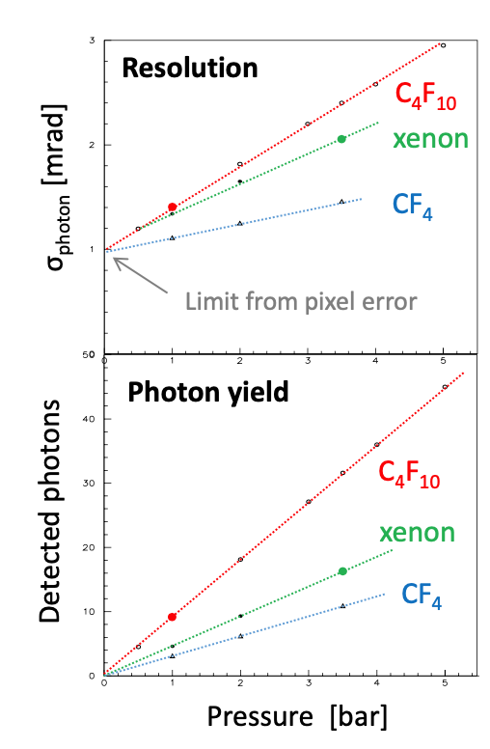
Gas radiator
C₄F₁₀ baseline solution
Long term choice may need to be different
(4.3.1) Study of radiator alternatives to fluorocarbons

Slide 9
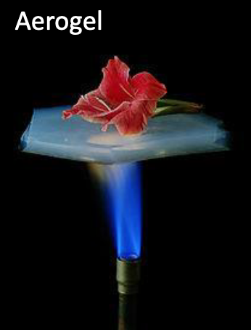
photosensors
Silicon PMs likely technology : Excellent photon detection efficiency, compact, high granularity
  Assume can fit sensor and readout electronics in few mm
Prototype requirements need 10x10cm array with mm-scale pixelization. This is not available. Development is aligned with other WP tasks
  Synergy with 4.3.3
Dark count rate falls with temp so assume some cooling required, again overlap with 4.3.3 (but need to insulate from the gas)
Readout electronics (developed in 4.1.3) – timing capabilities could be used to reduce dark count rates

Slide 10
Summary
4.3.3 seeks to design and build a prototype for a cellular compact RICH detector that could be placed around a tracking volume at FCC-ee to provide Heavy flavour research capabilities
Simulation work is progressing well
Requirements of the detector in the presence of background and other realistic effects need further development
Technologies being developed in DRD4 have synergies
Prototype could also be a test bed for some of these activities.

