Slide 1

ALLEGRO Noble Liquid
Upcoming Beam Tests
J.Rutherfoord
13 December 2024
v1

Slide 2
Proposal to ALLEGRO collaboration
The University of Arizona group proposes to be responsible for organizing all test beam runs at the CERN North Area
Provide all cryostat/cryogenics systems
  Also DAQ, trigger, …
Coordinate with CERN services for scheduling, procurements, safety, …
Organize ALLEGRO testbeam aims and needs
Manage the test beam run

Slide 3
Arizona Management Experience
Test beam runs organized and run
  1993 November H8 – EM Energy resolution
  1995 Summer H6 – Test realistic preamps …
  1998 Summer H6 – Hadron Energy resolution
  2003 Summer H6 – FCal Calibration Run
  2004 Summer H6 – Correct FCal/HEC transition
  2005 Summer H6 – Fully populated readout
  2021 Summer H2 – FCalPulse (Space-charge)
  2022 Summer H8 – FCalPulse (Space-charge)

Slide 4
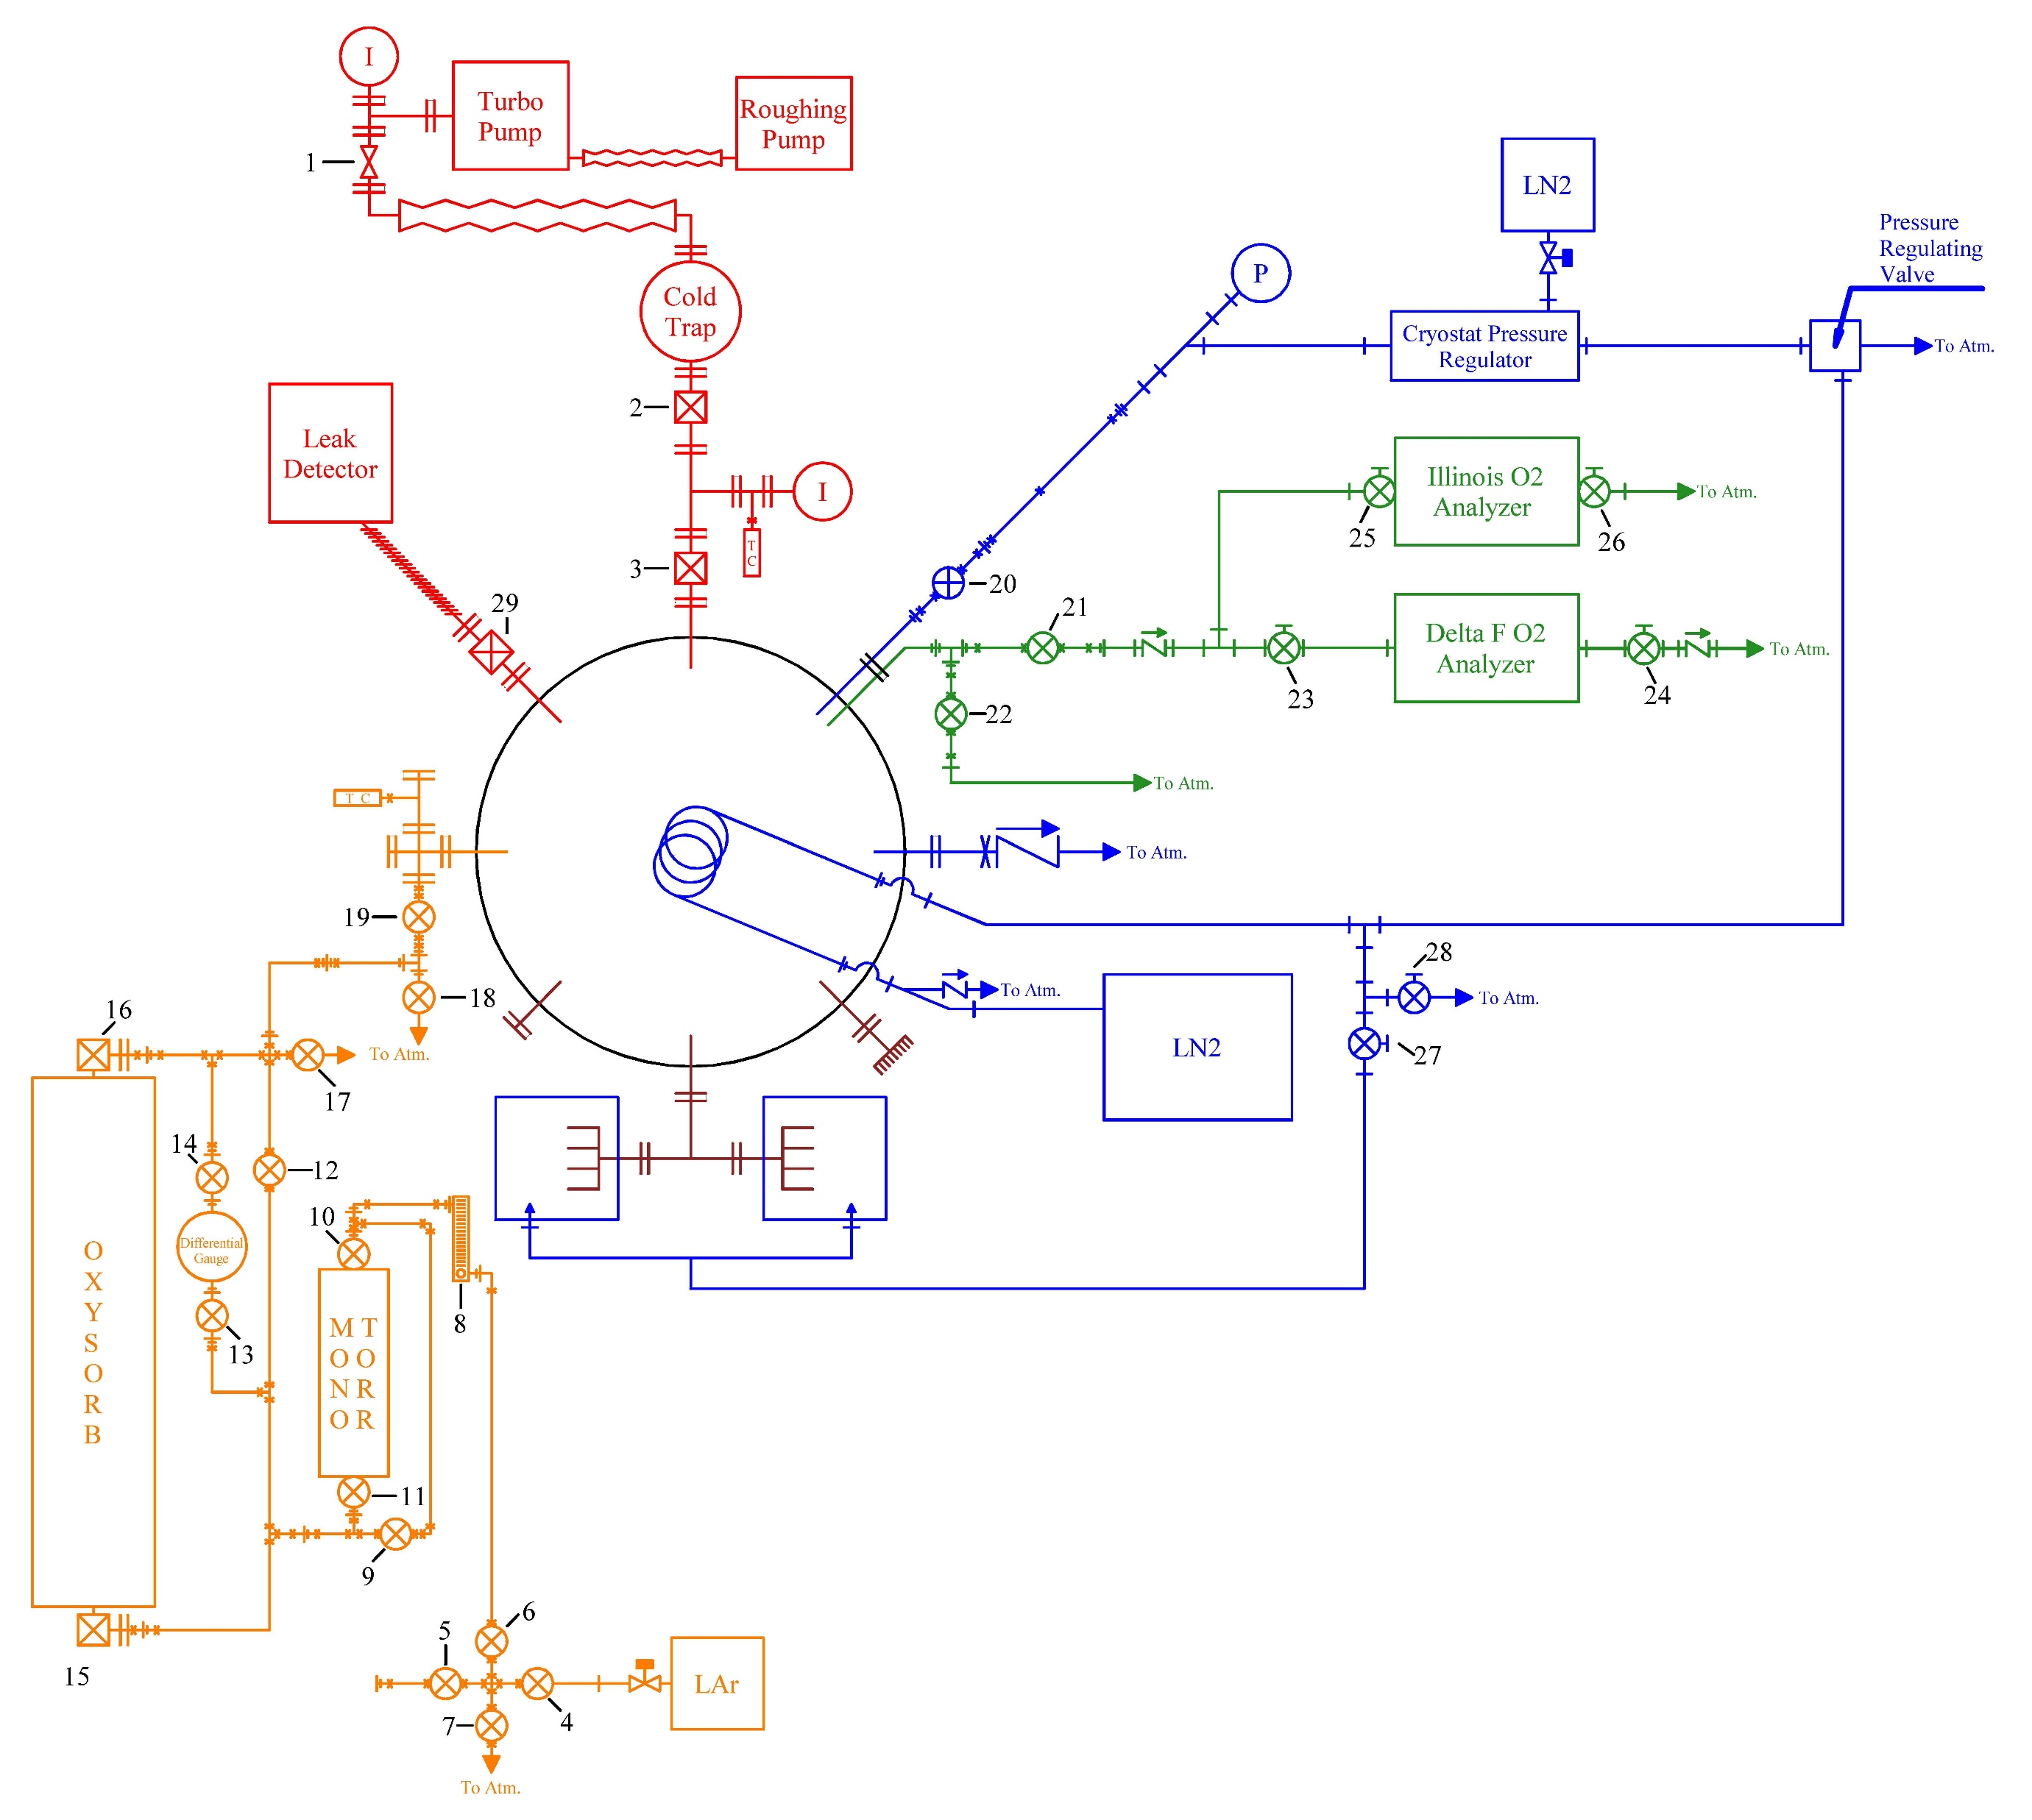
Cryostat/Cryogenics system schematic

Slide 5
Cryogenics System properties
Designed to be “baked out”
No “O-rings”, all metal (Cu) seals
  Earlier versions have rubber O-rings
Pull vacuum ~ 10⁻⁵ Torr
Safety “pop-off” valves
Anti-freezing LN2 flow-control valve
Safe in power outages – pressure regulated valves

Slide 6
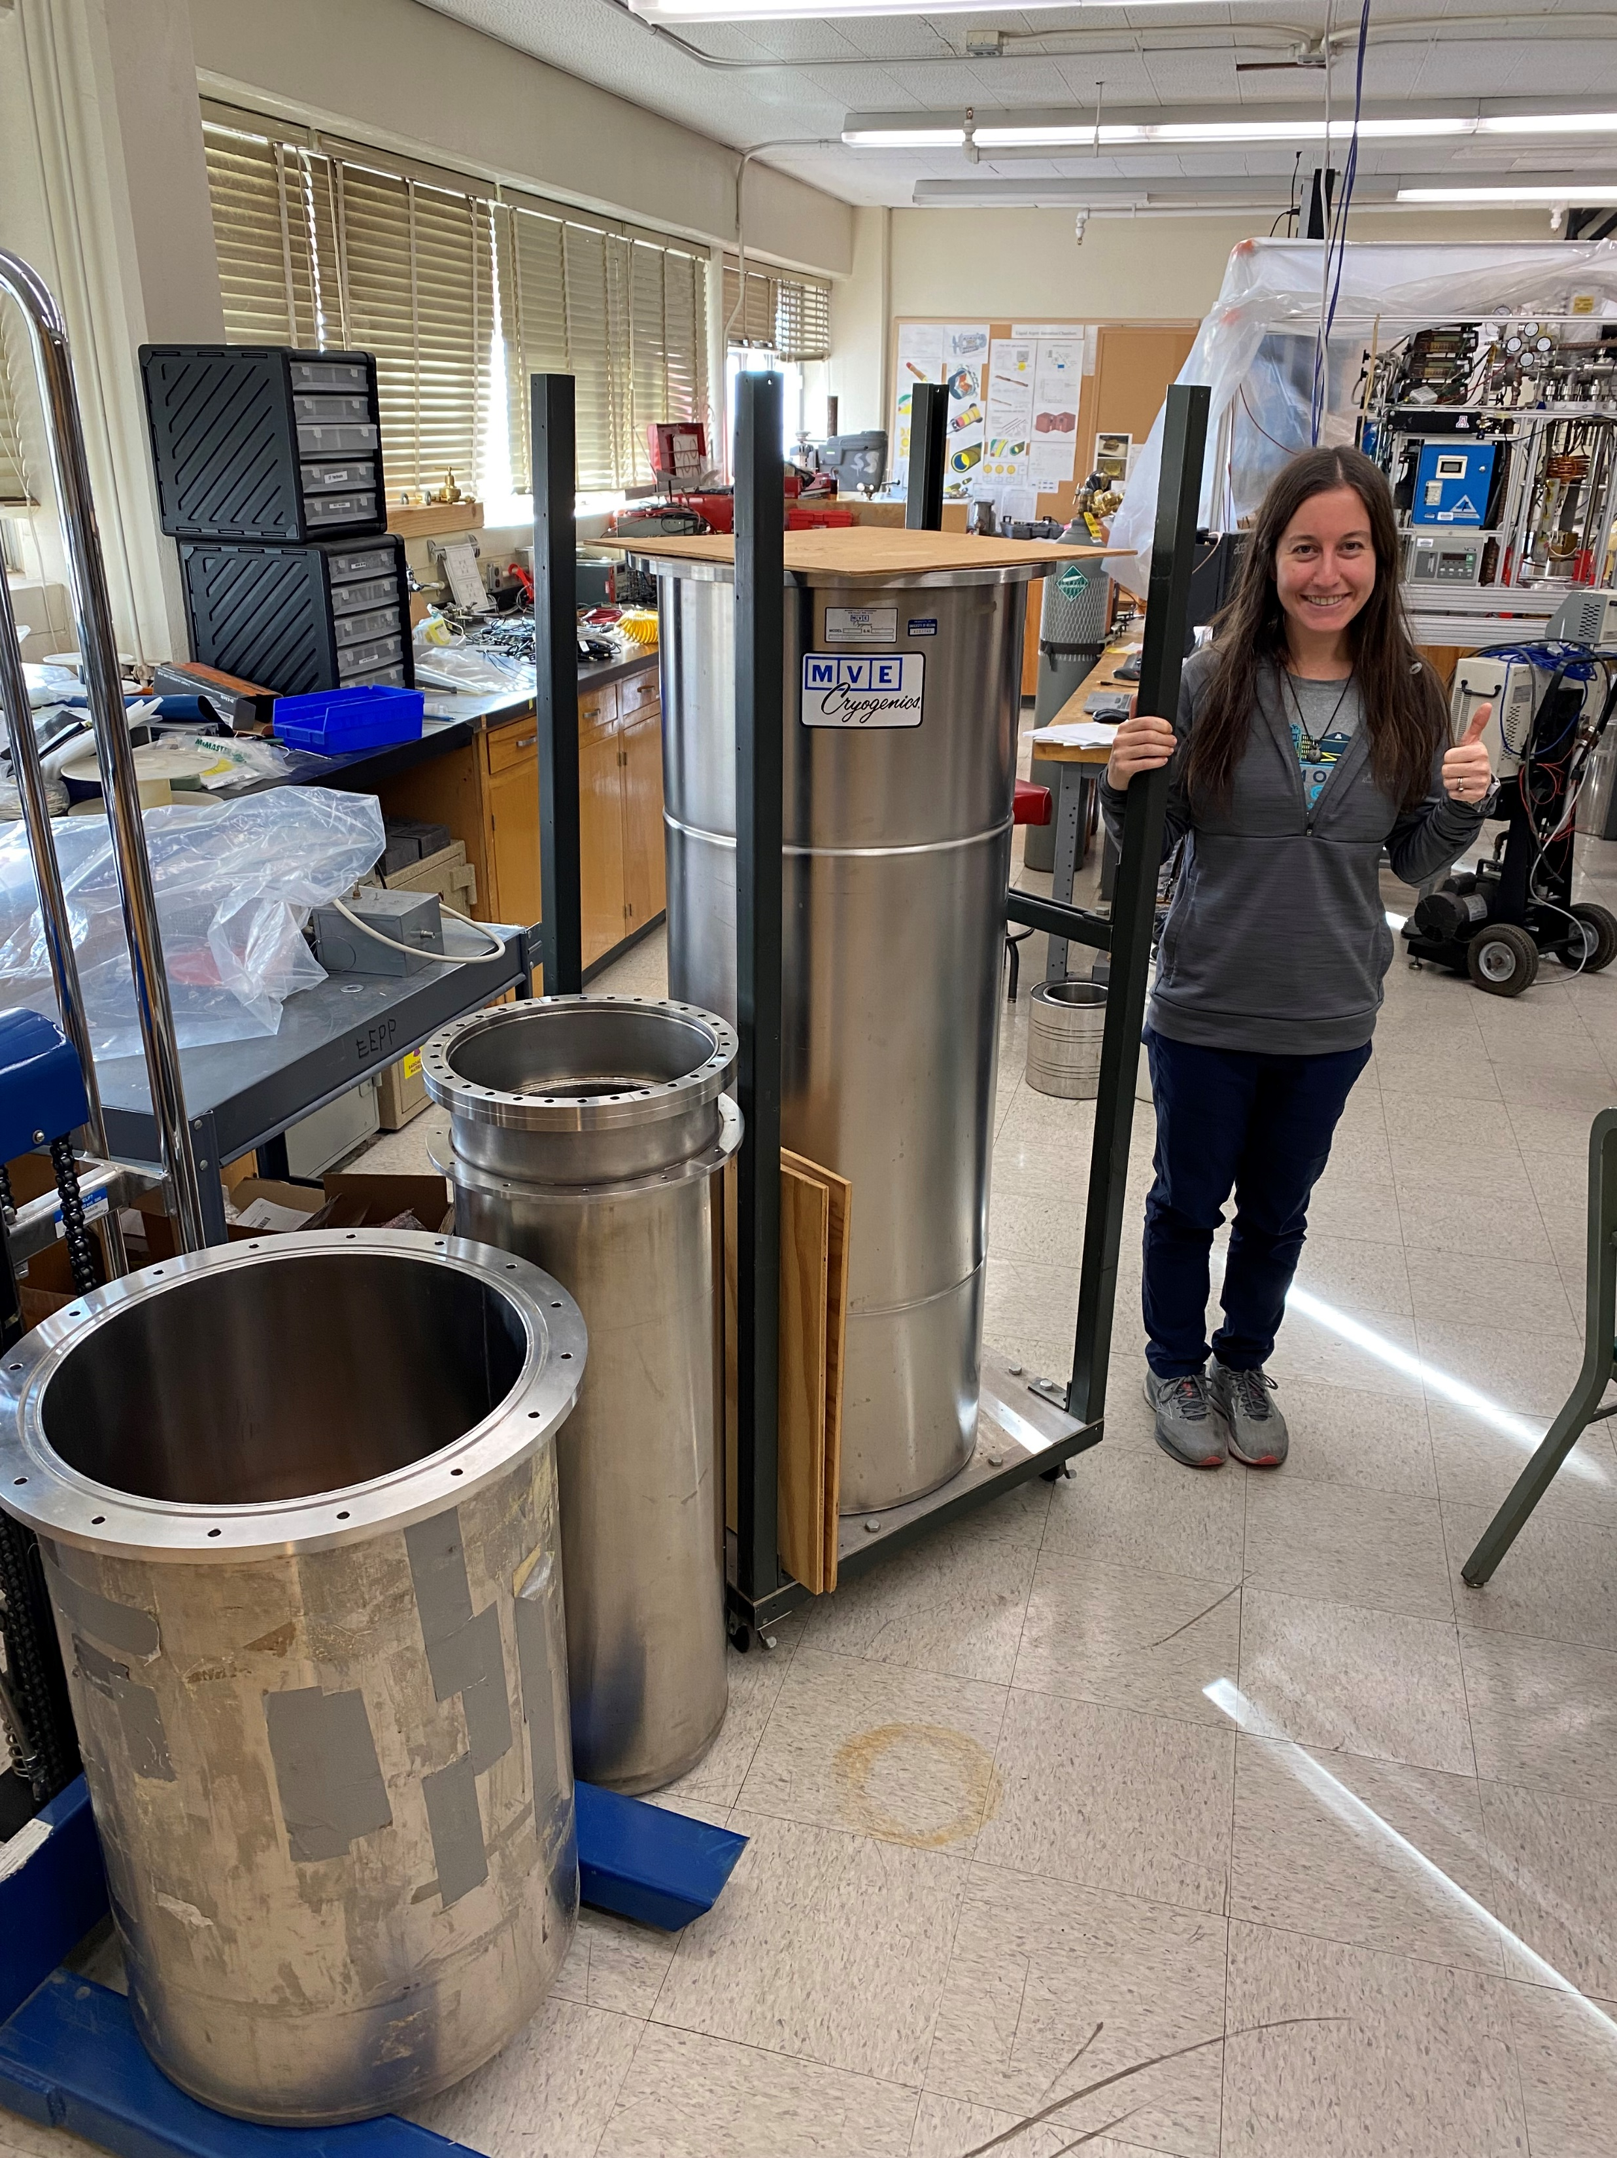
Inner Diameter 428 mm
Inner Diameter 260 mm
Inner Diameter 428 mm
Depth
600 mm

Slide 7
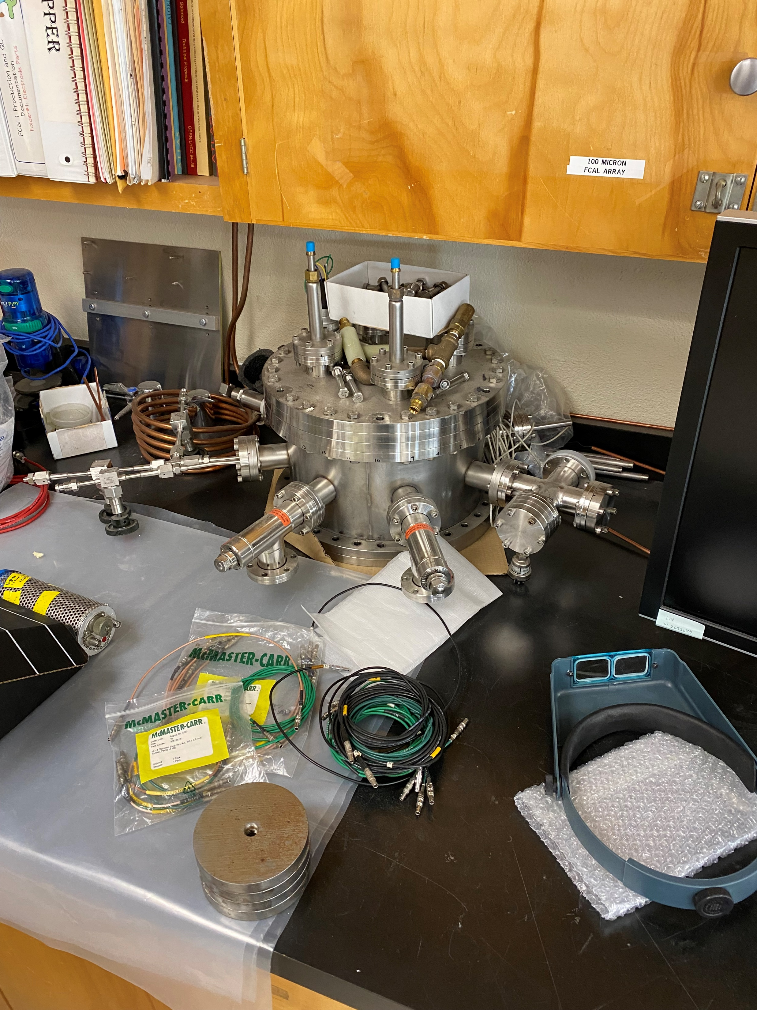

Slide 8
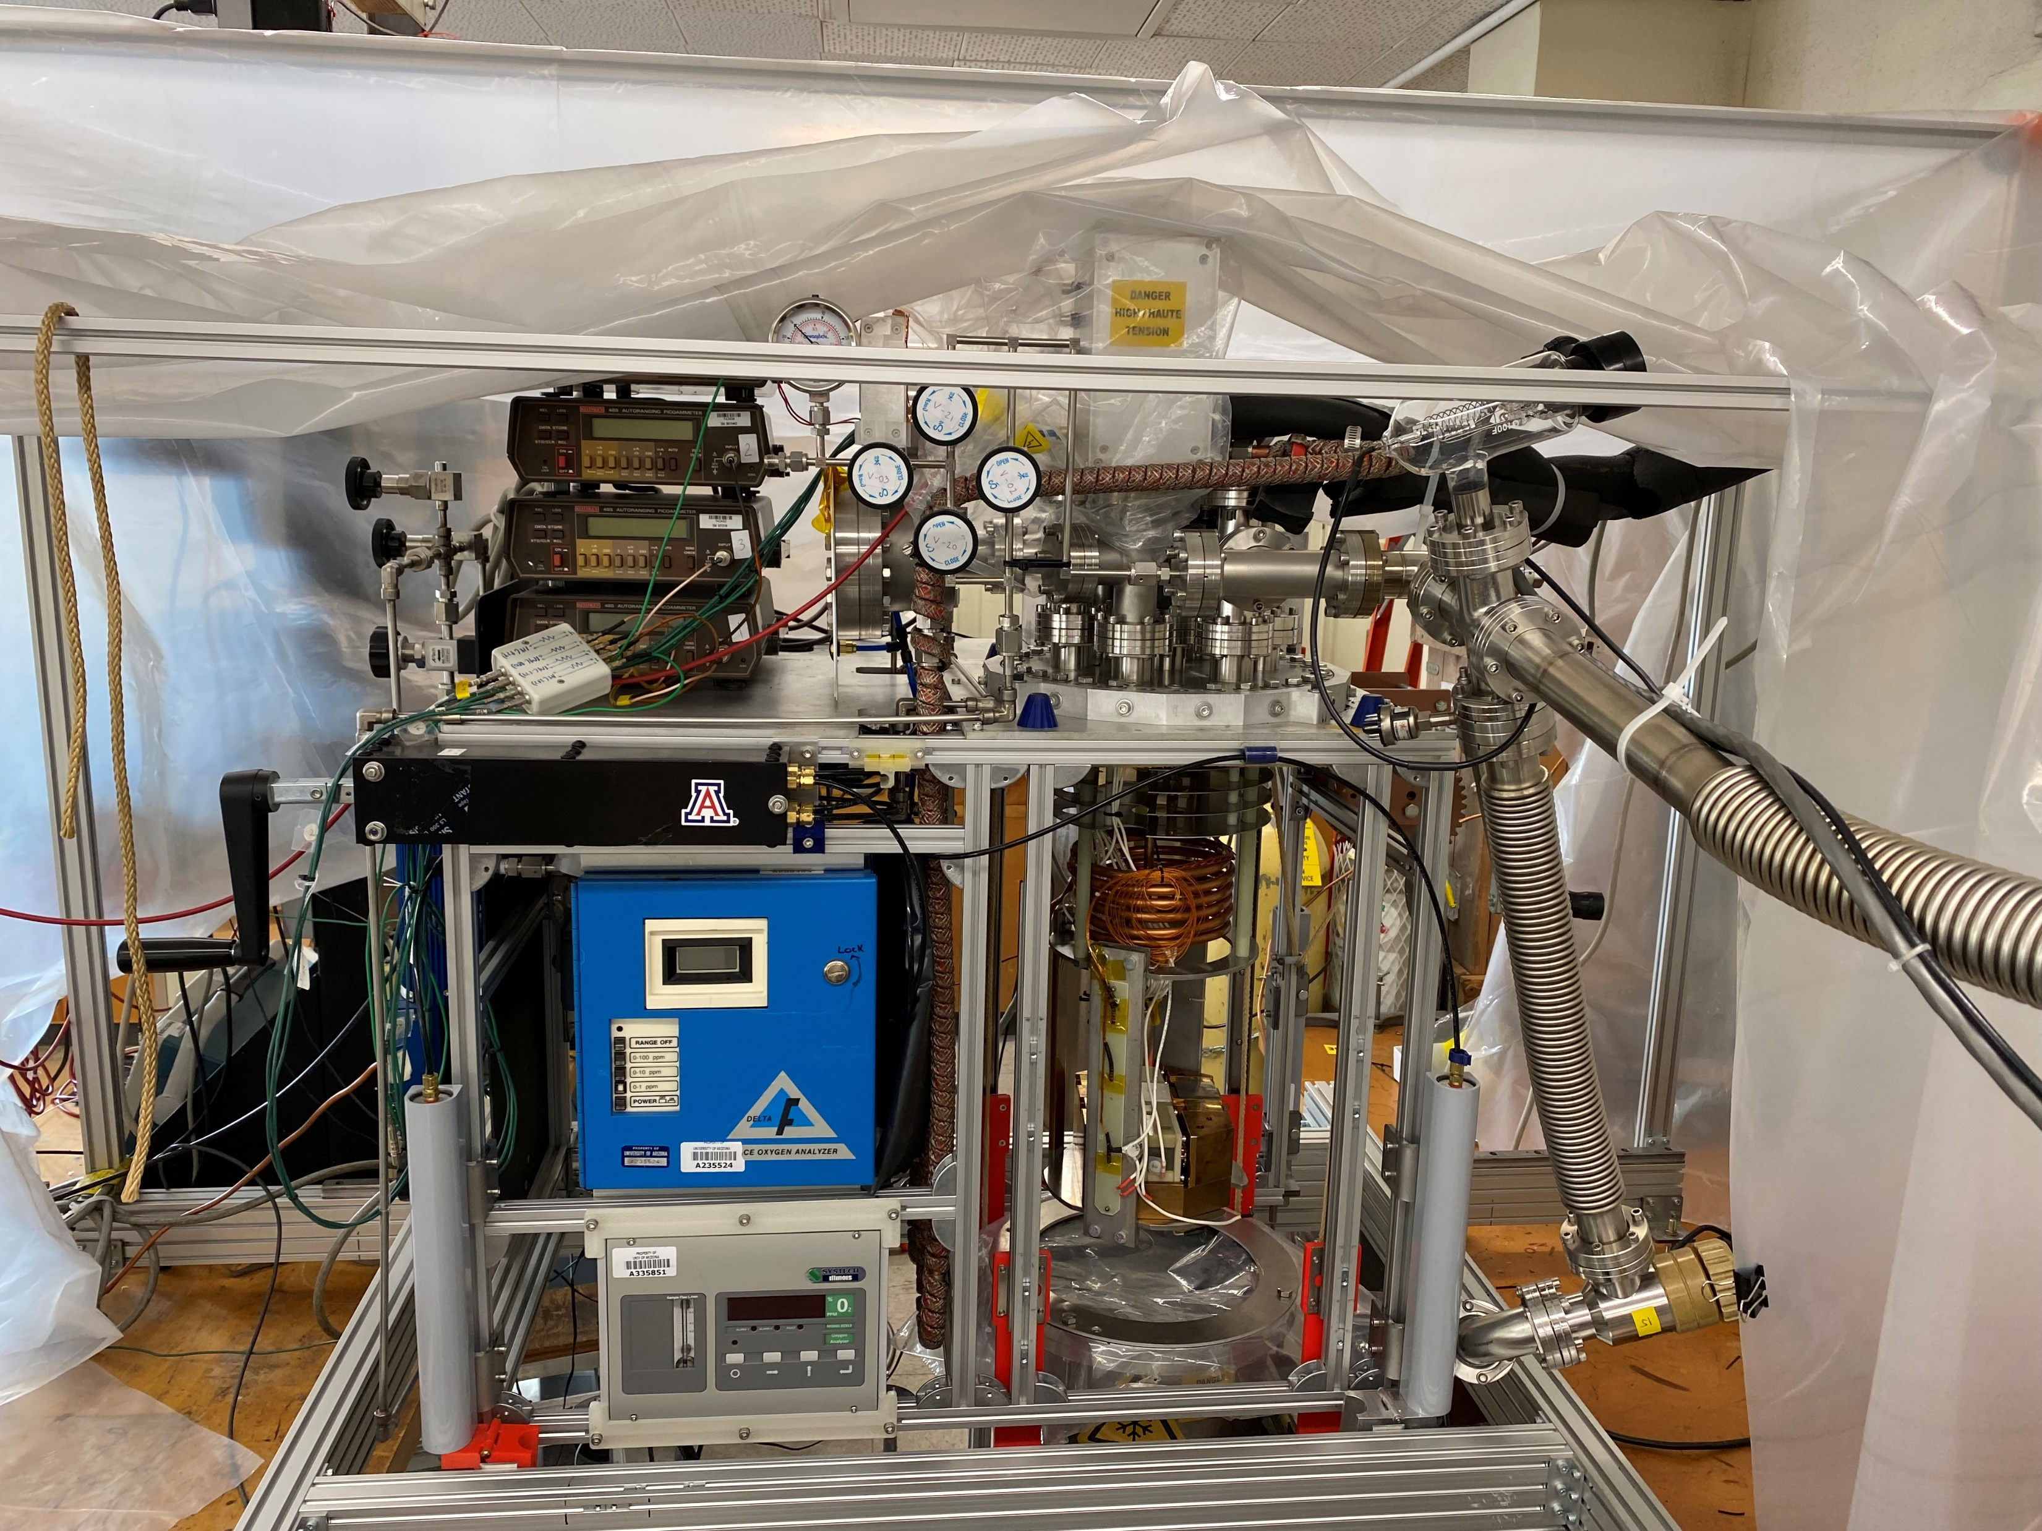

Slide 9
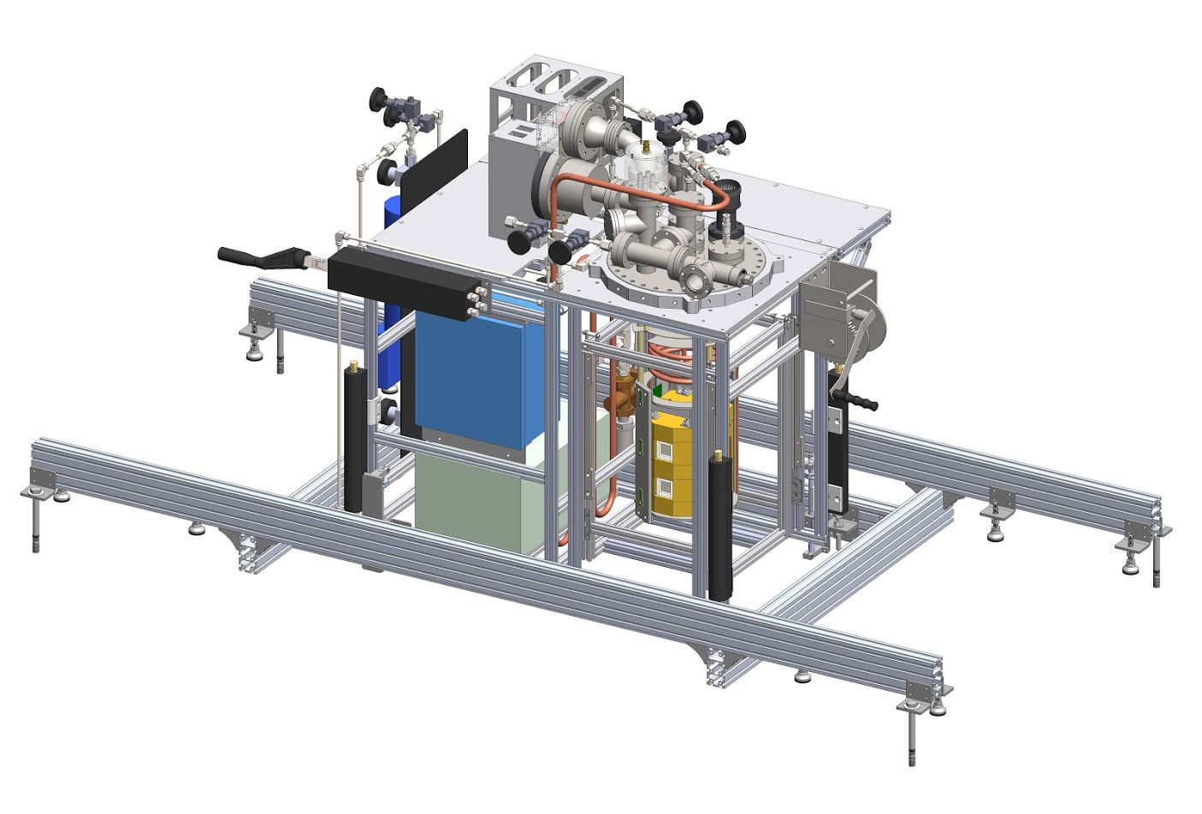
Setup in CERN North Area

Slide 10
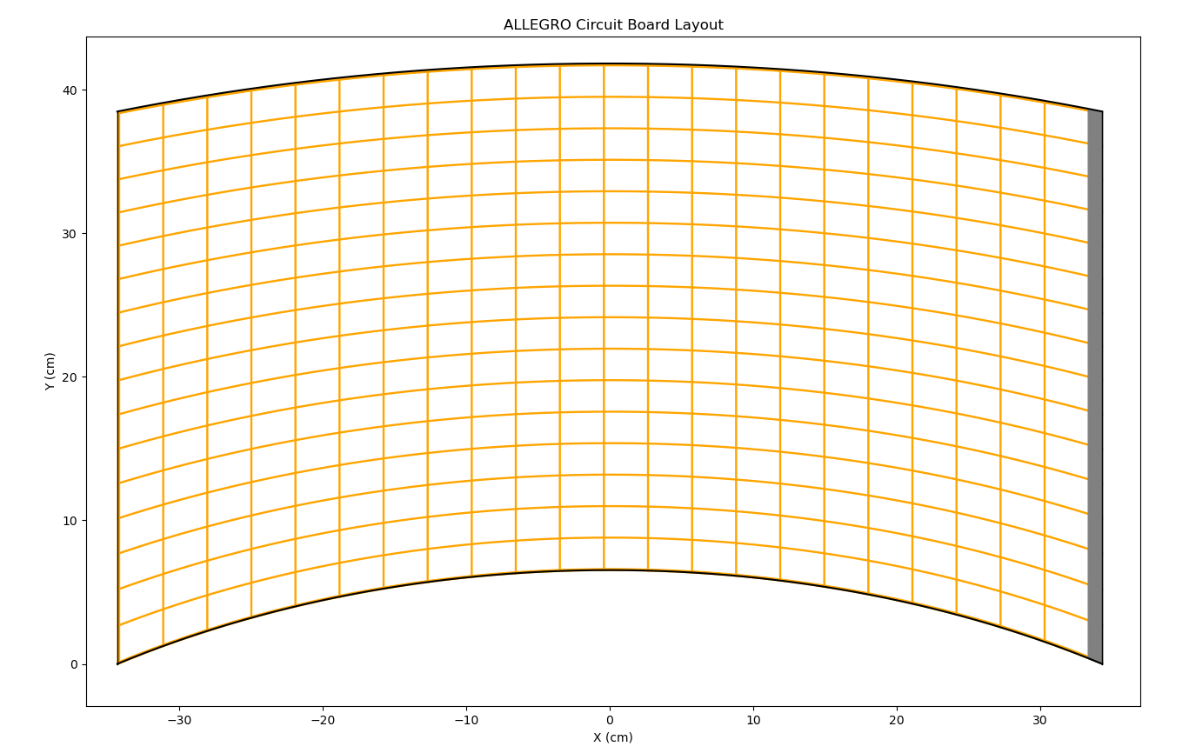

Slide 11
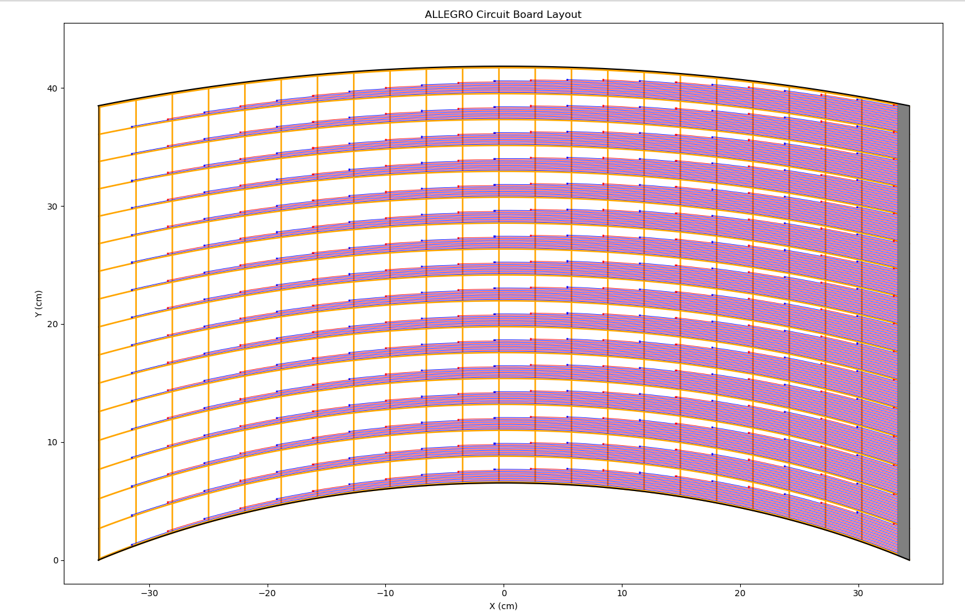

Slide 12
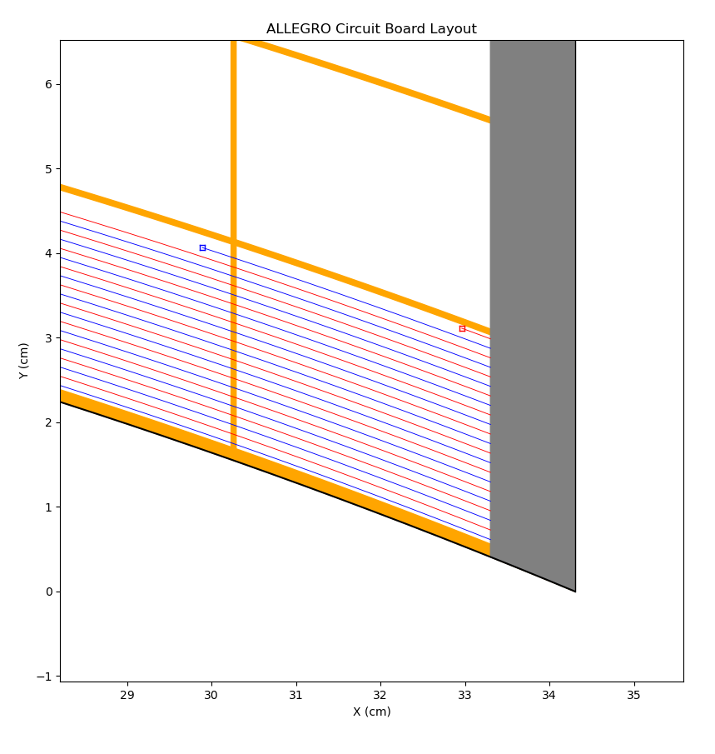

Slide 13
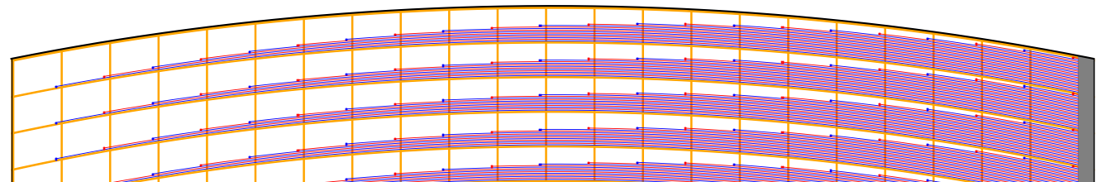
700 mm
EM shower initiator
350 GeV e⁻ beam
428 mm
Cryostat top view
absorber/readout/absorber boards

Slide 14
DAQ
Preamp 8 ns risetime
32 – 40 channels digitizer
2 ns sampling 14 bit adc
5 Msample buffer

