Slide 1
MP3 Piquet
Progress meeting
What have we (not) done ?
Main interventions
Reminder: Working rules
Continuation / Feedback

Slide 2
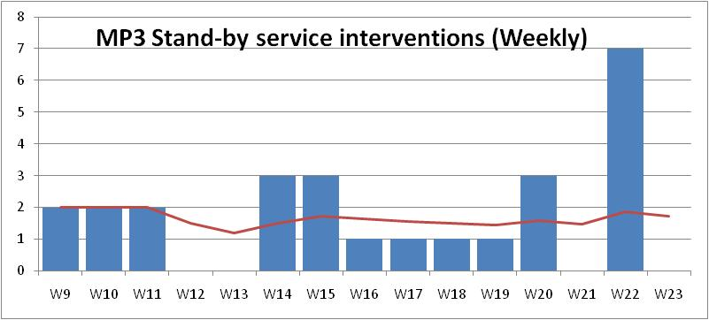
MP3 Piquet
What have we done ? : 26 interventions / Average ≈ 2/week
  Operators manual / Automatic analysis tool (Markus and …)
  Quench test campaign (not formally MP3 piquet)
What have we (I) not done ?
  Follow-up meetings (ad-hoc or once a month …): This one but …
  Update MP3 website including minutes
  …

Slide 3
MP3 Piquet
Main interventions:
  Check trips / heaters discharges
  Current leads trip (and subsequent verification campaign)
  Not counted: QPS/Operation support advises
  ….
Appreciated by OP / For them, no doubt that this should continue

Slide 4
MP3 Piquet
Working rules:
+ One week stand-by per staff every 2 months
+ Starting Tuesday at 7:00 am [For Monday meeting]
+ Duties :
Available by phone & at < 1 hour of an efficient internet connection
Check at least daily the logbooks (OP, QPS, MPP)
Attend morning meetings if relevant
Fill MPP logbook and send email to list after intervention
[List: us + Nuria, Andrea, Reiner, Knud, Andrzej, relevant staff (CRG,…)…
Workload : 1 hour + 3.5 hours + 7 * 15 min = 6.25 hours every 8 weeks so < 2 % but availabilty one WE and 7 nights every 2 months

Slide 5
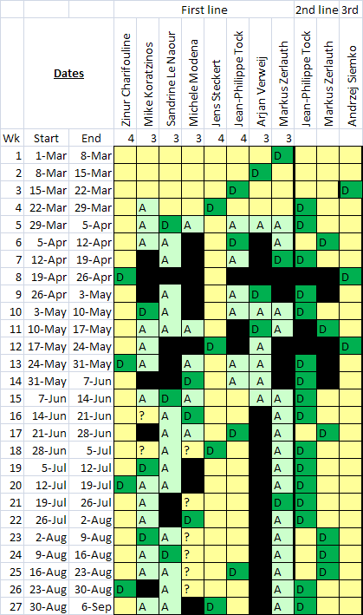
MP3 Piquet
Continuation / Feedback:

