Slide 1
Industrial & Human Resources
Return for Ukraine
Update since March 2023
CERN-Ukraine Committee Meeting 21.06.2024
Christoph Schäfer / CERN International Relations

Slide 2
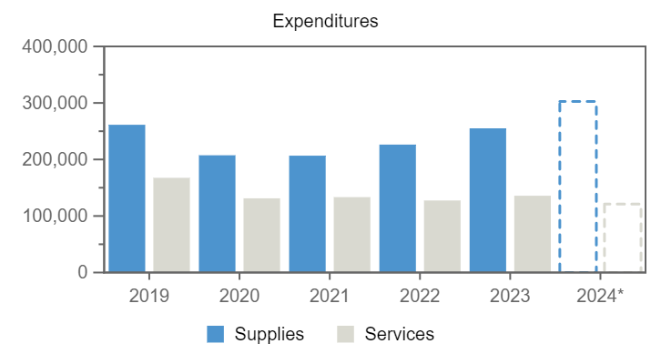
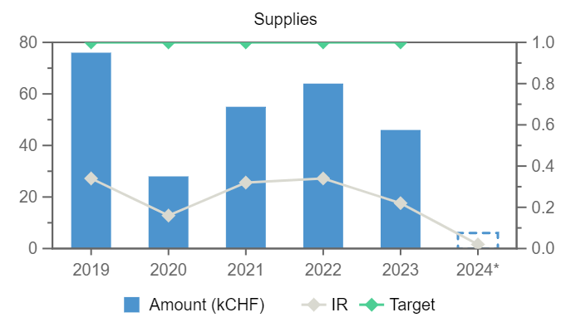

Supplies
Services
76
28
55
64
46
–
–
–
–
–
6
–
Expenditures (Ukraine, kCHF)
Year
2019
2020
2021
2022
2023
2024*
Annual contributions and industrial returns for Ukraine
Contributions (kCHF)
Expenditures (All countries totals, kCHF)
Expenditures (Ukraine, kCHF)
Year
Country Contribution
All Countries
%
Year
Supplies
Services
Year
Remaining
Procurement**
Personnel
2019
1 000
1 171 420
0.09
2019
261 375
167 528
2019
-54
78
976
2020
1 000
1 196 893
0.08
2020
207 407
131 216
2020
- 194
30
1 164
2021
1 000
1 199 321
0.08
2021
206 717
133 358
2021
- 676
56
1 620
2022
1 000
1 206 284
0.08
2022
226 311
127 469
2022
-1 145
64
2 081
2023
1 000
1 230 382
0.08
2023
255 070
135 859
2023
- 833
46
1 787
2024
1 046
1 265 843
0.08
2024*
302 518
121 036
2024*
- 209
6
1 248
Industrial Return
Annual Industrial Return
Supplies
Services
Year
Ratio
Target
Ratio
Target
2019
0.34
1
–
0.4
2020
0.16
1
–
0.4
2021
0.32
1
–
0.4
2022
0.34
1
–
0.4
2023
0.22
1
–
0.4
2024*
0.02
–
–
–
*Provisional figure based on commitments

Slide 3
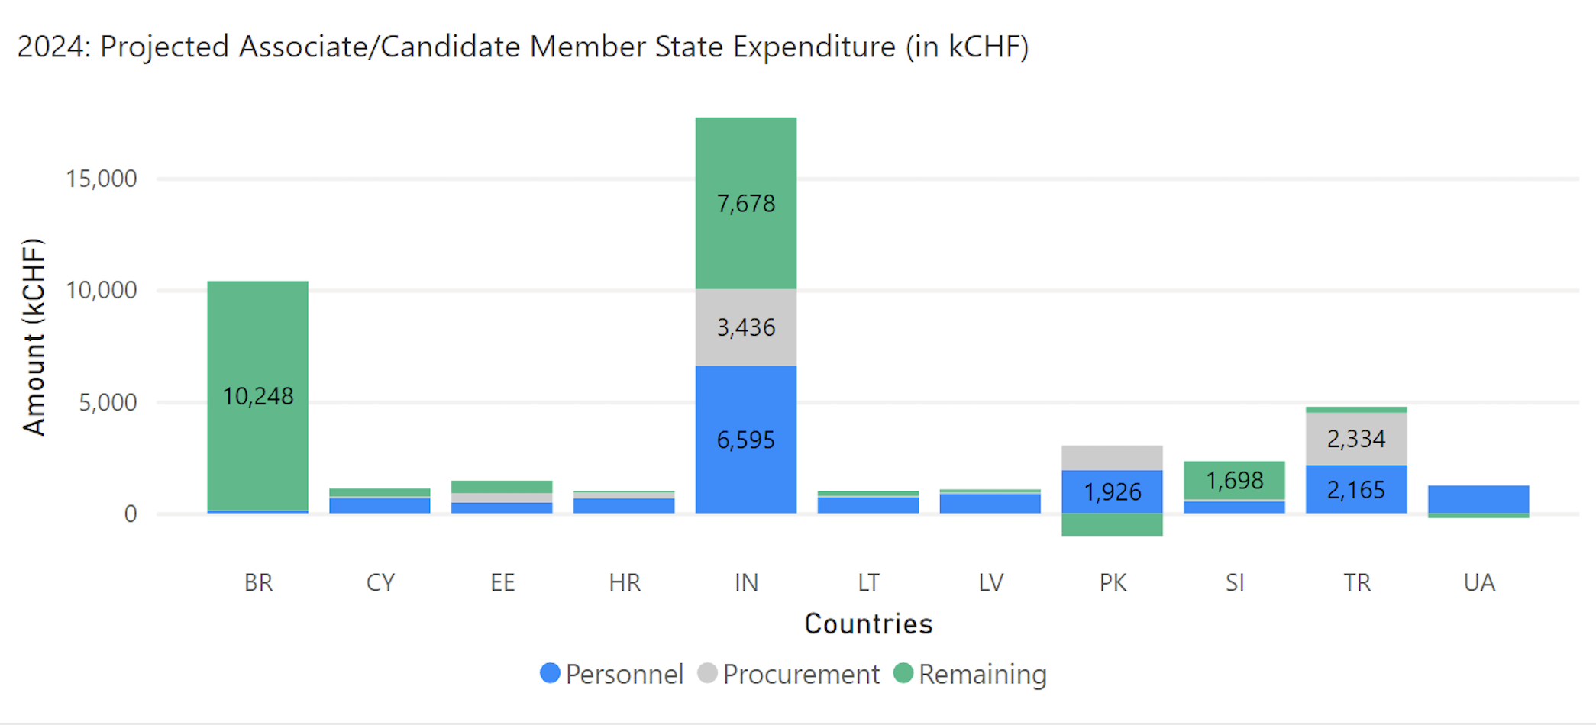

Slide 4
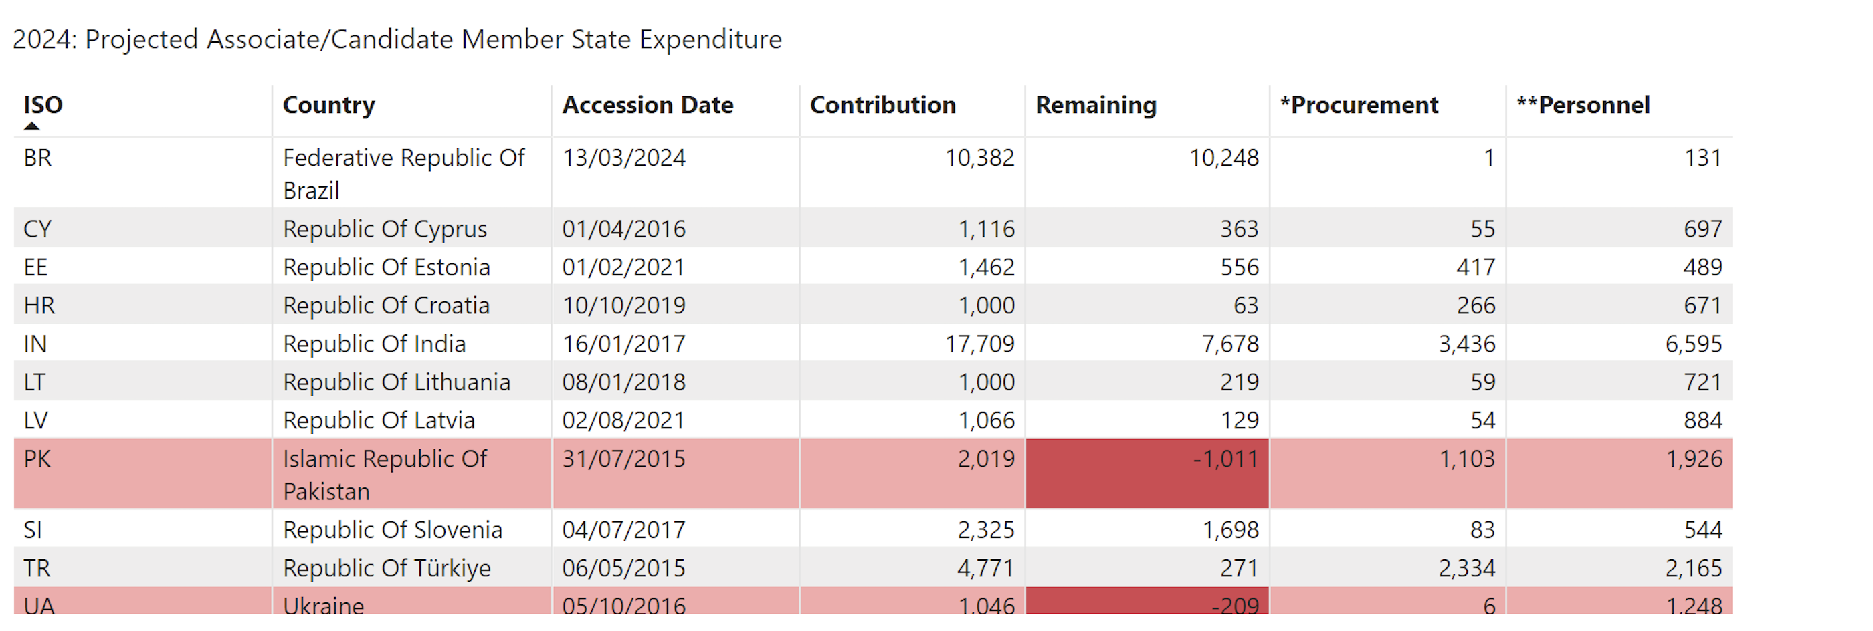
Key message: Ukraine gets more money out than is putting in

Slide 5
List of contract/orders with the highest turnover in 2024 for Ukraine
Contract/Order
Description
Supplier
Amount (CHF)
CT1200072
30 DAYS
NOTZ METALL AG
3 079
CA1121477
TUBES POUR INJECTION PLUGS
NOTZ METALL AG
1 845
CA1558332
J3085917, CMS TUBES AND ELBOWS P1
NOTZ METALL AG
724
CT1102974
TUBE INOX 316L D.12 X 10 RE
NOTZ METALL AG
264

Slide 6
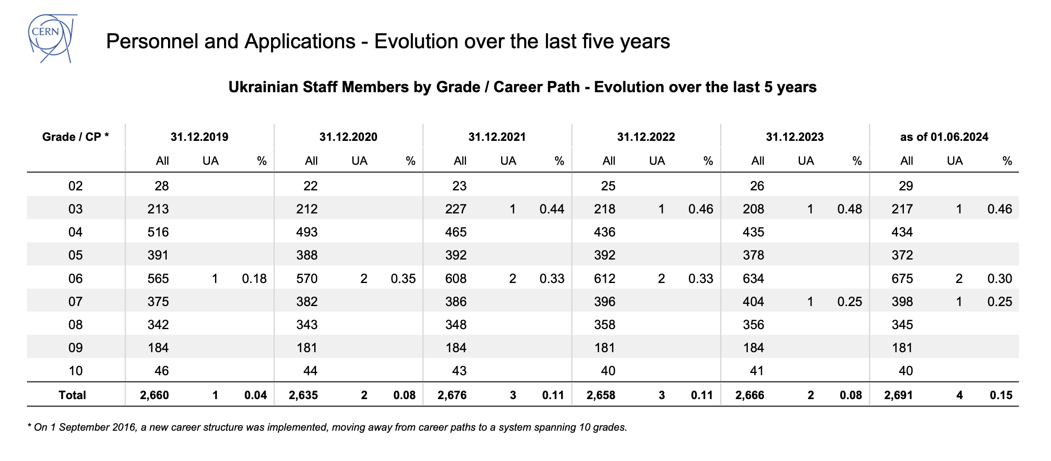

Slide 7
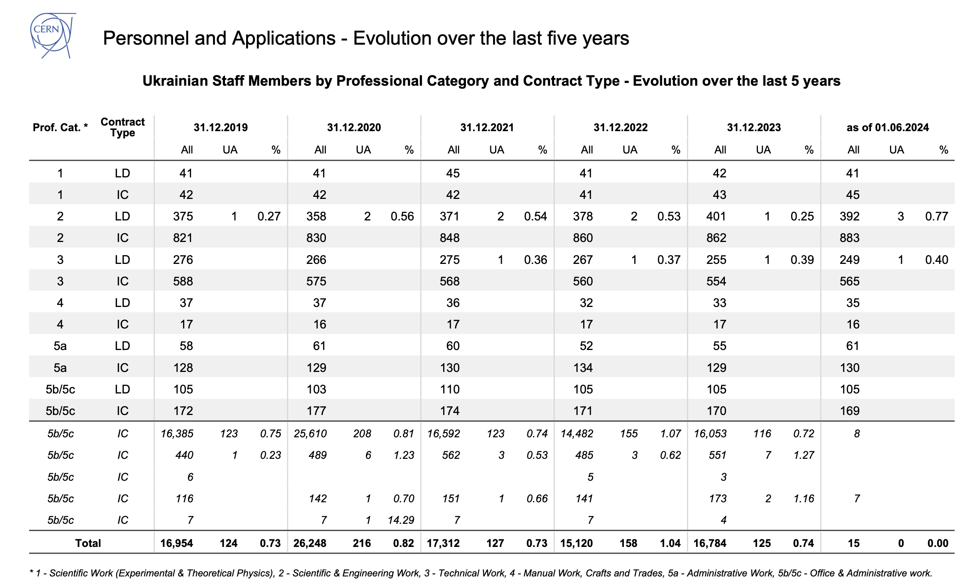

Slide 8
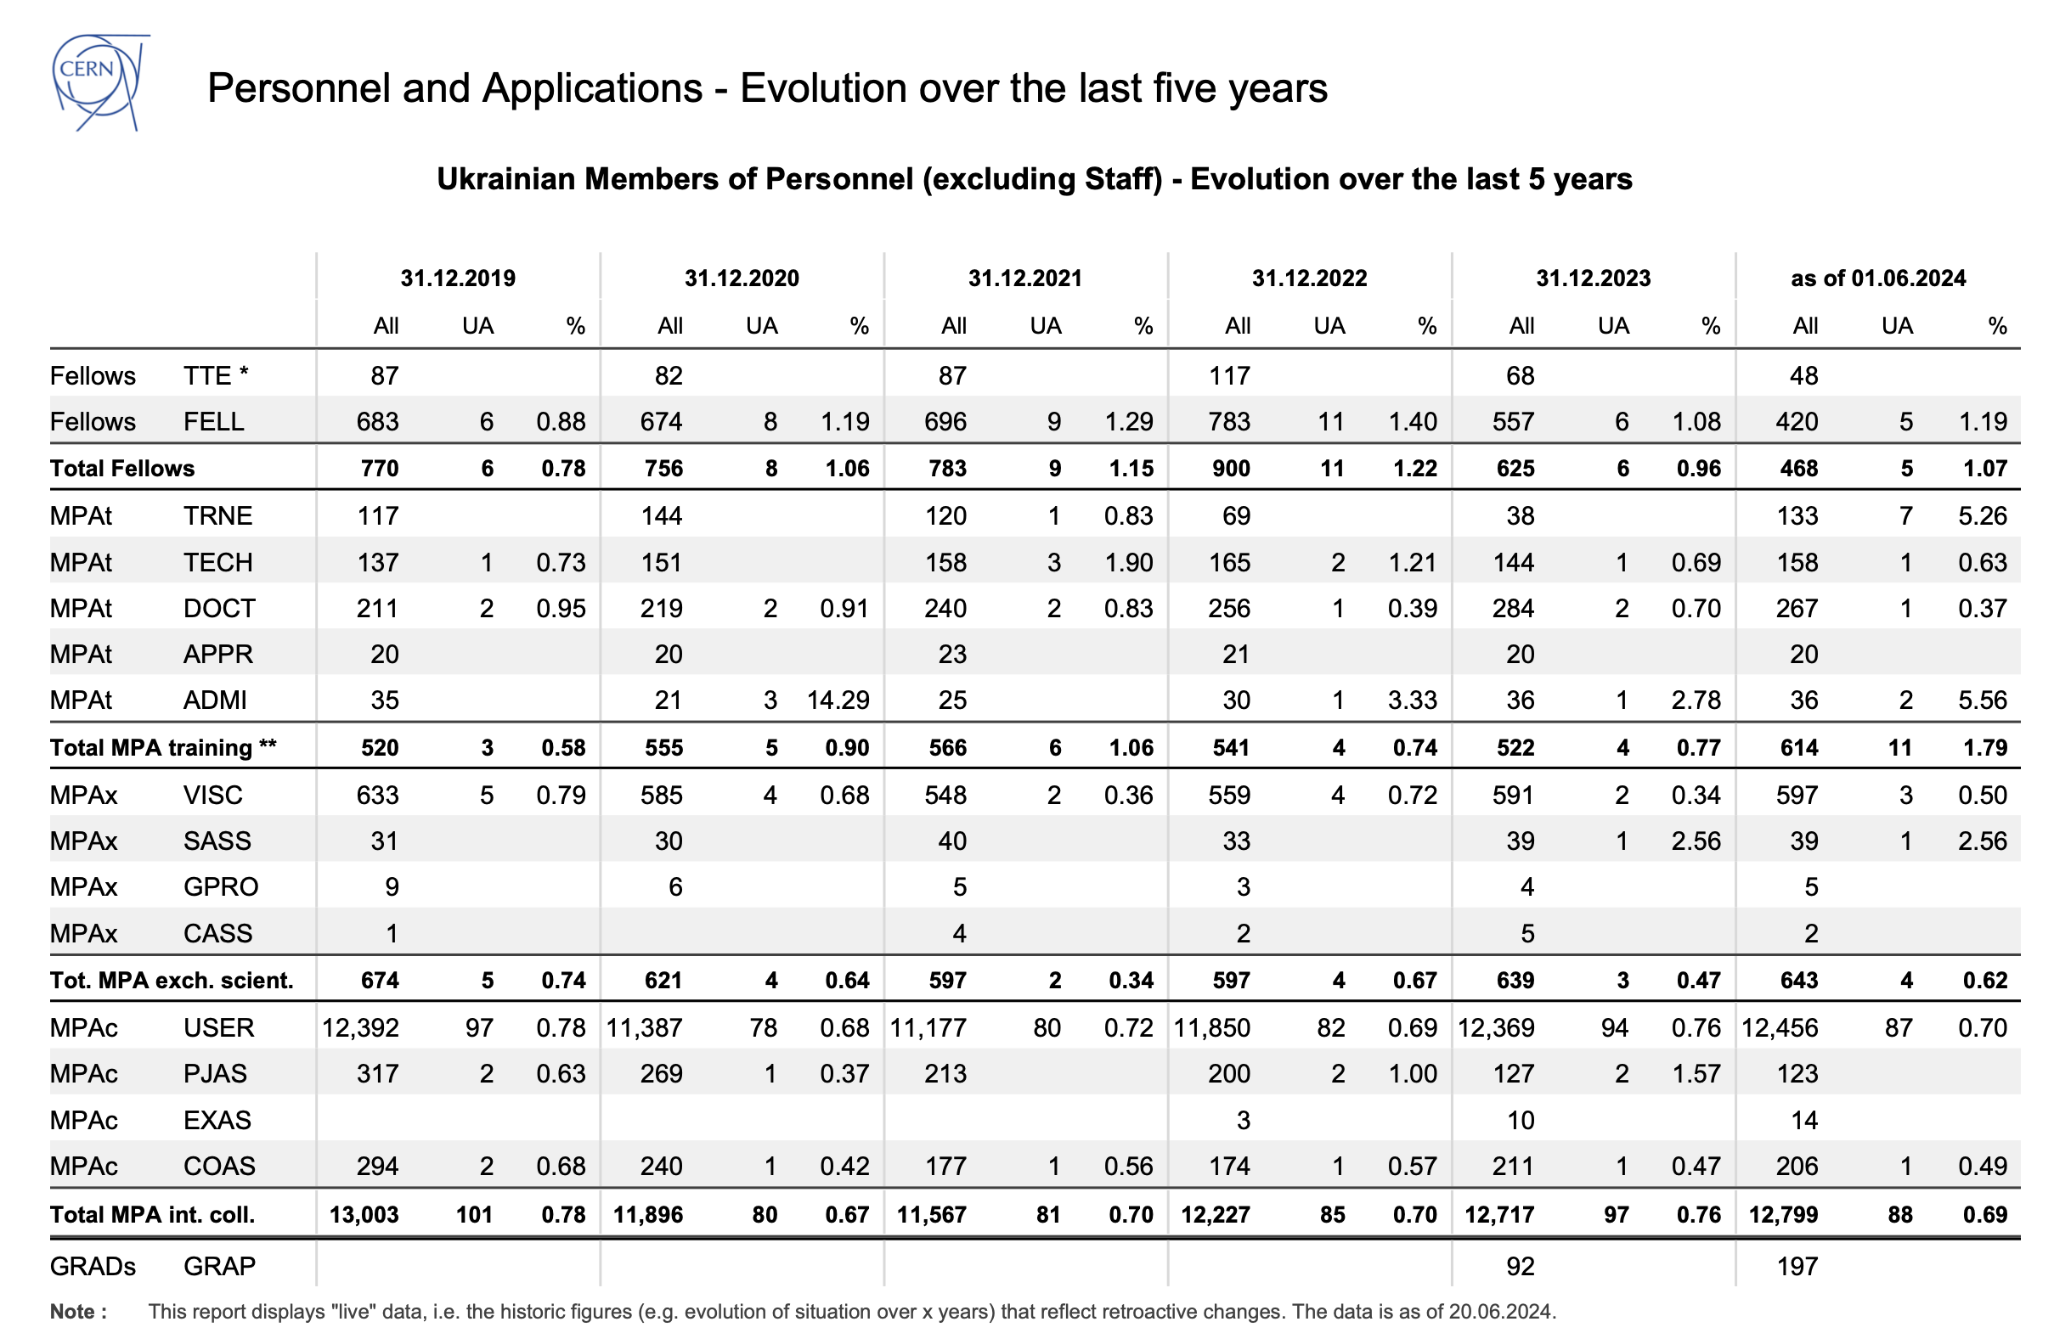
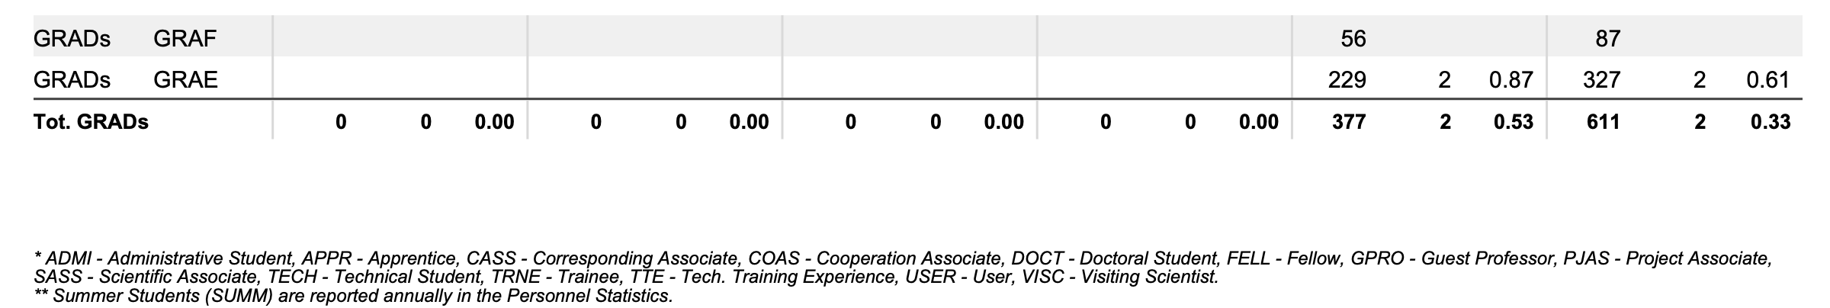

Slide 9
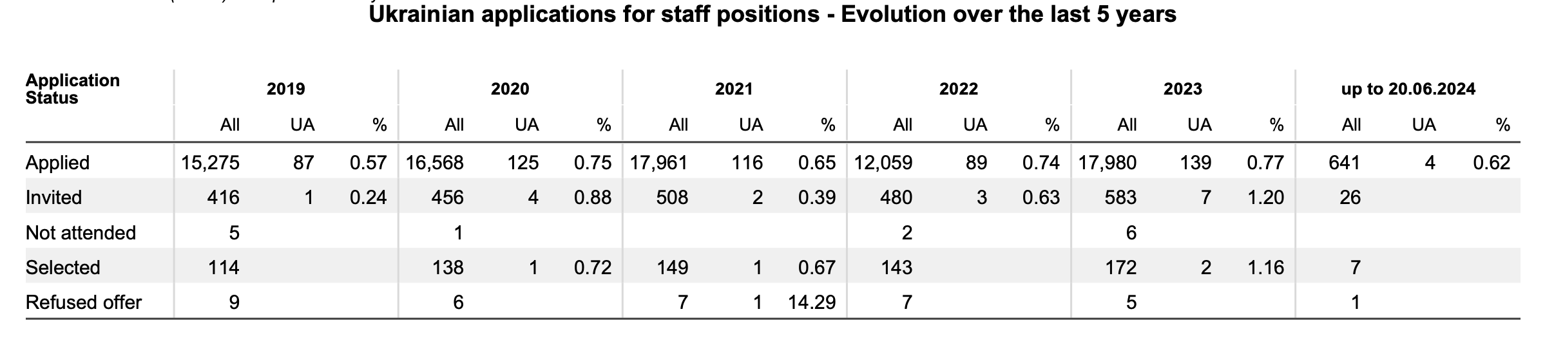

Slide 10
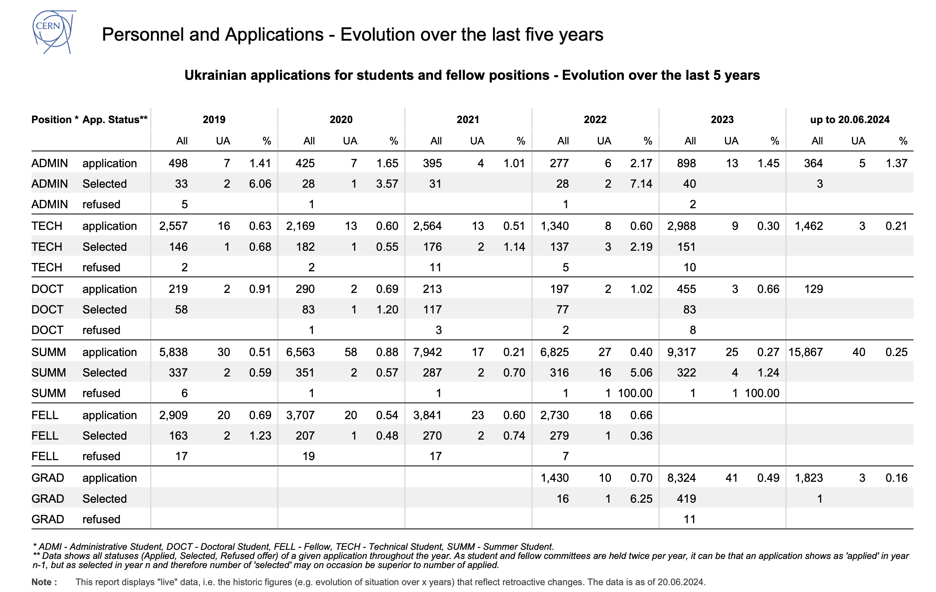

Slide 11
Outreach programmes since March 2023
Online Teacher programme with 50 Ukrainian participants (https://indico.cern.ch/e/UATP24online-1).
One CERN visit of 48 young Ukrainians (13-15 years) having asylum in the vicinity
Beam Line for Schools only one application

Slide 12
Ukrainian Remote Traineeship Programme
Officially launched in Q1 2024 and based on an exceptional memorandum backed by the CERN Directorate
Initial duration: 6 months from the first hire (01/02)
Extension of the program in the works, with funding available through donations (tbc)
130 applications since launch
62 eligible candidates
Out of which:
9 hired
5 currently offered, recruitment process has begun
8 projects still available and more to come…
67 rejected candidates
1 Withdrawn application
Main rejection reasons:
Not a Ukrainian National
Not resepcting the constraint of currently residing in Ukraine (territory unoccupied)

