Slide 1




28nm front end ASIC and 12” LGADs for 3D integration
IWORID 2025, Bratislava
Davide Braga
On behalf of the 3D Integrated Sensing Solutions (3DIntSenS) Collaboration

Slide 2
3D Integrated Sensing Solutions: Project Overview
2-year R&D project funded under the DOE “Accelerate Innovations in Emerging Technologies” call
Joint effort by SLAC, Fermilab and LLNL teams
Highly granular precision timing detectors, essential for achieving scientific breakthroughs across HEP, NP, BES, and FES applications, require 3D-integration between high performance sensors and readout ASICs that has been cost-prohibitive for the majority of scientific community
Objective: Develop technology to enable cost-effective large-scale particle detectors with 3D-integrated ASIC designs to simultaneously achieve 10 μm position resolution and 10 ps precision timing, with low-power consumption and high throughput rates.
Technical approach:
Develop 3D integration capability 12” LGAD and 12” 28nm ASIC wafer-to-wafer bonding (next phase)
Design and manufacture LGADs on 12” 65nm CMOS foundry node for 3D integration with advanced ASIC technology
Develop ASICs in 12” 28nm CMOS node to meet aggressive power and timing requirements for HEP, BES, FES applications

Slide 3
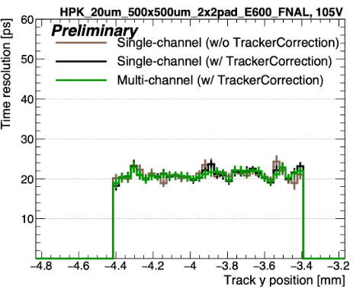
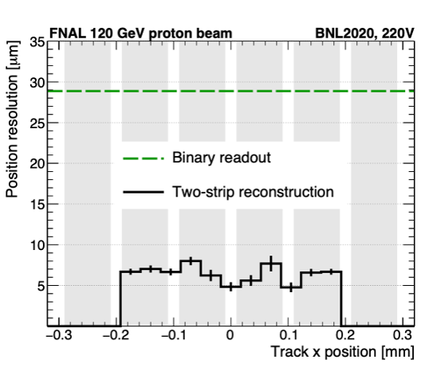
LGAD: Low Gain Avalanche Diode detectors
Thin silicon sensors with gain layer for high-field region and charge multiplication
Moderate internal gain (~10:20), to improve SNR.
Applications in:
High Energy Physics: 4D particle tracking: provide excellent timing (<30ns) and position resolution.
CMS and ATLAS are building first-generation detectors (1mm pixel pitch, ~30ps resolution).
Beam demonstration of ~5 μm, ~30 ps resolutions with AC-LGADs beam.
Particle ID with Time of Flight
Fusion Energy Science: Inertial Confinement Fusion (ICF) experiments measure peak plasma burn durations below 100 ps: need to sample with precision ~10 ps.
Basic Energy Science: Development of large area camera systems for deployment at DOE Photon sources
Synchrotron radiation facilities
Time-resolved X-ray imaging
Soft X-ray imaging: gain improves signal-to-noise for soft x-rays
20ps time resolution
Hamamatsu 20 μm AC-LGAD sensor
~5ps pos. resolution
BNL AC-LGAD

Slide 4
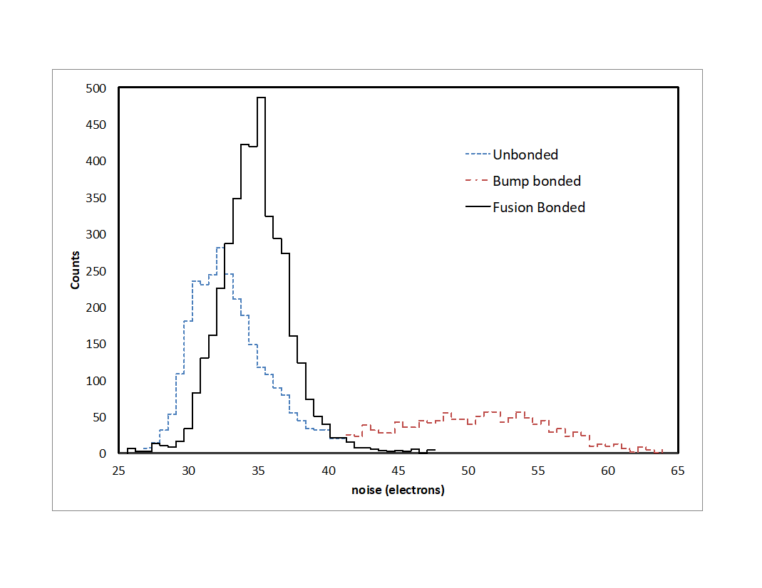
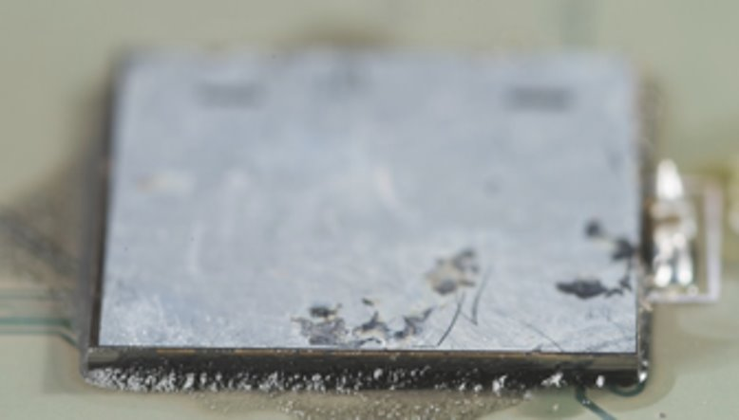
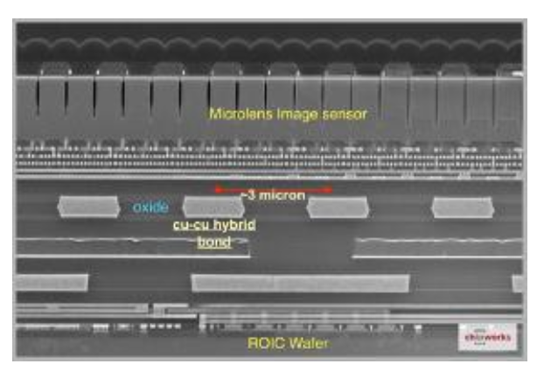
3D integration: motivation
Demonstration at Fermilab (2009-2014)
Reducing input and interconnect capacitance reduces noise and improves SNR and jitter
VIPIC 1 (64 x 64 pixels)​
Lower input capacitance in the fusion-bonded version​
ENC on fusion bonded device is close to that measured for floating inputs​
ENC=40e C<20fF​
ENC=70e C>80fF
VIPIC1 with DBI bonded sensor Sn-Pb bump-bonded on PCB

Slide 5
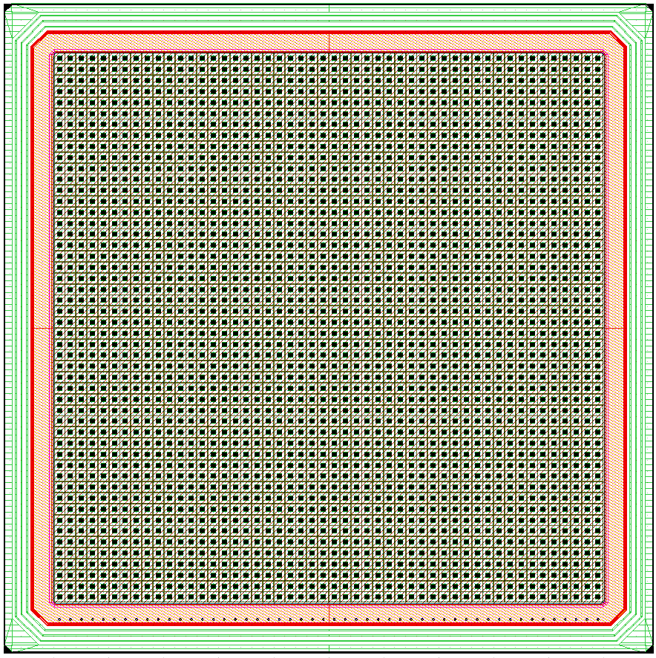
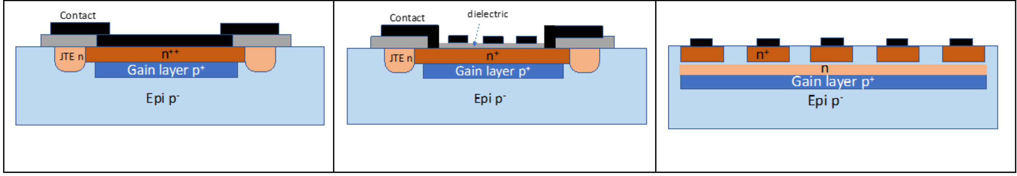
LGAD Development
Development in partnership with Tower Semiconductor
Full wafer run on 12” process 65nm process (first LGAD process on 12” wafers)
Reach Through (RT) LGADs:
Proven design with planned deployment for the CMS and ATLAS upgrades
Limited fill factor due to junction termination extension (JTE), used to compare to existing devices
AC LGADs:
Solve the fill factor problem
Bipolar signals, resistive cathode, complex response.
Deep Junction (DJ) LGADs:
Also provide 100% fill factor but require high energy implants or engineered substrates.
New variety of LGAD, loss of gain between pixels
100µm pitch AC coupled LGAD 50x50 prototype array layout:
DC LGAD
AC LGAD
Deep Junction LGAD
Notes:
Reach Through (RT) LGADs: “Standard" types as used by CMS and ATLAS which utilize a moderate energy p implant "reaching through" the cathode. When depleted this layer forms a region of space charge which, in turn, generates the high field gain layer.
AC LGADs: Gain region identical to the RT type. Instead of direct DC readout though the cathode implant they are AC coupled to the readout electrode. No need for field termination structures between pixels, increasing fill factor.
Deep Junction (DJ) LGADs: high field region buried away from the cathode, with an additional n-type implant serving to moderate the near-surface field. Allows for DC readout without field termination structures. Interpixel region gain can be reduced.
Fabrication Test Structures:
Oxide quality/Charge
Surface recombination velocity
Contact resistance
Implantation resistance
Carrier lifetime

Slide 6
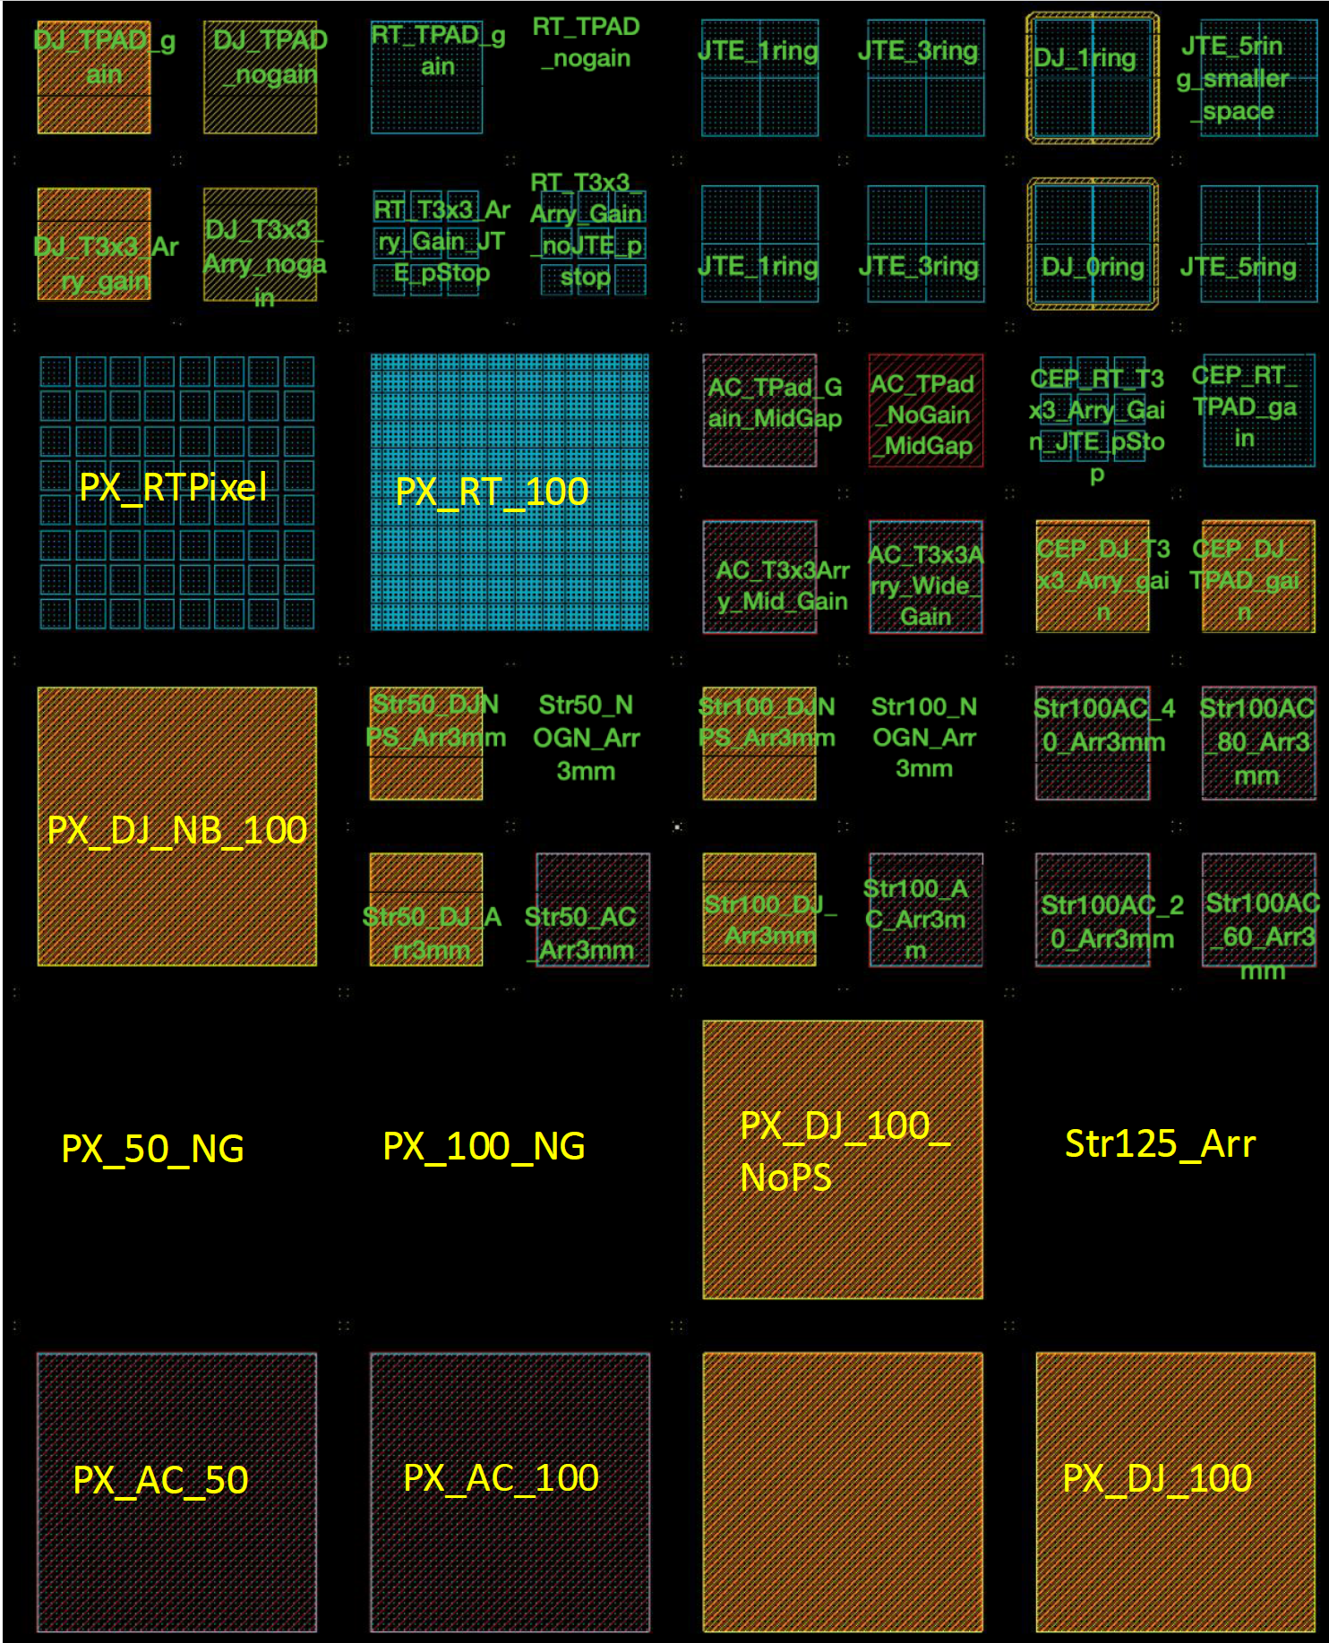
LGAD Development
~50 separate sensor structures:
11 6x6mm pixels arrays (50, 100 µm pitch) for BB
12 3x3mm strip arrays (20, 40, 60, 80, 100 µm pitch) for WB
16 device test structures (Foundry PCMs + 3x3 macro pixels + pad diodes)
8 guard ring test structure
Sensor study to optimize doses, energies and edge termination strategies. Production splits.
Standard CMOS model forces special considerations for detector design: define active regions to exclude STI, metal density and spacing, angles restricted to 45º and 90º, vias size and location, oxide thickness, etc.
3000 mm
3x3 mm
6x6 mm
2400 mm

Slide 7
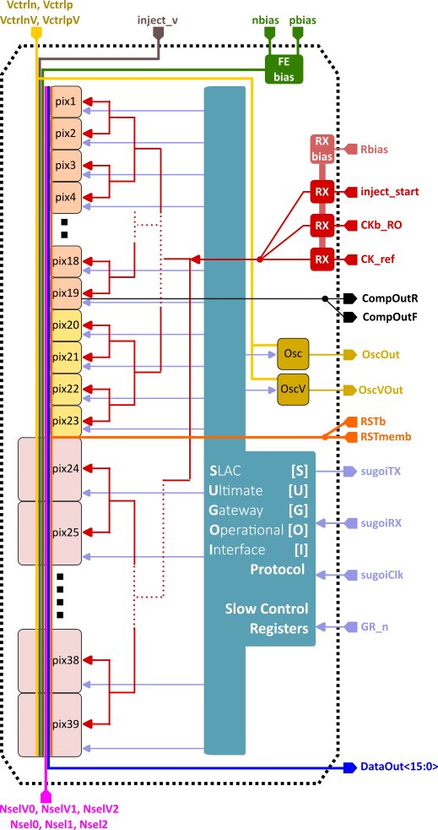
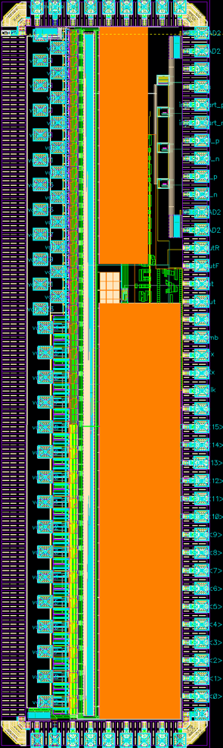
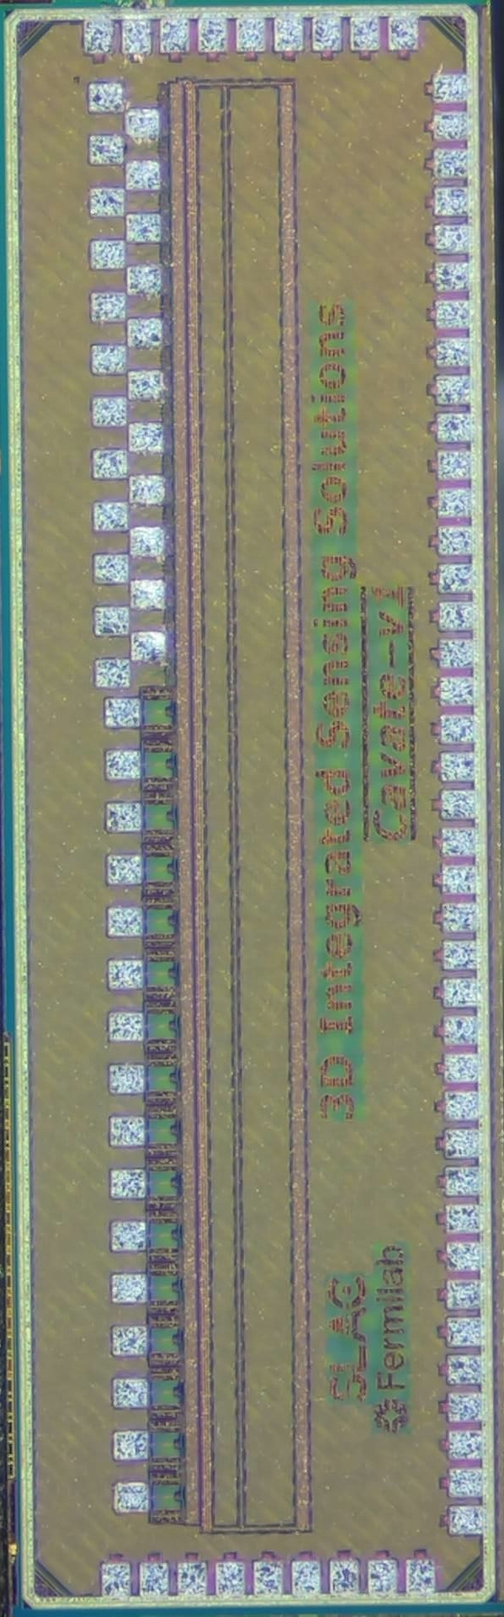
Readout ASIC: 1st prototype
see Bojan Markovic's TWEPP 2024 presentation
The first 28nm LGAD readout ASIC prototype (1x3mm²) was submitted for fabrication in August 2024:
Linear pixel array (39 pixels) of different flavors: 2 variants of 50µm and 1 variant of 100µm size pixels;
Timing critical signals (clock, test injection signal) distributed via balanced distribution three; low-jitter receives courtesy of Carl Grace (LBNL);
Sparsified readout (pixel address, TOA and TOT data are sent out for pixels that receive events over the threshold);
SLAC’s SUGOI protocol for ASIC slow-control configuration;
First readout ASIC prototype: block schematic, layout, and die
3 mm
1 mm

Slide 8
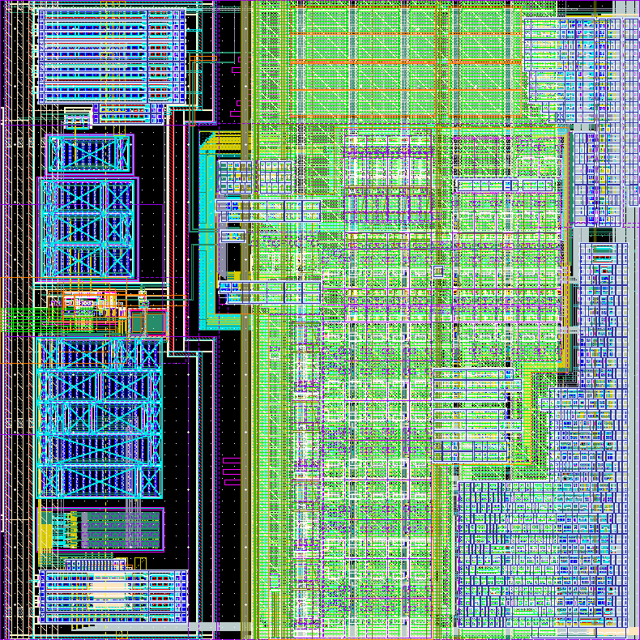
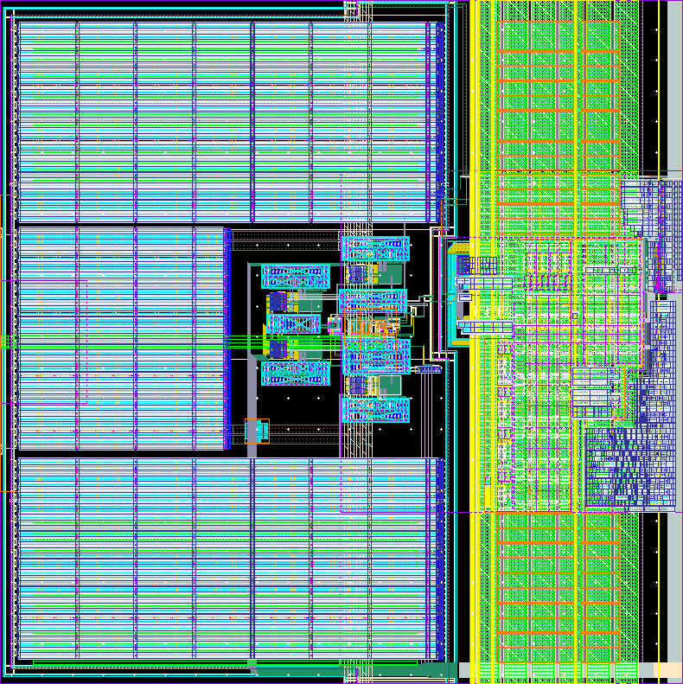
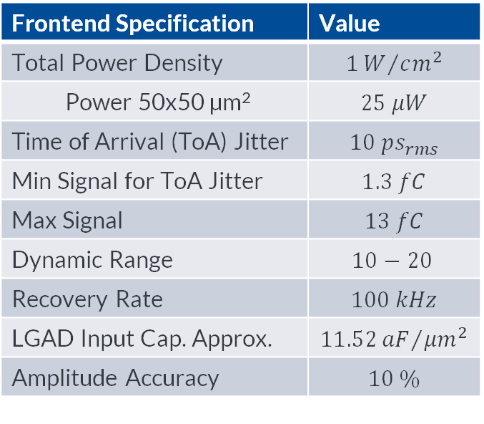
Pixel
50 µm pixel layout:
Analog frontend in deep n-well shared between column pixels
Analog section uses about 40 % of the 50 µm pixel area
Digital section includes:
TDC performing both TOA and TOT measurements, based on silicon demonstrated design (see Julia Mendez TWEPP talk)
Readout logic
Decoupling caps (plenty in the 100 µm pixel version)
Deep N-well
decoupling Caps
TDC
FE
dec. C
RO
100 µm pixel layout:
Frontend Specification | Value
Total Power Density | $$1W/{cm^{2}}$$
Power 50x50 µm² | $$25 μW$$
Time of Arrival (ToA) Jitter | $$10 ps_{rms}$$
Min Signal for ToA Jitter | $$1.3 fC$$
Max Signal | $$13 fC$$
Dynamic Range | $$10−20$$
Recovery Rate | $$100 kHz$$
LGAD Input Cap. Approx. | $$11.52{aF}/{{μm}^{2}}$$
Amplitude Accuracy | $$10 \%$$
decoupling Caps
Jitter specification is paramount
decoupling Caps
FE
TDC
RO
[1] J. Mendez et al. ”Design update and characterization of sub-10ps TDC ASIC in 28nm for future 4D trackers”, TWEPP 2024.
[2] L. Ruckman et al. “Design and characterization of sub-10ps TDC ASIC in 28nm CMOS technology for future 4D trackers”, TWEPP 2023.
decoupling Caps
Analog
Digital

Slide 9
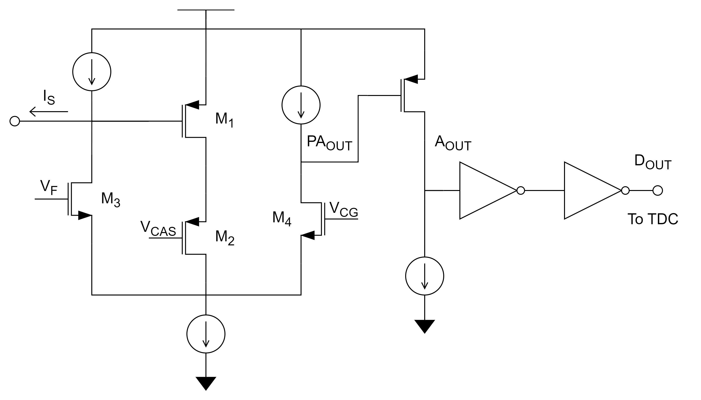
Analog Front-End: Architecture
@Troy England (FNAL, tengland@fnal.gov)
50 µm e⁻ and h⁺ readout, 100 µm e⁻ readout
The signal path consists of:
Preamplifier
The circuit is based on [1]
Open loop voltage gain at frequencies of interest, active feedback for DC biasing and recovery.
Time over threshold used to access amplitude information
additional gain
abundant gain used in place of a specialized comparator
digital buffer
Support circuitry includes:
current mirrors
DAC for setting the threshold (V_{CG} , 5bit)
charge injection for testing
[1] “A transimpedance amplifier using a novel current mode feedback loop” https://www.sciencedirect.com/science/article/pii/0168900295014543

Slide 10
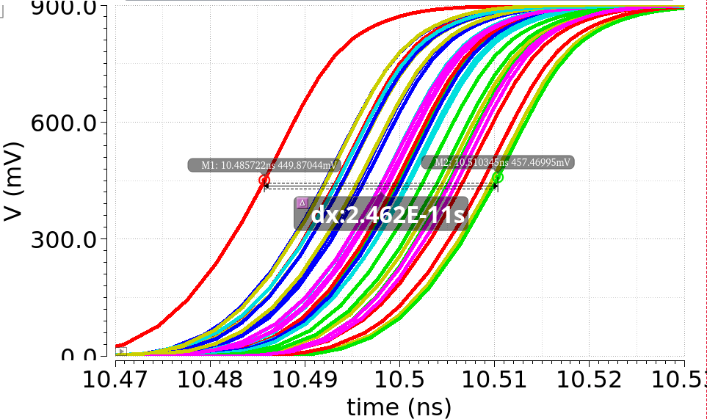
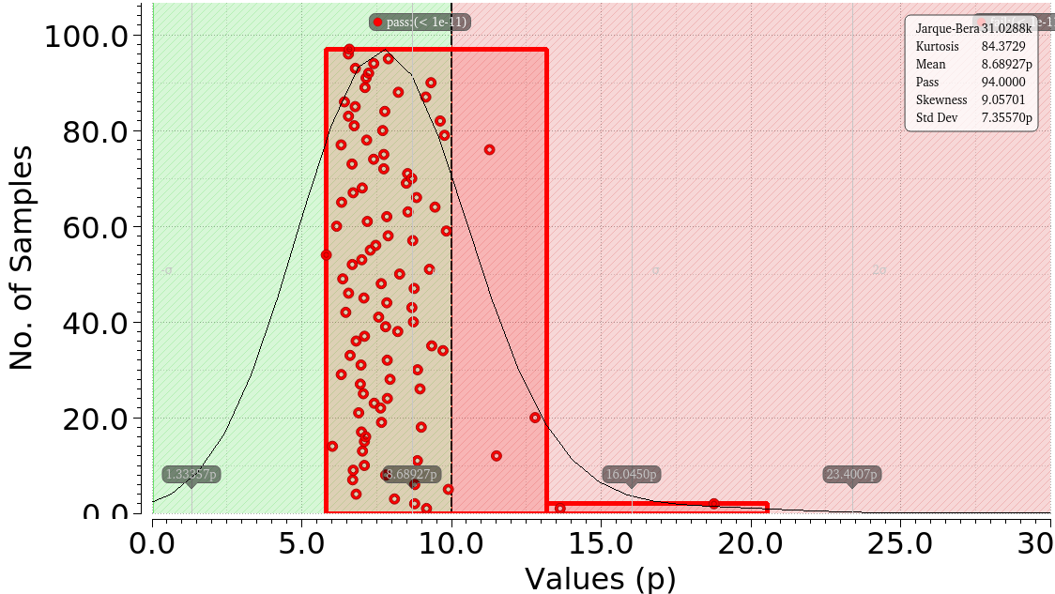
Analog Front-End: TOA Jitter Simulation
@Troy England (FNAL, tengland@fnal.gov)
Filled RCC PEX simulation:
Nominal PVT, conservative accuracy, 30 runs
Minimum input charge: 1.3 fC
Noise to 30 GHz
Includes 10 nV/rtHz supply noise
Includes LGAD capacitance
No noise from LGAD (landau fluctuations)
100 Monte Carlo runs with both Global and Local variation:
The DAC provides enough range and resolution to deal with the variation
30 transient noise runs at each MC point with conservative accuracy and 30 GHz max frequency
1.3 fC input charge
Standard deviation of ToA within each Monte Carlo point
Digital Output
One stray point (badly calibrated) out at 80 ps_{rms}
Std. Dev. = 5.7 ps

Slide 11
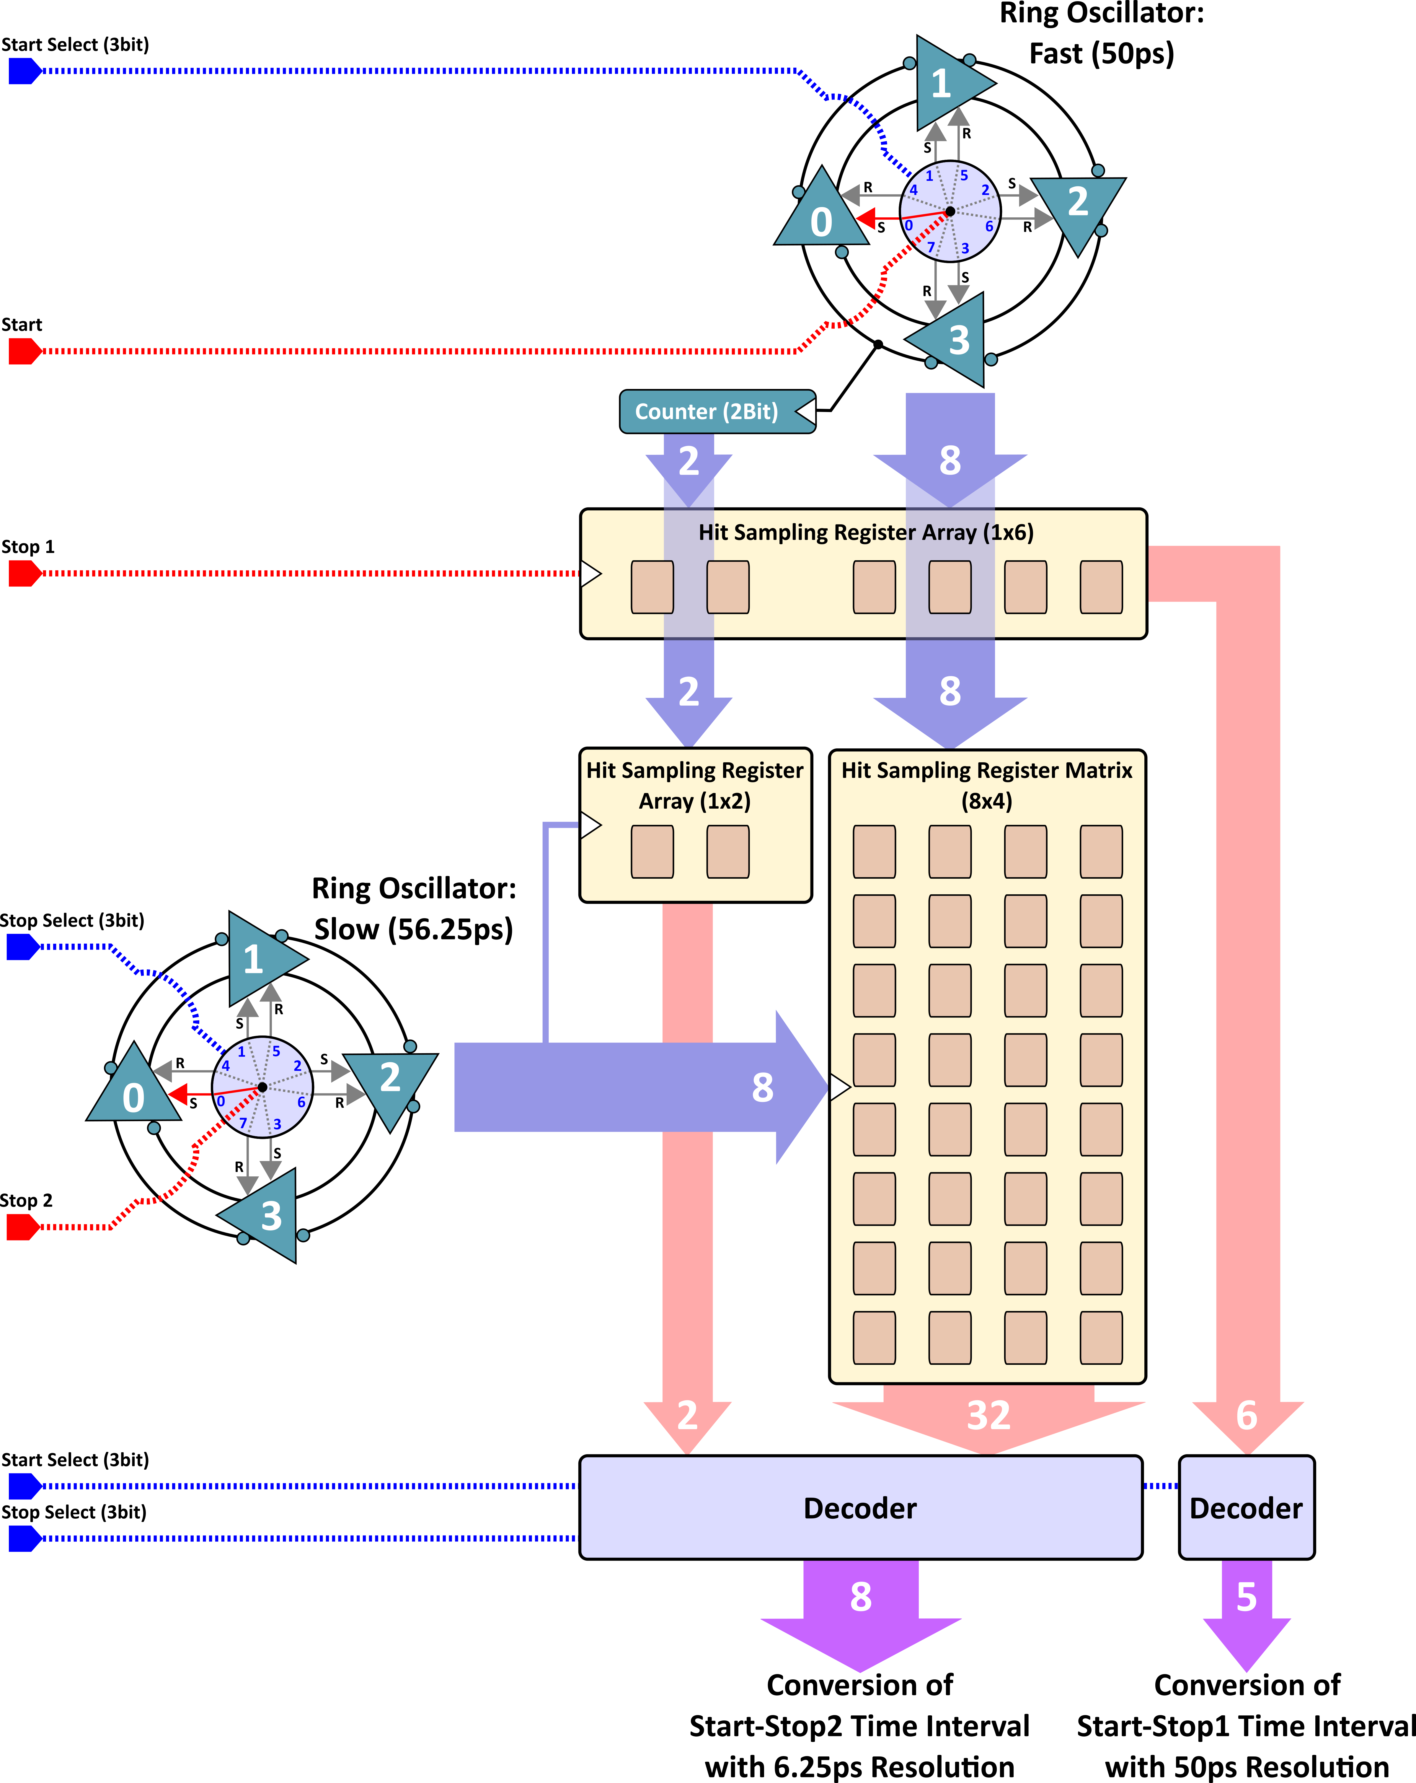
28nm TDC Architecture
@Bojan Markovic (SLAC, markovic@slac.stanford.edu)
2D Vernier Architecture:
Fast Ring Oscillator with 50ps propagation delay cells;
Slow Ring Oscillator with 56.25ps propagation delay cells;
START + two STOP signal for simultaneous time-of-arrival (TOA) and time-over-threshold (TOT) measurements;
Start-Stop1 - Coarse time resolution (TOT): 50ps;
Start-Stop2 - Fine time resolution (TOA): 56.25ps - 50ps = 6.25ps;
Sliding scale technique for improvement of conversion linearity:
Both ring oscillators have programable starting conditions via delay cell set/reset function;
Starting conditions randomly selected each measurement cycle and corresponding values subtracted from the conversion result;
Same time intervals converted with different parts/bins of the TDC conversion characteristics;
Sliding scale transforms the non-linearities into stochastic variable thus effectively improving the conversion linearity at the expense of worsening single-shoot precision.
2D Vernier Architecture:
Fast Ring Oscillator with 50ps propagation delay cells;
Slow Ring Oscillator with 56.25ps propagation delay cells;
START + two STOP signal for simultaneous time-of-arrival (TOA) and time-over-threshold (TOT) measurements;
Start-Stop1 - Coarse time resolution (TOT): 50ps;
Start-Stop2 - Fine time resolution (TOA): 56.25ps - 50ps = 6.25ps;
Sliding scale technique for improvement of conversion linearity:
Both ring oscillators have programable starting conditions via delay cell set/reset function;
Starting conditions randomly selected each measurement cycle and corresponding values subtracted from the conversion result;
Same time intervals converted with different parts/bins of the TDC conversion characteristics;
Sliding scale transforms the non-linearities into stochastic variable thus effectively improving the conversion linearity at the expense of worsening single-shoot precision.

Slide 12
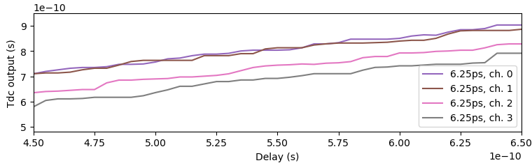
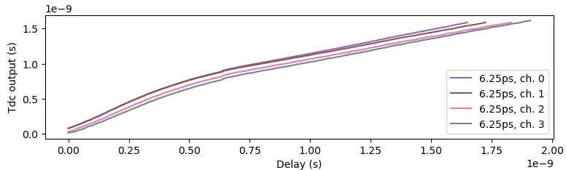
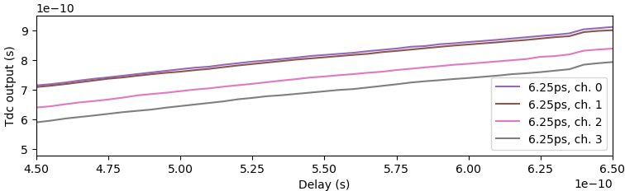
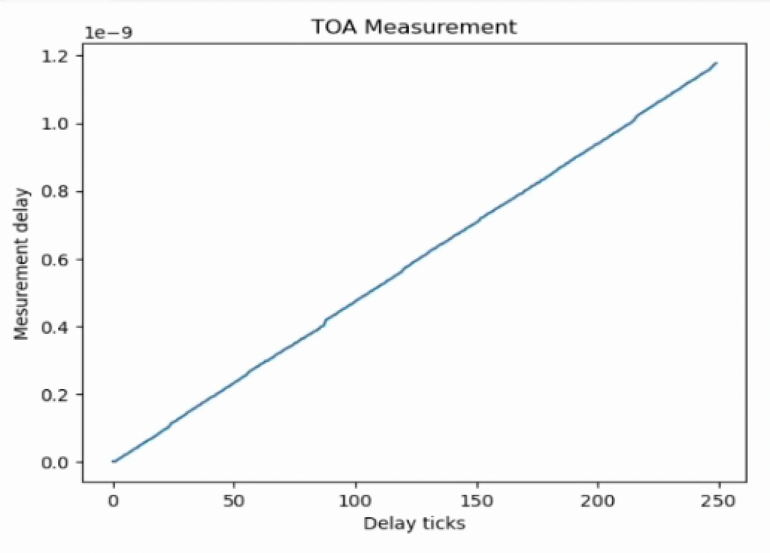
Sliding-Scale Linearity Improvement
Achieving sub-10ps resolution in all PVT conditions requires Vernier architecture (LSB given by the difference of propagation delays) that suffers heavily from mismatch (especially true for implementations that target small pixel sizes) resulting in significant non-linearities of the TDC characteristics.
The developed TDC implement the sliding-scale technique [1,2] for linearity improvement to mitigate the weakness of the Vernier approach.
6.25ps (TOA) TDC Output VS programmable delay:
zoom
Sliding-scale OFF: Mismatch
Oscilloscope measurement (no ASIC):
Sliding-scale ON: Linearity improvement
SY58608U
Non-linearity
[1] C. Cottini, E. Gatti, and V. Svelto, “A new method for analog to digital conversion,” Nucl. Instr. Meth., vol. 24, p. 241, Aug. 1963.
[2] E. Gatti, P. F. Manfredi, and D. Marino, “Analysis and characterization of cyclic-scale compensated analog-to-digital converters,” Nucl. Instrum. Methods, vol. 165, no. 2, pp. 225–230, Oct. 1979.

Slide 13
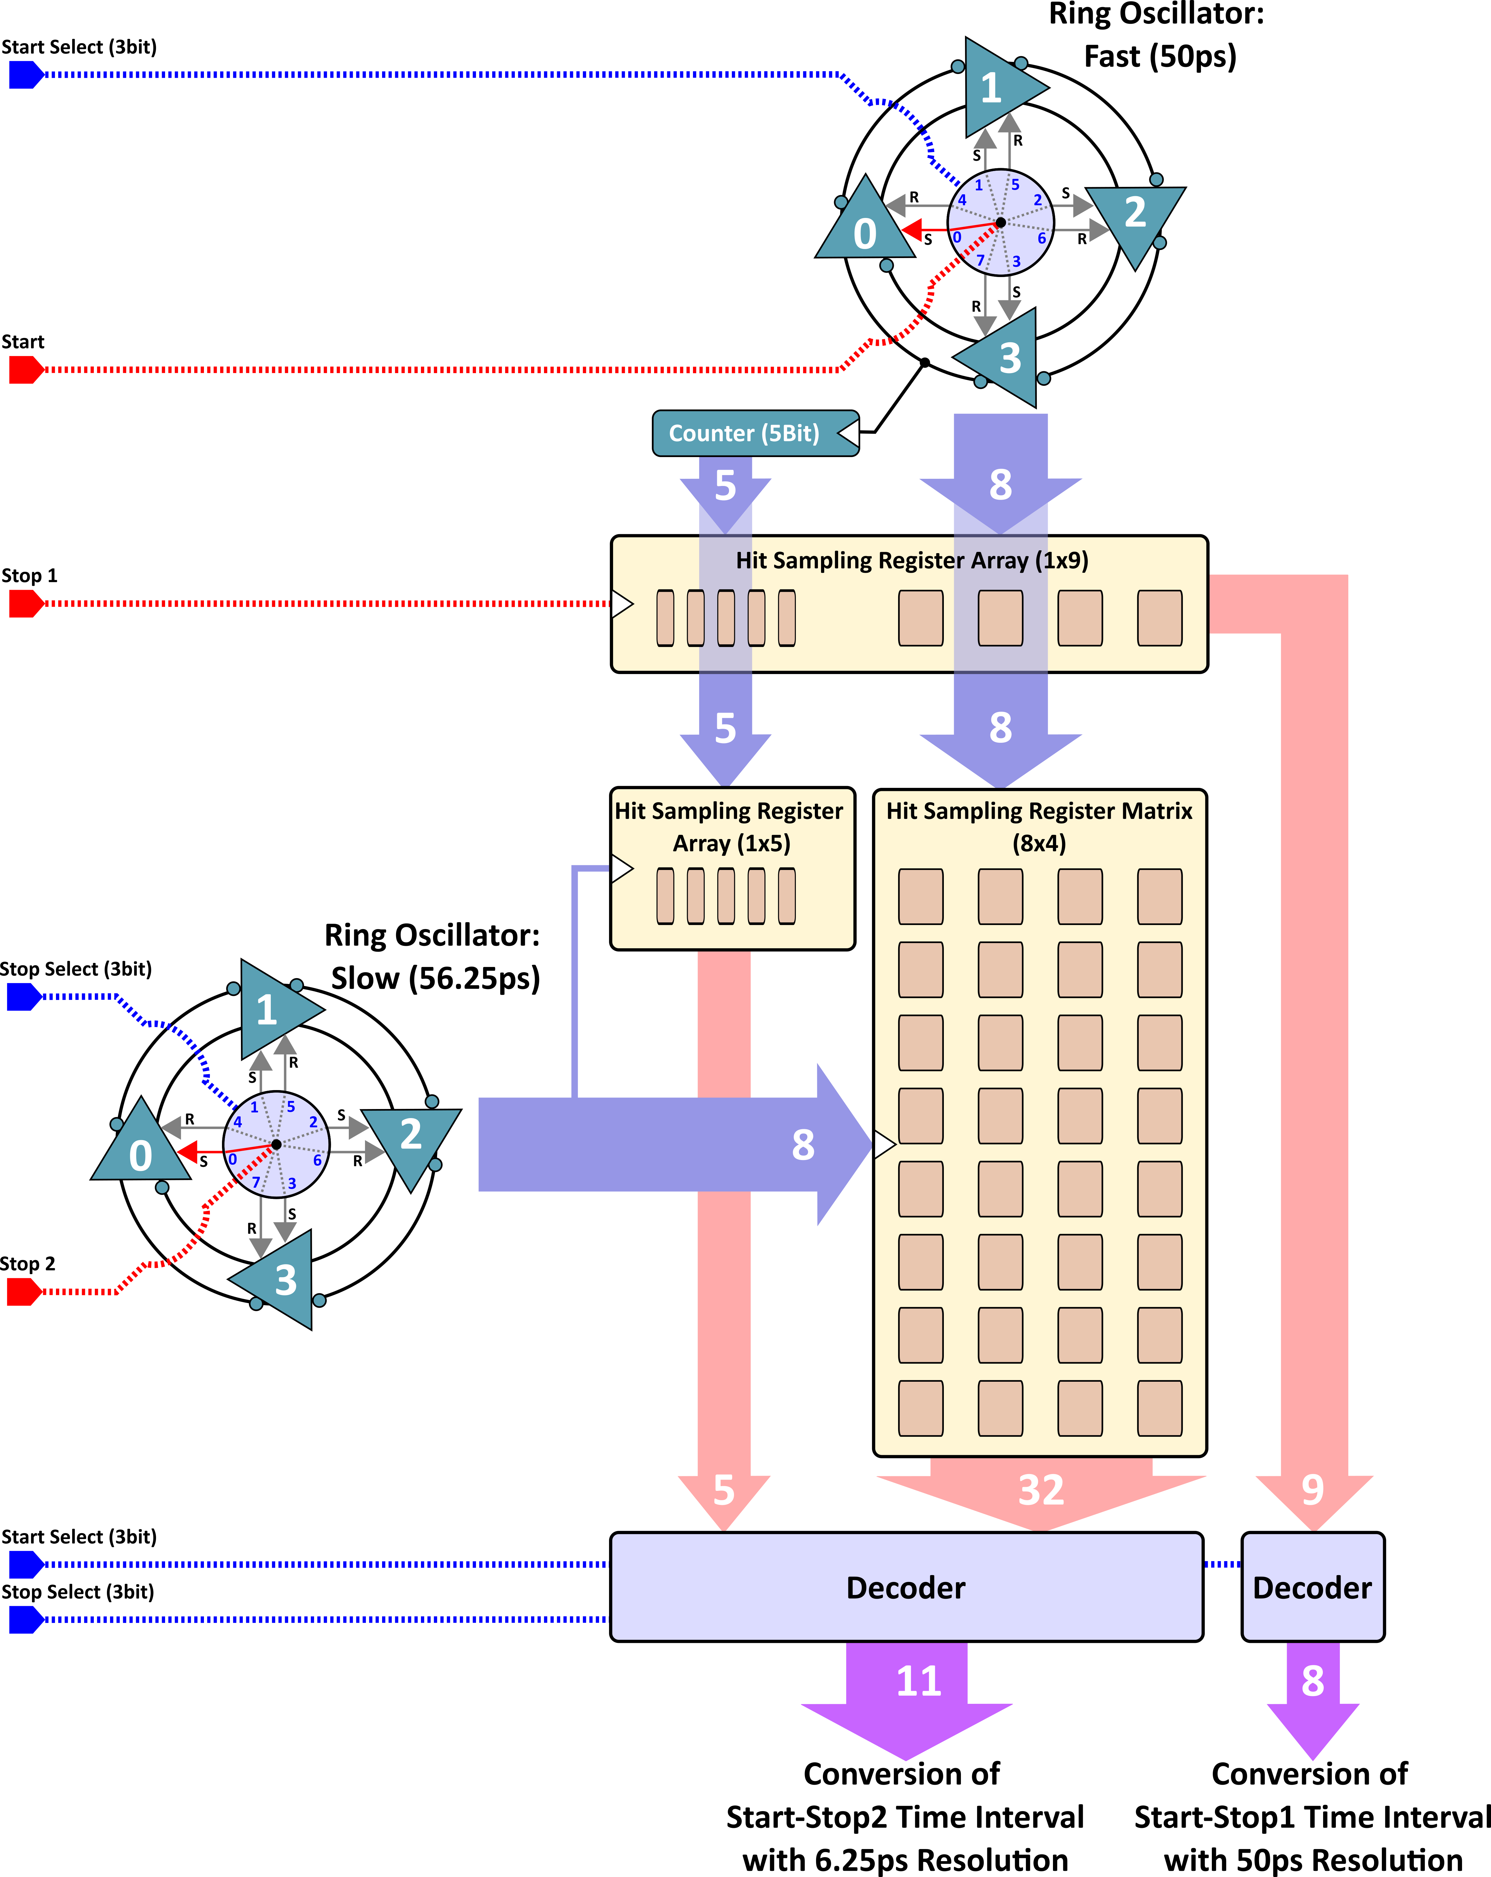
TDC improvements
@Bojan Markovic (SLAC, markovic@slac.stanford.edu)
Added 3 bit to TOA and TOT to extend the range from 1.6ns to 12.8ns
Added decoupling caps on TDC control lines (Vctrl) to limit the disturbances causing characteristic curvature and jitter increase
Fixed top level parasitic that caused race condition in counter sampling, resulting in “glitches” in conversion characteristic
Vctrl Decoupling C.
3 additional bits (TOA and TOT)
TDC
 | TDC metrics
Technology | 28nm
Timing resolution | 6.25ps (TOA) / 50ps (TOT)
Time depth | 1.6ns (8bit / 5bit) 12.8ns (11bit / 8bit) easily extendable by simple addition of bits to the counter
TDC area | 26µm x 40.5µm (1.7µm x 13.3µm per additional bit)
Power consumption | (average, 25ns conversion cycle / bunch crossing)
10% occupancy | 16µW 51.1µW
1% occupancy | 2.5µW 6.2µW

Slide 14
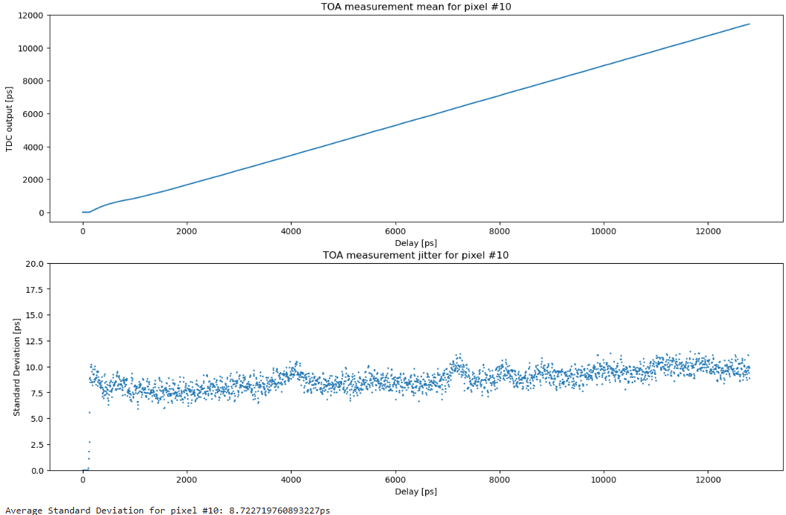
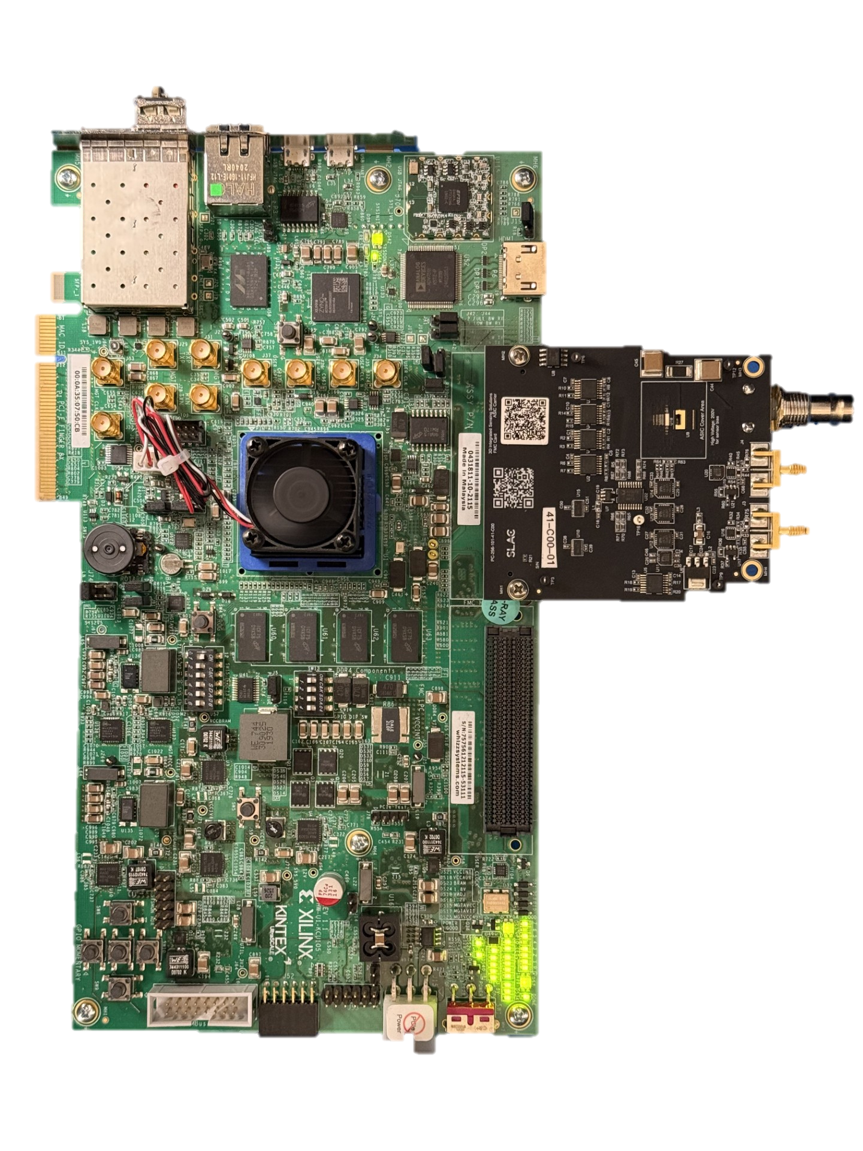
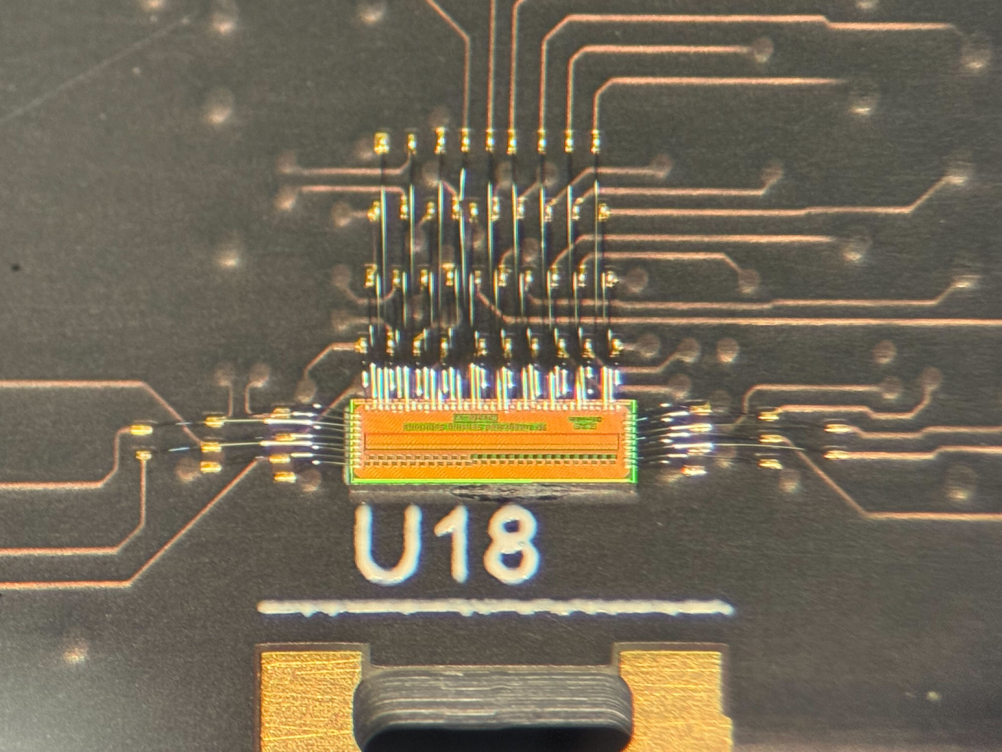
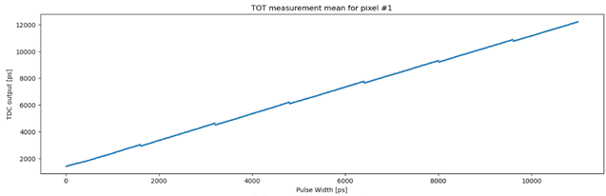
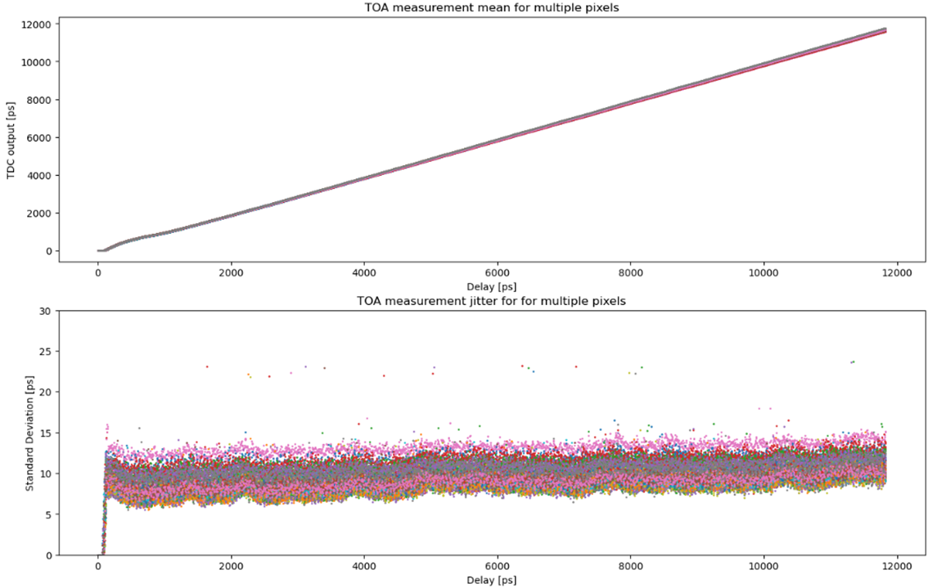
TDC characterization
TDC TOA (6.25ps LSB) Characteristics (single pixel)
TDC prototype ASIC test setup:
Jitter ≈ 8.7ps
TDC TOT (50ps LSB) Characteristics (single pixel)
TDC TOA Characteristics (all 39 pixels)
Artefact of FPGA pulse-width generation (not TDC issue)
Summary:
Overall good performance
Few issues that are well understood and fixed for MPW2
Full system jitter is around 10 ps_{rms}
Confidence in achieving sub-10ps system jitter in MPW2
Average jitter for all pixels ≈ 9.5ps

Slide 15
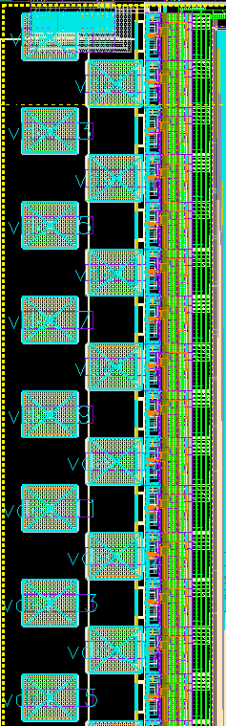
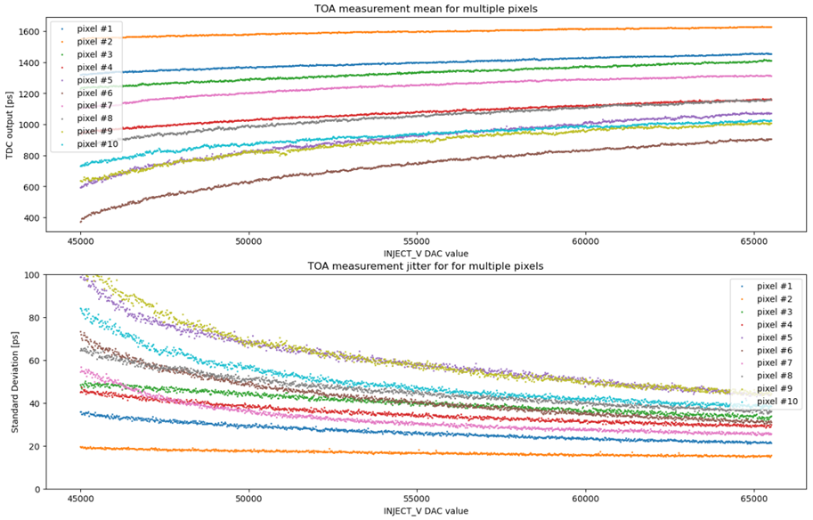
Front-end characterization
Issue with charge injection circuit pulses on test boards limits the test range
Issue with power supply distribution means that pixel rows sees increasing supply impedance (worse for large pixels)
Dominates jitter except for first few pixels
Even pixels achieve better pixels than odds because of reduce connection capacitance to the pad. Channel #2 achieves 20ps
→ fixed in the next iteration

Slide 16

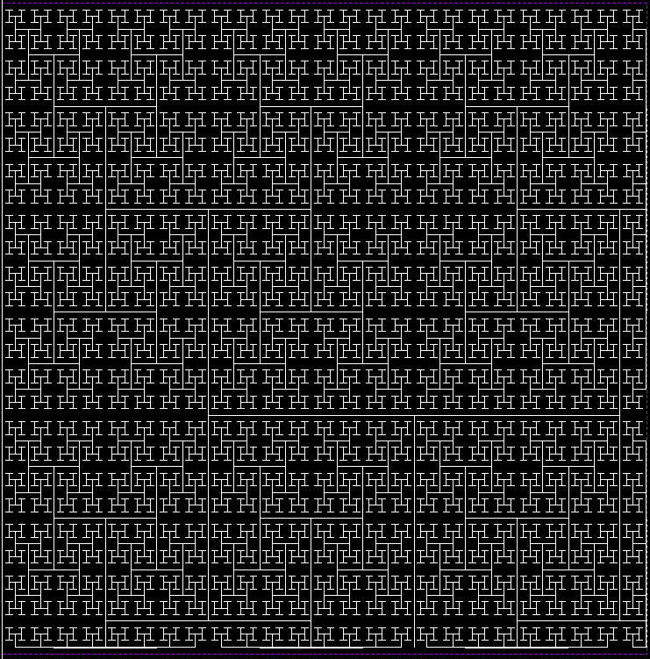
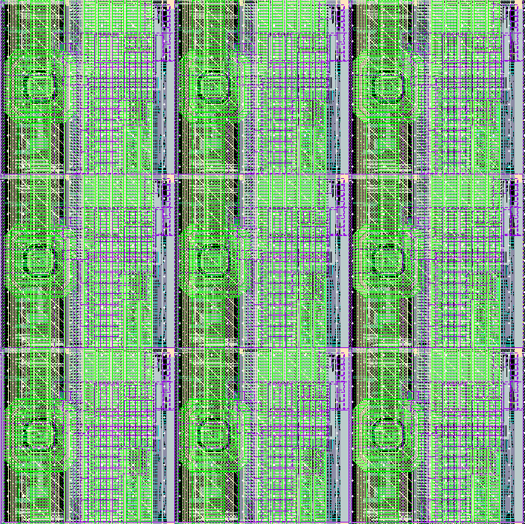
Readout ASIC: 2nd prototype
2nd prototype in 28nm to be taped out in September 2025
THRIGLAV: THRee-d InteGrated LgAd driVer
(5x6mm²) with 100x100 50µm pitch pixel array, incorporating learning from the 1st run.
100x100 pixel matrix with clock distribution tree completed
Optimization of pixel blocks based on feedback from MPW1 in progress
Digital control and readout logic design, fast IO driver.
At the end of 2nd year, we anticipate first demonstration of 28nm readout chip bump-bonded to the prototype LGAD array with high-precision timing performance.
For the next project phase, we would proceed to wafer-to-wafer bonding of 12” LGAD and 12” 28nm ASIC wafers.
Layout of the pixel matrix highlighting the clock distribution three with zoom on 3x3 pixel region

Slide 17
Summary and Next Steps
LGAD and ASIC development proceeding in parallel
The first 28nm LGAD readout ASIC prototype was submitted for fabrication
LGAD fabrication run at Tower Semiconductor imminent
Characterization of first prototype revealed issue with power distribution, but combination of pixel front end and TDC demonstrated sub 20ps jitter
Second readout ASIC to be submitted in September, incorporating lessons from the 1st run
Towards 3D: bump bonded ASIC + sensor characterization and beam test to follow
Next project phase: wafer-to-wafer bonding of 12” LGAD and 12” 28nm ASIC wafers

Slide 18
Acknowledgements
SLAC: Julie Segal (PI), Bojan Markovic, Lorenzo Rota, Angela Kok, Chris Kenney, Ariel Shwartzman, Aseem Gupta, Julian Mendez, Larry Ruckman, Christos Bakalis
Fermilab: Troy England, Ron Lipton, Davide Braga, Artur Apresyan, Farah Fahim, Shuoxing Wu, Sergey Los, Benjamin Parpillon
LLNL: Arthur Carpenter, Ann Garafalo, Clemet Trosseille
Fermilab is hiring!
Senior & entry level Analog ASIC design engineer positions are available
https://fermilab.jobs/ and/or contact me directly

Slide 19
Backup

Slide 20
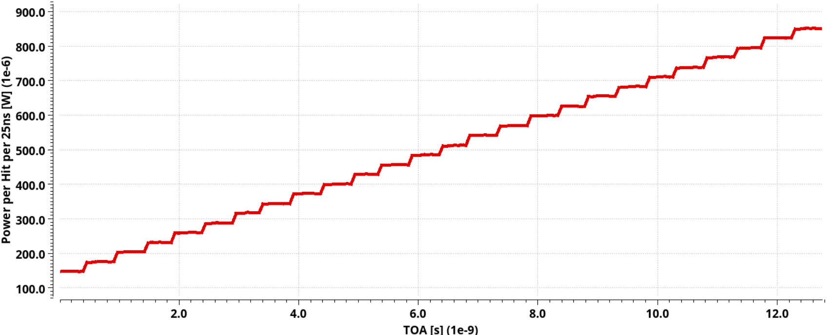
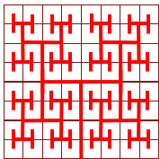

Power Consumption
Average power within 25ns window VS TOA (RCX):
 | Power Consumption (average, 40MHz clock ) [µW]
 | 50 µm x 50 µm pixel |  |  |  | 100 µm x 100 µm pixel
Occupancy | FE | TDC | *Clk three | Tot. | FE | TDC | *Clk three | Tot.
0% | 11.6 | 1.2 | 1.2 | 14 | 81 | 1.2 | 2.4 | 84.6
1% | 11.6 | 6.2 | 1.2 | 19 | 81 | 6.2 | 2.4 | 89.6
2% | 11.6 | 11.2 | 1.2 | 24 | 81 | 11.2 | 2.4 | 94.6
4% | 11.6 | 21.2 | 1.2 | 34 | 81 | 21.2 | 2.4 | 104.6
6% | 11.6 | 31.1 | 1.2 | 43.9 | 81 | 31.1 | 2.4 | 114.5
8% | 11.6 | 41.1 | 1.2 | 53.9 | 81 | 41.1 | 2.4 | 124.5
10% | 11.6 | 51.1 | 1.2 | 63.9 | 81 | 51.1 | 2.4 | 134.5
TDC idle consumption (due to leakage): ~1.2µW
TDC power consumption depends on time-interval being measured
For uniformly distributed time-intervals 𝑇𝑖 the average power consumption per Hit in a 25ns measurement window is:
Average power consumption:
For 10% occupancy: ~ 51.1µW
For 1% occupancy: ~ 6.2µW
$$P_{\frac{av}{hit}/T_{CK}}=500μW$$
*Clock distribution contribution is derived assuming hierarchical tree on a matrix of 256x256 50µm pixels and 128x128 100µm pixels (parasitic extracted sim.)
$$P_{av}=1.2μW∙\left(1−Occupancy\right)+P_{\frac{av}{hit}/T_{CK}}∙Occupancy$$

Slide 21
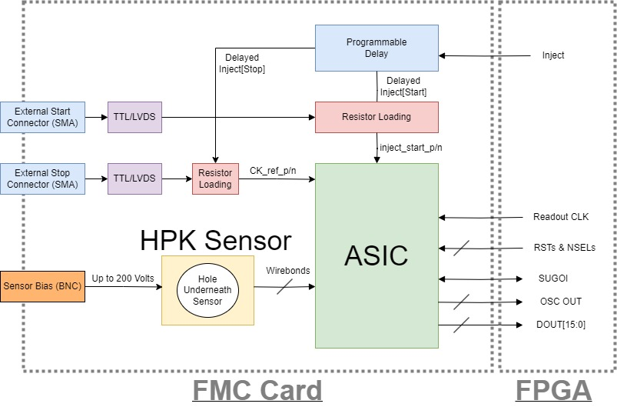
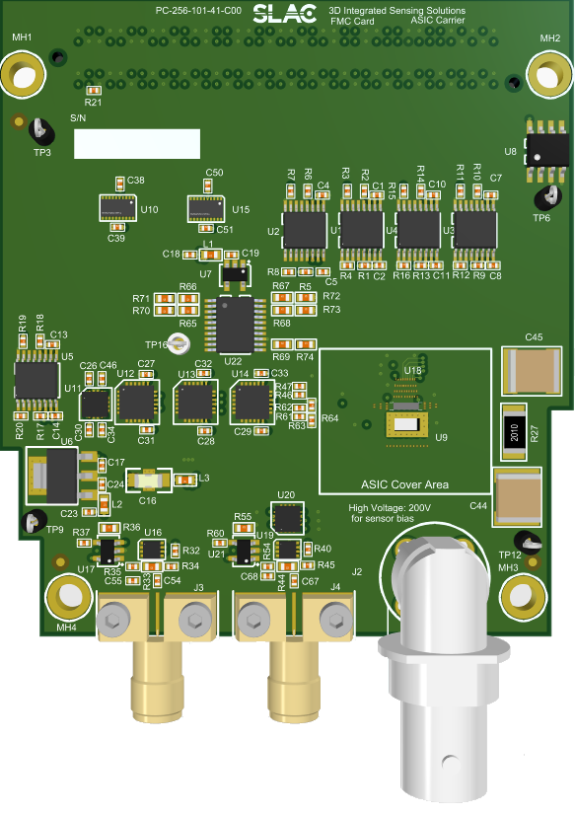
PCB Carrier for LGAD Sensor and ASIC
LGAD Sensor
PCB carrier for both the LGAD sensor and ASIC
Sensor outputs directly wire bonded to ASIC analog inputs
Internal mode: programmable delay ICs for sweeping the TDCs entire range
External mode: Using external START/STOP TTL signals to synchronize with external system

