Slide 1

Optimization of a 3D neutron imaging sensor through combined simulation approaches
Matteo Polo, Jixing Ye, Lucio Pancheri, Alberto Quaranta, Gian-Franco Dalla Betta

Slide 2
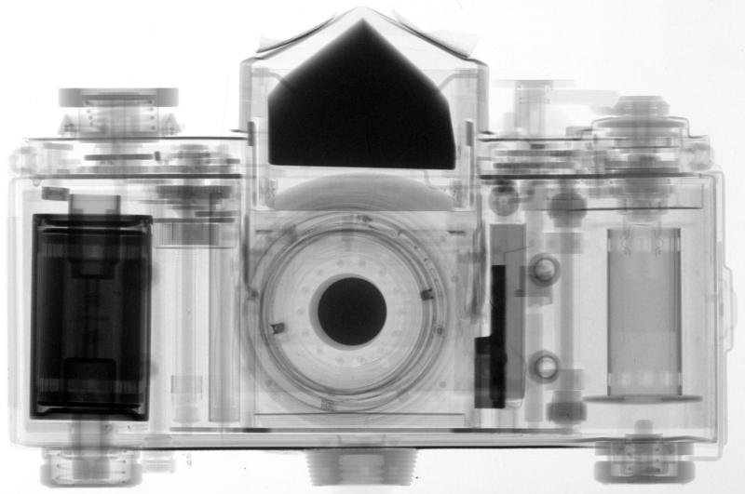

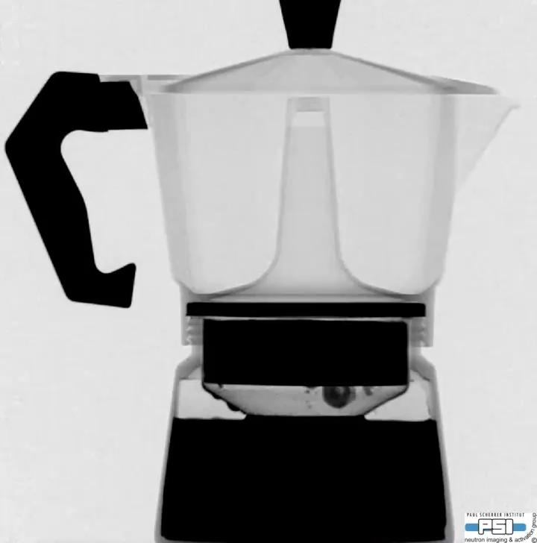

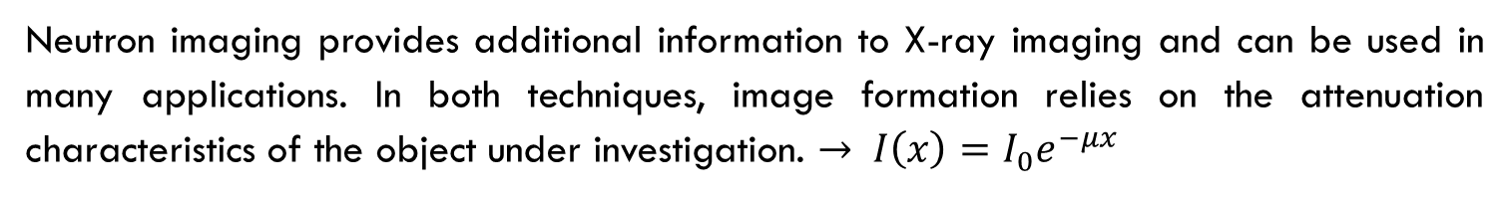

Neutron imaging
Neutron imaging provides additional information to X-ray imaging and can be used in many applications. In both techniques, image formation relies on the attenuation characteristics of the object under investigation. $→ I\left(x\right)=I_{0}e^{−μx}$
Neutrons
$$μ_{n}∝ \frac{1}{A}$$
X-ray
$$μ_{X}∝Z$$
Figures sourced from the Paul Scherrer Institute (PSI), https://www.psi.ch

Slide 3
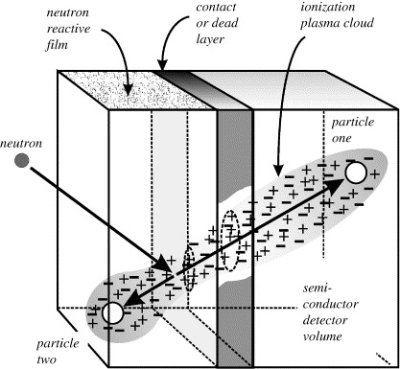
Neutron Silicon Detector
The resulting efficiency for semiconductor planar detectors coated with¹⁰B or ⁶Li is on the order of 3-4%
Coated 3D silicon detectors were first proposed as an alternative to planar silicon detectors in the late 80s, to increase the efficiency
Kansas State University
Groups engaged in the development of 3D sensors for neutrons
Lawrence Livermore National Laboratory
McGregor, Douglas S., et al. "Design considerations for thin film coated semiconductor thermal neutron detectors—I: basics regarding alpha particle emitting neutron reactive films." Nuclear Instruments and Methods in Physics Research Section A: Accelerators, Spectrometers, Detectors and Associated Equipment 500.1-3 (2003): 272-308.
Rennselaer Polytechnic Institute
University of Trento & FBK & INFN
Dalla Betta G-F and Povoli M (2022) Progress in 3D Silicon Radiation Detectors. Front. Phys. 10:927690. doi: 10.3389/fphy.2022.927690

Slide 4
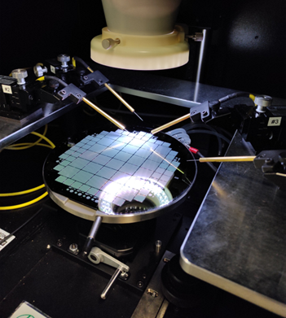
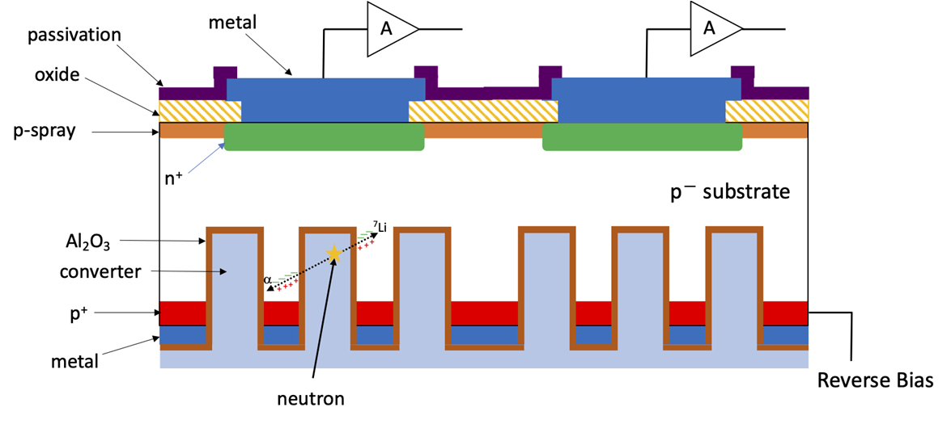
3d Detector for neutrons at UNITN
The 3D detector consist of planar (thickness 275 μm) n-on-p pixels on the front side, whereas Deep Reactive Ion Etching (DRIE) is used only on the back side to etch deep (~25 μm) and narrow cavities to be filled by proper converting materials. The pixel pitch is 55 × 55 μm to ensure compatibility with Medipix electronics. This sensor derives from the Hyde2 project.
The passivation is necessary to reduce the effects caused by DRIE, as the creation of the p+ implant precedes the DRIE.

Slide 5
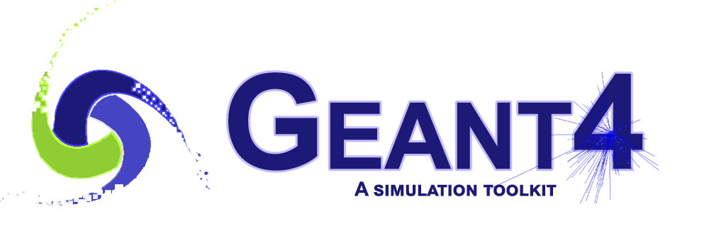



Optimal Geometry via Simulation
To simulate the proper functioning of the device, it was decided to separate the neutron capture part from the charge collection part. So two different software are used
Toolkit for the simulation of the passage of particles through matter
Device simulation tools simulate the electrical characteristics of semiconductor devices

Slide 6
GEANT4
Passage of particles through matter

Slide 7
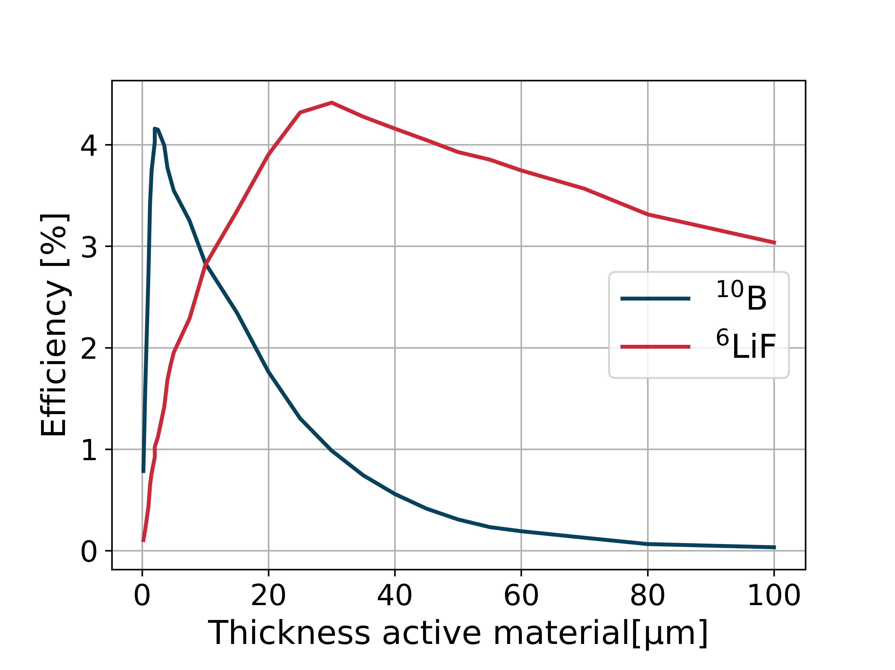
Planar Detector
As reference the efficiency in the case of planar detector are simulated.
The QGSP_BIC_HP list is used.
Two different converter material are tested:
⁶Li(n,α)³H
Q=4.8MeV and σ=8.7·10² b
¹⁰B(n,α) ⁷Li
Q=2.8MeV and σ=3.6·10³ b

Slide 8
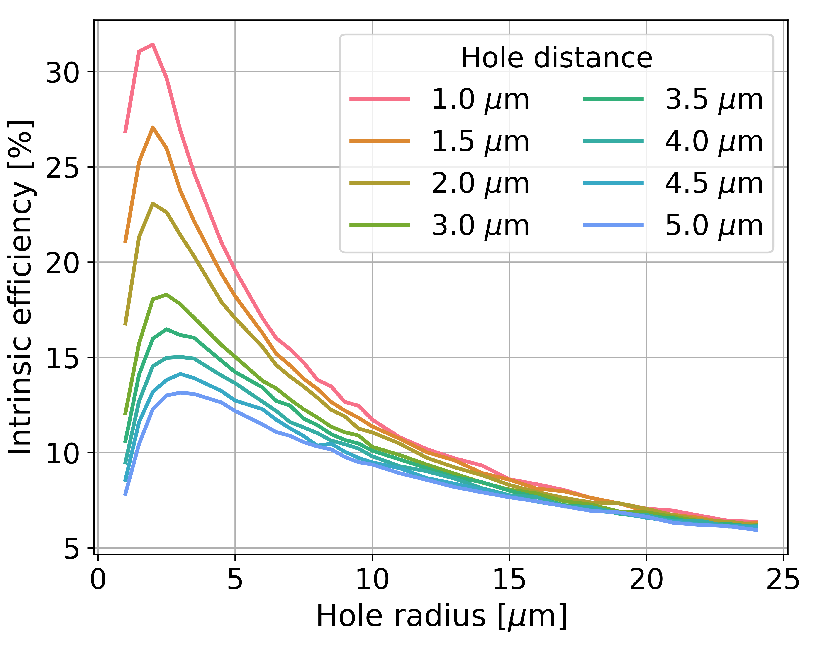
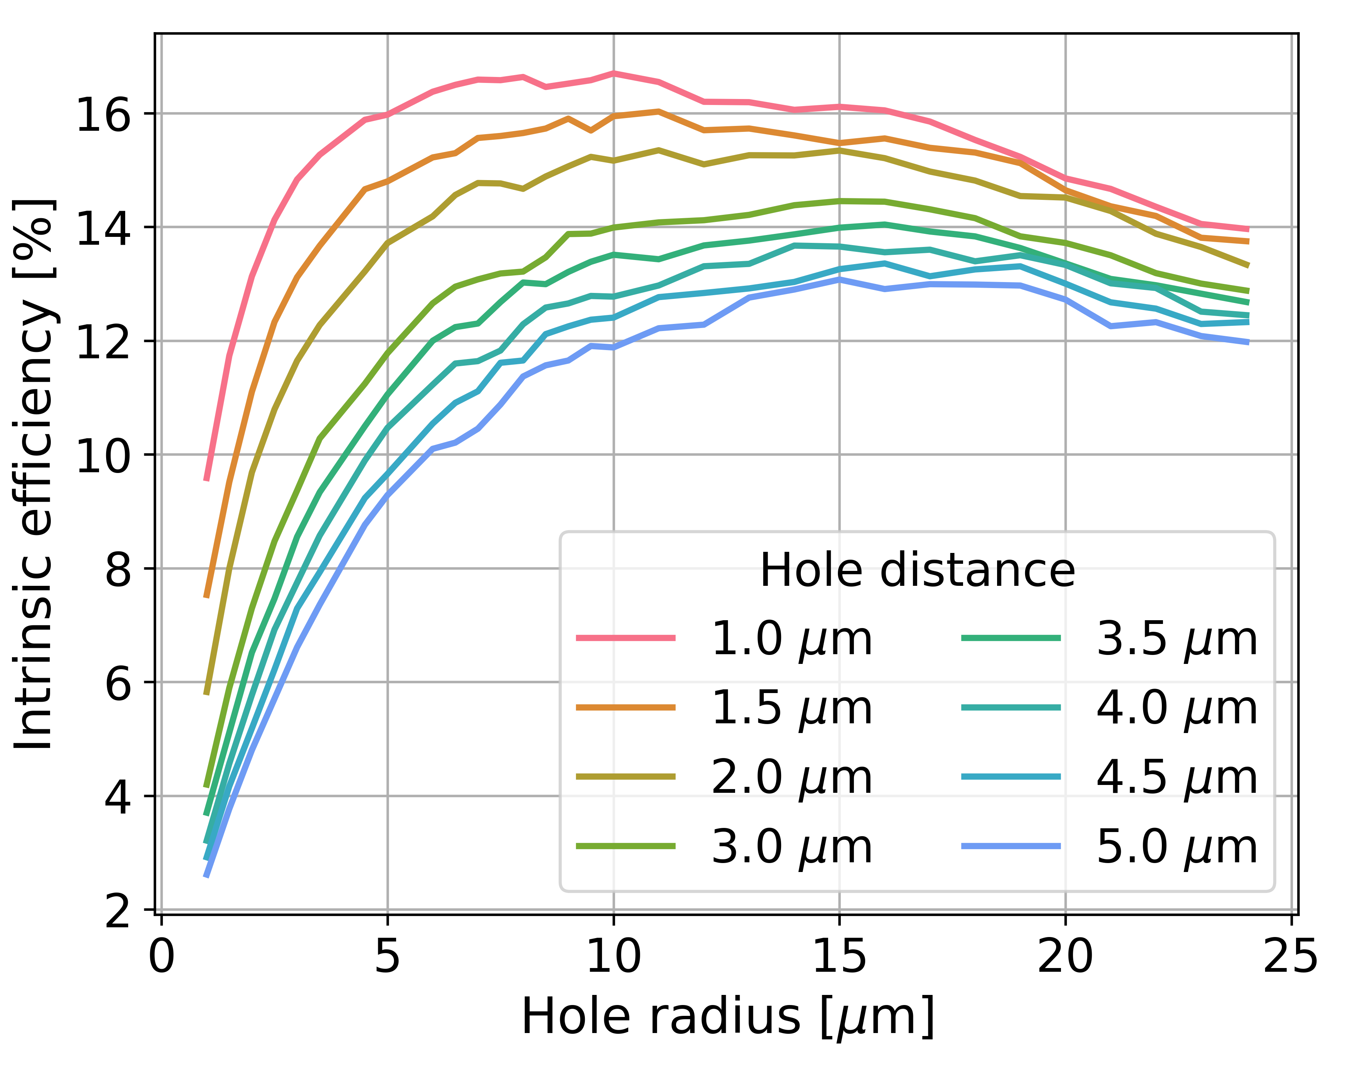
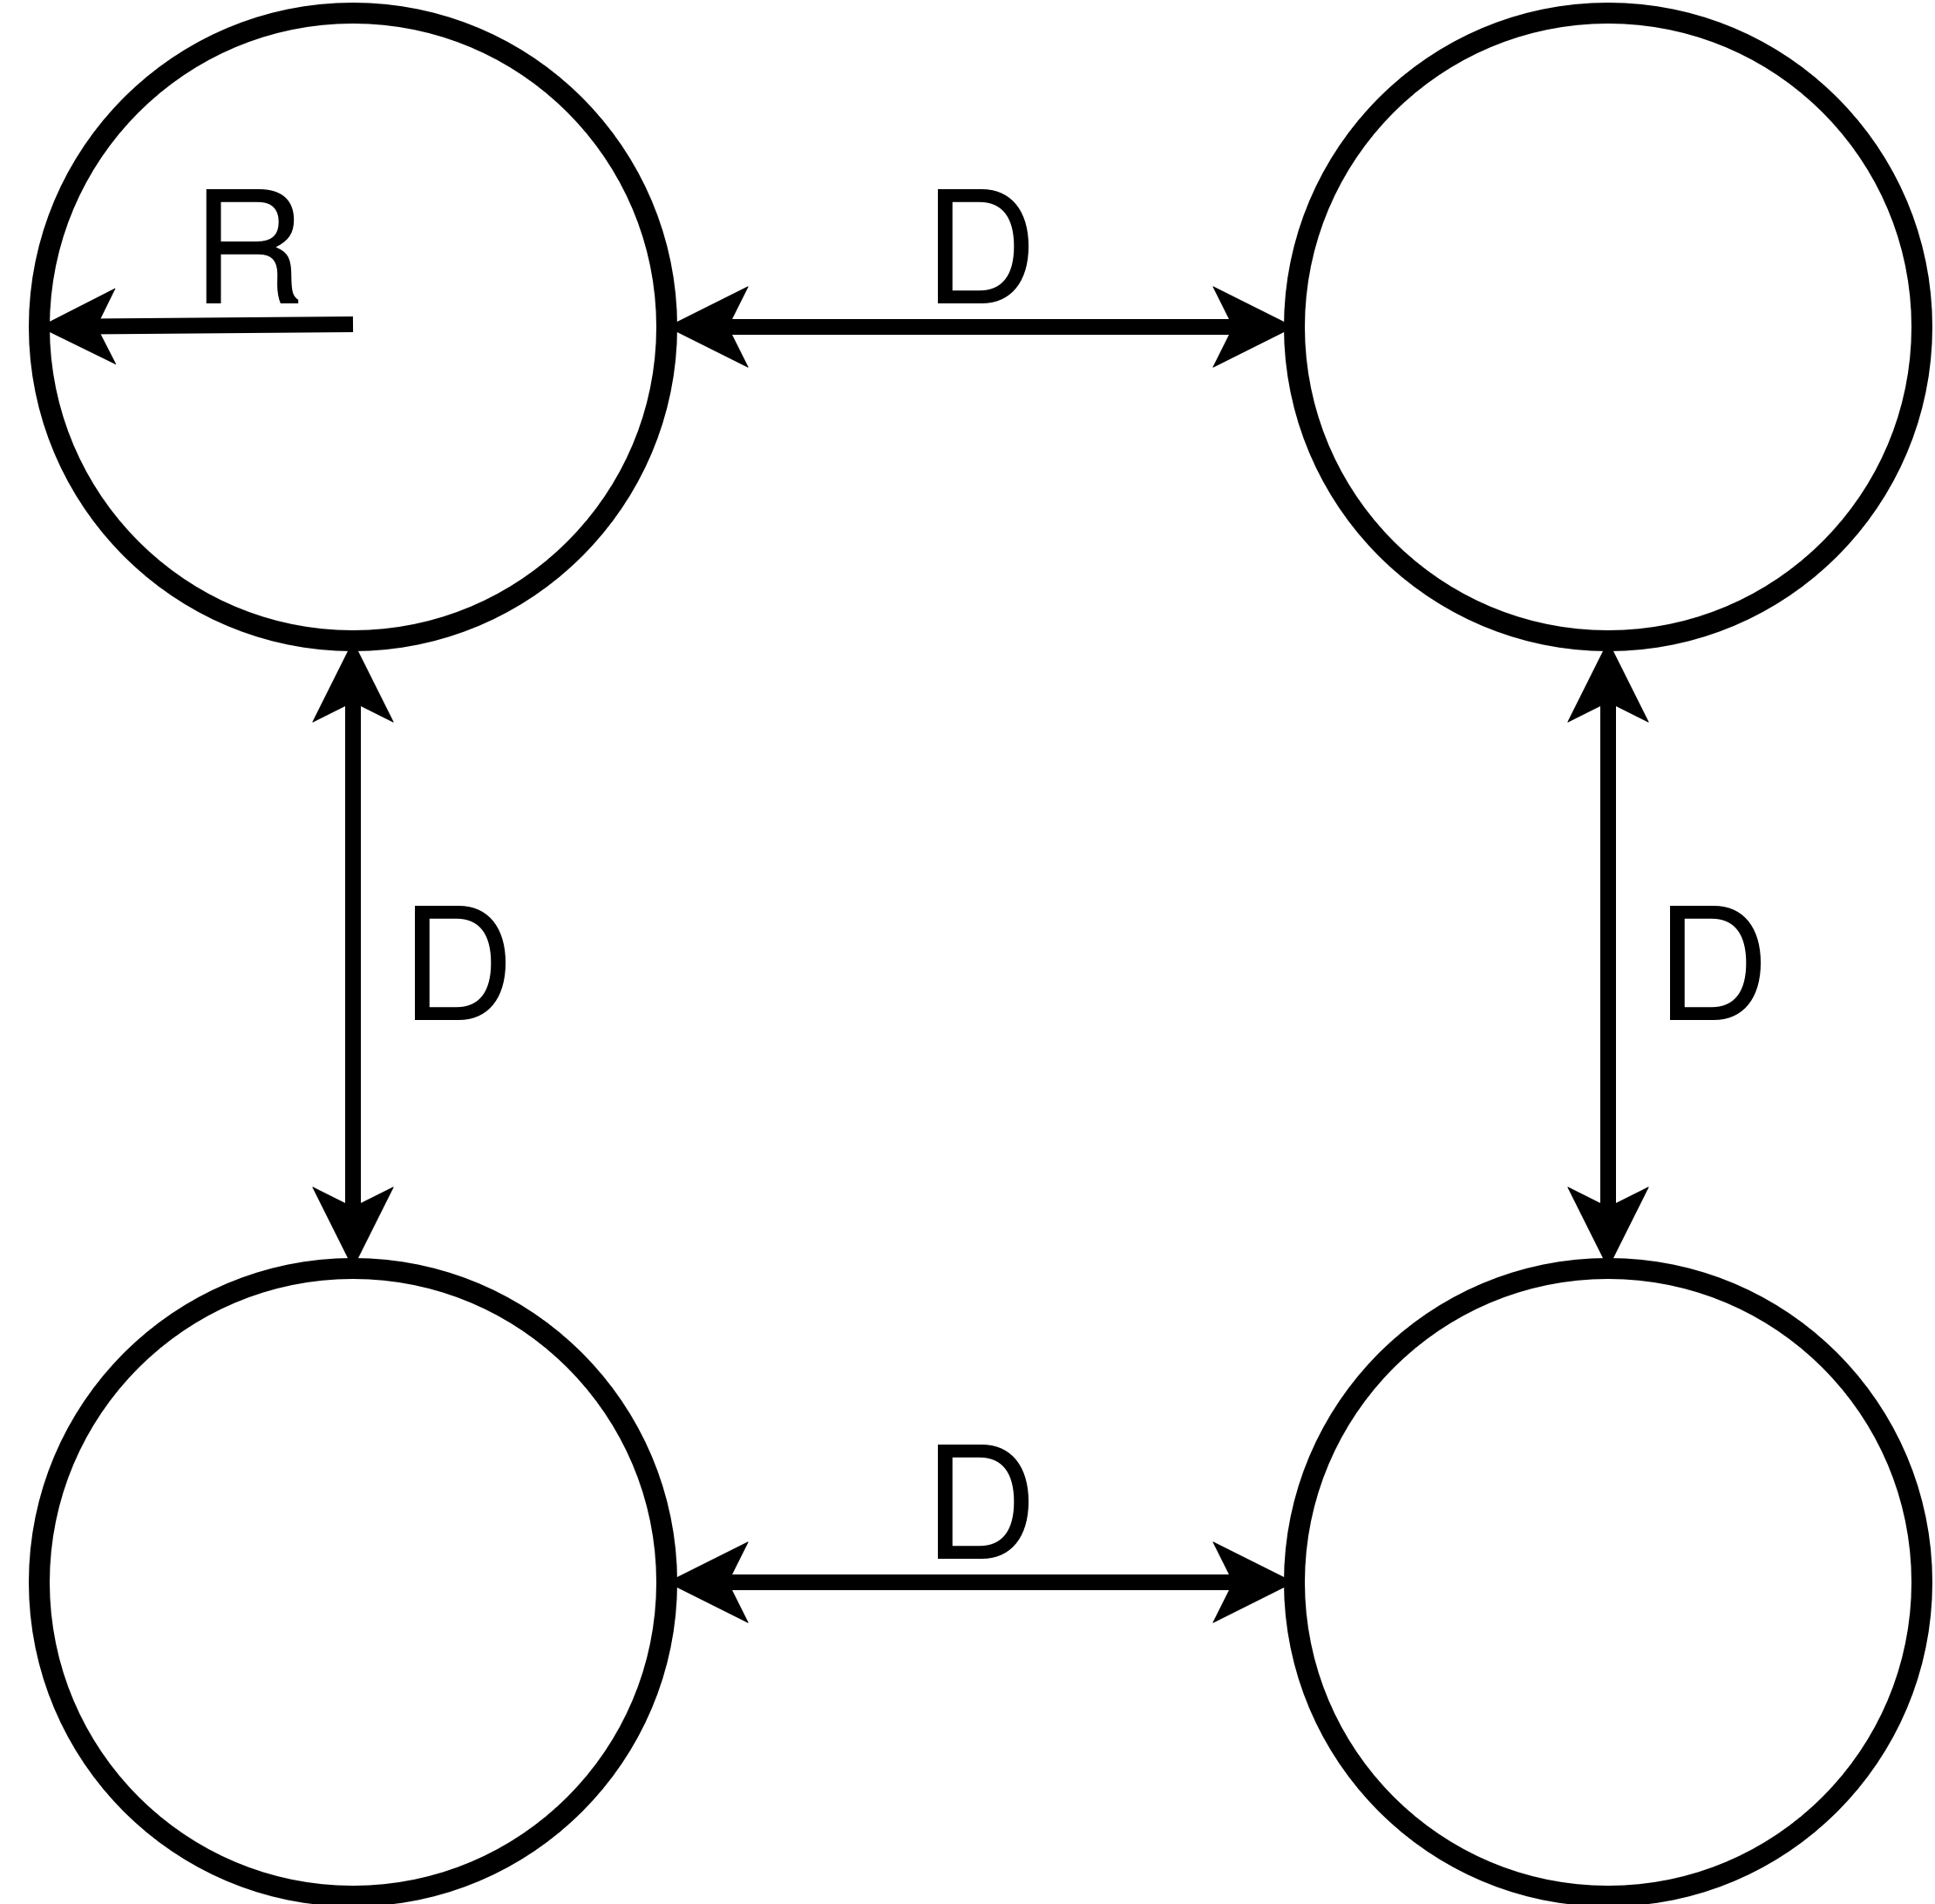
Efficiency of 3d sensor
The optimal radius (R) and distance (D) are determined to achieve the highest efficiency performance in the proposed device
Boron-10
Lithium-6 Fluoride

Slide 9
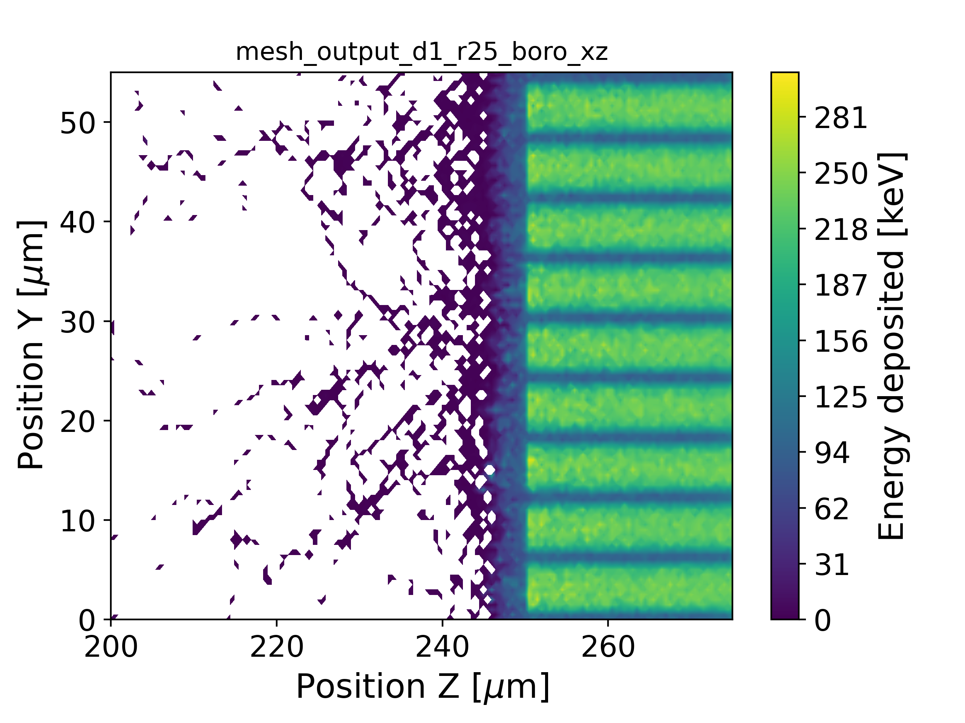
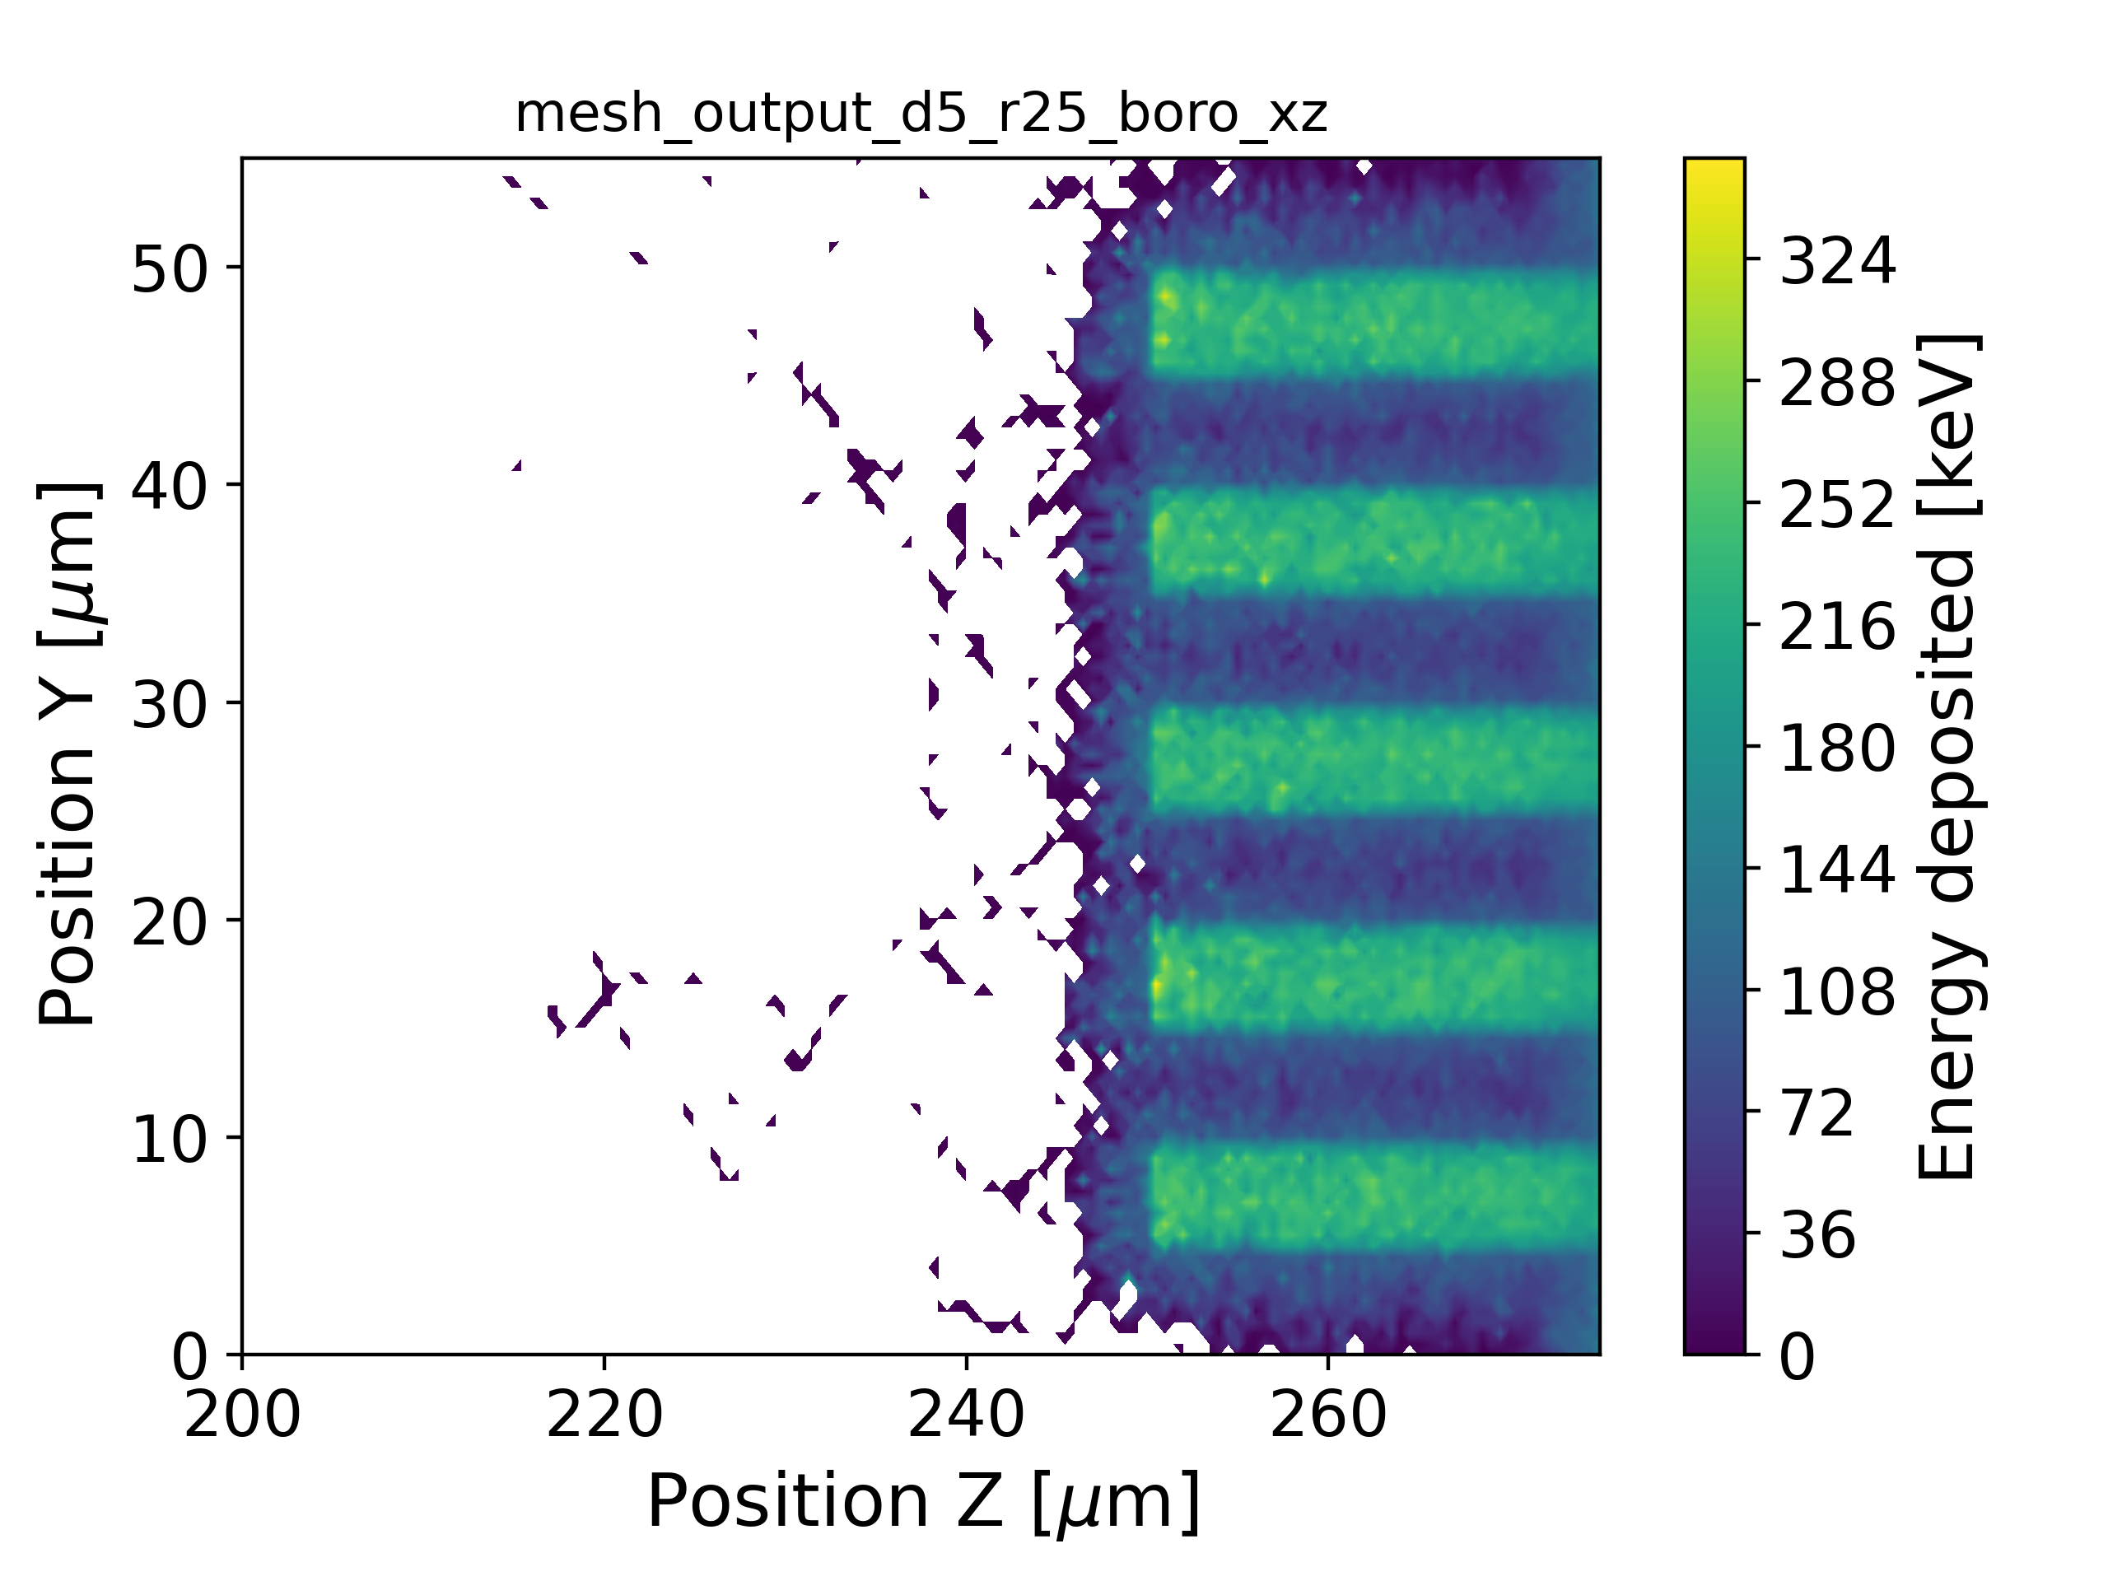
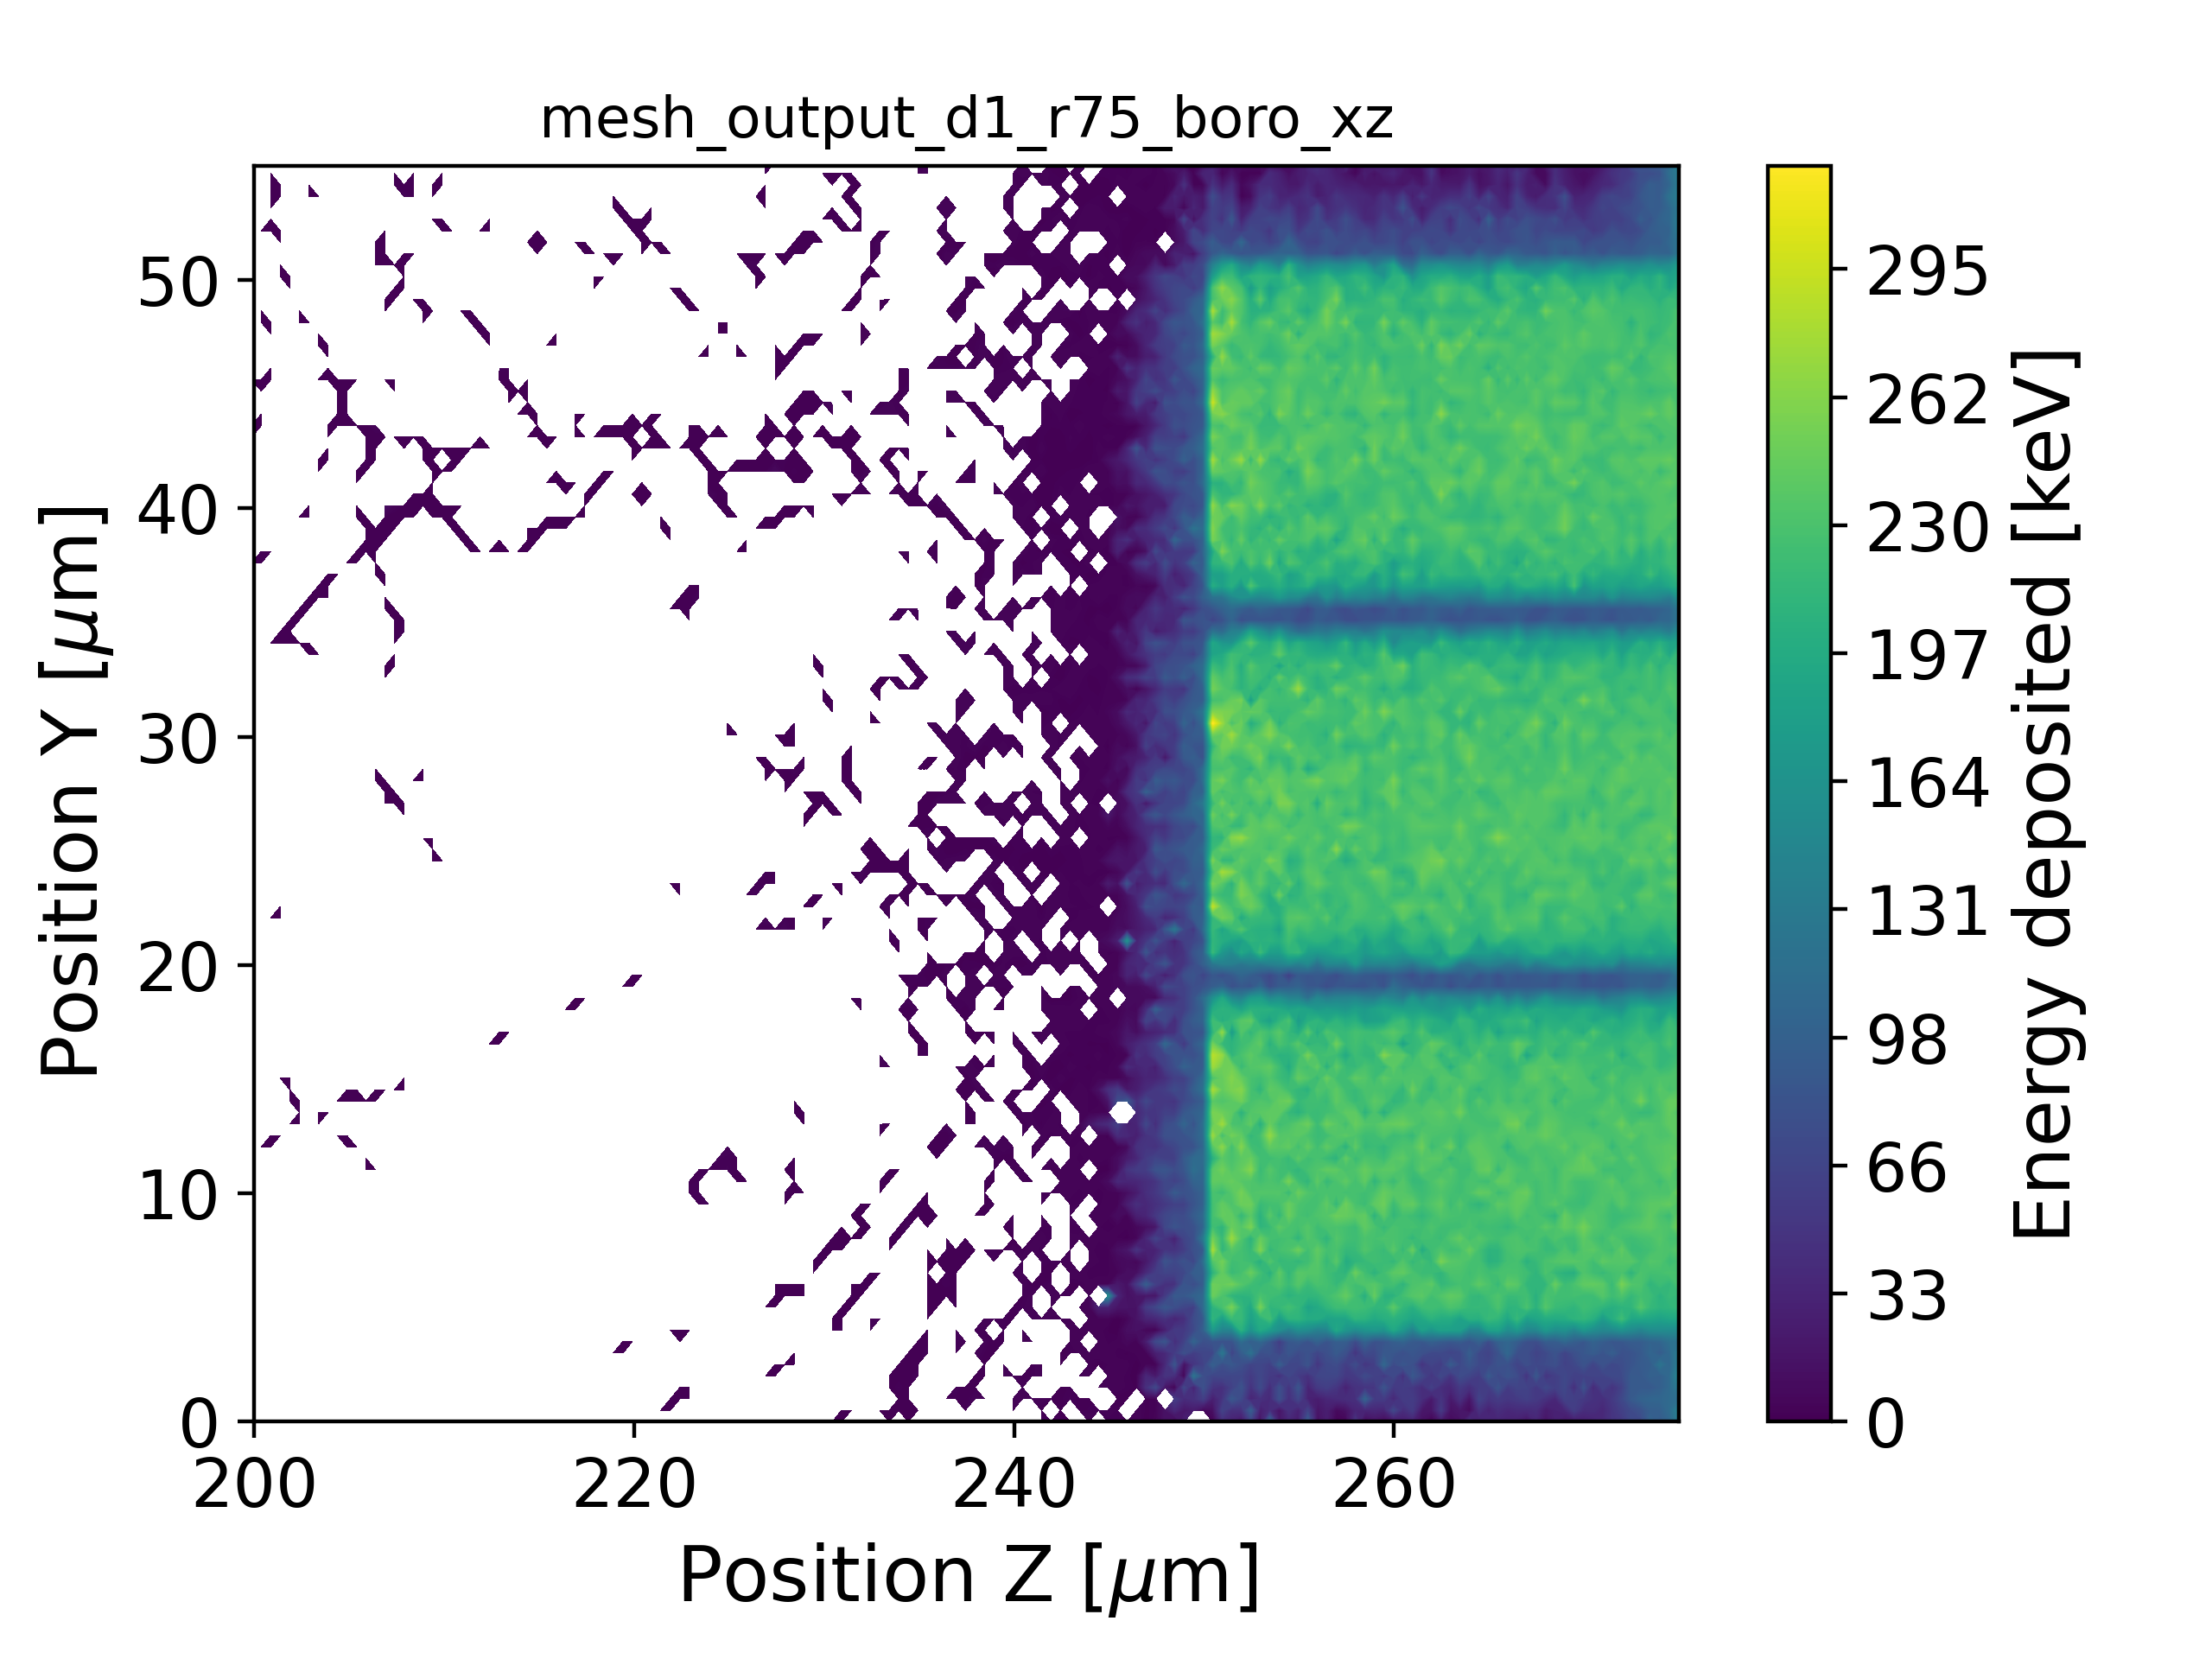
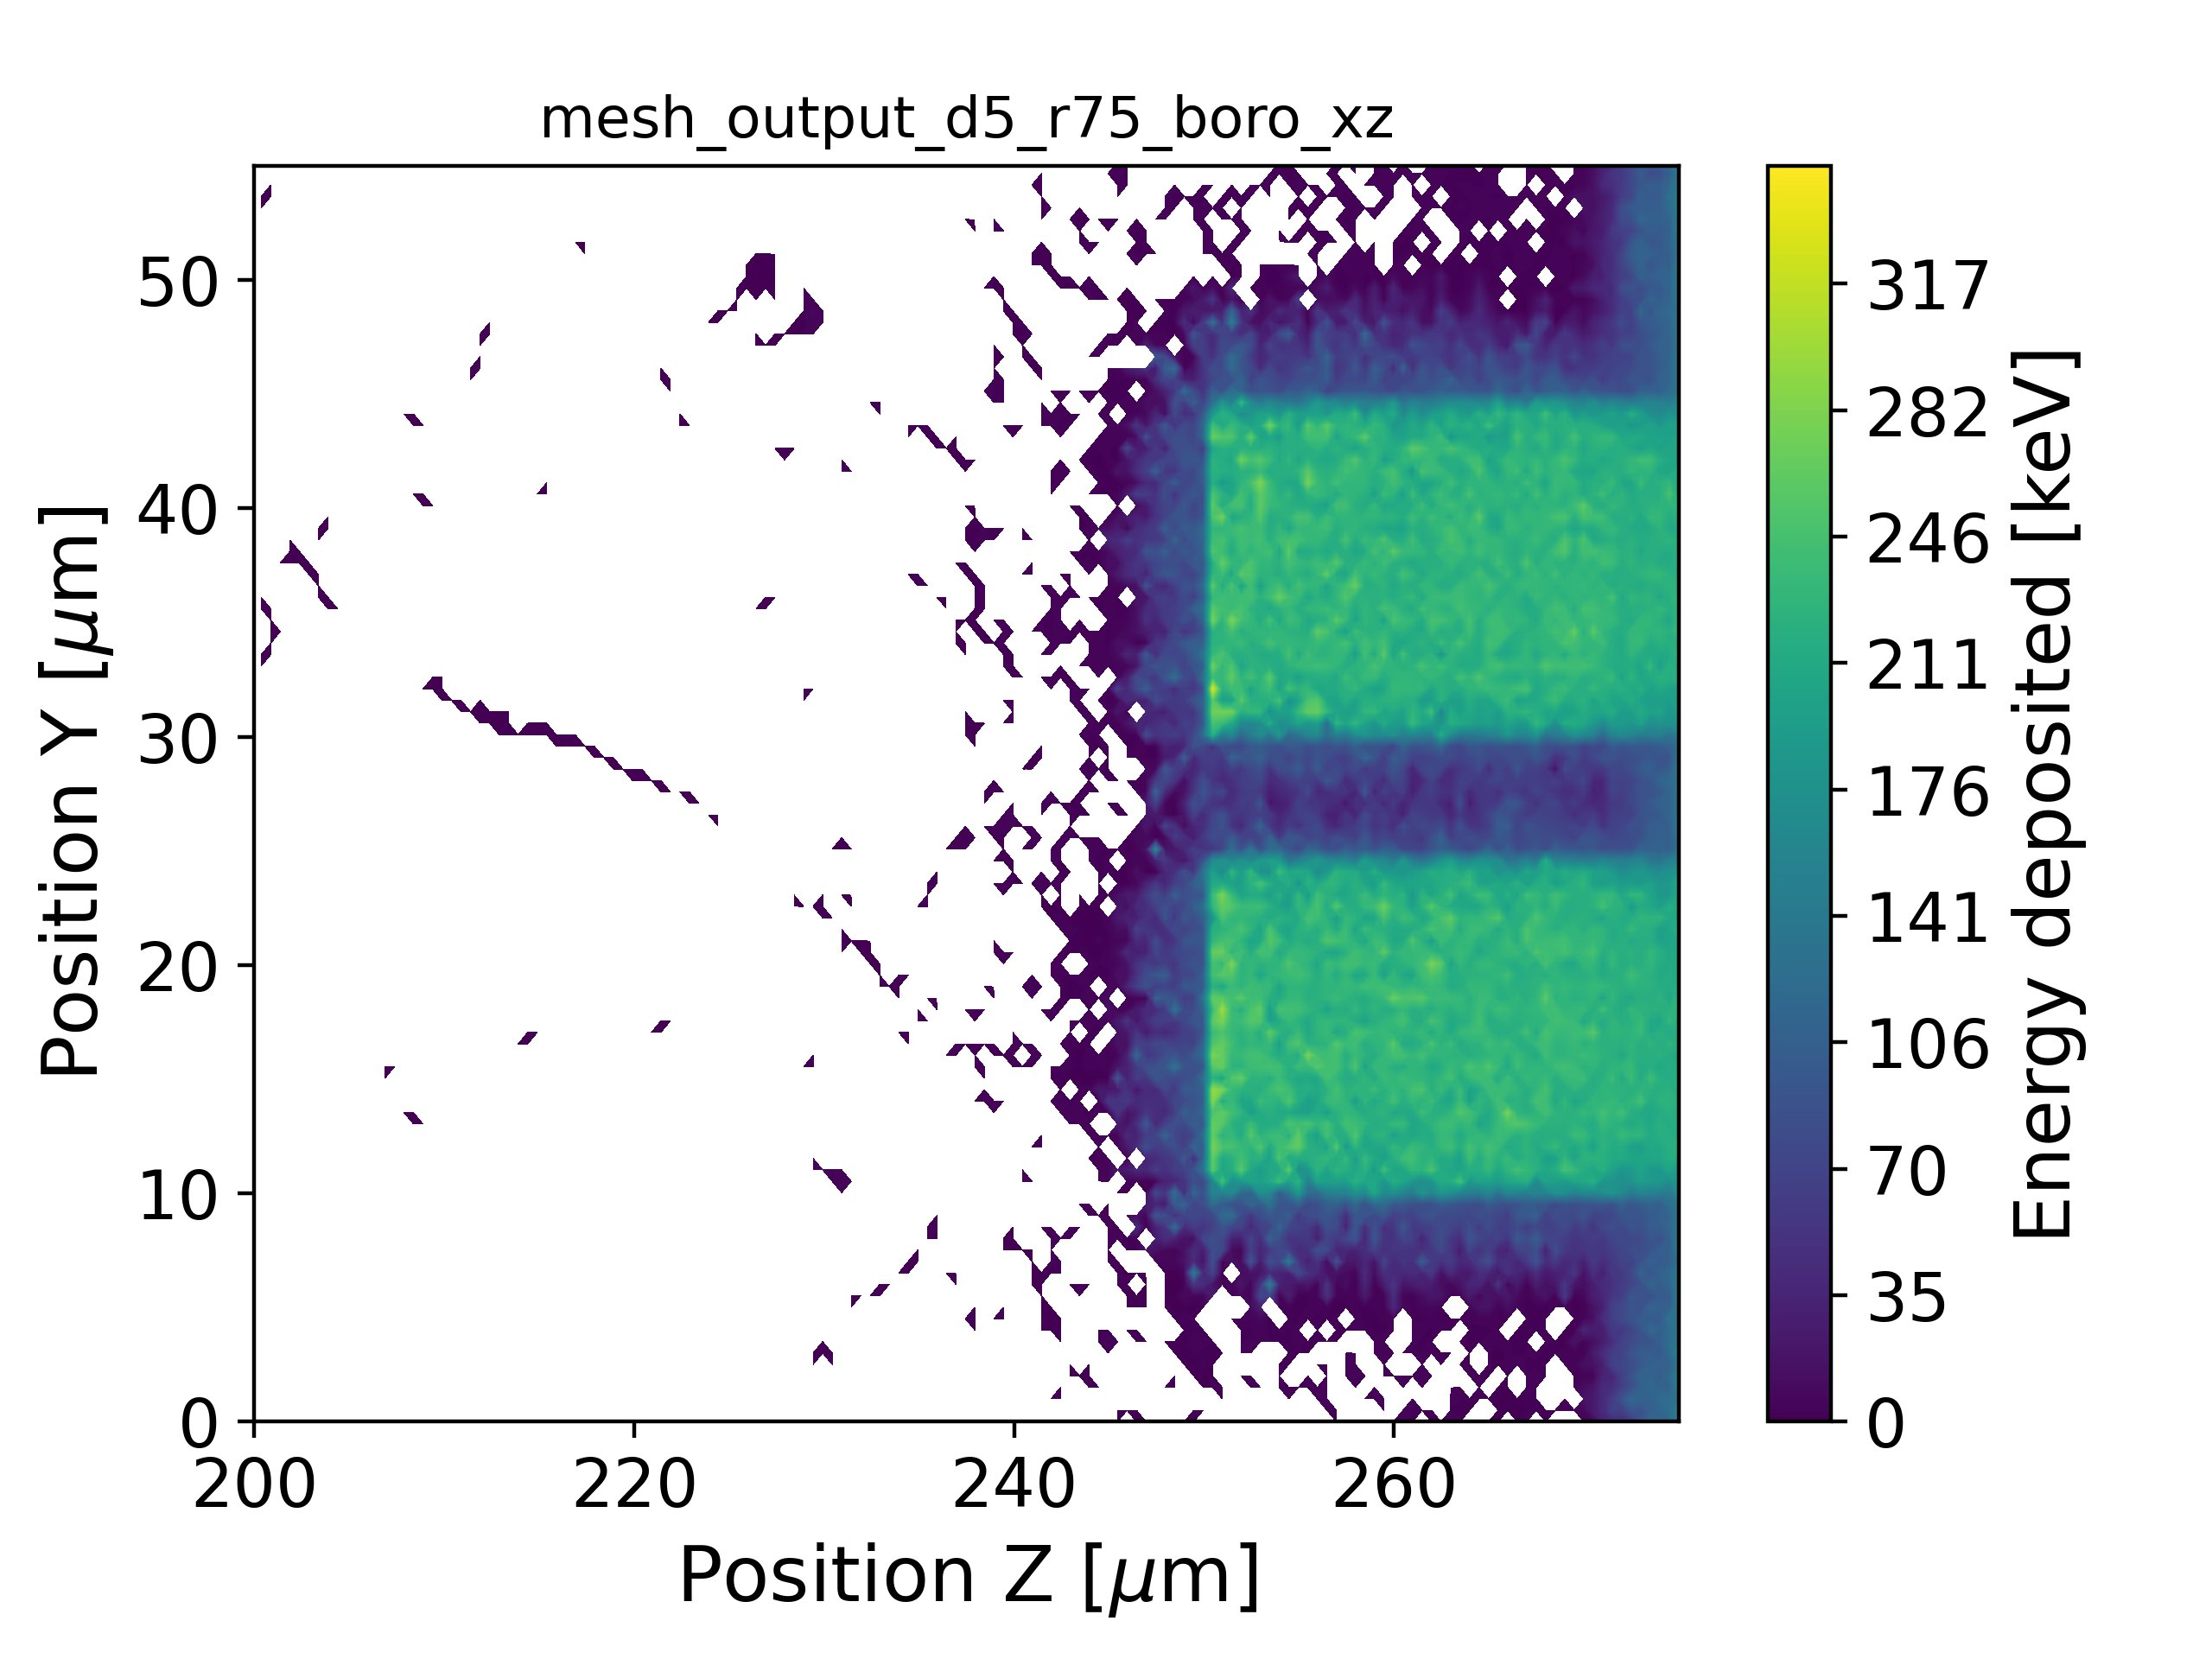
Energy deposition maps -- ¹⁰B
D=1um, R=2.5um
D=5um, R=2.5um
From GEANT4, the maps of the deposited energy were determined. A mesh with cubes of 500 nm side length was used.
¹⁰B |  | D[um]
 |  | 1 | 5
R[um] | 2.5 | 32% | 13%
 | 7.5 | 15% | 10%
D=1um, R=7.5um
D=5um, R=7.5um

Slide 10
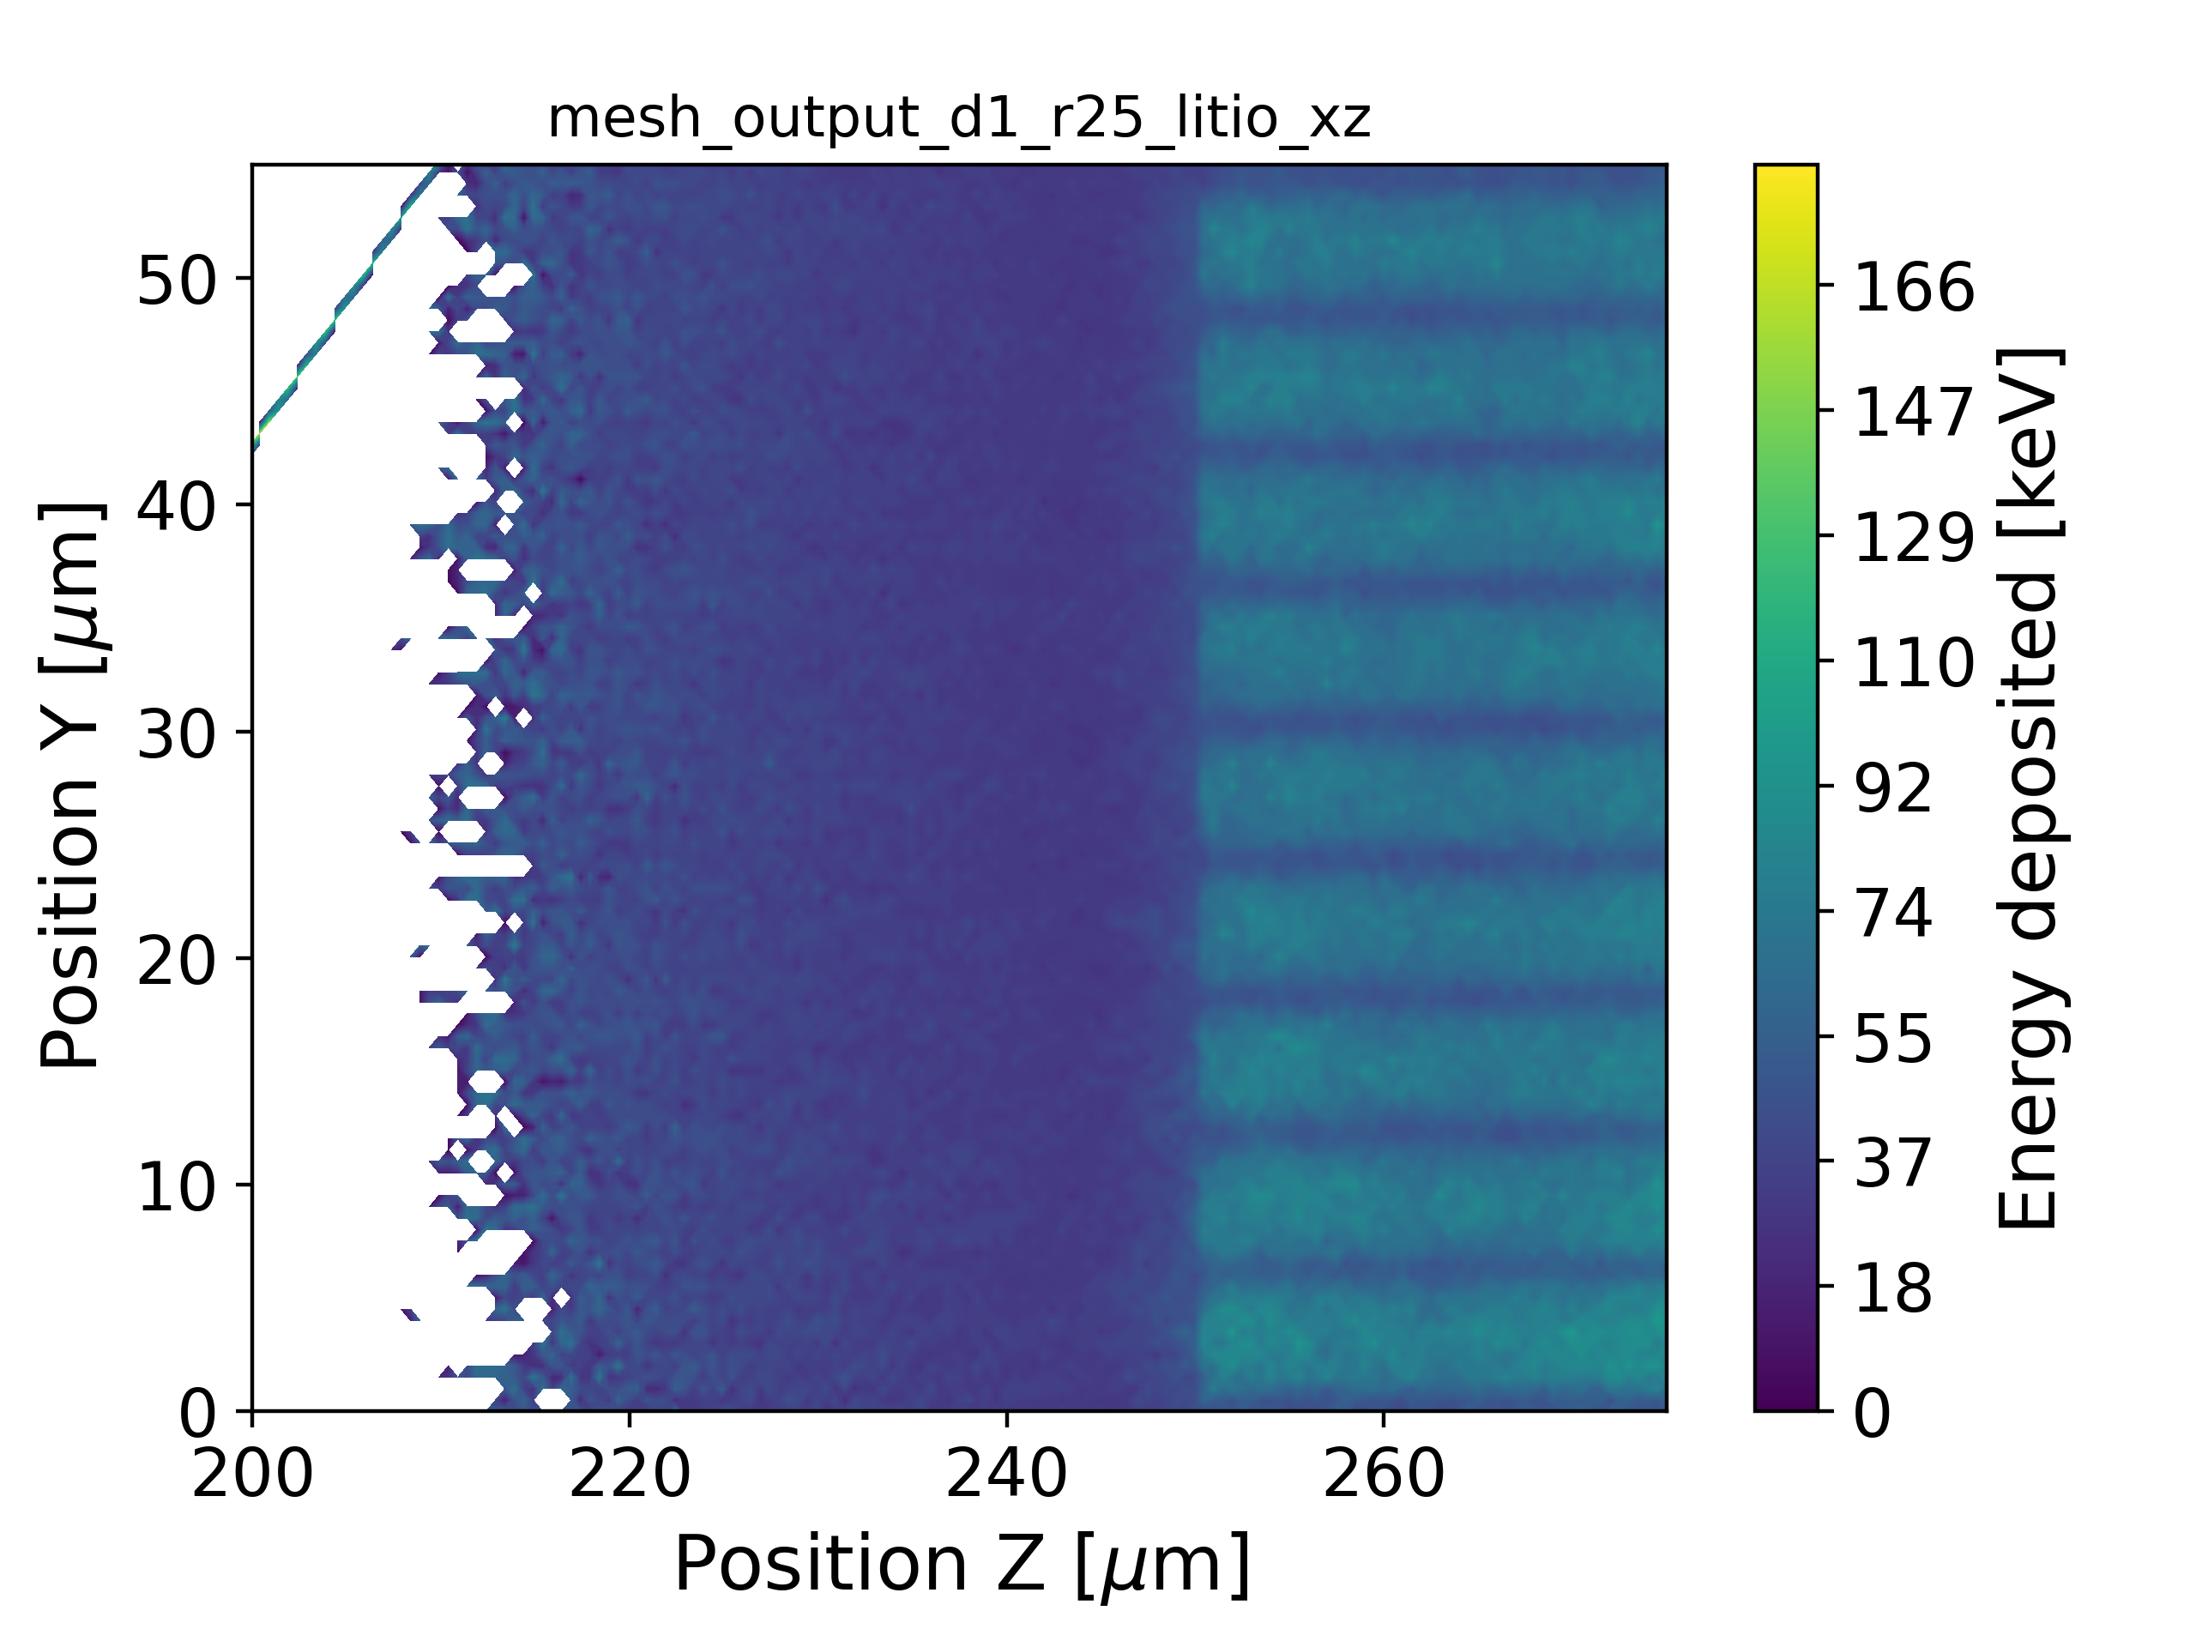
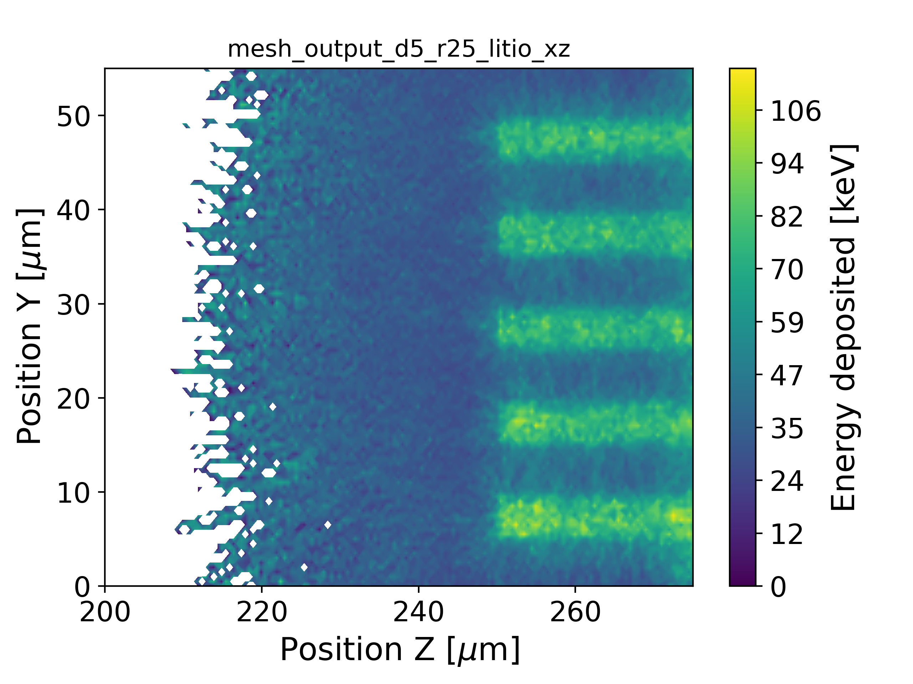
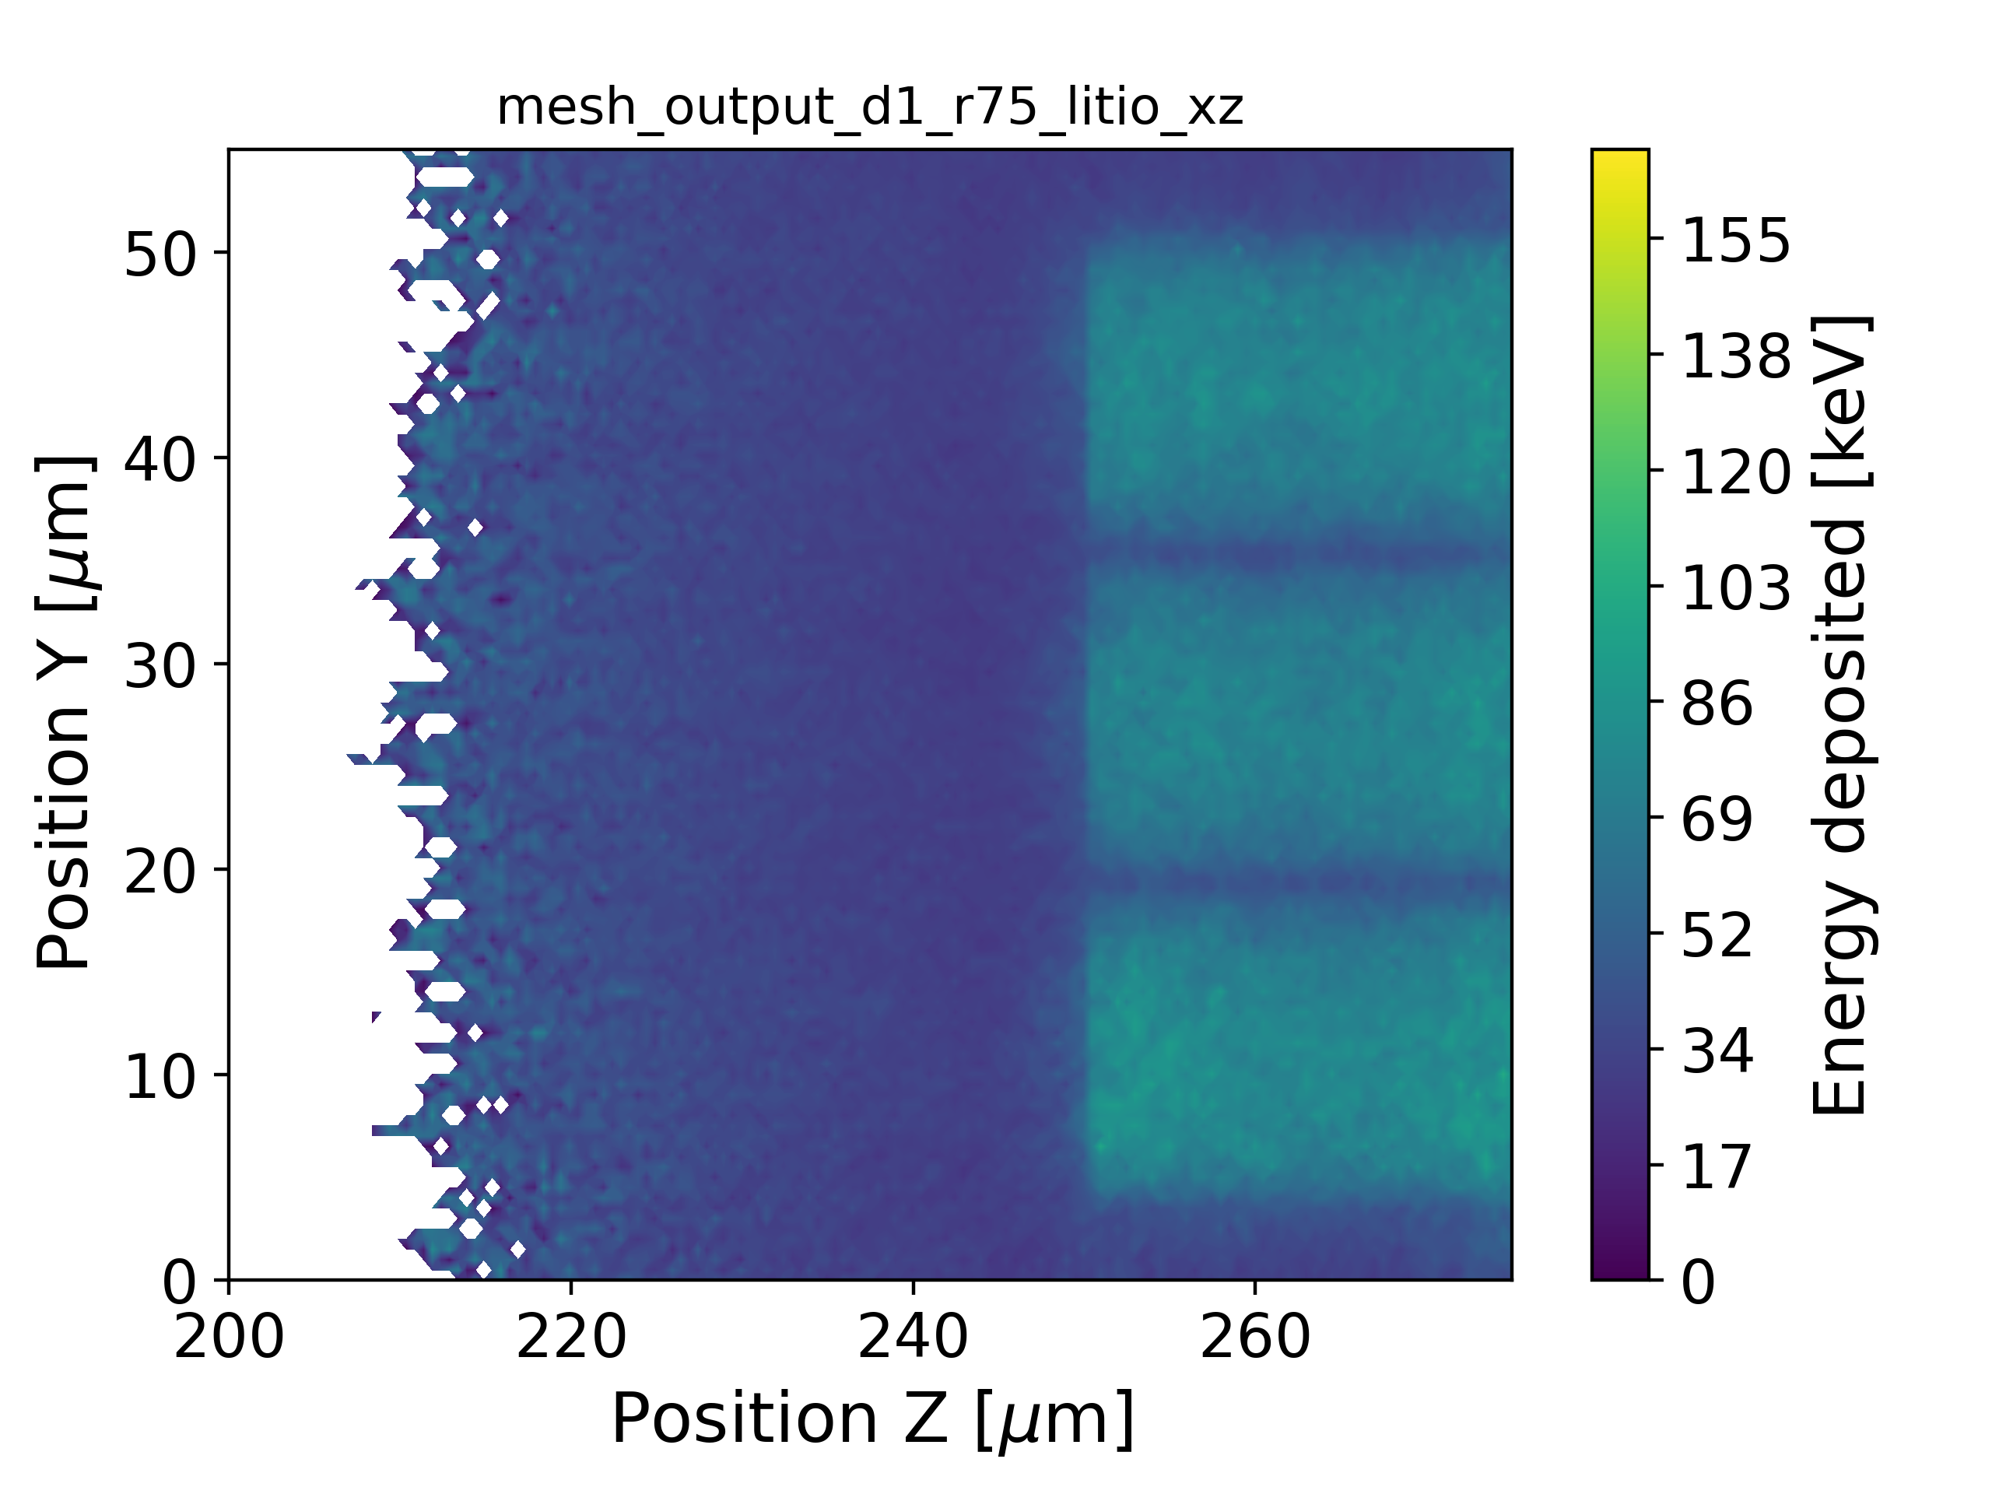
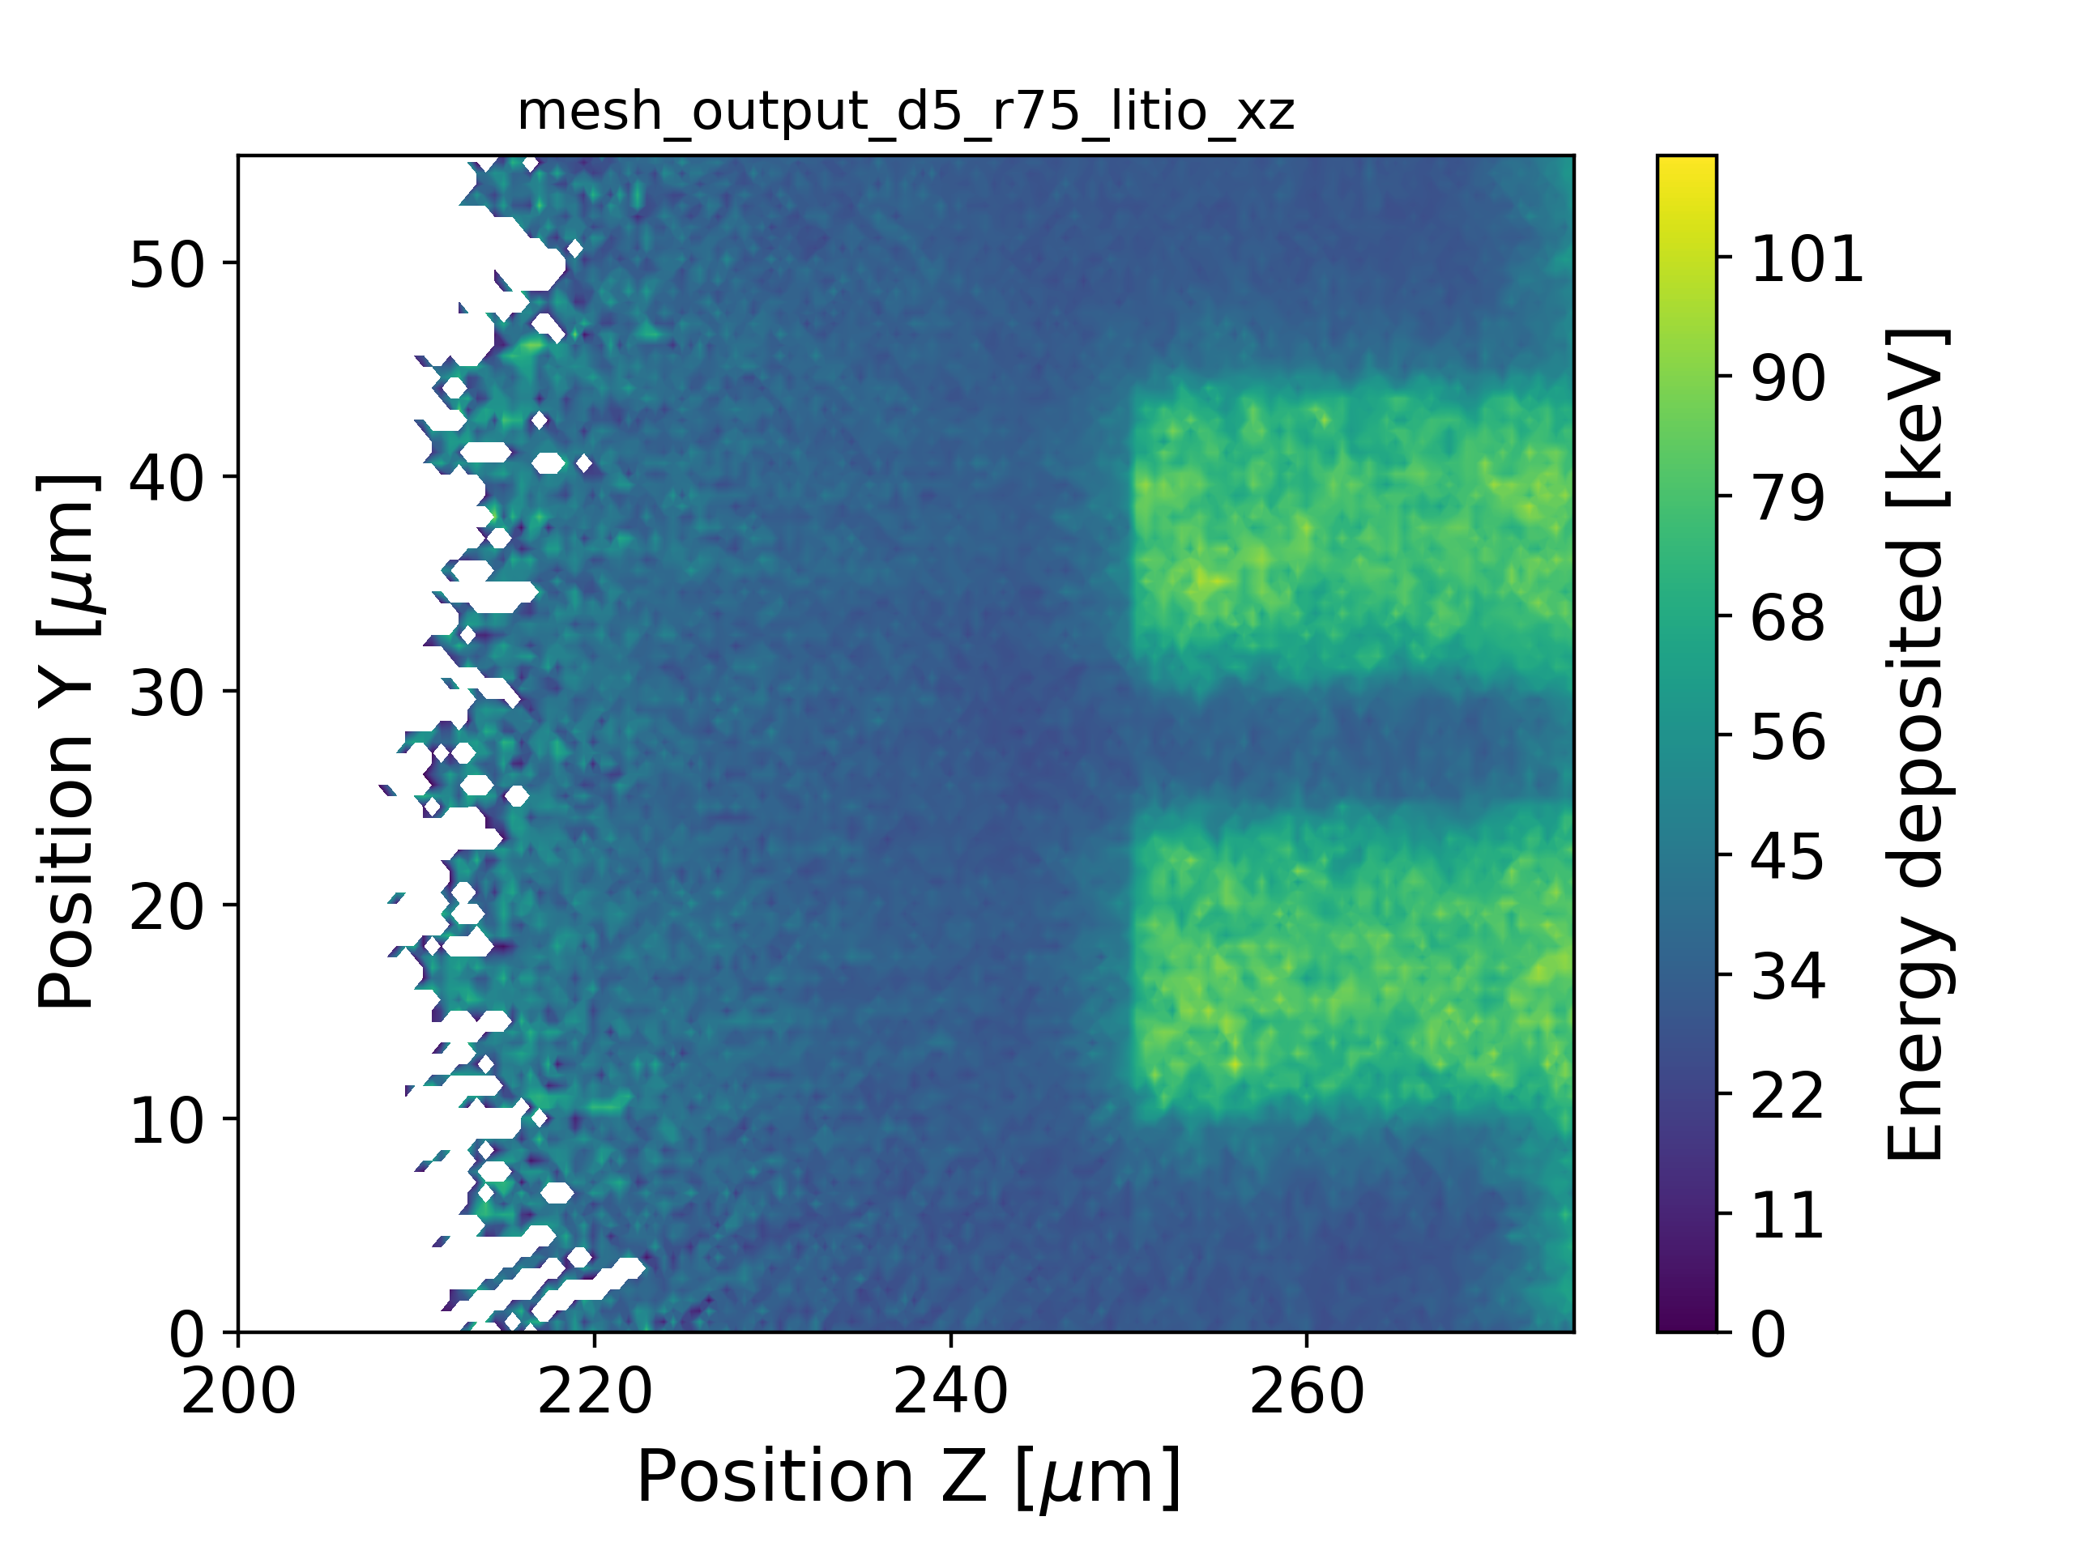
Energy deposition maps -- ⁶LiF
D=1um, R=2.5um
D=5um, R=2.5um
From GEANT4, the maps of the deposited energy were determined. A mesh with cubes of 500 nm side length was used.
⁶LiF |  | D[um]
 |  | 1 | 5
R[um] | 2.5 | 13% | 6%
 | 7.5 | 16% | 11%
D=1um, R=7.5um
D=5um, R=7.5um

Slide 11
TCAD – Device simulation
Electrical characteristics of semiconductor devices

Slide 12
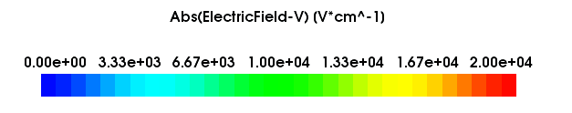
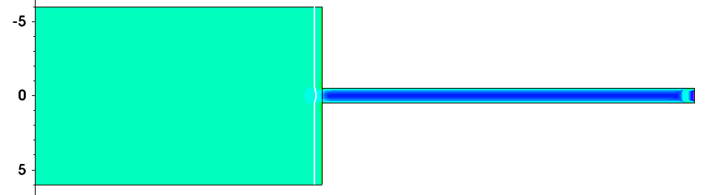
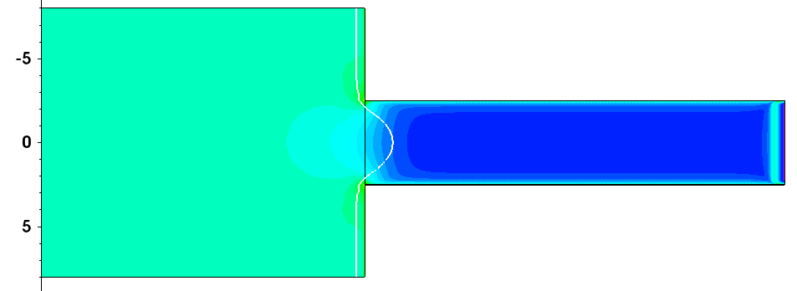
Electric field maps
The simulation allows the extraction of the electric field map, which makes it possible to estimate and map the depletion region, necessary for the correct functioning of the sensor. The Q_{ox} (passivation layer) is set to -1·10¹¹ cm⁻²
D=1um
D=5um

Slide 13
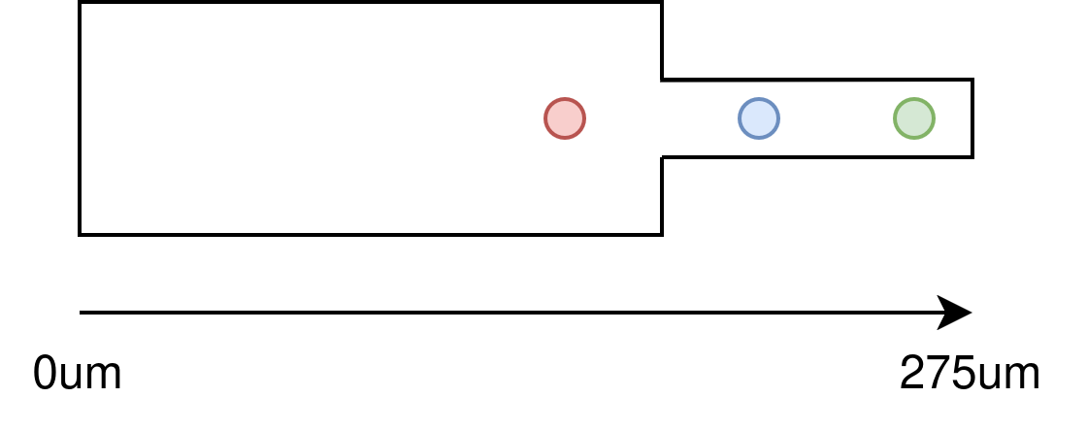
Transient simulation
Simulation setup: OpticalGeneration command used
Charge deposition: Fixed number of charges deposited
Deposition positions: Three distinct spatial locations:
Red (A): 245um
Blue (B): 258um
Green (C): 268um

Slide 14
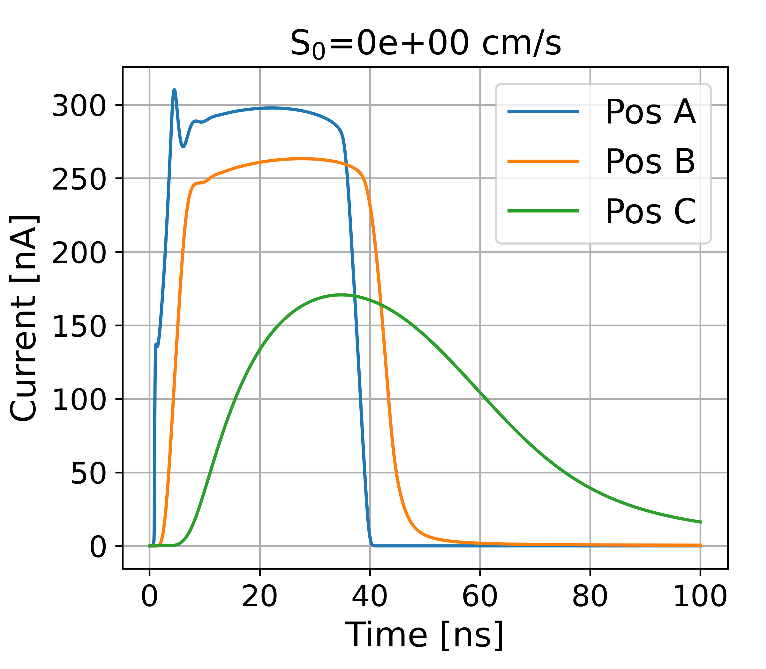
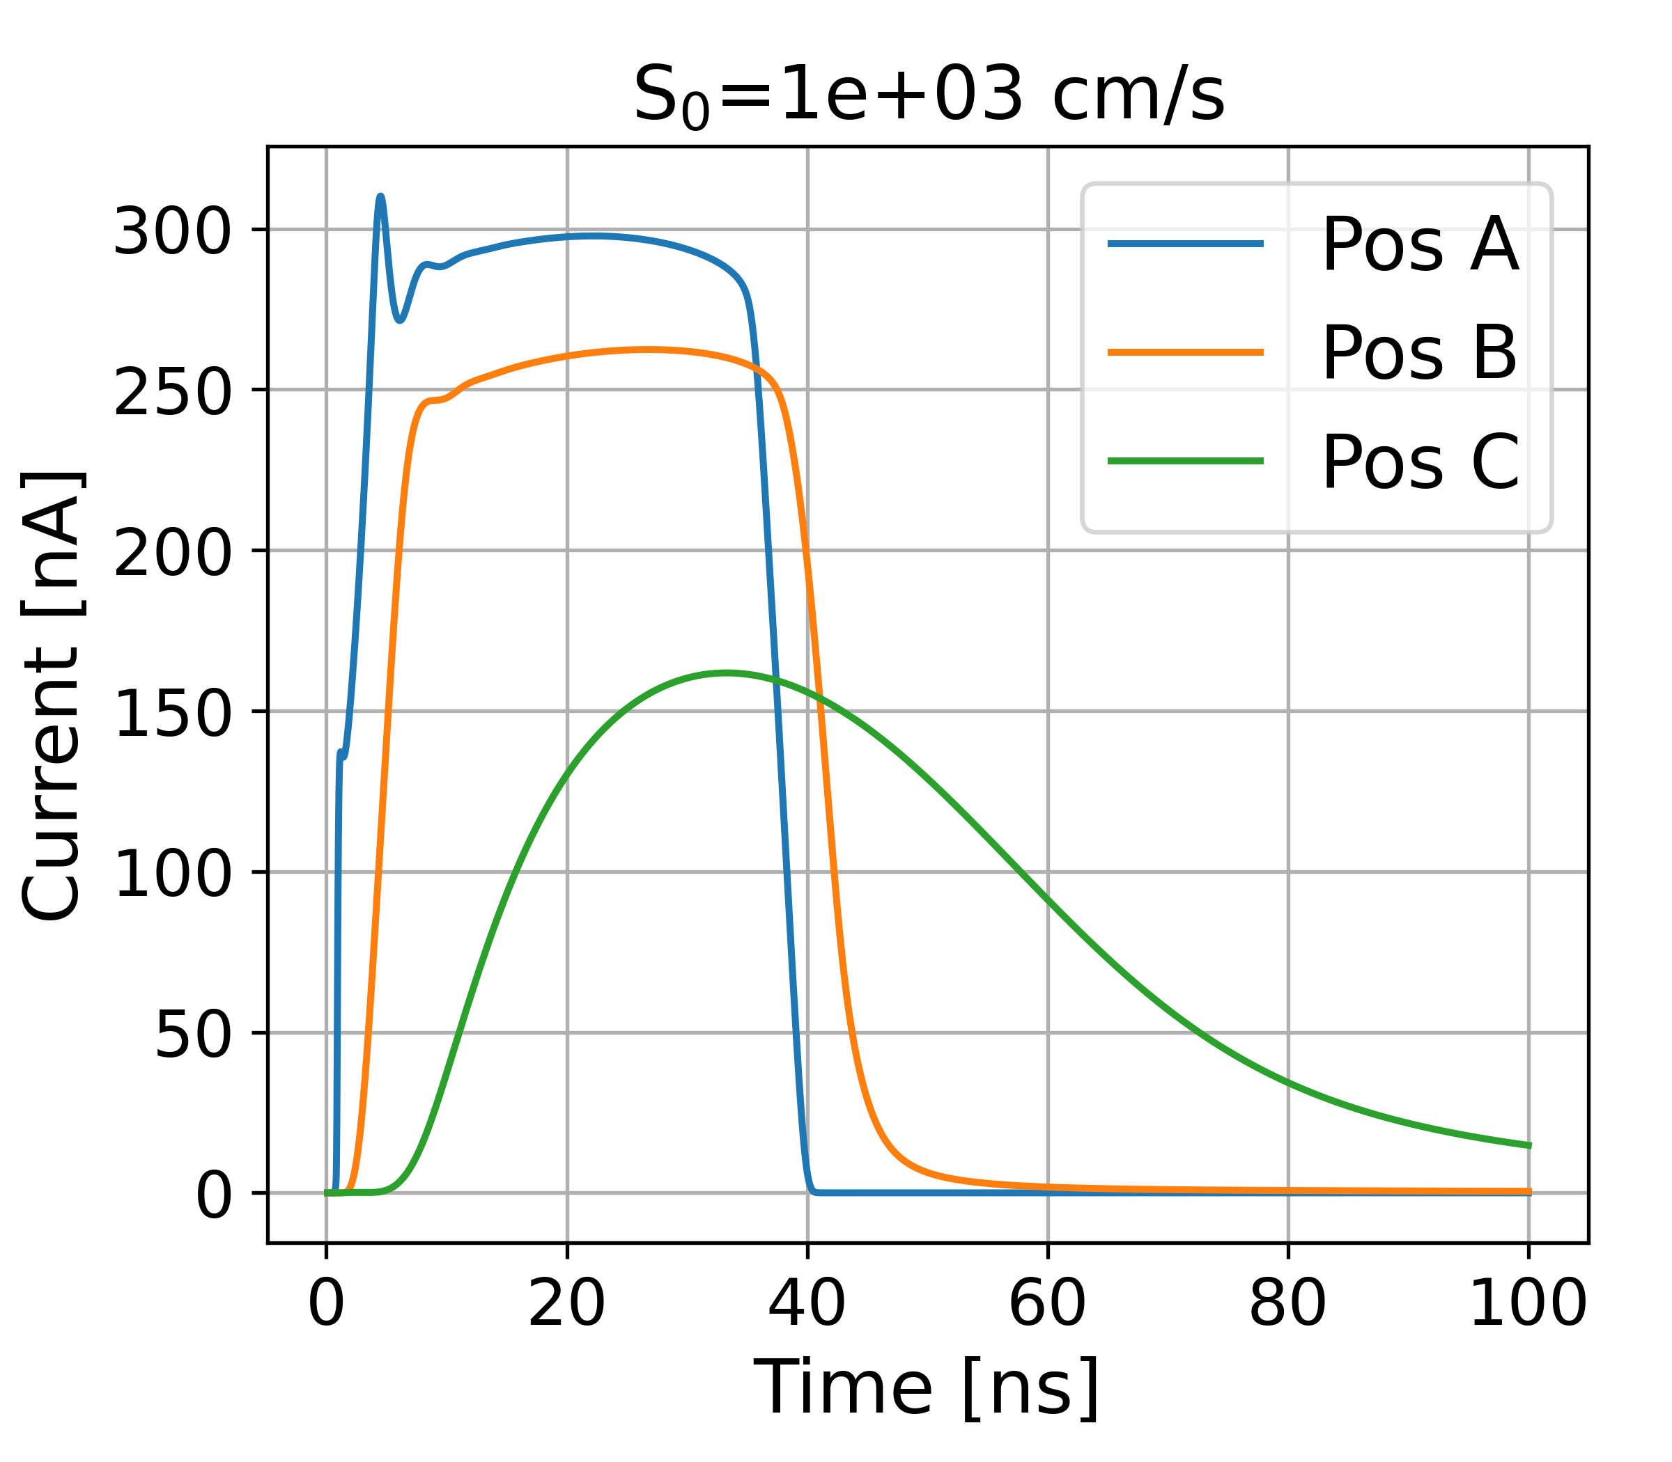
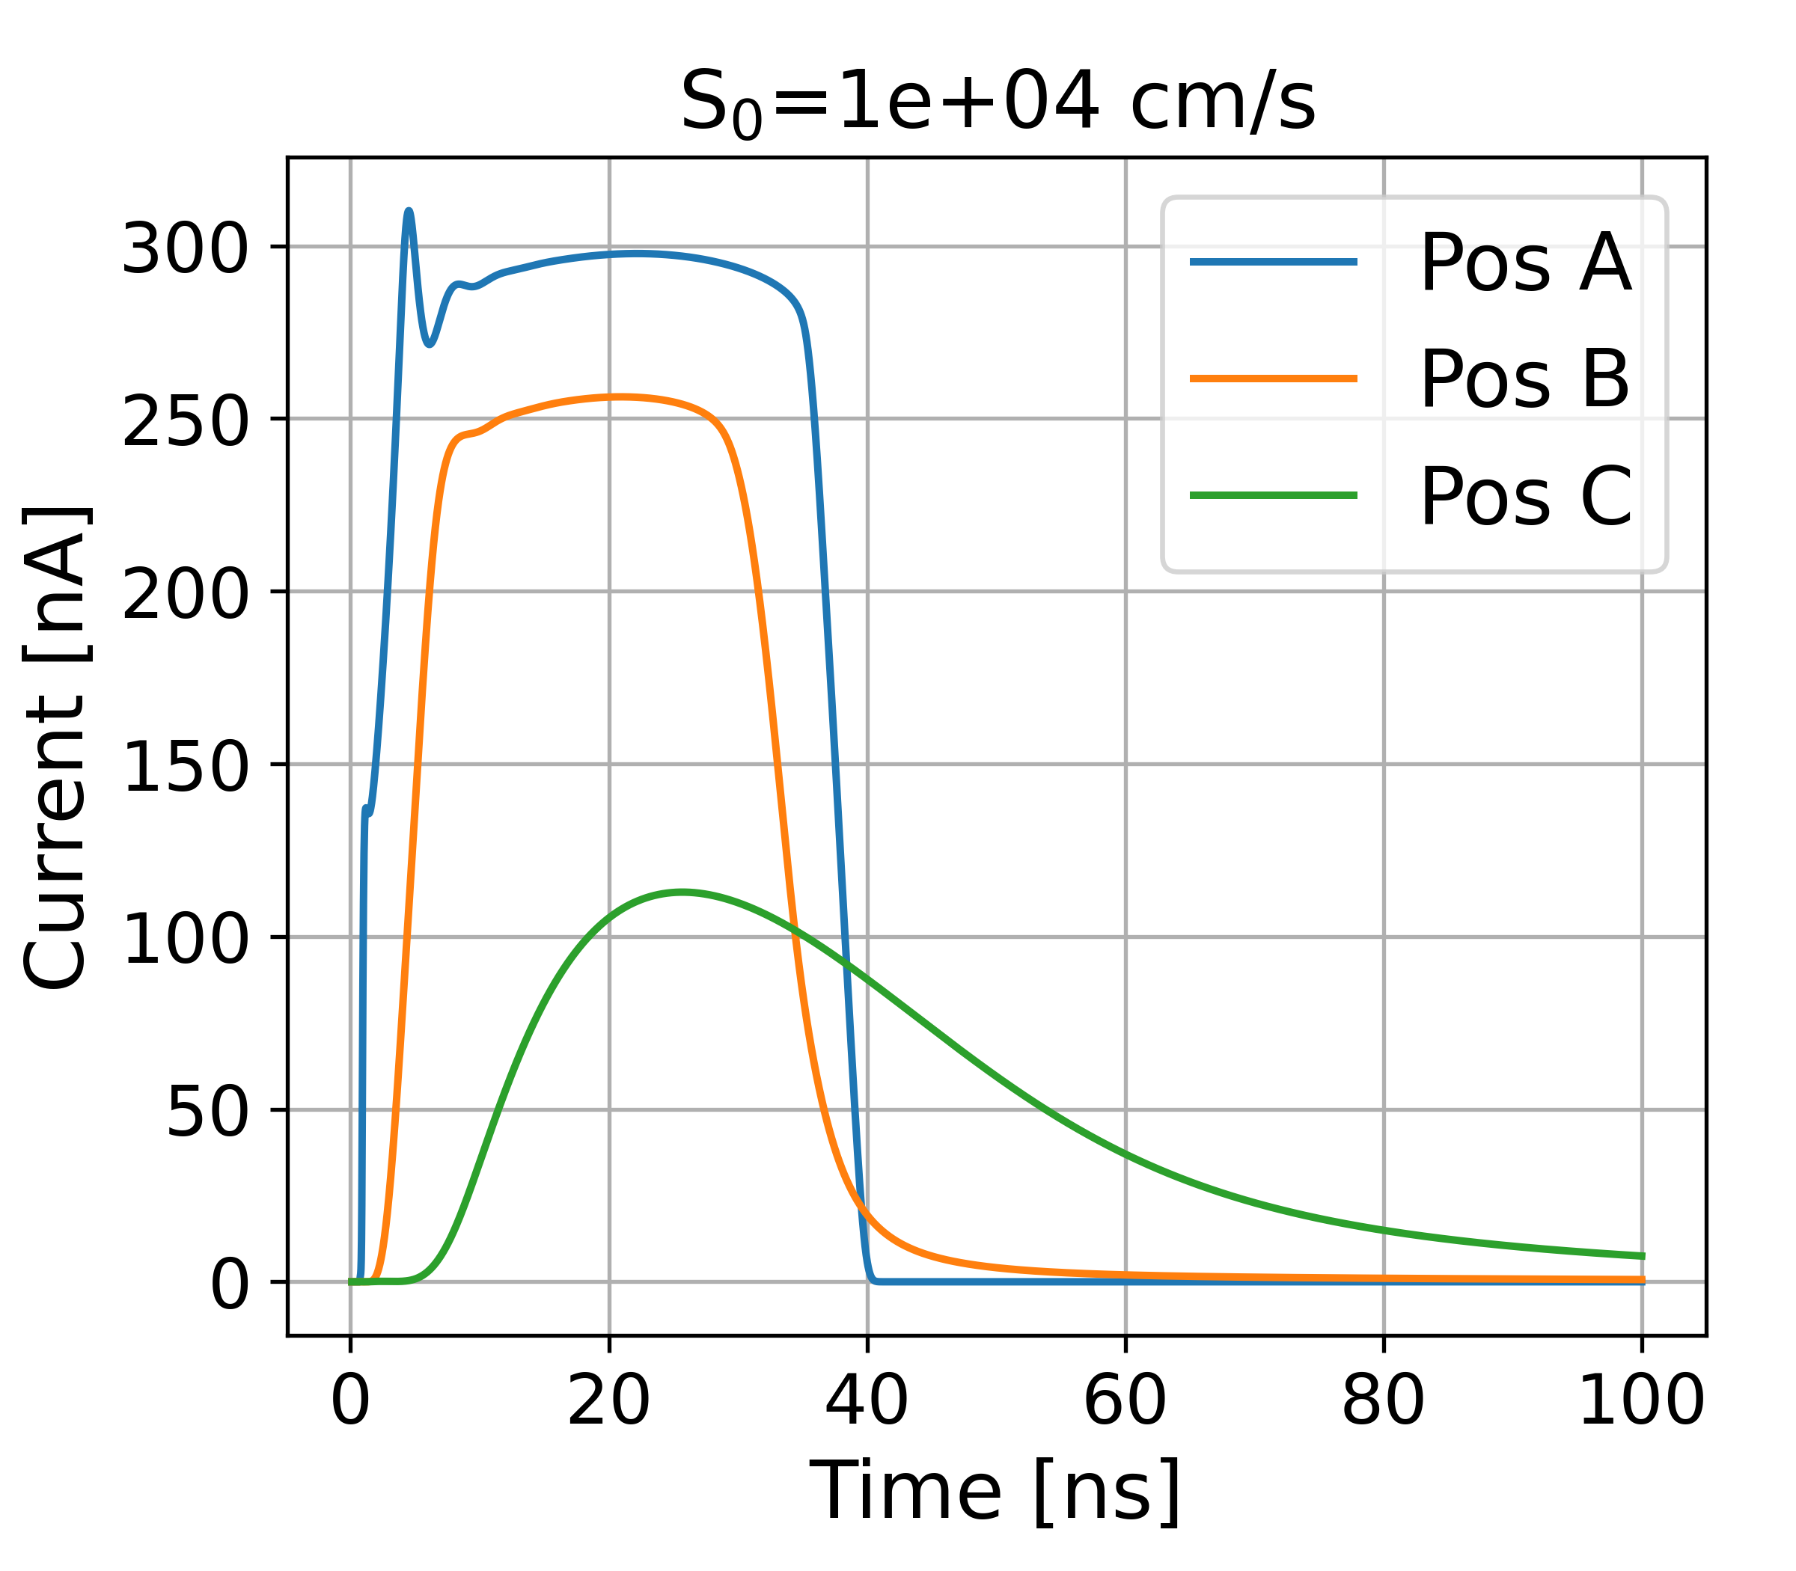
Transient simulation D=1um
Different value of Surface recombination velocity (S₀) are simulated

Slide 15
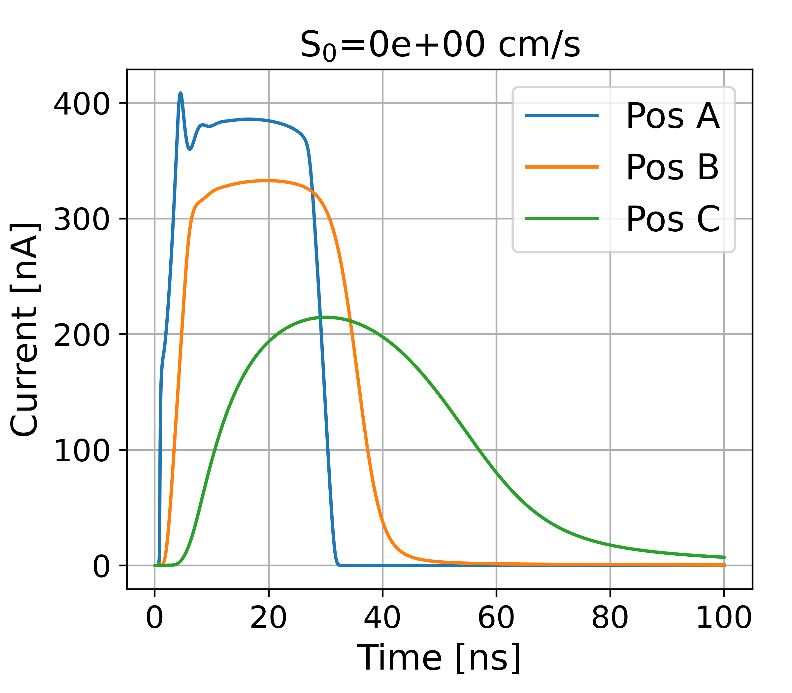

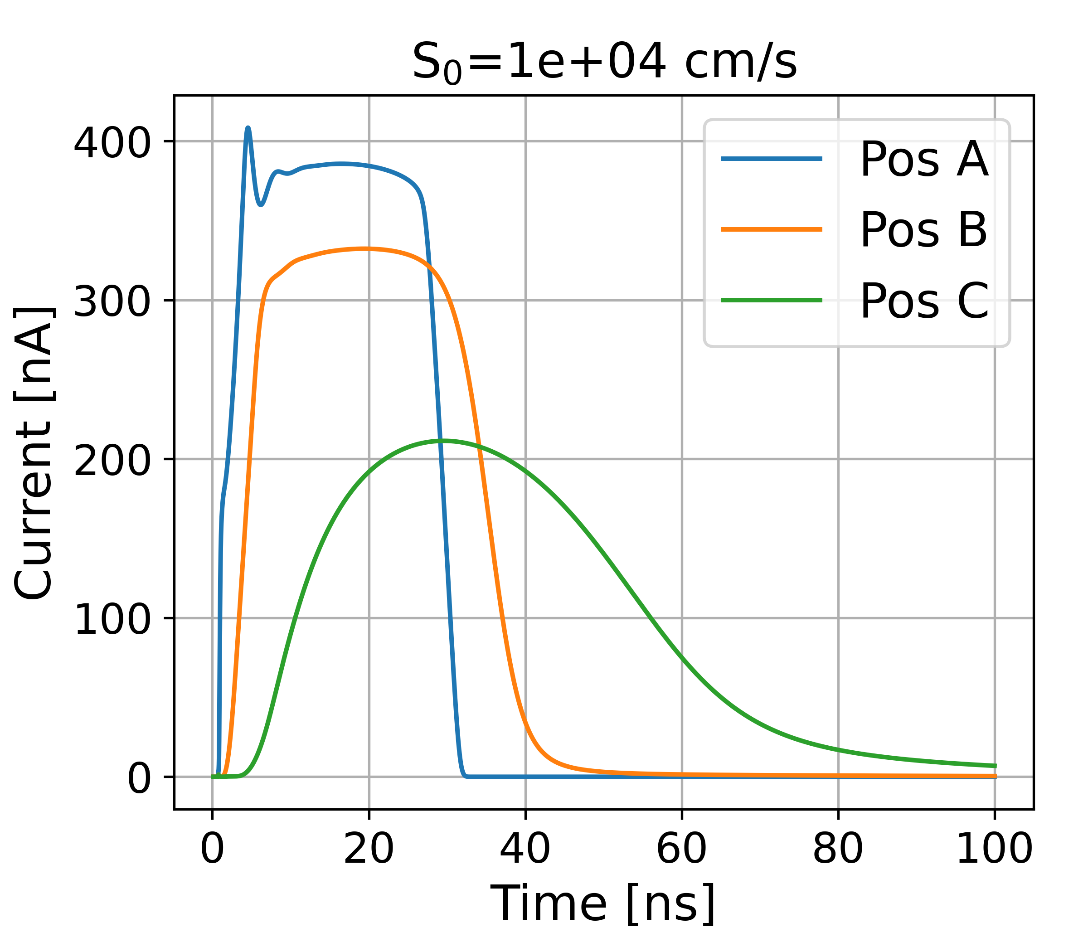
Transient simulation D=5um
Different value of Surface recombination velocity (S₀) are simulated

Slide 16
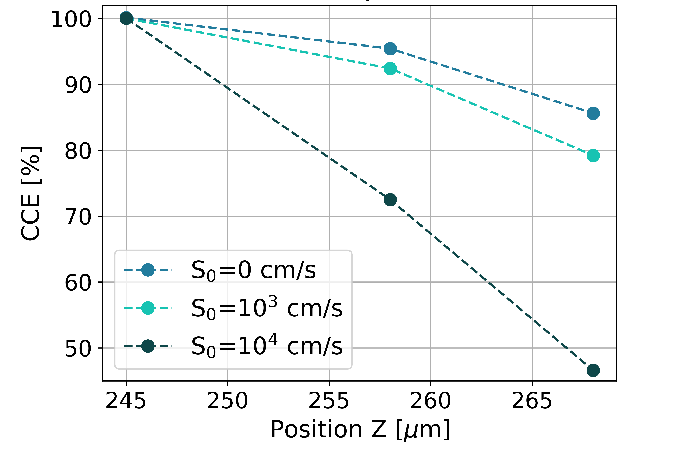
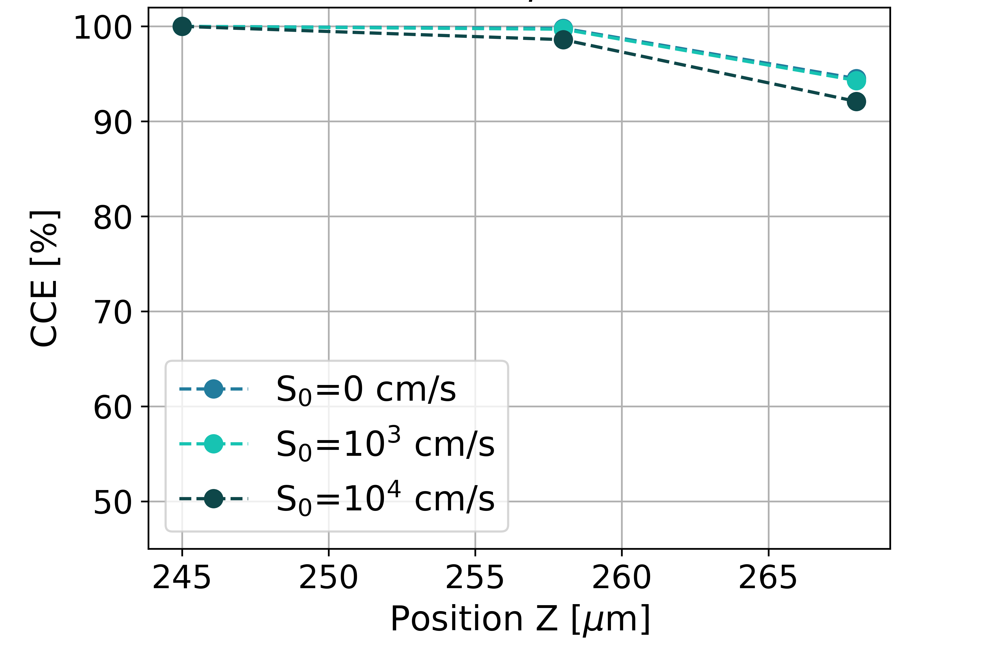
Transient simulation Results
A maximum of three points per geometry is considered, due to the time required for each individual simulation.
D=1um
D=5um

Slide 17
ALLPIX2 Simulations
Semiconductor Detector Monte Carlo Simulation Framework

Slide 18
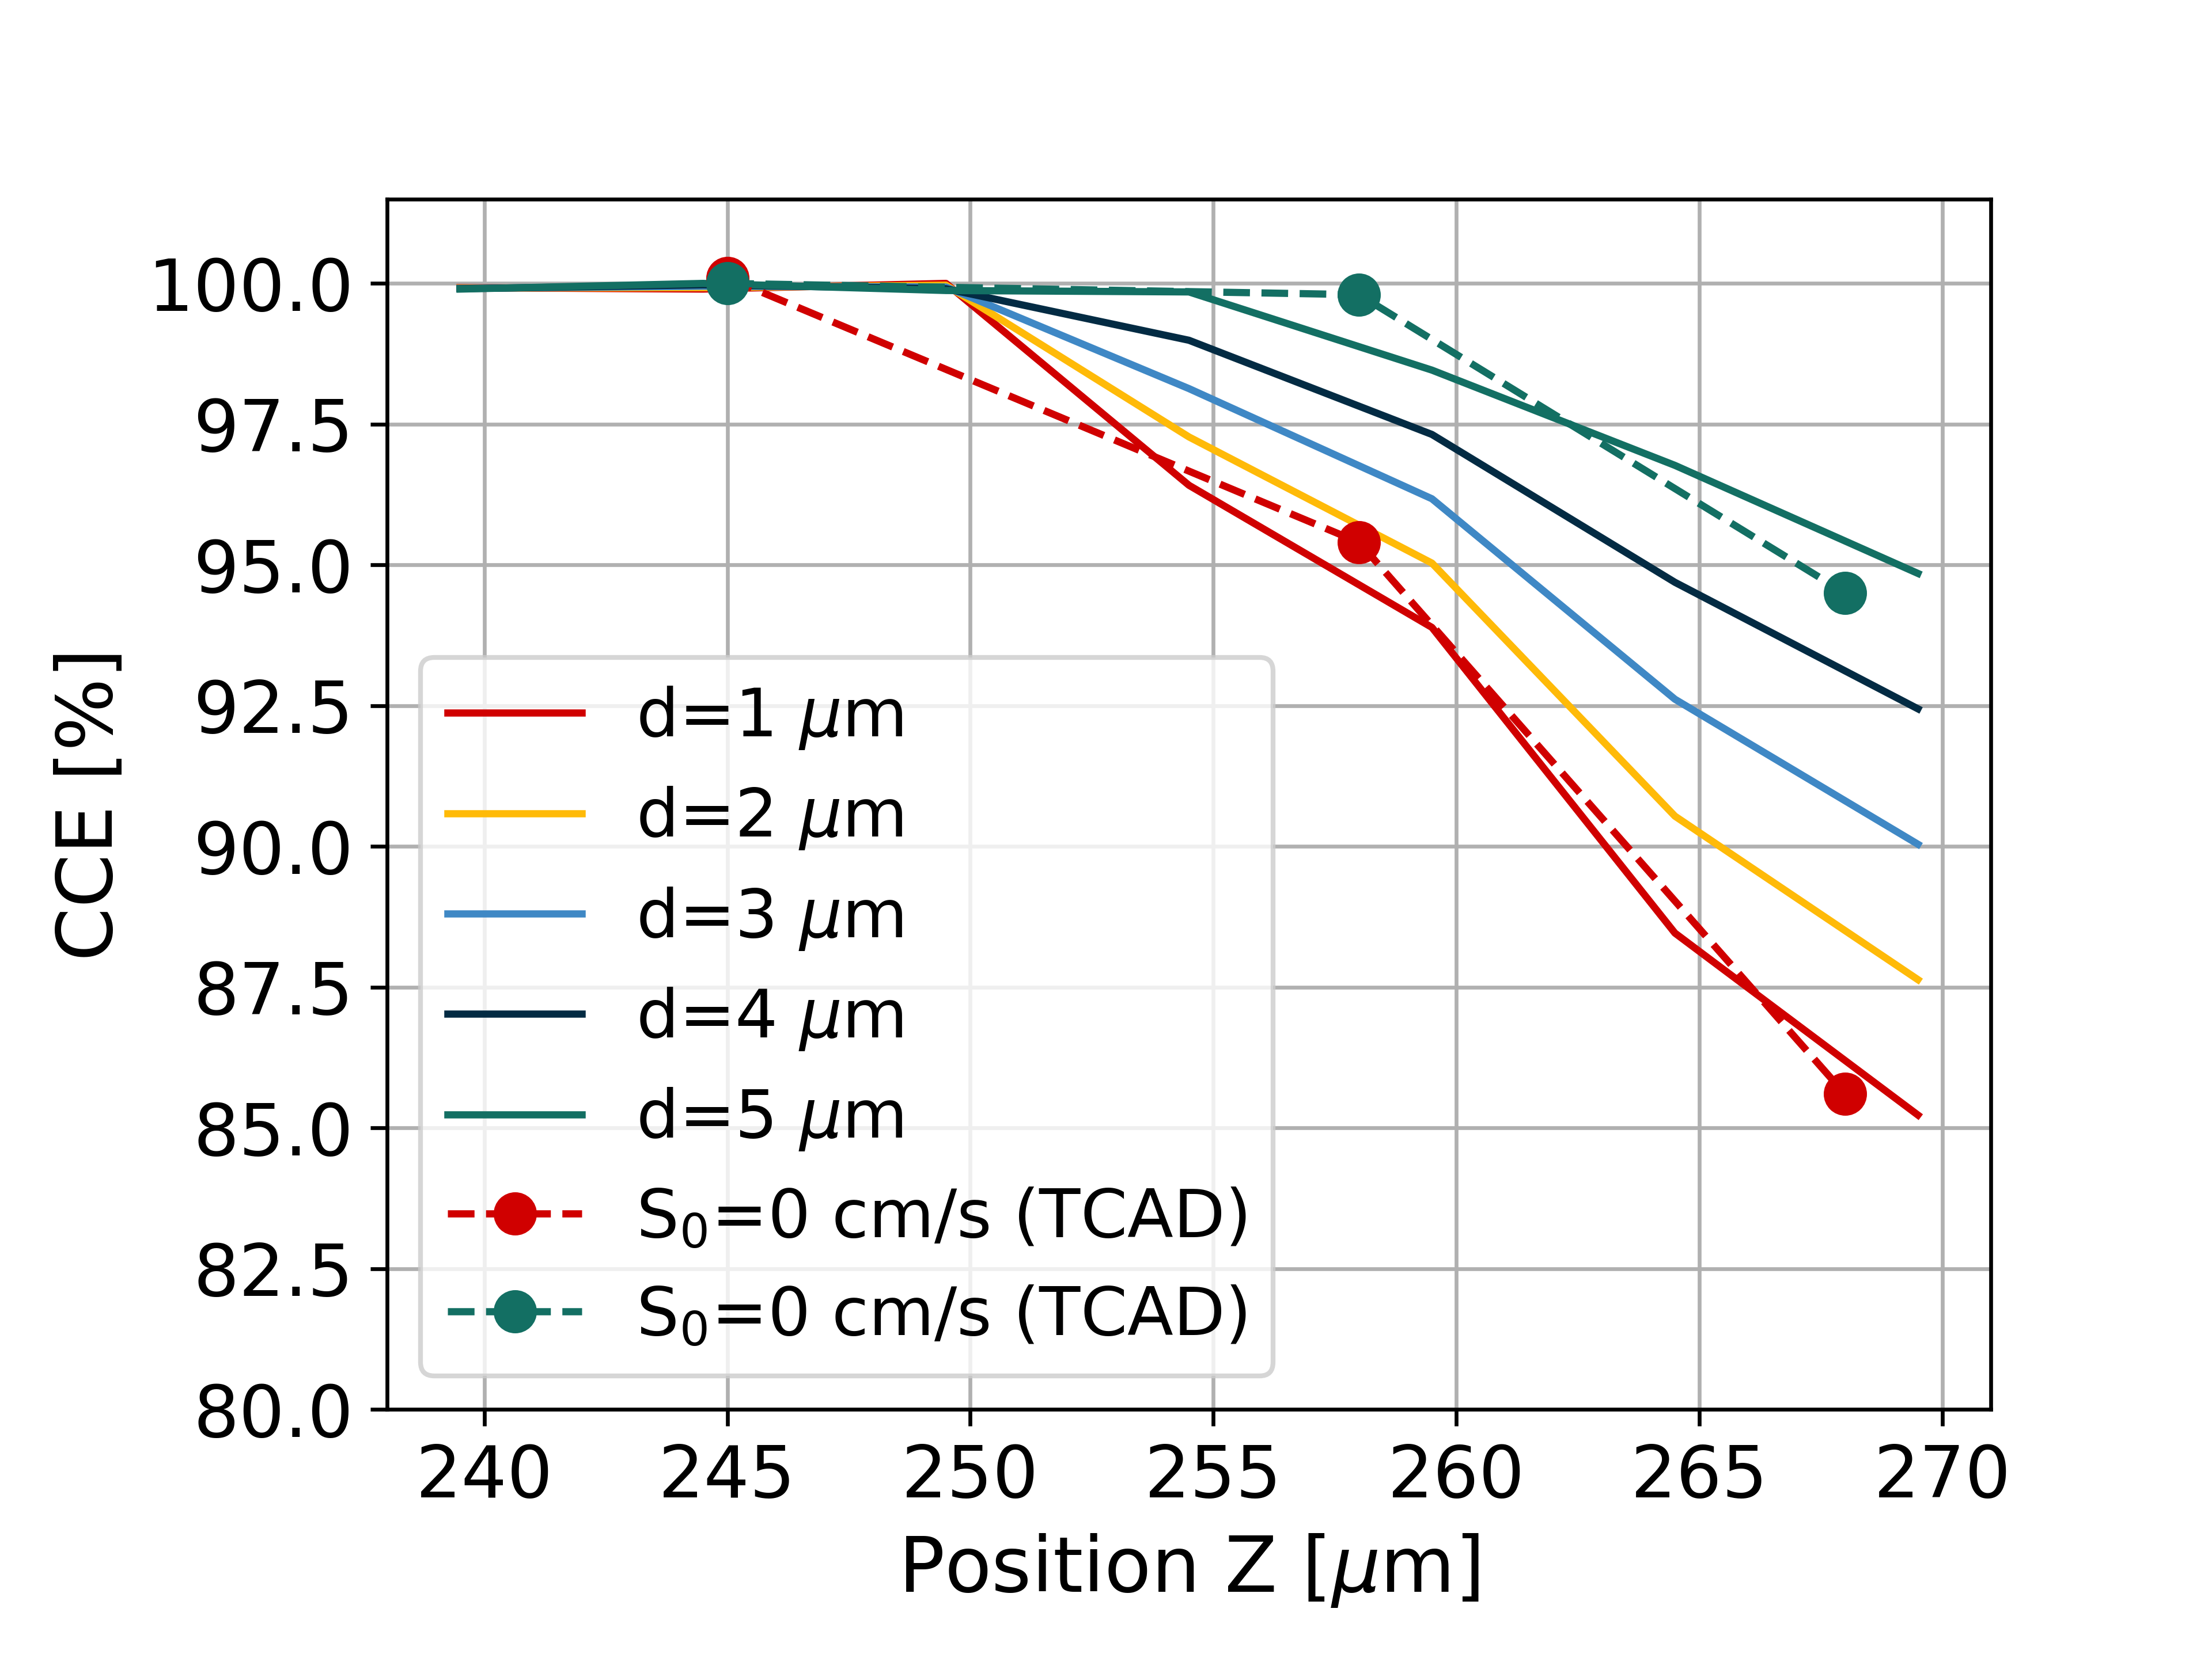
Charge collection efficiency
TCAD simulations used as reference
The Allpix² code was modified because 3D detector geometries are not implemented.
Computational time drastically reduced.

Slide 19
Final remarks

Slide 20

Main Goal
Data from neutron capture and charged particle interaction
Electric field and weighting potential map
Find the most efficient configuration

Slide 21
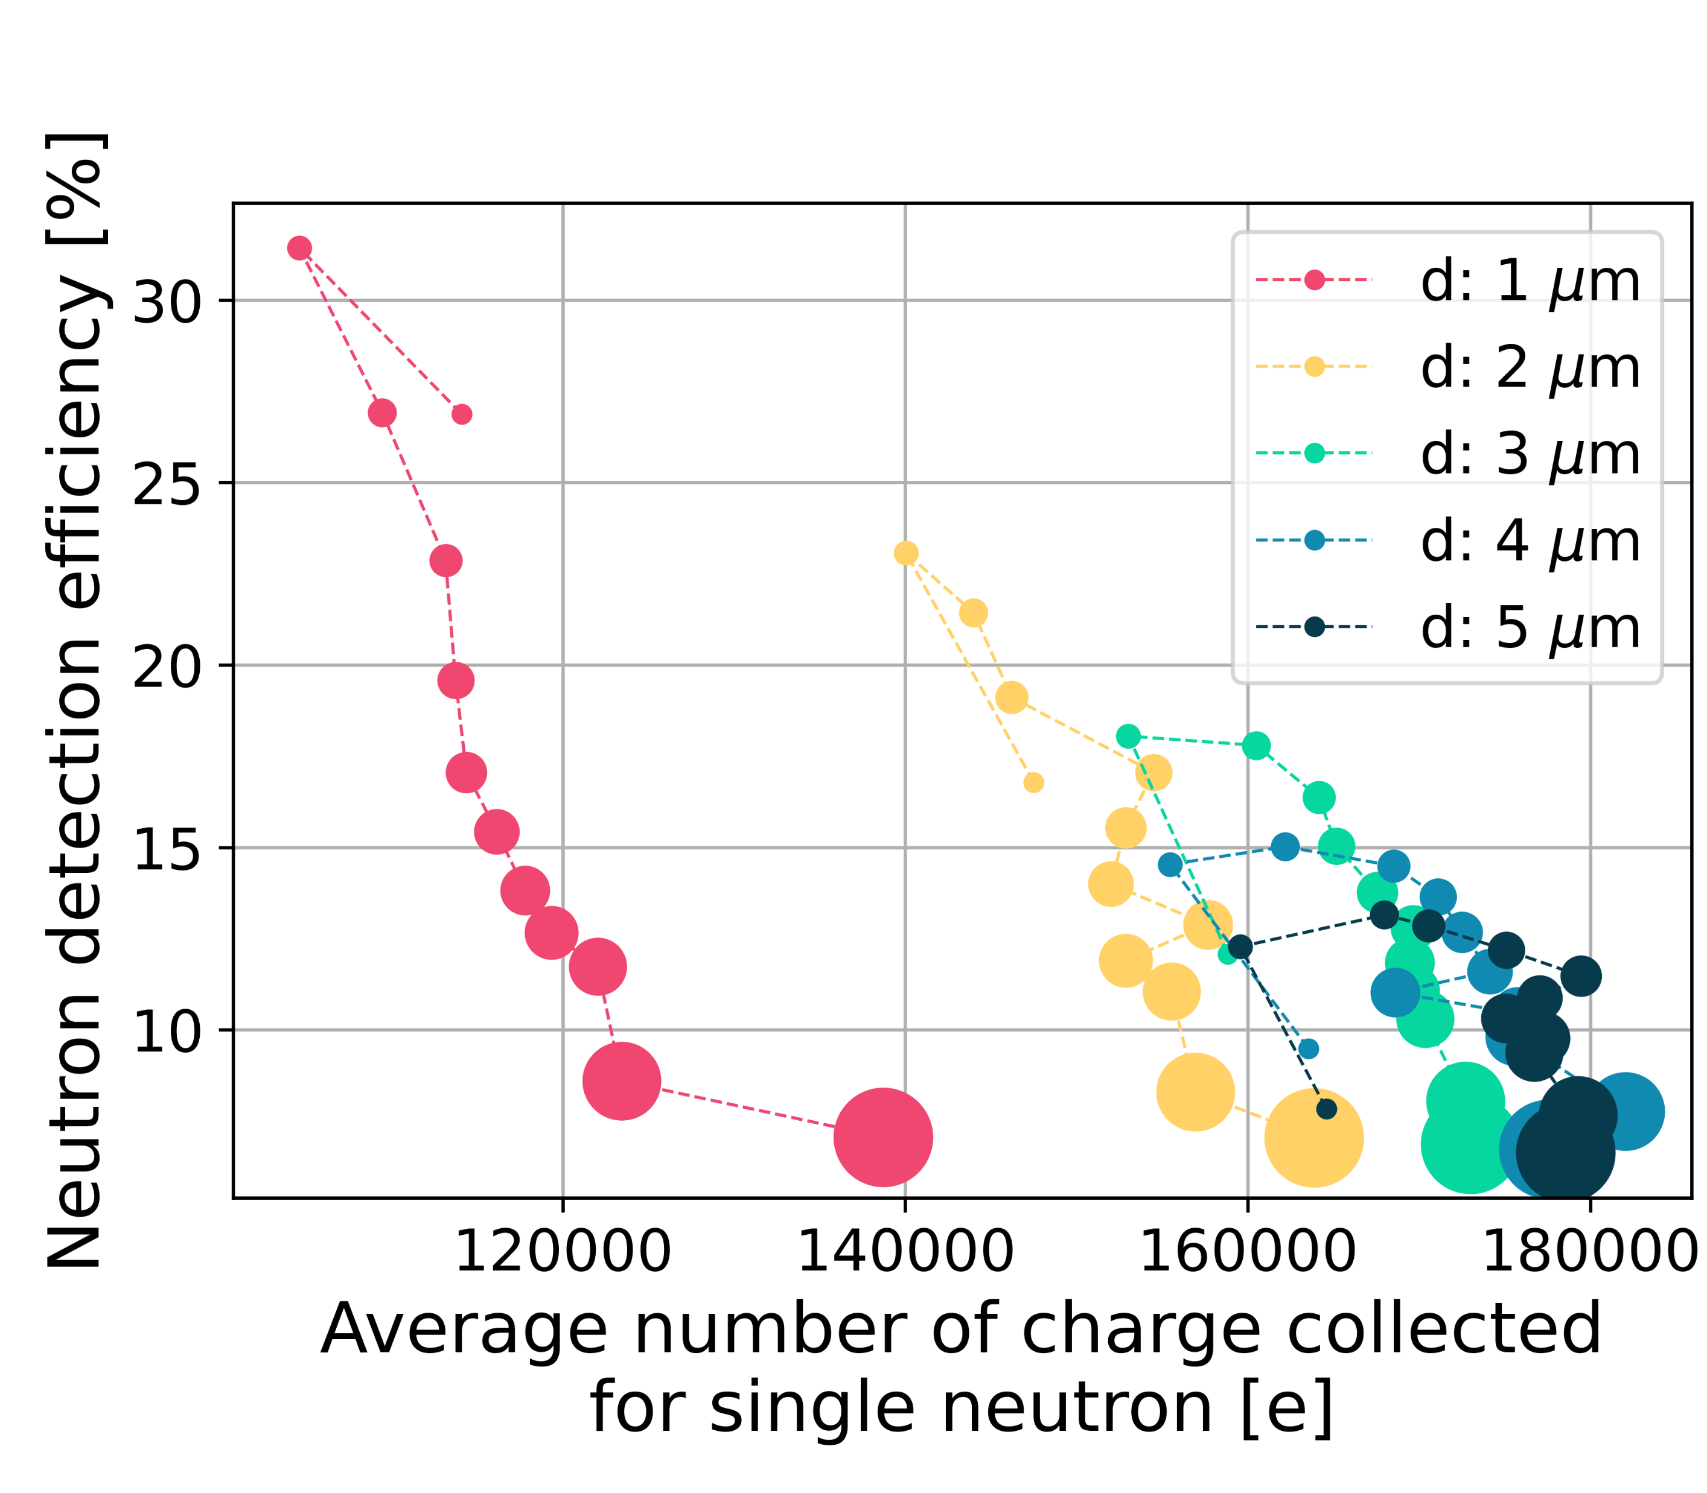
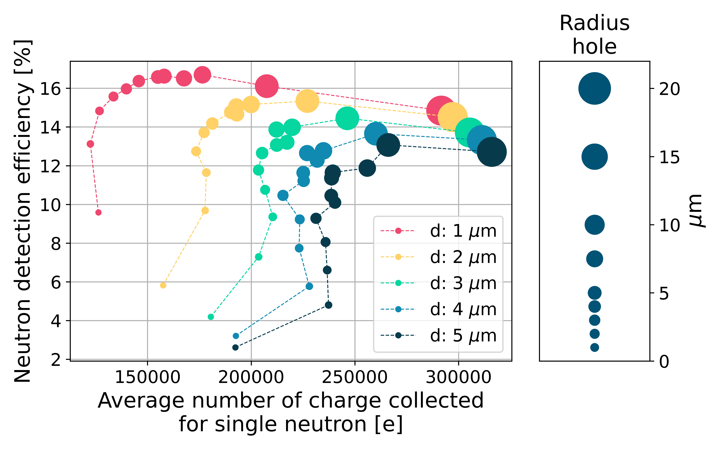
Final results
By merging the results from Allpix² and Geant4, it is possible to identify the geometry that maximizes both intrinsic efficiency and the collected charge per single event
Boron-10
Lithium-6

Slide 22
Conclusion
According to GEANT4, the configuration with boron and small, closely spaced holes can result in an efficiency greater than 30%.
TCAD data indicates that the most effective configuration involves large, widely spaced holes.
Allpix² is now fully operational, and code modifications are being applied to enable data merging and identify the optimal sensor configuration.
The next step is to prototype sensors to validate whether these results can be achieved in practice.

Slide 23
Thanks for your attention

Slide 24
Backup slides

Slide 25
Allpix2 configuration
The used module:
DepositionPointCharge
source_type = “point”
DopingProfileReader & ElectricFieldReader & WeightingPotentialReader
TransientPropagation
mobility_model = "jacoboni“
surface_reflectivity = 1.0

