Slide 1


Characterization and Performance Evaluation of ITk Pixel Production Modules for the ATLAS Upgrade
Md Arif Abdulla Samy, Craig Buttar, Richard Bates, Dzmitry Maneuski, Liam Cunningham, Ruirui Han, Sneha Naik, Kamil Dulak, Fiona Grant, Calum Gray, Frederick Doherty, Christopher Lickley, Jon Taylor, Vedika S. Kumar

Slide 2
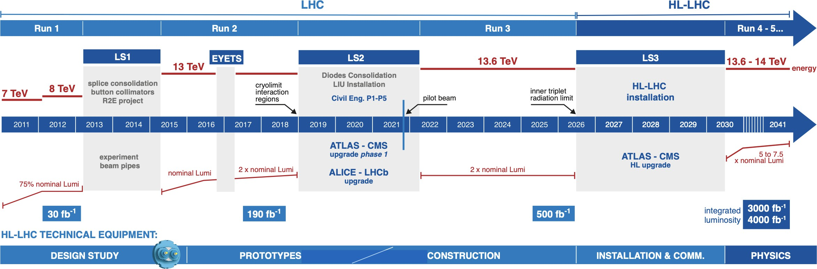
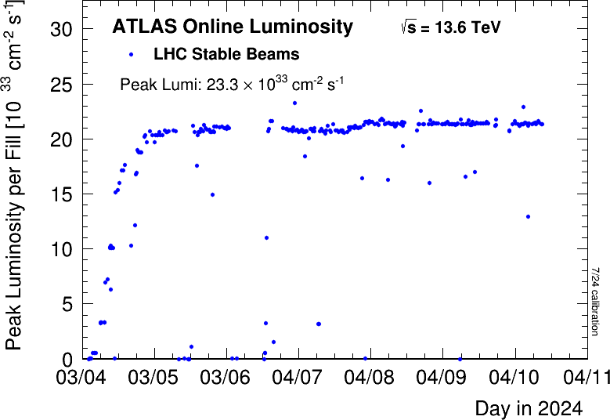
Large Hadron Collider (LHC)
Last update: Oct 2024
We are here
200 pile-up events
50 pile-up events
https://hilumilhc.web.cern.ch/sites/default/files/2024-10/HL-LHC_October2024.pdf
High-luminosity large hadron collider (HL-LHC) :
integrated luminosity: more than 250 fb⁻¹/year
instantaneous luminosity expected to be 75 x 10³³ cm² s⁻¹
Source:https://home.cern/resources/faqs/high-luminosity-lhc / NIMA 1070 (2025) 169978
https://atlas.web.cern.ch/Atlas/GROUPS/DATAPREPARATION/PublicPlots/2024/
DataSummary/figs/peakLumiByFill.png

Slide 3
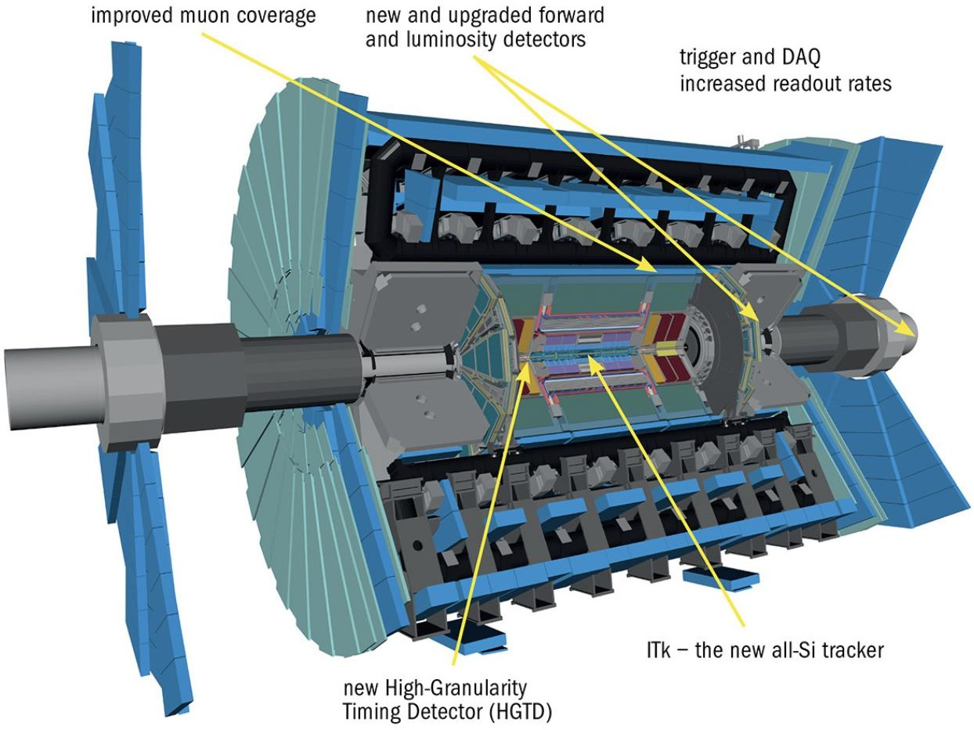
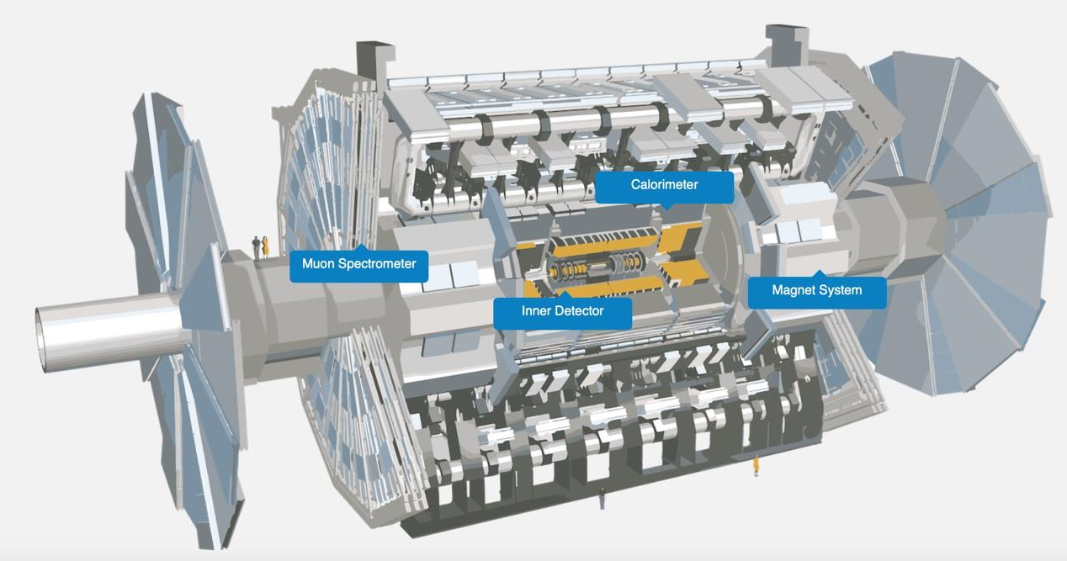
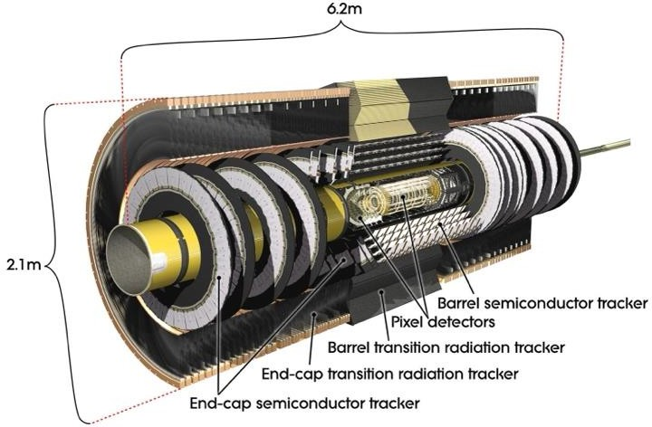
ATLAS update for HL-LHC
The current innermost detection system of ATLAS is the Inner Detector
Present layout
HL-LHC
era
Future layout
https://atlas.cern/Discover/Detector
Inner Detector (ID)
Max Acceptance |ɳ| = 2.5
Pixel Detector: channels
Semiconductor million channels
Transition
92 million
Tracker: 6
Inner Tracker (ITk)
Max Acceptance |ɳ| = 4.0
https://atlas.cern/Updates/Fe ature/High-Luminosity- ATLAS
ITk Pixel Detector: 5 billion channels
ITk Strip Detector: 60 million channels
3
Radiation
Tracker: 350.000 channels
ID will be replaced by the all-Si tracker ITk
https://atlas.cern/Discover/Detector/Inner-Detector
Notes:
The ITk Pixel detector has been designed to replace the Inner Detector of ATLAS for operating in the hasher environment of the high luminosity era of the LHC:
Higher granularity
Better radiation hardness
Higher acceptance

Slide 4


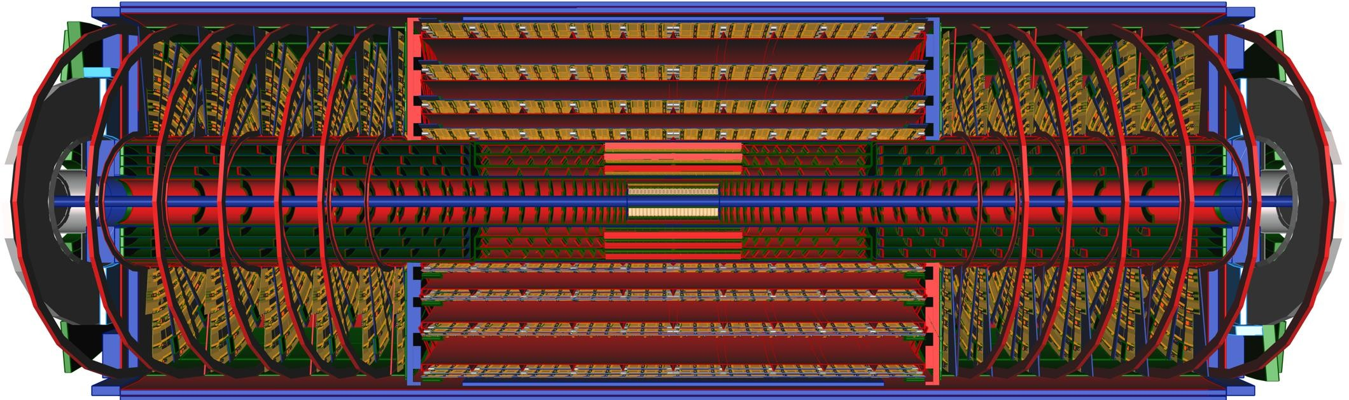
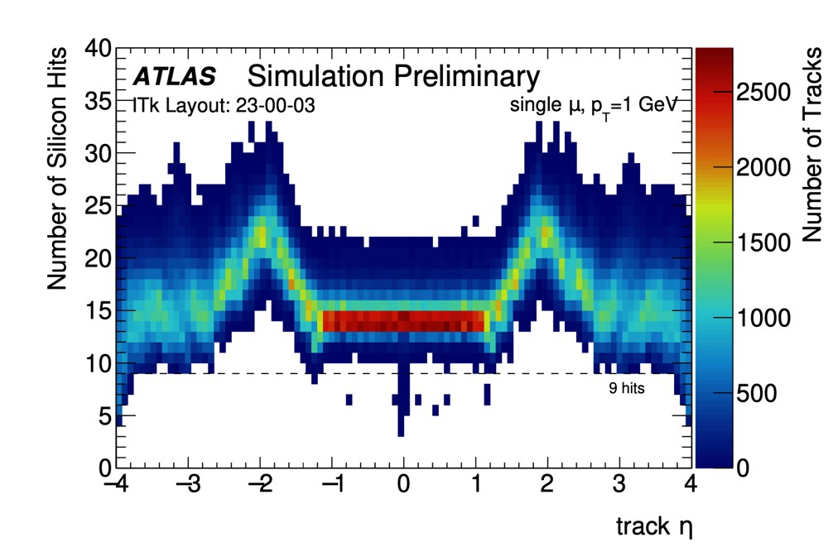
Inner Tracker-ITk
ATL-PHYS-PUB-2021-024
For Pixel overview- see the talk of Umberto M.
For the ITk Strip, see Katie W. Pass’ talk
For Strip overview- see the talk of Marta B.
Closest to the interaction point
At least 9 hits/track
Occupancy kept < 1% thanks to the higher granularity
Composed of two parts: ITk Pixel with 5 pixel barrels and rings and ITk Strip with 4 strip barrels and strip disks
Replaceable two innermost layers at half of the lifetime: ITk Pixel
Inner System (IS) with Endcaps and Barrels
ATL-PHYS-PUB-2021-024

Slide 5
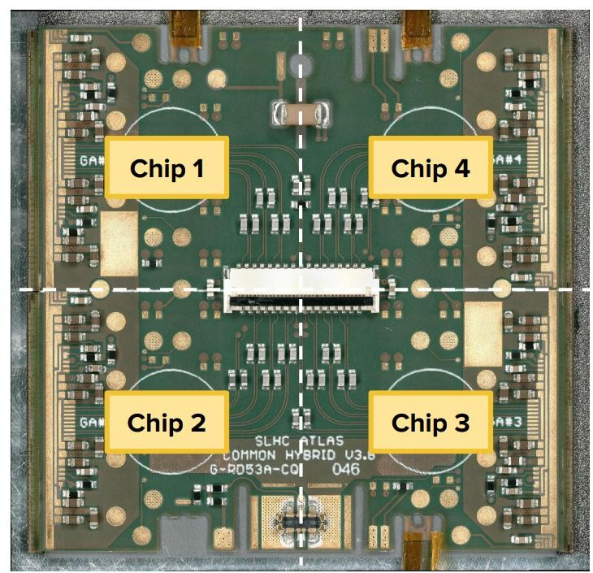
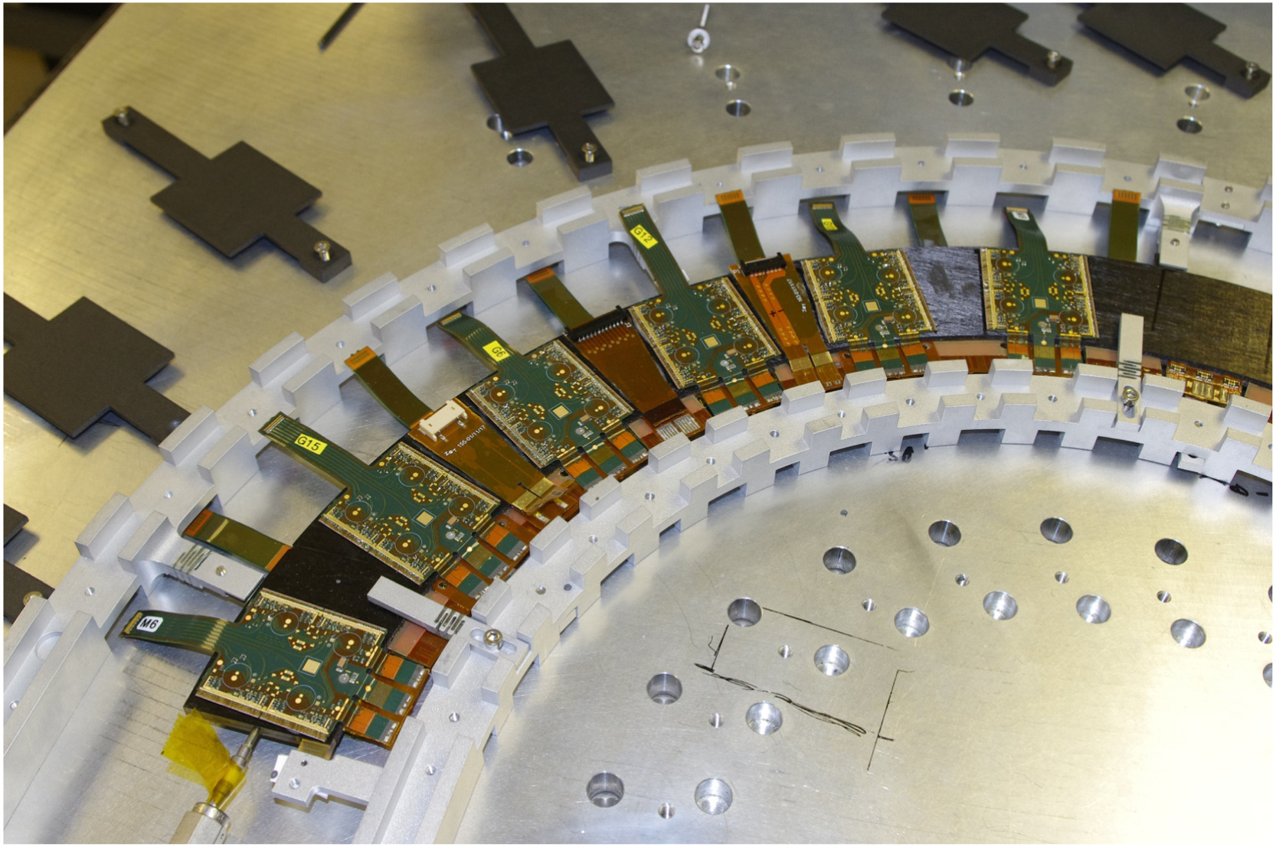
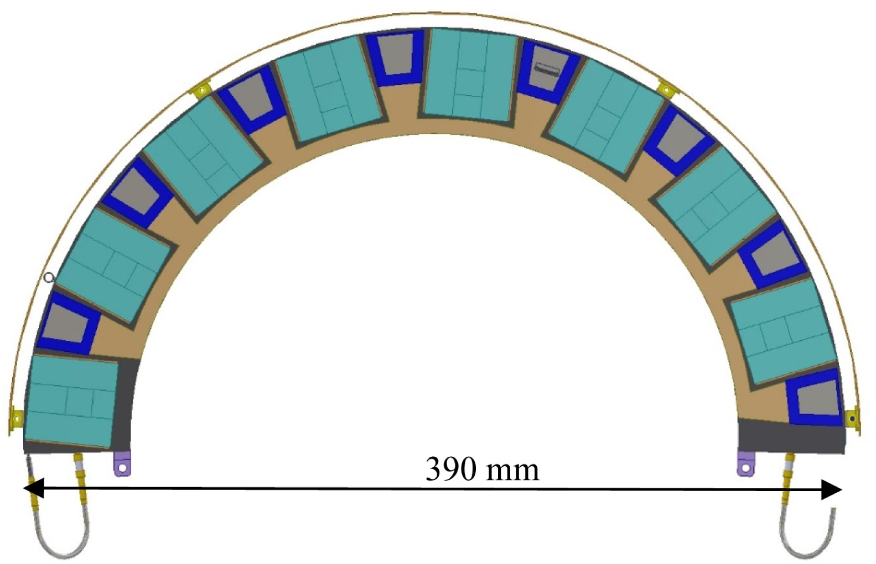
Pixel Module Sites
10 clusters for pixel module assembly (31 assembly sites) and testing across the globe
United Kingdom Pixels is one of the clusters
UK cluster is responsible for assembly endcap quad pixel modules with planar sensors, QA/QC them, load them in half ring and deliver them to CERN
UK cluster has three assembly and testing sites:
For the ITk Strip, see Katie W. Pass’ talk
University of Glasgow
University of Liverpool
University of Oxford
Quad module
from top
These three site will assemble and test about 600 modules each
University of Glasgow has finished their pre-production batch with ITkPixV1.1 chip, and started their production batch of pixel modules with ITkPixV2 chip
Quad module half ring
Matheson, John, Jon Taylor, and A. T. L. A. S. ITk. "ATLAS ITk pixel endcap demonstrator “Ring-0” construction and testing." Nuclear Instruments and Methods in Physics Research Section A: Accelerators, Spectrometers, Detectors and Associated Equipment 986 (2021): 164753.
Notes:
Half ring picture

Slide 6
Pixel Module workflow
Bare module Reception
Bare module comes from hybridization vendor after flip chip and bump bonding
Visual inspection (VI) and IV is done
Assembly
Flexible PCB is glued with bare module
Wirebonding is done
Initial Warm
Done at 20⁰C temperature
Sensor IV
Pull test is done
Final VI
Full Electrical test
Parylene Masking
VI
Mask put on module to prevent parylene to cover unwanted places
Caps on connectors
Parylene Coating
Module get coated with parylene
Parylene unmasking
Masks are taken out
Caps are taken out
VI
Post Parylene Warm
Sensor IV
Tuning of the chip
Pixel Failure Analysis (PFA)
Thermal Cycle
Thermally cycle the for 10 cycles from 40⁰C to -45⁰C
Final Warm
Final Cold
Done at 20⁰C temperature
Sensor IV
Full Electrical test
Done at -15⁰C temperature
Sensor IV
Full Electrical test
Module Loading
Modules are attached with half ring structure
For the ITk Strip, see Katie W. Pass’ talk
Notes:
Half ring picture

Slide 7
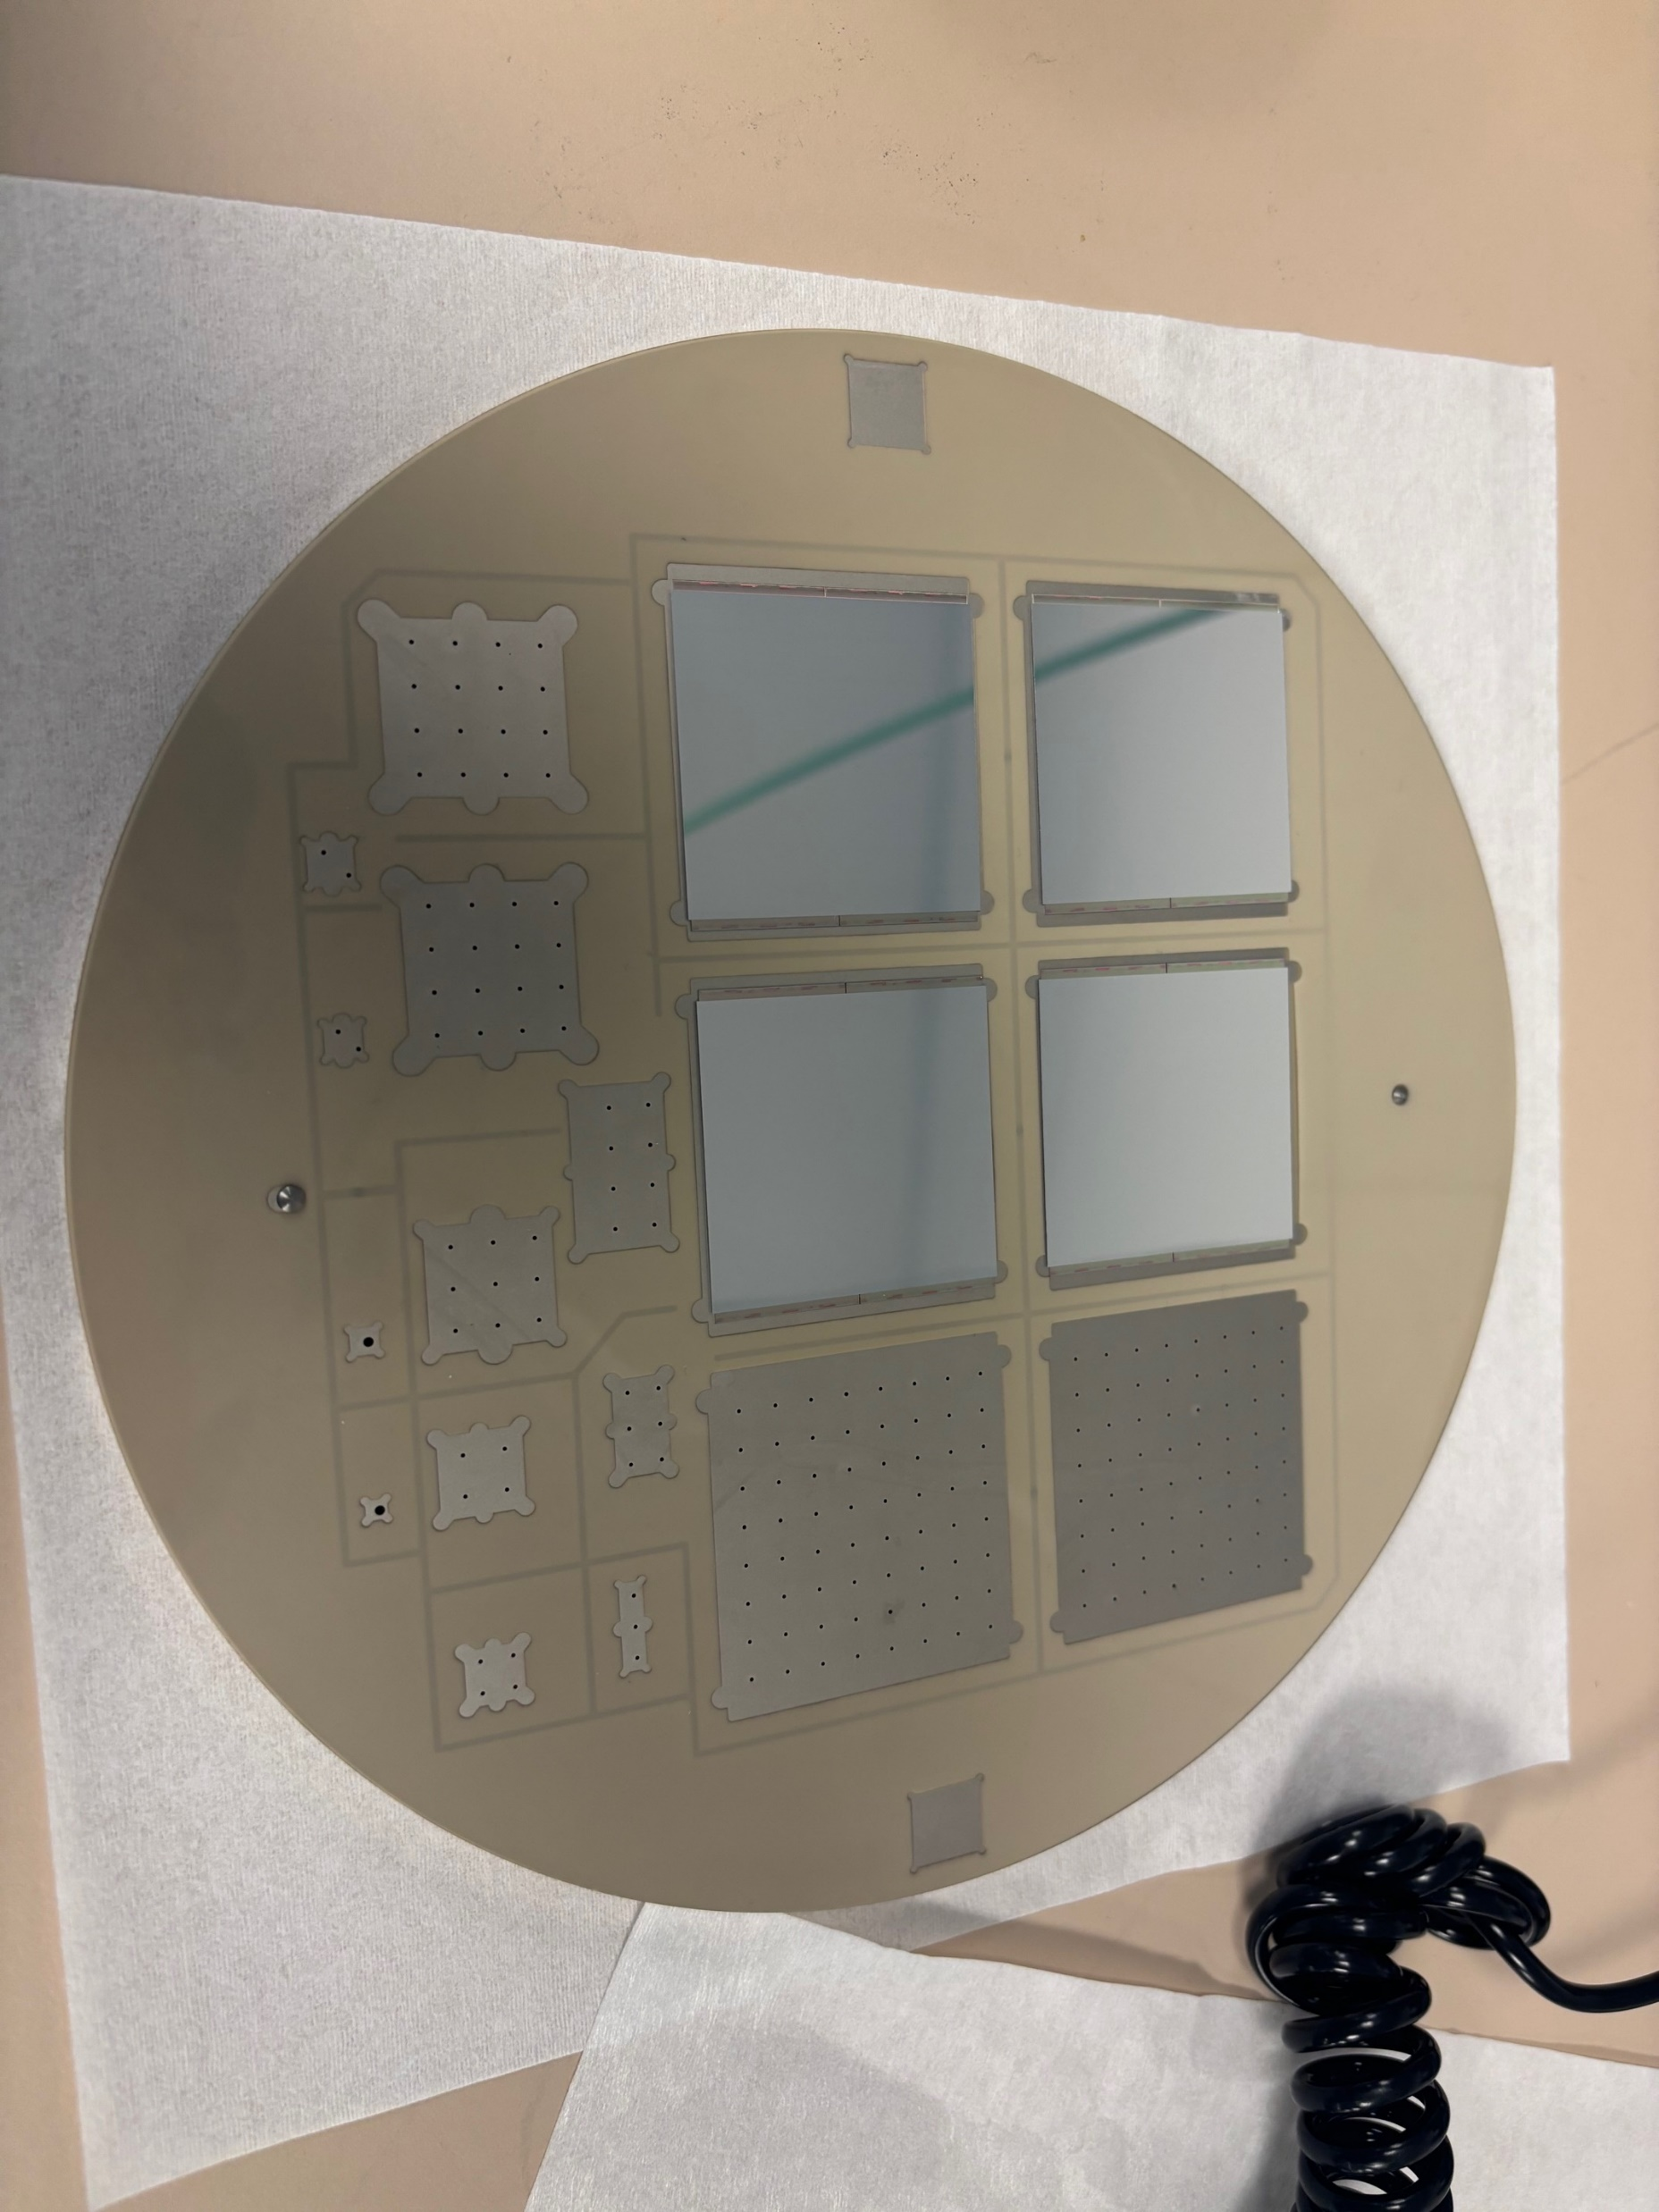
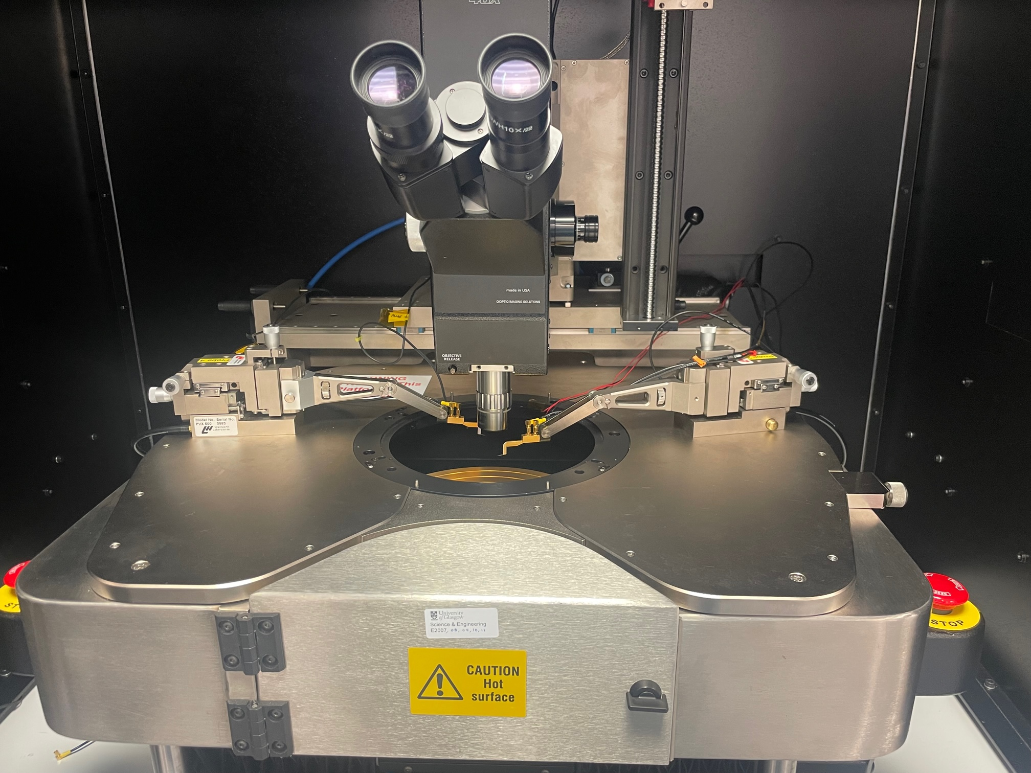
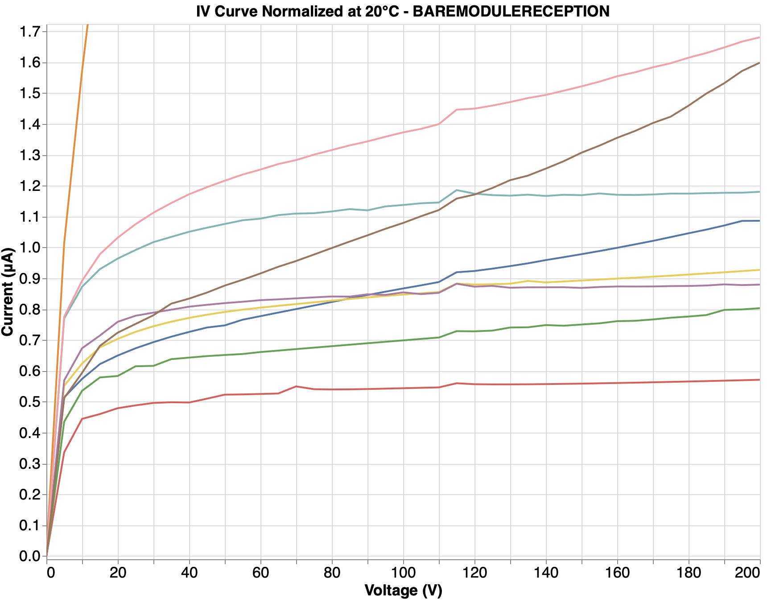
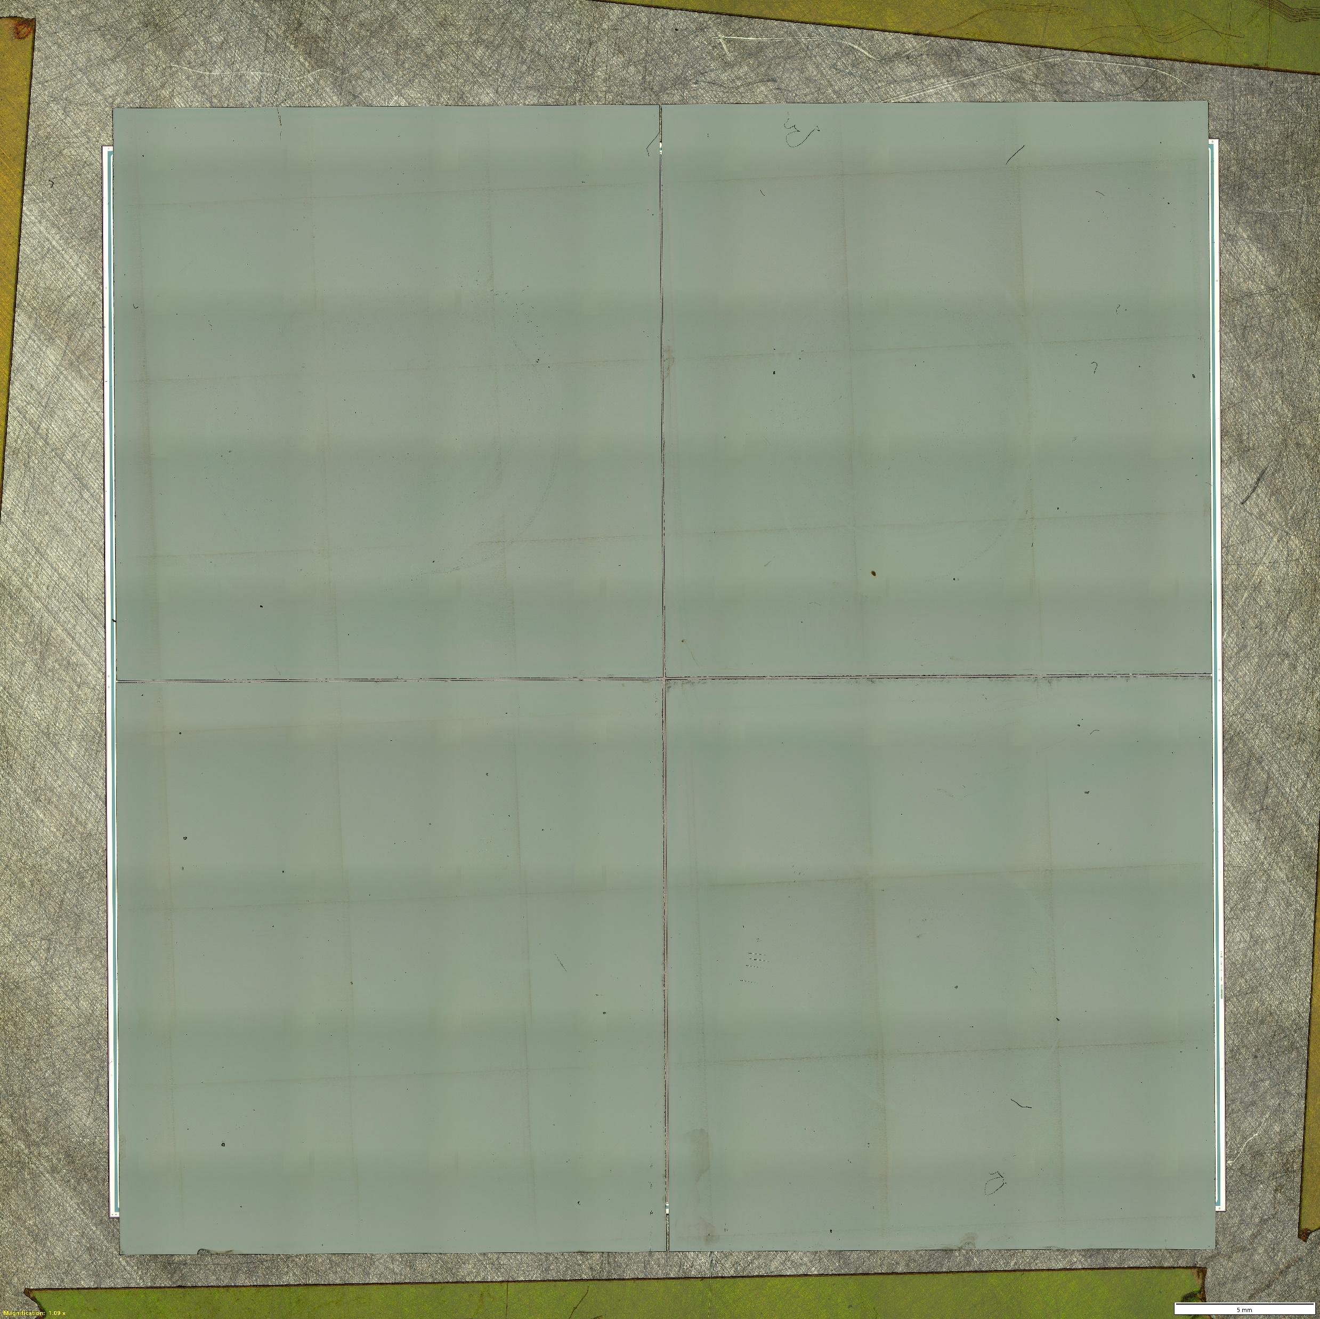
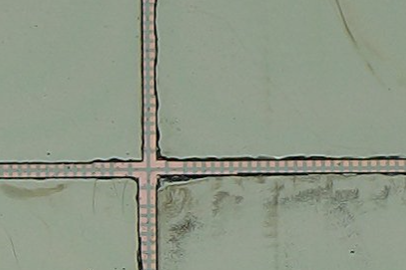
Bare Module reception
Bare module comes from hybridization vendor after flip-chip of sensor and FE-chips
Manually probed at probe station with specialized chuck
Probed 26 bare modules with visual inspection, all with 150 µm sensor
One module has been failed for bad IV (greater than 1.5 µA/cm²)
Automatic probing being developed
Specialize chuck for multi-module probing
Wentworth AVT702 probe station
20UPGB43200139: an example of passed module

Slide 8
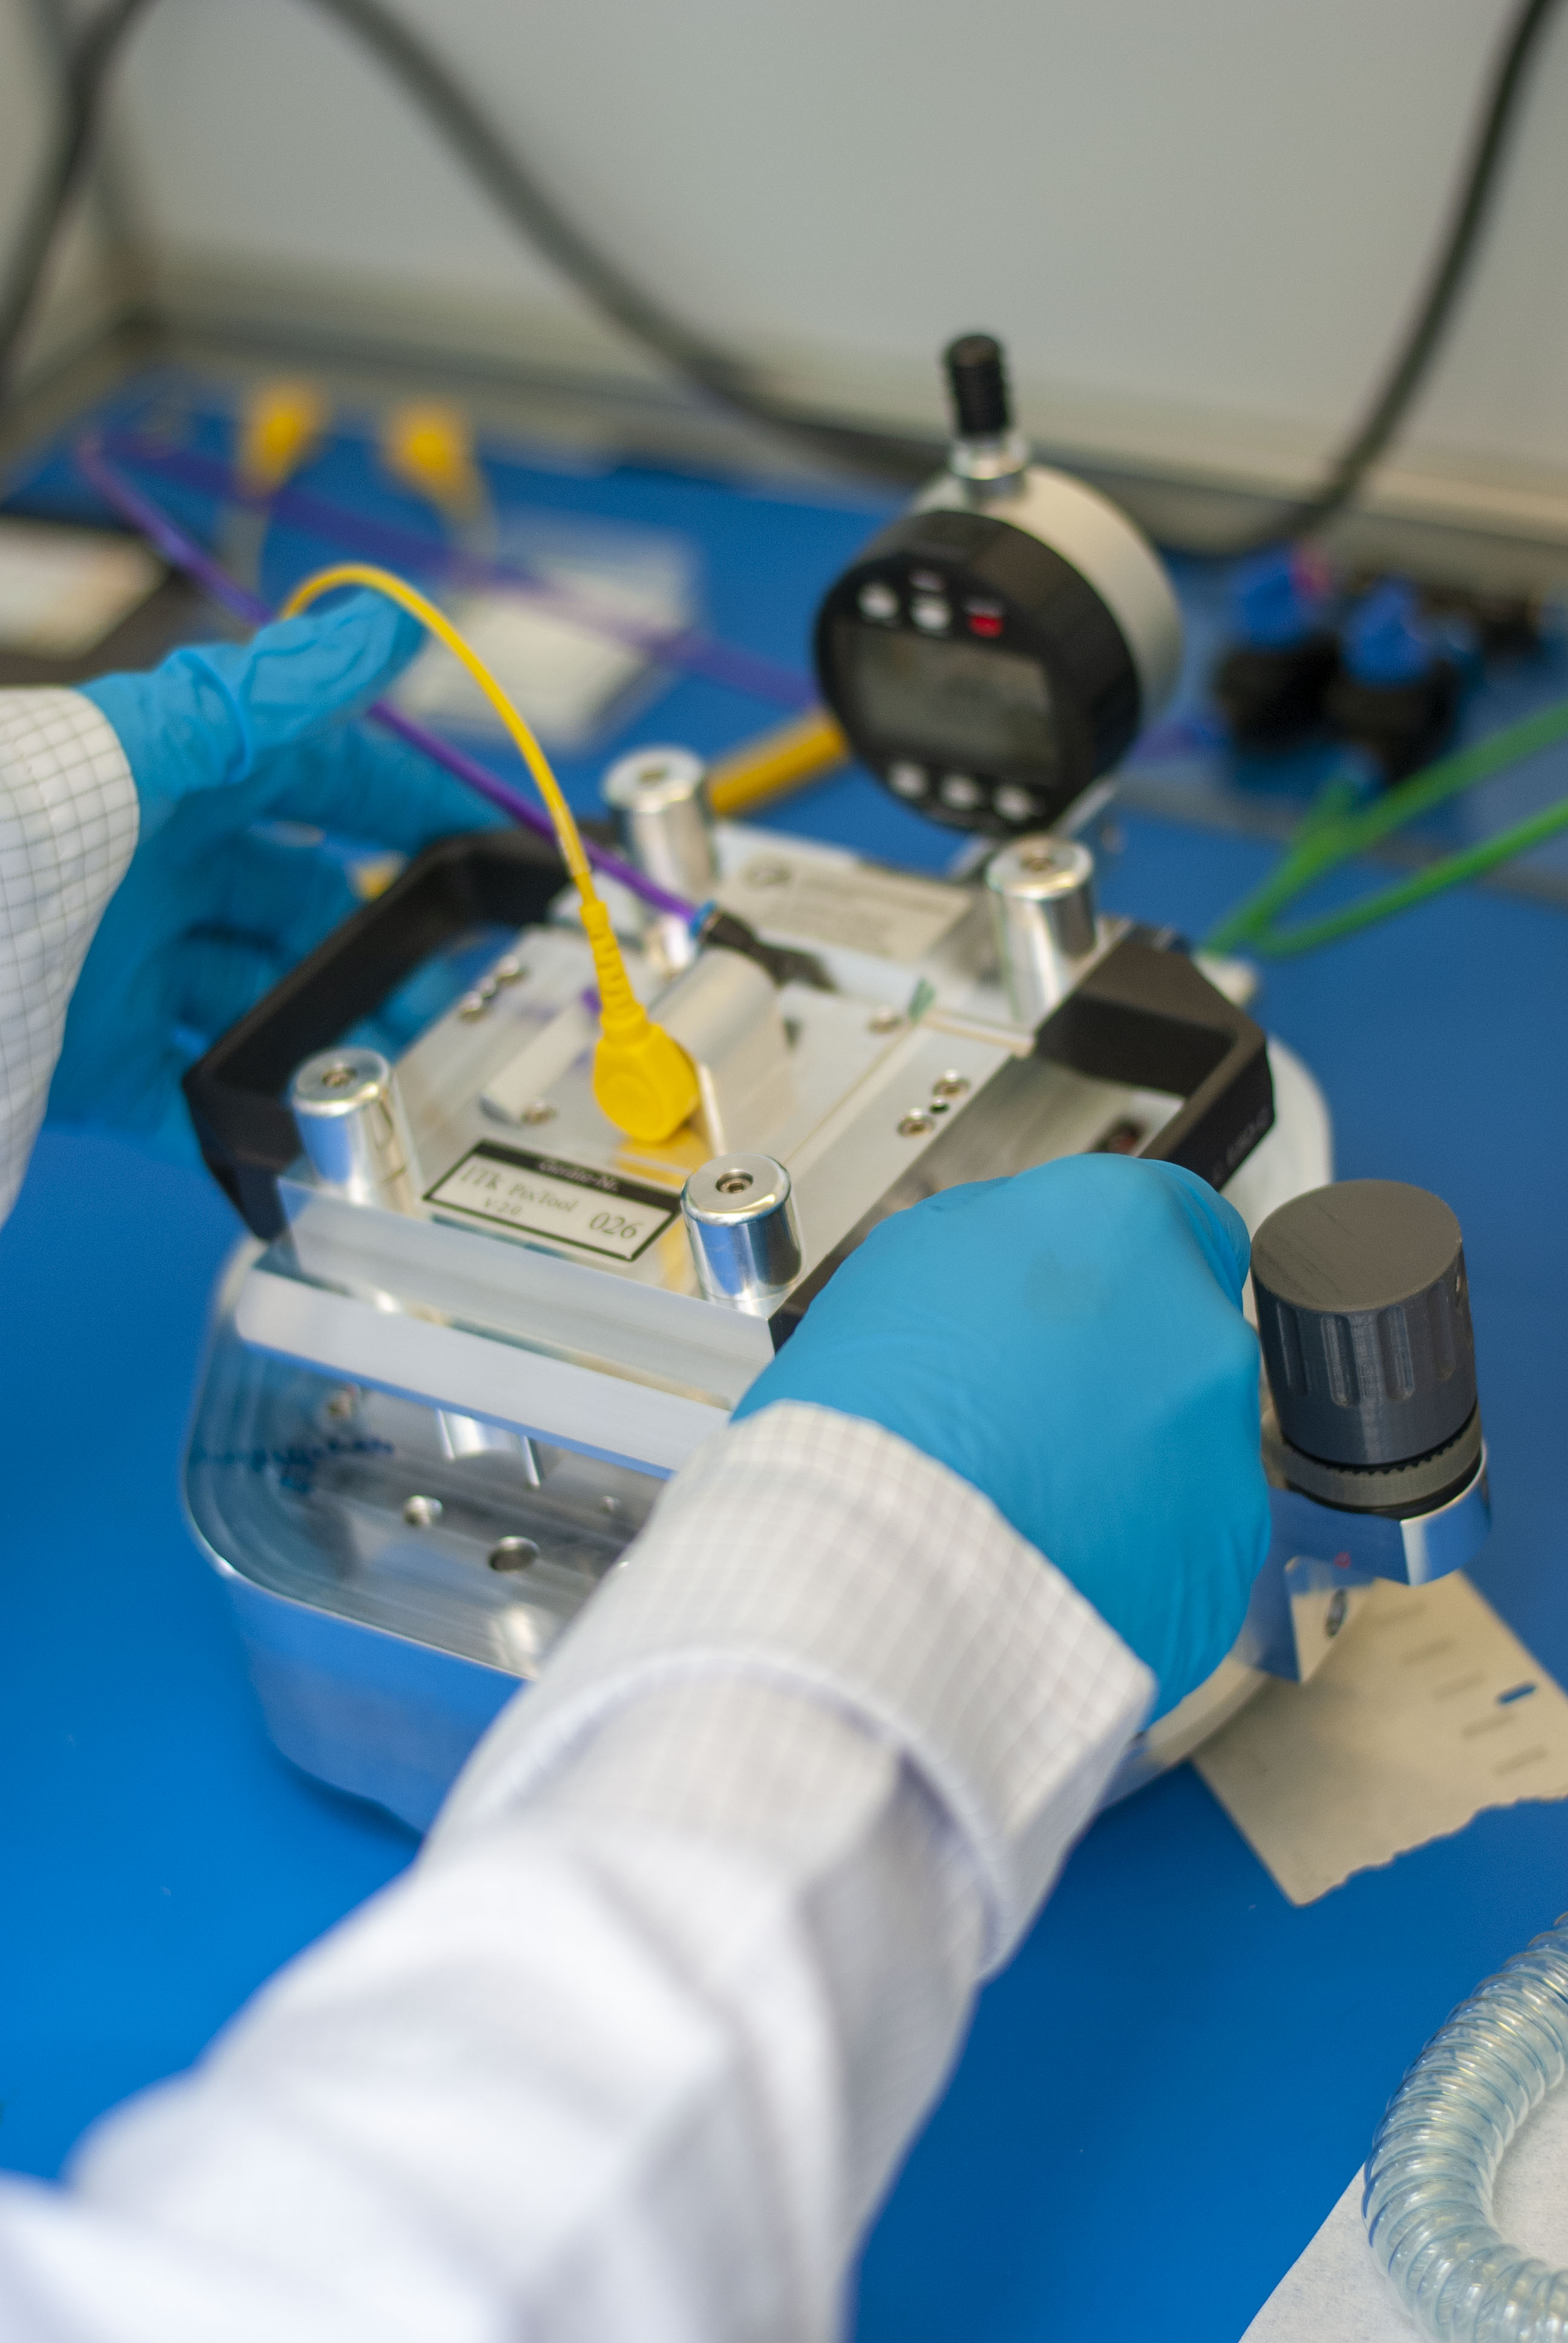
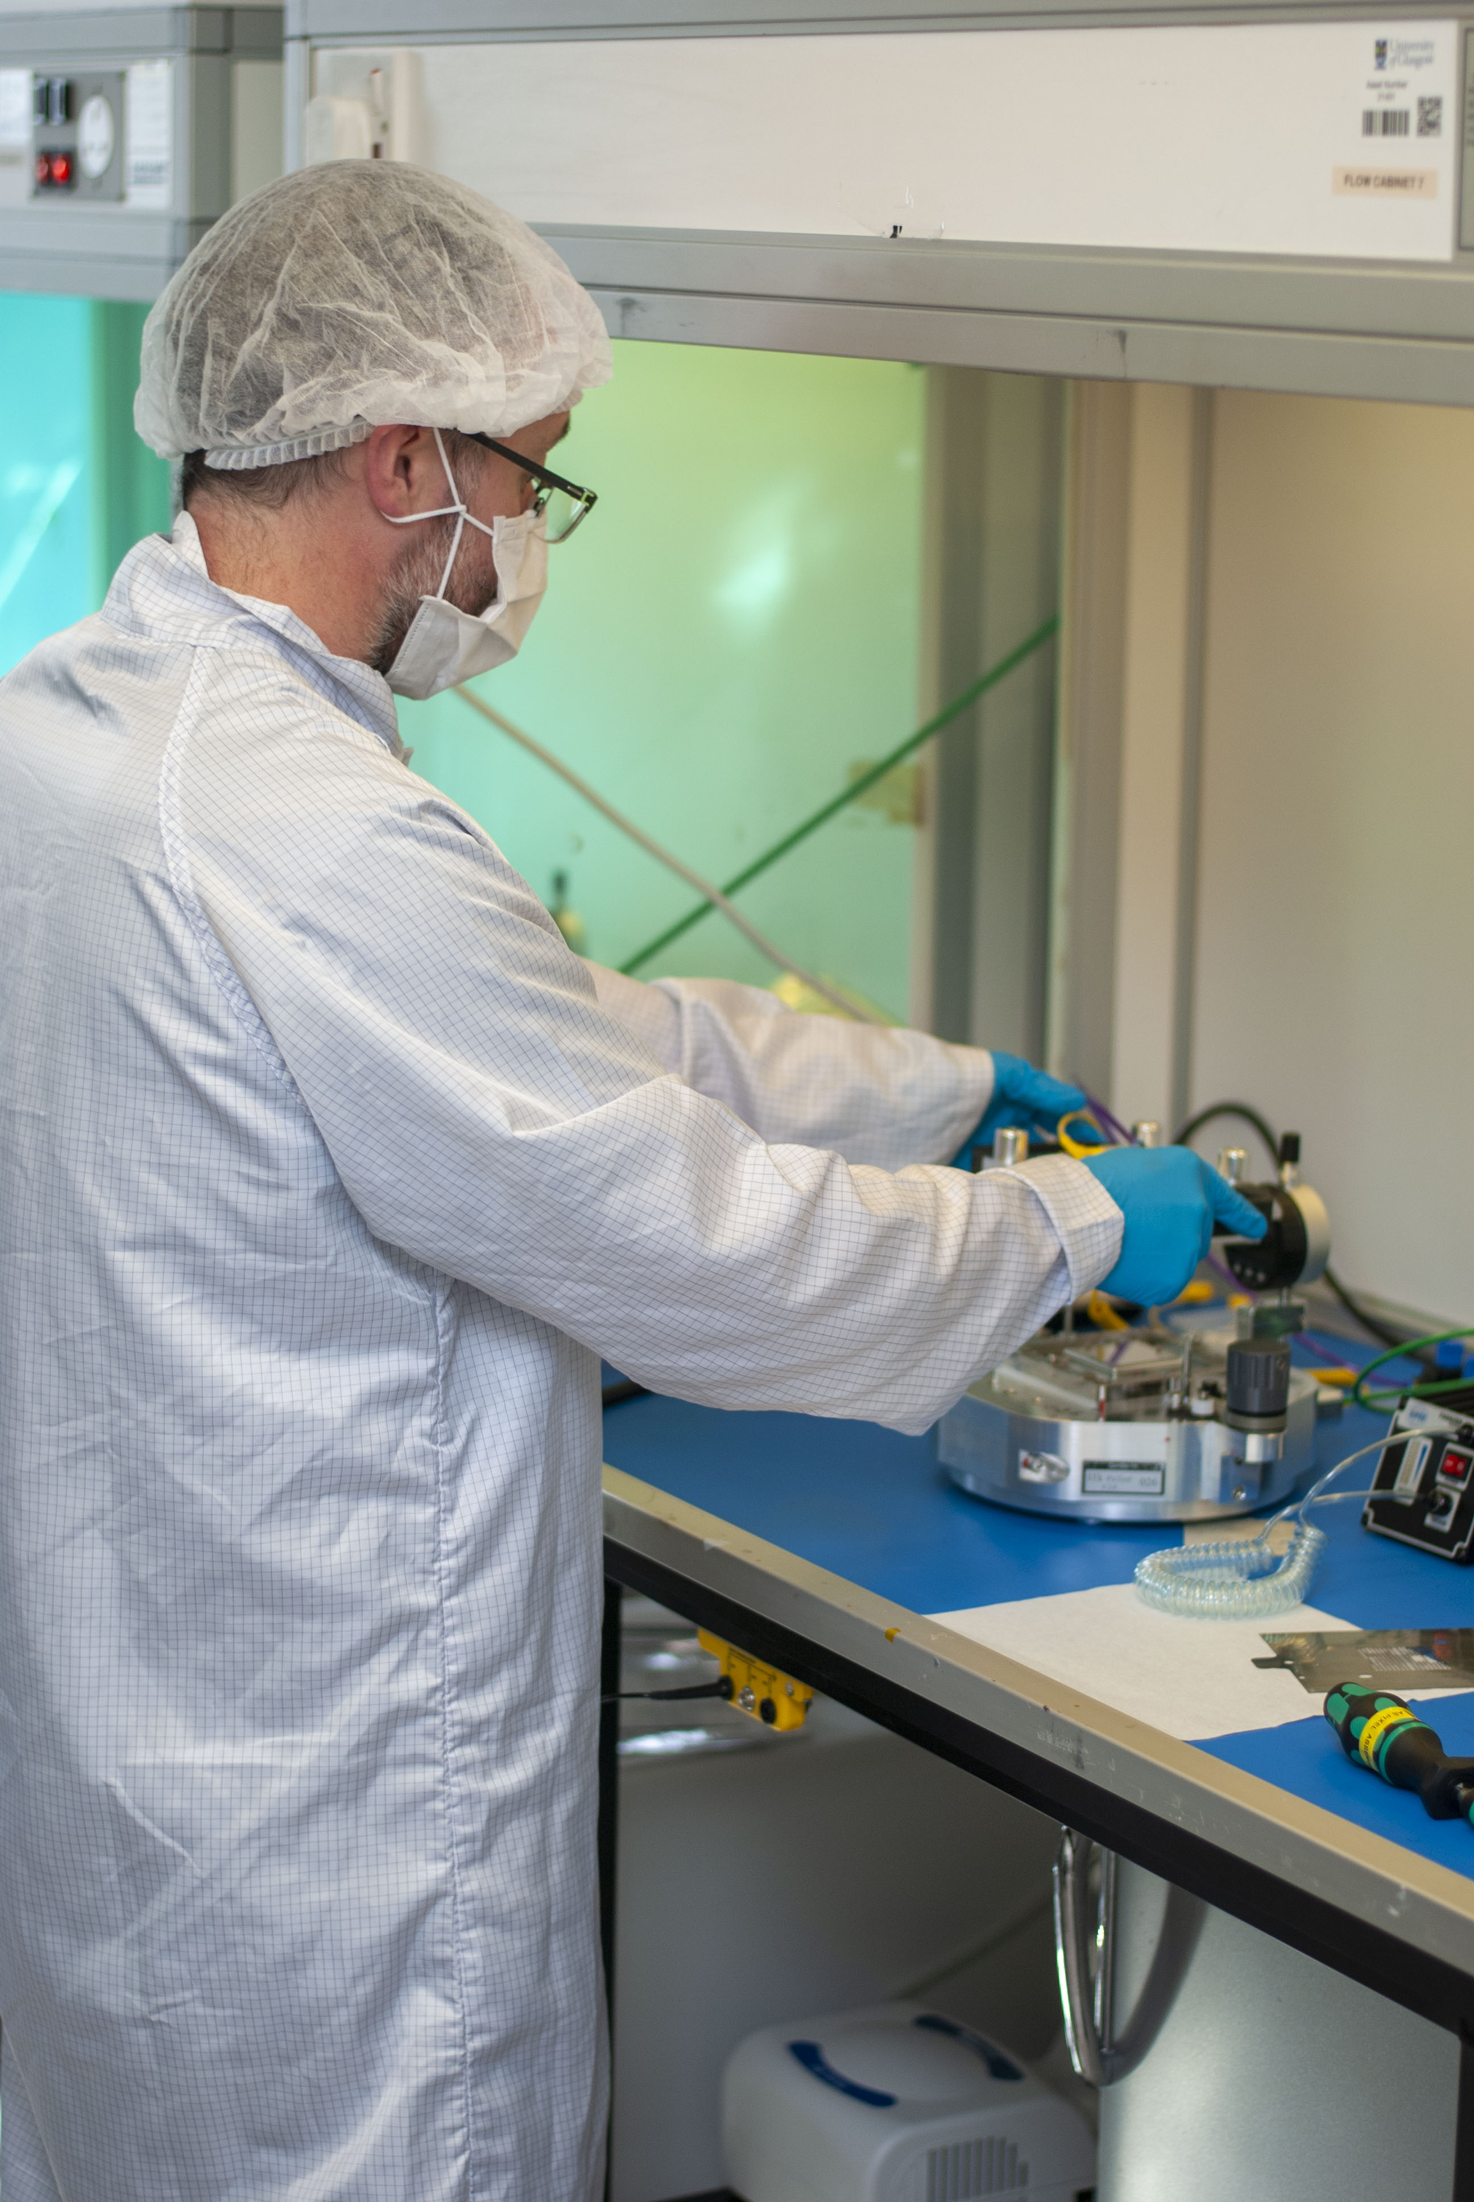
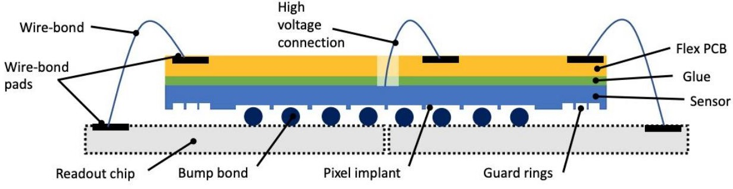
Assembly
Glasgow has four assembly stations, with four assembly jig
It takes about 30 minutes to assemble a module, but about 24 hours to cure the glue in jig, wirebonding, pull test, visual inspection needs additional time
assembly jig has been designed to minimize variation due to operator. It controls relative position of bare module and flex PCB and glue thickness.
With four jigs, four modules can be made at a same time
Glasgow has committed to produce 8 modules in a week with wire bonding, pull test and visual inspection
For the ITk Strip, see Katie W. Pass’ talk

Slide 9
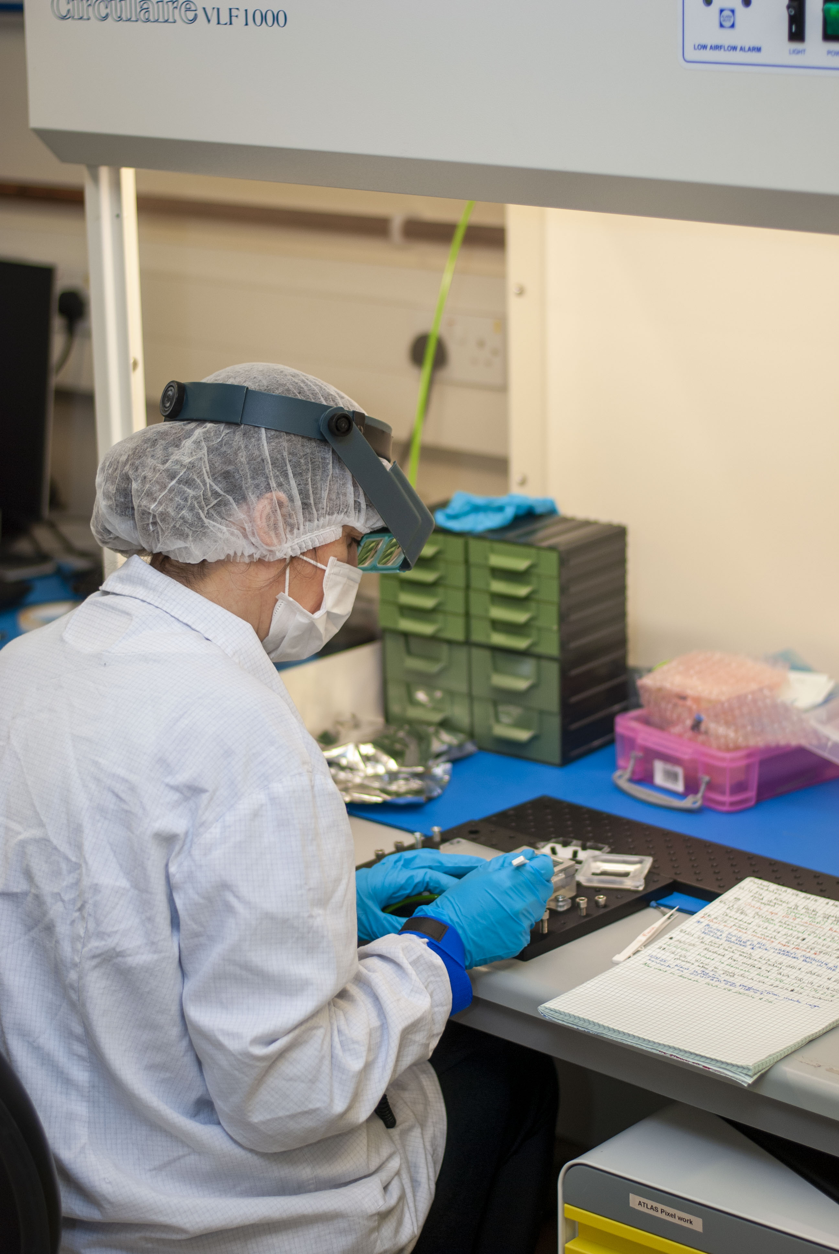
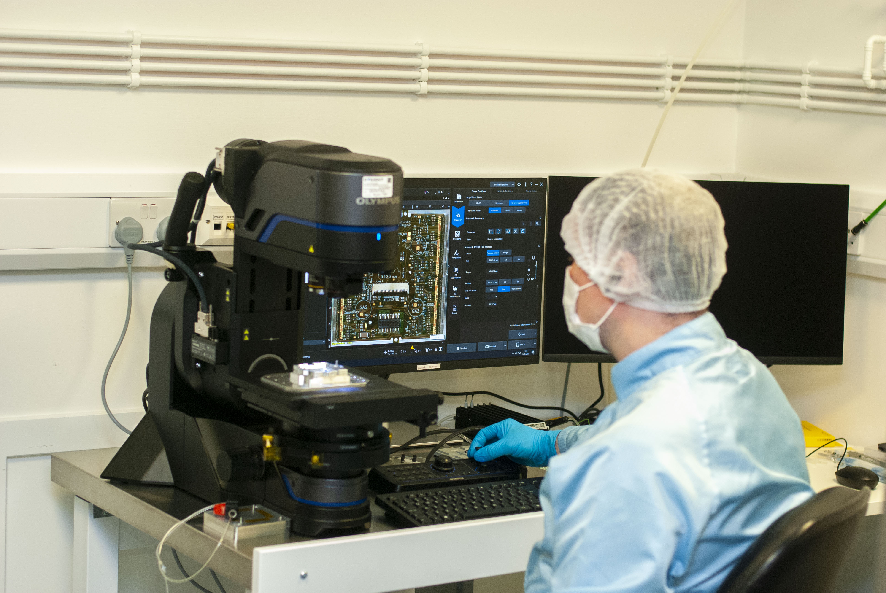
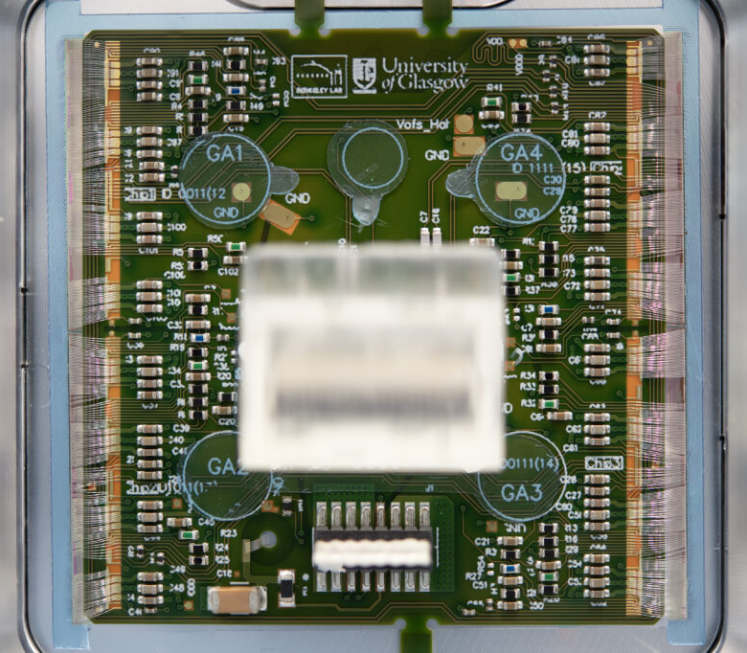
Quality Control Testing
After assembly, a visual inspection is done
An Initial Warm test is done maintaining warm temperature (20⁰C)- a series of tests including module IV
Again Visual inspection is done, connectors on module are masked in preparation for parylene coating of module and shipped to Liverpool for coating Liverpool is going to parylene coat all the modules in UK cluster
For the ITk Strip, see Katie W. Pass’ talk
Quad Module
Module is shipped back to Glasgow, unmasked and visually inspected again, and made ready for Final Test:
Post-parylene warm test (20⁰C) is done, module is thermally cycled for 10 cycles from +40⁰C to -45⁰C
Final Warm test is done at warm temperature (20⁰C), and Final Cold test is done at cold temperature (-15⁰C) with a source scan with Mini X2 X-ray gun
Masking process
Visual Inspection
Masked Module

Slide 10
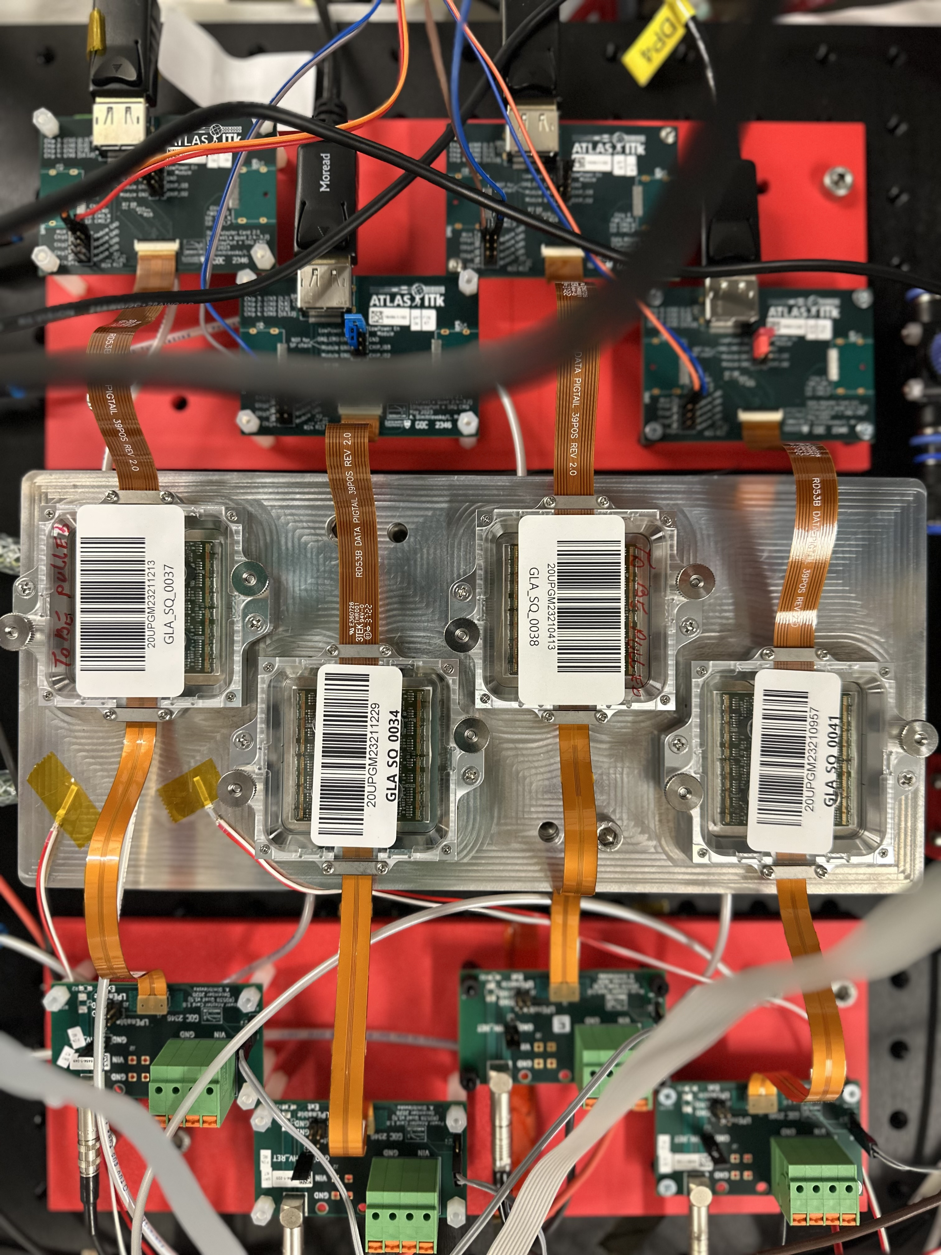
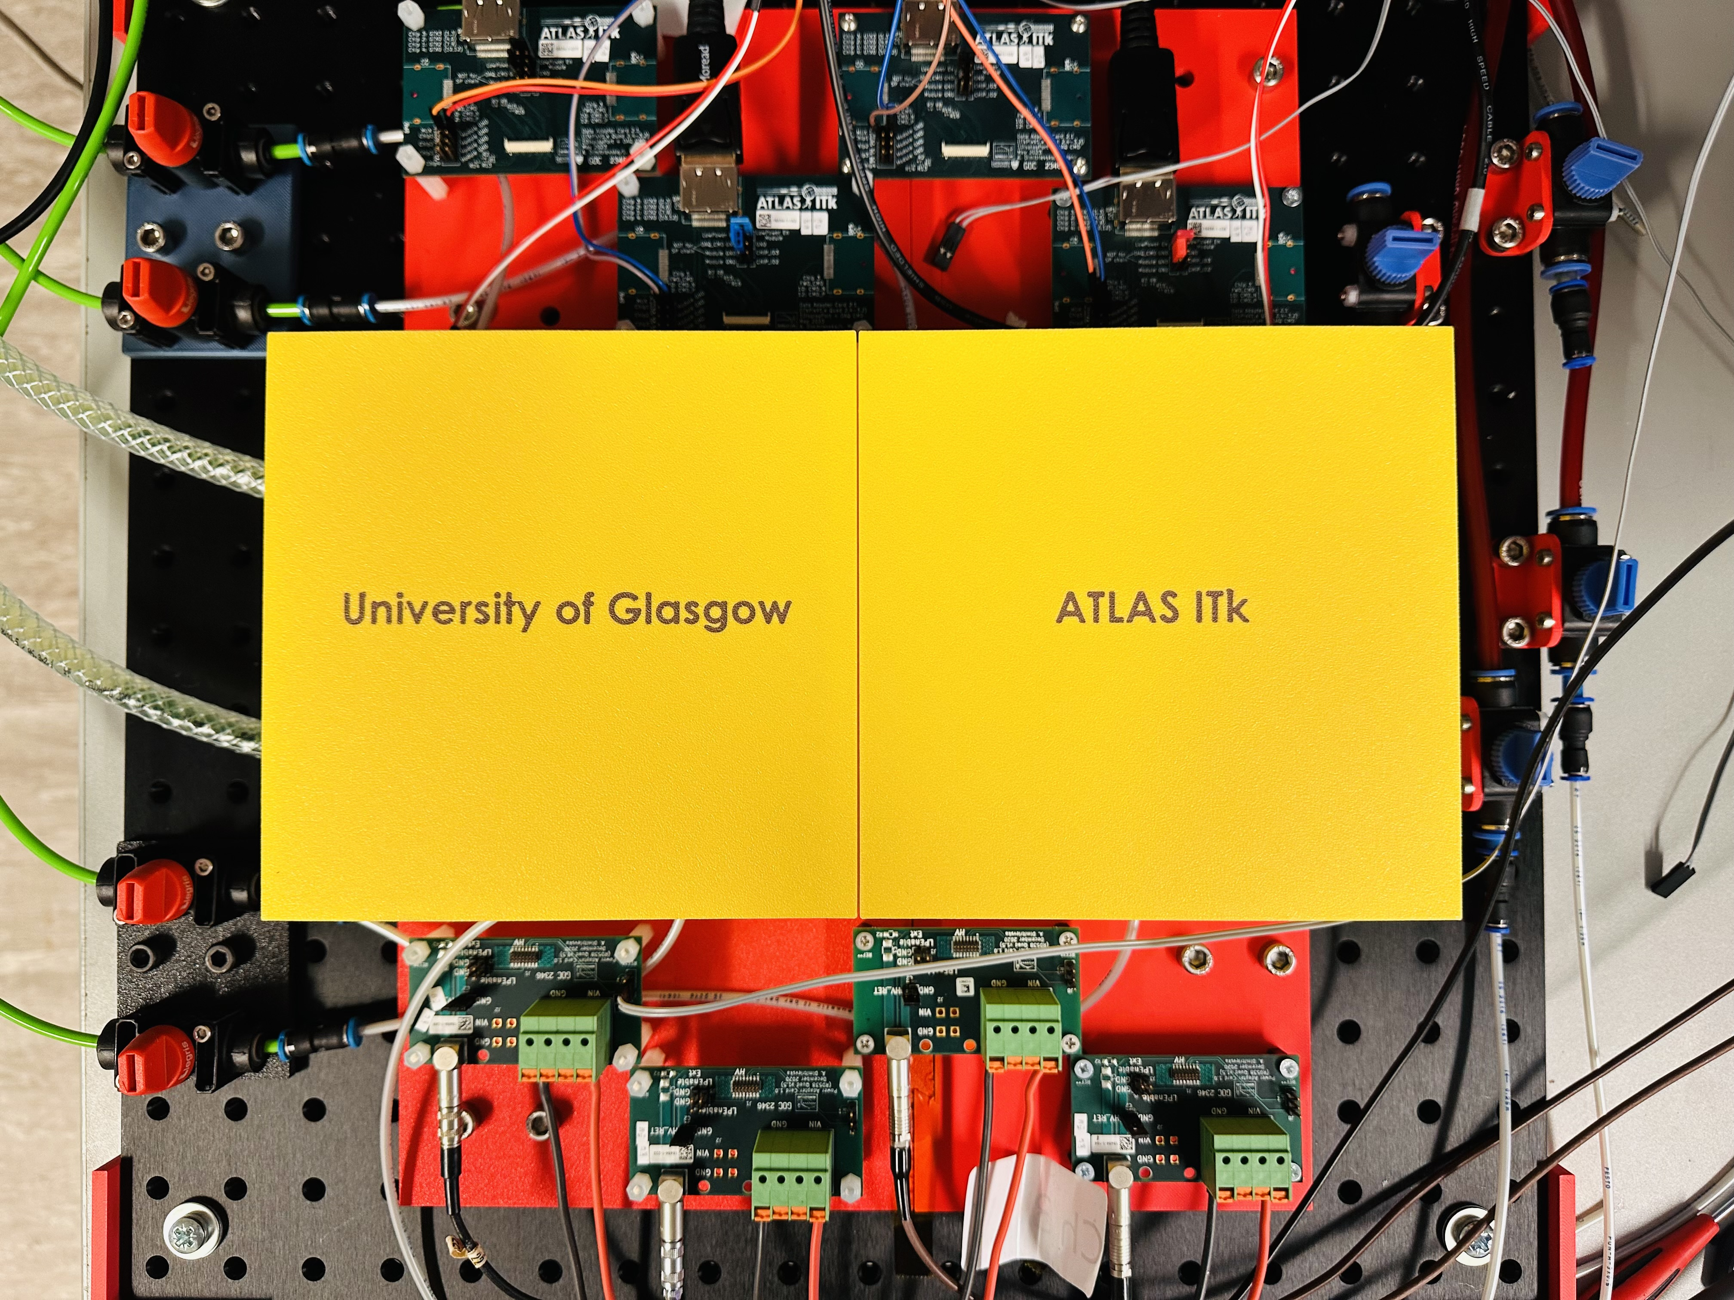
Module testing setup (warm)
Vacuum
DAQ PC
Card 1
Card 2
Chiller is always set to 14⁰C
Four modules can run parallelly
Four Device Control Setup (DCS) is there to read temperature and humidity of the four modules
Initial warm test can be done in four modules by ~ 3 hours
Card 3
Card 4
DMM 6500
(10 Ch)
HMP 4040
LV
Chiller
DCS
DCS
GOLD
GREEN
Wiener crate HV supply
DCS
DCS
Blue
Warm parallel Setup
ORANGE

Slide 11
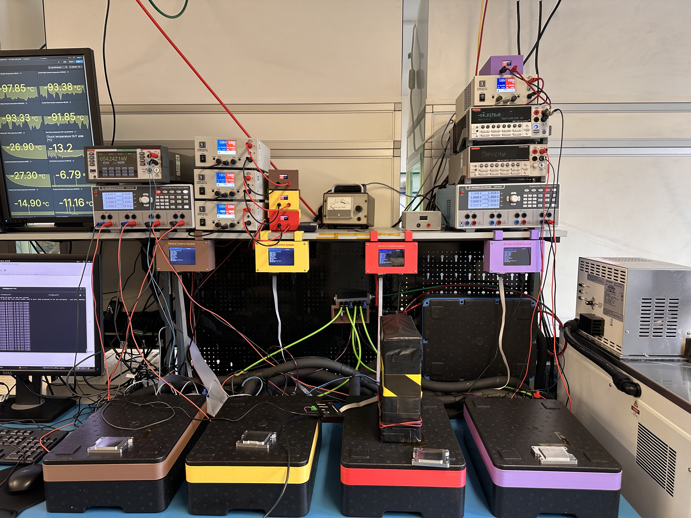
Module testing setup (Cold)
Chiller is always set to - 40⁰C
Four modules can run parallelly
Thermal cycle of 10 (+40⁰C to -45⁰C) takes almost 7 hours
Final test takes almost two days
DMM 6500
Peltier Switch box
(10 Ch)
HMP 4040
LV
DCS
Wiener crate HV supply
DAQ PC
Chiller
Card 1
Card 2
Card 3
Mini X2 X-ray gun
Card 4
Cold parallel Setup

Slide 12
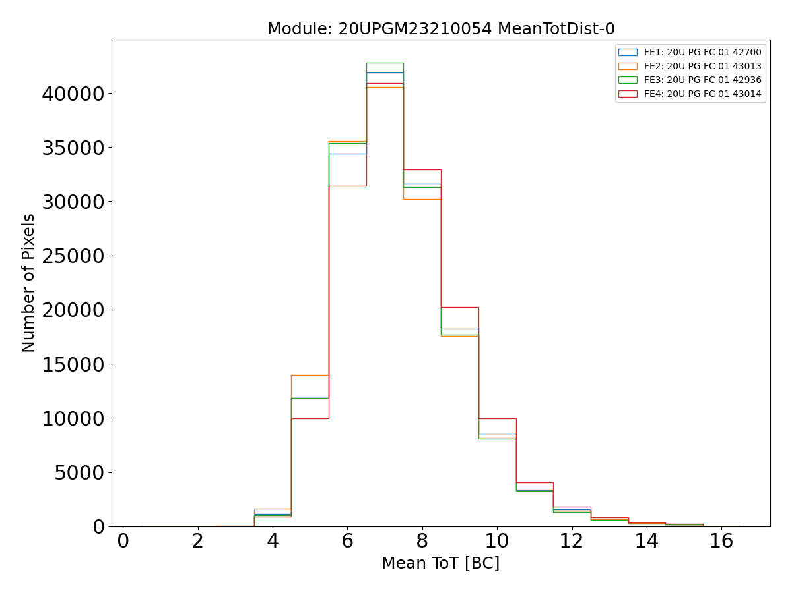
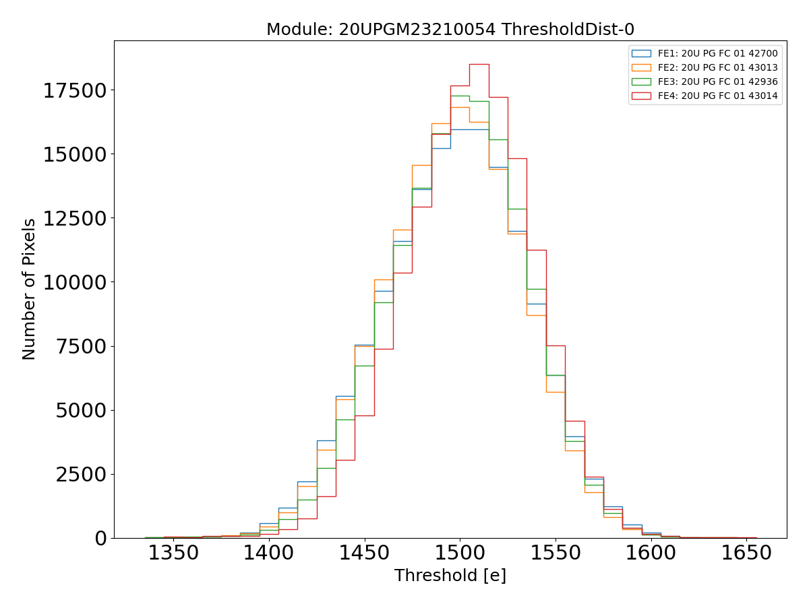
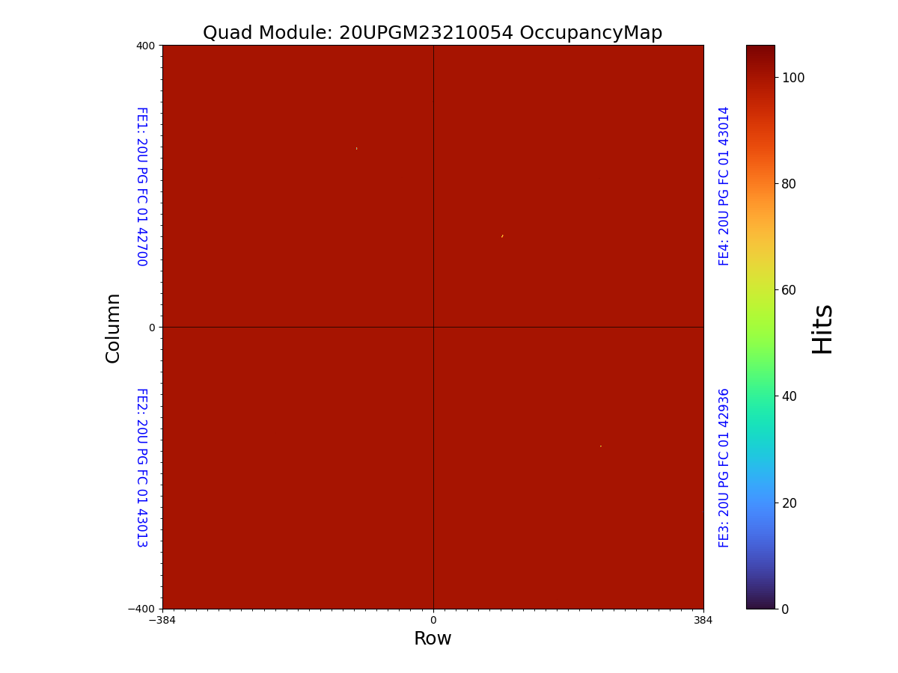
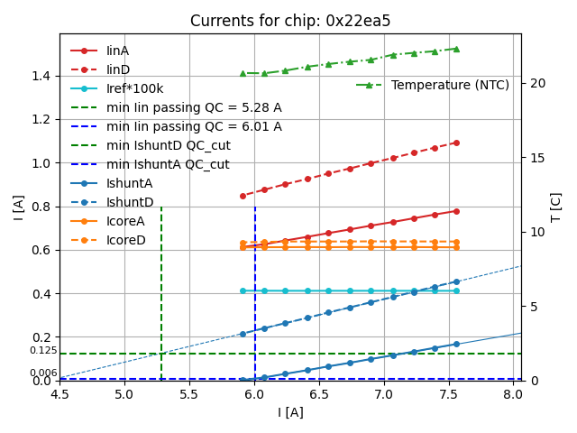
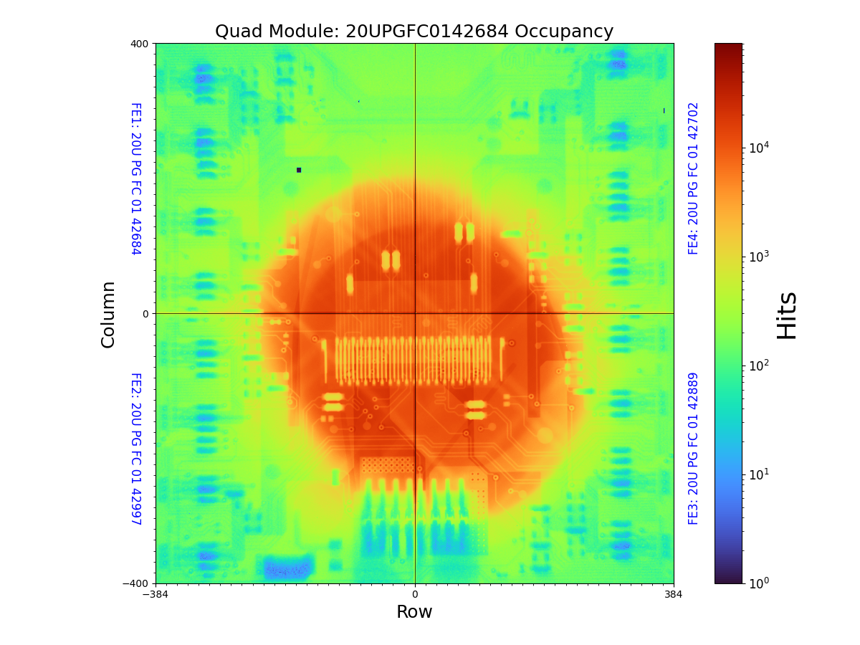
Module test results
In each stage of quality control process, a series of tests are repeated including IV at the different stages
Electrical tests include trimming of different internal circuits and registers, evaluation of internal currents and voltages
Tests also includes scanning of all pixels, tuning , disconnected bump scan and source scan with X-ray gun
To pass, a module has to pass in all the tests (green) at all stages
ToT scan
Key | Data
MODULE_TEMPERATURE | 20
ANALYSIS_VERSION | localdb-tools v2.5.0
QUAD-MODULE_ADC_CALIBRATION | 1 | 2 | 3 | 4
QUAD-MODULE_SLDO | 1 | 2 | 3 | 4
QUAD-MODULE_VCAL_CALIBRATION | 1 | 2 | 3 | 4
QUAD-MODULE_ANALOG_READBACK | 1 | 2 | 3 | 4
QUAD-MODULE_LP_MODE | 1 | 2 | 3 | 4
QUAD-MODULE_INJECTION_CAPACITANCE | 1 | 2 | 3 | 4
QUAD-MODULE_MIN_HEALTH_TEST | 1 | 2 | 3 | 4
QUAD-MODULE_TUNING | 1 | 2 | 3 | 4
QUAD-MODULE_PIXEL_FAILURE_ANALYSIS | 1 | 2 | 3 | 4
MODULE_BAD_PIXEL_NUMBER | 62
MODULE_ELECTRICALLY_BAD_PIXEL_NUMBER | 57
MODULE_DISCONNECTED_PIXEL_NUMBER | 5
QUAD-MODULE_DATA_TRANSMISSION | 1 | 2 | 3 | 4
MODULE_DISABLED_COLUMNS_NUMBER | 0
Threshold scan after tuning
SLDO
Source scan
Disconnected Bump scan

Slide 13
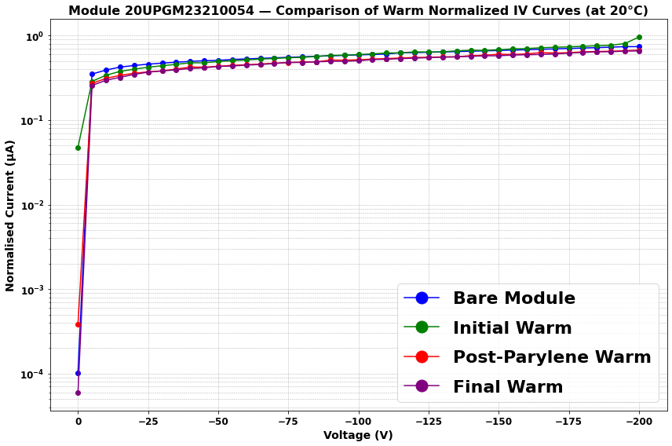
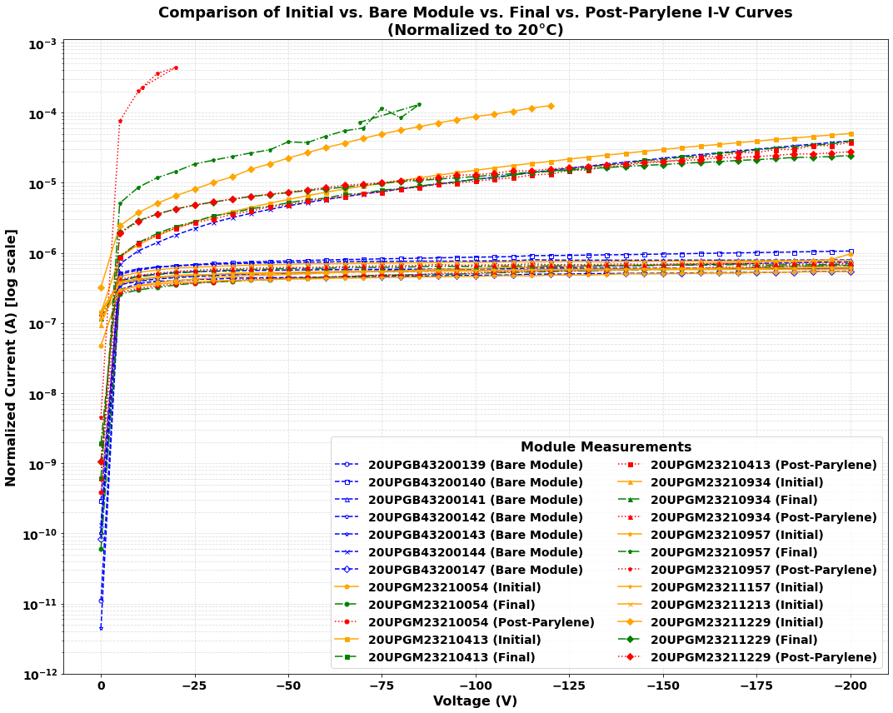
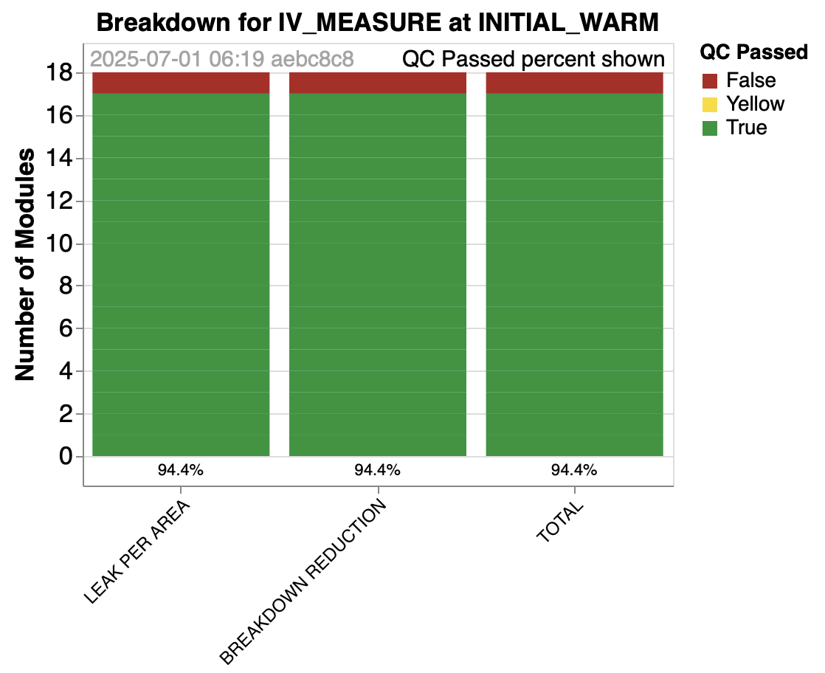
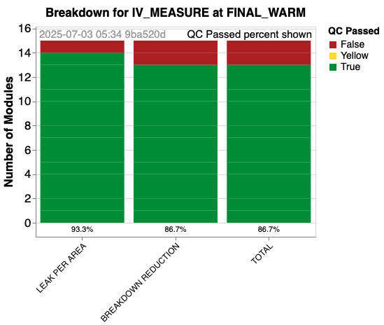
Module IV yield
For the ITk Strip, see Katie W. Pass’ talk
IV of one good module on all stage
IV of all module on all stage
26 bare modules received, and reception tests done,18 have been assembled into modules and went through initial test. 14 were tested through final stage
At initial test, one module breaks down early
At Final test, another module recorded reduction in breakdown voltage (reduction more then 10 V)
All other module has leakage current less than 1.5 µA/cm² ,and breakdown voltage more than 200 V

Slide 14
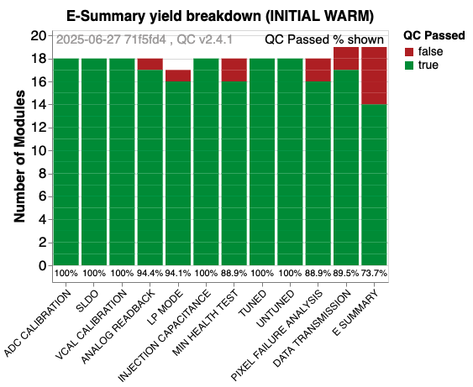
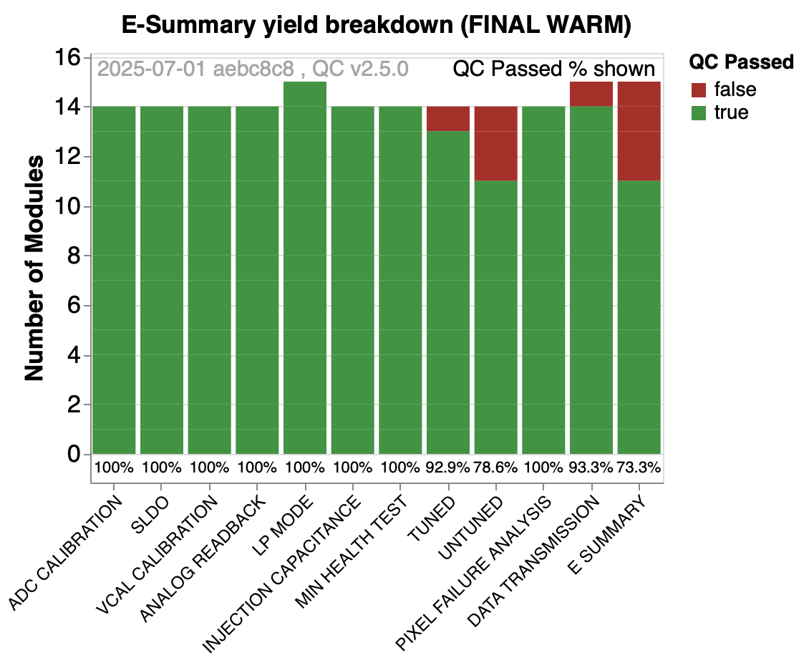
Module Electrical QC yield
For the ITk Strip, see Katie W. Pass’ talk
One of the modules have one chip (chip 4) disabled
Some of the modules are yet to be finished testing after parylene coating
Overall yield ~73% , which is much better then pre-production yield (53.8%)

Slide 15
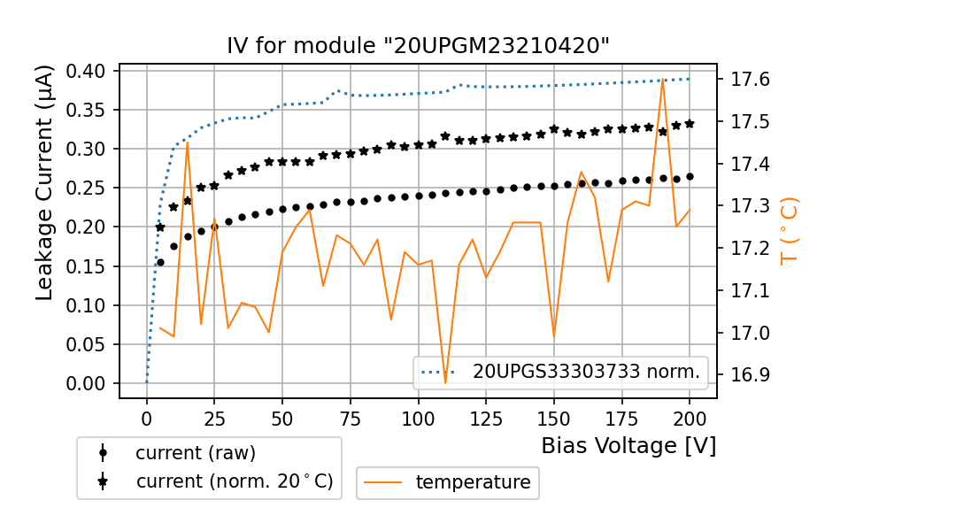
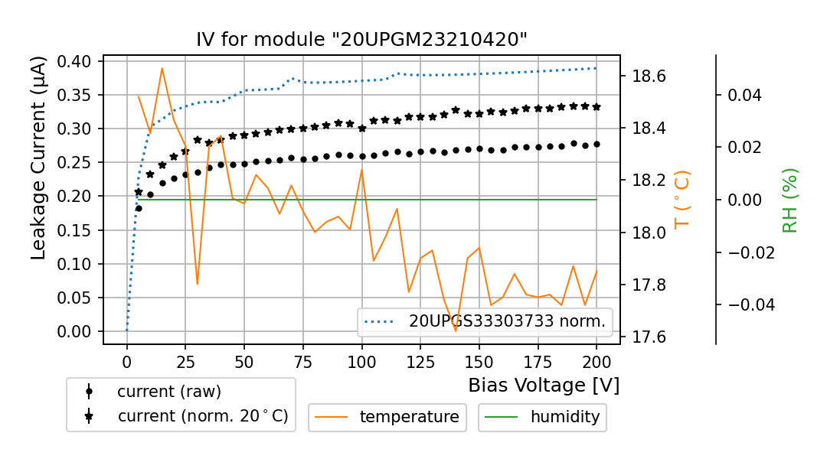
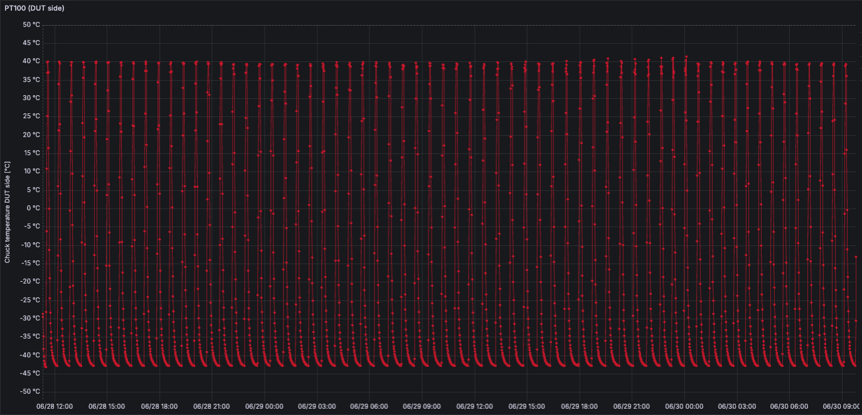
Before and after extensive Thermal cycle
One module was considered to perform long Thermal cycles (normal thermal cycle consist of 10 cycles)
Cycled within +40⁰C to -45⁰C
Cycled 70 time over two days
Intention is to stress the module thermally to see any deviation in module characteristics, specially bump bond delamination
 | Before Thermal Cycle | After Thermal Cycle
MODULE_BAD_PIXEL_NUMBER | 91326 | 91326
MODULE_ELECTRICALLY_BAD_PIXEL_NUMBER | 91321 | 91321
MODULE_DISCONNECTED_PIXEL_NUMBER | 5 | 6
No Difference is detected in terms of IV and Bump delamination
Before TC
QUAD-MODULE_PIXEL_FAILURE_ANALYSIS | 1 | 2 | 3 | 4
After TC

Slide 16
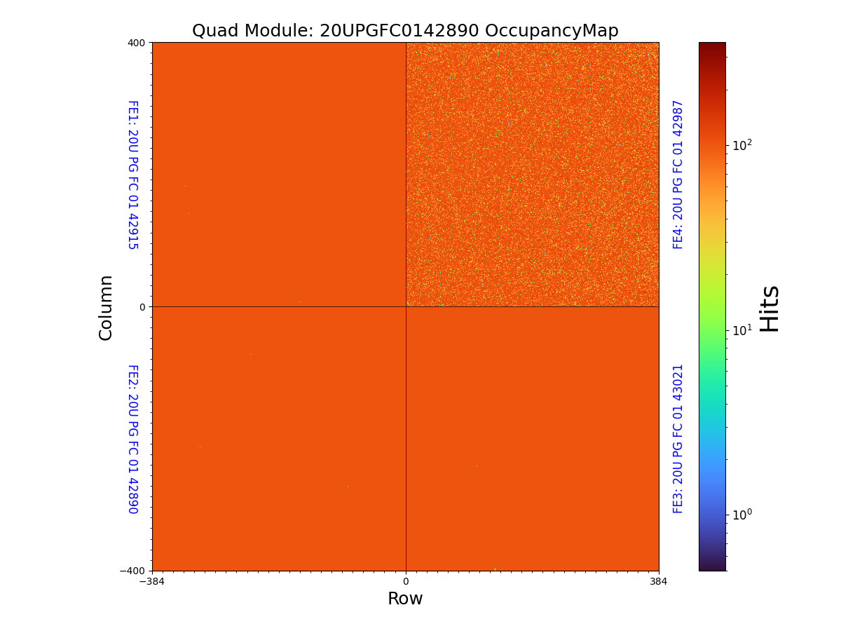
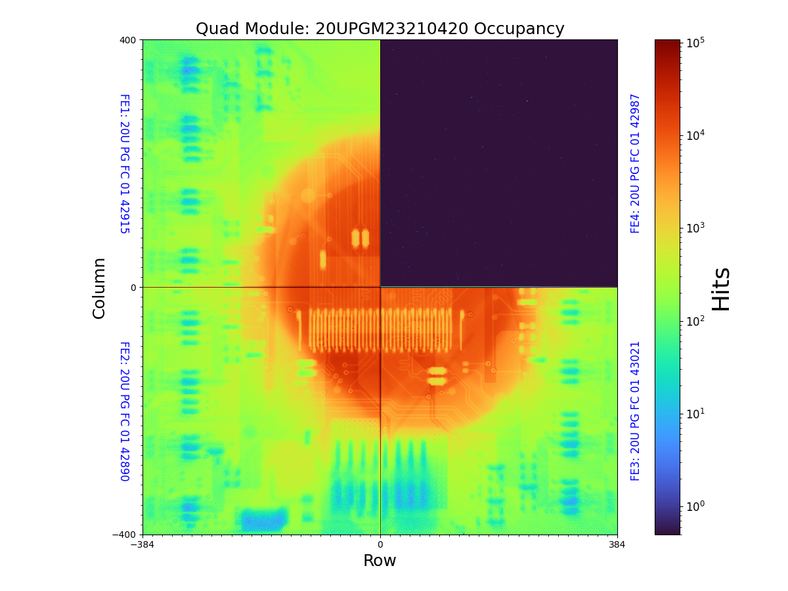
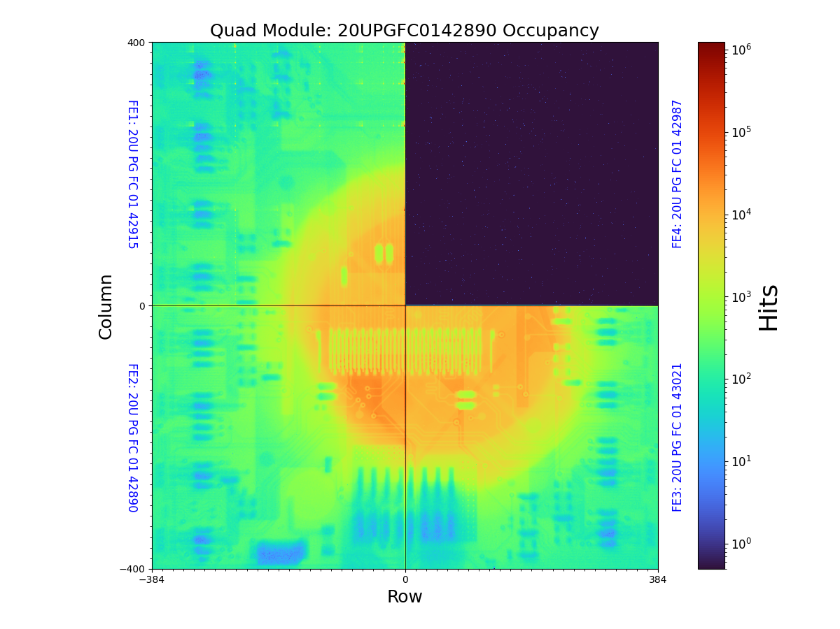
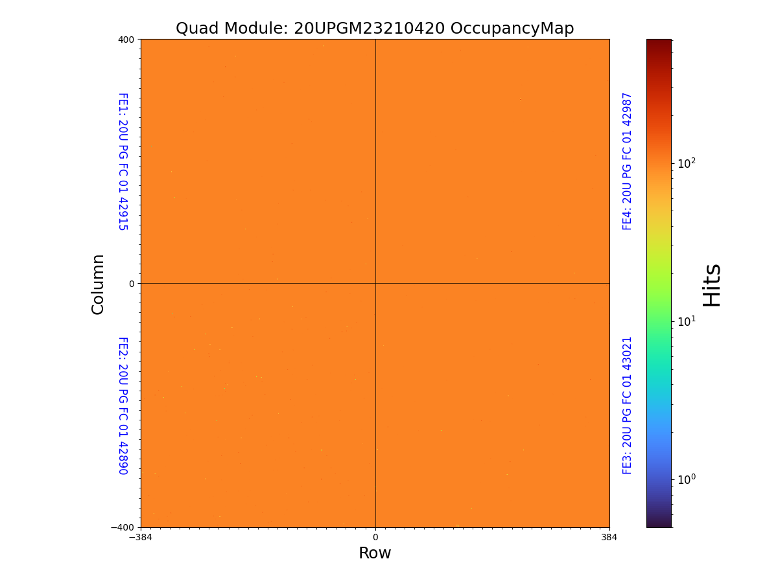
Before and after extensive Thermal cycle-continued
Chip 4 has bad communication, do not record any hits in source scan
No significant changes can be seen, other then reduction of noise in chip 4
After TC
Before TC
Before TC
Disconnected
Bump Scan
Source Scan
After TC

Slide 17
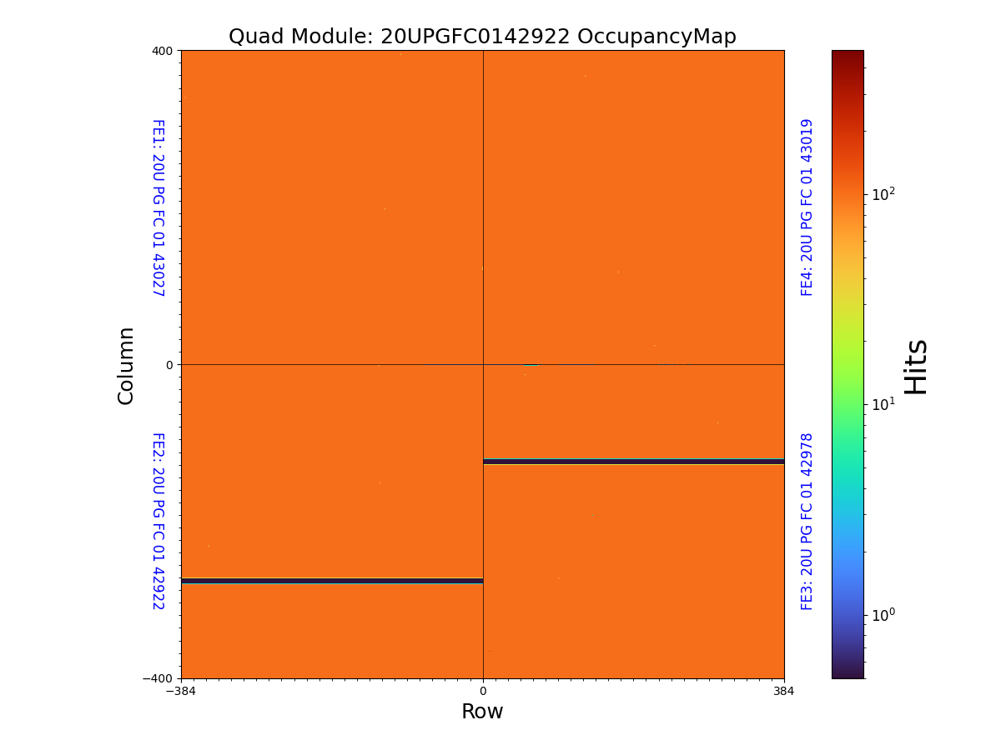
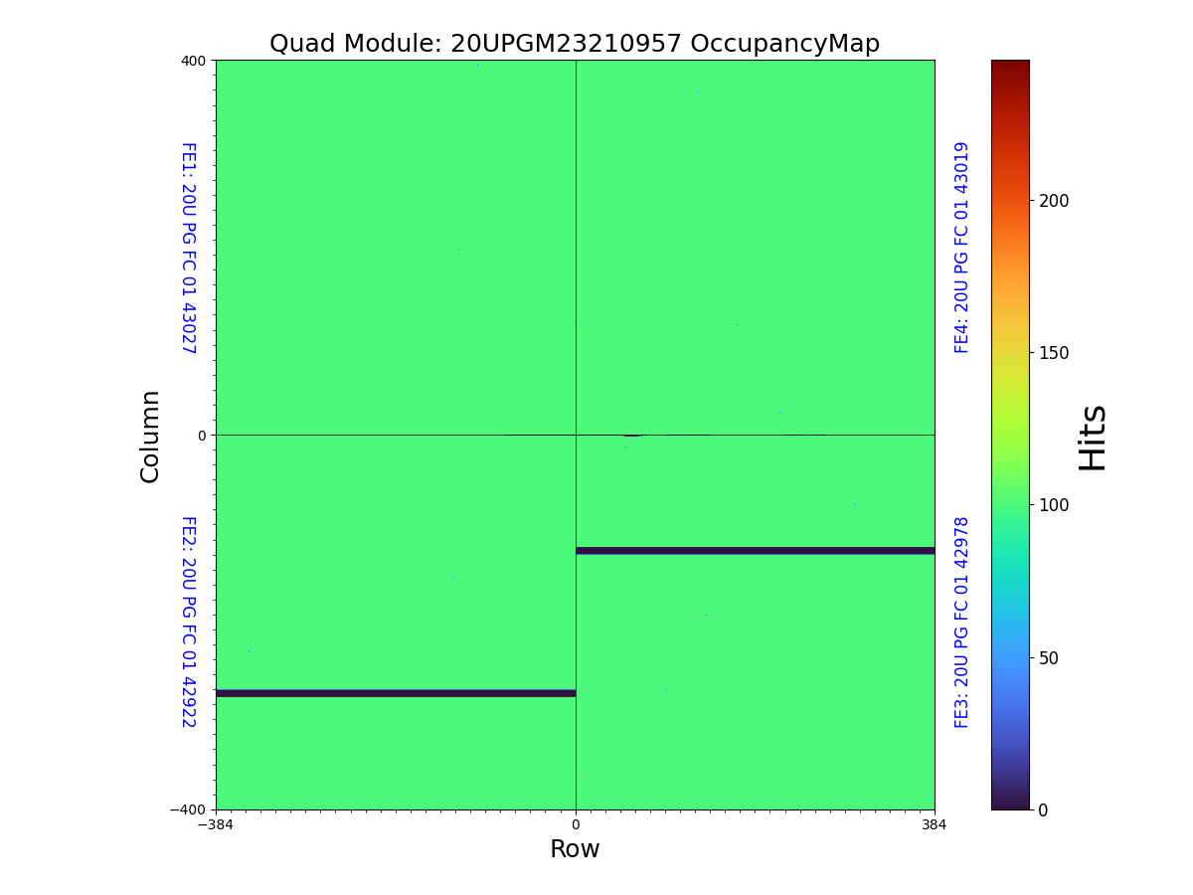
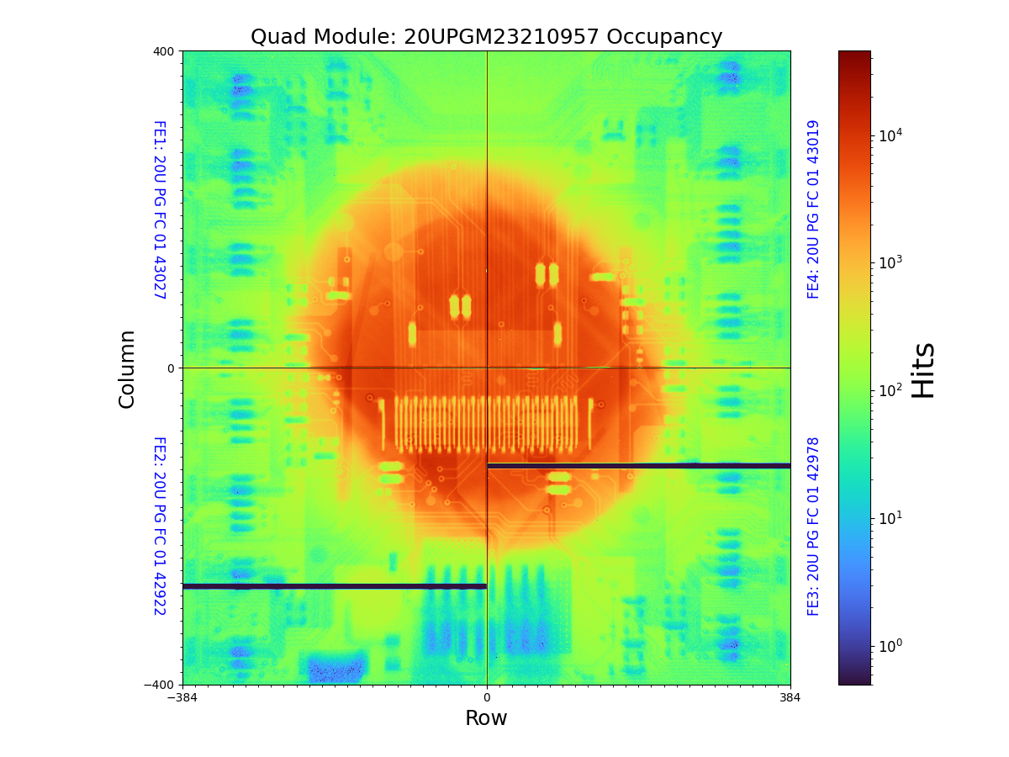
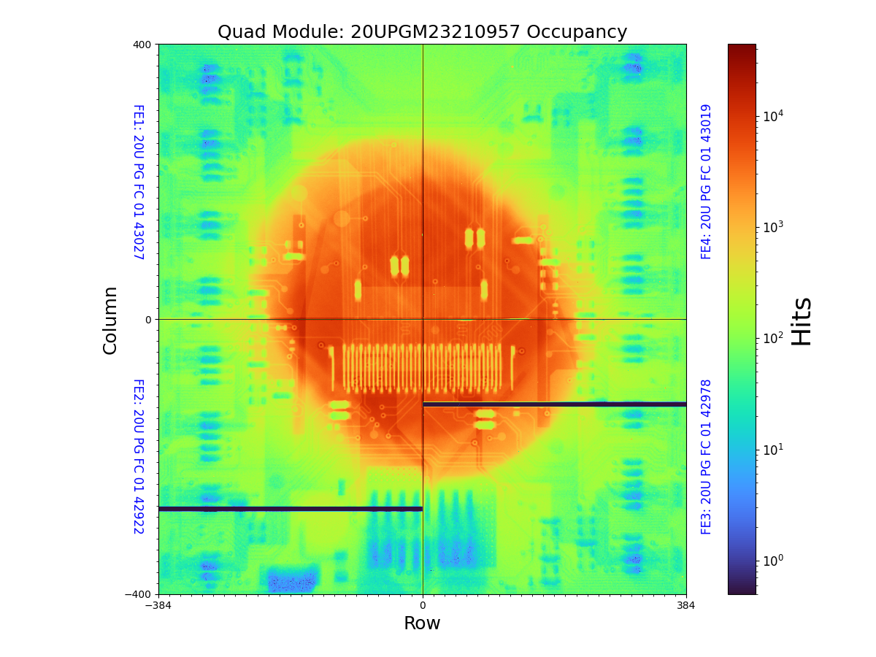
Before and after extensive Thermal cycle-CC module
Another module was considered to perform long Thermal cycles with broken core column (known as Core Column issue)
Cycled within +40⁰C to -45⁰C
Cycled 70 time over two days
Intention is to stress the module thermally to see any deviation , or increase in more broken columns
No Difference is detected in terms of bump delamination or increase of core column problem
 | Before Thermal Cycle | After Thermal Cycle
MODULE_BAD_PIXEL_NUMBER | 6554 | 6553
MODULE_ELECTRICALLY_BAD_PIXEL_NUMBER | 6296 | 6301
MODULE_DISCONNECTED_PIXEL_NUMBER | 258 | 252
QUAD-MODULE_PIXEL_FAILURE_ANALYSIS | 1 | 2 | 3 | 4

Slide 18
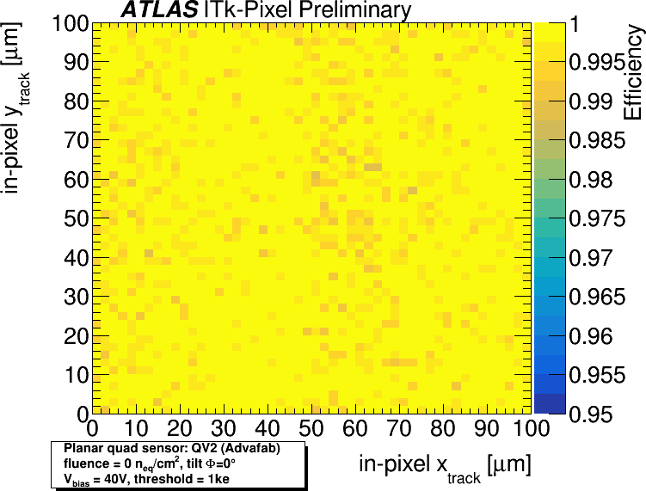
Test beam result
One module was tested under 120 GeV pion beam at CERN
Module was tested before irradiation
It showed more then 99 % hit efficiency at 20 V bias at sensor
More study will be done after irradiation
More information at poster session
“Up-to-date test beam results of ATLAS ITk Pixel sensors and modules”
https://indico.cern.ch/event/1455346/contributions/6323044/attachments/3006994/5300730/Trento_2025_ITk_Pixel_Testbeam_CKrause.pdf

Slide 19

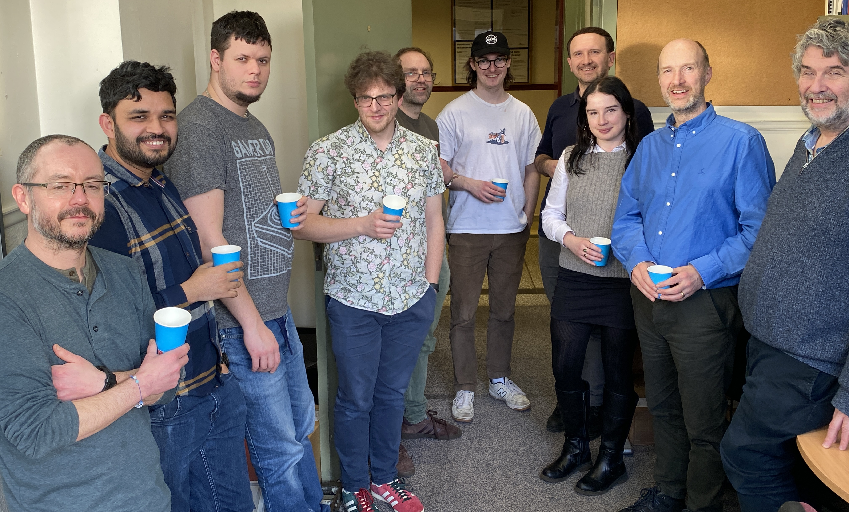
Conclusion
Production has started slowly, but progressively
No significant bump delamination was seen in any module
Though we have a bit less yield (~73%) then the target yield (78%), we are trying to improve
Maximum failure came from core column, software and a bit handling
Have identified some problems in process, and learning more and adapting
With more experience predicting to be much better in future production batches

