Slide 1
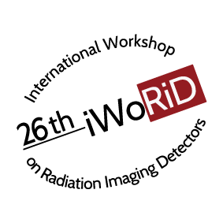
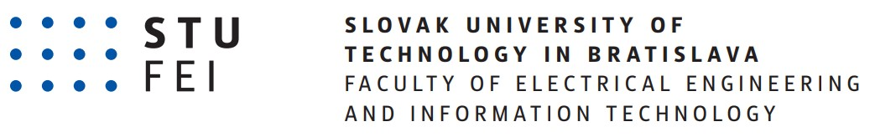


Comparison between simulated neutron interactions and captured images for fast neutron imaging
authors: F. Révai, J. Lüley, B. Vrban, Š. Čerba, V. Filová, O. Glavo, V. Nečas, N. Saito
e-mail: filip.revai@stuba.sk
Affiliation:
Faculty of Electrical Engineering and Information Technology
Slovak University of Technology in Bratislava

Slide 2
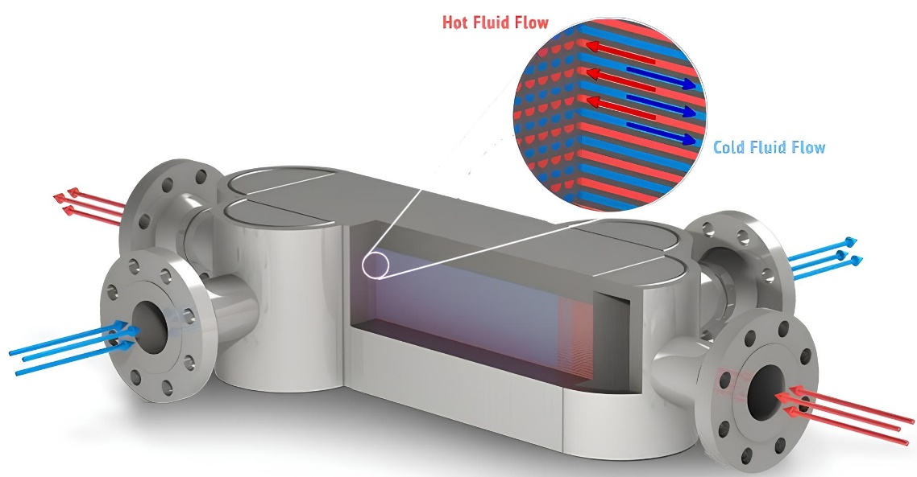
Introduction
New inspection methods.
New improved technologies in nuclear industry – heat exchanger.
The methods used in practice are not sufficient.
Testing the functionality and uncovering defects.
Introduction
Design
Functionality
Experiment
Results
Conclusion

Slide 3
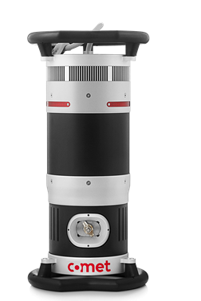
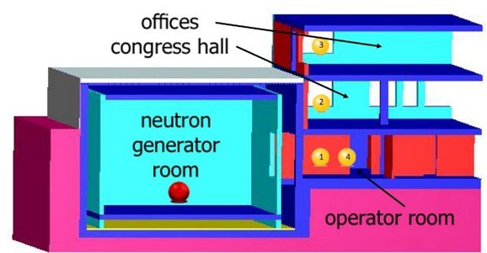
Introduction
New neutron laboratory.
Radiography using X-ray lamp.
Defectoscopy using D-D generator.
Portability and in-situ measurements.
Introduction
Design
Functionality
Experiment
Results
Conclusion

Slide 4
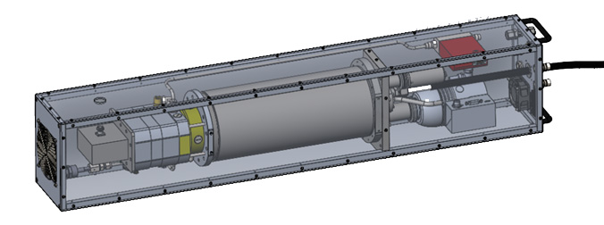
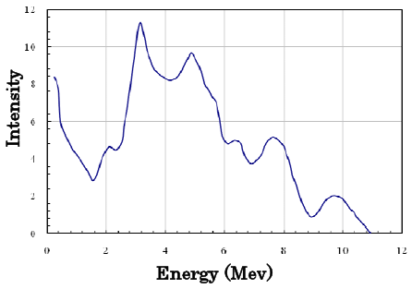
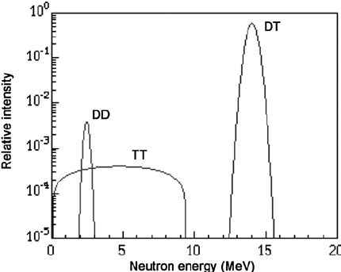
Design
Adelphi DD 108
Yield: 3 x 10⁸ n/s
Average energy: 2.5 MeV
D-D neutron generator
Introduction
Design
Functionality
Experiment
Results
Conclusion
Plastic scintillator
Astro camera
AmBe energy spectrum
D-D energy spectrum
Notes:
So lets talk about the parts of the device. There are 3 main components. Well as mentioned before we would like to use a D-D generator as the source. It will be the Adelphi DD 108. It has a yield of 3 x 10+8 n/s with the 2,5MeV average energy of fast neutrons. However the D-D generator is not in operation just yet so for the testing of the functionality of our device we used an Americium inducted with berylium radioisitope source. This source is a little different in comparission to the generator, maily because the average energy of fast neutrons is 4,25 MeV and the yield of neutrons is 2,2 x 10+6 n/s. But the biggest difference is the spectrum of the neutrons, we can say that the D-D generator produces almost monochormatic beam of neutrons on the other hand this is not a case with AmBe source as seen on these figures. Another difference is that the AmBe source produces primary gamma rays that can affect the measurements.

Slide 5
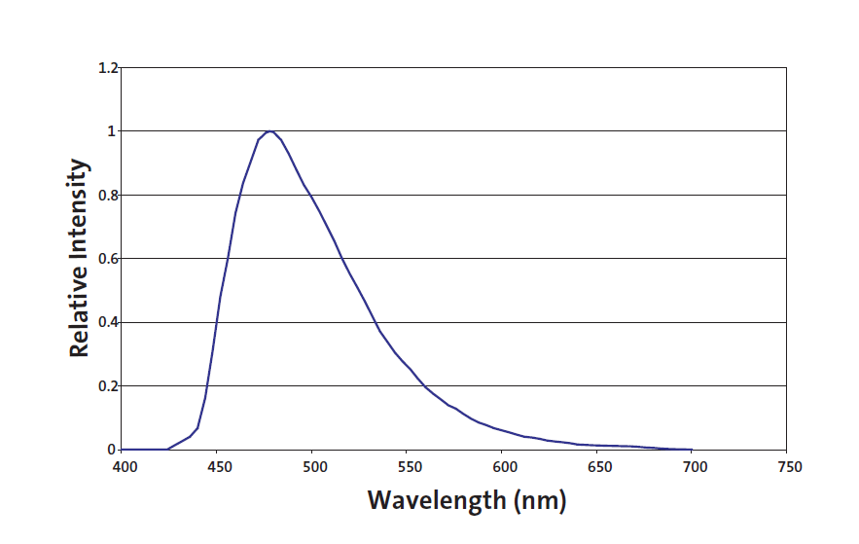
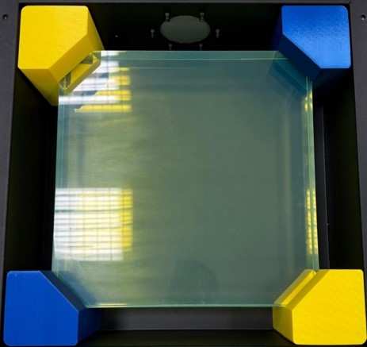
Design
NuDET Plastic scintillator
Material – polystyrene
Density – 1.03 g/cm³
Light output – 56%
D-D neutron generator
Introduction
Design
Functionality
Experiment
Results
Conclusion
Plastic scintillator
Light photons wavelenght output from green plastic
Astro camera
Notes:
The second important component is the plastic scintillator. Its a NuDET plastic which means it is made by Nuvia company. We chose this scintillator because of its properties, its made of polystyrene with density of 1,03 g/cm+3 and size is about 40x40x5 cm. Plastic scintillators are great option for with fast neutron detection, as the neutrons interact with hydrogen atoms through elastic scattering and effectively transfer energy to protons, that create the scintillations (visible light photons). Another advantage of this scintillator is because its green with light output of 56%, the created photons of visible light have the wavelenght that has the highest quantal efficiency with the CMOS chip that is in the camera. This means that most of the photons will be detected. Speaking of camera:

Slide 6
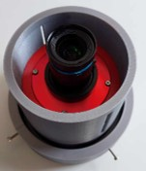
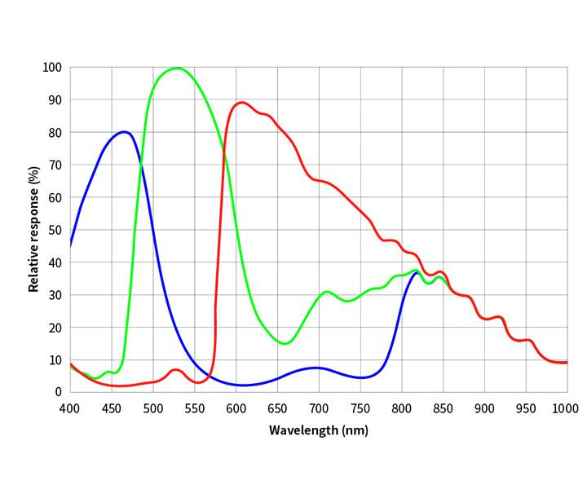
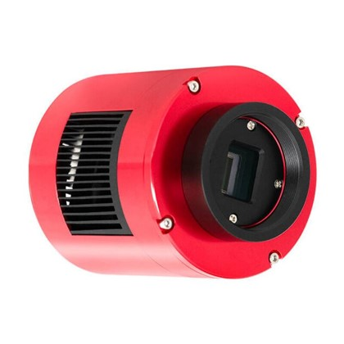
Design
ZWO Astro camera
Sensor – CMOS chip
Time exposure – up to 3 hours per image
D-D neutron generator
Introduction
Design
Functionality
Experiment
Results
Conclusion
Plastic scintillator
Astro camera
Camera response for different light wavelenght
Notes:
We chose the astronomy camera by ZWO. This is because we would be capturing light photons for long period of time, and the cmos chip provides great noise reduction and so, better resolution of the image. We combined it with camera lens that has higher luminosity. This means, the lens will be more sensitive to light, which in our case are the light photons, so this way we could ensure better resolution of the captured image. When the image is captured, it needs to be processed in a software. For this we are using a program called Siril. This is because this program is meant to process astronomy images. So it is compatible with our camera.

Slide 7
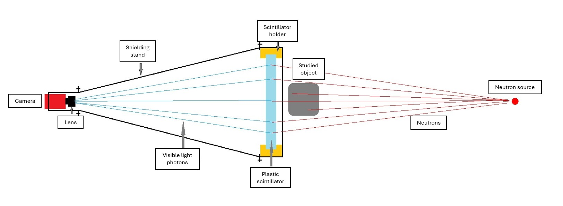
Design
Introduction
Design
Functionality
Experiment
Results
Conclusion
Notes:
So you can see, there is a lot we want to do and what I want to present to you today is what we achieved so far. First we designed a device for imaging. It would work like this, the fast neutrons emitted from the source will pass through the sample, and interact with scintillator, then the light photons will be captured by the camera in the end. The result of this would be an digital image that could be processed later. Seems simple on the paper but what in reality. That was what we tested and this presentation shows the results of an particular experiment, but more on that later.

Slide 8
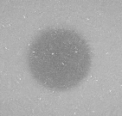
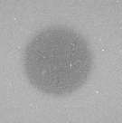
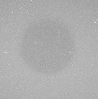
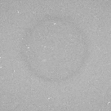
Functionality – contrast
Testing different material contrast
Cylinders with thickness of 1 cm
Introduction
Design
Functionality
Experiment
Results
Conclusion
Lead
Iron
Aluminum
Graphite
Notes:
So on paper it should work easily, but what in reality? Before the main experiment, we wanted to test the functionality of our device. Trying different configurations so that we could optimize the imaging process for future use with the DD generator.

Slide 9
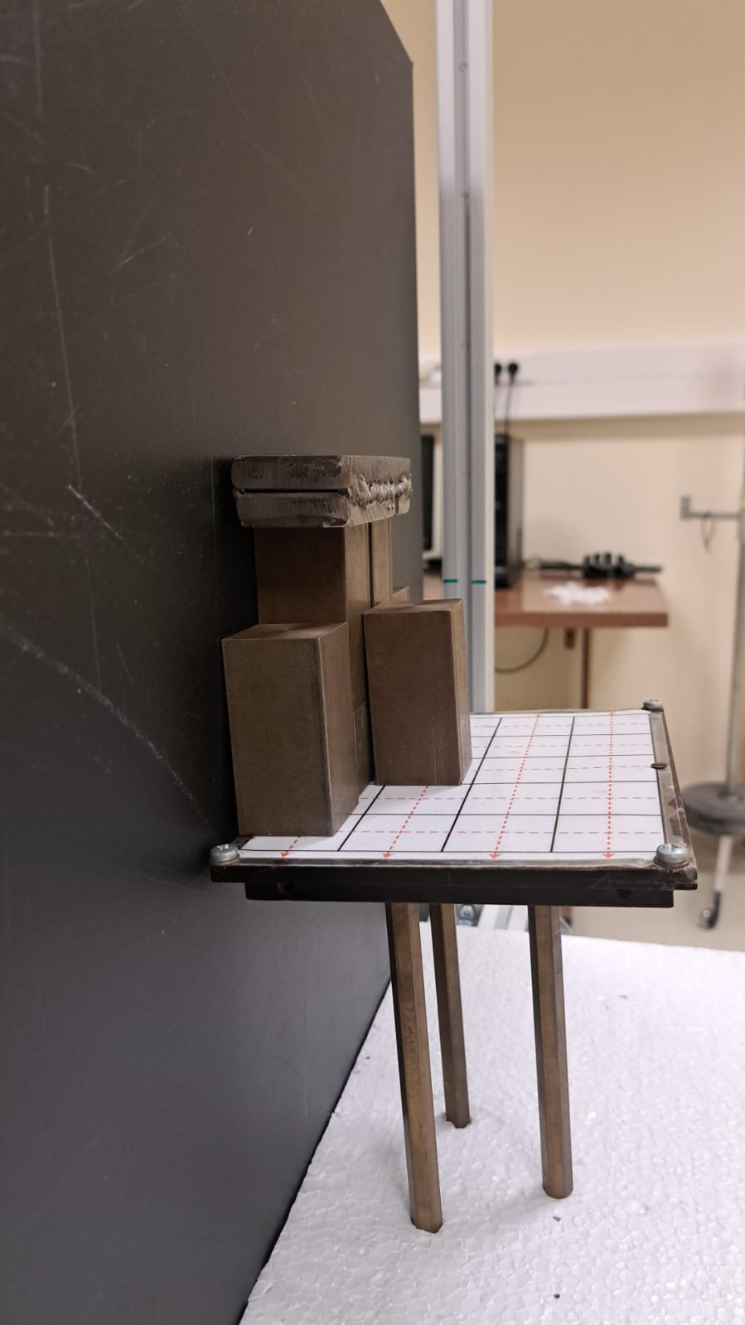
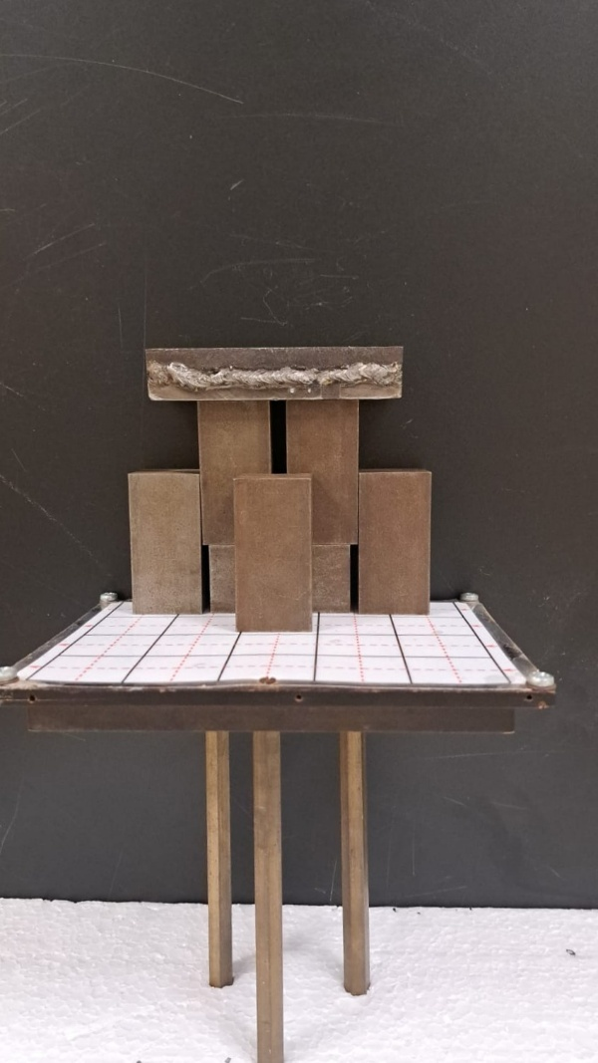
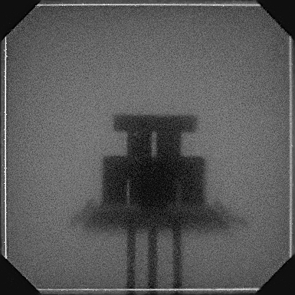
Functionality – spatial resolution
Introduction
Design
Functionality
Experiment
Results
Conclusion
Notes:
In this configuration, we put on stand, with three legs a plank, and on that plank we created this configuration of materials. This way we could also find out, what the possible detection resolution of our device is (the gaps). This is maybe not so obvious and needs a little bit of imagination, but when you look at the legs of the stand, one is clearly closer than other two. Also the plank dimension on the side is shown. However, if we move the source closer, further, more up or down the result would be different. Because the spatial resolustion depends heavily on the position of the source. In this case, the source was placed in a way, it was in the same height as the plank.

Slide 10
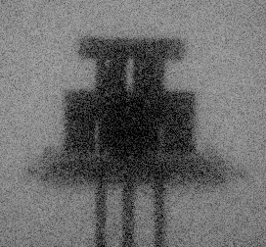
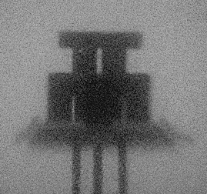
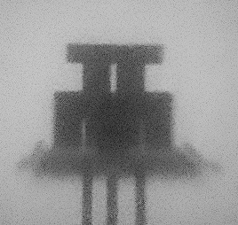
Functionality – image stacking
Introduction
Design
Functionality
Experiment
Results
Conclusion
1 image = 30 minutes
7x image
26x image
Notes:
What else we tried with this set up was instead of longer and longer exposure times, we captured more images with shorter time and then combined them into one image. This process can be a bit tricky, but is useful because the background noise would be less visible compared to image captured only ones for longer time. What we did was capture an image with time of exposure equal to 30 minutes. Then we took the same image 7 times a combined it. And finaly, the third image was created by combining 26 images. You can clearly see the difference between the images, the brightness and the sharpness of the object is better when combining images. This image stacking will be important for the main experiment, and as I am speaking about it, lets continue to it.

Slide 11
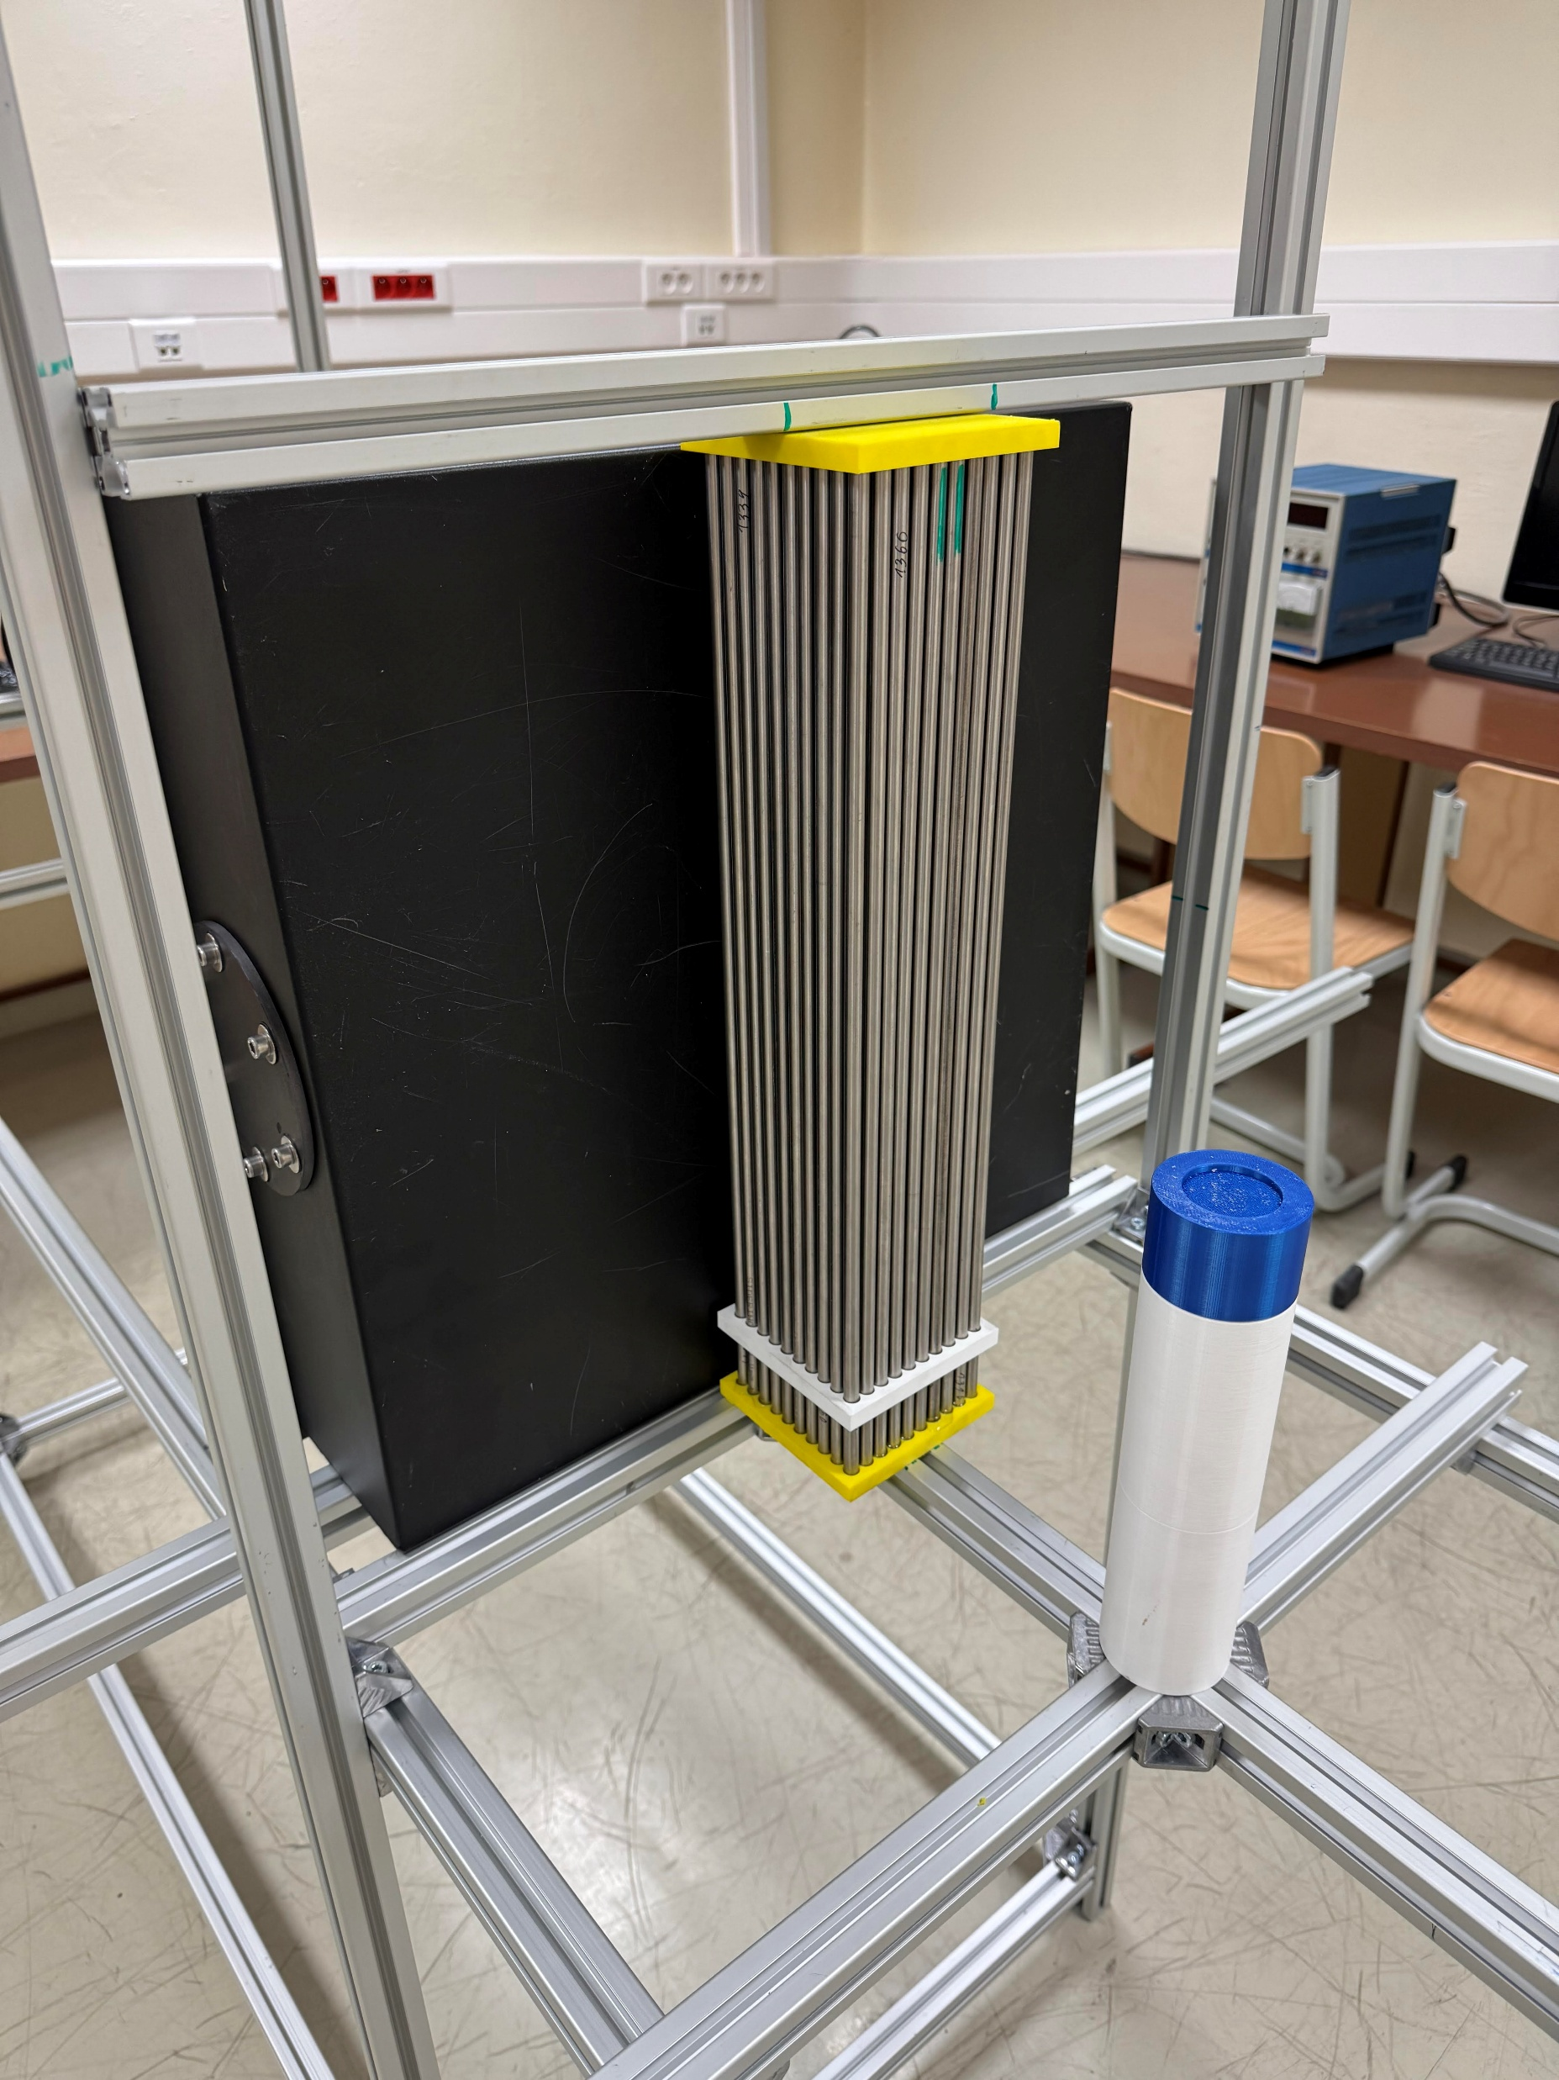
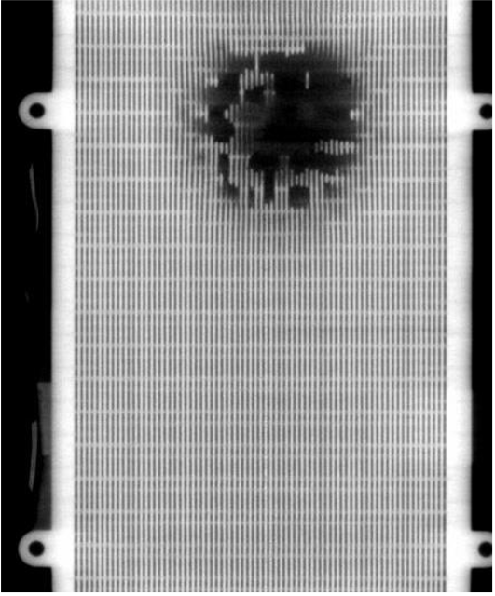
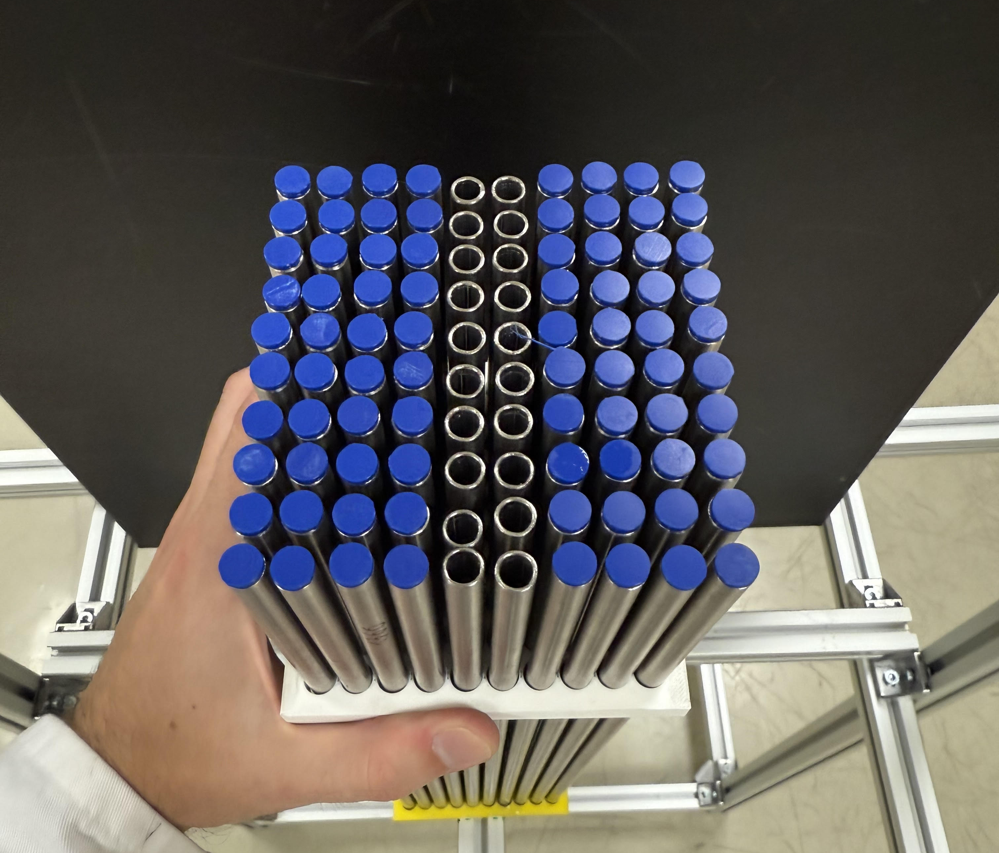
Experiment
Create a mock-up of heat exchanger
Used GEANT4 for simulation
Simulation of „burst“ defect
Introduction
Design
Functionality
Experiment
Results
Conclusion

Slide 12
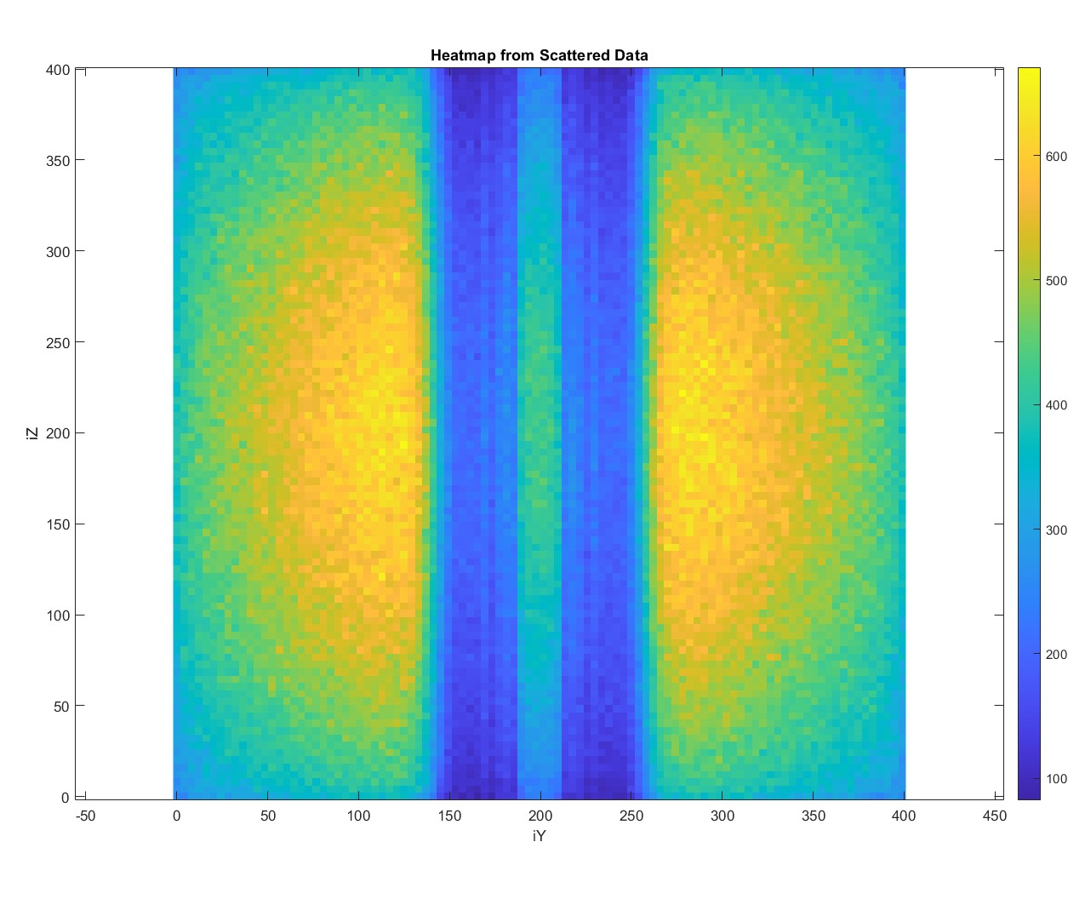
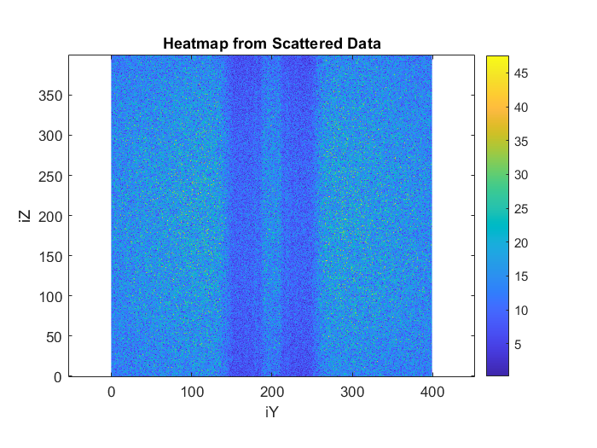
Experiment – simulation (first geometry)
Introduction
Design
Functionality
Experiment
Results
Conclusion
Results of simulation with only neutrons emmiting from the source
Results of simulation with gamma and neutrons emmiting from the source

Slide 13
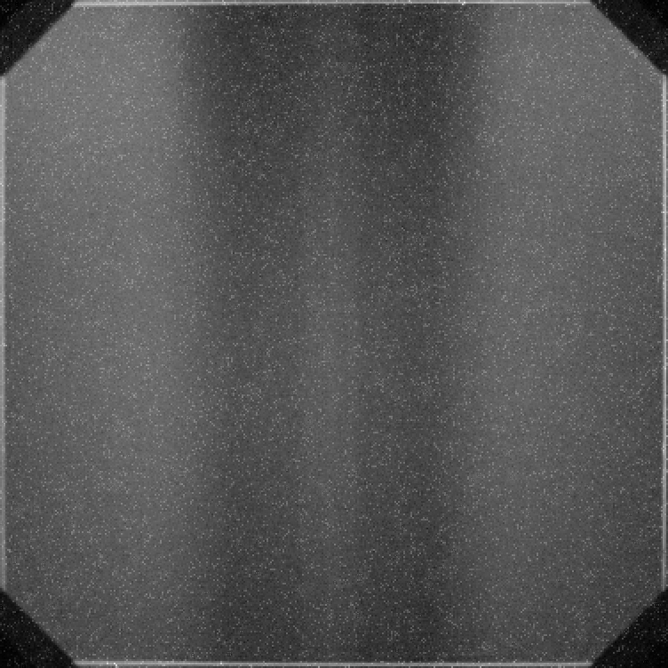
Results – measurements (first geometry)
Introduction
Design
Functionality
Experiment
Results
Conclusion
Results of the measurement (1 image)
Results of image stacking (20 images)

Slide 14
Experiment – second geometry
Introduction
Design
Functionality
Experiment
Results
Conclusion

Slide 15
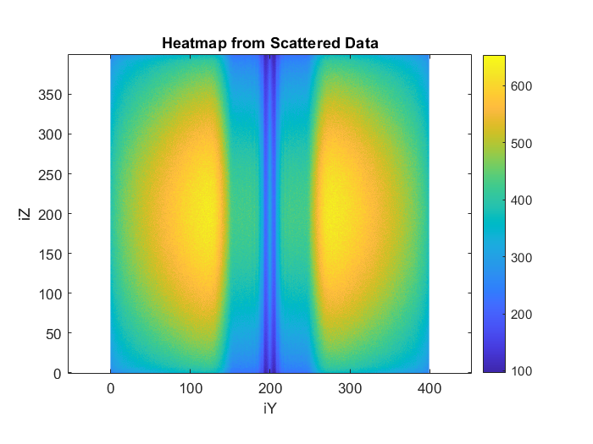

Experiment – simulation (second geometry)
Introduction
Design
Functionality
Experiment
Results
Conclusion
Results of simulation with gamma and neutrons emmiting from the source
Results of simulation with only neutrons emmiting from the source

Slide 16
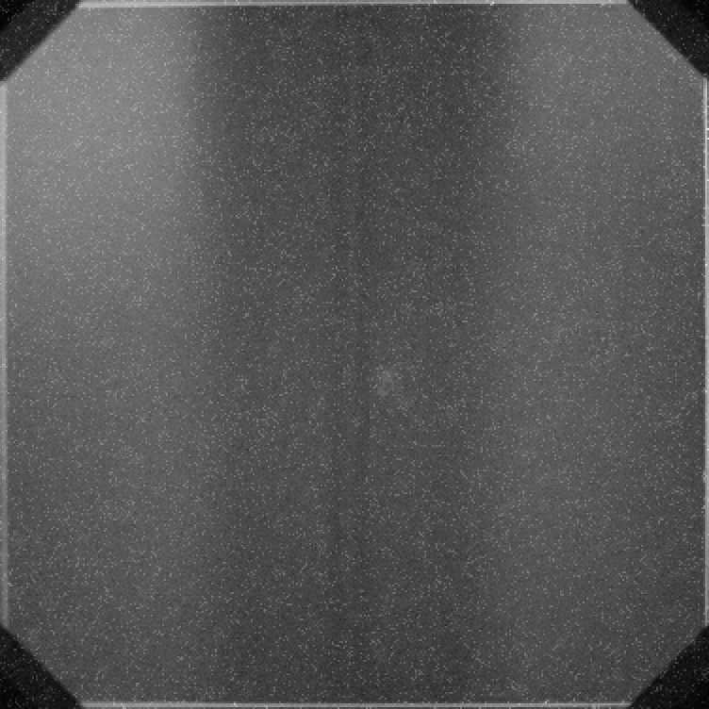
Results – measurements (second geometry)
Introduction
Design
Functionality
Experiment
Results
Conclusion
Results of the measurement (1 image)
Results of image stacking (26 images)

Slide 17
Conclusion
Tested the functionality of our design.
Device capable of capturing images using fast neutrons.
Comparing results to GEANT4 simulations.
Verification of the simulations
Possibility to detect a defect.
Optimization:
Scintillator - smaller thickness
Camera (lens) - higher luminosity
Implementation of DD generator
Introduction
Design
Functionality
Experiment
Results
Conclusion

Slide 18

Thank you for your attention

