Slide 1
nLGAD detector gain performance in the deep and near-ultraviolet (UV) spectral range
26th International Workshop on Radiation Imaging Detectors (IWORID2025)
July 6-10, 2025, Bratislava, Slovakia
Miloš Manojlović, Neil Moffat, Pablo Fernandez-Martínez, Jairo Villegas, Enric Cabruja, Mateusz Rebarz, Giulio Pellegrini, Salvador Hidalgo
Contact e-mail: milos.manojlovic@imb-cnm.csic.es

Slide 2
Outline
Motivation
Why study low-penetration radiation?
Introduction to Low Gain Avalanche Diodes (LGAD)
What are LGADs and the novel nLGAD ‘’flavour’’?
Measurement setup
Transient Current Technique (TCT)
Spectral Gain Response
Measurements under deep-UV and near-UV radiation
Conclusions & Future

Slide 3
Why study low-penetration radiation?

Slide 4
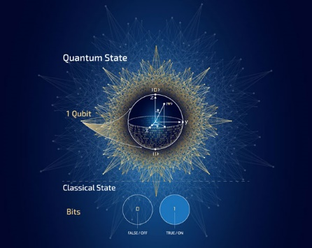
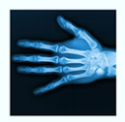

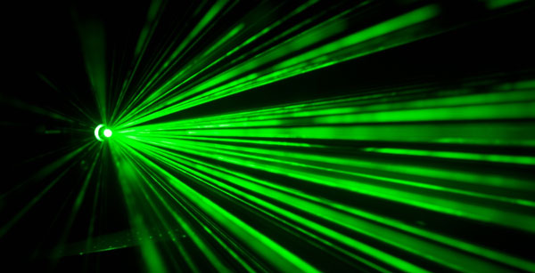


Why study low-penetration radiation?
Near-surface phenomena are challenging for traditional Si detectors due to recombination effects, which reduce quantum efficiency (depth around 1 µm)
Even more challenging is single-photon detection, which is crucial in many fields such as:
quantum information
fluorescence microscopy
biomedical imaging
soft X-ray astronomy (< 1 keV)
deep-UV in fusion experiments etc.
Photon/Particle
n++
Dead layer
Standard PiN diode
p++
Low surface e-field &
Recombination of e-h pairs

Slide 5
Low Gain Avalanche Diodes (LGAD)

Slide 6
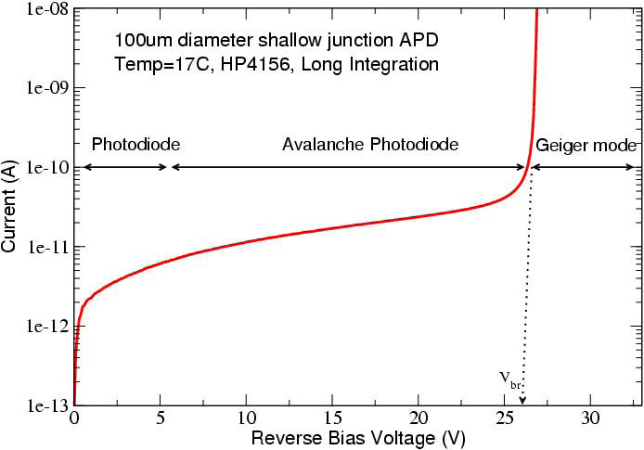
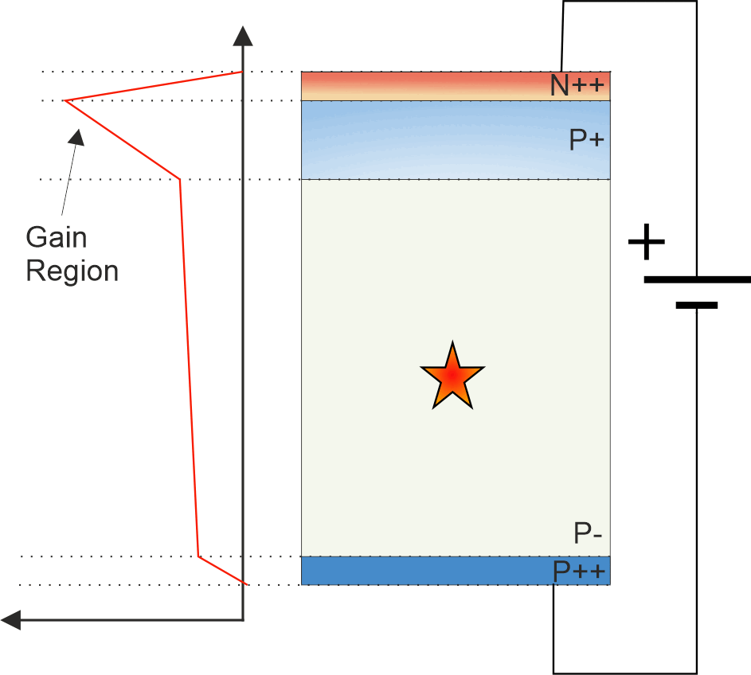
Low Gain Avalanche Detector
Proposed by IMB-CNM in 2014
Proportional response (linear mode operation)
Better sensitivity (Gain)
S/N ratio increased
Excellent timing resolution (~ 30 ps)
MIP detection for HEP
Thin detector integration with the same signal and higher collection efficiency
Linear mode
No Gain
Gain > 10⁴
Digital response
Moderate Gain
&
Proportional response
[1] A.G. Stewart et al. in Proc. of SPIE, Vol. 6119, 2006
Original paper
G. Pellegrini, et al., Technology developments and first measurements of Low Gain Avalanche Detectors (LGAD) for high energy physics applications, Nucl. Instrum. Methods A 765 (2014) 12.

Slide 7


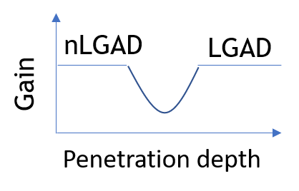
nLGAD Technology
Pellegrini, G., Salvador, H. V., David, F. G., Waleed, K., & Manfred, V. (2023). *Low-Penetrating Particles Low-Gain Avalanche Detector*. European Patent EP 3 971 997 B1.
p++
E-profile
n+
p++
n+
(~ 2 µm)
Drawbacks of standard LGAD
In “low energy physics” - range i.e. penetration depth of the radiation decreases, so the gain starts to diminish
To mitigate this effect
nLGAD technology
Cascade of multiplied e
(holes not shown)
n-
n++
n-type LGAD (nLGAD)
n-substrate
Inverted implantation polarity
Electron driven multipication when charge is generated prior to reaching the gain layer

Slide 8
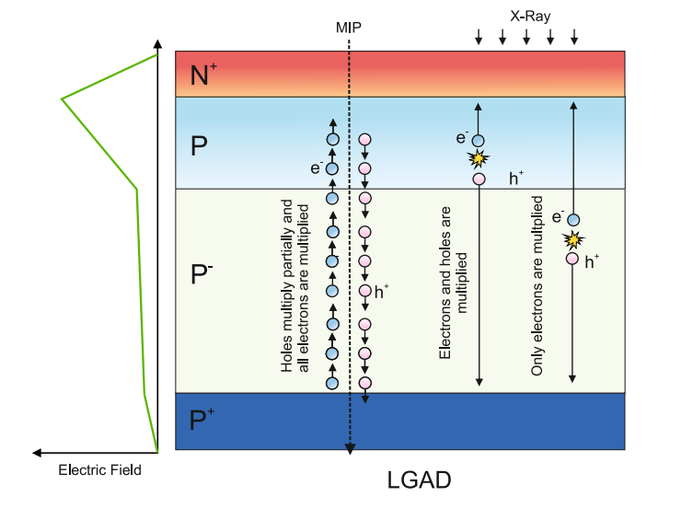
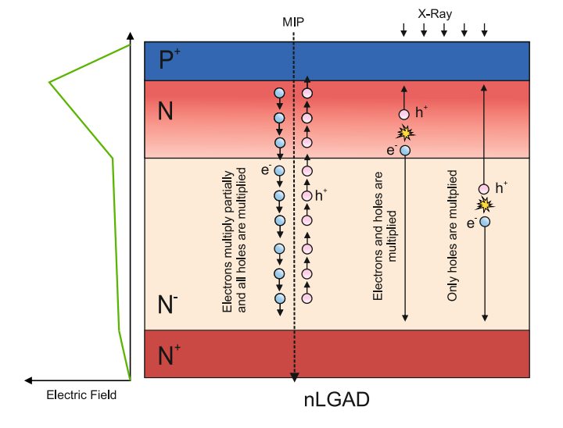
LGAD vs nLGAD

Slide 9
Results & Measurements

Slide 10
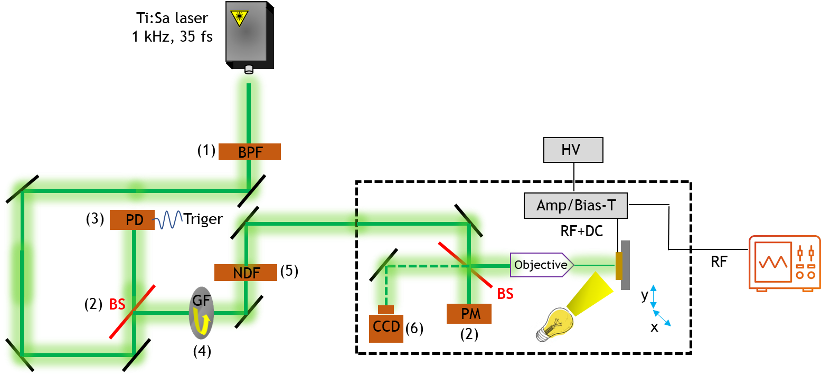
Transient Current Technique (TCT)
Band Pass Filter
Beam splitter
Photodiode
Gradient filter
Neutral-density filter
CCD
High speed oscilloscope
Tunable laser
200-2500 nm
Trigger
DUT
(7)
Reduce the suppression: Z scan is done so that laser is defocused

Slide 11
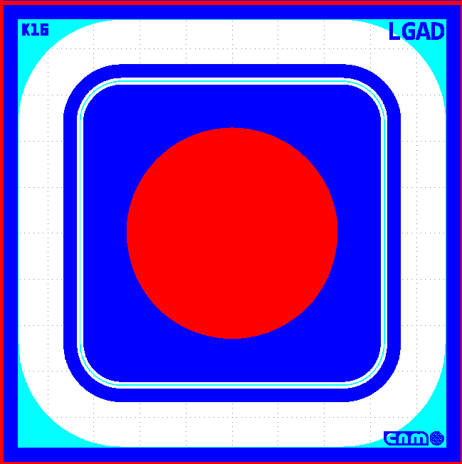
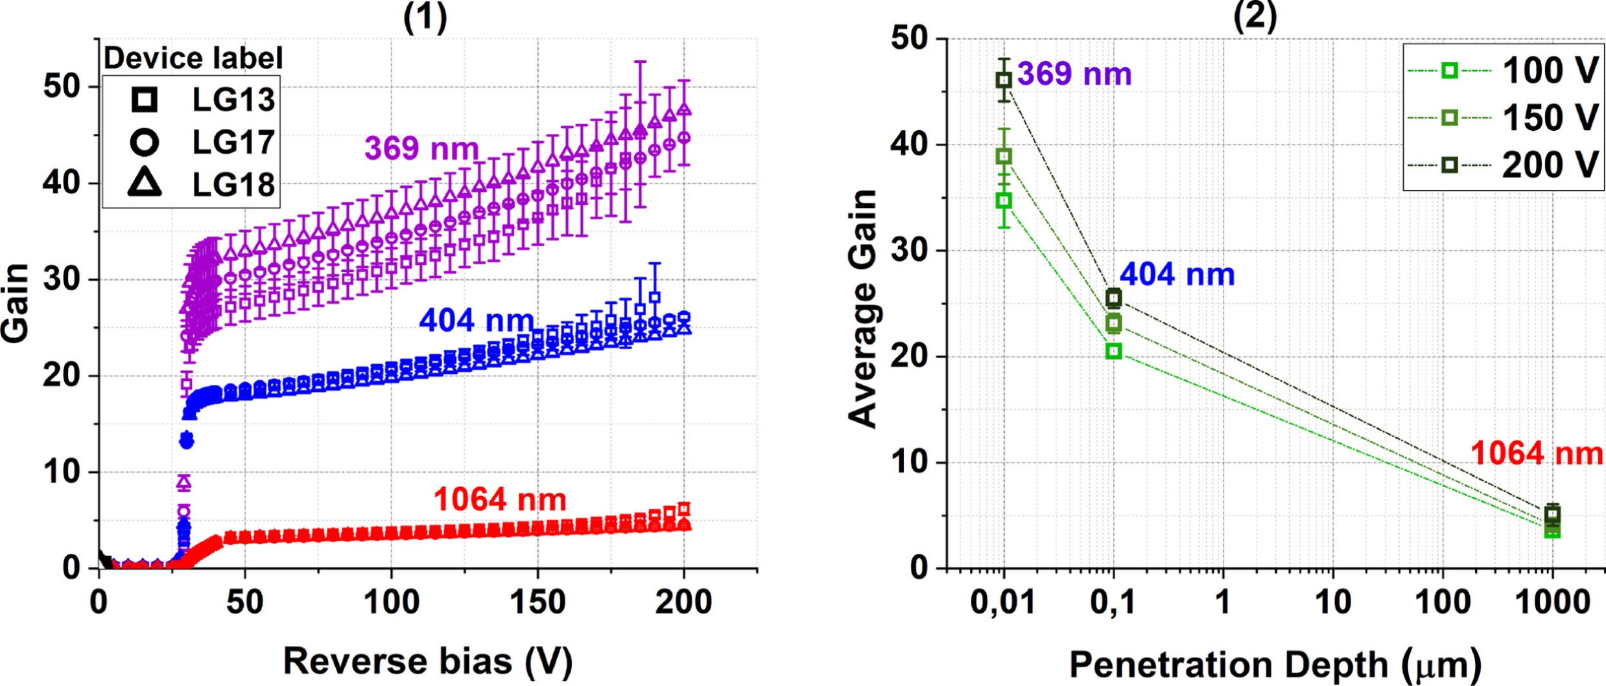
1st nLGAD run results
Concept confirmed
lower penetration depth translates to higher gain
Single pad detectors for now
[1] Villegas, J., Torres, C., Manojlovic, M., Jimenez-Ramos, M. C., Moffat, N., Lopez, J. G., & Hidalgo, S. (2025). NLGAD gain response to low-penetrating particles. Nuclear Instruments and Methods in Physics Research Section A: Accelerators, Spectrometers, Detectors and Associated Equipment, 1072, 170208. https://doi.org/10.1016/j.nima.2025.170208

Slide 12
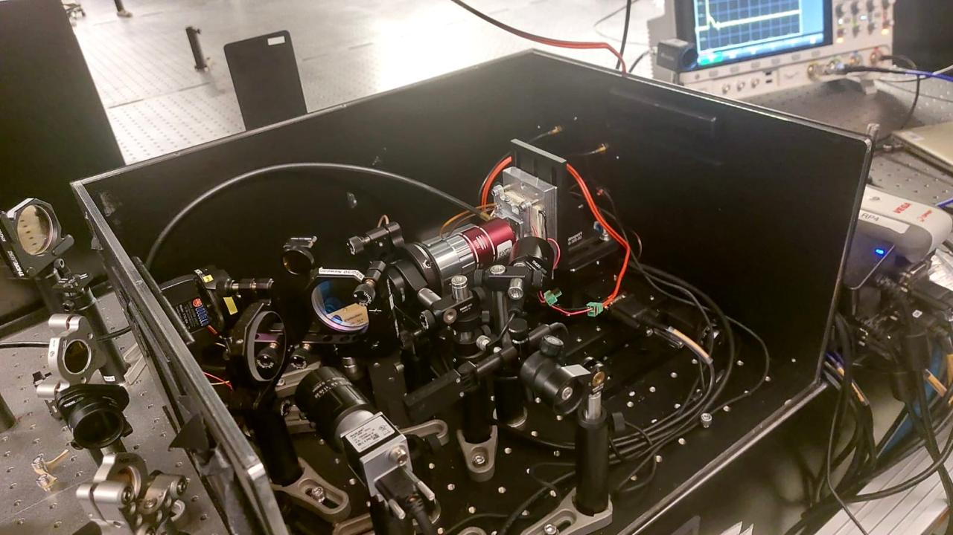
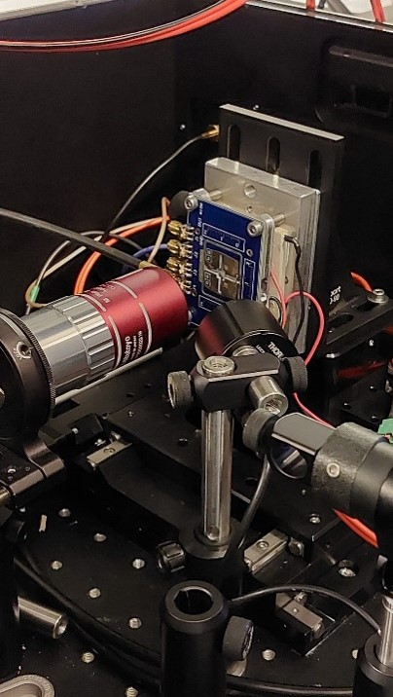
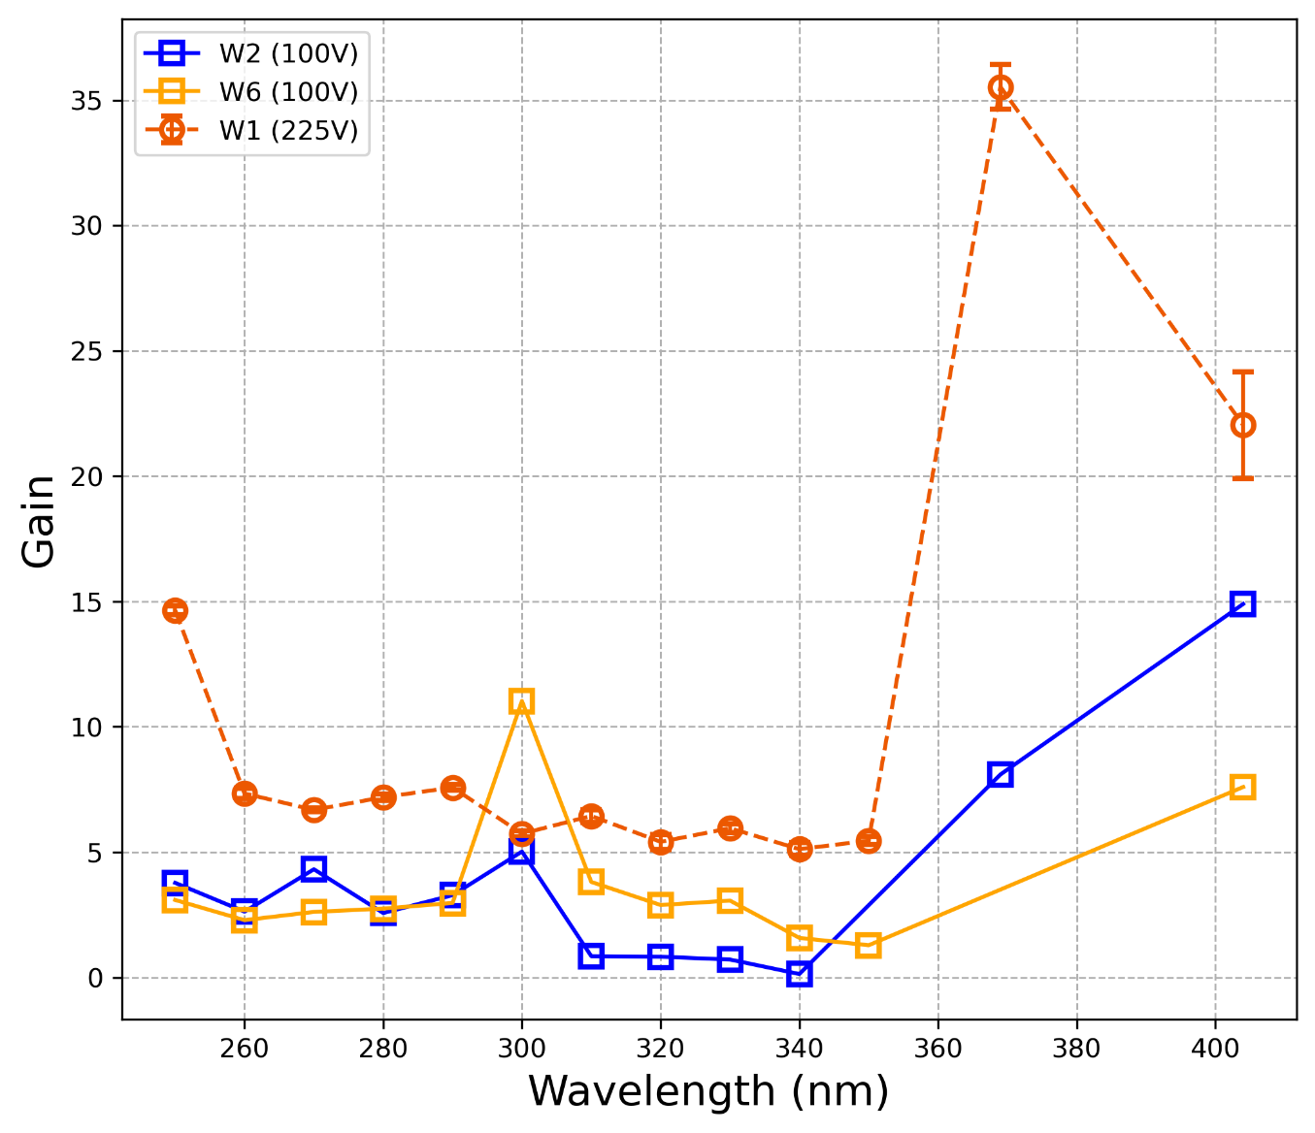
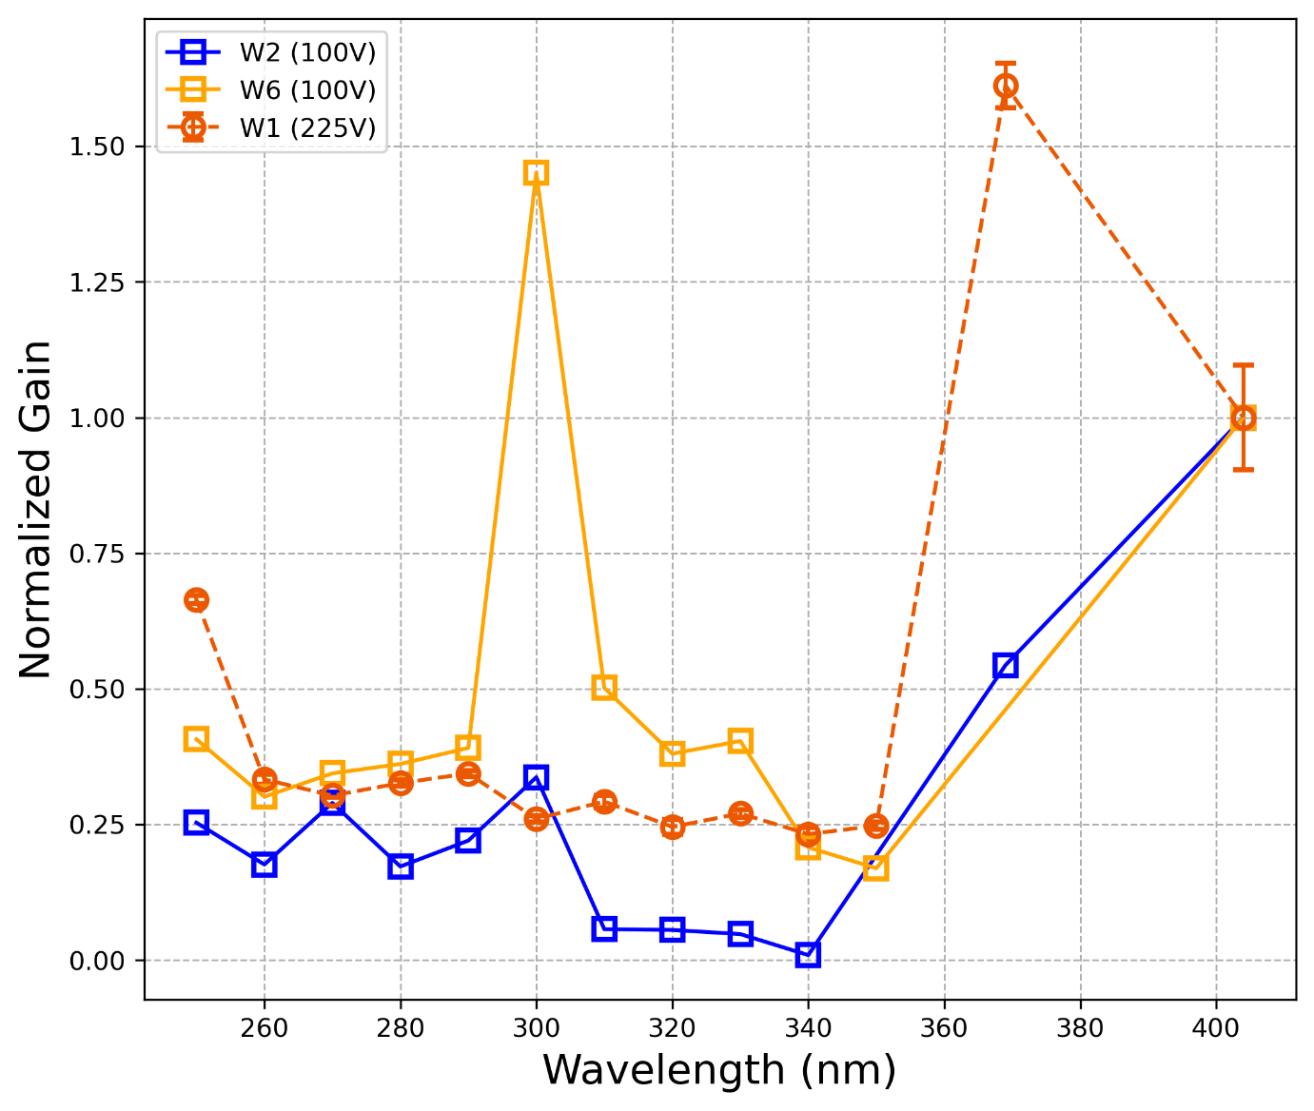
1st and 2nd nLGAD run results
The detectors are sensitivity to deep and near-ultraviolet light (UV)
Penetration depth ≲ 10 nm
Single pad detectors for now
We acknowledge ELI Beamlines (Czech Republic)
Femtosecond optics

Slide 13
Summary
First nLGAD productions at IMB-CNM showed good performance for low penetrating radiation, with optimal response (linear gain over 20-40) in the blue and near UV range
Medium UV region (down to 250 nm) explored: signals with gain observed. However, gain seems to be significantly lower than for the near UV range.
New designs explored and new run being fabricated to improve response in DUV range.
ELI TCT facility remarkable and helping us to develop DUV sensors for the future

Slide 14
Application: SoftPix project

Slide 15
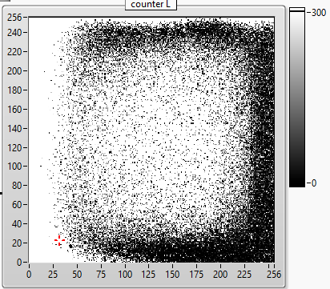
SoftPix project
What was the goal?
Production of photon counting píxellated detector with high spatial resolution (55 µm pitch)
How?
Bumb-bond the USJ-nLGAD and AC-LGAD with Timepix4 and Medipix3 ASIIC
Graphene
Passivation
p++
n+
Medical Imaging Application
280 < E < 530 eV
Water window range
X
│
R
A
Y
n-
A – Absorptance coefficient T – Transmittance coefficient
- Carbon
- Oxygen
n++
A ~ 1
Timepix3/Medipix4
ASIC
T ~ 1
Preliminary tests with pulse generator
For biopsy (for example after a mammography)
images on the spot
soft X-rays detected by a Timepix-LGAD device would give better contrast than hard X-rays
adequate resolution
H₂O

Slide 16
Conclusions & Future

Slide 17
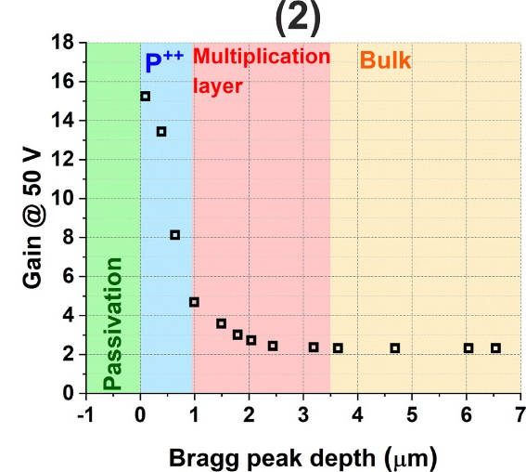
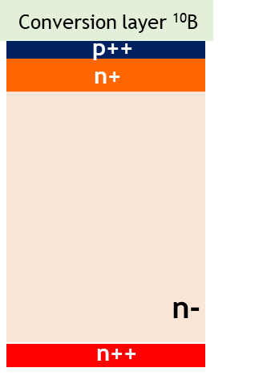
Conclusions
nLGAD seems like a promising technology for deep-UV, near-UV
For Soft X-ray detection further adaptation is required
High gain is preserved for low penetrating radiation
Limited to low-energy physics
Future
α-particle in fusion experiments
n
Low energy proton & ion detection
600 keV protons
α
Has repercussions in medical physics, particularly in ion cancer therapy using ions such as carbon
In progress…
¹⁰B+n→⁷Li+α+Q
Q = 2.79 MeV

Slide 18
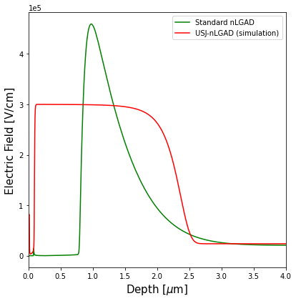
Ultra-shallow junction nLGAD (USJ-nLGAD): A New Benchmark in Low Penetration Radiation Detection Technology – work in progress…
Key modifications
Preliminary...
Same magnitude of field can be obtained with higher implant dose (demonstration)
Moving to low diffusivity p-type implant (BF₂)
Moving to ultra low implantation energies
Moving to laser annealing (minimum diffusion)
Moving to deep multiplication implant for more uniform gain response
Pixellated backside from 55 um to 220 um pitch
Antireflective coatings (MgF₂)
Dead layer (entrance window) minimized!
Quantum efficiency for Soft X-ray maximum
“Dead” layer
Ongoing...
October 2025

Slide 19

Acknowledgements
Thank you!
Acknowledgements
This work has been funded by the Spanish Ministry of Science and Innovation (MCIN/AEI/10.13039/501100011033/) and by the European Union’s ERDF program “A way of making Europe”. Grant references: PID2020-113705RB-C32 and PID2021-124660OB-C22. Also, it was funded by the European Union’s Horizon 2020 Research and Innovation funding program, under Grant Agreement No. 101004761 (AIDAInnova).

