Slide 1



C100
A 4-Megapixel, 2000 fps Wafer Scale Direct Electron Detection Sensor for 100keV Cryo-Electron Microscopy
Daniel Brown – STFC RAL
26th IWORID, 06-10 July 2025, Bratislava

Slide 2
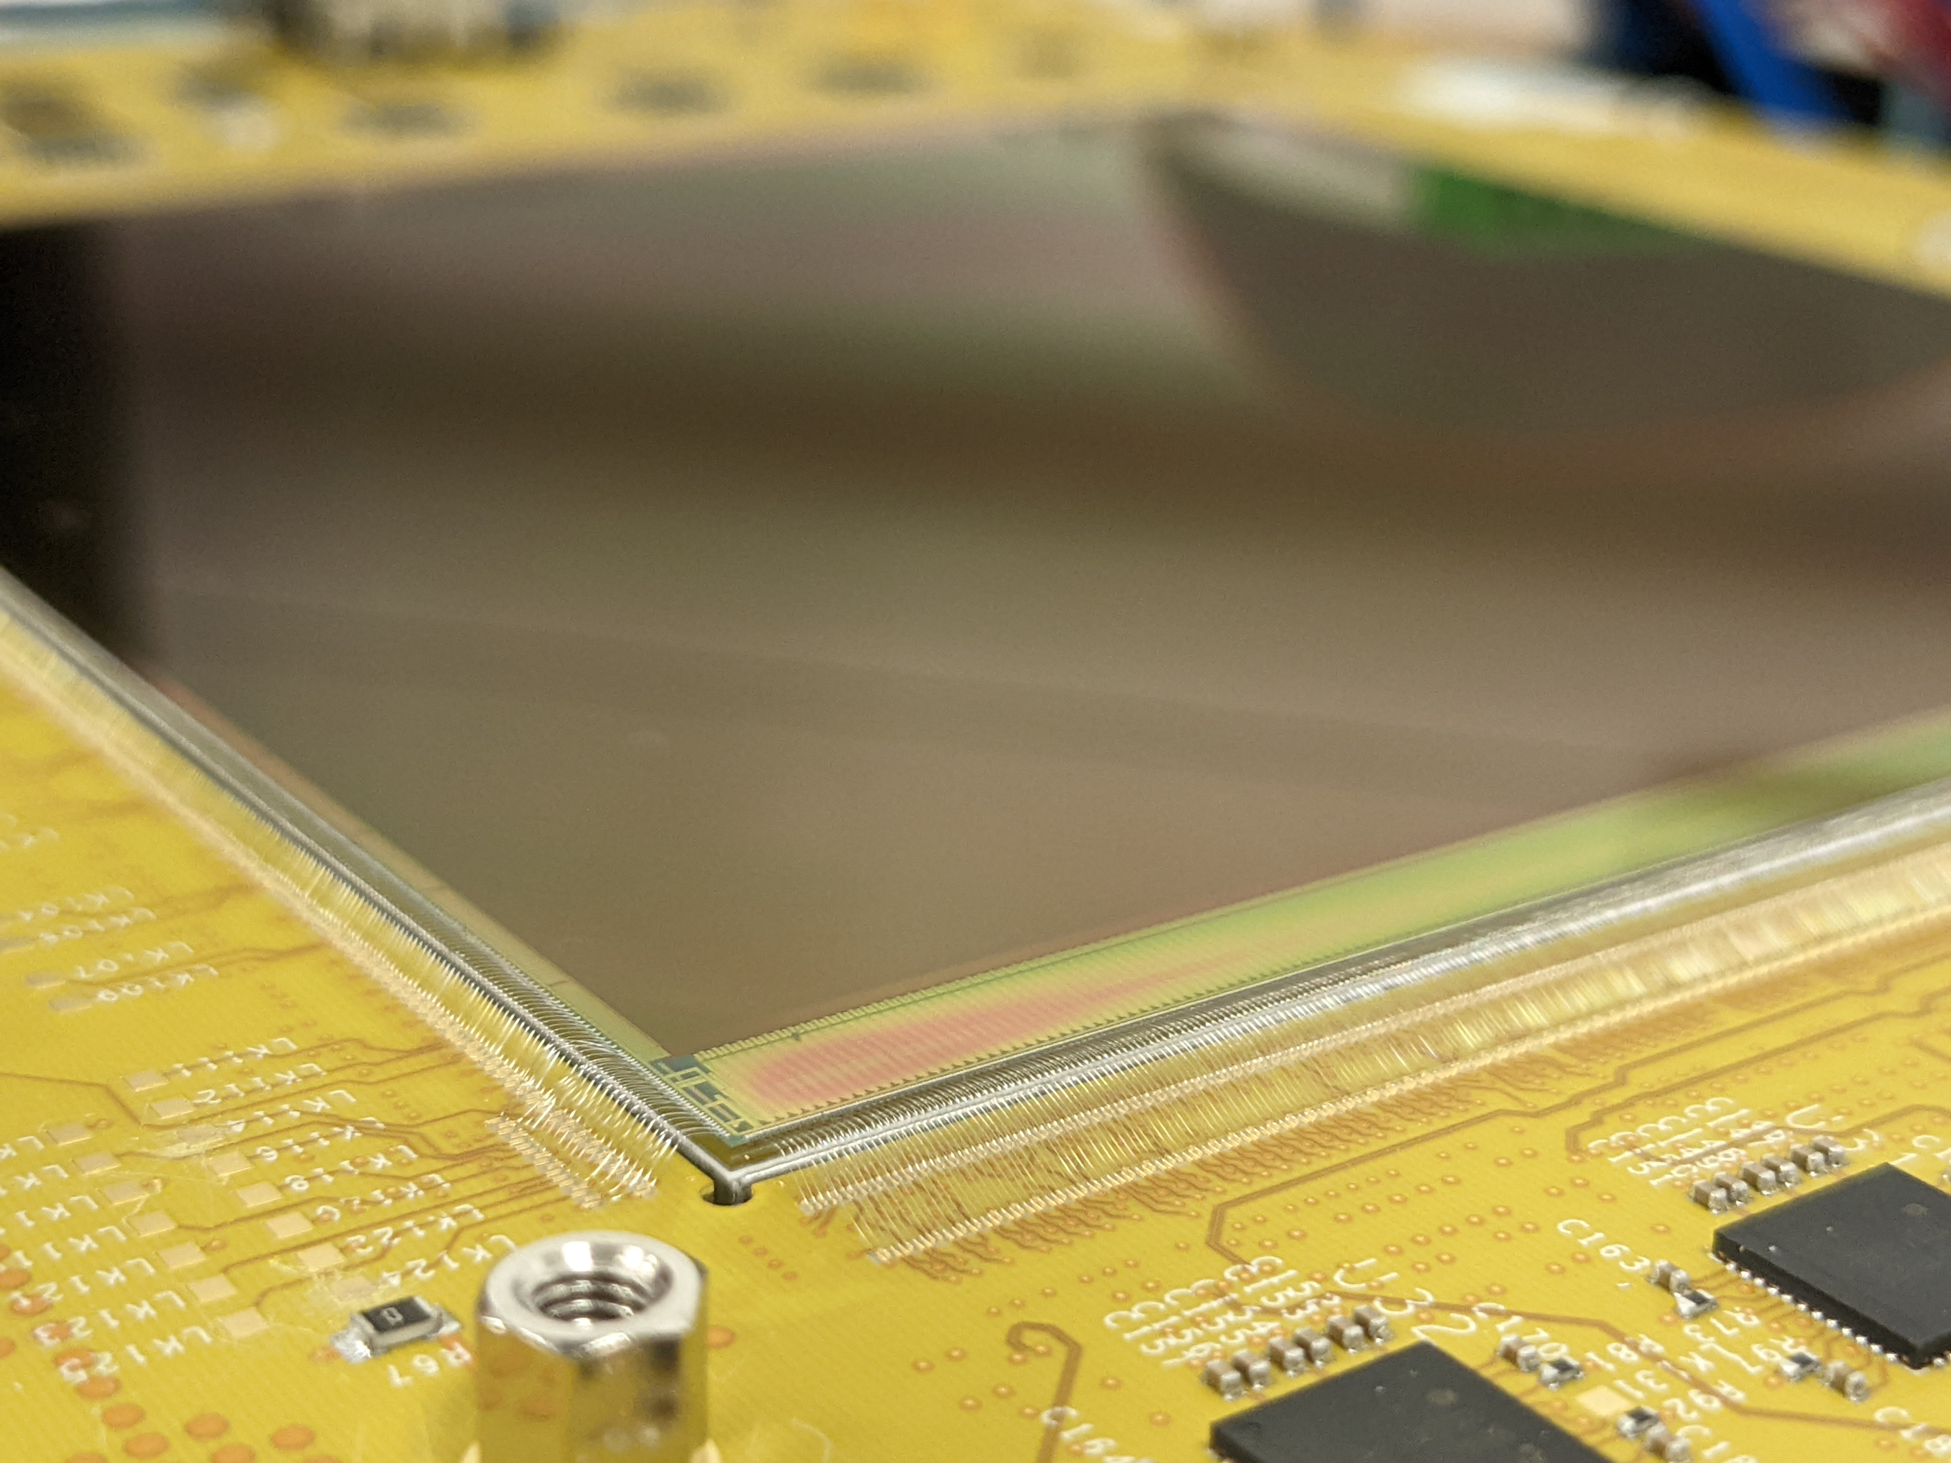
Outline
Introduction
Why 100 keV?
C100
Specifications
Architecture
Results
Conclusions
Acknowledgements
Image © STFC Alan Ford

Slide 3
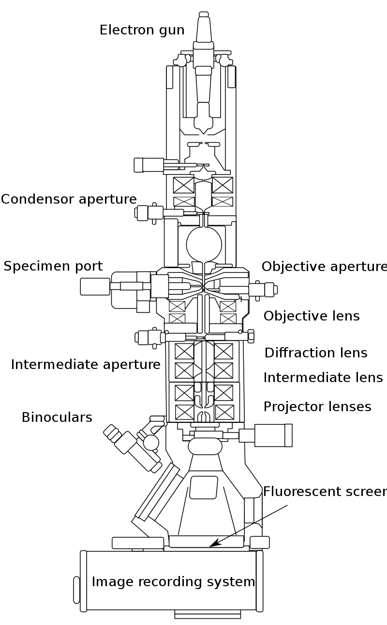
Introduction
Transmission Electron Microscopy (TEM) is a technique that allows to obtain high resolution images of thin samples.
The higher resolution is achieved due to the smaller De Broglie wavelength of the high energy electrons compared to visible light.
Cryo-Electron Microscopy (cryoEM) is a consequent technique used to image biological samples. The sample is prepared by flash-freezing to cryogenic temperatures, which preserves the sample structure and delays sample destruction during imaging.
CMOS Image sensors have been used to record images from cryo-electron microscopes for the last two decades.
https://en.wikipedia.org/wiki/Transmission_electron_microscopy

Slide 4
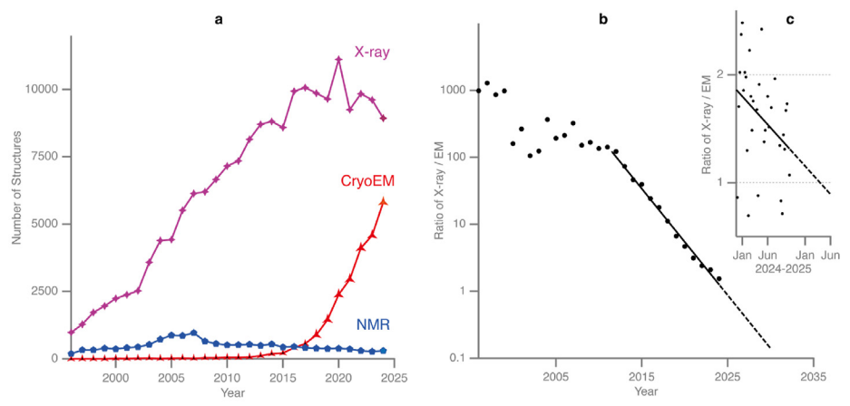
Introduction
The success of cryo-electron microscopy (cryo-EM) is clearly demonstrated by the number of released Protein DataBase entries per annum through the end of 2024.
Image from "Extending the reach of single-particle cryoEM", Ardan Patwardhan¹, Richard Henderson² and Christopher J. Russo²
The ratio of X-ray to cryo-EM released entries shows an exponential decrease from 2014 until 2022 (right plot).
This plot suggests that the date when there will be parity between X-ray and EM entries is expected to be in early 2025.
Notes:
NMR – Nuclear Magnetic Resonance spectroscopy

Slide 5
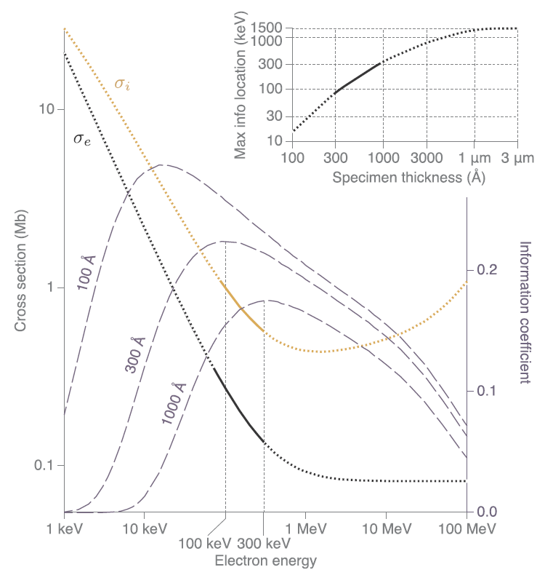
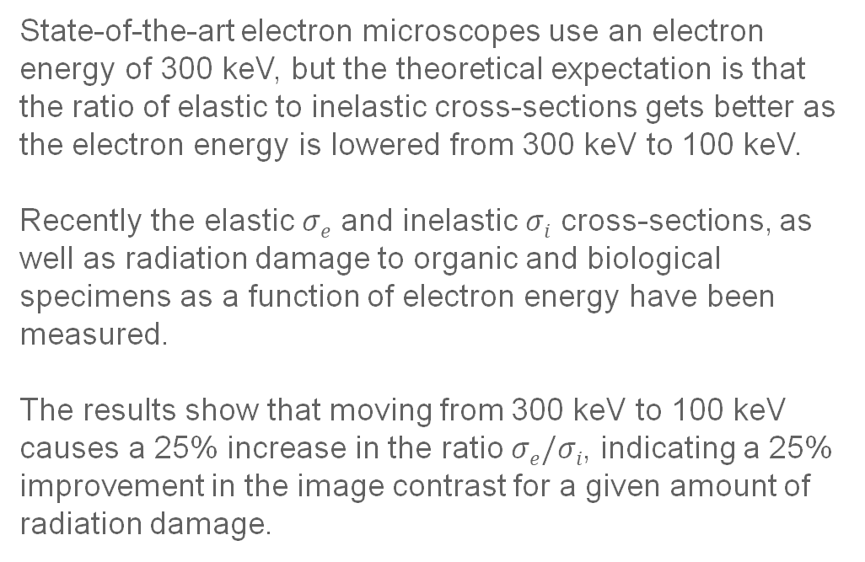
Why 100 keV?
State-of-the-art electron microscopes use an electron energy of 300 keV, but the theoretical expectation is that the ratio of elastic to inelastic cross-sections gets better as the electron energy is lowered from 300 keV to 100 keV.
Recently the elastic $σe$ and inelastic $σi$ cross-sections, as well as radiation damage to organic and biological specimens as a function of electron energy have been measured.
The results show that moving from 300 keV to 100 keV causes a 25% increase in the ratio $σe/σi$, indicating a 25% improvement in the image contrast for a given amount of radiation damage.
From M. Peet, R. Henderson,C. Russo, «The energy dependance of contrast and damage in electron cryomicroscopy of biological molecules» Ultramiscroscopy 203 (2019) 125-131
Scaling of cross-sections and information vs energy. The theoretical relationship between the elastic (σ_{e}) and inelastic (σ_{i}) scattering cross-sections for carbon are plotted vs. energy.

Slide 6
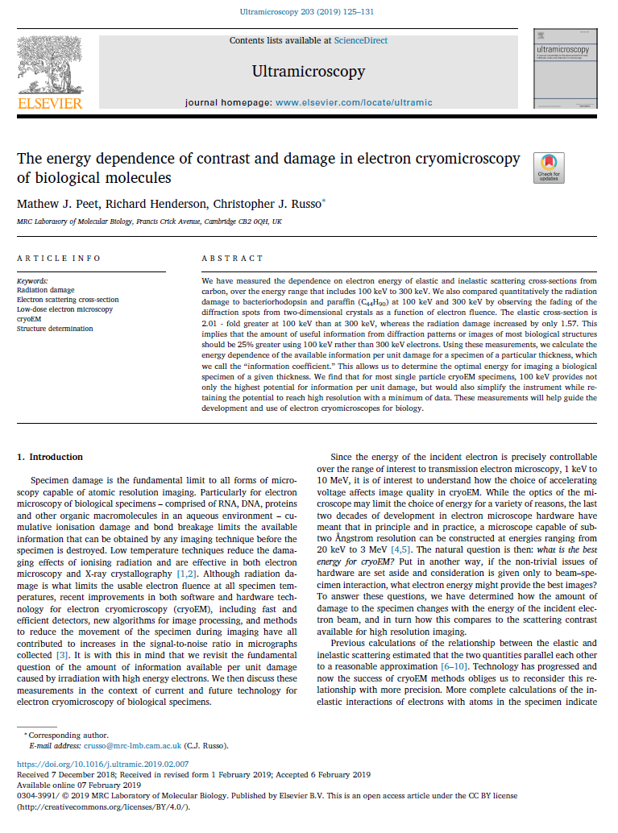
Why 100 keV?
Based on the latest literature, most single-particle cryoEM investigations would benefit from changing the electron energy from 300 to 100 keV.
The present limitation to low dose imaging at 100 keV is the detector.
“Currently available direct detectors are either optimised for higher energies (300 keV and above) or lack the combined features required
for cryoEM (DQE, number of pixels and frame rate).”
From M. Peet, R. Henderson,C. Russo, «The energy dependance of contrast and damage in electron cryomicroscopy of biological molecules» Ultramiscroscopy 203 (2019) 125-131
“The commercial production of a relatively low-cost 100 keV platform will enable many academic laboratories and pharmaceutical companies to join the cryoEM revolution in structural biology.”
From D. Krukauskas, “C100 – CMOS Sensor for 100 keV EM” Rosalind Franklin Institute annual meeting 2019

Slide 7
Why 100 keV?
Based on the latest literature, most single-particle cryoEM investigations would benefit from changing the electron energy from 300 to 100 keV.
The present limitation to low dose imaging at 100 keV is the detector.
“Currently available direct detectors are either optimised for higher energies (300 keV and above) or lack the combined features required
for cryoEM (DQE, number of pixels and frame rate).”
From M. Peet, R. Henderson,C. Russo, «The energy dependance of contrast and damage in electron cryomicroscopy of biological molecules» Ultramiscroscopy 203 (2019) 125-131
“The commercial production of a relatively low-cost 100 keV platform will enable many academic laboratories and pharmaceutical companies to join the cryoEM revolution in structural biology.”
From D. Krukauskas, “C100 – CMOS Sensor for 100 keV EM” Rosalind Franklin Institute annual meeting 2019

Slide 8
Why 100 keV?
Based on the latest literature, most single-particle cryoEM investigations would benefit from changing the electron energy from 300 to 100 keV.
The present limitation to low dose imaging at 100 keV is the detector.
“Currently available direct detectors are either optimised for higher energies (300 keV and above) or lack the combined features required
for cryoEM (DQE, number of pixels and frame rate).”
From M. Peet, R. Henderson,C. Russo, «The energy dependance of contrast and damage in electron cryomicroscopy of biological molecules» Ultramiscroscopy 203 (2019) 125-131
“The commercial production of a relatively low-cost 100 keV platform will enable many academic laboratories and pharmaceutical companies to join the cryoEM revolution in structural biology.”
From D. Krukauskas, “C100 – CMOS Sensor for 100 keV EM” Rosalind Franklin Institute annual meeting 2019

Slide 9
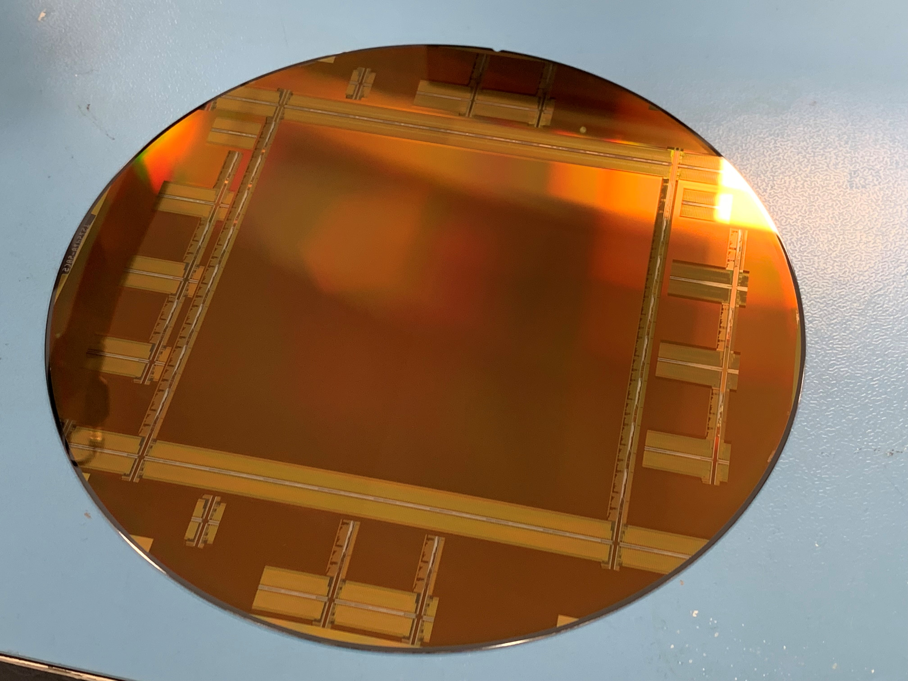


C100 Specifications
C100 project is a collaboration between
STFC Technology Department
RFI (Rosalind Franklin Institute)
The C100 camera system will be commercialised by UK company Quantum Detectors.
“Our aim is to increase, by an order of magnitude, the number of biological specimens that can prepared for analysis by structural biology.”
- Professor James Naismith, Director of RFI

Slide 10
C100 Specifications
Specification | Target
Sensor format | 2048 x 2048
Pixel pitch | 54 x 54 µm
Frame rate | 2000 fps | 2500 fps
Bit depth | 12 bits | 10 bits
Operation mode | Rolling shutter
Readout mode | Continuous
Readout type | Analogue CML lines
Sensor size | 200 mm wafer-scale sensor
Manufacturing process | Tower Semiconductors 180 nm CIS process
Sensitive area | 122.3 cm²
Radiation hard | YES
Back-thinning | NO
Dark pixels | Only on left and right sides of the pixel array
Pixel size minimises effects of scattering whilst ensuring high-resolution imaging.
Resolution and frame rate targets the requirements for future cryoEM detectors.
Stitched CMOS technology allows the manufacturing of large sensors with a non-interrupted sensitive area
Standard CMOS process enables cost-effective sensors which are constantly evolving.
High yield design employed to reduce probability and criticality of defects on wafer scale sensor.
From D. Krukauskas, “C100 – CMOS Sensor for 100 keV EM”
Rosalind Franklin Institute annual meeting 2019

Slide 11
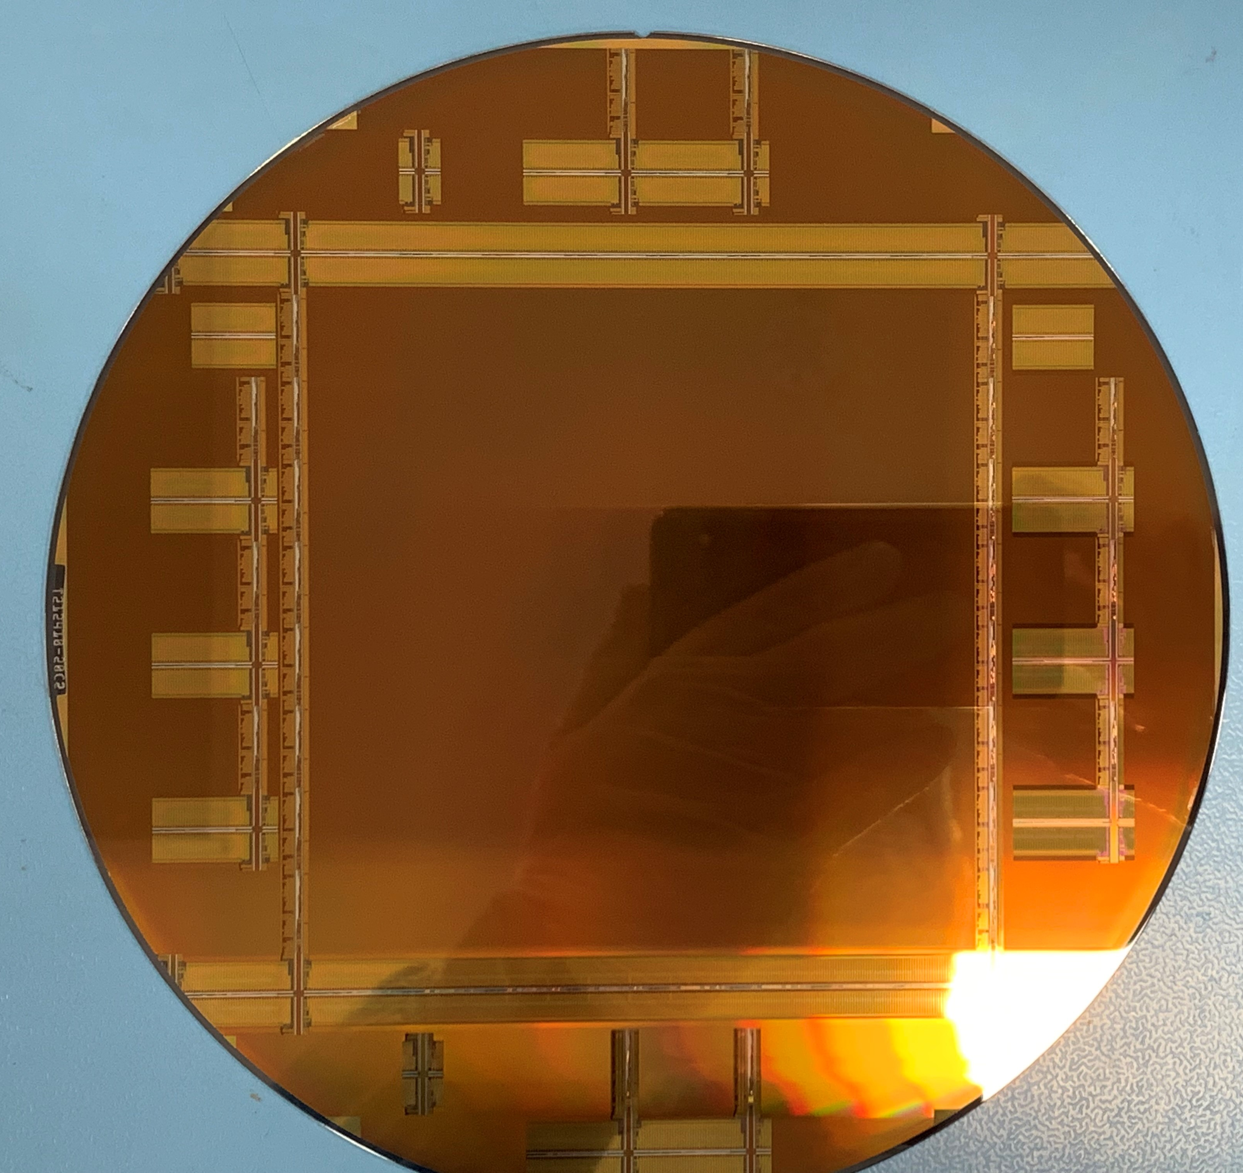
C100 Architecture
Wafer-scale stitched sensor.
Allows multiple size options.
A simple 3T pixel has been chosen for radiation hardness and improved yield.
Covers ~90% of the chip
Readout from two sides (top and bottom) as the line rate is limited by the very long vertical lines.
Programmable Gain Amplifiers (PGA) with three different gains, x1, x4 and x8.
Notes:
Pixel array is 8x8 stiches of 256x256 pixels (total of 2048x2048)
8 rows read at a time (4 up 4 down)
PGA gains x1, x4.5(?), x8 and x5.6 for combined 2 and 3. Also can bypass PGA

Slide 12
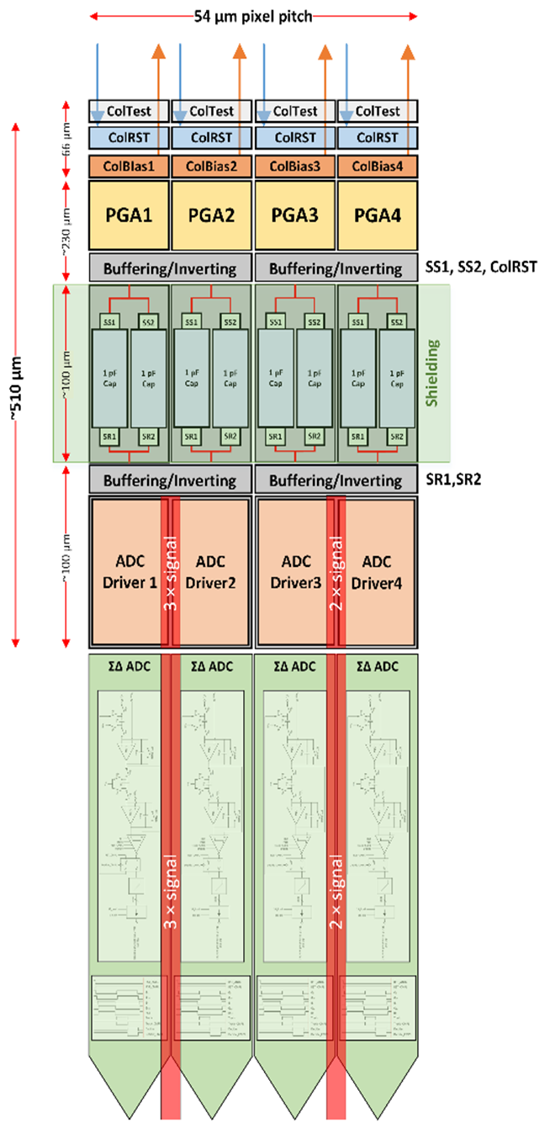
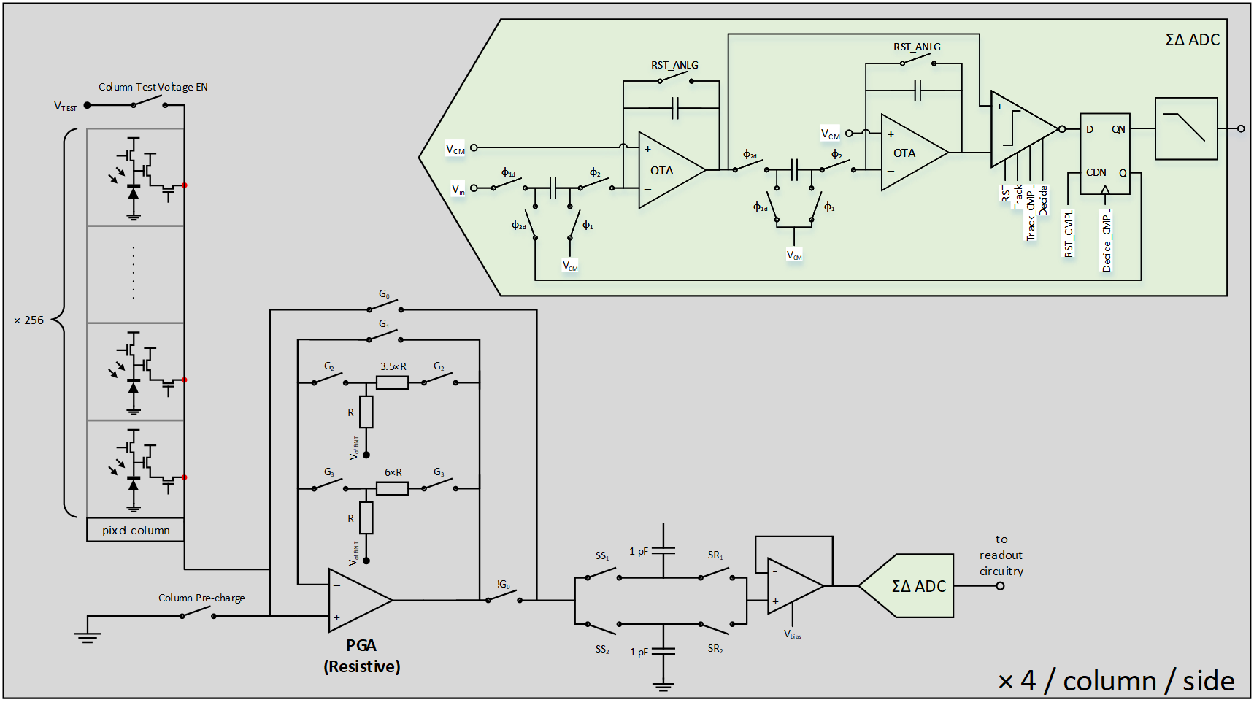
C100 Architecture
4 ADCs per column per side, for a total of 16,000 on-chip ADCs.
ΣΔADC chosen for its robustness to process and mismatch variations.
High Speed CML outputs, compliant with Xilinx AURORA 64b/66b© communication protocol.

Slide 13
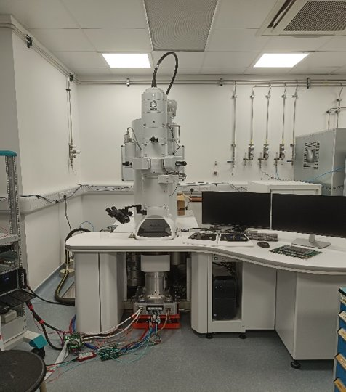
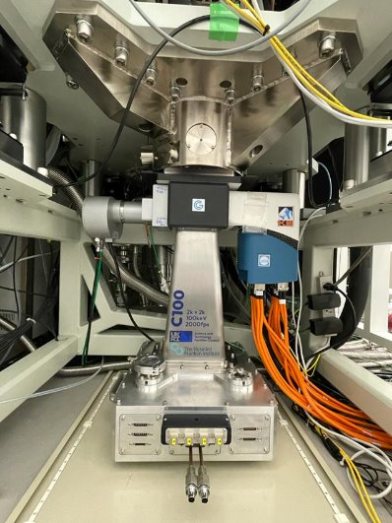
C100 Testing
Overview
Camera vacuum housing has been installed on a JEOL 1400 100keV electron microscope
All individual circuit blocks have been tested and shown working:
PGA and ADC perform as expected.
34 serialisers working successfully.
Full images acquired.
Yield has been very promising for wafer scale device.
6 sensors tested so far.
No major yield issues.

Slide 14
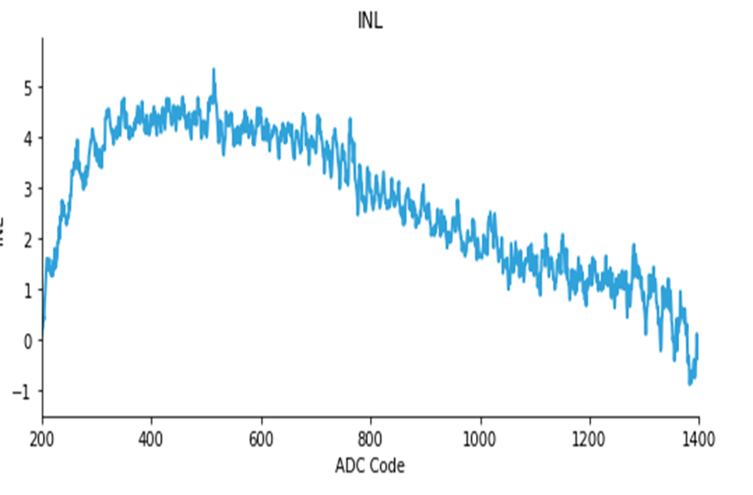
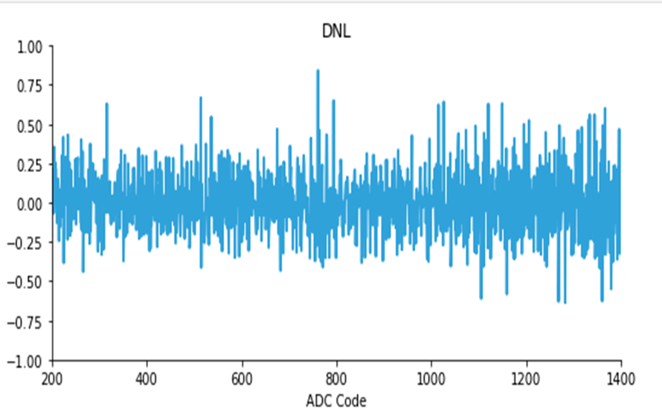
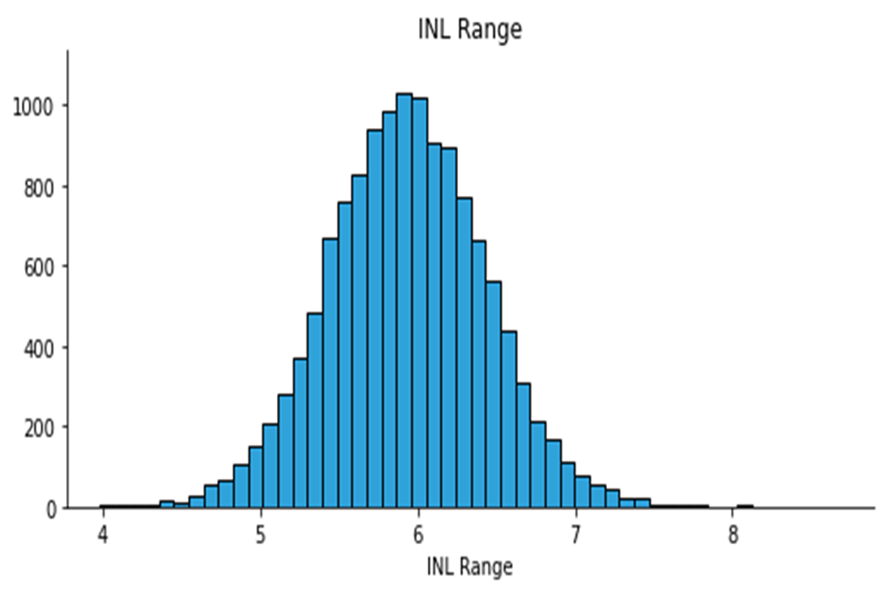
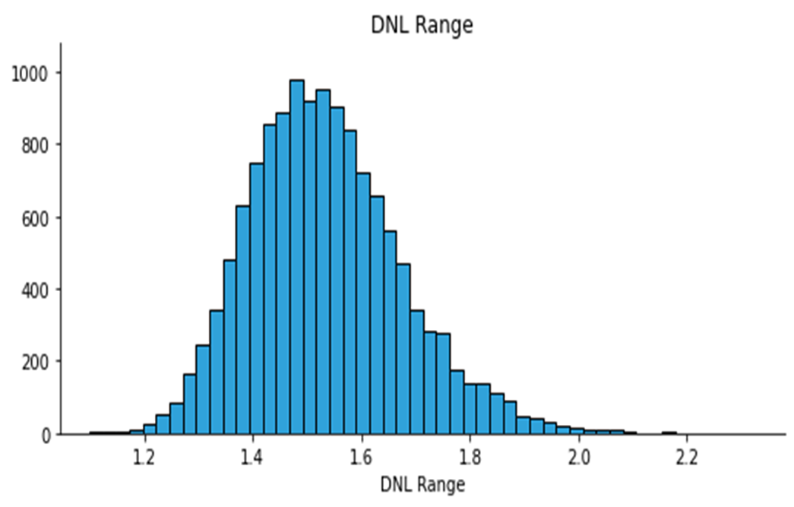
C100 Testing
ADC Evaluation
As there are 16,000 ADCs a small spread in performance is really important.
For a typical ADC, INL and DNL are plotted on the top.
The spread in INL and DNL (max-min) confirm the good performance of the ΣΔ ADC.
Notes:
INL – Integral nonlinearity
DNL – differential nonlinearity
“As there are 16,000 ADCs small spread in performance is important. At the top measured INL and DNL for an example ADC is shown. The overall INL is dominated by the linearity of the pixel so what is shown here is acceptable. The DNL shows no missing codes. The bottom plots show histograms of the INL and DNL of all ADCs, confirming a small spread in performance.”

Slide 15
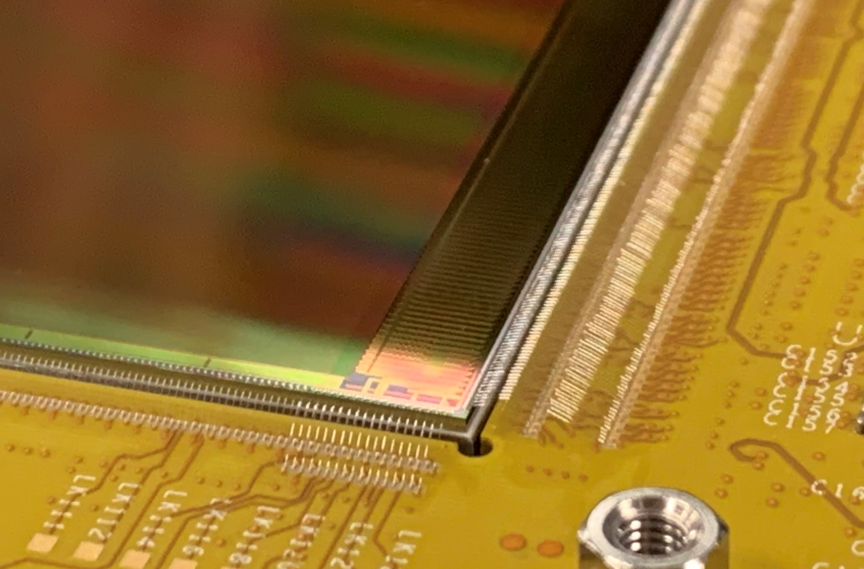
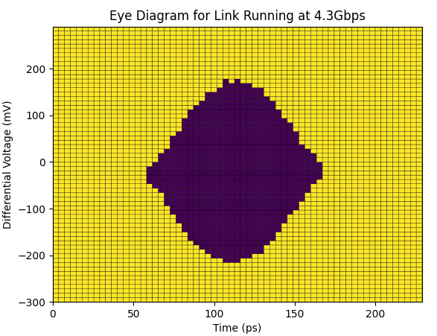
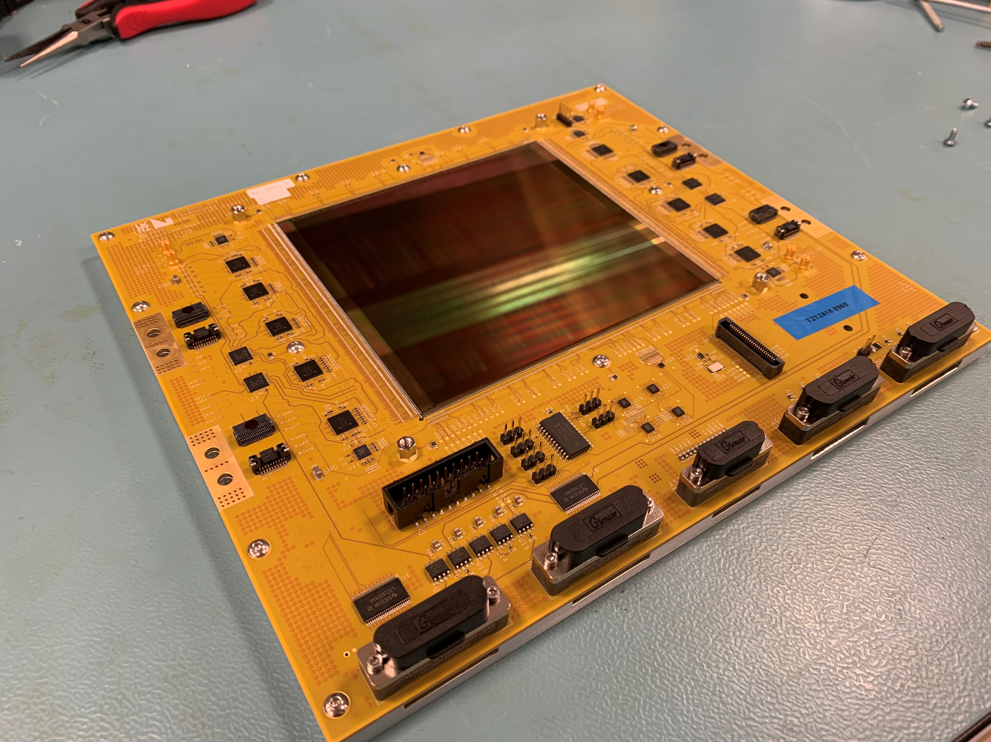
C100 Testing Serialiser
34 Aurora Serialisers @ 4.3 Gbps
Lane/channel locked for all transceivers
Total data rate over 110 Gbps
Bit Error Rate (BER) measured to be lower than 7x10⁻¹⁵
From “I. Sedgwick et al., PRECISE: A 5Gbps Serialiser for Scientific Detectors in a 180nm CMOS Image Sensor Process”, proceedings of NSS-MIC 2022, Milano, Italy”

Slide 16
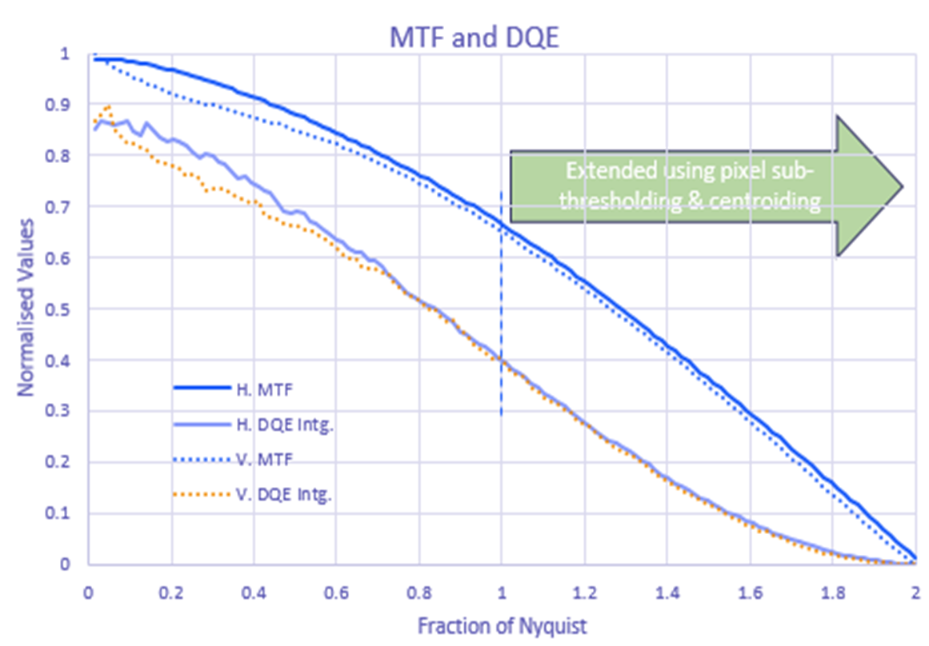
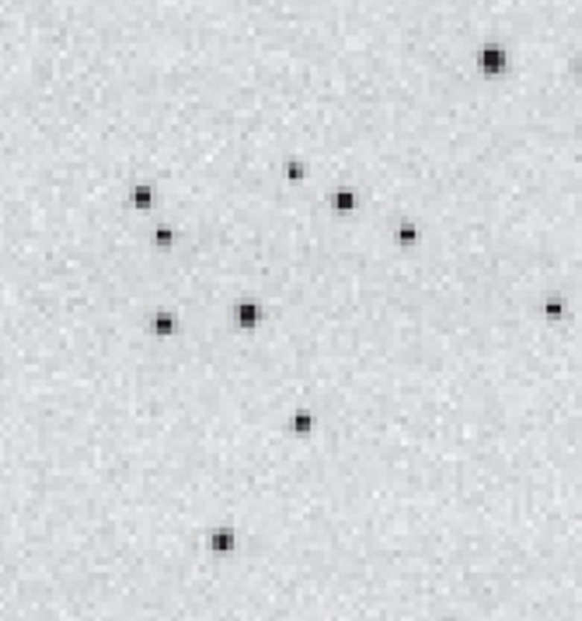
C100 Testing Performance
Measured MTF (Modulation Transfer Function) and DQE (Detective Quantum Efficiency) confirm the excellent performance of the sensor.
Single incident electrons are very well visible and distinguishable.
26th International Workshop on Radiation Imaging Detectors, 06-10 July 2025

Slide 17
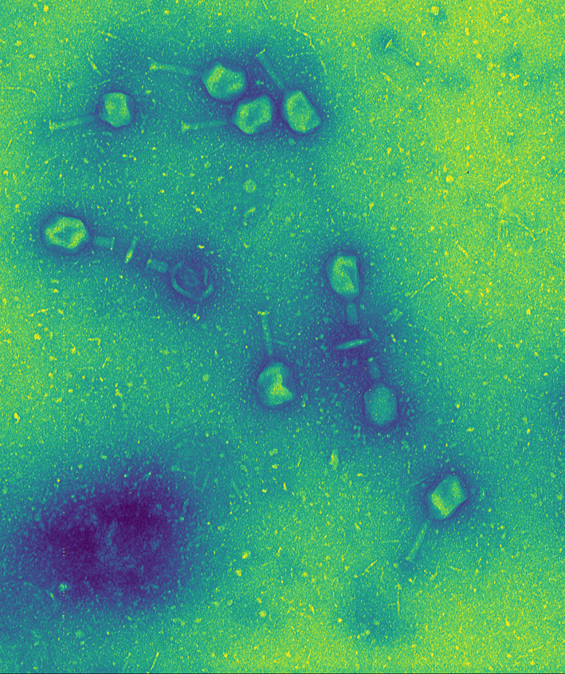
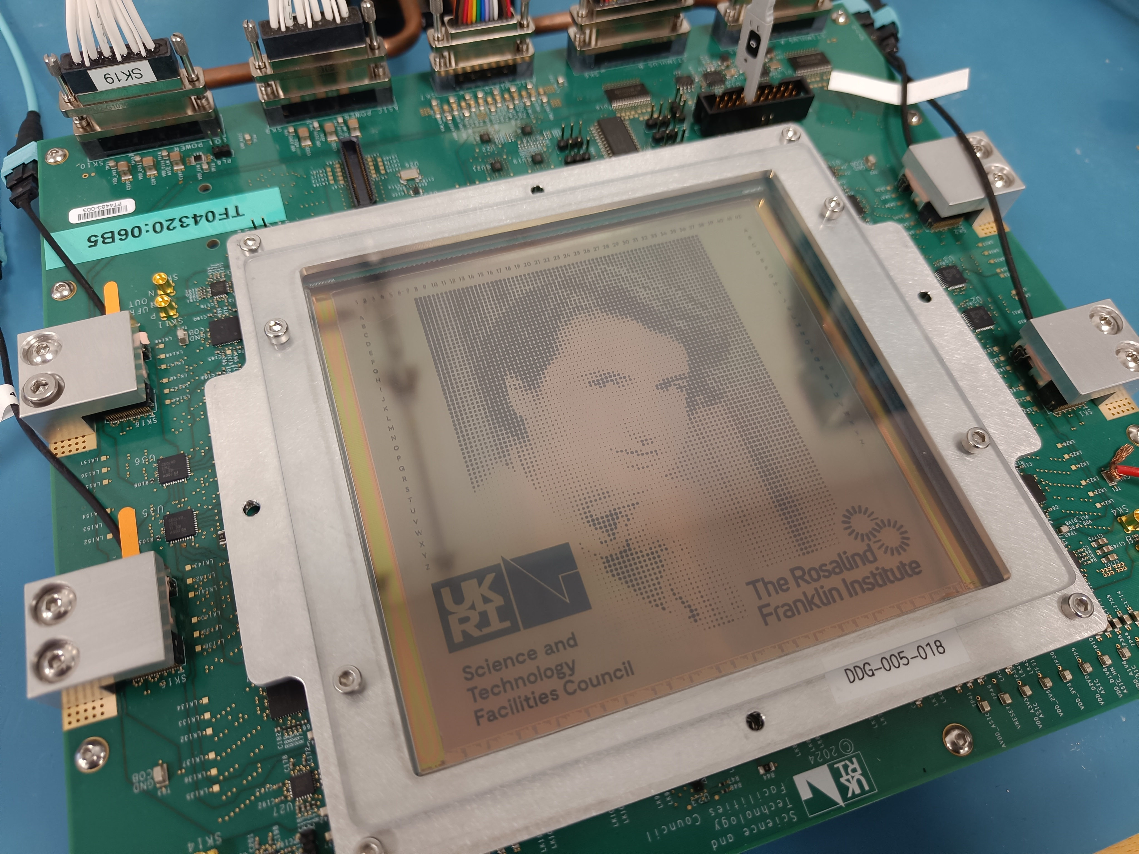
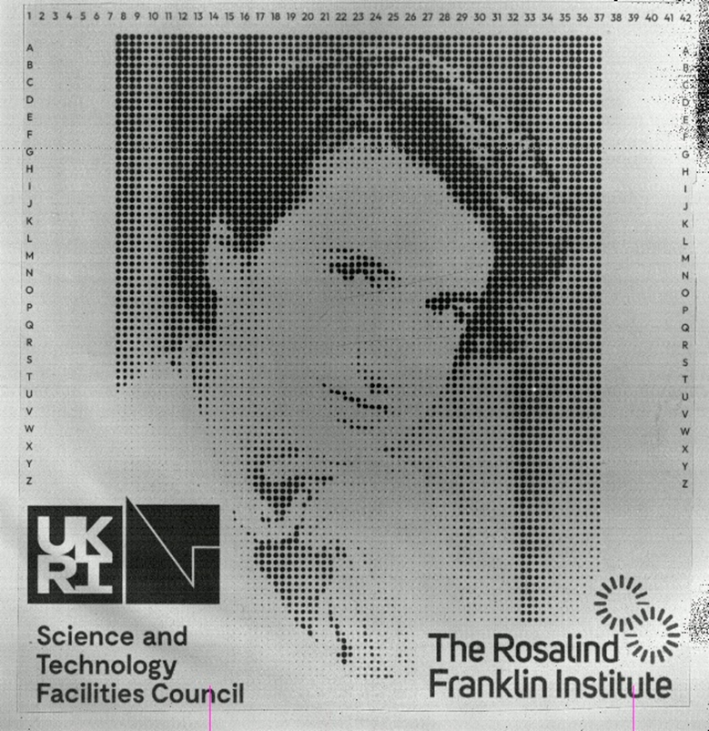
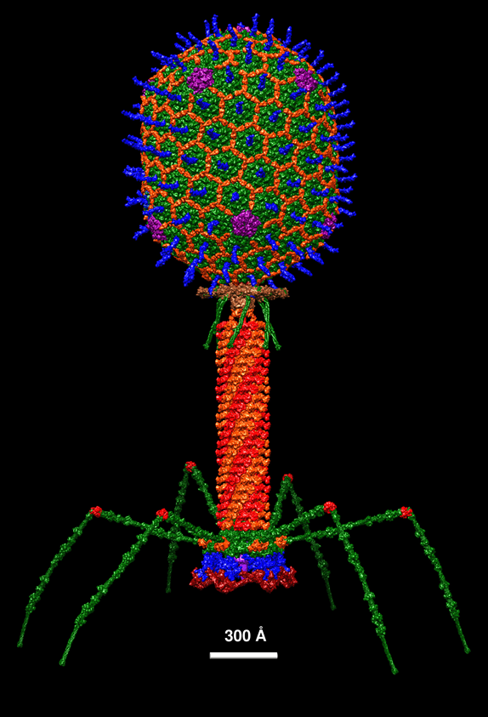
C100 Testing Images
https://en.wikiversity.org/wiki/WikiJournal_of_Science/Structural_Model_of_Bacteriophage_T4​
Full frames image acquired with light is shown on the left (featuring Rosalind Franklin).
Image of bacteriophage with C100 using 100keV electrons and its complete structural model.
26th International Workshop on Radiation Imaging Detectors, 06-10 July 2025

Slide 18

Conclusions
Theoretical studies suggest 100keV cryo-EM offers many benefits
Increased image contrast for a given amount of radiation damage.
Wider employment and accessibility of the technology.
100keV cryo-EM requires optimised sensors, like the C100 presented in this talk.
C100 performance have been tested with success.
The sensor will be commercially available in the coming months.
Notes:
Further work

Slide 19

Acknowledgements
Jim Naismisth
Angus Kirkland
Toby Starborg
Gwyndaff Evans
Jonathan Barnard
Herman Larsen
Matt Hart
Craig Macwaters
Ben Marsh
Sam Hutchings
Nicola Guerrini
Iain Sedgwick
Ivan Church
Chris Day
Roger Goldsbrough
Liam O’Ryan
Danail Vassiliev
Giulio Crevatin
Ben Bradnick
Matt Callahan
Mohamed El Sharkawy
Josh Wilkes
Kara McNab
Graham Dennis
Richard Henderson
Chris Russo
Greg McMullan

Slide 20

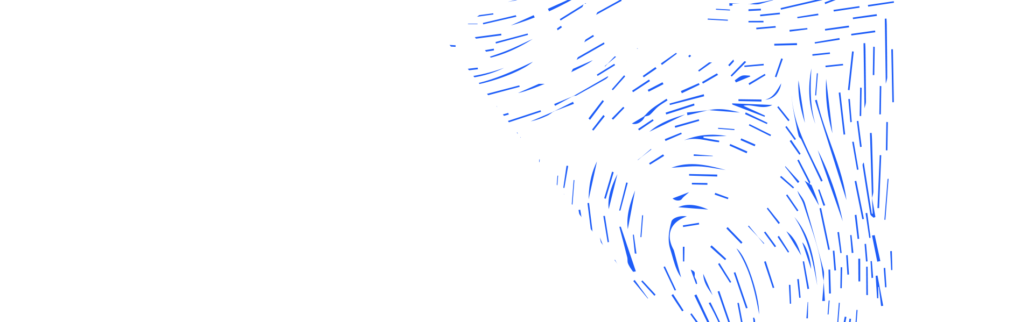




Daniel.Brown@stfc.ac.uk
Science and Technology Facilities Council
@STFC_matters
Science and Technology Facilities Council
26th International Workshop on Radiation Imaging Detectors, 06-10 July 2025

