Slide 1
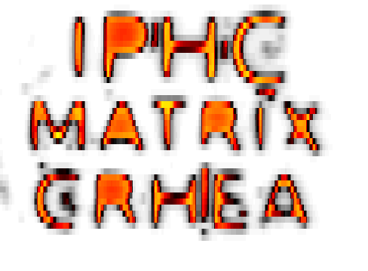










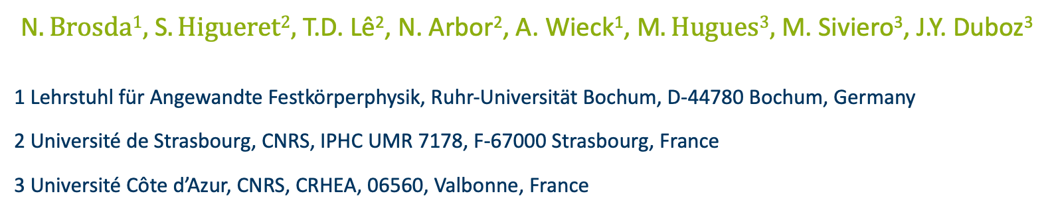
MATRIX: Simulation and Experimental Study of GaN Proton Detectors
N$. Brosda1,$ S$. Higueret2,$ T.D. Lê², N. Arbor², A. Wieck¹, M$. Hugues3,$ M. Siviero³, J.Y. Duboz³
1 Lehrstuhl für Angewandte Festkörperphysik, Ruhr-Universität Bochum, D-44780 Bochum, Germany
2 Université de Strasbourg, CNRS, IPHC UMR 7178, F‐67000 Strasbourg, France
3 Université Côte d’Azur, CNRS, CRHEA, 06560, Valbonne, France

Slide 2
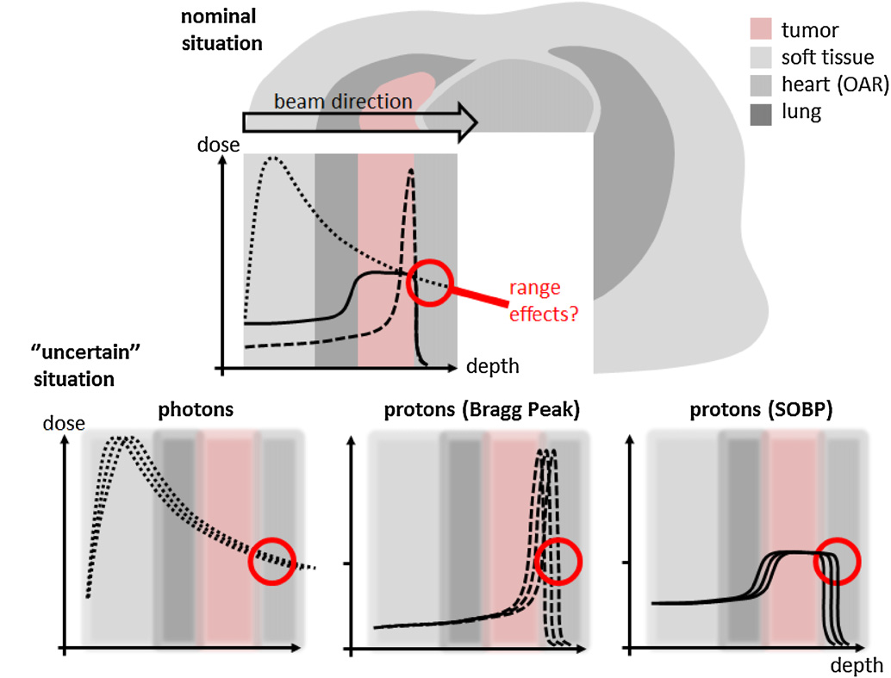
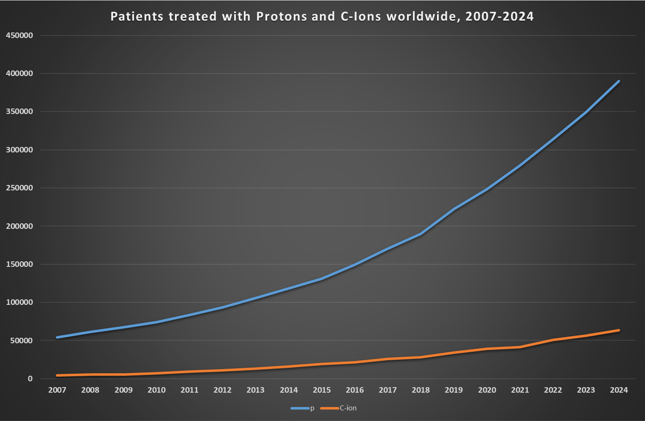
Motivation: Proton therapy
A.-C. Knopf and A. Lomax, “In vivo proton range verification: a review,” Phys. Med. Biol., vol. 58, no. 15, p. R131, Jul. 2013, doi: 10.1088/0031-9155/58/15/R131.
“PTCOG - Patient Statistics.” Accessed: Jul. 04, 2025. [Online]. Available: https://www.ptcog.site/index.php/patient-statistics

Slide 3
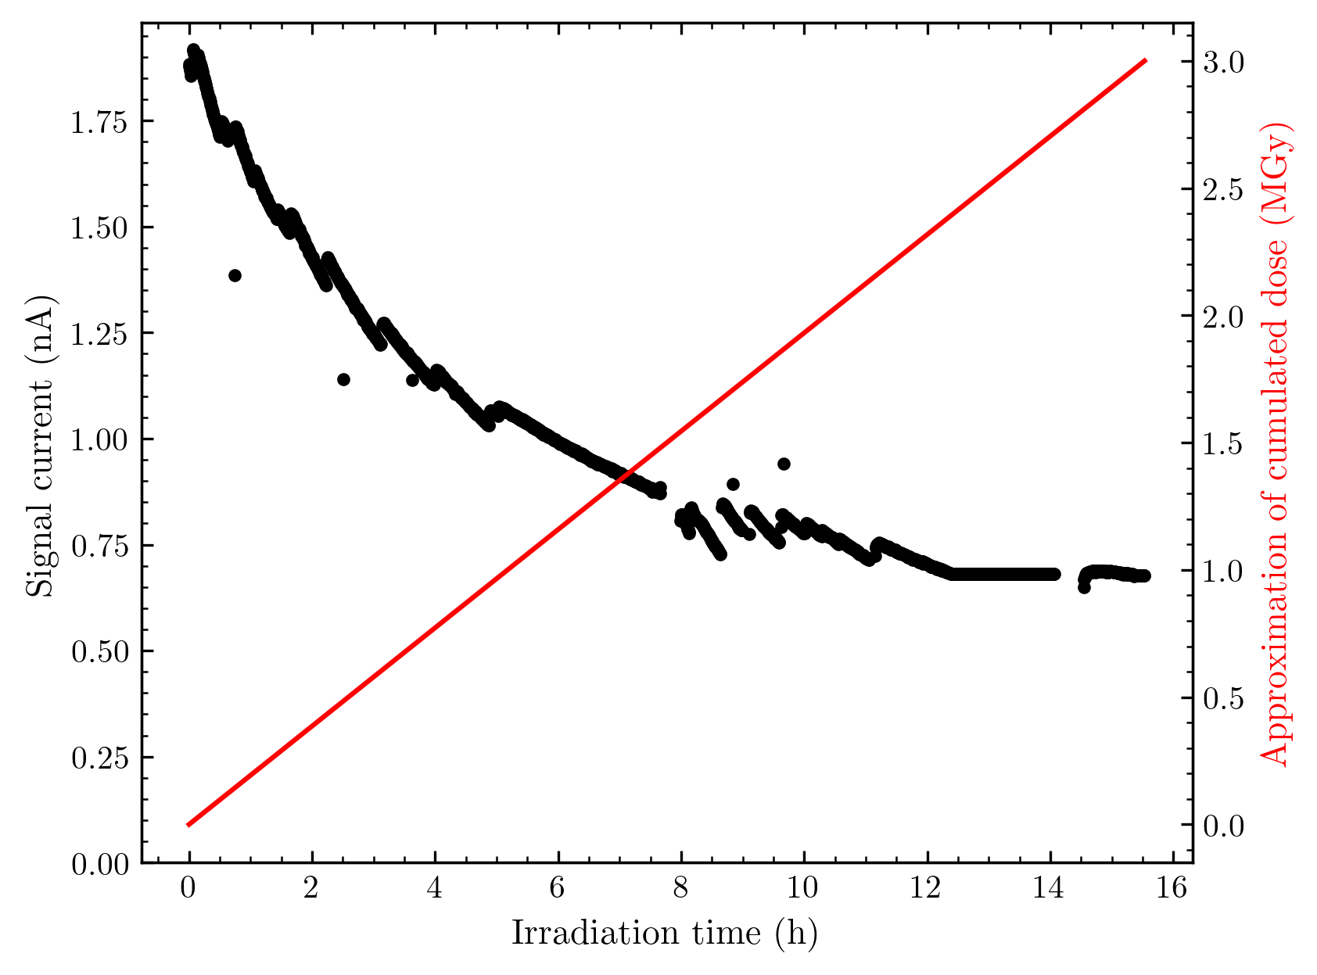
Why Gallium Nitride?
Large bandgap material (3.4 eV @ 300K)
Also, large displacement energies of…
Ga: 45 eV | N: 109 eV
Large radiation hardness?!
Matured fabrication methods from LED / high power electronics technology
Proof of concept + first steps:
J.-Y. Duboz et al., “GaN Schottky diodes for proton beam monitoring,” Biomed. Phys. Eng. Express, vol. 5, no. 2, p. 025015, Jan. 2019
J.-Y. Duboz et al., “Proton Energy Loss in GaN,” Phys. Status Solidi B, vol. 258, no. 8, p. 2100167, 2021
M. Siviero et al., “GaN diodes comparative study for high energy protons detection,” J. Semicond., vol. 46, no. 0, 2025
Total dose: 300 Mrad= 3 Mgy
24 MeV protons
25 nA beam current

Slide 4
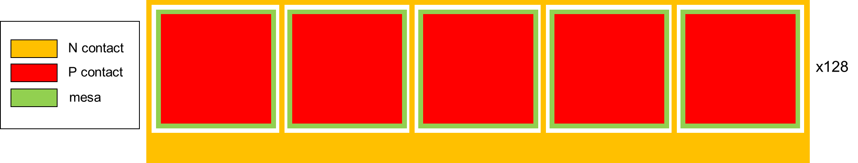
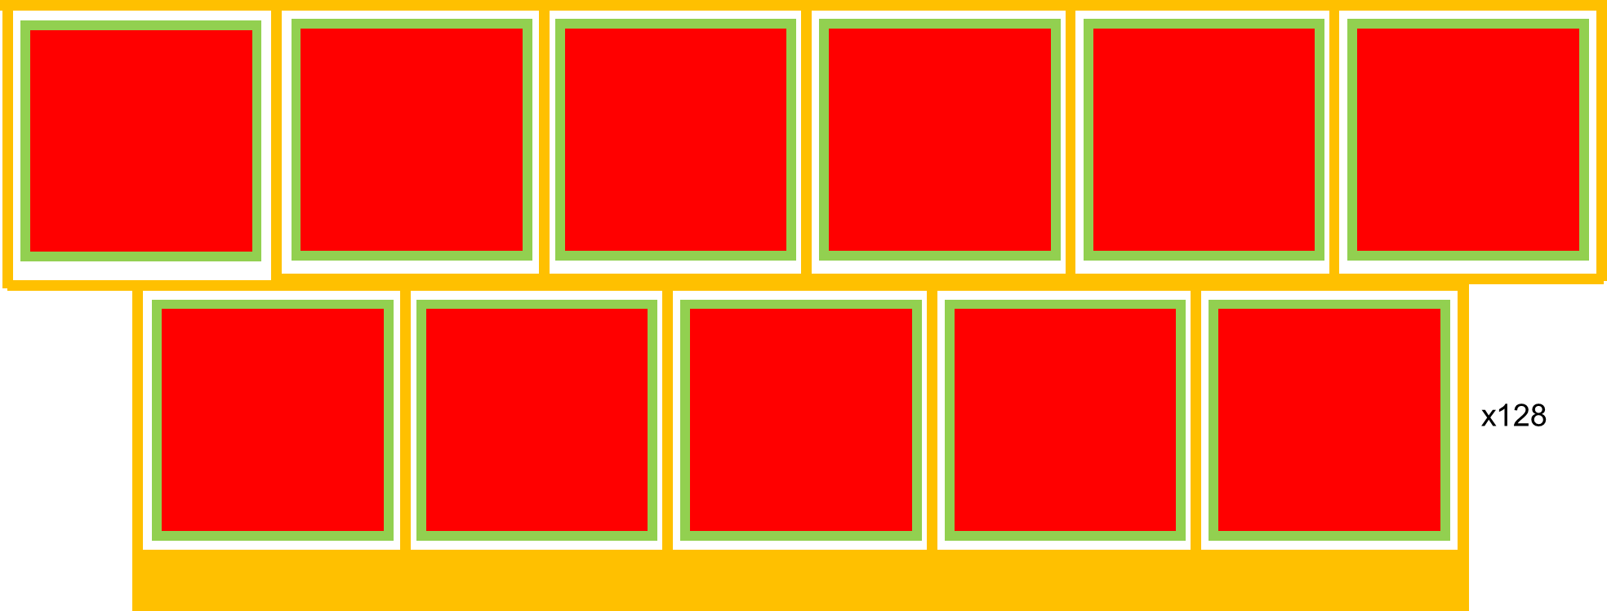
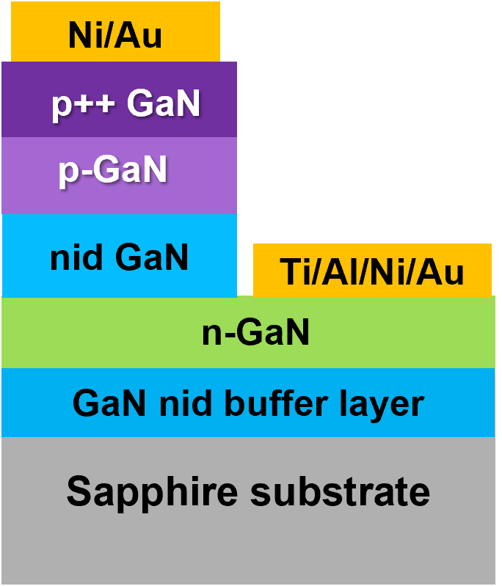

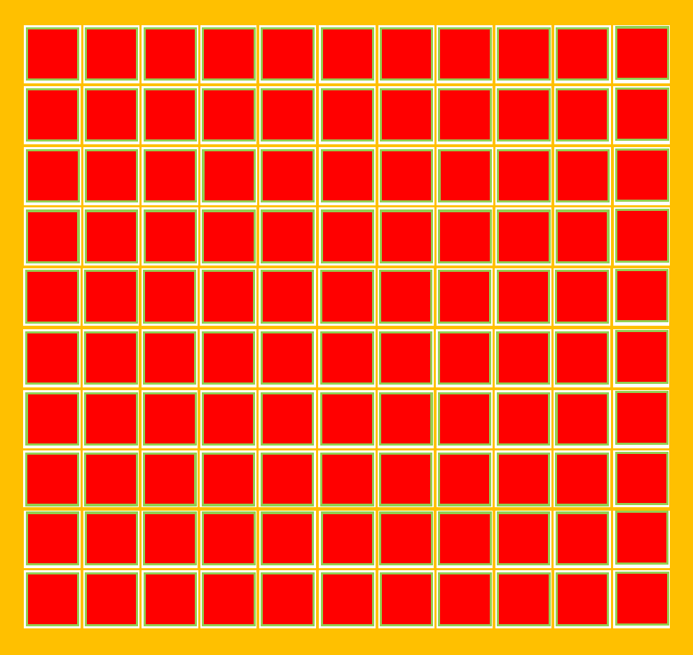
Detector Design
500µm pitch
500µm pitch
250 µm x 500 µm pitch
500µm and 1mm pitch

Slide 5
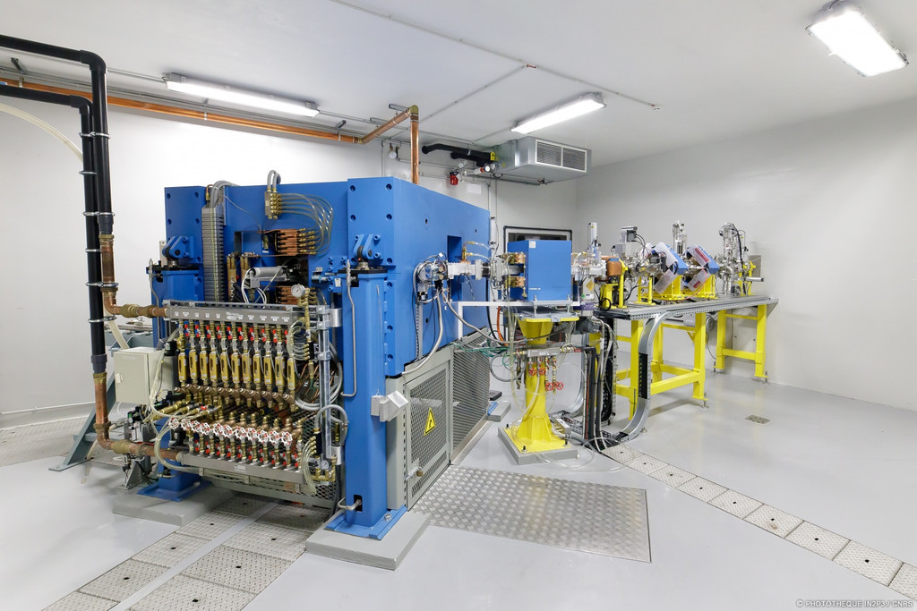
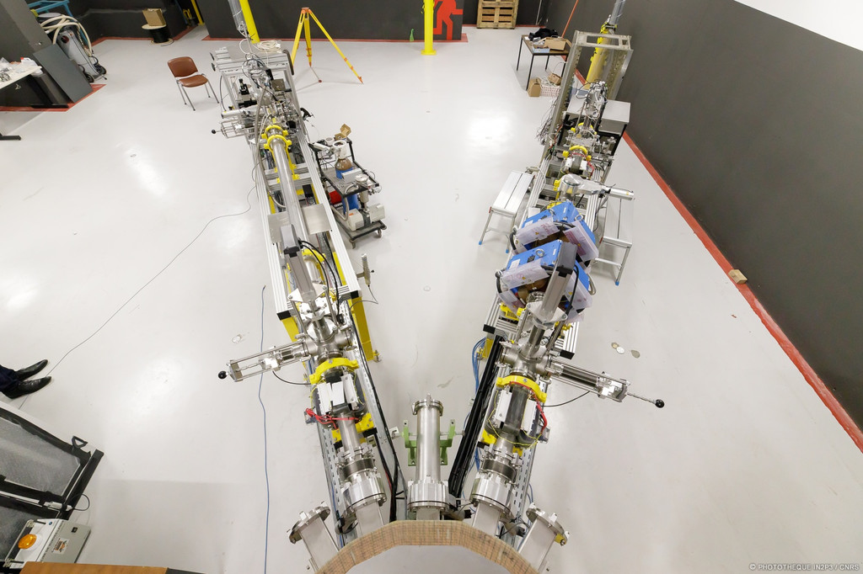

Measurement facility CYRCé
TR24 cyclotron from ACSI:
16 to 25 MeV and 300uA maximum
Beamlines for isotope production or proton irradiation
About CYRCé:
E. Bouquerel et al., “Design and commissioning of the first two CYRCé extension beamlines,” Nucl. Instrum. Methods Phys. Res. Sect. Accel. Spectrometers Detect. Assoc. Equip., vol. 1024, p. 166034, Feb. 2022, doi: 10.1016/j.nima.2021.166034.

Slide 6

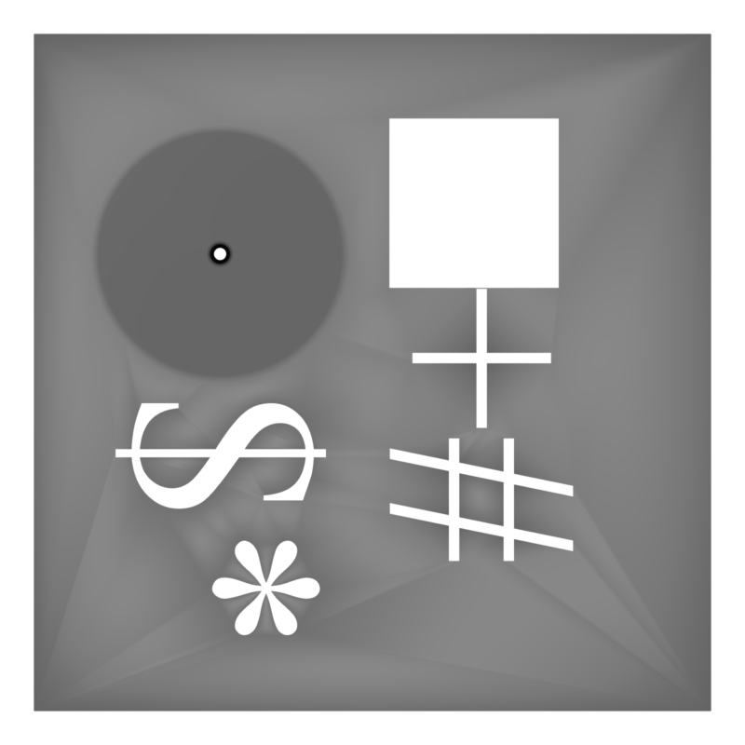
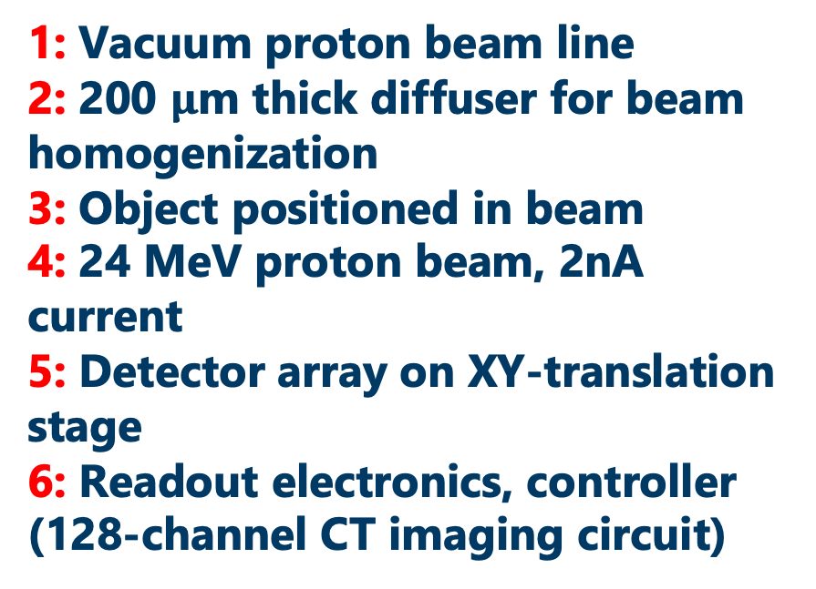
Measurement Setup
5
1: Vacuum proton beam line
2: 200 $μ$m thick diffuser for beam homogenization
3: Object positioned in beam
4: 24 MeV proton beam, 2nA current
5: Detector array on XY-translation stage
6: Readout electronics, controller (128-channel CT imaging circuit)
1
4
2
3
6

Slide 7
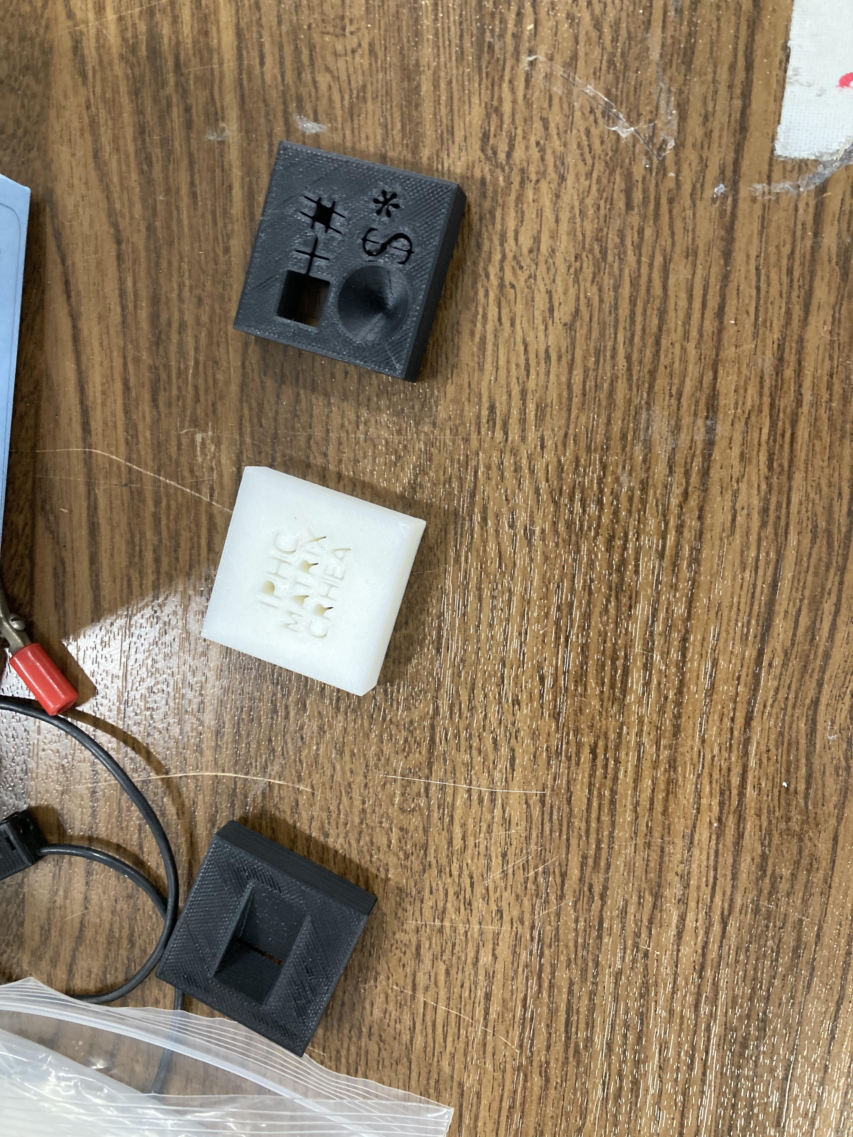
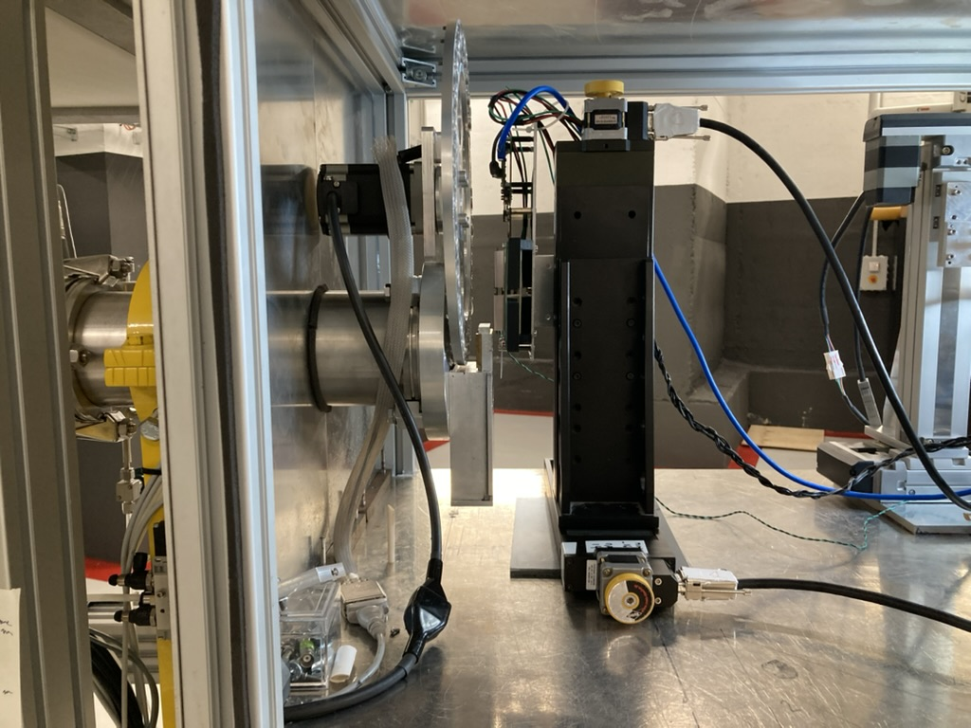
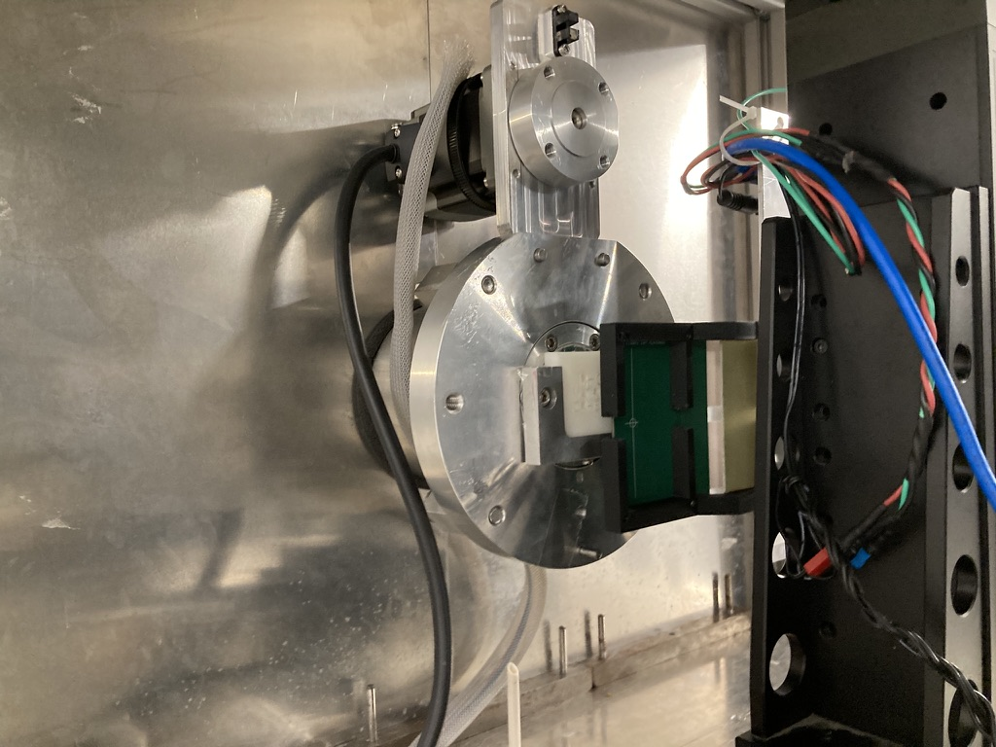
Measurement setup
Objects to image
Afterwards: Data processing and image generation

Slide 8
Signal quality
8
Normalization of response inhomogeneities
Raw data
Background Subtraction
0.5 x 0.5 mm²
All array diodes are working! - Diode yields 100 %
Response inhomogeneity < 2 %
Round apertures in the beamline ≈ 25 mm
2 x 64 diodes

Slide 9
2D Imaging “Misc shape”
0.5 x 0.5 mm²
2 x 64 diodes
Different energy = different signal!

Slide 10
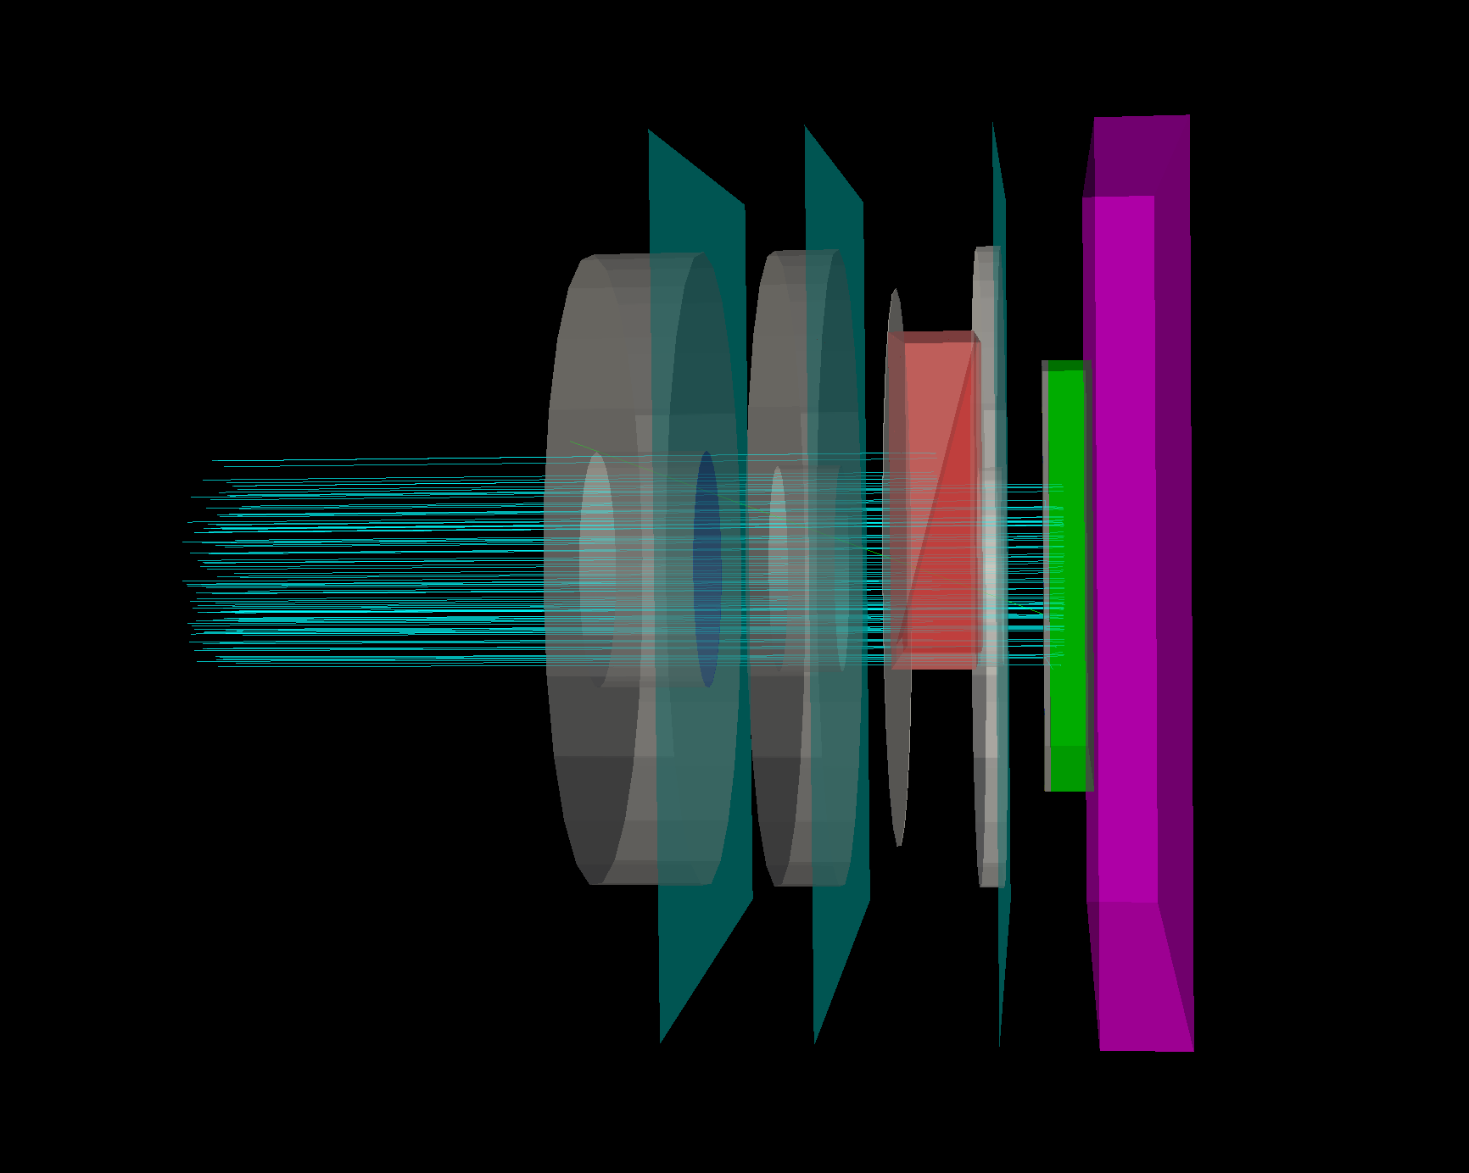
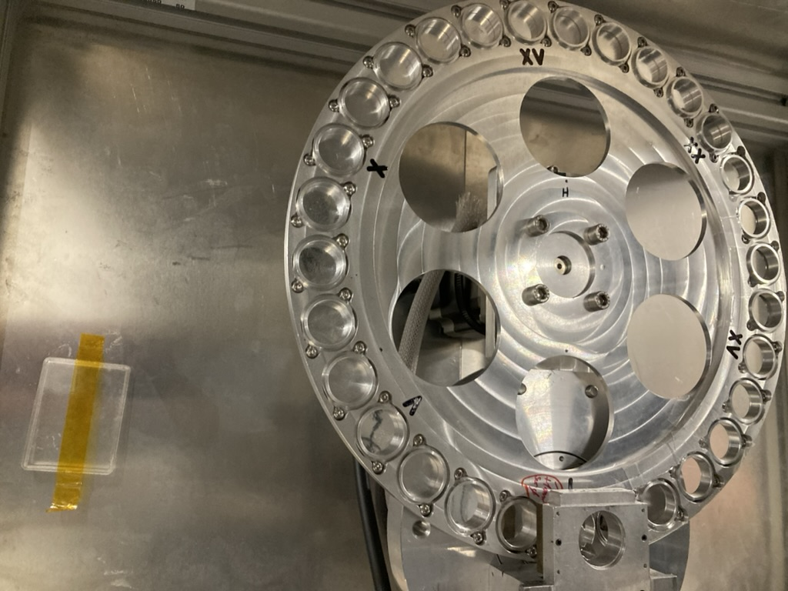

GATE10 Simulation

Slide 11
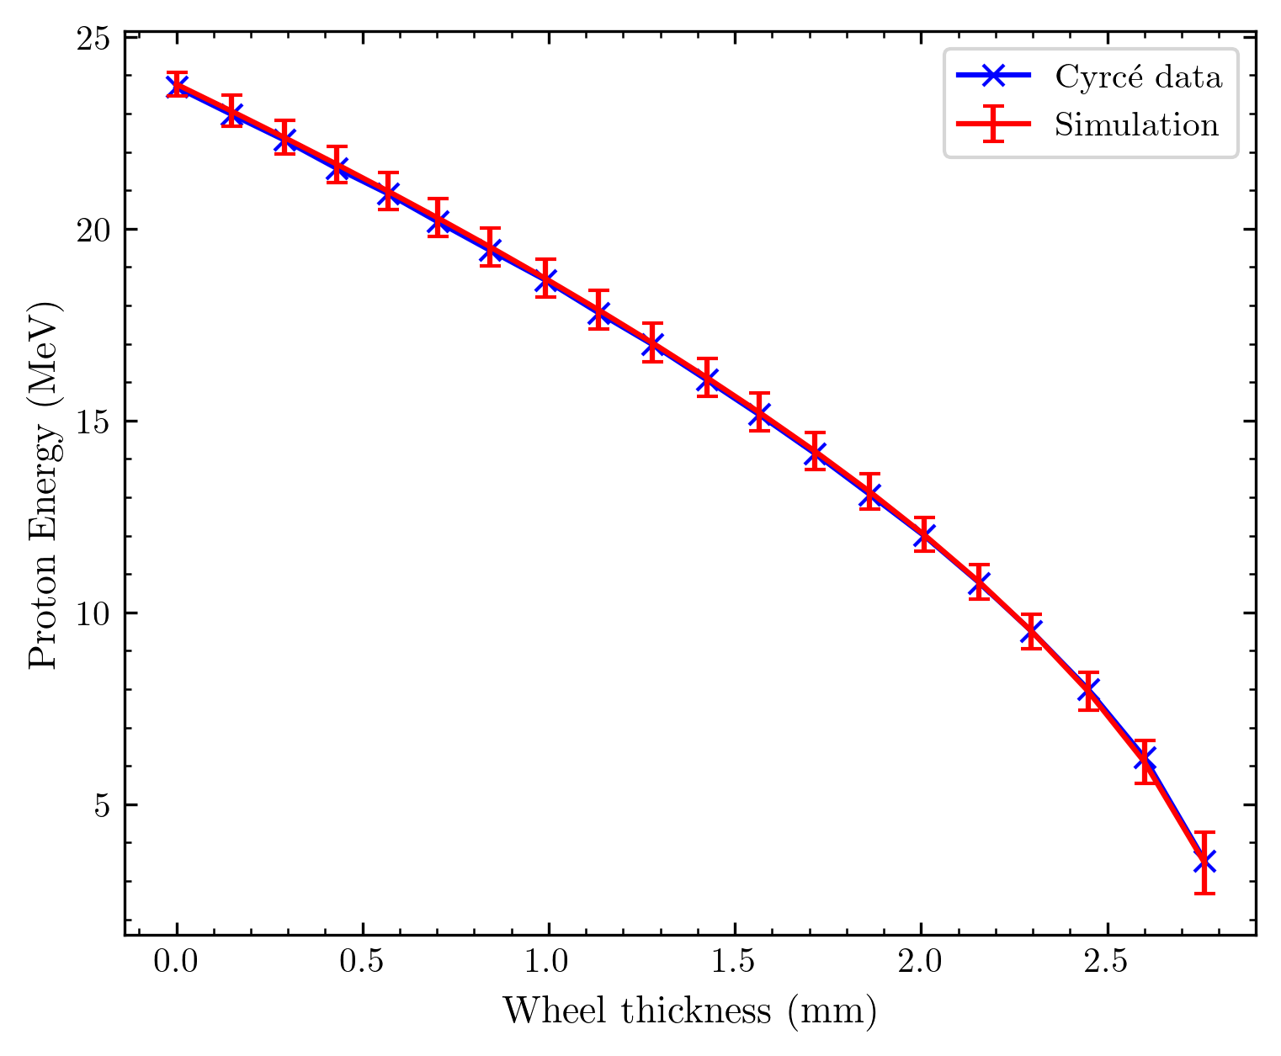
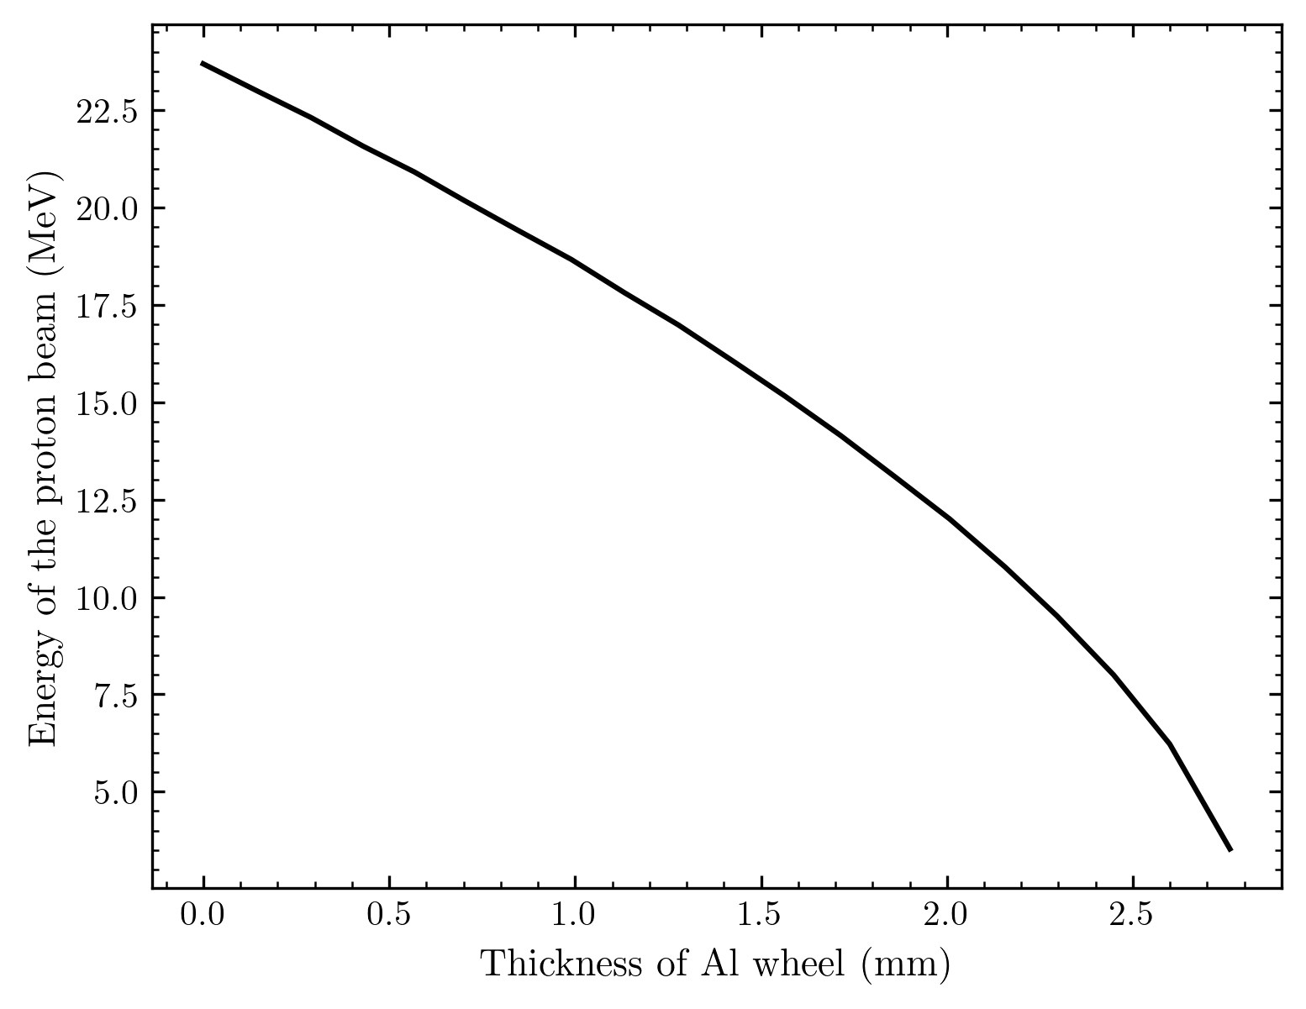
Energy Modulation at CYRCé

Slide 12
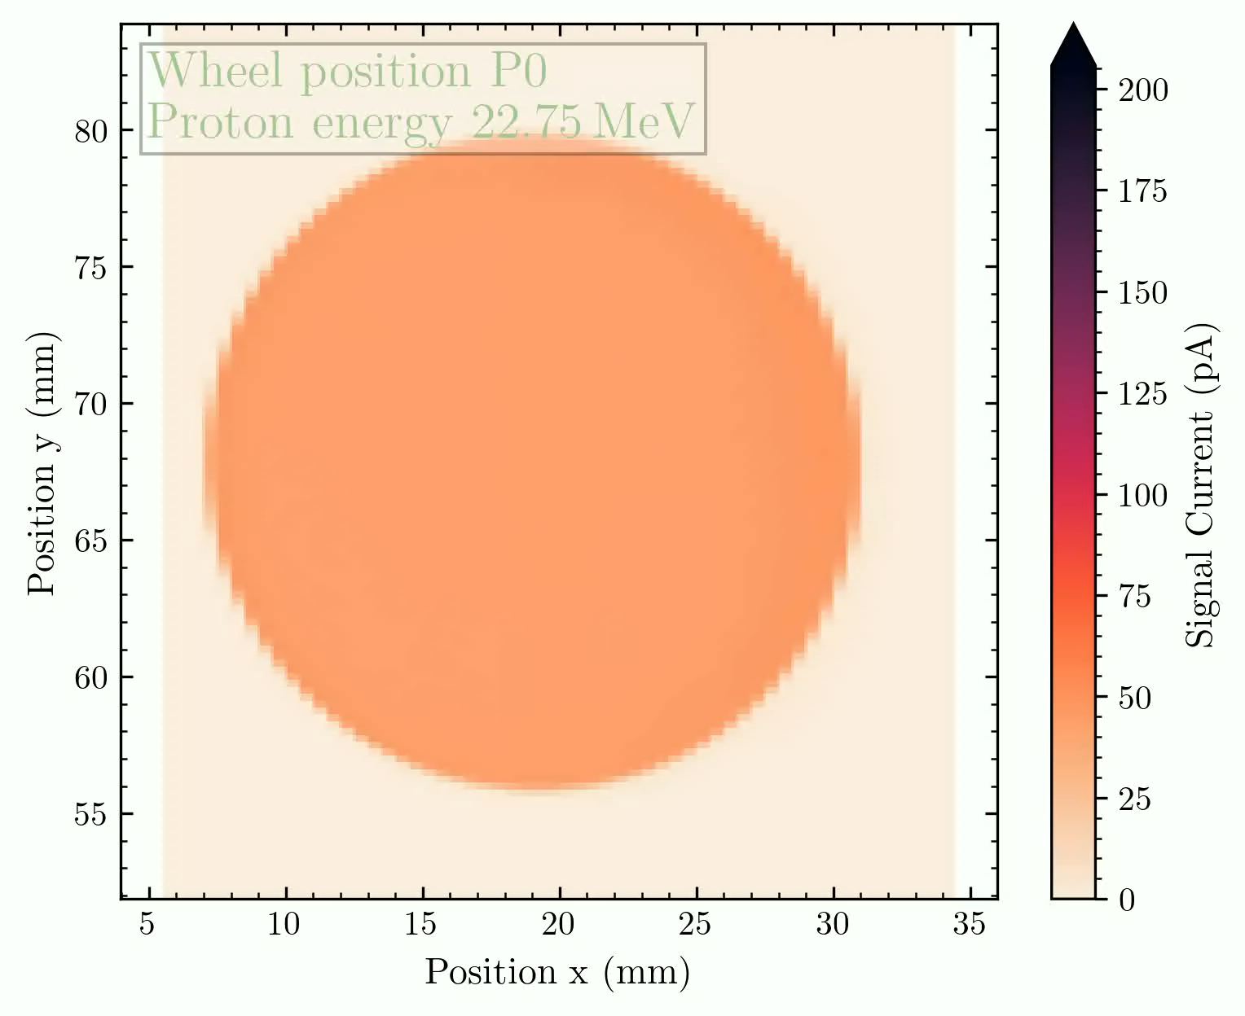
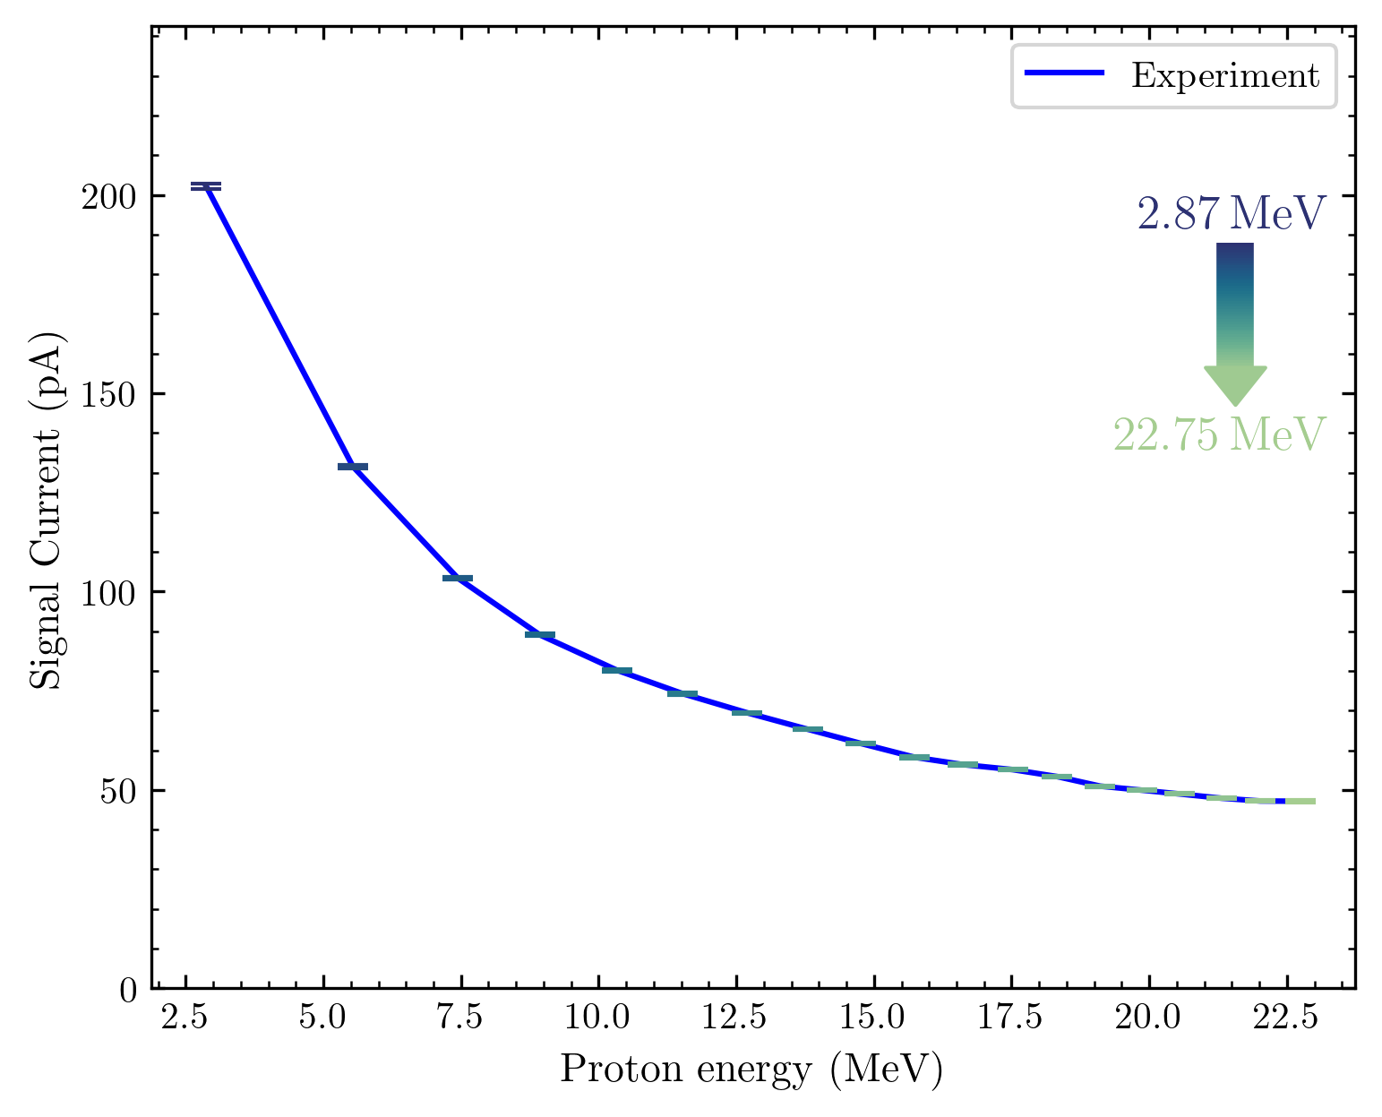
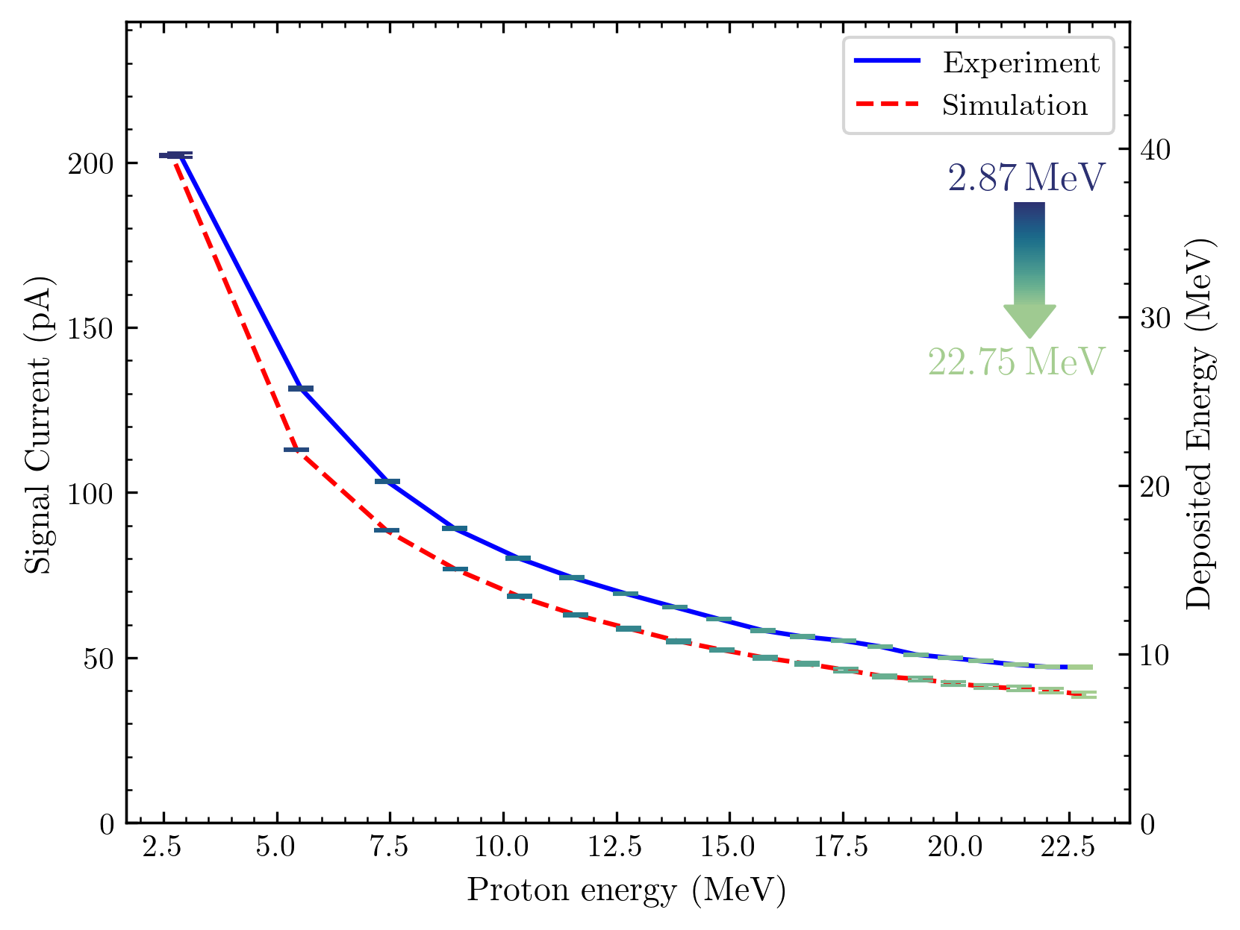
MATRIX response at different energies
0.5 x 0.5 mm²
2 x 64 diodes

Slide 13
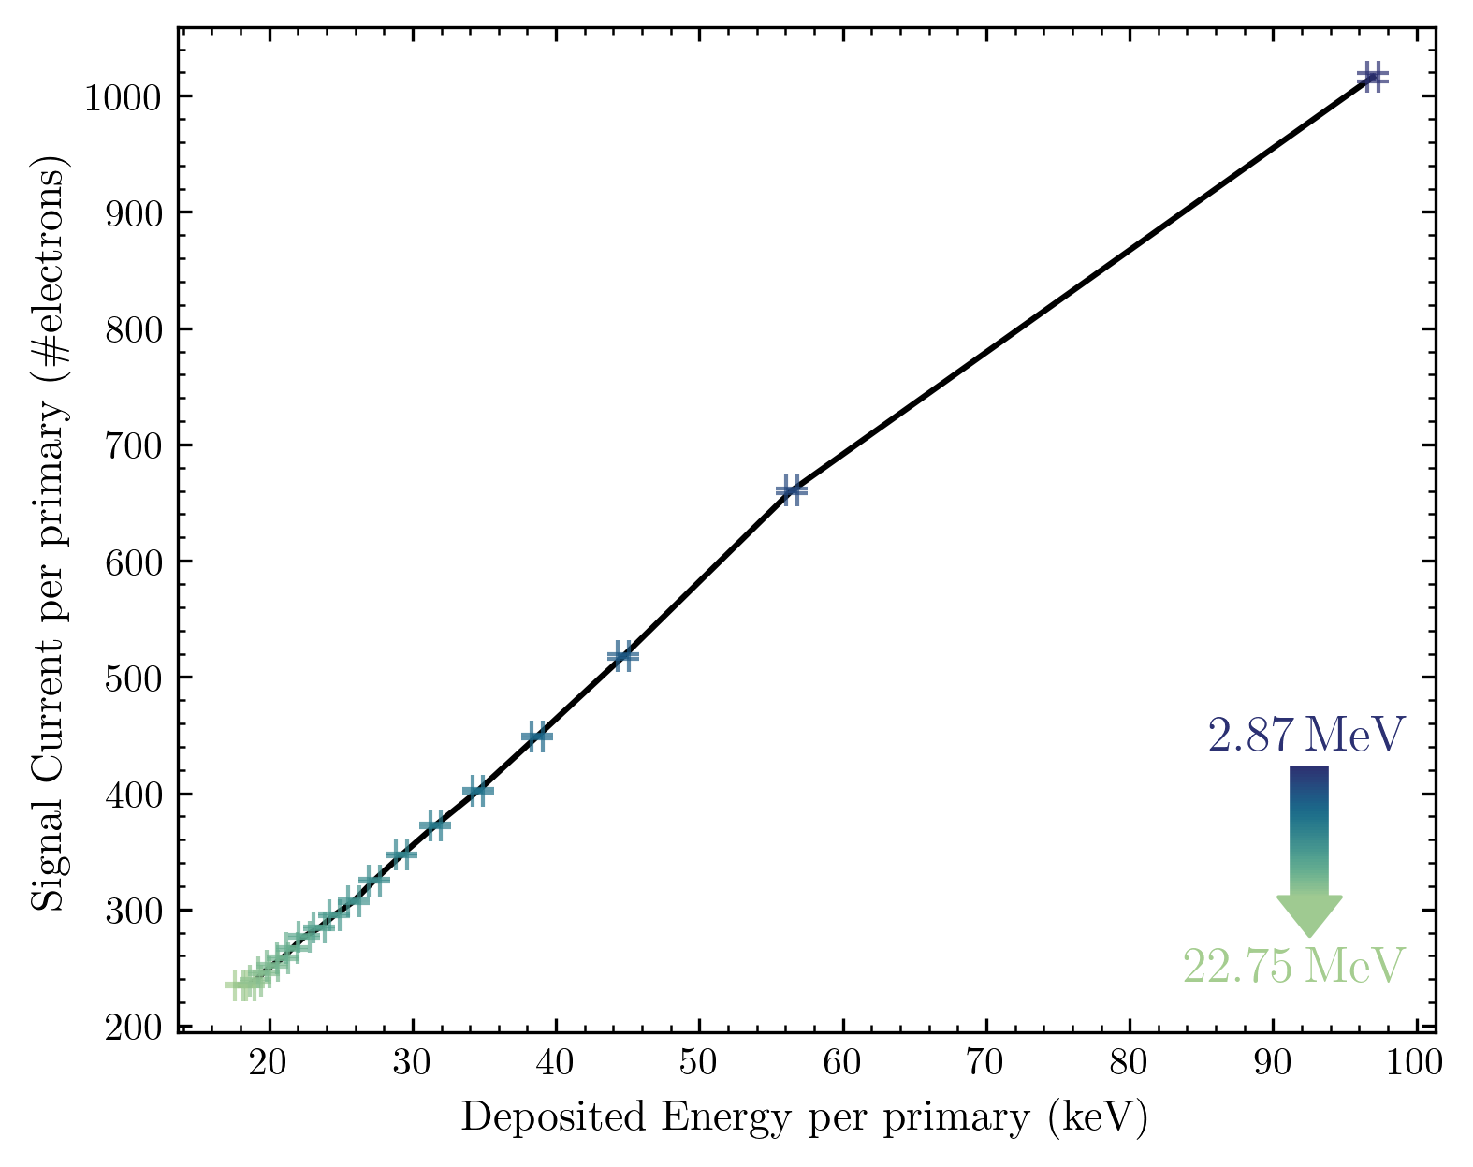
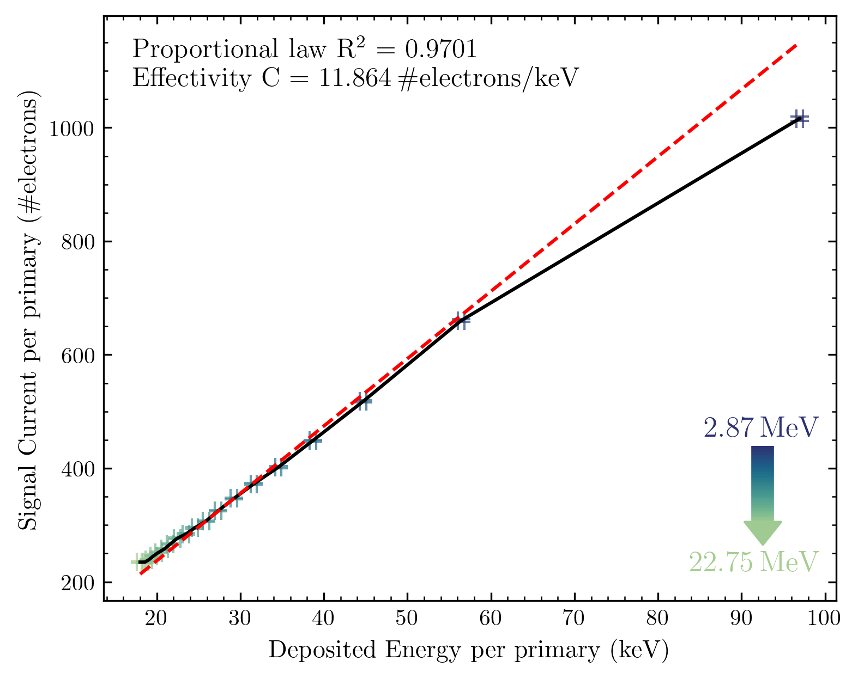
Response vs deposited energy

Slide 14
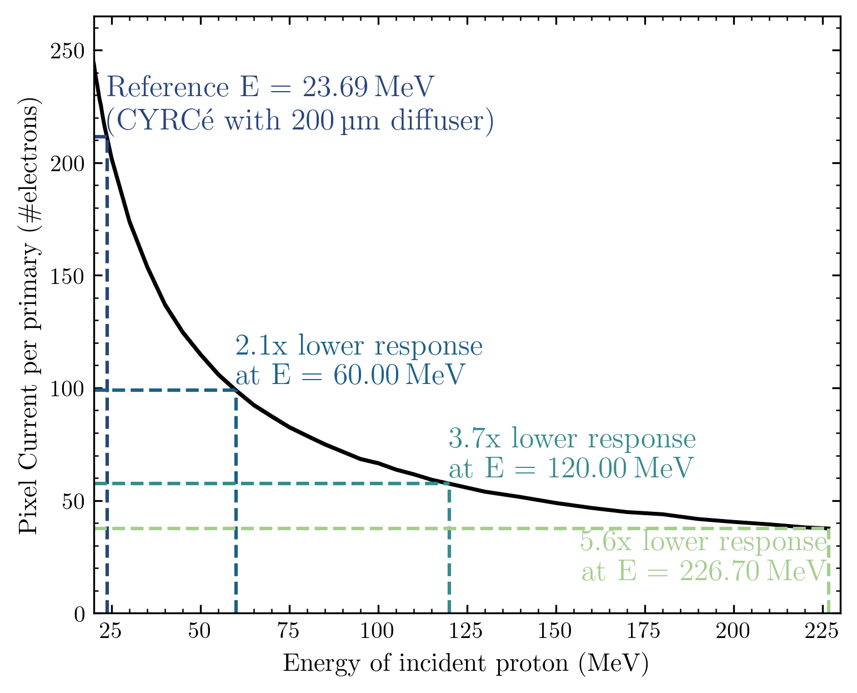
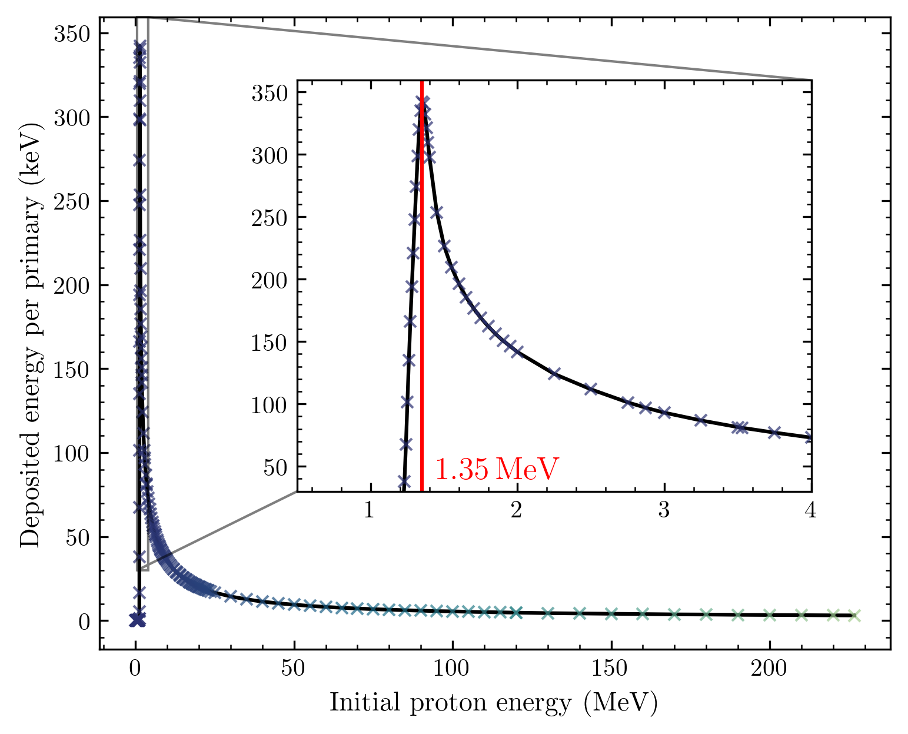
Extrapolation

Slide 15
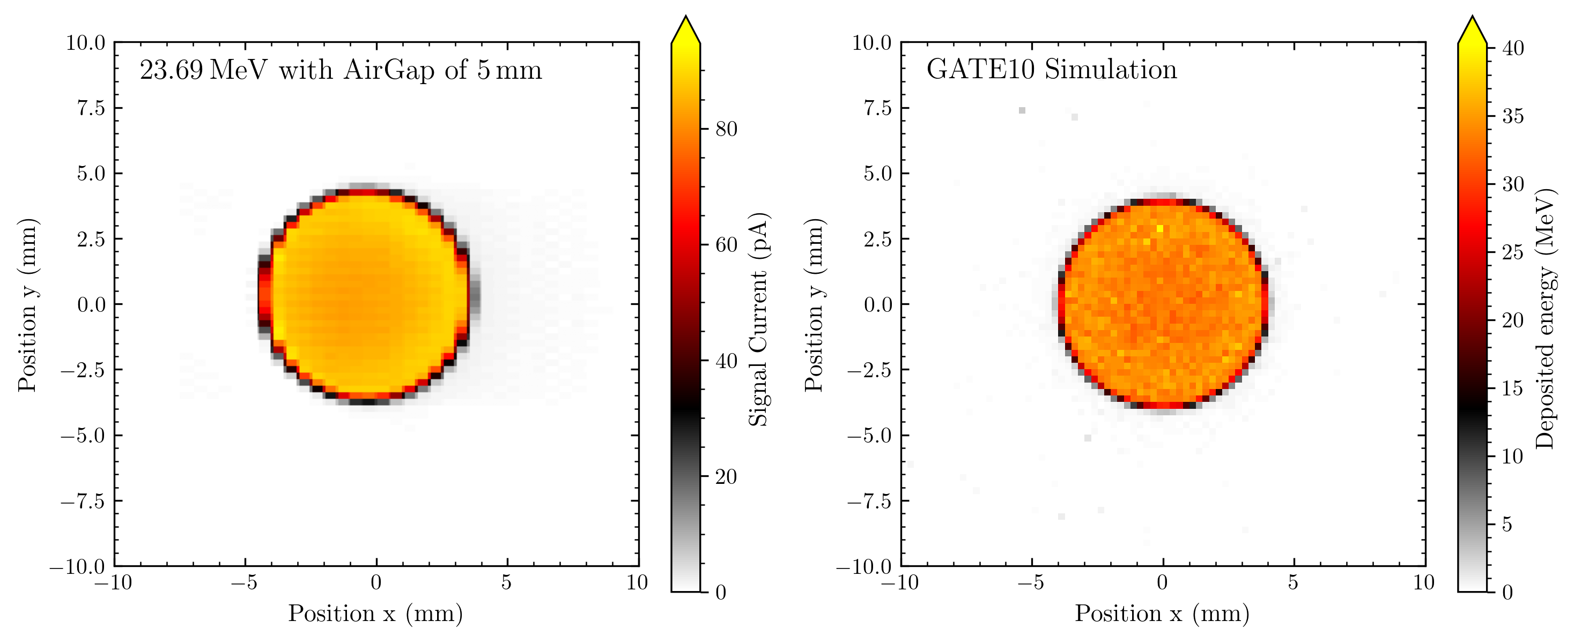
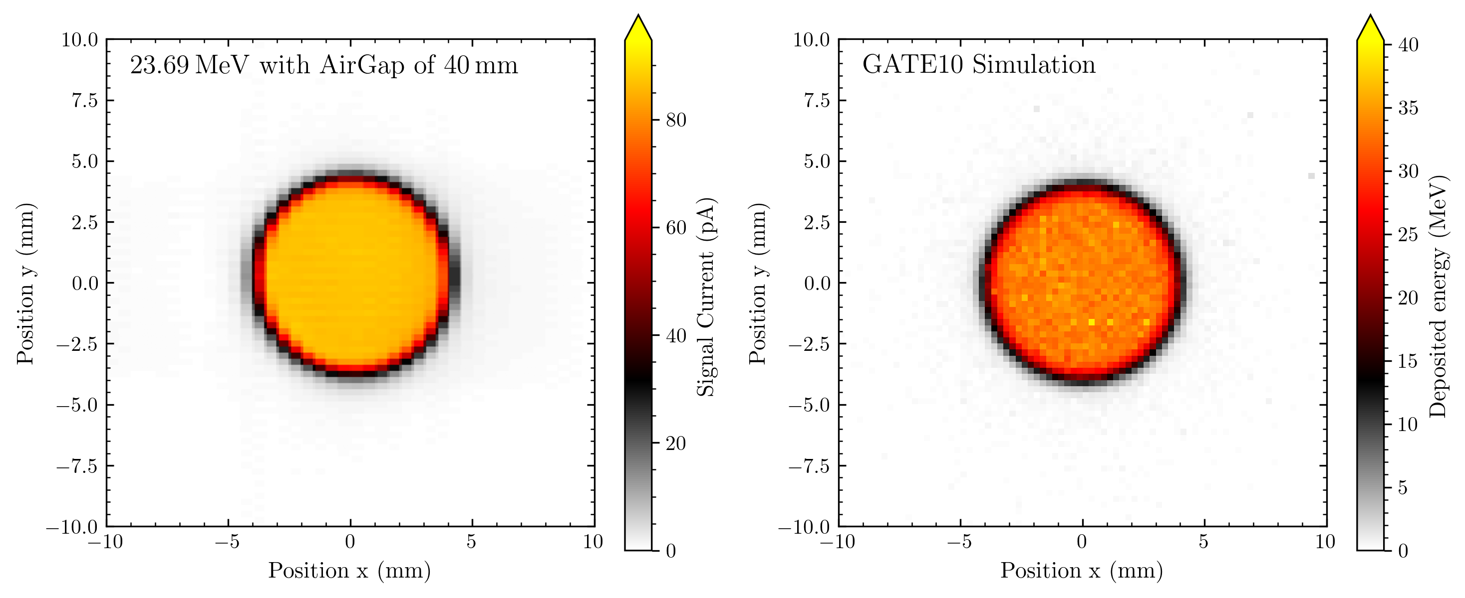
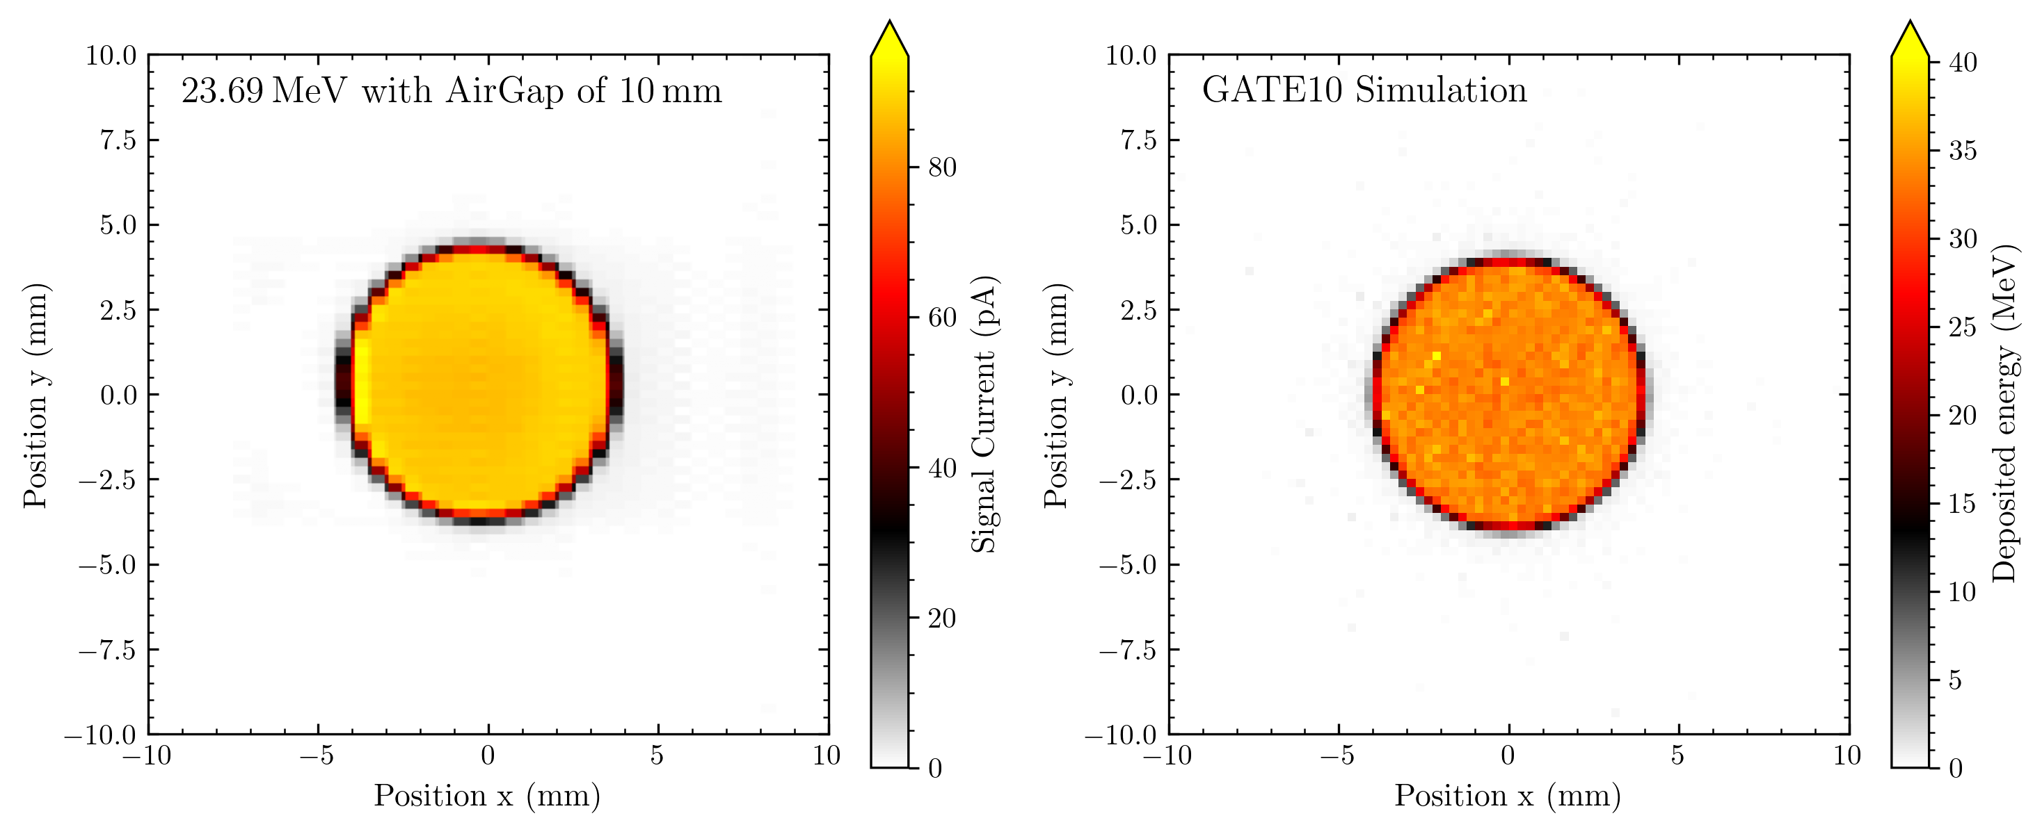
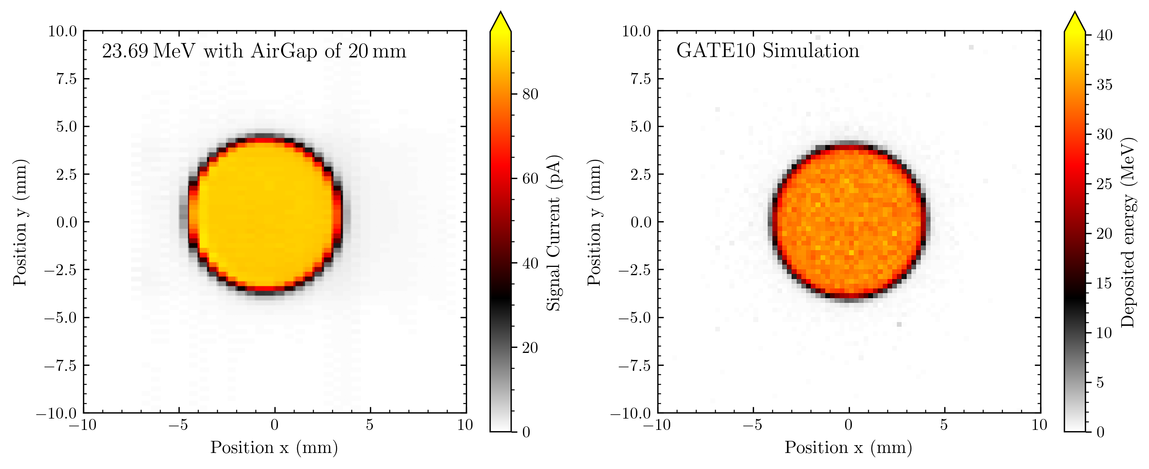
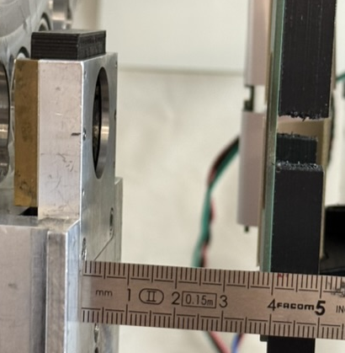
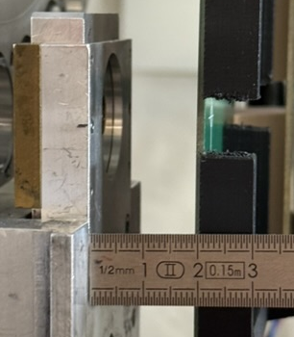
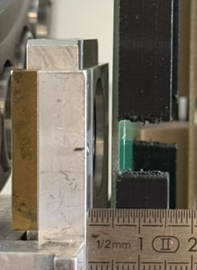
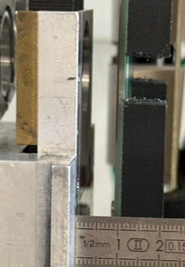
Straggling?
0.5 x 0.5 mm²
2 x 64 diodes

Slide 16
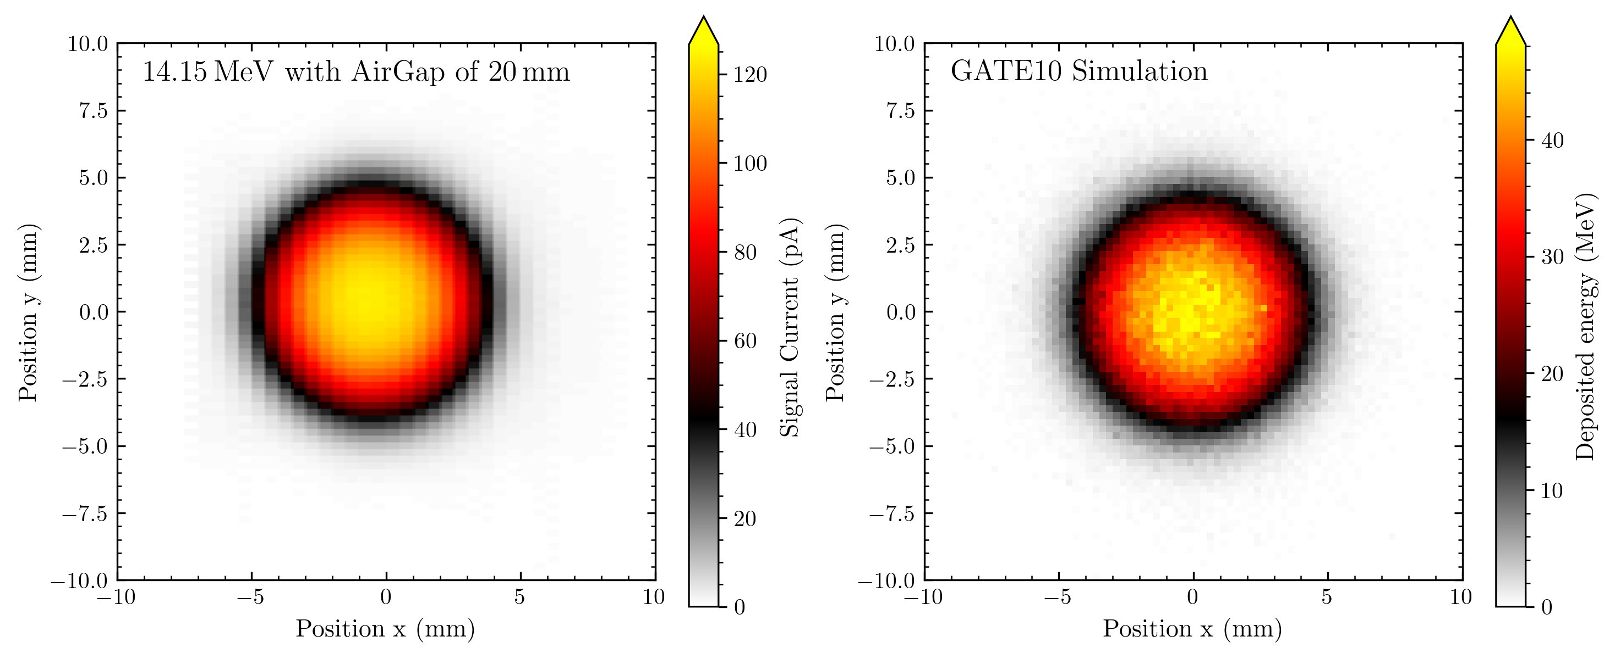
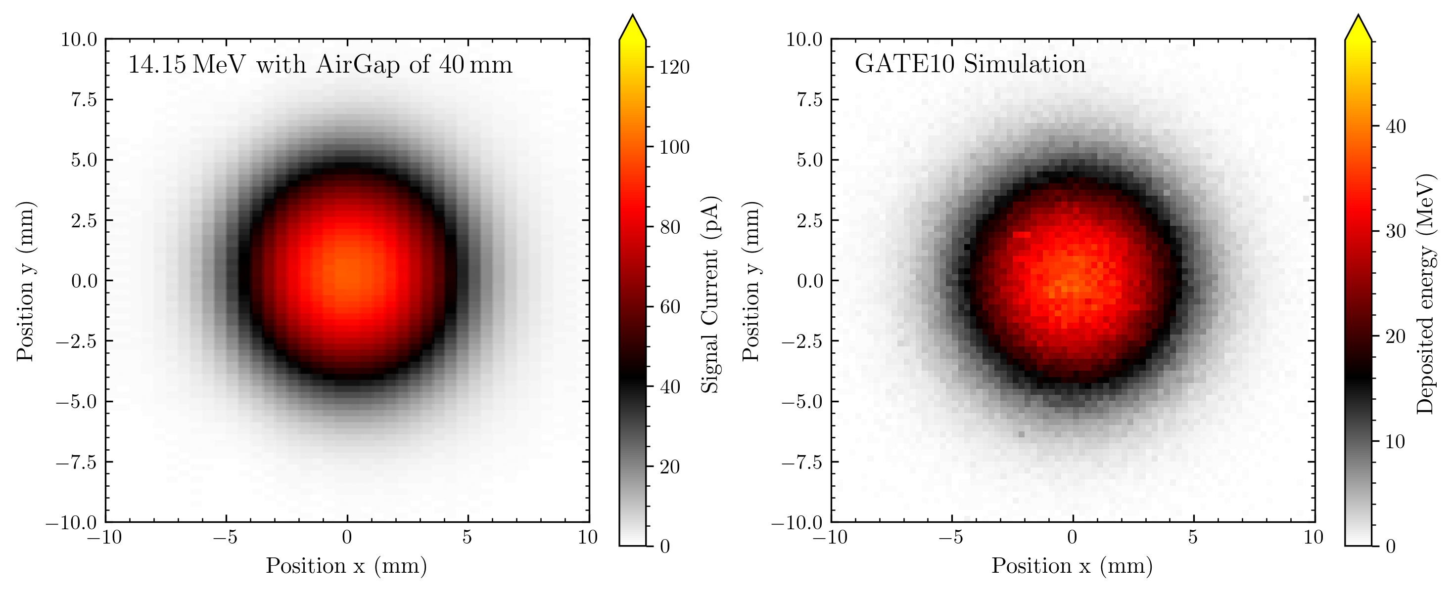
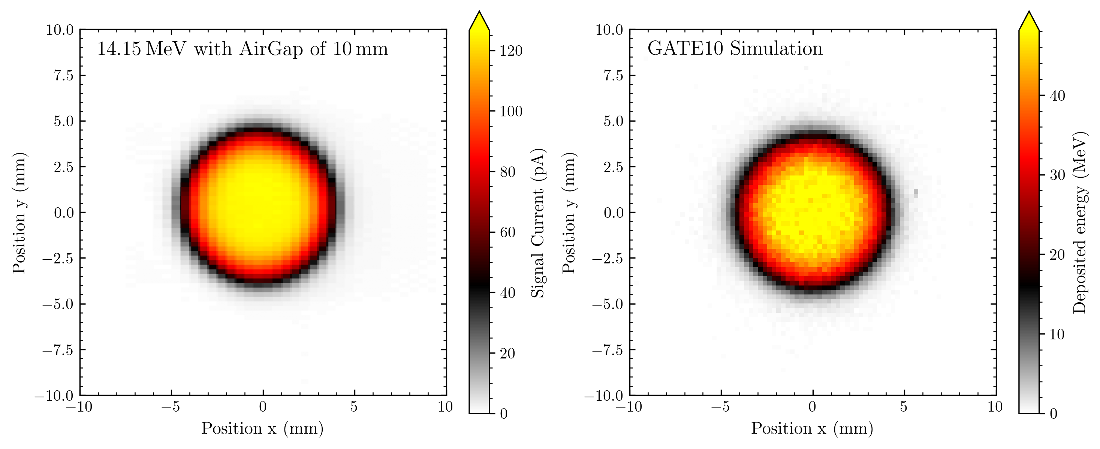
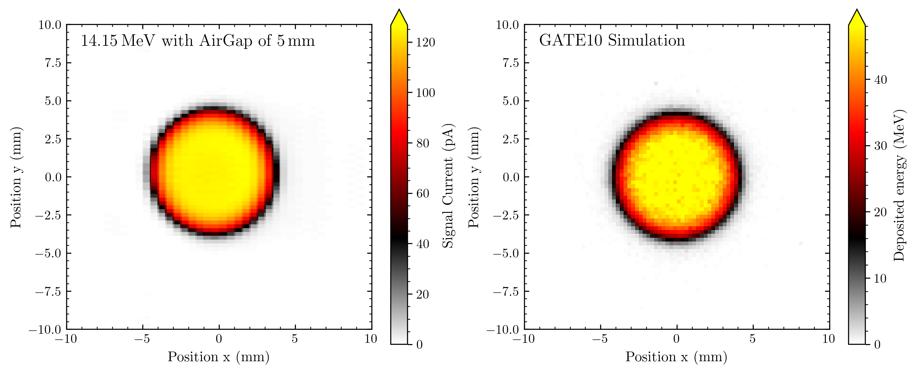
Straggling?
0.5 x 0.5 mm²
2 x 64 diodes

Slide 17
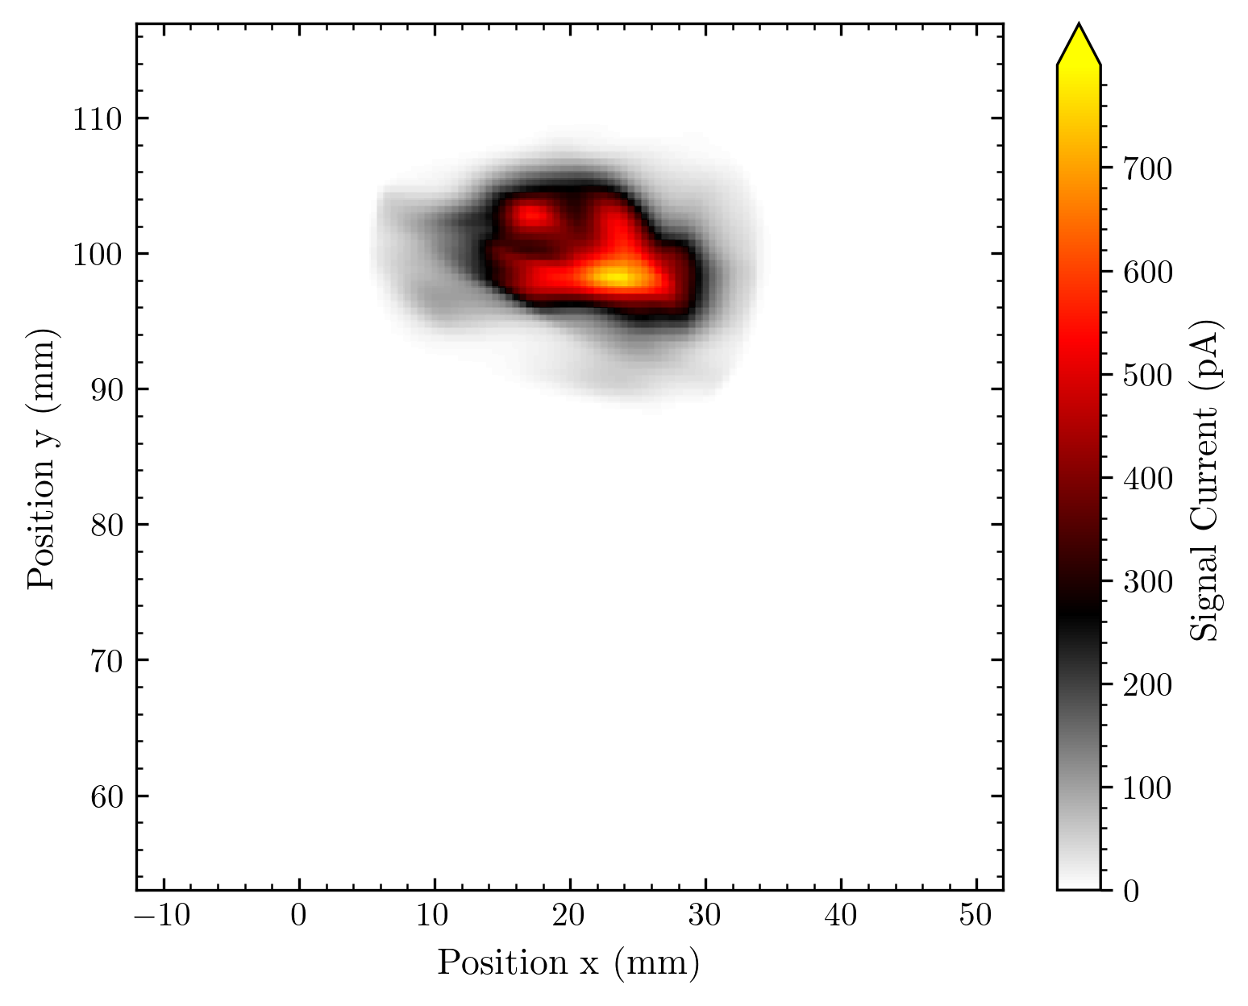
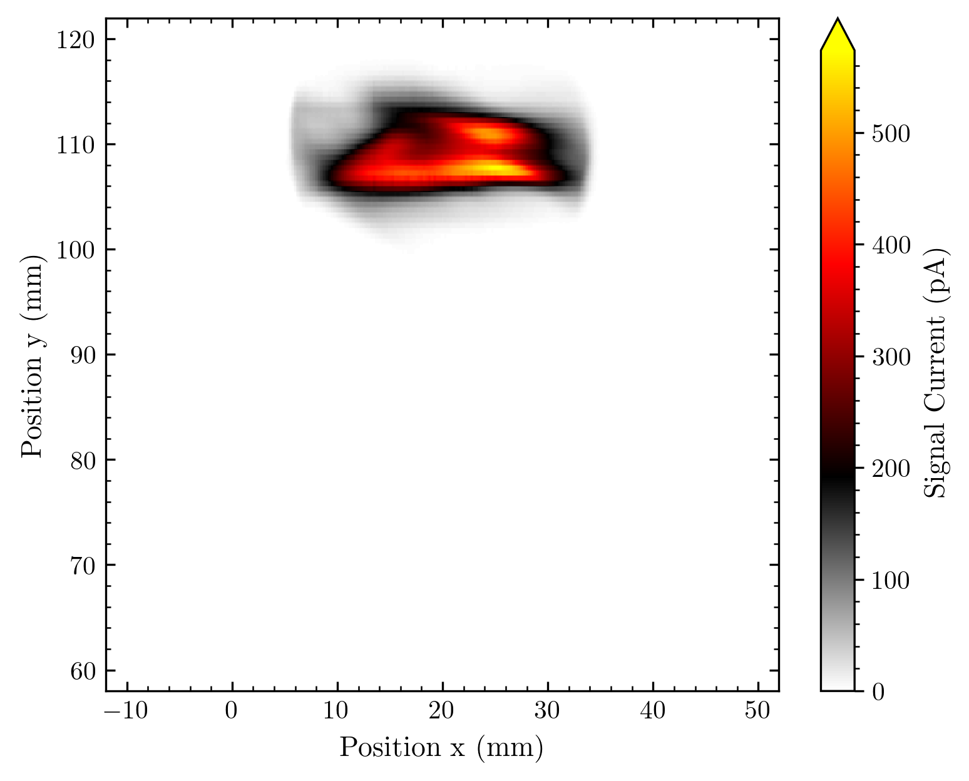
Undiffused Beam
0.5 x 0.5 mm²
0.25 x 0.5 mm²
1 x 128 diodes
1 x 128 diodes
Can we make a movie of how the beam changes (due to, e.g., collimation)? ☺

Slide 18
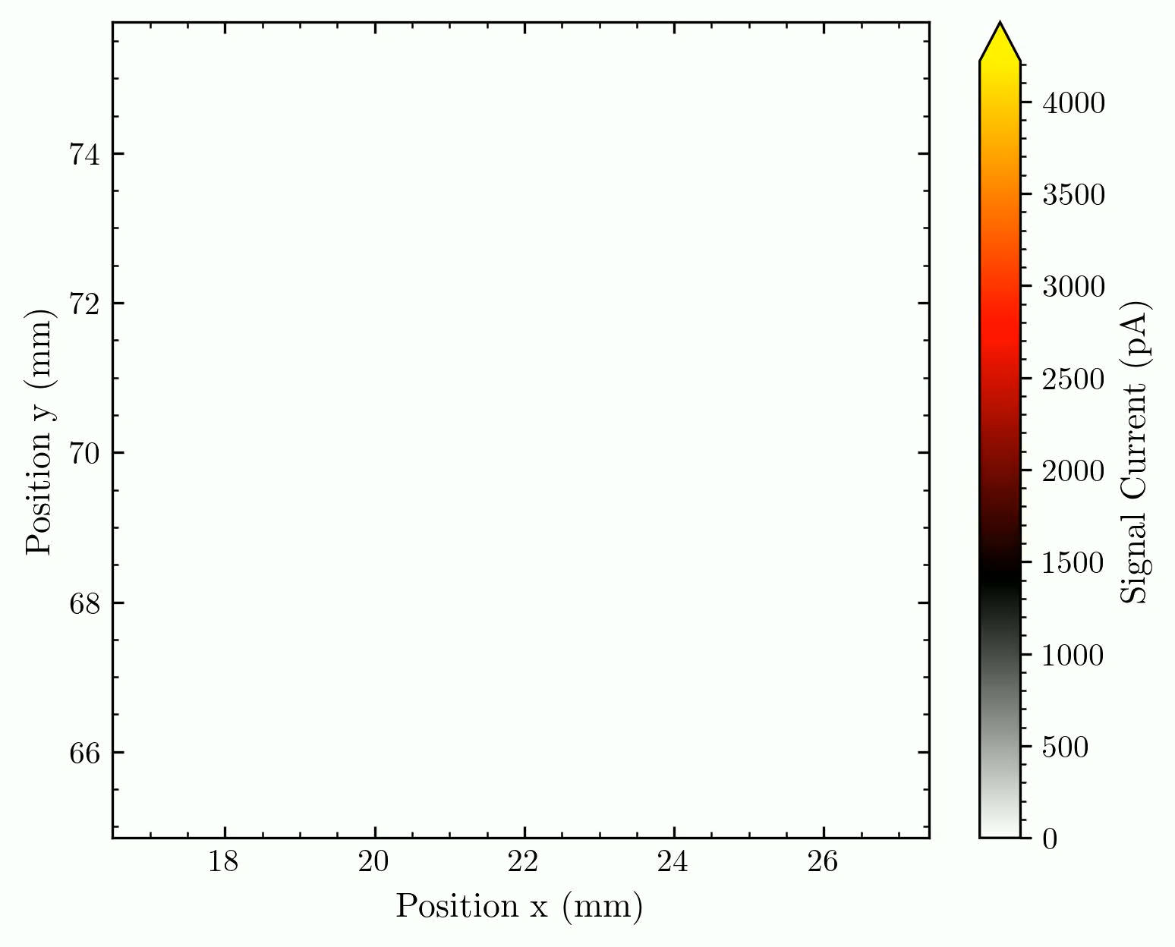
Time dependent imaging
Three phases:
Beam stability (no changes)
Live changes of beam collimation
Wire profiling inside the beamline
1 x 1 mm²
(1 fps – currently limited by readout software)
11 x 11 diodes

Slide 19
Next up:
Measuring at different facilities
Larger multiplexed arrays
Assessing the time resolution
We acknowledge financial support from MATRIX (DFG/ANR-22-CE92-0047), NECTAR (ITMI/INSERM-2021), and DFH/UFA CDFA-05-06 Doctoral School.
We gratefully acknowledge ams OSRAM for providing the AS5900 readout circuit used for data acquisition.
Nico Brosda
nico.brosda@rub.de

Slide 20
Key Facts: Readout Electronics
ams AS5900 26-Bit 128-Channel Low Noise Current-to-Digital Converter
low noise (down to 3200 electrons for full range up to 1 µA)
Low power dissipation down to 1 mW/channel
data transfer through LVDS interface with up to 80 Mbps
Used for X-ray detectors (CT imaging)

