Slide 1
DynamiX A prototype high-framerate, high-dynamic-range hard X-ray detector for 4th generation synchrotrons
Simon Knowles (STFC UKRI)
On behalf of the XIDyn Collaboration
iWoRiD 2025

Slide 2
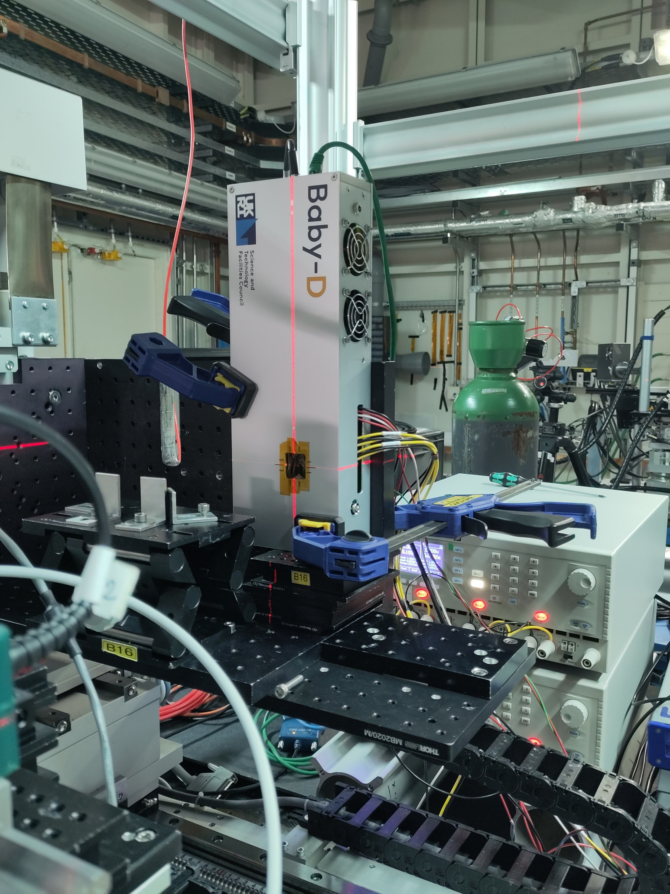
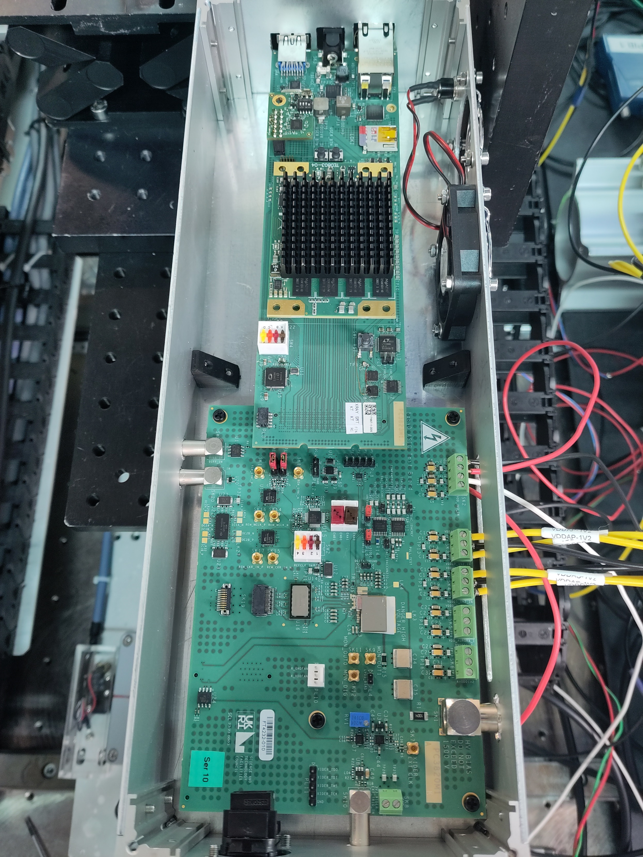
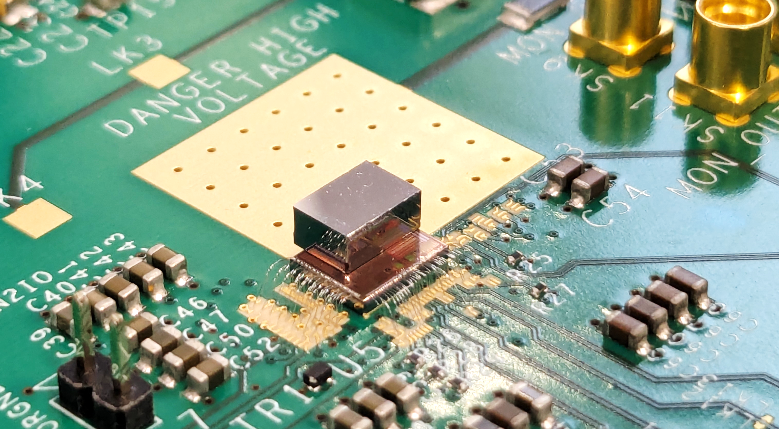
DynamiX Overview
Charge-integrating hybrid pixellated detector system prototype
Aims to meet challenges of synchrotron upgrades
Higher fluxes → new ASIC architecture
Higher energies → CZT sensor material
16 x 16 pixels on 110μm pitch
534kHz (adjustable) framerate to match Diamond orbit
Readout at 14Gbps
Aligning DynamiX at Diamond Light Source (DLS)
DynamiX bonded to 2mm Redlen HF-CdZnTe
Notes:
110um is not a small pitch!

Slide 3
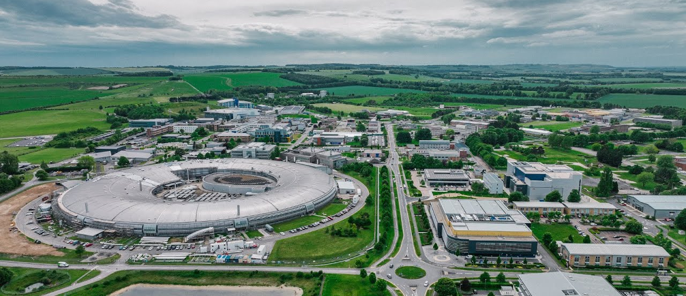
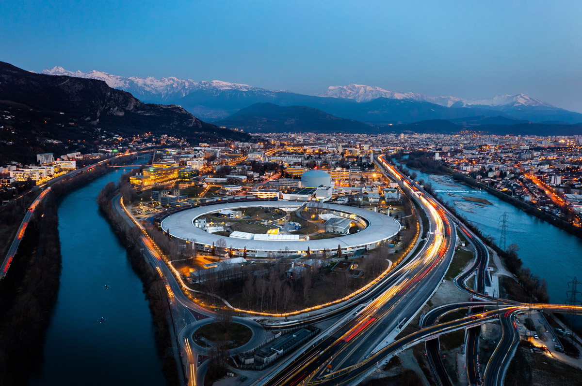
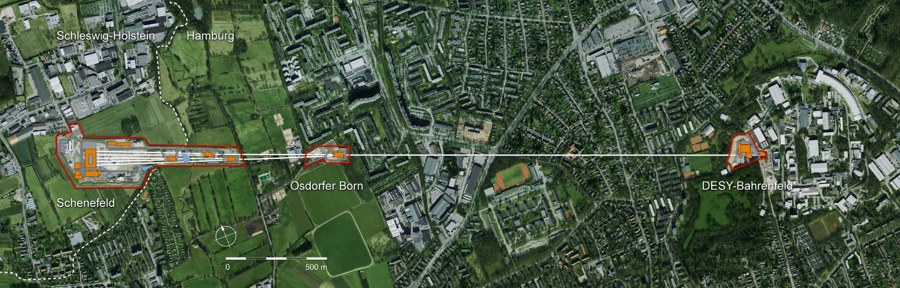
Content
Motivations
Chip architecture
Results from testing at DLS B16
Summary

Slide 4
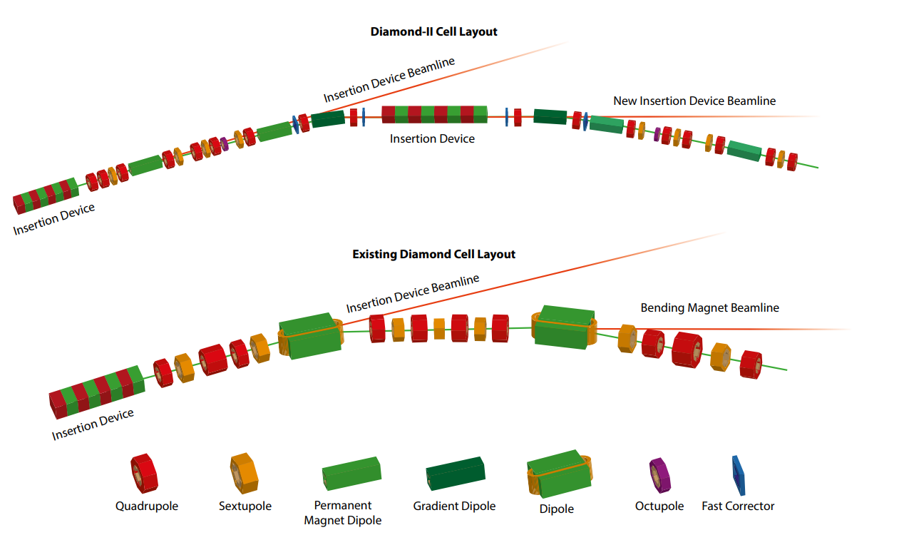

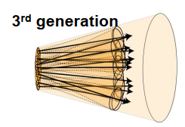
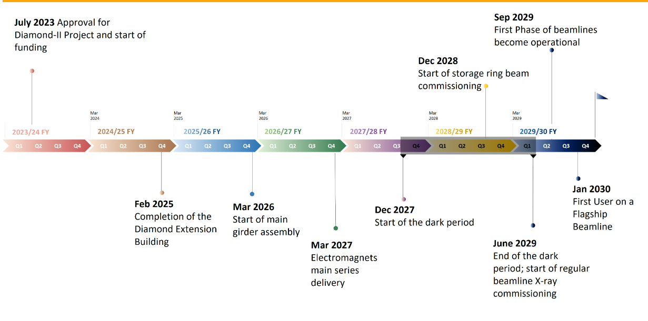
Motivation
Credit: https://www.diamond.ac.uk/Diamond-II.html
4th generation
Diamond II upgrade
Up to 10¹¹⁻¹² ph/mm²/s
Many beamlines >20keV
Mpixels for 2029
First light: 2029

Slide 5
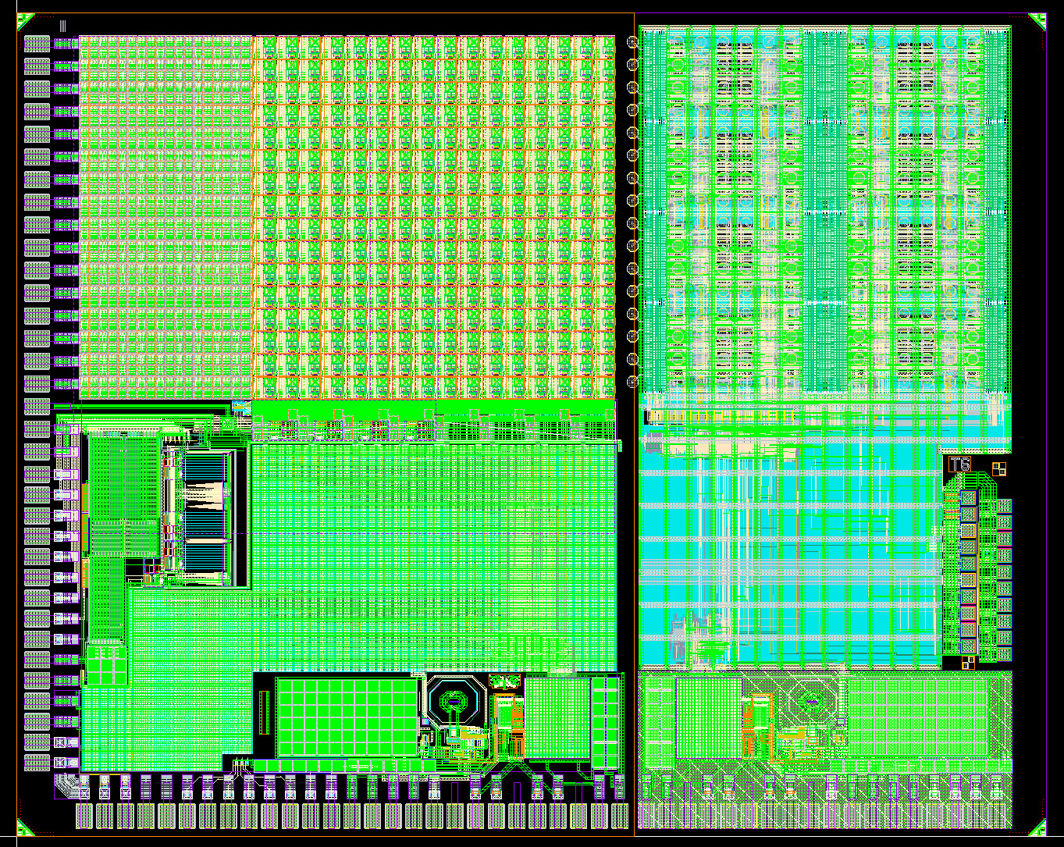
DynamiX Spec
The DynamiX Chip
Parameter | DynamiX
Flux | >10⁹ ph/s/pixel
Pixel Size | 110 μm
Frame Rate | 534 kHz (Synchrotron determined)
Dynamic Range | >10¹¹ ph/mm²/s
Energy | 25keV typical
Noise Level | <single photon

Slide 6
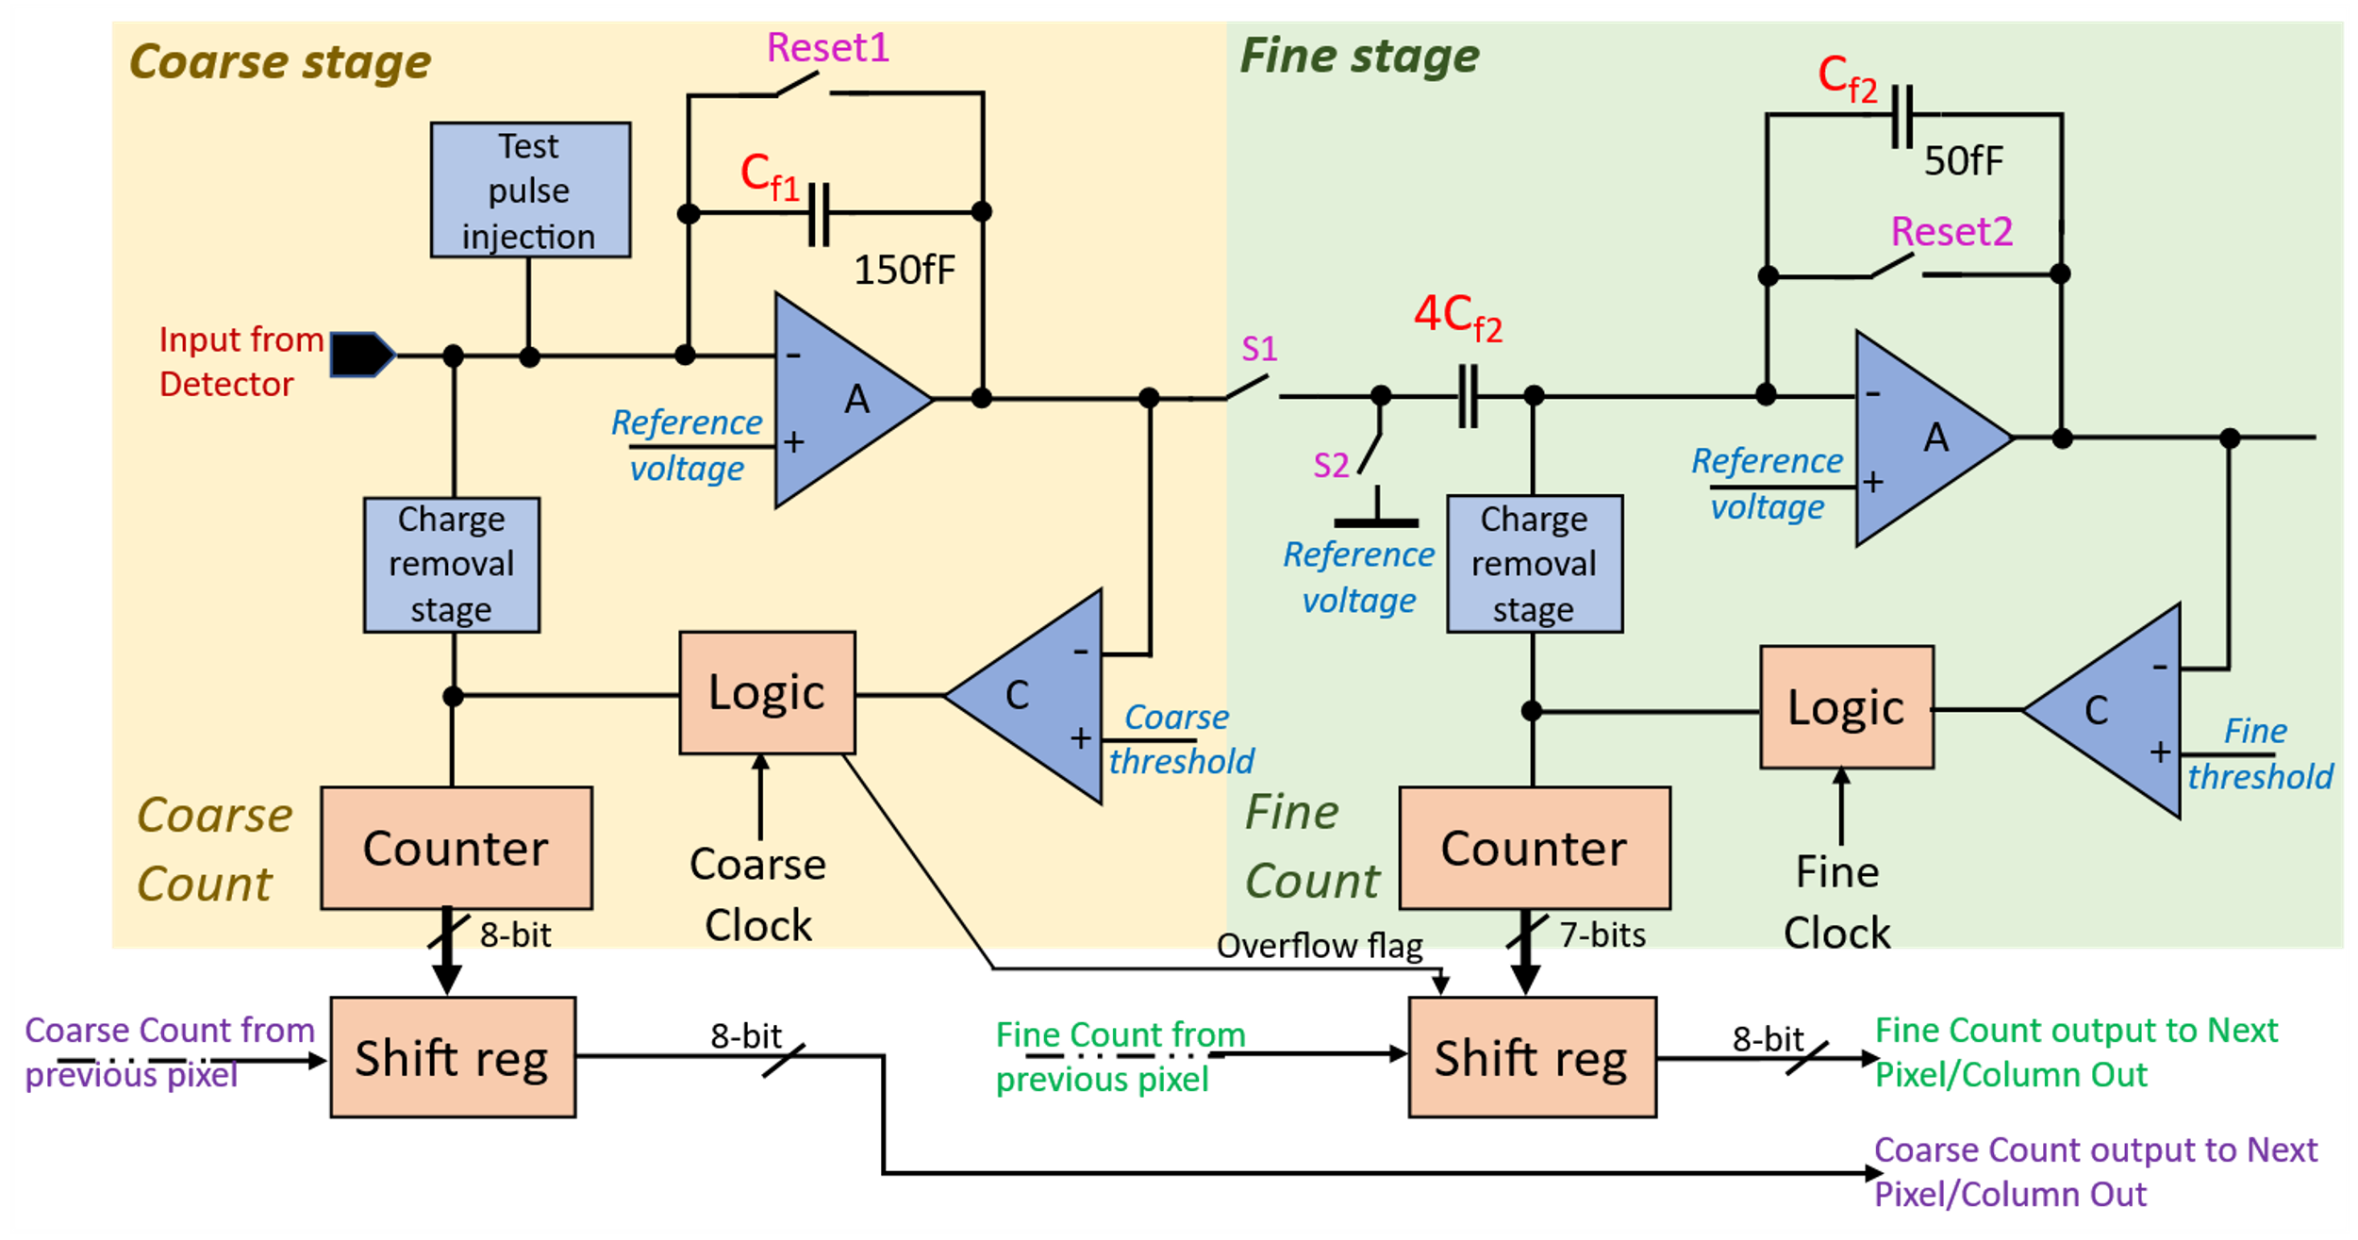
Chip Architecture
Incremental digital integration (per pixel):
2 stage charge cancellation circuit
Signal integrated in coarse stage cancelled and remainder passed to fine stage
Coarse and Fine counters output
Notes:
Start explanation with why we need charge subtraction then discuss how it works

Slide 7
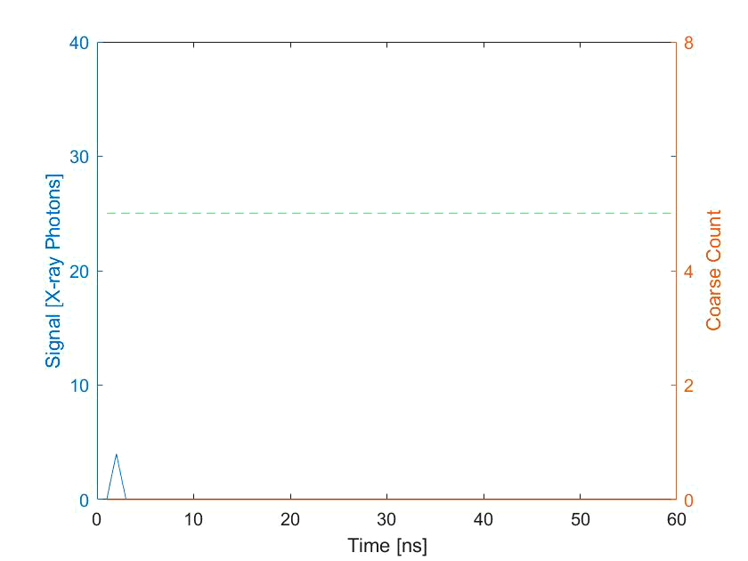
Coarse Stage (<6400 ph/pix/frame @ 30keV)
Signal
Coarse threshold
Coarse counts

Slide 8
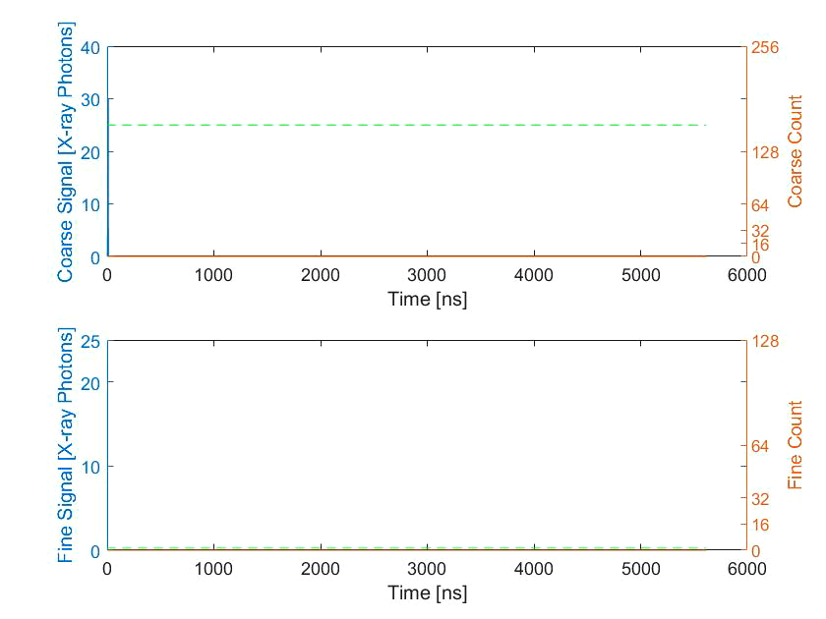
Transfer and Fine Stage (<25 ph/pix/frame @ 30keV)
NEW
FRAME
NEW
FRAME
8bit Coarse
8bit Coarse
7bit Fine
7bit Fine
1 orbit of Diamond
Notes:
CHARGE REMOVAL AND THRESHOLD ARE

Slide 9
Results from beam tests at DLS B16

Slide 10
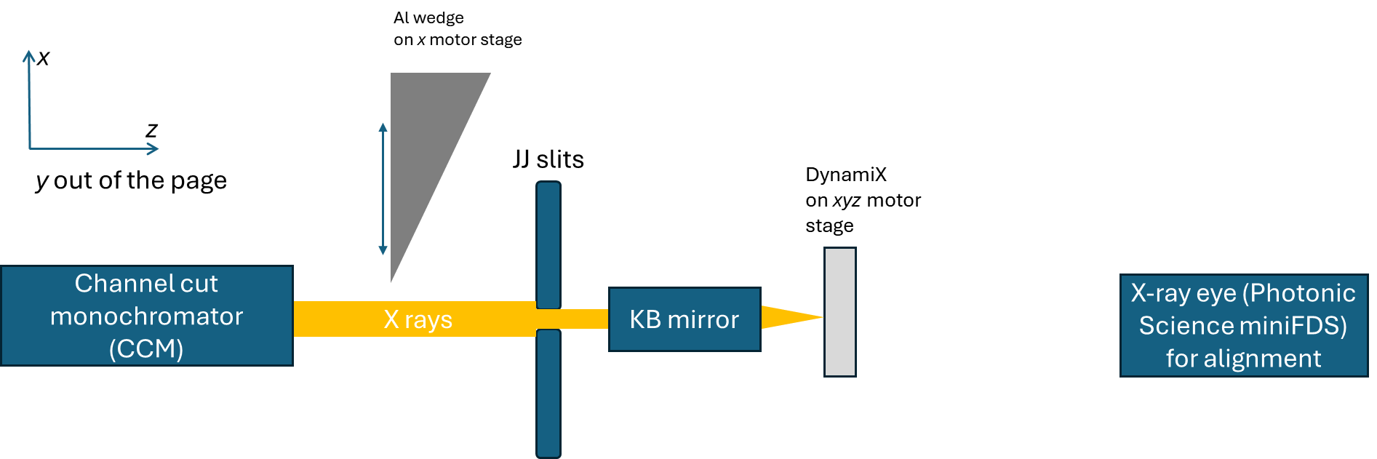
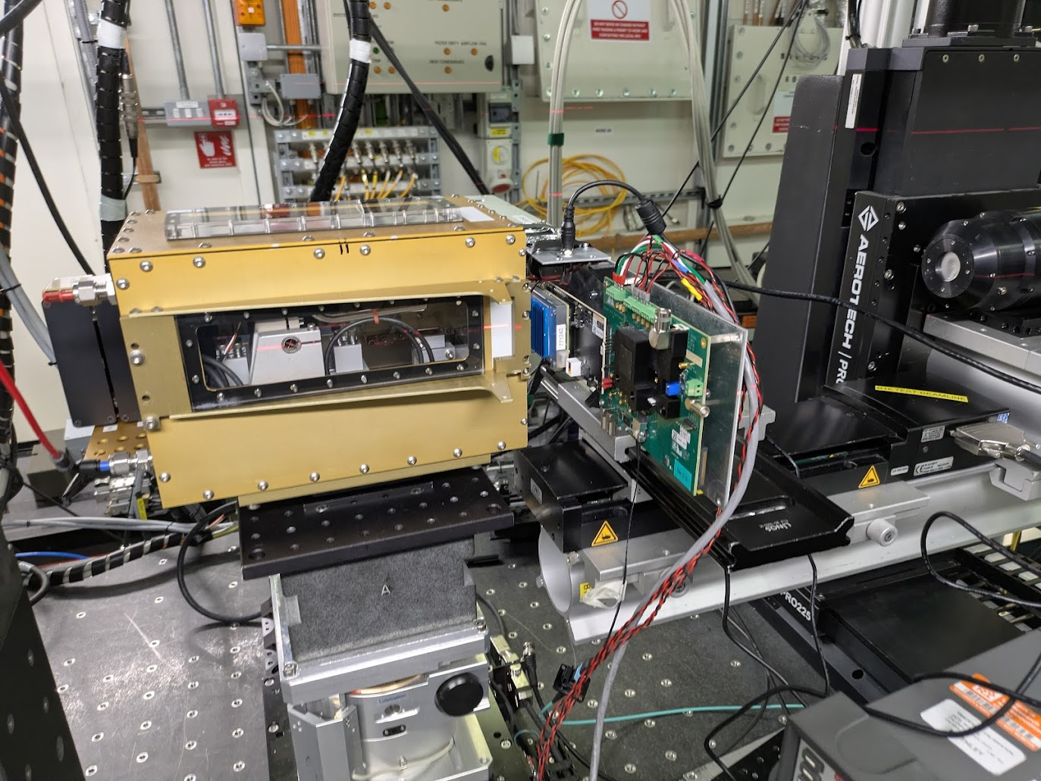
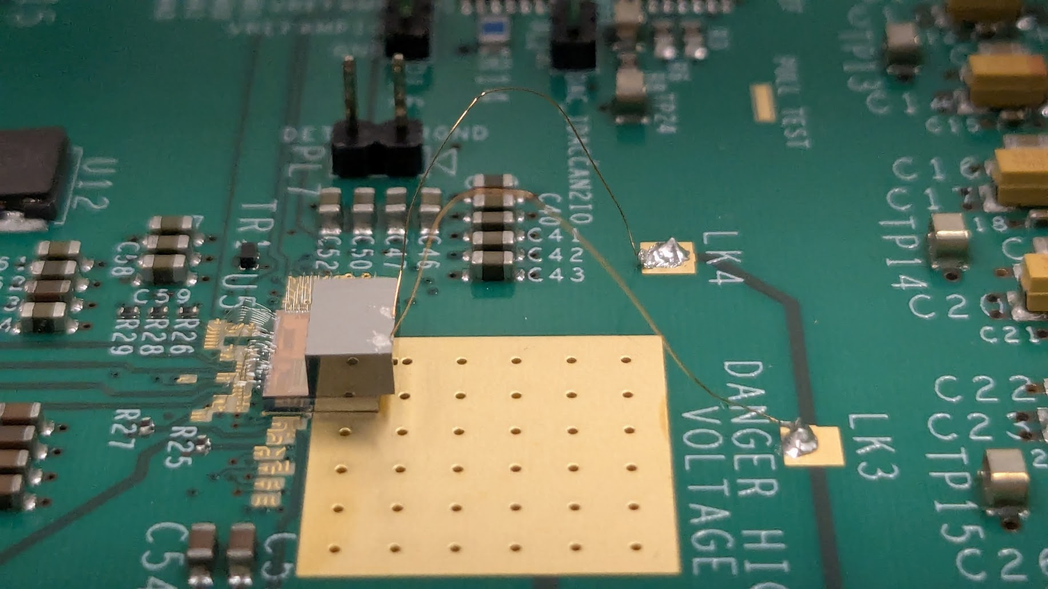
Setup at DLS B16 Test Beamline
Focusing used to access sub-pixel-sized beam
Beam energies of 20,30,40 and 50keV
Sensor biased to -1000V
Later switched to DCM to access higher fluxes at 20keV

Slide 11
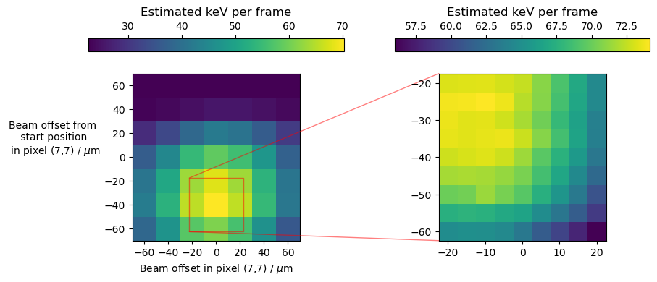
Charge sharing – raster scanning beam within pixel (20keV, ~20µm beam)
Measured signal in pixel strongly depends on beam alignment to centre of pixel
Evidence of charge sharing to neighbouring pixels in CZT
Destroys ability to resolve single photon peaks → challenging to calibrate without pencil beam centred in-pixel
Notes:
PLEASE DELETE/REPLACE PHOTO CREDIT IF CHANGING THE IMAGE.

Slide 12
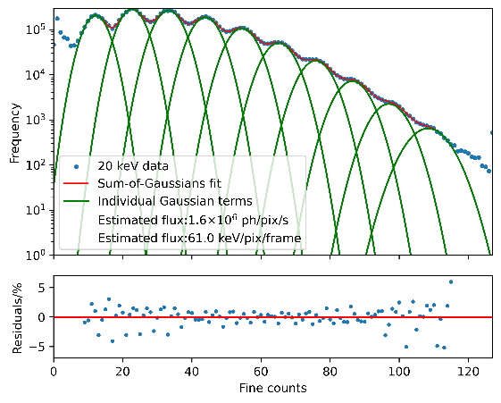
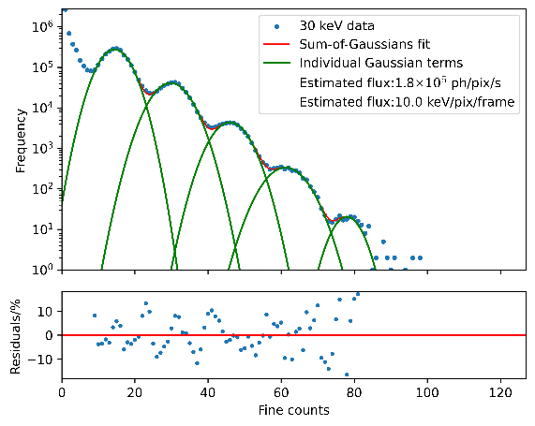
Single photon peaks
20keV
Able to resolve single-photon peaks (up to 10 single-photon peaks for 20keV beam)
Width σ ≈ 5.7keV (≈1200 e⁻ RMS)
Photodiode-measured fluxes:
20keV: 1.58 x10⁶ ph/pix/s
30keV: 2.80 x10⁵ ph/pix/s
30keV

Slide 13
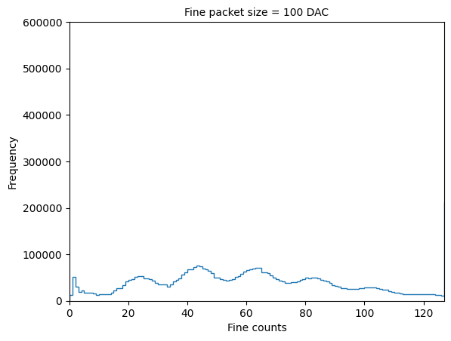
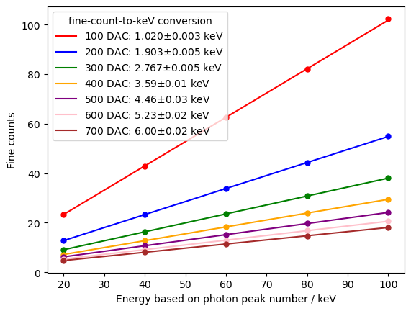
Single photon peaks – changing fine packet size
Measurements taken at 20keV, flux ≈1.6x10⁶ ph/s/pix
Can change digitisation resolution at expense of dynamic range
Smaller packets → more packets to remove same charge
Better quality fit with smaller packets → easier to estimate noise
Settled on packet size 100 DAC as this looks like 1 fine count ≈ 1 keV
Notes:
PLEASE DELETE/REPLACE PHOTO CREDIT IF CHANGING THE IMAGE.

Slide 14
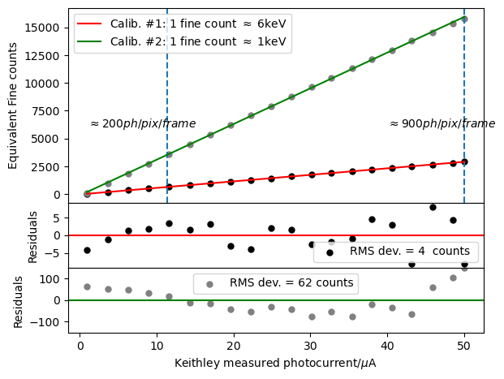
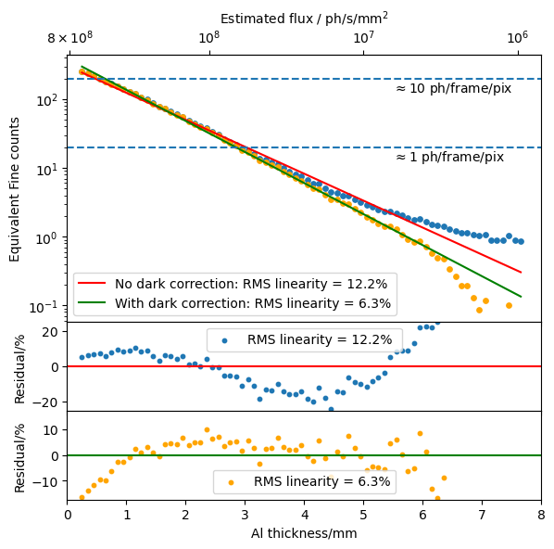
Linearity with increasing flux
Limit of flux from X ray set:
≈3x10¹⁰ ph/s/mm² equiv. @ 20keV
160kV W X-ray set (polychromatic)
20keV beam, moving Al wedge into beam
Design spec:
≈4 x 10¹¹ ph/s/mm² @20keV
Limited by flux available at the beamline, not the DynamiX detector
Notes:
PLEASE DELETE/REPLACE PHOTO CREDIT IF CHANGING THE IMAGE.

Slide 15
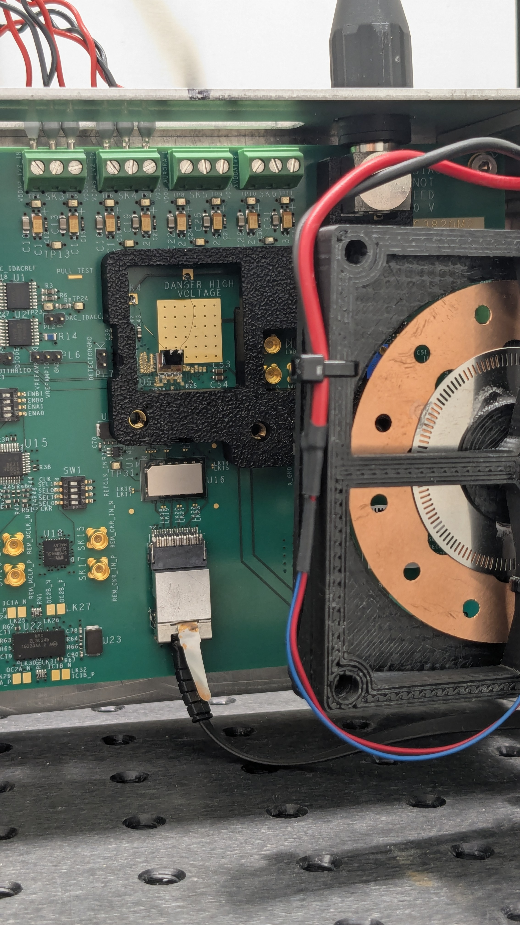
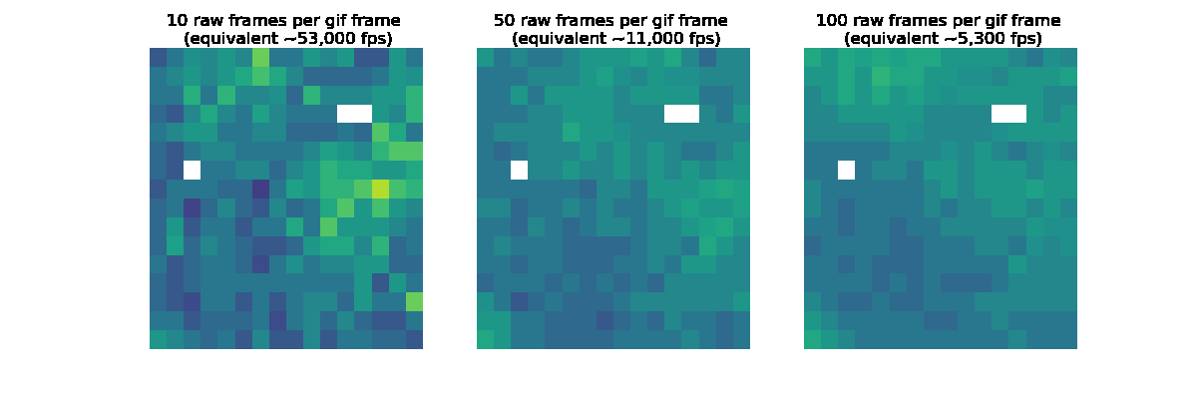
Whole array measurements
Imaged a spinning slitted disc (copper and steel) at 533kHz
100kV tube voltage, 30mA tube current
Frames flat-field corrected
Averaged over windows of 10,50 and 100 frames
Notes:
PLEASE DELETE/REPLACE PHOTO CREDIT IF CHANGING THE IMAGE.

Slide 16
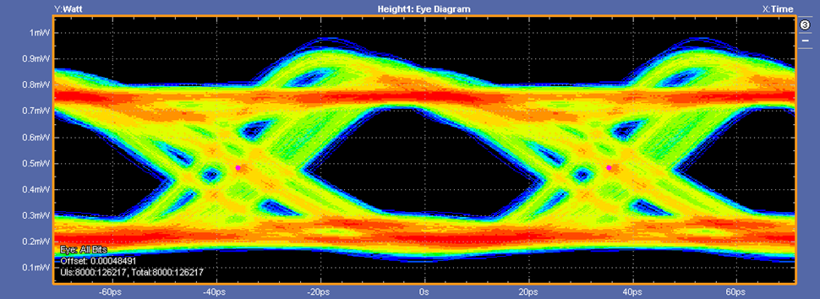
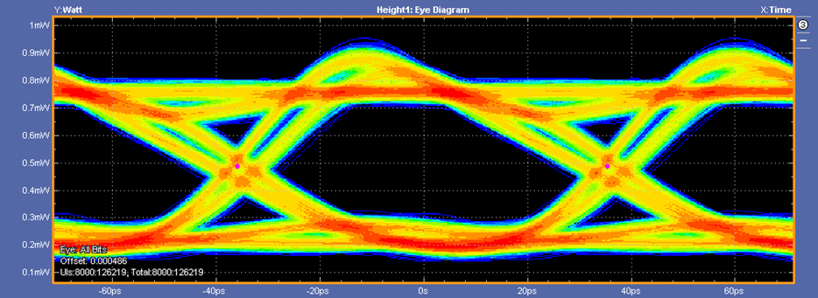
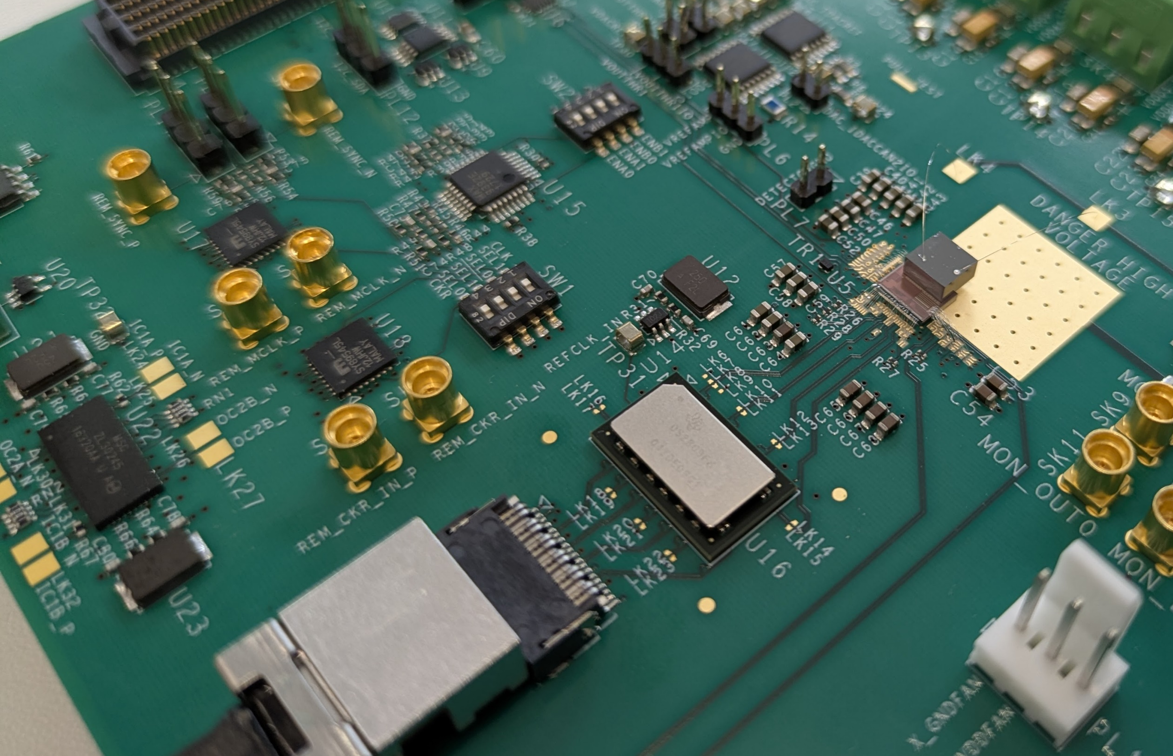
14 Gbps Serialiser Results
Aurora encoded 66b64b CML
14 Gbps working and continuously writing to disc at 534 kfps
Data passes through retimer IC → allows inspection of eye quality
Conversion to optical via Samtec FireFly close to ASIC
Receiver and frame built in FPGA with 100G UDP out
Eye diagrams without and with retiming
Samtec FireFly and retimer IC next to DynamiX ASIC

Slide 17
Towards the full-scale ASIC, XIDyn
DynamiX Chip
XIDER Chip
192 x 144 pixel ASIC, combining XIDER and DynamiX designs
Improvements to pixel design, including:
Increased trim range for calibration of thresholds & packet sizes
Switch to disconnect front end from pixel during transfer to prevent saturation
Submission planned for autumn this year, with wafers expected back in spring

Slide 18
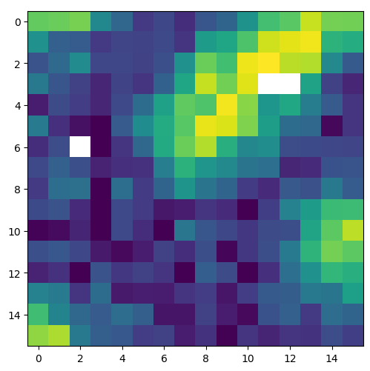
Summary
Testing at B16 DLS in Feb 2025
Continuous full-frame readout at 534 kHz
Able to resolve single photons with width σ ≈ 5.7keV
Measurements taken in range <1ph/pix/frame → ≈900 ph/pix/frame
Submission of full ASIC in autumn, tileable on 3 sides
Upcoming beamtimes at Diamond & ESRF to go to higher fluxes
Single-photon peaks @ 20 keV
Still from imaging spinning slitted disc at 534kfps
Rasting scanning beam within pixel
The DynamiX ASIC with Redlen HF-CZT

Slide 19
Additional Slides

Slide 20
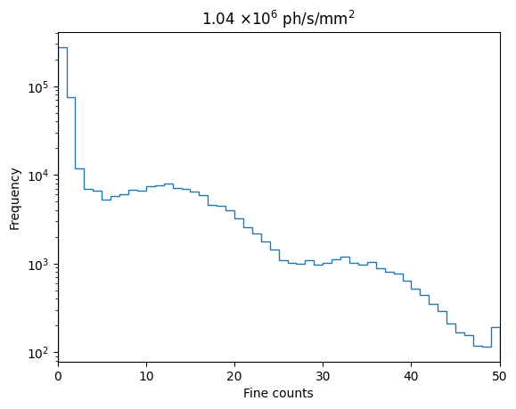
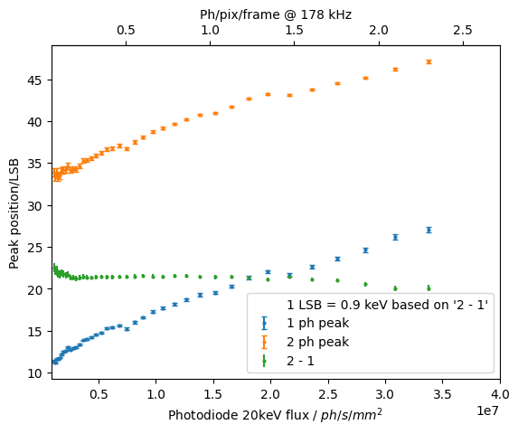
Leakage current shift
(FL = 3 Diamond turns)
1 and 2 photon peaks move to higher channel numbers with increasing flux
With FL = 1 turn, beam 50 µm x 50 µm, excess leakage current density in this flux range ≈ 41 nA/mm²
This effect has been seen in Redlen HF CZT before, e.g. Cline and XIDER
Notes:
PLEASE DELETE/REPLACE PHOTO CREDIT IF CHANGING THE IMAGE.

Slide 21
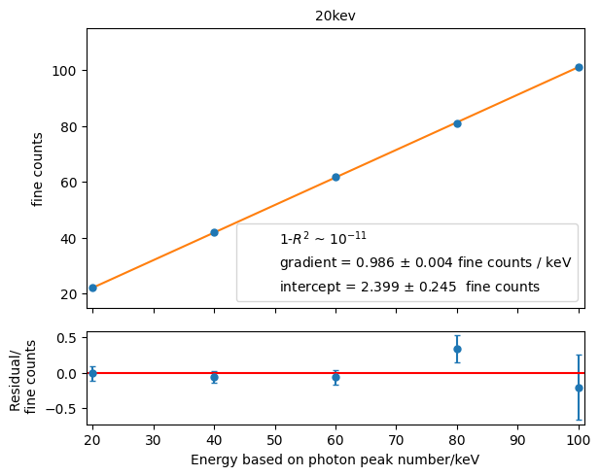
Calibrating from single photon peaks
(aim: 1 coarse = 64 fine)
1.Determine ADU → keV conversion from photon peak spacing
Notes:
PLEASE DELETE/REPLACE PHOTO CREDIT IF CHANGING THE IMAGE.

Slide 22
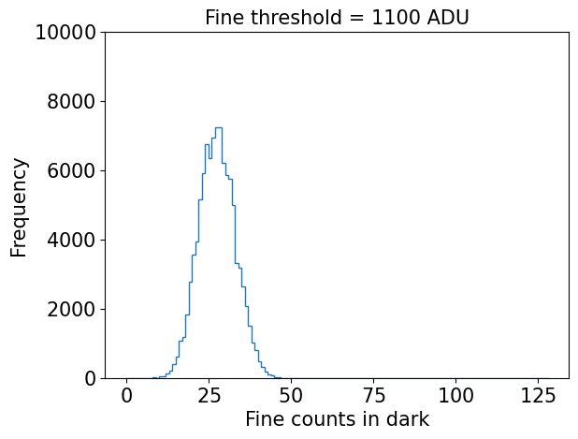
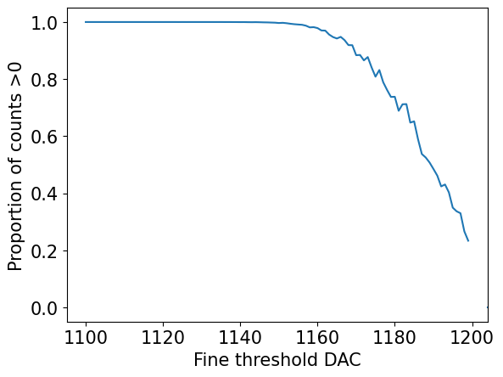
Calibrating from single photon peaks
(aim: 1 coarse = 64 fine)
1.Determine ADU → keV conversion from photon peak spacing
2.Change fine threshold to move noise peak to 0
Find threshold such that 50% counts are >0
Notes:
PLEASE DELETE/REPLACE PHOTO CREDIT IF CHANGING THE IMAGE.

Slide 23
Calibrating from single photon peaks
(aim: 1 coarse = 64 fine)
1.Determine ADU → keV conversion from photon peak spacing
2.Change fine threshold to move noise peak to 0
Find threshold such that 50% counts are >0
Can also estimate noise:
Look at σ of dark counts where distribution is well away from 0
σ ≈ 5.50 LSB ≈ 5.57 keV ≈ 1210 e⁻
150fF fine stage feedback, includes leakage + sensor capacitance
Notes:
PLEASE DELETE/REPLACE PHOTO CREDIT IF CHANGING THE IMAGE.

Slide 24
Calibrating from single photon peaks
(aim: 1 coarse = 64 fine)
1.Determine ADU → keV conversion from photon peak spacing
2.Change fine threshold to move noise peak to 0
Find threshold such that 50% counts are >0
3.Find test pulse setting to give 64 fine counts (≈65 keV)
Notes:
PLEASE DELETE/REPLACE PHOTO CREDIT IF CHANGING THE IMAGE.

Slide 25
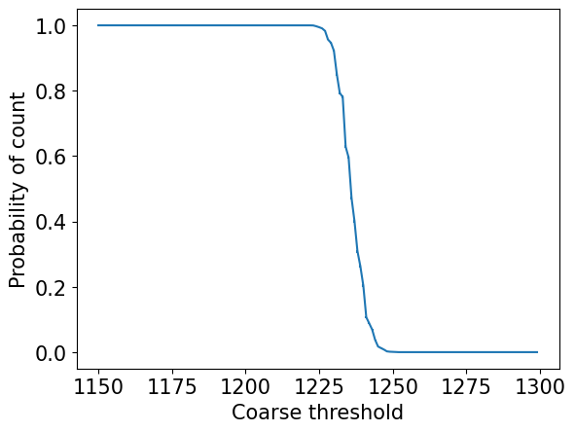
Calibrating from single photon peaks
(aim: 1 coarse = 64 fine)
1.Determine ADU → keV conversion from photon peak spacing
2.Change fine threshold to move noise peak to 0
Find threshold such that 50% counts are >0
3.Find test pulse setting to give 64 fine counts (≈65 keV)
4.Sweep coarse threshold while injecting 64 fine counts
Find threshold such that 50% chance of triggering
Set threshold slightly higher to avoid cancelling below baseline
Notes:
PLEASE DELETE/REPLACE PHOTO CREDIT IF CHANGING THE IMAGE.

Slide 26
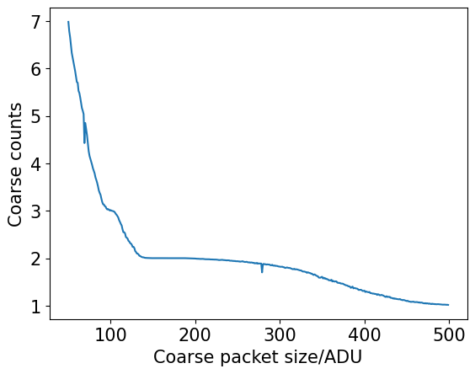
Calibrating from single photon peaks
(aim: 1 coarse = 64 fine)
1.Determine ADU → keV conversion from photon peak spacing
2.Change fine threshold to move noise peak to 0
Find threshold such that 50% counts are >0
3.Find test pulse setting to give 64 fine counts (≈65 keV)
4.Sweep coarse threshold while injecting 64 fine counts
Find threshold such that 50% chance of triggering
Set threshold slightly higher to avoid cancelling below baseline
5.Inject 3 coarse counts (=3 x 64 fine counts) and sweep coarse packet size
Find maximum packet corresponding to 2 coarse counts
Notes:
PLEASE DELETE/REPLACE PHOTO CREDIT IF CHANGING THE IMAGE.

Slide 27
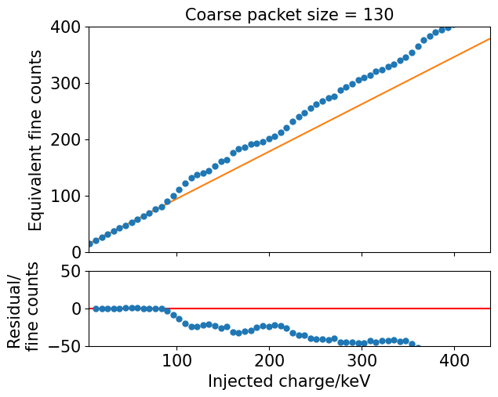
Calibrating from single photon peaks
(aim: 1 coarse = 64 fine)
1.Determine ADU → keV conversion from photon peak spacing
2.Change fine threshold to move noise peak to 0
Find threshold such that 50% counts are >0
3.Find test pulse setting to give 64 fine counts (≈ 65 keV)
4.Sweep coarse threshold while injecting 64 fine counts
Find threshold such that 50% chance of triggering
Set threshold slightly higher to avoid cancelling below baseline
5.Inject 3 coarse counts (=3 x 64 fine counts) and sweep coarse packet size
Find maximum packet corresponding to 2 coarse counts
6.Fine-tune coarse packet size by verifying goodness of fit while injecting increasing charge per frame
Fit only where injected charge < coarse thresh
Notes:
PLEASE DELETE/REPLACE PHOTO CREDIT IF CHANGING THE IMAGE.

Slide 28
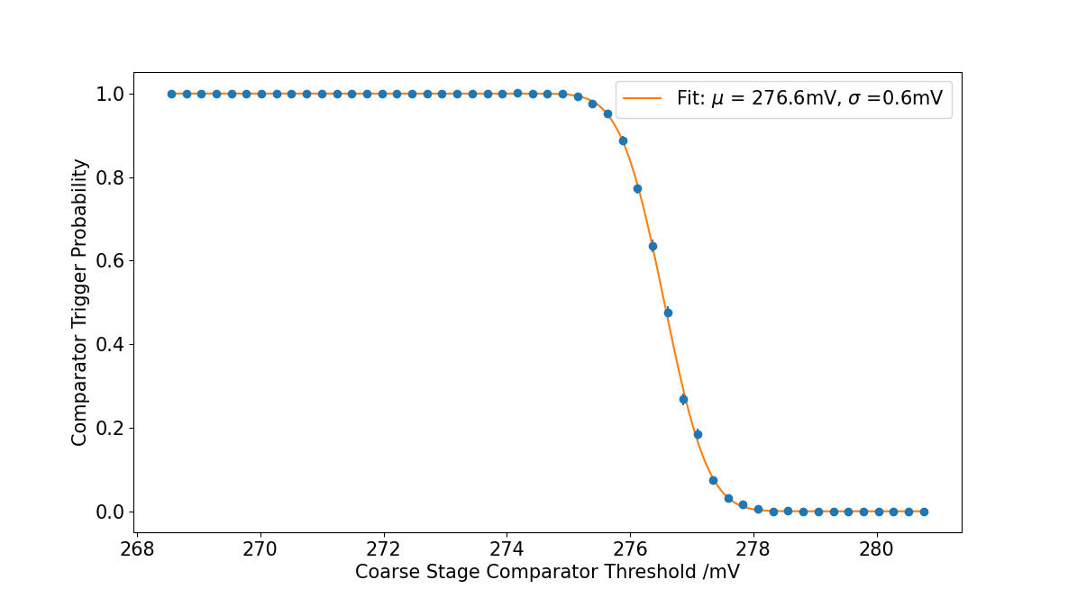
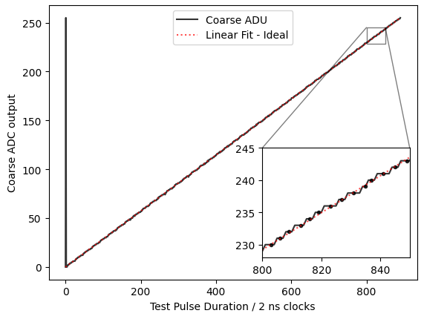
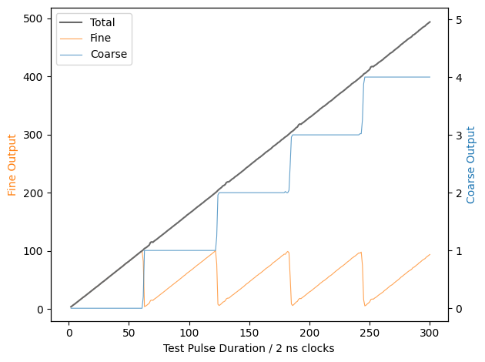
Pixel Test Results – Coarse Stage (inbuilt test pulse)
DNL 0.2 +/- 0.1
INL 0.7 +/- 0.3
Noise certainly below coarse threshold – does NOT trigger a count
Noise certainly above coarse threshold – triggers a count
Sweep coarse stage threshold → measure coarse output → repeat to obtain probability of triggering → determine dark noise
Injected test current (a.u.)
Injected test current (a.u.)
Vary input test current → measure coarse ADC output
Vary input test current → measure coarse and fine counts

Slide 29
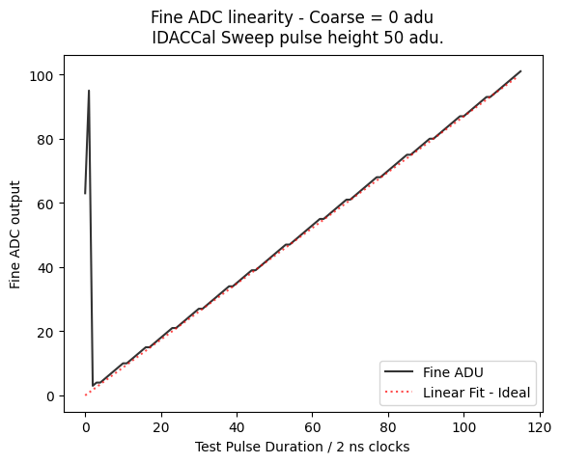
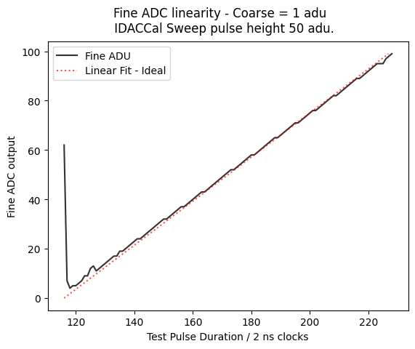
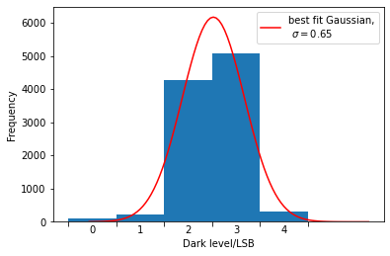
Pixel Test Results – Fine Stage (inbuilt test pulse)
1 fine count = 0.25 of 30keV Photon
Fine stage ADC linearity
Coarse =0
Coarse =1
Dark level/ fine counts
Injected test current (a.u.)
No current injected → measure counts due to noise
Increase injected current → measure fine ADC output

Slide 30
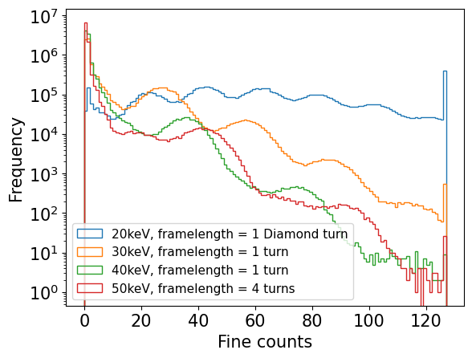
Single photon peaks
Monochromatic beam focused to sub-pixel level ≈50 μm x 50 μm and centred in pixel
Can resolve single photon peaks with a width σ ≈ 5.7keV (~1200 e- RMS)
Misalignment between peaks of same energy:
μ_{2x20 keV} ≠ μ_{40 keV}
μ_{3x20 keV} ≠ μ_{2x30 keV}
…
Thought to be due to flux-dependent excess leakage current in HF-CZT
40 keV
60 keV
80 keV
100 keV
Notes:
PLEASE DELETE/REPLACE PHOTO CREDIT IF CHANGING THE IMAGE.

