Slide 1


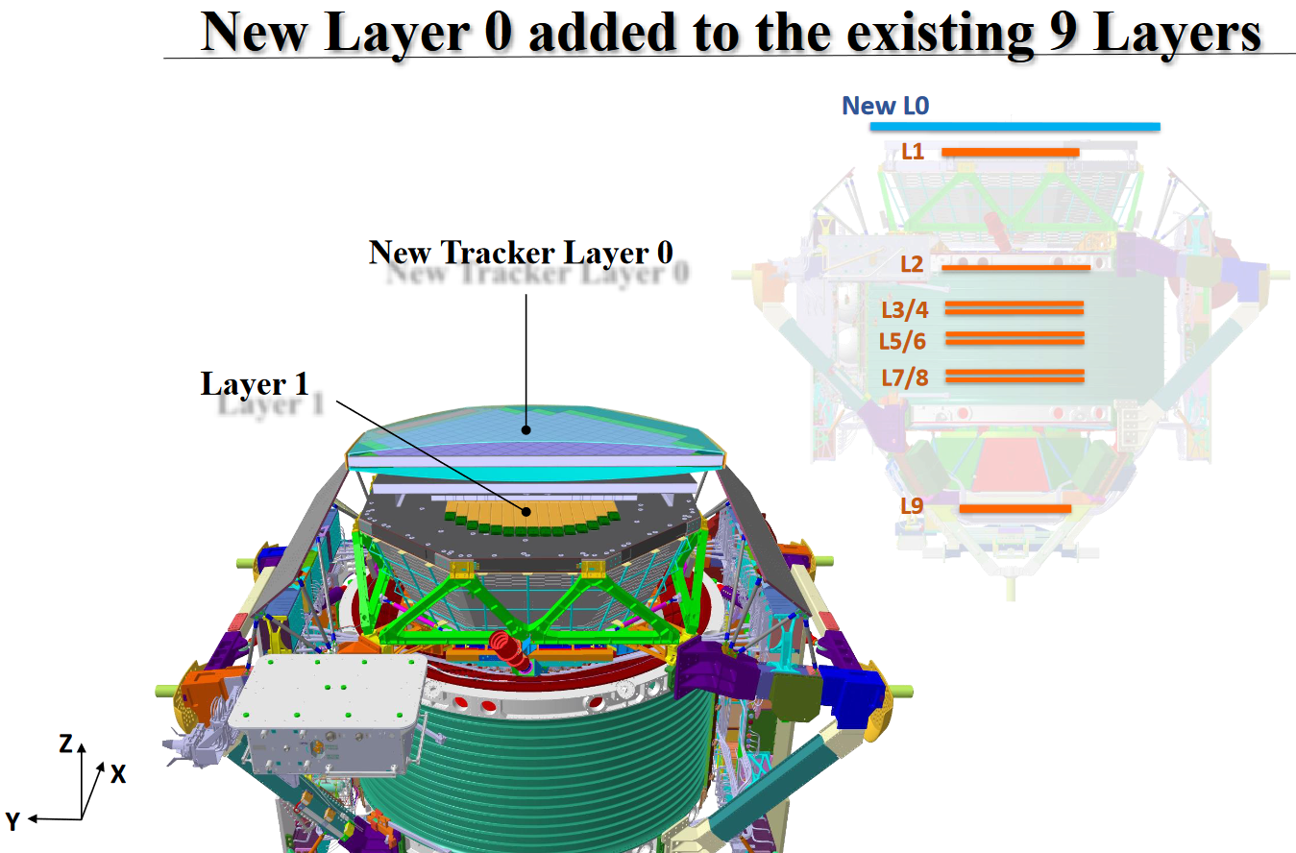
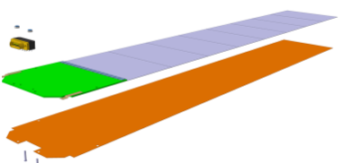
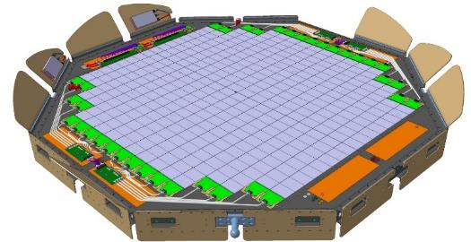
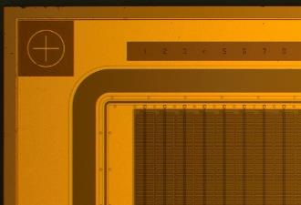


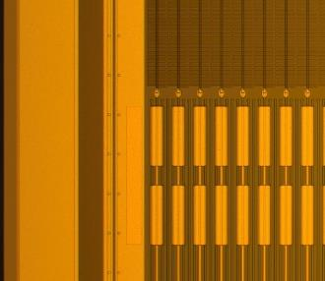
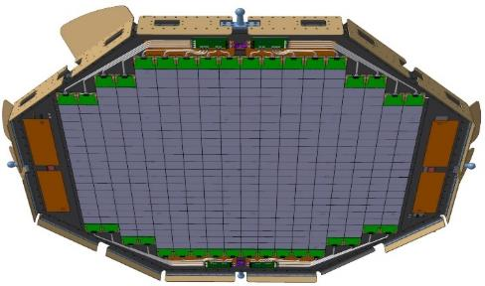
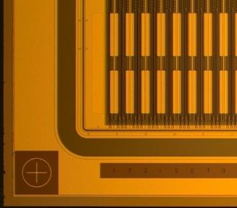
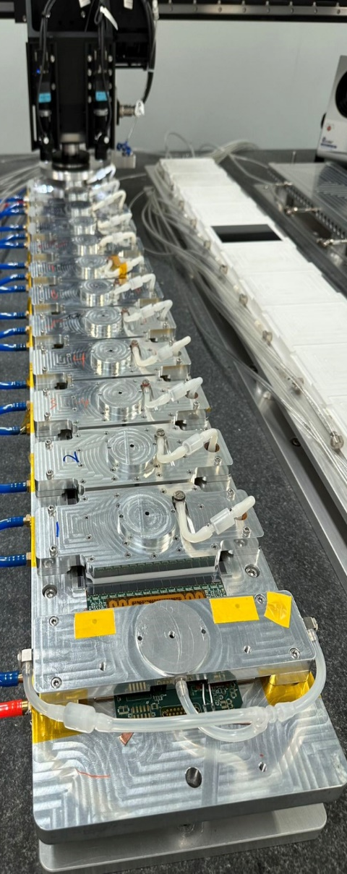
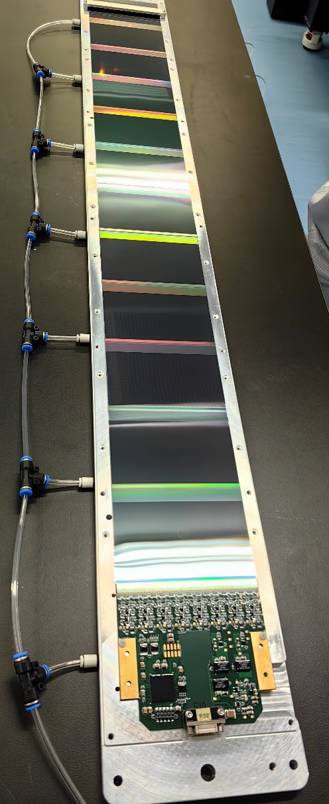
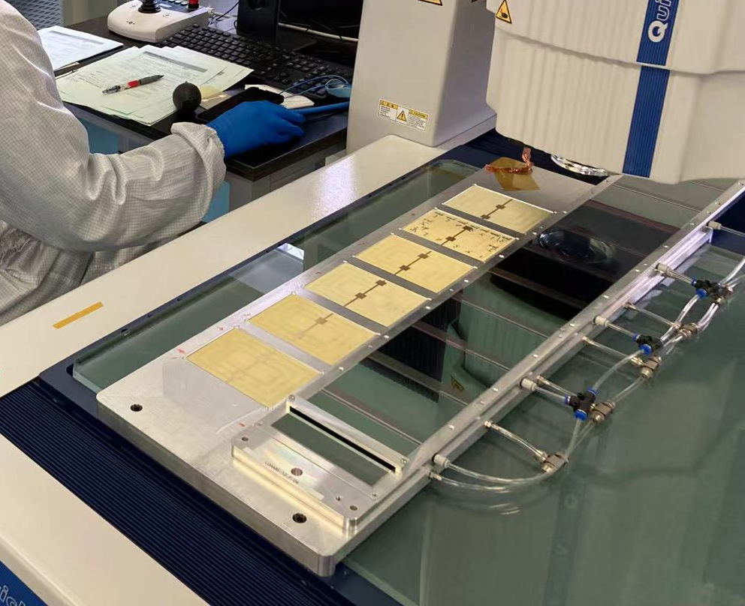
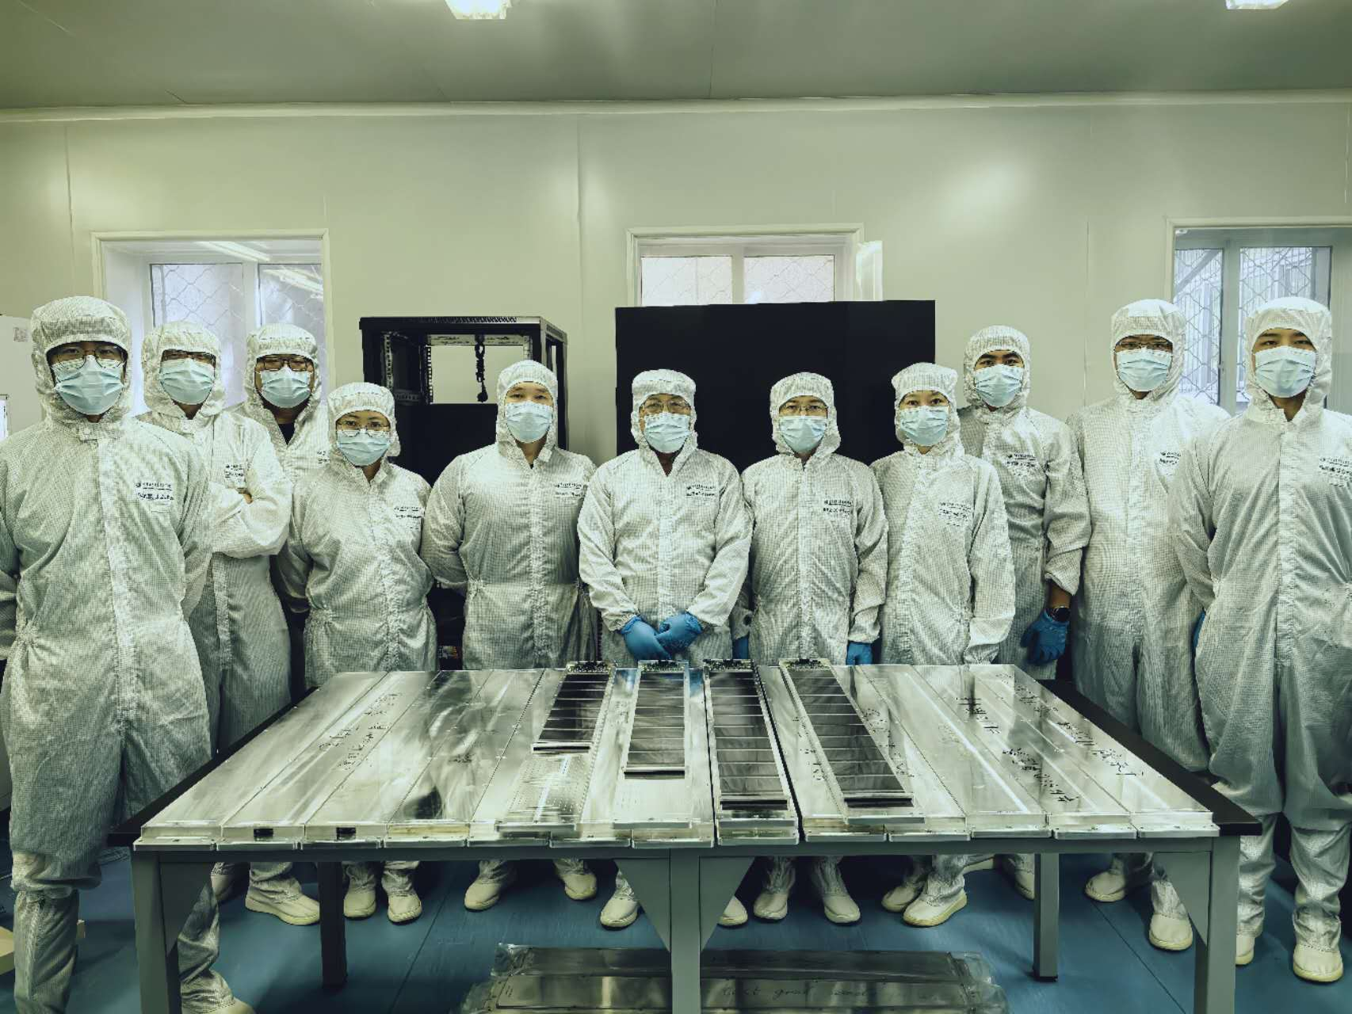
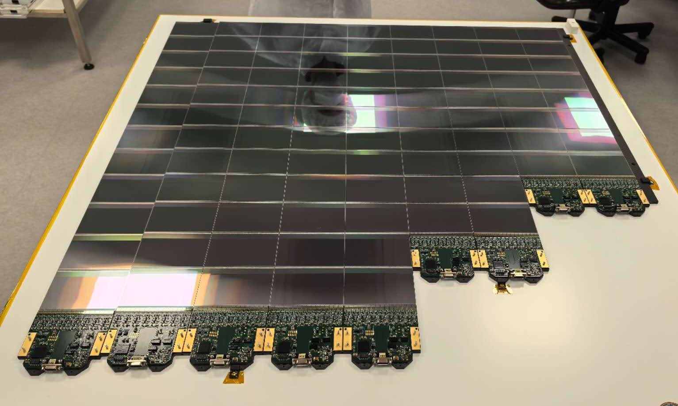
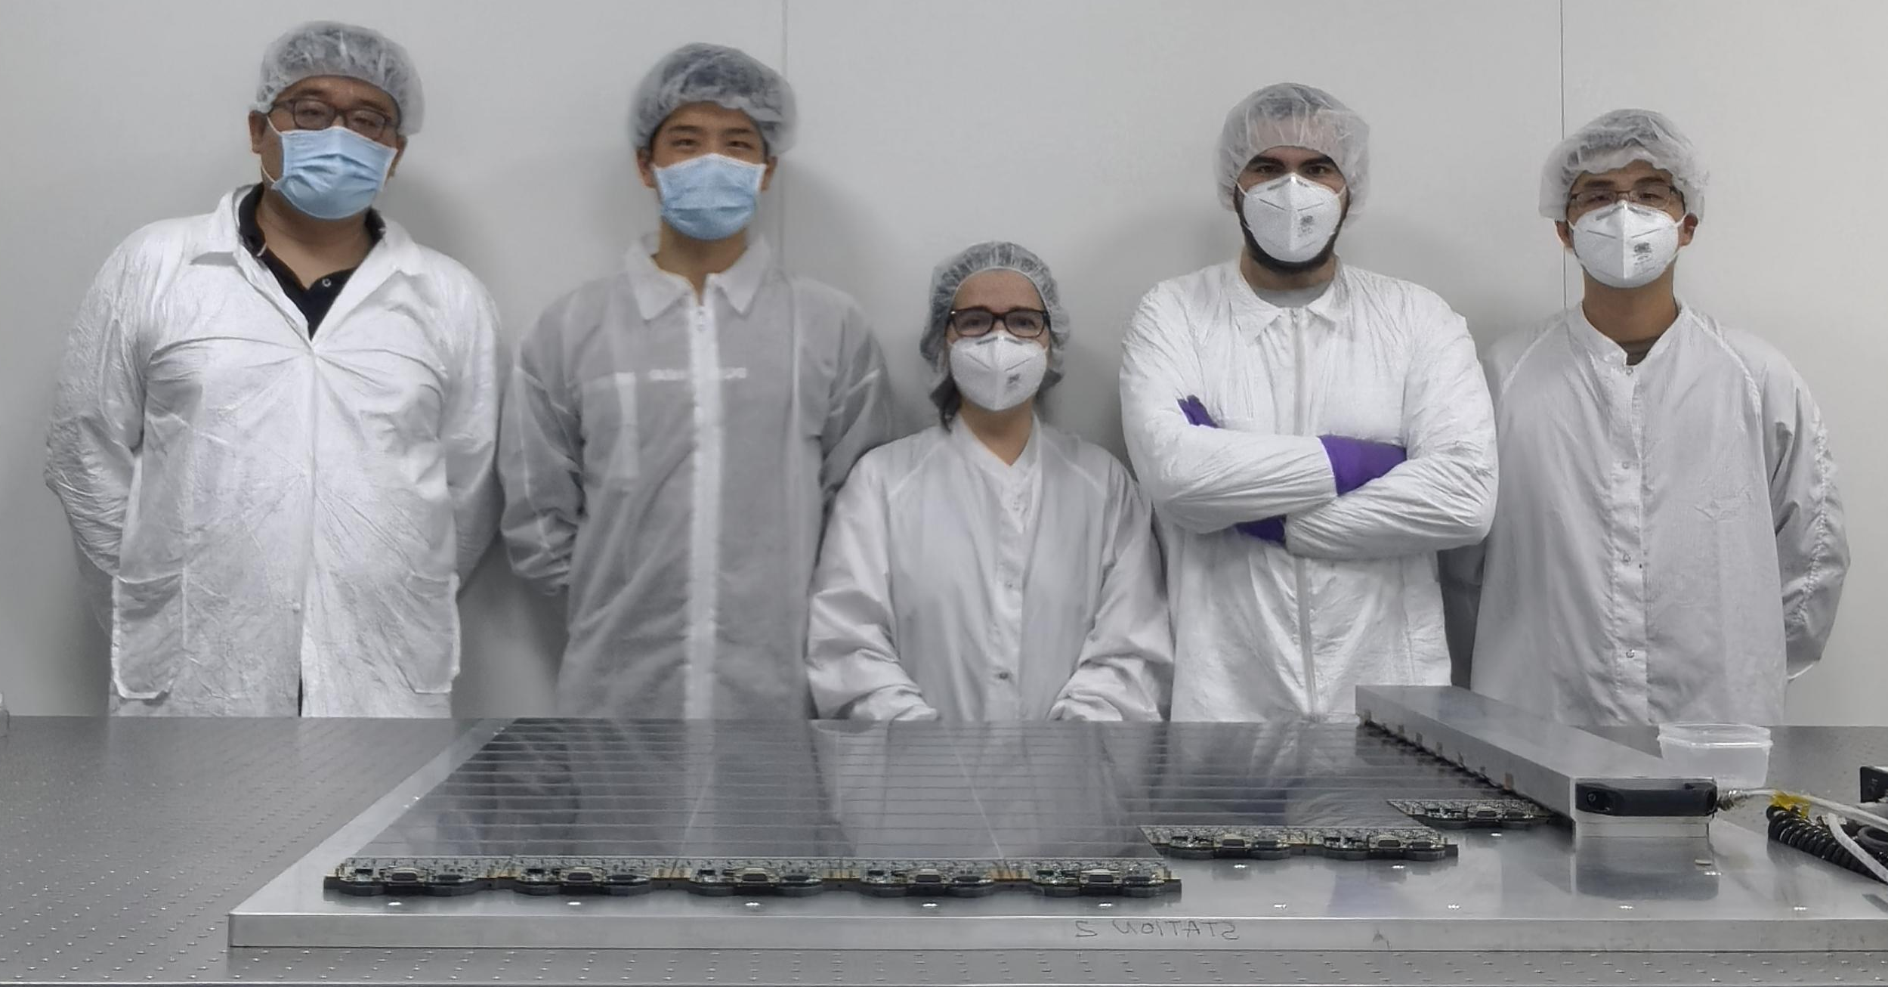
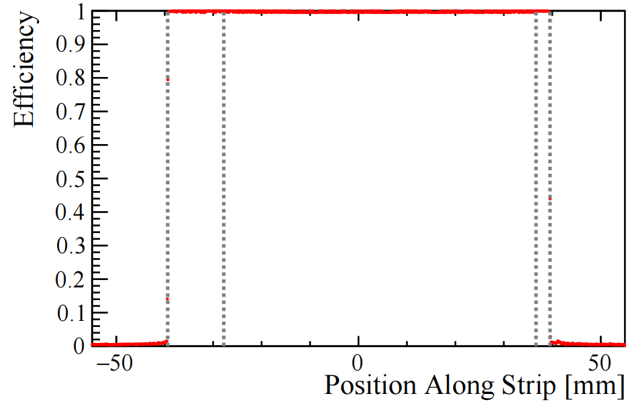
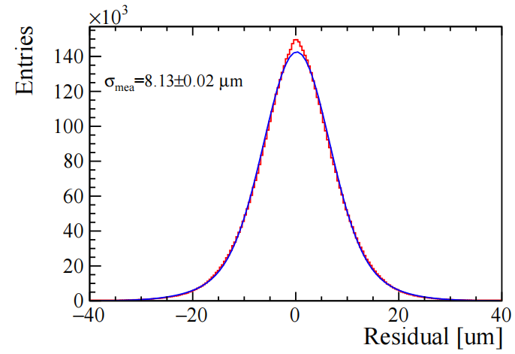
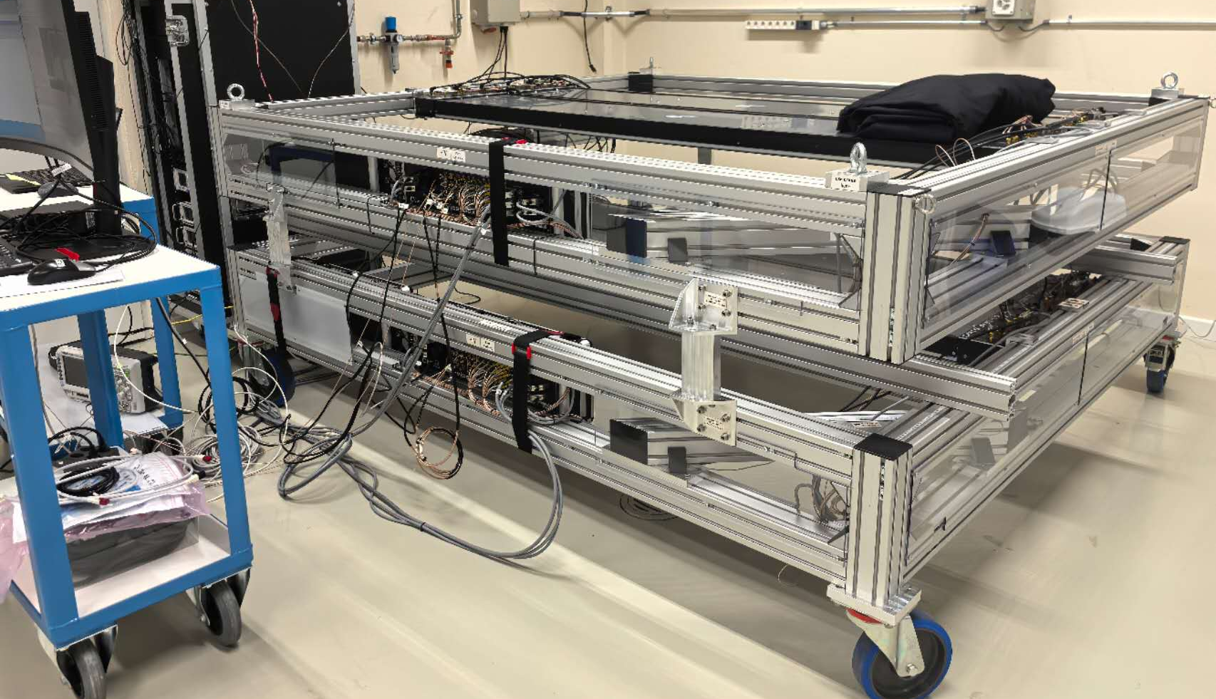
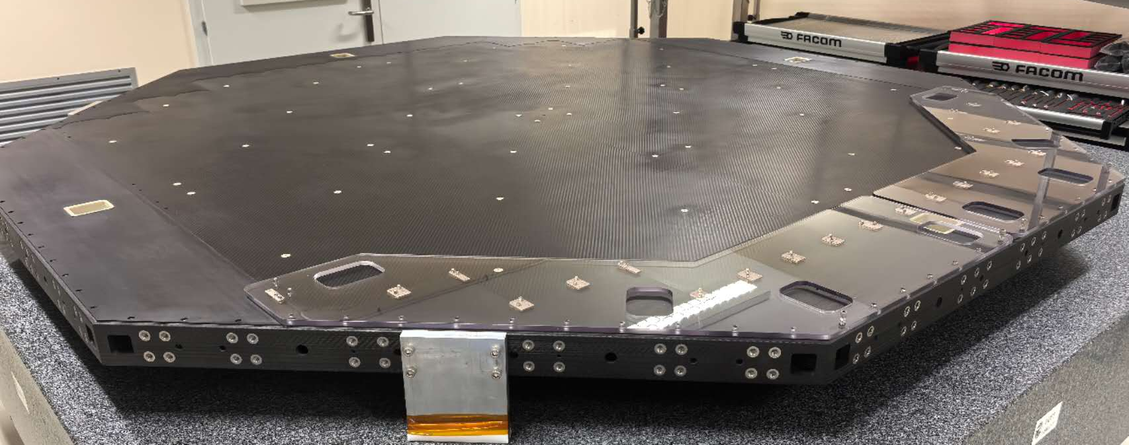
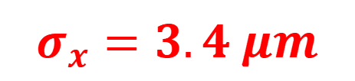
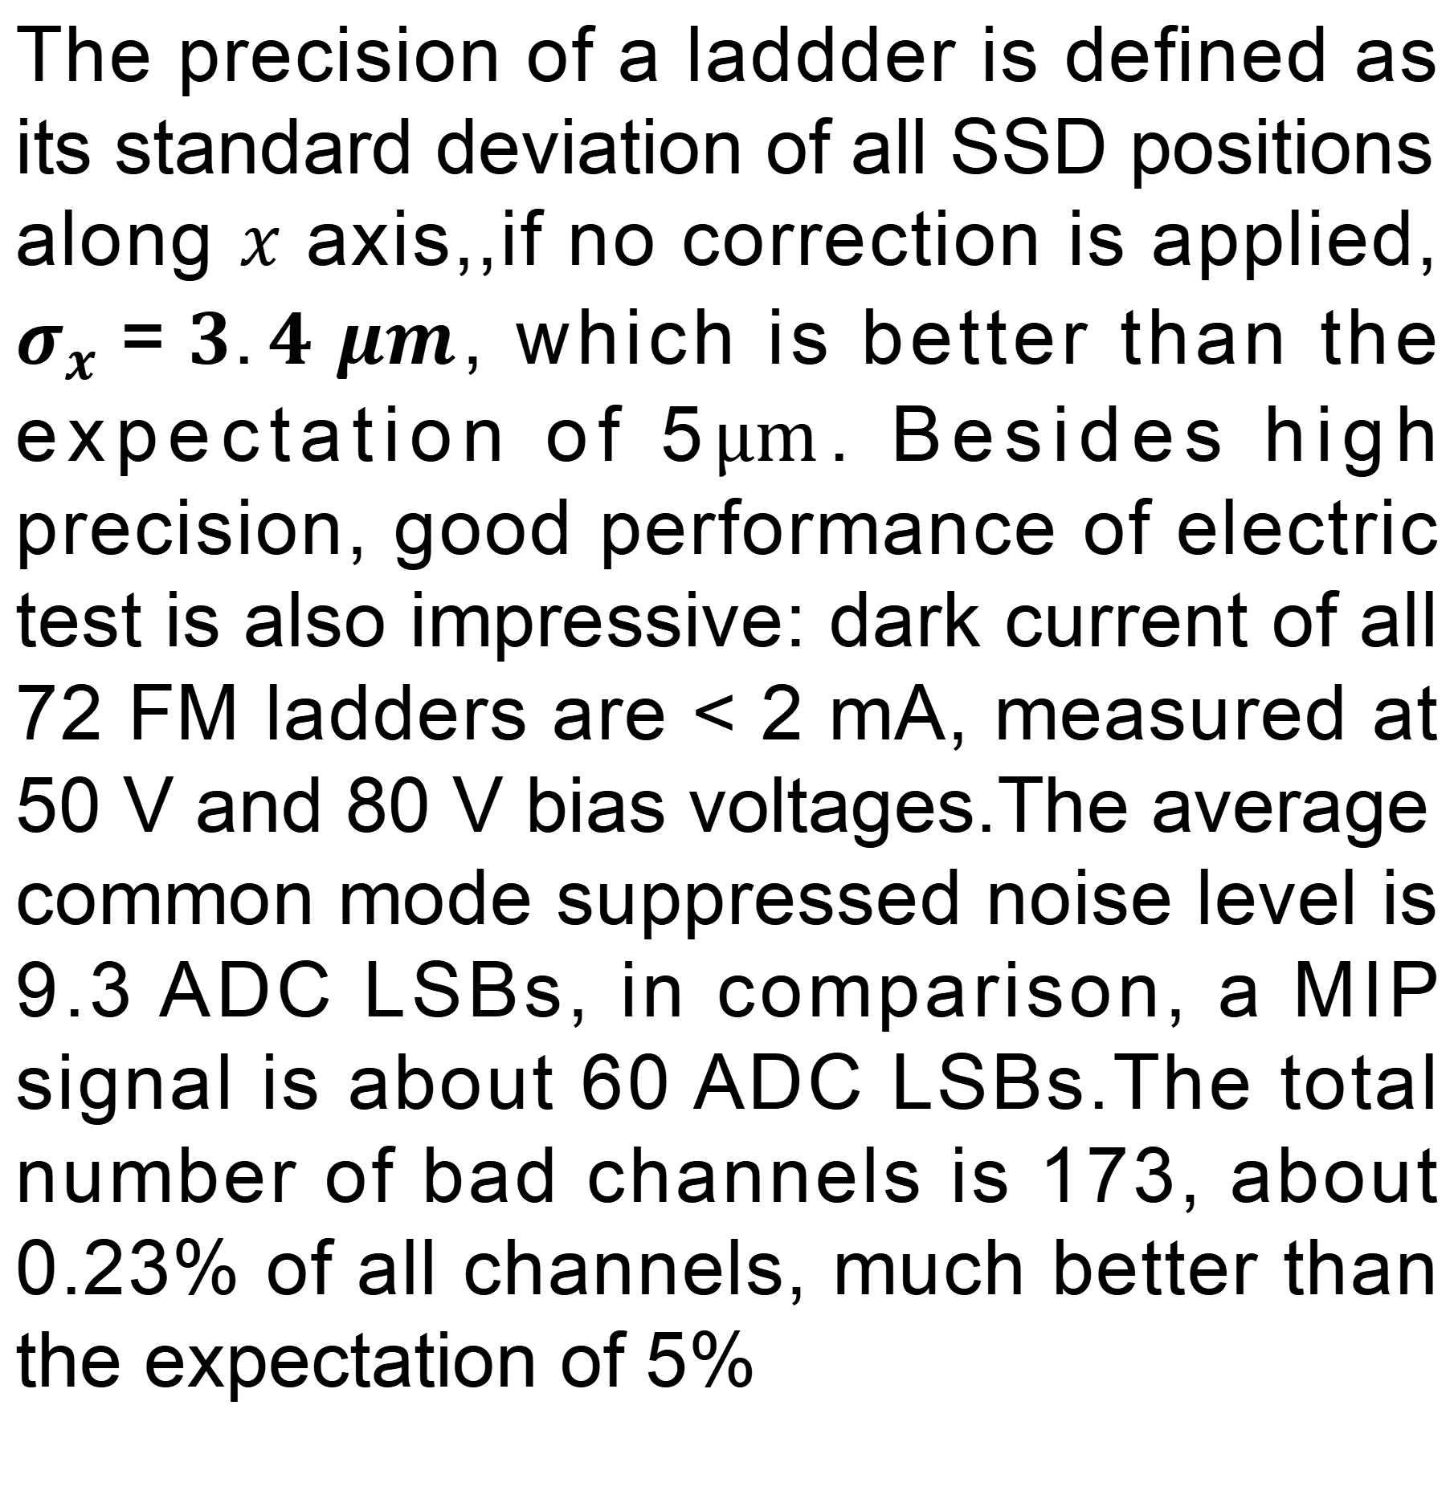
Poster ID：107
The Layer 0 upgrade of the AMS-02 experiment on the ISS
Qinze Li on behalf of AMSL0 team
Institute of High Energy Physics, CAS
AMS-02 and L0 Upgrade
AMS is a multipurpose particle physics detecor installed on the International Space Station. The objective of the experimental includes search of dark matter, the primordial anti-matter, and the origin and propagation of cosmic rays. AMS-02 detector has a large acceptance and is designed to provide precise measurement of charged cosmic rays. Components of the detector include: a silicon tracker, four planes of TOF scintillation counter, a transition radiation detector, a ring imaging Cherenkov detector, an electromagnetic calorimeter, and permanent magnet.
Detector Ladder
L0 tracker
  2 planes
  72 ladders
  768 detectors
AMSL0 increases the acceptance of cosmic rays to 300% and significantly improves the ability of identifying heavy ions. The L0 layer has two planes, each consists of 4 QLs(Quarter Layer), one QL is composed of 2, 2, 5 ladders of three different sizes: 8, 10, 12-SSD(Silicon Strip Detector). The main responsibility of IHEP is to produce all 72+4(spear) high quality ladders. The following stages, integration of QL and the full layer, is conducted in INFN-Perugia and CERN.
Top View
LEF
Y
12 × SSD
X
Bottom View
12 × SSD
(Silicon Strip Detector)
Wirebondings
IDE1140
ASIC
Frontend Electronics Board
LEF
fiducial mark
SSD
Y
Not to scale
LBB (L0 Bias Board)
X
Ladder Assembly Procedure
Chinese team (IHEP and SDIAT) use a custom designed robotic gantry to achieve high precision assembly, the sigma of positions in $x$ axis is better than 5$μm$, which can significantly improve spatial resolution of the detector, it is also the highlight of the work. The gantry can move in four dimensions: $x, y, z, θ$ with 1$μm$ and ${10}^{−6} rad$ precision. There are two high resolution cameras on the gantry head that can recognize two fiducial marks on one SSD simultaneously , they provide real-time coordinates information of SSD. Once the ladder is assembled, an optical metrology system is used to measure all the fiducial marks and fit the coordinates to give the sigma in $x$ axis.
rotation
•
•
•
•
•
•
•
•
X
Y
Assembling
Ladder
optical metrology system
High Quality Result
Since July 2022, IHEP team have devoted more than two years on research and production, in September 2024 we finished production of all L0 detector 72 FM ladders and 4 spares.
QL integration is operated in SERMS-INFN Perugia, all 8 QLs have been finished by IHEP, SDIAT and INFN team before 24 April, 2025, they will go through thermal vacuum test and metrology before being integrated as a full layer in CERN.
$$σ_{x}=3.4 μm$$
QL
The performance of a single SSD was investigate by beam test using beam on SPS in November 2024. As a result, the sensitive area of SSD gets an overall efficiency of 99.8 % and spatial resolution 7.6 µm for MIPs.
32+2 FM Ladders (8/10-SSD)
40+2 FM Ladders (12-SSD)
The precision of a laddder is defined as its standard deviation of all SSD positions along $x$ axis,,if no correction is applied, $σ_{x}=3.4 μm$, which is better than the expectation of 5$μm$. Besides high precision, good performance of electric test is also impressive: dark current of all 72 FM ladders are < 2 mA, measured at 50 V and 80 V bias voltages.The average common mode suppressed noise level is 9.3 ADC LSBs, in comparison, a MIP signal is about 60 ADC LSBs.The total number of bad channels is 173, about 0.23% of all channels, much better than the expectation of 5%
Currently, QLs are under metrology tests and CMT(Cosmic Muon Test). During the CMT, we set QLs as a cosmic muons counter with a scintillator system, to check the noise and the electronic performance. At the same time, hardware preparations related to the final assembly of full layers are also in process.
supporting plane
CMT
E-mail: liqz@ihep.ac.cn
26th International Workshop on Radiation Imaging Detectors
Nov 6-10, 2025, Bratislava, Slovakia

