Slide 1
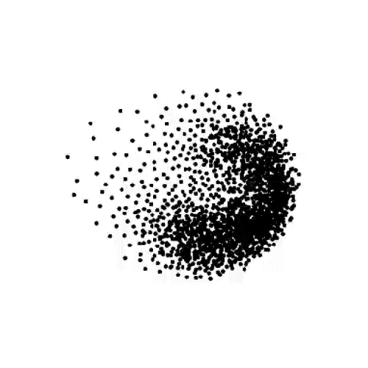
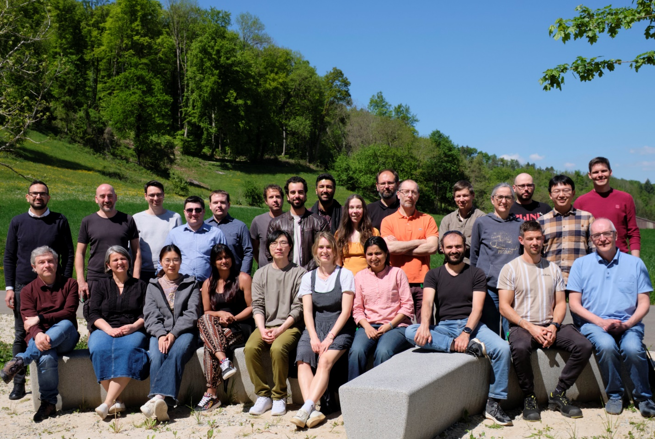
Detector Developments for the Swiss Light Source Upgrade
A. Bergamaschi, M. Brückner, M. Carulla, R. Dinapoli, S. Ebner, K. Ferjaoui, E. Fröjdh, V. Gautam, D. Greiffenberg, S. Hasanaj, A. Haugdal, J. Heymes, V. Hinger, V. Kedych, T. King, S. Li, C. Lopez-Cuenca, A. Mazzoleni, D. Mezza, K. Moustakas, A. Mozzanica, J. Mulvey, M. Müller, K.A. Paton, C. Posada Soto, C. Ruder, B. Schmitt, P. Sieberer, S. Silletta, D. Thattil, X. Xie, J. Zhang
Center for Photon Science, Paul Scherrer Institute (Switzerland)
IWORID20205, Bratislava (SK)
Monday 7th July 2025
Notes:
The Swiss Light Source is nearing the completion of its upgrade to a fourth-generation synchrotron, significantly enhancing its brilliance. This leads to a higher photon flux, while improving the coherence of the beam across the entire energy spectrum, from extreme ultraviolet to 80 keV hard X-rays.
To support the increased photon rates, we are developing the MATTERHORN detector, a single-photon counting pixel detector with a 75 µm pitch. It features faster shaping and utilizes multiple comparators and counters to achieve a count rate of up to 20 MHz per pixel with 90% efficiency. The novel digital readout architecture allows for a frame rate of up to 10 kHz with a single counter per pixel in 16-bit mode. This fast readout technology can also be combined with on-chip digitization in our charge-integrating detectors, enabling the handling of extreme photon rates using dynamic gain switching. The planned upgrade of JUNGFRAU will allow to reach up to 100 million photons per pixel per second at a 10 kHz frame rate. Additionally, we are developing a 1 Megapixel MÖNCH detector with a 25 µm pitch, offering noise levels below 20 e- rms ENC and 2 kHz frame rate. This will improve performance in photon-starved applications like Resonant Inelastic X-ray Scattering (RIXS) and fluorescence emission imaging, where higher brilliance enables greater sensitivity.
To extend the energy range of our detectors, we are improving sensor technologies beyond standard silicon. For hard X-rays, we are testing and characterizing high-Z sensors, primarily GaAs and CdZnTe, to build large-area single-photon counting detectors for hard X-ray diffraction. For soft X-rays below 2 keV, we collaborate with FBK to develop LGAD sensors optimized for soft X-ray detection, enabling single-photon counting down to 500 eV for the first time. The possibility of interpolating using LGAD sensors allows a resolution of approximately 1um and opens the possibility to develop a new hybrid detector technology for RIXS. These advancements will significantly contribute to the experiments at SLS2.0, paving the way for exciting new scientific discoveries.

Slide 2
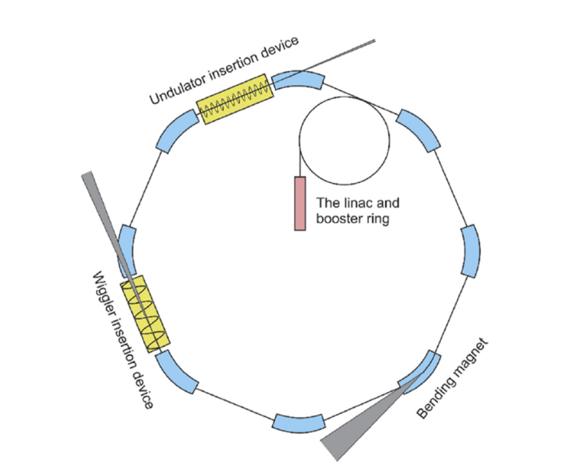
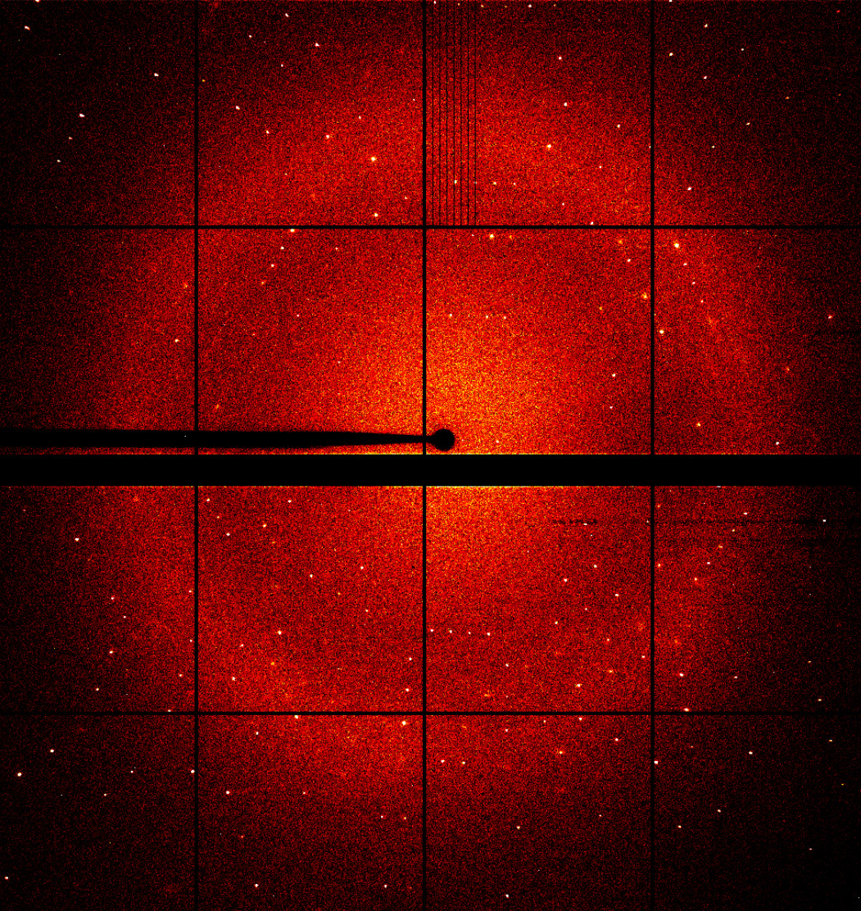
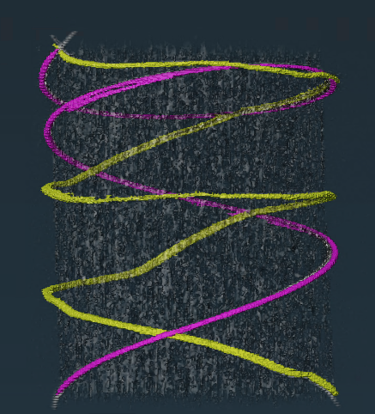
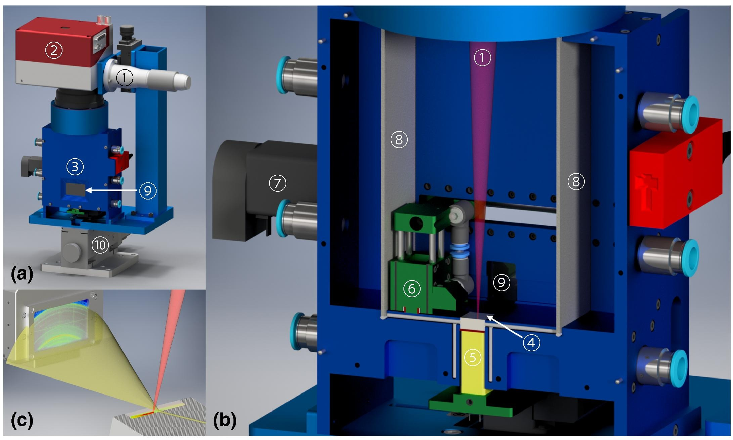
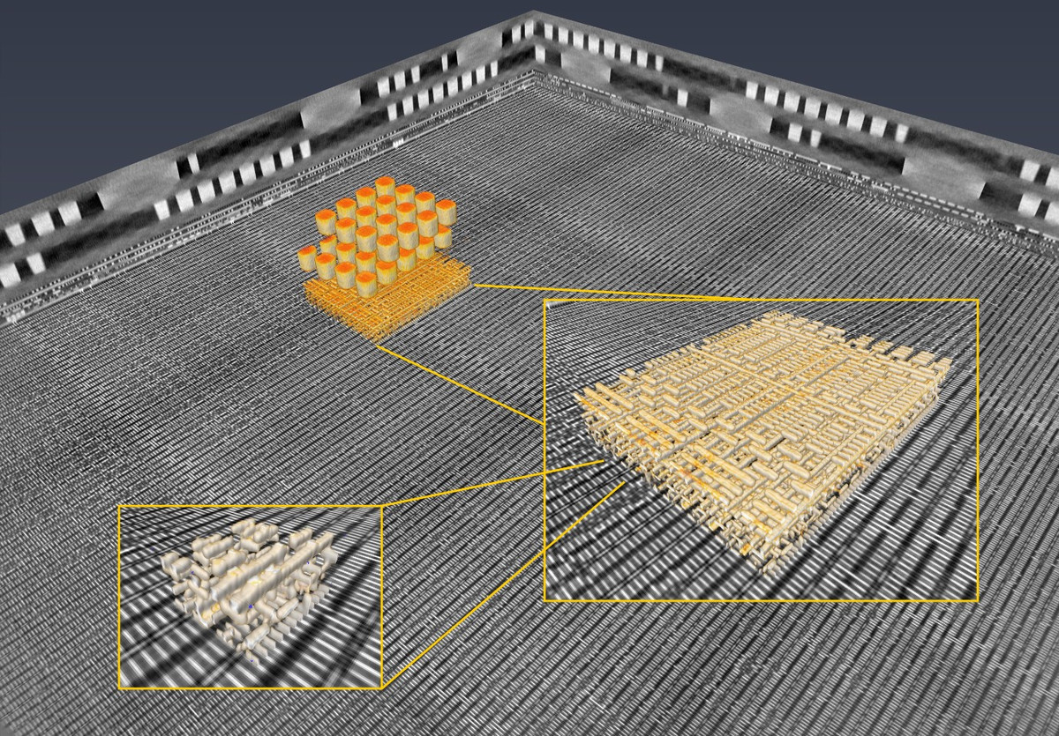
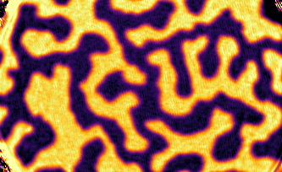
Synchrotron applications
Mitchell et al, 1999. Structure 7 (5), R111–R121
Synchrotrons are electron accelerators used to generate X-rays
High X-ray flux
Energy selection through monochromator
EUV (<100 eV) to hard X-rays (>100keV)
High intensity on the detector
Photon-starved applications possible
High speed
Coherence
Polarization
Pulsed time structure
Macromolecular Crystallography Leonarski et al.
Ptychography
Holler et al.
Full field fluorescence
imaging
Marone et al.
Operando diffraction Hocine et al.
Magnetic contrast ptychography – Butcher et al.

Slide 3
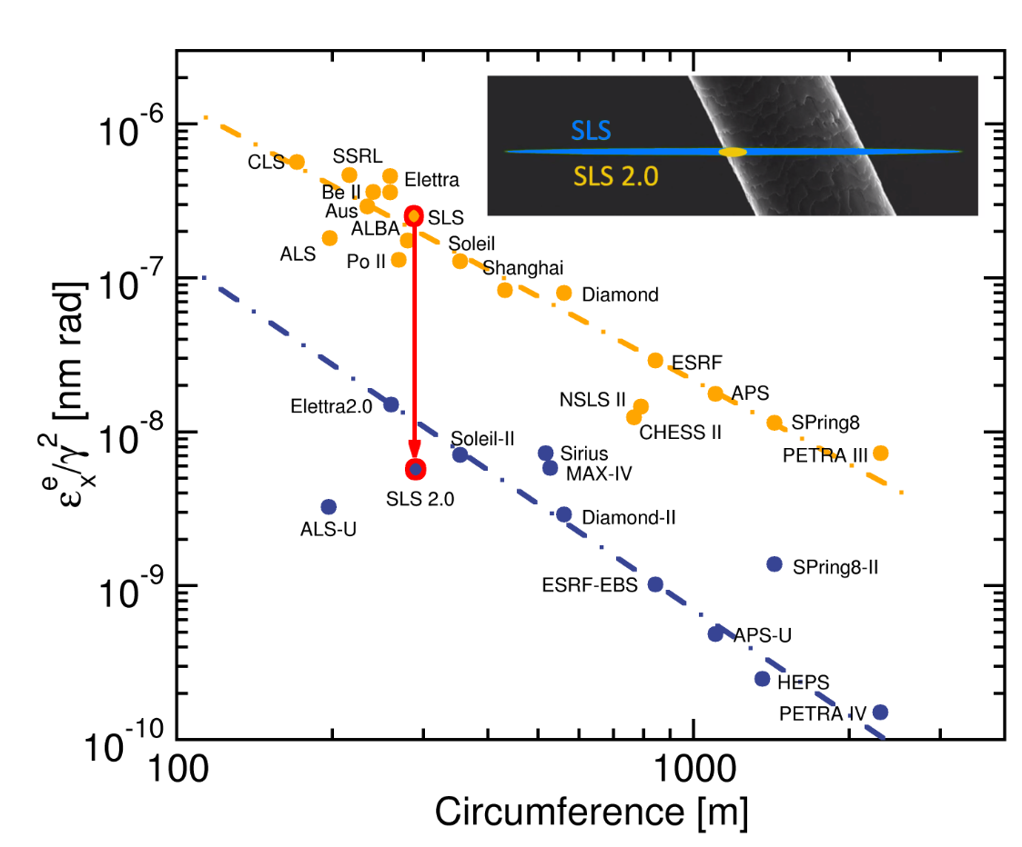
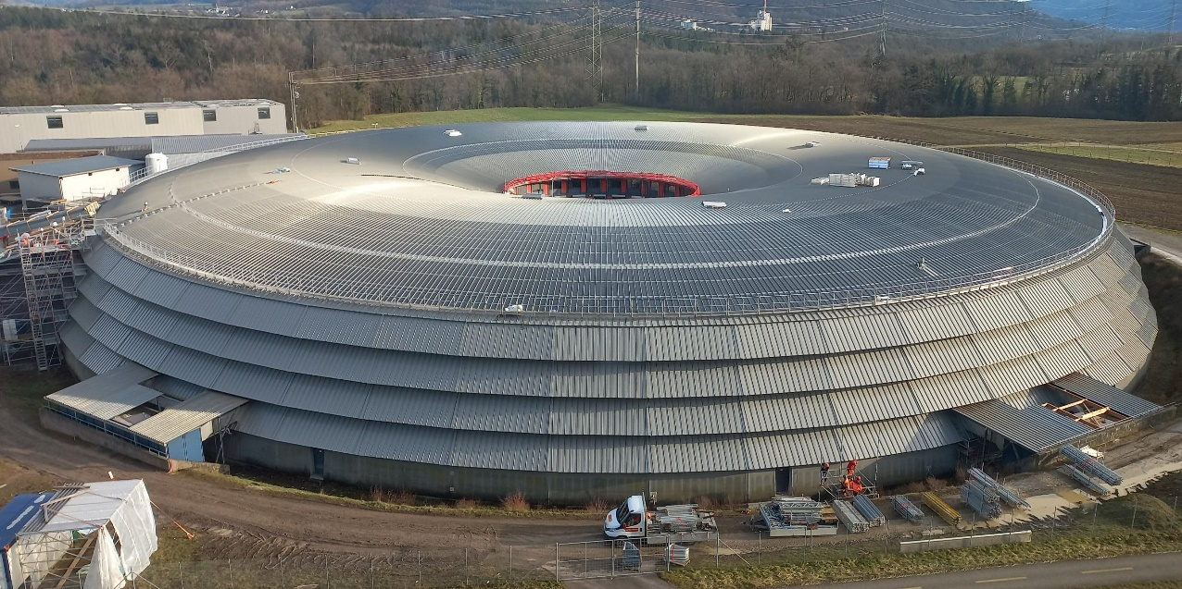
SLS 2.0 – a 4th generation synchrotron
Improved emittance, increased brightness
Higher coherence
More photons hitting the sample
First photons to the beamlines now
Pilot users at some beamlines Q3/2025
User operation Q3/2026

Slide 4
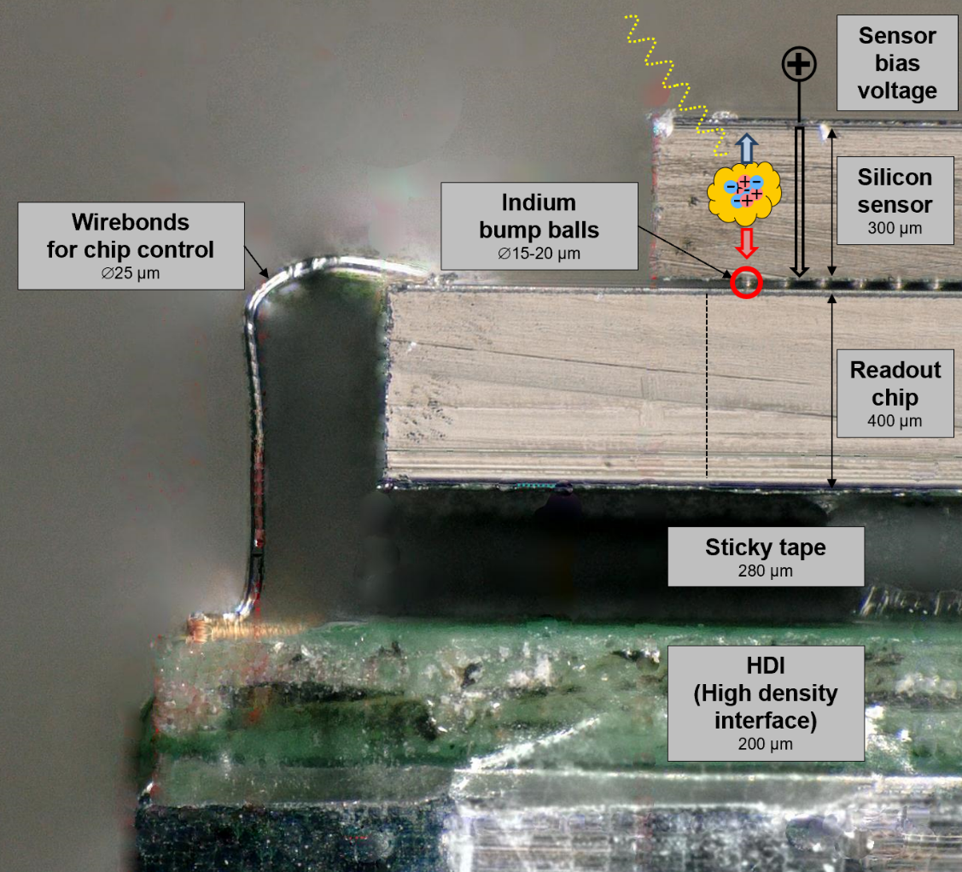
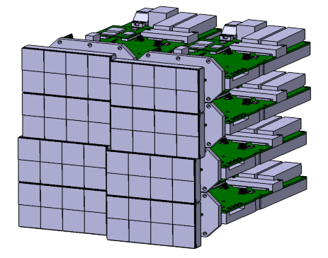
Hybrid detectors
Semiconductor sensor
Direct conversion
Versatile CMOS readout chip
Fast readout
Radiation hardness
Bump bonding
Minimum pixel pitch ~ 20 μm
Noise due to input capacitance
Large area by tiling

Slide 5
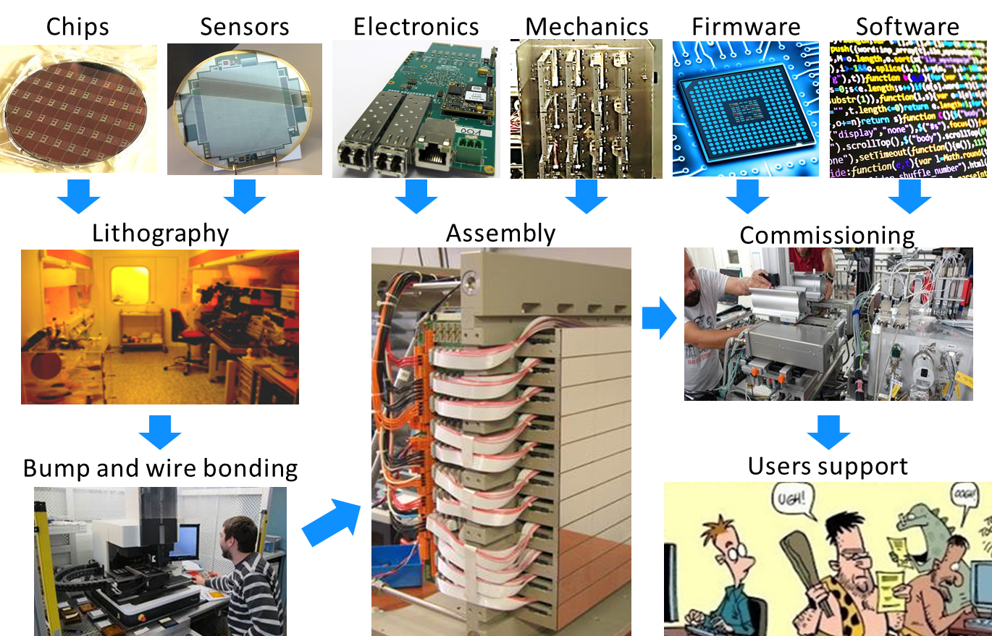
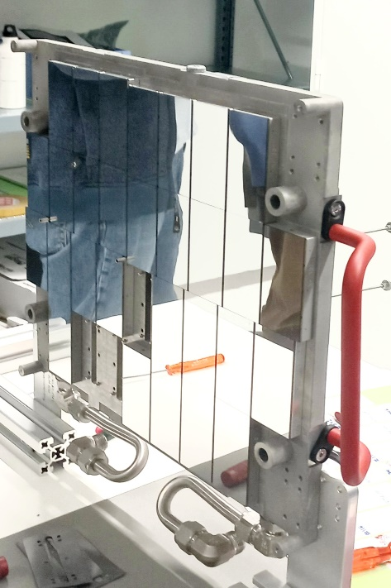
Everything in-house

Slide 6
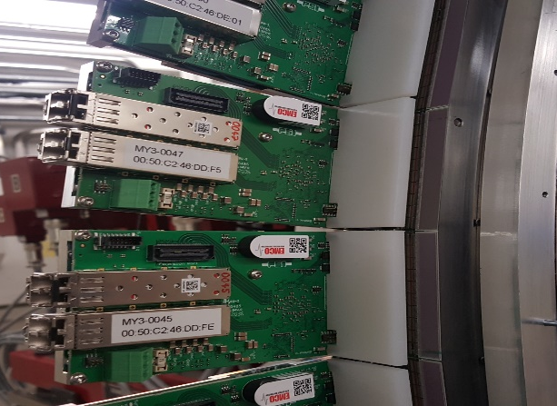
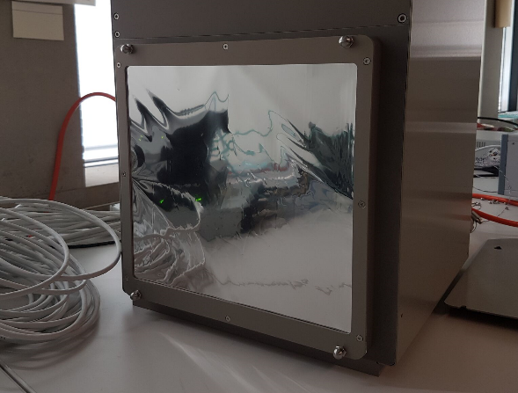
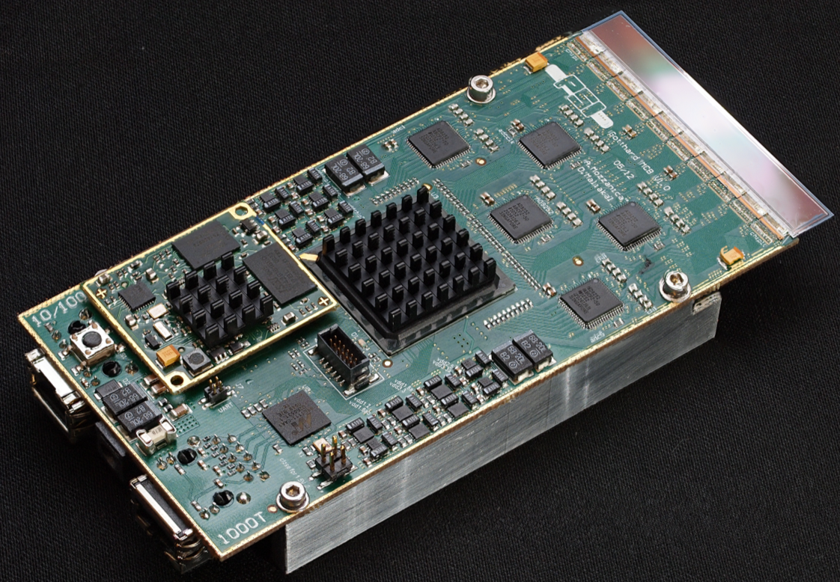
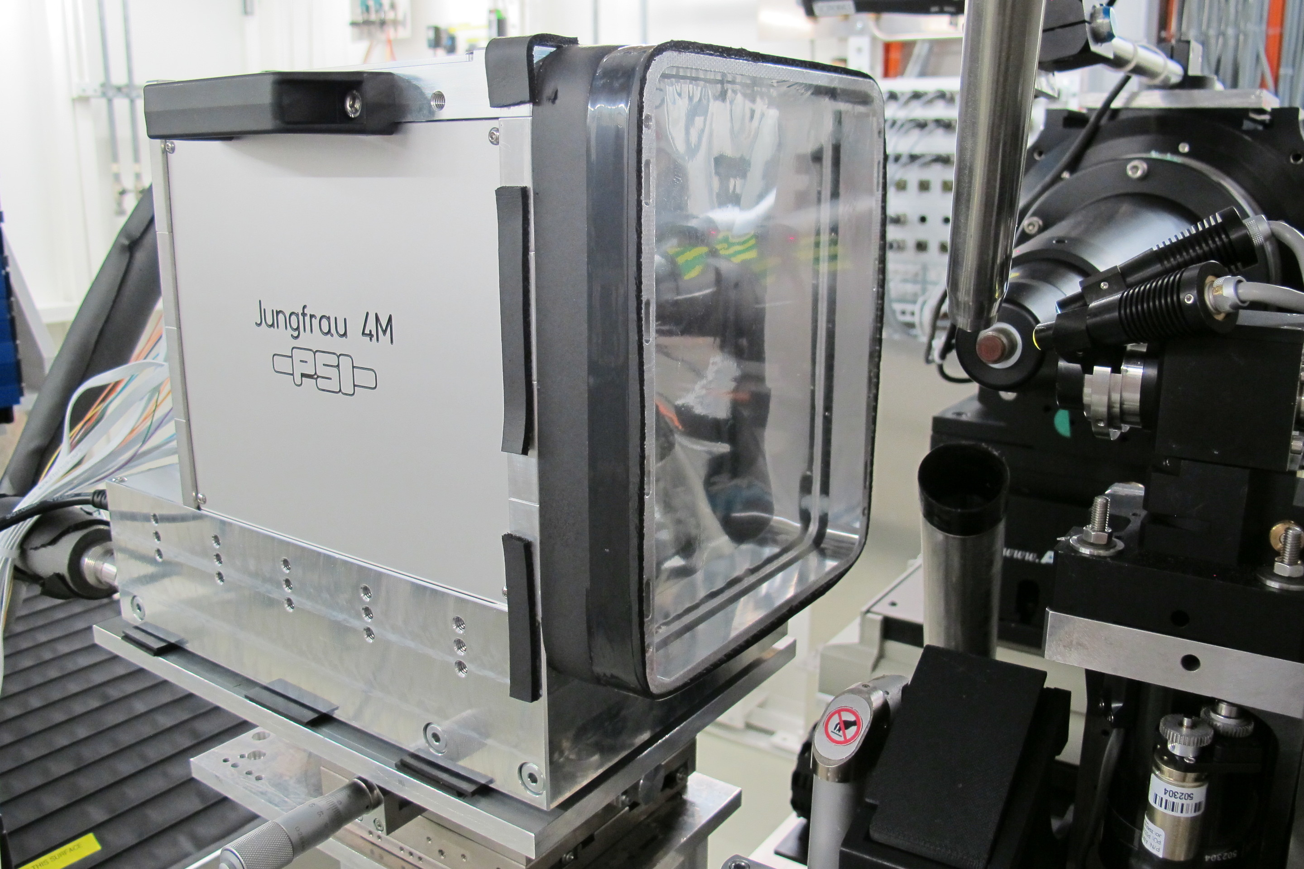
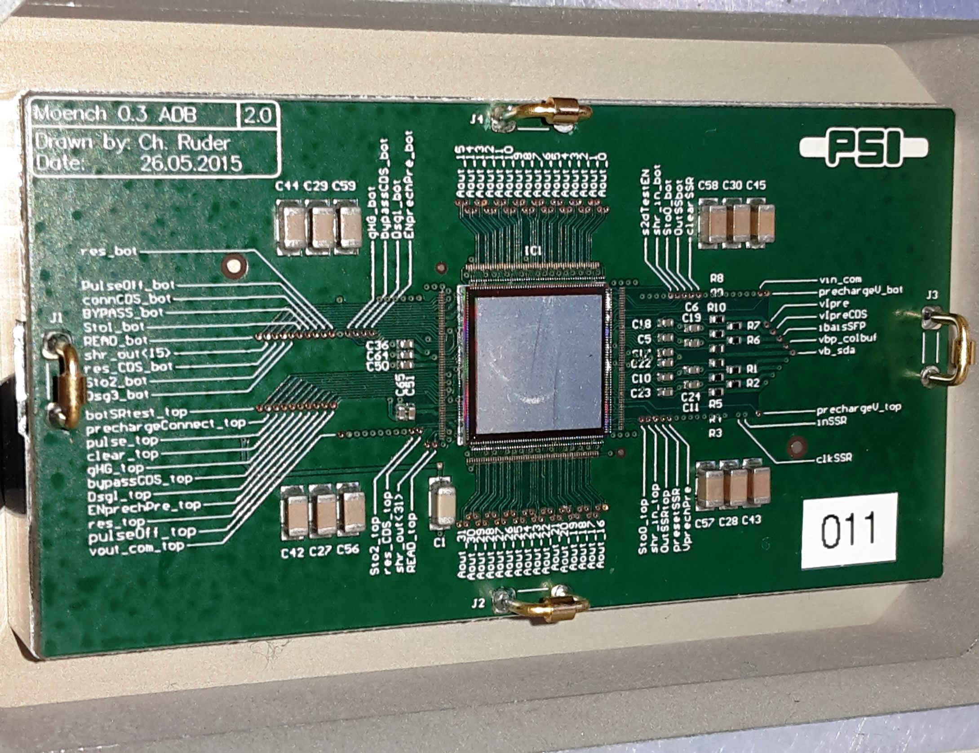
PSI Detector portfolio
 | Microstrip 1D | Pixel 2D
 | 25/50 µm pitch | 75 µm pitch | 25 µm pitch
Single photon counting
Charge integrating
MYTHEN
EIGER
GOTTHARD
JUNGFRAU
MÖNCH 0.3

Slide 7
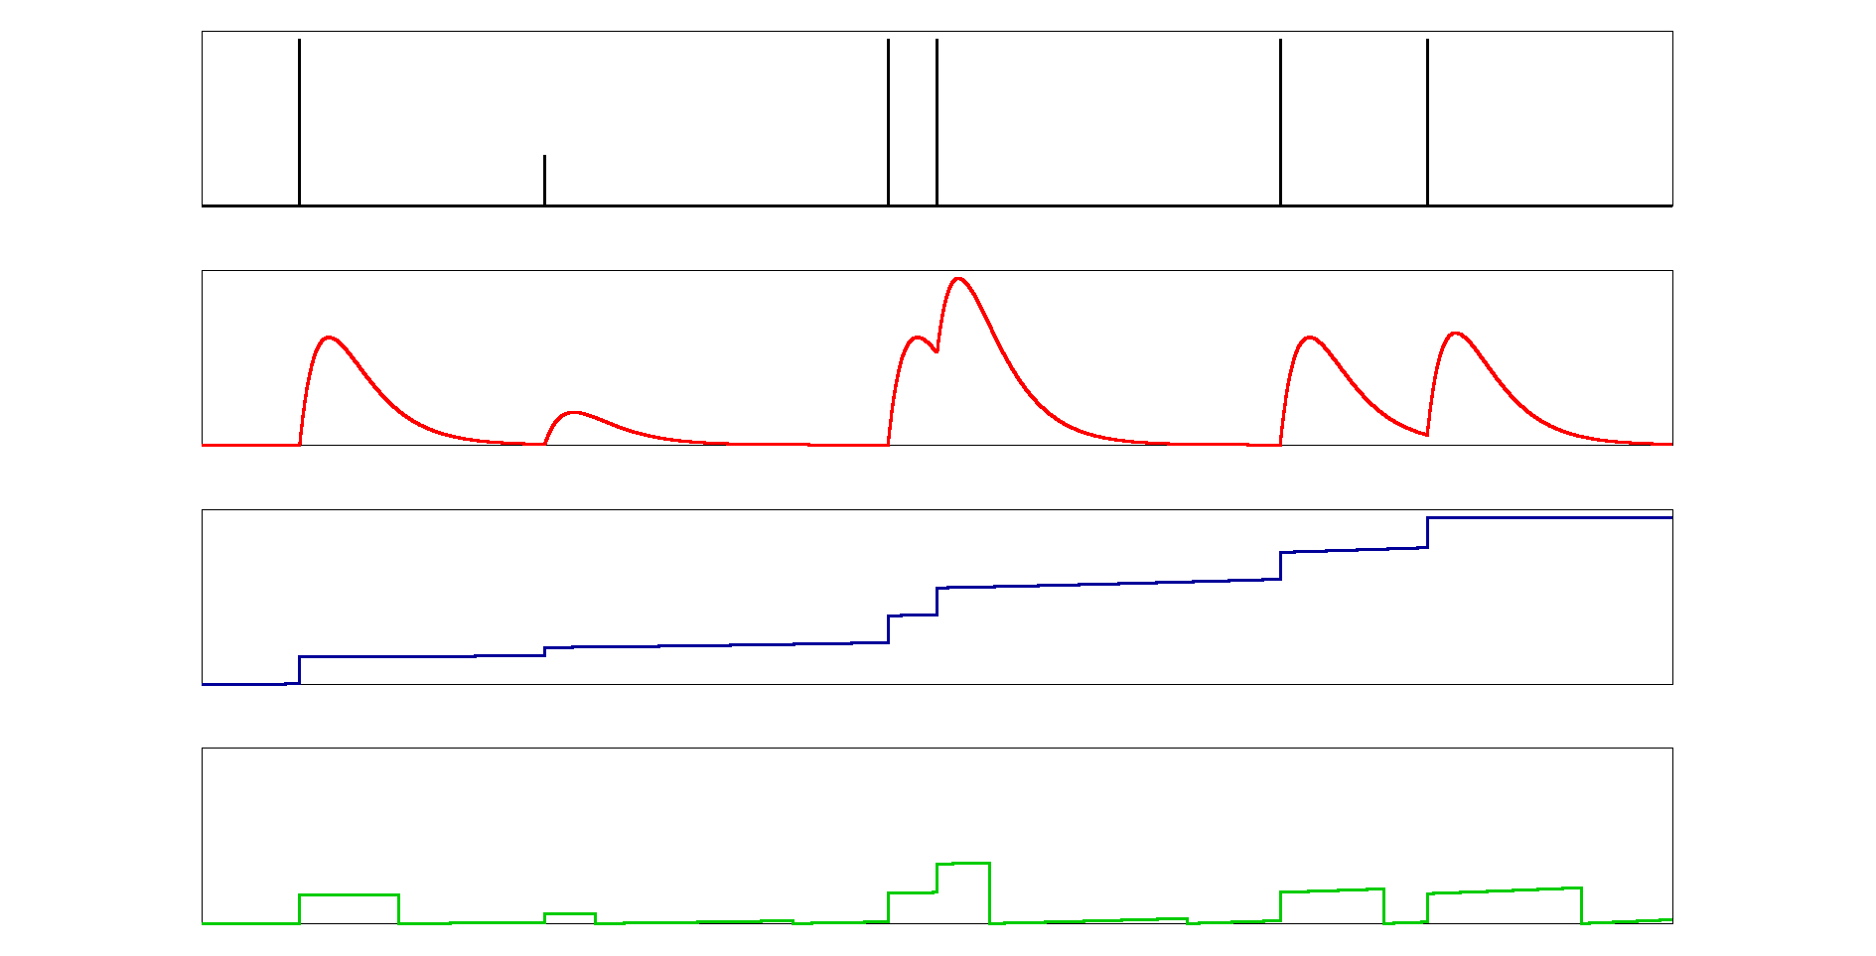
Readout modes
Photon counting
Charge integrating
Total
5
Total
5
fluorescence
fluorescence
Total
4
Total
5.5
+1
+1
+1
+1
Noiseless, very large dynamic range
Stable operation, well established calibration
Fluorescence suppression
Frame rate scales with counter depth
Pile-up ≳1MHz/pixel
Soft X-ray detection prevented by noise
Compromise between noise and dynamic range
Works also at pulsed sources
Detection of multiple soft X-rays
Saturation for long integration times

Slide 8
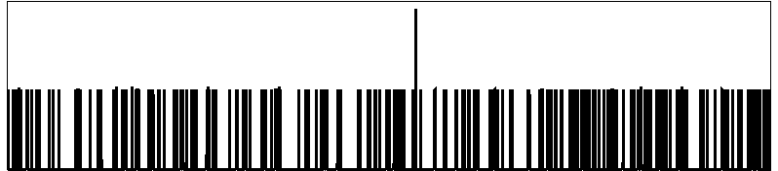
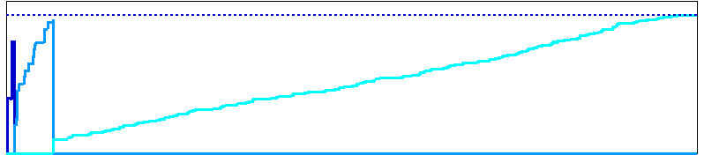
State of the art
Photon counting
Charge integrating with adaptive gain
Total
5
Total
5
fluorescence
fluorescence
Total
4
+1
+1
+1
+1
Noiseless, very large dynamic range
Stable operation, well established calibration
Fluorescence suppression
Frame rate scales with counter depth
Pile-up ≳1MHz/pixel
Soft X-ray detection prevented by noise
Single photon resolution for hard/tender X-rays
Detection of multiple soft X-rays
Dynamic range up to 10⁴ photons/pixel/s
Saturations for long integration times
Challenging calibration and cumbersome data processing

Slide 9
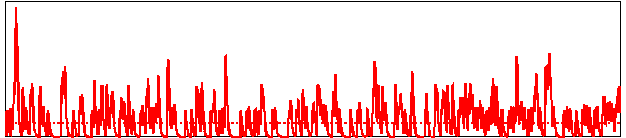
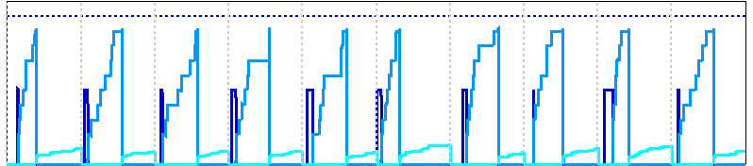
Upgraded light sources: many more photons!
Photon counting
Charge integrating with adaptive gain
Noiseless, very large dynamic range
Stable operation, well established calibration
Fluorescence suppression
Frame rate scales with counter depth
Faster shaping, pile-up tracking
Pile-up ≳1MHz/pixel
Soft X-ray detection prevented by noise
Single photon resolution for hard/tender X-rays
Detection of multiple soft X-ray
Works also at pulsed sources
Dynamic range up to ~10⁴ photons/pixel/s
Supported flux scales with frame rate
Saturations for long integration times
Challenging calibration and cumbersome data processing needs high throughput!

Slide 10
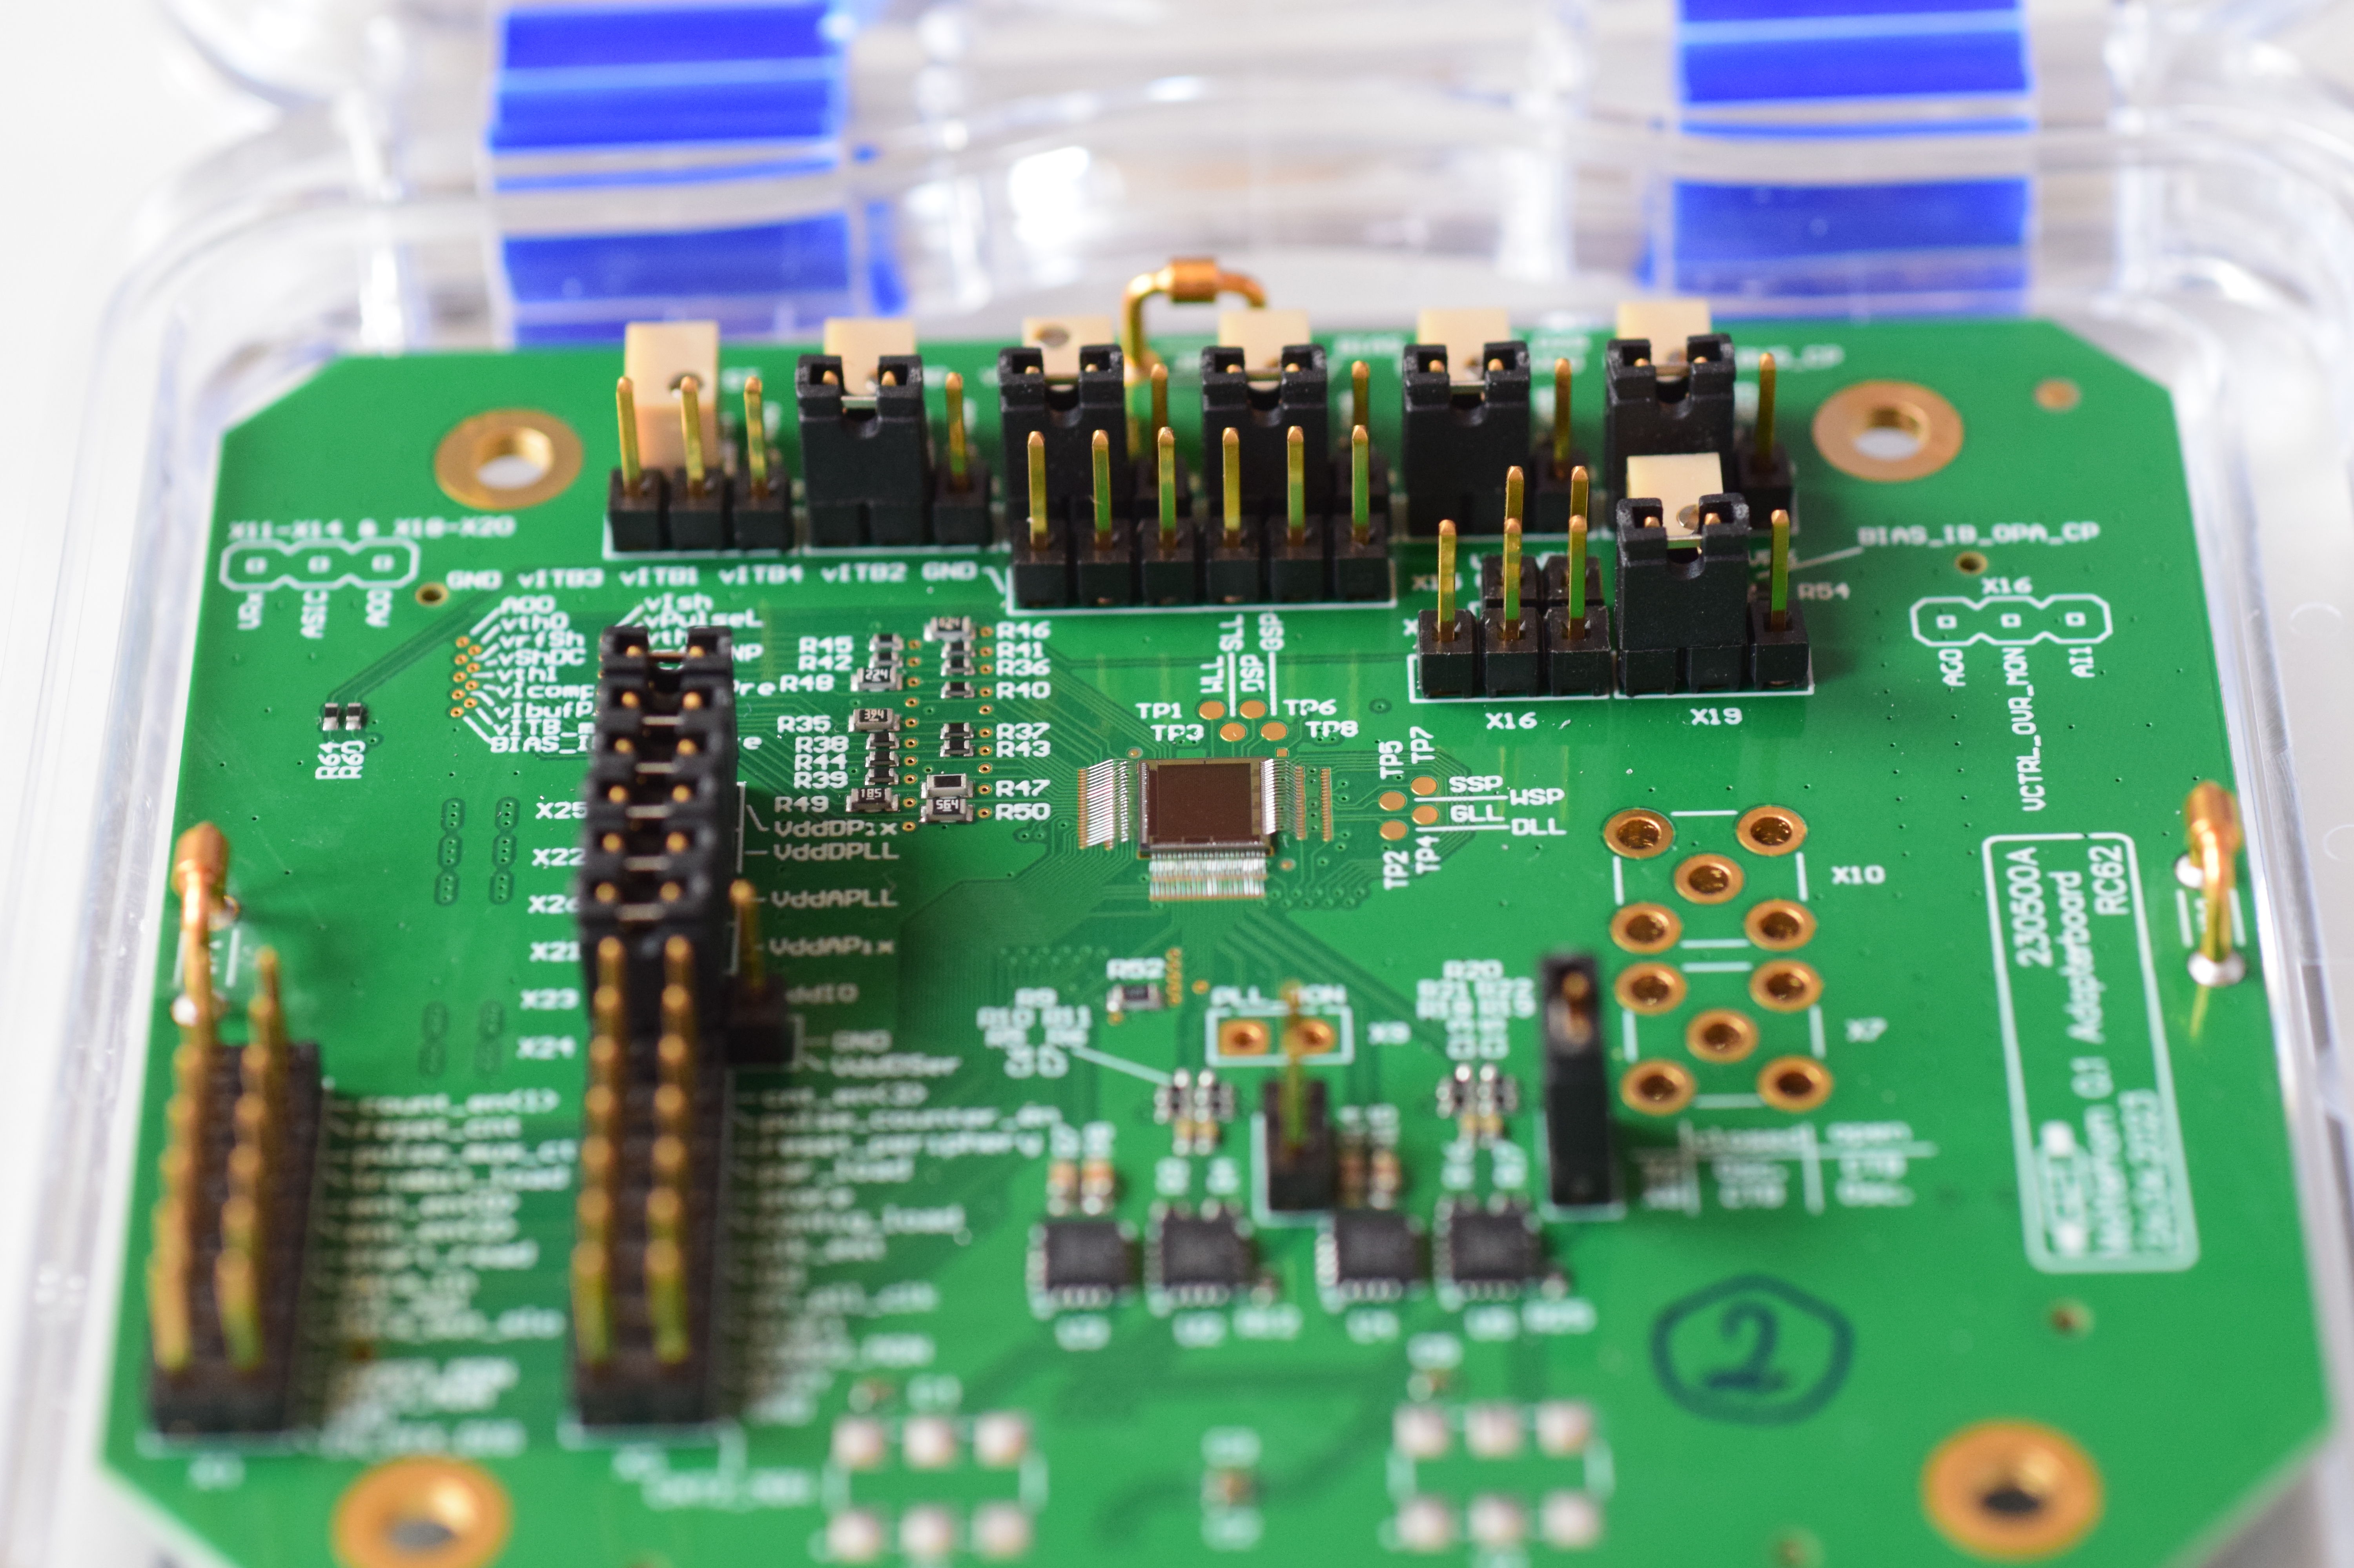
PSI Detector portfolio
 | Microstrip 1D | Pixel 2D
 | 25/50 µm pitch | 75 µm pitch | 25 µm pitch
Single photon counting
Charge integrating
MYTHEN
MATTERHORN
GOTTHARD
JUNGFRAU2
MÖNCH1.0

Slide 11
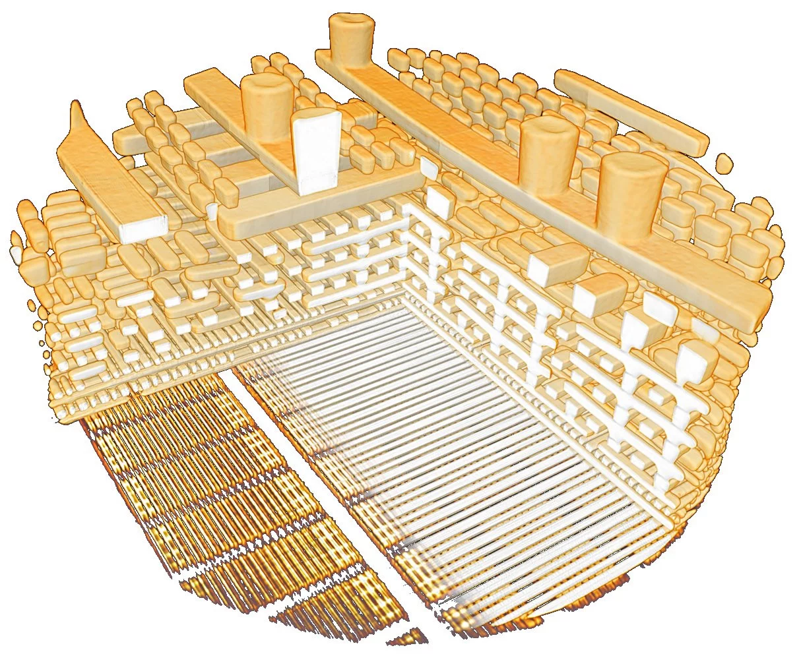
MATTERHORN: the next peak for single photon counting
 | EIGER | MATTERHORN
Pixel size | 75 x 75 µm²
Module size | 4 x 8 cm²
Thresholds | 1 | 4
Min Threshold | ~ 3 keV | ~ 1.5 keV
Counter depth | 12 bit | 4 x 16 bit
Max. Frame rate (8 bit) | 10 kHz (burst) | 20 kHz (continuous)
Count rate (90% efficiency) | 0.35 Mcounts/pixel/s | 20 Mcounts/pixel/s
Gating | ~ µs | ~ 20 ns
Full size ASIC submitted last week
Dual polarity analog chain
4 independent comparators and gatable counters
Pile-up tracking
Pump-multiprobe measurements
Synthesized digital periphery
On-chip PLL
4 x 3.125 GHz serializers / chip
100 Gb/s link / module
Hocine et al., Materials Today 2020
Aidukas et at., Nature 632, 81–88 (2024).

Slide 12
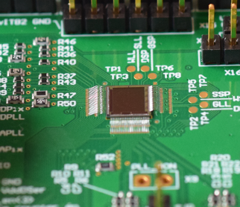
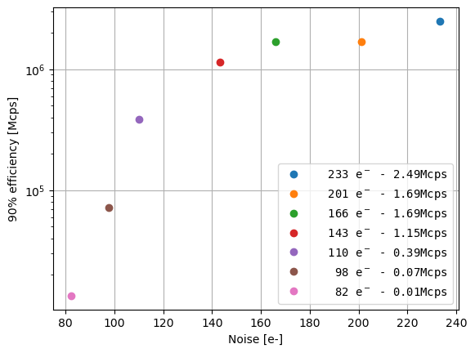
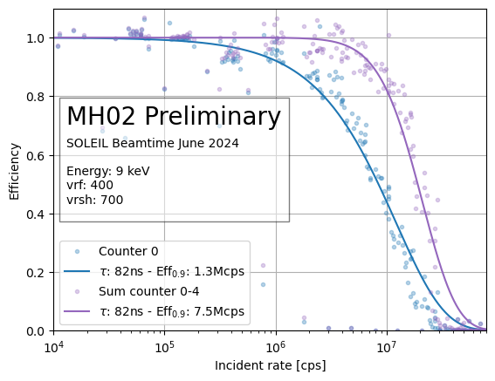
MATTERHORN prototypes
Preliminary prototype results (MH01-MH02)
Pixels | 48 x 48
Min threshold | < 2keV
Noise | 80 e- ENC rms
Threshold dispersion | 33 eV rms
Count rate capability with 90% efficiency
2.5 MHz (1 counter)
>7.5 MHz (3 counters)
Below expectation, due to low comparator current used
Courtesy E. Frojdh
Noise vs. rate capability
(one counter) MH01
Dose rate dependence of TID Damage in front-end electronics for SLS 2.0 Viveka Gautam
Monday poster session
Counter 0
Sum counter 0-3
12

Slide 13
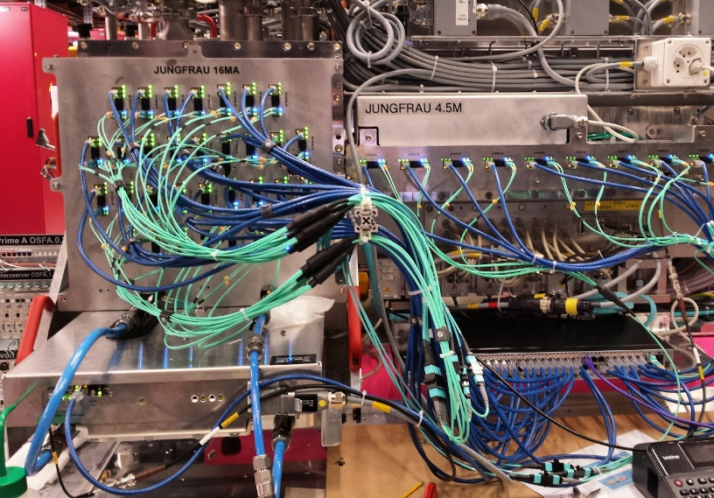
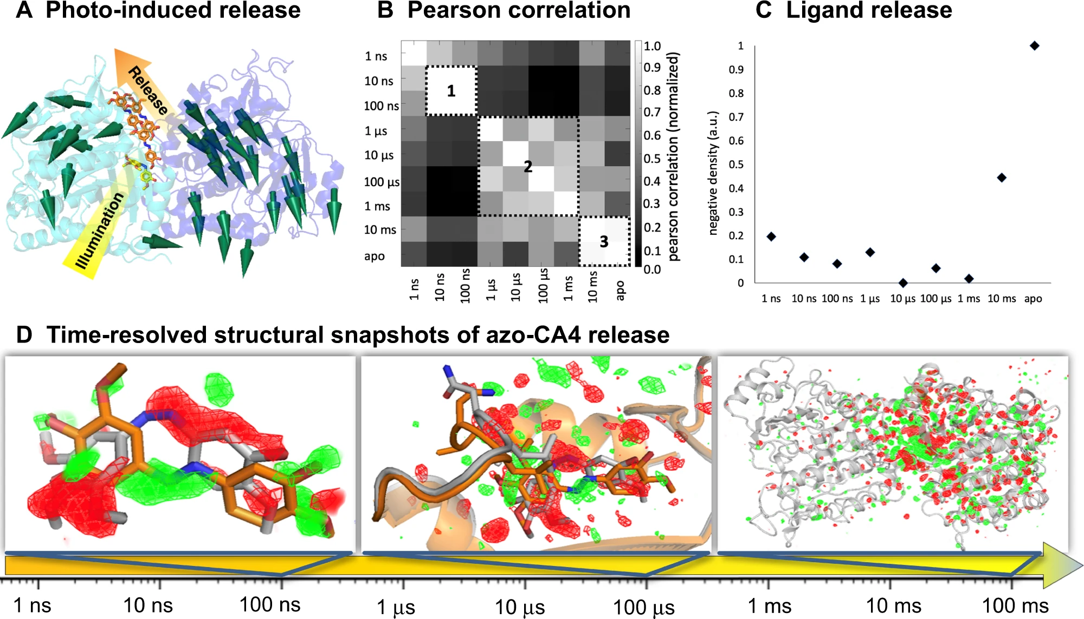
JUNGFRAU2: faster, even higher intensities
A 1M charge integrating hybrid pixel detector for electron diffraction
Khalil Ferjaoui
Monday 15:00
 | JUNGFRAU | JUNGFRAU2
Pixel size | 75x75 µm²
Module size | 4x8 cm²
Dynamic range (12 keV) | 10⁴
Min Energy* | ~ 800 eV | ~ 600 eV
Max Frame rate | 2.2 kHz | 10 kHz
Max count rate (12 keV) | 22 Mcounts/pixel/s | 100 Mcounts/pixel/s
Storage cells (burst mode) | 16 | 16-64 Rebin-able
Characterization of the JUNGFRAU 1.2 readout ASIC
Vadym Kedych
Thursday 11:00
At Synchrotrons full duty cycle 2 kHz 10 kHz
2 GB/s/module 10 GB/s/module
190 TB/day/module 1 PB/day/module
5.3 PB/day for a 16M detector 25 PB/day for a 16M detector
* with single photon resolution, standard silicon
Wranik et al. Nat Commun 14, 903 (2023).

Slide 14
Maximum detectable intensities
Faster than Moore! ≈2^{t/1.55y}
JUNGFRAU2
EIGER
CITIUS
MATTERHORN
Retriggering
by DECTRIS
PILATUS
Large pixels
Hatsui, PIXEL 2022, full duty cycle, burst mode 17.4 kHz

Slide 15
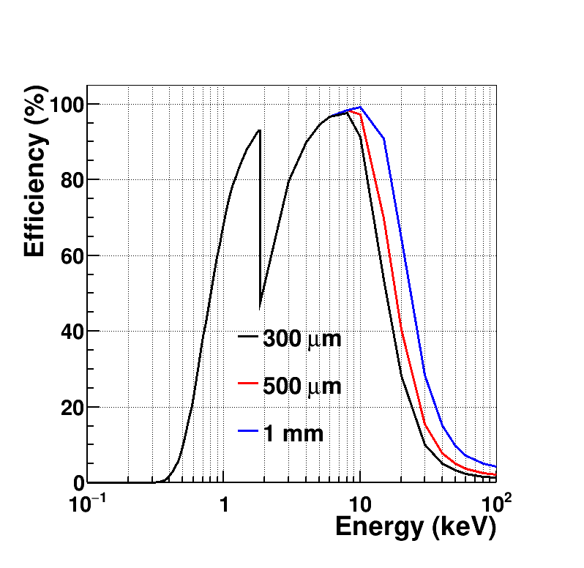
Silicon quantum efficiency
Standard
Silicon
LGAD
High-Z
3D Doping Concentration Imaging of Silicon Sensors Using Backside Pulsing
Xiangyu Xie
Wednesday poster session

Slide 16
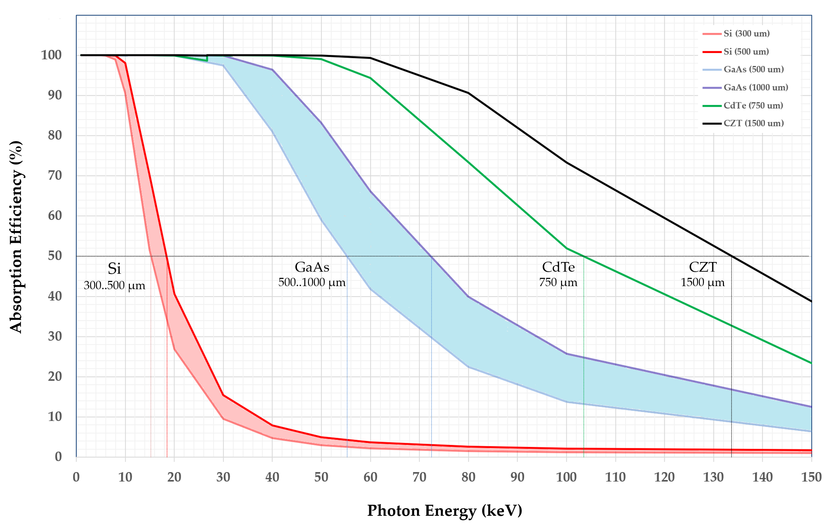
High-Z sensors for hard X-rays
CZT as a Material for Detecting Hard X-rays at Synchrotrons and FELs
Jonathan Mulvey
Tuesday 9:50
Enhancing the Performance of High-Z Sensors for Photon Science Applications
Kirsty Paton
Tuesday 10:10

Slide 17
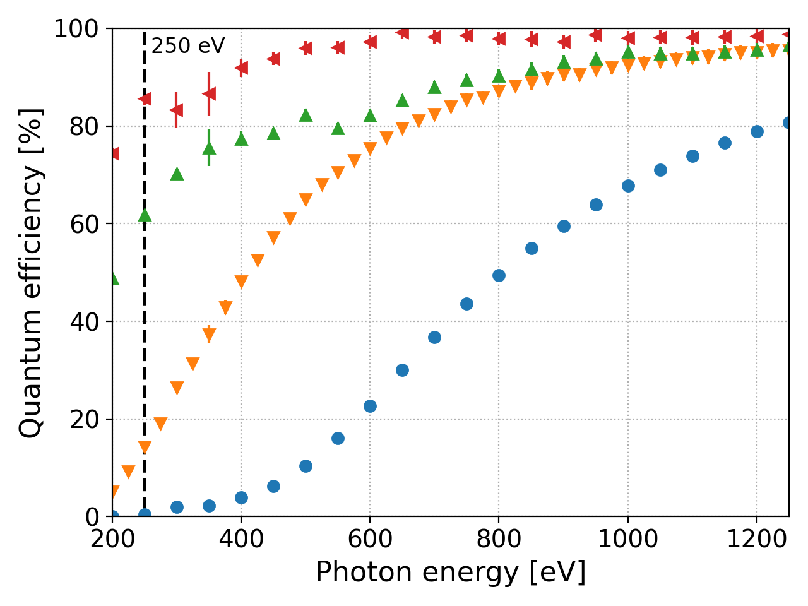
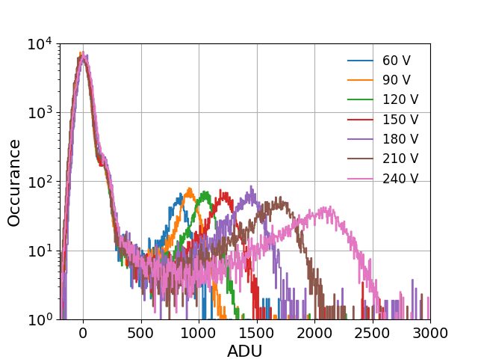

Soft X-rays detection
Courtesy J. Zhang
Al
Al
SiO/N
x x x x x x x x x x x x x
x
x x
n+
n+
p+
Carulla, et al.
Sensors. 2024; 24(3): 942.
& unpublished results
Standard
p-
n-
n-
Hard X-ray sensors
Optimized implant
Passivated surface
Thin passivation (2025)
p+
p+
Al
Al
ASIC
ASICS
Zhang, et al. JINST 2022; 17(11): C11011.
Characterisation of inverse LGADs in the soft X-ray energy range Shuqi Li
Tuesday 11:00
Andrä, Zhang et al.,
Jour. Synch. Rad. 2019.
Shallow absorption of soft X-rays
Thin entrance window technology with improved doping profile and thin passivation
Charge per photon comparable to electronic noise
Exploit internal multiplication of LGADs to increase SNR
Amplification
GOTTHARD 8.0 keV

Slide 18
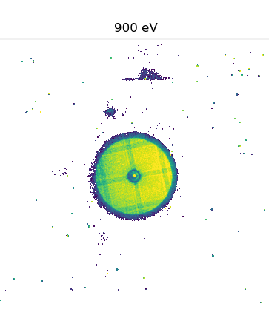
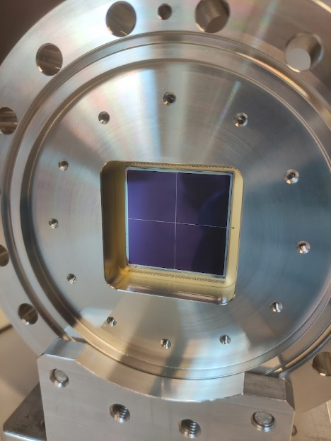

Single photon counting below 1 keV
Largest LGAD ever!
Single photon resolution down to ~500 eV
Effective noise reduction
Cooling required
Scientific papers at the Fe L-edge (700eV) and O K-edge (530 eV)
4 $×$ 4 cm² iLGAD
Image of a FZP acquired using EIGER
SIM beamline SLS
F. Baruffaldi et al., under review.
Notes:
Here is a reconstruction of the Siemens star with the new module. This is 6 x 6 um and the phase looks sharper. The Siemens star was 150 nm thick and made of permalloy. It looks much better than the previous module and this is the one we will use for the paper on the LGAD Eiger. Do you have a rough estimate of the timeline for that manuscript? I also attached an amplitude XMCD magnetic image from a Pt-Co multilayer (magnetisation out of plane) in which you can see the magnetic domains nicely. That structure is around 2 um and the image was taken with the previous module in February. Please let me know if you need something else.
XMCD: X-ray Magnetic Circular Dichroism
With the new module W9 we obtained a resolution of approximately 6 nm.

Slide 19
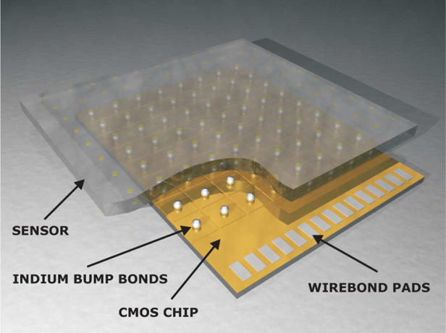
More X-rays for photon-starved applications
Total
5
With fast frame rates and low fluxes
Energy resolution ≲ keV
Super-resolution ~µm
Developments to sustain higher fluxes
Faster frame rates
Machine learning to handle pile-up
fluorescence
Total
5
Readout and reset
aare – A Flexible Data Analysis Library for Hybrid Pixel Detectors Erik Fröjdh
Wednesday poster session

Slide 20
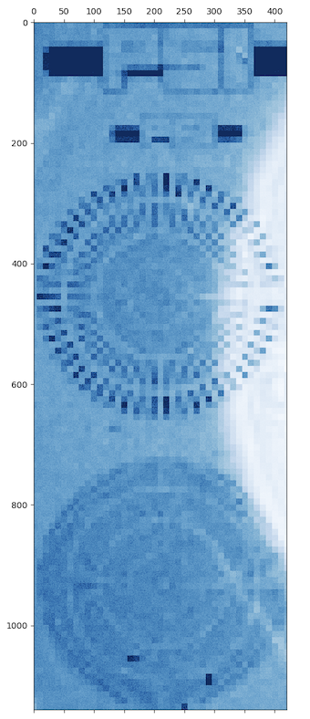
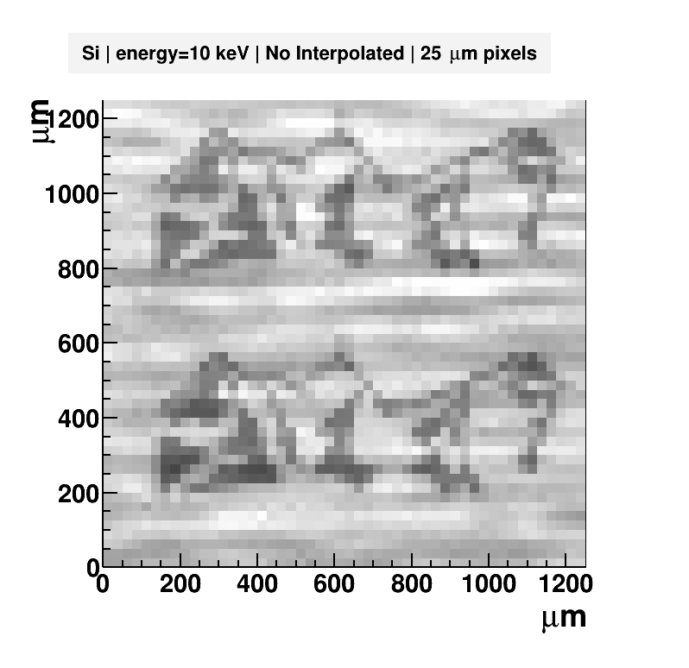
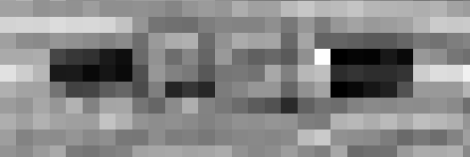
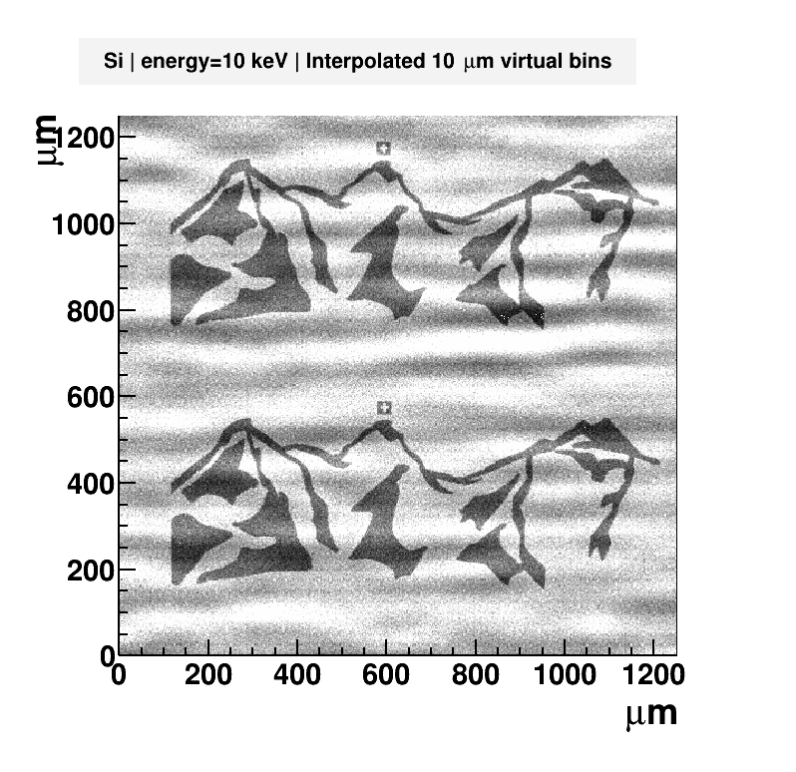
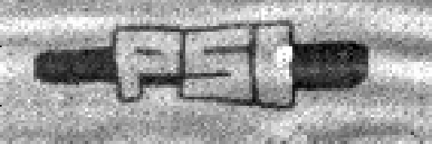
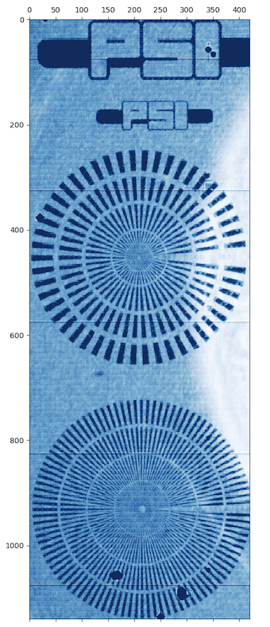
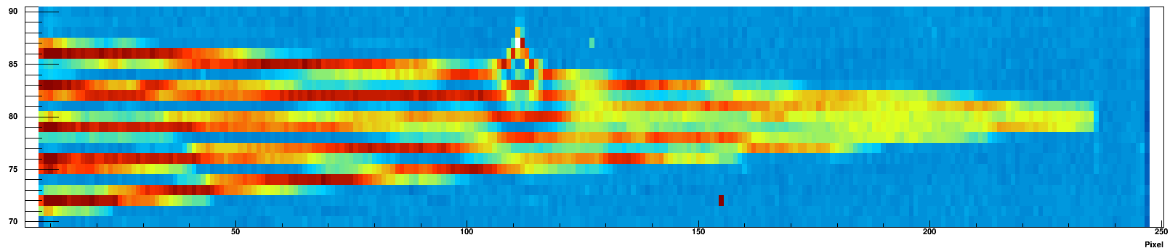
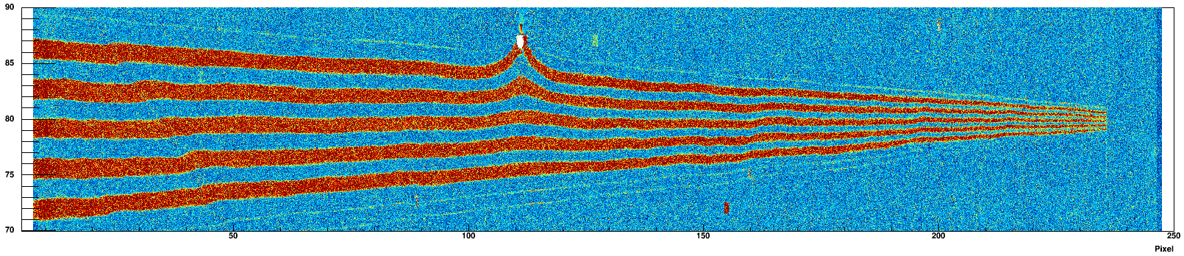
Super-resolution
LGAD sensor @ 500eV
Silicon sensor @ 10keV
GaAs sensor @ 10keV
100 μm
25 µm pixels
25 µm pixels
100 µm
25 µm pixels
5 µm bins
High frame rate RIXS spectroscopy using a JUNGFRAU detector with an iLGAD sensor
Viktoria Hinger
Wednesday poster session
1 µm bins
100 µm
Chiriotti et al., JINST (2022)
CdZnTe sensor @ 40 kVp
75 µm pixels
2.5 µm bins
300 µm
5 µm bins
Crystal defect
J. Zhang et al., unpublished
D. Greiffenberg et al., unpublished
Notes:
Timepix4 160 Gbps 2x2cm2 250kpixels 55um
event driven readout
Ca. 1.5MHz/pixel
Ca. 4MHz/mm2
Moench 20Gbps 1x1cm2 160kpixels 25um
6 kHz/pixel
0.1 MHz/mm2

Slide 21
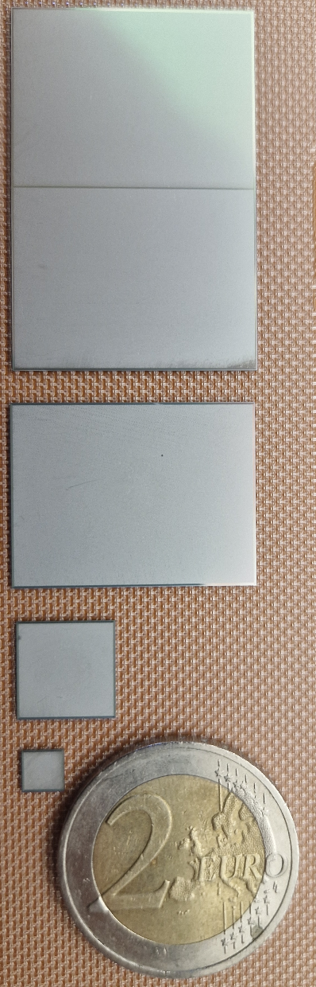
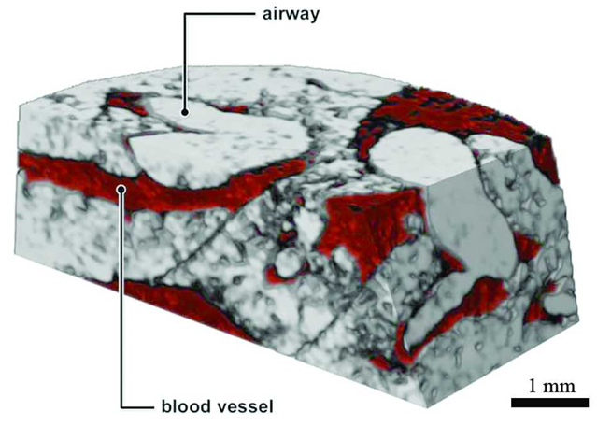

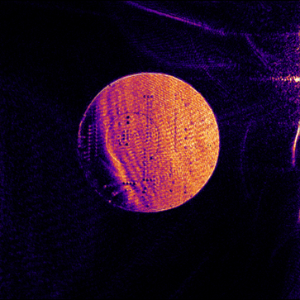
MÖNCH: high spatial and energy resolution
Targeting low noise
Hyperspectral imaging with super-resolution
RIXS combined with LGADs
Scalability is challenging
800 kpixel on a single chip
1.6 Mpixel module, non negligible gap
Huge data throughput
~ kHz frame rate, compromise with ROI
On-the-fly data reduction is mandatory!
MÖNCH1.0
modules
2.56 x 3.84 cm²
2028
MÖNCH1.0
2.56 x 1.92 cm²
2026
MÖNCH big prototype
1 x 1 cm²
2015
MÖNCH prototype
0.4 x 0.4 cm²
2013
Full field fluorescence
imaging
Marone et al.
Fourier ptychography
Wakonig et al.
C. Dullin et al., J. Synchrotron Rad. (2018)

Slide 22
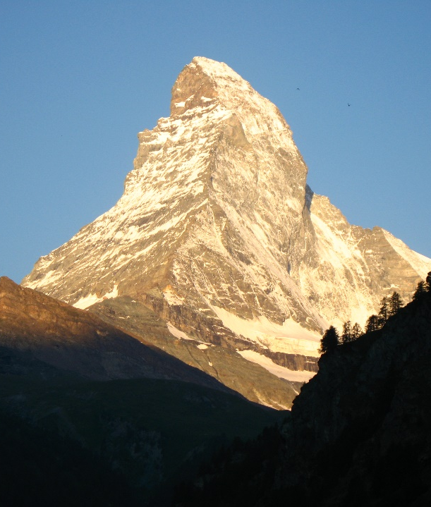



Summary
MATTERHORN single photon counting
Faster shaping
Pile-up tracking
Higher frame rate
JUNGFRAU2 and Megapixel MÖNCH
High frame rate
High performance data conversion and compression platform
LGADs for soft X-rays
Soft X-ray single photon counting
RIXS detector with interpolation
High-Z sensors for hard X-rays
Large area single photon counting
High resolution energy dispersive imaging

Slide 23

Detector plans for SLS2.0
16M MATTERHORN
1.5M MATTERHORN (OMNY)
1.5M JUNGFRAU (Serial laminography)
4M MATTERHORN High-Z
500k JUNGFRAU CZT (FFFT)
500k MATTERHORN LGAD
500k MATTERHORN (PEEM)
1M MÖNCH LGAD
60k MYTHEN3
4M MATTERHORN
4M MATTERHORN High-Z
4M JUNGFRAU LGAD
4M MATTERHORN High-Z
16M MATTERHORN
16M JUNGFRAU
4M MATTERHORN LGAD

Slide 24




1st Joint X-ray Sensor Workshop From Soft to Hard X-rays
ETH Zurich (Switzerland) 12.-16. January 2026
Bridging Science and Detection Technology for Soft X-ray Applications
Call for abstract is open!
High-Z Pixel Array Detectors for Photon Science
Abstract: hizpad.community@gmail.com
Webpage and registration: https://indico.psi.ch/e/XRaySensors2026
Registration for the two workshops is separate.
Notes:
Change QR code

Slide 25

Thank you!
Dose rate dependence of TID Damage in front-end electronics for SLS 2.0 Viveka Gautam
Monday poster session
High frame rate RIXS spectroscopy using a JUNGFRAU detector with an iLGAD sensor
Viktoria Hinger
Wednesday poster session
aare – A Flexible Data Analysis Library for Hybrid Pixel Detectors Erik Fröjdh
Wednesday poster session
3D Doping Concentration Imaging of Silicon Sensors Using Backside Pulsing
Xiangyu Xie
Wednesday poster session
A 1M charge integrating hybrid pixel detector for electron diffraction
Khalil Ferjaoui
Monday 15:00
Enhancing the Performance of High-Z Sensors for Photon Science Applications
Kirsty Paton
Tuesday 10:10
Characterisation of inverse LGADs in the soft X-ray energy range Shuqi Li
Tuesday 11:00
CZT as a Material for Detecting Hard X-rays at Synchrotrons and FELs
Jonathan Mulvey
Tuesday 9:50
Characterization of the JUNGFRAU 1.2 readout ASIC
Vadym Kedych
Thursday 11:00
Back: V. Kedych, M. Müller, P. Sieberer, K. Ferjaoui, M. Brückner, E. Fröjdh, J. Heymes, C. Lopez-Cuenca.
Middle: K. Moustakas, C. Ruder, J. Mulvey, S. Silletta, V. Hinger, A. Mozzanica, M. Carulla, X. Xie,.
Front: R. Dinapoli, A. Bergamaschi, S. Li, D. Thattil, J. Zhang, A. Mazzoleni, V. Gautam, D. Mezza, T. King, B. Schmitt.
Missing: S. Ebner, D. Greiffenberg, S. Hasanaj, K.A. Paton, C. Posada, A. Haugdal.

Slide 27

Large detectors
8 cm
>2.5 mm
4 cm
Chip
>0.5 mm

Slide 28






New counting modes
Reduce shaping time
Depend on fill pattern
Challenging calibration
Photons
Paralyzable
Time over Threshold
Bergamaschi, JSR (2011)
Analog and discriminator signal
Retriggering
Zambon, NIM A (2021)
Pile-up tracking
Andrä, JINST (2019)

Slide 29






Calibration into number of photons
Fresnel zone plate at XIL beamline, SLS, 92eV
Etched sensor (no Al), module mounted to flange in high vacuum
Bit masking
Pedestals
Gain factors
S. Redford et al., JOURNAL OF INSTRUMENTATION 11, C11013 (2016).

Slide 30





Adaptive gain methods
Noise increases with exposure time
Fast frame rate extends dynamic range
Challenging calibration
Linear
Ideal performance
Gain switching
JUNGFRAU, AGIPD, ePix
Detector output
Non linear
DSSC
Only qualitative trends!
Charge removal
MM-PAD, Xider, Dynamix
Input signal

Slide 31

Adaptive gain methods
Noise increases with exposure time
Fast frame rate extends dynamic range
Challenging calibration
Linear
Ideal performance
Gain switching
JUNGFRAU, AGIPD, ePix
Detector output
Non linear
DSSC
Only qualitative trends!
Charge removal
MM-PAD, Xider, Dynamix
Input signal

Slide 32


Energy resolved imaging at X-ray tubes
A full spectrum with an energy resolution of about 750 eV FWHM is acquired for each pixel
Siemens Star with spokes 60-0.5 µm gold on silicon with silicon microspheres
W-anode X-ray tube 40 kV 200 µA

Slide 33

Edge subtraction imaging
Images can be binned in energy
Below the L-edge gold becomes “transparent” to X-rays
Below Au L-edge
Siemens Star with spokes 60-0.5 µm gold on silicon with silicon microspheres
W-anode X-ray tube 40 kV 200 µA

Slide 34

High resolution energy resolved imaging
Color imaging works also in combination with interpolation.
Below Au L-edge
Interpolated to 1 µm bins
Siemens Star with spokes 60-0.5 µm gold on silicon with silicon microspheres
W-anode X-ray tube 40 kV 200 µA

