Slide 1



An overview of
HEXITEC and HEXITEC MHz and its applications
Dr Diana D Caprotti et al
8th of July 2025

Slide 2

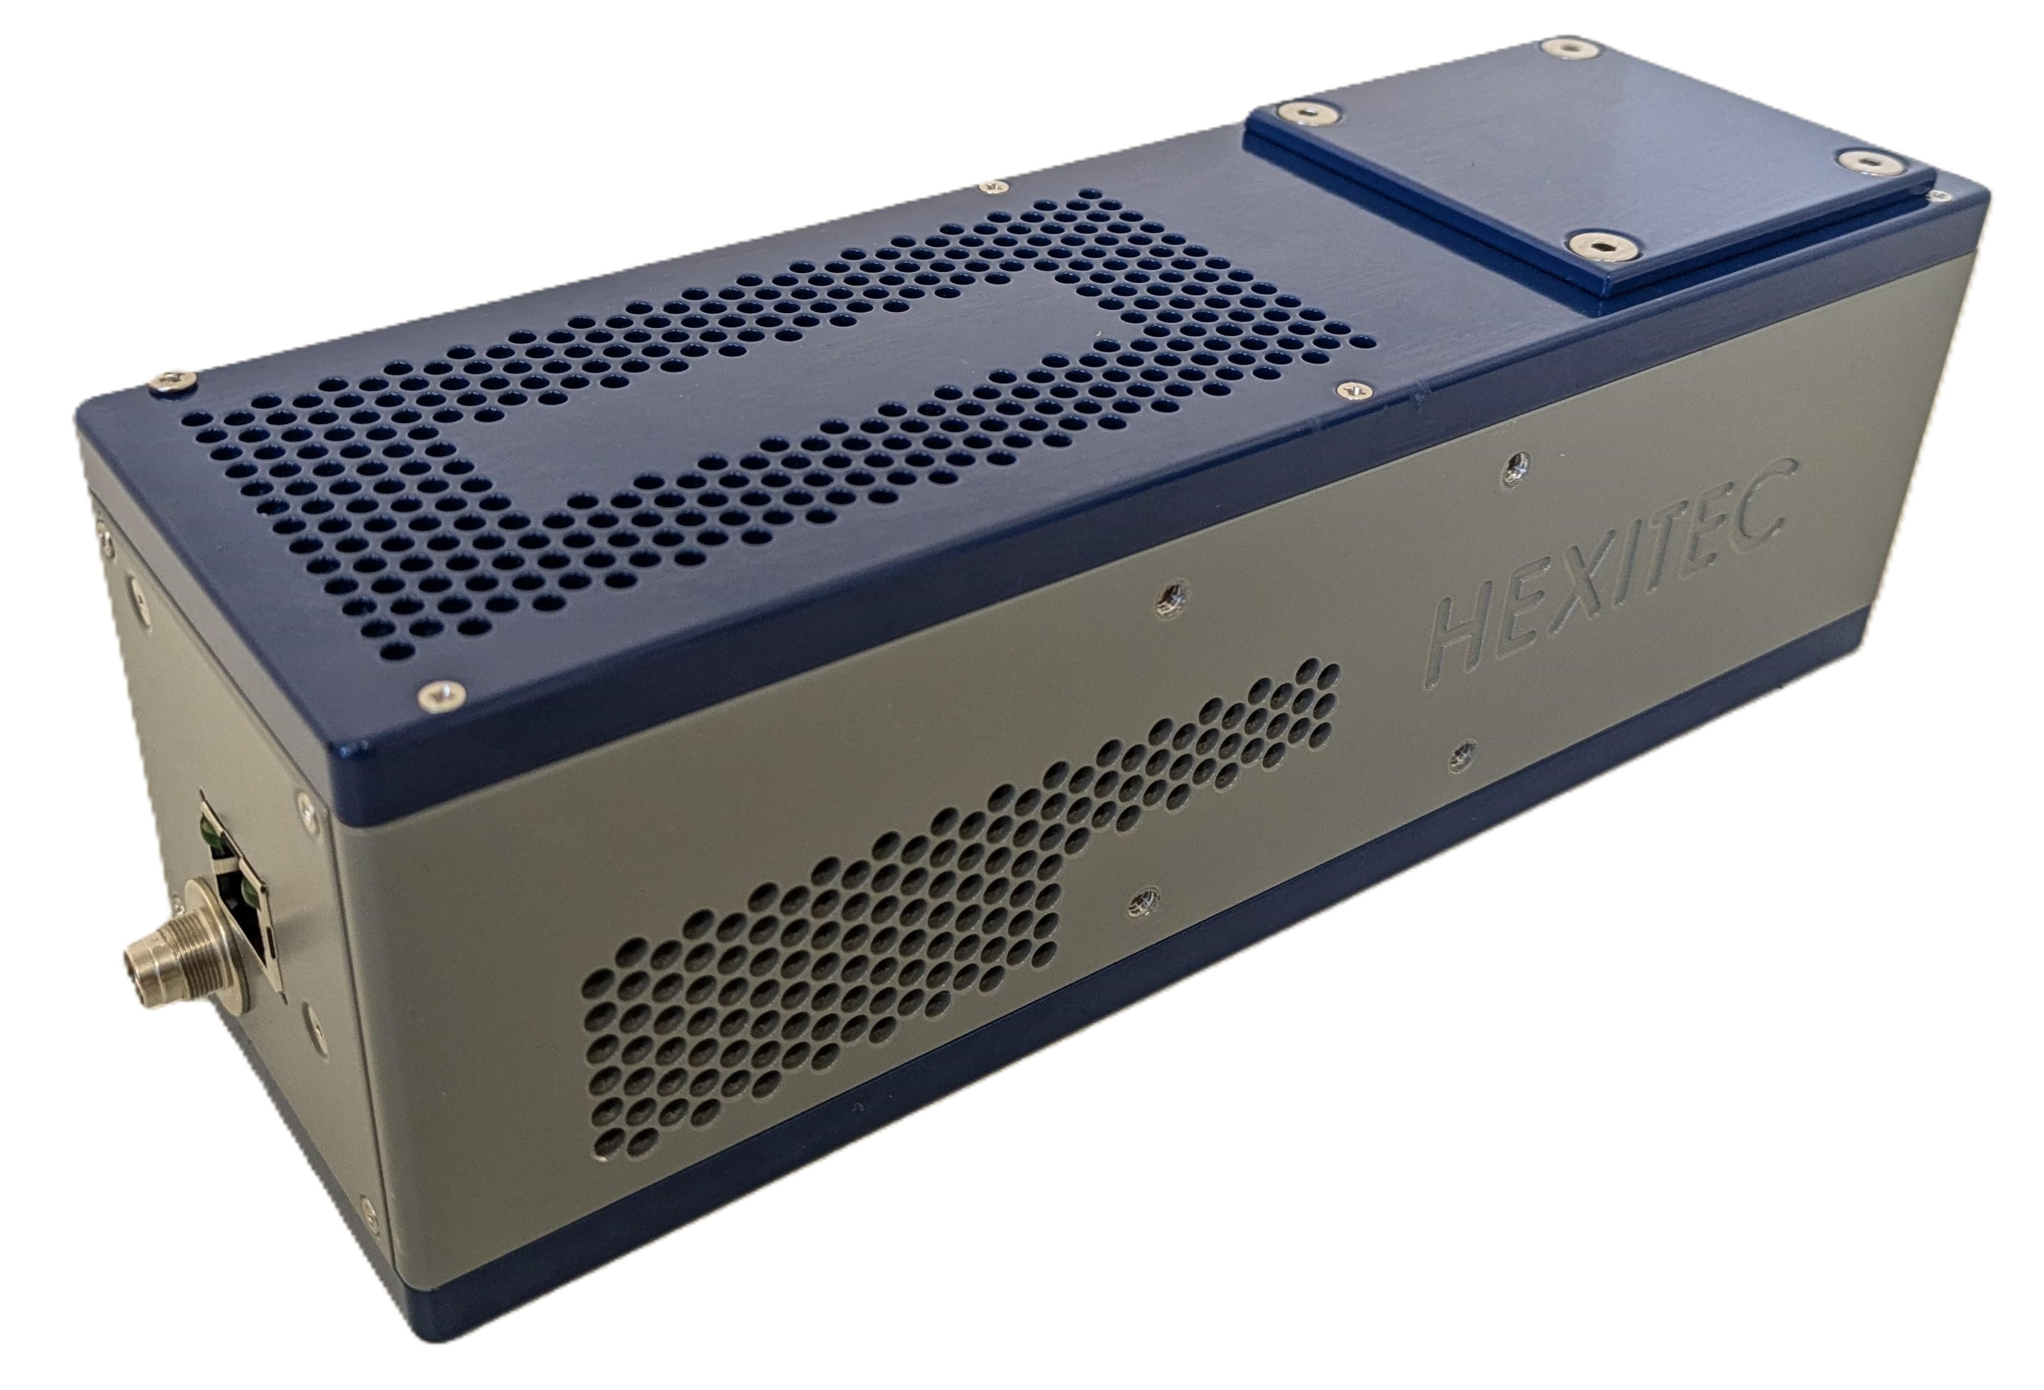
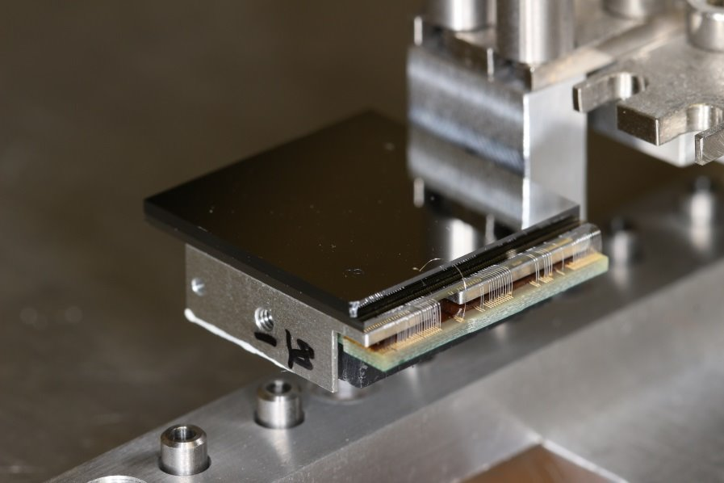
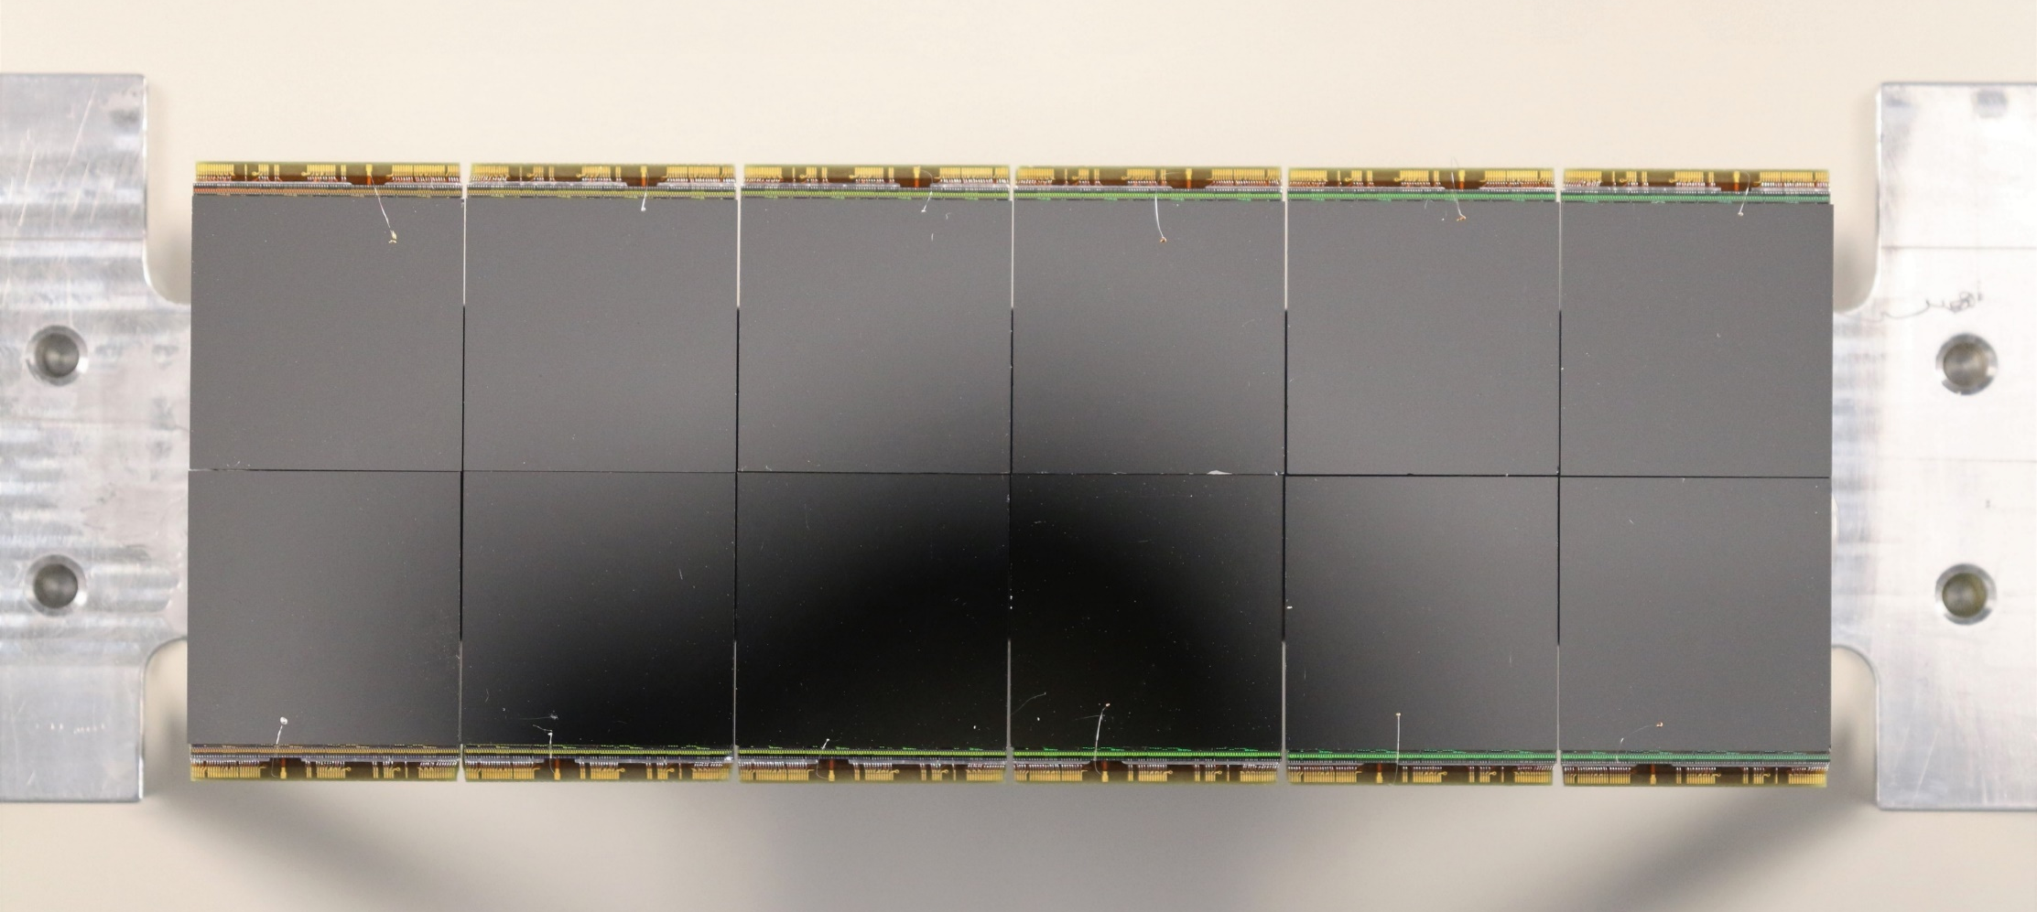
Agenda
1 Who are we - UKRI-STFC-RAL
An introduction to the UKRI Science and Technologies Facilities Council Rutherford Appleton Laboratory.
2 HEXITEC
Introducing the latest version of the technology, its architecture, initial results and camera status
3 HEXITEC applications
An overview of some of HEXITEC applications - credit to our collaborators
4 HEXITEC_{MHz}
Introducing the latest version of the technology and latest results

Slide 3



Who we are

Slide 4





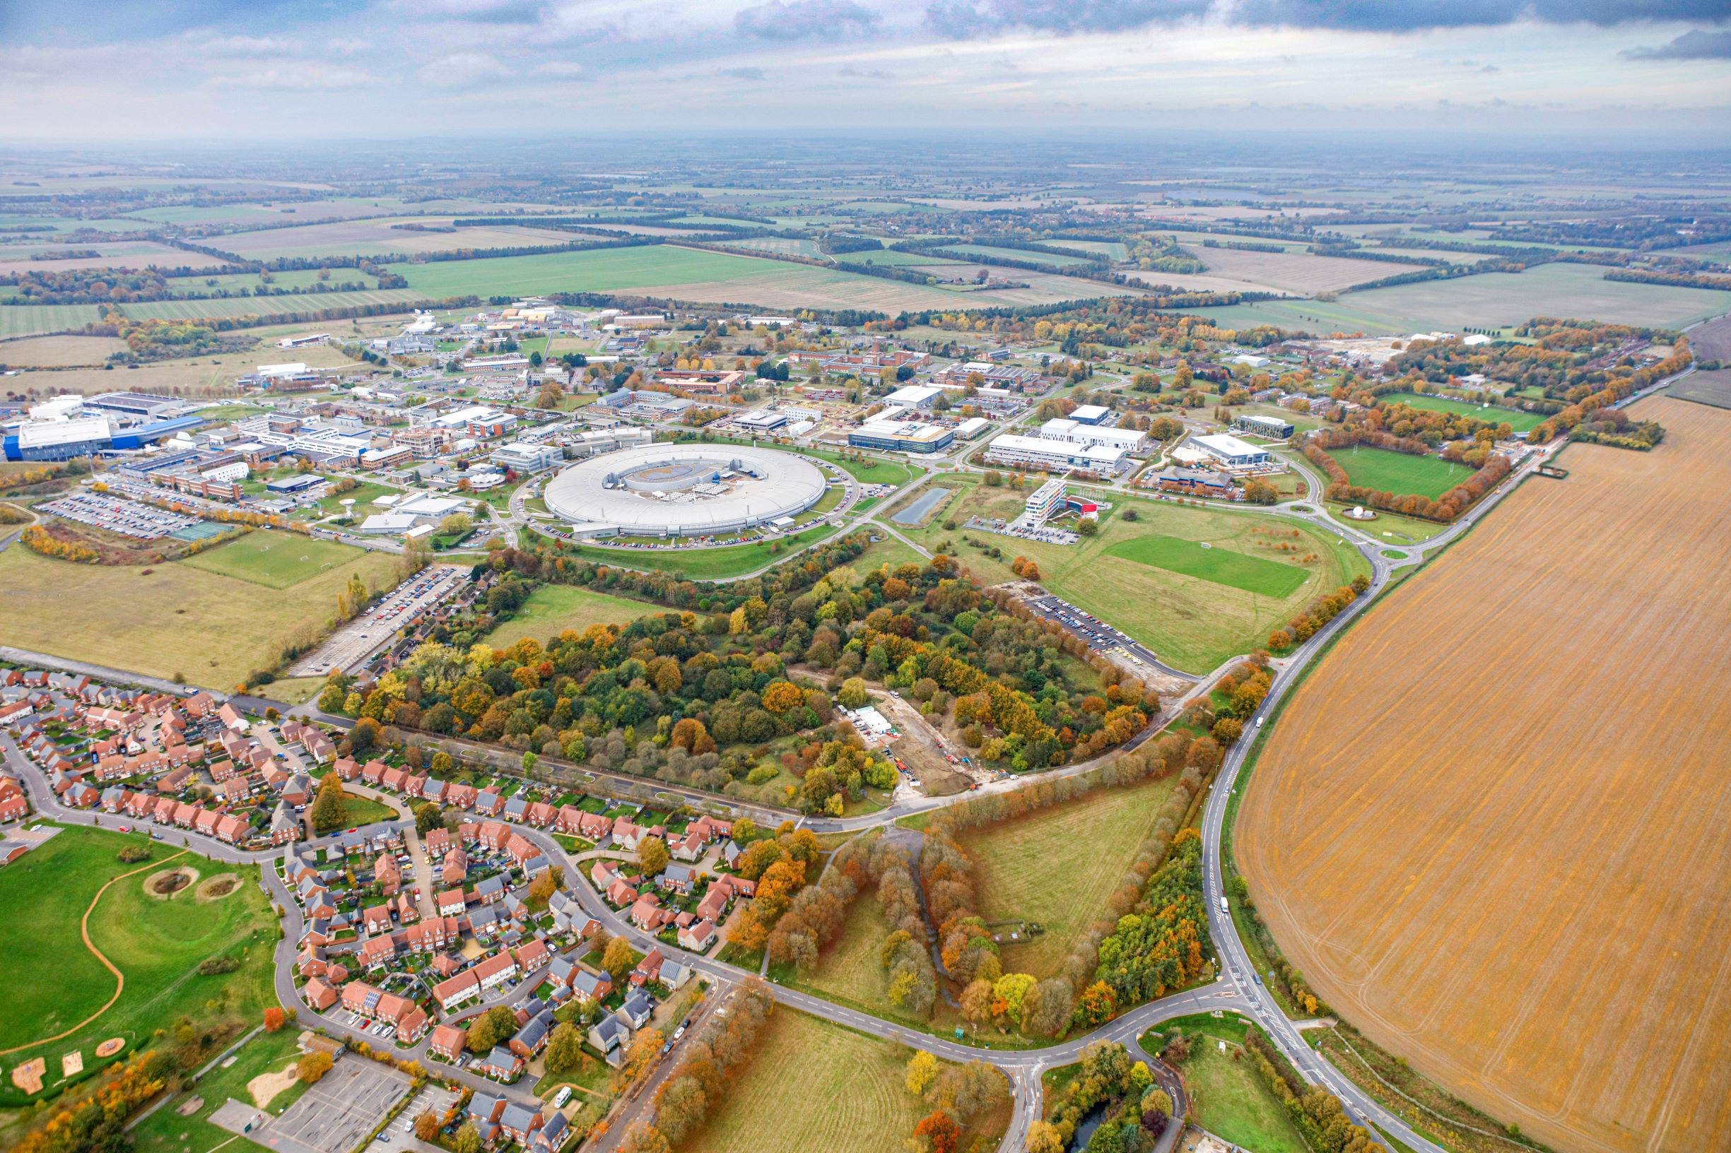

Who we are
Boulby Underground Laboratory
North Yorkshire
UK Astronomy Technology Centre
Edinburgh, Scotland
Daresbury Laboratory
Sci-tech Daresbury Campus, Liverpool City Region
Polaris House
Swindon, Wiltshire
Rutherford Appleton Laboratory
Harwell Didcot, Oxfordshire
Chilbolton Observatory
Stockbridge, Hampshire
…and around the world

Slide 5
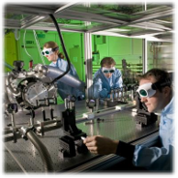
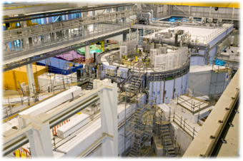
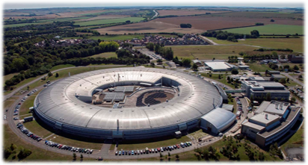
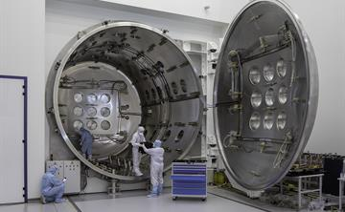
Who we are
Rutherford Appleton Laboratory
Home to:
Central Laser Facility
ISIS
Diamond Light Source
RAL Space

Slide 6
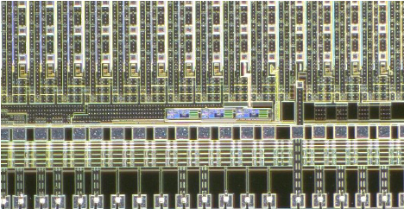
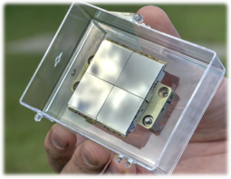
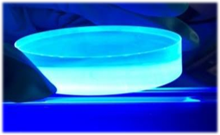
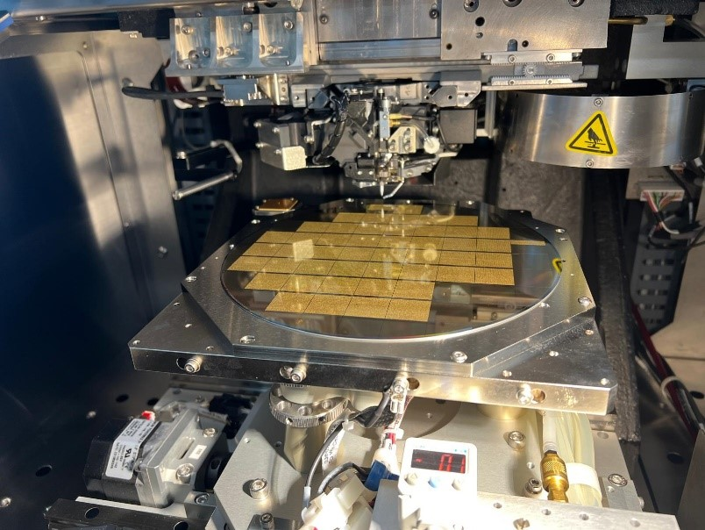
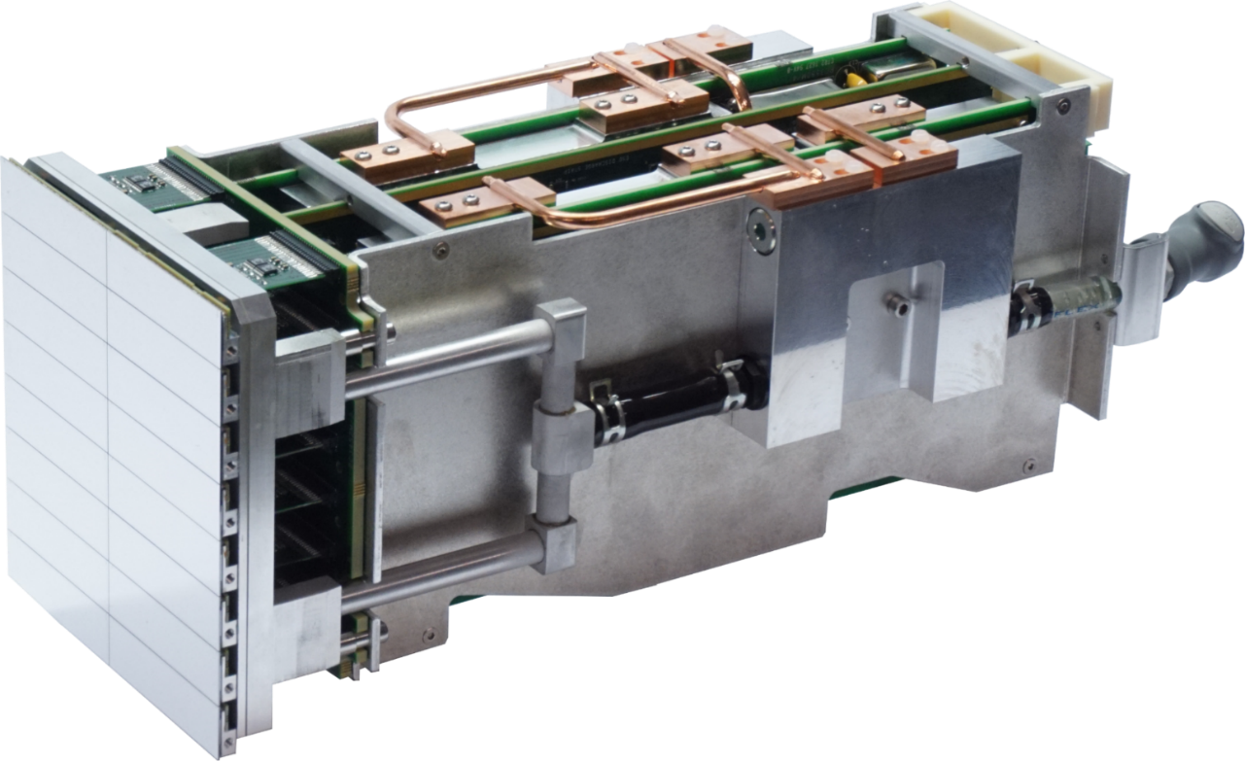
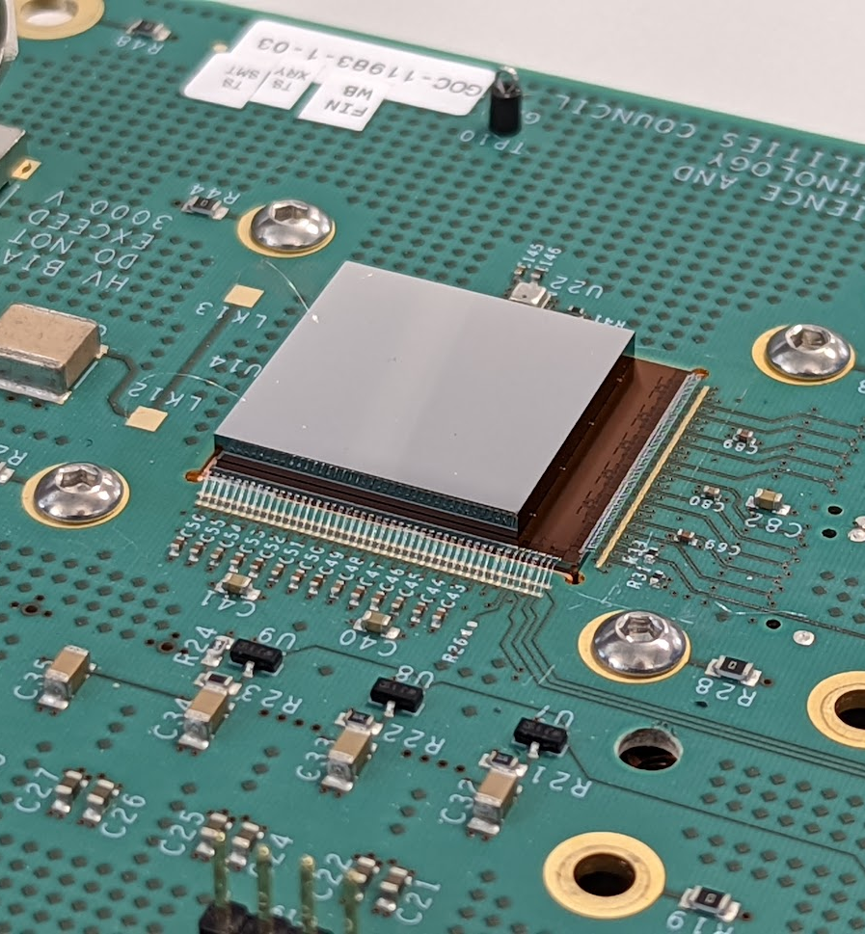
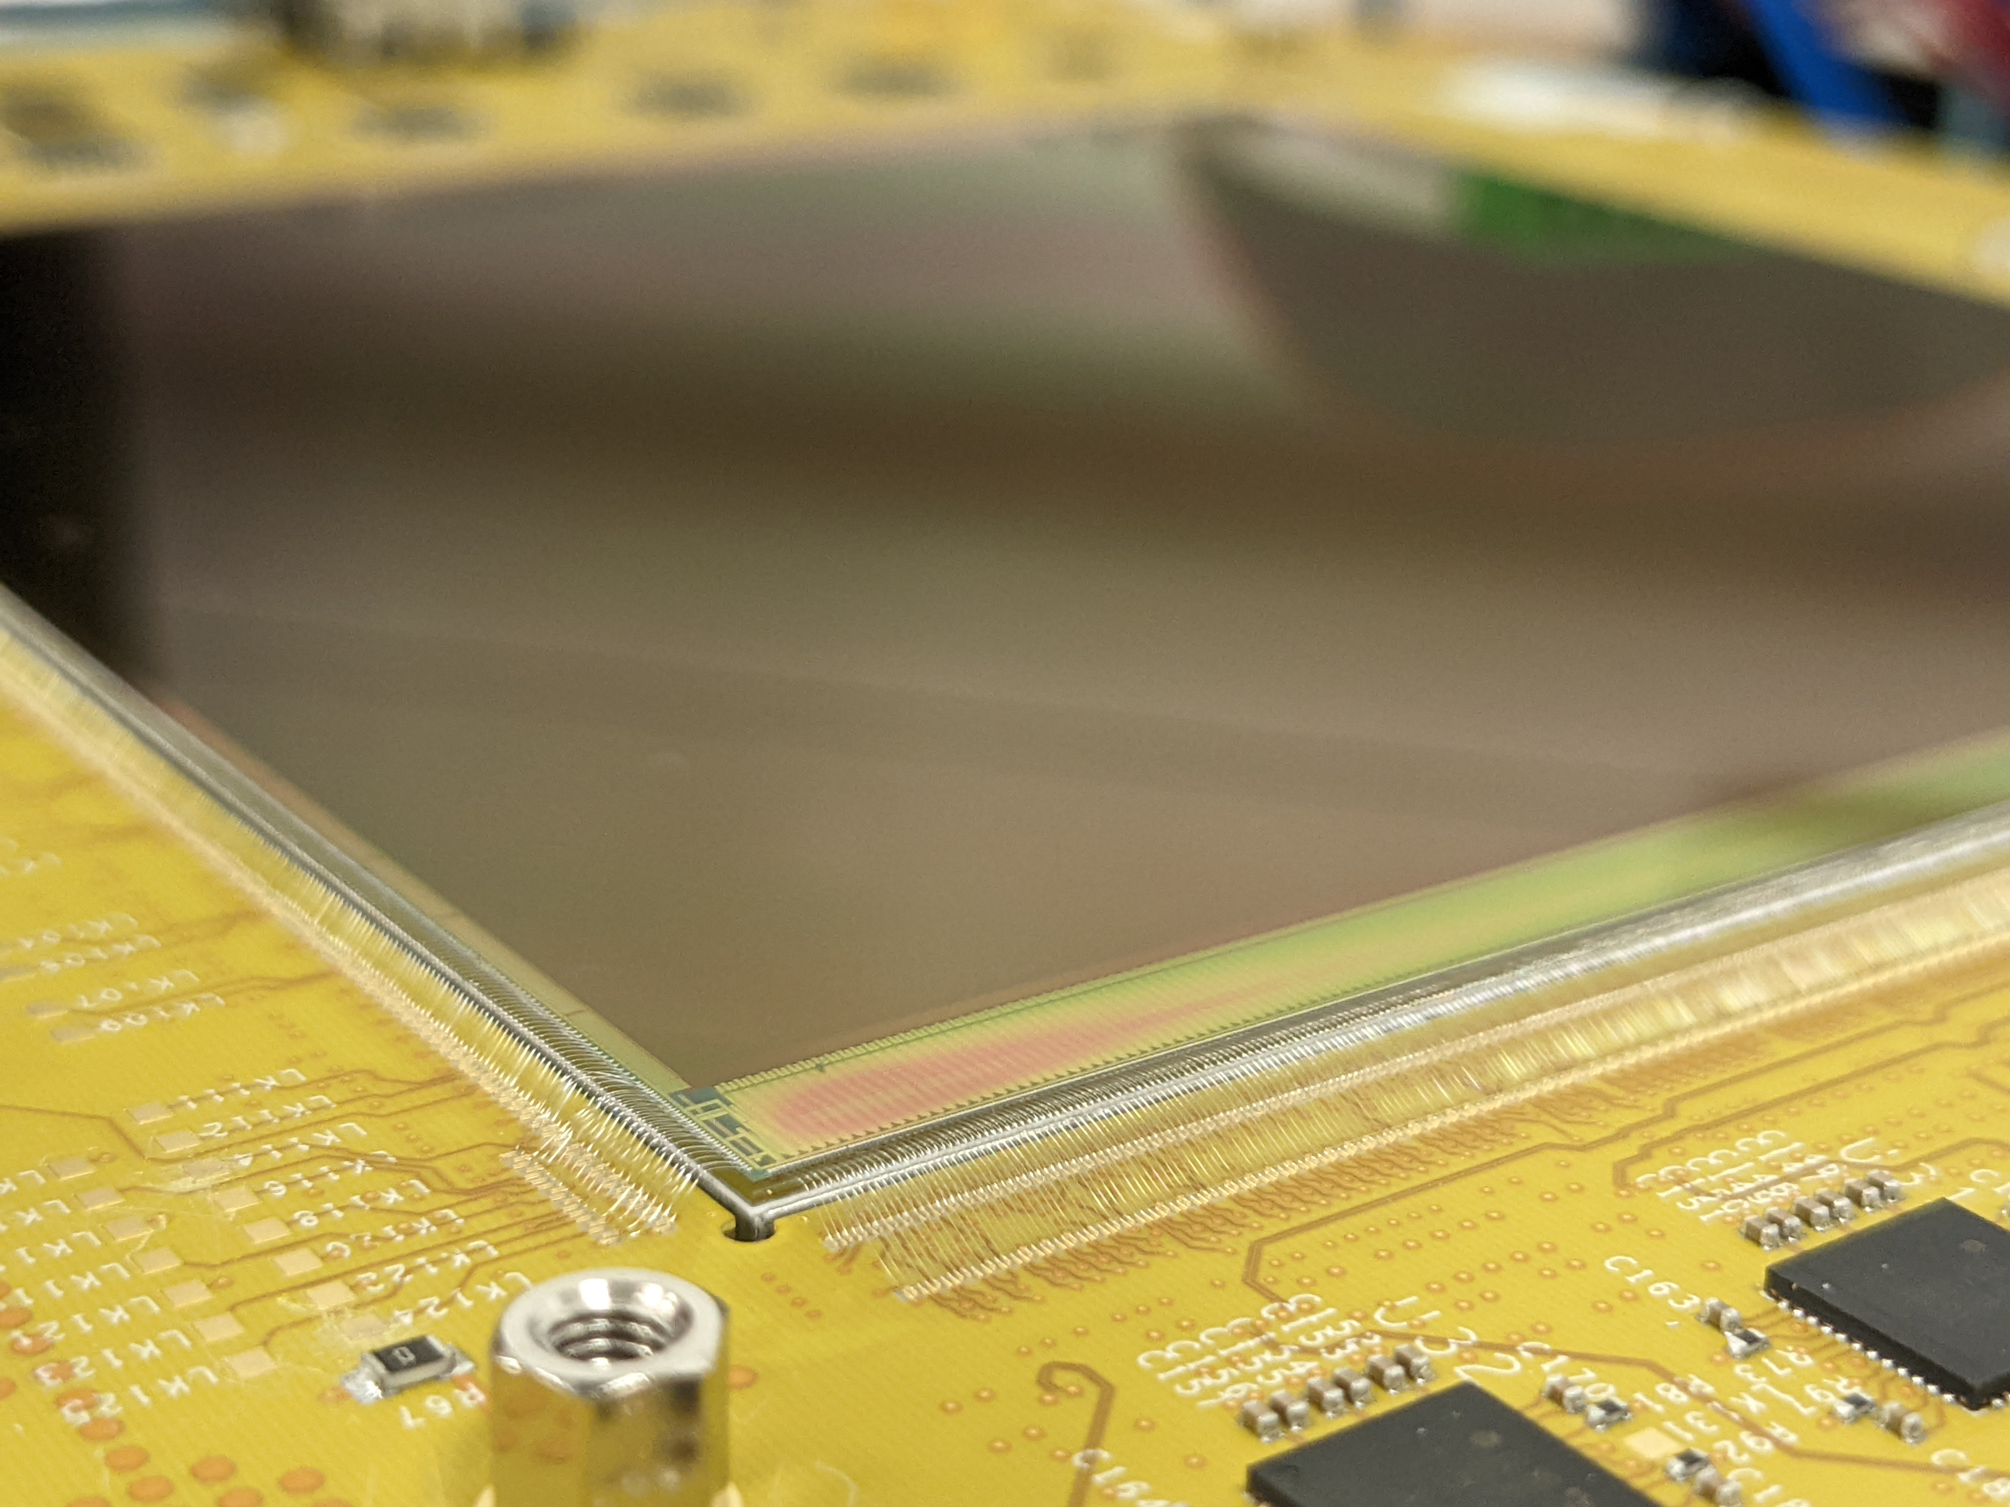
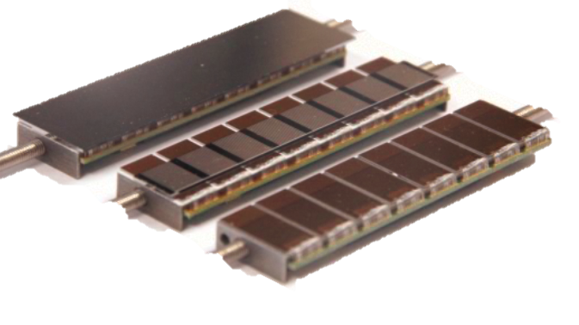
Who we are
Technology’s Detector and Electronics Division
ASIC design
CMOS sensors design
Detector Development
Electronics system design
Interconnect
One stop shop for detector systems

Slide 7
Agenda
1 Who are we - UKRI-STFC-RAL
An introduction to the UKRI Science and Technologies Facilities Council Rutherford Appleton Laboratory.
2 HEXITEC
An overview of the HEXITEC system
3 HEXITEC applications
An overview of some of HEXITEC applications - credit to our collaborators
4 HEXITEC_{MHz}
Introducing the latest version of the technology and latest results

Slide 8






The HEXITEC system
Priority: High resolution hard X-ray spectroscopy
250 µm pixel pitch choice
    Limited charge sharing events
    Moderate spatial resolution
20 × 20 test chip delivered in 2009
Full 80 × 80 system delivered in 2014
2014+ large area systems delivered
Parameter​ | Value​
Pixel Pitch (mm)​ | 250​
Array Size​ | 80 × 80​
Max Frame Rate (kHz)​ | 9.3​
High Gain (keV)​ | 2 – 200​
Low Gain (keV)​ | 6 – 600 ​
FWHM_{@60keV} (keV)​ | < 1​
Max flux rate (photons s⁻¹ mm⁻²) | < 2×10⁴

Slide 9
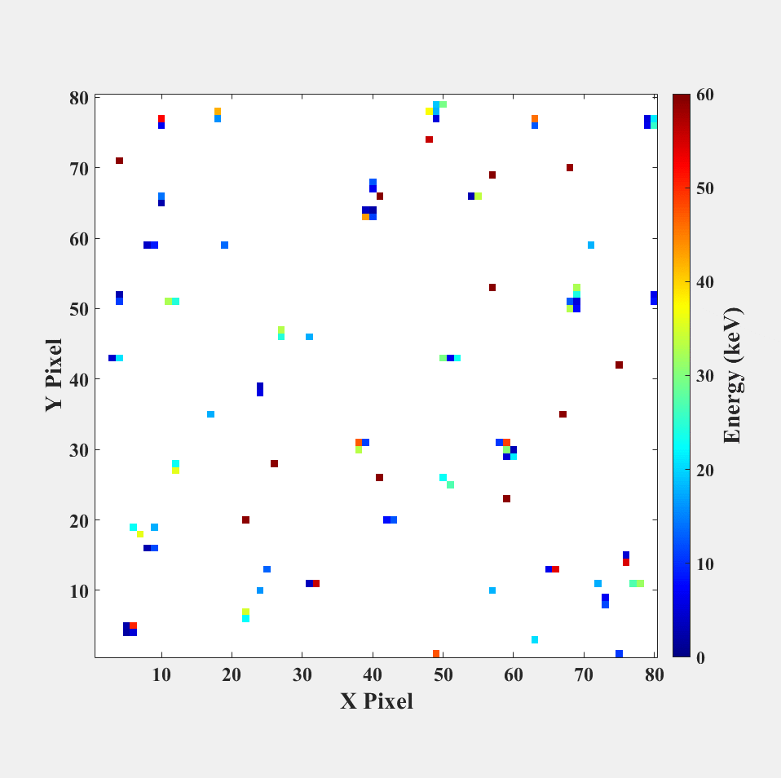
The HEXITEC system
Examples of typical frames of data
2mm CdZnTe sensor @ - 750 V
2 keV noise threshold applied
y = mx + c calibration
HEXITEC records the position and energy of each interaction

Slide 10
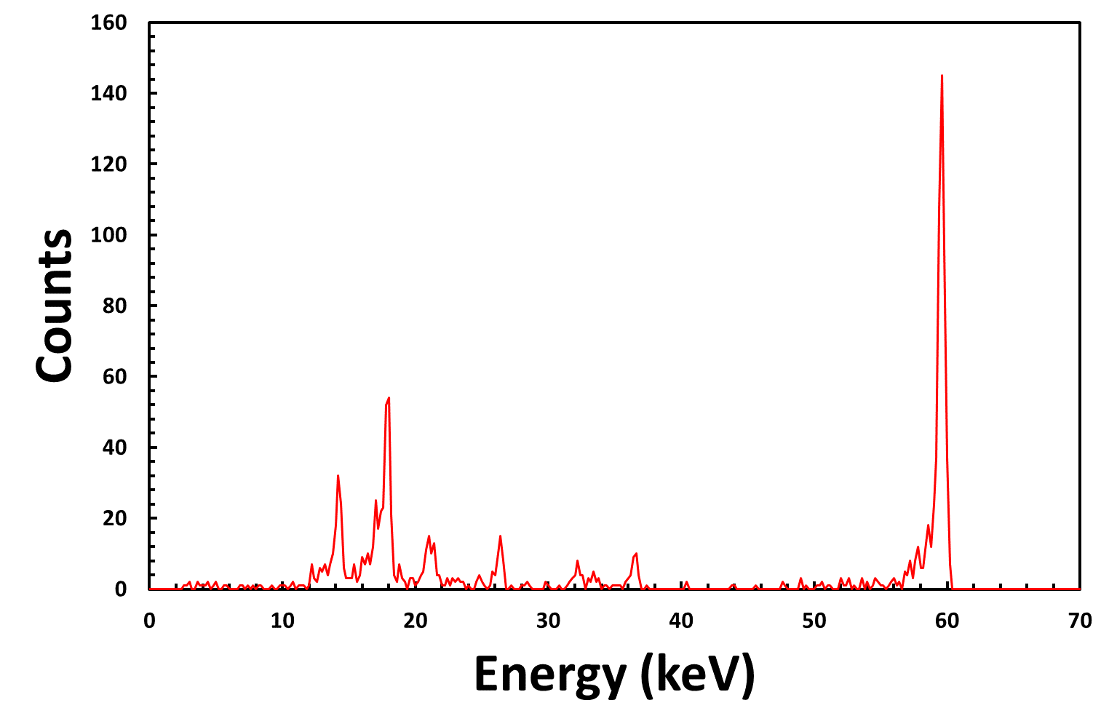
The HEXITEC system
2 mm CdZnTe @ - 750 V
Am-241 spectrum
FWHM = 700 eV
Energy values histogrammed for each pixel across many frames
Result: high resolution spectra!

Slide 11
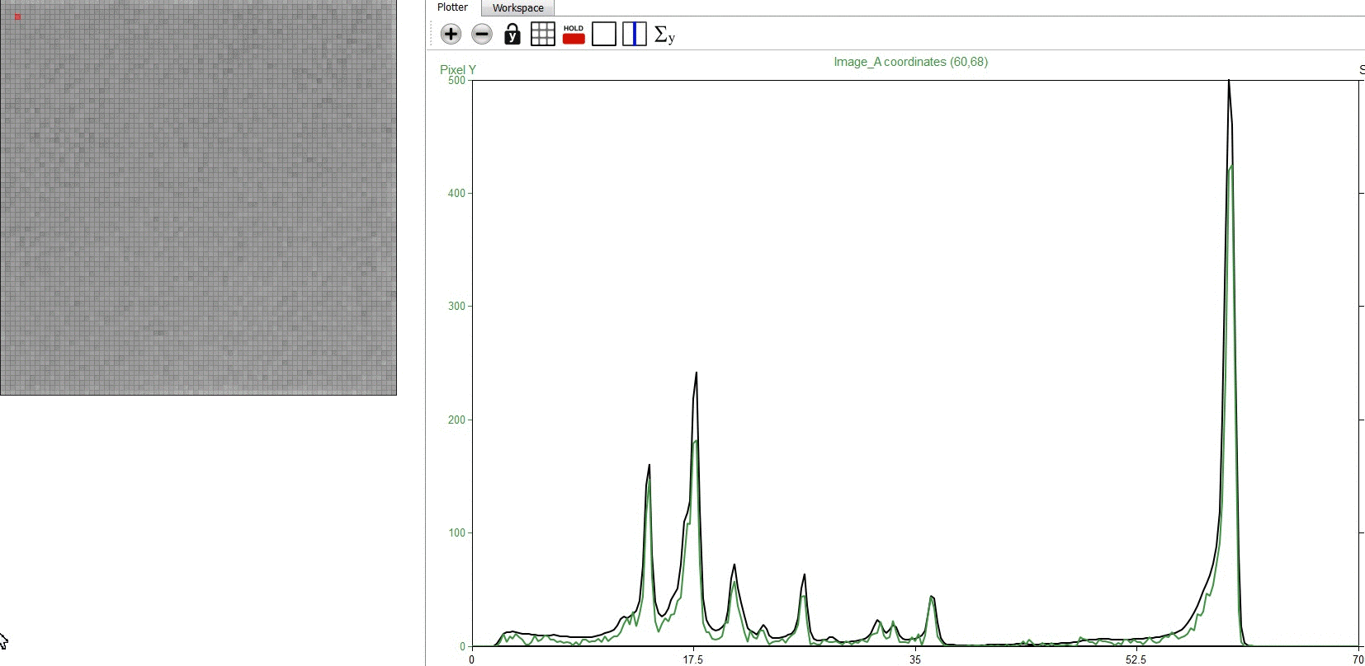
²⁴¹Am flat field
80 Pixels

Slide 12
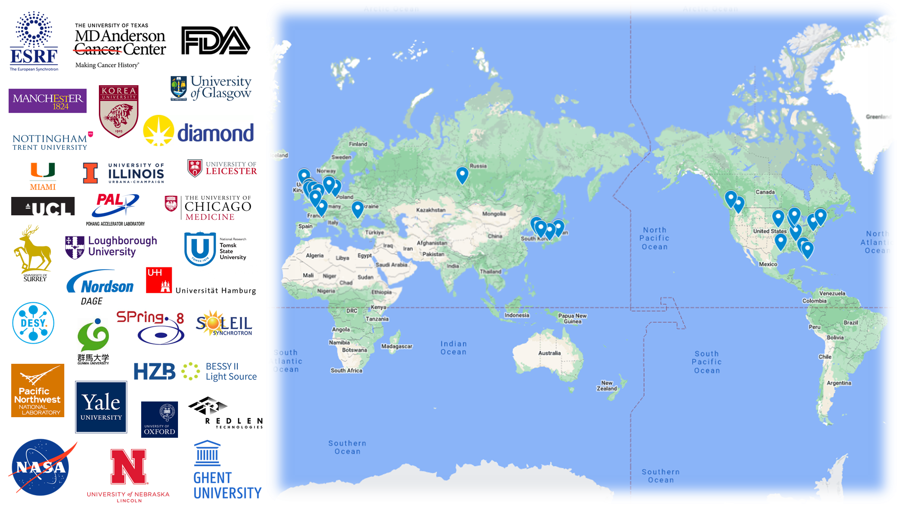
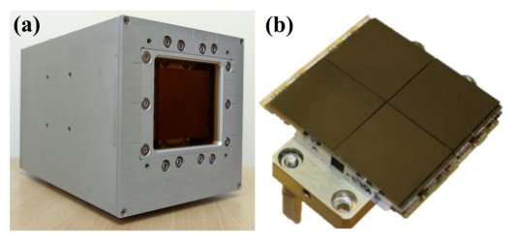
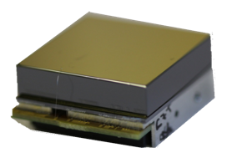
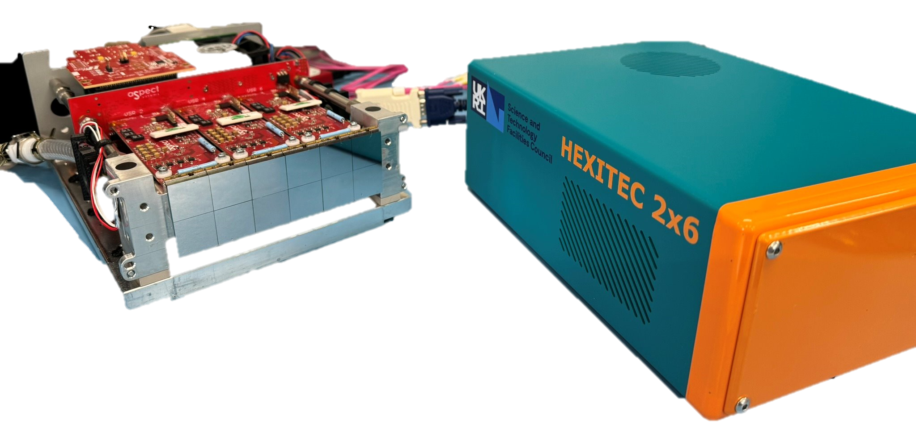
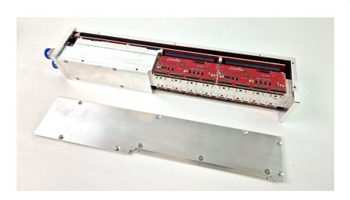
The HEXITEC system
Detector Module
Gig E System
2x2 System
2x6 System
2x8 System

Slide 13
Agenda
1 Who are we - UKRI-STFC-RAL
An introduction to the UKRI Science and Technologies Facilities Council Rutherford Appleton Laboratory.
2 HEXITEC
An overview of the HEXITEC system
3 HEXITEC applications
An overview of some of HEXITEC applications - credit to our collaborators
4 HEXITEC_{MHz}
Introducing the latest version of the technology and latest results

Slide 14

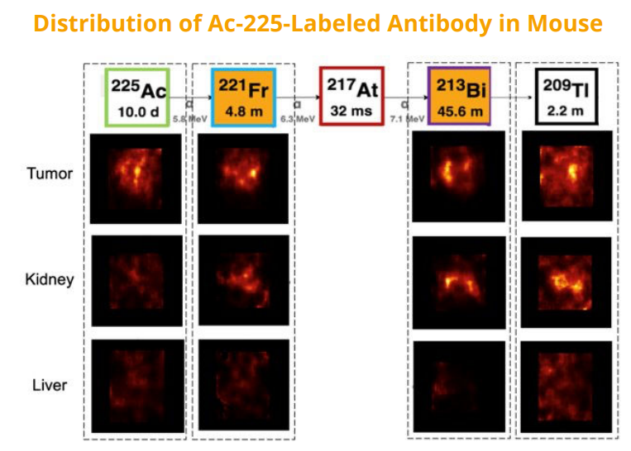
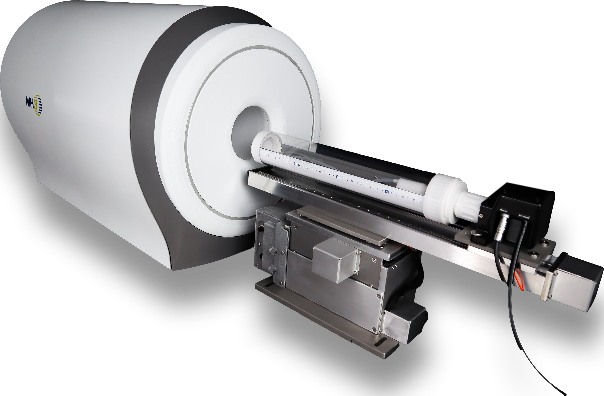
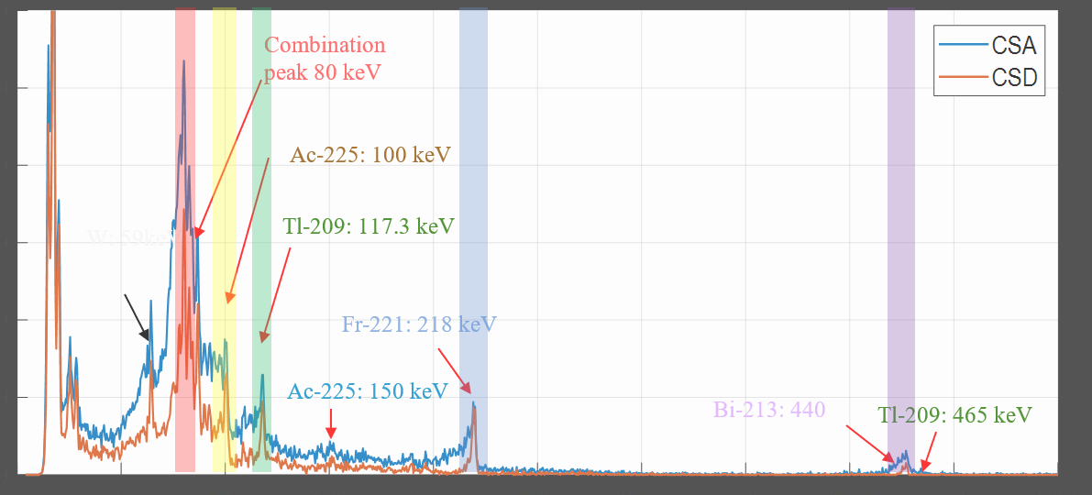

Nuclear Medicine
HEXITEC licensed to MH3D on the alpha-SPECT mini
Target market: radiopharmaceutical development for Targeted Alpha Therapy
Credit: MH3D/ Scintica
EM Zanonni et al (2025): doi: 10.1109/TRPMS.2025.3560558

Slide 15
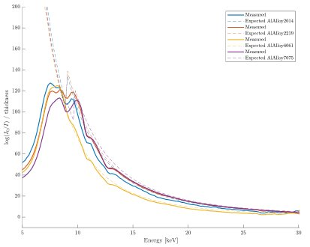
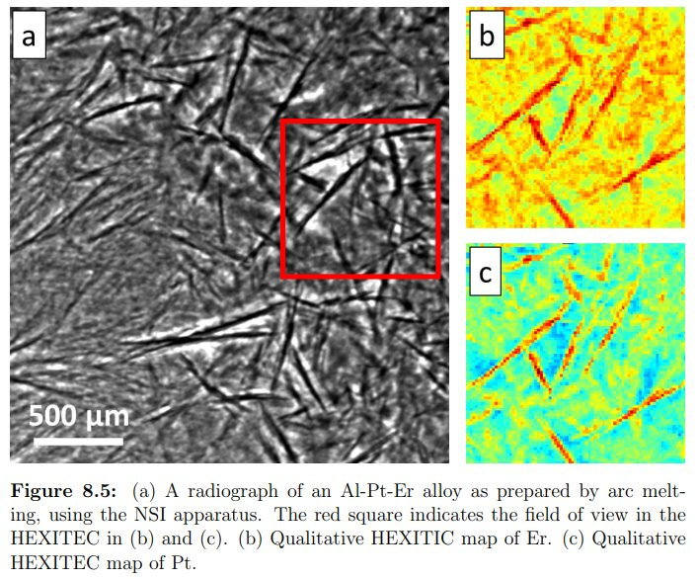
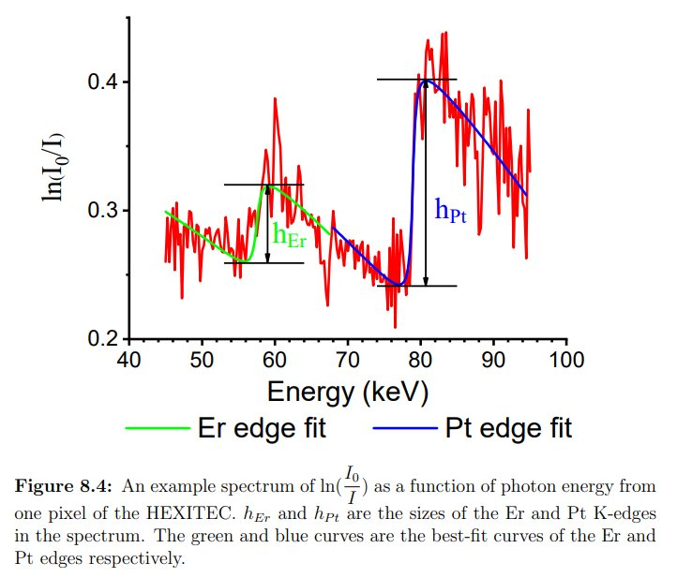


K-edge Imaging
Transmission Imaging to differentiate between different Al alloys
  Using machine learning and neural networks to differentiate between different Al alloys
Credit: Valentina Vicini (2024)
DOI: 10.1109/NSS/MIC/RTSD57108.2024.10656027

Slide 16
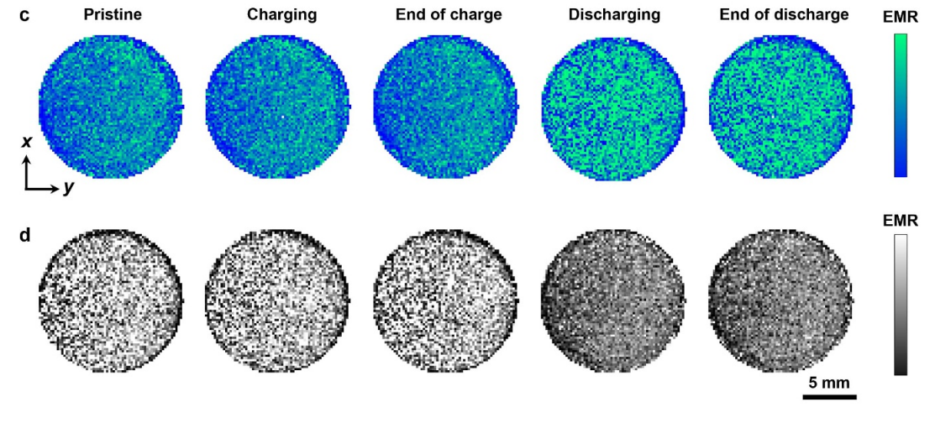


Compton Scattering
Measuring and imaging Li⁺ ion diffusion in operando inside a solid-state Li metal battery
  Compton scattering intensity related to electron density and thus charge in the battery
cathode
anode
Credit: C Huang (2025)
J. Phys. Energy 7 (2025) 025009

Slide 17
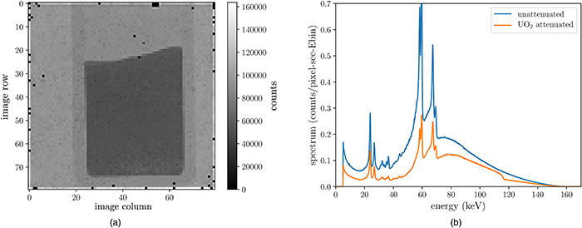

Uranium quantification
Uranium quantification in Nuclear Fuel:
  Determine the mass of Uranium and Uranium Oxide powders using spectral radiography
  σ = 0.62 % with HEXITEC compared to σ = 0.20 % COMPUCEA, but COMPUCEA destroys the sample
  HEXITEC provides a stable and accurate non-destructive characterisation of Uranium
A radiograph of the depleted UO powder
Credit: AJ Gilber et al (2023)
J. Appl. Phys. 134, 024902 (2023); doi: 10.1063/5.0147454

Slide 18

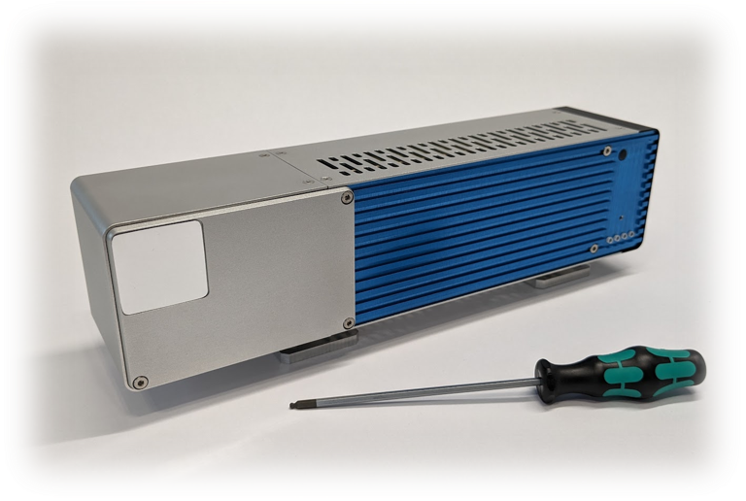
Agenda
1 Who are we - UKRI-STFC-RAL
An introduction to the UKRI Science and Technologies Facilities Council Rutherford Appleton Laboratory.
2 HEXITEC
An overview of the HEXITEC system
3 HEXITEC applications
An overview of some of HEXITEC applications - credit to our collaborators
4 HEXITEC_{MHz}
Introducing the latest version of the technology and latest results

Slide 19
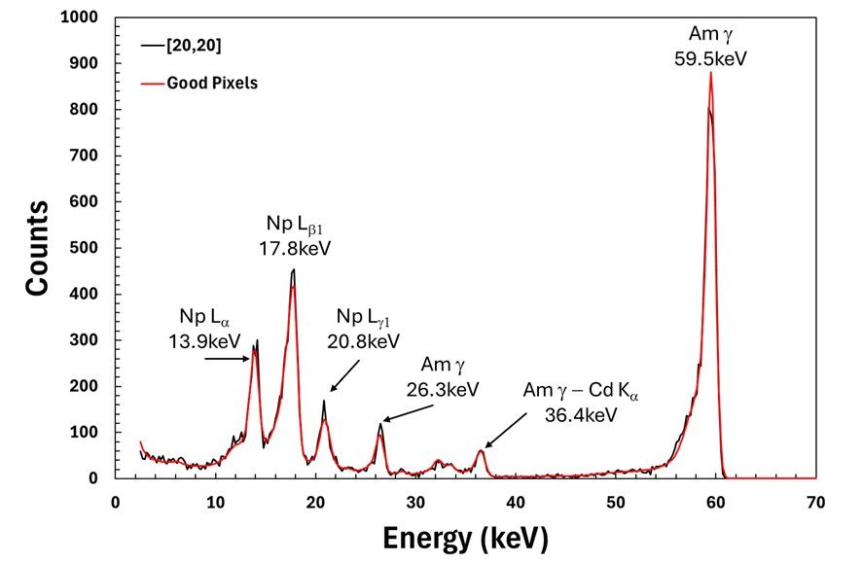
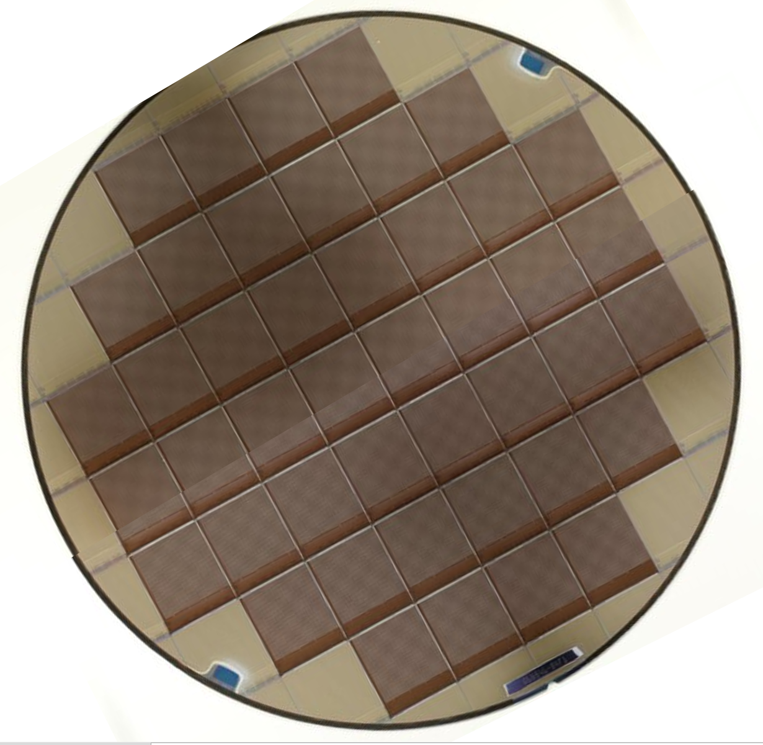
HEXITEC MHz spec
Parameter​ | HEXITEC | HEXITEC MHz
Pixel Pitch (mm)​ | 250​ | 250​
Array Size​ | 80 × 80​ | 80 × 80​
Max Frame Rate (kHz)​ | 9.3​ | 1000
Digitisation | Off-chip | On-chip
Detector type | Track + hold | Integrating
Energy range (keV) | 2 - 600 | 2 - 300
FWHM_{@ 60 keV} (keV)​ | < 1​ | <1
Max flux rate (photons s⁻¹ mm⁻²) | < 2×10⁴ | > 10⁶
Power consumption (W) | 1.5 | 15
Designed in TSMC 180 nm
Full spectroscopy @ 2×10⁶ ph s⁻¹ mm⁻²
Similar energy resolution capabilities to HEXITEC

Slide 20
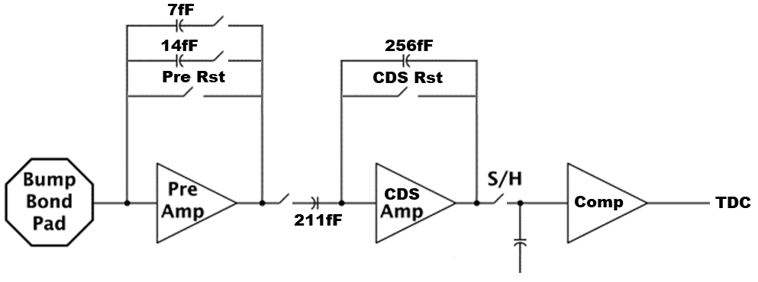
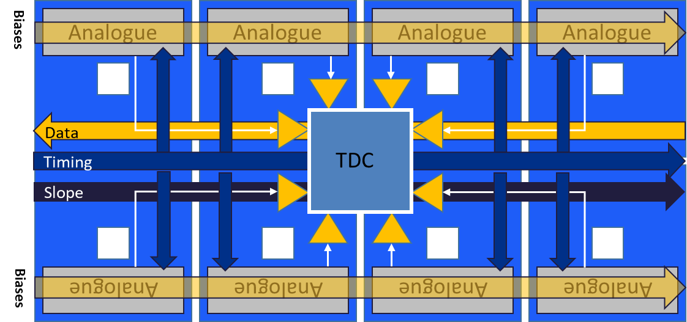
HEXITEC MHz architecture
Integrating architecture
t_{int} = 900 ns, t_{reset} = 100 ns
Front end noise ~ 100 electrons
TDCs shared in a 4×2 ‘super-pixel’
12-bit data out for each pixel
20 × 4.1 Gb s⁻¹ serialisers
Total data rate ≈ 10 GB s⁻¹
FPGA histogramming of data set
25 MB time slice

Slide 21
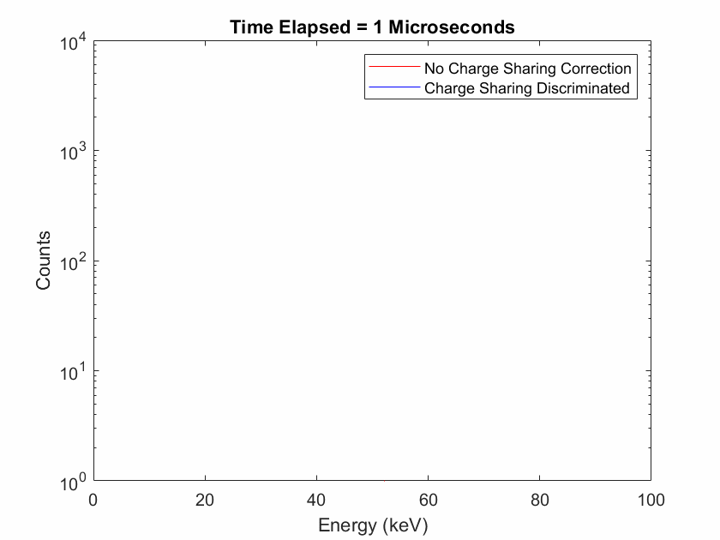
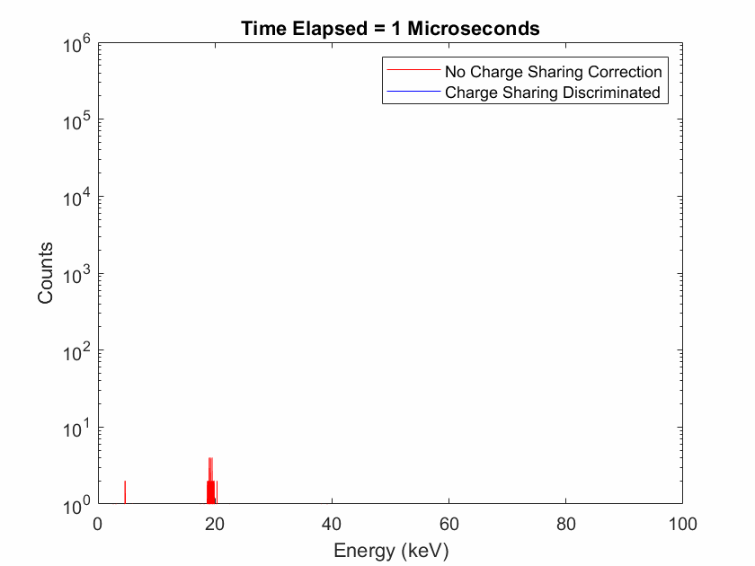


HEXITEC flux results
Occupancy = 10%
Occupancy = 50%
1×10⁶ ph s⁻¹ mm⁻²
1×10⁷ ph s⁻¹ mm⁻²

Slide 22
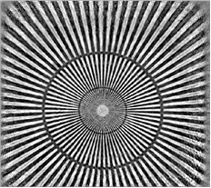
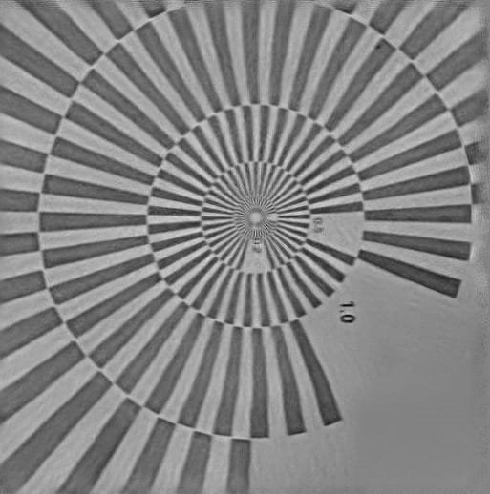
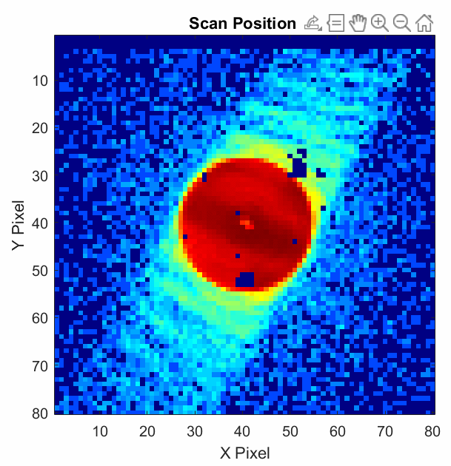
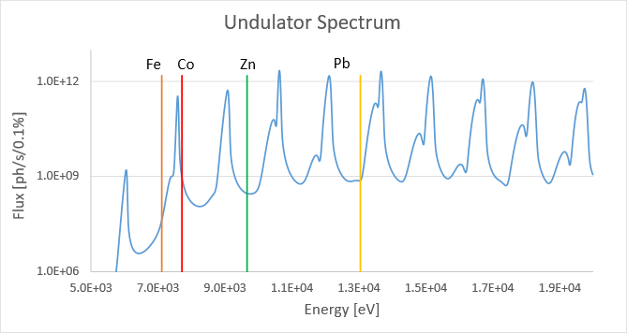
Hyperspectral Ptychography
Ptychographic phase image of a test target (40 µm field of view). Data was recorded with a monochromatic beam on the single-chip HEXITEC detector.
Match undulator spectrum with the absorption edges of the elements of interest​
HEXITEC-MHz enables simultaneous quantitative element-specific tomographic ptychograph with high spatial resolution

Slide 23
Final remarks
HEXITEC and HEXITEC MHz are spectroscopic detectors for use with high Z materials.
We are always looking for new collaborations and applications.
Please get in touch via hexitec@stfc.ac.uk
Thank you for listening!

