Slide 1
Charged-Particles Reconstruction at Muon Collider
Sara Shinde

Slide 2
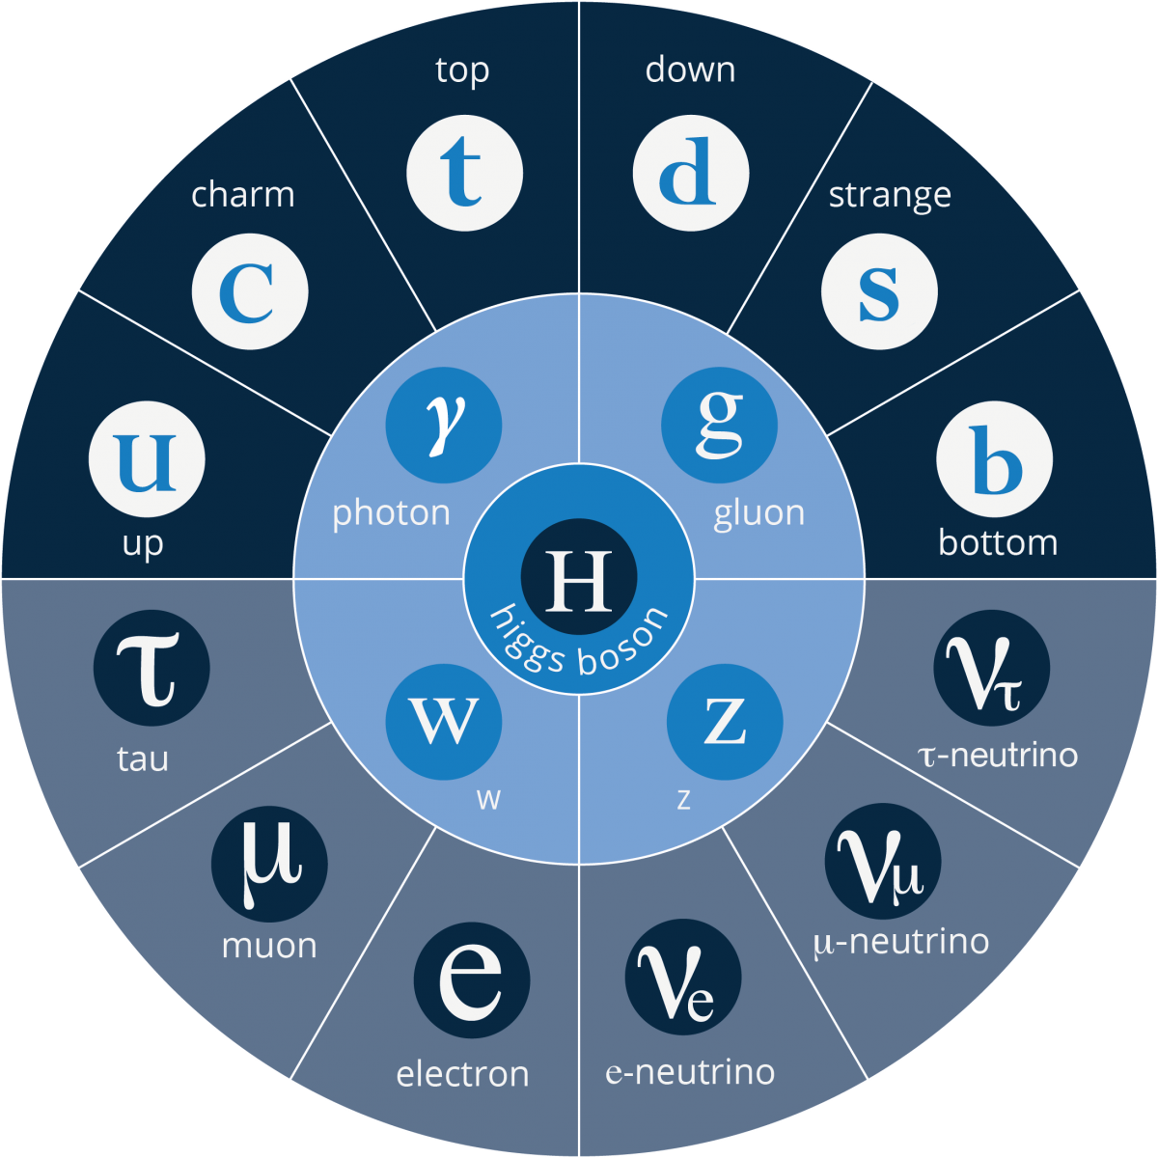
BEYOND THE STANDARD MODEL
The Standard Model (SM) in particle physics has been quite successful in explaining some of the observed physical phenomena.
However, several phenomena such as the existence of dark matter, matter-antimatter asymmetry in the universe, origin of neutrino masses, etc. cannot be explained by the Standard Model.
There is a need to look beyond the Standard Model (BSM).

Slide 3
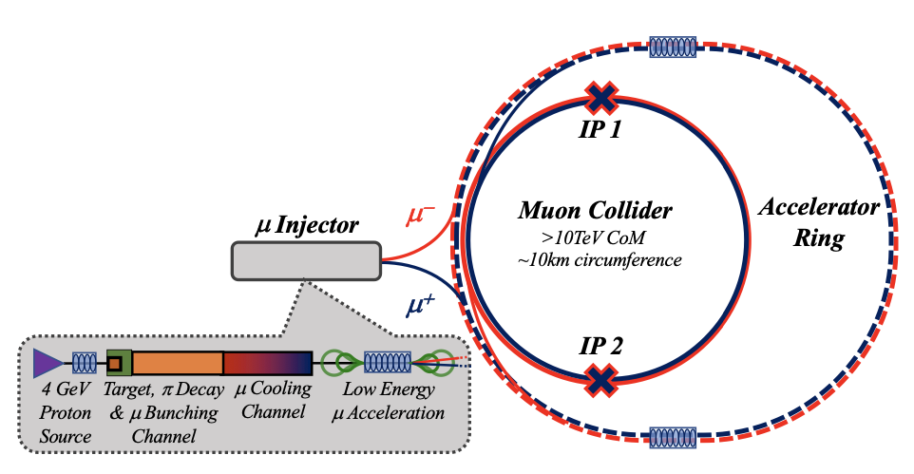
PROPOSED MUON COLLIDER
Collision energy can be expected to increase by at least an order of magnitude due to the recent technological developments that have taken place.
There is a need for future particle colliders in the multi-TeV scales that can increase the energy range for direct and indirect searches.
One of the ways in which this can be achieved is by building the proposed 100-km-long Future Circular Collider (FCC-hh), which will collide protons at 100 TeV centre-of-mass energy.

Slide 4
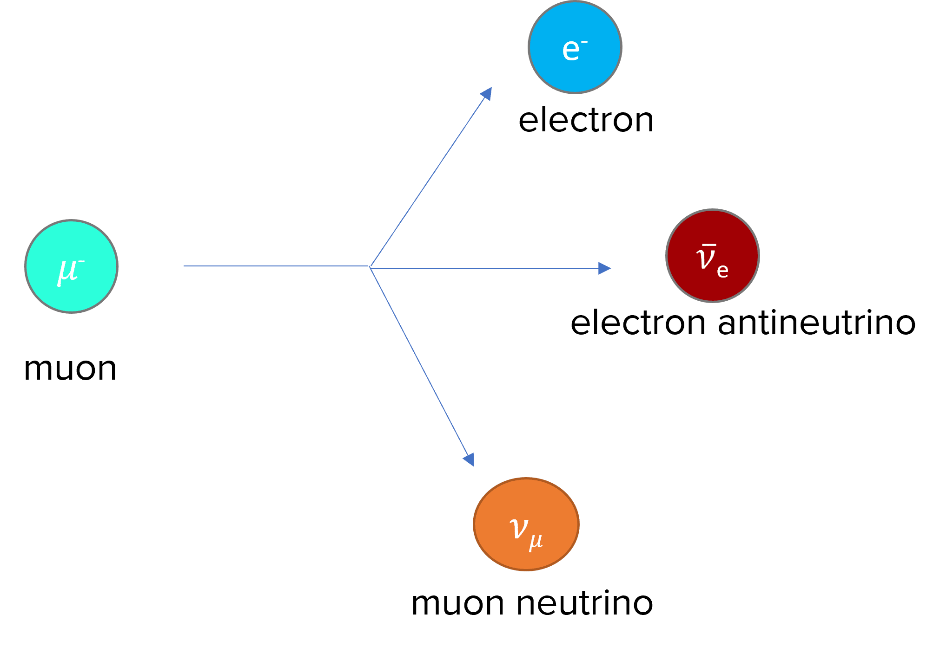
CHALLENGES
Despite the several advantages of muon colliders, building one poses significant technological challenges.
Muons are unstable and decay into an electron or positron accompanied by a neutrino and an antineutrino.
Another related problem caused by muon decay is that it causes dissipation of the muon beam.

Slide 5
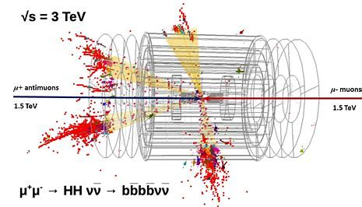
CHALLENGES
After muons decay, they tend to scatter in all directions. Some enter the detector and cause noise.
Every square centimetre of the active area of the tracker detector is hit hundreds of times.
A muon collider detector (MCD) faces the challenge of separating the products of muon collisions from an intense beam-induced background (BIB) from secondary and tertiary interactions of muon decay products.

Slide 6
TRACK RECONSTRUCTION
A track is an object reconstructed from hits positions of charged particle trajectories.
By measuring the momentum of the particles, we can reconstruct the particle tracks.
Track reconstruction is complicated by the large number of hits due to the beam-induced background (BIB-hits).
The spatial distribution of BIB-hits is different from the hits created by the particles generated from muon-muon collisions.

Slide 7
TRACK RECONSTRUCTION ALGORITHM
The tracking algorithm helps differentiate the BIB-hits from the tracks of charged particles generated by primary collisions.
We plan to carry out cluster shape analysis, which would help distinguish between signal and BIB events
The current tracking algorithm is relatively slow and takes several seconds to process one single event. My project will focus on making it faster and more efficient.
I plan to investigate how timing and reconstruction performance of the tracking algorithms can be improved by utilising directional information from specially-arranged silicon-detector layers in the particle detector.

Slide 8
TRACK RECONSTRUCTION ALGORITHM
I also plan to work on validating the improved algorithms to ensure that they can be used by all members of the collaboration, as well as explore other ways the algorithms can be improved/optimised.

