Slide 1


CERN
CH1211 Geneva 23 Switzerland
EDMS NO.
3063899
REV.
1.0
VALIDITY
APPROVED
REFERENCE
J. Ferradas Troitino TE/MSC
Date: 20/03/2024
NDT Report
X-ray Computed Tomography
HFM Inspection of SMC 11T 2G 103b coil
TESTS PERFORMED BY: | DOCUMENT PREPARED BY: | DOCUMENT APPROVED BY:
M. Celuch EN/MME/MM | M. Celuch EN/MME/MM | G. Arnau Izquierdo EN/MME/MM
 |  | EN ISO 9712 level 2 Card n° BO2-020101
List of notification: Jose Ferradas Troitino (TE/MSC) Juan Carlos Perez (TE/MSC) Aleksandra Bartkowska (EN/MME) Mickael Crouvizier (EN/MME)

Slide 2

REFERENCE
D J. Ferradas Troitino TE/MSC
EDMS NO.
3063899
REV.
1.0
VALIDITY
APPROVED
Aim
The main region of interest is the so-called layer jump (transition from the inner to outer conductor layer). We would like to investigate the conductor placement and any potential defect appearing in the volume.

Slide 3
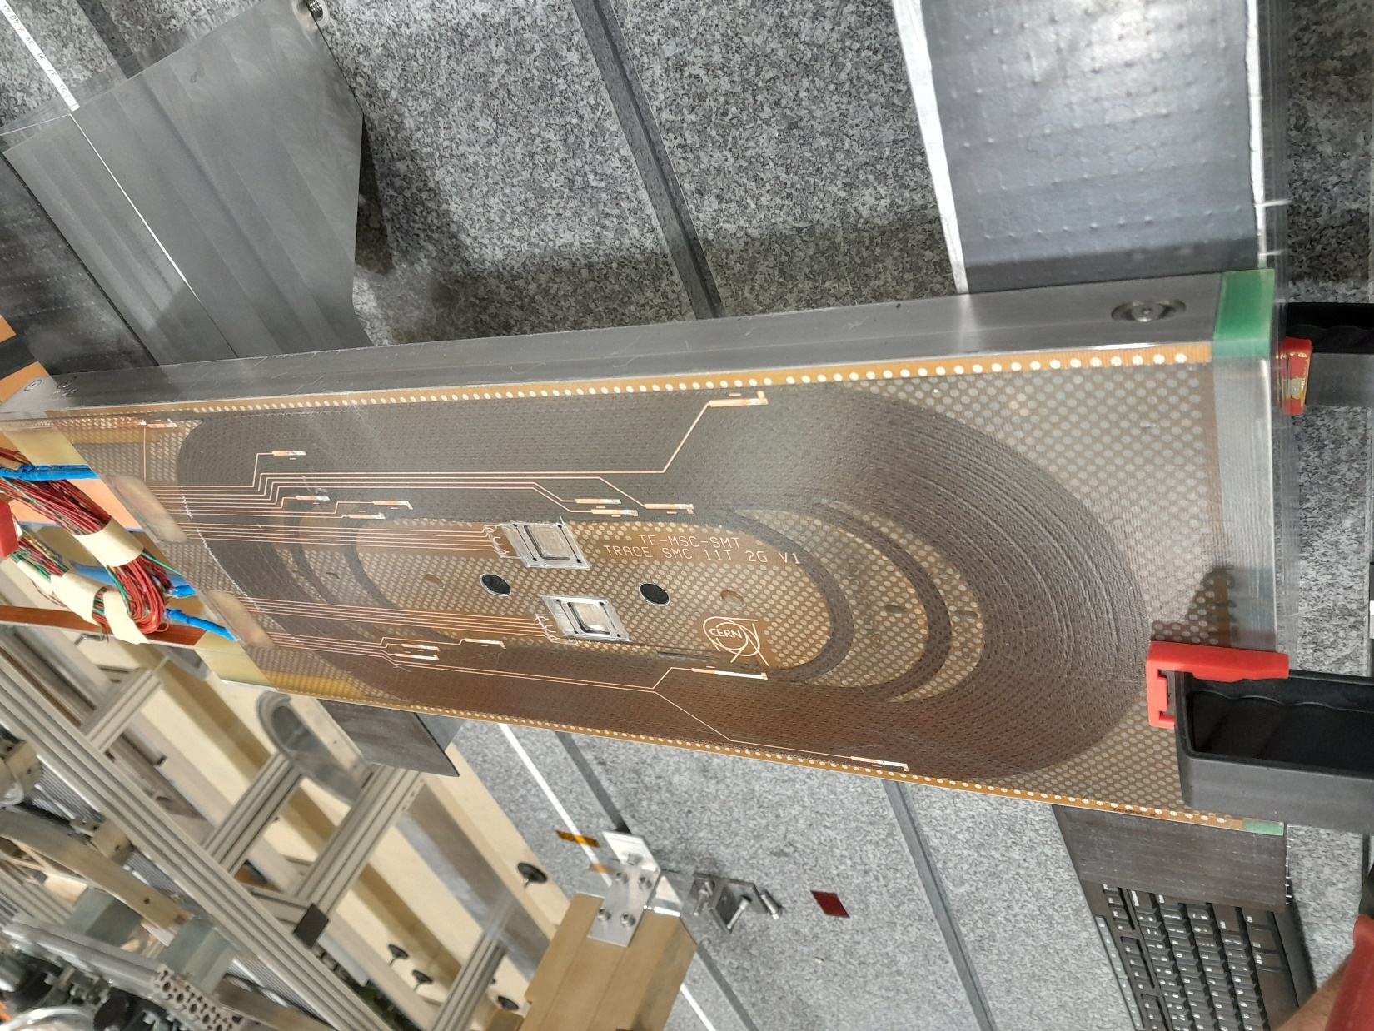
REFERENCE
J. Ferradas Troitino TE/MSC
EDMS NO.
3063899
REV.
1.0
VALIDITY
APPROVED
Figure 1. Inspected sample.

Slide 4
REFERENCE
J. Ferradas Troitino TE/MSC
EDMS NO.
3063899
REV.
1.0
VALIDITY
APPROVED
Testing conditions
Device | D7 LINAC
X-ray source: | Type | Voltage [MeV] | Frequency [Hz] | Voxel Size [mm] | FOD / FID [mm]
 | Siemens SILAC | 5.9 | 599.88 | 0.115 | 2700 / 3248.821
FOD – focus object distance
FID – focus imaging (flat panel) distance

Slide 5
REFERENCE
J. Ferradas Troitino TE/MSC
EDMS NO.
3063899
REV.
1.0
VALIDITY
APPROVED
Results
As one popped in/out strand can induce a wave of events the numbers below show only the amount of conductors affected by the pop in/out effect. So even if there are more than one event in the same cable it is counted as one.
2 cables affected (1 in connection and 1 in non-connection side)
All results obtained are available using the link:
\\cern.ch\dfs\Projects\ZeissMetrotomCT\2024\TE\MSC\HFM\
CT data (vgl file) can be viewed using Volume Graphics software:
\\cern.ch\dfs\Projects\ZeissMetrotomCT\Public\VGViewer
Images and videos available starting from the next page.

Slide 6
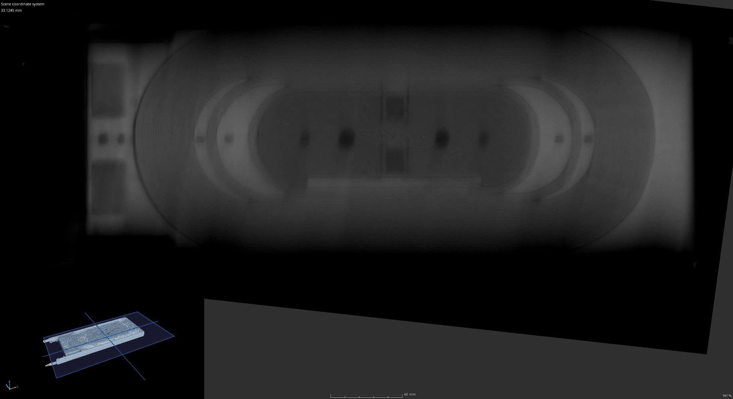
Vid. 1 – SMC 103b – top view.

Slide 7
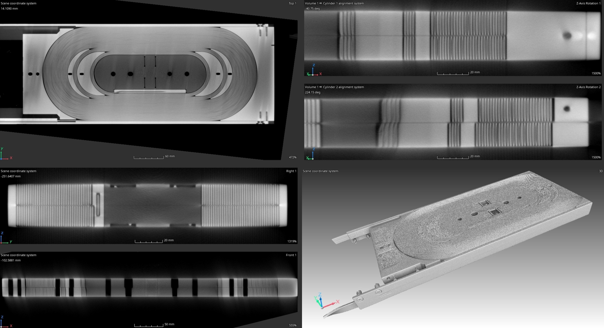
Fig. 2 – SMC 103b – quad view.

Slide 8
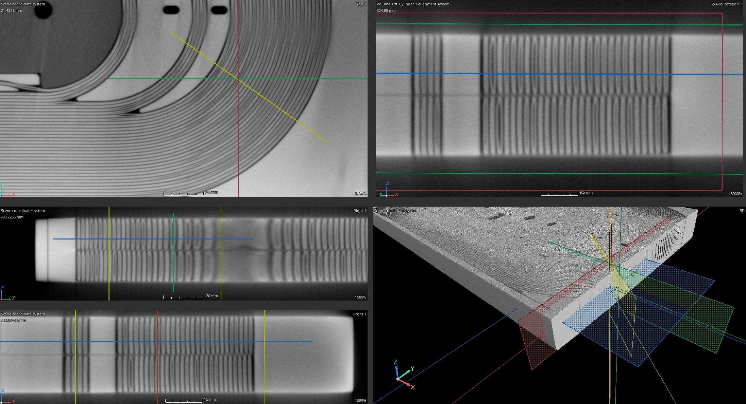
Fig. 3 – SMC 103b – quad view.

Slide 9
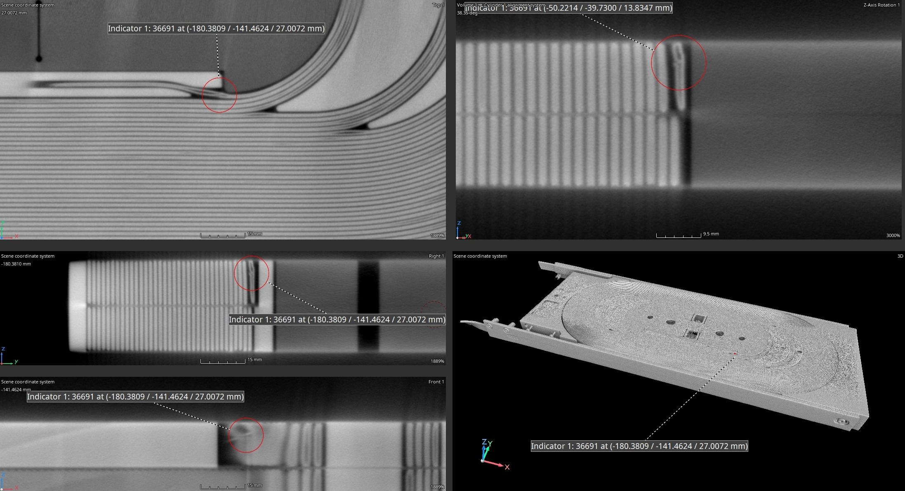
Fig. 4 – SMC 103b – quad view – affected cable on non-connection side.

Slide 10
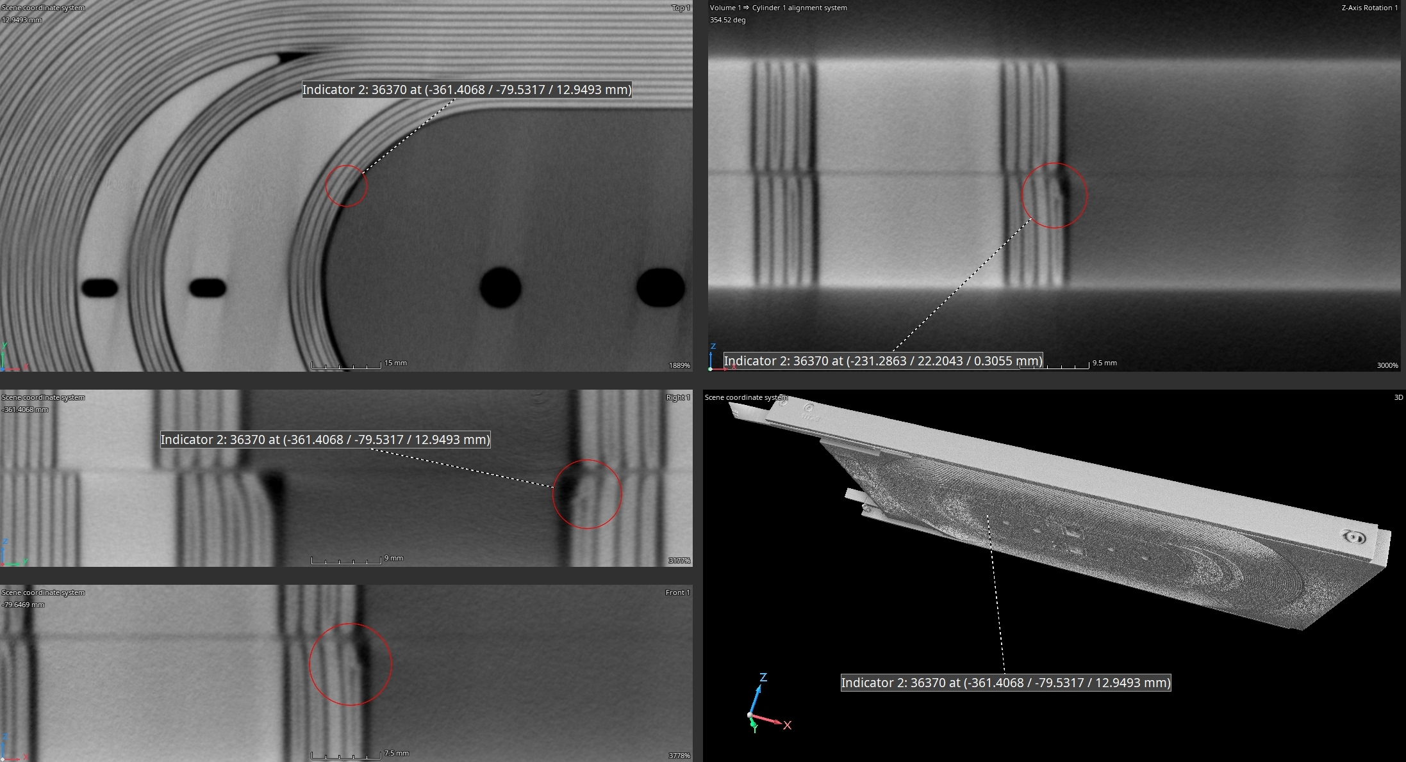
Fig. 5 – SMC 103b – quad view – affected cable on connection side.

Slide 11
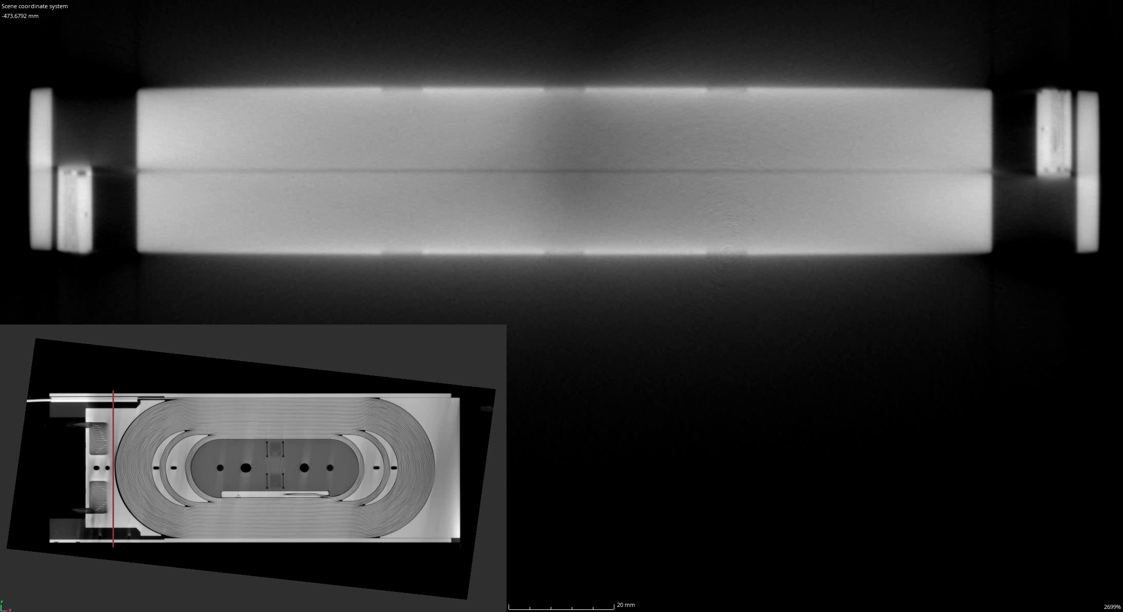
Vid. 2 – SMC 103b – right view.

Slide 12
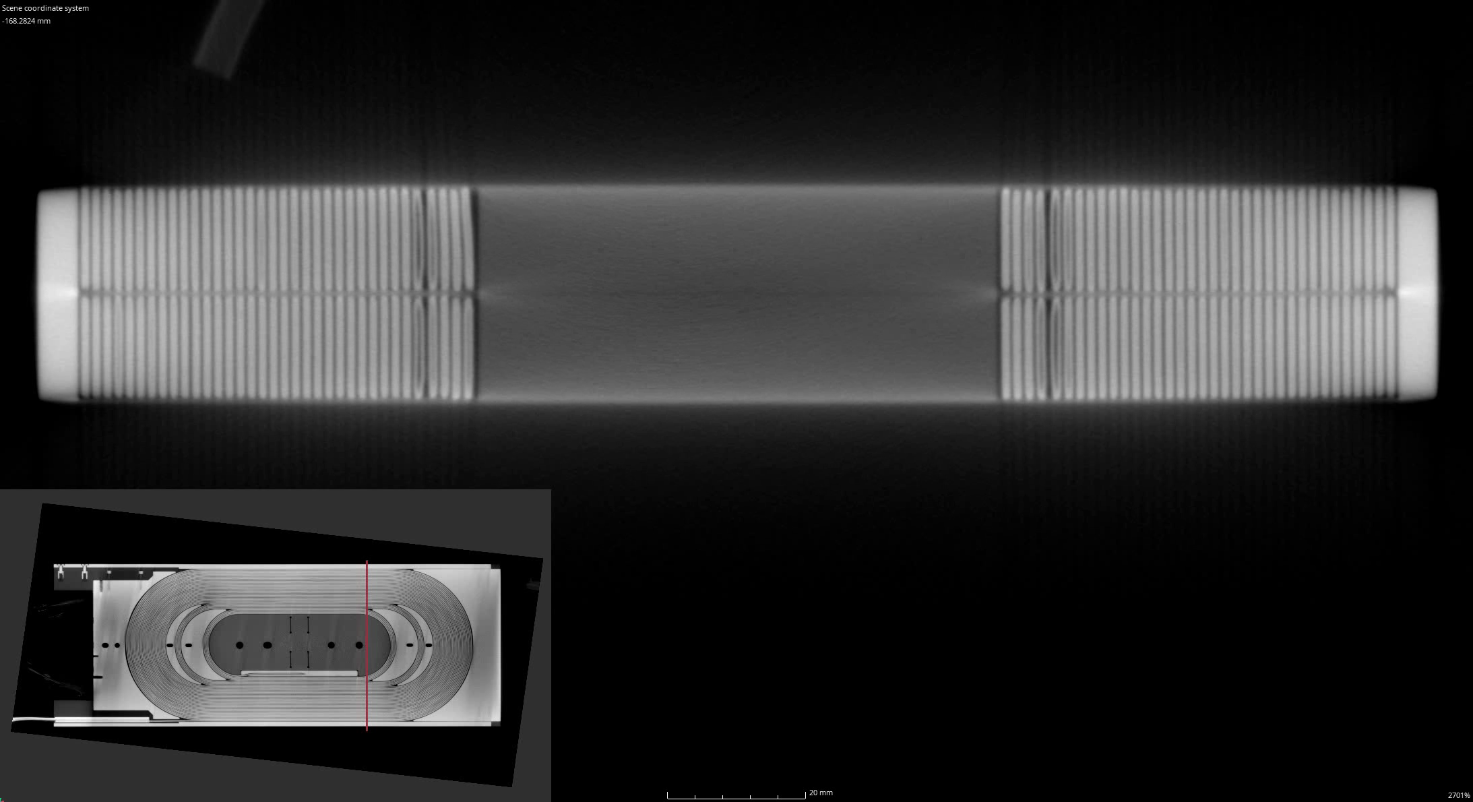
Vid. 3 – SMC 103b – right view – layer jump.

Slide 13
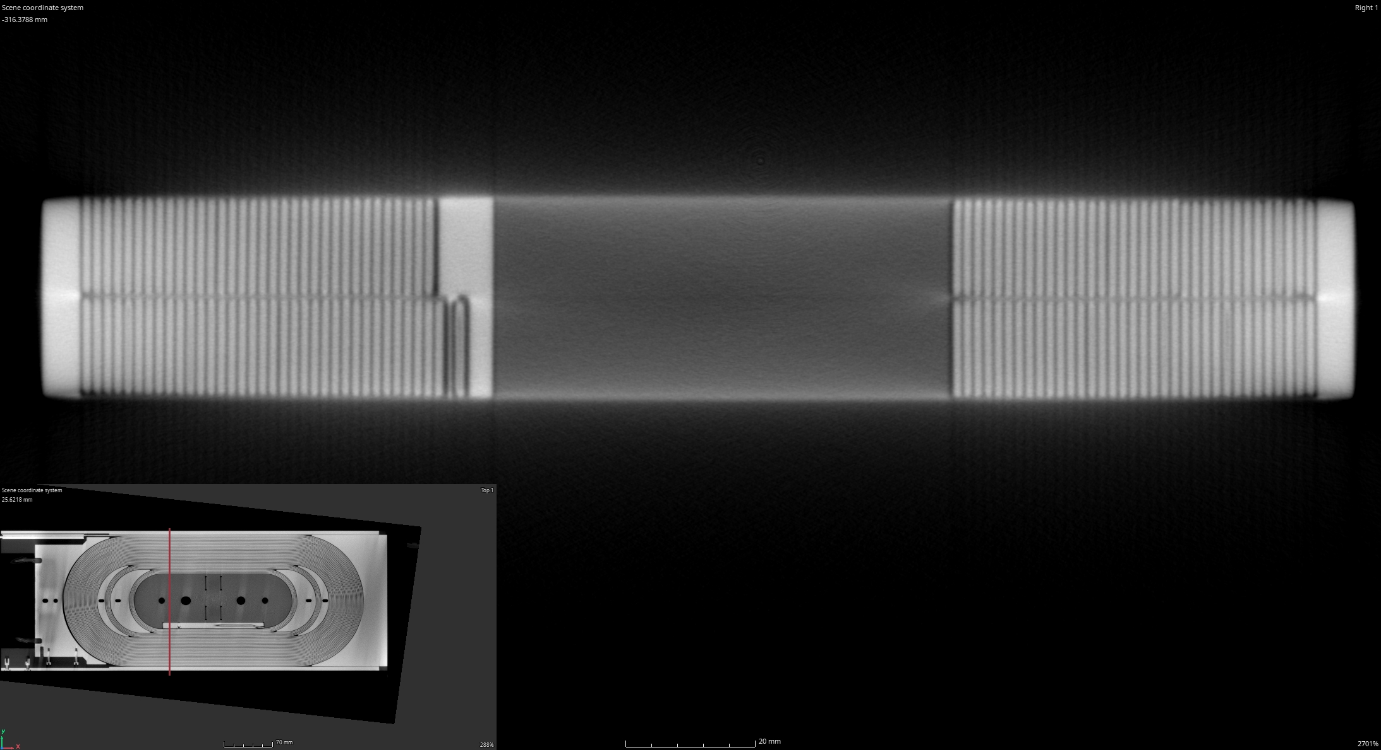
Fig. 6 – SMC 103b – right view – layer jump.

Slide 14
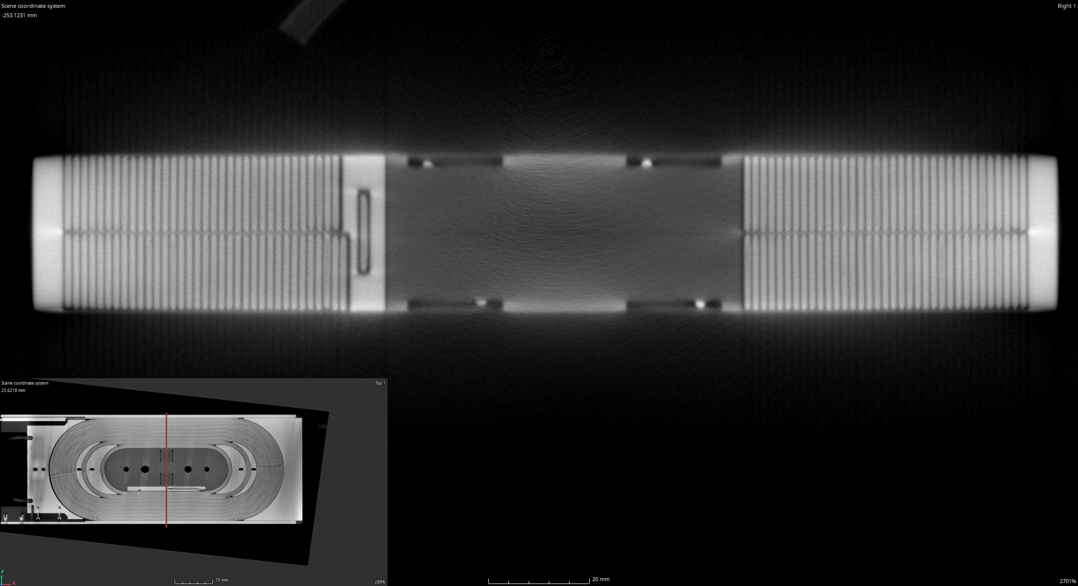
Fig. 7 – SMC 103b – right view – layer jump.

Slide 15
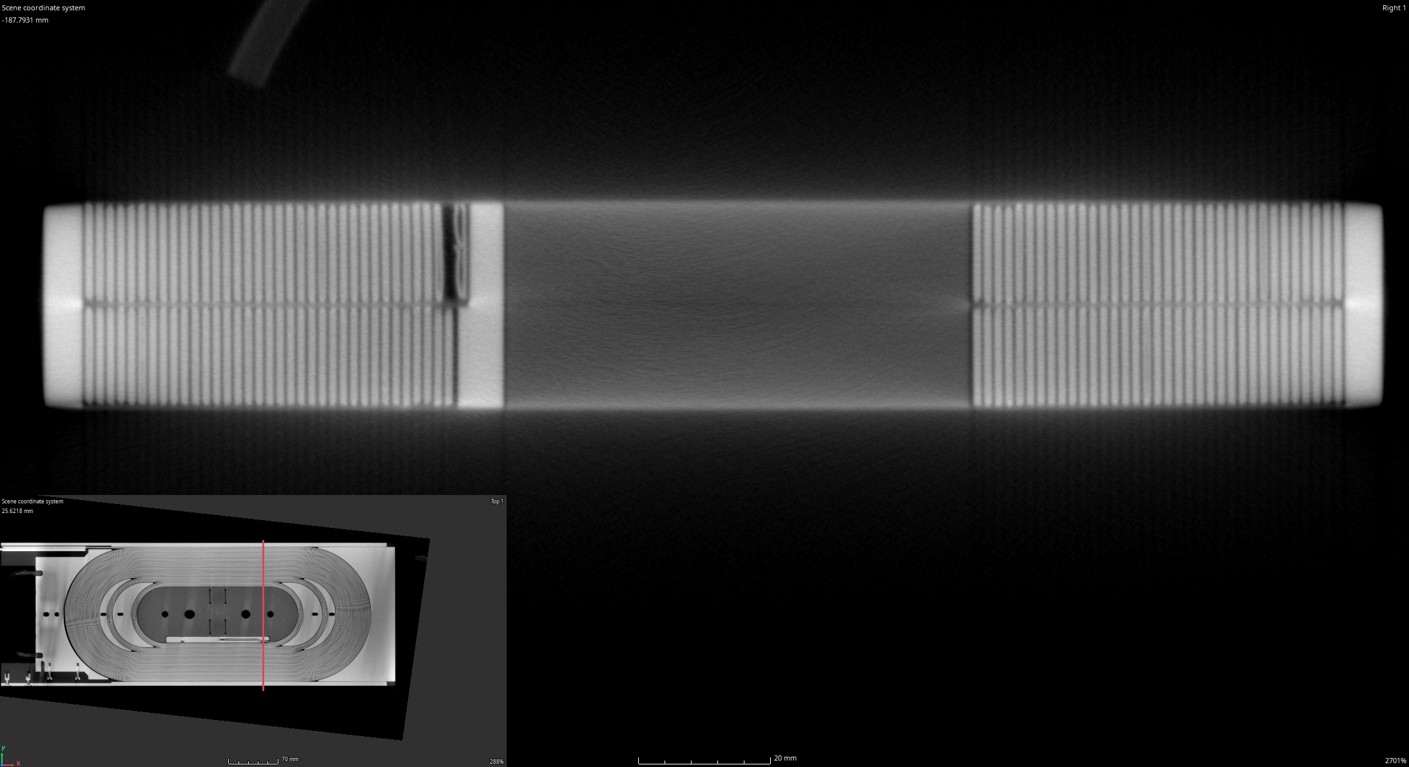
Fig. 8 – SMC 103b – right view – layer jump.

Slide 16
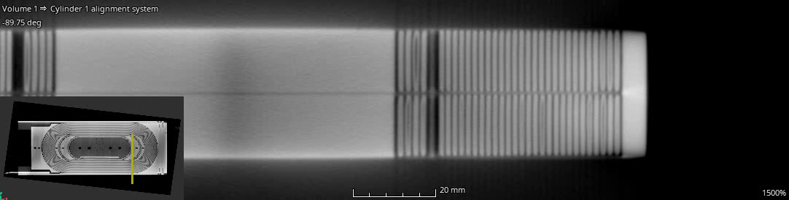
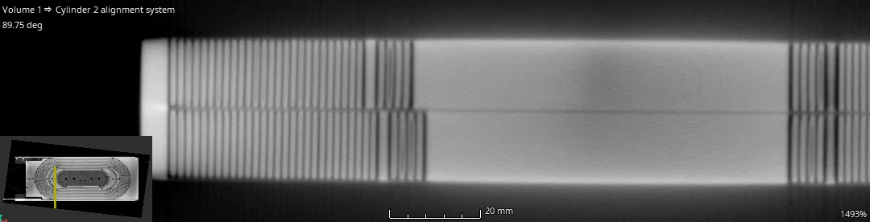
Vid. 4 – SMC 103b – rot views.

