Slide 1
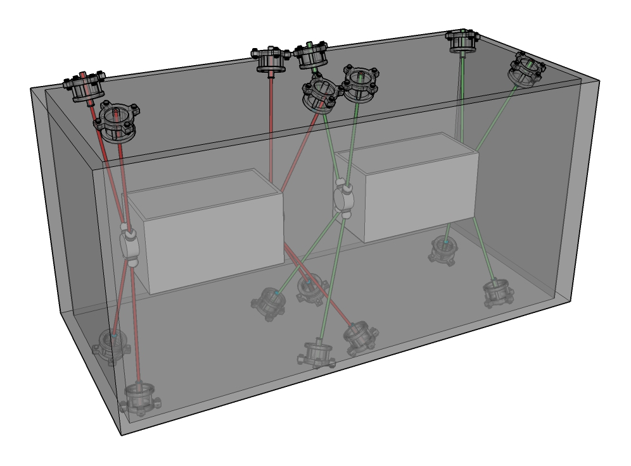
Internal monitoring for Crab-cavities
Vivien RUDE / Mateusz Sosin
2024-07-03
HL-LHC Collaboration Triumf-CERN

Slide 2
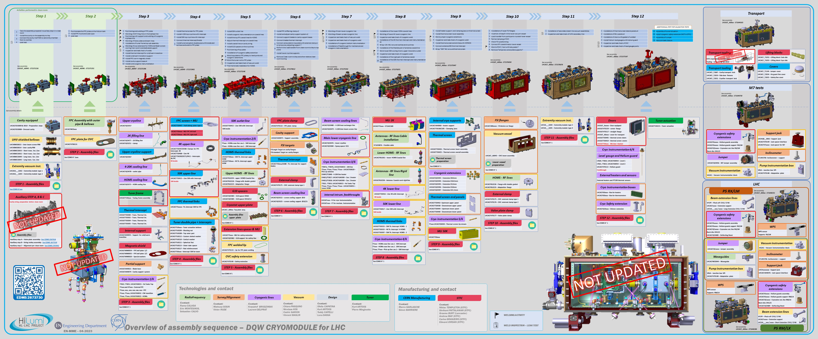
From Teddy Capelli

Slide 3
 | Step
Part 0 : CMM data | 0 | Validation of trolley
 |  | Position of the capacitive plates w.r.t. external references → CERN
 |  | Valve plate measurement
Part 1 : in clean room | 1-2 | Alignment in ISO5 (before connection in ISO4)
 |  | Alignment in ISO5 (after connection in ISO4)
Part 2 : before cryostating | 4-5 | Alignment of different equipment
 |  | Installation of FSI supports
 |  | Measurement of FSI supports
 |  | Installation FSI targets
Part 3 : cryostating (top plate) | 6 | Alignment of the cavities before cryostating
 |  | Measurement of the top plate cryomodule
 |  | Alignment trolley and top plate
Part 4 : cryostating (OVC cryomodule) | 10 | Measurement of the OVC cryomodule
 |  | Alignment top plate and OVC cryomodule
Part 5 : after cryostating | 10 | Installation of FSI heads on OVC and top plate
 |  | Measurement of FSI heads on OVC and top plate
 |  | FSI validation (comparison with a laser tracker)
 |  | Alignment with adjustment system
Part 6 : cold test at Triumf | 12 | Measurement ambient pressure
 |  | Measurement under vacuum
 |  | Measurement at cold
Part 7 : cold test at CERN |  | Measurement ambient pressure
 |  | Measurement under vacuum
 |  | Measurement at cold

Slide 4
Thank you
for your attention

