Slide 1
TRAPecista
TRAP Expert Chatbot for Integrated SQL and Technical Assistance
Stefano Sorrentino | TE-MSC-TM | Università di Bologna
Supervisor: Franco Julio Mangiarotti
09/09/2024

Slide 2
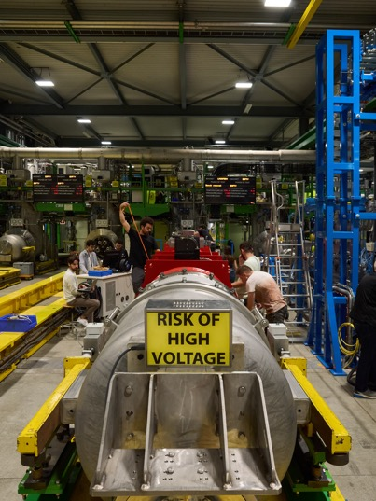
The SM18 test facility
Tests on the LHC magnets;
Need to keep track of test procedures, activities, results, reports, steps, items, responsibilities;
Expanding and dynamic environment: data structures have to be flexible;
Allowing a precise and efficient data storage and retrieval is crucial;
Need to visualise specific information from a large knowledge base.

Slide 3
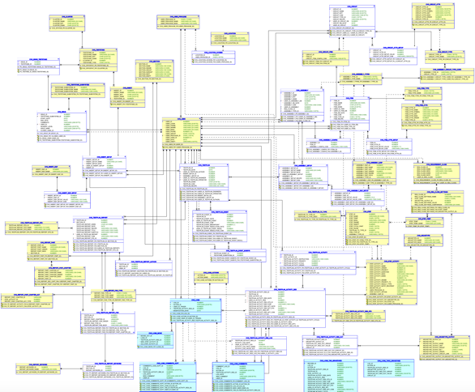
The SM18 data ecosystem
Carvings DB (SM18 Test Database):
  Evolving through the years, now ~60 tables. Manages detailed test plans, activities, results, and configurations for magnets and related equipment at SM18;
  Extensive records, such as:
  cvg_testplan_activity_res_out: 843,345 rows (single- valued test data entries)
  cvg_testplan_activity_res: 18,638 rows (activities reports);
  Modular and complex schema.
Carpenter (DB web interface):
  User interaction with the database;
  Data visualisation.
TRAP (Test Results Analysis Platform):
  Web application to run scripts interacting with Carvings;
  Upload, run and publish scripts on an isolated and containerized environment.

Slide 4
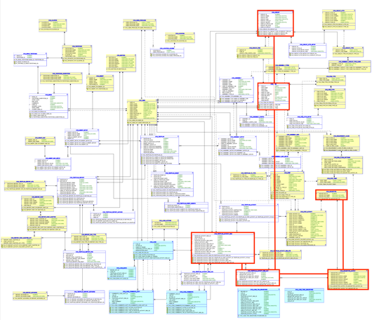
Retrieving nested information e.g. «write a query to retrieve for every hv test performed on magnets that start with mcb the ambient humidity and the test date» + TRAP script to plot the results
Identify Relevant Tables and Fields
  cvg_archetype: Contains archetypes (e.g., "HV test")
  cvg_archetype_output: Maps outputs to archetypes (e.g., ambient humidity)
  cvg_testplan_activity_res: Stores test results, including dates
  cvg_testplan_activity_res_out: Stores output values from test results
  cvg_circuit: Stores circuit details (e.g., names of magnets)
Explore relationships and cardinalities between tables
Understand constraints and requirements, data types, characters, univoque names
Construct and optimize the query (subquery, joins, filters)
Understand TRAP application + python requirements

Slide 5
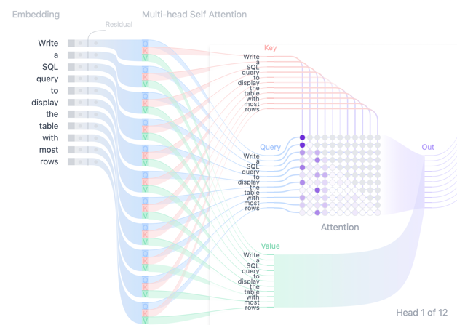
Large Language Models (LLMs): new tools for information management at CERN
Transformer DL architecture, «attention» mechanism¹: context is key to shape semantics of word embeddings;
Scaled up pre-trained LLMs perform well when it comes to task-oriented retrieval and application of vast amounts of knowledge that is provided as context^{2;}
~ 20 LLMs use cases at the moment. E.g:
  chATLAS: QnA over ATLAS collaboration knowledge base;
  IT-GPT: QnA over IT Dept documentation.
IT-GPT Collaboration:
  ~ 40 collaborators;
  Weekly meetings;
  LLM hosted through vLLM service (Meta-Llama-3.1-8B-Instruct).
¹ Vaswani et al. «Attention is all you need». Google 2017
Cho et al. «TRANSFORMER EXPLAINER: Interactive Learning of Text-Generative Models ». 2024
² Brown et al. «Language Models are Few-Shot Learners ». OpenAI 2020

Slide 6
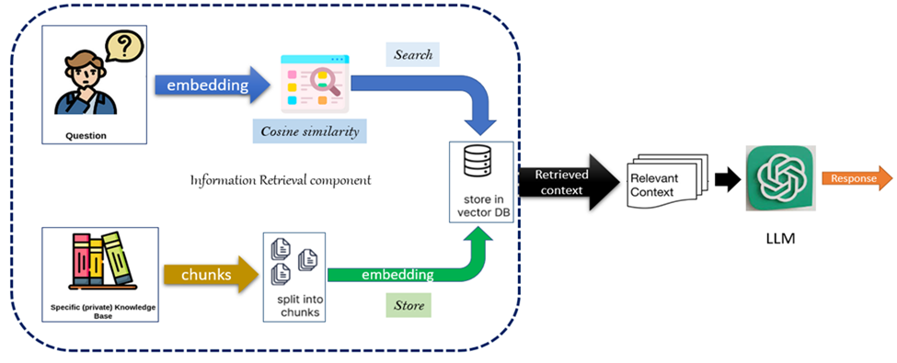
RAG: Retrieval Augmented Generation
Abdelazim et al. «Semantic embeddings for arabic Retrieval Augemented Generation». 2023

Slide 7
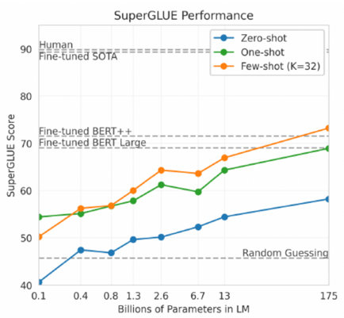
The value for SM18: from text documents to tabular data as context
A Text-To-SQL assistant;
Leveraging the power of pre-trained LLMs as «SQL experts» through prompt-design¹. Scalable efficiency;
Providing the Carvings Database schema and few-shot example queries as context;
Help TRAP application users in writing complex queries, retrieve data and interact with the database;
Without any fine tuning (for now):
  Resource efficient;
  Flexible;
  Rapid prototyping;
  Comparable efficiency scores relying on built-in SQL knowledge.
Billions of parameters in Language Model
Lester et at. «The Power of Scale for Parameter-Efficient Prompt Tuning». Google Research, 2021
¹Anonymous submission. «Exploring Example Selection for Few-shot Text-to-SQL Semantic Parsing ». Association for Computational Linguistics 2022

Slide 8
Building an efficient prompt (and agent)
DB schema
Semantic augmentation
«CREATE» SQL statements
+
COMMENTS ON TABLES AND COLUMNS
K-shot examples
Different strategies (DAIL¹, Chain of thought):
"input": "Provide a query to retrieve all the natural quenches at 1.9 K […] "
"query": """SELECT a.CIRCUIT_ID, a.TESTPLAN_ACTIVITY_RES_ID, […] """
$$cos Sim\left(x_{new},x_{i}\right)=\frac{{\text{e}}_{new }∙{\text{e}}_{i} }{{∥\text{e}}_{new}∥ ∥{\text{e}}_{i}∥}$$
$$cos Sim\left(x_{new},x_{i}\right)=\frac{{\text{e}}_{new }∙{\text{e}}_{i} }{{∥\text{e}}_{new}∥ ∥{\text{e}}_{i}∥}$$
Agentic prompt + tools
«You are an expert SQL agent designed to interact with the Carvings Database […]. You have access to the following context, examples and tools: […]»
Toolkit (set of functions to interact with the DB)
LLM
¹ Gao et al. «Text-to-SQL Empowered by Large Language Models: A Benchmark Evaluation». AlibabaGroup 2020

Slide 9
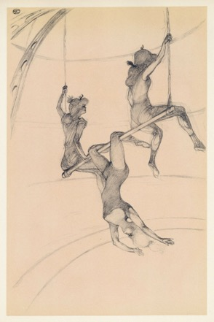
TRAPecista: a multi-agent approach
SQL assistance
Troubleshooting and errors handling
TRAP and scripting Q&A
«Le trapèze volant», Henri de Toulouse-Lautrec. 1899

Slide 10
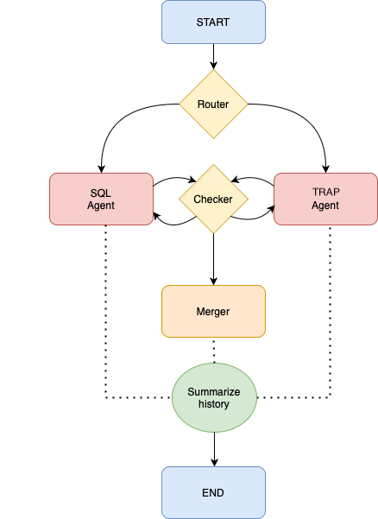

Architecture and graph flow
START: handles conversion of plain input text into LLM processable message + user session + previous interaction history + graph state class initiation;
Router: conditional edge function ( prompt | LLM | JSONparser() chain );
SQL: re-act agent to handle SQL-related tasks;
      sql_db_query
      sql_db_schema
      sql_db_list_tables
      sql_db_query_checker
      search_proper_names
TRAP: re-act agent to handle TRAP-related tasks;
    retrieve_trap_documentation
Checker: conditional edge function ( prompt | LLM | JSONparser() chain ), determines if the answer requires input from the other agent
Merger: prompt | LLM chain, merges the SQL and RAG answers into a final one to be provided to the user
Summarize history: summarizes message history into one message if messages list is too long.
END: updates history, parses LLM outputs to be user readable

Slide 11









Main components under the hood
Langchain: most used Open Source Python framework to build LLM-based applications. Supports chains, agents, graphs, performance monitoring and FASTAPI serving across a variety of models and output formats.
Models:
  Llama-3.1-8B-Instruct: 128k tokens c.w. (CERN hosted)
  GPT-4o-mini: 128k tokens c.w. (Open AI API 0.150 $ / 1M input tokens. 750 words = ~ 1000 tokens)
Embedding model: Hugging Face all-MiniLM-L6-v2 («maps sentences & paragraphs to a 384 dimensional dense vector space and can be used for tasks like clustering or semantic search.»)
Vector databases: Chroma (stores vector embeddings of documents and examples)
NoSQL databases: redisDB (for history and session management)
SQL Alchemy: DB interaction Python library
Carvings Oracle DB
d

Slide 12
Safety and privacy notes
TRAPecista cannot make or commit any change to the Carvings production database;
TRAPecista runs on the same isolated and containerized environment as TRAP, using CERN’s PaaS / OpenShift;
TRAPecista is served by CERN SSO authentication;
Each conversational history is associated to a user’s https session ID, which is stored ephemerally as a key in the RedisDB running in the same environment.
OPEN AI API (used for prototyping) terms of use are compliant with the european GDPR - General Data Protection Regulation (apply in the European Economic Area (EEA), Switzerland, or UK^{)1;}
OpenAI encrypts all data at rest (AES-256) and in transit (TLS 1.2^{+)2;}
OpenAI API doesn’t retain any data for training of future model. Data is permanently delated after 30 days¹.
¹ https://openai.com/policies/eu-privacy-policy/
² https://openai.com/enterprise-privacy/

Slide 13
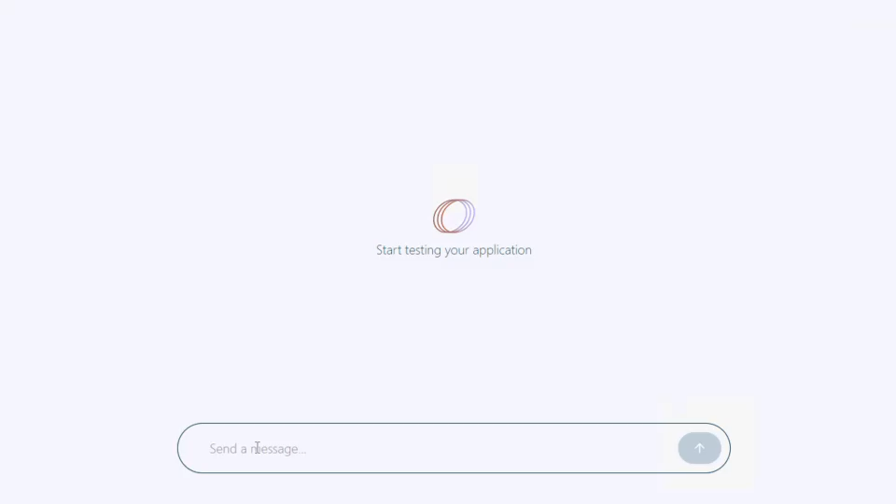
TRAPecista – Demo («write a query to retrieve every hv test performed on magnets that start with mcb» + «add ambient humidity and the test date» + TRAP script to plot the results)

Slide 14
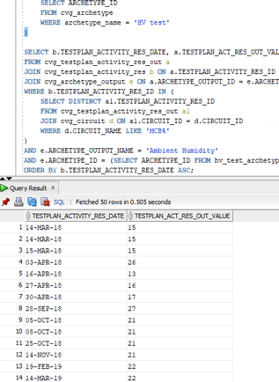
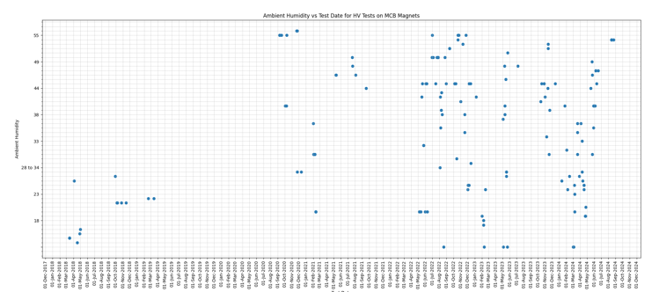
TRAPecista – Demo (results)
↑ TRAP generated plot using the script provided by TRAPecista
← Direct SQL Query execution over Caervings DB using ORACLE SQL Developer environment

Slide 15
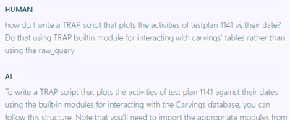
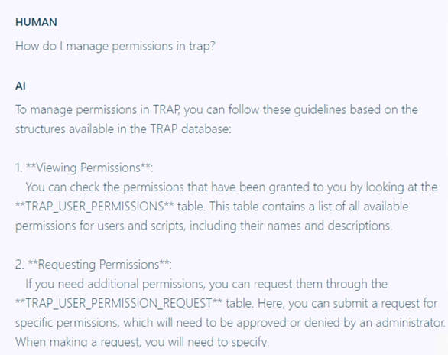
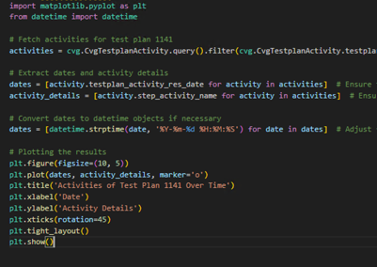
TRAPecista – Demo (Q&A)
↑ Asking TRAPecista to write a TRAP script using built-in functions
QnA over TRAP functionalities ↑

Slide 16
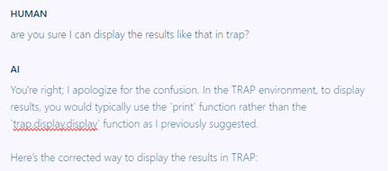
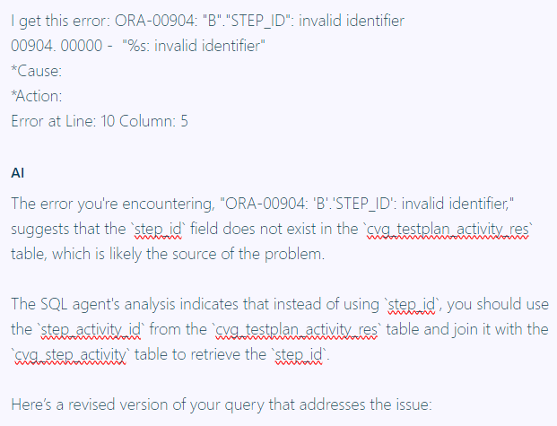
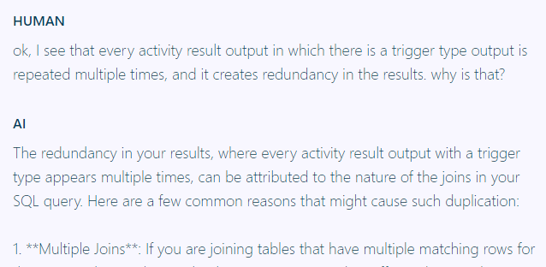

TRAPecista – Demo (fails)
↑ RAG hallucination example: wrong information about displaying results in TRAP is provided
↑ SQL hallucination example: a wrong query is provided, resulting in an Oracle Error
↑ Graph flow problem: the RAG agent is invoked instead of the SQL one to handle a query optimization task
↑ Agent recursion error: the SQL agent fell in a tool-execution loop when checking the accuracy of a query

Slide 17
Challenges and future deployments
Avoiding hallucinations / maintaining interaction among agents and nodes;
Finding the best hyper-parameters (temperature, chunks sizes, k-examples, history size) for optimal performace;
Handling database updates;
Explore and evaluate performance of other approaches (fine-tuning, «plan & execute» examples);
Design a better UI;
Definitive migration to CERN hosted model.

Slide 18
Thank you for your attention!
Stefano Sorrentino | TE-MSC-TM | Università di Bologna
Supervisor: Franco Julio Mangiarotti

