Slide 1
AI based inspection system for cabling anomaly detection
AI based inspection system for cabling anomaly detection
Javier Presmanes Cardama, TE-MSC-LSC

Slide 2
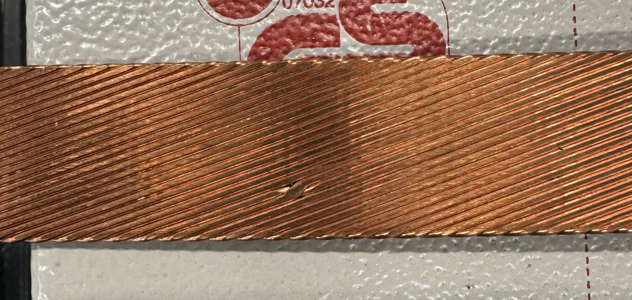
The problem
Huge healthy images dataset
Reduced unhealthy images dataset
Repetitive pattern/features over timer
Notes:
The principal problem is that we have to identify the defects on a cable created by a machine who does not normally produces these defects.
- Small collection of defect cables
Huge collection of healthy cables
On our side we can take into account that the features in one image (angle, length, area) is always the same for all the strands in the cable.

Slide 3
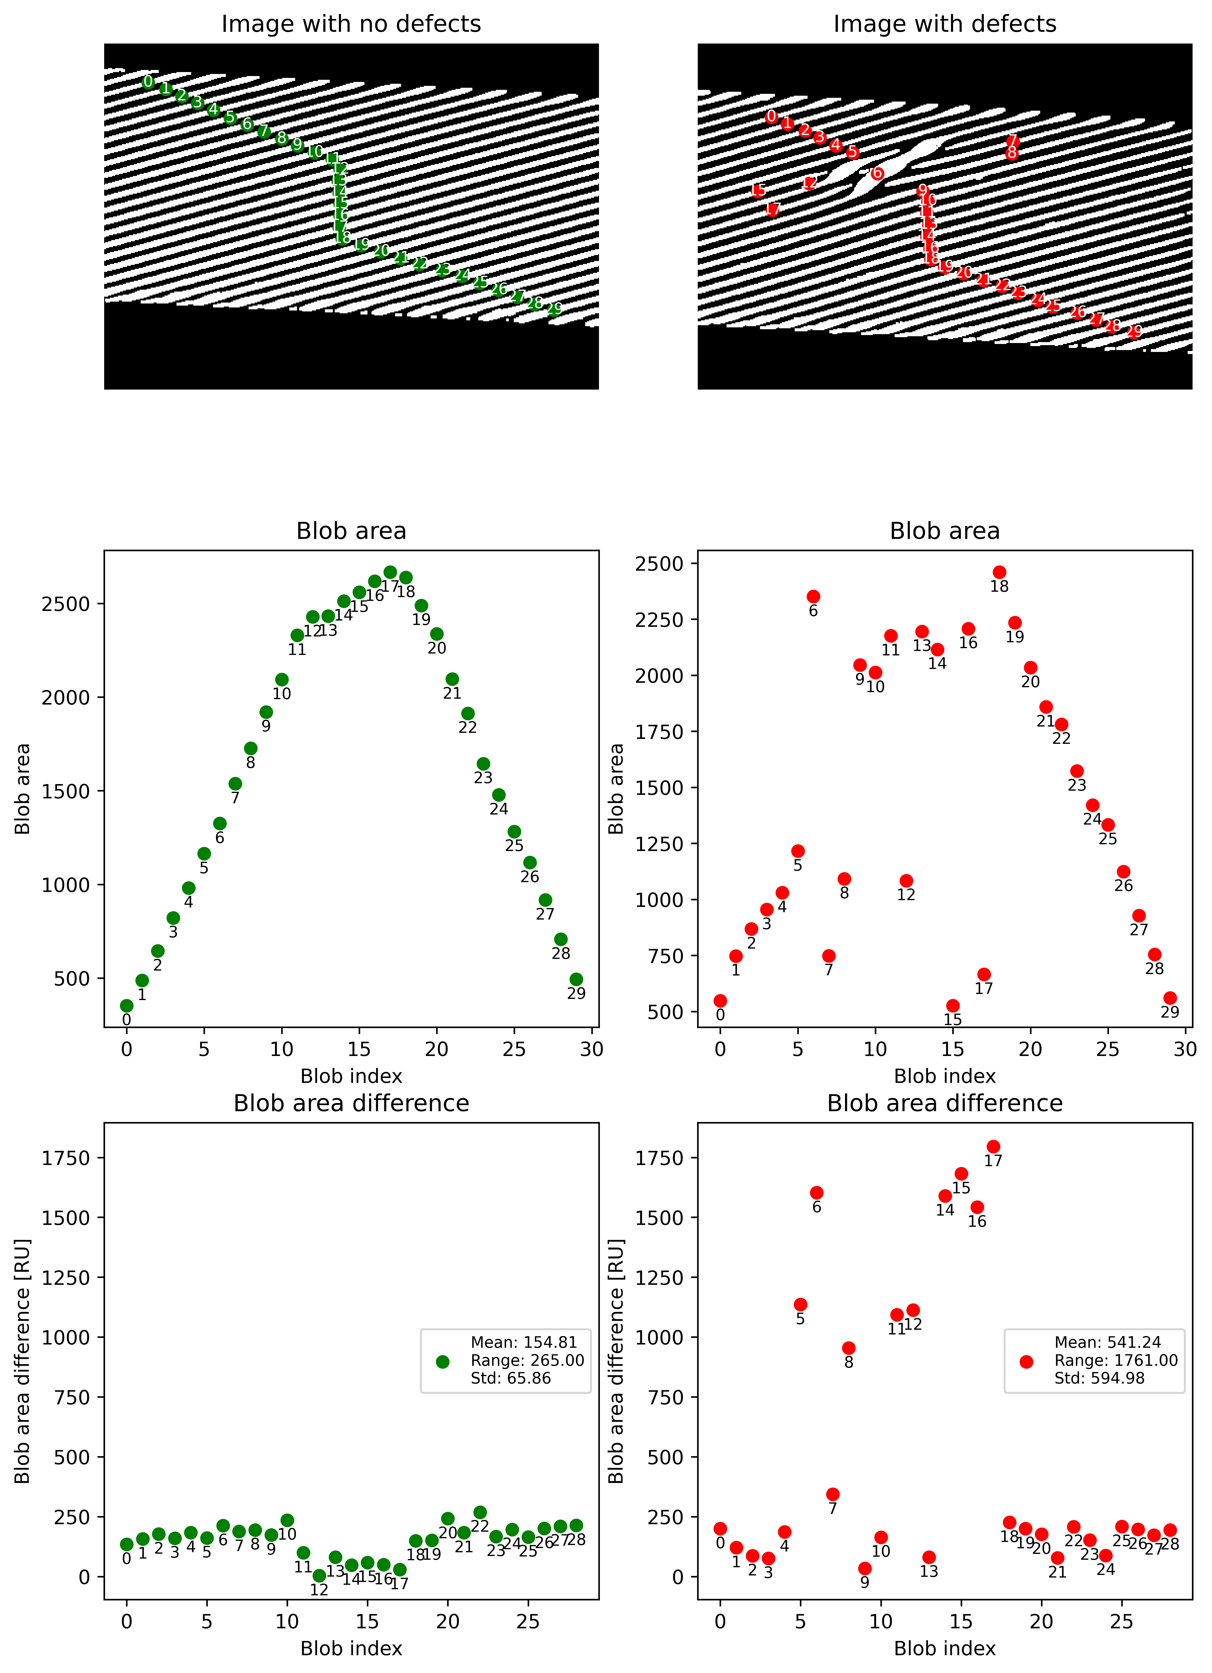
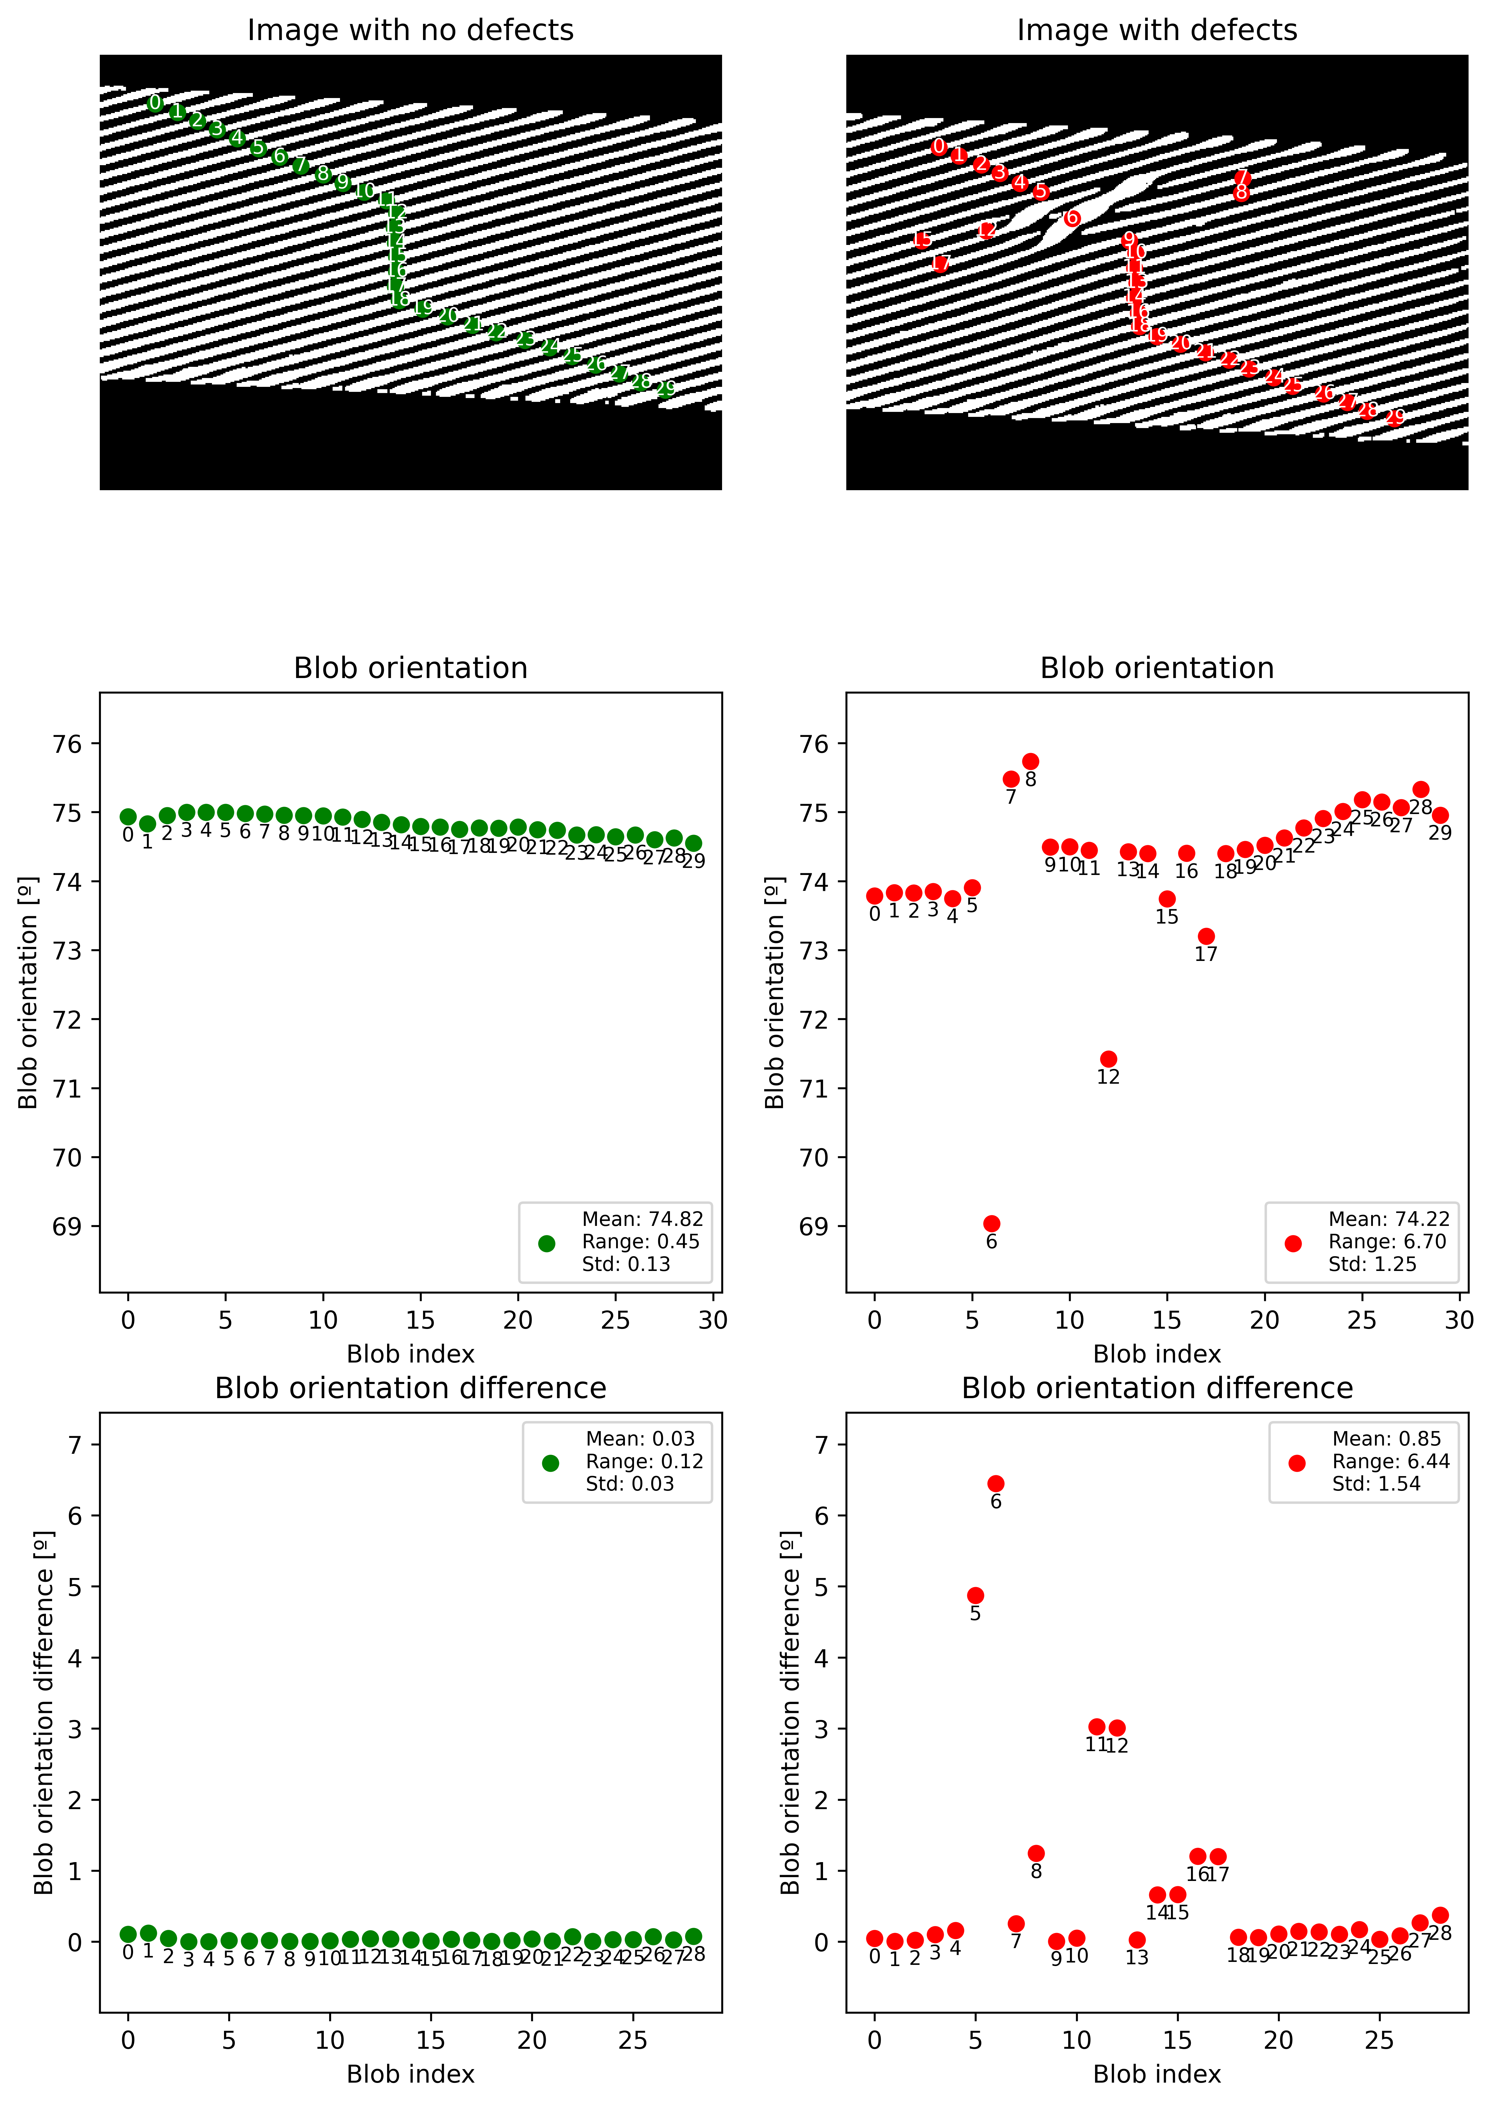
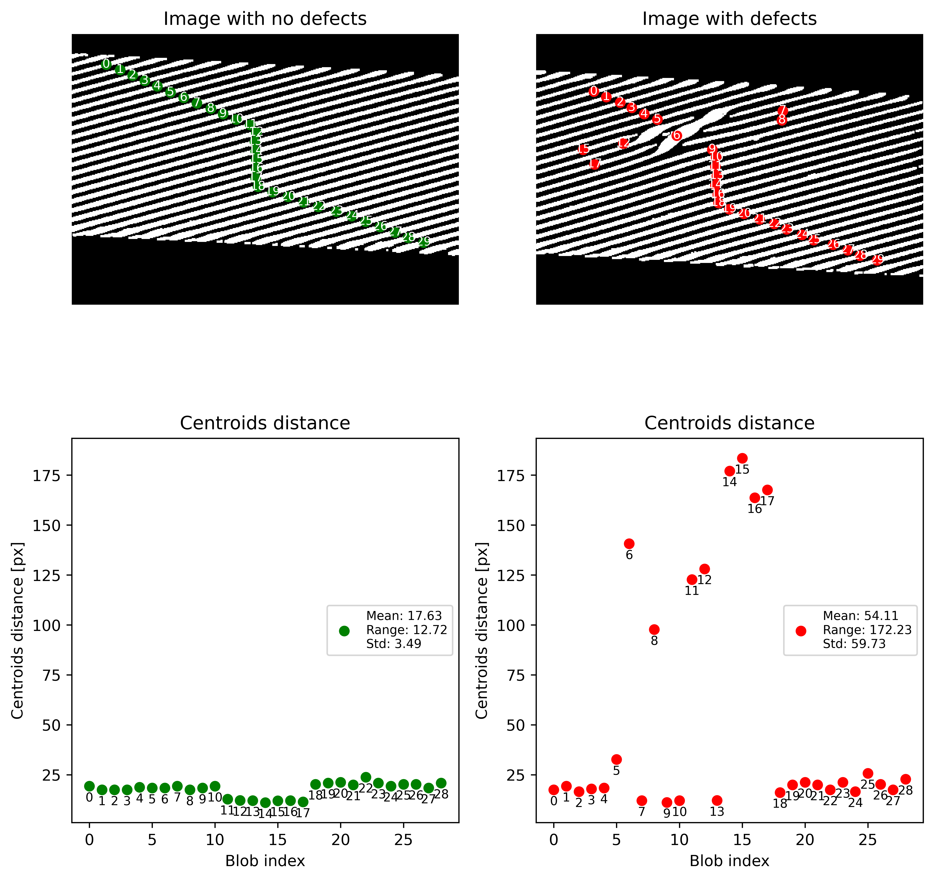
First Approach : Statistical analysis based on features
Notes:
First approach was to preprocessing the image and pass from colooured image to white and black image.
Then, isolating individual wires in order to be able to extrac features
We can compare here the difference between a healthy cable and a defect cable based on some features.

Slide 4
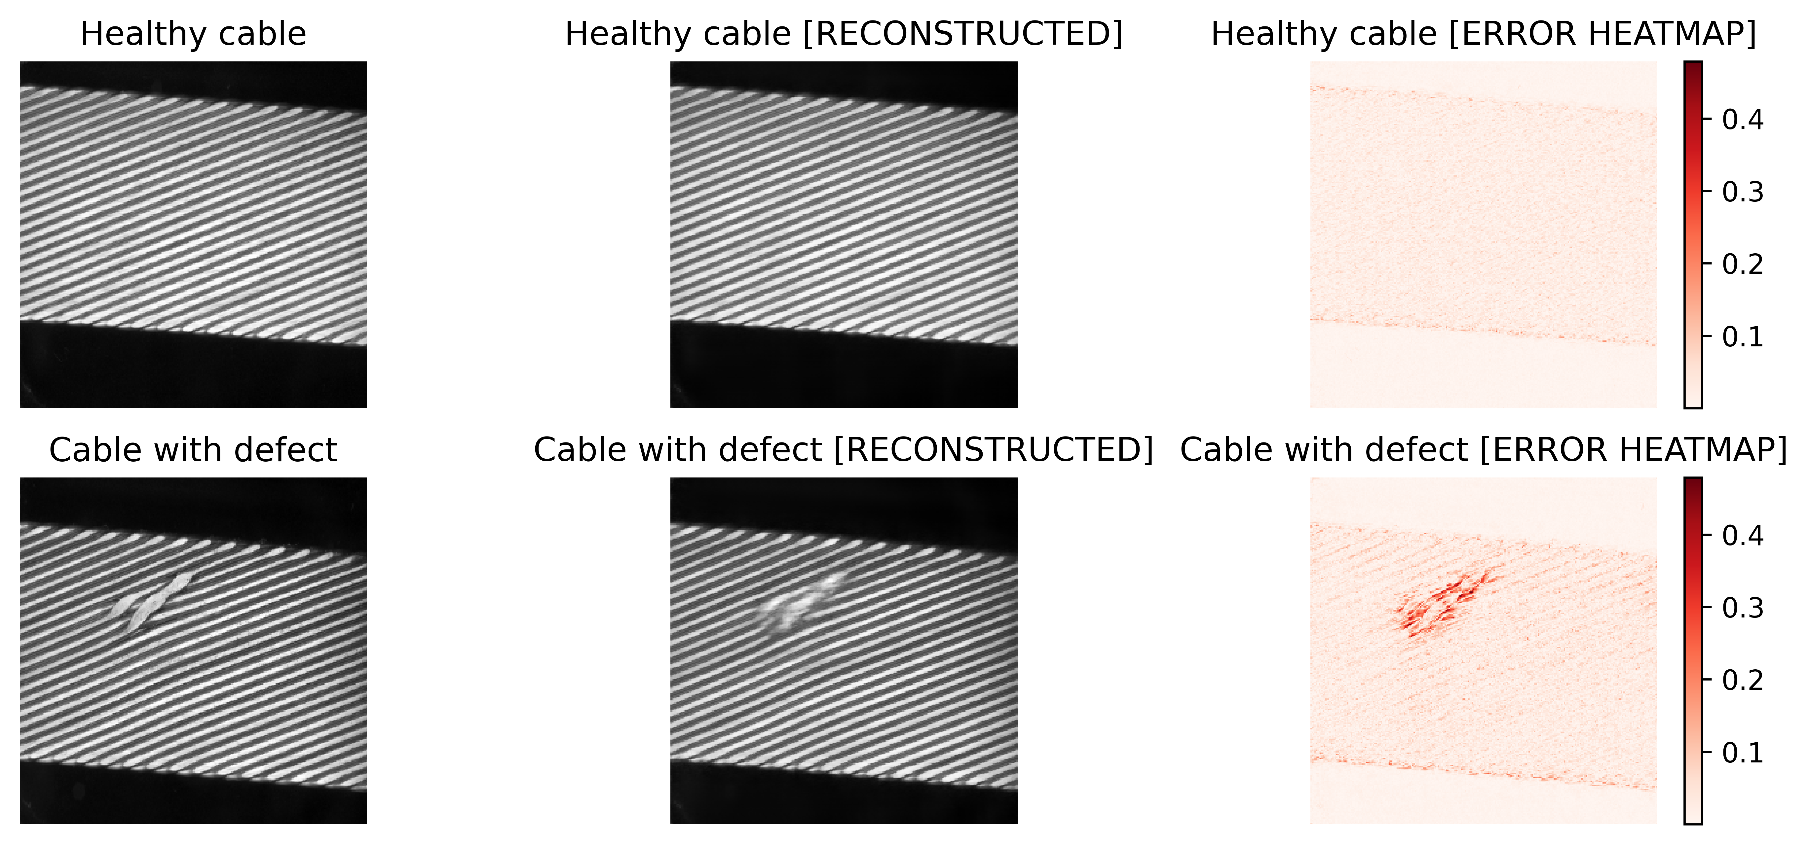
Second approach : Using Autoencoders and reconstruction error
Notes:
On the other hand, for my master thesis I tried to find a machine learning alternative approach
After some research and thanks to Olivia, Lukas and Christoph I decided to try using autoencoders.
In this approach, the autoencoder is used to memorize the features of a bunch of healthy cables. Due to the training based only on good cables, when it finds a defect on the image, it does not know how to reconstruct it and therefore the recontruction heatmap have higher values on it.
Comparing the reconstruction error within the dataset used for training and the results from the small dataset with defects, we can set a threshold for defining what is a defect cable and what is not.

Slide 5
Comparison
Feature statistical analysis | Autoencoders
+ Real-world data calibration | - Sensitive to setup changes
+ Allows parametrization and algorithm control | - “Blackbox”
+ Easy to modify the algorithm | - Training time can be a handicap for development
- Can be slow | + Very fast
- Software complexity | + Easy to integrate in existing software
Notes:
Pros for feature analysis:
+ Allows real world calibration data (comparing to real size and cable manufacturing caracteristics)
+ Allows parametrization (more strands, different angles, different densitity)
+ Easy to control and modify the algorithm
Cons for the feature analysis:
Expensive in time for computing some feature extraction
Software complexity for parallelization of the feature extraction in order to accomplish time constrain (200ms)
Pros for Autoencoders:
+ Its very fast (16ms for a bunch of images)
+ Easy to integrate since it is a blackbox you only need to setup the libraries and feed with the specific input of the balckbox
Cons for the Autoencoder:
Its sensitive to setup changes since it learns patterns and camera position, inclination etc… could affect to the pattern reconstruction
It’s a blackbox so it is not easy to understand what is learning
Takes a while to train, so testing different architectures without knowing the results is going to produce can be heavy.

Slide 6
Extracting the geometry of Nb₃Sn wires for Quench simulations using AI
Extracting the geometry of Nb₃Sn wires for Quench simulations using AI
Josef Baumann, TE-MSC-LSC

Slide 7
The problem
Notes:
Basically: wanted to extract the geometry ((x/y) coordinates) using a SEM image of a MQXF wire cross-section
Modelling electronic and magnetic behavior of real superconducting strand geometries
Predict for example AC-losses/quenches
We also would like to use the geometries for mechanical modelling

Slide 8
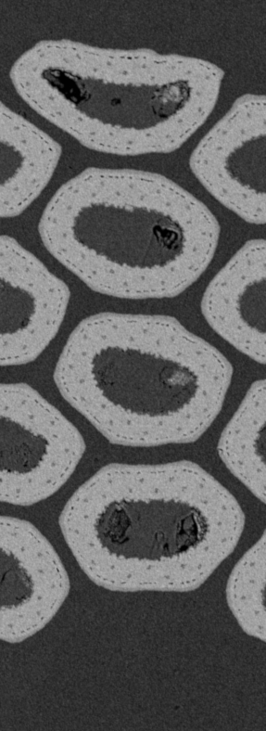


First approach: Harris corner detector
Jianbo Shi and Carlo Tomasi. Good features to track. In Computer Vision and Pattern Recognition, 1994. Proceedings CVPR'94., 1994 IEEE Computer Society Conference on, pages 593–600. IEEE, 1994.
Notes:
Based on Harris Corner Detector:
1. Detects changes in image: Looks for places where the intensity of pixels changes a lot in different directions
2. Calculates a “corner score” -> tells how much pixel values change around the pixel
3. Points with high scores are likely to be corners

Slide 9

Second approach: Machine learning
Arganda-Carreras, I., Kaynig, V., Rueden, C., Eliceiri, K. W., Schindelin, J., Cardona, A., & Sebastian Seung, H. (2017).
Trainable Weka Segmentation: a machine learning tool for microscopy pixel classification. Bioinformatics, 33(15), 2424–2426.
Notes:
AI (plugin ImageJ: Trainable Weka Segmentation): When training the AI, you basically just cycle the features you want to have a look at and the AI will find these features in similar images
Very simple to use tool
- find basically the areas where the corners are in the center
-> you see the areas where the “cornerism” is high the areas are quite big
=> ADVANTAGE: I can decide how precise I want the filaments to be described by simply selecting the area range

Slide 10
Comparison Harris corner detector and Weka Segmentation
Harris (mathematical) | Weka (AI)
+ well known algorithm | - “black box”
+ low computational requirements (faster) | - high computational requirement (slower)
+ no training needed | - needs to be trained
- sensitive to scale and rotation | + adaptable
- careful parameter tuning needed | - overfitting
- Not robust to noise and low contrast areas | + more flexible
Notes:
Summary:
- Harris: Simple, mathematical and efficient solution
AI: flexibility and high robustness

