Slide 1
AI Opportunities in TE-MSC
Stephan Russenschuck with contributions from M. Bonora, M. Buzio, A. Lu,
M. Liebsch, S. Sorentino, V. DiCapua, M. Pentella,

Slide 2
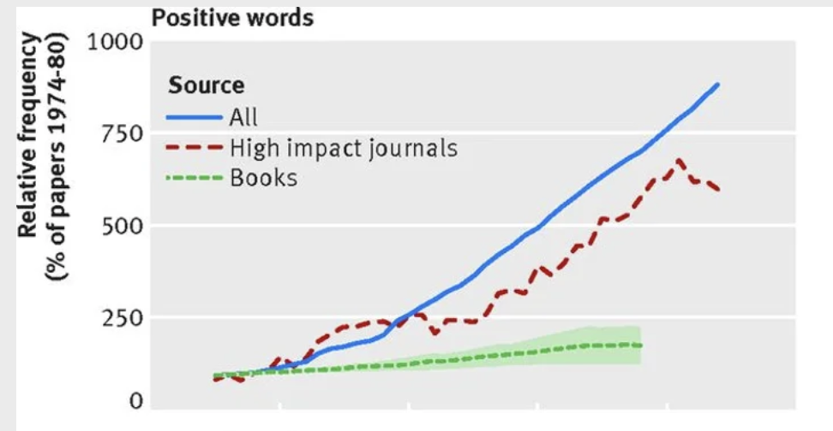
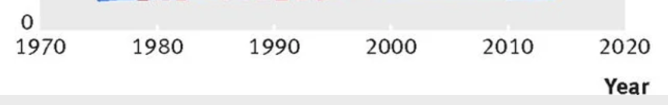
Is the AI-Boom a Science Hype?
Pareto-front
Genetic algorithms
Simulated annealing
Fuzzy set optimization
Particle swarms
ANN-based optimization (FNN)
Digital twins
Use of robust, novel, innovative,
unprecedented in science writing
Survivorship bias? Mistaking a successful subset as the entire set
John Horgan, Scientific American Blog
Notes:
FNN Feed-forward neural networks

Slide 3


GPT and BERT
Generative pre-trained transformers (2017)
Bidirectional Encoder Representations from Transformers (2018)
Attention is all you need
Large Language Models LLM (translation, speech recognition, spell-checking, search engines,
chatbots)
Computer vision (face-detection autofocus, noise reduction, generated bokeh)
Image generators
Robotics
Finance
Workflow automation
Fraud detection
Medical diagnostics
Coding assistance
Driving assistants (autonomous systems)
Three cats sitting on chairs, yawning and wearing party hats. Created with
Notes:
Generative pre-trained transformers = large language model released by OpenAI <- Deep learning architecture developed by researchers at GOOGLE in 2017
Bidirectional Encoder Representations from Transformers

Slide 4
Ask ChatGPT
How can I measure the integrated magnetic field in accelerator magnets?
In particle accelerators, precise measurement of the integrated magnetic field generated by various electromagnets (such as bending dipoles, quadrupoles, sextupoles, and other higher-order lenses) is essential to ensure accurate beam steering, focusing, and stability. There are several methods and techniques for measuring the integrated magnetic fields in these electromagnets:
Rotating Coil Magnetometers (Rotating Coils)
Principle: A coil is rotated within the magnetic field, and the voltage induced by the changing magnetic flux through the coil is measured. The integrated field is proportional to the time integral of the voltage signal.
Usage: This is one of the most common methods used for field measurements in both dipole and higher-order magnets (quadrupoles, sextupoles, etc.).
Advantages:
  Provides precise field measurements and allows detection of higher-order field components.
  Measures the integral of the field directly along the length of the magnet.
Challenges: Requires careful alignment and calibration. The precision of the coil manufacturing and the rotation mechanism is critical.
2. Hall Probes
Principle: A Hall sensor, which is sensitive to magnetic fields, is moved through the magnetic field along the length of the magnet. The Hall voltage produced is proportional to the local magnetic field.
Usage: Used for measuring the magnetic field at discrete points along the length of the magnet. It can be used to create a field map.
Advantages:
  Good for direct, localized measurements of the magnetic field strength.
  Provides information on field uniformity and variations.
Challenges: The Hall probe must be accurately positioned. It measures the local field, so integrating over the length of the magnet requires scanning or moving the probe.
3. NMR Probes (Nuclear Magnetic Resonance)
Principle: NMR probes measure the resonance frequency of a sample material (typically a proton in a hydrogen nucleus) placed in a magnetic field, which is proportional to the strength of the magnetic field.
Usage: Commonly used for extremely precise measurements of very uniform magnetic fields, particularly in dipoles and regions where high field accuracy is required.
Advantages: Highly accurate, with a precision on the order of parts per million (ppm).
Challenges: Limited to measuring very homogeneous magnetic fields and is typically not used for higher-order multipoles like quadrupoles or sextupoles.
Omissions

Slide 5
Ask ChatGPT
How can I measure the integrated magnetic field in accelerator magnets?
4. Fluxmeters
Principle: Fluxmeters are used to measure the magnetic flux through a coil, which is related to the integrated magnetic field strength across the area enclosed by the coil.
Usage: Used in conjunction with stationary or moving coils to measure the total magnetic flux, particularly in dipole magnets.
Advantages: Directly measures the integrated magnetic field (also known as the magnetic flux).
Challenges: Accuracy depends on the coil's size, geometry, and alignment. It is less practical for higher-order fields due to their complex spatial distributions
5. Vibrating Wire Technique
Principle: A current-carrying wire is placed inside the magnet, and when it vibrates in response to the Lorentz force, the frequency of vibration depends on the magnetic field strength. By measuring the wire's vibrations, the field strength can be inferred.
Usage: Can be used for precise field mapping and measuring higher-order magnetic fields.
Advantages: Provides detailed field measurements and can resolve complex field distributions.
Challenges: The setup can be complex and sensitive to vibrations and mechanical alignment.
6. Search Coils
Principle: A search coil is moved through the magnetic field, and the induced voltage is measured. The voltage is integrated to obtain the total flux.
Usage: Used to measure the integrated magnetic field strength over the length of the magnet.
Advantages: Simple and effective for measuring the integrated magnetic field in dipoles and quadrupoles.
Challenges: For higher-order lenses, more complex coil geometries and careful positioning are required to capture the specific field components.
7. Harmonic Coil Systems (Multiple Coil Configurations)
Principle: A system of coils arranged in a specific pattern is used to measure different multipole components of the magnetic field. As the coil array rotates or moves through the field, the induced voltages are analyzed to separate out the different harmonics (dipole, quadrupole, sextupole, etc.).
Usage: Especially useful for characterizing higher-order magnetic lenses such as quadrupoles, sextupoles, and beyond.
Advantages: Capable of measuring the entire field distribution and resolving individual multipole components.
Challenges: Complex setup and analysis. Requires accurate coil geometries and sophisticated data processing techniques.
Hallucination
Repetitions

Slide 6


Ask ChatGPT
How can I measure the integrated magnetic field in accelerator magnets?
8. Stretched Wire Method
Principle: A wire is stretched across the length of the magnet, and a current is passed through it. The wire experiences a force due to the magnetic field (Lorentz force). By moving the wire and measuring the force at different positions, the magnetic field can be reconstructed.
Usage: Often used for measuring the integrated field gradient in quadrupoles and higher-order lenses.
Advantages: Simple to implement for integrated field measurements and sensitive to field gradients.
Challenges: Sensitive to alignment errors and mechanical precision of the setup.
9. Laser-based Interferometric Techniques
Principle: Laser interferometry can be used to measure small displacements or oscillations caused by the magnetic forces acting on current-carrying wires or magnets. These displacements can be correlated with the magnetic field strength.
Usage: Used in high-precision applications, especially for mapping fields in higher-order magnets where extreme precision is needed.
Advantages: Very high precision and non-invasive.
Challenges: Requires sophisticated optical setups and is sensitive to environmental vibrations.
Summary of Methods:
For Dipole Magnets: Rotating coil magnetometers, fluxmeters, NMR probes, and Hall probes are commonly used to measure the integrated magnetic field.
For Quadrupoles and Higher-Order Lenses: Harmonic coil systems, rotating coils, vibrating wire techniques, and stretched wire methods are often used for characterizing field gradients and higher-order field components.
Hallucination
Reference? Could be worth trying
Main concern: Intellectual property -> CERN copyright committee
How best to integrate domain-specific knowledge

Slide 7
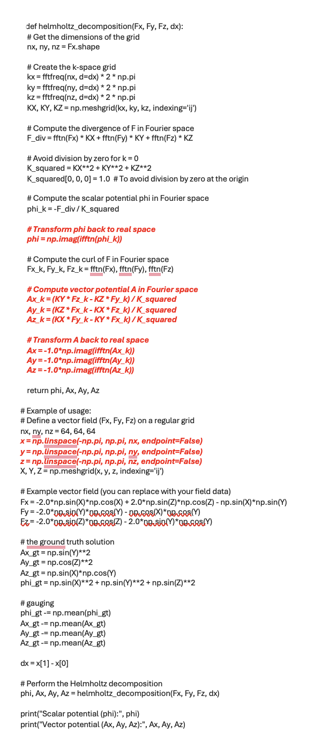
Ask ChatGPT (Coding Assistance)
Lack of experience in the group:
Perhaps much better results using tools such as GitHub Copilot
Given the three components of the magnetic flux density on a grid, can you create Python code for computing the scalar and vector potentials on the same grid using the Helmholtz decomposition?
Main concern: Intellectual property, data privacy, licensing

Slide 8
AI as a support tool: Pilots
Knowledge management using AI tools
  Domain-specific assistants
    → example: TRAPecista
    26+ registered projects at CERN (AccGPT)
Support of design/production/test processes
  Magnet design
  Production follow up and QA
  Measurement analysis
  Reporting
Resources: 2 TECH/DOCT Backed up by their supervisors, IT expert (3 years), and centralized support
Product generation engineering –
models and pipelines
Magnet Model Management Layer 3ML

Slide 9
AI for specific tasks: Pilots
MBSE (Digital Twins, Hybrid Modelling)
Time-series prediction
  -> Example: Real-time prediction of magnetic fields in accelerator magnets for machine control
  Hysteresis and eddy-current modeling
  Quench-signal analysis
Ignorance (unrecognized systematic effects) mitigation
Physics-informed neural networks (PINNs) versus deep learning (transformers)
What must/can be measured, what must/can be simulated, what can we predict
Resources: 2-3 TECH/DOCT (engineering, applied physics, not IT) on project budgets. Backed up by their supervisors, a group IT expert, and central support.

Slide 10
Enabling Functionality
AI lives from training data. Ensure that our data are structured and accessible
  Databases and structured storage of measurements (magnetic, material), processes (production, control) → 3ML, eMIP, Test and Measurement databases
  Programmatic access to data (Python, web services), well-defined data structures
Physical resources such as GPUs and servers
Frameworks, guidelines, and training to develop machine-learning solutions
  Hyper-Parameters: Training sets, feature dimensionality, learning algorithms (supervised/unsupervised), validation sets.
Benchmarking of AI libraries, LLM model builders, models (horses for courses), vector database architectures
Resources: 1.5 Staff FTE + 2 TECH/ADMIN students + 3 FSU independent of any AI application
Resources: Working groups (ATS) and competency pool (groups) backed up by central support (CERN IT?)
Notes:
Manufacturing and Inspection Plan

Slide 11

Roles in software development/application for acc. magnets
Developer
Expert knowledge
Group or central
Designer/Operator
Domain knowledge
Sections
User base?
Data privacy
Simulation
DAQ
Controls
AI Frameworks
(LLMs)
Design/Modeling
Test/Measurement
Operation
Maintenance
Knowledge management
Expert users
Group

