Slide 1

Machine Learning in the Vacuum Group
TE-TM
André Rocha (andre.rocha@cern.ch)
TE-VSC
Technology Department
On behalf of the vacuum group

Slide 2
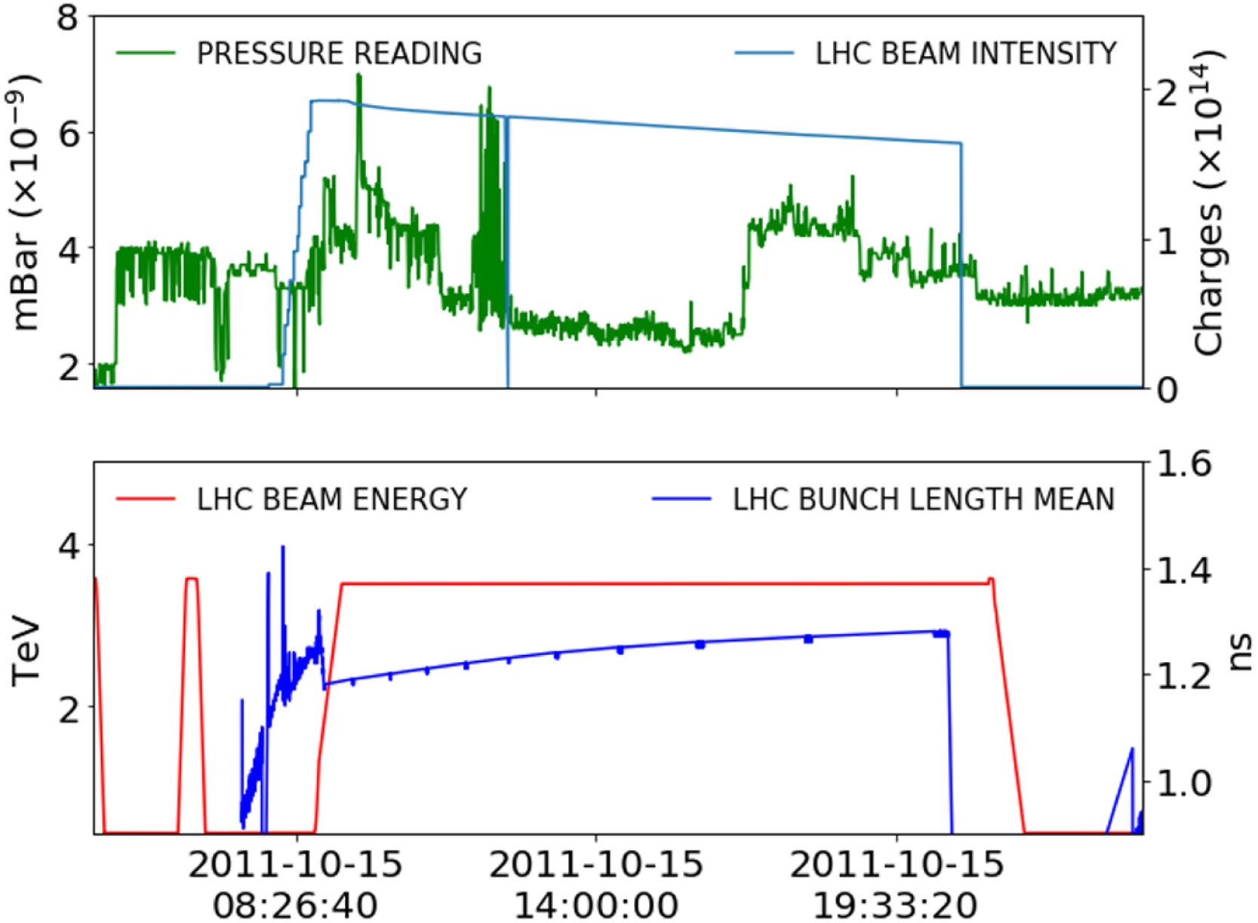
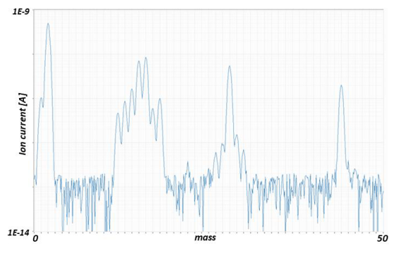
Introduction
mass spectrum graph
AI usage in TE-VSC: Limited, with a promising future
Automatic Heating Detection from Vacuum Pressure Readings – Collaboration ABP & VSC
  Goal: automatically classify and detect abnormal patterns indicative of temperature increases
  Paper: Machine learning for beam dynamics studies at the CERN Large Hadron Collider
Automated Mass Spectra Analysis - Collaboration with IDAL (University of Valencia)
  Goal: Automatic gas identification in mass spectra
Generative AI for coding
  Tool: Jetbrains AI assistant (ChatGPT-based, paid license)
  Applications: coaching, generation of code snippets, reviews, automated documentation
AI tools are promising for diverse Vacuum related problems including:
  Advanced fault detection / diagnostics
  Data Analysis
  Predictive maintenance
  Process simulation
Indication of temperature increase from data correlation
Mass spectrum
Notes:
Add here mass spectra graph

Slide 3
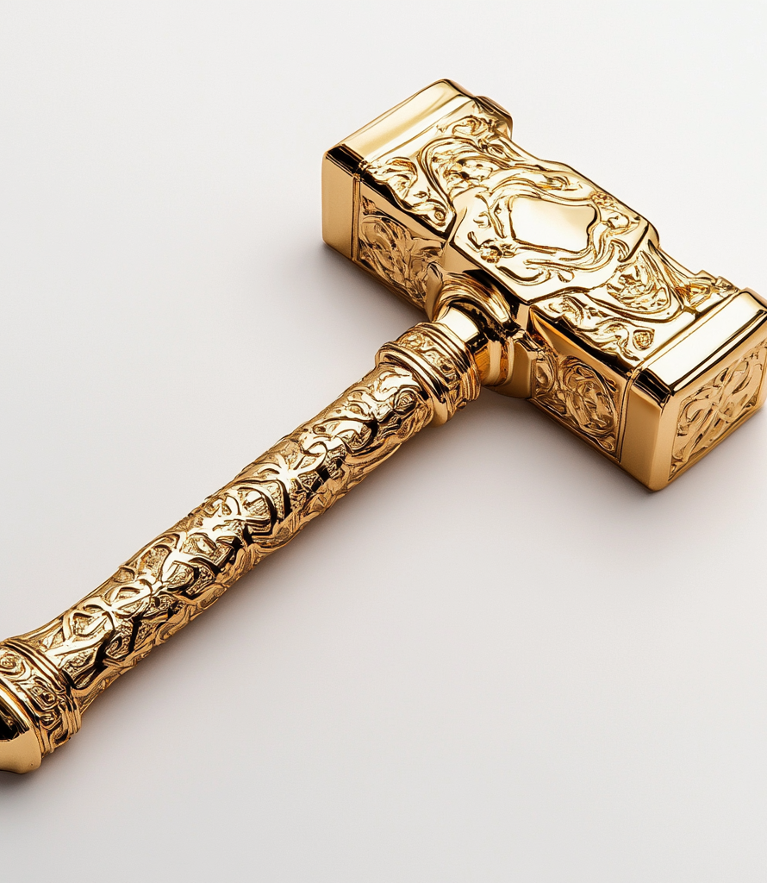
Some words of caution
No feasibility studies have yet been performed on the cases we’re about to show
Watch out for the golden hammer: over-reliance on a shiny new tool
ML algorithms likely outperform traditional algorithms when:
  Handling Large and Complex Data Sets
  Discovering Non-Linear and Hidden Relationships
  High Dimensionality (input parameters) problems
  Continuous Learning and Adaptation
  Natural Language Processing and Understanding
  Image and Pattern Recognition

Slide 4
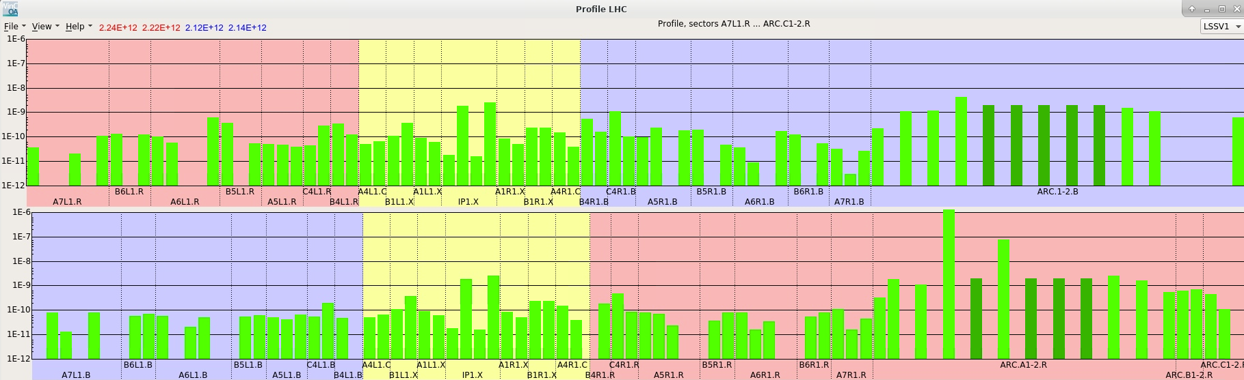
Pressure Anomaly Detection
Currently, vacuum levels are compared to fixed pressure baselines (piquet daily monitoring + threshold alarms). If the pressure is below a predefined threshold, it is considered good enough. This is a rather unrefined method:
  Lack of historical context: Doesn’t take into consideration past pressure values, which might have indicated conditions were degrading
  Beam characteristics ignored: Doesn’t consider presence or absence of beam and its characteristics which influence pressure
  Non-linear pressure dynamics: multiple phenomena contribute to the pressure and define what’s normal or not
  Inability to detect early signs of failure: subtle deviations from normal pressure patterns can go undetected
Notes:
Vacuum Quality Classifier
Pressure Anomaly Detection
Log analysis
Gauge calibration
Parameter adjustment for coatings
Wear detection in pumps

Slide 5

Pressure Anomaly Detection
A vacuum classifier to provide a deeper insight into pressure evolution in each sector
Causes of anomalies could be identified in a similar way
Input Parameters
Anomaly Detection
Classification
P(Pressure Improving)
Current Pressure
Reference Pressure
Pressure X mins moving AVG
Pressure Max Value last X mins
Beam Current
Number of bunches
Temperature
P(Pressure Stable)
P(Pressure Degrading)
Notes:
Vacuum Quality Classifier
Pressure Anomaly Detection
Log analysis
Gauge calibration
Parameter adjustment for coatings
Wear detection in pumps

Slide 6


SuperKEKB Pressure Anomaly detection
Objective: Develop a pressure anomaly detection system using ML for the SuperKEKB accelerator’s vacuum system
Fault detection: detects faults in pressure measured by ~600 gauges in real-time, ensuring early intervention
Methodology: 2 Feed-forward neural networks (FNN) trained on actual abnormal behaviors
Fault classification: can detect the following types of faults:
  Leak or pump failure
  Overheating or discharge
  Pumping down or leak
  Abnormal orbit or leak
  Pressure burst or leak
Anomaly Detection
P(Pres Gauge 1 is Abnormal)
$$Input Parameters$$
P(Pres Gauge 2 is Abnormal)
P(Pres Gauge n is Abnormal)
Cause Detection
P(Leak or Pump Failure)
$$Input Parameters$$
P(Overheating or discharge)
P(Abnormal orbit or leak)
Suetsugu, Y. (2024). Machine-learning-based pressure-anomaly detection system for SuperKEKB accelerator. Phys. Rev. Accel. Beams, 27, 063201. DOI: 10.1103/PhysRevAccelBeams.27.063201.

Slide 7
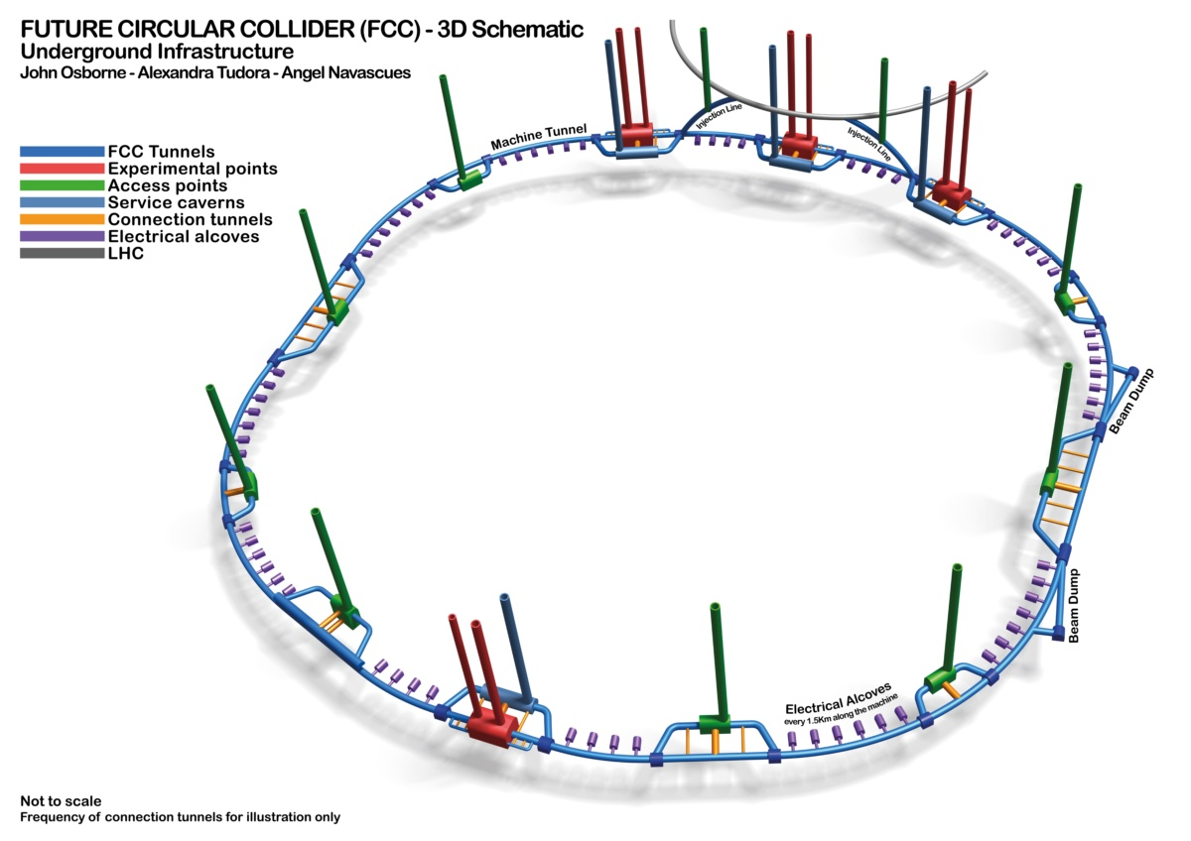
The Future of Vacuum System Monitoring
Monitoring of large-scale control systems expected to include some forms of machine learning algorithms
Manual monitoring of a vacuum system the size of FCC is impractical
  Effective Monitoring of thousands of gauges requires automated tools
Early fault detection is critical
  Scaling up the number of devices may bring availability issues
  Identification of issues before they escalate maximizes intervention opportunities
Automation is economically essential
  The cost of downtime of the FCC due to vacuum system failures most likely justifies investment in automated diagnostics
We should start gaining knowledge on machine learning today if we are to deploy mature tools for the FCC
  The LHC could be the test bench of FCC in terms of machine learning

Slide 8
Running ML Algorithms in the Vacuum Control System
Data Requirements for AI: running ML algorithms requires processing of vast amounts of data, either in batch or stream
Batch processing: already possible using NxCALS - ideal for offline data analysis where processing delays are acceptable.
Stream Processing: Enables near real-time data processing. To maintain optimal performance of the vacuum SCADA, implement a data pipeline utilizing stream processing engines like Kafka, which ensure scalability and redundancy.
SCADA
Machine Learning
External Systems
Vacuum Data Pipeline

Slide 9
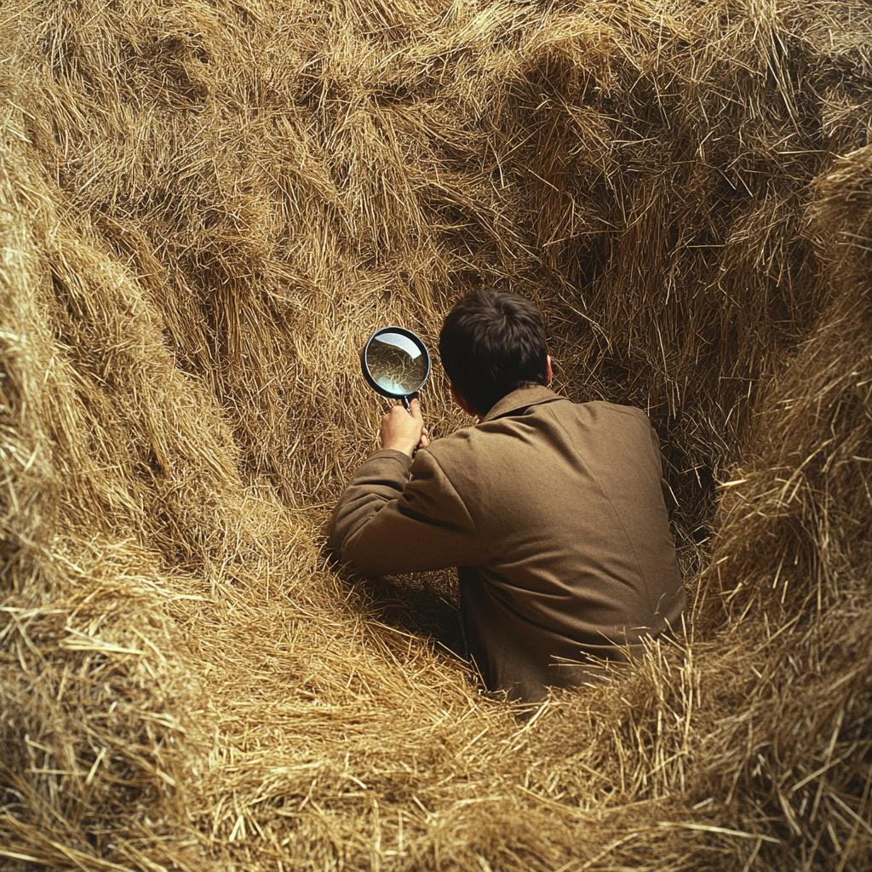
Application Failure Detection
Vacuum software applications produce over 500k log messages per day
Important log messages are often hidden within thousands of less relevant entries
Traditional methods (peak detections, visual search, keywords search are insufficient), especially when multiple events occur simultaneously (eg: failures will be obscured by thousands of high severity messages when PLCs are under maintenance for example)
What if we could have something looking into every log message and application metric and flag the unordinary events ?
The needle in the haystack
Application Logs
Memory Used
Network latency
Requests per Second
Log Message: SEVERE
“You should really take a look into this one”
Notes:
Examples: user application crash.. How to tell if it’s a network problem, memory problem, code problem ? If a system correlates everything it may be easier to detect. If the system tells us “hey, memory was way higher than normal when the application crashed”

Slide 10
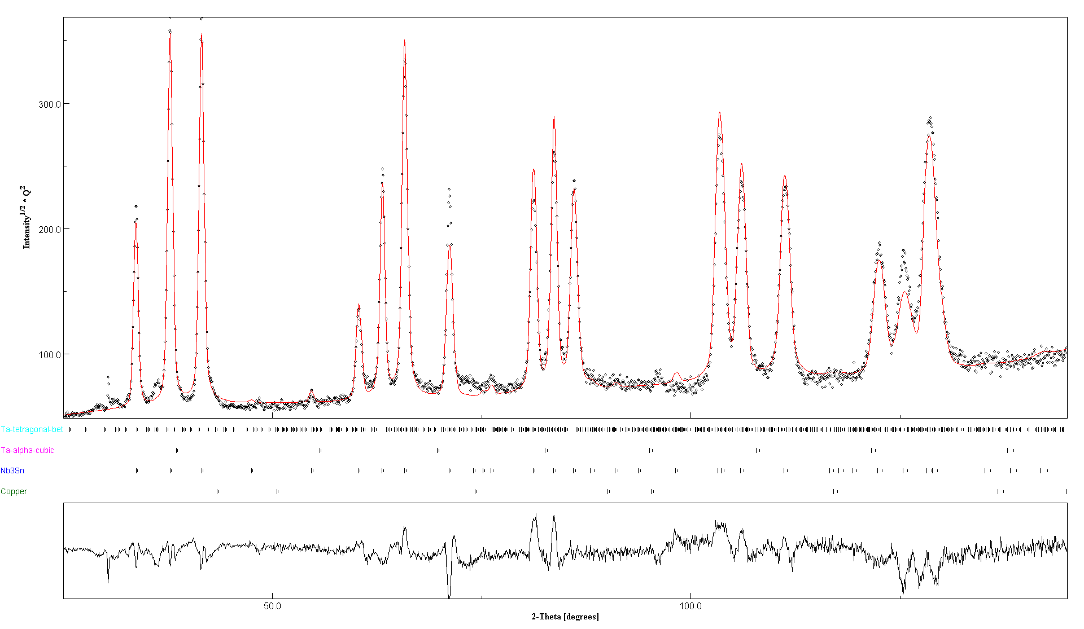
Material and Plasma Analysis
Purpose: Analyze materials to identify structure, composition, and reactions
Process: Several techniques involved:
  X-ray Diffraction - crystallographic structure, phase composition, and other structural properties of materials
  Optical Emission Spectroscopy - Optical Emission Spectroscopy (OES) to analyze the light emitted by different species in the plasma, revealing the ongoing chemical processes
  Others - (X-Ray fluorescence, I-V Measurements)
Challenge: manual analysis techniques are quite time consuming
ML Objective: Use machine learning to automate and accelerate the analysis of diffraction patterns and spectra
X-Ray Diffraction Pattern
Optical emission spectrum
Notes:
OES: Optical Emission Spectroscopy - A technique used to analyze the elemental composition of a material by detecting the light emitted by excited atoms or ions.
XRD: X-ray Diffraction - A technique used to determine the crystallographic structure, phase composition, and other structural properties of materials.
XRF: X-ray Fluorescence - A method used to determine the elemental composition of materials by detecting the characteristic secondary (or fluorescent) X-rays emitted from a material that has been excited by primary X-rays.
I(V): Current-Voltage (I-V) Measurement - A technique used to characterize electrical properties of materials, often used in studies of semiconductors, coatings, and other electronic materials.

Slide 11
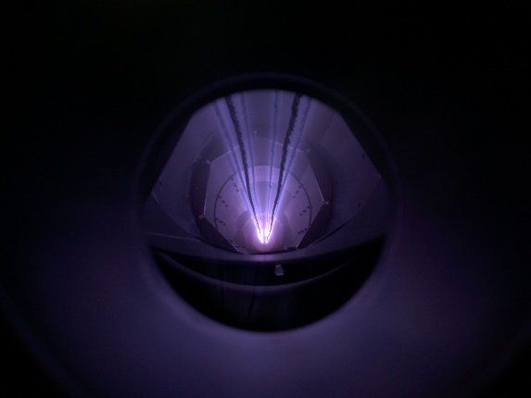
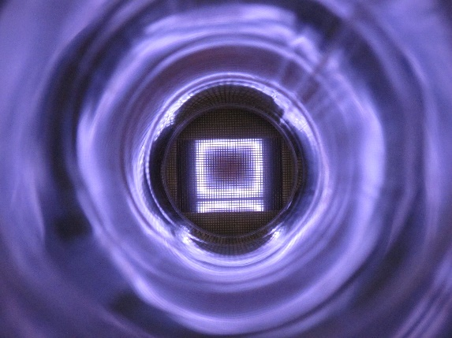
Plasma Control for Coatings
Purpose: Plasmas are used to coat surfaces for various applications (beam pipes, RF cavities, etc)
Process: Coatings are performed by Plasma Control – using High-Power Impulse Magnetron Sputtering (HIPIMS) or Direct Current Magnetron Sputtering (DCMS)
ML Objective: Identify the plasma settings (voltage current frequency, duty cycle, power, pressure) that will optimize one or several intended characteristics of the coating (surface resistance, field dependency, maximum achievable field, external field sensitivity, thermal conductivity, impedance, and roughness.)
Input Parameters
Thin Film Characteristics
Optical Emission Spectroscopy
Output
X-Ray Diffraction
[voltage current frequency, duty cycle, power, pressure, etc..]
Optimized for 1 or more thin film targets (impedance, maximum field, etc)
X-Ray Fluorescence
Current Voltage Measurements

Slide 12
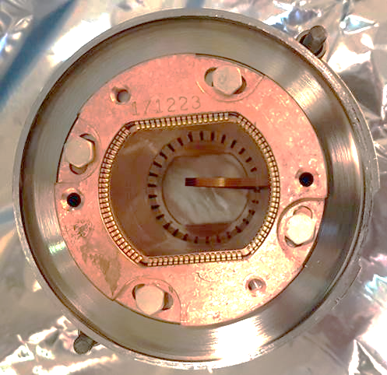
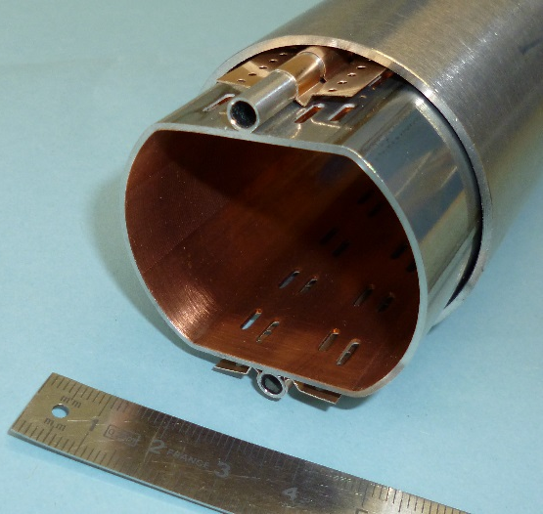
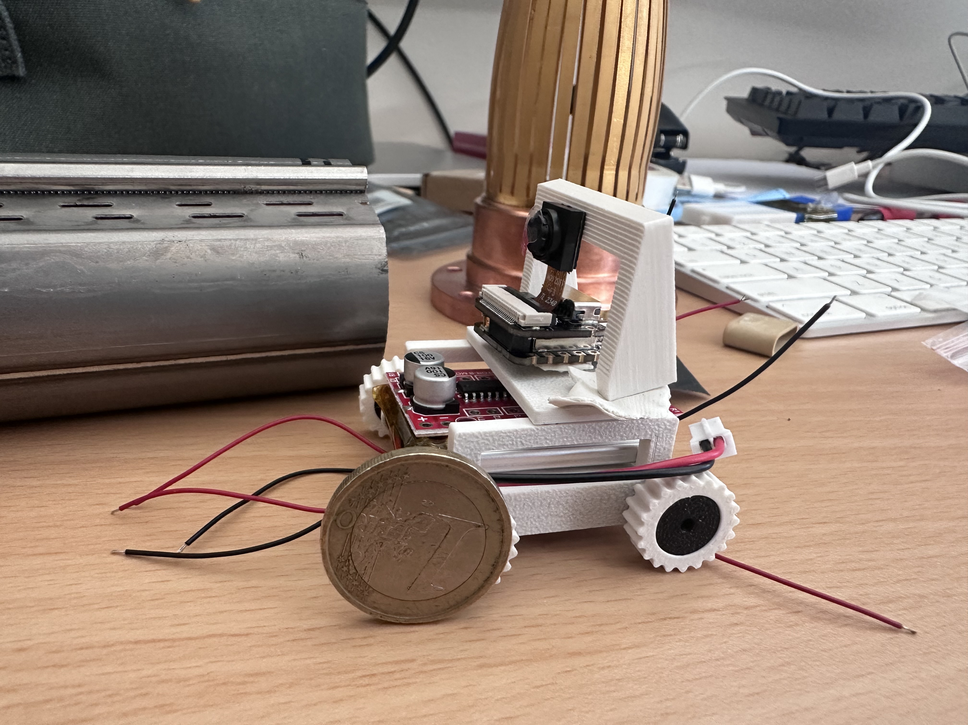
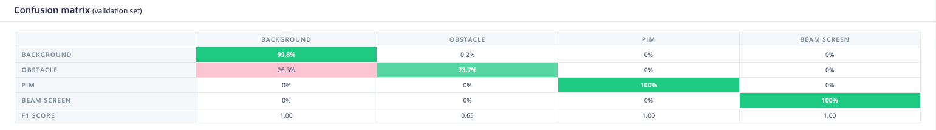
Automated Beam Screen Inspection
Purpose: Inspection system for the LHC beam screen
Process: An Inspection system with cameras will travel an entire ARC (2.8 Kms) to identify blockages in the beam screen
Objective for ML: Automated recognition of beam pipe blockages
Challenge: limited size of the device; Inspection system has to be fully autonomous; computation to be performed inside of the device
Bent rf finger
LHC Beam Pipe
Prototype Inspection System

Slide 13
Final Remarks
Machine Learning of Stand-alone applications (independent on vacuum controls data)
  Can start right away provided resources are available as there are no pre-requisites
  Examples: X-Ray Diffraction Analysis, Thin Films Coating Optimizations, Beam screen defect analysis
Machine Learning on vacuum control system data
  Batch processing: can already be performed with limited data (eg: pressures / ion pump currents)
  Stream processing: Building a vacuum data pipeline will allow for near real-time processing
    Ballpark estimate: 1 to 2 FTE Years
Current staffing levels in software team are limited
  The team is currently focused on maintenance and hardware-related developments necessary for HI-LUMI -> no capacity for R&D
  Limited in-house knowledge and experience in machine learning
Strategic focus on machine learning
  To realize the potential of machine learning, a gradual increase in the allocation of time and resources to ML initiatives will be essential
  Creating strategic collaborations with expert institutes or other groups at CERN is an attractive strategy
Notes:
https://www.jove.com/v/10446/x-ray-diffraction-for-determining-atomic-and-molecular-structure

Slide 14
Thank you !

