Slide 1
CRG opportunities for AI/ML apps
Potential applications and intentions, foreseeable investment
Presented by L. Serio on behalf of the CRG group for brainstorming at TE-TM
Monday 9th of September 2024

Slide 2
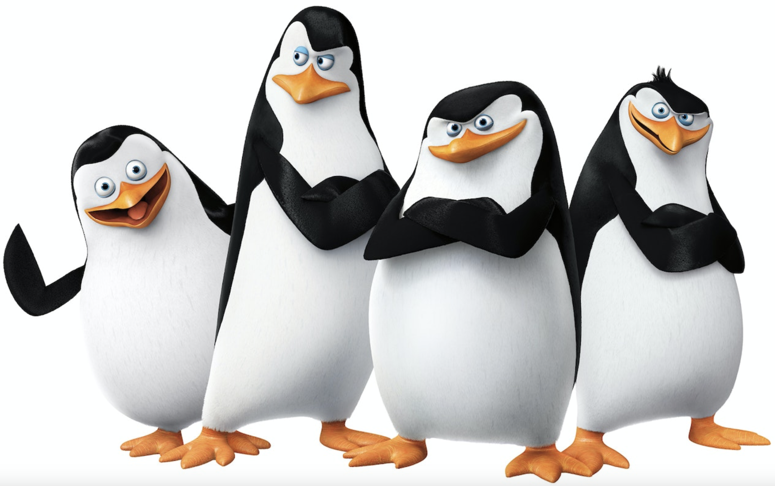

TE-CRG Projects portfolio (ext. funded) all covered by KT agreements approved by the ATS sector and TE department✓ with CRG technologies synergies
  CAFEIN-FL - Federated Learning Platform ✓
  CAFEIN - Anomaly detection and prediction ✓
    Brain pathologies screening
    Breast cancer screening
    IoT medical (EEG signals analysis) and industrial devices (CRG compressors vibration analysis)
  TRUSTROKE -Trustworthy stroke management platform
  UMBRELLA - Improved prediction, detection and treatment for comprehensive stroke management
  STELLA Smart Technology to Extend Lives with Linear Accelerators ✓
  Market Intelligence Platform with WHO to model, predict and improve resilience of supply chains ✓

Slide 3
Recognized technologies expertise & infrastructures
Based/benchmarked on novelties and number of published results, assessment of funded projects, impact and implementation on real world applications
  FEDERATED LEARNING – TE-CRG
  FEDERATED LEARNING AGGREGATION ALGORITHMS – TE-CRG
  FEDERATED LEARNING OPERATING PLATFORM – TE-CRG
  NETWORK and COMMUNICATION SECURITY – IT
  OPERATION OF COMPLEX and SECURE IT INFRASTRUCTURE - IT
  GRAPH NEURAL NETWORKS for complex problem solving and modelling – TE-CRG

Slide 4
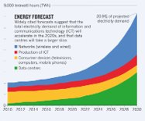
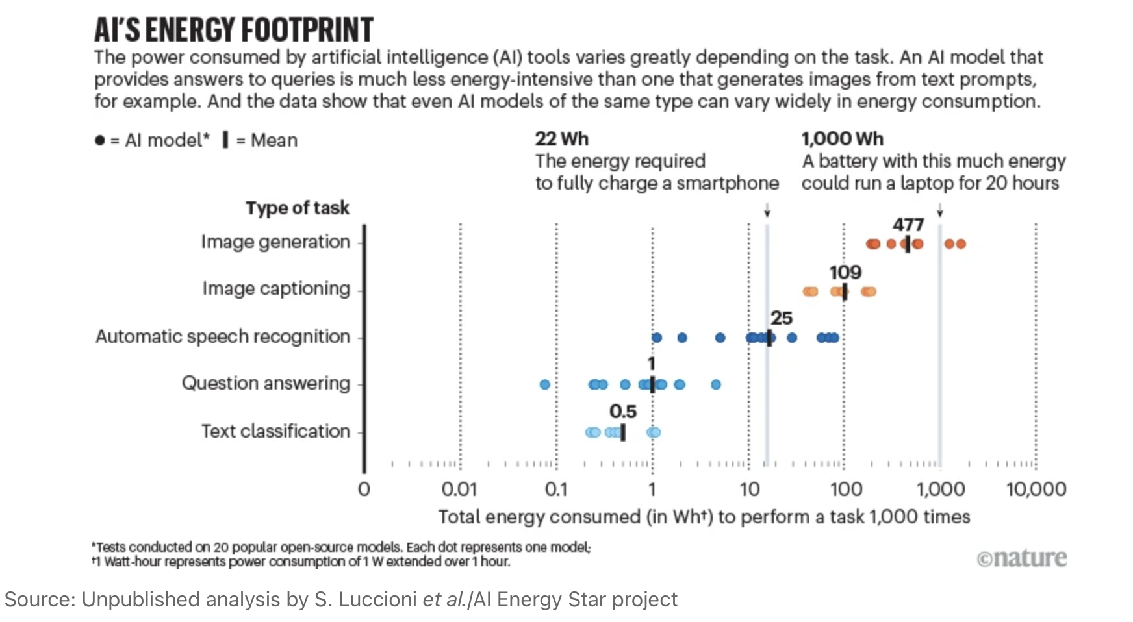
TE-CRG
Potential applications & intentions with funding proposal
CAFEIN Platform for AI/ML developments and training (technology and platform):
  Federated Learning Platform sustainability analysis and long-term decision on CERN role (developer, operator, open-source, KT) – TBA with KT and ongoing projects
  Carbon tracker and optimise – waiting KT funding/other call - 1 PhD and 1 ORIGIN
Large centralized data centers for AI and big-data analytics​
​
15% of the global Green House Gas (GHG) emissions of Information and Communication Technology ecosystem​
Contribute to about 0.3 % of global CO2 emissions

Slide 5
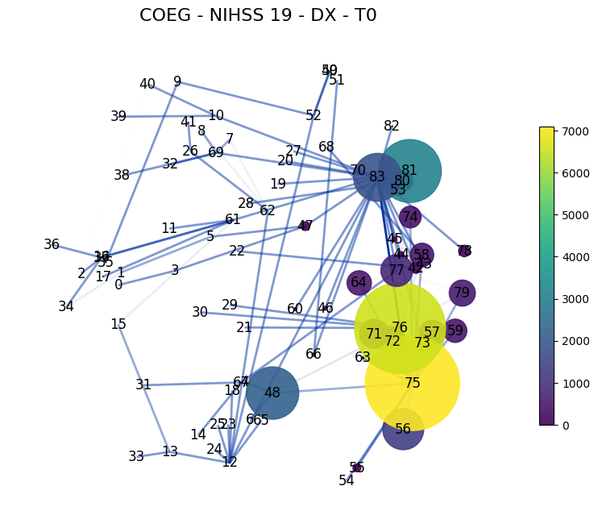
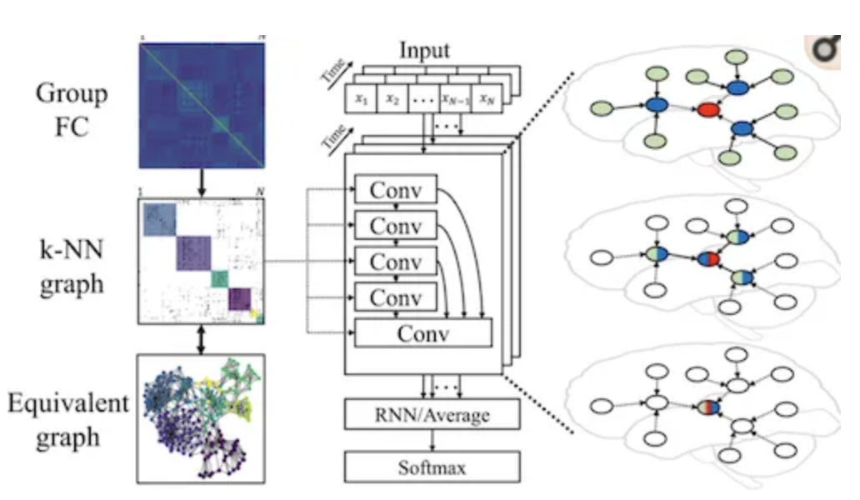
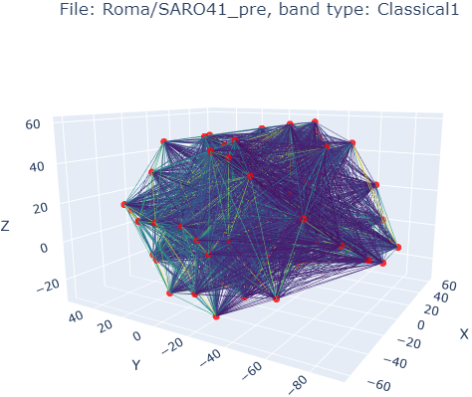
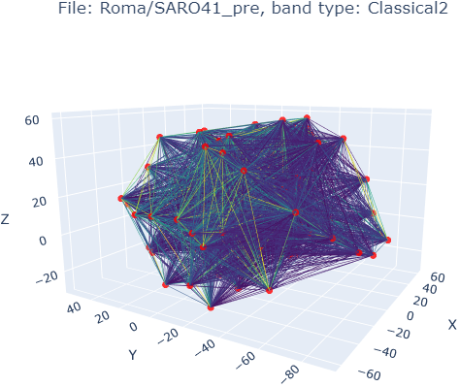
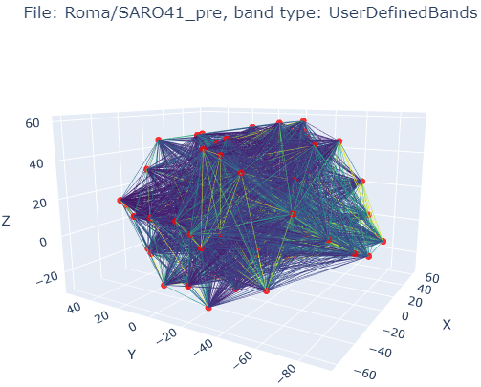

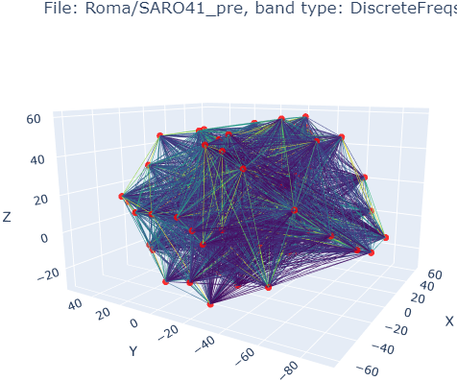
TE-CRG
Potential applications & intentions with funding proposal
Medical technologies:
  GNNs for brain functionalities modelling (management of pathologies, diagnosis, prediction and prevention) – KT funding for MA, new call 1 PhD

Slide 6
TE-CRG
Potential applications & intentions with funding proposal
Accelerator technologies applications implementation based on developments
    ML/AI expertise support funded from ext. funding
    Internal funding for implementation in TE-CRG - 1 FTE GRAD for 2 years (also PT share)
      Complex systems simulations via data driven modelling (GNNs, autoencoder, NN, etc. for diagnostics, training, advanced controls)
      Fault analysis, RUL and dependencies mining (GNN, autoencoder, APRIORI and genetic algorithm, etc. for prescriptive maintenance, diagnostics, resilient design)
      LLMs to support maintenance and operation tasks (chatbot, reporting) to complete the development and implementation of the GNN models for use for diagnostic (digital twin), advanced controls and risk analysis (med & ind)
      Applications implementation for prescriptive maintenance based on the developed/tested algorithms: e.g. anomaly detection and RUL for rotating machinery

Slide 7
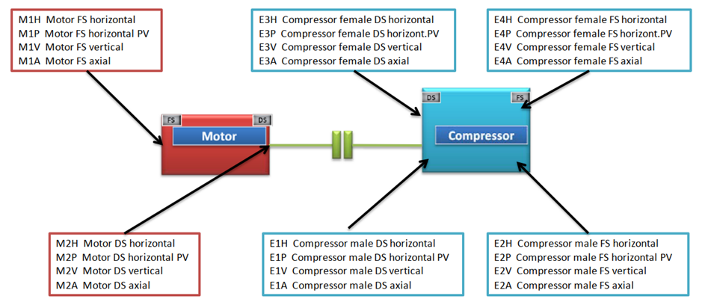


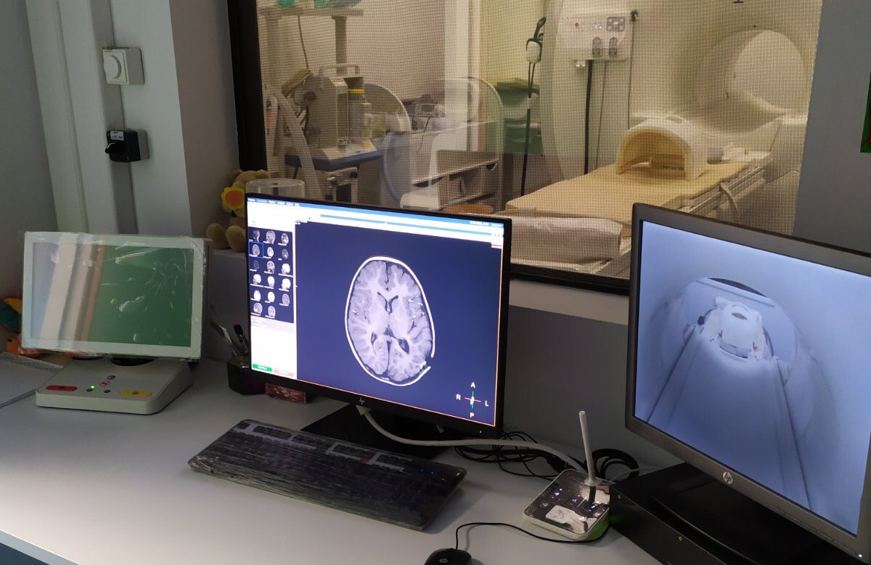
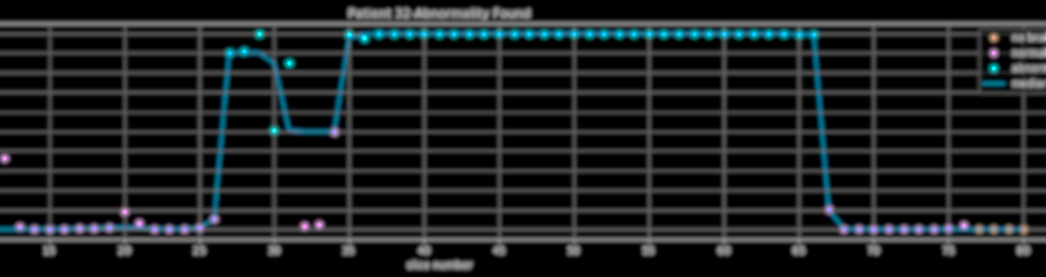
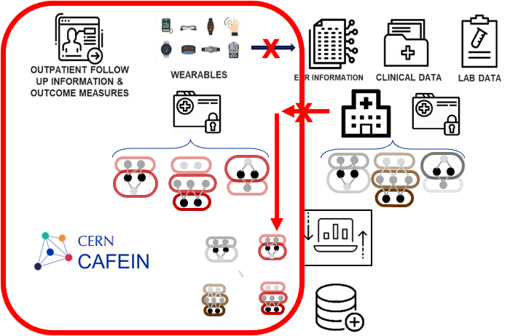
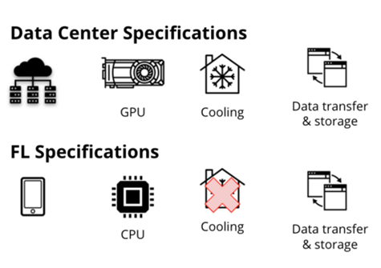
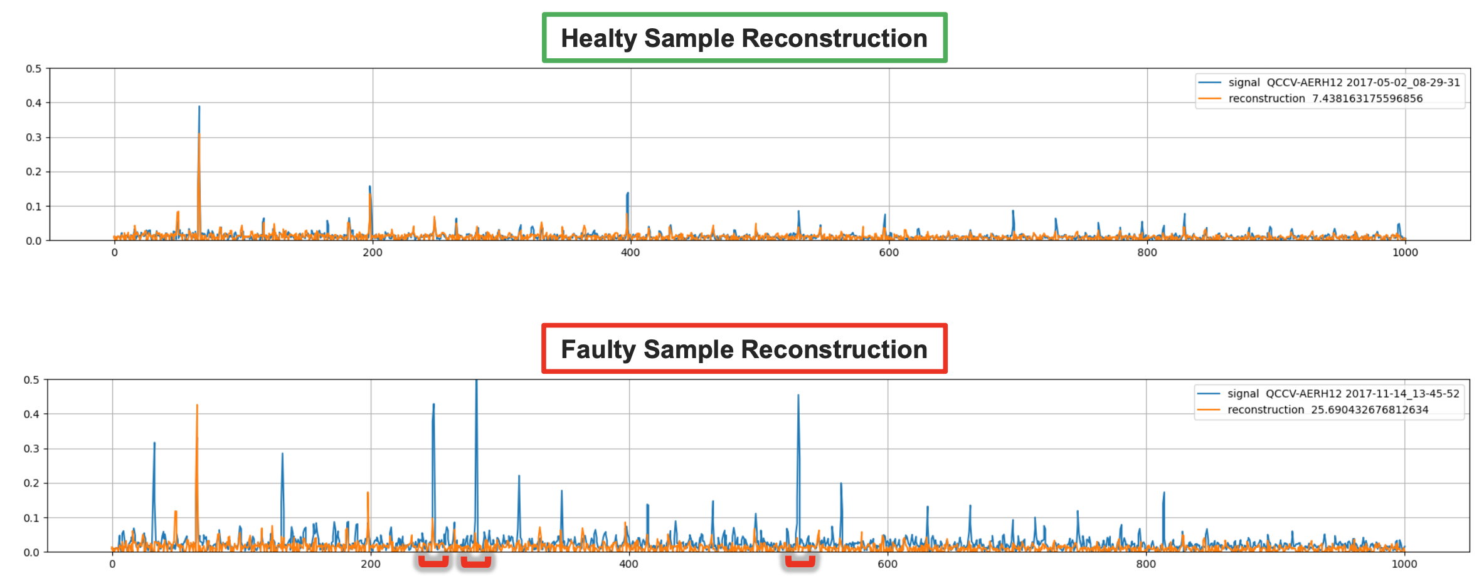
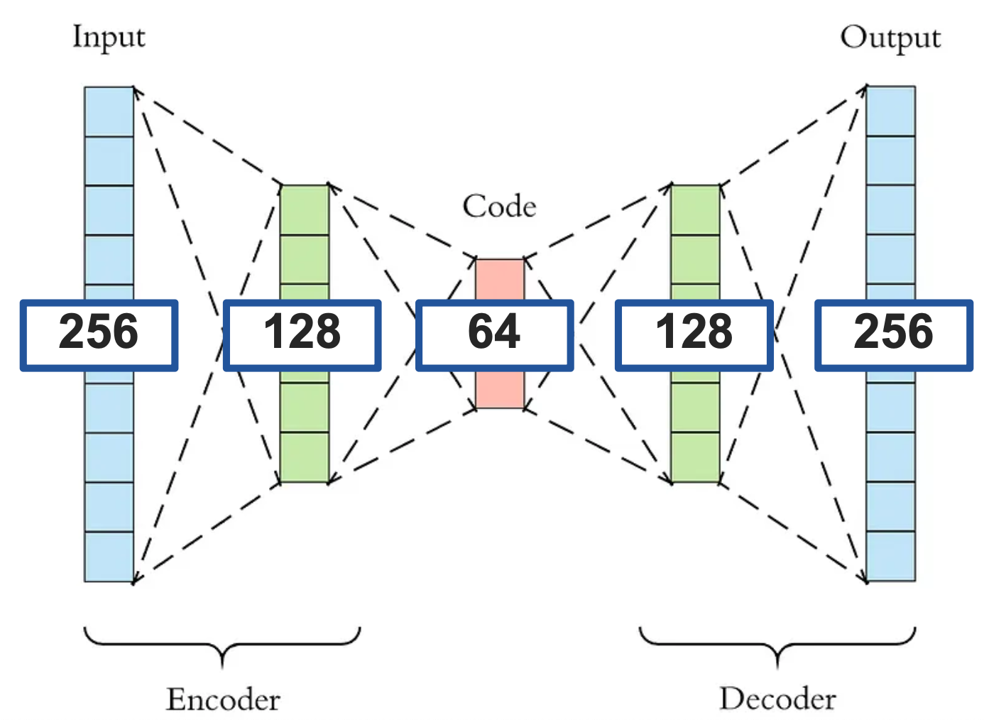
Prescriptive maintenance on IoT Federated devices
  Investigation for cryogenics application(s):
  Investigation medical application(s):
  AI powered - IOT Federated Learning infrastructure for prescriptive maintenance on cryogenics helium compressors.
  Carbon cost optimized architecture
  Adaptation of the system developed for industrial applications to integrate it in the CAFEIN federated learning infrastructure.
  Optimization of software and development of dedicated hardware to optimize the system for medical use.
Technology Transfer
Ref.: A Carbon Tracking Model for Federated Learning: Impact of Quantization and Sparsification - L. Barbieri, S. Kianoush, M. Nicoli, S. Savazzi, L. Serio - arXiv:2310.08087 - 2023 IEEE 28th CAMAD, October 2023
Ref. :Machine Learning Framework for Anomaly Detection and Maintenance Optimization in Large-Scale Cryogenic Systems – P. Cacace et al. - ICEC 2024 Geneva

Slide 8
TE-CRG
AI/ML “potential” future activities with developments
Similar resource requirements with synergies with other apps – ~ 2 FTE GRAD
    Use of AI/ML techniques in some of the existing tools in the CRG group
    Support to operators for daily anomaly detection
    Support to maintenance activities and analysis of Infor EAM and NXCALS data and text (NLP)
    Support for functional and risk analysis study and validation
    Support for the design optimization for future cryo system (FCC, etc)
    Data reduction in NXCALS data to accelerate data retrieval and offline analysis (filtering)
    Use neural networks as equation solver for CFD or process simulations

Slide 9
TE-CRG
AI/ML tools and support
Required support and tools
    HTCondor and Swan
    AFT and NXCALS (future add Infor EAM)
    3 GPUs workstations for medical applications
    H2020 funding covers investment for hardware – infrastructure (medical apps)
    H2020 and WHO funding to cover new MPE resources for the medical projects

Slide 10
AI/ML strategy inputs
AI/ML competences shall be fostered in future to have educated (constant training) scientists in the matter
No need to internalize or centralize most of the activities, the interest, competencies and know how is in the applications development and this is best managed within the equipment groups
Keep existing collaborations and promote new in the interest of the activities/applications (and in particular seek external funding where CERN competences and infrastructure can be used to develop, test and deploy AI for society, indirectly will help create the resources for us)
Maintain a minimum set of internal resources knowledgeable and constantly trained – this as a requirements to invest in training and allow / promote personnel to devote PT to AI
Identify minimum required centralized (efficiency) support for tools, hardware and training

Slide 11
TE-CRG
AI/ML collaborations - all covered by KT agreements approved by the ATS sector and TE dept.
Internal and external existing or potential collaborations of interest
TRUSTroke Project (H2020 funding) – 2023 – 2027
UMBRELLA Project (H2020 funding) – 2024 – 2029
STELLA Project (ICEC and DoE) – 2024 - 2025
WHO/IARC cancer screening platform (KT funding) – 2023 – 2026
WHO- MIP supply chain management for pandemics (WHO / EU) – 2024 - 2025
External labs: Centro Nazionale delle Ricerche (CNR), IARC, WHO, Vall d'Hebron Hospital, Policlinico Gemelli, UKC Ljubjiana, Josef Stefan Institute, Stroke Alliance for Europe, + 30)
Universities: National and Kapodistrian University of Athens, Politecnico di Milano, BRNO University, La Sapienza Rome, UZ Leuven
Companies: Abzu, DATRIX, EATRIS, EURECAT, Nora Health, NACAR, SIEMENS Healthineers

