Slide 1
Performance estimates for the new
HL-LHC baseline & variants
R. De Maria, S. Kostoglou, R. Tomas
H. Bartosik, I. Efthymiopoulos, L. Mether, N. Mounet, G. Sterbini
WP2 02/07/2024

Slide 2
Baseline
Input from new proposed DMR
Run | Year | Efficiency | Bunch intensity (1e11 ppb) | β_{x}* (cm) | β_{y}* (cm) | CC | PU_{max} | Days Intensity ramp-up | Days Proton physics [1] | # colliding IP1/5 bunches [2] | # colliding IP8 bunches | Emit start of SB (μm) | IP1/5 crossing plane | IP1/5 φ/2 (μrad) | LHCb L_{peak} (1e33 Hz/cm²) [3]
4 | 2029 | 0.5 | 1.8 | 30 | 30 | off | 101 | 20 | 6 | 2748 | 2574 | 2.5 | H/V | 250 | 2
 | 2030 | 0.5 | 2.2 | 25 | 25 | on | 132 | 15 | 136 | 2748 | 2574 | 2.5 | H/V | 250 | 2
 | 2031 | 0.5 | 2.2 | 20 | 20 | on | 132 | 10 | 154 | 2748 | 2574 | 2.5 | H/V | 250 | 2
 | 2032 | 0.5 | 2.2 | 20 | 20 | on | 132 | 10 | 152 | 2748 | 2574 | 2.5 | H/V | 250 | 2
5 | 2035 | 0.5 | 2.2 | 15 | 15 | on | 132 | 15 | 152 | 2748 | 2574 | 2.5 | H/V | 250 | 2
 | 2036 | 0.5 | 2.2 | 15 | 15 | on | 132 | 10 | 195 | 2748 | 2574 | 2.5 | H/V | 250 | 2
 | 2037 | 0.5 | 2.2 | 15 | 15 | on | 132 | 10 | 198 | 2748 | 2574 | 2.5 | H/V | 250 | 2
 | 2038 | 0.5 | 2.2 | 15 | 15 | on | 132 | 10 | 198 | 2748 | 2574 | 2.5 | H/V | 250 | 2
6 | 2040 | 0.5 | 2.2 | 15 | 15 | on | 132 | 15 | 165 | 2748 | 2574 | 2.5 | H/V | 250 | 2
 | 2041 | 0.5 | 2.2 | 15 | 15 | on | 132 | 10 | 203 | 2748 | 2574 | 2.5 | H/V | 250 | 2
[1]: No ion operation beyond Run 4
[2]: 25ns_2760b_2748_2492_2574_288bpi_13inj_800ns_bs200ns
[3]: Not considering LHCb upgrade after LS4, up to 3% loss of integrated lumi for ATLAS/CMS.

Slide 3
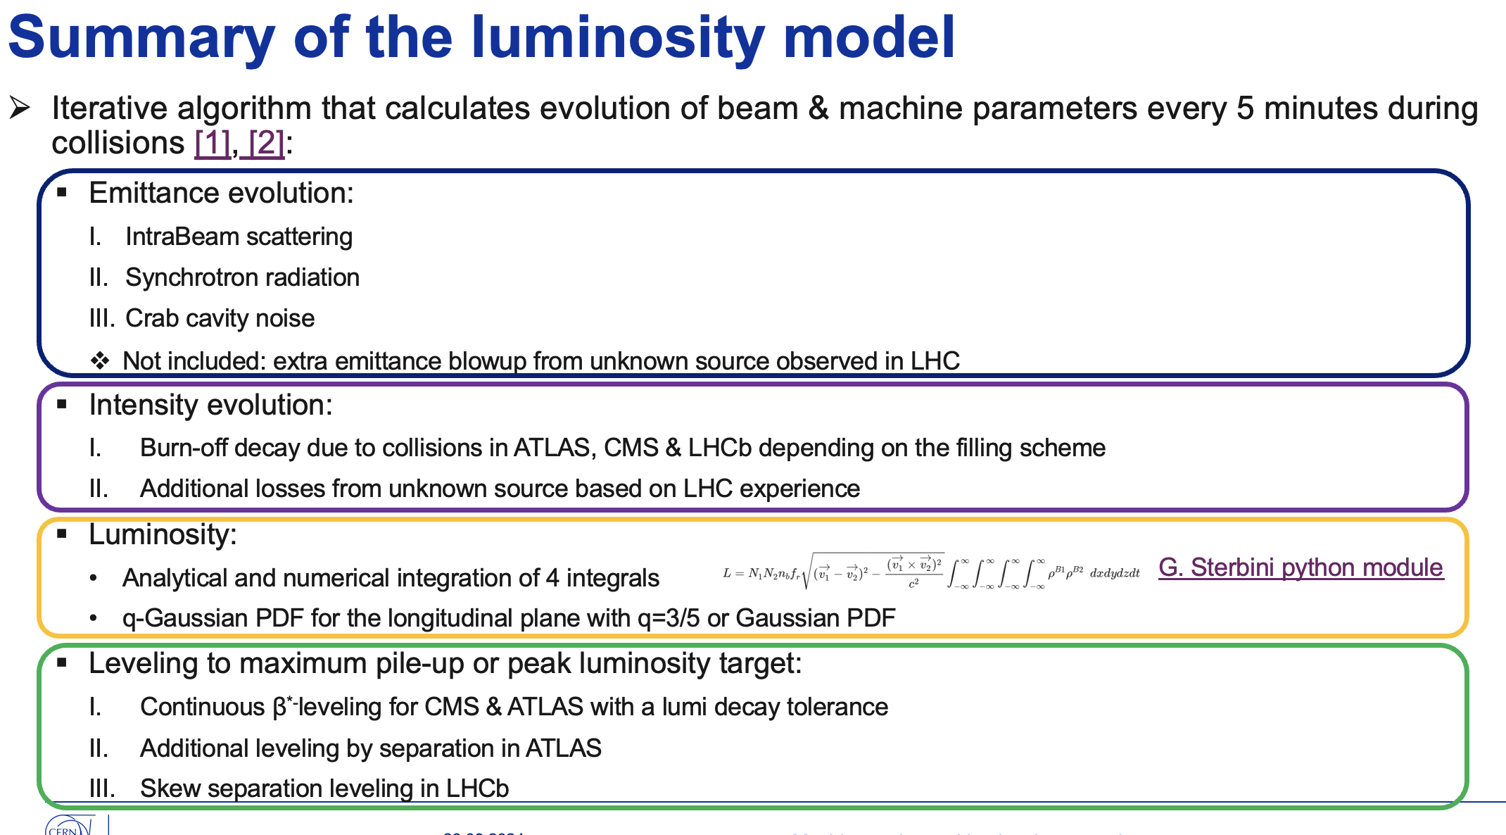

Slide 4
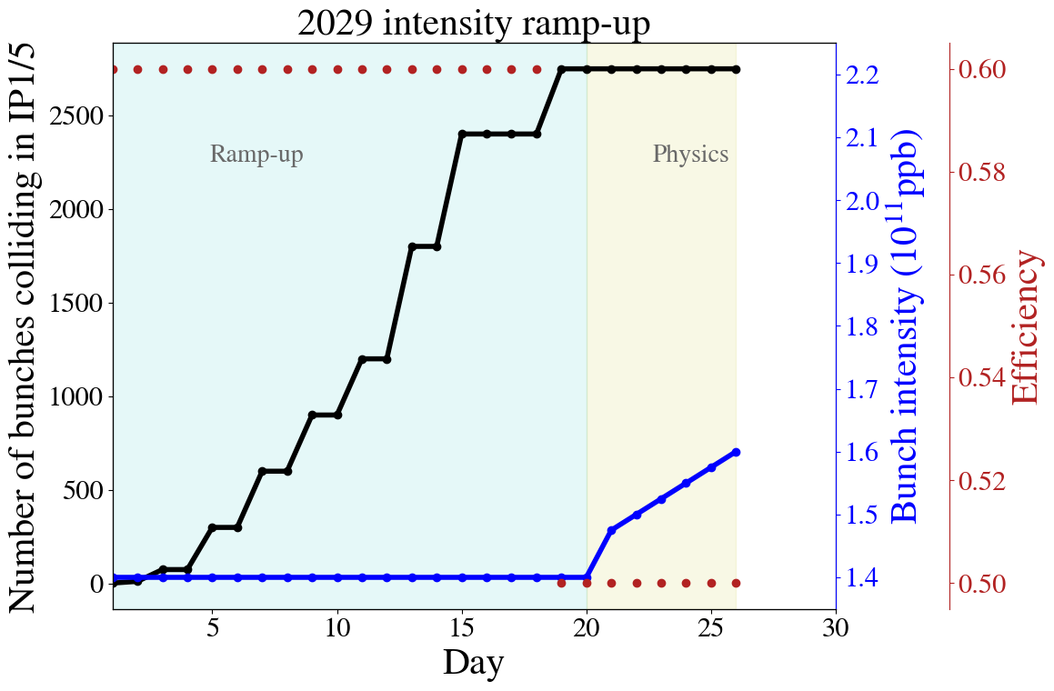
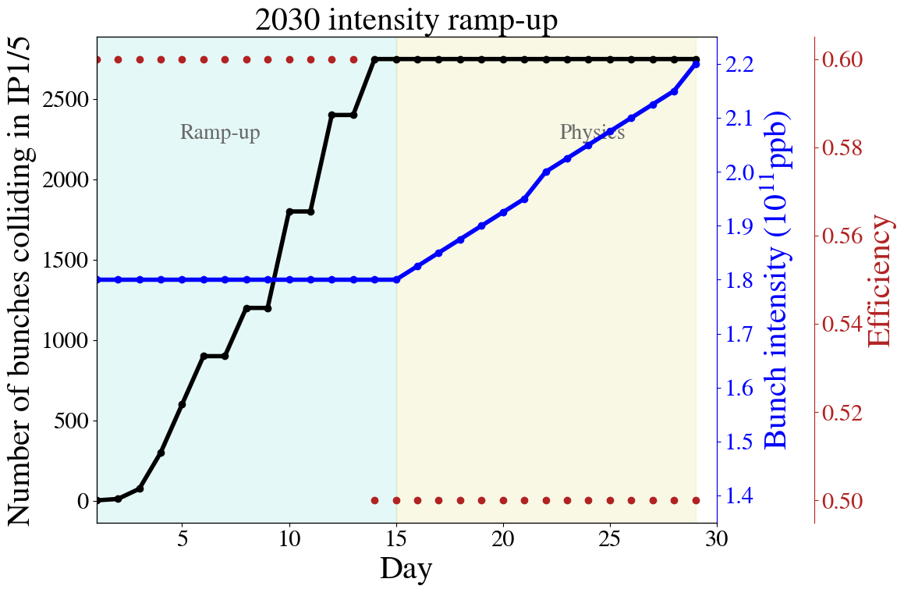
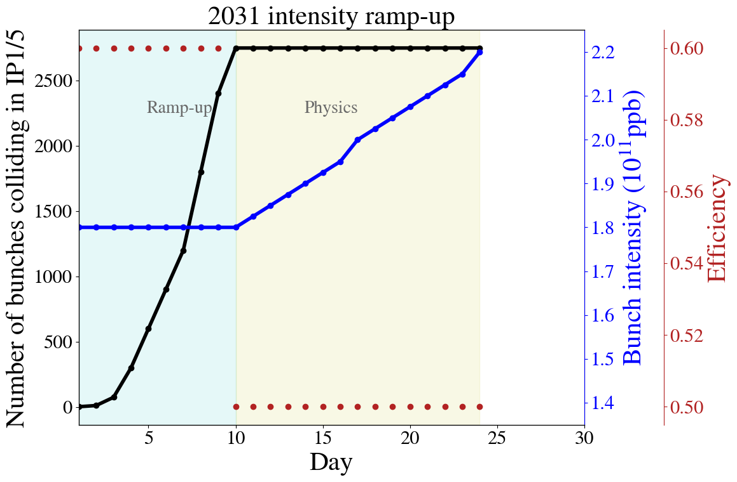


Intensity ramp up
Based on Riccardo’s Chamonix 2024 talk
Run 4
Run 5

Slide 5
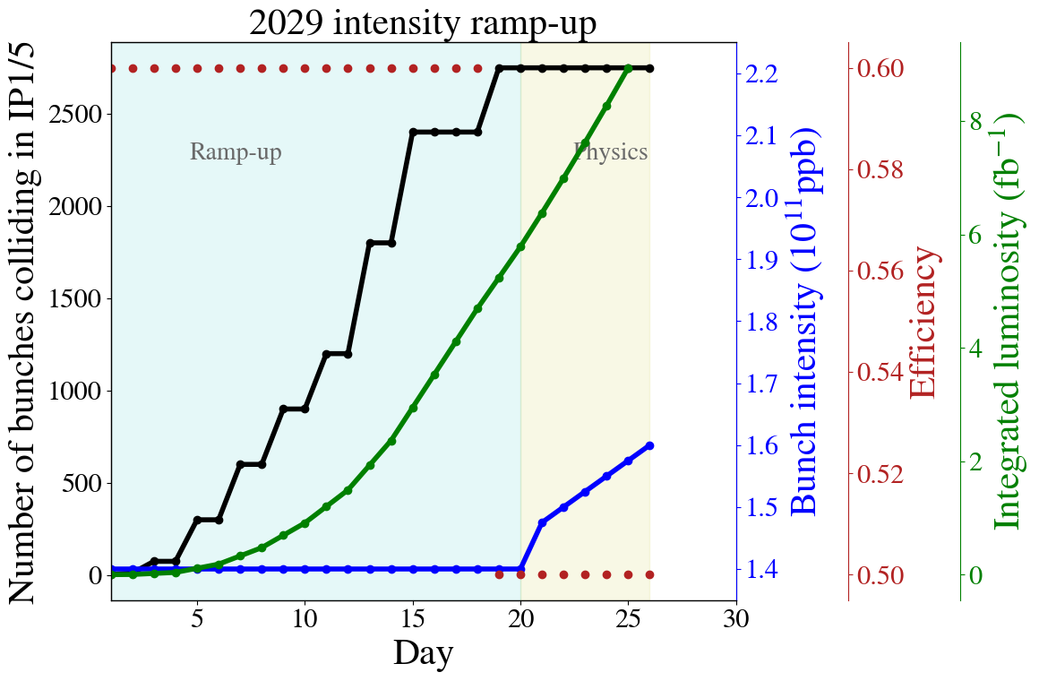
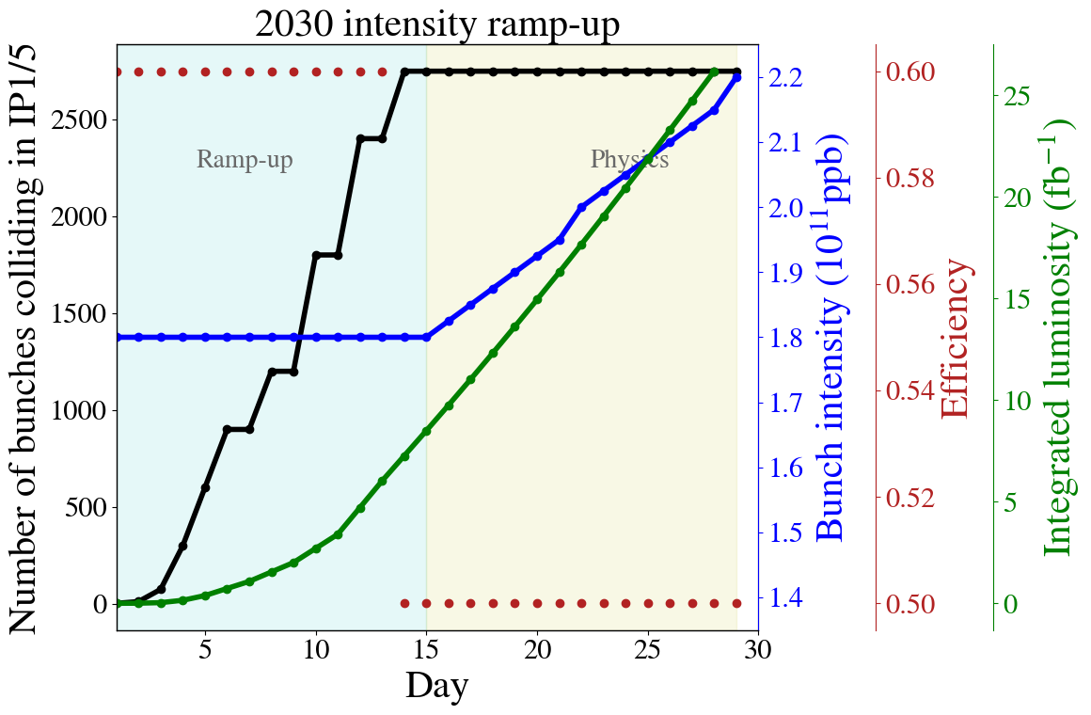
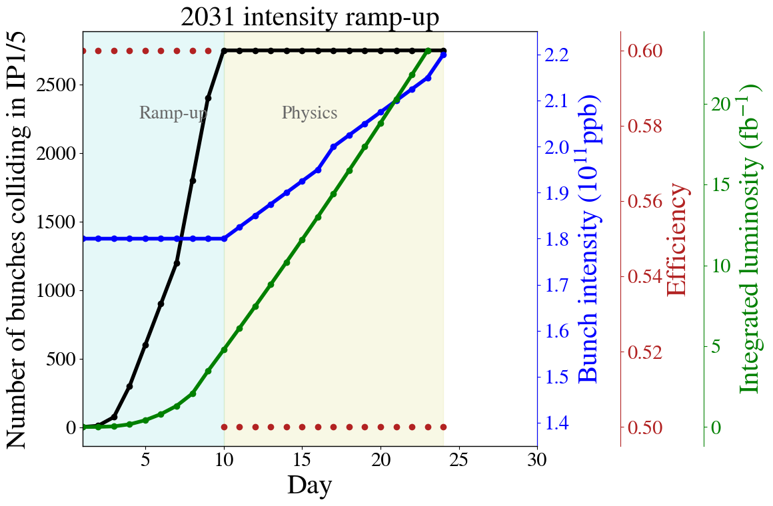

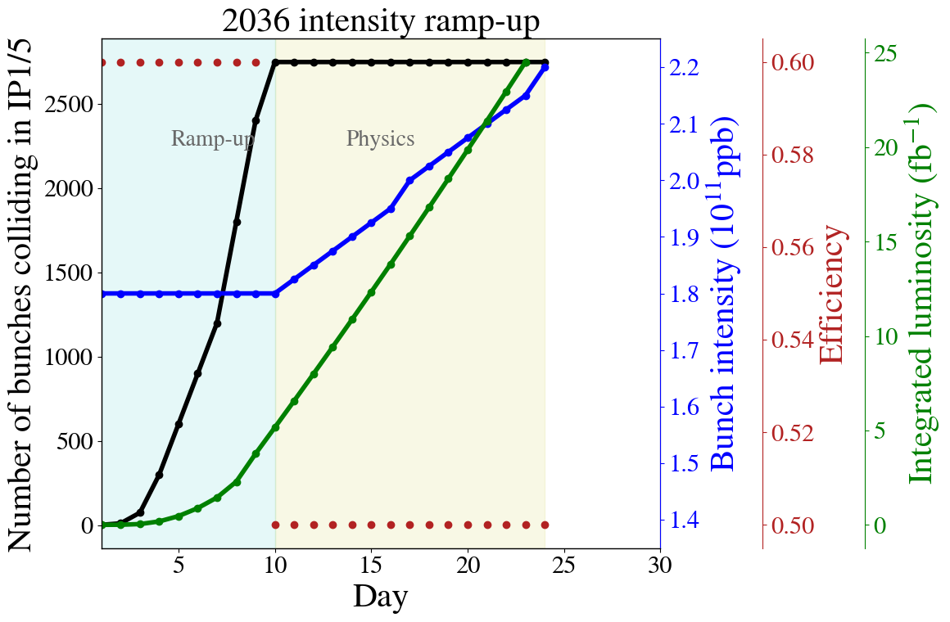
Intensity ramp up
Based on Riccardo’s Chamonix 2024 talk
Run 4
Run 5

Slide 6
Variations
Run | Year | Efficiency | Bunch intensity (1e11 ppb) | β_{x}* (cm) | β_{y}* (cm) | CC | PU_{max} | Days Intensity ramp-up | Days Proton physics [1] | # colliding IP1/5 bunches [2] | # colliding IP8 bunches | Emit start of SB (μm) | IP1/5 crossing plane | IP1/5 φ/2 (μrad) | LHCb L_{peak} (1e33 Hz/cm²) [3]
4 | 2029 | 0.5 | 1.8 | 30 | 30 | off | 101 | 20 | 6 | 2748 | 2574 | 2.5 | H/V→V/H | 250 | 2
 | 2030 | 0.5 | 2.2 | 25 | 25 | on | 132 | 15 | 136 | 2748 | 2574 | 2.5 | H/V→V/H | 250 | 2
 | 2031 | 0.5 | 2.2 | 20→8 | 20→18 | on | 132 | 10 | 154 | 2748 | 2574 | 2.5 | H/V→V/H | 250 | 2
 | 2032 | 0.5 | 2.2 | 20→8 | 20→18 | on | 132 | 10 | 152 | 2748 | 2574 | 2.5 | H/V→V/H | 250 | 2
5 | 2035 | 0.5 | 2.2 | 15→8 | 15→18 | on | 132 | 15 | 152 | 2748 | 2574 | 2.5 | H/V→V/H | 250 | 2
 | 2036 | 0.5 | 2.2 | 15→8 | 15→18 | on | 132 | 10 | 195 | 2748 | 2574 | 2.5 | H/V→V/H | 250 | 2
 | 2037 | 0.5 | 2.2 | 15→8 | 15→18 | on | 132 | 10 | 198 | 2748 | 2574 | 2.5 | H/V→V/H | 250 | 2
 | 2038 | 0.5 | 2.2 | 15→8 | 15→18 | on | 132 | 10 | 198 | 2748 | 2574 | 2.5 | H/V→V/H | 250 | 2
6 | 2040 | 0.5 | 2.2 | 15→8 | 15→18 | on | 132 | 15 | 165 | 2748 | 2574 | 2.5 | H/V→V/H | 250 | 2
 | 2041 | 0.5 | 2.2 | 15→8 | 15→18 | on | 132 | 10 | 203 | 2748 | 2574 | 2.5 | H/V→V/H | 250 | 2
”Flat 8/18 cm”

Slide 7
Variations
Run | Year | Efficiency | Bunch intensity (1e11 ppb) | β_{x}* (cm) | β_{y}* (cm) | CC | PU_{max} | Days Intensity ramp-up | Days Proton physics [1] | # colliding IP1/5 bunches [2] | # colliding IP8 bunches | Emit start of SB (μm) | IP1/5 crossing plane | IP1/5 φ/2 (μrad) | LHCb L_{peak} (1e33 Hz/cm²) [3]
4 | 2029 | 0.5 | 1.8 | 30 | 30 | off | 101 | 20 | 6 | 2748→ 2440 | 2574→ 2240 | 2.5 | H/V | 250 | 2
 | 2030 | 0.5 | 2.2 | 25 | 25 | on | 132 | 15 | 136 | 2748→ 2440 | 2574→ 2240 | 2.5 | H/V | 250 | 2
 | 2031 | 0.5 | 2.2 | 20 | 20 | on | 132 | 10 | 154 | 2748→ 2440 | 2574→ 2240 | 2.5 | H/V | 250 | 2
 | 2032 | 0.5 | 2.2 | 20 | 20 | on | 132 | 10 | 152 | 2748→ 2440 | 2574→ 2240 | 2.5 | H/V | 250 | 2
5 | 2035 | 0.5 | 2.2 | 15 | 15 | on | 132 | 15 | 152 | 2748→ 2440 | 2574→ 2240 | 2.5 | H/V | 250 | 2
 | 2036 | 0.5 | 2.2 | 15 | 15 | on | 132 | 10 | 195 | 2748→ 2440 | 2574→ 2240 | 2.5 | H/V | 250 | 2
 | 2037 | 0.5 | 2.2 | 15 | 15 | on | 132 | 10 | 198 | 2748→ 2440 | 2574→ 2240 | 2.5 | H/V | 250 | 2
 | 2038 | 0.5 | 2.2 | 15 | 15 | on | 132 | 10 | 198 | 2748→ 2440 | 2574→ 2240 | 2.5 | H/V | 250 | 2
6 | 2040 | 0.5 | 2.2 | 15 | 15 | on | 132 | 15 | 165 | 2748→ 2440 | 2574→ 2240 | 2.5 | H/V | 250 | 2
 | 2041 | 0.5 | 2.2 | 15 | 15 | on | 132 | 10 | 203 | 2748→ 2440 | 2574→ 2240 | 2.5 | H/V | 250 | 2
”Round hybrid”: 25ns_2452b_2440_1952_2240_248bpi_12inj_mixed

Slide 8
Variations
Run | Year | Efficiency | Bunch intensity (1e11 ppb) | β_{x}* (cm) | β_{y}* (cm) | CC | PU_{max} | Days Intensity ramp-up | Days Proton physics [1] | # colliding IP1/5 bunches [2] | # colliding IP8 bunches | Emit start of SB (μm) | IP1/5 crossing plane | IP1/5 φ/2 (μrad) | LHCb L_{peak} (1e33 Hz/cm²) [3]
4 | 2029 | 0.5 | 1.8 | 30 | 30 | off | 101 | 20 | 6 | 2748→ 2736 | 2574→2370 | 2.5→ 2.2 | H/V | 250 | 2
 | 2030 | 0.5 | 2.2 | 25 | 25 | on | 132 | 15 | 136 | 2748→ 2736 | 2574→2370 | 2.5→ 2.2 | H/V | 250 | 2
 | 2031 | 0.5 | 2.2 | 20 | 20 | on | 132 | 10 | 154 | 2748→ 2736 | 2574→2370 | 2.5→ 2.2 | H/V | 250 | 2
 | 2032 | 0.5 | 2.2 | 20 | 20 | on | 132 | 10 | 152 | 2748→ 2736 | 2574→2370 | 2.5→ 2.2 | H/V | 250 | 2
5 | 2035 | 0.5 | 2.2 | 15 | 15 | on | 132 | 15 | 152 | 2748→ 2736 | 2574→2370 | 2.5→ 2.2 | H/V | 250 | 2
 | 2036 | 0.5 | 2.2 | 15 | 15 | on | 132 | 10 | 195 | 2748→ 2736 | 2574→2370 | 2.5→ 2.2 | H/V | 250 | 2
 | 2037 | 0.5 | 2.2 | 15 | 15 | on | 132 | 10 | 198 | 2748→ 2736 | 2574→2370 | 2.5→ 2.2 | H/V | 250 | 2
 | 2038 | 0.5 | 2.2 | 15 | 15 | on | 132 | 10 | 198 | 2748→ 2736 | 2574→2370 | 2.5→ 2.2 | H/V | 250 | 2
6 | 2040 | 0.5 | 2.2 | 15 | 15 | on | 132 | 15 | 165 | 2748→ 2736 | 2574→2370 | 2.5→ 2.2 | H/V | 250 | 2
 | 2041 | 0.5 | 2.2 | 15 | 15 | on | 132 | 10 | 203 | 2748→ 2736 | 2574→2370 | 2.5→ 2.2 | H/V | 250 | 2
”Round BCMS”: 25ns_2744b_2736_2246_2370_240bpi_13inj_800ns_bs200ns_BCMS_5x48b

Slide 9
BCMS performance in 2024
Emittance start of injection (μm) | B1H | B1V | B2H | B2V
Fills 9575-9663 | 1.57 | 1.59 | 1.5 | 1.5
Fills 9664-9694 | 1.19 | 1.27 | 1.13 | 1.16
% | -24.2 | -20.1 | -24.7 | -22.7
Emittance end of injection (μm)
Fills 9575-9663 | 1.77 | 1.71 | 1.63 | 1.62
Fills 9664-9700 | 1.49 | 1.44 | 1.32 | 1.31
% | -15.7 | -16 | -18.7 | -18.8
Emittance start of SB (μm)
Fills 9575-9663 | 1.84 | 1.66 | 2.25 | 2.3
Fills 9664-9694 | 1.57 | 1.53 | 1.99 | 2.04
% | -14.67 | -7.83 | -11.56 | -11.3
Bunch intensity (1e11 ppb) | B1 INJPHYS | B2 INJPHYS | B1 STABLE | B2 STABLE
Fills 9573-9663 | 1.59 | 1.59 | 1.56 | 1.55
Fills 9664-9694 | 1.62 | 1.62 | 1.59 | 1.57
% | +1.89 | +1.89 | +1.92 | +1.29

Slide 10
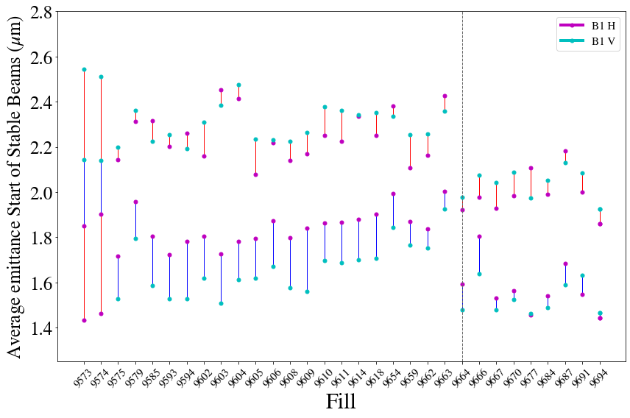
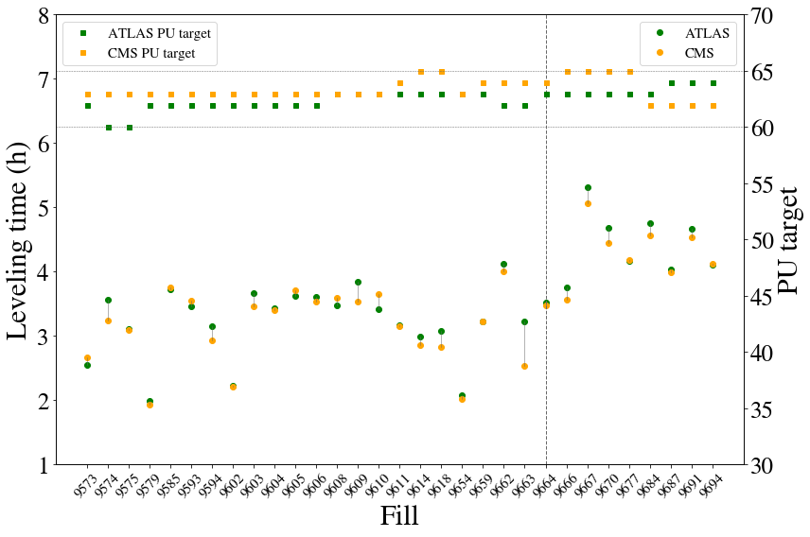
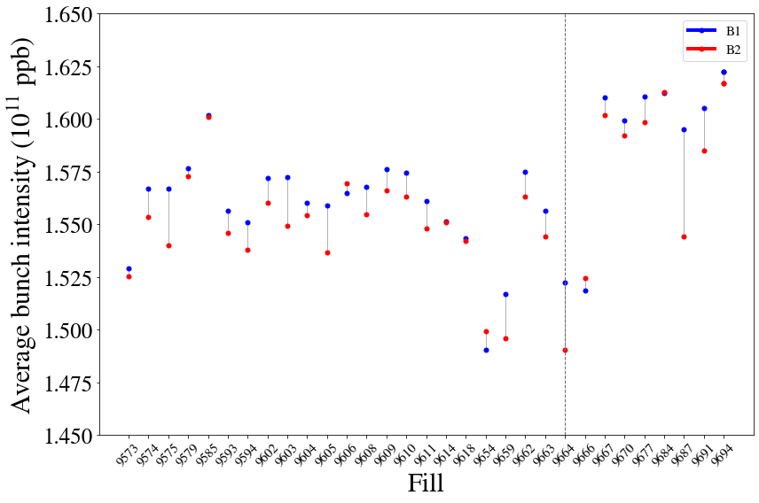
BCMS performance in 2024: Leveling time
Emittance
Leveling time
PU target
Bunch intensity
Step in leveling time results from the combination of smaller emittances at start of SB and increased bunch intensity.
Notes:
9614, 9618, 9667, 9670

Slide 11
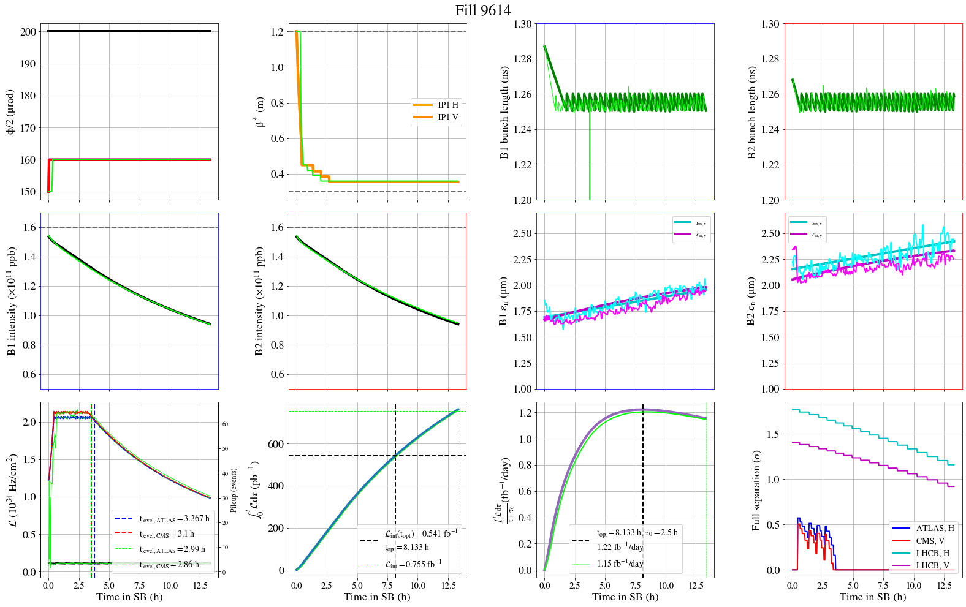
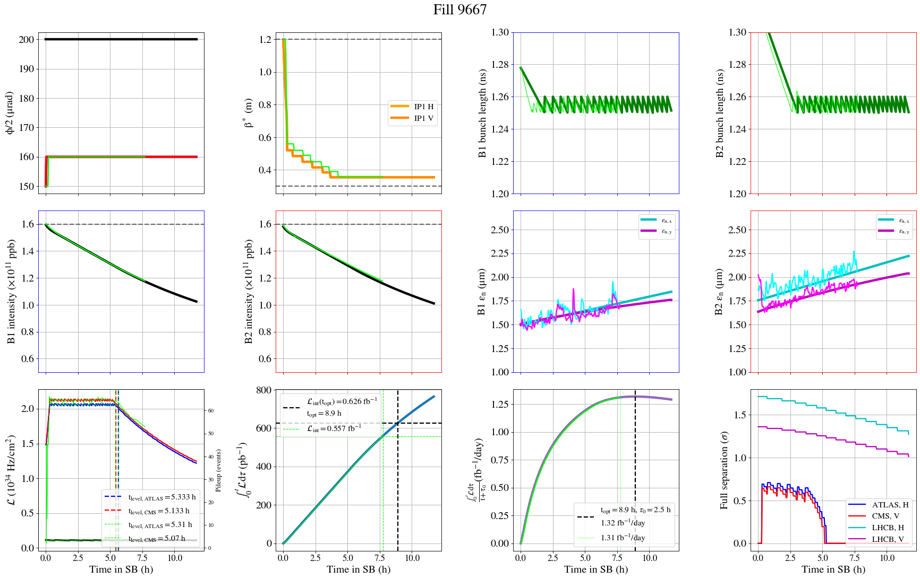
BCMS performance in 2024: Performance gain
Fill 9614, Standard
Fill 9667, BCMS
Considering a turn-around time of 2.5h:
        From 1.22 fb⁻¹/day with standard to 1.32 fb⁻¹/day with BCMS: +8.2% integrated luminosity for fills that make it to the optimal fill length (>8h)

Slide 12
BCMS performance in 2024: Performance gain
Fill 9614, Standard
Fill 9667, BCMS
Based on BCMS experience of 2024, 10% smaller emittance at start of SB + 2% larger bunch intensity
→ 8% gain in integrated luminosity for LHC. Explore feasibility of BCMS scenario as baseline for HL-LHC?
Considering a turn-around time of 2.5h:
        From 1.22 fb⁻¹/day with standard to 1.32 fb⁻¹/day with BCMS: +8.2% integrated luminosity for fills that make it to the optimal fill length (>8h)

Slide 13
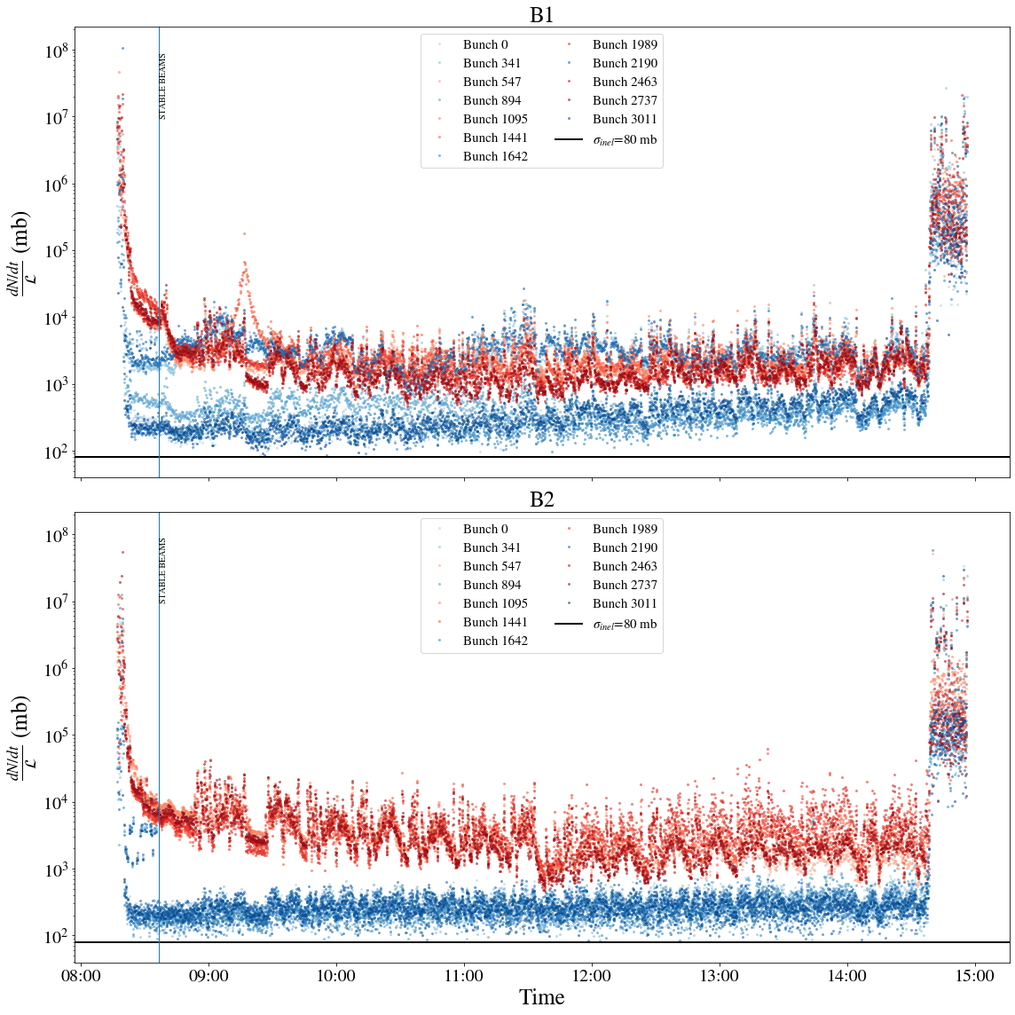
BCMS performance in 2024: Performance gain
Fill 9614, Standard
Fill 9667, BCMS
Impact of tails in the LHC to be considered and studied (“BCMS with reduced tails” from the injectors F. Asvesta, M. Bozatzis).
MD on non-factorization of VdM beams E. Lamb, G. Sterbini
Considering a turn-around time of 2.5h:
        From 1.22 fb⁻¹/day with standard to 1.32 fb⁻¹/day with BCMS: +8.2% integrated luminosity for fills that make it to the optimal fill length (>8h)

Slide 14
Variations
Run | Year | Efficiency | Bunch intensity (1e11 ppb) | β_{x}* (cm) | β_{y}* (cm) | CC | PU_{max} | Days Intensity ramp-up | Days Proton physics [1] | # colliding IP1/5 bunches [2] | # colliding IP8 bunches | Emit start of SB (μm) | IP1/5 crossing plane | IP1/5 φ/2 (μrad) | LHCb L_{peak} (1e33 Hz/cm²) [3]
4 | 2029 | 0.5 | 1.8 | 30 | 30 | off | 101 | 20 | 6 | 2748 | 2574 | 2.5 | H/V | 250 | 2
 | 2030 | 0.5 | 2.2 | 25 | 25 | on | 132 | 15 | 136 | 2748 | 2574 | 2.5 | H/V | 250 | 2
 | 2031 | 0.5 | 2.2 | 20 | 20 | on | 132 | 10 | 154 | 2748 | 2574 | 2.5 | H/V | 250 | 2
 | 2032 | 0.5 | 2.2 | 20 | 20 | on | 132 | 10 | 152 | 2748 | 2574 | 2.5 | H/V | 250 | 2
5 | 2035 | 0.5 | 2.2 | 15 | 15 | on | 132 | 15 | 152→130 | 2748 | 2574 | 2.5 | H/V | 250 | 2
 | 2036 | 0.5 | 2.2 | 15 | 15 | on | 132 | 10 | 195→172 | 2748 | 2574 | 2.5 | H/V | 250 | 2
 | 2037 | 0.5 | 2.2 | 15 | 15 | on | 132 | 10 | 198→175 | 2748 | 2574 | 2.5 | H/V | 250 | 2
 | 2038 | 0.5 | 2.2 | 15 | 15 | on | 132 | 10 | 198→175 | 2748 | 2574 | 2.5 | H/V | 250 | 2
6 | 2040 | 0.5 | 2.2 | 15 | 15 | on | 132 | 15 | 165→141 | 2748 | 2574 | 2.5 | H/V | 250 | 2
 | 2041 | 0.5 | 2.2 | 15 | 15 | on | 132 | 10 | 203→179 | 2748 | 2574 | 2.5 | H/V | 250 | 2
“Nominal ions” → “Extended ions”

Slide 15
Scenarios
Scenario | Optics | Duration | Filling scheme
Baseline | Round Run4 20cm | Nominal ions | Standard
Round hybrid | Round Run4 20cm | Nominal ions | Hybrid
Round BCMS | Round Run4 20cm | Nominal ions | BCMS
Flat 8/18 cm | Flat 8/18 cm | Nominal ions | Standard
Vbaseline extended ions | Round Run4 20cm | Extended ions | Standard
Round hybrid extended ions | Round Run4 20cm | Extended ions | Hybrid
Round BCMS extended ions | Round Run4 20cm | Extended ions | BCMS
Flat extended ions | Flat | Extended ions | Standard

Slide 16
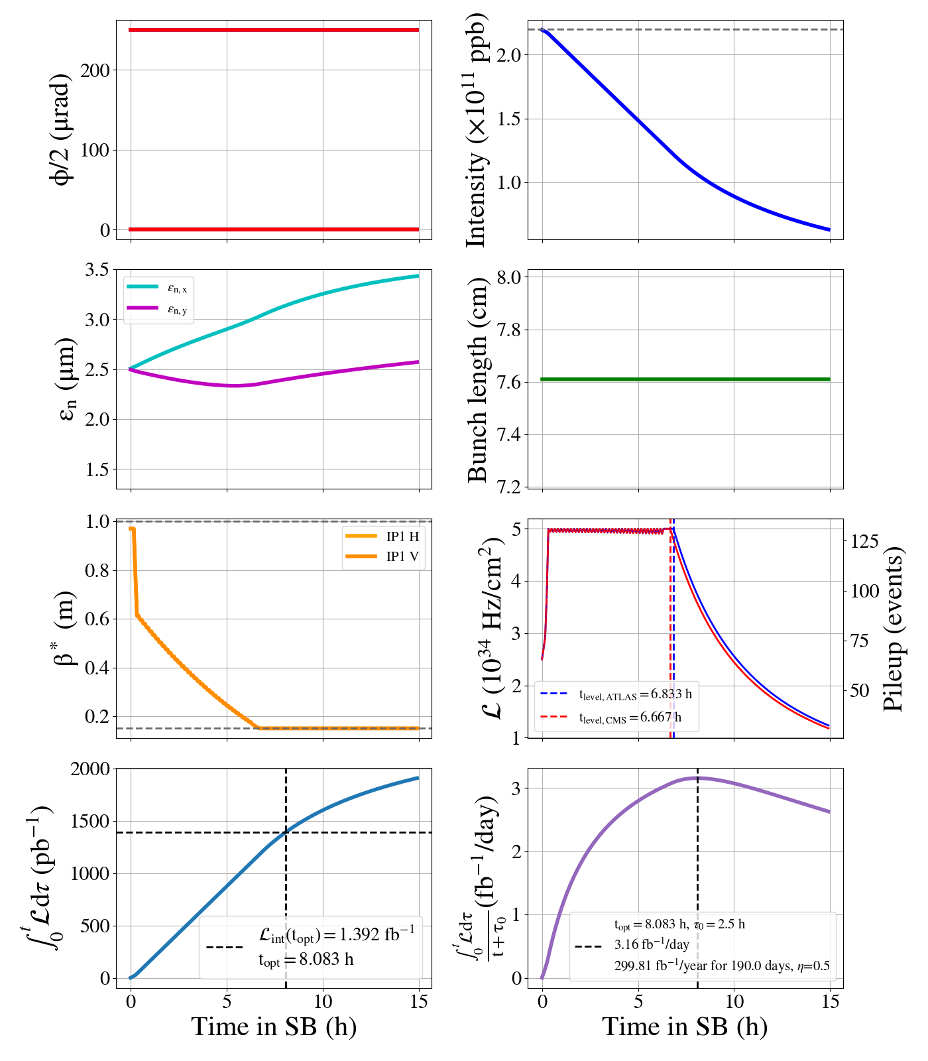
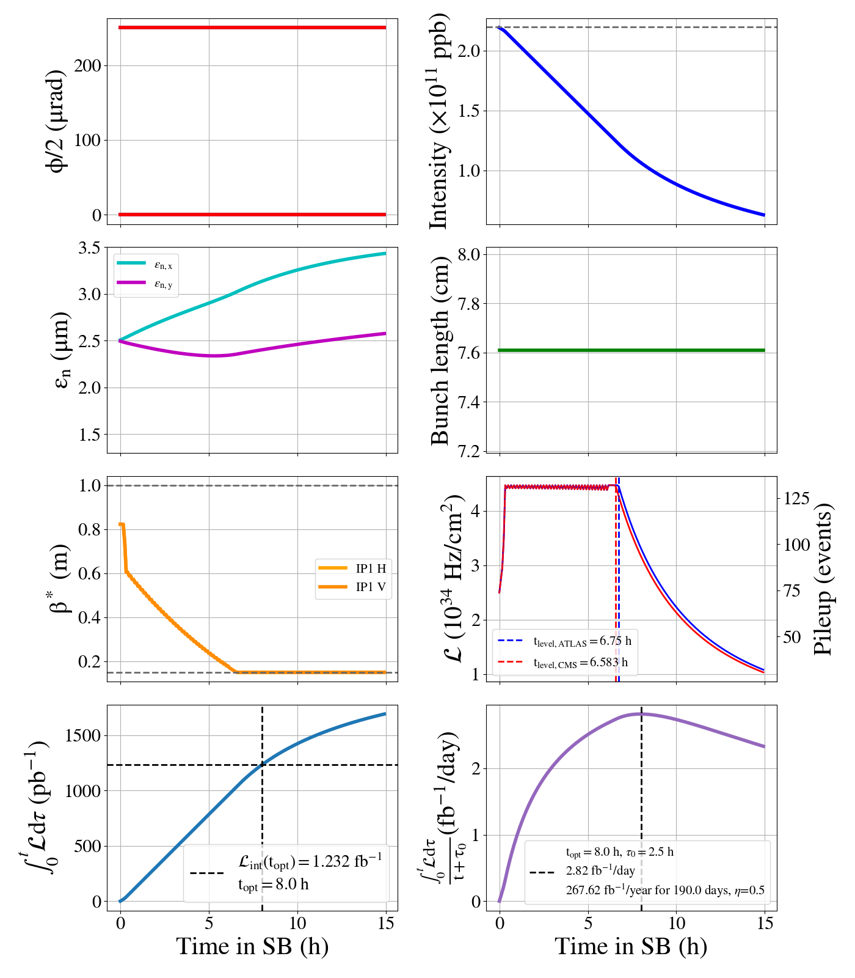
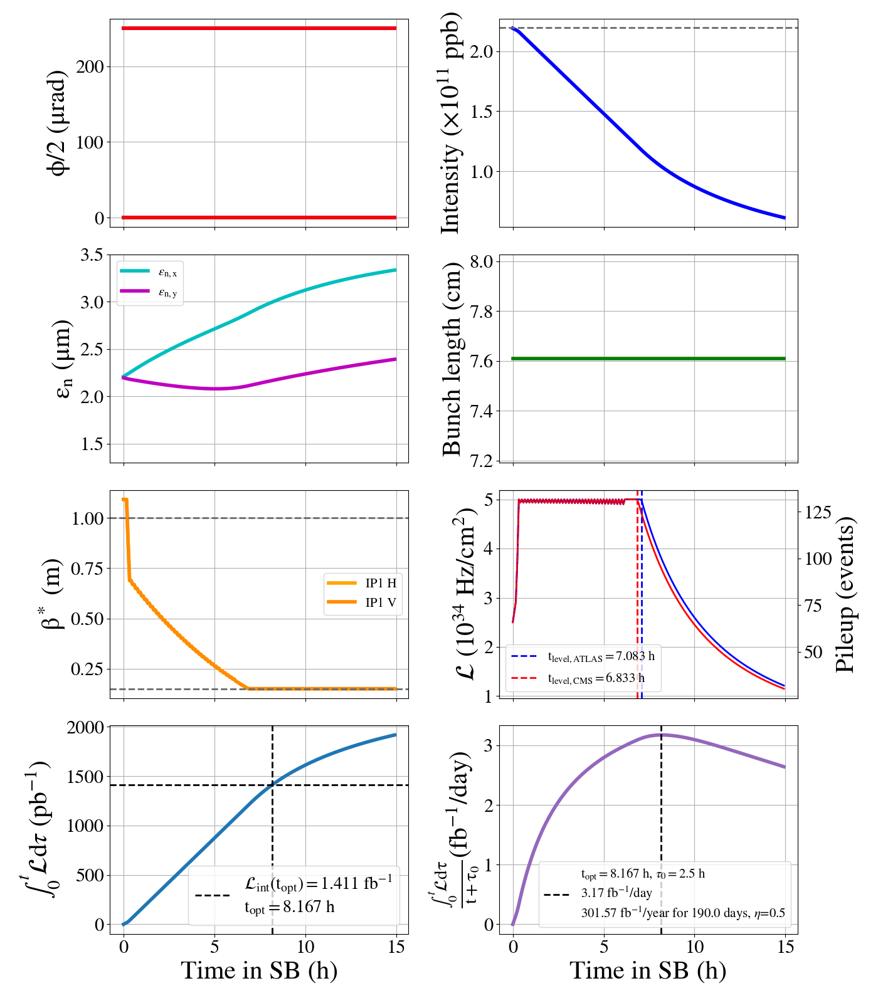
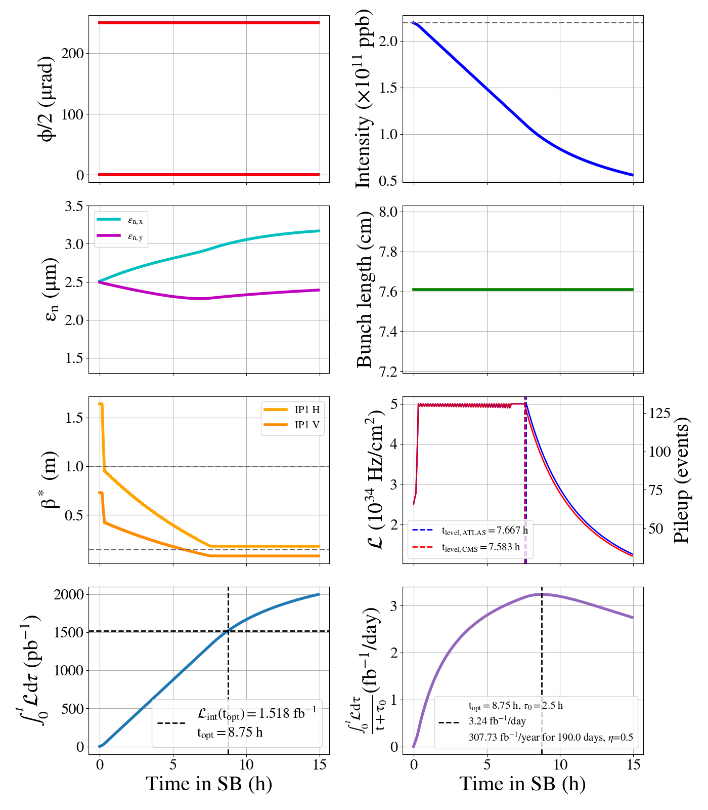
Leveling time & optimal fill length
Baseline
Round hybrid
Round BCMS
Flat 8/18 cm
Run 6 | Baseline | Round hybrid | Round BCMS | Flat 8/18 cm
Run 6 leveling time (h) | 6.7 | 6.5 | 6.8 | 7.5
Run 6 optimal fill length (h) | 8.1 | 8 | 8.2 | 8.8
Yearly integrated lumi (fb-1) | 269.1 | 240.9 | 270.9 | 277
For Run 4, reaching 15 cm instead of 20 cm results in 3.44% increase of integrated lumi per year

Slide 17
Yearly & total integrated luminosity
Run | Year | Baseline | Round hybrid | Round BCMS | Flat 8/18 cm | Vbaseline extended ions | Round hybrid extended ions | Round BCMS extended ions | Flat 8/18 cm extended ions
4 | 2029 | 9.6 | 9.1 | 10 | 9.6 | 9.6 | 9.1 | 10 | 9.6
 | 2030 | 208 | 186.1 | 210.7 | 208 | 208 | 186.1 | 210.7 | 208
 | 2031 | 238.8 | 213.4 | 241 | 254.1 | 238.8 | 213.4 | 241 | 254.1
 | 2032 | 235.7 | 210.7 | 237.9 | 250.8 | 235.7 | 210.7 | 237.9 | 250.8
5 | 2035 | 248.5 | 222.6 | 250.2 | 256 | 213.8 | 191.6 | 215.3 | 220.3
 | 2036 | 311.7 | 278.6 | 313.7 | 320.5 | 275.4 | 246.2 | 277.2 | 283.2
 | 2037 | 316.4 | 282.9 | 318.4 | 325.3 | 280.1 | 250.5 | 281.9 | 288.1
 | 2038 | 316.4 | 282.9 | 318.4 | 325.3 | 280.1 | 250.5 | 281.9 | 288.1
6 | 2040 | 269.1 | 240.9 | 270.9 | 277 | 213.2 | 207.1 | 232.8 | 238.1
 | 2041 | 324.3 | 289.9 | 326.4 | 333.4 | 286.5 | 256.1 | 288.3 | 294.6
Total (fb⁻¹) |  | 2478.5 | 2217 | 2497.7 | 2560 | 2259.2 | 2021.2 | 2277.1 | 2334.9

Slide 18
Realtive yearly & total integrated luminosity
Run | Year | Baseline (fb-¹) | Round hybrid | Round BCMS | Flat 8/18 cm | Vbaseline extended ions | Round hybrid extended ions | Round BCMS extended ions | Flat 8/18 cm extended ions
4 | 2029 | 9.6 | -5.21% | 4.17% | 0% | 0% | -5.21% | 4.17% | 0%
 | 2030 | 208 | -10.53% | 1.30% | 0% | 0% | -10.53% | 1.30% | 0%
 | 2031 | 238.8 | -10.64% | 0.92% | 6.41% | 0% | -10.64% | 0.92% | 6.41%
 | 2032 | 235.7 | -10.61% | 0.93% | 6.41% | 0% | -10.61% | 0.93% | 6.41%
5 | 2035 | 248.5 | -10.42% | 0.68% | 3.02% | -13.96% | -22.90% | -13.36% | -11.34%
 | 2036 | 311.7 | -10.62% | 0.64% | 2.82% | -11.65% | -21.02% | -11.07% | -9.14%
 | 2037 | 316.4 | -10.58% | 0.63% | 2.81% | -11.48% | -20.83% | -10.90% | -8.94%
 | 2038 | 316.4 | -10.58% | 0.63% | 2.81% | -11.48% | -20.83% | -10.90% | -8.94%
6 | 2040 | 269.1 | -10.48% | 0.67% | 2.94% | -20.78% | -23.04% | -13.49% | -11.52%
 | 2041 | 324.3 | -10.60% | 0.65% | 2.81% | -11.66% | -21.03% | -11.10% | -9.15%
 |  | 2478.5 | -10.55% | 0.77% | 3.28% | -8.85% | -18.45% | -8.13% | -5.79%
Reaching 15 cm in Run 4 results in 3.44% increase of integrated lumi per year
Slight increase with BCMS (+1%) for HL-LHC
+3% gain with flat optics
-9% if ion runs beyond Run 4
-10% with hybrid, -19% if hybrid + ion runs beyond Run 4
Loss of performance due to ion runs beyond Run 4 can be partially mitigated with flat optics

Slide 19
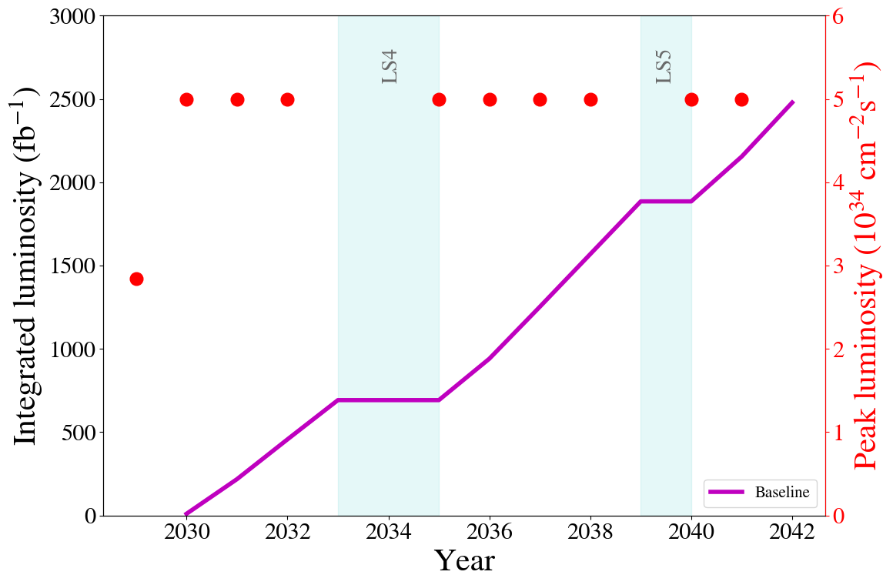
Summary

Slide 20
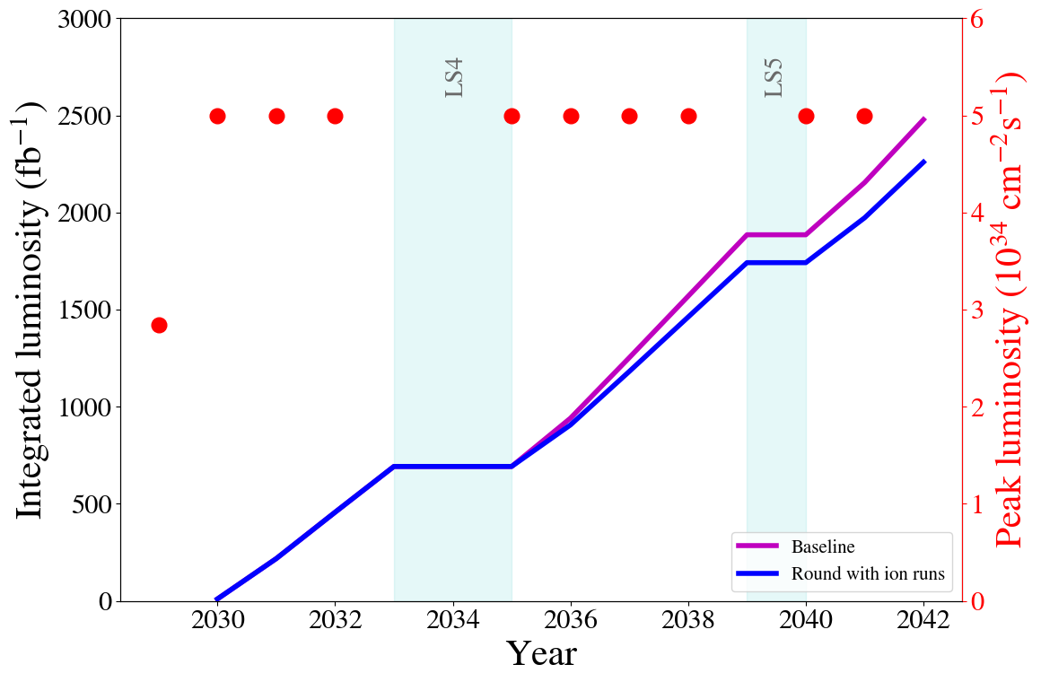
Summary

Slide 21
Backup slides

Slide 22
Variations
Run | Year | Efficiency | Bunch intensity (1e11 ppb) | β_{x}* (cm) | β_{y}* (cm) | CC | PU_{max} | Days Intensity ramp-up | Days Proton physics [1] | # colliding IP1/5 bunches [2] | # colliding IP8 bunches | Emit start of SB (μm) | IP1/5 crossing plane | IP1/5 φ/2 (μrad) | LHCb L_{peak} (1e33 Hz/cm²) [3]
4 | 2029 | 0.5 | 1.8 | 30 | 30 | off | 101 | 20 | 6 | 2748 | 2574 | 2.5 | H/V | 250 | 2
 | 2030 | 0.5 | 2.2 | 25 | 25 | on | 132 | 15 | 136 | 2748 | 2574 | 2.5 | H/V | 250 | 2
 | 2031 | 0.5 | 2.2 | 20 | 20 | on | 132 | 10 | 154 | 2748 | 2574 | 2.5 | H/V | 250 | 2
 | 2032 | 0.5 | 2.2 | 20→ 15 | 20 → 15 | on | 132 | 10 | 152 | 2748 | 2574 | 2.5 | H/V | 250 | 2
5 | 2035 | 0.5 | 2.2 | 15 | 15 | on | 132 | 15 | 152 | 2748 | 2574 | 2.5 | H/V | 250 | 2
 | 2036 | 0.5 | 2.2 | 15 | 15 | on | 132 | 10 | 195 | 2748 | 2574 | 2.5 | H/V | 250 | 2
 | 2037 | 0.5 | 2.2 | 15 | 15 | on | 132 | 10 | 198 | 2748 | 2574 | 2.5 | H/V | 250 | 2
 | 2038 | 0.5 | 2.2 | 15 | 15 | on | 132 | 10 | 198 | 2748 | 2574 | 2.5 | H/V | 250 | 2
6 | 2040 | 0.5 | 2.2 | 15 | 15 | on | 132 | 15 | 165 | 2748 | 2574 | 2.5 | H/V | 250 | 2
 | 2041 | 0.5 | 2.2 | 15 | 15 | on | 132 | 10 | 203 | 2748 | 2574 | 2.5 | H/V | 250 | 2
”Round Run4 20 cm”→ “Round Run4 15cm”

