Slide 1

ARC cryogenic capacity in the HL-LHC era
Benjamin Bradu
(TE-CRG)
228th HiLumi WP2 Meeting – 02/07/2024

Slide 2
Content
Cryo infrastructures evolutions for HL-LHC
Consequences for the ARC beam screen cryo capacities
What will happen after LS3 for LHC cryogenics ?
BST project
Conclusion

Slide 3
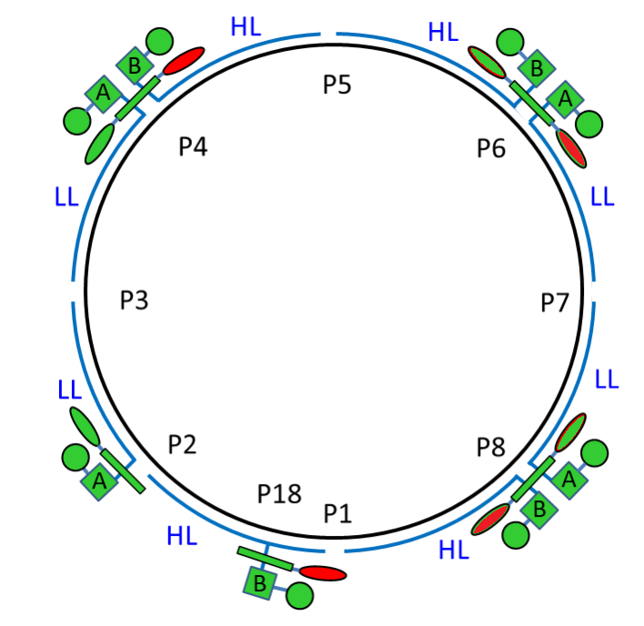
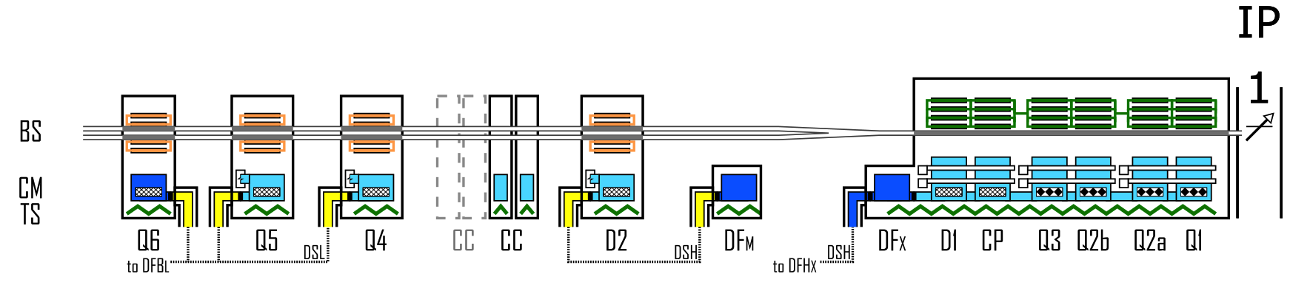
Cryo infrastructures evolutions for HL-LHC (reminder)
Non Hilumi sectors (LL) : S23, S34, S67, S78
  No changes in cryogenics infrastructures (cryoplants “A” )
  PS: the cryoplant “A” for S34 was already upgraded during LS2 for HiLumi
Hilumi sectors (HL) : S12, S45, S56, S81
  Existing cryo infrastructures (cryoplants “B”) remains but…
  The IT + DFBX + D2 + associated QRL removed until Q4
  ➔ capacity recovery in the existing cryoplants “B” !
  2 new cryoplants at P1/P5 will be installed
    Will manage the future IT+CP+D1+DFX+DFM+D2+CC
    (not discussed in this presentation)
New cryoplant
LHC cryogenics today
Remain attached
to existing cryoplants “B”
Handled by
new cryoplants
New cryoplant

Slide 4
Consequences for the ARC cryo capacities
LHC cryoplants are supplying many devices in parallel at different temperatures
  Thermal shields between 50 K and 75 K
  Main superconducting magnets at 1.9 K (ARC dipoles/quadrupoles)
  Stand Alone superconducting magnets at 4.5 K (D3, Q4, Q5, Q6)
  RF cavities at 4.5 K (at P4 only)
  DFB at 4.5 K with their current leads and superconducting links
  Inner Triplet (IT) at 1.9 K around experiments (dynamic heat loads, depending on luminosity)
  Beam Screens (BS) between 4.5 K and 20 K (dynamic heat loads, depending on beams – sync rad + impedance + ecloud)
Changes for HL-LHC:
The available ARC beam screen cryogenic capacities will slightly increase in HL sectors !
No changes expected
for HL-LHC
Beam Screen heat loads
Up to 5 kW
(25%)
IT heat loads
~1 kW (5%)
1 Cryoplant capacity
~18 kW @ 4.5 K
Basic
Heat loads
~12 kW
(70%)
Expected changes in HL-LHC | Helium massflow | Q @ 1.9 K [per sector] | BS Capa 4.5 K - 20 K [per ARC] | BS Capa 4.5 K - 20 K [per half-cell of 53m] | Concerned sectors
Removal of IT/D1 at P1 & P5 in LS3 | -12 g/s | -280 W | +1.3 kW | +25 W/hc | S12, S81, S45, S56

Slide 5
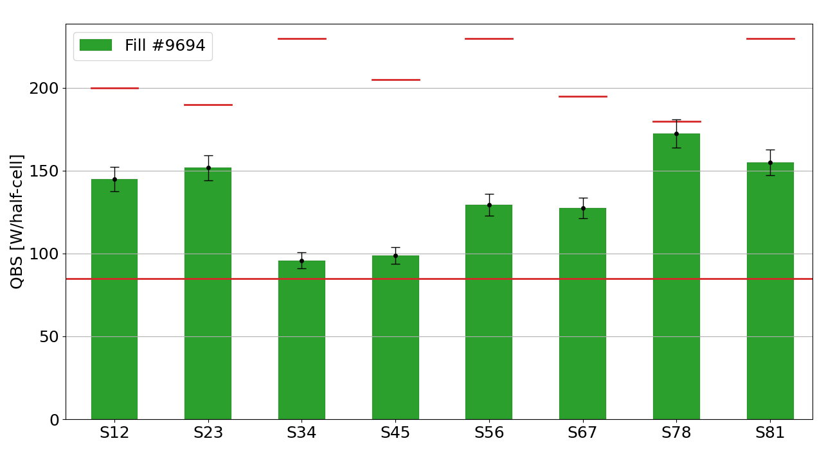
Where are we today (2024) ?
Beam Screen cryogenic heat load averages in each ARC measured during fill #9694
  31st May 2024 with 2352 bunches @ 1.62e11 ppb (3x36b scheme)
Cryogenics is running at its ultimate limit in S78
  BS heat loads are in average more than twice higher than expected
Cryo Beam Screen
capacities for the Run 3
LHC Design Report
=85 W/hc
PS: All LHC cryoplants are slightly different and have different capacities & loads (RF, SAM, DFB, triplets, etc.)

Slide 6
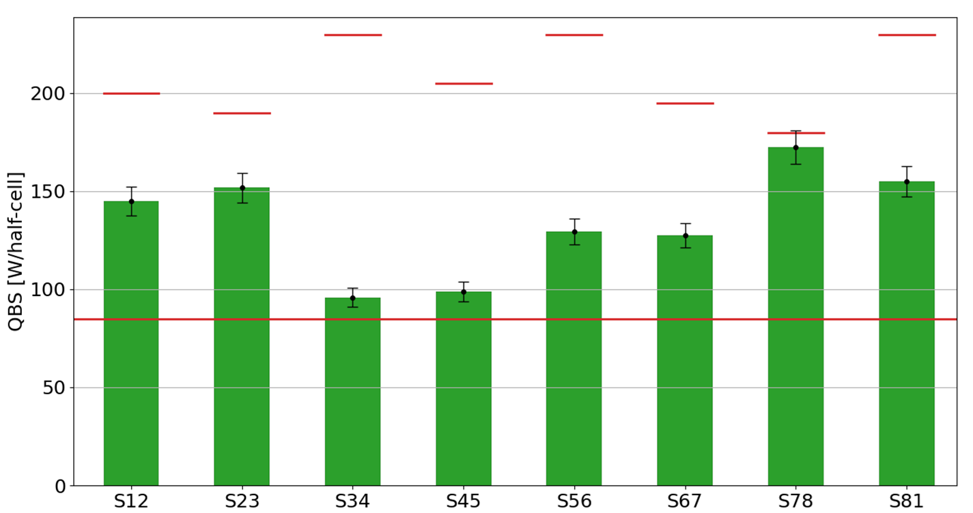
What will happen after LS3 ?
ARC Beam screen capacities will increase in HL sectors by +25 W/hc (IT/D1 removal)
ARC beam screen heat loads will increase due to the HL-LHC beams
(depending on filling schemes and intensities)
+ 25W/hc
+ 25W/hc
+ 25W/hc
+ 25W/hc
+ ???
+ ???
+ ???
+ ???
+ ???
+ ???
+ ???
+ ???
LHC DR
=85 W/hc

Slide 7
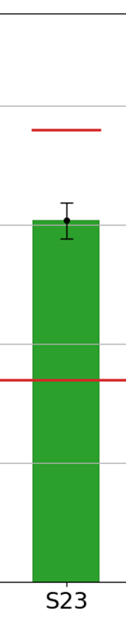
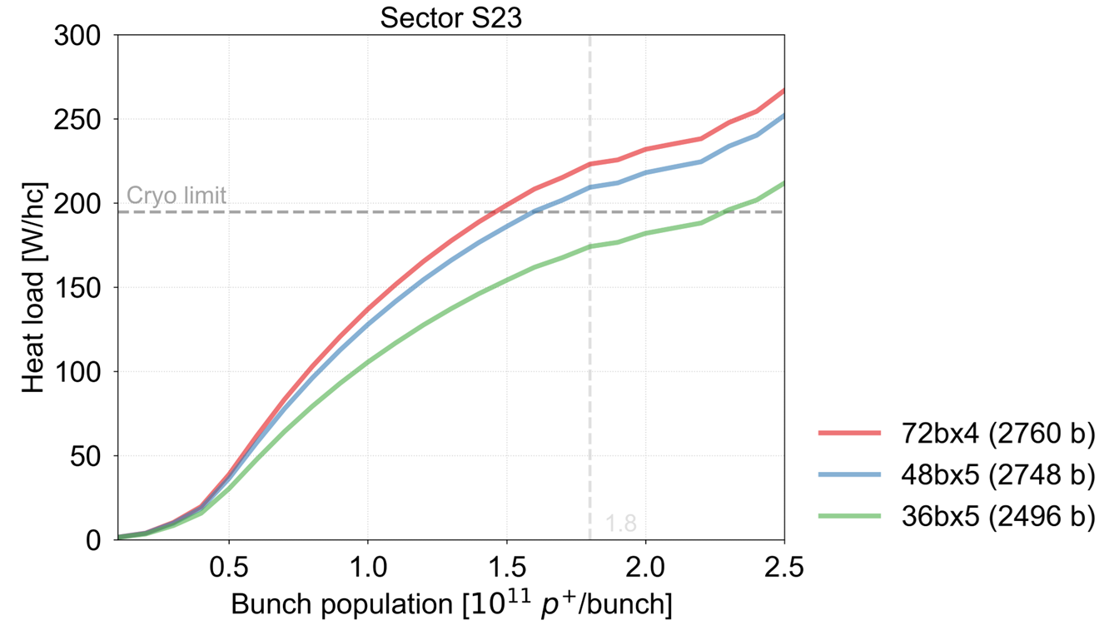
HL-LHC beam screen heat load forecast
E-cloud simulations done by BE-ABP and presented in Chamonix 2023 by Lotta Mether
  Assuming no BS treatment and no more beam screen surface degradation during LS3
  (optimistic scenario)
Additional ARC beam screen heat load expected
with HL-LHC beams
➔ Does not work !
S23 capacity
=180 W/hc
(no change)
HL-LHC forecast (48bx5)
➔ 240 W/hc
LHC DR
=85 W/hc
Fill #9694
(2024 measure in 36bx3)
2.3

Slide 8
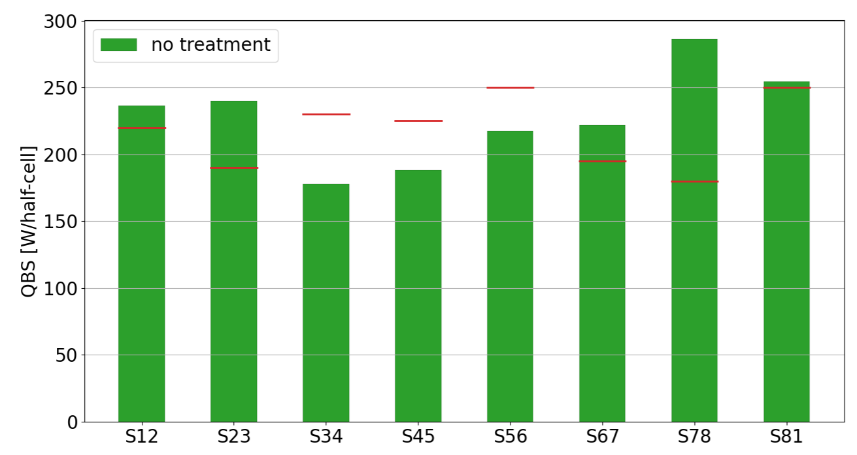
The same exercise was achieved for each sector
➔ Impossible to operate HL-LHC with the forecast beams due to the extra heat loads generated by the e-clouds
☹
☹
☹
☺
☹
☹
☹
☹
☺
☺
☹
LHC DR
=85 W/hc

Slide 9
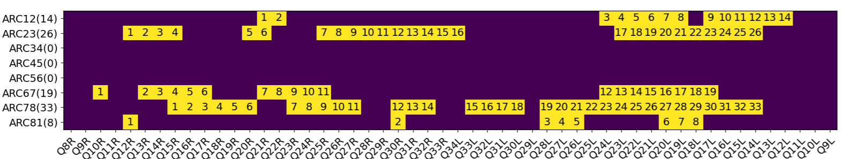
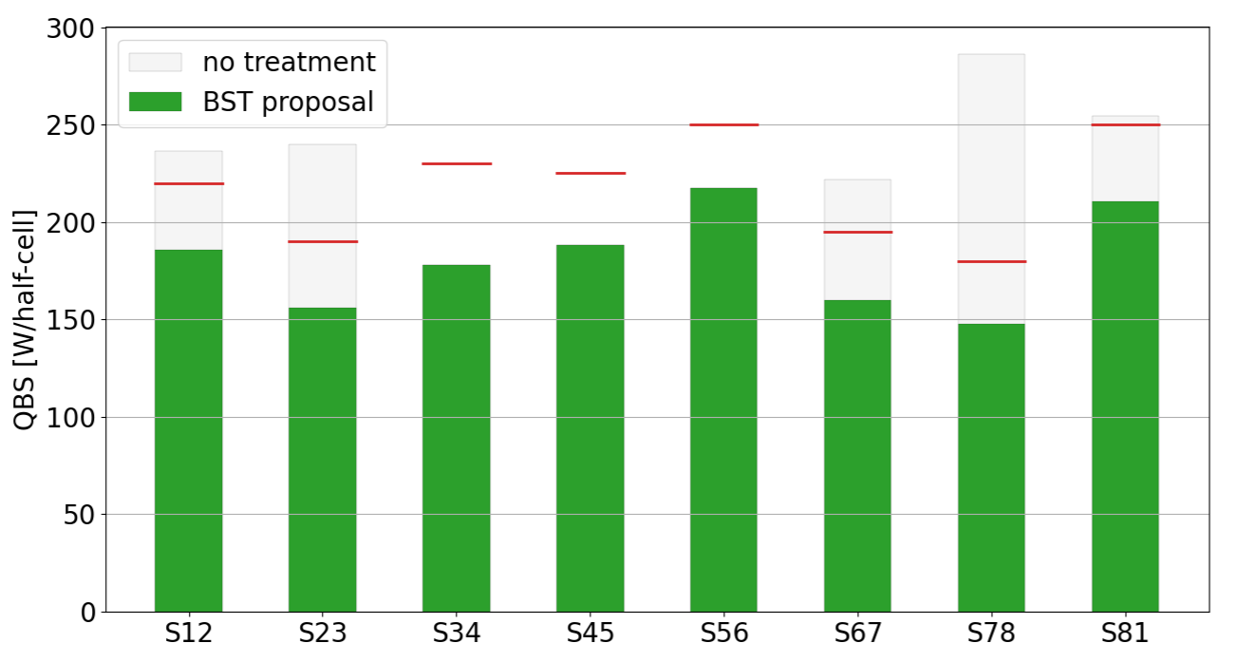
Proposed solution: Beam Screen Treatment (BST)
Deposit a thin Amorphous Carbon over the BS surface to reduce the e-clouds heat loads (in situ)
Project managed by TE-VSC (G. Rosaz)
Objective is to treat 100 half-cells (2 x 5.3 km) of beam screens during the LS3
Sector margins after treatment if no more degradation: [34,34,52,37,33,35,32,40] W/hc
~15% margin in all sectors is mandatory due to the uncertainly on the treatment efficiency and on potential further BS surface degradations during LS3

Slide 10
Conclusion
LHC cryogenics infrastructures will remain the same for the ARC cooling in the HL-LHC era
  The cryogenic BS capacities for the ARC will slightly increase after LS3 in the HL sectors
  (~ +10%) due to the removal of the IT+D1 around P1 & P5 from the existing cryoplants
Nevertheless, the HL-LHC beams will induce up to +150% of heat loads on beam screens due to the e-clouds ➔ not manageable by cryo, 5/8 sectors will be above the ultimate limits !
Solutions consists in “treating” 2x5 km of beam screens during LS3 to reduce the e-clouds (carbon coating)
  BST project under study/preparation by TE-VSC, already included in LS3 planning
  This solution would allow to restore enough cryo margin in all ARC for HL-LHC beams
Reducing the e-cloud heat loads handled by the existing LHC cryogenic infrastructures is essential to operate the HL-LHC properly, this is not an option.

