Slide 1

ᑐ ᑌ ᑎ ᕮ
Supernova Pointing
Background Study Update
Harry Akins 02/07/2024

Slide 2
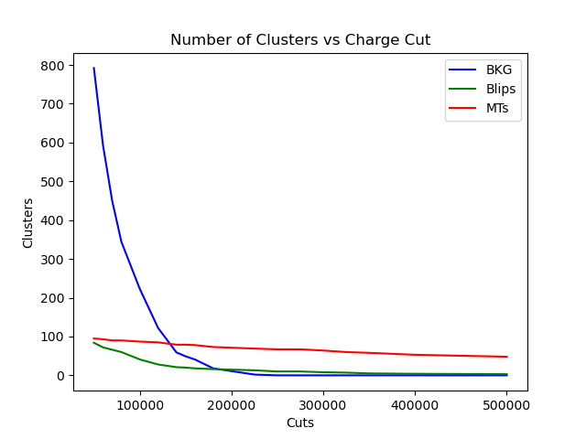
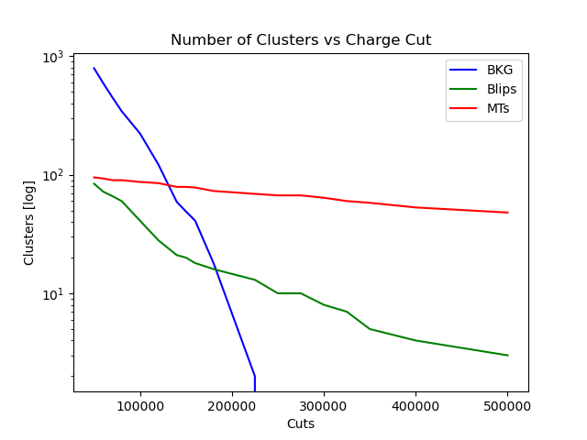

Benchmark Dataset used For Model Testing

Slide 3
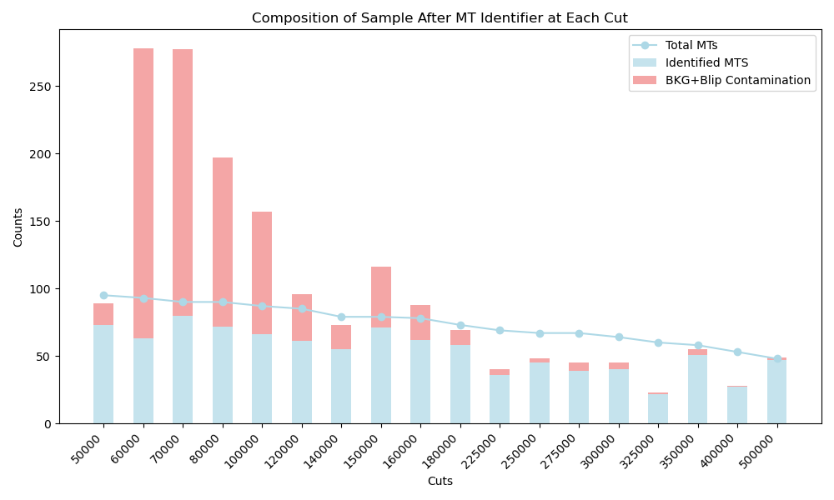
Many models trained using adc-cut data
Now using benchmark dataset to test each model
To the right, benchmark data is cut, then given to trained mt_identifier model
What is shown is the output of the model

Slide 4
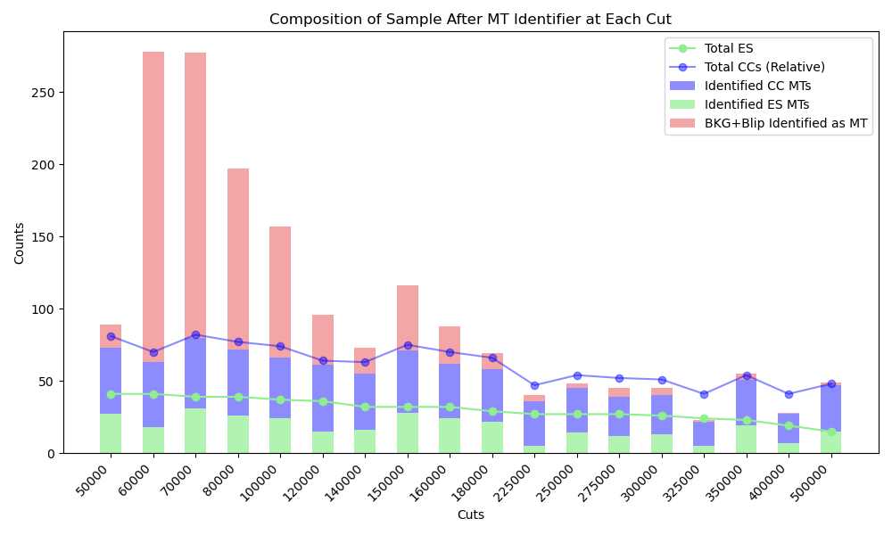
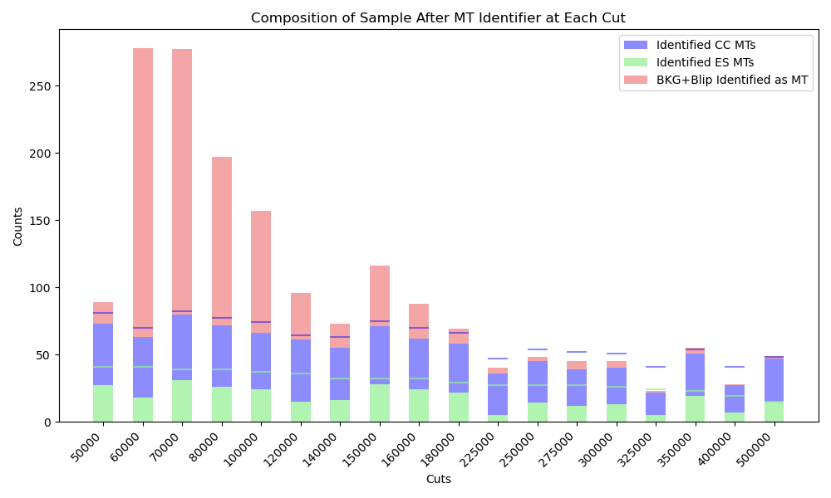
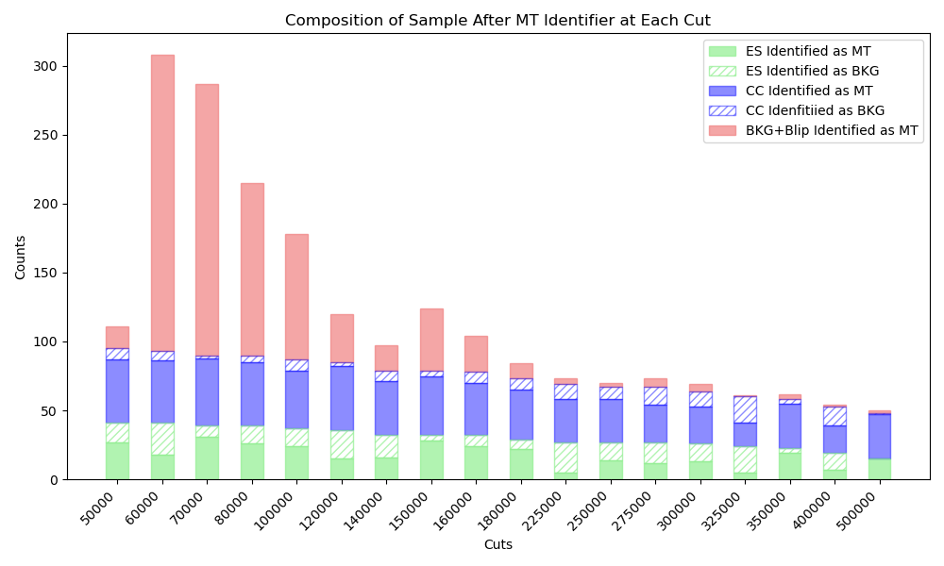

Slide 5
Total CCs are Relative

Slide 6
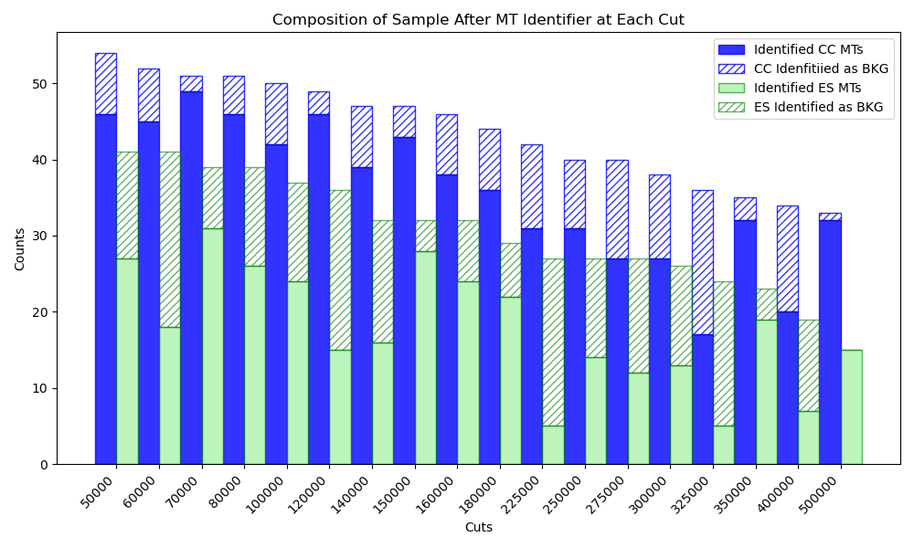
Closer look at ES and CC events

Slide 7
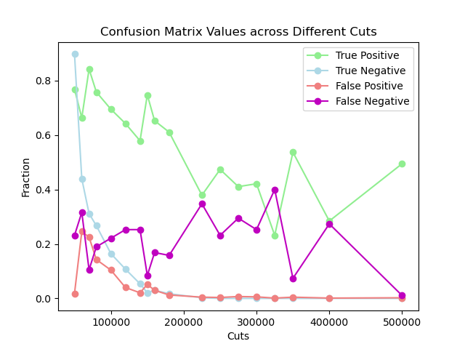
“Absolute” confusion matrix values
True Positive: (# MTs identified as MT) / (Total MTs at initial cut (50,000))
False Negative: (#MTs identified as Bkg) / (Total MTs at initial cut (50,000))
True Negative: (# Bkgs identified as bkg) / (Total bkg at initial cut (50,000))
False Positive: (# Bkgs identified as MT) / (Total bkg at initial cut (50,000))

Slide 8
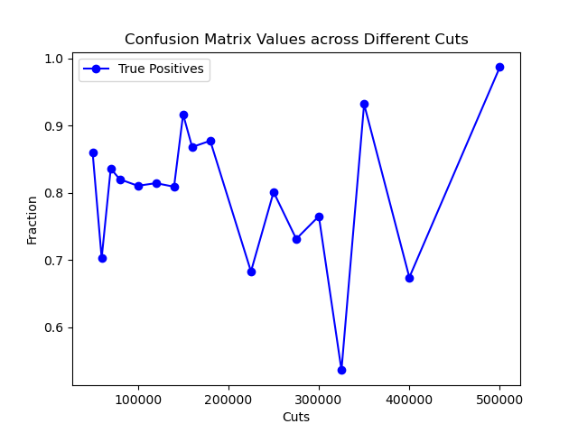
F1 Score

Slide 9
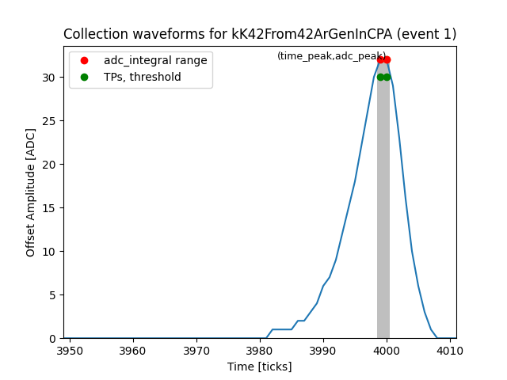
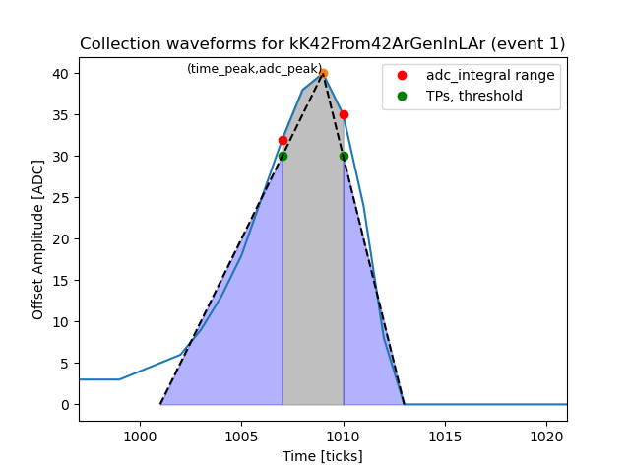
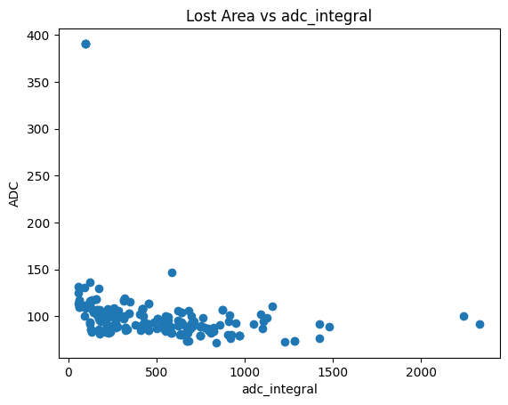
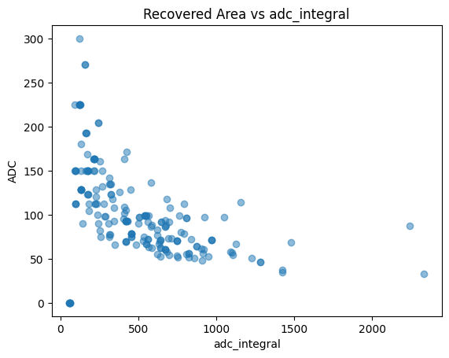

Slide 10
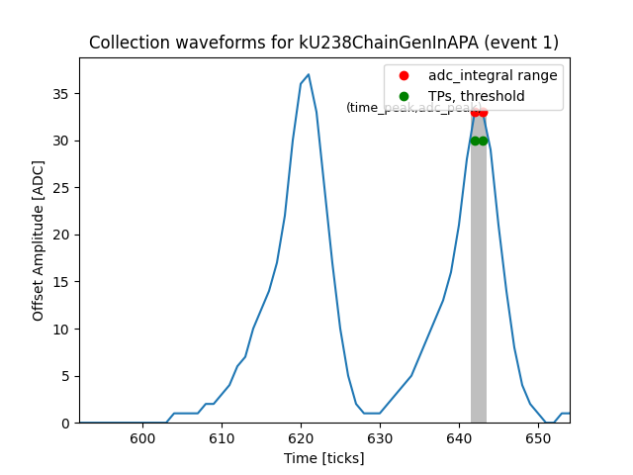
Outlier

Slide 11
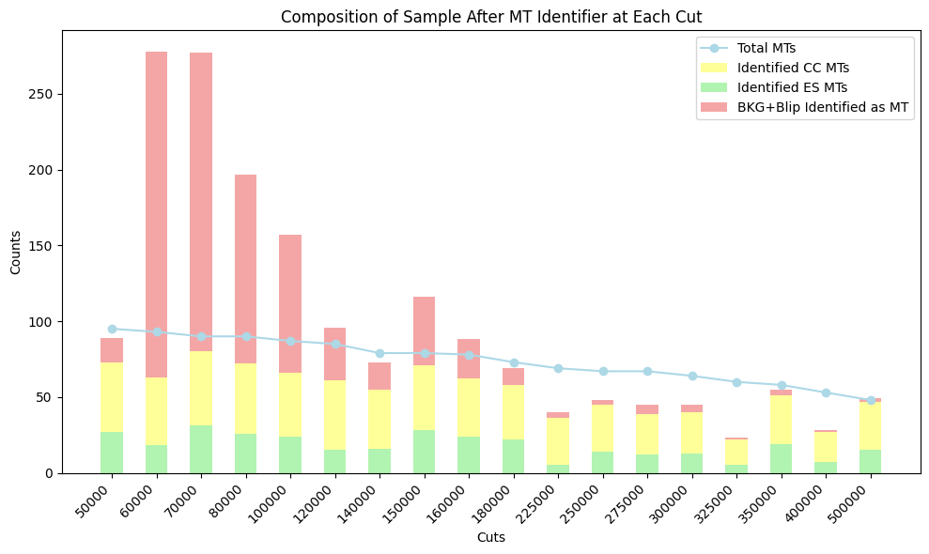
Extras

