Slide 1
Integration News
10.07.2024
F. Valchkova-Georgieva & Dieudonne Adrien Ngo'O Ella

Slide 2
  Integration topics:
  Integration of FCC-ee Arc-cell (ST1743700_01)
  Integration of Underground strucutre point A (ST1874371_01)
  Integration of Underground strucutre point L (ST1859242_01)

Slide 3
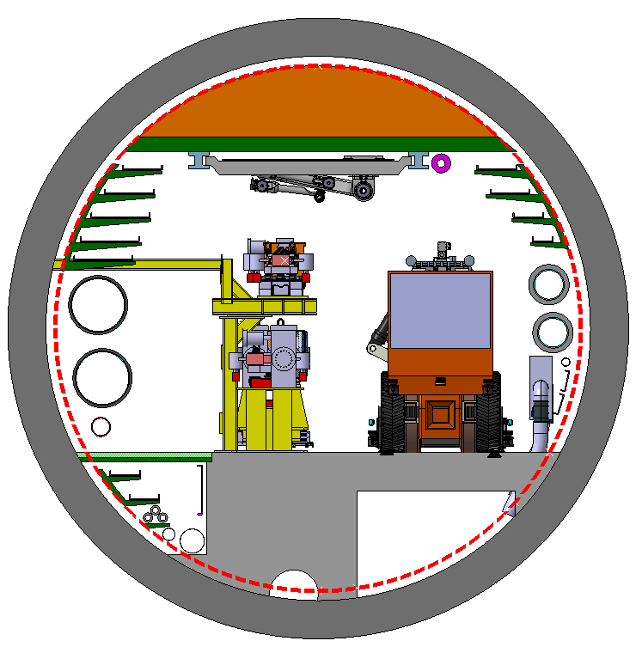
  Integration of FCC-ee machine elements (regular arc)
Machine tunnel 5.5m in diameter
He/Smoke extraction
5 DC Cable trays:
1x400mm
1x500mm
3x600mm
Leaky feed
4 Cable trays
Chilled water
DN300
Magnet vehicle
Transport space reservation
2.2m x 2.25m (LxH)
1030
Demineralized water
DN550
Compressed air
DN80
980
3 DC Cable trays:
2x 300mm
1x 500mm
Cable trays:
2x 200mm
HV Cable
Reject water
DN125
Raw water
DN250
Collider Center

Slide 4
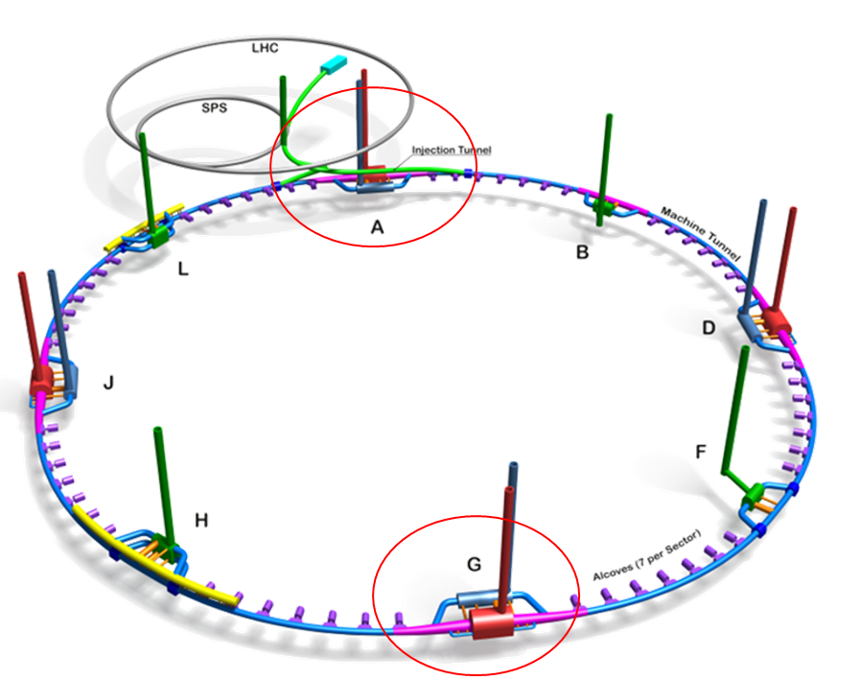
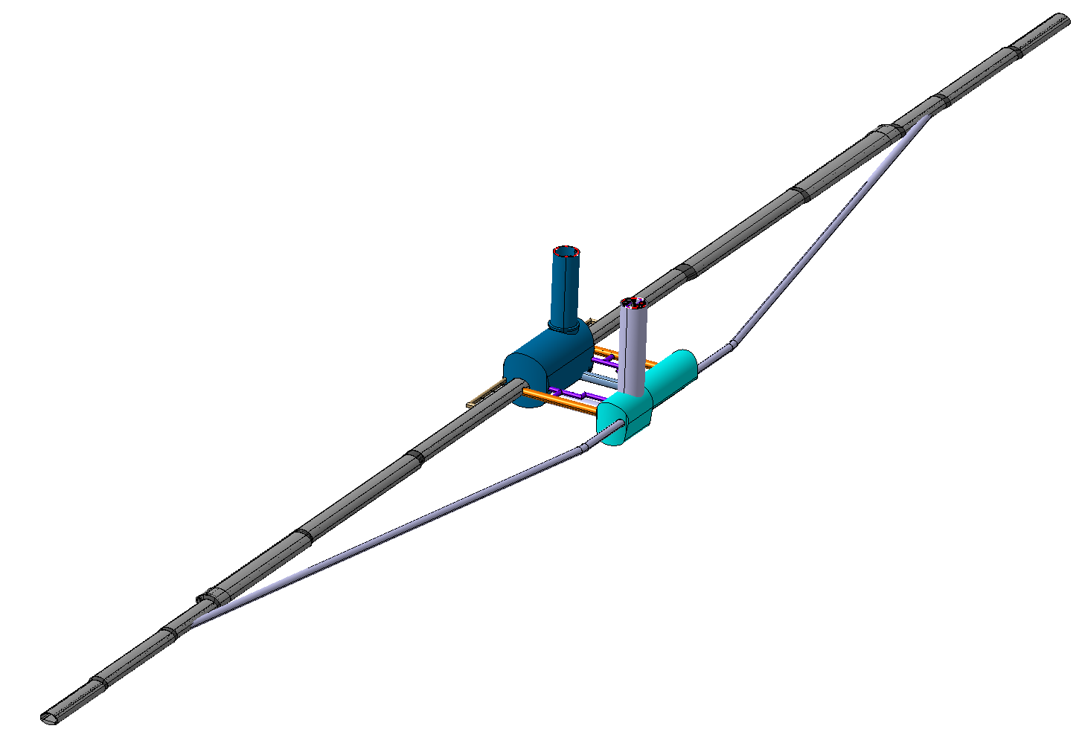
  FCC-ee Underground Structure at point A
2 x Evacuation
connection tunnel
Experimental Shaft ø18m
Experiment Cavern
Survey Gallery
Bypass tunnel ø 5.5m
Machine tunnel
Service Cavern
Connection tunnel ø 5.5m

Slide 5
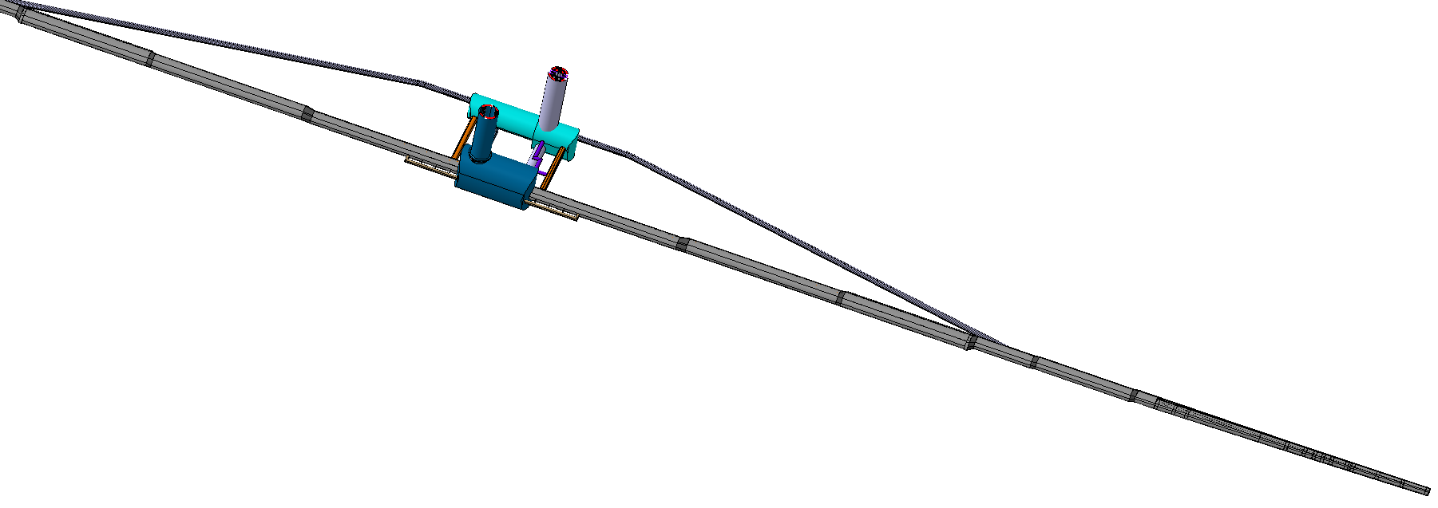
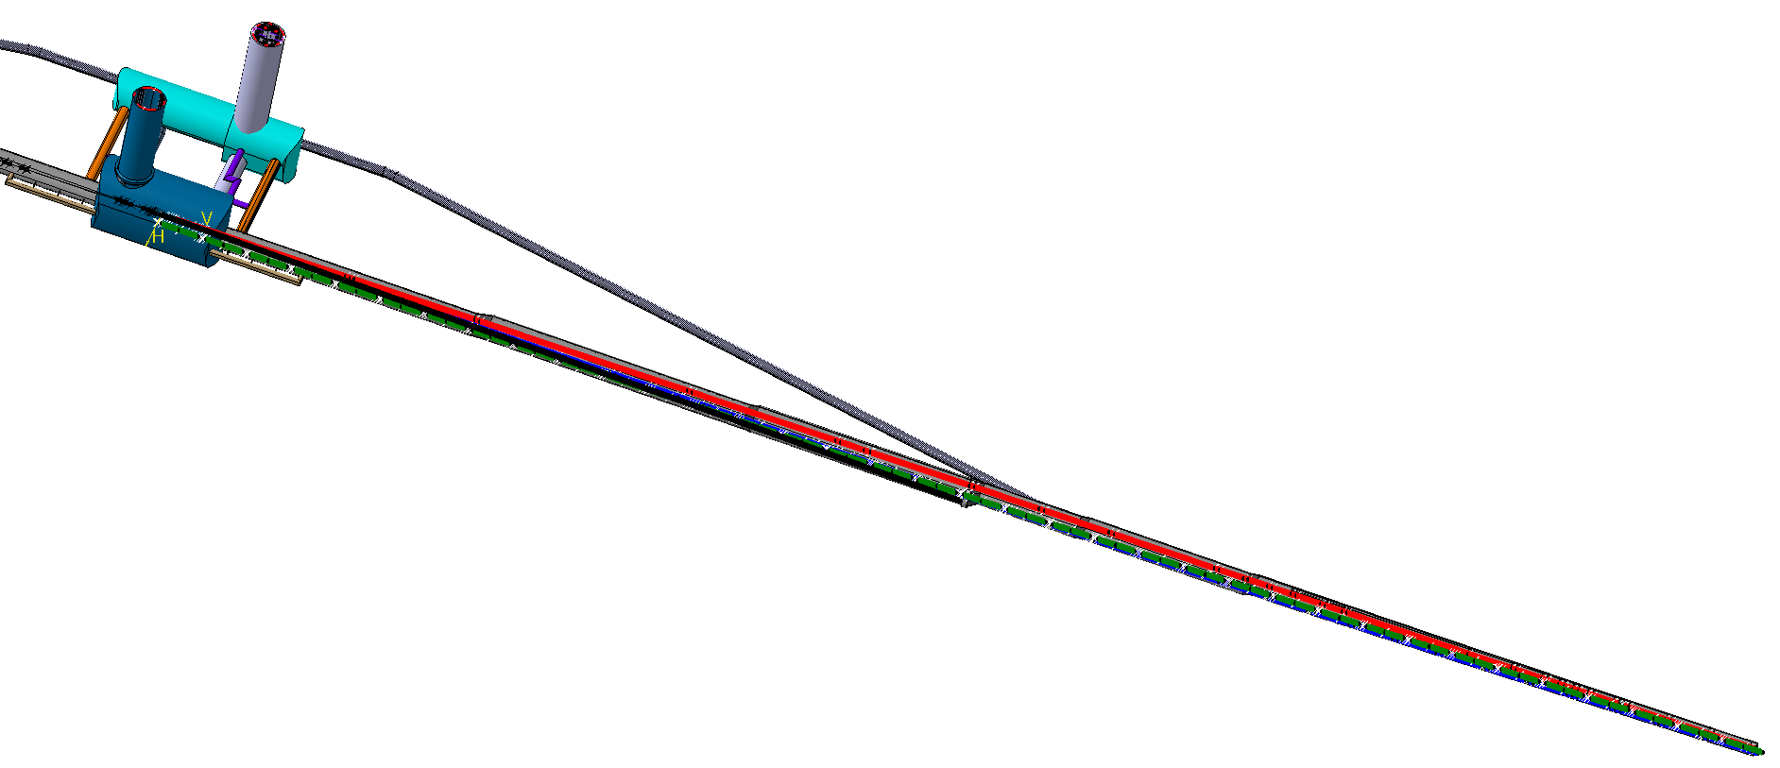
  FCC-ee Underground Structure at point A

Slide 6
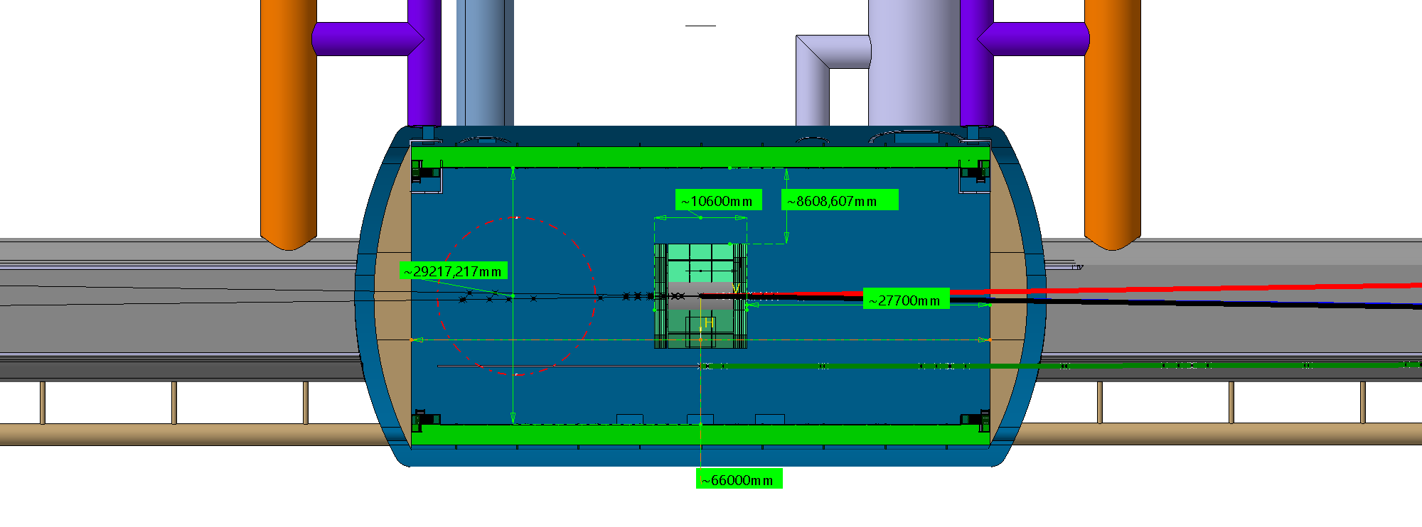
  FCC-ee integration study at point A

Slide 7
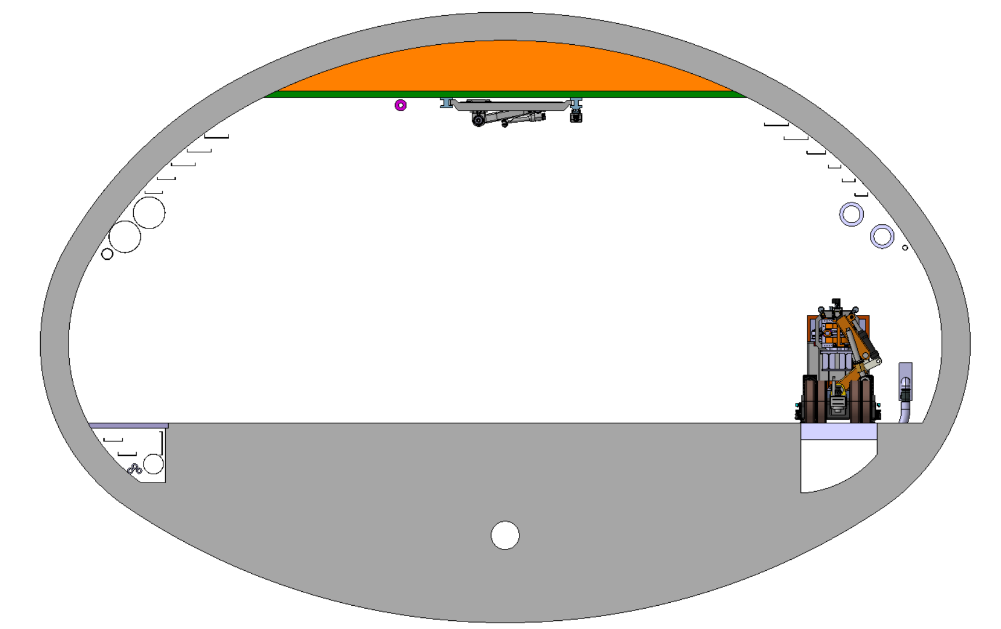
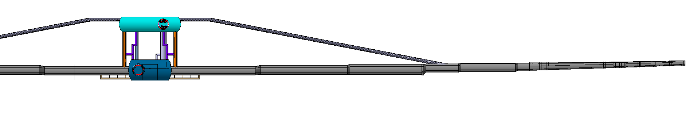
  FCC-ee integration study at point A
  Section 1
Beamstrahlung
5.73m
6160.7mm
3390.7mm
E+ ring
Booster ring
339.4mm
2.01m
0.98m
E- ring
14.8m
150m
948m

Slide 8
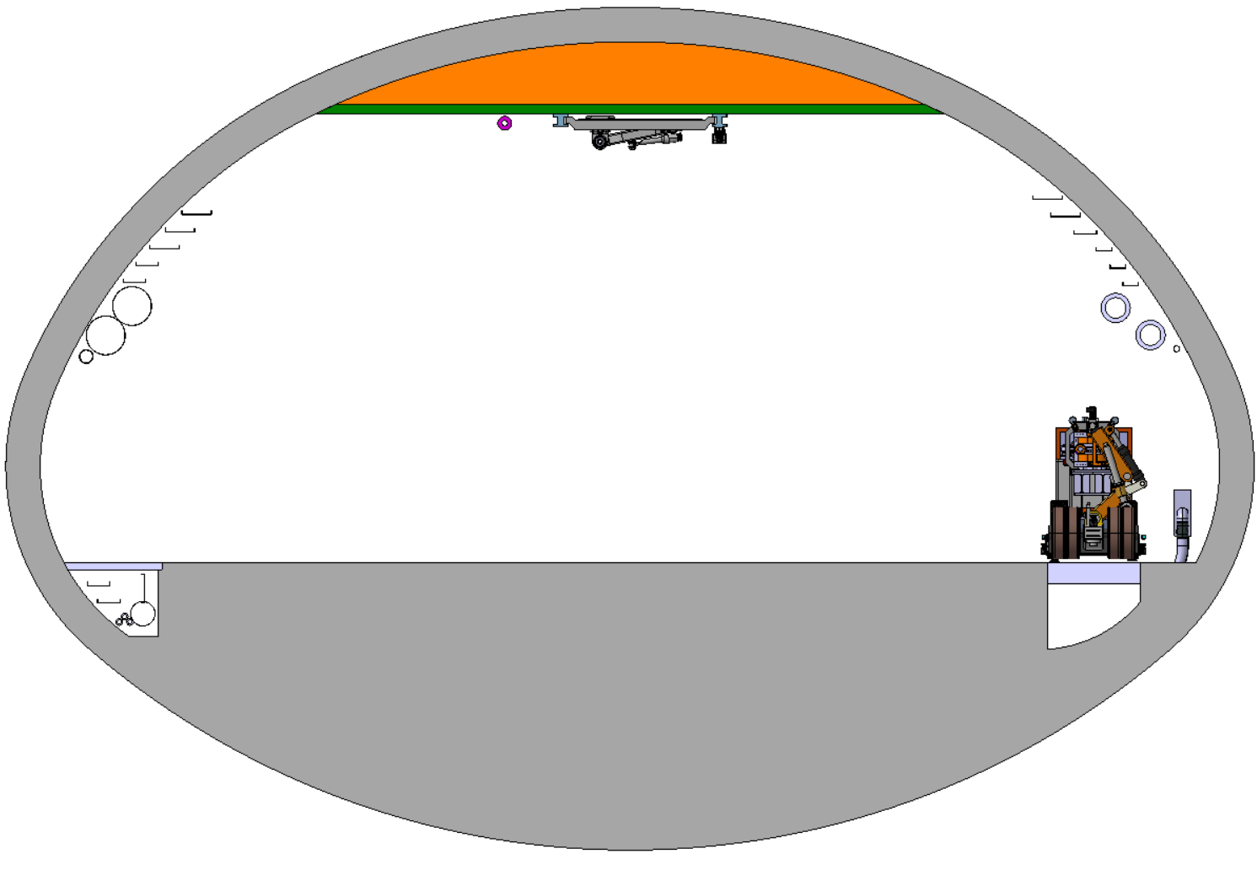
  FCC-ee integration study at point A
  Section 2
Beamstrahlung
6.51m
3467.5mm
7132mm
E+ ring
2603.2mm
Booster ring
2.01m
0.98m
E- ring
16.4m
10m
160m
948m

Slide 9
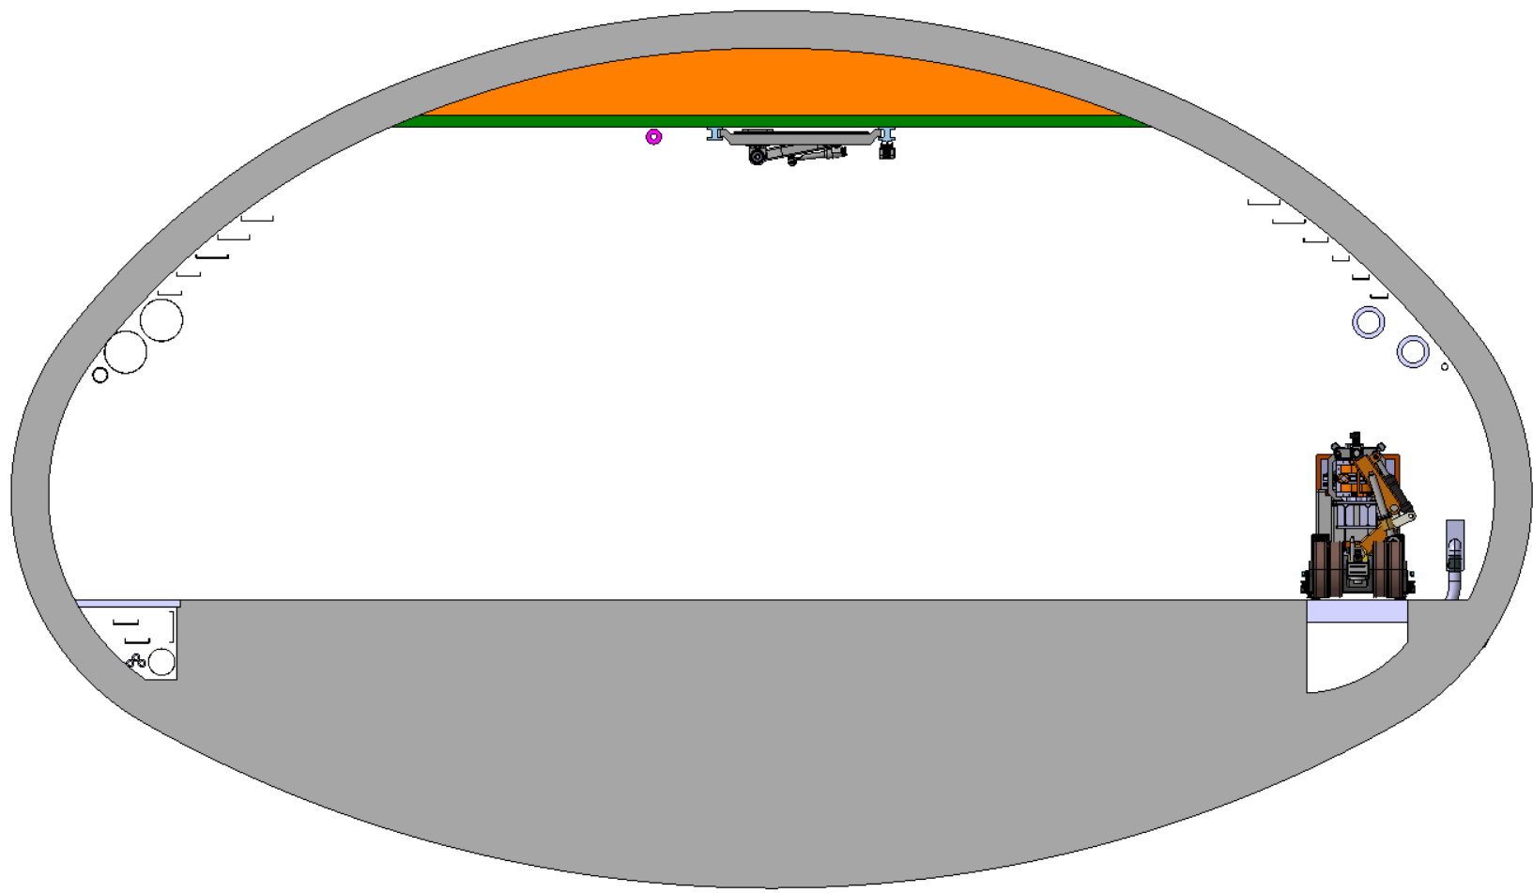
  FCC-ee integration study at point A
Beamstrahlung
  Section 3
1720mm
6.3m
8640mm
E+ ring
4340mm
Booster ring
0.98m
E- ring
18.6m
5m
132m
948m

Slide 10
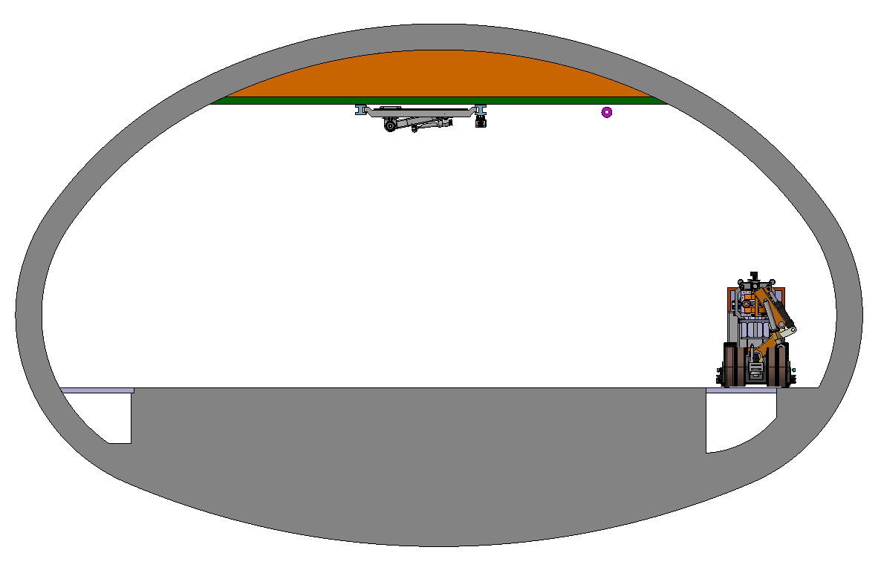
  FCC-ee integration study at point A
Booster ring
  Section 4
E+ ring
16mm
5.4m
9340mm
E- ring
0.98m
14.5m
5m
60m
948m

Slide 11
  FCC-ee integration study at point A
Booster ring
  Section 5
E+ ring
5.4m
8643mm
900mm
E- ring
0.98m
14.5m
5m
100m
948m

Slide 12
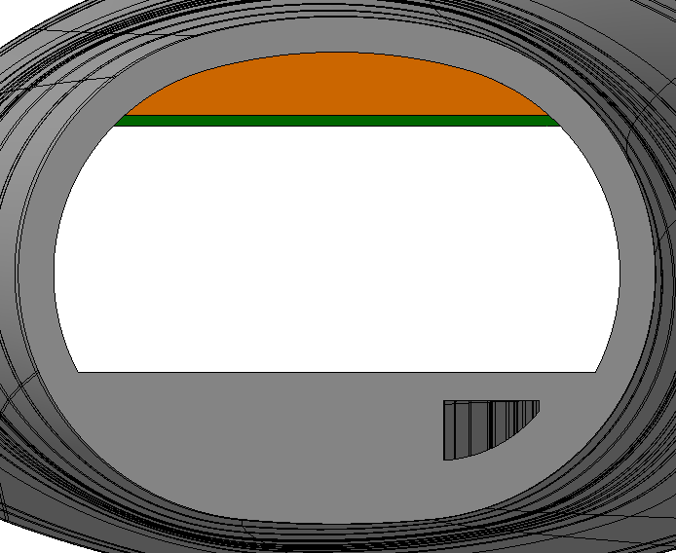
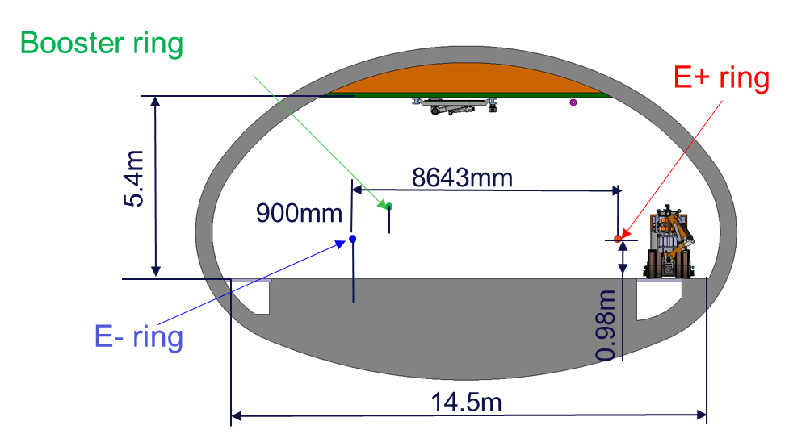
  FCC-ee integration study at point A
  Section 6
E+ ring
2518mm
3.5m
1853mm
E- ring
0.98m
7.3m
288m
948m

Slide 13
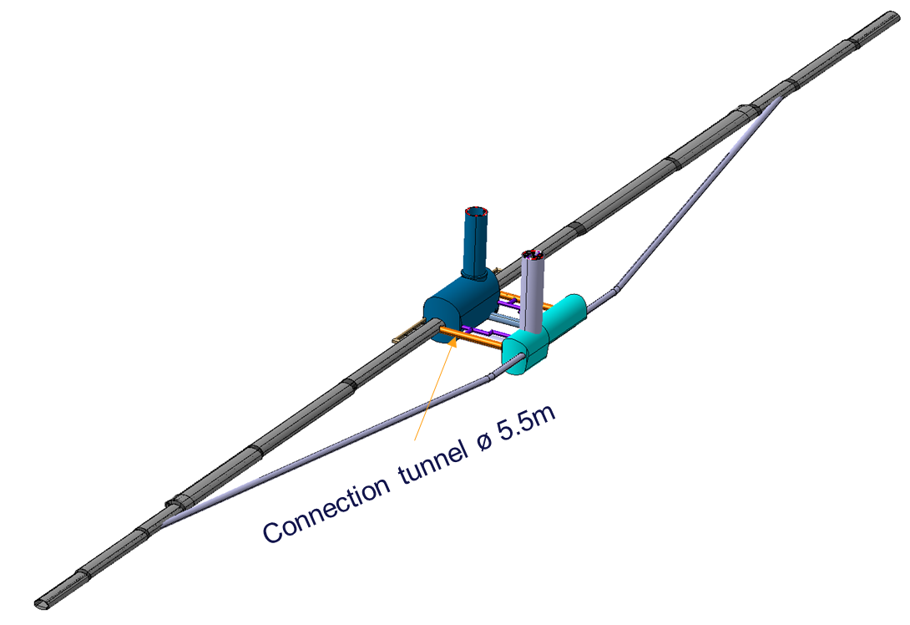
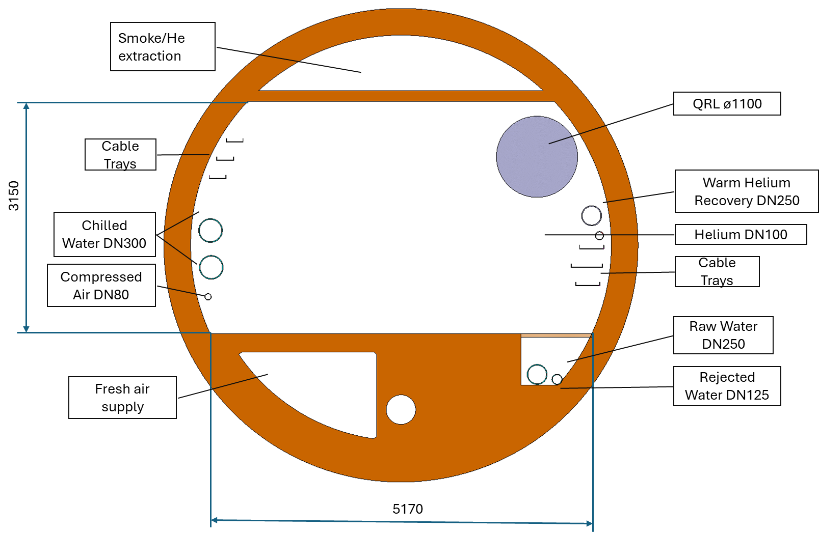
  FCC-ee Underground Structure at point A
Connection tunnel 5.5m in diameter

Slide 14
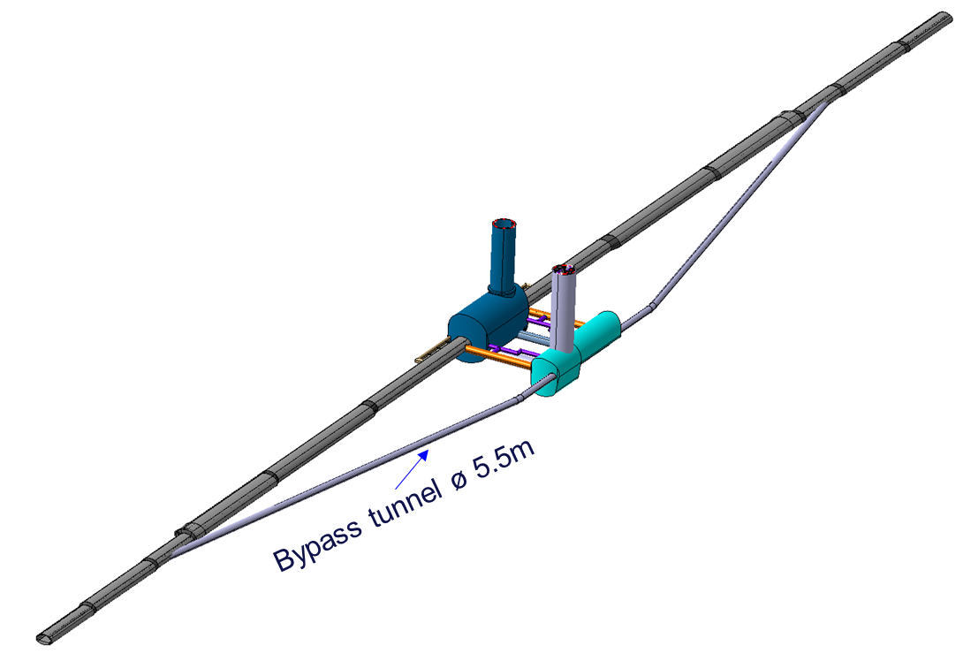
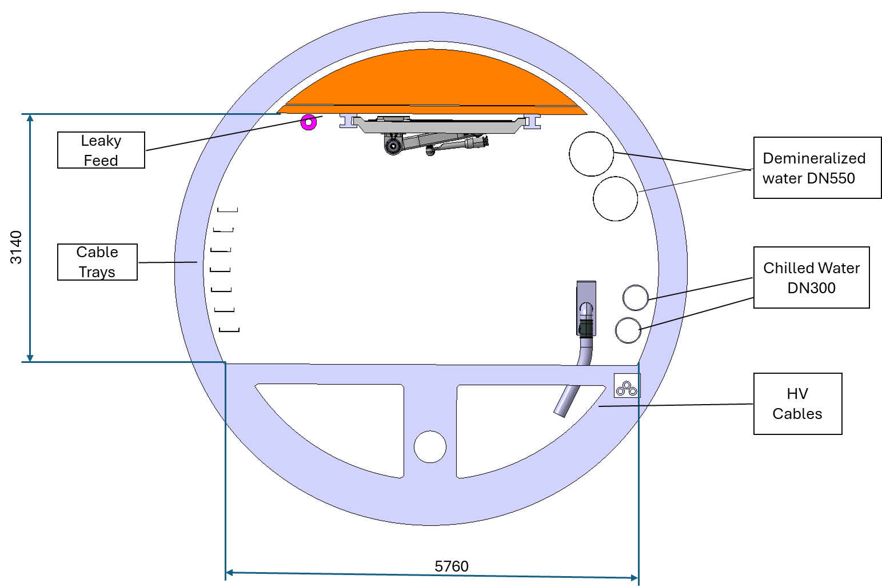
  FCC-ee Underground Structure at point A
Bypass tunnel 5.5m in diameter

Slide 15
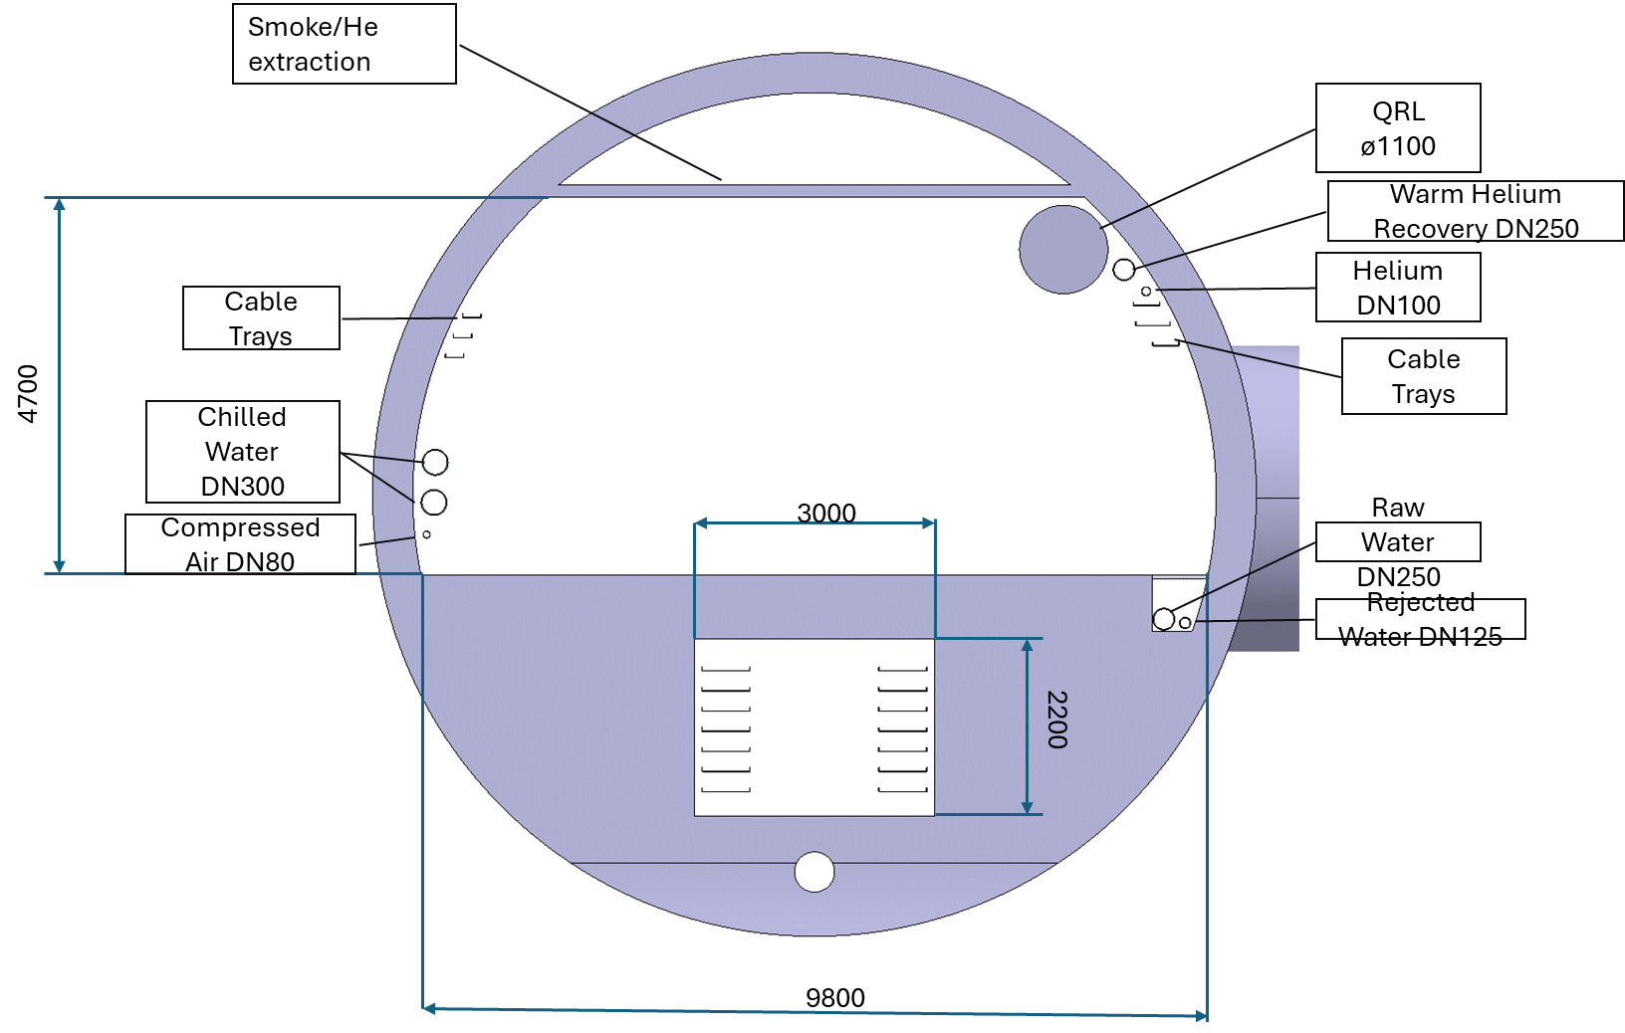
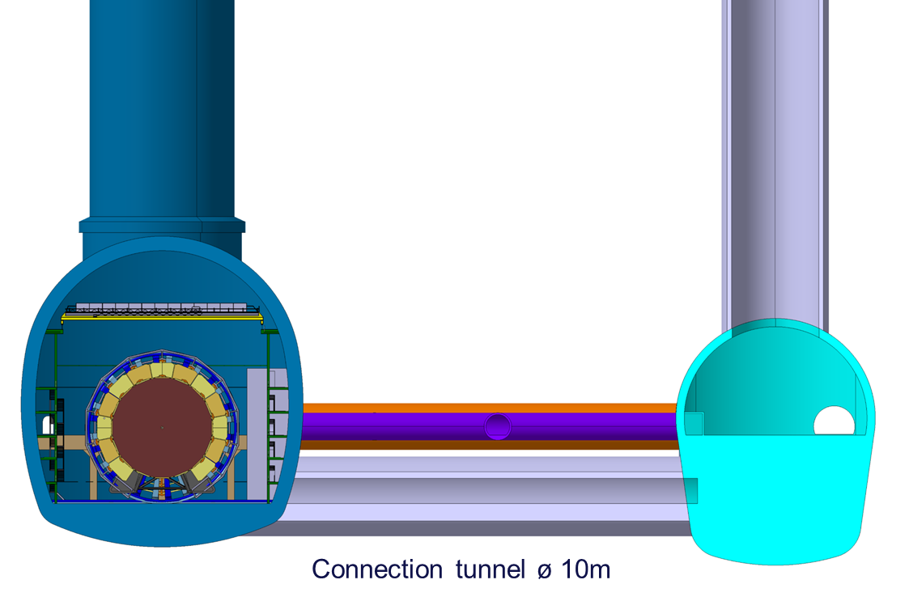
  FCC-ee Underground Structure at point A
Connection tunnel 10m in diameter

Slide 16
Thank you for your attention.
F. Valchkova-Georgieva
16

