Slide 1
Integration News
24.07.2024
F. Valchkova-Georgieva & Dieudonne Adrien Ngo'O Ella

Slide 2
  Integration topics:
  Integration of FCC-ee Big Alcove and Small Alcove
  Integration of Underground strucutre point L (ST1859242_01)

Slide 3
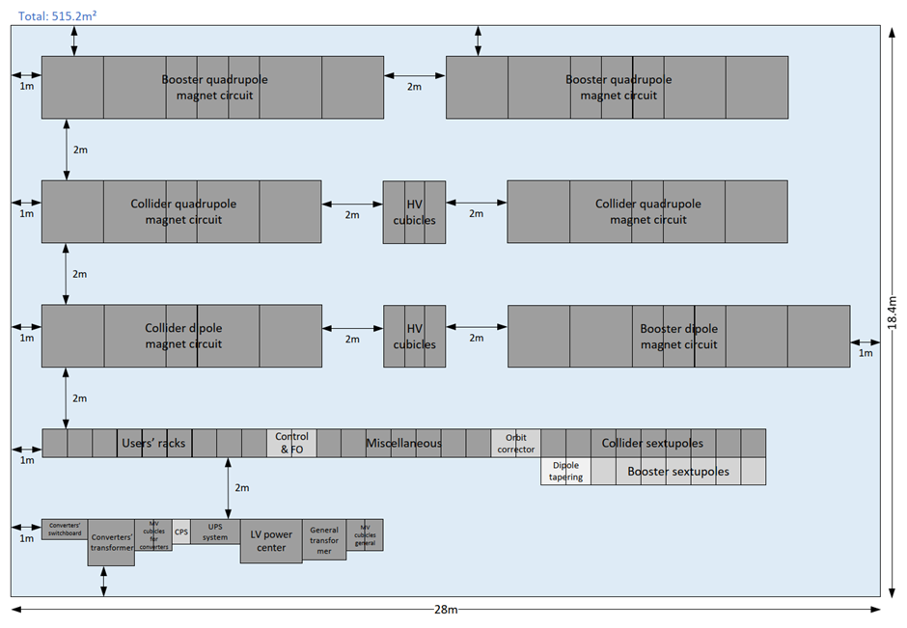
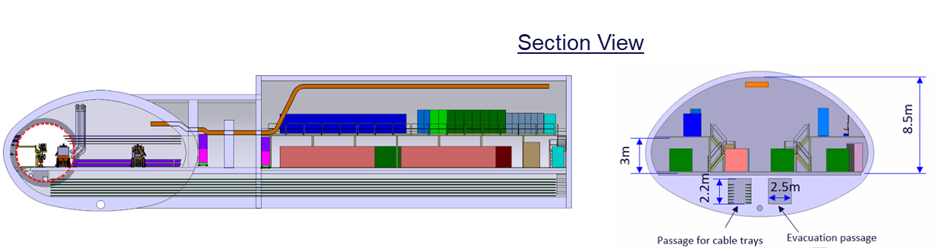
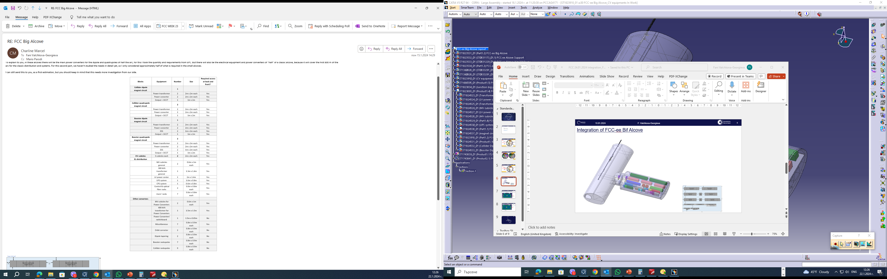
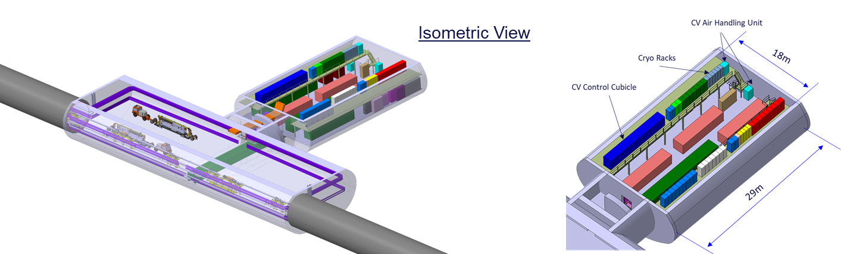
  Integration of FCC-ee Big Alcove
  Electrical requirements for Big Alcoves (FCC WEEK 2024):

Slide 4
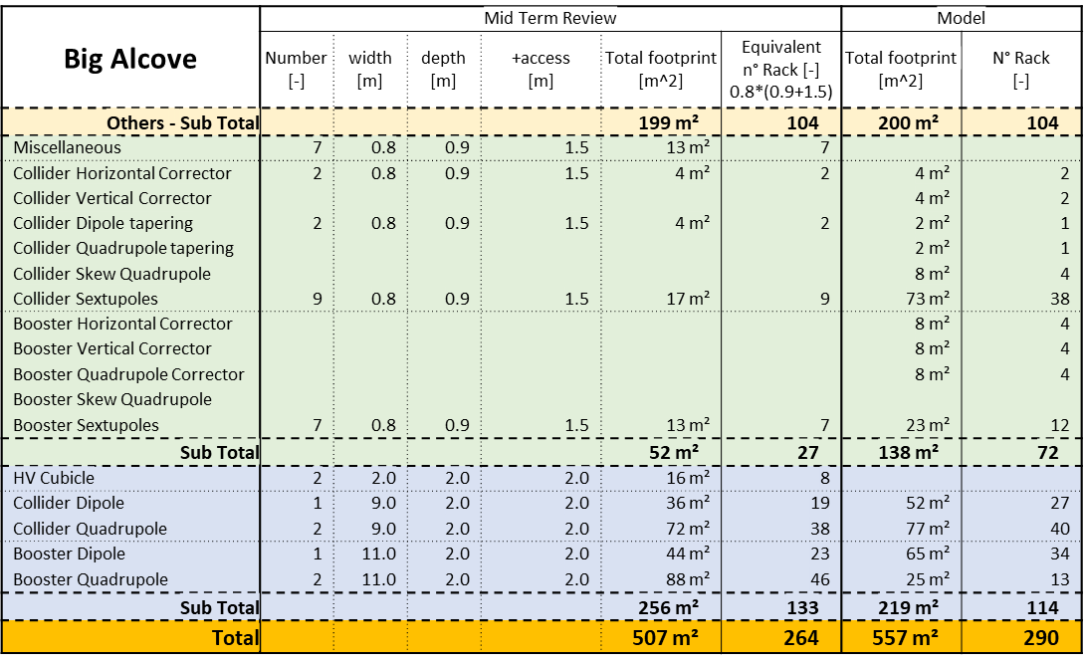
  Integration of FCC-ee Big Alcove
  Electrical requirements 2023:
  Electrical requirements July 2024:

Slide 5
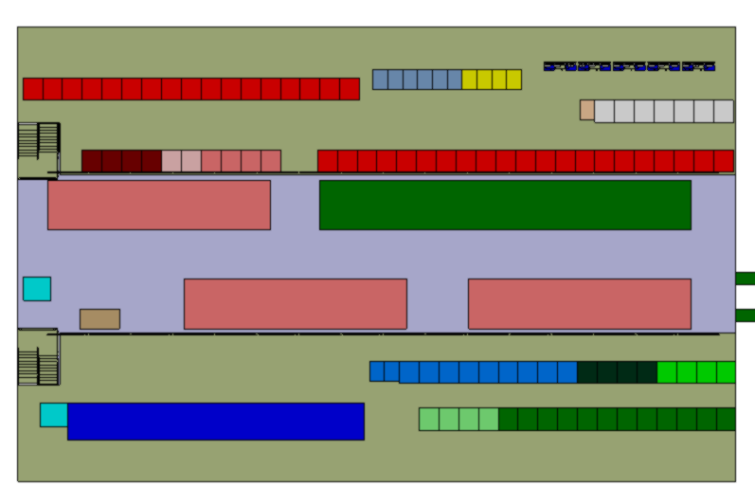
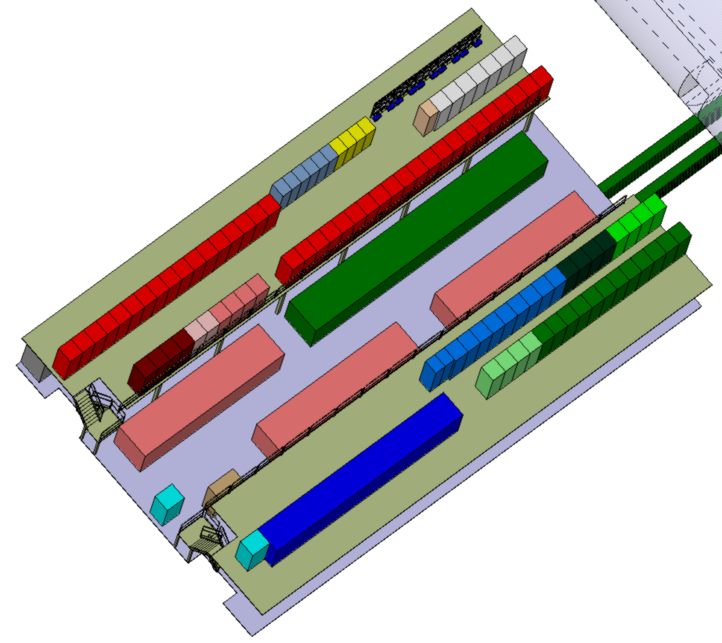
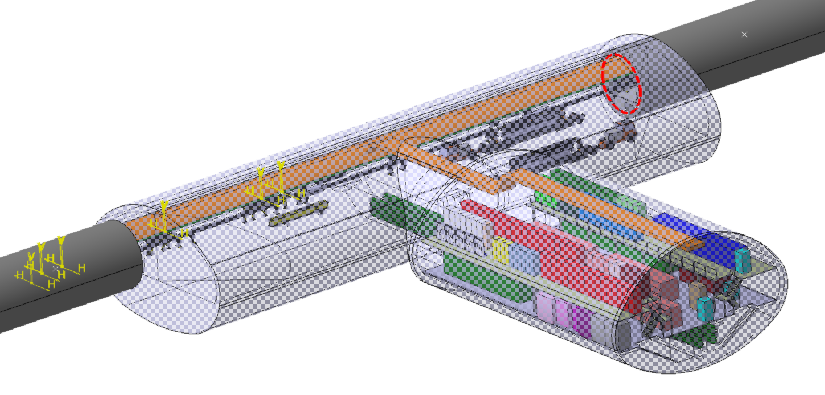
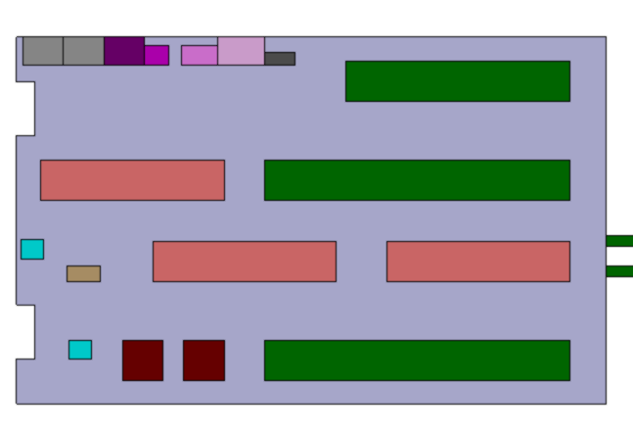
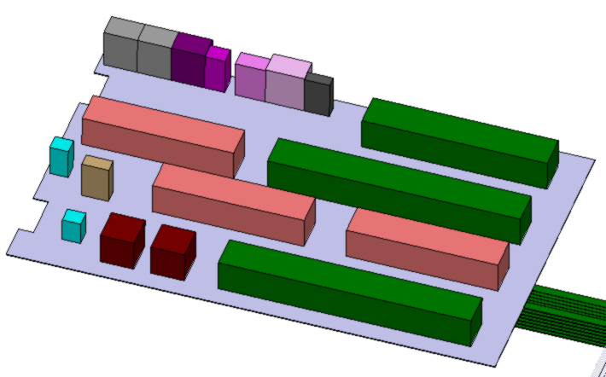
  Integration of FCC-ee Big Alcove July 2024
Second level
29m
18m
First level

Slide 6
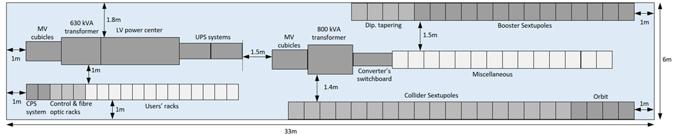
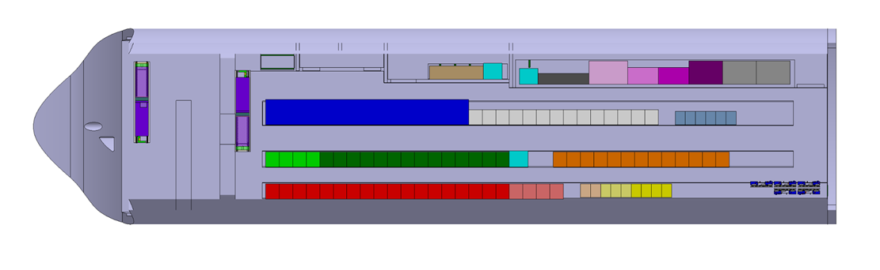
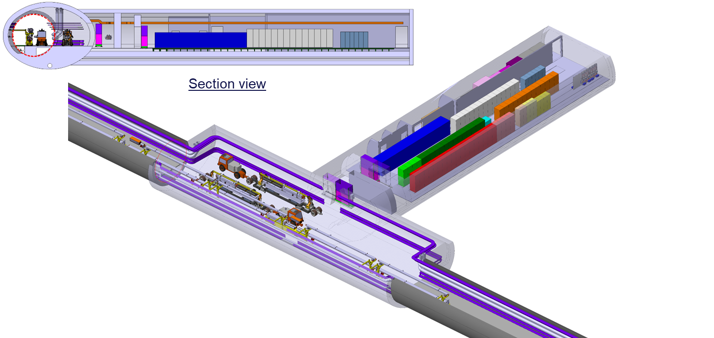
  Integration of FCC-ee Small Alcove
  Electrical requirements for Small Alcoves (FCC WEEK 2024):
5.1m
35m
10.6

Slide 7
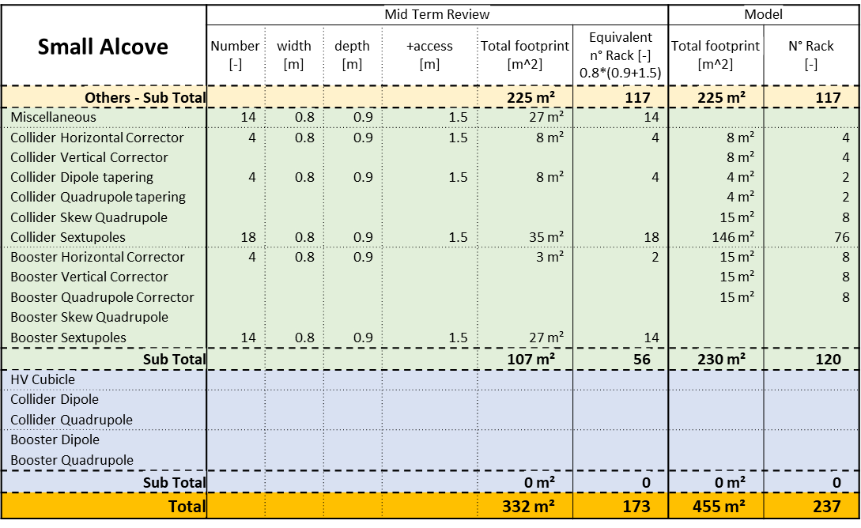
  Integration of FCC-ee Small Alcove
  Electrical requirements 2023:
  Electrical requirements July 2024:

Slide 8
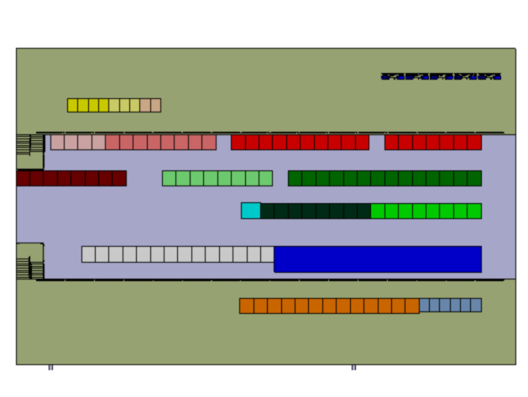
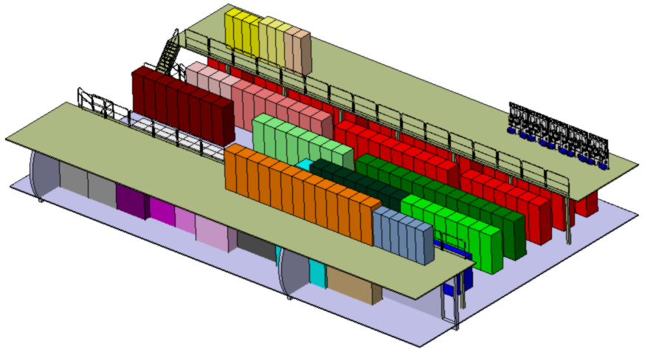
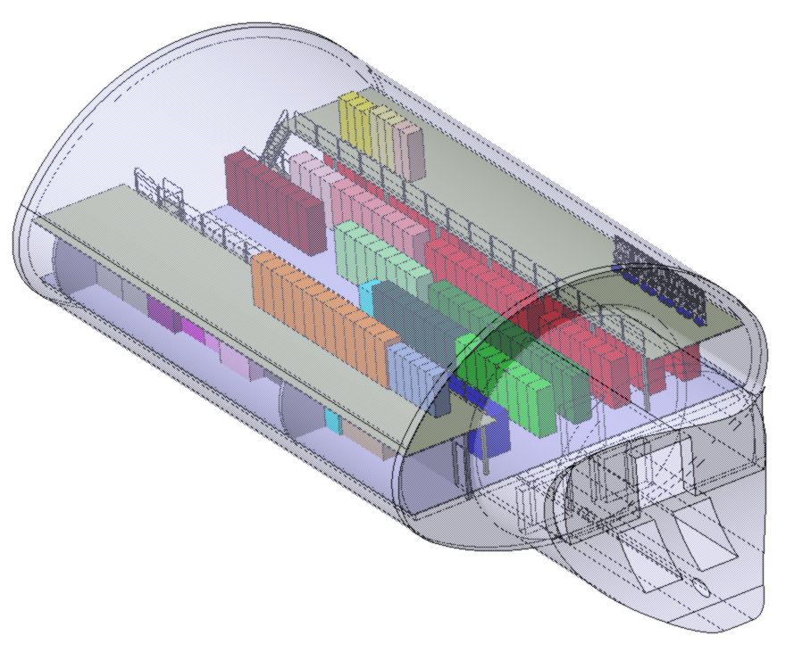
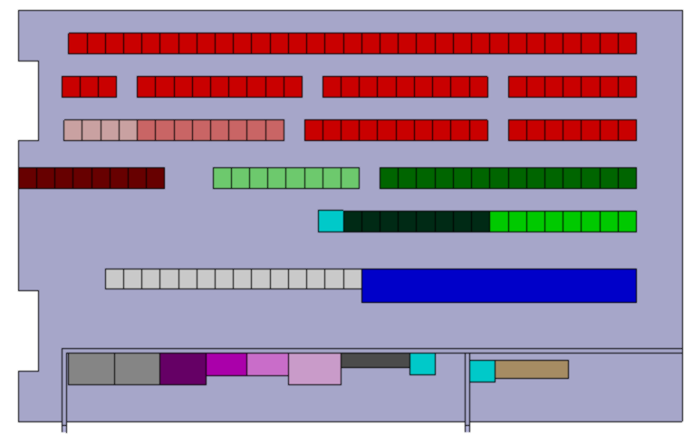
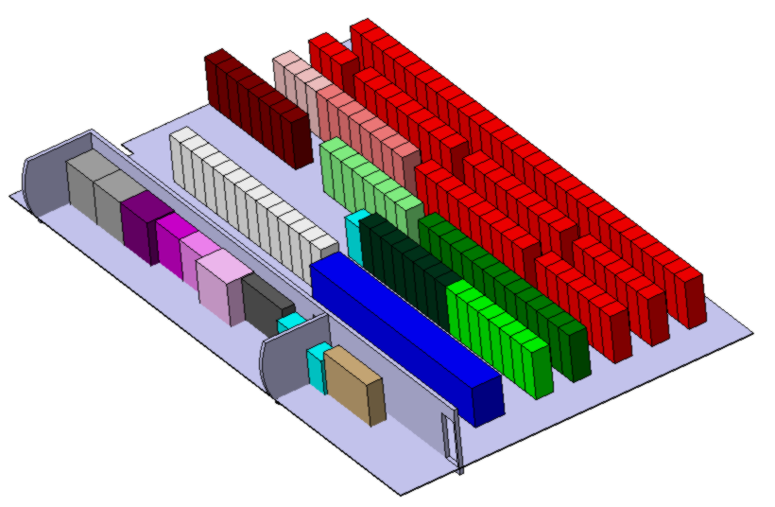
  Integration of FCC-ee Small Alcove July 2024
18m
Second level
29m
First level

Slide 9
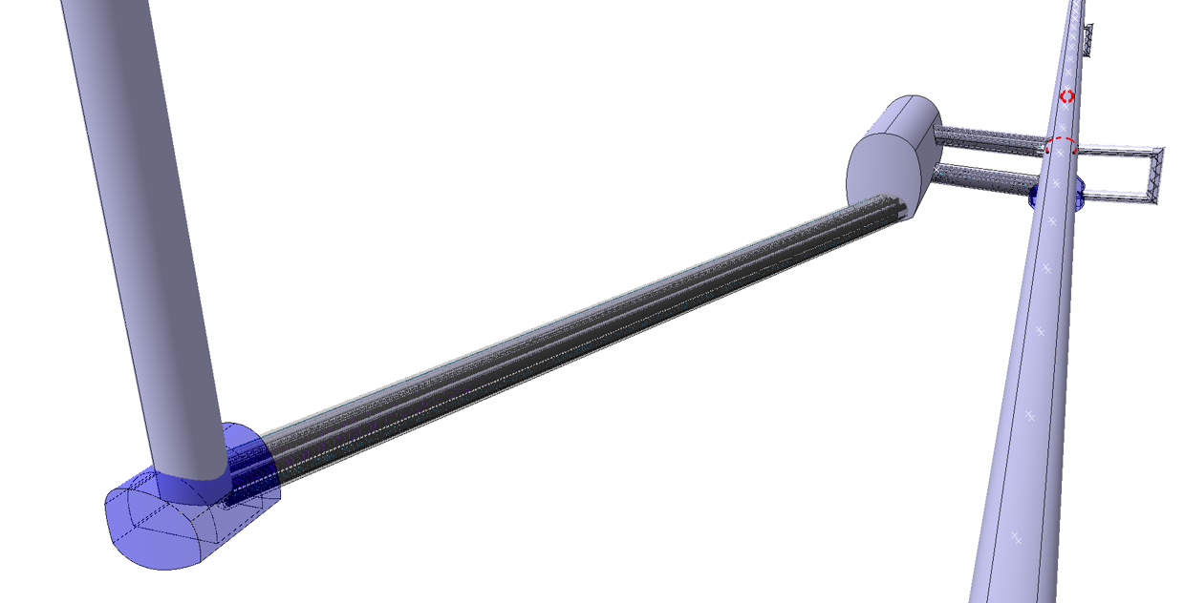
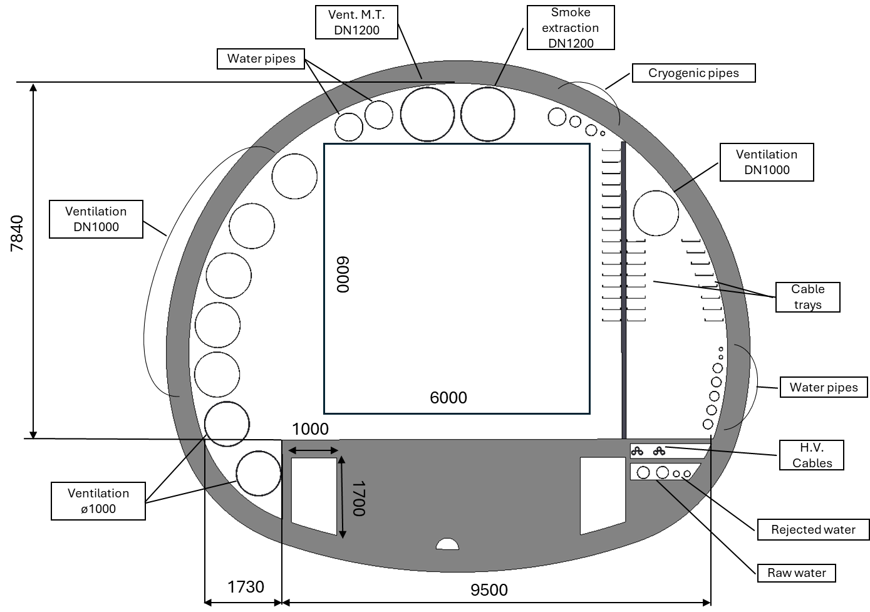
  Integration of Underground structure point L
Connection tunnel
Transport space occupation
LCB (lower cold box)
dimensions: 13x6x6 m (LxWxH)
- weight: 42 tonnes

Slide 10
Thank you for your attention.
F. Valchkova-Georgieva
10

