Slide 1
FCC Polarimeter
Integration
LASER HUTCH Specifications
24 July / FCC_Integration meeting
Robert Kieffer, on behalf of the EPOL working group and of the CERN BI group.

Slide 2
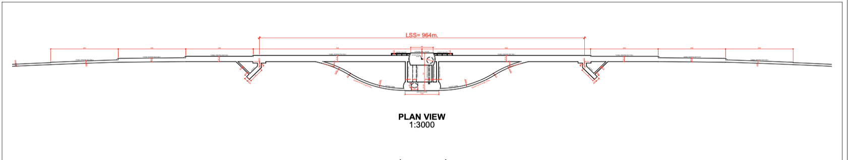
FCCee Polarimeters baseline in Experimental IP A
24 July / FCC_Integration meeting
Robert Kieffer
Laser IP
830m from IP
Laser IP
830m from IP
300m
300m
Laser hutch
Accessible 24h/7d
Laser hutch
Accessible 24h/7d
Extra tunnel to Laser Hutch
Extra tunnel to Laser Hutch
New bypass tunnel elongated to reach after the BS dump
New bypass tunnel elongated to reach after the BS dump
The base line is to use the magnet BL1.4 as spectrometer on each beam, followed by 75m of free beam propagation to separate the compton photons and compton electrons from the main beam.
In order to insure full time availlabilty of the RDP energy calibration the Laser hutch need to be accessible 24h/7days while close to the Laser IP (50m max). As few mirror folds and view ports as possible to maintain a good laser circular polarisation.
UPDATE from L. Bromiley and T. Watson (after the FCC week)
Cost estimate for the two full lenght 830m tunnels 33MCHF
Cost estimate for the two 300m extra tunnels connected to the extended bypass 12MCHF

Slide 3
24 July / FCC_Integration meeting
Robert Kieffer
Civil Engineering Polarimeter Point A Side view sketch
Laser hutch
LSS Tunnel
Distance fixed by
Radiation Levels

Slide 4
24 July / FCC_Integration meeting
Robert Kieffer
Civil Engineering Polarimeter Point A Top view sketch
Emergency Door
Laser passing on the roof top
Laminar flow turbines
Racks
Climatic control 0.5deg
RF synchro
Racks for
Polarimeter sensors
Distance 836m from IP A
Emergency passage
SR Light
Lab
5x6m
Laser hutch
24h/7j
5x6m
ISO7 air
LSS Tunnel
Sas
Distance fixed by
Radiation Levels
Molasse Material
Hutch Doors
Tunnel
Beam 1
Beam 2

Slide 5
24 July / FCC_Integration meeting
Robert Kieffer
Characteristics needed for the Laser Hutch 1/6.
Environmental:
Temperature stability +/- 1C. (the spec +/- 0.5C is nice, but sometimes very expensive from the ventilation group).
Relative humidity < 50% (desirable) or non-condensing environment.
HEPA filtering (laminar flow ISO5) .
Positive pressure compared to SAS and outside the lab. There is a pressure gradient decreasing from inside the lab to lower pressure in the tunnel.
No windows allowed.
Heat sources (electronic racks) outside the hutch to limit the heat to dissipated inside.

Slide 6
24 July / FCC_Integration meeting
Robert Kieffer
Characteristics needed for the Laser Hutch 2/6.
Laser safety:
SAS available for laser safety and PPE/laser goggles.
Illuminated Laser ON warning sign.
Interlock on entry doors. Laser safety system
Emergency beam off buttons.
Emergency power off buttons.
Access controls RFID for authorized personnel or dedicated key. Patrol mode for laser alignment.
Fire extinguisher.
Doors should have emergency exit capability (push to open from inside).

Slide 7
24 July / FCC_Integration meeting
Robert Kieffer
Characteristics needed for the Laser Hutch 3/6.
SAS:
The SAS should have dimensions of at least 2 m x 3 m and adjacent to the laser room (as a buffer zone).
Storage unit for tools, basic laser replacements, clean room booties, surgical masks and robes. Appropriate size is around 1.5 m (height), 1 m (wide), 80 cm (depth) or similar. Better to have 2 of these storage units.
Compact cabinet with PPE (goggles) to be placed near entrance door at chest/eye level.
Sticky mats in floor.
Both doors should be double doors (>1.2 m wide opening in total) to allow for easy installation of large equipment.

Slide 8
24 July / FCC_Integration meeting
Robert Kieffer
Characteristics needed for the Laser Hutch 4/6.
Laser room size:
Two optical table of size 2 x 1.2 m (weight ~ 200+ Kg)
Minimum gap between tables and surrounding walls or equipment must be at least 1 m.
Minimum laser room size is then 4 x 6 m.
Minimum laser room height should be around 2.5 m in order to accommodate for the laser enclosure + HEPA filtering.
Laser control unit and chillers usually fit in standard racks (9U - 12U) under optical table, however if these can be better placed in racks outside the hutch.

Slide 9
24 July / FCC_Integration meeting
Robert Kieffer
Characteristics needed for the Laser Hutch 5/6.
Electrical characteristics:
Voltage: 95-240 VAC
Frequency: 50/60 Hz
Max current: TBD
Total power consumption: 5 - 10 kW
Electric protection class: I
IP classification: IP30
Dedicated circuit breaker panel with at least 3 circuits: Laser cooling, laser unit power and diagnostic equipment.
Racks outside the Hutch

Slide 10
24 July / FCC_Integration meeting
Robert Kieffer
Characteristics needed for the Laser Hutch 6/6.
Water supply:
Temperature: 5-25 C
Flow: 5-10 l/m
Quality: Filtered < 50uM, <200mg Chlorine/l
Maximum pressure: 8 bar (desirable <5 bar)
Flow is regulated by the chiller system.
Manual valves for quick shut-off of water circuit.
Gas supply:
Supply of pure nitrogen for laser beam transport. Minimum pressure 1 bar. No specs for purity, desirable >99%

Slide 11
Thank you for your attention.
24 July / FCC_Integration meeting
Robert Kieffer
11

Slide 12
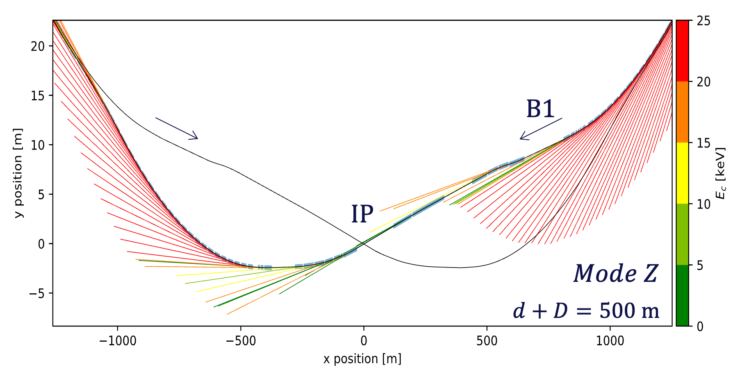
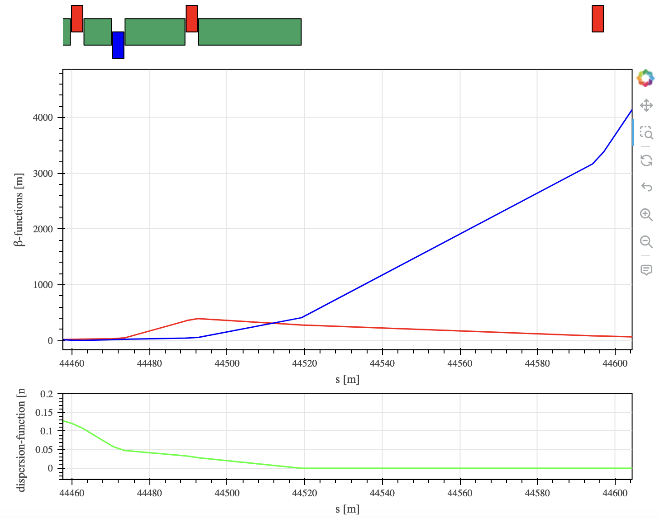
FCCee Polarimeters baseline in Experimental IP A
24 July / FCC_Integration meeting
Robert Kieffer
BL1.4
Polarimeter
Survey plot from Daniele Butti
Laser IP
Laser IP
Laser IP
GHC optics is used. The polarimeter is not yet tested in the LCC optics.
Synchrotron Radiation fan shows a potentially strong contamination from SR in the compton gammas extraction line.

Slide 13
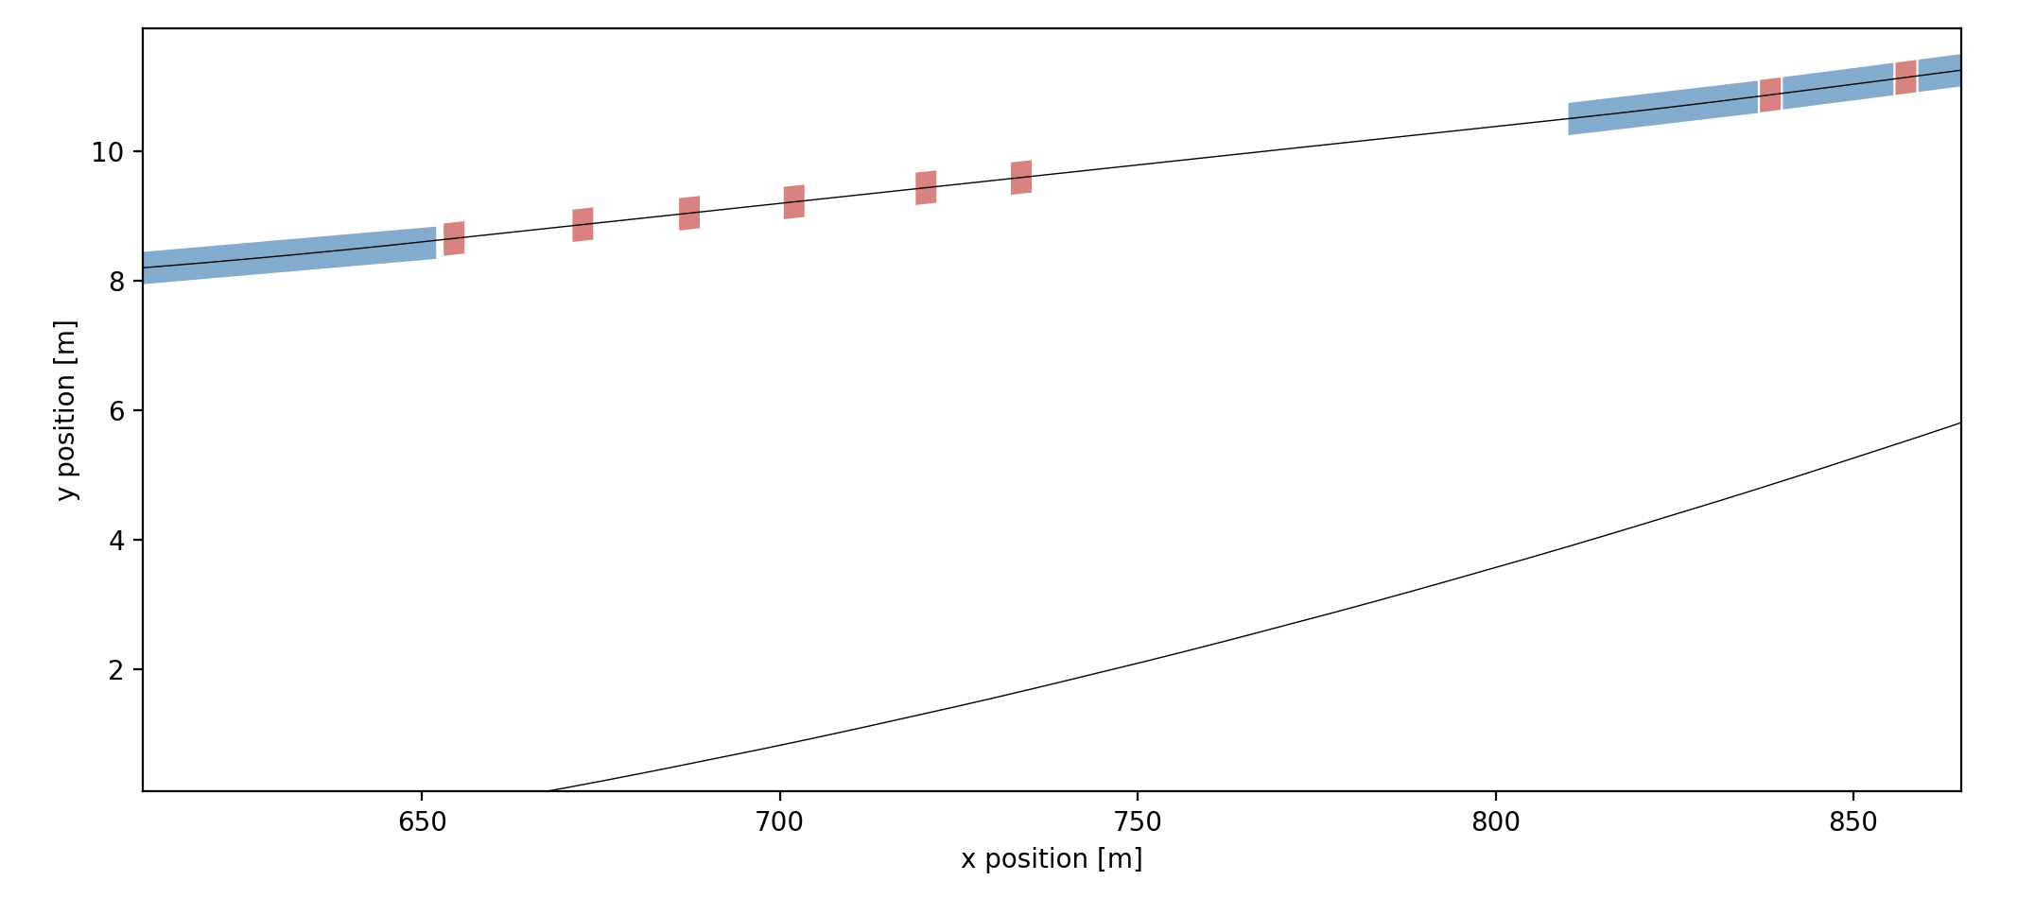
FCCee Polarimeters baseline in Experimental IP A
24 jully / FCC_Integration meeting
Robert Kieffer
Robert Kieffer
Electrons
BL1.4
Photons
100 m propagation distance
Laser IP
7m between beams

