Slide 1
Integration News
07.08.2024
F. Valchkova-Georgieva & Dieudonne Adrien Ngo'O Ella

Slide 2
  Integration topics:
  Integration of Underground strucutre point A _ FR (ST1874371_01)
  Integration of Big Alcove with Laser Hutch

Slide 3
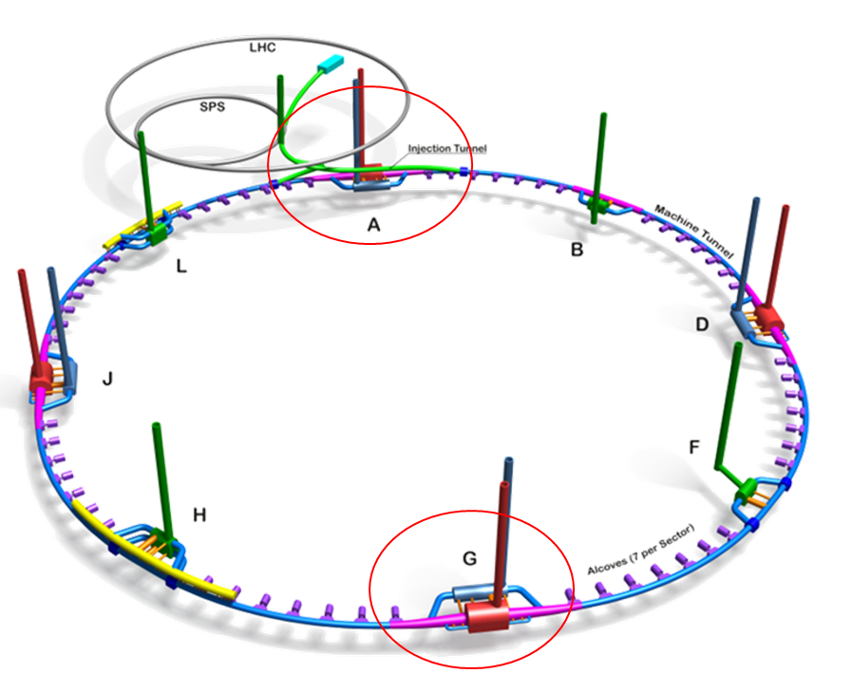
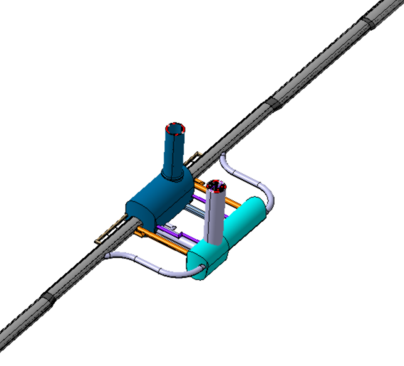
  FCC-ee Underground Structure at point A
2 x Evacuation
connection tunnel
Experimental Shaft ø18m
Experiment Cavern
Bypass tunnel ø 5.5m
Survey Gallery
Machine tunnel
Service Cavern
Connection tunnel ø 5.5m

Slide 4
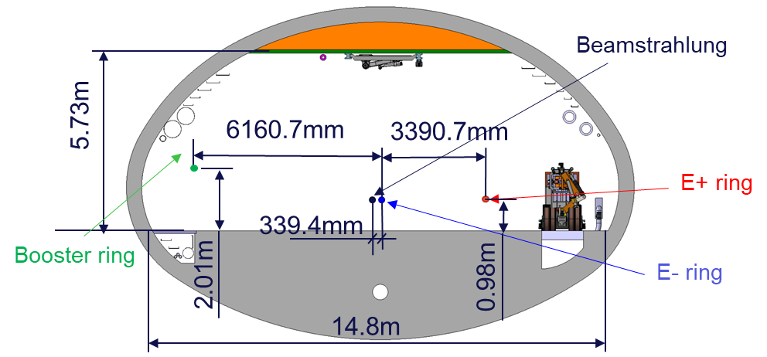
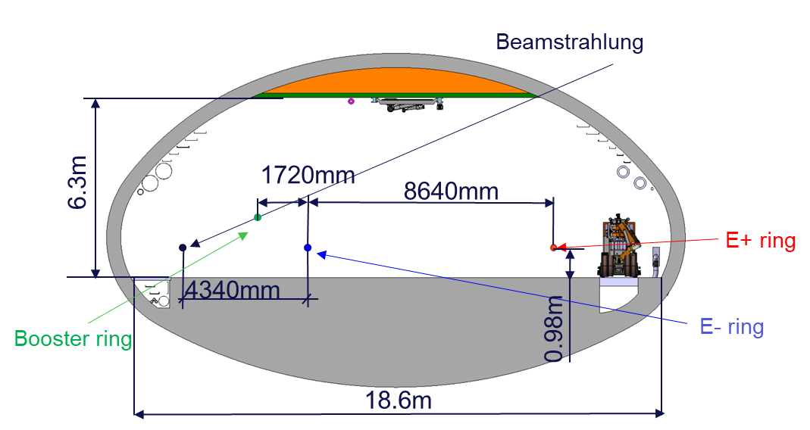
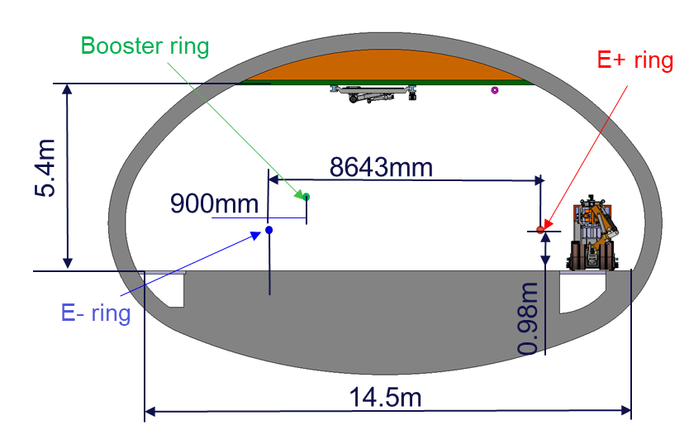
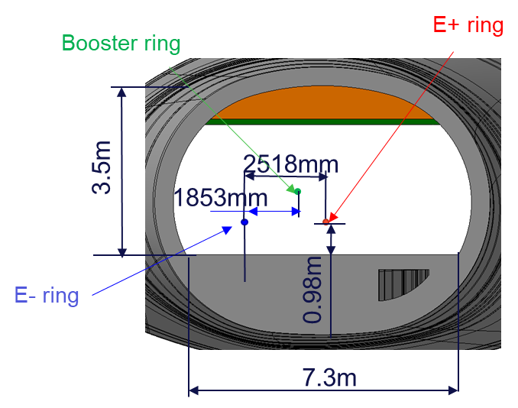
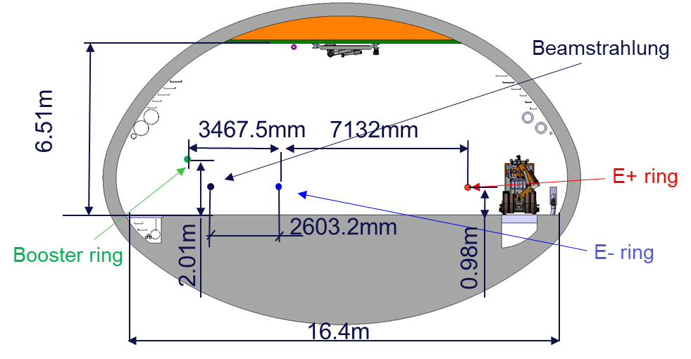
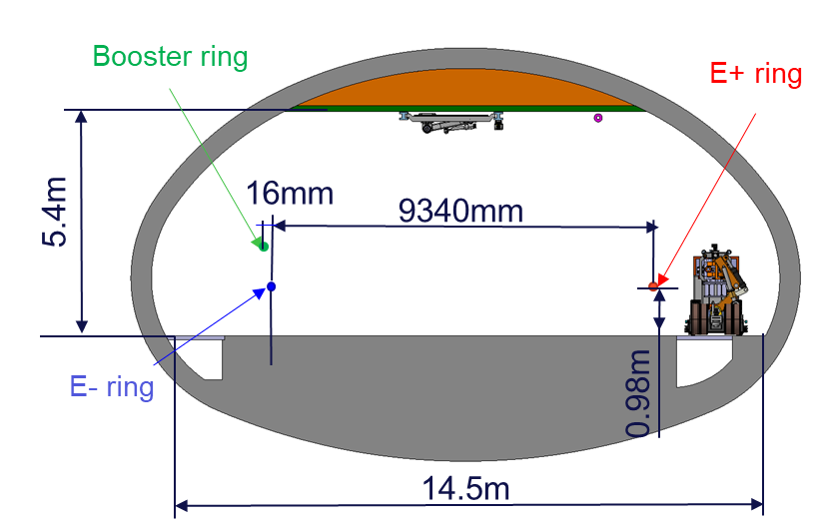
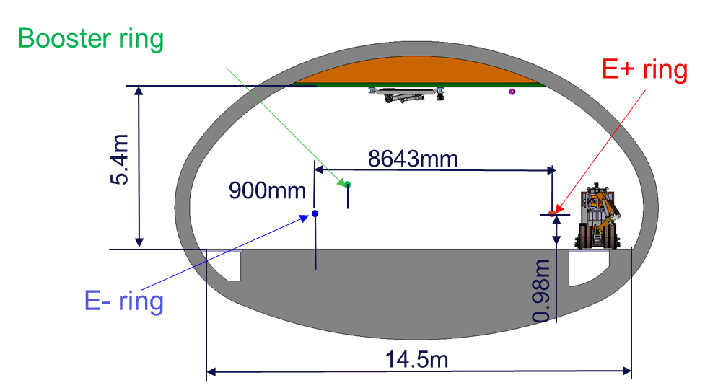
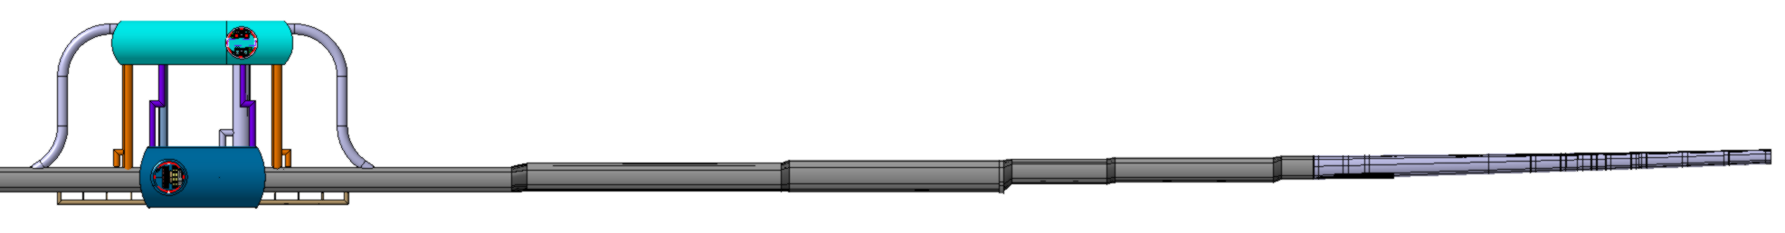
  FCC-ee integration study at point A
  Section 1
  Section 3
  Section 5
  Section 7
  Section 2
  Section 4
  Section 6
1
2
Big Alcove
3
4
5
6
7
10m
5m
5m
5m
5m
132m
20m
97m
150m
160m
60m
100m
288m
948m

Slide 5
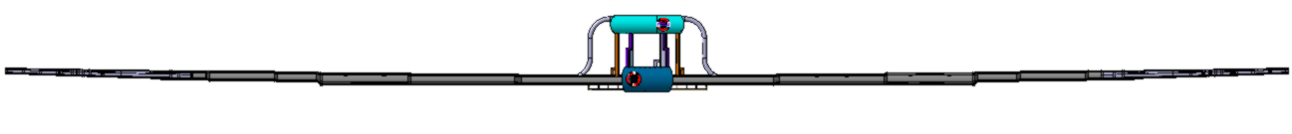
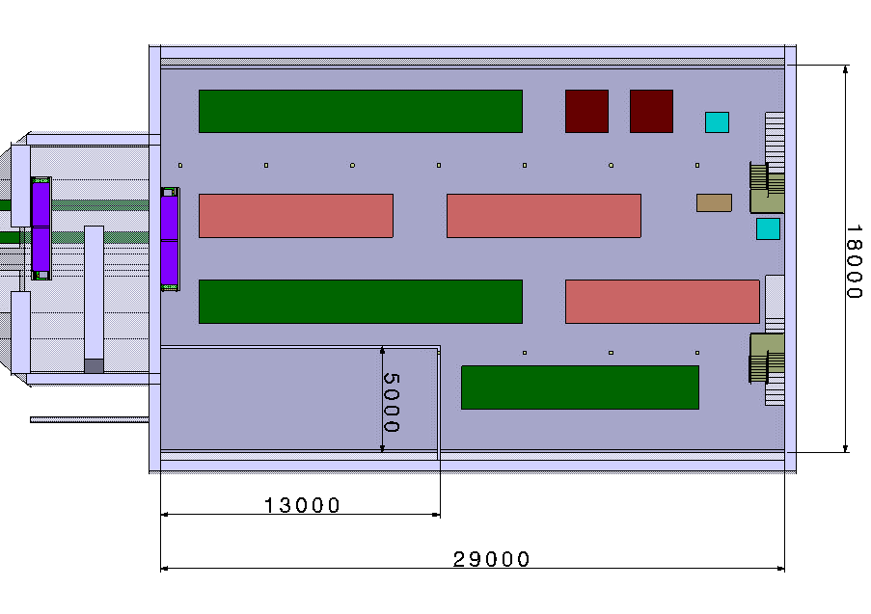
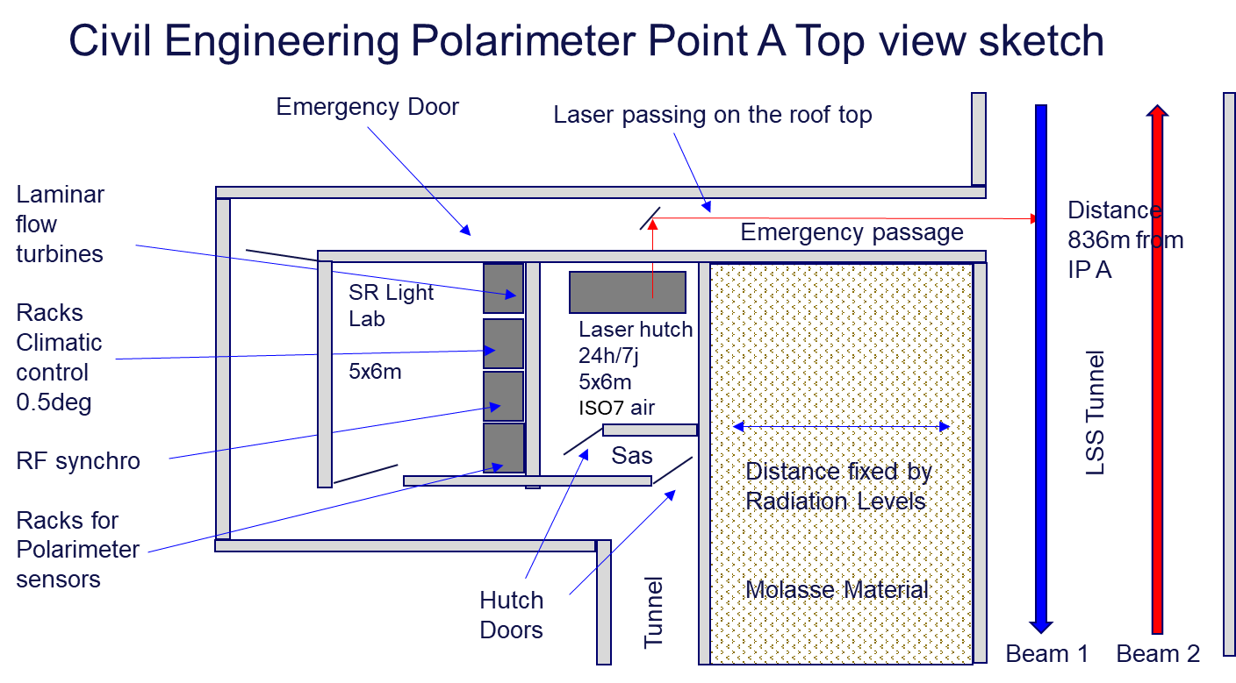
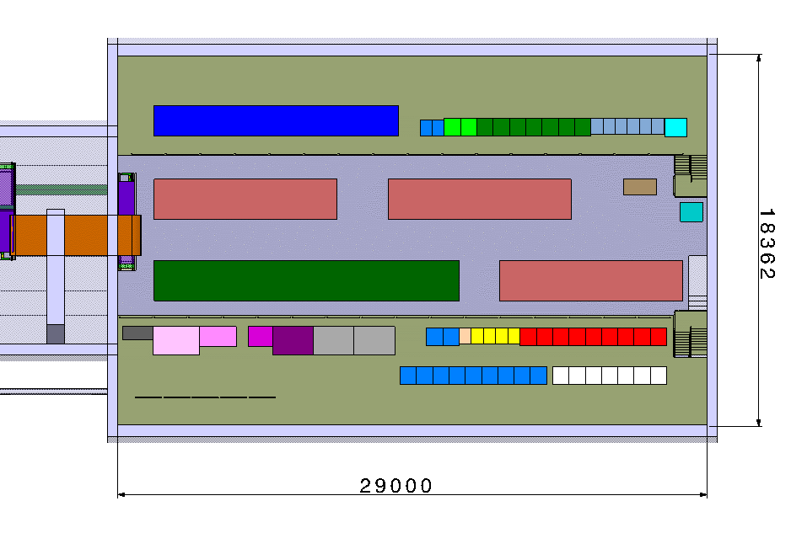
  FCC-ee Integration of Big Alcove with Laser Hutch at point A
830m
Big Alcove
Machine level
Second level
Laser Hutch

Slide 6
Thank you for your attention.
F. Valchkova-Georgieva
6

