Slide 1
Experimental Access shafts – Baseline Modification
Henriques, O. Rios HSE Unit
FCC Integration Meeting
07/08/2024

Slide 2
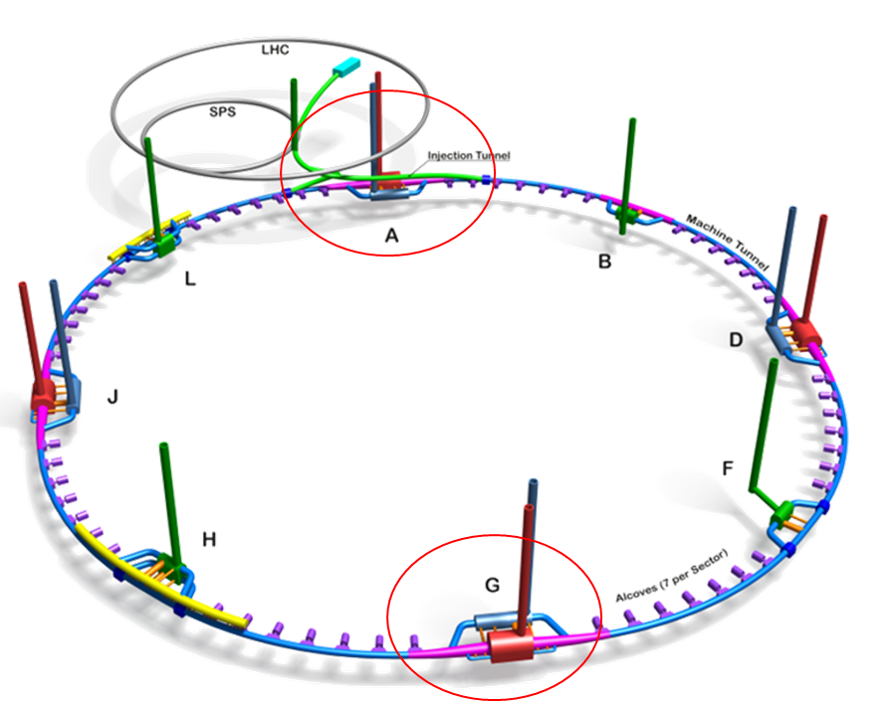
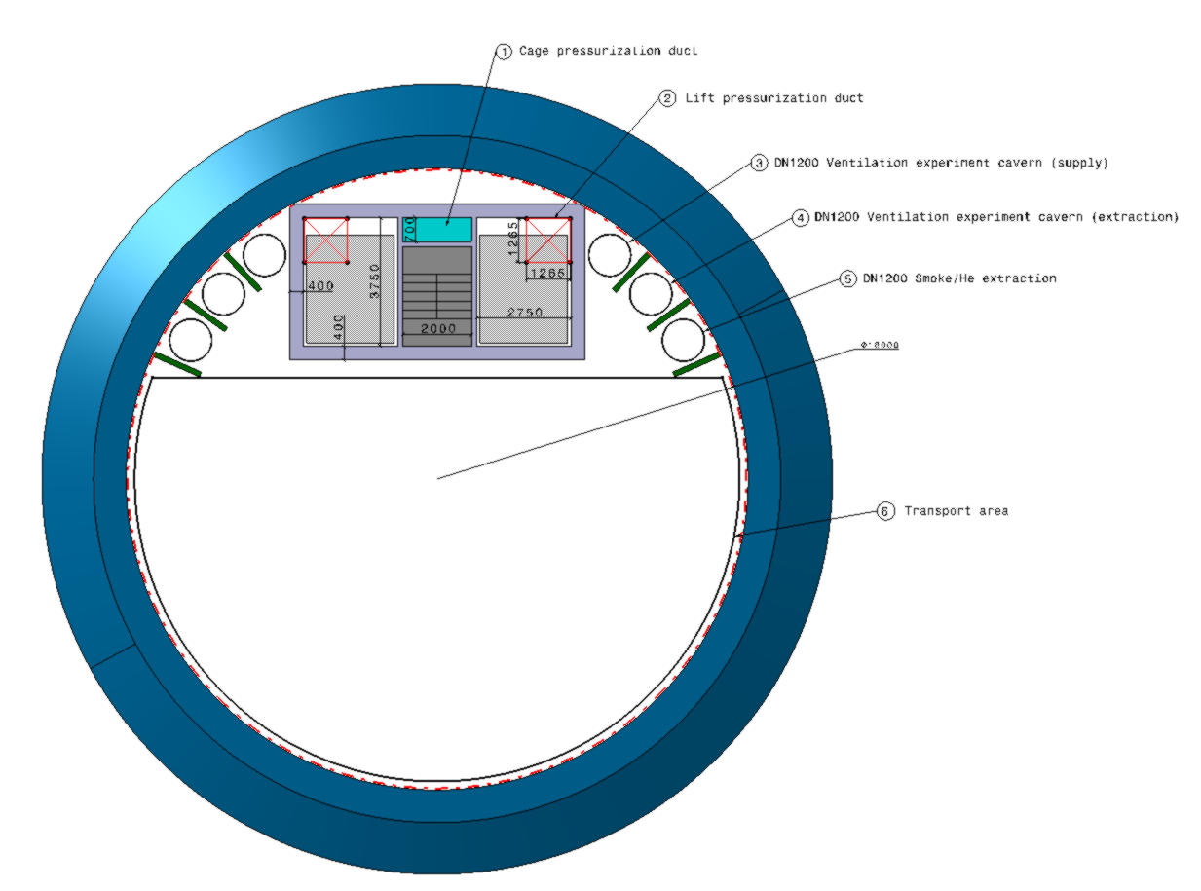
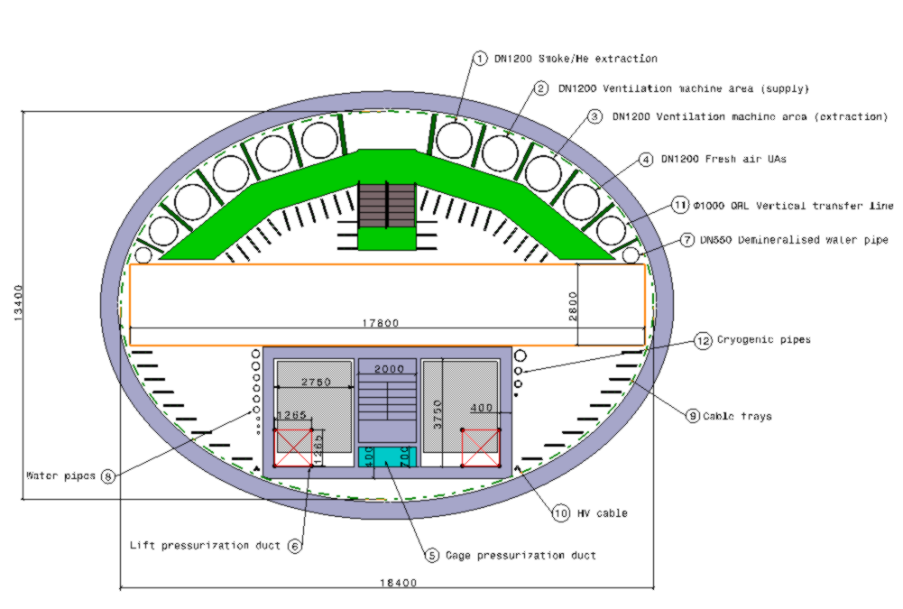
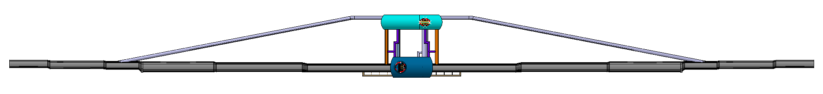
  FCC-ee Underground Structure at point A – MTR (Jan 2023)
Trigger of baseline modification: Request to remove the pressurized lifts (stairs)
Experiment Shaft
Elliptical Service Shaft
1.7 km
F. Valchkova-Georgieva

Slide 3
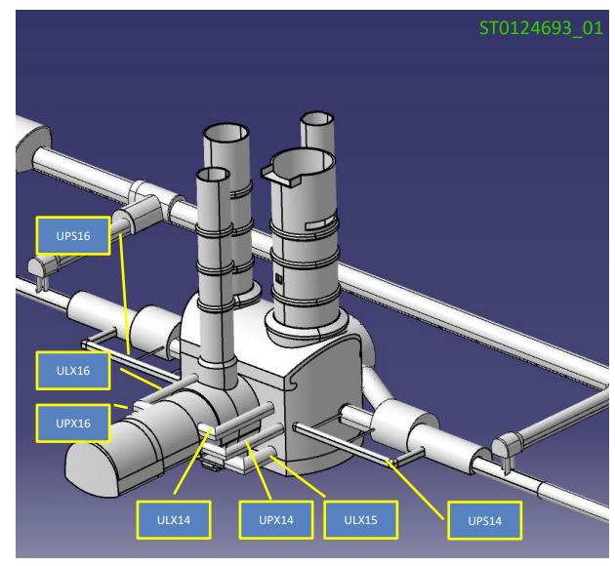
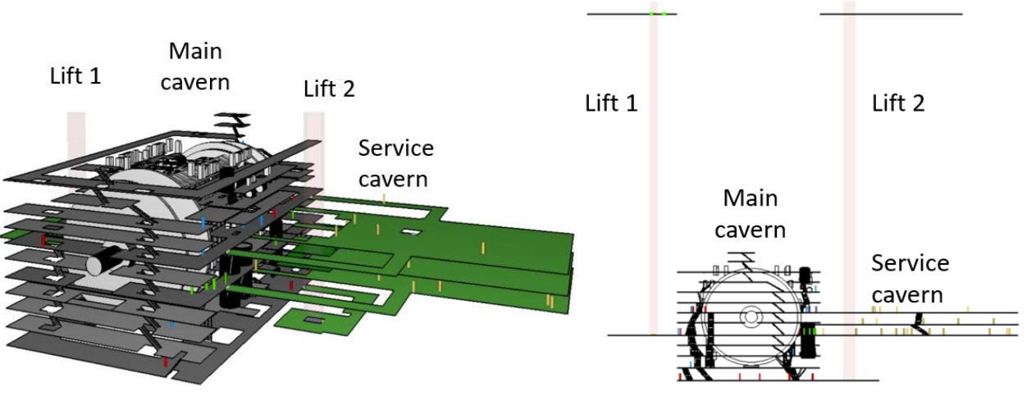
Current Evacuation Concept in ATLAS
There are in total seven exits from UX15, and they lead to places of relative safety, which are compartmentalized with respect to the cavern:
There are two exit shafts from Point 1: PM15 and PX15;
FIRIA ATLAS risk assessment
EDMS 2396252
Randomly distributed occupants

Slide 4
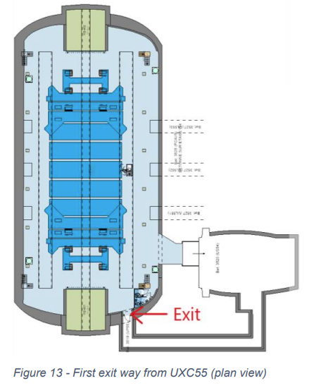
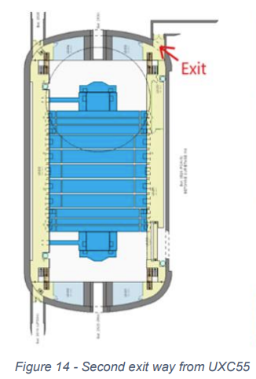
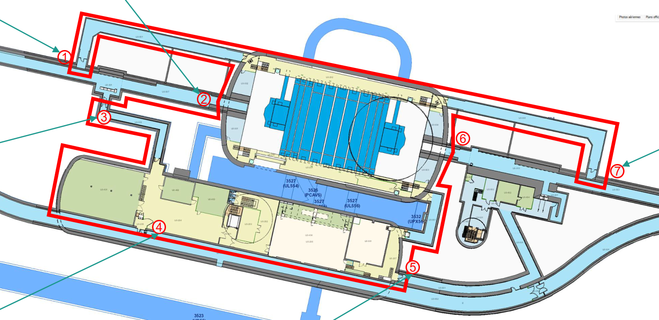
Current Evacuation Concept in CMS
Two independent exits ways to surface at two different levels (W2, U0)
+ 2 exists to LHC machine (gallerie geometre)
There are two exit shafts from Point 5:
PM54 and PM56
W2 Level
U0 Level
FIRIA CMS risk assessment
EDMS 2758294

Slide 5
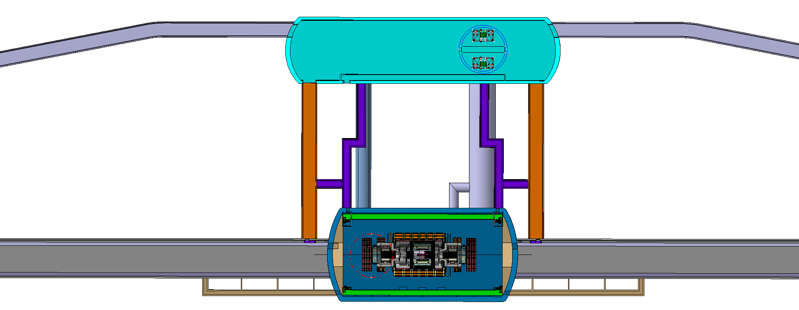
F. Valchkova-Georgieva
  FCC-ee Underground Structure at point A – FS (modification proposal)
Outcome of meeting (6/5/24) + side discussion:
Redundant & separate evacuation paths for Exp and Machine
Circular service Shaft ø18.2 m
‘machine’ safety area (>50 m2)
2 x pressurized lift cage
‘Exp’ Safety area
Possibility to evacuate occ to the next Point was deemed not feasible.
Experimental cavern egress
Machine tunnel egress
F. Valchkova-Georgieva

Slide 6
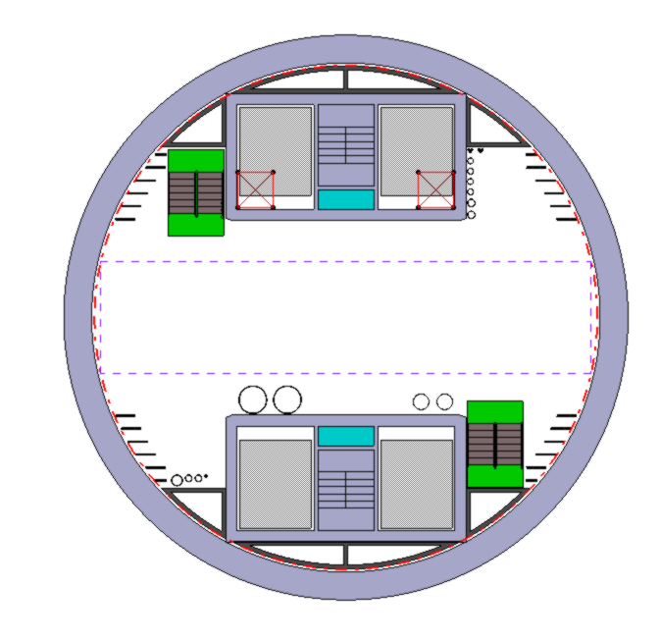
  FCC-ee Underground Structure at point A – FS (modification proposal)
Modification proposal acceptable from Safety:
17.8 m clearance
18.2 x 13.5 m elliptical shaft
18.2 m diameter circular shaft
Impact:
Cost: same quantity of lifts
  MTR: 2 (cavern) + 2 (service)
  FS: 4 (service)
Cost / drawback: ~ 35 % more excavated material
Cost: CE works ?? More expensive (?) but there were already discussions to try to avoid elliptical shafts due to tech reasons…

