Slide 1
Classical description of quark interactions
Changsha University
Zhiguang Tan(谭志光)
Advances, Innovations, and Prospects in High-Energy Nuclear Physics

Slide 2
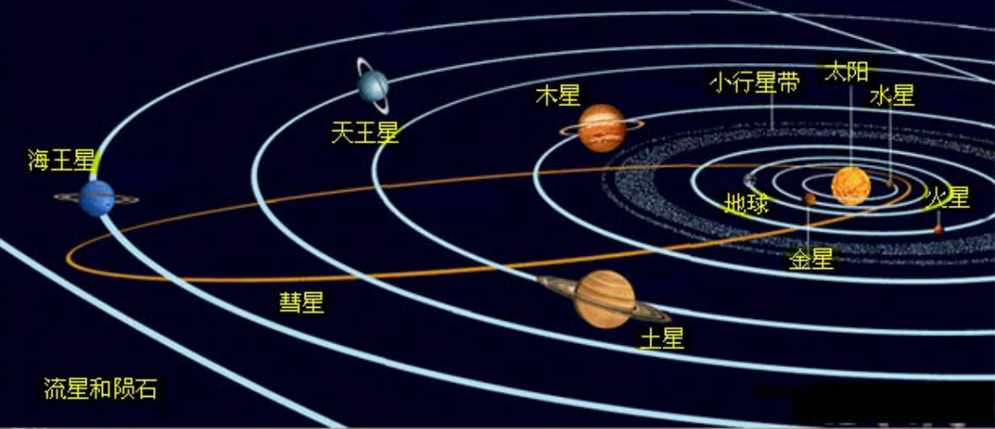
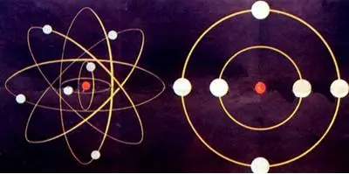
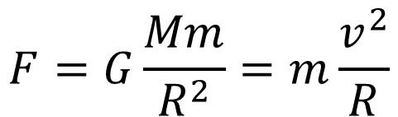
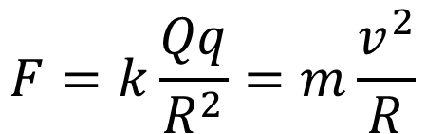
Classical interaction
- 1 -
Universal gravitation
$$F=G\frac{Mm}{R^{2}}=m\frac{v^{2}}{R}$$
Electrostatic attraction
$$F=k\frac{Qq}{R^{2}}=m\frac{v^{2}}{R}$$
Advances, Innovations, and Prospects in High-Energy Nuclear Physics

Slide 3
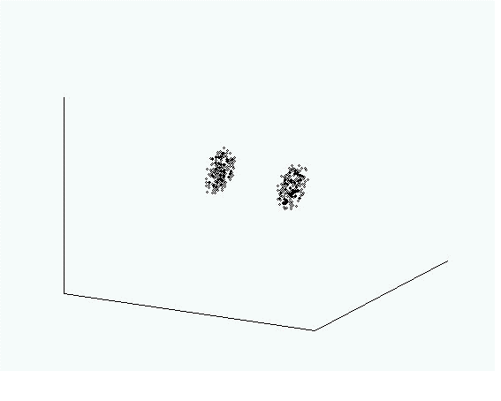

How about quarks
- 2 -
Advances, Innovations, and Prospects in High-Energy Nuclear Physics

Slide 4
Outline
- 3 -
2
1
Potential model
2
Classical description
3
Parameters and results
5
Advances, Innovations, and Prospects in High-Energy Nuclear Physics

Slide 5



1.Potential model
- 4 -
$V\left(r\right)=−\frac{a}{r}+br$ Physical review D, 1980,21(1): 203.
$V\left(r\right)=k_{0}e^{−α^{2}r^{2}/2}+cr−\frac{a}{r}−\frac{b}{r^{2}}$
$$\text{To} \text{Phys}\text{. }\text{J}\text{, 2019, 3: 197−215}$$
$V\left(r\right)=ar^{2}+br−\frac{c}{r}+\frac{d}{r^{2}}+e$
Modern Physics Letters A, 2022, 37(02): 2250010.
$$∇^{2}ψ+\frac{2μ}{ℏ^{2}}\left[E−V\left(r\right)\right]ψ\left(r,θ,φ\right)=0$$
$$M_{nl}=m_{q1}+m_{q2}+E_{nl}$$

Slide 6
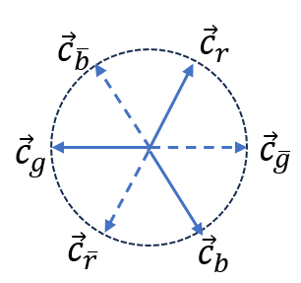


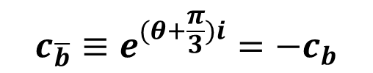

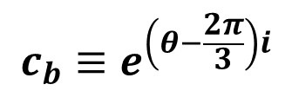
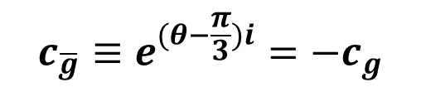
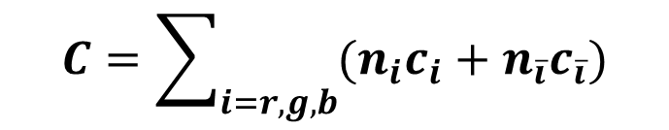


2. Classical description
- 5 -
Color charge
Three element color charges and their anti-charges
Mesons and baryons are color neutral
Multicolored charged particles
e.g. di-quark
$$c_{r}≡e^{θi}$$
$$c_{\overline{r}}≡e^{(θ+π)i}=−c_{r}$$
$$c_{g}≡e^{\left(θ+\frac{2π}{3}\right)i}$$
$$c_{\overline{g}}≡e^{(θ−\frac{π}{3})i}=−c_{g}$$
$$c_{b}≡e^{\left(θ−\frac{2π}{3}\right)i}$$
$$c_{\overline{b}}≡e^{(θ+\frac{π}{3})i}=−c_{b}$$
$$c_{i}+c_{\overline{i}}=0$$
$$c_{r}+c_{g}+c_{b}=0$$
$$C=\sum_{i=r,g,b}{{(n}_{i}c_{i}+n_{\overline{i}}c_{\overline{i}}})$$

Slide 7
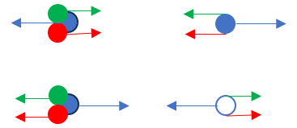

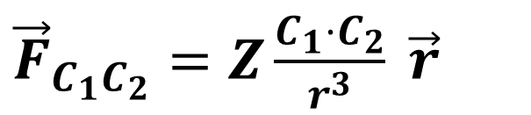

2. Classical description
- 6 -
Interaction between two color charge
${\vec{F}}_{C_{1}C_{2}}=Z\frac{C_{1}⋅C_{2}}{r^{3}} \vec{r}$
$$E_{p}=−\frac{Z}{r}$$
The dot product between two unit color charges
$$c_{i}⋅\left(±c_{j}\right)=\left\{\begin{matrix}±1 & i=j \\ ∓\frac{1}{2} & i≠j\end{matrix}\right.$$
Interaction between a quark and a Neutral particle
Advances, Innovations, and Prospects in High-Energy Nuclear Physics

Slide 8
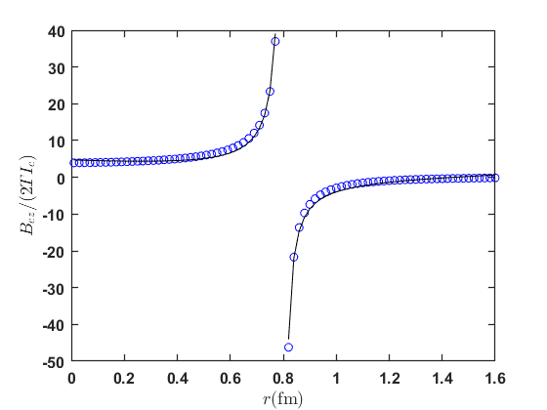
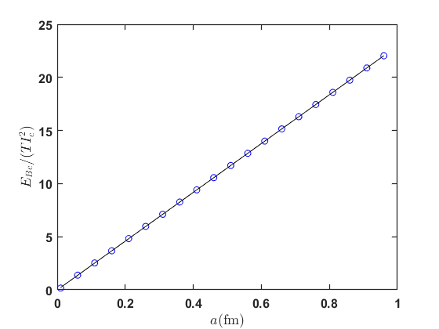
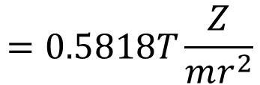




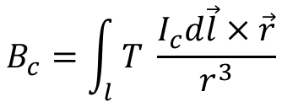
2. Classical description
- 7 -
The color magnetic field
Circular motion of color charge forms color flow
$$B_{c}=\int_{l}{T \frac{I_{c}d\vec{l}×\vec{r}}{r^{3}}}$$
$$I_{c}=|c|\frac{v}{2πa}$$
$$a$$
Circular color flow excited color magnetic field
$$B_{cz}=2TI_{c}[\frac{1}{a−r}E\left(k\right)+\frac{1}{a+r}K(k)]$$
The color magnetic field energy
$$E_{Bc}=22.97TI_{c}^{2}r$$
$$=0.5818T\frac{Z}{mr^{2}}$$

Slide 9
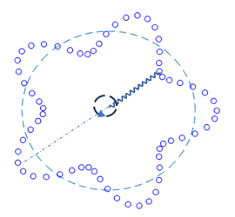

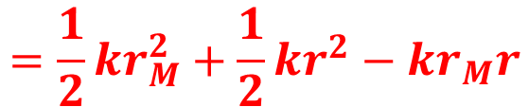

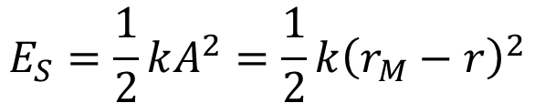
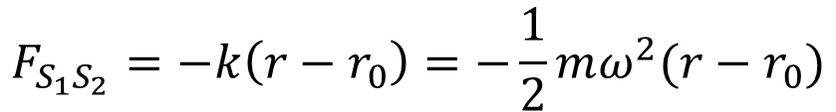
2. Classical description
- 8 -
Interaction from spin
Color flow attracts in the same direction and repels in the opposite direction
$$F$$
$$F$$
Treating spin as the rotational motion of color charge
the harmonic oscillator potential caused by spin
$$F_{S_{1}S_{2}}=−k\left(r−r_{0}\right)=−\frac{1}{2}mω^{2}(r−r_{0})$$
$$E_{S}=\frac{1}{2}kA^{2}=\frac{1}{2}k{\left(r_{M}−r\right)}^{2}$$
$$=\frac{1}{2}kr_{M}^{2}+\frac{1}{2}kr^{2}−kr_{M}r$$

Slide 10
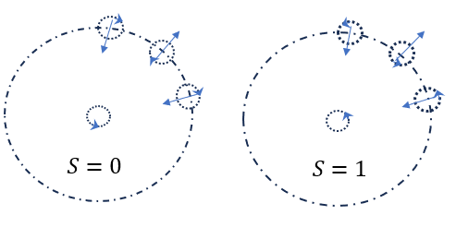
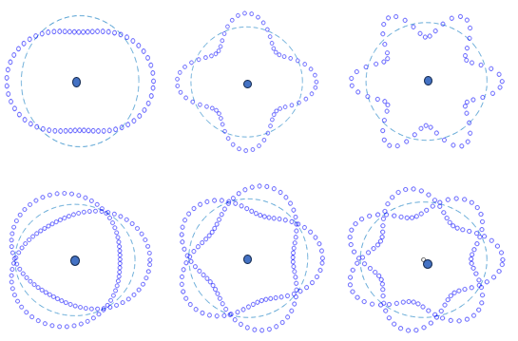
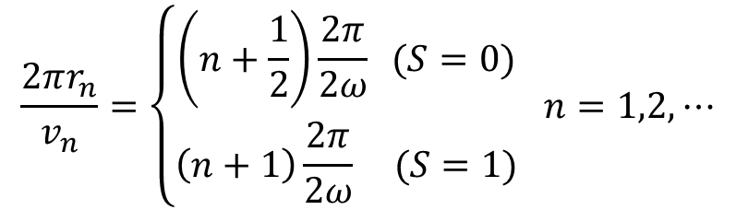
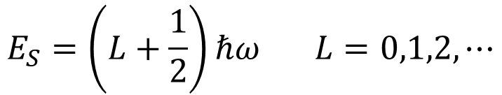
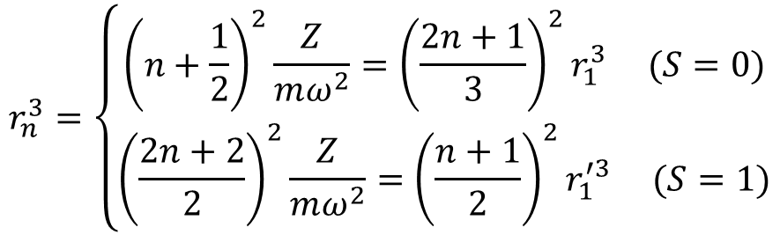
2. Classical description
- 9 -
Quantization hypothesis
$$E_{S}=\left(L+\frac{1}{2}\right)ℏω L=0,1,2,⋯$$
$$\frac{2πr_{n}}{v_{n}}=\left\{\begin{matrix}\left(n+\frac{1}{2}\right)\frac{2π}{2ω} (S=0) \\ \left(n+1\right)\frac{2π}{2ω} (S=1)\end{matrix} n=1,2,⋯\right.$$
$$r_{n}^{3}=\left\{\begin{matrix}{\left(n+\frac{1}{2}\right)}^{2}\frac{Z}{mω^{2}}={\left(\frac{2n+1}{3}\right)}^{2}r_{1}^{3} (S=0) \\ {\left(\frac{2n+2}{2}\right)}^{2}\frac{Z}{mω^{2}}={\left(\frac{n+1}{2}\right)}^{2}r_{1}^{′3} (S=1)\end{matrix}\right.$$

Slide 11

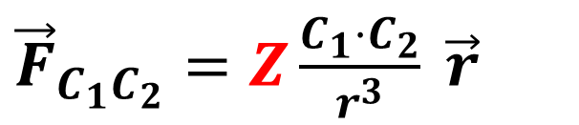
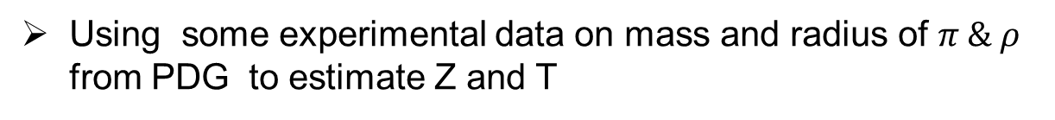
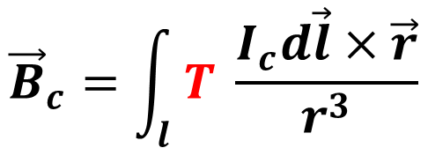
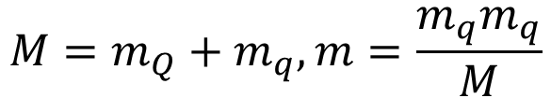
3. Parameters and results
- 10 -
${\vec{F}}_{C_{1}C_{2}}=Z\frac{C_{1}⋅C_{2}}{r^{3}} \vec{r}$
$${\vec{B}}_{c}=\int_{l}{T \frac{I_{c}d\vec{l}×\vec{r}}{r^{3}}}$$
$M_{n,L}=M−\frac{Z}{2r_{n}}+0.5818T\frac{Z}{mr_{n}^{2}}+\left(L+\frac{1}{2}\right)ℏω$
with
$$M=m_{Q}+m_{q}, m=\frac{m_{q}m_{q}}{M}$$
Using some experimental data on mass and radius of $π \& ρ$ from PDG to estimate Z and T
$$Z≈1.33×{10}^{−26}Nm^{2}, T≈4.43×{10}^{−44}Ns^{2}$$

Slide 12
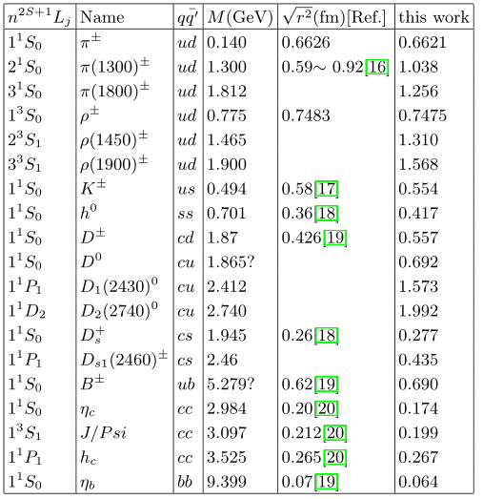
3. Parameters and results
- 11 -
Calculation on some other mesons' radii and compare with literatures

Slide 13
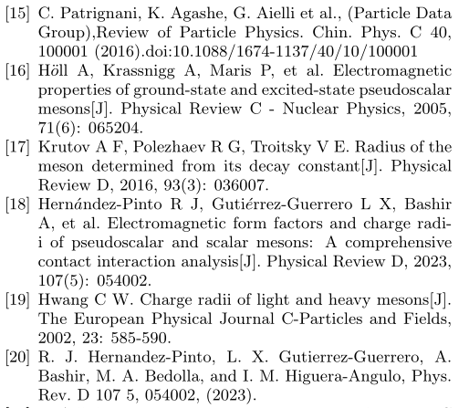
Reference data source
- 12 -

Slide 14
Summary
- 13 -
we propose a classical expression based on color charge interactions between a pair of quarks.
Especially, the design of the superposition and dot multiplication of quark color charges predicts the existence of non unit color charge elementary particles.
The estimated vacuum static color gravitational constant 𝑍 and color magnetic field constant 𝑇 presented in this talk are quite rough. However, we are eager to obtain more accurate values as soon as possible.
we hope that the classic approach in this report can provide a simple and visualizable approach to study the interior of microscopic particles.

Slide 15
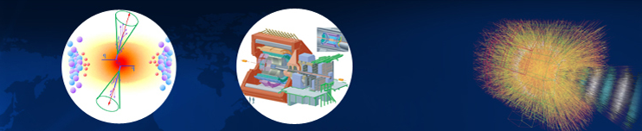
Thank you！

Slide 16
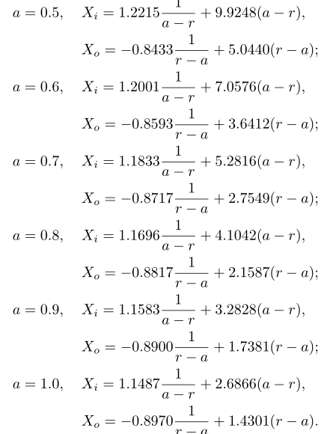
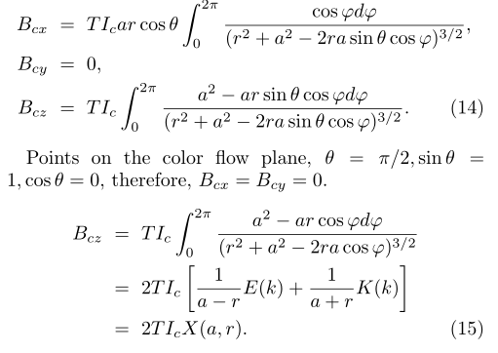









$$z$$
$$P$$
$$\vec{r}$$
$$\vec{R}$$
$$θ$$
$$φ$$
$$\vec{a}$$
$$y$$
$$x$$

Slide 17
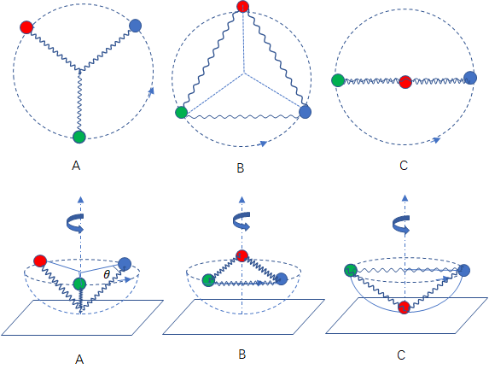

Slide 18
